Slide 1
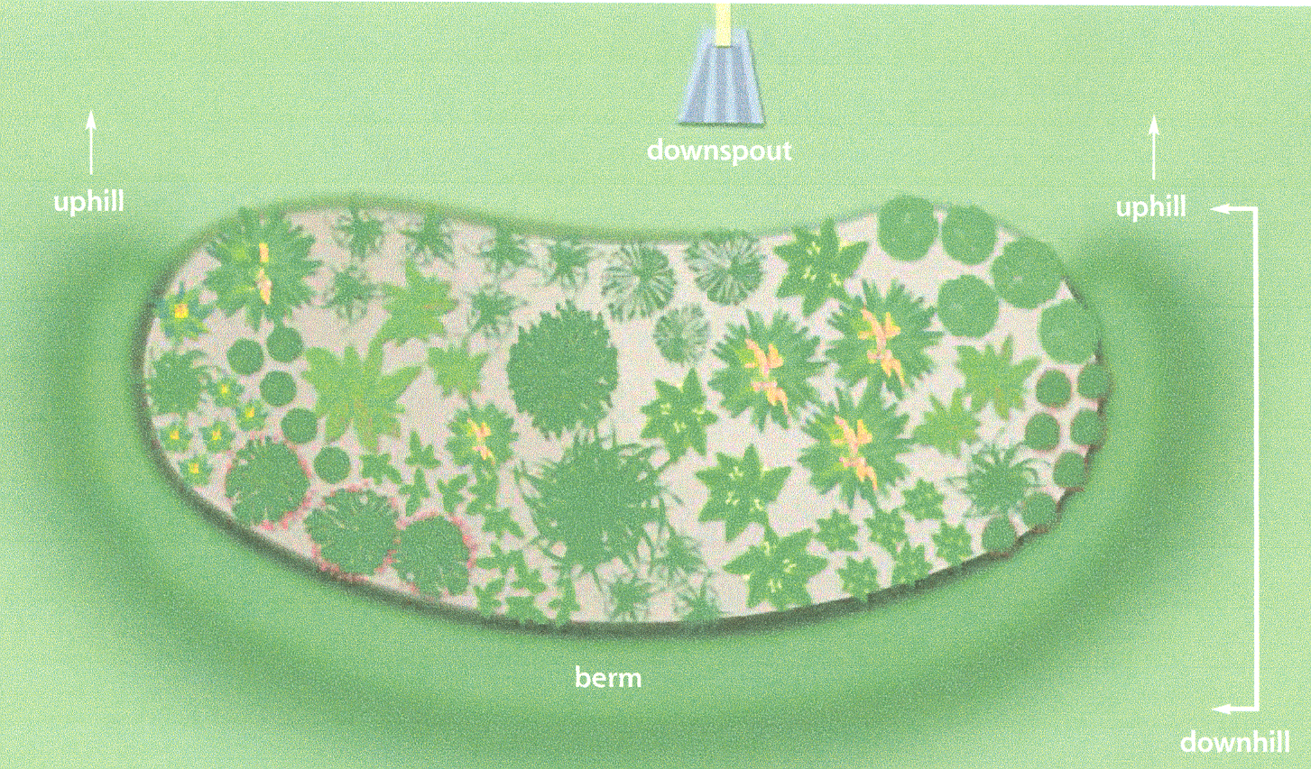
Layout of Rain Garden
Rain gardens are usually not square or a perfect circle
The long length should be perpendicular to the major slope
The shorter length should go down the major slope

Slide 2
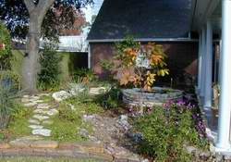
Layout of Rain Garden
Think about where excess storm water will go
You cannot send your overflow onto your neighbors property
Local
government has
jurisdiction over land
disturbing activities
Notes:
Layout of the Rain Garden
It is necessary to plan for the rain garden to have some overflows with large storm events. This means that as the rain garden is being planned and designed, you must consider where the overflow should be located. It should not be located such that it will cause a stream of water to flow onto your neighbors property. It is best to have the overflow take the same route that it would have taken before the rain garden was there. For example, if a downspout previously went onto a driveway and flowed into the street, it would be appropriate to have the rain garden collecting water from that downspout to have its overflow directed onto the driveway.

Slide 3
Installing the Rain Garden
Pointers
  Bottom of the rain garden should be level
  Top of berm should be about the same elevation as the uphill edge of the rain garden
Notes:
Installing the Rain Garden
Here you see a bird’s eye view of a typical rain garden. Note that the longest length of the rain garden should be across the steepest slope of the rain garden.
The blue arrow indicates the overflow path for this rain garden. In this case, the berm is lower in elevation where the blue arrow is located to allow stormwater from larger events to flow out of this overflow area in a controlled way.

Slide 4
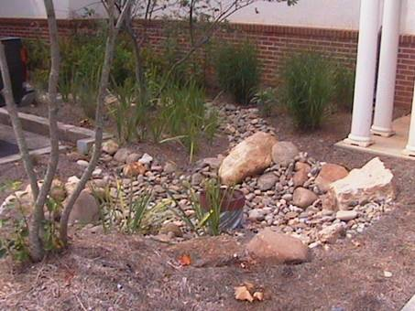
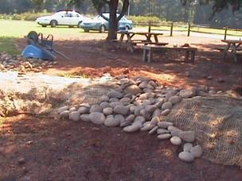
Overflow Area
Always have an overflow method for larger storms
  Lower area in the berm somewhere
  Drain pipe within rain garden

Slide 5
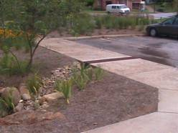
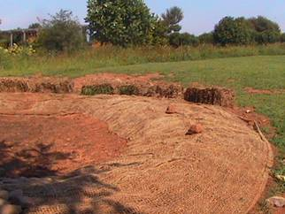
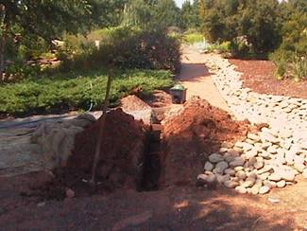
Connecting the Rain Garden
Create a shallow wide swale or bury a corrugated drain pipe to carry flow from gutter into the rain garden
Line swales with turfgrass or gravel to prevent erosion
Notes:
Connecting the Rain Garden
Since rain gardens should not be up against houses or buildings, it is important to consider how the drainage area will be connected to the rain garden. Above are 3 typical ways of connecting impervious areas to the rain garden. The top method uses a grate and pipe fixture across a sidewalk. The second picture has a grass filter strip at the top of the rain garden where water flows in by sheet flow through the turfgrass above it. The bottom picture shows a rock covered swale or dry creek bed created to carry water into a rain garden.

Slide 6
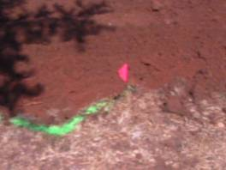
Installing the Rain Garden
Layout edge of rain garden with rope or garden hose
Set aside the top 4-6 inches of soil (topsoil), excavate the hole then use the top soil to backfill the planting area.
Move the soil in the rain garden area down to the bottom edge of the rain garden

Slide 7
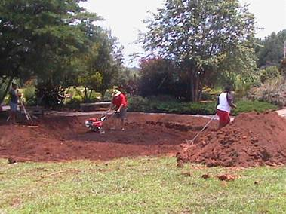
Installing the Rain Garden
Prepare the soil for planting
  Add lime and fertilizer as recommended by soil test
  Spread 2 to 4 inches of compost and mix or till it into the whole area of the rain garden
Now you are ready
to plant
Notes:
Installing the Rain Garden

Slide 8
Plants
A wide variety of plants in both size texture and color makes for an interesting rain garden
Rain gardens can be designed to attract butterflies and birds with the right plant choices
Mix trees, shrubs, perennials, ornamental grasses and turfgrasses
Plants must be wet and drought tolerant
  Really tough plants

Slide 9
Trees for Rain Gardens
Red Maple
River Birch
Crape Myrtle
Black Gum
Bald Cypress
Green Ash
Willow Oak
Serviceberry
Hornbeam
Sweetbay Magnolia
Dahoon Holly
Winter King Hawthorn
Sugar Hackberry
Fringetree
Gingko
Persimmon
Loblolly Pine

Slide 10
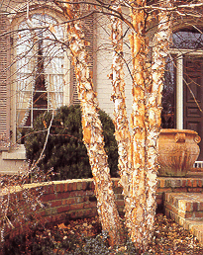
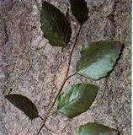
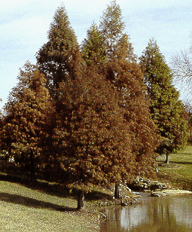
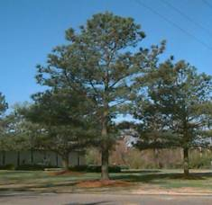
River Birch
Bald Cypress
Loblolly Pine

Slide 11
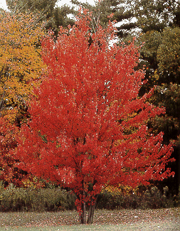
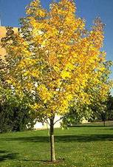
Red Maple
Gingko

Slide 12
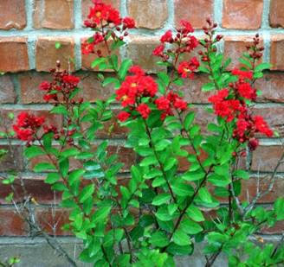
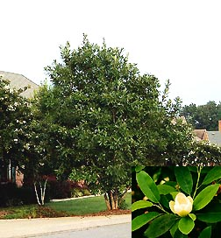
Crape Myrtle
Sweetbay Magnolia

Slide 13
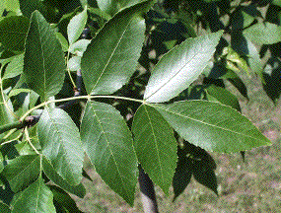
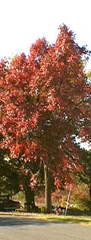
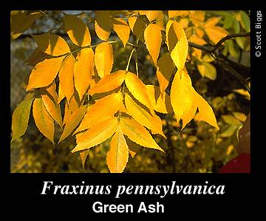
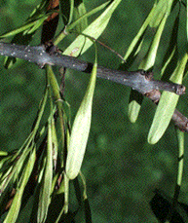
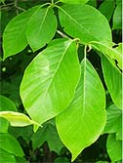
Black Gum

Slide 14
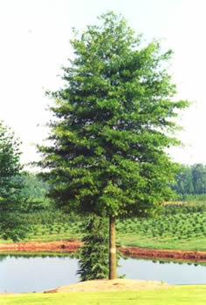
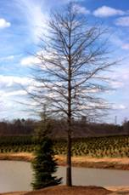
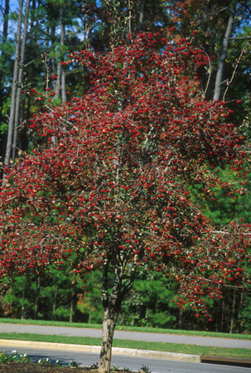
Willow Oak
Winter King Hawthorn

Slide 15
Shrubs for Rain Gardens
Winterberry
Arrowwood
Buttonbush
Summersweet Clethra
Wax Myrtle
Chokeberry
American Beautyberry
Bottlebrush Buckeye
Inkberry
Oakleaf Hydrangea
Virginia Sweetspire

Slide 16
Deciduous Shrubs
Provide Seasonal Interest
  Flowers
  Berries
  Fall Color
More Natural Growth Form
Majority of Wetland Plants are Deciduous

Slide 17
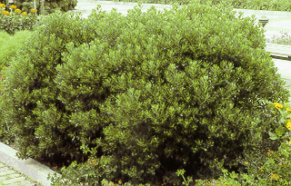
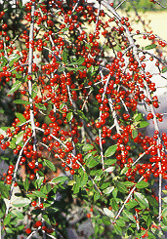
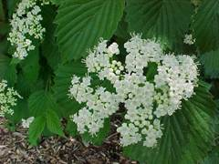
Yaupon Holly
Inkberry
Arrow wood

Slide 18
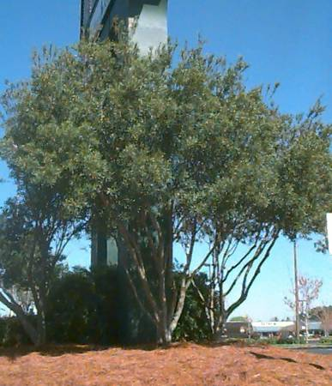
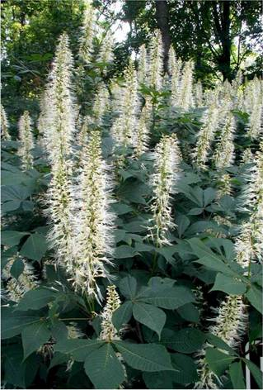
Southern Wax Myrtle
Bottlebrush
Buckeye

Slide 19
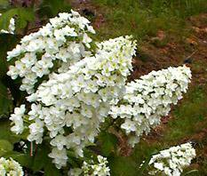

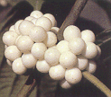
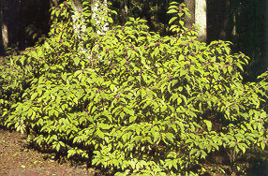

Oakleaf Hydrangea
American Beauty Berry

Slide 20

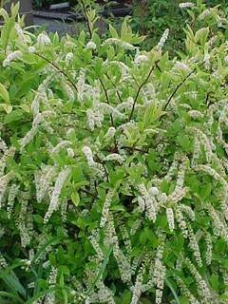
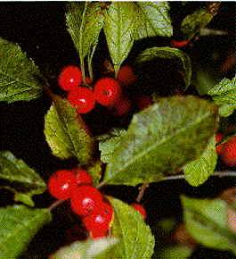
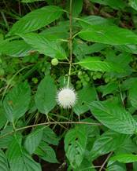
Virginia
Sweetspire
Spice Bush
Winterberry
Buttonbush

Slide 21
Herbaceous Plants for Rain Gardens
Asters
Blackeyed Susan
Lobelia
Northern Sea Oats
Cardinal Flower
Goldenrod
Ironweed
Joe Pye Weed
Rose or Swamp Mallow
Swamp Milkweed
Royal Fern
Cinnamon Fern
Netted Chain Fern
Broad Beech Fern
Canna Lilies
Yellow Flag Iris
Rushes
St. Johns Wort
Foam Flower
White Arrow Arum
Jack-in-the-Pulpit

Slide 22
Herbaceous Plants for Rain Gardens- Groundcovers
Shuttleworth ginger
Partridge berry
Zoysia
Liriope
Mondograss

Slide 23
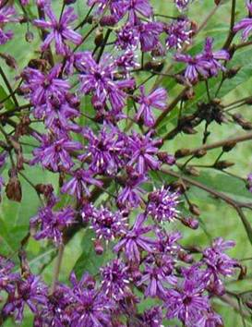

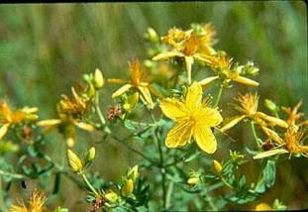
Canna Lilies
St. Johns Wort
Ironweed

Slide 24
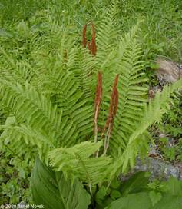
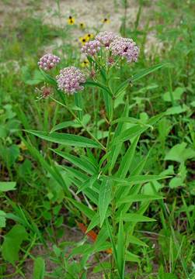
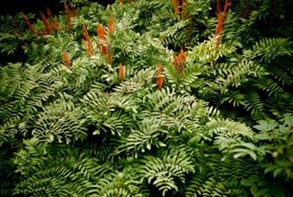
Swamp
Milkweed
Cinnamon
Fern
Royal Fern

Slide 25
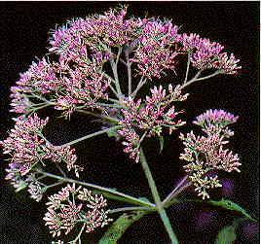
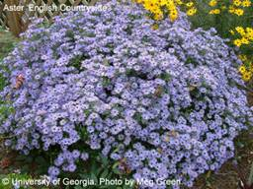
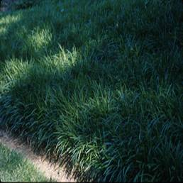

Asters
Joe Pye
Weed
Blackeyed Susan
Liriope

Slide 26
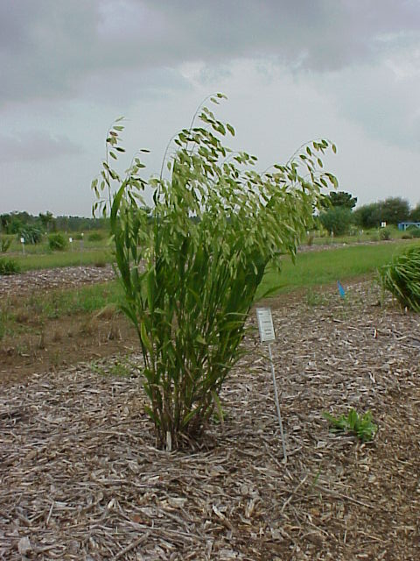
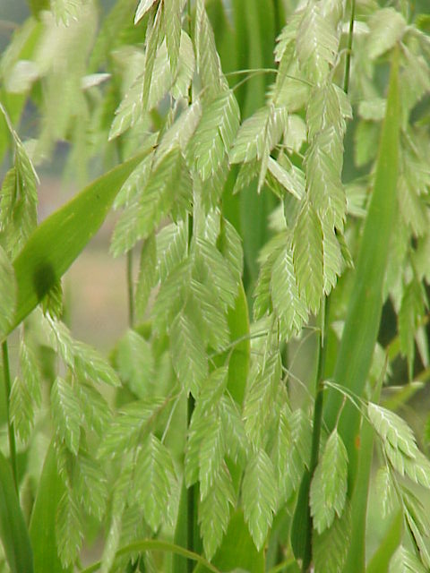
Chasmanthium latifolium
Northern Sea Oats
Notes:
Upland Sea Oats (Chasmanthium latifolium) is a native, deciduous, clump forming, perennial grass. The summer foliage will reach a height of 2 to 3 feet and is topped with inflorescences reminicent of the Coastal Sea Oats. This plant performs well in moist or dry sites and will tolerate light shade to full sun.

Slide 27
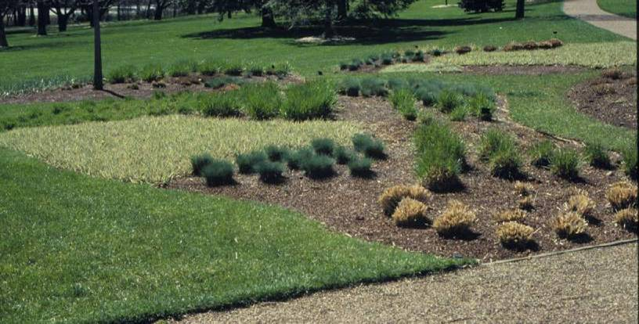
Miscanthus sinensis
Silver Grass
Phalaris arundinaceae
Ribbon Grass
Festuca cinerea
Silver Fescue
Pennisetum alopecuroides
Fountain Grass
Notes:
Waiting until the soil and air temperatures are warm enough for new spring growth will ensure the time between pruning and new growth is diminishe. As the temperatures warm, new growth will occur within days of pruning, bringing a wave of new colors and textures to the early spring garden.

Slide 28
Plants to Avoid
Those Susceptible to Root Rots
  Most coniferous shrubs
  Azaleas
  Indian Hawthorn
  Camelias

Slide 29
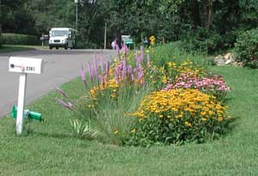
Maintenance
No special maintenance required...
Routine periodic landscaping maintenance
  Weeding
  Pruning
  Replacing plants
  Plant Division
  Replacement of mulch

Slide 30
Credits
Photos of Completed Rain Garden Examples courtesy of City of Maplewood http://www.ci.maplewood.mn.us/index.asp?Type=B_BASIC&SEC={F2C03470-D6B5-4572-98F0-F79819643C2A}
Plant photos from Vegetation for Bioretention Areas, Allen Caldwell, CED, NC State CES or from Todd Hurt, GCES, Cherokee County and Gary Wade, GCES, Horticulture Specialist
Rain Gardens A How-to Manual for Homeowners University of Wisconsin Extension Pub #GWQ037
http://clean-water.uwex.edu/pubs/raingarden/rgmanual.pdf
Intro Picture - Rain Gardens of West Michigan
www.raingardens.org

Slide 31
Resources Used to Create This Presentation
Photo of Completed Rain Garden Example courtesy of City of Maplewood http://www.ci.maplewood.mn.us/index.asp?Type=B_BASIC&SEC={F2C03470-D6B5-4572-98F0-F79819643C2A}
All slides with this symbol were derived from information from the NEMO website – Nonpoint Source Education for Municipal Officials http://nemo.uconn.edu/

Slide 32
GCES Recommended Resources
A Compilation of Low Maintenance Plants for Georgia Landscapes
http://pubs.caes.uga.edu/caespubs/Agriculture/horticulture/H-91-009.htm
Environmentally Friendly Landscape Practices
http://pubs.caes.uga.edu/caespubs/Agriculture/horticulture/H-00-060.htm
Landscape Plants for Georgia
http://pubs.caes.uga.edu/caespubs/pubcd/B625.htm
Soil Preparation and Planting Procedures for Ornamental Plants in the Landscape
http://www.ces.uga.edu/pubcd/B932-w.htm
Soil Testing for Home and Gardens
http://pubs.caes.uga.edu/caespubs/pubs/PDF/L387.pdf

Slide 33



Questions and Thoughts

