Slide 1
Landscaping for Water Quantity
MASTER GARDENER
ADVANCED TRAINING
May 1, 2008
Georgia Experiment Station
Notes:
Landscaping for Water Quantity.
MASTER GARDENER ADVANCED TRAINING.
May 1, 2008.
Georgia Experiment Station.

Slide 2
Landscaping for Water Quantity
Why is our fresh water so valuable?
Do I need to reduce my water use?
How do I reduce water consumption?
Can I use less water and still have an attractive, healthy lawn/landscape?
What is Xeriscaping all about?
Notes:
Landscaping for Water Quantity.
Why is our fresh water so valuable?
Do I need to reduce my water use?
How do I reduce water consumption?
Can I use less water and still have an attractive, healthy lawn/landscape?
What is Xeriscaping all about?

Slide 3
Landscaping for Water Quantity
Of all the earth’s water, 97% is salt water located in the oceans and seas.
2% of the earth’s water is tied up in polar ice caps.
Only 1% of the earth’s water is available for drinking purposes and other uses (landscaping, gardening).
Notes:
Landscaping for Water Quantity
Of all the earth’s water, 97% is salt water located in the oceans and seas.
2% of the earth’s water is tied up in polar ice caps.
Only 1% of the earth’s water is available for drinking purposes and other uses (landscaping, gardening).

Slide 4
Landscaping for Water Quantity
61% of our drinking water comes from surface water supplies (streams, lakes, rivers); while 39% comes from groundwater (underground wells and aquifers).
The average daily demand for water in the United States is 338 billion gallons.
Notes:
Landscaping for Water Quantity
61% of our drinking water comes from surface water supplies (streams, lakes, rivers); while 39% comes from groundwater (underground wells and aquifers).
The average daily demand for water in the United States is 338 billion gallons.

Slide 5
Landscaping for Water Quantity
Global demand for fresh water will double every 20 years.
12 billion people by the year 2100. Fifty percent of the population will reside in mega cities of 12 to 15 million.
Demand for fresh water and other resources will escalate tremendously!
Notes:
Landscaping for Water Quantity
Global demand for fresh water will double every 20 years.
12 billion people by the year 2100. Fifty percent of the population will reside in mega cities of 12 to 15 million.
Demand for fresh water and other resources will escalate tremendously!

Slide 6
Landscaping for Water Quantity
Since 1965 the population of the US has grown by 52%, while the demand for water has tripled.
Today we are finding additional and different ways to use more and more water than before.
Notes:
Landscaping for Water Quantity
Since 1965 the population of the US has grown by 52%, while the demand for water has tripled.
Today we are finding additional and different ways to use more and more water than before.

Slide 7
Landscaping for Water Quantity
Average residential water use increases 30% - 50% during the summer months when citizens turn on their outdoor irrigation or watering systems.
Notes:
Landscaping for Water Quantity
Average residential water use increases 30% - 50% during the summer months when citizens turn on their outdoor irrigation or watering systems.

Slide 8
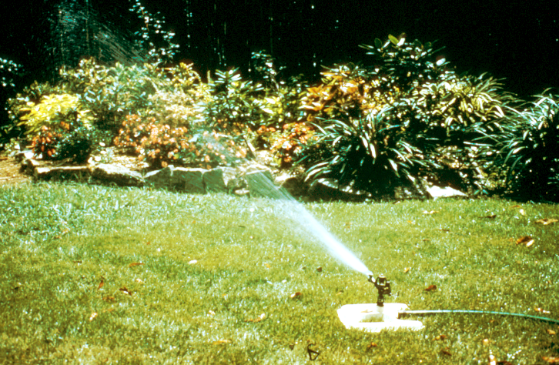
Notice any problems?
Notes:
Lawns are generally the largest users of water in the landscape during the summer.

Slide 9
Landscaping for Water Quantity
One portable lawn sprinkler operating one hour uses 360 gallons of water.
This is equivalent to:
--> 12 five-minute showers
--> 50 runs of the dishwasher
--> 225 flushes of the toilet
--> 12 loads of laundry
Notes:
Landscaping for Water Quantity
One portable lawn sprinkler operating one hour uses 360 gallons of water.
This is equivalent to:
--> 12 five-minute showers
--> 50 runs of the dishwasher
--> 225 flushes of the toilet
--> 12 loads of laundry

Slide 10
Outdoor Watering Options
Summer Surcharge: Rate increases 25% to 100% when use exceeds average winter consumption.
Rationing: Odd/Even outdoor watering.
Once a week watering.
Total bans on outdoor Use.
XERISCAPING.
Notes:
Outdoor Watering Options
Summer Surcharge: Rate increases 25% to 100% when use exceeds average winter consumption.
Rationing: Odd/Even outdoor watering.
Once a week watering.
Total bans on outdoor Use.
XERISCAPING.

Slide 11
What is Xeriscaping?
Pronounced “Zeri-scaping”.
Not Zero-scaping.
Coined in Colorado in 1981.
From the Greek word “xeros” or dry.
Xeriscaping = xeros + landscaping.
Notes:
What is Xeriscaping?
Pronounced “zeri-scaping”.
Not ZERO-scaping.
Coined in Colorado in 1981.
From the Greek word “xeros” or dry.
Xeriscaping = xeros + landscaping.

Slide 12
So, what exactly is Xeriscaping?
Landscaping that uses water-conserving techniques, such as drought tolerant plants, mulching, efficient irrigation, etc.
The practice of utilizing methods to conserve water in the yard and garden.
Landscaping in ways that does not require supplemental watering.
Water-efficient landscaping.
Notes:
So, what exactly is Xeriscaping?
Landscaping that uses water-conserving techniques, such as drought tolerant plants, mulching, efficient irrigation, etc.
The practice of utilizing methods to conserve water in the yard and garden.
Landscaping in ways that does not require supplemental watering.
Water-efficient landscaping.

Slide 13
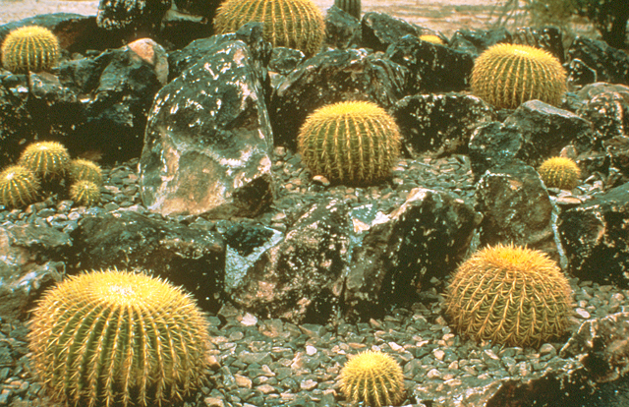
To many people, Xeriscaping implies cactus gardens or barren landscapes!
Notes:
To many people, Xeriscaping implies cactus gardens or barren landscapes! A Xeriscape is not a dry, prickly cacti garden.

Slide 14
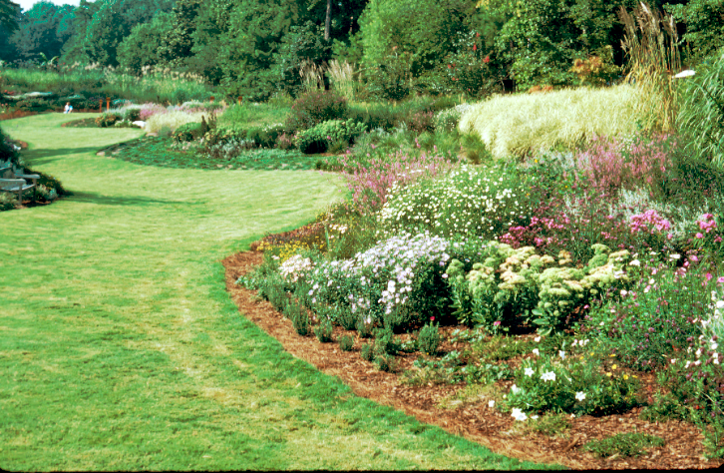
This is a Xeriscape! A traditional landscape made water-efficient.
Notes:
It’s more like this! This is a Xeriscape! A traditional landscape made water-efficient.
A sloping color bed which drains water into the turf high water use area.

Slide 15
Facts and Fallacies of Xeriscaping
True or False?
Any landscape that uses little or no supplemental water is a Xeriscape.
More plants are killed each year from over-watering than from the lack of water.
Drought-tolerant plants are best for water-efficient landscapes
Notes:
Facts and Fallacies of Xeriscaping
True or False?
1. False
True
3. False

Slide 16
Facts and Fallacies of Xeriscaping
True or False?
4. Native plants are more tolerant of moisture extremes.
5. Turfgrass has the highest requirement for supplemental water of any plant in the landscape.
6. Turfgrass frequently receives the highest amount of supplemental water of any plant in the landscape.
Notes:
4. True
5. Maybe - it depends on the turfgrass. Fescue does require the most but bermuda does not.
6. True

Slide 17
Seven Steps to Xeriscaping
Planning and Design
Soil Improvement
Appropriate Plant Selection
Practical Turf Areas
Efficient Irrigation
Use of Mulches
Appropriate Maintenance
Notes:
Seven Steps to Xeriscaping
Planning and Design
Soil Improvement
Appropriate Plant Selection
Practical Turf Areas
Efficient Irrigation
Use of Mulches
Appropriate Maintenance

Slide 18
Seven Steps to Xeriscaping
Planning and Design
Soil Improvement
Appropriate Plant Selection
Practical Turf Areas
Efficient Irrigation
Use of Mulches
Appropriate Maintenance
Notes:
Seven Steps to Xeriscaping
Planning and Design
Soil Improvement
Appropriate Plant Selection
Practical Turf Areas
Efficient Irrigation
Use of Mulches
Appropriate Maintenance

Slide 19
Divide the Landscape into Three Water-use Zones
Oasis Zone
High Water Use Area
Transition Zone
Moderate Water Use
Xeric Zone
Little to NO Extra Water
Notes:
Divide the Landscape into Three Water-use Zones
Oasis Zone - High Water Use Area
Transition Zone - Moderate Water Use
Xeric Zone - Little to NO Extra Water

Slide 20
High Water-use Zone
“Oasis Zone”
Small, “high-impact” or high visibility area of the landscape where plants are provided their optimum water requirement at all times.
Entrance to Home
Notes:
High Water-use Zone - “Oasis Zone”
“Small, ‘high-impact’ or high visibility area of the landscape where plants are provided their optimum water requirement at all times.”
Example: Entrance to Home

Slide 21
Moderate Water-use Zone
“Transition Zone”
Plants are watered during establishment. Then, once established, they are watered only when they show signs of water stress.
Azaleas, dogwoods, redbuds, herbaceous perennials.
Notes:
Moderate Water-use Zone – “Transition Zone”
Plants are watered during establishment. Then, once established, they are watered only when they show signs of water stress.
Examples: Azaleas, dogwoods, redbuds, herbaceous perennials.

Slide 22
Low Water-use Zone
“Xeric Zone”
Once established, plants are provided no supplemental irrigation, except during periods of extreme drought.
Native Areas, Junipers, Crepe Myrtle, Yaupon Holly, Oaks
Notes:
Low Water-use Zone - “Xeric Zone”
Once established, plants are provided no supplemental irrigation, except during periods of extreme drought.
Examples: Native Areas, Junipers, Crepe Myrtle, Yaupon Holly, Oaks

Slide 23
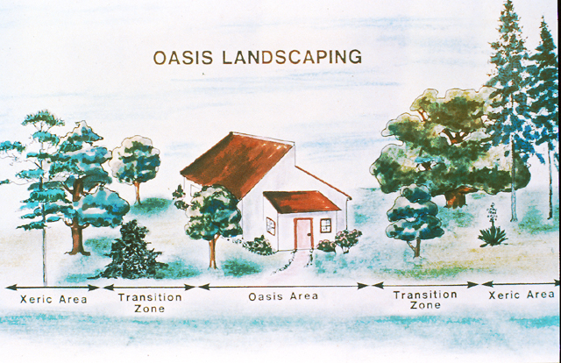
Notes:
Picture showing “Oasis”, “Transition” and “Xeric” zones.

Slide 24
Watering Zones
Identify the water zones in your landscape.
Moisture, sun, shade, wind, heat - create different watering zones or microclimates.
After identifying watering zones, select plants that can survive and thrive within these zones without much watering.
This is what Xeriscaping is all about !!!
Notes:
Watering Zones
Identify the water zones in your landscape.
Moisture, sun, shade, wind, heat - create different watering zones or microclimates.
After identifying watering zones, select plants that can survive and thrive within these zones without much watering.
This is what Xeriscaping is all about !!!

Slide 25
Watering Zones Tips
To reduce watering and maintenance, try to group plants by their watering needs.
Place high water-use plants in moist spots.
Place low water-use plants in dry areas.
Consider low water-use shrubs, trees and groundcovers as alternatives to turfgrass.
Consider zoysia, centipede or bermuda grasses instead of fescue grasses.
Notes:
Watering Zones Tips
To reduce watering and maintenance, try to group plants by their watering needs.
Place high water-use plants in moist spots.
Place low water-use plants in dry areas.
Consider low water-use shrubs, trees and groundcovers as alternatives to turfgrass.
Consider zoysia, centipede or bermuda grasses instead of fescue grasses.

Slide 26
High Impact Areas Don’t Have to be Irrigated
Ground Covers
Shaded Patios/Decks
Mulched Areas
Drought – tolerant plants
Planters
Notes:
High Impact Areas Don’t Have to be Irrigated
Ground Covers
Shaded Patios/Decks
Mulched Areas
Drought – tolerant plants
Planters

Slide 27
Benefits of Shade
Be sure that you plan for plenty of shade in your landscape.
Shade cast by trees or structures can cool landscapes by as much as 20 degrees.
Shade reduces heat buildup from hard surfaces like driveways, walks, walls and reduces water evaporation from the soil.
Trellis, arbors, walls and fences can provide shade and scatter light.
Notes:
Benefits of Shade
Be sure that you plan for plenty of shade in your landscape.
Shade cast by trees or structures can cool landscapes by as much as 20 degrees.
Shade reduces heat buildup from hard surfaces like driveways, walks, walls and reduces water evaporation from the soil.
Trellis, arbors, walls and fences can provide shade and scatter light.

Slide 28
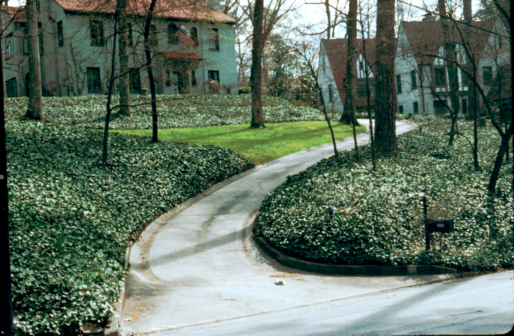
Notes:
Notice the limited turf in this yard. There was probably too much tree shade for turfgrass. Ground covers were utilized to absorb water runoff from the hill. Adding design curves and an interesting contrast to the small turf area.

Slide 29
Seven Steps to Xeriscaping
Planning and Design
Soil Improvement
Appropriate Plant Selection
Practical Turf Areas
Efficient Irrigation
Use of Mulches
Appropriate Maintenance
Notes:
Seven Steps to Xeriscaping
Planning and Design
Soil Improvement
Appropriate Plant Selection
Practical Turf Areas
Efficient Irrigation
Use of Mulches
Appropriate Maintenance

Slide 30
Soil Improvement
Carefully prepared planting areas can reduce water usage by almost half.
Properly prepared soils absorb and hold moisture better than poorly prepared soils.
Well-prepared soils encourage plants to grow deep, healthy root systems.
Good soil helps plants to become healthier and better able to endure drought.
Notes:
Soil Improvement
Carefully prepared planting areas can reduce water usage by almost half.
Properly prepared soils absorb and hold moisture better than poorly prepared soils.
Well-prepared soils encourage plants to grow deep, healthy root systems.
Good soil helps plants to become healthier and better able to endure drought.

Slide 31
What is a “good” soil?
A good soil has organic matter that:
- holds moisture well,
- provides good aeration or air movement in the soil,
- allows for good drainage, and
- provides nutrients.
Notes:
What is a “good” soil?
A good soil has organic matter that:
- holds moisture well,
- provides good aeration or air movement in the soil,
- allows for good drainage, and
- provides nutrients.

Slide 32
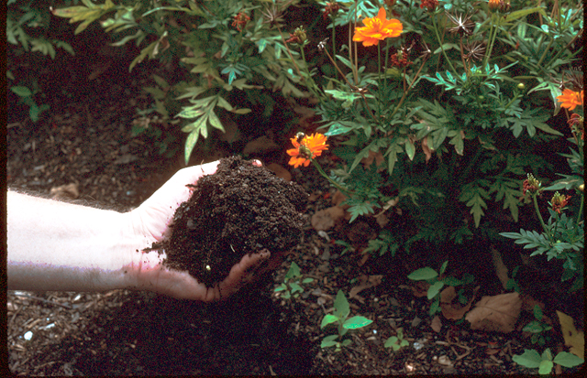
Notes:
Finely ground pinebark mulch – composts into organic matter, while protecting plants from weeds & heat and retaining moisture.

Slide 33
How Much Amendment to Use
25% by Volume
3 inches incorporated to a 12 – inch depth
1 cu. yd. / 100 sq. ft. = 3 in. on soil surface
1 cu. yd. / 27 cu. ft. = Nine 3 cu. ft. bags or 13 – 2 cu. ft. bags / 100 sq. ft.
Notes:
How Much Amendment to Use
25% by Volume
3 inches incorporated to a 12 – inch depth
1 cu. yd. / 100 sq. ft. = 3 in. on soil surface
1 cu. yd. / 27 cu. ft. = Nine 3 cu. ft. bags or 13 – 2 cu. ft. bags / 100 sq. ft.

Slide 34
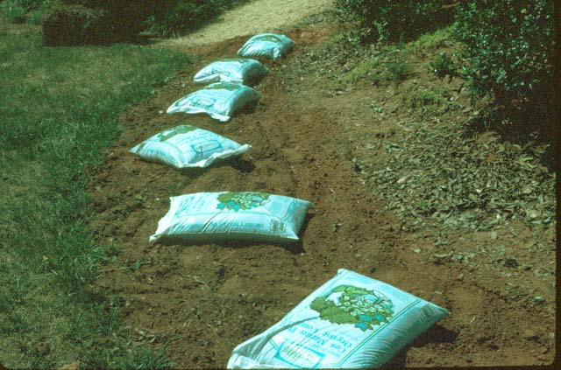
Organic Amendments
3 inches incorporated to a 12-inch depth
Notes:
Organic Amendments
3 inches incorporated to a 12-inch depth

Slide 35
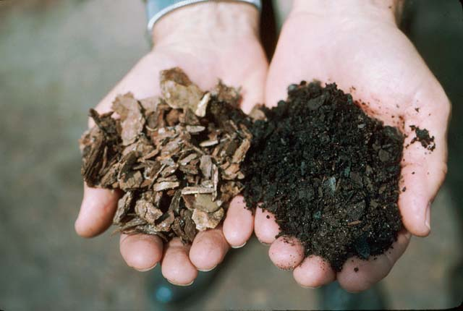
Use only decomposed organic material (right) as a soil amendment.
Notes:
Use only decomposed organic material (right) as a soil amendment.

Slide 36
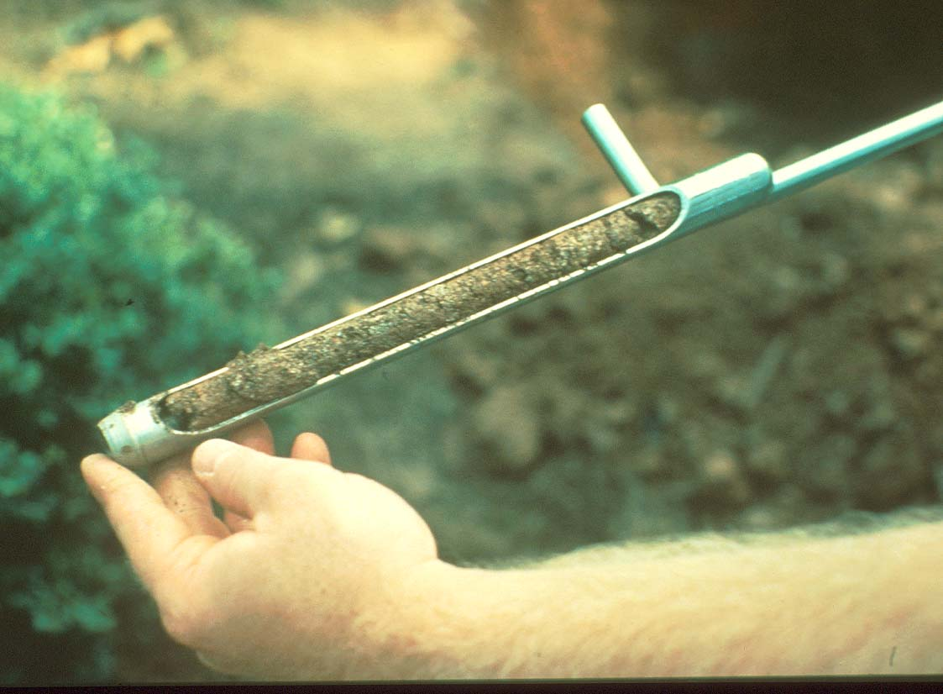
Get Your Soil Tested
Notes:
Get Your Soil Tested by your local County Extension office.

Slide 37
Soil Testing
Analyzes soil nutrient content and pH.
Analyzes soil structure and texture.
Analyzes soil drainage characteristics.
Recommends proper nutrient needs and lime requirements.
Healthy plants - start with healthy soil!
Notes:
Soil Testing
Analyzes soil nutrient content and pH.
Analyzes soil structure and texture.
Analyzes soil drainage characteristics.
Recommends proper nutrient needs and lime requirements.
Healthy plants - start with healthy soil!

Slide 38
pH and Plants
Most Trees and Shrubs
pH 5.2-6.5
Rhododendrons & Hollies
pH 4.0-5.0
Ornamental Cherries
pH 6.5-7.5
Notes:
pH and Plants
Most Trees and Shrubs - pH 5.2-6.5
Rhododendrons & Hollies - pH 4.0-5.0
Ornamental Cherries - pH 6.5-7.5

Slide 39
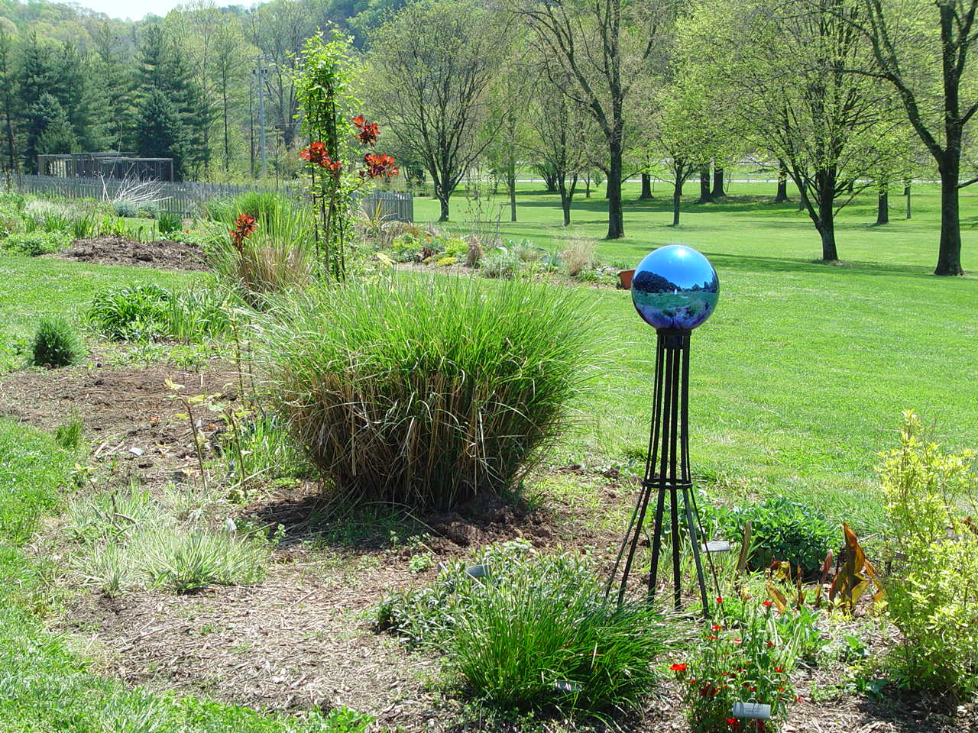
Site Analysis
Select plants adapted to the site.
Make site changes (as necessary) to fit the plants.
Notes:
Site Analysis
Select plants adapted to the site.
Make site changes (as necessary) to fit the plants.

Slide 40
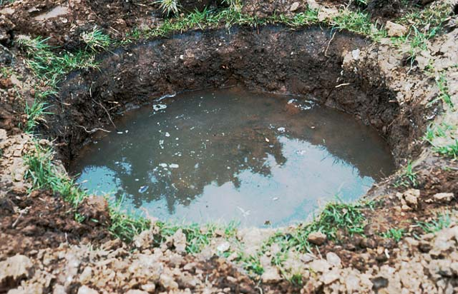
Notes:
Check drainage by digging a 1’ x 1’ hole and time how long it takes the hole to drain.
If the hole is slow to percolate, scarify the sides of the hole and plant the plant a couple inches above the soil line and cover with mulch.

Slide 41
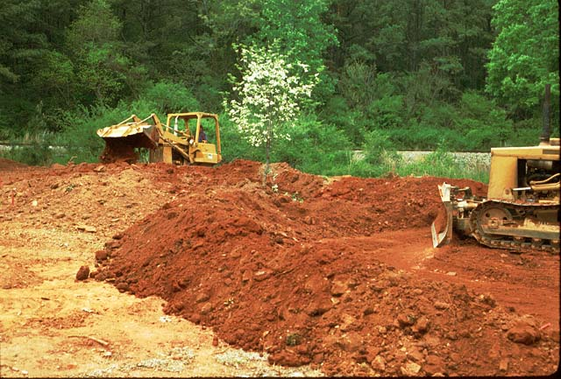
Top Soil ???
Notes:
Sometime what you see isn’t what you got!
Many new homes have “top soil” added. It’s always technically called top soil – but usually it is subsoil .
Poor soil, subsoil, etc. may impact drainage, nutrition, and texture.

Slide 42
Seven Steps to Xeriscaping
Planning and Design
Soil Improvement
Appropriate Plant Selection
Practical Turf Areas
Efficient Irrigation
Use of Mulches
Appropriate Maintenance
Notes:
Seven Steps to Xeriscaping
Planning and Design
Soil Improvement
Appropriate Plant Selection
Practical Turf Areas
Efficient Irrigation
Use of Mulches
Appropriate Maintenance

Slide 43
Plant Selection
Pick the best plants for your landscape.
Many native plants are water-wise; they are already adapted to hot, dry weather.
100s of beautiful, hearty plants to pick.
Contact your local Extension office for information on plant selection.
University of Georgia “Gold Medal” plants.
Notes:
Plant Selection
Pick the best plants for your landscape.
Many native plants are water-wise; they are already adapted to hot, dry weather.
100s of beautiful, hearty plants to pick.
Contact your local Extension office for information on plant selection.
University of Georgia “Gold Medal” plants.

Slide 44
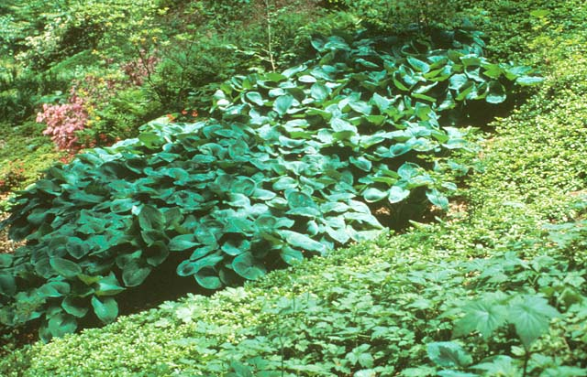
Notes:
Use plants with similar needs in certain environments.
This is a great example of a woodland garden.
Astilbe, hosta, azalea, fern, foam flower.

Slide 45
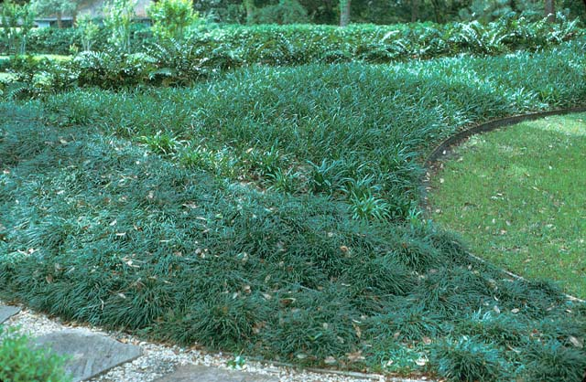
Notes:
Use drought tolerant groundcovers like mondograss. Another benefit - less grass to mow!

Slide 46
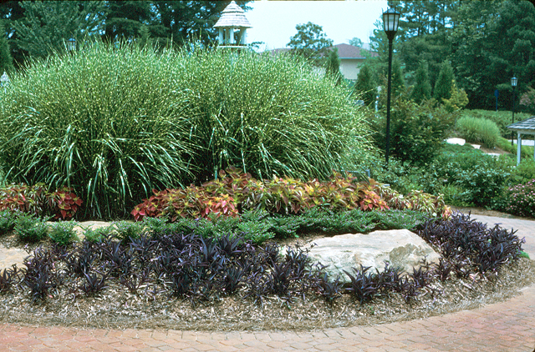
Notes:
Full sun, low water-use plants with attractive foliage color! Purple heart, Mexican heather, coleus, zebragrass.

Slide 47
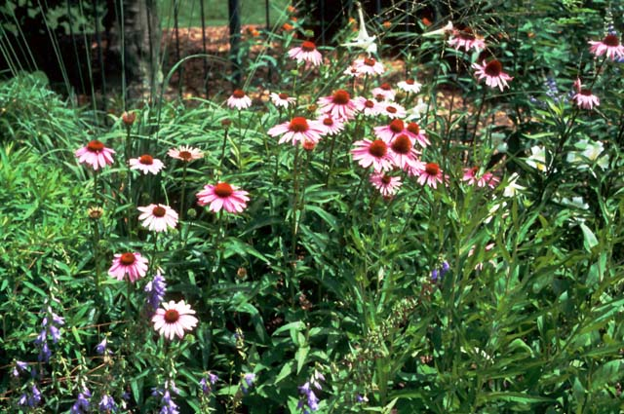
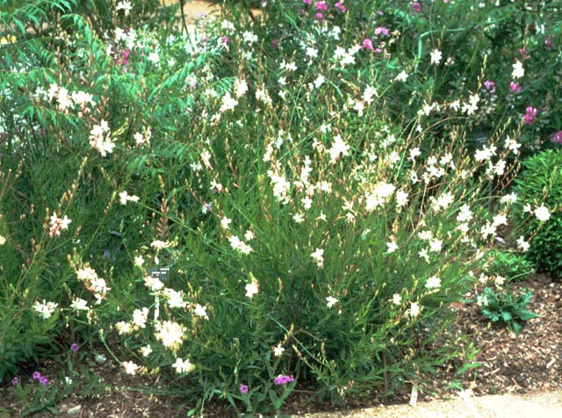
Purple Coneflower
(Ehinacea purpurea)
Gaura
(Gaura lindheimeri)
Notes:
Two examples of very drought tolerant plants.
However, gaura won’t tolerate a wet area during a year with too much rain.
Be careful to chose an area that drains well for all “drought tolerant” plants.

Slide 48
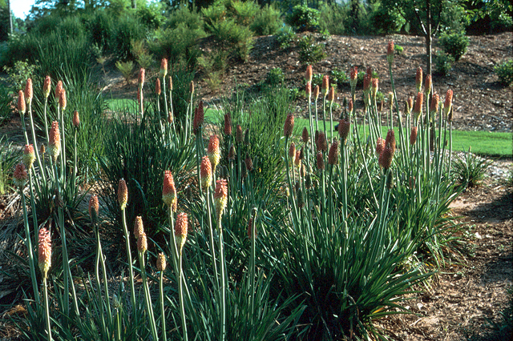
Red Hot Poker or Torch Lily
(Kniphofia uvaria)
Notes:
This is a good low-maintenance drought tolerant plant. Red hot Poker or Torch Lily (Kniphofia uaria)

Slide 49
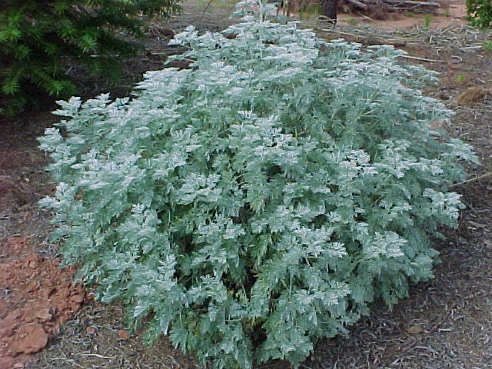
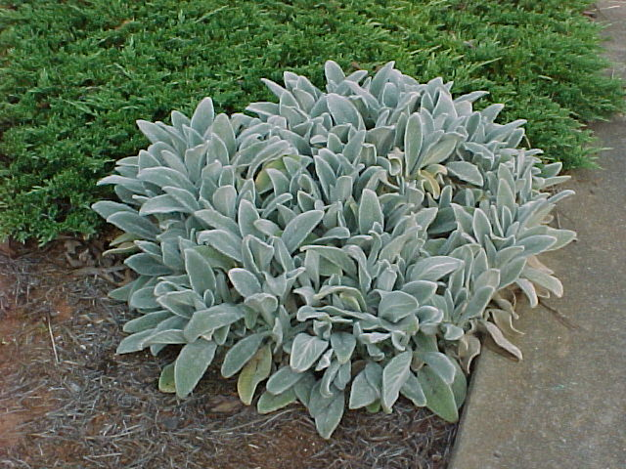
Artemisia “Powis Castle”
Sedum
Verbena
Annual Periwinkle
Lamb’s Ear
Gaura
Gazania
Portulaca
Notes:
Both of these plants need lots of sun and a dry spot. Lambs ear will develop heart rot in wet conditions. Artemisia will rot at the crown and shrivel up.

Slide 50
Low Water Use ANNUALS
Ageratum, Celosia, Calendula, Cleome, Coleus, Cornflower, Cosmos, Dusty Miller, Gaillardia, Geranium, Lantana, Marigold, Ornamental Pepper, Periwinkle, Petunia, Phlox, Poppy, Portulaca, Salvia, Sweet Alyssum, Wax Begonia, Verbena, Vinca, Zinnia
Notes:
Low Water Use ANNUALS
Ageratum, Celosia, Calendula, Cleome, Coleus, Cornflower, Cosmos, Dusty Miller, Gaillardia, Geranium, Lantana, Marigold, Ornamental Pepper, Periwinkle, Petunia, Phlox, Poppy, Portulaca, Salvia, Sweet Alyssum, Wax Begonia, Verbena, Vinca, Zinnia.

Slide 51
Low Water Use PERENNIALS/HERBS
Asters, Black-eyed Susan, Blanket Flower, Butterfly Weed, Cotoneaster, Daylily, Geranium, Goldenrod, Ironweed, Joe-Pye Weed, Lambs Ear, Lantana, Lavender, Mints, Mistflower, Oregano, Parsley, Pinks, Purple Coneflower, Queen Anne’s Lace, Rosemary, Sage, Stonecrop, Swamp Milkweed, Thyme, Tickseed, Wild Bleeding Heart, Wild Columbine and Yarrow.
Notes:
Low Water Use PERENNIALS/HERBS
Asters, Black-eyed Susan, Blanket Flower, Butterfly Weed, Cotoneaster, Daylily, Geranium, Goldenrod, Ironweed, Joe-Pye Weed, Lambs Ear, Lantana, Lavender, Mints, Mistflower, Oregano, Parsley, Pinks, Purple Coneflower, Queen Anne’s Lace, Rosemary, Sage, Stonecrop, Swamp Milkweed, Thyme, Tickseed, Wild Bleeding Heart, Wild Columbine and Yarrow.

Slide 52
Low Water Use SHRUBS
Abelia, Aucuba, Arborvitae, Arrowwood, Barberry, Beautyberry, American Boxwood, Black Chokeberry, Butterfly Bush, Deutzia, English Boxwood, Euonymus, Forsythia, Fothergilla, Grapeholly, Hawthorn, Hollies, Inkberry, Junipers, Mahonia, Mountain Laurel, Nandina, Pyracantha, Quince, Scotch Broom, Spirea, Virginia Sweetspire, Wax Myrtle Winterberry, Witch Hazel and Yucca.
Notes:
Low Water Use SHRUBS
Abelia, Aucuba, Arborvitae, Arrowwood, Barberry, Beautyberry, American Boxwood, Black Chokeberry, Butterfly Bush, Deutzia, English Boxwood, Euonymus, Forsythia, Fothergilla, Grapeholly, Hawthorn, Hollies, Inkberry, Junipers, Mahonia, Mountain Laurel, Nandina, Pyracantha, Quince, Scotch Broom, Spirea, Virginia Sweetspire, Wax Myrtle Winterberry, Witch Hazel and Yucca.

Slide 53
Low Water Use SMALL TREES
American Hophornbeam, Crape Myrtle, Elder, Flowering Crabapple, Cypress, Foster’s Holly, Fringe Tree, Ginkgo, Hornbeam, Japanese Flowering Cherry, Junipers, Magnolia, Nellie R Stevens, Paw Paw, Persimmon, Redbud, Sassafras, Serviceberry, Smoketree, Smooth Sumac, Vitex, White Fringe Tree, White Mulberry and Witch Hazel.
Notes:
Low Water Use SMALL TREES
American Hophornbeam, Crape Myrtle, Elder, Flowering Crabapple, Cypress, Foster’s Holly, Fringe Tree, Ginkgo, Hornbeam, Japanese Flowering Cherry, Junipers, Magnolia, Nellie R Stevens, Paw Paw, Persimmon, Redbud, Sassafras, Serviceberry, Smoketree, Smooth Sumac, Vitex, White Fringe Tree, White Mulberry and Witch Hazel.

Slide 54
Low Water Use LARGE TREES
Bald Cypress, Black Gum, Bur Oak, Ginkgo, Green Ash, Hackberry, Japanese Cryptomeria, Lacebark Elm, Laurel Oak, Loblolly Pine, Magnolia, Pistachio, Red Maple, River Birch, Sweetgum, Thornless Honeylocust, Tulip Tree, Water Oak, White Oak, Yellowwood and Zelkova.
Notes:
Low Water Use LARGE TREES
Bald Cypress, Black Gum, Bur Oak, Ginkgo, Green Ash, Hackberry, Japanese Cryptomeria, Lacebark Elm, Laurel Oak, Loblolly Pine, Magnolia, Pistachio, Red Maple, River Birch, Sweetgum, Thornless Honeylocust, Tulip Tree, Water Oak, White Oak, Yellowwood and Zelkova.

Slide 55
Low Water Use VINES/GROUNDCOVERS/
ORNAMENTAL GRASSES
Ajuga, Blue Fescue, Big Bluestem, Creeping Phlox, Foamflower, Fountain Grass, Green and Gold, Hypericum, Indian Grass, Leadwort, Lilyturf or Liriope, Little Bluestem, Maiden Grass, Mondograss, Pampas Grass, Sensitive Fern, St. John’s Wort, Switch Grass, Thrift, Wintercreeper Euonymus, Woodland Phlox.
Notes:
Low Water Use VINES/GROUNDCOVERS/ORNAMENTAL GRASSES
Ajuga, Blue Fescue, Big Bluestem, Creeping Phlox, Foamflower, Fountain Grass, Green and Gold, Hypericum, Indian Grass, Leadwort, Lilyturf or Liriope, Little Bluestem, Maiden Grass, Mondograss, Pampas Grass, Sensitive Fern, St. John’s Wort, Switch Grass, Thrift, Wintercreeper Euonymus, Woodland Phlox.

Slide 56
Seven Steps To Xeriscaping
Planning and Design
Soil Analysis
Appropriate Plant Selection
Practical Turf Areas
Efficient Irrigation
Use of Mulches
Appropriate Maintenance
Notes:
Seven Steps To Xeriscaping
Planning and Design
Soil Analysis
Appropriate Plant Selection
Practical Turf Areas
Efficient Irrigation
Use of Mulches
Appropriate Maintenance

Slide 57
Use Turfgrass for a Purpose
Aesthetic Value (Welcome Mat)
Recreational Surface
Erosion Control
Minimize the amount of irrigated turfgrass
Notes:
Use Turfgrass for a Purpose
Aesthetic Value (Welcome Mat)
Recreational Surface
Erosion Control
Minimize the amount of irrigated turfgrass

Slide 58
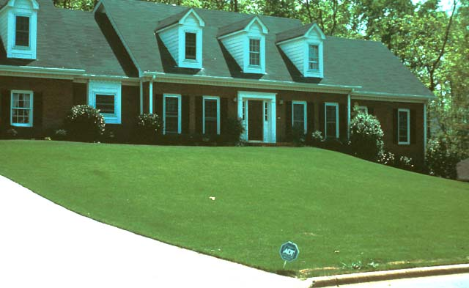
Notes:
Is this appropriate use of turfgrass?

Slide 59
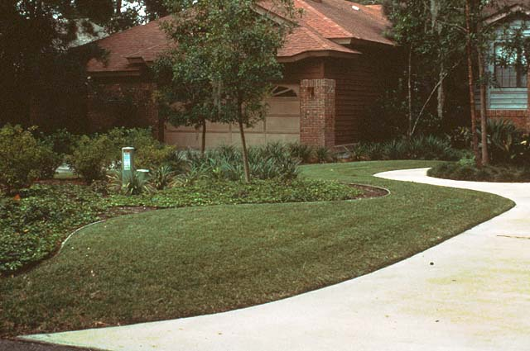
Notes:
Notice the use of turf near the porous surface.
It also is nice to step in when getting out of the car.
The curves of the beds out line the walkway making the turf another element of color.

Slide 60
Drought Tolerance of Turf
Hybrid Bermuda
Zoysia
Centipede
Fescue
Notes:
Drought Tolerance of Turf (high to low)
Hybrid Bermuda
Zoysia
Centipede
Fescue

Slide 61
Turfgrass Tips
Consider a low water-use turfgrass, like bermudagrass, centipede or zoysia.
Bermuda is the most drought tolerant.
Grasses go dormant in very dry conditions and spring back when rainfall returns.
Mow turfgrass higher during hot weather.
Fertilize according to soil test results.
Notes:
Turfgrass Tips
Consider a low water-use turfgrass, like bermudagrass, centipede or zoysia.
Bermuda is the most drought tolerant.
Grasses go dormant in very dry conditions and spring back when rainfall returns.
Mow turfgrass higher during hot weather.
Fertilize according to soil test results.

Slide 62
Turfgrass Watering Tips
Water lawns after dew fall but before it dries in mornings to decrease disease problems.
Apply enough water to soak the soil 5 - 7 inches deep. Deep watering = deep roots.
Apply 1 inch of water/week in active growth.
Core aerate to loose soil/increase absorption.
Visit www.georgiaturf.com for more info.
Notes:
Turfgrass Watering Tips
Water lawns after dew fall but before it dries in mornings to decrease disease problems.
Apply enough water to soak the soil 5 - 7 inches deep. Deep watering = deep roots.
Apply 1 inch of water/week in active growth.
Core aerate to loose soil/increase absorption.
Visit www.georgiaturf.com for more info.

Slide 63
Sprinkler Watering Tips
How do I determine how much water my sprinkler system is applying?
Place 6 to 8 shallow cans in the lawn area.
Run your sprinkler system for 15 minutes.
Measure depth in each can and add all the numbers; divide total by number of cans.
The resulting number is the average amount of water your sprinklers apply in 15 minutes.
Multiply that number by 4 to determine inches/hour.
Notes:
Sprinkler Watering Tips
How do I determine how much water my sprinkler system is applying?
Place 6 to 8 shallow cans in the lawn area.
Run your sprinkler system for 15 minutes.
Measure depth in each can and add all the numbers; divide total by number of cans.
The resulting number is the average amount of water your sprinklers apply in 15 minutes.
Multiply that number by 4 to determine inches/hour.

Slide 64
Turfgrass Mowing Tips
Remove no more than 1/3 of the growth.
Mow higher during periods of high heat.
Keep mower blades sharp. Dull blades tear.
Do not scalp or mow excessively low.
Grasscycle or return grass clippings to the lawn. Recycling clippings provides nutrients.
Notes:
Turfgrass Mowing Tips
Remove no more than 1/3 of the growth.
Mow higher during periods of high heat.
Keep mower blades sharp. Dull blades tear.
Do not scalp or mow excessively low.
Grasscycle or return grass clippings to the lawn. Recycling clippings provides nutrients.

Slide 65
Turfgrass Fertilizing Tips
Use a mechanical spreader to distribute fertilizers and lime correctly and uniformly.
Use a drop-type spreader rather than a rotary type spreader near bodies of water.
Close spreader when passing over paths, driveways and sidewalks.
Fertilize according to soil test results.
Notes:
Turfgrass Fertilizing Tips
Use a mechanical spreader to distribute fertilizers and lime correctly and uniformly.
Use a drop-type spreader rather than a rotary type spreader near bodies of water.
Close spreader when passing over paths, driveways and sidewalks.
Fertilize according to soil test results.

Slide 66
Turfgrass IPM Tips
Do not over-water turfgrass = disease.
Do not over-fertilize turfgrass = stress.
Dethatch and aerate when needed.
Encourage beneficial insects and predators.
Increase mowing height in shady areas.
Control weeds in ornamentals, along fence rows, banks, etc. before they infest lawns.
Notes:
Turfgrass IPM Tips
Do not over-water turfgrass = disease.
Do not over-fertilize turfgrass = stress.
Dethatch and aerate when needed.
Encourage beneficial insects and predators.
Increase mowing height in shady areas.
Control weeds in ornamentals, along fence rows, banks, etc. before they infest lawns.

Slide 67
Seven Steps To Zeriscaping
Planning and Design
Soil Improvement
Appropriate Plant Selection
Practical Turf Areas
Efficient Irrigation
Use of Mulches
Appropriate Maintenance
Notes:
Seven Steps To Zeriscaping
Planning and Design
Soil Improvement
Appropriate Plant Selection
Practical Turf Areas
Efficient Irrigation
Use of Mulches
Appropriate Maintenance

Slide 68
Efficient Irrigation
Water only plants that need water.
Water at night or early morning.
Use a hand-held hose.
Use drip tubing or soaker hoses.
Use a timer and rain sensor on your irrigation system.
Notes:
Efficient Irrigation
Water only plants that need water.
Water at night or early morning.
Use a hand-held hose.
Use drip tubing or soaker hoses.
Use a timer and rain sensor on your irrigation system.

Slide 69
Hand Watering
The simplest and most common method.
Biggest advantage: avoids over-watering.
Nozzles control flow and spray patterns.
When water is no longer absorbed into the ground, move on to another area.
Wait an hour, check moisture penetration by plunging a screwdriver into the soil.
Soil should be moist to a depth of 6 - 8 in.
Notes:
Hand Watering
The simplest and most common method.
Biggest advantage: avoids over-watering.
Nozzles control flow and spray patterns.
When water is no longer absorbed into the ground, move on to another area.
Wait an hour, check moisture penetration by plunging a screwdriver into the soil.
Soil should be moist to a depth of 6 - 8 in.

Slide 70
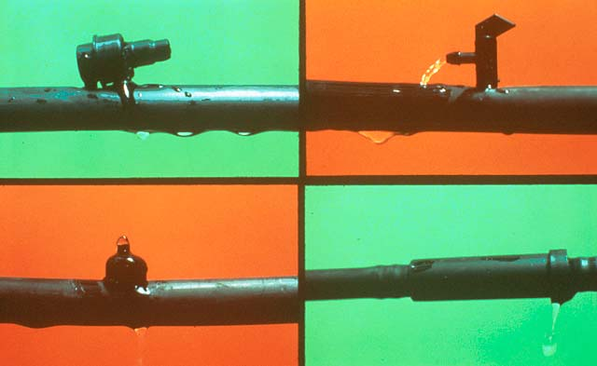
Convert to Drip Irrigation
Conserve by watering individual plants
Notes:
4. PRAYER FOR RAIN. Periodic drought makes the problem even more pronounced, causing reservoir and river levels to drop and often forcing water authorities and elected officials to place restrictions or bans on outdoor water use in an effort to conserve available water supplies.

Slide 71
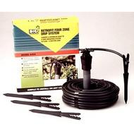
Drip Irrigation
Uses 30% to 50% less water than sprinkler irrigation.
Avoids spraying foliage so diseases are less likely to occur.
No spray drift.
Only need to water 25% of the root area.
Notes:
Drip Irrigation
Uses 30% to 50% less water than sprinkler irrigation
Avoids spraying foliage so diseases are less likely to occur
No spray drift
Only need to water 25% of the root area
Different drip irrigation nipples are available.

Slide 72
Drip Irrigation
Works well for small areas or for watering individual plants.
Supplies 1 to 4 gallons of water per hour, applies water directly to the soil.
Little water wasted due to evaporation or runoff.
Particularly good for mulched areas.
Notes:
Drip Irrigation
Works well for small areas or for watering individual plants.
Supplies 1 to 4 gallons of water per hour, applies water directly to the soil.
Little water wasted due to evaporation or runoff.
Particularly good for mulched areas.

Slide 73
Sprinkler Systems
Sprinkler systems cover large areas.
Manual systems require you to open the valve, time watering and shut off the flow.
Automatic systems offer the benefit of timed, programmable controllers.
Automatic system tips: reset as conditions change; split applications if runoff noticed;
turn system off during rainy periods.
Notes:
Sprinkler Systems
Sprinkler systems cover large areas.
Manual systems require you to open the valve, time watering and shut off the flow.
Automatic systems offer the benefit of timed, programmable controllers.
Automatic system tips: reset as conditions change; split applications if runoff noticed; turn system off during rainy periods.

Slide 74
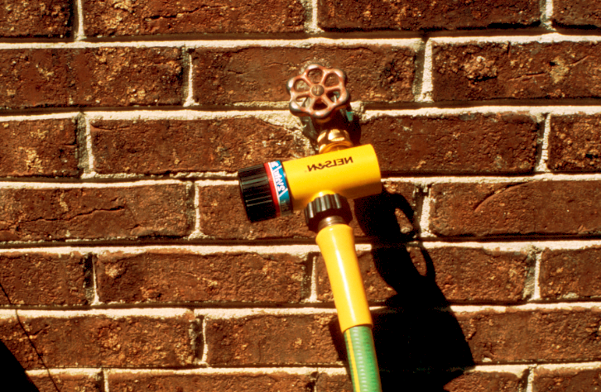
Manual System
Lawn Sprinkler and Simple Timer
Notes:
TIMER FOR FAUCET CONNECTION. If you use a portable lawn sprinkler, a low-cost timer connected at the faucet can be set to turn the sprinkler off after a designated period of time. This will prevent you from over-watering an area.

Slide 75
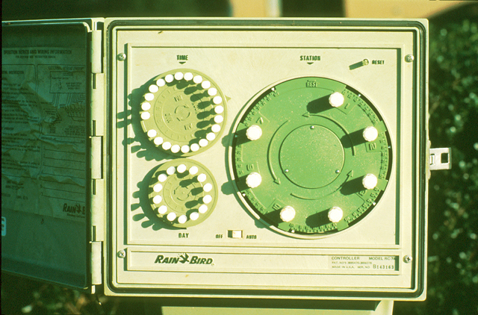
Automatic System with programmable controllers
Notes:
Adjust timers frequently according to changes in rainfall patterns.

Slide 76
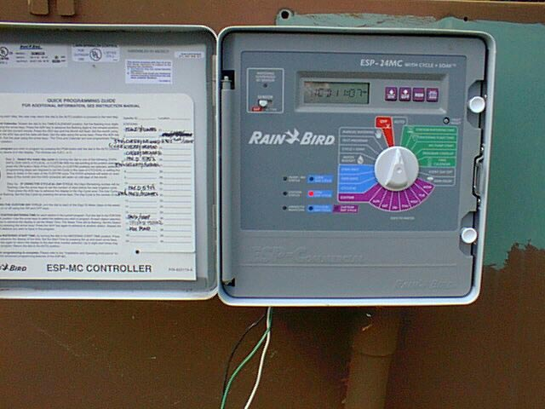
Automatic Timer
More difficult to set.
Automatically turns irrigation on.
Automatic shutoff.
Notes:
78. ADJUSTING THE TIME CLOCK. If your landscape has an automated irrigation system, remember to adjust it according to changes in rainfall patterns. Don’t just set it and forget it.

Slide 77
Sprinkler Irrigation Tips
Correct Number of Heads / Zone
MPR Nozzles
Clogged Nozzles
Damages / Leaking Nozzles
Obstructed Nozzles
Too Much or Too Little Pressure
Pressure Regulator & Backflow Preventor
Notes:
Sprinkler Irrigation Tips
Correct Number of Heads / Zone
MPR Nozzles
Clogged Nozzles
Damages / Leaking Nozzles
Obstructed Nozzles
Too Much or Too Little Pressure
Pressure Regulator & Backflow Preventor

Slide 78
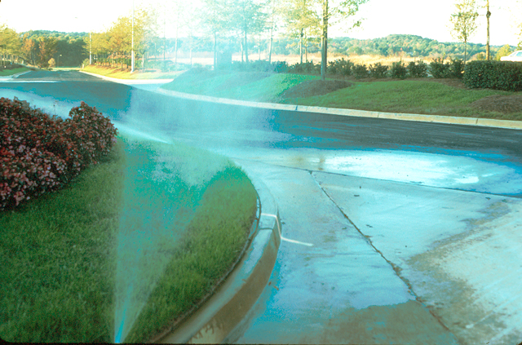
What’s the problem here?
Notes:
Check sprinkler heads often! Make sure they are hitting their zone!

Slide 79
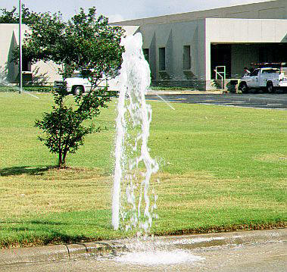
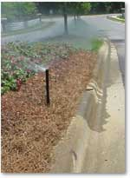
Hit The Target!
Check for leaks
Don’t water the
pavement
Notes:
Hit the Target! Check for faulty heads!

Slide 80
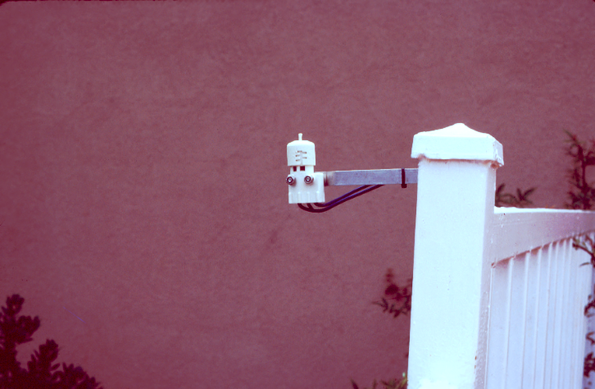
A low-cost rainfall sensor will prevent the irrigation system from running during rain.
Notes:
A low-cost rainfall sensor will prevent the irrigation system from running during rain.

Slide 81
Rain Sensors
Small, simple, relatively cheap devices.
Rain sensors prevent over-watering.
Once a designated amount of rainfall has been detected, the sensor turns off the irrigation system.
Soil moisture sensors available and more accurate; but somewhat more complicated.
Notes:
Rain Sensors
Small, simple, relatively cheap devices.
Rain sensors prevent over-watering.
Once a designated amount of rainfall has been detected, the sensor turns off the irrigation system.
Soil moisture sensors available and more accurate; but somewhat more complicated.

Slide 82
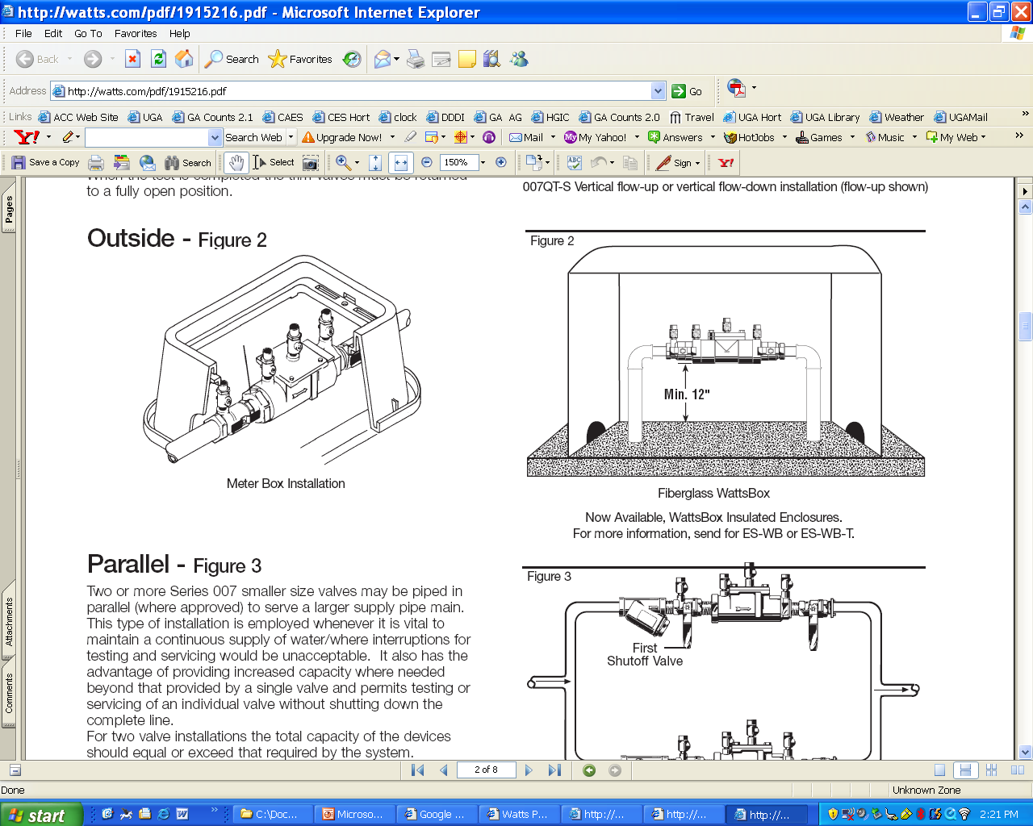
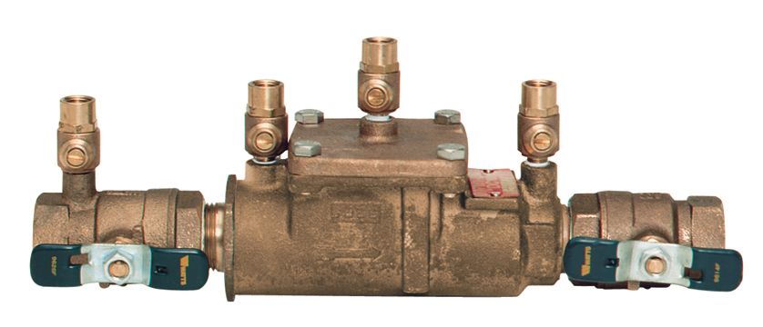
Check your Ordinances
A Backflow Prevention may be required to prevent your
irrigation system from contaminating water supplies

Slide 83
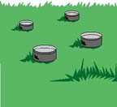
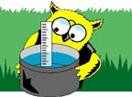
How do I know how long I need to irrigate?
Set out tuna cans or rain gauges
randomly throughout your lawn.
Measure how much water
was applied and calculate how long it will take to apply the water you need.

Slide 84
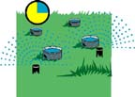
Check Uniformity of Application
Set out tuna cans or rain gauges randomly throughout your lawn.
Individually turn on each irrigation zone for 15 minutes.
Check to be sure irrigation is uniform and adjust heads if irrigation isn’t uniform.

Slide 85
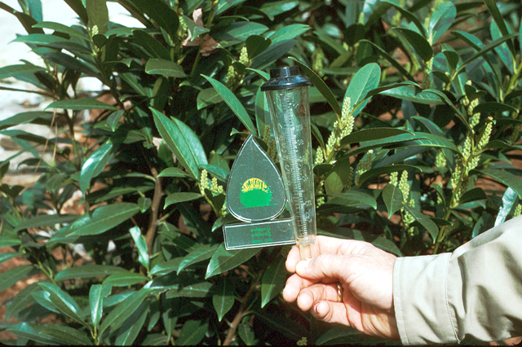
Use a rain gauge to track rainfall and to determine when to irrigate.
½- to 1-inch of rainfall per month is sufficient for most established woody ornamentals.
Notes:
Use a rain gauge to track rainfall and to determine when to irrigate.
½- to 1-inch of rainfall per month is sufficient for most established woody ornamentals.

Slide 86
REMEMBER:
More plants are killed each year from over-watering than from the lack of water!
Notes:
REMEMBER: More plants are killed each year from over-watering than from the lack of water!

Slide 87
Watering Trees
Water within and just beyond the drip line; or the area under the branches.
Do not water at the base of the tree.
Direct water to the soil and not the leaves; wet foliage is prone to disease and scorch.
Use sprinklers, soakers, drip, tree gators.
Mulch from the trunk to edge of drip line.
Notes:
Watering Trees
Water within and just beyond the drip line; or the area under the branches.
Do not water at the base of the tree.
Direct water to the soil and not the leaves; wet foliage is prone to disease and scorch.
Use sprinklers, soakers, drip, tree gators.
Mulch from the trunk to edge of drip line.

Slide 88
Tree Irrigation
Ooze Hoze
Garden Hose
T - Connector
Notes:
Tree Irrigation. Use a soaker or “ooze” hose.

Slide 89
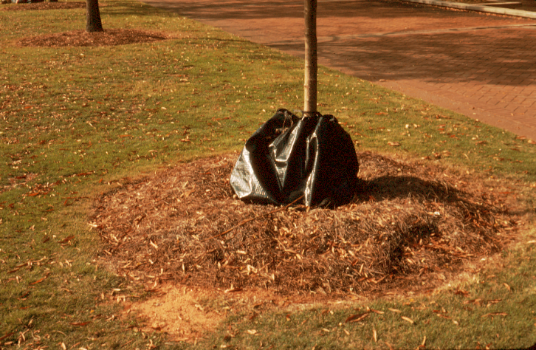
Treegator
Notes:
Tree gators are filled with water then slowly release water around the root system.
They can be expensive but very efficient.

Slide 90
Target irrigation to plants that show signs of stress.
Gray/green Color
Wilting
Dying Branches
Use a hand-held hose with water breaker or sprinkler can to direct water to those plants that need water the most!
Notes:
Target irrigation to plants that show signs of stress.
Gray/green Color
Wilting
Dying Branches
Use a hand-held hose with water breaker or sprinkler can to direct water to those plants that need water the most!

Slide 91
Efficient Irrigation
Watch Indicator Plants for Signs of Moisture Stress
Annuals
Hydrangeas
Azaleas
Thread-leaf Japanese Maples
Notes:
Efficient Irrigation
Watch Indicator Plants for Signs of Moisture Stress
Annuals
Hydrangeas
Azaleas
Thread-leaf Japanese Maples

Slide 92
Efficient Irrigation
WHEN TO WATER
For most efficient use of water, irrigate between 9pm - 10am to avoid excessive evaporative loss of water.
Don’t water when it is windy or during the heat of the day.
Notes:
Efficient Irrigation
WHEN TO WATER
- For most efficient use of water, irrigate between 9pm - 10am to avoid excessive evaporative loss of water.
- Don’t water when it is windy or during the heat of the day.

Slide 93
Efficient Irrigation
HOW TO WATER
A thorough soaking that saturates the soil to a depth of 6 to 8 inches is better for plants than shallow, frequent waterings.
Deep watering = deep, healthy roots
Shallow watering = shallow, weak roots
Notes:
Efficient Irrigation
HOW TO WATER
A thorough soaking that saturates the soil to a depth of 6 to 8 inches is better for plants than shallow, frequent waterings.
Deep watering = deep, healthy roots
Shallow watering = shallow, weak roots

Slide 94

Efficient Irrigation
HOW MUCH TO WATER
Shrubs: up to once a week - apply one gallon of water per foot of plant height.
Lawns: up to once a week -
up to one inch per application.
Trees: up to once a week;
one inch of water under entire
canopy.

Slide 95
Seven Steps To Zeriscaping
Planning and Design
Soil Improvement
Appropriate Plant Selection
Practical Turf Areas
Efficient Irrigation
Use of Mulches
Appropriate Maintenance
Notes:
Seven Steps To Zeriscaping
Planning and Design
Soil Improvement
Appropriate Plant Selection
Practical Turf Areas
Efficient Irrigation
Use of Mulches
Appropriate Maintenance

Slide 96
Benefits of Mulch
Prevents evaporative water loss from the soil.
Prevents soil-borne diseases.
Insulates the roots of plants from extreme cold and heat.
Reduces weed competition.
Reduces erosion.
Notes:
Benefits of Mulch
Prevents evaporative water loss from the soil.
Prevents soil-borne diseases.
Insulates the roots of plants from extreme cold and heat.
Reduces weed competition.
Reduces erosion.

Slide 97
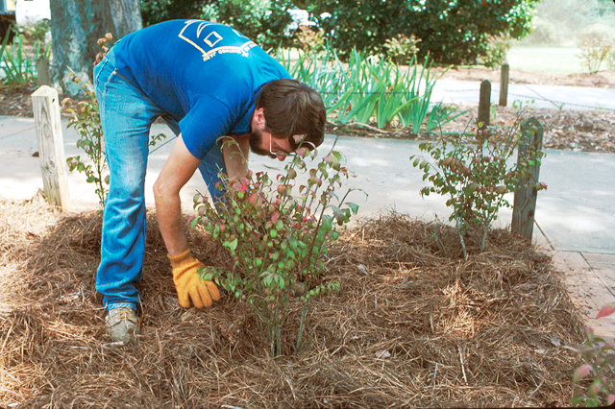
Best Mulches
Organic
Fine-textured
Non-matting
Notes:
Best Mulches: Organic, Fine-textured and Non-matting.

Slide 98
How Much Mulch To Apply?
3 to 5 inches is sufficient.
1 bale of pine straw covers 50 – 80 sq. ft., depending on the size of the bale.
9 – 3 cu. ft. bags of pine bark mulch will cover 100 sq. ft. to a 3-inch depth.
Notes:
How Much Mulch To Apply?
3 to 5 inches is sufficient.
1 bale of pine straw covers 50 – 80 sq. ft., depending on the size of the bale.
9 – 3 cu. ft. bags of pine bark mulch will cover 100 sq. ft. to a 3-inch depth.
Be sure not to add TOO MUCH mulch! More than 5 inches is TOO MUCH!

Slide 99
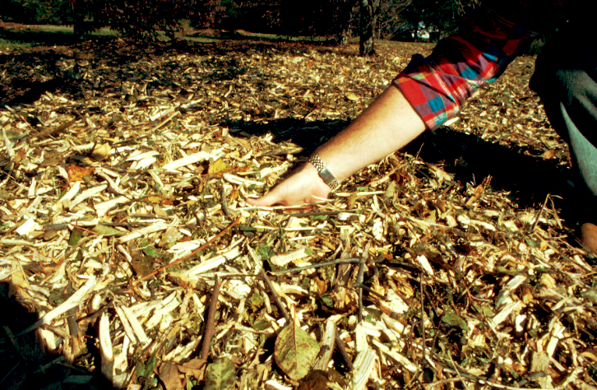
Make Sure Mulch is Composed!
Green Mulch Can Rob Plants of Essential Nitrogen.
Notes:
Make Sure Mulch is Composed! Green Mulch Can Rob Plants of Essential Nitrogen.

Slide 100
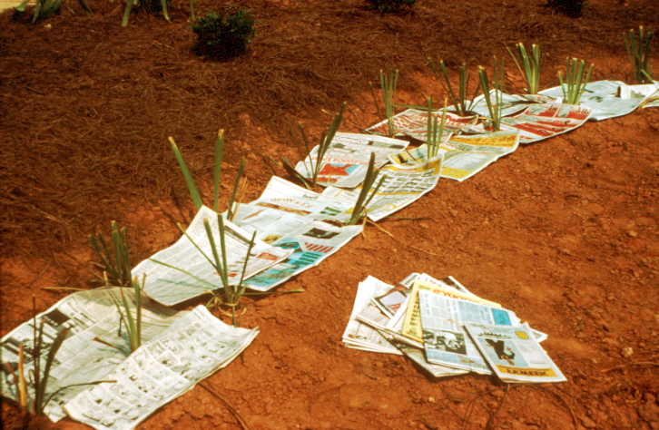
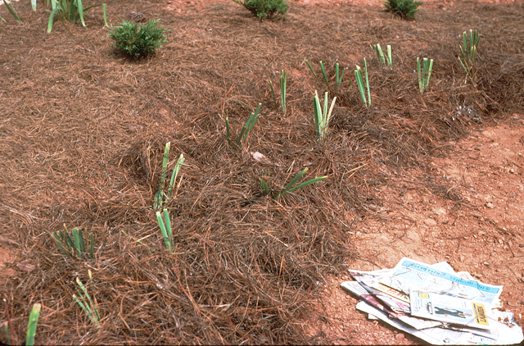
A good way
to recycle old newspapers.
Newspapers placed under mulch, 2 to 3 sheets thick, helps provide an added barrier to moisture loss.
Notes:
A good way to recycle old newspapers organically. Newspaper placed under much, 2- to 3-sheets thick, helps provide an added barrier to moisture loss.

Slide 101
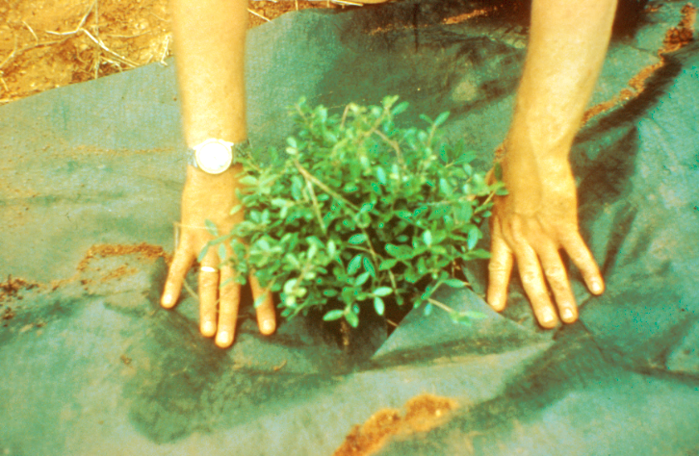
Landscape fabrics under mulch prevent weeds and conserves moisture in the soil.
Notes:
Landscape fabrics under mulch prevent weeds and conserves moisture in the soil. Ask the audience what their experiences have been with landscape fabrics?

Slide 102
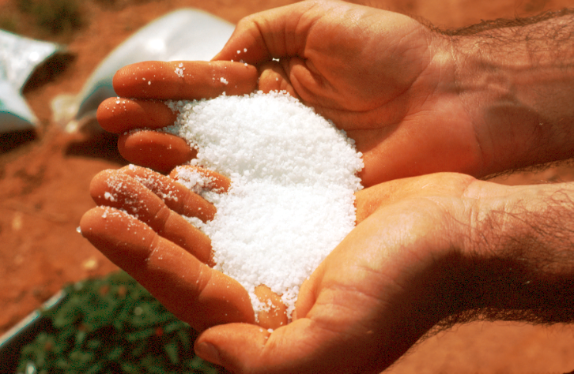
Hydrogel
Water Absorbing Polymer
Notes:
Hydrogel. Water Absorbing Polymer. There are several polymers available to help retain moisture in the soil.
It is best to place the polymer in a bucket and fill it with water. Once the water has been absorbed add it to the soil.

Slide 103
Conserving Moisture in the Soil
Hydro-Gel
(Hydrosource, Terrasorb)
DriWater
(www.driwater.com)
Notes:
Conserving Moisture in the Soil.
Hydro-Gels. (Hydrosource, Terrasorb)
DriWater: (www.driwater.com)

Slide 104
Mulching Tips
Before mulching, remove all weeds.
Spread mulch material out evenly over the soil to cover the entire root zone.
Avoid over-mulching and mulch volcanoes.
Avoid placing mulch against tree trunks.
Inorganic mulches: long-lasting; stone, rocks.
Organic mulches: pine straw, pine bark, cedar chips, etc. Decay/add organic matter.
Notes:
Mulching Tips
Before mulching, remove all weeds.
Spread mulch material out evenly over the soil to cover the entire root zone.
Avoid over-mulching and mulch volcanoes.
Avoid placing mulch against tree trunks.
Inorganic mulches: long-lasting; stone, rocks.
Organic mulches: pine straw, pine bark, cedar chips, etc. Decay/add organic matter.

Slide 105
Seven Steps To Zeriscaping
Planning and Design
Soil Improvement
Appropriate Plant Selection
Practical Turf Areas
Efficient Irrigation
Use of Mulches
Appropriate Maintenance
Notes:
Seven Steps To Zeriscaping
Planning and Design
Soil Improvement
Appropriate Plant Selection
Practical Turf Areas
Efficient Irrigation
Use of Mulches
Appropriate Maintenance

Slide 106
Avoid Frequent Flushes of Vegetative Growth Brought on by:
Fertilization
Pruning
Irrigation
Notes:
Avoid Frequent Flushes of Vegetative Growth Brought on by:
Fertilization
Pruning
Irrigation

Slide 107
To Avoid Excessive Vegetative Growth
Use low-nitrogen fertilizers.
Use slow-release-type fertilizers.
Limit fertilization during dry periods.
Reduce number of applications.
Notes:
To Avoid Excessive Vegetative Growth
Use low-nitrogen fertilizers.
Use slow-release-type fertilizers.
Limit fertilization during dry periods.
Reduce number of applications.

Slide 108
Too Much Nitrogen
Increases pest problems.
Increases top growth.
Reduces root growth.
Increases pruning requirements.
Increases run-off into groundwater.
Notes:
Too Much Nitrogen
Increases pest problems.
Increases top growth.
Reduces root growth.
Increases pruning requirements.
Increases run-off into groundwater.

Slide 109
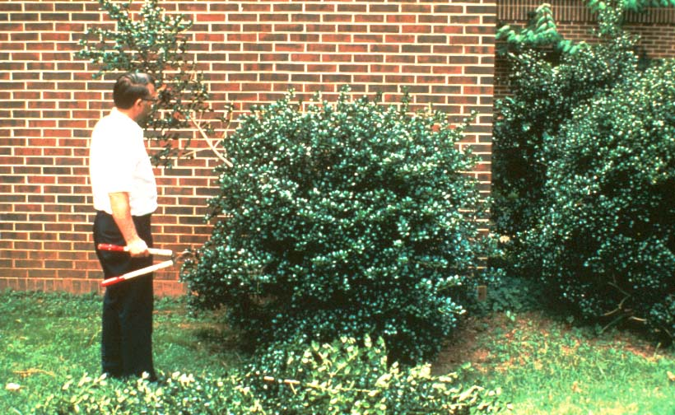
Prune by selective thinning instead of shearing.
Notes:
Prune by selective thinning instead of shearing.
Thinning cuts remove a large branch to open the canopy.
Hedging cuts shear the top of the plant stimulating new shoots to form.

Slide 110
Pruning Tips
Use thinning cuts to reduce size of plants.
Avoid shearing/??? cuts, if possible.
Avoid heavy pruning in times of drought.
Heavy pruning stimulates more growth that results in higher water needs.
Notes:
Pruning Tips
Use thinning cuts to reduce size of plants.
Avoid shearing/??? cuts, if possible.
Avoid heavy pruning in times of drought.
Heavy pruning stimulates more growth that results in higher water needs.

Slide 111
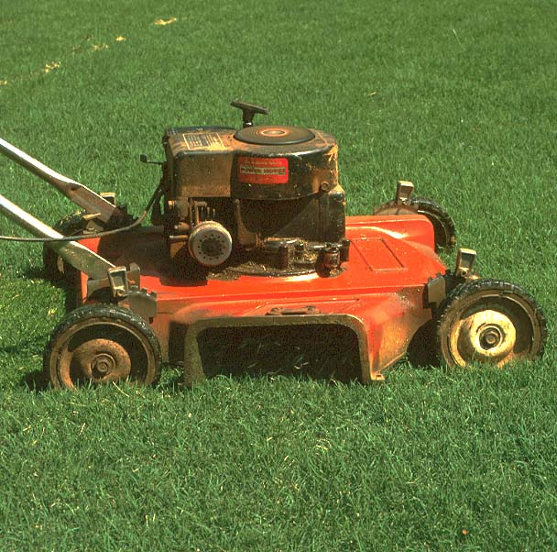
Grasscycling
Let the Clips Fall Where they May
Clippings DO NOT Cause Thatch
Clippings
Add
Nitrogen
Back
to the
Soil
Clippings
Help Hold
Moisture
in the soil
Notes:
Grasscycling. Let the Clips Fall Where they May.
Clippings DO NOT Cause Thatch.
Clippings Help Hold Moisture in the soil.
Clippings Add Nitrogen Back to the Soil.

Slide 112
Top Ten “Water Wise” Tips
Water early in the day or early evening.
Use drip or soaker hoses.
Water thoroughly but slowly.
Know your plant’s water needs.
Plant it correctly.
Mulch to conserve water.
Raise Mower height in summer.
Maintain proper growing conditions.
Control weeds.
Plan your landscape.
Notes:
Top Ten “Water Wise” Tips
1. Water early in the day or early evening.
2. Use drip or soaker hoses.
3. Water thoroughly but slowly.
4. Know your plant’s water needs.
5. Plant it correctly.
6. Mulch to conserve water.
7. Raise Mower height in summer.
8. Maintain proper growing conditions.
9. Control weeds.
10. Plan your landscape.

Slide 113
Let’s Recap Xeriscaping:
Quality Landscaping that Conserves Water and Protects the Environment
Water Conservation through Creative Landscaping
Water-Efficient Landscaping
Notes:
Let’s Recap Xeriscaping:
Quality Landscaping that Conserves Water and Protects the Environment
Water Conservation through Creative Landscaping
Water-Efficient Landscaping

Slide 114
Xeriscaping … one more time,
A Low Maintenance Approach
to
Water Wise Landscapes !
Notes:
Xeriscaping … one more time,
A Low Maintenance Approach to Water Wise Landscapes !

Slide 115
A Low Maintenance Approach
to
Water Wise Landscapes !
People Save Water !
Notes:
A Low Maintenance Approach to Water Wise Landscapes ! People Save Water !

Slide 116
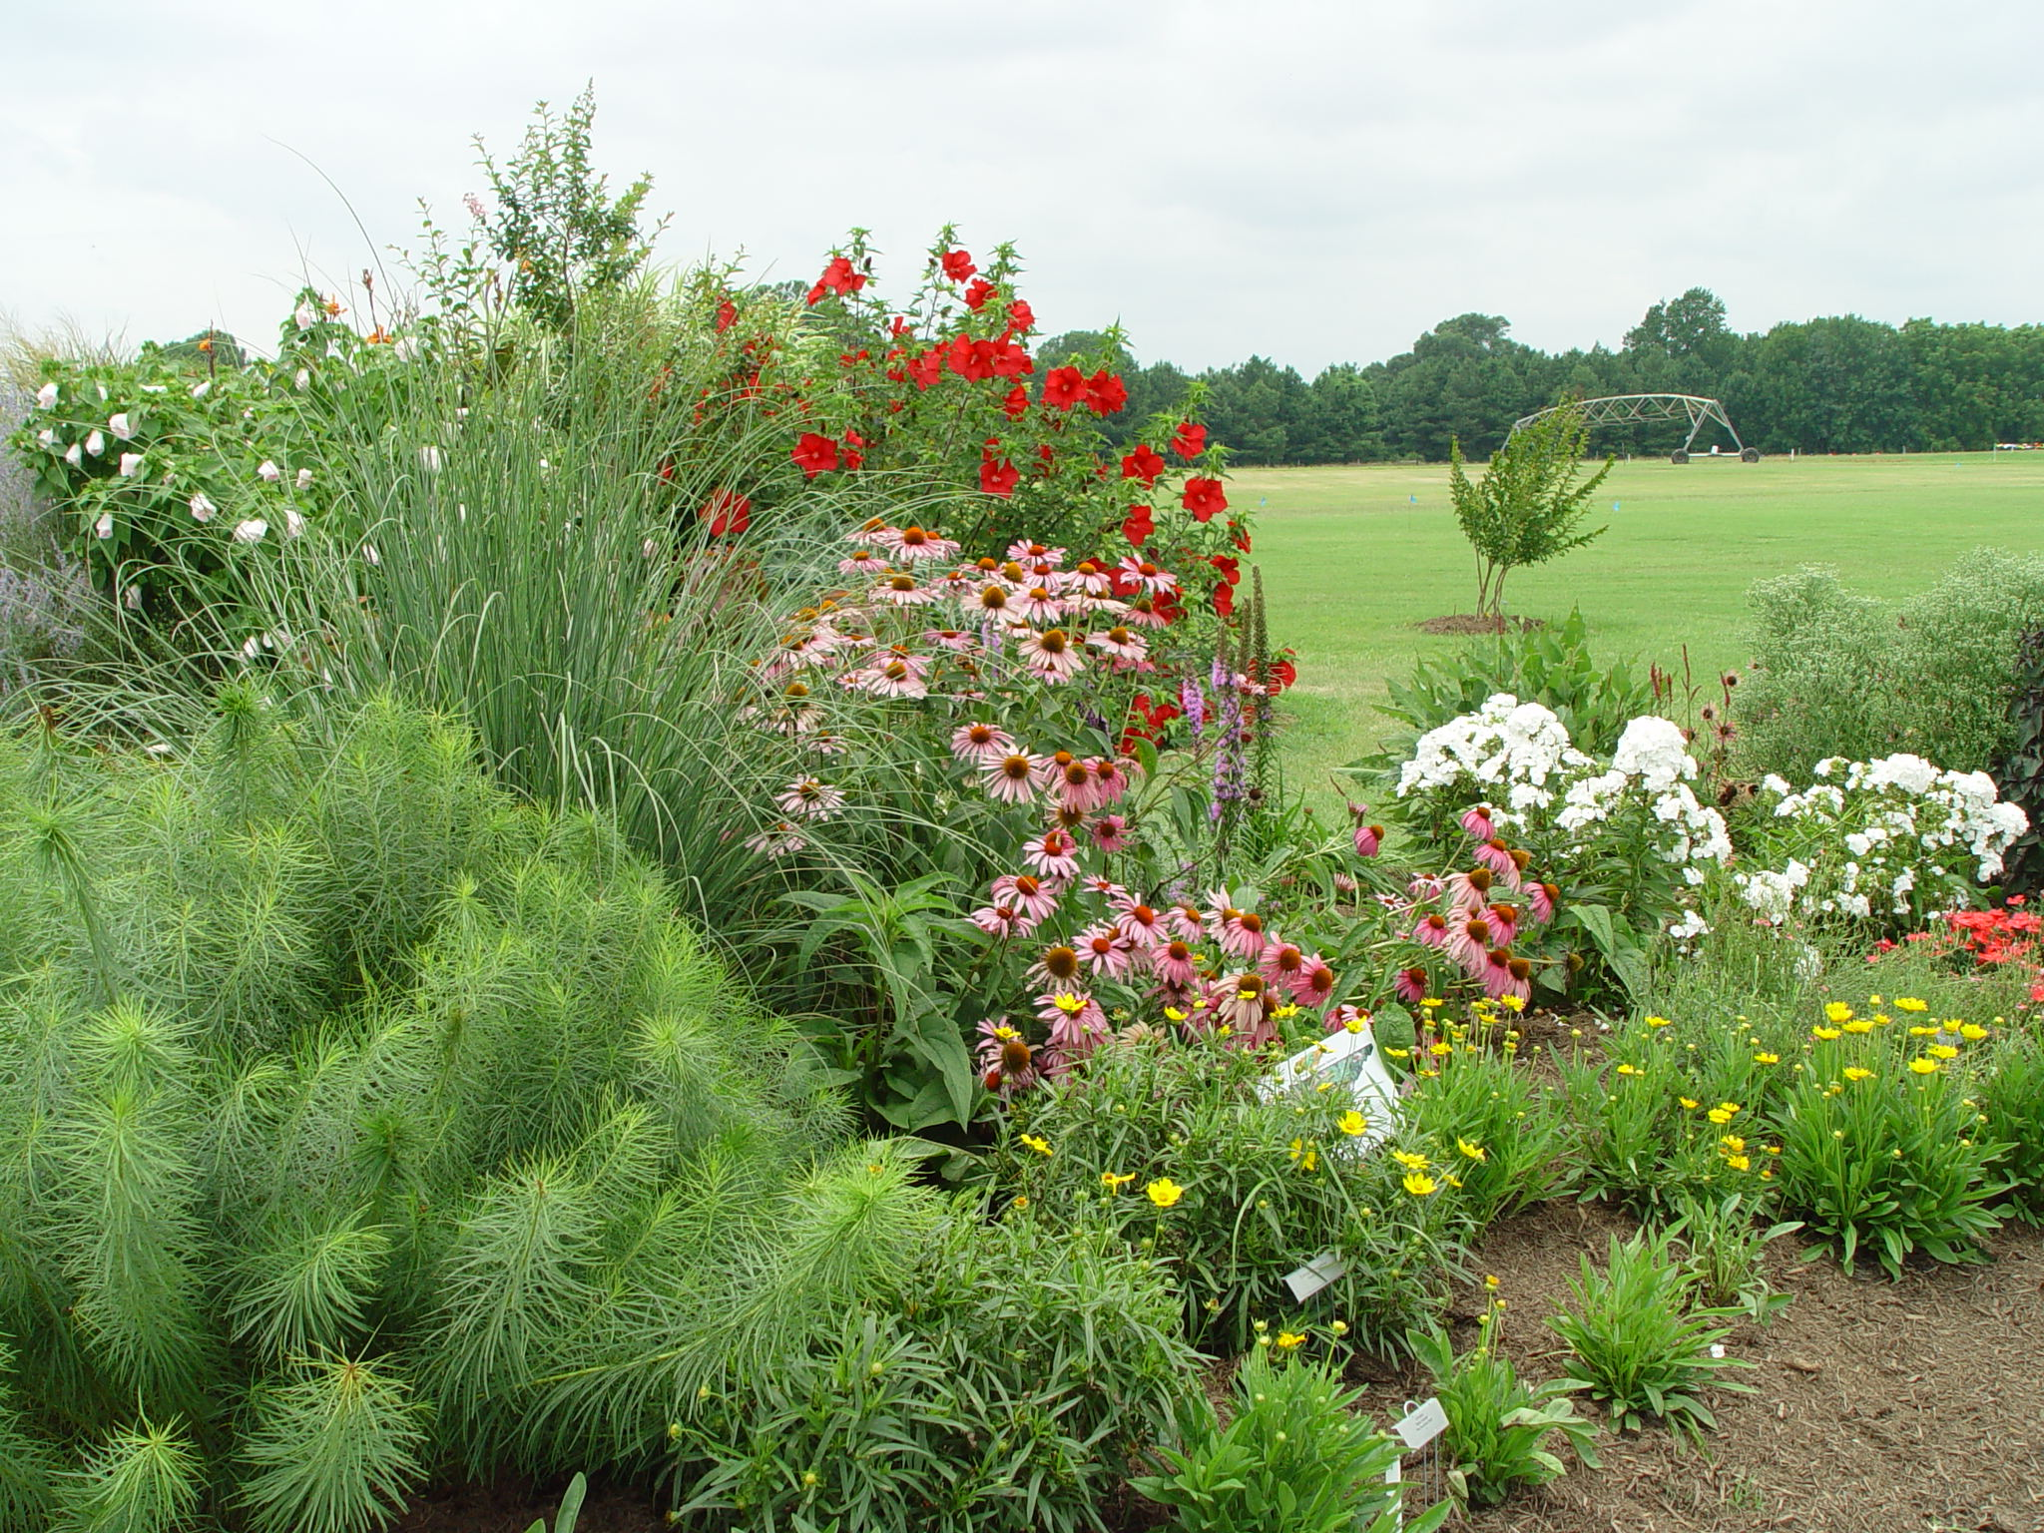
Xeriscape
A Beautiful Way to Have Twice
the Landscape for Half the Water
Notes:
A beautiful, healthy xeriscape. Xeriscape.
A Beautiful Way to Have Twice the Landscape for Half the Water.

Slide 117
Special thanks to -
Dr. Gary L. Wade,
Extension Horticulturist,
The University of Georgia
Notes:
It’s more like this! A sloping color bed which drains water into the turf high water use area.
Special thanks to - Dr. Gary L. Wade, Extension Horticulturist, The University of Georgia.

Slide 118
Landscaping for Water Quantity
Irrigation Systems
Design
Equipment & Efficiency
Maintenance
Management
Notes:
Landscaping for Water Quantity
Irrigation Systems
Design
Equipment & Efficiency
Maintenance
Management

Slide 119
Irrigation System Design
Homes with automatic systems
use substantially more water
outdoors.
A good design cannot overcome poor management and maintenance of a system.
System design must match up with landscape design – water use zones.
Notes:
Irrigation System Design
Homes with automatic systems use substantially more water outdoors.
A good design cannot overcome poor management and maintenance of a system.
System design must match up with landscape design – water use zones.

Slide 120
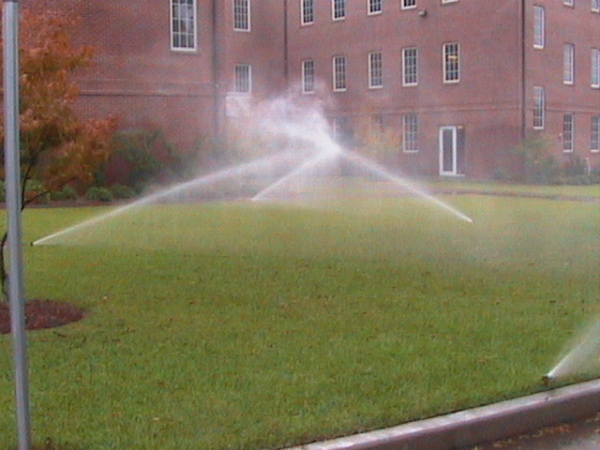
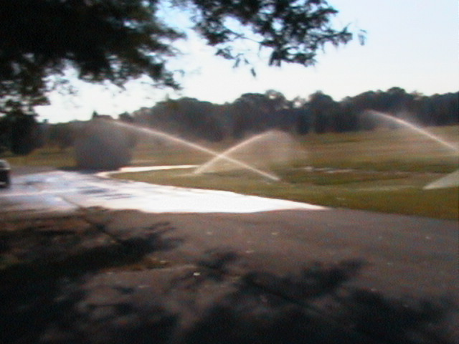
Irrigation System Design
Irrigation systems can have a wide range of costs depending on the features of the system design.
The least expensive design may not be the most water conserving or efficient.
Notes:
Irrigation System Design
Irrigation systems can have a wide range of costs depending on the features of the system design.
The least expensive design may not be the most water conserving or efficient.

Slide 121
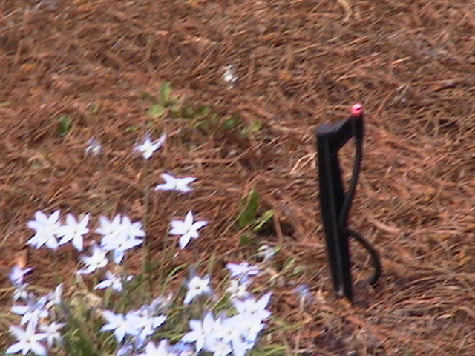


Irrigation System Design
Landscape water-use zoning is matched to the irrigation system zoning …
  Ornamental beds may use sprinklers, microsprays or drip emitters.
  Perennial flowers, bushes and trees may only need irrigation for establishment and drought conditions – is a permanent system really necessary?
Notes:
Irrigation System Design
Landscape water-use zoning is matched to the irrigation system zoning …
- Ornamental beds may use sprinklers, microsprays or drip emitters.
- Perennial flowers, bushes and trees may only need irrigation for establishment and drought conditions – is a permanent system really necessary?

Slide 122


Irrigation System Design
Landscape water-use zoning is matched to the irrigation system zoning …
  Large turf areas use
  impact or rotor sprinklers.
  Small turf areas may use sprinklers or sprays.
Notes:
Irrigation System Design
Landscape water-use zoning is matched to the irrigation system zoning …
- Large turf areas use impact or rotor sprinklers.
- Small turf areas may use sprinklers or sprays.

Slide 123
Irrigation System Design
Design must have high uniformity and application efficiency to be water conserving.
Uniformity – evenness that water is spread over the target area.
Application efficiency – amount of applied water that is useful to targeted plant materials.
Notes:
Irrigation System Design
Design must have high uniformity and application efficiency to be water conserving.
Uniformity – evenness that water is spread over the target area.
Application efficiency – amount of applied water that is useful to targeted plant materials.

Slide 124
Uniformity
Calculated as a percent.
Indicates the evenness of the spreading out of the water.
Major controlling factors in design:
  Proper nozzles sizes
  Proper sprinkler, spray or emitter spacing
  Proper pressure
Notes:
Uniformity
Calculated as a percent.
Indicates the evenness of the spreading out of the water.
Major controlling factors in design:
- Proper nozzles sizes
- Proper sprinkler, spray or emitter spacing
- Proper pressure

Slide 125

Uniformity – Side View
Notes:
Uniformity – Side View

Slide 126


Uniformity- Overhead Pattern
Poor
Good
Notes:
Uniformity- Overhead Pattern

Slide 127

Uniformity
Sprinkler heads should be spaced no further apart than their radius of throw.
Proper operating pressure is needed to get the correct distribution of water at each nozzle.
  Pressure regulators required on slopes
  Proper pipe sizes
  Adequate upstream pressure
Notes:
Uniformity
Sprinkler heads should be spaced no further apart than their radius of throw.
Proper operating pressure is needed to get the correct distribution of water at each nozzle.
- Pressure regulators required on slopes
- Proper pipe sizes
- Adequate upstream pressure

Slide 128

Uniformity
Uniformity Losses can result from …
  Operating pressures too high or low.
  Operating pressures that vary too much in one zone.
  Pattern interference from plant materials or other objects.
  High Winds.
  Poorly maintained systems.
Notes:
Uniformity
Uniformity Losses can result from …
- Operating pressures too high or low.
- Operating pressures that vary too much in one zone.
- Pattern interference from plant materials or other objects.
- High Winds.
- Poorly maintained systems.

Slide 129
Adjust for Uniformity
Uniformity should be checked at the beginning of the irrigation season.
Irrigation hardware should be compatible.
Each zone should have the same make and model of sprinkler heads.
The sprinkler heads within a zone should have the same precipitation rate.
Plants with similar water needs should be grouped in the same zone.
Adjust the arc of the sprinkler head to achieve the maximum coverage without watering the pavement.
Notes:
Adjust for Uniformity
Uniformity should be checked at the beginning of the irrigation season.
Irrigation hardware should be compatible.
Each zone should have the same make and model of sprinkler heads.
The sprinkler heads within a zone should have the same precipitation rate.
Plants with similar water needs should be grouped in the same zone.
Adjust the arc of the sprinkler head to achieve the maximum coverage without watering the pavement.

Slide 130
Application Efficiency
Calculated as a percentage
  Water available to plants/total water applied
Losses of water include
  Poor uniformity
  Evaporation before reaching soil
  Deep percolation
  Wetting impervious surfaces
  Pattern break up from interference from plant materials or other objects
Notes:
Application Efficiency
Calculated as a percentage
- Water available to plants/total water applied
Losses of water include
- Poor uniformity
- Evaporation before reaching soil
- Deep percolation
- Wetting impervious surfaces
- Pattern break up from interference from plant materials or other objects

Slide 131
Irrigation System Leaks
Run one zone at a time and observe each sprinkler head in the zone. Bubbling, misting or unusual spray patterns indicate defective or damage sprinkler heads.
Look for breaks in the pipe fittings.
Excessively wet areas with standing water (evidenced by excessively green turf, turf mounding, water seeping from turf or pavement edge) indicate underground leaks.
Notes:
Irrigation System Leaks
Run one zone at a time and observe each sprinkler head in the zone. Bubbling, misting or unusual spray patterns indicate defective or damage sprinkler heads.
Look for breaks in the pipe fittings.
Excessively wet areas with standing water (evidenced by excessively green turf, turf mounding, water seeping from turf or pavement edge) indicate underground leaks.

Slide 132
Irrigation System Leaks (cond.)
Cracks in the pavement near the system can be the result of a leaky irrigation system.
Use PVC pipe to listen at the valve boxes for water running when the zone is not turned on.
If you detect leaks in your irrigation system, contact your irrigation contractor.
Notes:
Irrigation System Leaks (cond.)
Cracks in the pavement near the system can be the result of a leaky irrigation system.
Use PVC pipe to listen at the valve boxes for water running when the zone is not turned on.
If you detect leaks in your irrigation system, contact your irrigation contractor.

Slide 133

Irrigation System Maintenance
Check for obvious leaks on a regular basis.
Do a water meter check for leaks at least annually.
  Turn off all water and look at water meter to see if any water is leaking
Flush system each Spring when starting up system for the first time.
Observe any weird spray patterns (or dry spots) and change out nozzles when needed.
Notes:
Irrigation System Maintenance
Check for obvious leaks on a regular basis.
Do a water meter check for leaks at least annually.
- Turn off all water and look at water meter to see if any water is leaking
Flush system each Spring when starting up system for the first time.
Observe any weird spray patterns (or dry spots) and change out nozzles when needed.

Slide 134


Spring Start Up
Flush out system – clean out any critters that have moved in.
- open the ends of drip tubes
  - remove spray and sprinkler nozzles
Replace nozzles and close up drip lines and run the system and check for clogged nozzles or pipes.
Check all valves for leaks.
Reset controller for proper run times.
Replace batteries on controllers.
Notes:
Spring Start Up
Flush out system – clean out any critters that have moved in.
- open the ends of drip tubes
- remove spray and sprinkler nozzles
Replace nozzles and close up drip lines and run the system and check for clogged nozzles or pipes.
Check all valves for leaks.
Reset controller for proper run times.
Replace batteries on controllers.

Slide 135
Winterizing a System
Turn off main valve to irrigation system.
Set automatic controllers to “rain” setting.
Turn on each valve in the system to release pressure.
Drain water out of irrigation components to the extent possible.
Notes:
Winterizing a System
Turn off main valve to irrigation system.
Set automatic controllers to “rain” setting.
Turn on each valve in the system to release pressure.
Drain water out of irrigation components to the extent possible.

Slide 136
Irrigation Management
Goals of irrigation management are:
  Apply only the water needed for a healthy landscape.
  Stop regular irrigation schedules when rain is falling.
  Increase water application during prolonged dry spells appropriately.
  Apply different amounts of water to different kinds of plant materials according to the plant needs.
Maximum efficiency requires weekly and sometimes daily adjustments.
Notes:
Irrigation Management
Goals of irrigation management are:
- Apply only the water needed for a healthy landscape.
- Stop regular irrigation schedules when rain is falling.
- Increase water application during prolonged dry spells appropriately.
- Apply different amounts of water to different kinds of plant materials according to the plant needs.
Maximum efficiency requires weekly and sometimes daily adjustments.

Slide 137
Irrigation Management
Major problems
  Too much water
  Watering too frequently
Notes:
Irrigation Management
Major problems
- Too much water
- Watering too frequently

Slide 138

Mechanical Controller
Easy to set
Must manually turn on timer
Automatic shutoff
Notes:
80. TIMER FOR FAUCET CONNECTION. If you use a portable lawn sprinkler, a low-cost timer connected at the faucet can be set to turn the sprinkler off after a designated period of time. This will prevent you from over-watering an area.

Slide 139
Automatic Timer
More difficult to set
Automatically turns irrigation on
Automatic shutoff
Notes:
78. ADJUSTING THE TIME CLOCK. If your landscape has an automated irrigation system, remember to adjust it according to changes in rainfall patterns. Don’t just set it and forget it.

Slide 140


Irrigation Management
Recommended hardware features for controllers for water efficiency include:
  3 independent programs.
  Station run times from one to 200 minutes.
  3 start times per program.
  Water budgeting from 0-200%.
Notes:
Irrigation Management
Recommended hardware features for controllers for water efficiency include:
- 3 independent programs.
- Station run times from one to 200 minutes.
- 3 start times per program.
- Water budgeting from 0-200%.

Slide 141

Irrigation Management
Recommended hardware features for controllers for water efficiency include:
  Odd, even, weekly and interval program capability.
  365 day calendar adjusted for leap year.
  Rain/weather shut-off device capability.
Notes:
Irrigation Management
Recommended hardware features for controllers for water efficiency include:
- Odd, even, weekly and interval program capability.
- 365 day calendar adjusted for leap year.
- Rain/weather shut-off device capability.

Slide 142

Irrigation Management
Recommended hardware features for controllers for water efficiency include:
  Off, Auto and Manual operation modes without disturbing programming.
  Diagnostic circuitry to notify you when station is shorted or power failure has occurred.
  Non-volatile memory or battery back-up.
Notes:
Irrigation Management
Recommended hardware features for controllers for water efficiency include:
- Off, Auto and Manual operation modes without disturbing programming.
- Diagnostic circuitry to notify you when station is shorted or power failure has occurred.
- Non-volatile memory or battery back-up.

Slide 143
Irrigation Management
Best Management Practices (BMPs)
  Know how to adjust the controller and change watering times based on weather.
  Water at night – 10 PM - 7 AM.
  Know the differences in water needs of plant materials.
Notes:
Irrigation Management
Best Management Practices (BMPs)
- Know how to adjust the controller and change watering times based on weather.
- Water at night – 10 PM - 7 AM.
- Know the differences in water needs of plant materials.

Slide 144

Irrigation Scheduling
Update controller if it is limited in flexibility.
Rain shutoff device.
For areas with perennials, shrubs and trees - do not water regularly, only when needed once established.
Notes:
Irrigation Scheduling
Update controller if it is limited in flexibility.
Rain shutoff device.
For areas with perennials, shrubs and trees - do not water regularly, only when needed once established.

Slide 145

Irrigation Scheduling
Know the rules in your area
Schedule for conservation
What days?
What hours?
Stay out of trouble
Notes:
Irrigation Scheduling.
Know the rules in your area.
- Schedule for conservation.

Slide 146
Check your Ordinances.
Backflow Prevention may be required to prevent your
irrigation system from contaminating water supplies.
Notes:
Check your Ordinances. Backflow Prevention may be required to prevent your irrigation system from contaminating water supplies.

Slide 147
Automatic vs. Manual Irrigation
Mayer et al. (1999) found that homes with automatic systems use more than twice the amount of water as manually irrigated homes on average.
Most automatic systems do not use more water than local climate conditions require for optimum growth of turf grass.
Manual – 39% of ET.
Automatic – 47% of ET.
Notes:
Automatic vs. Manual Irrigation
Mayer et al. (1999) found that homes with automatic systems use more than twice the amount of water as manually irrigated homes on average.
Most automatic systems do not use more water than local climate conditions require for optimum growth of turf grass.
Manual – 39% of ET.
Automatic – 47% of ET.

Slide 148
Automatic vs. Manual Irrigation
Automatic systems are cost effective for most commercial landscapes due to the labor savings.
For small spaces, automatic systems are not cost effective and drought tolerant plantings with mulching make more sense.
Notes:
Automatic vs. Manual Irrigation
Automatic systems are cost effective for most commercial landscapes due to the labor savings.
For small spaces, automatic systems are not cost effective and drought tolerant plantings with mulching make more sense.

Slide 149
Summary Irrigation System BMPs
Quality irrigation system design to maximize uniformity and application efficiency.
Proper maintenance and upkeep of the irrigation system.
Adjust controllers for weather conditions.
Water plant materials only as needed.
Notes:
Summary Irrigation System BMPs
Quality irrigation system design to maximize uniformity and application efficiency.
Proper maintenance and upkeep of the irrigation system.
Adjust controllers for weather conditions.
Water plant materials only as needed.

Slide 150

Other Water Savings Options
Harvest rainwater with rain barrels.
Use gray water in locations where allowed.
Notes:
Other Water Savings Options
Harvest rainwater with rain barrels.
Use gray water in locations where allowed.

Slide 151
Special thanks to -
Dr. Rose Mary Seymour
Extension Water Resources Specialist
The University of Georgia
Notes:
Special thanks to -
Dr. Rose Mary Seymour
Extension Water Resources Specialist
The University of Georgia

