Slide 1
Landscaping For Water Quality
MASTER GARDENER
ADVANCED TRAINING
May 1, 2008
Georgia Experiment Station
Notes:
Landscaping For Water Quality
MASTER GARDENER ADVANCED TRAINING
May 1, 2008
Georgia Experiment Station

Slide 2
Landscaping for Water Quality
What is landscaping for water quality?
Is this something that I can really do?
Will my efforts actually make a difference?
Why would I want to do this anyway?
Notes:
Landscaping for Water Quality
What is landscaping for water quality?
Is this something that I can really do?
Will my efforts actually make a difference?
Why would I want to do this anyway?

Slide 3
Landscaping for Water Quality
Landscaping for water quality is the use of principles and techniques to:
- preserve clean water in the landscape.
- reduce the potential for pollution of water
in the environment.
- maintain an attractive, healthy landscape.
Notes:
Landscaping for Water Quality
Landscaping for water quality is the use of principles and techniques to:
- preserve clean water in the landscape.
- reduce the potential for pollution of water in the environment.
- maintain an attractive, healthy landscape.

Slide 4
Landscaping for Water Quality
Landscaping for water quality utilizes:
- Rain barrels
- Cisterns
- Detention and retention ponds
- Infiltration zones
- Pollution control measures
- Proper pesticide usage
- BMPs (Best Management Practices)
Notes:
Landscaping for Water Quality
Landscaping for water quality utilizes:
- Rain barrels
- Cisterns
- Detention and retention ponds
- Infiltration zones
- Pollution control measures
- Proper pesticide usage
- BMPs (Best Management Practices)

Slide 5
Landscaping for Water Quality
Laws that Protect Water Quality
In 1972, the federal government passed the Clean Water Act to restore and maintain the chemical, physical and biological integrity of the nation’s waters.
www.epa.gov
Notes:
Landscaping for Water Quality
Laws that Protect Water Quality.
In 1972, the federal government passed the Clean Water Act to restore and maintain the chemical, physical and biological integrity of the nation’s waters.
www.epa.gov

Slide 6
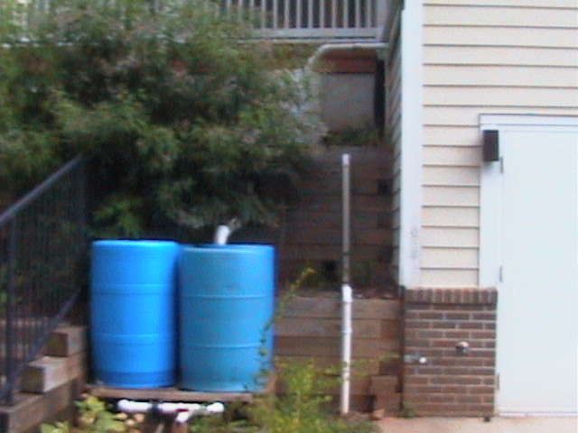
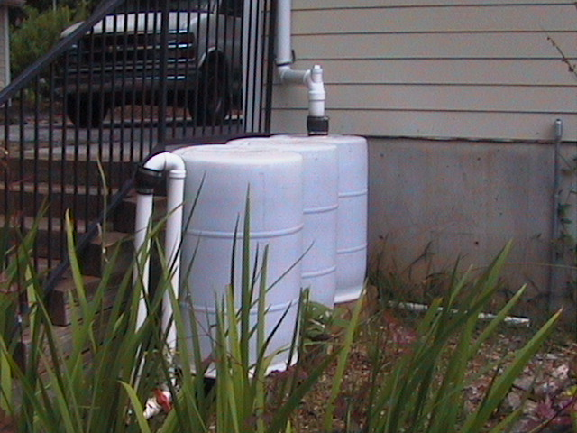
Rain Barrels
Notes:
Rain Barrels
(2 pictures)

Slide 7
Rain Barrels and Rain Harvesting
Rain barrels are one of many techniques we can use to make our landscapes more environmentally friendly.
Notes:
Rain Barrels and Rain Harvesting
Rain barrels are one of many techniques we can use to make our landscapes more environmentally friendly.

Slide 8
Why Harvest Rain?
Reduce off-site storm water runoff.
Contribute to improved water quality of local streams.
Reduce erosion.
Increase infiltration of water on-site.
Reduce water costs.
Conserve water and energy.
Notes:
Why Harvest Rain?
Reduce off-site storm water runoff.
Contribute to improved water quality of local streams.
Reduce erosion.
Increase infiltration of water on-site.
Reduce water costs.
Conserve water and energy.

Slide 9
How Can I Harvest Rainwater?
Harvested water for landscape uses does not require chemical and biological clean up.
Components of rain harvesting system:
  - Collection area
  - Transport system
  - Filtration
  - Storage
  - Delivery and Distribution
Notes:
How Can I Harvest Rainwater?
Harvested water for landscape uses does not require chemical and biological clean up.
Components of rain harvesting system:
- Collection area
- Transport system
- Filtration
- Storage
- Delivery and Distribution

Slide 10
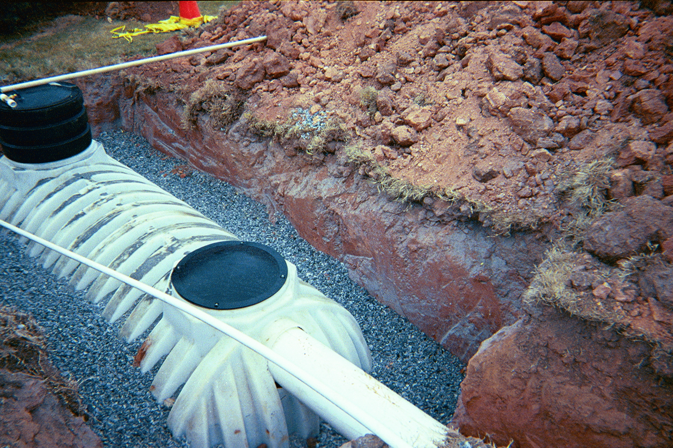
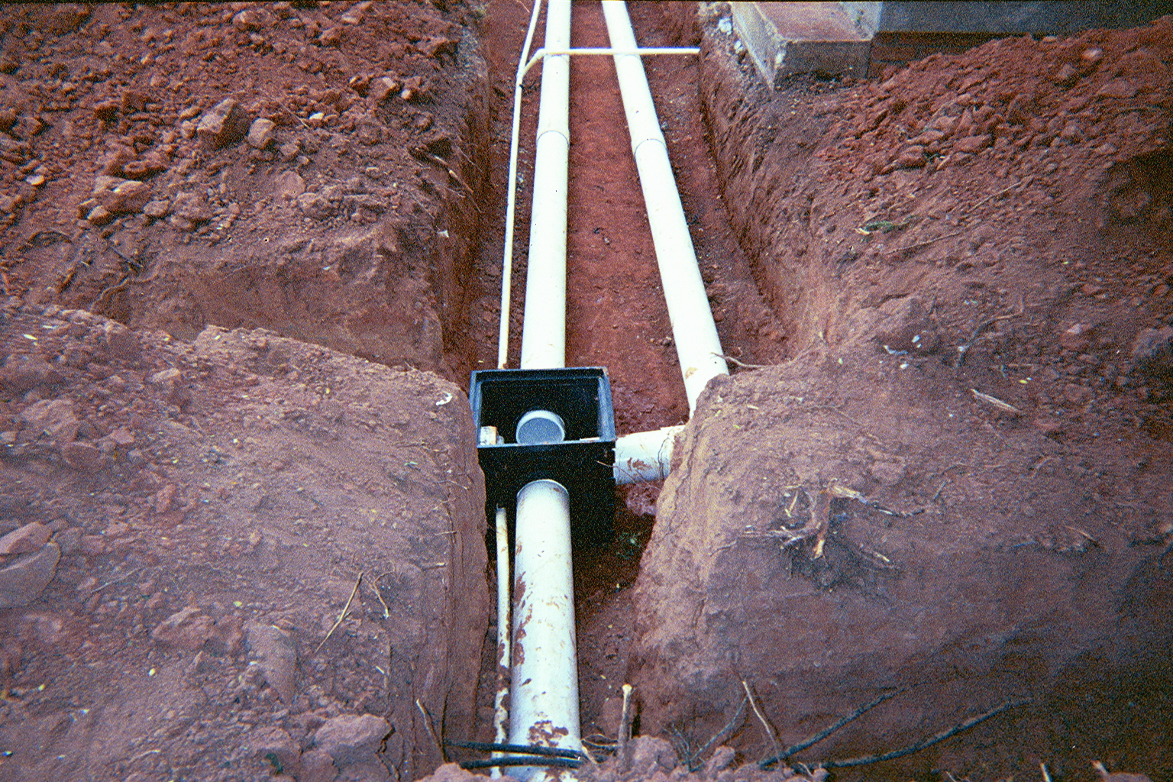
Collection Area and Transportation
Collection is most often rooftops.
Other impervious areas.
Turf areas and planting beds.
Transportation carries water from collection area to storage.
  Gutters
  Underground pipes
Notes:
Collection Area and Transportation
Collection is most often rooftops.
Other impervious areas.
Turf areas and planting beds.
Transportation carries water from collection area to storage.
- Gutters
- Underground pipes

Slide 11
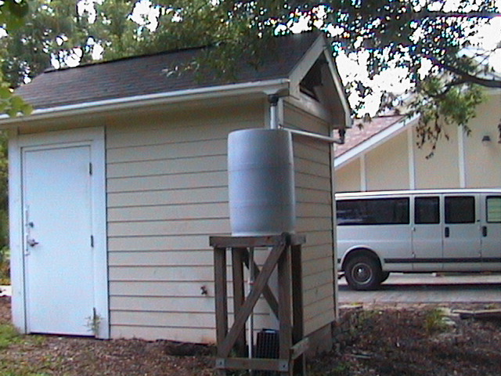
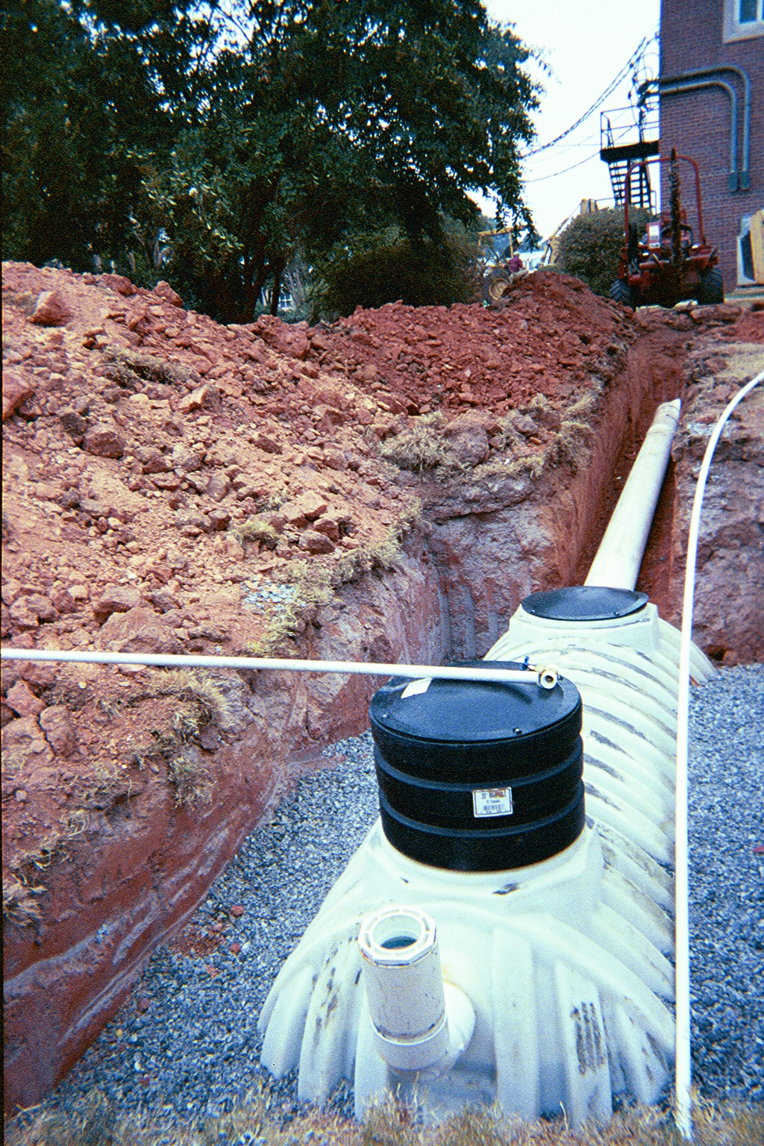
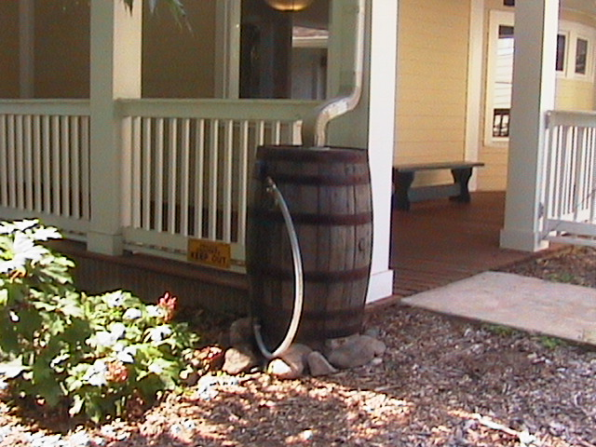
Filtration and Storage
Storage needs to be closed to keep out mosquitoes OR
Storage may be a pond where native ecosystem would provide mosquito control
Notes:
Filtration and Storage
Storage needs to be closed to keep out mosquitoes OR
Storage may be a pond where native ecosystem would provide mosquito control

Slide 12
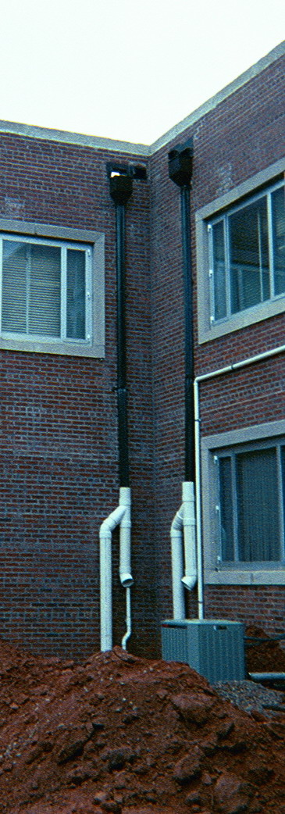
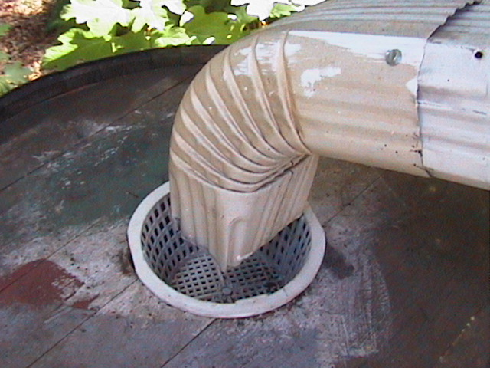
Filtration
Filtration needs depend on the particular collection area and any dirt or sediments that it would contribute.
Notes:
Filtration
Filtration needs depend on the particular collection area and any dirt or sediments that it would contribute.

Slide 13
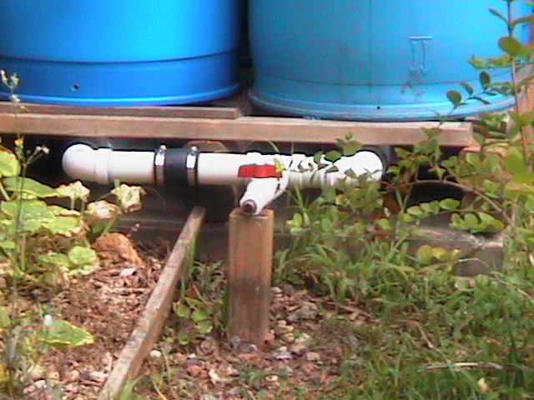
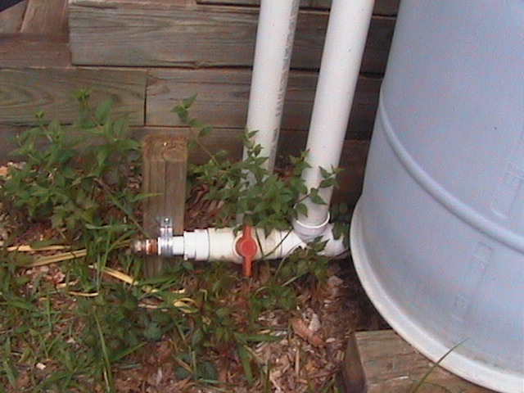
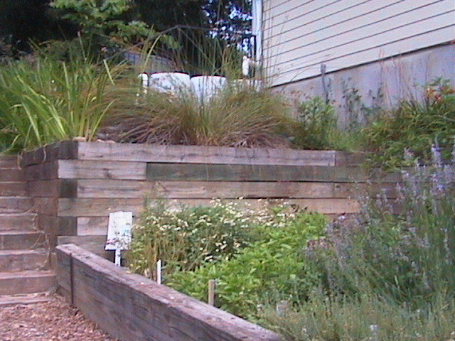
Distribution
After filter
Pressurized
  Will require a pump and energy
  Pipes and applicators must fit with the pressure the pump creates
  Most likely drip applicators
Non-pressurized
  Gravity flow
  Use spigots and hose
  Elevation of storage
  is critical
Notes:
Distribution
After filter
Pressurized
- Will require a pump and energy
- Pipes and applicators must fit with the pressure the pump creates
- Most likely drip applicators
Non-pressurized
- Gravity flow
- Use spigots and hose
- Elevation of storage is critical

Slide 14
Storage Overflow
Cisterns and barrels can only hold so much rain.
Must have an overflow.
Notes:
Storage Overflow
Cisterns and barrels can only hold so much rain.
Must have an overflow.

Slide 15
How Much Storage?
Amount of Rainfall that can be collected= Collection area (sq. ft.) X inches of rain X 0.75 X 0.62
Amount of water that you might use in your landscape= inches needed - .8 X rainfall
Inches needed depends on the plant materials, weather and soil
Gallons = sq. ft. area to irrigate X inches depth X 0.62
Notes:
How Much Storage?
Amount of Rainfall that can be collected= Collection area (sq. ft.) X inches of rain X 0.75 X 0.62
Amount of water that you might use in your landscape= inches needed - .8 X rainfall
Inches needed depends on the plant materials, weather and soil
Gallons = sq. ft. area to irrigate X inches depth X 0.62

Slide 16
Example
Example: 1200 sq. ft of lawn, 6 inches ET of Lawn, Average 3 inches of rainfall, 2000 sq. ft roof
Irrigation water needed = 6 in -3 in = 3 in
Convert to gallons needed = 1200 sq. ft. X 3 in X 0.62 =2232 gal
2000 sq ft X 3 in X 0.75 X 0.62 =2790 gal
Notes:
Example:
Example: 1200 sq. ft of lawn, 6 inches ET of Lawn, Average 3 inches of rainfall, 2000 sq. ft roof
Irrigation water needed = 6 in -3 in = 3 in
Convert to gallons needed = 1200 sq. ft. X 3 in X 0.62 =2232 gal
2000 sq ft X 3 in X 0.75 X 0.62 =2790 gal

Slide 17
Maintenance
Clean filters.
Wash and clean out above ground barrels yearly.
Keep roof gutters clean to minimize trash in storage.
Notes:
Maintenance
Clean filters.
Wash and clean out above ground barrels yearly.
Keep roof gutters clean to minimize trash in storage.

Slide 18
Rain Barrels and Rain Harvesting
Rain barrels are one of many techniques we can use to make our landscapes more environmentally friendly.
Any Questions ?
Notes:
Rain Barrels and Rain Harvesting
Rain barrels are one of many techniques we can use to make our landscapes more environmentally friendly.
Any Questions ?

Slide 19
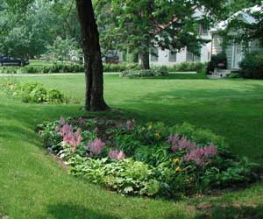
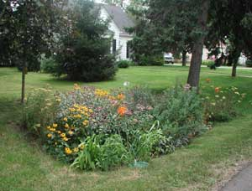
Rain Gardens
Notes:
Landscaping for Water Quality
Rain Gardens
(2 pictures)

Slide 20
What is a Rain Garden?
A rain garden is a landscaped, low area where water from rooftops, driveways, other hard surfaces, etc. is diverted and contained, so that the runoff will infiltrate the soil, and not drain into streets and storm drains.
A rain garden reduces stormwater runoff along with any associated pollutants allowing the water to seep slowly into the ground and pollutants to break down.
Rain gardens also reduce peek storm flows preventing extensive soil erosion and reducing flooding.
Notes:
What is a Rain Garden?
A rain garden is a landscaped, low area where water from rooftops, driveways, other hard surfaces, etc. is diverted and contained, so that the runoff will infiltrate the soil, and not drain into streets and storm drains.
A rain garden reduces stormwater runoff along with any associated pollutants allowing the water to seep slowly into the ground and pollutants to break down.
Rain gardens also reduce peek storm flows preventing extensive soil erosion and reducing flooding.

Slide 21
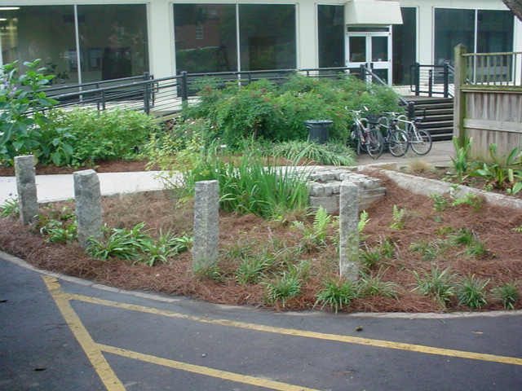
This is a simple Rain Garden …
Notes:
This is a simple rain garden …

Slide 22
So - Why Should We Consider Rain Gardens?
Photo Copyright 1999, Center for Watershed Protection
Notes:
1
So - Why Should We Consider Rain Gardens?
Many conventional neighborhoods use curbs and gutters to convey stormwater runoff away from residential streets as quickly as possible.

Slide 23
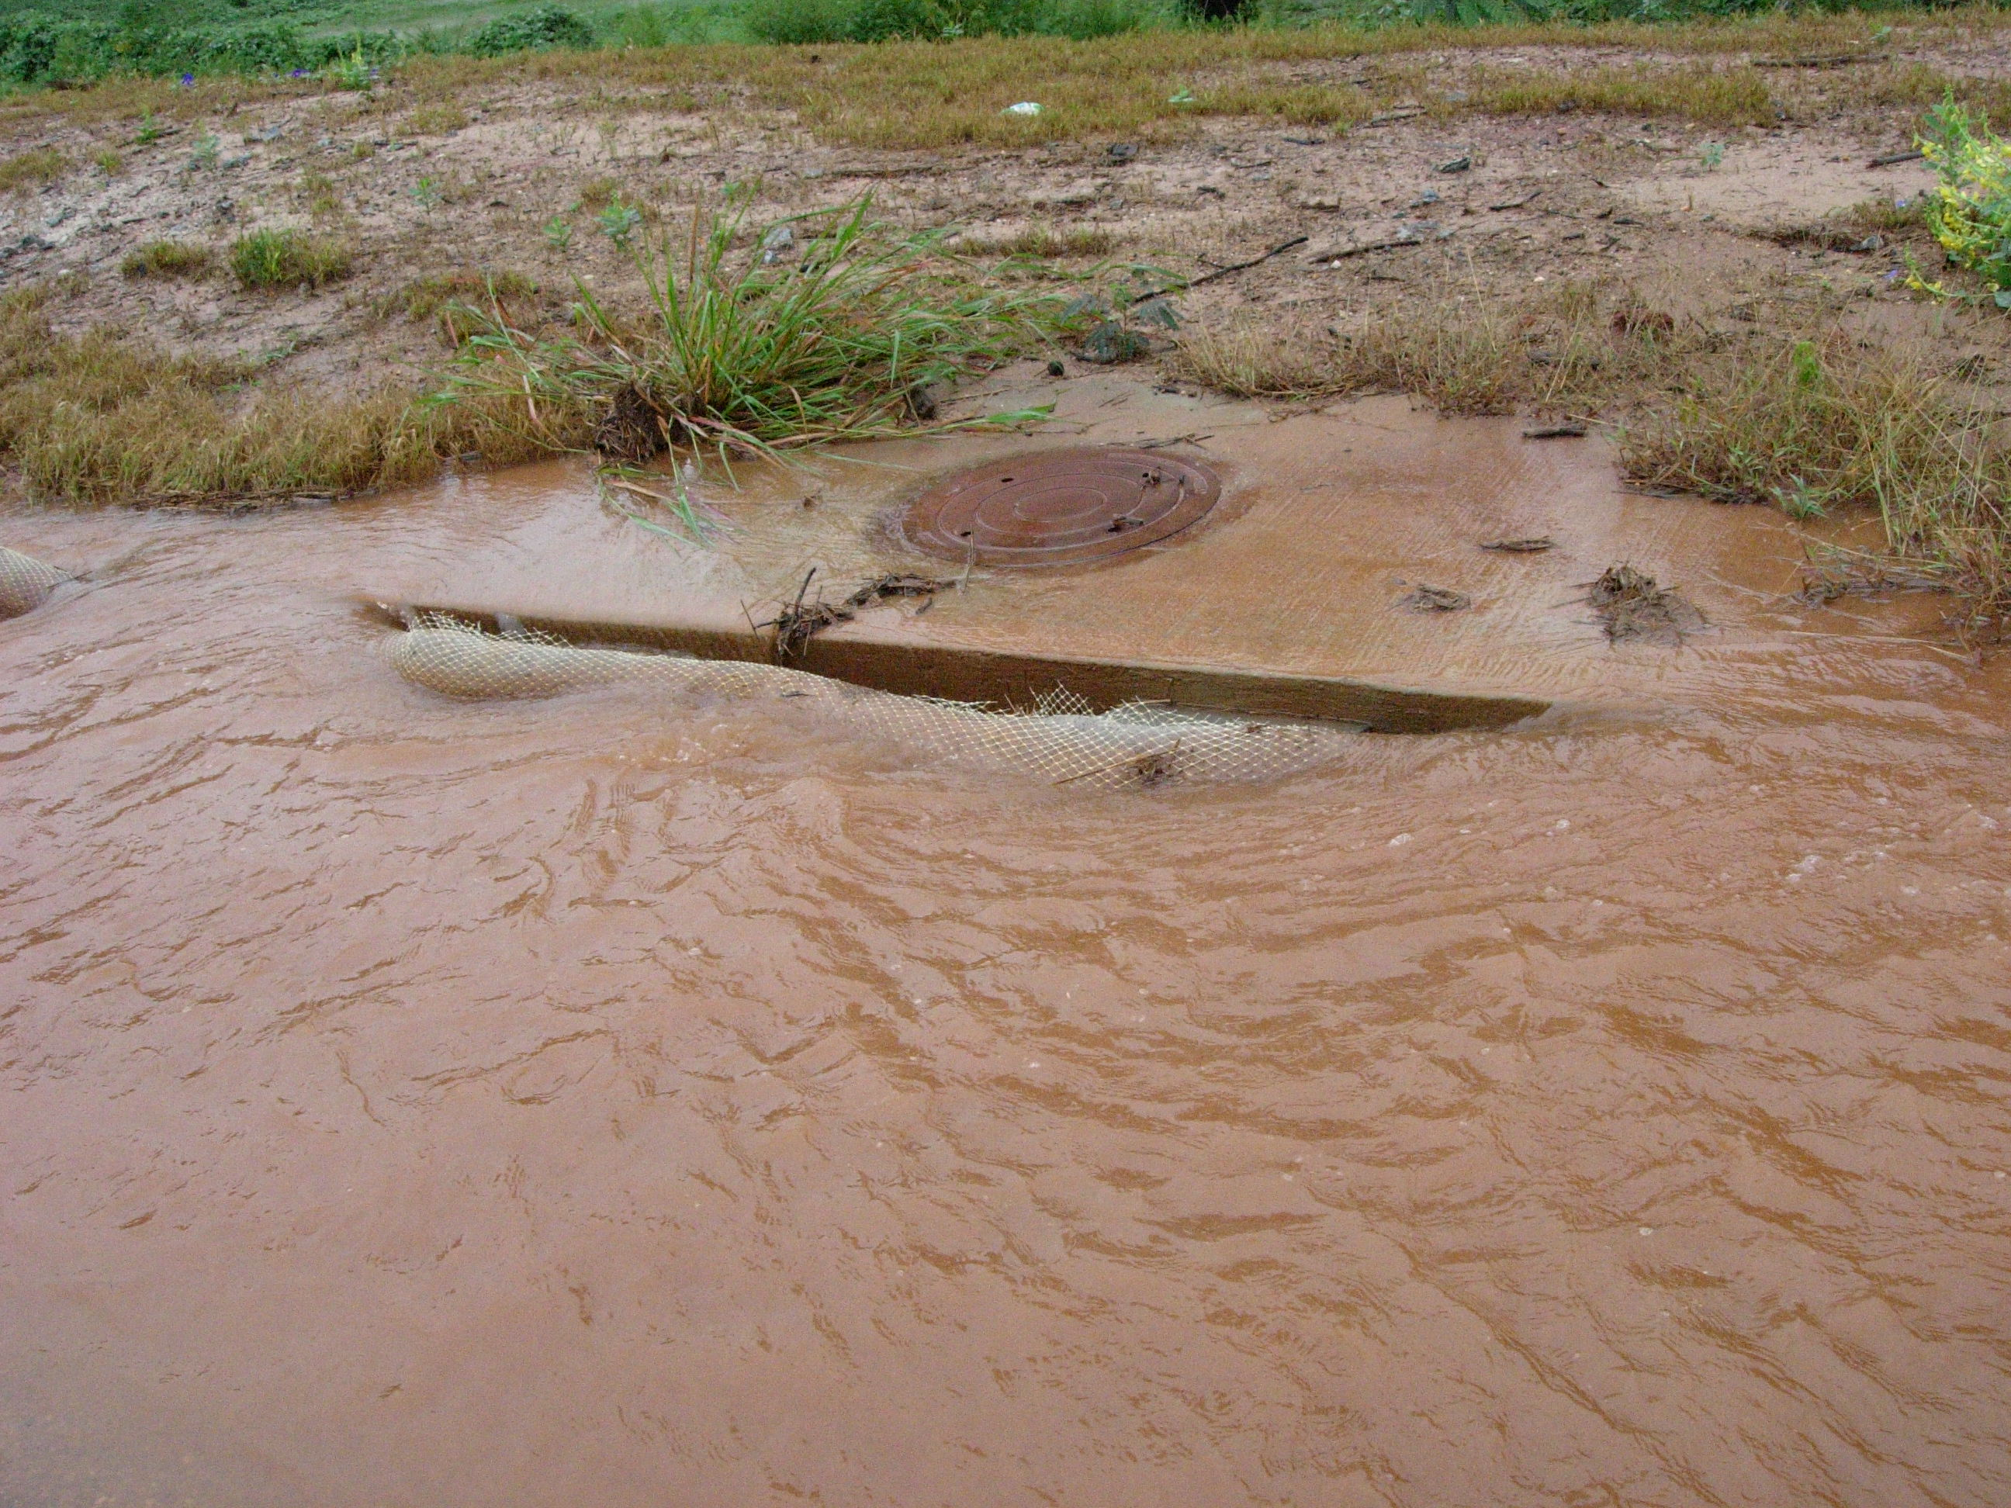
Notes:
With more development - housing, business construction, etc. - we soon have this occurring!

Slide 24

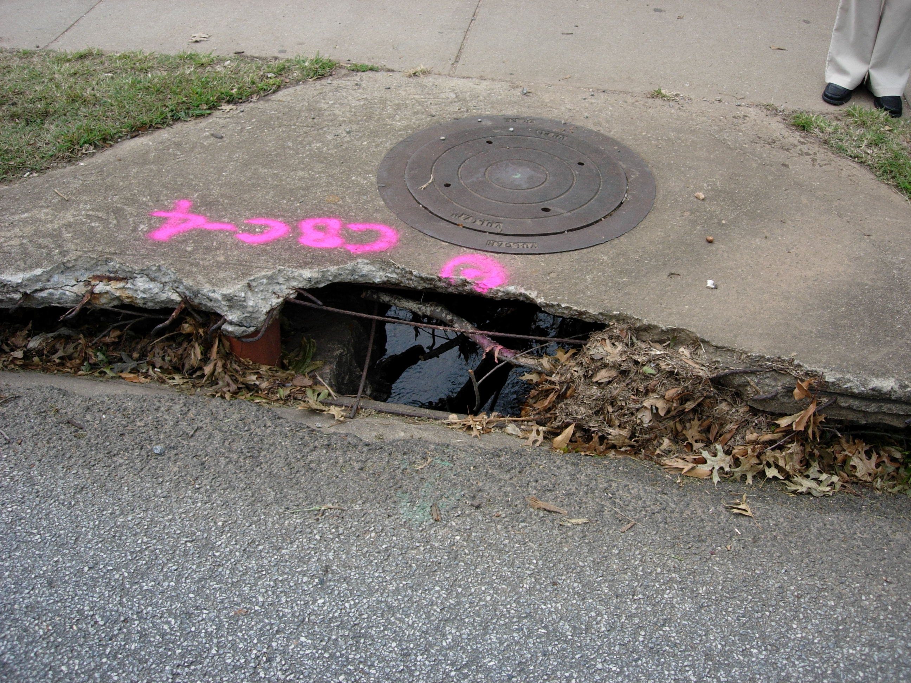

Notes:
Damage to streets, sewers, etc.

Slide 25
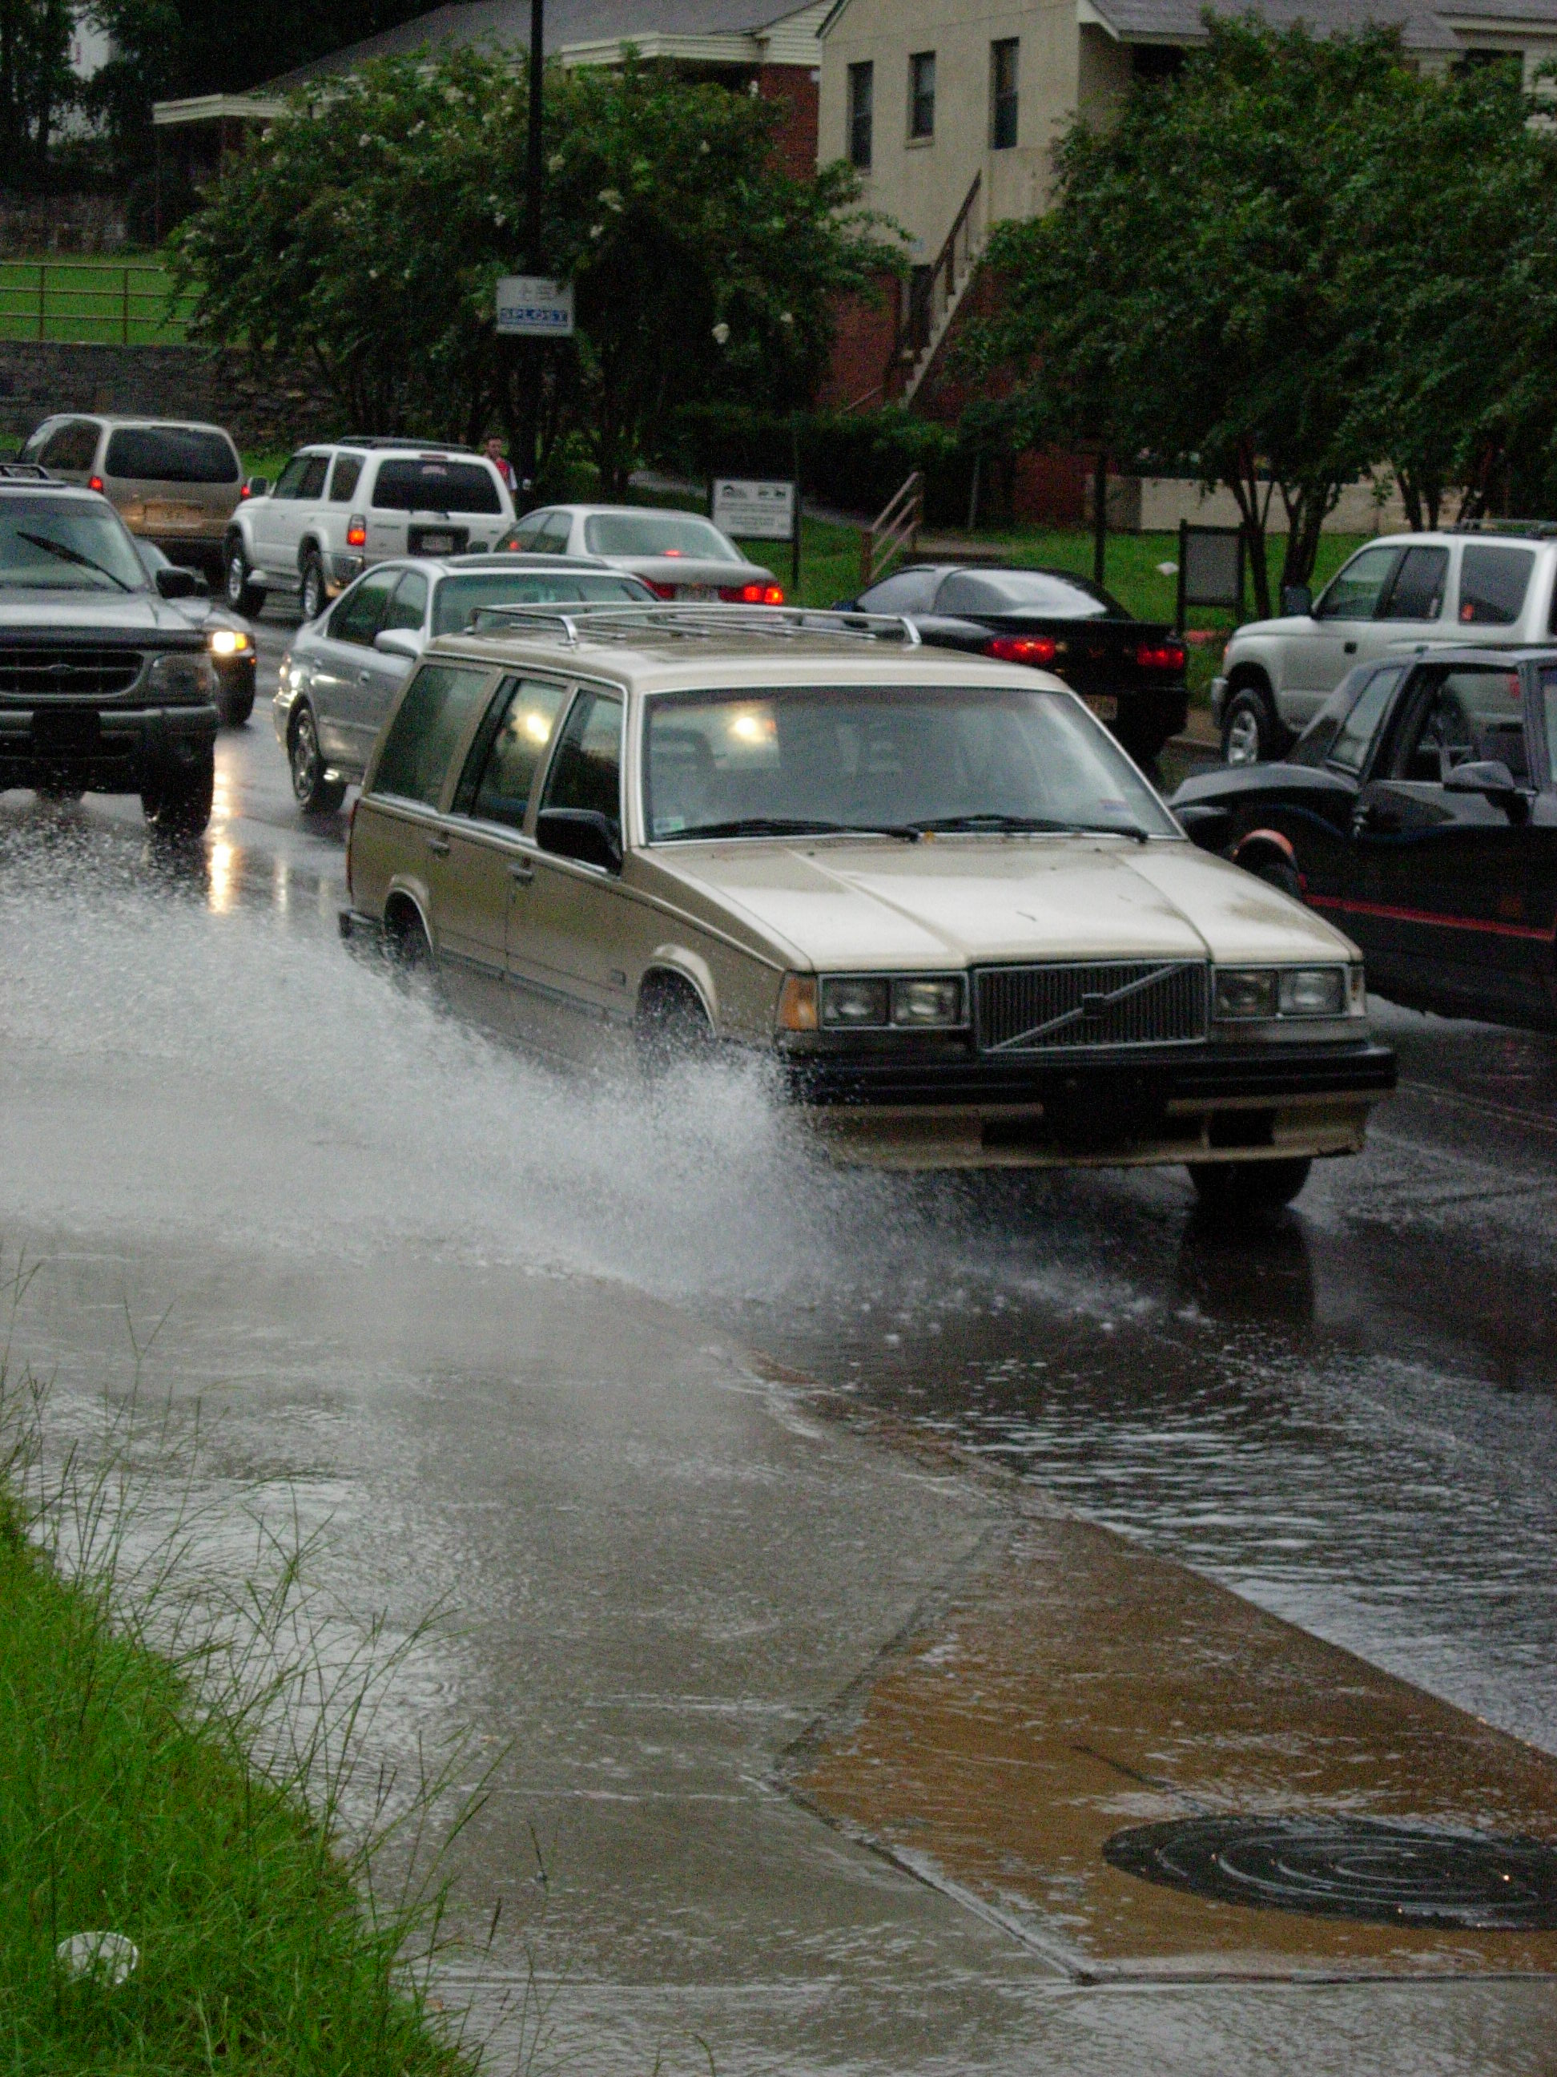
Notes:
Stormwater runoff may pose a driving hazard.

Slide 26
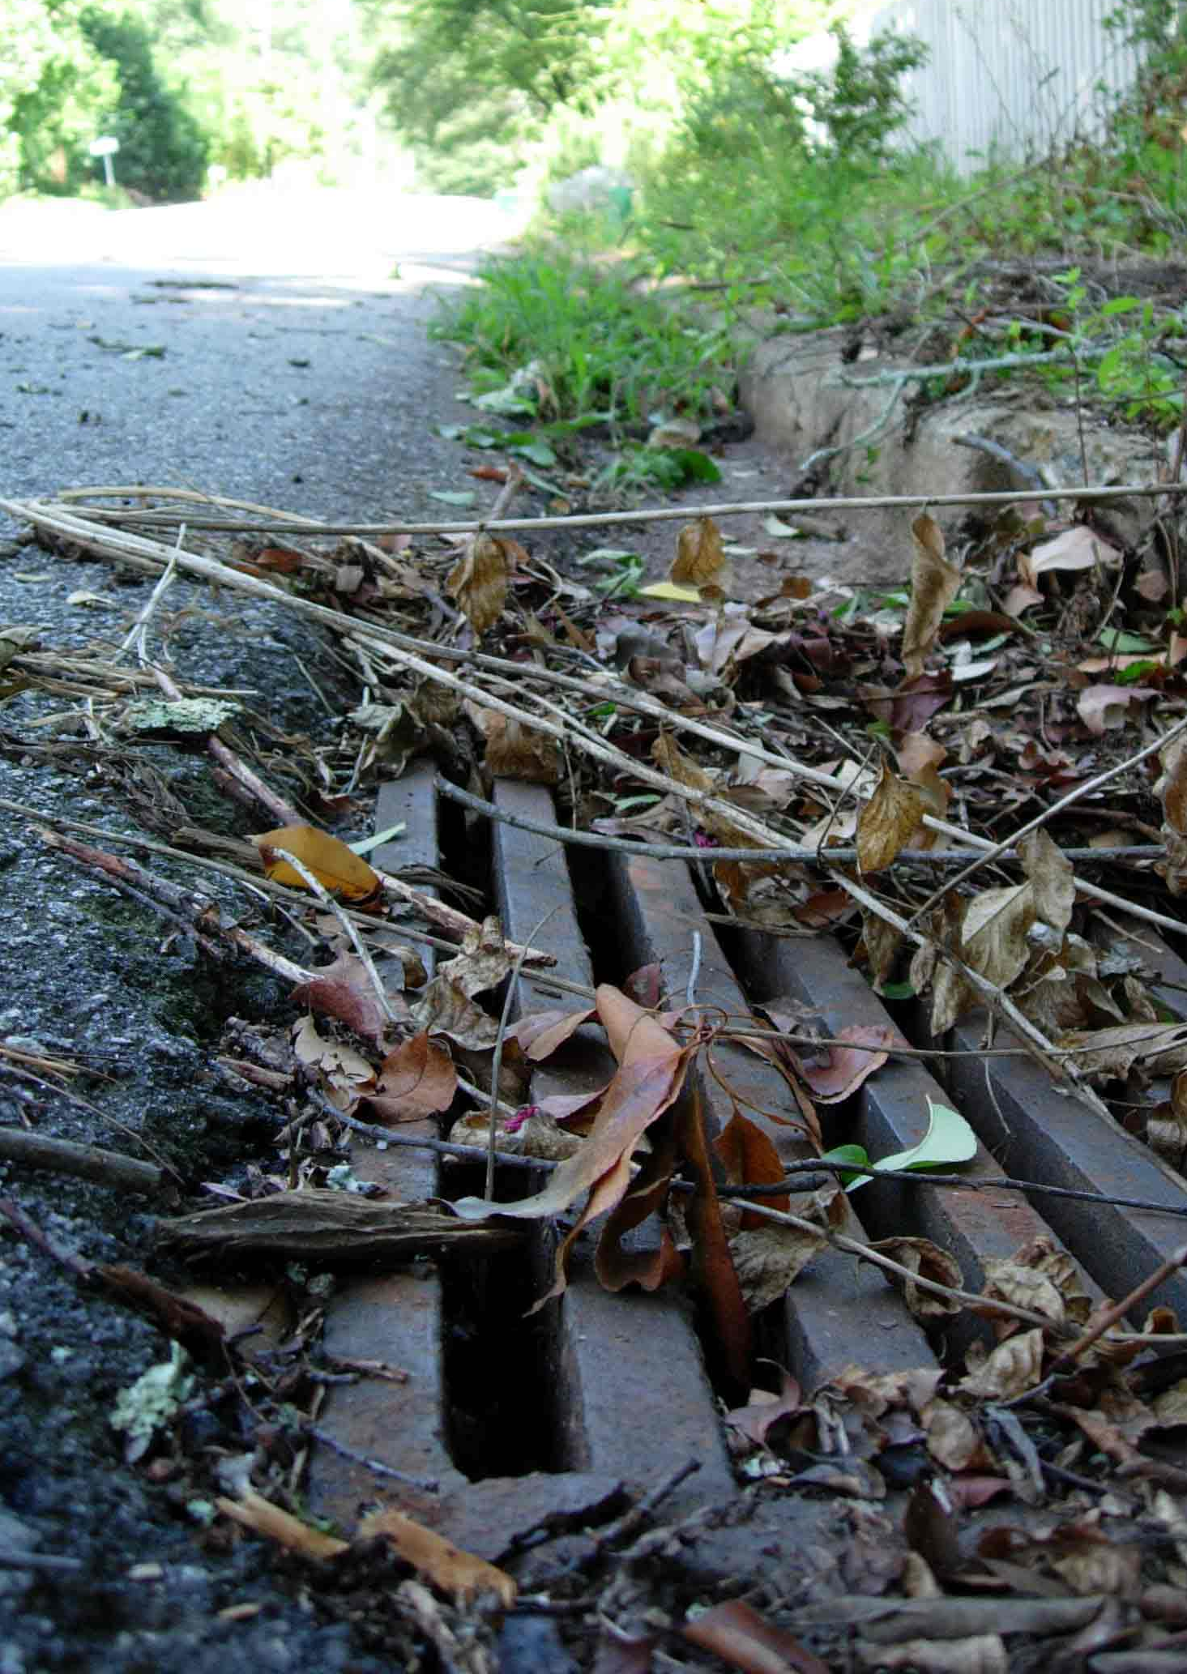
Rain Gardens
Reduce Stormwater Runoff
Stormwater runoff carries non-point source pollution to our rivers and streams.
Stormdrains lead directly to rivers and streams.
Notes:
Pollution concerns may occur.

Slide 27
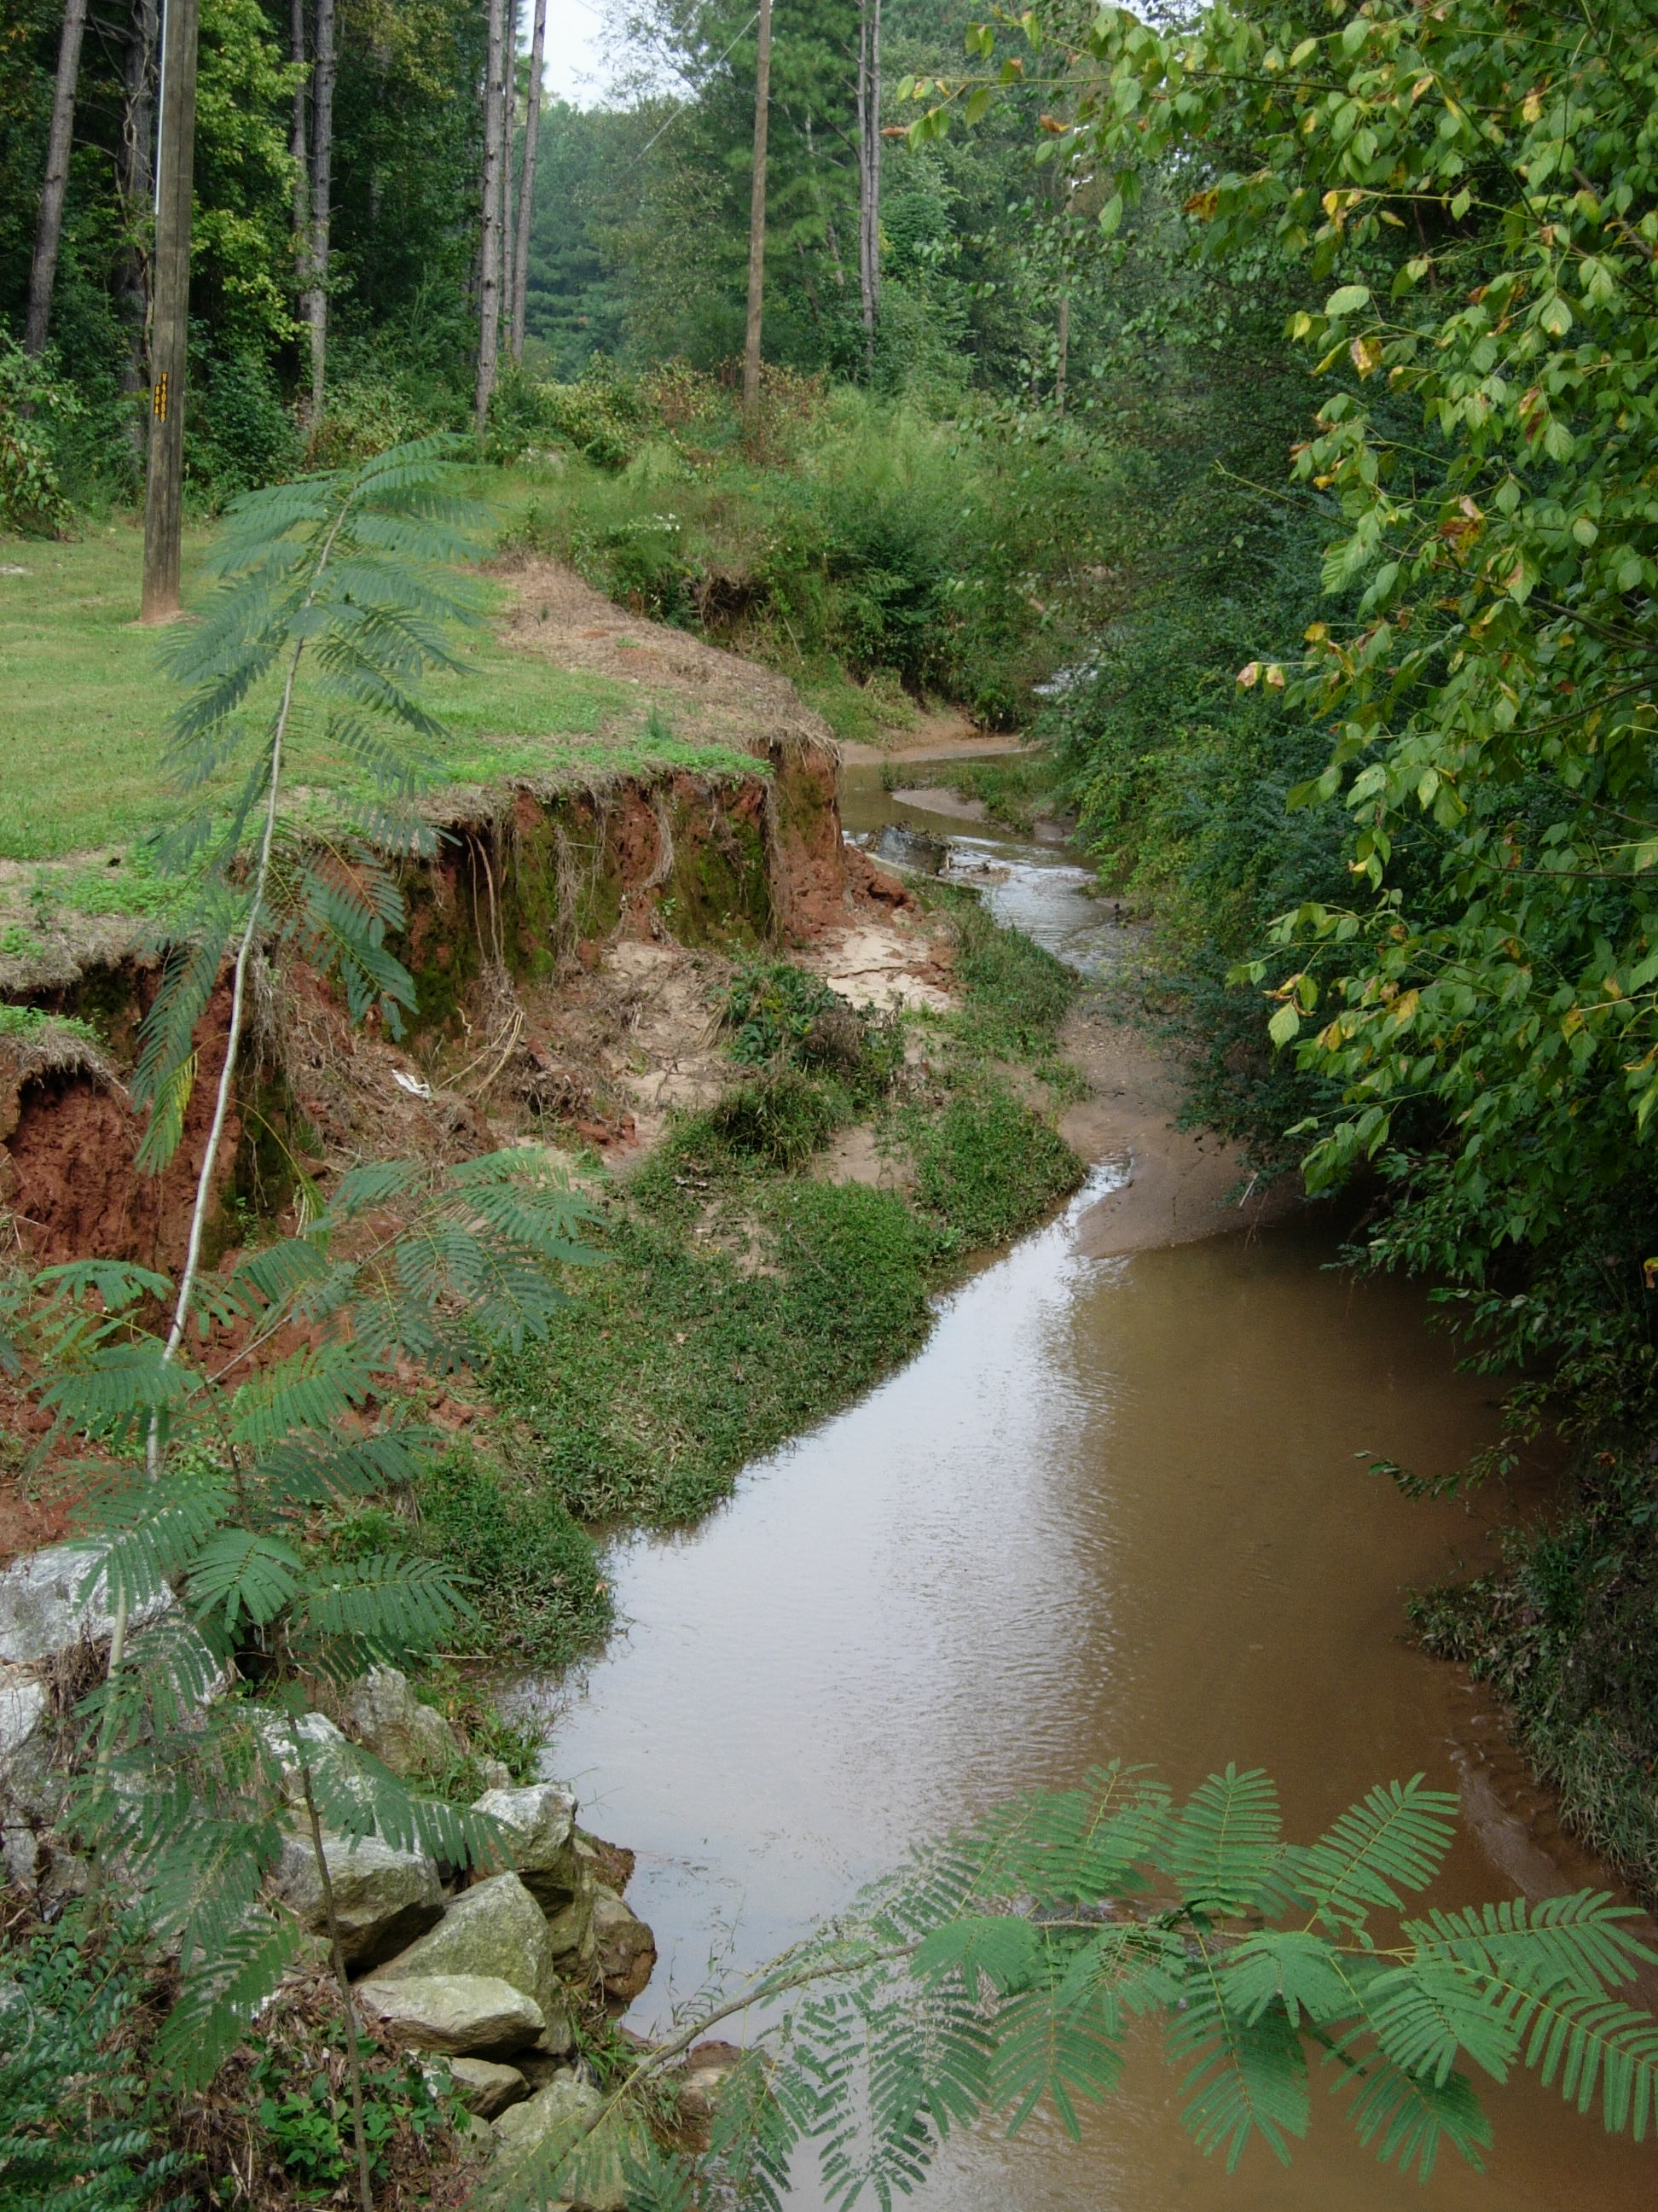
Erosion Problems
Notes:
Are you beginning to see how rain gardens can alleviate some of the problems? Is this what we want?

Slide 28
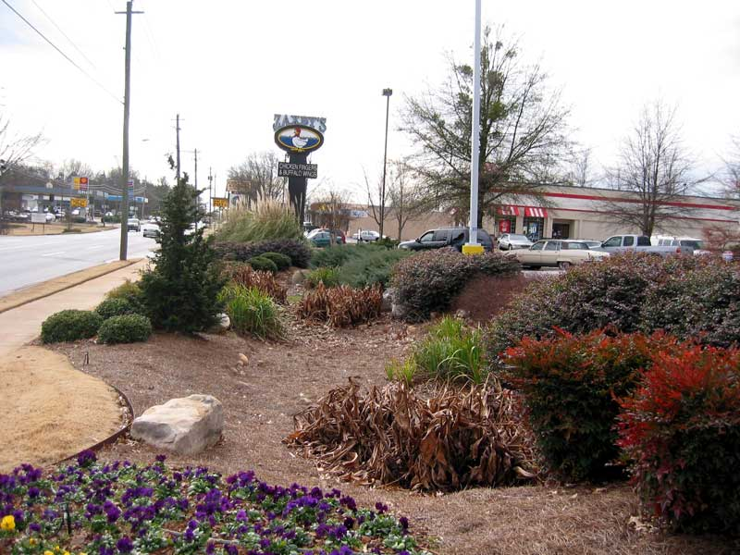
This is a Rain Garden
This is a Rain Garden!
Notes:
Or is THIS what we want? A beautifully landscaped and functional rain garden!

Slide 29
Rain Gardens Provide Beauty and Help to Protect the Environment
Plants in a rain garden can be colorful and attractive; and rain gardens can serve as a habitat for butterflies and other wildlife.
At the same time, rain gardens create a more natural flow for runoff and storm water.
Rain gardens collect and filter runoff water, reduce erosion, flooding and pollution from chemicals, fertilizers, pesticides, etc.
Notes:
Rain Gardens Provide Beauty and Help to Protect the Environment
To recap the pluses that rain gardens offer –
Plants in a rain garden can be colorful and attractive; and rain gardens can serve as a habitat for butterflies and other wildlife.
At the same time, rain gardens create a more natural flow for runoff and storm water.
Rain gardens collect and filter runoff water, reduce erosion, flooding and pollution from chemicals, fertilizers, pesticides, etc.

Slide 30
Getting Started
How big does it need to be?
Where do I need to locate it?
Soil considerations?
What plants should we use?
Notes:
Getting Started
How big does it need to be?
Where do I need to locate it?
Soil considerations?
What plants should we use?

Slide 31
How big do I make my rain garden?
Design it to handle a 1.25 inch rain event
(this captures 80% of rainfall events)
Square footage x 1.25 in. (or .104 ft) = X cu ft of water
Notes:
How big do I make my rain garden?
Design it to handle a 1.25 inch rain event (this captures 80% of rainfall events)
Square footage x 1.25 in. (or .104 ft) = X cu ft of water

Slide 32
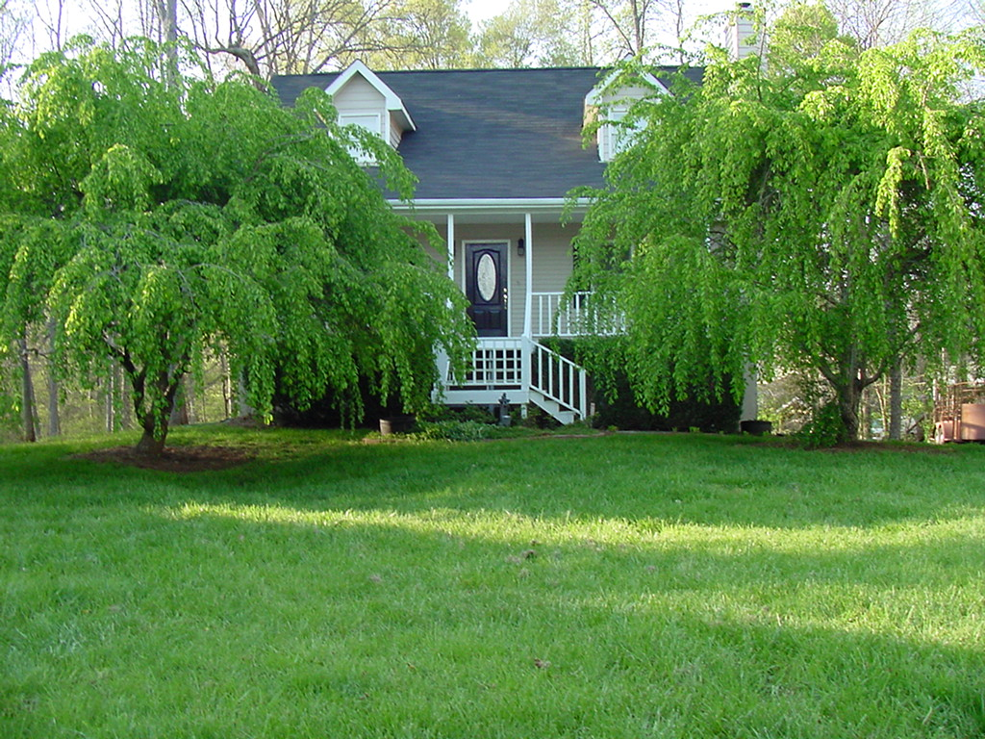
30 feet
60 feet
60 x 30 = 1800 sq. ft.
1800 sq. ft. x .104 ft. of rain (1.25 in rain)=
187 cu. Ft. of water
Just for Fun
187 cu. ft. of water x 7.48 = 1398 gallons
Notes:
60’ X 30’
60 x 30 = 1800 sq. ft.
1800 sq. ft. x .104 ft. of rain (1.25 in rain)=
187 cu. Ft. of water
Just for Fun
187 cu. ft. of water x 7.48 = 1398 gallons

Slide 33
187 cu. Ft. of water
10 x 12 x 1.5 feet deep = 180 cu. Ft.
Notes:
187 cu. Ft. of water
10 x 12 x 1.5 feet deep = 180 cu. Ft.

Slide 34
Where does it need to be?
Rain gardens do well in natural depression areas.
Locate the rain garden down slope from any buildings. At least 10 feet from buildings/houses.
Away from large trees (easier digging).
In areas that take advantage of natural slope.
Consider the size and placement in the landscape design. It may be easier to create two separate rain gardens.
Notes:
Where does it need to be?
Rain gardens do well in natural depression areas.
Locate the rain garden down slope from any buildings. At least 10 feet from buildings/houses.
Away from large trees (easier digging).
In areas that take advantage of natural slope.
Consider the size and placement in the landscape design. It may be easier to create two separate rain gardens.

Slide 35
Where does it NOT need to be?
Next to a building foundation.
Over a septic system.
Where water stands for long periods.
  - High seasonal water table areas.
Poor soils; poorly-drained soils.
Slopes greater 12%.
Over utilities (call before you dig).
- 1-800-282-7411
Inside the dripline of any valued trees.
Notes:
Where does it NOT need to be?
Next to a building foundation.
Over a septic system.
Where water stands for long periods.
- High seasonal water table areas.
Poor soils; poorly-drained soils.
Slopes greater 12%.
Over utilities (call before you dig).
- 1-800-282-7411
Inside the dripline of any valued trees.

Slide 36
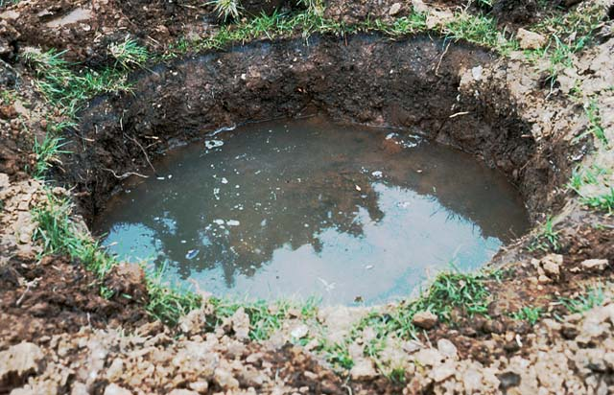
Problem Soils
If soils are high in clay or have been compacted during development, they may not have the capacity to infiltrate well.
The rain garden area soil can be removed and replaced with a better draining soil (>0.5 inch/hour).
Should drain <48 hrs.

Slide 37
Soil Considerations
Do a perk test. Dig an 8 by 8 inch hole 8 inches deep and fill with water. If it takes more than 8 hours to drain then the soil needs to be amended.
In poorly-drained sites, excavate 10-12 inches of soil from hole, mix 3-6 inches of coarse sand or small gravel with excavated soil and replace into rain garden.
Bring 2 cups of soil to Extension Office for soil test.
(nominal fee, results in two weeks).
Add lime and fertilizer according to soil test results, 3-6 inches of organic matter then till to a depth of 6 inches.
Notes:
Soil Considerations
Do a perk test. Dig an 8 by 8 inch hole 8 inches deep and fill with water. If it takes more than 8 hours to drain then the soil needs to be amended.
In poorly-drained sites, excavate 10-12 inches of soil from hole, mix 3-6 inches of coarse sand or small gravel with excavated soil and replace into rain garden.
Bring 2 cups of soil to Extension Office for soil test ($8 fee, results in two weeks)
Add lime and fertilizer according to soil test results, 3-6 inches of organic matter then till to a depth of 6 inches.

Slide 38
More Soil Considerations
For extremely clay-based, heavy or poorly-drained soils, it will be beneficial to remove 1 to 2 feet of the native soil and replace it with a porous, well-drained soil mix.
A good “rain garden soil” mixture is composed of - 50-60% sand, 20-30% topsoil and 20-30%compost.
The clay content in he replacement soil should be no more than 10%.
Notes:
More Soil Considerations
For extremely clay-based, heavy or poorly-drained soils, it will be beneficial to remove 1 to 2 feet of the native soil and replace it with a porous, well-drained soil mix.
A good “rain garden soil” mixture is composed of - 50-60% sand, 20-30% topsoil and 20-30%compost.
The clay content in he replacement soil should be no more than 10%.

Slide 39
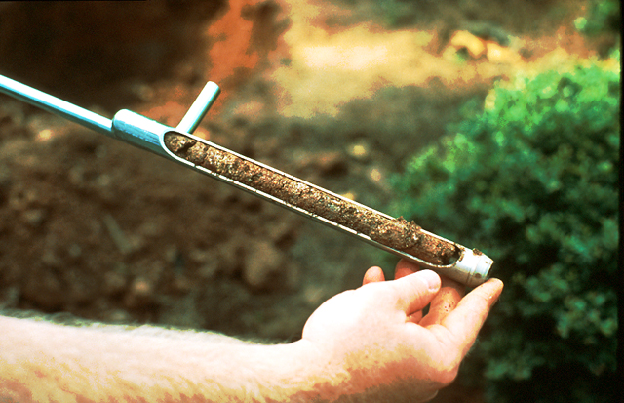
Soil Testing
Infiltration Test
  Dig a hole 6-8 inches
  deep and wide
  Fill hole with water
  & let it drain out
  Refill hole, if water does not drain in 12 hours, not a good location for a rain garden
  Soil Chemistry Test
  Take 1 cups of soil to UGA Extension
    Results will tell whether lime is needed to adjust pH and whether fertilizer is needed
    ~$6 fee - takes 1-2 weeks for results

Slide 40
Excavating
Use a rope or water hose to layout the edge of the rain garden.
For smaller projects, use the excavated soil to build a berm on the downhill side of the garden.
For deep gardens set aside the top 4-6 inches of soil (topsoil), excavate the hole then use the top soil to backfill the planting area.
For large projects, it may be easier to hire a landscaper.
Notes:
Excavating
Use a rope or water hose to layout the edge of the rain garden.
For smaller projects, use the excavated soil to build a berm on the downhill side of the garden.
For deep gardens set aside the top 4-6 inches of soil (topsoil), excavate the hole then use the top soil to backfill the planting area.
For large projects, it may be easier to hire a landscaper.

Slide 41
Now the fun part - Picking the plants!
Determine sun exposure
  Full sun = 6 or more hours of direct sun
  Part Sun to Part Shade=
    less than 6 hours of direct sun
  Shade = virtually no direct sun
Don’t forget specific site problems
  Deer!
  Plants will need to be watered until established
Notes:
Now the fun part - Picking the plants!
Determine sun exposure
- Full sun = 6 or more hours of direct sun
- Part Sun to Part Shade = less than 6 hours of direct sun
- Shade = virtually no direct sun
Don’t forget specific site problems
- Deer!
- Plants will need to be watered until established

Slide 42
Selecting Plants for the Rain Garden
In the rain garden, select plants that are:
- hardy
- drought-tolerant
- wet-soil tolerant
- native
Georgia Cooperative Extension Service
Bulletin #H-91-009:
A Compilation of Low-Maintenance Landscape Plants
Notes:
Selecting Plants for the Rain Garden
In the rain garden, select plants that are:
- hardy
- drought-tolerant
- wet-soil tolerant
- native
Georgia Cooperative Extension Service Bulletin #H-91-009:
A Compilation of Low-Maintenance Landscape Plants

Slide 43
Trees for Rain Gardens
Deciduous / Evergreen
Plant as Specimens or in Groups
Consider Bark / Shape / Flowering
Provide Habitats for Birds
Notes:
Trees for Rain Gardens
Deciduous / Evergreen
Plant as Specimens or in Groups
Consider Bark / Shape / Flowering
Provide Habitats for Birds

Slide 44
Trees for Rain Gardens
Red Maple
River Birch
Crape Myrtle
Black Gum
Bald Cypress
Green Ash
Willow Oak
Sweetbay Magnolia
Dahoon Holly
Winter King Hawthorn
Sugar Hackberry
Fringetree
Gingko
Persimmon
Loblolly Pine
Notes:
Trees for Rain Gardens
Red Maple Sweet Bay Magnolia
River Birch Dahoon Holly
Crape Myrtle Winter King Hawthorn
Black Gum Sugar Hackberry
Bald Cypress Fringetree
Green Ash Gingko
Willow Oak Persimmon
Loblolly Pine

Slide 45
Shrubs for Rain Gardens
Winterberry
Arrowwood
Buttonbush
Summersweet Clethra
Wax Myrtle
American Beautyberry
Bottlebrush Buckeye
Inkberry
Oakleaf Hydrangea
Virginia Sweetspire
Notes:
Shrubs for Rain Gardens
Winterberry American Beautyberry
Arrowwood Bottlebrush Buckeye
Buttonbush Inkberry
Clethra Oakleaf Hydrangea
Wax Myrtle Virginia Sweetspire

Slide 46
Deciduous Shrubs
Provide Seasonal Interest
  - Flowers
  - Berries
  - Fall Color
More Natural Growth Form
Majority of Wetland Plants are Deciduous
Notes:
Deciduous Shrubs
Provide Seasonal Interest
- Flowers
- Berries
- Fall Color
More Natural Growth Form
Majority of Wetland Plants are Deciduous

Slide 47
Evergreen Shrubs
Foliage Year Round
Provide Structure
Most Noticeable in Winter
Provide Screens
Generally, Not as Tolerant to Extremely Wet Conditions
Notes:
Evergreen Shrubs
Foliage Year Round
Provide Structure
Most Noticeable in Winter
Provide Screens
Generally, Not as Tolerant to Extremely Wet Conditions

Slide 48
Herbaceous Plants for Rain Gardens
Swamp Milkweed
Royal Fern
Cinnamon Fern
Canna Lilies
Yellow Flag Iris
Rushes
Zoysia
Liriope
Mondograss
Asters
Blackeyed Susan
Lobelia
Northern Sea Oats
Cardinal Flower
Goldenrod
Ironweed
Joe Pye Weed
St. Johns Wort
Notes:
Herbaceous Plants for Rain Gardens
Asters Swamp Milkweed
Blackeyed Susan Royal Fern
Lobelia Cinnamon Fern
Northern Sea Oats Canna Lilies
Cardinal Flower Yellow Flag Iris
Goldenrod Rushes
Ironweed Zoysia
Joe Pye Weed Liriope
St. Johns Wort Mondograss

Slide 49
Border Plants for the Rain Garden
You may also want to establish a grass or groundcover border along the upper edge of the rain garden to slow down runoff water as it enters into the rain garden.
Plant a grass or groundcover border along the bottom side of the rain garden to help keep water from flowing out of the garden.
Notes:
Border Plants for the Rain Garden
You may also want to establish a grass or groundcover border along the upper edge of the rain garden to slow down runoff water as it enters into the rain garden.
Plant a grass or groundcover border along the bottom side of the rain garden to help keep water from flowing out of the garden.

Slide 50
Plants to Avoid
Those Susceptible to Root Rots:
  - Azaleas
  - Junipers
  - Indian Hawthorn
  - Chinese Privet
Notes:
Plants to Avoid
Those Susceptible to Root Rots:
- Azaleas
- Junipers
- Indian Hawthorn
- Chinese Privet

Slide 51
Mulching the Rain Garden
Once the plants are in place, the rain garden should have a 3 to 5 inch covering of mulch.
Lighter mulches such as pine bark or straw will often float away in heavy rains and be washed to the edges of the rain garden.
Better choices are more dense mulches, such as pine straw, wood chips or shredded wood.
Notes:
Mulching the Rain Garden
Once the plants are in place, the rain garden should have a 3 to 5 inch covering of mulch.
Lighter mulches such as pine bark or straw will often float away in heavy rains and be washed to the edges of the rain garden.
Better choices are more dense mulches, such as pine straw, wood chips or shredded wood.

Slide 52
Weeding the Rain Garden
Remove weeds on a regular basis as rain garden plants continue to mature.
Replenish mulch as necessary to reduce weed competition.
Pre-emergent herbicides are available to prevent germination of annual weeds.
Notes:
Weeding the Rain Garden
Remove weeds on a regular basis as rain garden plants continue to mature.
Replenish mulch as necessary to reduce weed competition.
Pre-emergent herbicides are available to prevent germination of annual weeds.

Slide 53
Pondering Points
The planting plan design should include species that tolerate extremes.
Rain gardens can be left to evolve into a natural wild condition.
Native plants are best adapted to local climate and once established are generally low maintenance.
Notes:
Pondering Points
The planting plan design should include species that tolerate extremes.
Rain gardens can be left to evolve into a natural wild condition.
Native plants are best adapted to local climate and once established are generally low maintenance.

Slide 54
Pondering Points
(continued)
When planted with native species rain gardens can have additional value as a wildlife habitant.
Shrub, trees, and ground covers absorb up to 14 times more rainwater than a grass lawn.
Notes:
Pondering Points (continued)
When planted with native species rain gardens can have additional value as a wildlife habitant.
Shrub, trees, and ground covers absorb up to 14 times more rainwater than a grass lawn.

Slide 55
Maintenance?
No special maintenance required ...
Routine periodic landscaping maintenance
  - Weeding
  - Irrigation
  - Pruning
  - Replacing Plants
  - Plant Division
  - Replacement of Mulch
Notes:
Maintenance?
No special maintenance required ...
Routine periodic landscaping maintenance
- Weeding
- Irrigation
- Pruning
- Replacing Plants
- Plant Division
- Replacement of Mulch

Slide 56
Landscaping for Water Quality
What is a Detention Pond?
A detention pond is a low-lying area designed to hold a set amount of water while slowly draining to another location.
What is a Retention Pond?
A retention pond is designed to hold a specific amount of water indefinitely.
Notes:
Landscaping for Water Quality
What is a Detention Pond?
A detention pond is a low-lying area designed to hold a set amount of water while slowly draining to another location.
What is a Retention Pond?
A retention pond is designed to hold a specific amount of water indefinitely.

Slide 57
Special thanks to
Todd Hurt, Education Coordinator
Center for Urban Agriculture
The University of Georgia
Notes:
Special thanks to
Todd Hurt, Education Coordinator
Center for Urban Agriculture
The University of Georgia

Slide 58
Pesticides
Do pesticides affect water quality?
Do we need to be concerned?
What can I do to help prevent pesticides from polluting water ?
Notes:
Pesticides
Do pesticides affect water quality?
Do we need to be concerned?
What can I do to help prevent pesticides from polluting water ?

Slide 59
What are Pesticides?
Pesticides are synthetic organic chemicals or naturally occurring compounds used to control weeds, insects and mites, diseases, nematodes and other pests.
--------------
Chemical pesticides: 2,4-D, Sevin, Daconil, etc.
Organic pesticides: insecticidal soaps, oils, etc.
Notes:
What are Pesticides?
Pesticides are synthetic organic chemicals or naturally occurring compounds used to control weeds, insects and mites, diseases, nematodes and other pests.
------------------
Chemical pesticides: 2,4-D, Sevin, Daconil, etc.
Organic pesticides: insecticidal soaps, oils, etc.

Slide 60
Mode of Action
Contact pesticides kill the target organism by weakening or disrupting the cellular membranes; death can be very rapid.
Systemic pesticides must be absorbed or ingested by the target organism to disrupt its physiological or metabolic process; generally systemics are slow-acting.
Notes:
Mode of Action
Contact pesticides kill the target organism by weakening or disrupting the cellular membranes; death can be very rapid.
Systemic pesticides must be absorbed or ingested by the target organism to disrupt its physiological or metabolic process; generally systemics are slow-acting.

Slide 61
Pesticide Formulations
The formulation is the chemical or active ingredient and the physical form in which the pesticide is sold.
Examples of formulations include:
- Emulsifiable concentrates
- Wettable powders
- Dusts
Notes:
Pesticide Formulations
The formulation is the chemical or active ingredient and the physical form in which the pesticide is sold.
Examples of formulations include:
- Emulsifiable concentrates
- Wettable powders
- Dusts

Slide 62
Pesticide Degradation
Ideally, the pesticide stays in the treated area or environment long enough to produce the desired results and then degrades into harmless materials.
Notes:
Pesticide Degradation
Ideally, the pesticide stays in the treated area or environment long enough to produce the desired results and then degrades into harmless materials.

Slide 63
Pesticide Degradation
Three modes of pesticide degradation:
Biological - breakdown by micro-organisms.
Chemical - breakdown by chemical reactions.
Photochemical - breakdown by ultraviolet or visible light.
Notes:
Pesticide Degradation
Three modes of pesticide degradation:
Biological - breakdown by micro-organisms.
Chemical - breakdown by chemical reactions.
Photochemical - breakdown by ultraviolet or visible light.

Slide 64
Half Life of Pesticides
The rate at which a pesticide degrades is called the half-life. The half-life is the amount of time it takes for half of the pesticide to be converted into something else or for its concentration to become half of its initial level.
Notes:
Half Life of Pesticides
The rate at which a pesticide degrades is called the half-life. The half-life is the amount of time it takes for half of the pesticide to be converted into something else or for its concentration to become half of its initial level.

Slide 65
Half Life of Pesticides
The half life of a pesticide in the environment depends on its chemical properties and formulation
and
certain environmental conditions, such as temperature, moisture, etc.
Notes:
Half Life of Pesticides
The half life of a pesticide in the environment depends on its chemical properties and formulation
and certain environmental conditions, such as temperature, moisture, etc.

Slide 66
Pesticides and Water Pollution
Water is a valuable natural resource that must be protected for future generations.
Today, one of the greatest threats to our water sources and supplies comes from contamination by pollutants.
Pollutants may include organic and inorganic substances, like chemicals, fertilizers and pesticides.
Notes:
Pesticides and Water Pollution
Water is a valuable natural resource that must be protected for future generations.
Today, one of the greatest threats to our water sources and supplies comes from contamination by pollutants.
Pollutants may include organic and inorganic substances, like chemicals, fertilizers and pesticides.

Slide 67
Pesticide Factors
Affecting Water Pollution
Chemical properties of the pesticide.
Formulation of the pesticide.
Rate and method of application.
Pesticide persistence.
Frequency of rainfall; timing of irrigation.
Nearness to ponds, rivers, streams, etc.
Depth to ground water.
Notes:
Pesticide Factors Affecting Water Pollution
Chemical properties of the pesticide.
Formulation of the pesticide.
Rate and method of application.
Pesticide persistence.
Frequency of rainfall; timing of irrigation.
Nearness to ponds, rivers, streams, etc.
Depth to ground water.

Slide 68
Pesticide Pollutants
When pesticides move off-site via runoff or leaching they are then considered to be pollutants.
Runoff is the movement of pesticides across the soil surface into bodies of water.
Leaching is the movement of pesticides through the soil into ground water.
Notes:
Pesticide Pollutants
When pesticides move off-site via runoff or leaching they are then considered to be pollutants.
Runoff is the movement of pesticides across the soil surface into bodies of water.
Leaching is the movement of pesticides through the soil into ground water.

Slide 69
Point and Non-Point Discharge
Pesticides enter water sources in two ways:
Point discharges comes from specific, identifiable locations, like pesticide spills.
Non-source point discharges do not come from specific, identifiable locations. They enter water from many diffuse sources. Run-off and septic systems are primary sources of non-point discharges.
Notes:
Point and Non-Point Discharge
Pesticides enter water sources in two ways:
Point discharges comes from specific, identifiable locations, like pesticide spills.
Non-source point discharges do not come from specific, identifiable locations. They enter water from many diffuse sources. Run-off and septic systems are primary sources of non-point discharges.

Slide 70
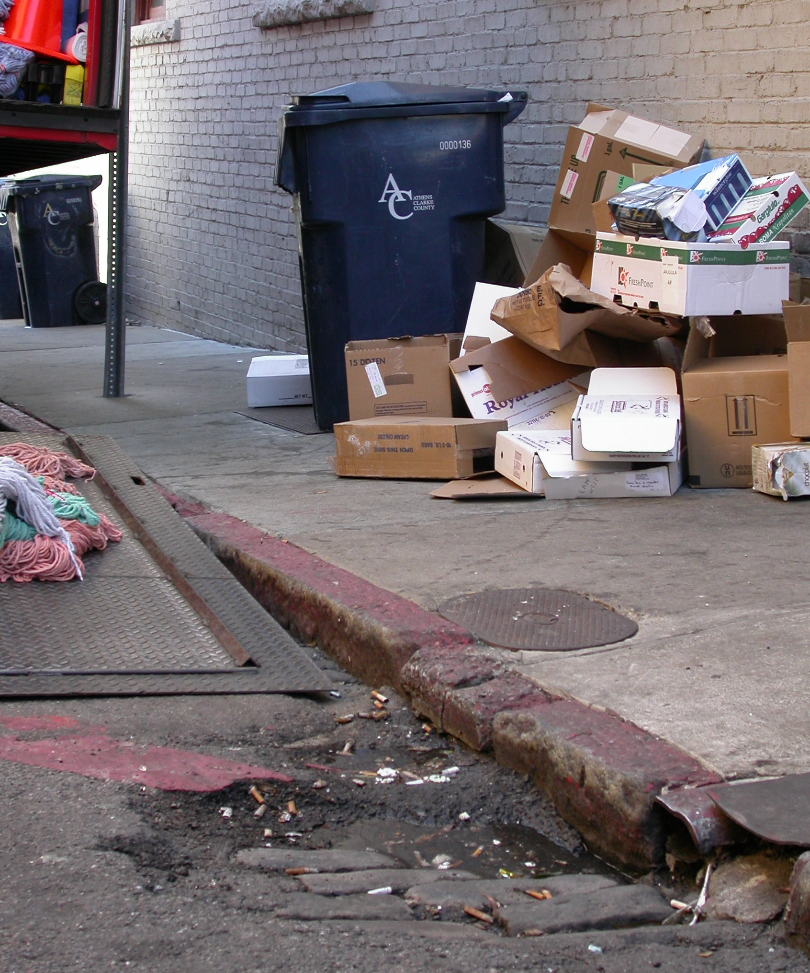
Point vs. Non-Point Pollution
Non-point Source Pollution
Pollution that does not come from a single identifiable source.
Motor Oil • Sediment • Cooking Grease • Pet Waste Excess Fertilizer • Yard Waste • Litter • Pesticides Household Hazardous Waste • Detergents • Metals
Notes:
Point vs. Non-Point Pollution. Point vs. Non-Point Pollution. Pollution that does not come from a single identifiable source.
Motor Oil • Sediment • Cooking Grease • Pet Waste Excess Fertilizer • Yard Waste • Litter • Pesticides Household Hazardous Waste • Detergents • Metals

Slide 71
Point vs. Non-Point Pollution
Stormwater runoff carries nonpoint source pollution to our rivers and streams.
Stormdrains lead directly to rivers and streams.

Slide 72
Protecting Water from Pesticides
Avoid unnecessary pesticide treatments.
Calibrate all application equipment.
Apply at proper rates and times per label.
Apply pesticides at the lowest effective rates.
Follow all other label instructions.
Store and dispose of pesticides properly.
Notes:
Protecting Water from Pesticides
Avoid unnecessary pesticide treatments.
Calibrate all application equipment.
Apply at proper rates and times per label.
Apply pesticides at the lowest effective rates.
Follow all other label instructions.
Store and dispose of pesticides properly.

Slide 73
Integrated Pest Management
IPM is a method of controlling pest populations through socially acceptable, environmentally responsible and economically practical methods.
IPM incorporates a variety of cultural, biological and chemical methods to efficiently manage pest populations while lowering the dependence on chemical means of control.
Notes:
Integrated Pest Management
IPM is a method of controlling pest populations through socially acceptable, environmentally responsible and economically practical methods.
IPM incorporates a variety of cultural, biological and chemical methods to efficiently manage pest populations while lowering the dependence on chemical means of control.

Slide 74
Integrated Pest Management
IPM involves using a variety of methods to control pests: cultural, mechanical, biological and chemical.
- Use disease and insect resistant plants.
- Hand destroy if pest numbers not excessive.
- Rotate annuals to reduce reoccurring pests.
- Prune out dead and diseased plant parts.
- Mow lawns and apply fertilizers correctly.
Notes:
Integrated Pest Management
IPM involves using a variety of methods to control pests: cultural, mechanical, biological and chemical.
- Use disease and insect resistant plants.
- Hand destroy if pest numbers not excessive.
- Rotate annuals to reduce reoccurring pests.
- Prune out dead and diseased plant parts.
- Mow lawns and apply fertilizers correctly.

Slide 75
Advantages to Using IPM Practices
Reductions in the potential for pesticide resistance,
Reductions in the costs of pesticides,
Reductions in your exposure to chemicals,
Reductions to other environmental impacts.
Notes:
Advantages to Using IPM Practices
Reductions in the potential for pesticide resistance,
Reductions in the costs of pesticides,
Reductions in your exposure to chemicals,
Reductions to other environmental impacts.

Slide 76
What are Biological Controls?
Biological controls occur naturally.
Diseases, parasites and predators that exist in our landscapes and gardens attack and kill harmful pests.
It is important to conserve and enhance naturally-occurring biological control agents in our landscapes and gardens.
Notes:
What are Biological Controls?
Biological controls occur naturally.
Diseases, parasites and predators that exist in our landscapes and gardens attack and kill harmful pests.
It is important to conserve and enhance naturally-occurring biological control agents in our landscapes and gardens.

Slide 77
More About Biological Controls
Learn to identify biological control agents like beneficial insects and wildlife that are indigenous to your area; and learn to conserve them in your landscape and garden.
Utilize a variety of flowering annual and perennial plants to provide food for beneficials.
Create habitats in your landscape that attract birds and other wildlife that prey on insect pests.
Notes:
More About Biological Controls
Learn to identify biological control agents like beneficial insects and wildlife that are indigenous to your area; and learn to conserve them in your landscape and garden.
Utilize a variety of flowering annual and perennial plants to provide food for beneficials.
Create habitats in your landscape that attract birds and other wildlife that prey on insect pests.

Slide 78
Using Pesticides
You may not always be able to control certain pests and their damage without using pesticides.
Pesticides include: insecticides, fungicides, miticides, herbicides, nematicides, etc.
Pesticides are classified as chemical or organic.
Pesticides are an important component of an Integrated Pest Management Program.
Notes:
Using Pesticides
You may not always be able to control certain pests and their damage without using pesticides.
Pesticides include: insecticides, fungicides, miticides, herbicides, nematicides, etc.
Pesticides are classified as chemical or organic.
Pesticides are an important component of an Integrated Pest Management Program.

Slide 79
More About Using Pesticides
Select the pesticide and formulation based upon the target pest, application equipment available, hazards of the pesticide and the applicator’s experience with pesticides.
If possible, use chemical pesticides only as a spot application. Blanket coverage may destroy beneficial insects and desirable plants.
No single herbicide, insecticide, fungicide, etc. is appropriate for all landscape pest problems
-------------------------------------------
ALWAYS carefully read and follow all label directions when using pesticides.
Notes:
More About Using Pesticides
Select the pesticide and formulation based upon the target pest, application equipment available, hazards of the pesticide and the applicator’s experience with pesticides.
If possible, use chemical pesticides only as a spot application. Blanket coverage may destroy beneficial insects and desirable plants.
No single herbicide, insecticide, fungicide, etc. is appropriate for all landscape pest problems
-------------------------------------------
ALWAYS carefully read and follow all label directions when using pesticides.

Slide 80
Information on Pesticides
The University of Georgia Extension Service is your best source of information for:
* Choosing the correct pesticides.
* Using pesticides correctly.
* Storing pesticides.
* Disposing of pesticides.
Notes:
Information on Pesticides
The University of Georgia Extension Service is your best source of information for:
* Choosing the correct pesticides.
* Using pesticides correctly.
* Storing pesticides.
* Disposing of pesticides.

Slide 81
Information on Related Topics
Contact your local County Extension Agent.
Call 1-800-ASK-1UGA
Websites:
www.caes.uga.edu
www.gaurbanag.org
www.georgiaturf.org
Notes:
Information on Related Topics
Contact your local County Extension Agent.
Call 1-800-ASK-1UGA
Websites:
www.caes.uga.edu
www.gaurbanag.org
www.georgiaturf.org

Slide 82
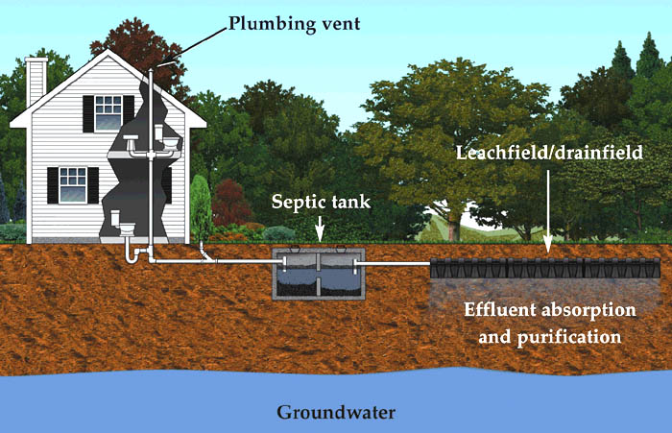
Septic Systems
Notes:
Landscaping for Water Quality. Septic (or On Site) Systems.

Slide 83
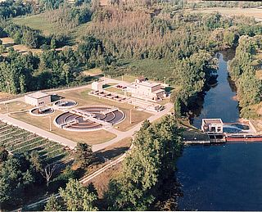
Wastewater Management
Urban - central sewer
Rural - onsite systems
Suburbs – mixed
  Distance
  Availability of funds
Notes:
Waste Water Management. Urban – central sewer. Rural – Onsite systems. Suburbs/mixed – Distance and Availability of funds.

Slide 84
Function of Wastewater Management
Move wastewater out of the home
  Central sewer - wastewater moves through pipes and a treatment system to surface water
  Onsite system – wastewater moves into and through the soil to ground and surface water
Renovate the wastewater
  Immobilize or remove inorganic constituents
  Decompose organic components
  Disinfect the wastewater
    Immobilize, remove, or disable pathogens
  When does wastewater become water?
Notes:
Function of Wastewater Management.
Move wastewater out of the home
- Central sewer - wastewater moves through pipes and a treatment system to surface water
- Onsite system – wastewater moves into and through the soil to ground and surface water
Renovate the wastewater
- Immobilize or remove inorganic constituents
- Decompose organic components
- Disinfect the wastewater
- Immobilize, remove, or disable pathogens
- When does wastewater become water?

Slide 85
Wastewater Management in Georgia
40%+ of housing units in Georgia use on-site systems for wastewater disposal.
  1,500,000+ units
  50,000+ onsite systems permitted annually in Georgia
    - 50%+ of new homes built
Georgia is typical for SE states and other growth regions.
Notes:
Wastewater Management in Georgia.
40%+ of housing units in Georgia use on-site systems for wastewater disposal
- 1,500,000+ units
- 50,000+ onsite systems permitted annually in Georgia
- 50%+ of new homes built
Georgia is typical for SE states and other growth regions.

Slide 86
Is This Bad?
Onsite systems are economical and an environmentally benign method to manage wastewater if:
  Properly installed on suitable soils and
  Properly managed
USEPA considers onsite systems to be an integral part of Nation’s wastewater management infrastructure.
  Permanent solution for wastewater management
Notes:
Is This Bad?
Onsite systems are economical and an environmentally benign method to manage wastewater if:
- Properly installed on suitable soils and
- Properly managed
USEPA considers onsite systems to be an integral part of Nation’s wastewater management infrastructure.
- Permanent solution for wastewater management

Slide 87
Onsite System Components
Notes:
Onsite System Components

Slide 88
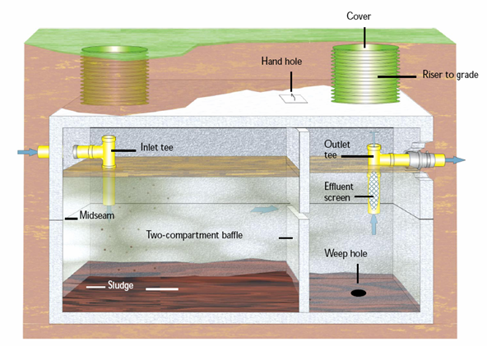
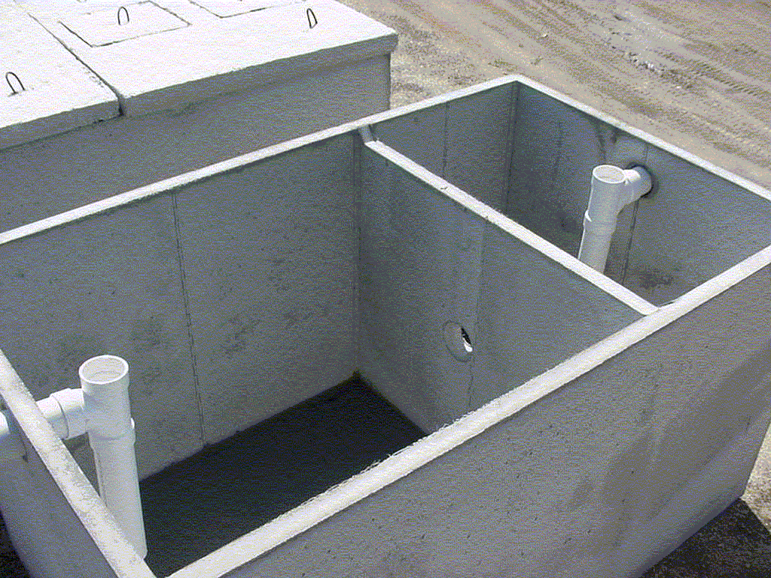
Septic Tanks
1,000 - 1,500 gallon water tight tank (concrete, polyethylene, etc).
Collects large solids.
Limited decomposition of organic material (about 30% does not decompose) – reason tank must be periodically pumped.
Notes:
Septic Tank
1,000 - 1,500 gallon water tight tank (concrete, polyethylene, etc).
Collects large solids.
Limited decomposition of organic material (about 30% does not decompose) – reason tank must be periodically pumped.

Slide 89
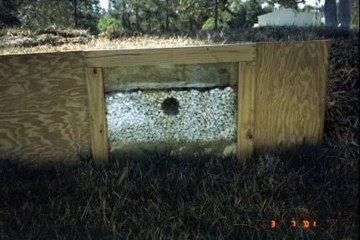
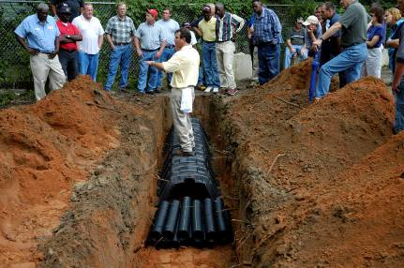
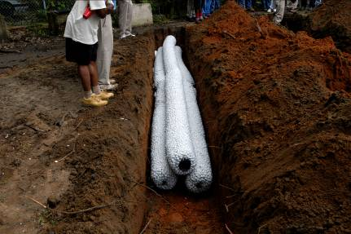
Drainfield
Distributes wastewater into the soil.
Temporary storage.
Little, if any, treatment.
Notes:
Drainfield.
Distributes wastewater into the soil.
Temporary storage.
Little, if any, treatment.

Slide 90
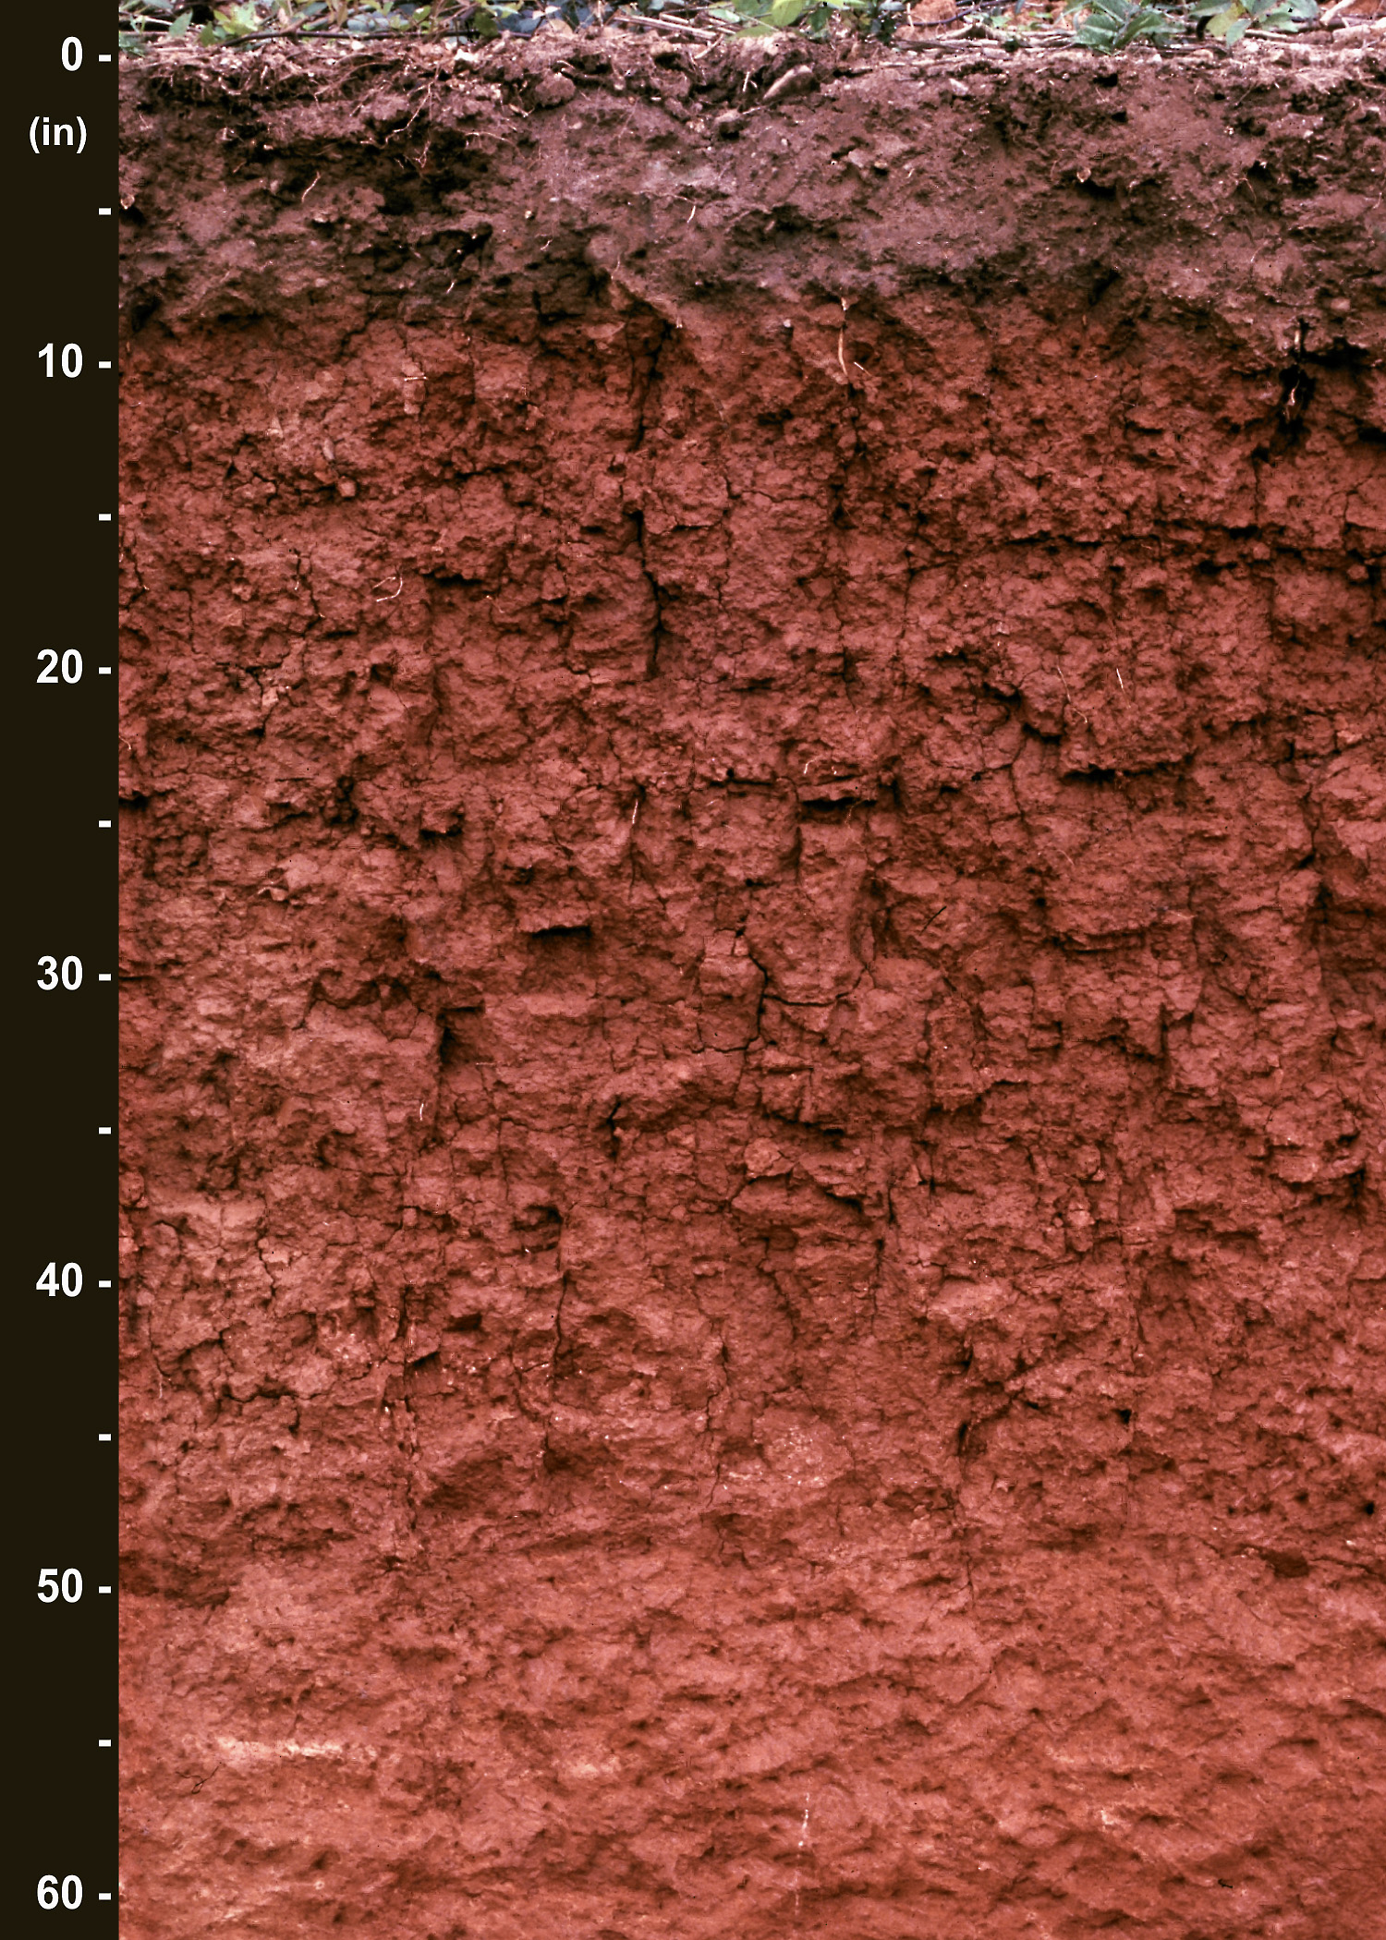
The Soil
The transport and treatment media.
The rate of water movement depends on properties of the soil.
Natural process purifies the wastewater.
Notes:
The Soil.
The transport and treatment media.
The rate of water movement depends on properties of the soil.
Natural process purifies the wastewater.

Slide 91
Potential Contaminants
Organic matter
Bacteria and viruses
Nitrate
Phosphorus
  Heavy Metals
Emerging contaminants of concern
  Pharmaceuticals, hormones, etc.
Notes:
Potential Contaminants.
Organic matter
Bacteria and viruses
Nitrate
Phosphorus
- Heavy Metals
Emerging contaminants of concern
- Pharmaceuticals, hormones, etc.

Slide 92
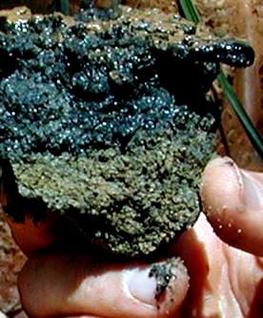
Organic Matter, Bacteria and Viruses
Organic matter (BOD and TSS)
  Removed in a few inches of soil.
Bacteria and viruses
  In most soils, complete removal by 1-2’ of unsaturated soil.
  Exception may be sandy soils with seasonal water table rising into adsorption field (unsuitable soils).
Notes:
Organic Matter, Bacteria and Viruses.
Organic matter (BOD and TSS)
- Removed in a few inches of soil
Bacteria and viruses
- In most soils, complete removal by 1-2’ of unsaturated soil.
- Exception may be sandy soils with seasonal water table rising into adsorption field (unsuitable soils).

Slide 93
Phosphorus
Phosphorus
  In most soils, P is not a concern.
    Subsoil discharge
    P “fixation”
      Clay and Fe oxides are important adsorbents
  Setbacks from waterbodies.
    Long travel distance
  Long-term loading in sensitive environments?
Notes:
Phosphorus.
Phosphorus
- In most soils, P is not a concern.
- Subsoil discharge
- P “fixation”
- Clay and Fe oxides are important adsorbents
- Setbacks from waterbodies.
- Long travel distance
- Long-term loading in sensitive environments?

Slide 94
Nitrogen
Organic N in wastewater converted to nitrate in the soil.
Nitrate moves through the soil with water.
Dilution helps maintain low groundwater nitrate concentrations.
  Housing density (lot size)
    Drainfield area (3,000 ft²) compared to total area receiving rainfall (25-50,000 ft²)
  Point of measurement should be considered
Denitrification may be important in certain environments.
  Shallow ground water?
  Effect of riparian buffers has not been evaluated
Notes:
Nitrogen.
Organic N in wastewater converted to nitrate in the soil.
Nitrate moves through the soil with water.
Dilution helps maintain low groundwater nitrate concentrations.
- Housing density (lot size)
- Drainfield area (3,000 ft²) compared to total area receiving rainfall (25-50,000 ft²)
- Point of measurement should be considered
Denitrification may be important in certain environments.
- Shallow ground water?
- Effect of riparian buffers has not been evaluated

Slide 95
Riparian Buffers?
Buffers have been shown to remove 90% of nitrate (agricultural sources) in ground water in Coastal Plain landscapes.
Will the same effect occur for nitrate from onsite systems?
Probably but no data is available.
N₂
NO₃⁻
NO₃⁻
denitrification
NO₃⁻
Notes:
Riparian Buffers?
Buffers have been shown to remove 90% of nitrate (agricultural sources) in ground water in Coastal Plain landscapes.
Will the same effect occur for nitrate from onsite systems?
Probably but no data is available.

Slide 96
Heavy Metals and Emerging Contaminants
Metals
  Low concentration in household wastewater.
  Strongly adsorbed in soil.
Emerging contaminants
  Low concentrations.
  Fate in soil is mostly unknown.
Notes:
Heavy Metals and Emerging Contaminants.
Metals
- Low concentration in household wastewater.
- Strongly adsorbed in soil.
Emerging contaminants
- Low concentrations.
- Fate in soil is mostly unknown.

Slide 97
What are Suitable Soils?
Acceptable percolation rate.
Rock and seasonal water table more than 2 feet below wastewater infiltrative surface.
  Unsaturated soil for treatment
Technology/designs are available to overcome most soil limitations.
  More expensive than conventional
Notes:
What are Suitable Soils?
Acceptable percolation rate.
Rock and seasonal water table more than 2 feet below wastewater infiltrative surface.
- Unsaturated soil for treatment
Technology/designs are available to overcome most soil limitations.
- More expensive than conventional

Slide 98
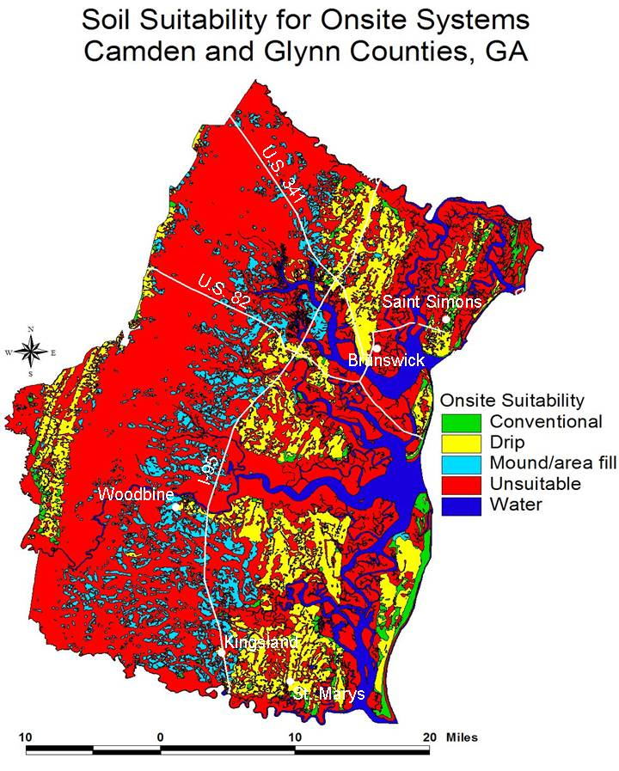
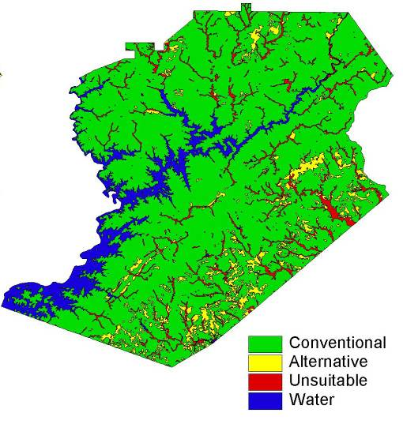
On-Site System Suitability
Hall County
Camden and Glynn Counties
Notes:
On-site System Stability.
Hall County. Camden and Glynn Counties.

Slide 99
Onsite System Failure
Hydraulic failure
  Toilet will not flush and shower does not drain.
  Partially treated wastewater rising to soil surface.
    Potential treat to water quality and human health
      Runoff to ditches, streams, and other water bodies
Inadequate soil treatment
  Rarely a problem in Georgia even in sandy soils
    Soil clogging enhances treatment
Notes:
Online System Failure.
Hydraulic failure
- Toilet will not flush and shower does not drain
- Partially treated wastewater rising to soil surface
- Potential treat to water quality and human health
- Runoff to ditches, streams, and other water bodies
Inadequate soil treatment
- Rarely a problem in Georgia even in sandy soils
- Soil clogging enhances treatment

Slide 100
Causes of Hydraulic Failure
Early failure
  Unsuitable Soils
  Faulty installation
  Both addressed by certification and inspection
Long term failure
  Abnormally high water use
  Poor site water management
  Improper or no maintenance
Notes:
Causes of hydraulic Failure.
Early failure
- Unsuitable Soils
- Faulty installation
- Both addressed by certification and inspection
Long term failure
- Abnormally high water use
- Poor site water management
- Improper or no maintenance

Slide 101
Water Use
Leaks, 14
gpd
Toilet, 19 gpd
Faucets, 16 gpd
Shower, 17 gpd
Dishwasher, 1
Laundry, 22 gpd
gpd
Notes:
Water Use. Leaks, 14 gpd; Toilet, 19gpd; Shower,17gpd; Laundry, 22gpd; Dishwasher, 1 gpd and Faucets,16 gpd.

Slide 102
Gray-Water Separation
60-65% of total wastewater
  1,000 gal/week (1” over 1,600 ft²)
  Bathtub and/or shower
  Laundry
  Kitchen and dishwasher not included
Surface discharge requires NPDES permit from EPD
  2 subsurface systems needed
Notes:
Gray-Water Separation.
60-65% of total wastewater
- 1,000 gal/week (1” over 1,600 ft²)
- Bathtub and/or shower
- Laundry
- Kitchen and dishwasher not included
Surface discharge requires NPDES permit from EPD
- 2 subsurface systems needed

Slide 103
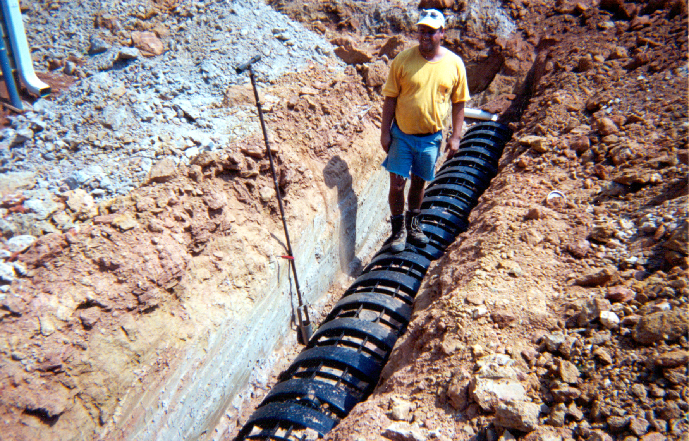
Site Water Management
Divert water from gutter downspouts, natural drainage, roofs, drives, and other impervious surfaces away from onsite system drain field.
Notes:
Site Water Management.
Divert water from gutter downspouts, natural drainage, roofs, drives, and other impervious surfaces away from onsite system drain field.

Slide 104
Maintenance
Necessary for long-term performance.
  Septic tank clean-out (pumping)
  Inspection
  More extensive maintenance needed for advanced designs and treatment systems
    Pumps, timers, valves, etc.
Lack of homeowner knowledge is a problem.
  Assume service by central sewer
  No understanding of on-site system
Regulated/required maintenance?

Slide 105
What is the Future?
Notes:
What is the Future?

Slide 106
Distributed Systems
One large on-site system for several houses
  System installed on best-suited soils.
    Drainfield area can be used as a park or as green space since wastewater is underground
  Advanced treatment often included
  Same housing density
Unit of government or company responsible for maintenance.
  Monthly homeowner fee
  Bonding
Notes:
Distributed Systems.
One large on-site system for several houses.
- System installed on best-suited soils
- Drainfield area can be used as a park or as green space since wastewater is underground
- Advanced treatment often included
- Same housing density
Unit of government or company responsible for maintenance.
Monthly homeowner fee
Bonding

Slide 107
Cluster or Community System
Every house
has a
septic tank with
a pump
Advanced
treatment
and
best soils
Notes:
Cluster or Community System.
- Every house has a septic tank with a pump.
- Advanced treatment and best soils.

Slide 108
Contract Operation/Ownership
Contract operation
  System property of homeowner
  Maintenance/guaranteed performance provided for monthly fee
3rd party ownership
  Company or government agency owns onsite system
  Responsible for maintenance and operation
Notes:
Contract Operation/Ownership.
Contract operation
- System property of homeowner
- Maintenance/guaranteed performance provided for monthly fee
3rd party ownership
- Company or government agency owns onsite system
- Responsible for maintenance and operation

Slide 109
Summary
Onsite wastewater management systems are an economical and environmentally benign alternative to centralized waste treatment if:
  soils are favorable,
  system is suitable for the site and properly installed, and
  system is properly and regularly maintained.
New technologies, designs, and operating paradigms are becoming available to improve long-term performance.
Notes:
Summary.
Onsite wastewater management systems are an economical and environmentally benign alternative to centralized waste treatment if
- Soils are favorable,
- the system is suitable for the site and properly installed, and
- the system is properly and regularly maintained
New technologies, designs, and operating paradigms are becoming available to improve long-term performance.

