Slide 1
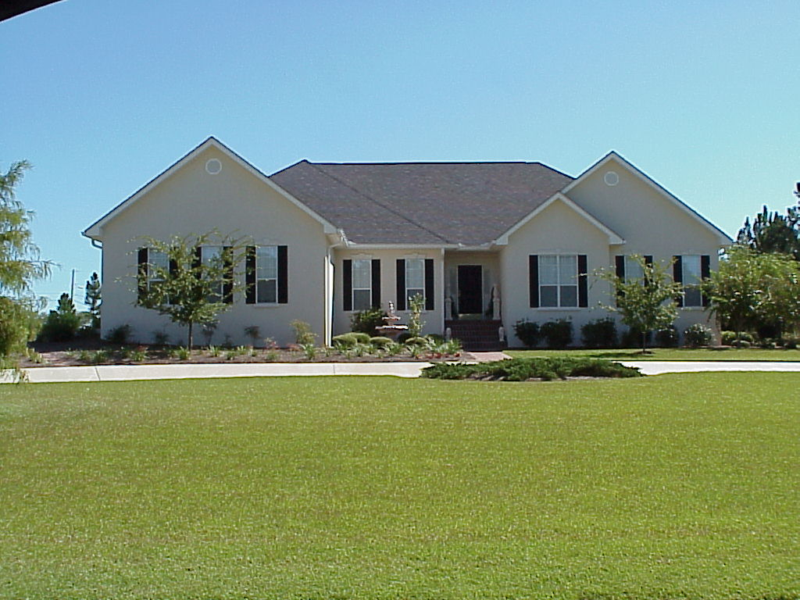

Landscape Weed Control
Todd Hurt
Training Coordinator, UGA Center for Urban Agriculture
Notes:
High quality landscape is desirable
Does not happen by accident

Slide 2
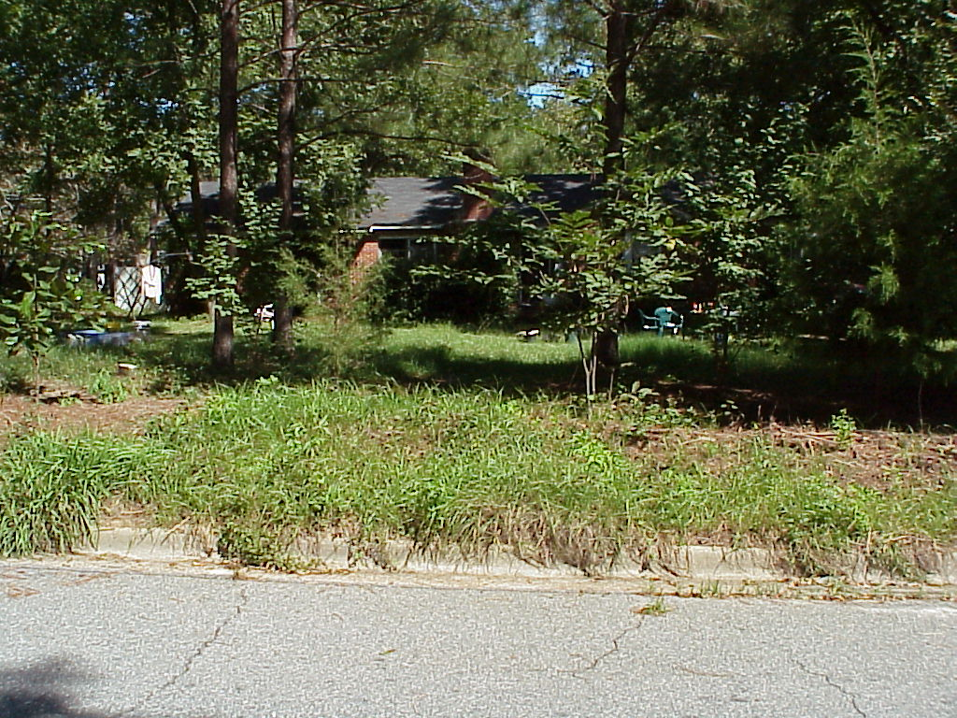
Notes:
Weeds interfere with the health and beauty of landscaped area.

Slide 3
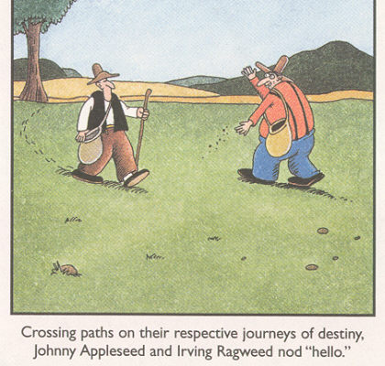
What is a weed?
Today we will discuss:
  Basic Weed Id
  Common Landscape Weeds
  Use of Control Guide
  New consumer herbicide labels

Slide 4
Weed Life Cycles
Annual: Completes growth cycle in a single growing season (Crabgrass).
Perennial: A plant that can persist more than two years, and reproduce through roots or seeds (Clover).
Notes:
Refer to slide

Slide 5
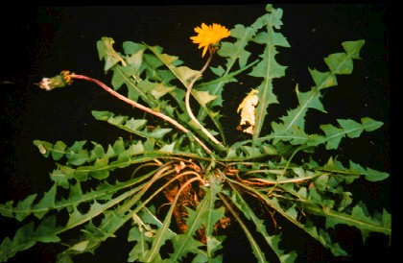
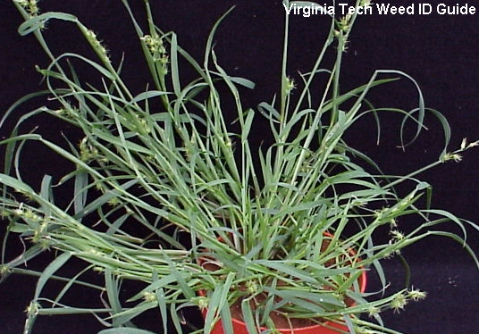
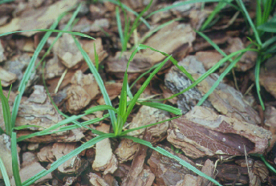
General Classification
Broadleaf- dicots, netted veins, showy flowers
Grass – monocots, hollow stems, nodes, parallel veins
Sedge – Triangular, no nodes, plant parts in 3’s
“Sedges have edges”

Slide 6
Summer annual grasses
Notes:
Summer annuals germinate in mid to late spring, and usually complete their life cycle by mid to late fall.

Slide 7
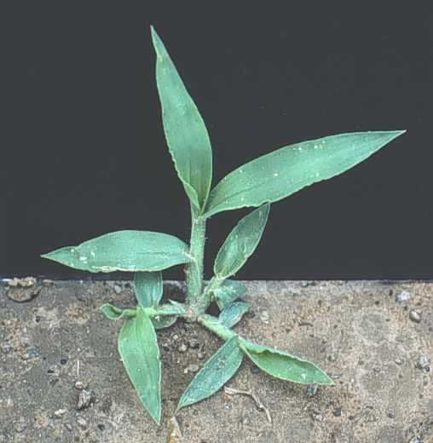
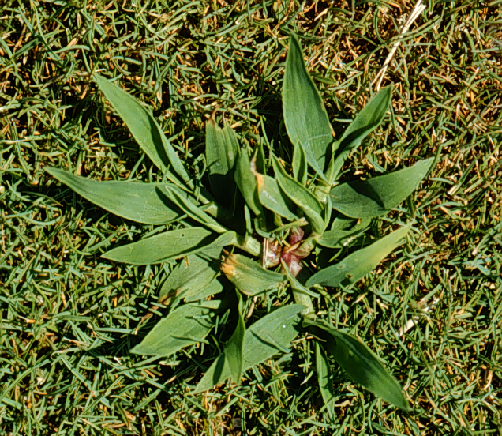
Southern crabgrass
Smooth crabgrass
Notes:
There are several species of crabgrass, but two of the most common are Southern and Smooth crabgrass. Germinate well in moist, warm soils (~60 ºF). Crabgrass control is the same regardless of type.

Slide 8
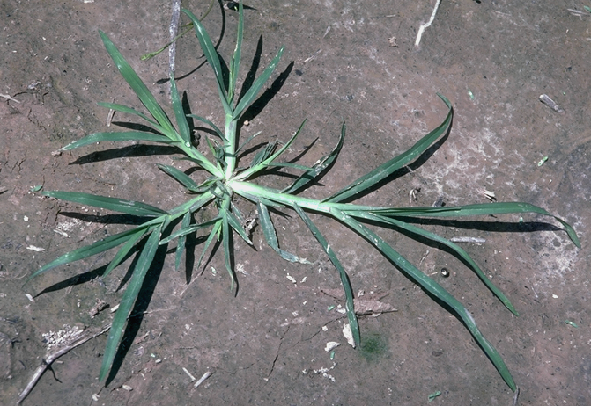
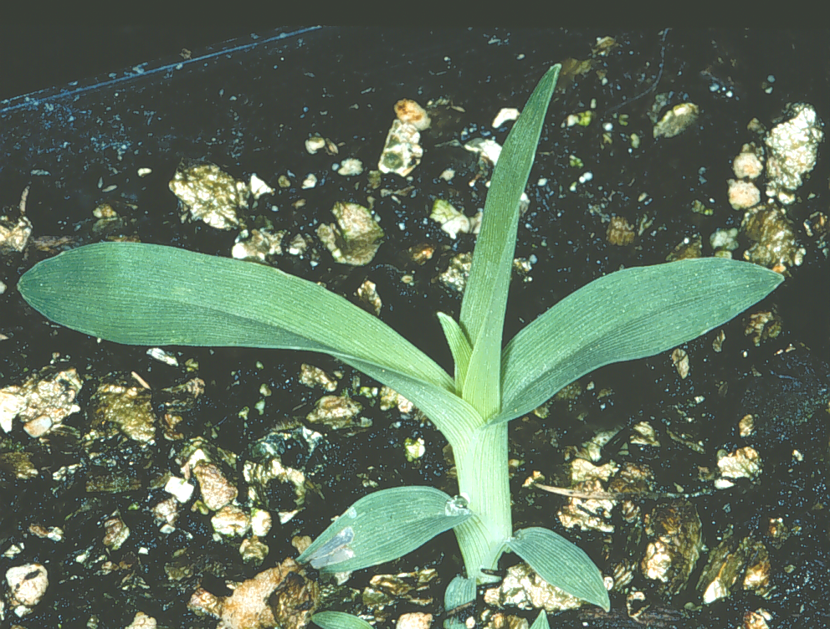
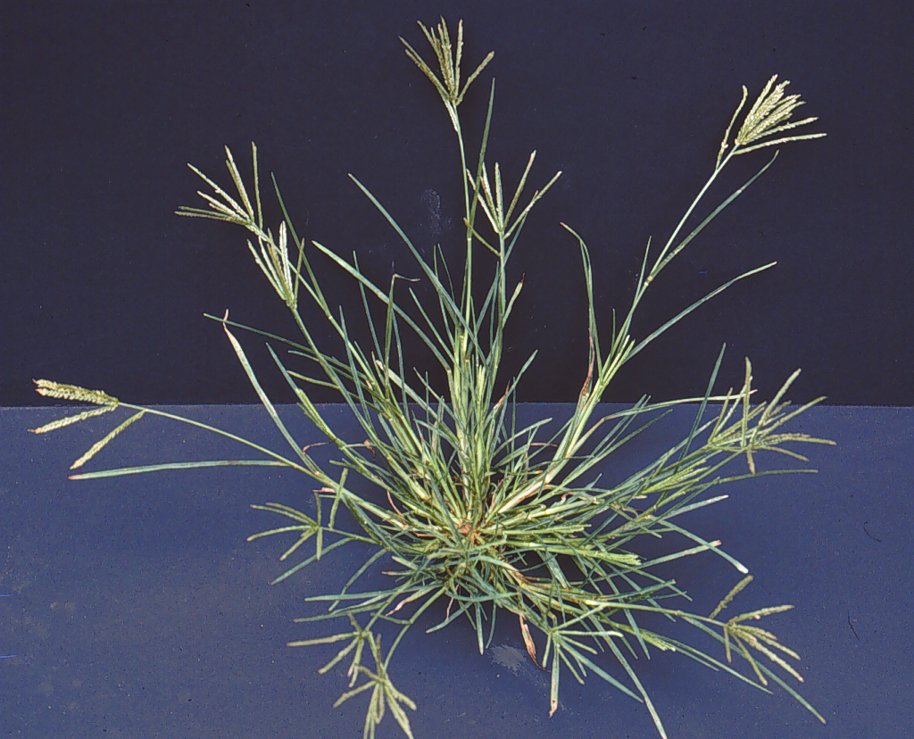
Goosegrass
Notes:
Goosegrass has a flat stem with a silvery center, and prefers compacted soils. It germinates under moist warm conditions. Resistances has developed to some pre-emergence herbicides.

Slide 9
Winter annual grasses
Notes:
Winter annuals germinate in late fall to early winter, and complete their life cycle in late spring to early summer.

Slide 10
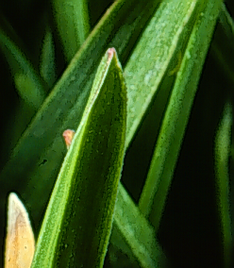
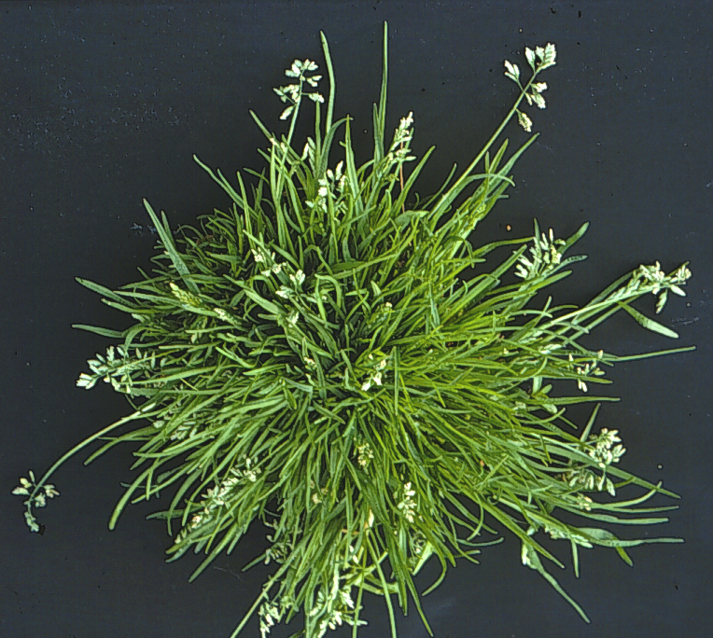
Annual bluegrass
Boat shaped leaf tip
Notes:
Annual bluegrass prefers compacted soils. There are several varieties of annual bluegrass, but most annual bluegrasses germinate from late summer to early fall. An identifying feature of bluegrass are tufted growth and boat-shaped leaf tips.

Slide 11
Winter annual broadleaf weeds
Notes:
Winter annuals germinate in late fall to early winter, and complete their life cycle in late spring to early summer.

Slide 12
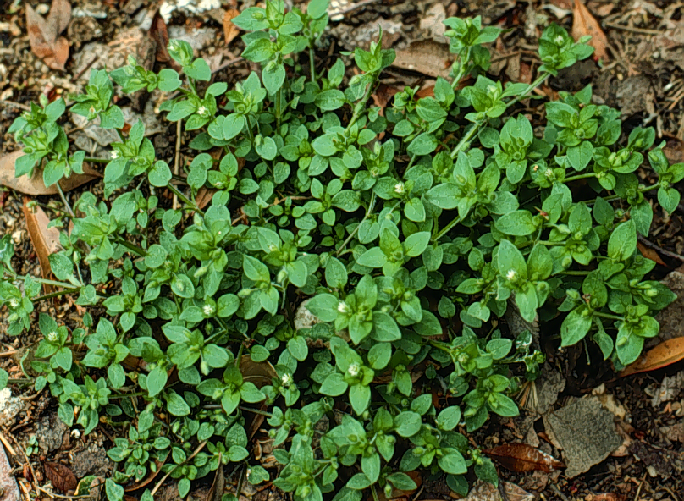
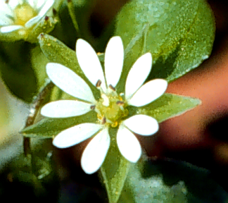
Common chickweed
Notes:
Common winter annual in most landscapes. Low growing, spreading, with small white flowers.

Slide 13
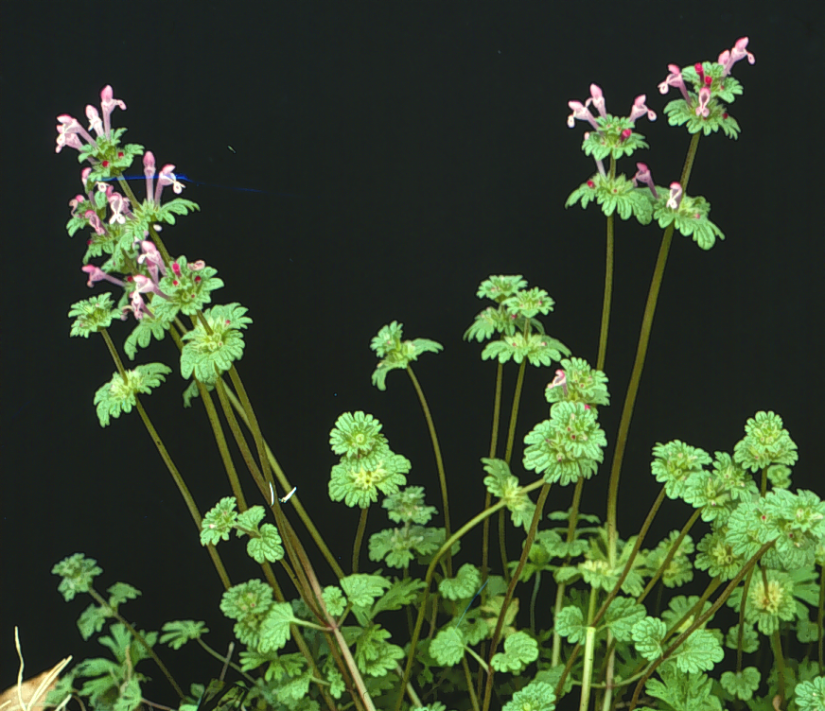
henbit
Henbit
Notes:
Henbit in a common winter annual in most landscapes. It has a square stem and small purple flowers.

Slide 14
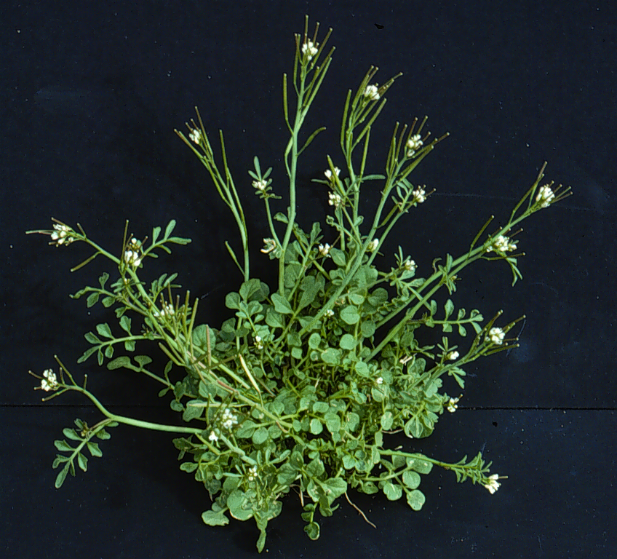
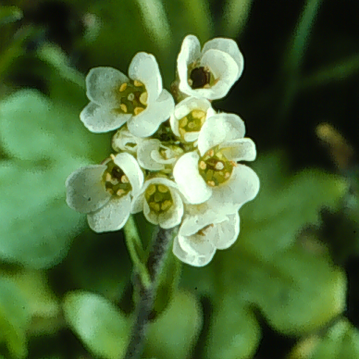
Hairy bittercress
Notes:
Hairy bittercress is a major winter annual throughout the United States. It has a very quick life cycle, able to go from seed to flower in less than ten days. It will grow to about six inches tall, and the seeds can be thrown from the pods up to 20 feet.

Slide 15
Summer annual broadleaf weeds
Notes:
Summer annuals germinate in mid to late spring, and usually complete their life cycle by mid to late fall.

Slide 16
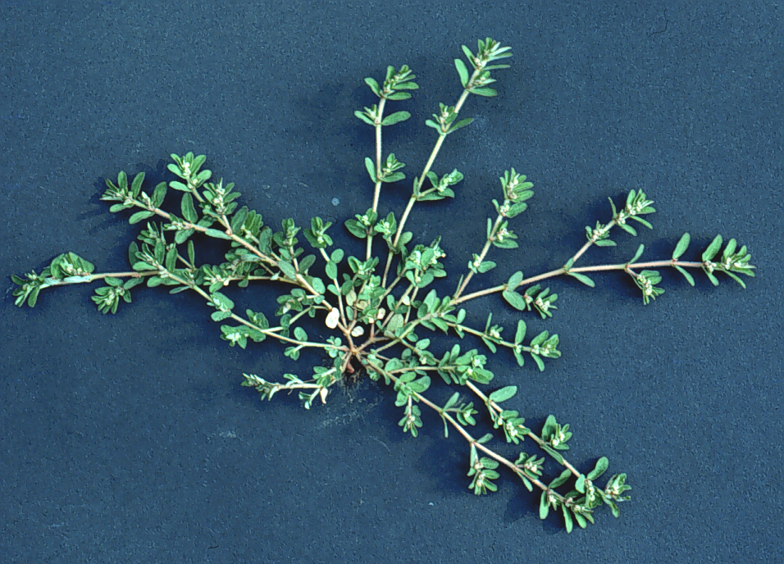
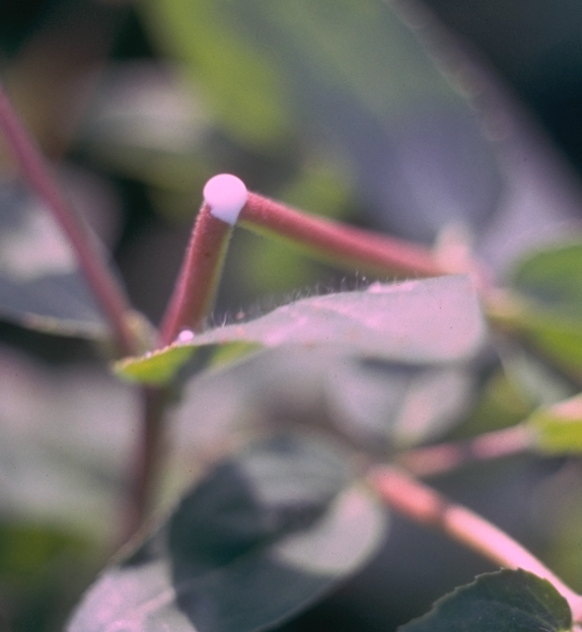
Prostrate spurge
Milky sap
Notes:
Difficult summer annual that germinates in warmer soils. There are several species and they are identified by their low growing habit and milky sap that is produced when the stem is broken. It is tolerant to several common pre-emergent herbicides.

Slide 17
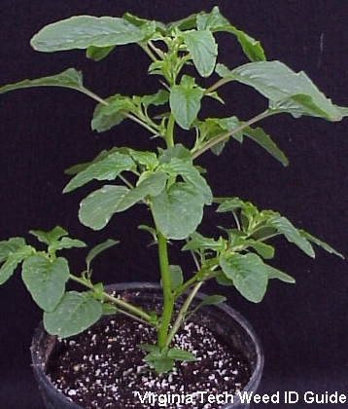
Spiny Amaranth (Pigweed)
Seed / Plant
Pigweed >200,000
Lambsquarters >30,000
Crabgrass 53,000
Annual Bluegrass 2,000

Slide 18
Perennial broadleaf weeds
Notes:
A plant that can persist more than two years, and can reproduce through either seeds or vegetative structure (roots, tubers, rhizomes, stolons, etc.).

Slide 19
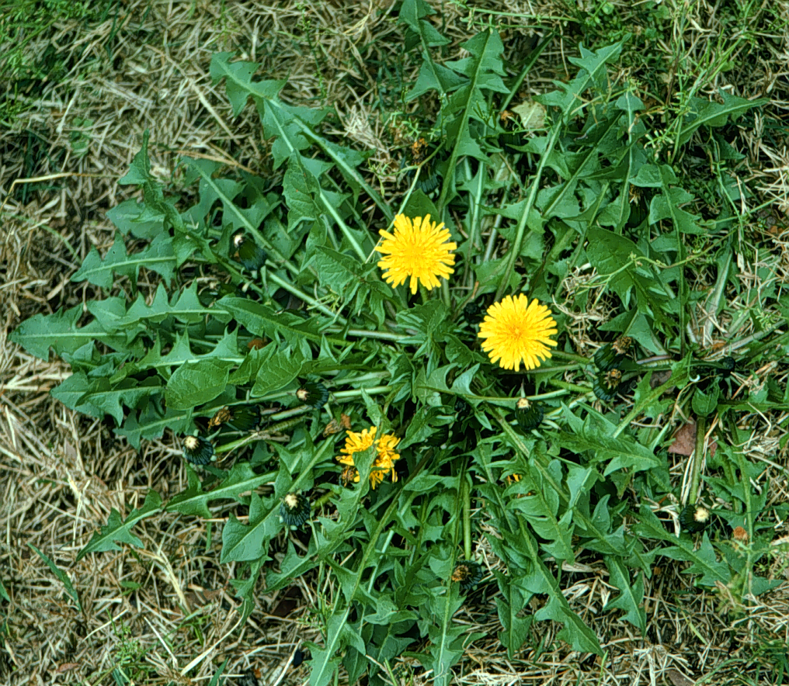
Dandelion
Notes:
Very common perennial, noted for yellow flower and wind blown seed. The tap-root makes this plant difficult to control. Young leaves are commonly eaten, and flower buds make great wine!

Slide 20
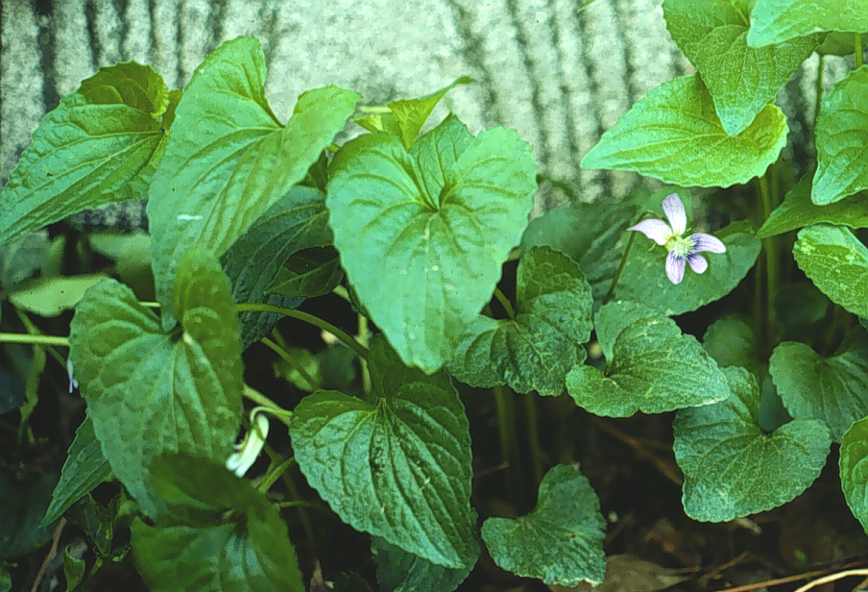
Wild violet
Notes:
Wild violet is extremely hard to selectively control in turfgrass. It is a well known wild flower, but can be invasive under certain situations. Flowers can be purple, pink, or white.

Slide 21
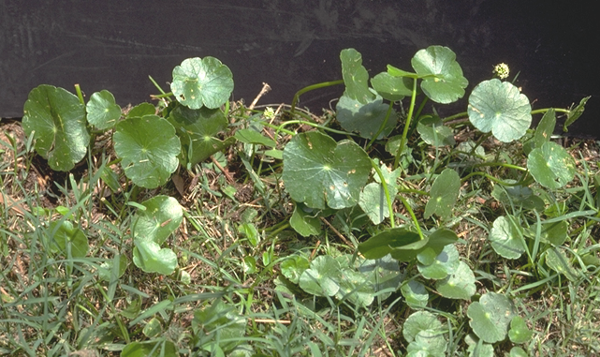
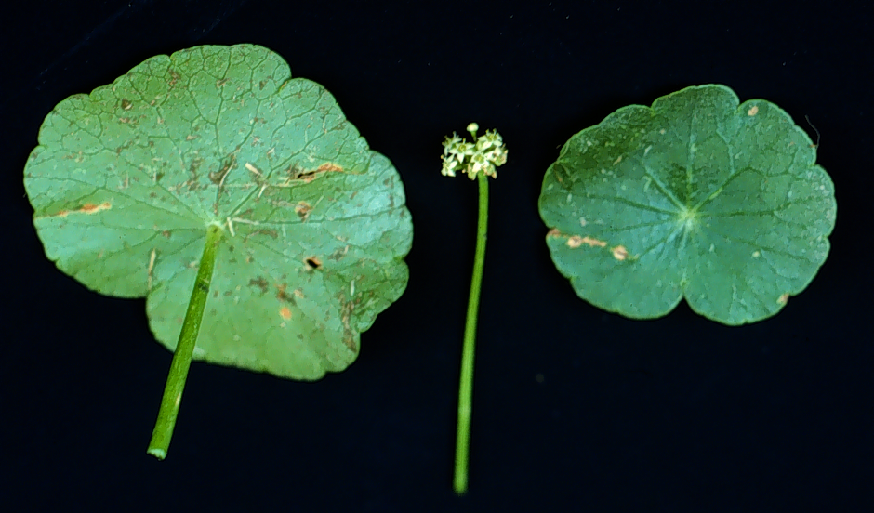
Pennywort or Dollarweed
Notes:
An invasive creeping perennial, mostly found in moist and / or shady location. Shiny round leaves, spreads by rhizomes and stolons, flower are inconspicuous.

Slide 22
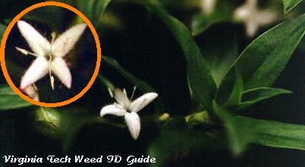
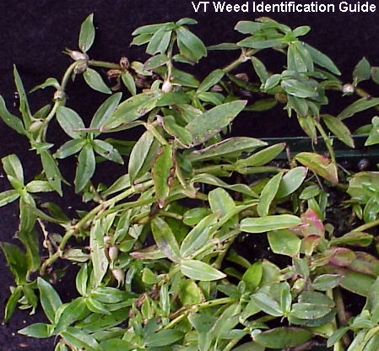
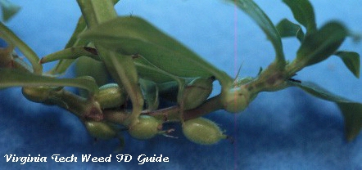
Virginia Buttonweed

Slide 23
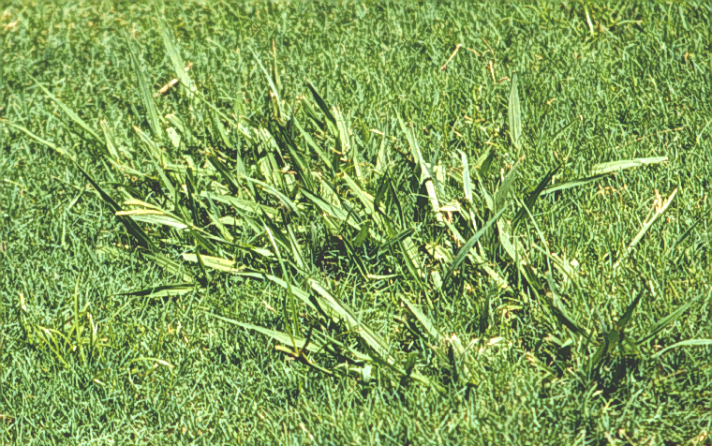
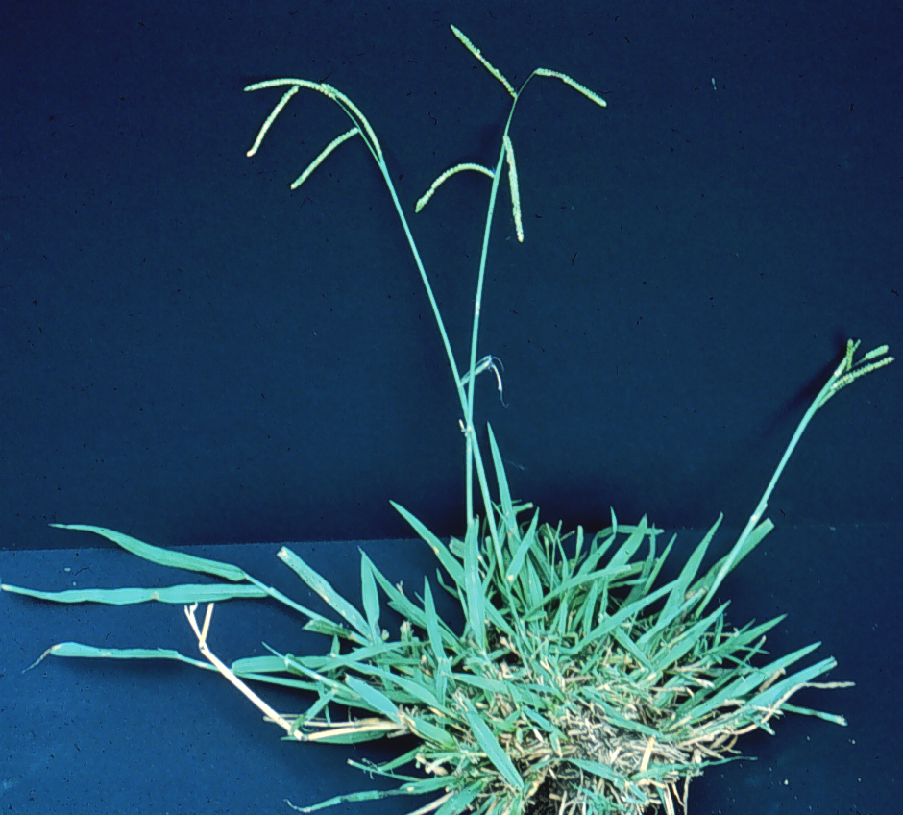
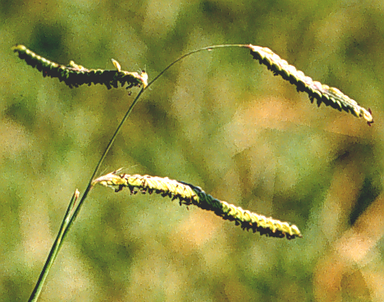
Dallisgrass
Notes:
Warm-season perennial grass that reproduces by seed and very short rhizomes. Can be difficult to control with herbicides.

Slide 24
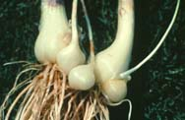
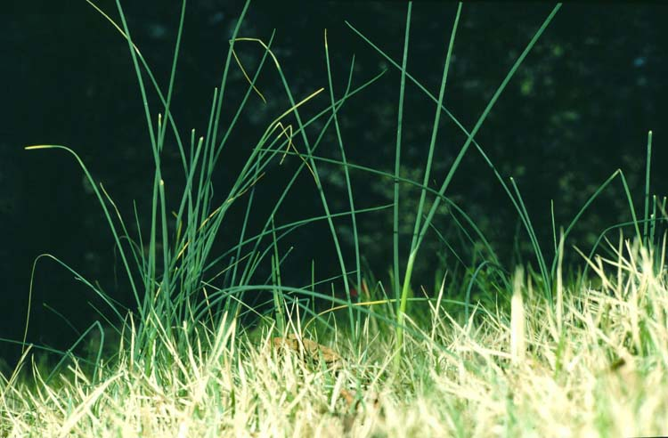
Wild garlic
bulbs and bulblets
Notes:
Wild garlic appears in winter and / or early spring. Mainly originates from bulbs. Plant is difficult to control because of short window of growth. Flowers can produce seeds, bulbs, or live plants.

Slide 25
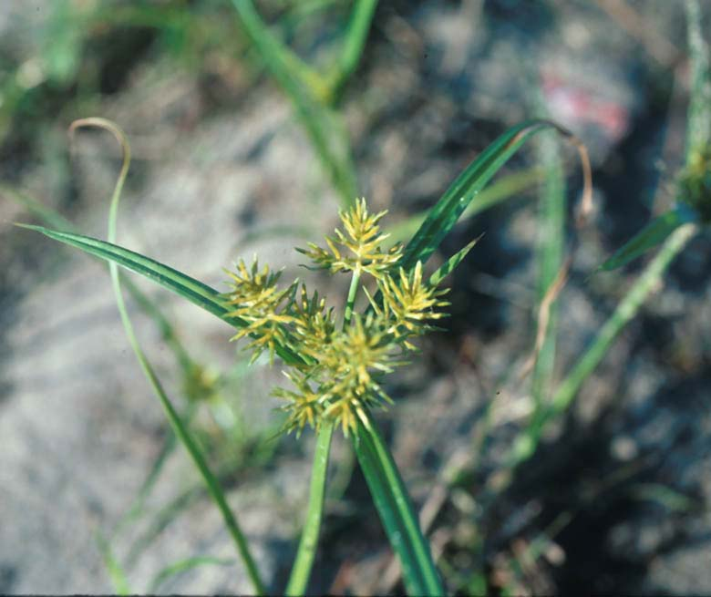
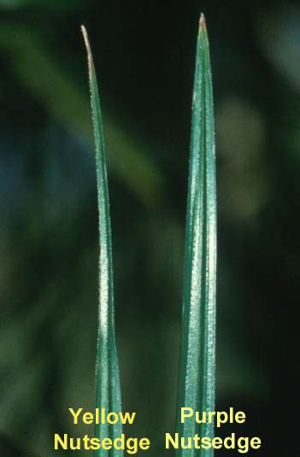
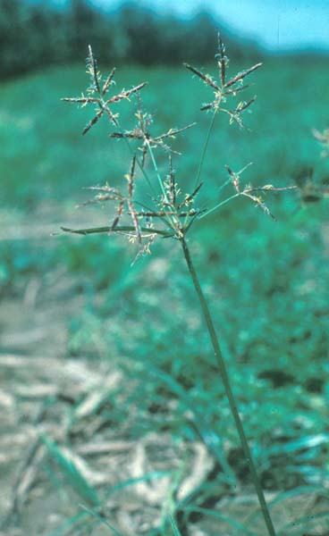
Purple and Yellow Nutsedge
Yellow nutsedge flower
Leaf tips differ
Purple nutsedge flower
Notes:
Yellow and purple nutsedge are difficult to control sedges because of there tuber and rhizome system. If plants are not in flower, they can be identified by their different leaf tips. Both plant can grow under diverse conditions (wet to dry). Both plants have made the top 10 list of the worlds worst weeds, with purple being number one!

Slide 26
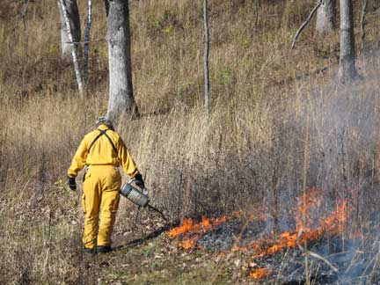
Waging the war on Weeds
Cultural
Physical
Biological
Chemical

Slide 27
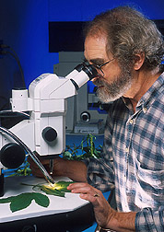
Biological Control
ARS plant pathologists found that a Myrothecium bioherbicide killed 100 percent of kudzu weeds treated at different growth stages and under varying physical and environmental conditions.

Slide 28
Herbicides
Identify weed
Check safety on plant
Follow label directions
Avoid drift

Slide 29
Herbicide Classification
Preemergence: Applied before weed seed germination (Preen®). Generally no control of emerged weeds.
Postemergence: Applied after weed emergence. Generally no control of unemerged weeds.
Notes:
Refer to slide

Slide 30
Herbicide Classification
Contact: Causes localized plant tissue injury. Does not readily move through the plant (Finale®)
Systemic: Readily moves through the plant tissue (Roundup®)
Notes:
Refer to slide

Slide 31
Herbicide Classification
Selective: Kills some plant species, but does not damage others (Weed-B-Gon®)
Nonselective: Generally kills all plant species (Roundup®)
Notes:
Refer to slide

Slide 32
Preemergence Herbicide Application Dates
Fall - Sept 1 - 15, N.GA
- Oct 1 - 15, S.GA
Spring - Mar 1 - 30, N.GA
- Feb 15 - Mar 15, S.GA
Notes:
Refer to slide. Above Macon is North Georgia, and Macon and south is South Georgia.

Slide 33
Using the UGA Pest Management Handbook

Slide 34
http://www.ent.uga.edu/pmh/

Slide 35
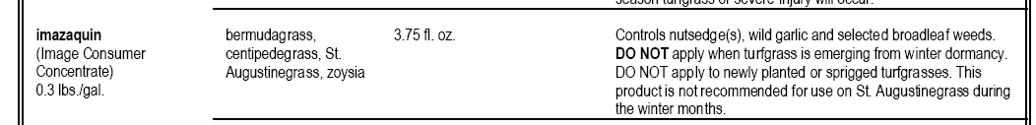
Image

Slide 36
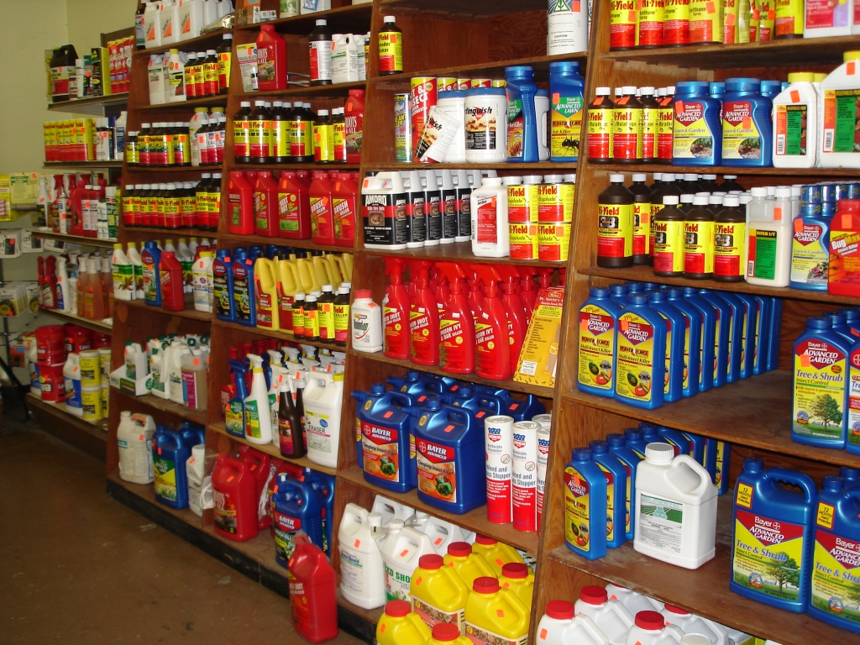
Now Lets Look at the Products

Slide 37
Preemergent Turfgrass Herbicides
Annual grass control in all turfgrasses
  Balan (benefin)
  Surflan (oryzalin)
  XL (benefin + oryzalin)
  Team Pro (benefin + trifluralin)
  Halts (pendimethalin)
  Dimension (dithiopyr)

Slide 38
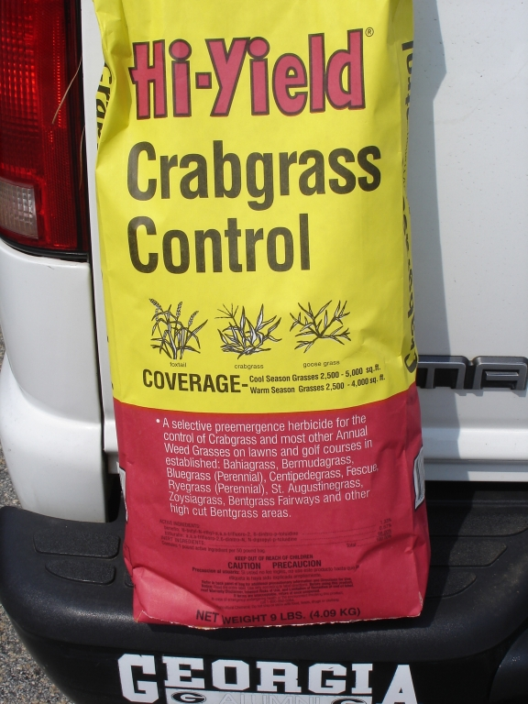
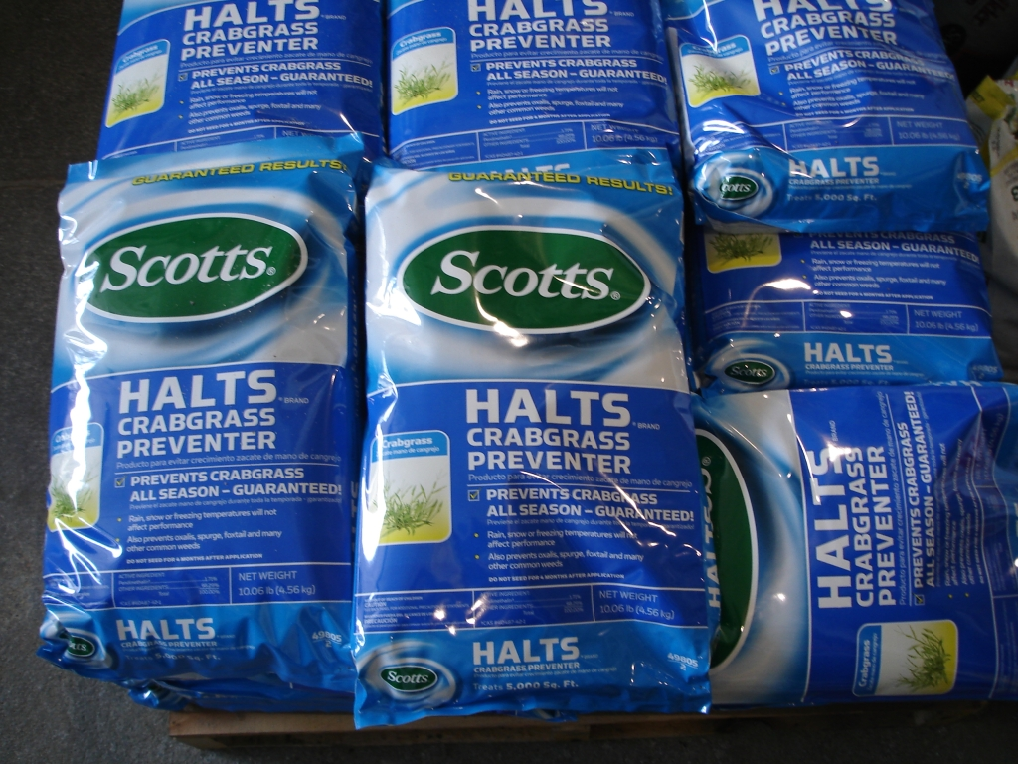
Turfgrass Preemergence Herbicides w/o Fertilizer
Benefin / Trifluralin
Pendimethalin

Slide 39
Pre-emergent Herbicides in Ornamentals
Surflan (oryzalin)
Treflan/ “Preen”(trifluralin)
Snapshot (trifluralin and isoxaben)
XL (benefin and oryzalin)
Casoron (dichlobenil)
Notes:
Surflan is only available as a sprayable. Treflan is available primarily as a granular, and both Treflan and Surflan control a similar spectrum of weeds. Snapshot and XL are both granular herbicides that control a broad spectrum of annual grass and broadleaf weeds. Both of Snapshot and XL contain two preemergent herbicides to give the products a broader spectrum of weed control. Casoron can only be used in certain woody ornamentals, but provides excellent control of many difficult to winter weeds (Example = Florida Betony). All of these herbicides can be gotten at your local farm supply store, but may have to be ordered.

Slide 40
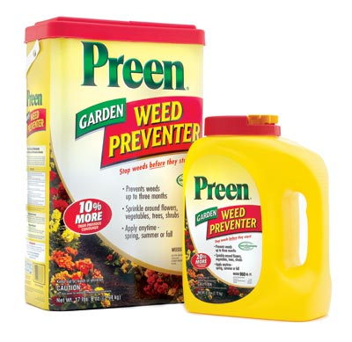
Preen Garden Weed Preventer
1.47% Trifluralin

Slide 41
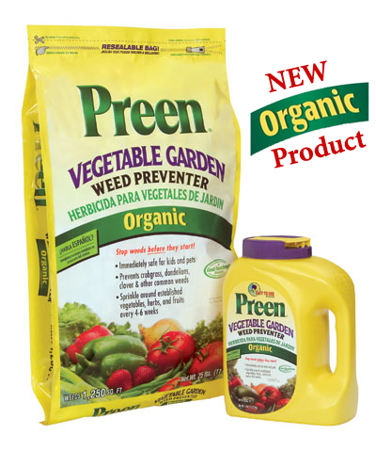
Preen Vegetable Garden Weed Preventer
100% Corn Gluten

Slide 42
Postemergent Herbicides
Is RoundUp Still Round Up??
Notes:
Refer to slide

Slide 43
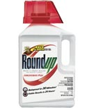
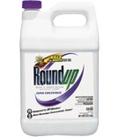
Round Up
Roundup Weed and Grass Killer Concentrate Plus
18% glyphosate
.73% diquat
Roundup Weed and Grass Killer Super Concentrate
50.2% glyphosate

Slide 44
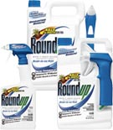
RoundUp Grass and Weed Killer RTU (Ready to Use)
Confused yet?
  They took the diquat out of the “RoundUp Grass and Weed Killer Plus” concentrate but put in Sythe.
2% glyphosate
2% pelargonic acid (Sythe)

Slide 45
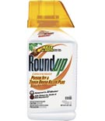
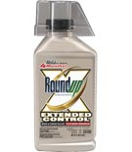
More Roundup Labels…
Roundup® Extended Control Weed & Grass Killer Plus Weed Preventer Concentrate
18% Glyphosate
.73% Diquat
.3% Imazapic
Roundup® Poison Ivy & Tough Brush Killer Plus Concentrate
2% Triclopyr
18% Glyphosate
Notes:
Triclopyr increases the control of brush species
Imazapic is an Imidazolinone herbicide that has a soil half life of 120 days and is useful in forestry situations.

Slide 46
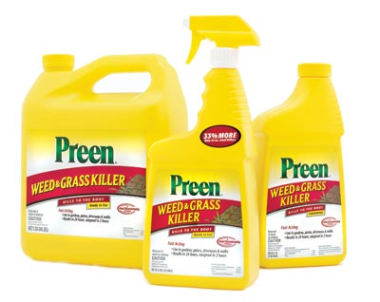


More Glyphosate labels…

Slide 47


More Glyphosate labels…

Slide 48


More Glyphosate Combo Products
Ortho® Season-Long MAX™ Weed & Grass Killer Plus Preventer Concentrate
8% Glyphosate
1.5% Oxyfluorfen
.1% Diquat
Ortho® GroundClear® Complete Vegetation Killer Concentrate
.08% Imazapyr
5% Glyphosate

Slide 49


Bayer Advanced™ PowerForce® Grass & Weed Killer Concentrate
5.78% Glufosinate
Non-selective
Contact kill
Notes:
Glufosinate was discovered by the Japanese in 1972 as a byproduct of the soil bacterium Streptomyces.
It is mostly contact kill with symptoms appearing in 1-2 days >50 degree F

Slide 50

Diquat

Slide 51


Prometon ***Caution***
Notes:
Soil Sterilants *** Be careful active in the soil for up to a year, may move offsite.
Triazine family PSII inhibitor

Slide 52
Selective Turf Herbicides

Slide 53
2,4-D Mixtures
Does not control weedy grasses
Good - dandelion, plantains, wild garlic
Poor to fair – common chickweed, henbit
Use on all turfgrasses except St. Augustine
Example = Weed-B-Gon
Notes:
Refer to slide. Available in many formulation (sprayable and granular). Be sure to keep spray drift off of desirable plant material.

Slide 54

Ortho® Weed-B-Gon MAX® Weed Killer For Lawns Concentrate
13.72% MCPA
1.56% Triclopyr
1.35% Dicamba
Most cool and warm season turf
Do not use on:
  Centipede
  St. Augustinegrass

Slide 55

Ortho® Weed-B-Gon® For Southern Lawns Concentrate
5.3% MCPP
3.05% 2,4-D
1.3% Dicamba
Centipedegrass
Bahiagrass
Bermudagrass
Fescue
St. Augustinegrass
Do not use on:
  Floratam St. Aug.

Slide 56

Ortho® Weed-B-Gon® Chickweed, Clover and Oxalis Killer for Lawns
8% Triclopyr
Fescue
Bluegrass
Zoysia
Do not use on:
  Centipede
  Bermuda
  St.Augustine
  Bahia
Notes:
Triclopyr is pyradine compound similar to 2,4,5-T (Agent Orange without the dioxin problem)

Slide 57

Ortho® Weed-B-Gon® Crabgrass Killer For Lawns Concentrate
8.4 Calcium acid methanearsonate
Do not use on
  Centipede
  St. Aug.
  Bahia

Slide 58

Bayer Advanced™ All-in-One Weed Killer for Lawns Concentrate
9.8% MSMA
3.18% 2,4-D
1.6% Mecoprop
.79% Dicamba
Bermuda (<90)
Zoysia
Fescue (<85)
Bluegrass
Do not use on:
  Centipede
  St. Aug.
  Bahia

Slide 59

Bayer Advanced™ Southern Weed Killer for Lawns Concentrate
7.59% 2,4-D
1.83% Mecoprop
.84% Dicamba
Most cool and warm season turf
Do not use on Floratam St. Aug.
<85 degrees F.

Slide 60



Other 2,4-D Products

Slide 61


More 2,4-D Products
Be careful with Ester Formulations

Slide 62
Atrazine
Can be used on: Centipede, St. Augustine, Zoysia
Dormant bermudagrass
Cool-season grasses and bahiagrass are not tolerant
Comes in both sprayable and granular formulations
Depending on the weed, atrazine has both pre and post emergence activity
Notes:
Refer to slide!

Slide 63


Atrazine Products

Slide 64
MSMA DSMA CMA
Postemergence control of weedy grasses.
Use in tall fescue, zoysia, bermuda
Initially discolor tolerant turfgrass species.
Avoid application above 90º F.
Do not use on centipede and St. Augustine
Example = Ortho Crabgrass Killer Formula II
Notes:
Refer to slide. Only available in sprayable formulations. These herbicides may be removed from the market in the near future, because of the arsenic in their formulations. However this arsenic is in a very unavailable form, and these products have been on the market for 30+ years. There are no other herbicides that can replace these herbicides in many situations!

Slide 65



Crabgrass Killers
Notes:
MSMA and CAMA

Slide 66
Image for Crabgrass
35.78% MSMA
Ky Bluegrass
Bermuda
Tall Fescue
Zoysia
Do not apply to:
  St. Aug.
  Centipede

Slide 67
Image for Nutsedge
3.3% Imazaquin
Bermuda
Centipede
St. Aug.
Zoysia
Controls sedges, wild garlic, select broadleaf weeds

Slide 68
Image for St. Aug. and Centipede
4% Atrazine
St. Aug.
Centipede
Zoysia
Dormant Bermuda
Do not apply to:
  Cool Season Grasses
Controls:
  Broadleaf weeds
  Annual Bluegrass

Slide 69
Graminocides
Grass Killers
The “fops” and “dims”

Slide 70


Fluazifop
Ortho® Grass-B-Gon® Garden Grass Killer
.48% Fluazifop-P-Butyl

Slide 71


Sethoxydim
Notes:
Vantage is labeled for crabgrass control in Centipede.

Slide 72


Basagran
Notes:
Basagran controls a number of broadleaf weeds and yellow nutsedge in most turf and has a limited label allowing it to be sprayed over the top of certain ornamentals such as ivy and liriope.

Slide 73
Brush Killers

Slide 74


Bayer Advanced™ PowerForce® Brush Killer Plus Concentrate
8.8% Triclopyr
Hard to kill perennials and woody plants
Cut stump treatments

Slide 75

Spectracide Brush Killer
9.7% 2,4-D Ester
4.78% dicloprop
1.65% dicamba

Slide 76
Always read the herbicide label!
Notes:
Refer to slide

Slide 77
Credits:
Todd would like to expressly thank
Mark Czarnota, Nina Eckberg, & Tim Murphy with UGA for several weed control slides and concepts used in this presentation and to Virginia Tech Extension for their generous contribution of weed id photos.
The Virginia Tech Weed Id Website may be found at:
http://www.ppws.vt.edu/weedindex.htm
Notes:
Credits
Program brought to you by The University of Georgia Department of Horticulture and Crop and Soil Sciences

