Slide 1
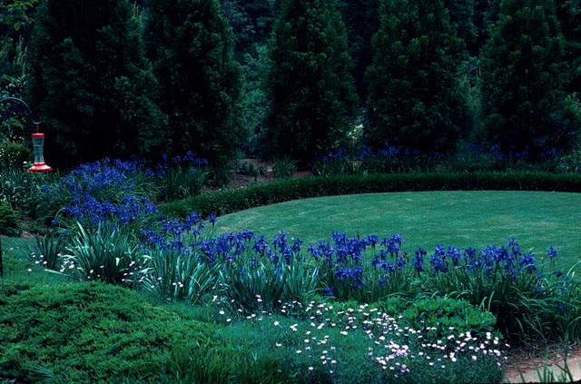
Part 2: Landscape Management
Notes:
69. Now that we’ve thoroughly analyzed the site, selected plants appropriate to the site, made changes to the site to fit the type of plants we want to grow, prepared the soil and planted properly, it’s time to think about landscape management and how we are going to properly care for the landscape

Slide 2
Fertilization
Notes:
70. Fertilization is confusing to a lot of people because there are so many types of fertilizers and fertilizer formulations from which to choose.

Slide 3
Types of Fertilizer
General-purpose
(10-10-10, 16-4-8)
Slow-release
Organic
Liquid
Notes:
71. General-purpose type fertilizers, such as 10-10-10 or 16-4-8, that you buy in 40 pound bags, are most widely used for landscape fertilization. (#) Slow-release fertilizers are formulated to release their nutrients over an extended period of time. They last longer in the landscape than general-purpose fertilizers, but they also cost more per pound. (#) Organic fertilizers, such as Milorganite and Bone Meal, also release nutrients slowly, but many lack certain nutrients or are low in nutrient content. (#) Then there are liquid fertilizers that are fast acting, and provide readily available nutrients to the plant. Liquid fertilizers tend to leach readily from the soil and have to be re-applied frequently. Each of these products has advantages and disadvantages.

Slide 4
Selecting a Fertilizer
Consider:
Cost
Type of plants to be fertilized
Site conditions
Growth response required
Soil test results
Notes:
72. The decision as to which of the fertilizer formulations to use will depend on a number of factors. (#) Cost is definitely one of them. Osmocote, for instance, is a micro-encapsulated slow-release fertilizer often used for annual flowers. It costs $2 to $3 per pound, while a general-purpose fertilizer costs just a few cents per pound. Therefore, a general-purpose fertilizer is more economically practical for fertilizing trees and shrubs. (#) One should also consider the type of plants to be fertilized. Annual flowers, for instance, have a high demand for nutrients throughout the growing season and will benefit from a fertilizer that releases its nutrients slowly throughout the season. On the other hand, established trees and shrubs absorb nutrients early in the growing season and will benefit from a general-purpose fertilizer applied at the beginning of the growing season. (#) The site conditions should also be considered. For instance, plants growing in shade generally require less fertilizer than those growing in the sun (#) Also consider the growth response desired. A newly planted ground cover, for instance, will benefit from an incorporated general-purpose fertilizer supplemented with weekly applications of a liquid fertilizer to encourage rapid establishment and growth. (#) Last, but not least, consider soil test results. A soil test is the most scientific way of determining which fertilizer formulation is best for your plants.

Slide 5
General Fertilization
16-4-8, 12-4-8
New Plantings
10-10-10, 8-8-8, 13-13-13
Notes:
73. Most plants in the landscape can be fertilized with one general-purpose type fertilizer, such as 16- 4- 8 or 12- 4- 8. Research has shown that phosphorus, the middle number in the analysis, is held readily by the soil and is not required in as large a quantity as nitrogen and potassium that tend to leach readily from the soil It has also been determined that about twice as much potassium (point to the 8 in the analysis) is needed as phosphorus. On new plantings, a complete, balanced fertilizer, such 10-10-10, 8-8-8 or 13-13-13 is often recommended to assure an abundant supply of all three nutrients during establishment.

Slide 6
Forms of Slow-release Nitrogen
IBDU (Isobutylene diurea)
Sulfur-coated urea
Ureaformaldehyde
Notes:
74. When purchasing a general-purpose fertilizer, look for one containing slow-release nitrogen, such as ammoniacal nitrogen, IBDU, sulfur-coated urea or ureaformaldehyde. These formulations help hold nitrogen in the soil and prevent it from leaching out with rain or irrigation.

Slide 7
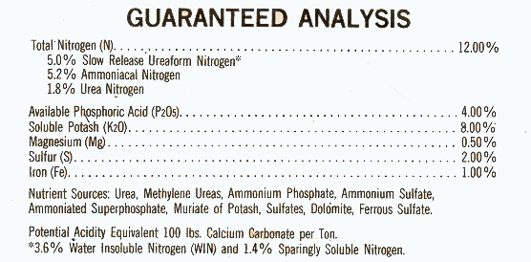
Get the most nutrients you can for your dollar
Notes:
75. Try to get the most nutrients for your dollar. This product contains not only nitrogen, phosphorus and potassium, but also magnesium, sulfur and iron. Also note that 5% of the nitrogen in this product is slow-release ureaform. The cost of a 40 lb. bag of this fertilizer was about fifty cents more than a 10-10-10 fertilizer containing only N - P - K, but it is the better value from the nutrient standpoint.

Slide 8
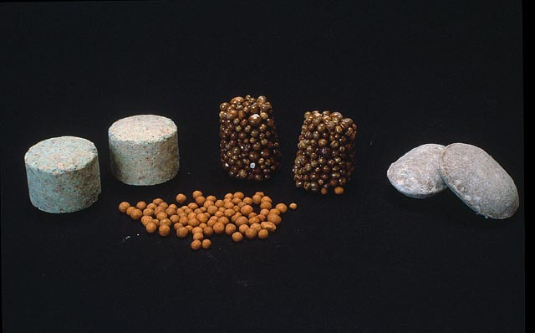
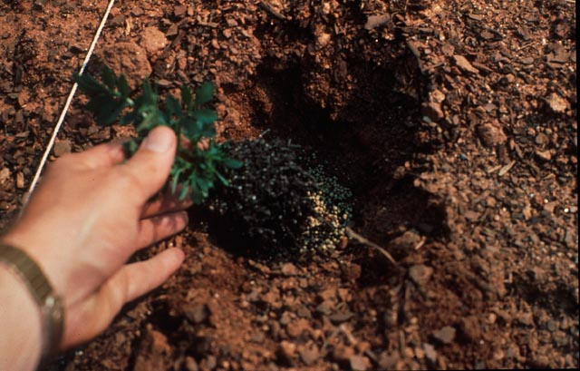
Notes:
76. Here are some examples of the slow-release fertilizer products on the market. The center foreground shows Osmocote, a micro-encapsulated slow-release fertilizer. Fertilizer is gradually released over several months through tiny pores in the BB-like coating. In the center back row are Osmocote pellets, a relatively new product consisting of Osmocote granules cemented together in the shape of a pellet. The pellets are sold in several sizes. Like convenience foods, they make fertilization more convenient because you don’t have to measure the granules- just toss a pellet in the planting hole. At the back left are Agriform tablets having a release duration of 12 to 18 months, while the product to the right is Woodace briquets, which have a release duration of up to two years. (#) One of the benefits of a slow-release fertilizer, such as Osmocote, is that it can be placed directly in the planting hole beneath the plant without burning the roots. Furthermore, by placing fertilizer in the hole instead of broadcasting it over the bed, weeds are likely to be less of a problem.

Slide 9
Nitrogen Uptake Throughout the Year
% Nitrogen Uptake
40
FULLY
OPENED
LEAVES
DORMANT
DORMANT
RAPID SHOOT GROWTH
30
MID-LEAF FALL
20
BUD SWELL
SHOOT GROWTH STOPS
10
JAN
FEB
MAR
APR
MAY
JUN
JUL
AUG
SEP
OCT
NOV
DEC
J.Amer.Soc.Hort.Sci. 103(4),1986.
Notes:
77. Plants generally absorb nutrients during the growing season, as this slide on nitrogen uptake shows. Notice how nitrogen uptake increases in March when the buds begin to swell, then increases as shoots and leaves begin to grow. It peaks in mid-summer, then begins a gradual decline as autumn approaches. Note that there is little uptake of nitrogen during December, January and February, so it would not be wise to fertilize during the winter months when plants are dormant because the fertilizer will simply leach from the soil and be of little benefit to the plant.

Slide 10
Fertilization Frequency
Depends on:
The type of fertilizer and its release duration
The type of plants being fertilized
The desired growth rate
Notes:
78. There is no cook-book formula for determining how frequently to fertilize. (#) It depends on the type of fertilizer you purchase and the release duration, (#) the type of plants being fertilized (#) and the desired growth rate.

Slide 11
Fertilizing Established Plants
How Much to Apply?
1 pound of nitrogen per 1,000 square feet
Notes:
79. Most fertilizer recommendations are given in pounds of nitrogen to apply per acre or per 1000 square feet. The same is true for turfgrasses and ornamentals. As a general rule on ornamental plants, 1 pound of nitrogen per 1000 square feet is recommended. Now, you might ask how to calculate the actual amount of product to use to provide this amount of nitrogen.

Slide 12
16-4- 8
10/16 = 0.6 lbs. per 100 sq. ft.
2 cups of dry, granular fertilizer = 1 lb.
Therefore, approximately 1 cup (1/2 lb.) of 16-4-8 will be needed per 100 sq. ft. of bed area.
Notes:
80. To do this, divide the first number in the analysis, the nitrogen content, into the number 10, a constant, to arrive at the rate per 100 square feet. For a 16-4-8 fertilizer, the rate would be 0.6 lbs. per 100 square feet, or approximately ½ lb. (#) For dry granular fertilizers, approximately 2 cups = 1 pound. Therefore, in this example, approximately 1 cup of 16-4-8 fertilizer would be applied over each 100 square feet of bed area.

Slide 13
50 ft.
5 ft.
5 ft. x 50 ft. = 250 sq. ft.
16 - 4 - 8 = 0.6 lbs./100 sq. ft.
0.6 x
100 250
=
X = 1.5 lbs. (3 cups)
Notes:
81. Let’s say you have a landscape bed that looks like this and you want to know how much 16-4-8 fertilizer to broadcast over the bed. (#) The length of the bed is approximately 50 feet (#) and the width is approximately 5 feet. Of course, the bed is not a perfect rectangle ( few landscape beds are), but notice how it is a little wider than 5 feet on one end and a little narrower than 5 feet on the other end. (#) So we’re going to estimate that this bed contains approximately 250 square feet. (#) The application rate of a 16-4-8 fertilizer to apply the 1 lb. of nitrogen per 1,000 sq. ft. is 0.6 lbs. per 100 sq. feet. (#) To find out how much we need for 250 square feet, we set up a proportion like this. If we need 0.6 lbs per 100 sq. feet, how much do we need per 250 sq. ft.? (#) Cross multiplying and solving for X, the answer is 1 ½ lbs. or approximately 3 cups. So 3 cups of the 16- 4 - 8 fertilizer would be evenly broadcast over the bed.

Slide 14
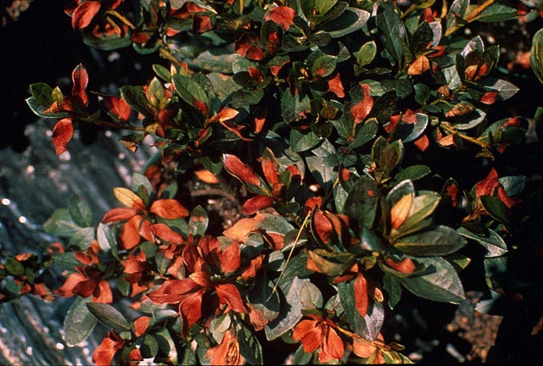
Notes:
82. Applying fertilizers at the recommended rate is very important because it will prevent injury like this. The fertilizer was thrown haphazardly by the hand-full under this azalea. Fertilizers are chemically salts and can cause significant damage to the roots of plants when they are applied at too high a rate. When the roots are injured, foliar burn like this becomes evident.

Slide 15
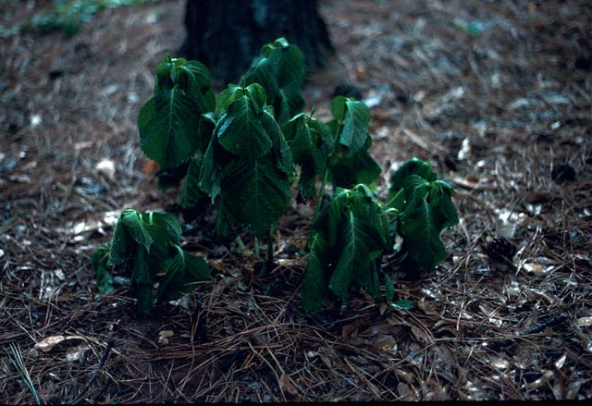
Never Fertilize Stressed Plants
Notes:
83. Never fertilize plants stressed by drought, excess moisture, or some other environmental or cultural factor. Until the environmental or cultural factor can be corrected, fertilizing will simply make the problem worse.

Slide 16
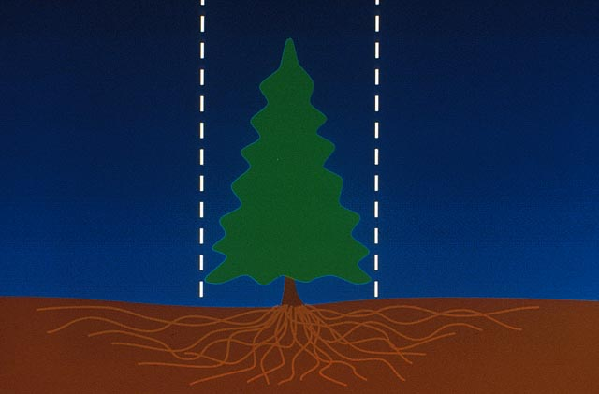
Fertilize
Fertilize
4 ft.
4 ft.
Notes:
84. Most of the absorptive roots on a tree are within an area extending about 4 feet from the trunk to 1 ½ times the canopy spread. Research in Florida has shown that roots of well-established trees can extend as much as 3 times the canopy spread. Therefore, begin broadcasting fertilizer about 4 feet from the trunk and extend the fertilizer beyond the drip line or tips of the canopy, if possible. There are few absorptive roots within 4 feet of the trunk, so avoid applying fertilizer close to the trunk.

Slide 17
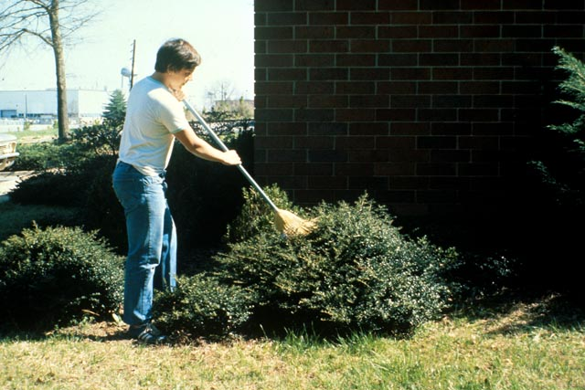
Notes:
85. Always broadcast granular fertilizers when the foliage of shrubs is dry, and use a rake or broom to brush it off the foliage. It is not necessary to remove the mulch when fertilizing. It will dissolve and make its way to the roots. However, it’s best to irrigate thoroughly soon after applying fertilizer to wash the any residual fertilizer off the foliage and to begin dissolving granules and getting the nutrients to the root zone.

Slide 18
Questions?
Notes:
86. (#) Let’s pause here and see if anyone has a question or comment about fertilizers and fertilization.

Slide 19
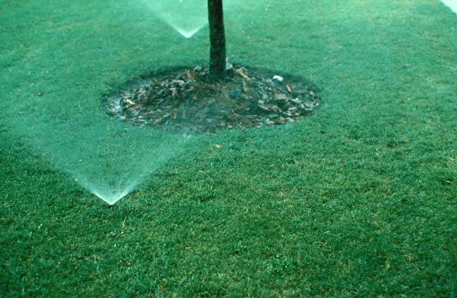
Irrigation
Make Every Drop Count
Notes:
87. Now let’s talk briefly about landscape irrigation. Water supply problems are an on-going concern during the summer months in Georgia. Periodic drought and growing population in urban areas make the problem worse. It’s important that we all do our part to “Make Every Drop Count”.

Slide 20
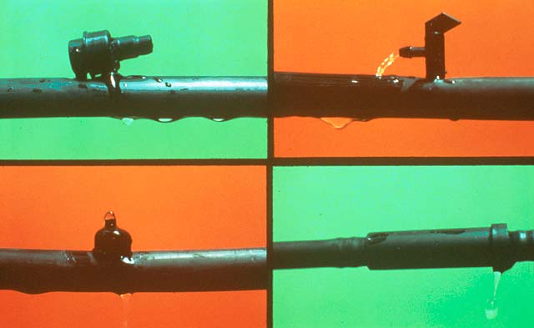
Drip Irrigation
Uses 30% to 50% less water than sprinkler irrigation
Avoids spraying foliage so diseases are less likely to occur
No spray drift
Only need to water 25% of the root area
Notes:
88. Drip irrigation is an efficient way of irrigating ornamental plants in the landscape. (#) It uses 30% to 50% less water than sprinkler irrigation. (#) It avoids spraying water on foliage, so foliar diseases are less likely to occur. (#) Also, there is no spray drift and water loss with drip irrigation, (#) and you only need to water about 25% of the root system to provide the plant’s water needs. Water is very mobile once it is inside the plant, and moves readily to areas where it is needed.

Slide 21
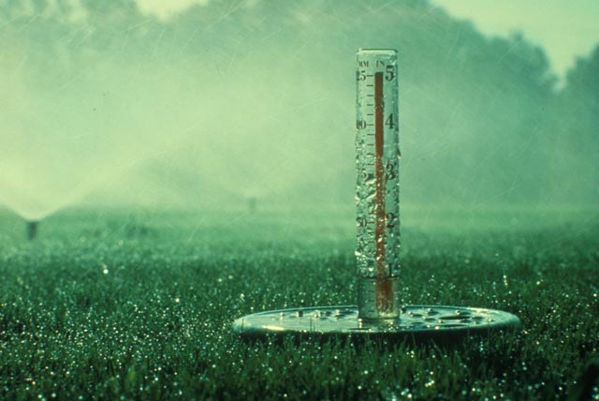
Monitor the Output of Your Sprinkler System
Notes:
89. Sprinklers are currently the best choice for turfgrass irrigation. When using a sprinkler system, be sure to monitor the output of your system by setting several rain gauges or cans throughout the turfgrass area and turning the system on for a timed interval. Then calculate the amount of water applied per hour. This is also a good way to check for uniformity in the application rate. If the system was designed and installed correctly, all parts of the turf area should be receiving the same amount of water.

Slide 22
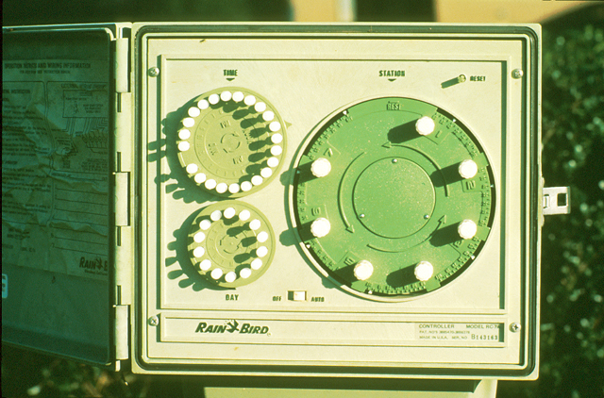
Adjust timers frequently according to changes in rainfall patterns
Notes:
90. If the operation of the sprinkler system is controlled with a time clock, make certain the operation times are changed frequently, according to changes in rainfall patterns. Applying an inch of water soon after a 1-inch rainfall is wasteful.

Slide 23
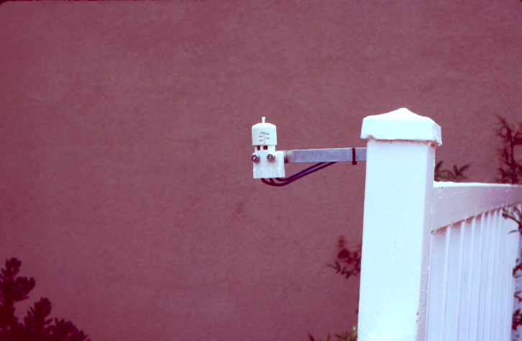
A low-cost rainfall sensor will prevent the irrigation system from running during rain
Notes:
91. All sprinkler systems should include a rainfall sensor device that detects rainfall and prevents the system from running during rain. Master Gardeners are supposed to set the example for others in their neighborhood, and irrigating during rain is not a good example.

Slide 24
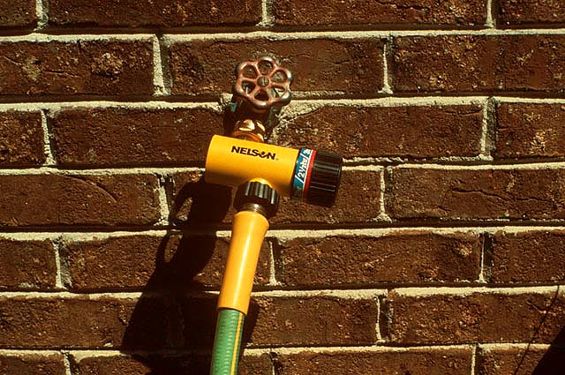
Notes:
92. If an oscillating lawn sprinkler is used instead of an in-ground irrigation system to irrigate turfgrass, an irrigation timer is a wise investment. Once you determine the output of your system and how long you need to let the water run to apply the desired amount of water, the timer can be set to turn the system off when the right amount of water has been applied.

Slide 25
Target irrigation to plants that show signs of stress
Gray/green Color
Wilting
Dying Branches
Use a hand-held hose with water breaker or a sprinkler can to target irrigation to plants that need water
Notes:
93. It’s important to remember that not all plants in the landscape need irrigation. Ideally, 60% or more of the plants in your landscape should be watered by Mother Nature. Most well-established and healthy trees and shrubs can survive extended periods of limited rainfall without supplemental irrigation. It’s a wise conservation practice to target your irrigation to plants that show signs of stress. (#) Watch for gray/green foliage, wilting or dying branches as an indicator of drought stress, and direct water to plants that show symptoms of moisture stress. (#) A hand-held hose with an attached water breaker is an efficient method for targeting irrigation to plants that need water. However, make certain water is applied at a rate at which the soil can absorb it. Applying water too rapidly results in run-off and provides little benefit to the targeted plants.

Slide 26
For most efficient use of water, irrigate between 9 pm and 9 am to avoid evaporative loss of water.
Avoid light, frequent irrigation because it encourages shallow rooting and increases water demand of the plant.
Notes:
94. For most efficient use of water, irrigate between 9 pm and 9 am to avoid evaporative loss of water. Irrigating during these times does not promote foliage diseases, because the foliage is usually moist anyway from the night-time dew. (#) Also, avoid light, frequent irrigation because it encourages shallow rooting and increases water demand of the plant. When you do water, water thoroughly to saturate the root zone to a depth of 12 inches.

Slide 27
Questions?
Notes:
95. (#) Now, let’s pause and see if you have any questions or comments about landscape irrigation.

Slide 28
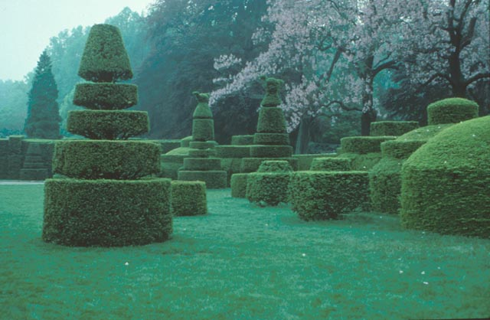
Pruning
Notes:
96. No lecture on landscape management would be complete without a thorough discussion of pruning. Pruning involves both science and art - it requires a scientific understanding of how plants respond to various pruning cuts and an art in actually making the cuts appropriately to maintain plant health and proper wound healing.

Slide 29
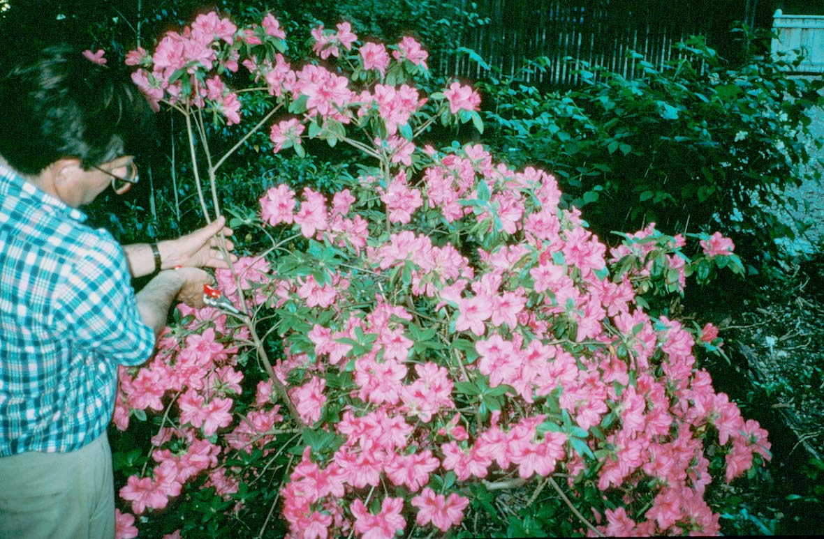
Why Prune?
Notes:
97. First and foremost, we should prune with a purpose. Never prune just for the sake of pruning. Azaleas, for instance, are typically pruned after they bloom, but that does not mean they have to be pruned after bloom. If the plants have a desirable growth habit, size and shape, they may not need pruning at all! The azalea in this picture had produced some lanky growth that was out of proportion with the rest of the plant, so pruning was necessary to shape the plant.

Slide 30
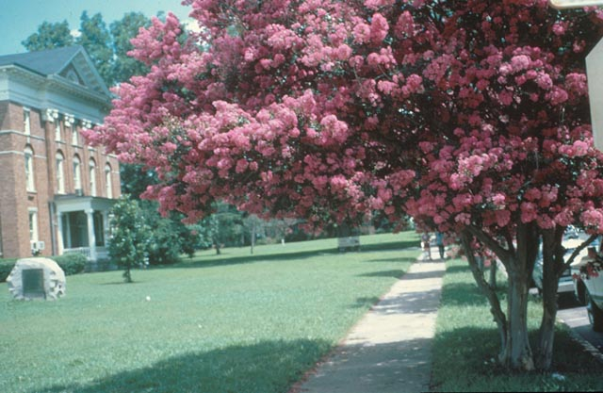
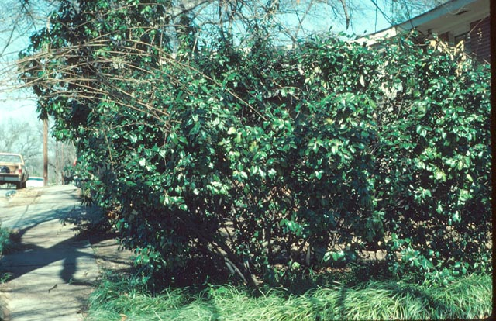
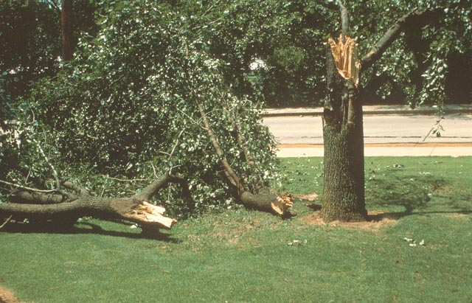
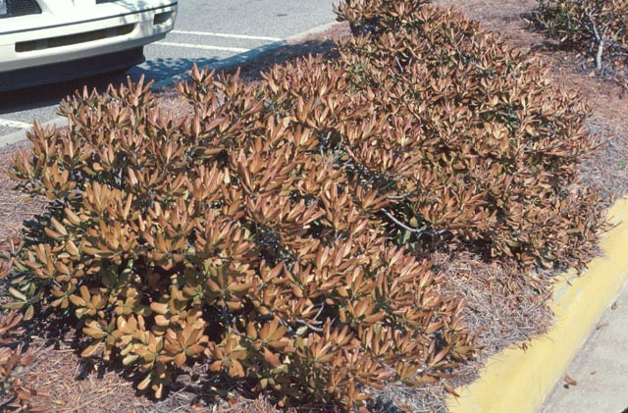
Notes:
98. Sometimes, we must prune plants that are planted too close to walkways or drives and interfere with traffic flow. (#) Vigorous growing plants often require pruning to maintain a desired size or shape and to keep them within the scale of the surrounding landscape. (#) Sometimes, Mother Nature prunes for us via wind or ice storms. (#) Still other times we have to prune plants that have been damaged by extreme winter cold.

Slide 31
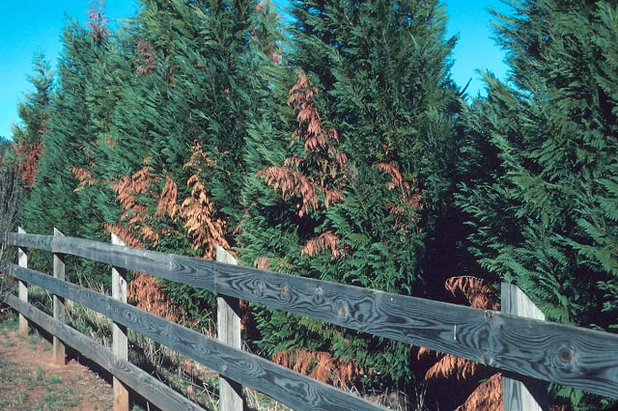
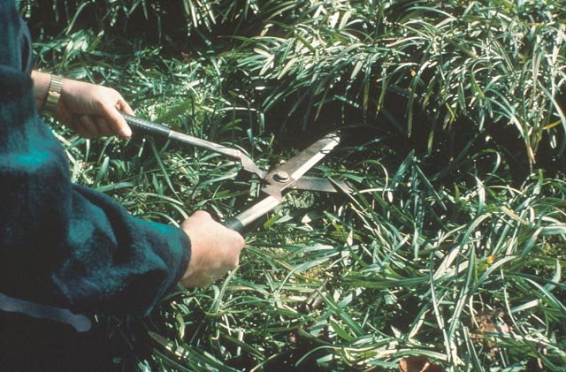
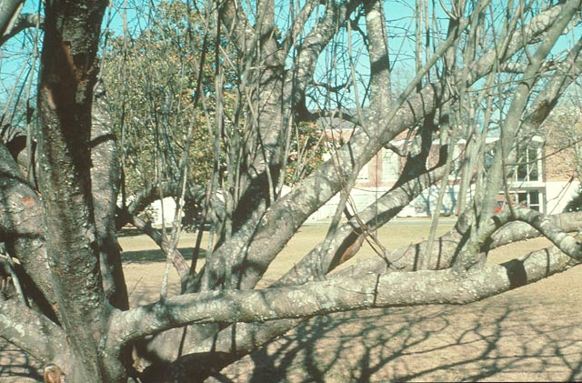
Notes:
99. Sometimes we prune to remove dead, diseased or damaged wood from plants. In this example, Bot Canker disease had infected these Leyland Cypress trees and was causing selected branches to turn brown and die. (#) Other times we prune plants to remove winter foliage and make way for new spring growth. Liriope and ornamental grasses are two examples of this type of pruning. (#) Some trees, like ornamental crabapples and plums, form vigorous upright shoots, called water sprouts, from their main branches. These detract from the appearance of the tree and are best pruned out when they are young.

Slide 32
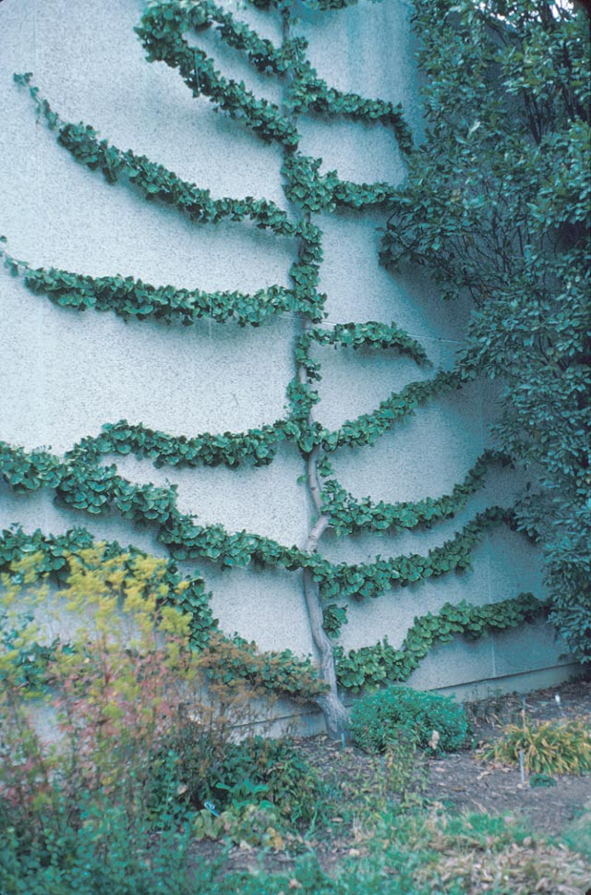
Espalier
Notes:
100. Espalier is a French art form in which plants are trained to grow along a wall or arbor. This photo shows a Ginkgo tree that has been trained to grow along a wall. Espalier is high maintenance pruning.

Slide 33
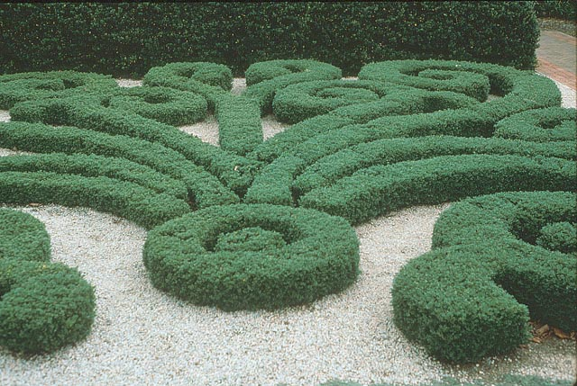
Notes:
101. Artistic pruning is sometimes done in public gardens to create focal points. Chemical plant growth regulators are often sprayed on the plants to reduce their pruning requirements.

Slide 34
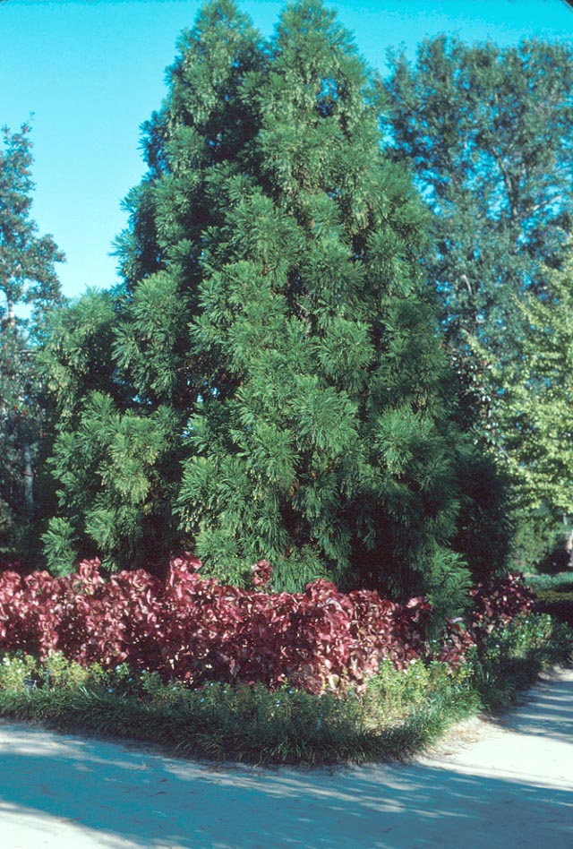
Notes:
102. Finally, some plants, like these Japanese Cedars, develop a pyramidal growth form with little to no pruning. Again, always prune with a purpose in mind.

Slide 35
Three T’s for Proper Pruning
Using the appropriate TOOL
Using the correct TECHNIQUE
Pruning at the right TIME
Notes:
103. Once you establish a reason for pruning, then it’s important to know the three T’s for proper pruning: (#) Using the right TOOL for the pruning task, (#) Using the correct TECHNIQUE to accomplish your objective, (#) and pruning at the right TIME to minimize cold damage or to avoid removing flower buds.

Slide 36
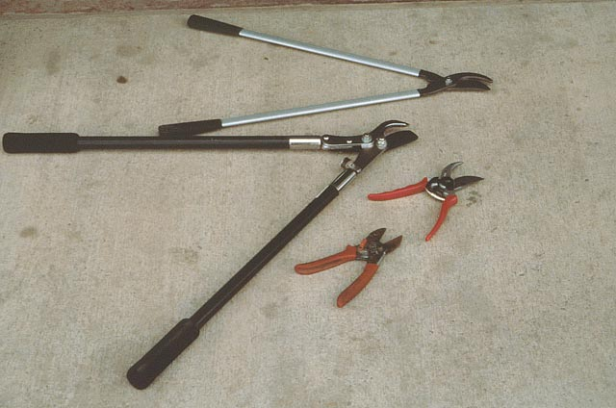
Loppers
Scissor-cut
Anvil-cut
Hand Pruners
Notes:
104. For clean cuts, always use the right tool for each pruning task. For cuts pencil size or smaller, (#) use hand pruners. There are two basic types of hand pruners: (#) scissor-cut pruners and (#) anvil-cut pruners. Scissor-cut pruners have two sharpened blades that cut like scissors, while anvil-cut pruners have one cutting blade and a flat, anvil-like surface that the blade cuts against. Scissor-cut pruners are better for herbaceous stems since the anvil-cut shears tend to crush the tissue. (#) Loppers, or lopping shears, are used to cut branches larger than a pencil up to two inches in diameter. Loppers are available with metal handles (top) or wooden handles (bottom).

Slide 37
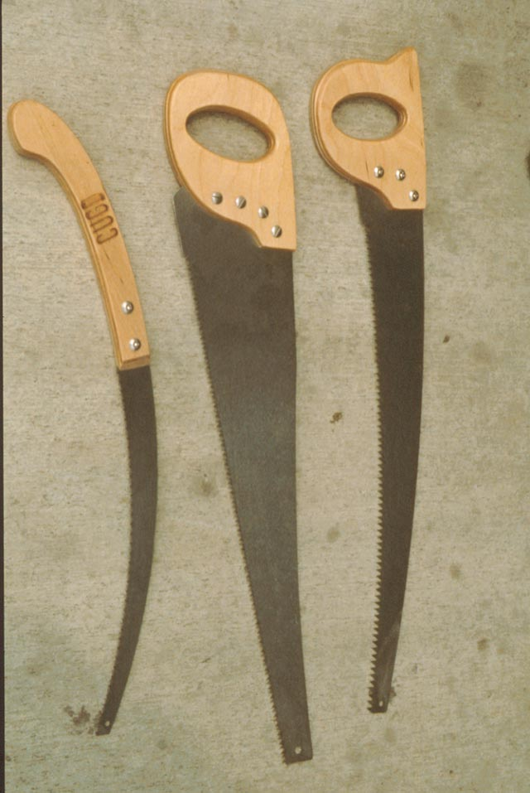
Notes:
105. Pruning saws generally have coarser teeth than carpenter saws and are designed to cut on both the pull stroke and push stroke for greater cutting efficiency. Saws with narrow blades are handy for maneuvering within tight spaces.

Slide 38
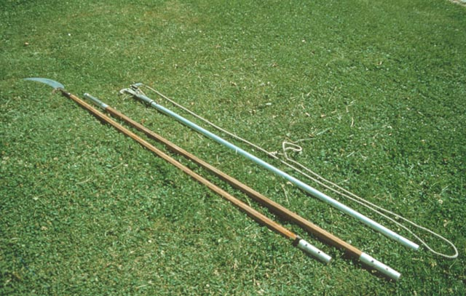
Pole Pruner
Notes:
106. Pole pruners are used to remove tree limbs and branches beyond reach from ground level. They are available with both wooden handles and telescoping metal handles. A cutting blade at the top is controlled by pulling on a rope, called a lanyard, from ground level. Most pole pruners also have a saw at their end for removing branches larger than the cutting blade can cut.

Slide 39
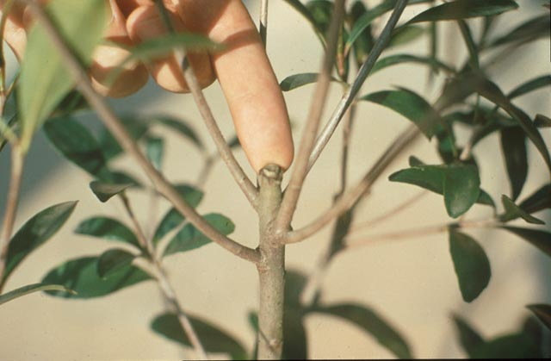
Basic Principle of Pruning
Most re-growth occurs within 6
to 8 inches of the cut
Apical Dominance
Auxin
Notes:
107. Before pruning, it’s important to understand a basic botanical principle of pruning. That is that most of the re-growth occurs within 6 to 8 inches of where the cut is made. (#) Botanically this phenomenon is called “Apical Dominance” and it is influenced by a hormone (#) called auxin produced within the terminal bud of plants. Auxin inhibits lateral bud growth as long as the terminal bud is intact, but when the shoot tip and auxin inhibitor are removed, the buds or shoots closest to the cut are signaled to grow vigorously

Slide 40
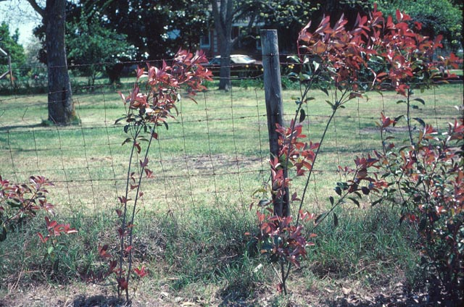
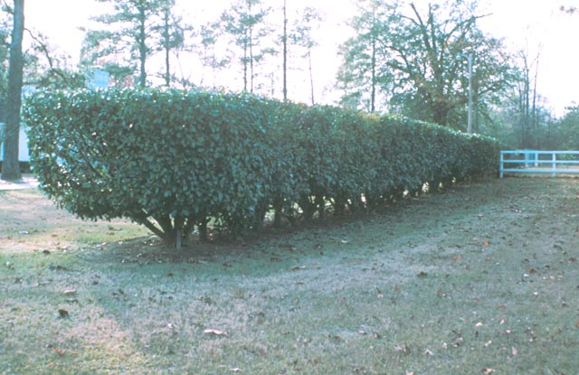
Notes:
108. Notice where the new growth occurred when these plants were pruned. They were planted to become a hedge, but very little growth will occur at the bottom, (#) so as the plants mature, the hedge will be bare at the bottom, as if it were standing on legs.

Slide 41
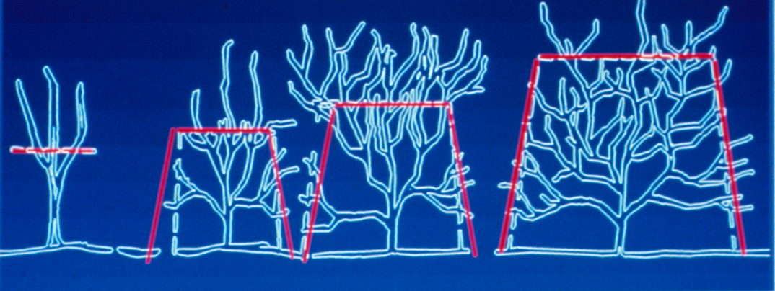
Formal Hedge Pruning
6 - 8 in.
Planting
Year 1
Year 2
Year 3
Notes:
109. When planting a hedge, it may be necessary to prune the plants to within 6 to 8 inches of ground level to encourage branching (if they are already well branched at the base, this is not necessary). (#) If a formally pruned hedge is desired, begin tapering the new growth in a pyramidal shape. This allows light to reach the lower canopy and helps maintain growth in the lower canopy. (#) (#) Continue this pyramidal type pruning with each new flush of growth until the desired height is achieved..

Slide 42
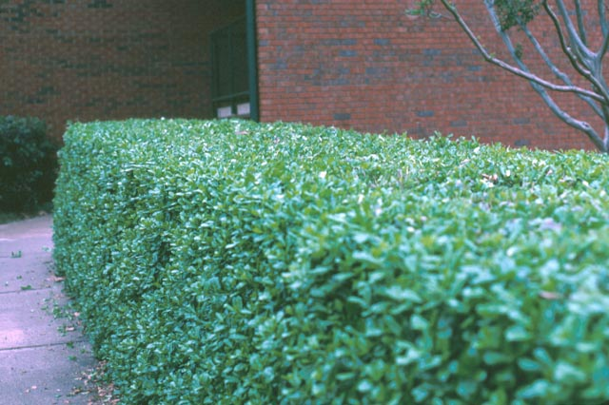
Notes:
110. This Dwarf Burford Holly was pruned in a formal, pyramidal form. Notice how the growth remained thick and dense throughout the canopy.

Slide 43
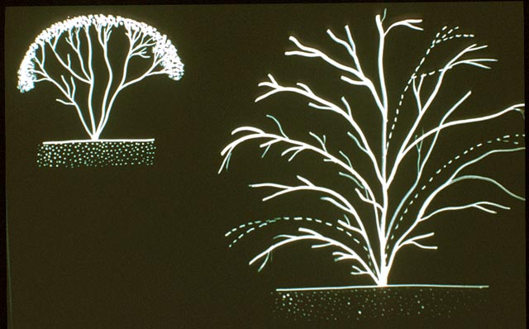
Heading
Pruning
Technique
Thinning
Notes:
111. There are two basic types of pruning techniques.... (#)HEADING , and (#) THINNING. Heading is the indiscriminate cutting of branches back to the same level. Shearing is an example of heading. Many small-leaf evergreen shrubs are sheared in the landscape. Thinning, on the other hand, refers to the removal of selected branches within the canopy back to the main trunk, a side branch or bud. Heading results in a more formal appearance while thinning results in more informal appearance.

Slide 44
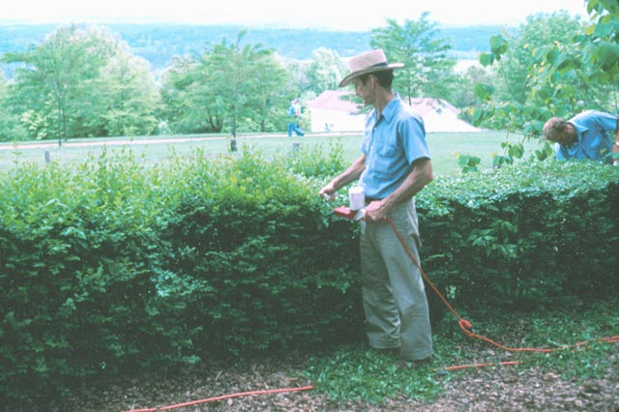
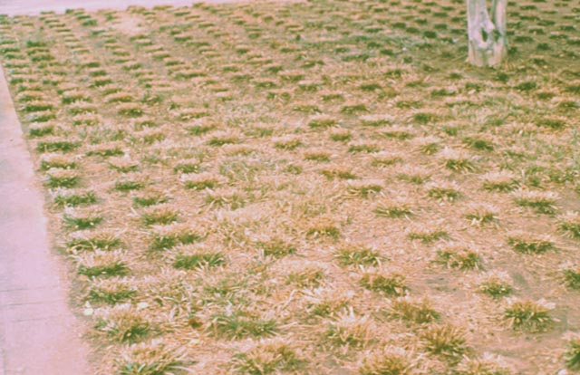
Notes:
112. Shearing hedges into a formal shape is an example of heading. (#) On liriope, it’s a common practice to set the lawnmower in the highest wheel setting and mow off the previous year’s growth at the end of winter. This is another example of heading. Liriope pruning is done prior to spring growth - early February in south Georgia and late February in north Georgia.

Slide 45
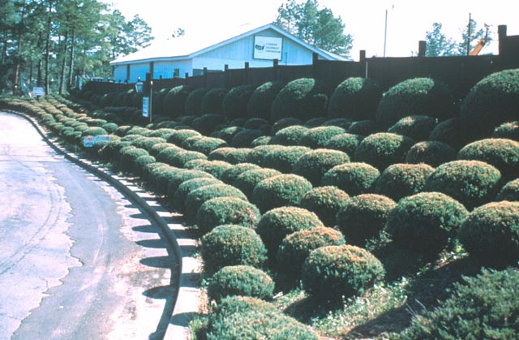
Notes:
113. Avoid shearing plants whenever possible, because it results in a thick, dense outer canopy and reduces air circulation within the plant. As a result, plants are more prone to insect and disease problems. It is also high maintenance - once you shear plants, you’ll have to keep shearing them frequently to maintain their shape. That’s fine if you want to be a slave to your landscape. Can you imagine the maintenance requirements of this landscape? If you’re not careful, shearing will result......

Slide 46
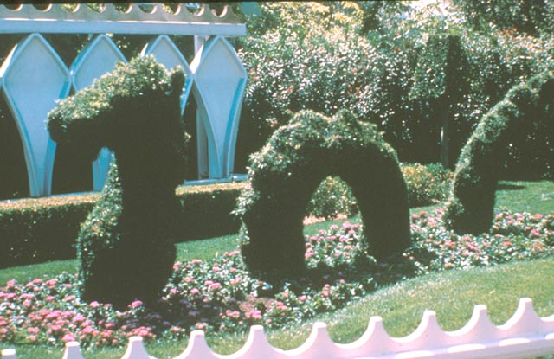
Notes:
114. … in a landscape monster that will require every minute of your spare time, just to keep it looking good.

Slide 47
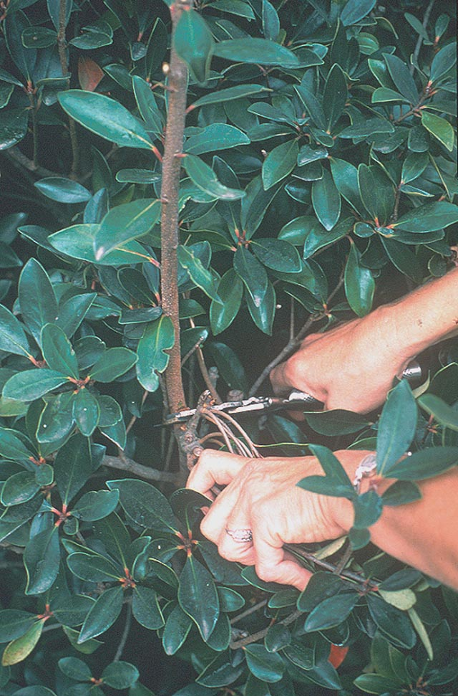
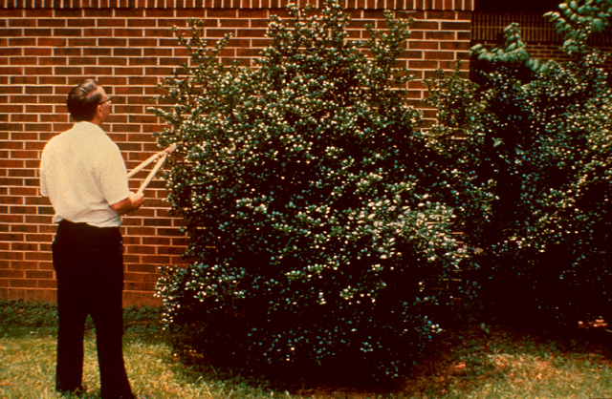
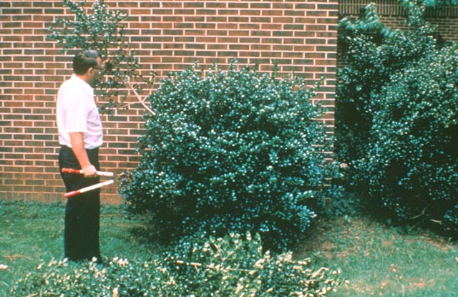
Notes:
115. Selective thinning is not only is better for the health of the shrub, it results in a more informal, natural appearance and is lower maintenance than heading. (#) This holly plant needed to be reduced in size and shaped a little. (#) With thinning cuts, a natural-looking growth form was maintained and the plant canopy was reduced in size. The plant may only need pruning once or twice a year.

Slide 48
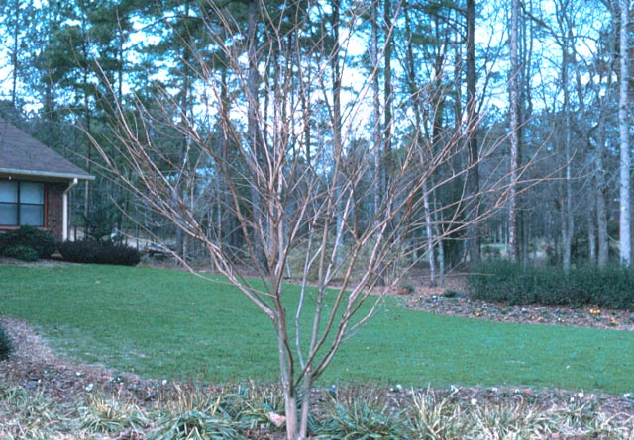
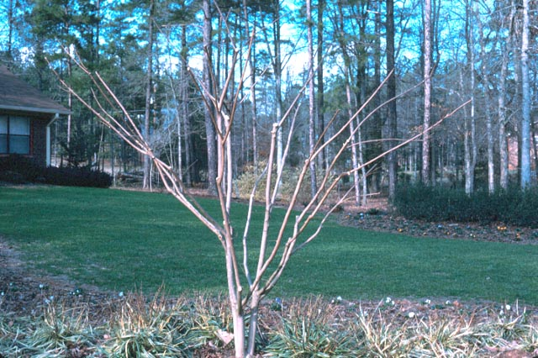
Crepe Myrtle Pruning
Before Pruning
After Pruning
Notes:
116. Many woody ornamentals in the landscape are pruned using a combination of thinning and heading cuts. Crape myrtle, for instance, is a striking accent plant when pruned in tree-form with 3 to 5 main trunks. (#) Selective thinning is done to remove branches growing inward, branches rubbing other branches, and generally to open up the canopy. Then, a few heading cuts are done back to a side branch or bud to maintain form and balance of the canopy.

Slide 49
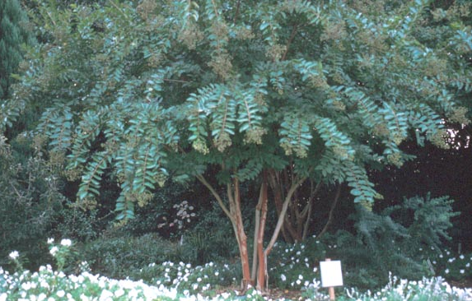
Notes:
117. Careful, selective pruning results in long cascading branches and a beautiful form the following growing season. Notice also how the canopy has been raised to show off the attractive exfoliating bark.

Slide 50
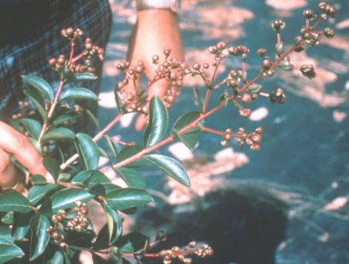
Notes:
118. Some crape myrtles that bloom early can be forced to bloom a second time by pruning off the seed clusters after the first flush of bloom. This diverts the energy of the plant from forming seeds into new growth and flowers. Use hand pruners to cut just below each seed cluster. This is a time consuming process and is not essential to the health of the plant, but the repeat bloom in late summer may make it worth the effort.

Slide 51
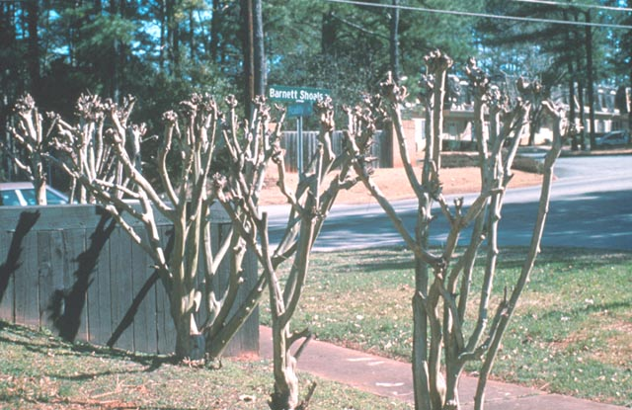
Notes:
119. Crape myrtle is one of the most abused plants in the landscape. It’s common to see it pruned like this each year. In the landscape industry, this is referred to as “crape murder”! (#) Please avoid this type of pruning. It results in masses of thick, dense growth that encourages aphid and sooty mold problems in spring. It also is unsightly in the winter and makes the landscape looked butchered.

Slide 52
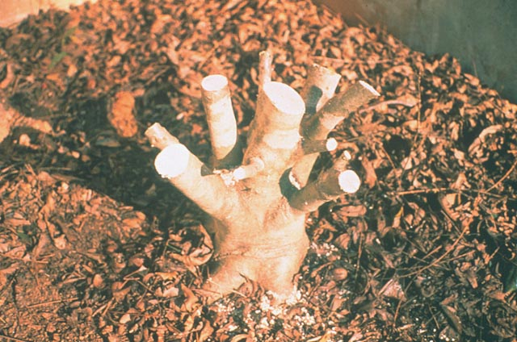
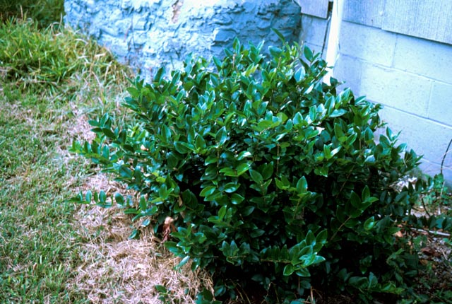
Renewal Pruning
Never do renewal pruning in fall or early winter
Do renewal pruning 4 to 6 weeks before spring growth begins
Notes:
120. An extreme form of heading is called RENEWAL PRUNING. This is sometimes done on established broadleaf evergreen shrubs that have grown too large for their location. Renewal pruning involves cutting back the main trunk and branches to within 8 to 12 inches of ground level. (#) Renewal pruning should not be done in fall or early winter before the plants are fully dormant, because tender new growth may emerge and be damaged by winter freezes. (#) The best time to do renewal pruning is 4 to 6 weeks prior to the spring growing season. (#) By mid-summer of the following year, an abundance of new growth will occur. Prune as necessary to shape the new growth.

Slide 53
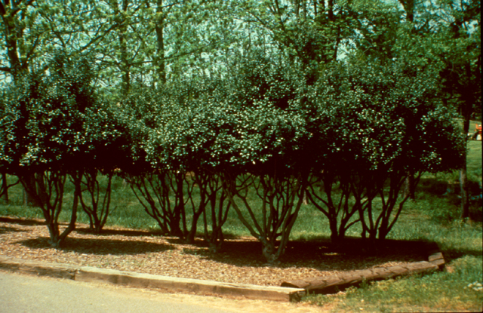
Notes:
121. Renewal pruning may not always be necessary. For instance, these Burford Holly plants had gotten large and were creating a visibility and security problem in this city park. However, instead of rejuvenating the plants, the lower branches were removed and the canopy was raised. This resulted in an attractive growth form and improved the visibility into the park. Often overgrown shrubs can be shaped into small trees that provide interest and accent in the landscape.

Slide 54
Renewal Pruning
Year 1:
Remove half the growth
Thinning and heading cuts
Year 2:
Remove other half of old wood
Shrub is now smaller
Notes:
122. Still another approach to renewal pruning that is less drastic, is to bring back the canopy gradually over a period of two to three years. In this example, the red lines indicate the branches that are removed. In year one, about half of the growth is removed with thinning and heading cuts. (#) The next year, the other half of the old wood is removed. (#) The result is a smaller shrub that continues to provide visual interest throughout the renewal period. Consider this technique when you need to reduce the height of shrubs in high visibility areas.

Slide 55
Do Not Severely Prune
Conifers (Pine, Spruce, Juniper) Boxwood
Notes:
123. Certain landscape plants do not respond well to renewal pruning. Conifers, including pine, spruce and juniper, are not capable of forming new growth from old wood. If you prune these plants back to old wood, a lower branch will try to become dominant, but no new growth will form adjacent to the cut. Boxwood is very slow to re-grow once it is severely pruned, so renewal pruning over time is better than drastic pruning all at once on this plant.

Slide 56
Deciduous
Tree
Pruning
Notes:
124. Now let’s turn our attention to pruning of deciduous trees. Major pruning of deciduous trees is done during the winter time. During winter, the tree has no leaves and it’s easier to see the limb arrangement and determine where to make cuts. Insects and diseases are also less of a problem in winter, so there is less chance of infection of the wound.

Slide 57
Notes:
125. Before pruning a deciduous tree, stand back and look at it a few minutes and determine which branches need removal and where you will make the cuts. (#)(#) (#) (#) First, remove any root suckers and any sprouts lower than the main scaffold branches. (#) Remove any low-growing branches that may interfere with maintenance or pedestrian traffic. (#) (#) (#) Remove any water sprouts, which are upright vigorous growths along the main branches. Certain trees, such as plums and crab apples, tend to form water sprouts more readily than other trees. (#) Remove any inward-growing branches that are rubbing other branches. (#) Determine which branch is the leader branch (usually this is the most upright, vigorous branch in the top of the tree) and remove adjacent branches that may compete with the leader branch. (#) Then it’s a matter of making selective thinning cuts to balance the framework of the tree. (#) (#) (#) Remember to cut back to a side branch or bud and avoid leaving a stub. (#) The end result is a well-shaped tree and a beautiful addition to the landscape.

Slide 58
Making the Cut
Right
Wrong
B: too wide an angle
A: just above a bud,
slight angle
C: too far from the bud
D: too close the bud
Notes:
126. When pruning back to a bud, prune just above the bud at a slight angle as shown in diagram A. The reason for the angle is so water will be sure to run off and not stand on the cut surface and promote wood decay. (#) Avoid leaving too wide an angle when making the cut (diagram B) because it provides a wider surface area for disease infection. (#) The cut in diagram C is also incorrect because it was made too far from the bud and will have a difficult time healing. Buds produce auxin that promote wound healing, and when the wound is too far from the bud, the effect of auxin on wound healing is reduced. (#) Finally, diagram D is incorrect because the cut was made too close to the bud and the bud was injured. When this occurs, the effect of the auxin produced by the bud on wound healing is also reduced

Slide 59
Pruning Influences Growth Habit
Notes:
127. Pruning technique influences the growth habit of the plant. If you desire a more upright, narrow canopy, prune to buds and branches growing inward and upward, as shown on the left. If a more open canopy is desired, prune so the branches grow outward and away from the center as shown at the right.

Slide 60
Notes:
128. The main branches, called scaffold branches, are a critical component of the tree. Ideally, the scaffold branches should be arranged in a spiral around the main trunk like spokes on a wheel. (#) This tree shows an excellent arrangement of its scaffold branches. Scaffold selection and training should begin soon after the tree is planted and when it is young.

Slide 61
Notes:
129. This is a hazard tree due to its co-dominant leader and weak crotch that is prone to splitting in wind or ice storms. One of the branches needs to be removed as soon as possible. This should have been done several years prior to this picture.

Slide 62
Notes:
130. Bradford Pear, a common landscape tree, is genetically determined to have structural problems. (#) This tree tends to send its branches upright and have narrow crotch angles where they join the main trunk. (#) As the tree matures, it will literally self destruct in heavy winds or ice storms. For this reason, Bradford Pear normally has a life span of about 10 to 15 years in the landscape.

Slide 63
Removing a large branch
Jump Cut
Notes:
131. When removing a large branch from a tree, a jump cut is recommended to avoid ripping and tearing of the bark on the main trunk. This involves making 3 separate cuts. First, make an upward cut about 1/3 of the way through the branch, 1 to 2 feet from the main trunk. A second cut is made downward several inches beyond the first cut. The weight of the branch will cause the branch to break back to the first cut. Then, when the weight of the branch is eliminated and a stump remains, a third cut can be made just outside the swollen area, called the “branch collar”, where the branch joins the main trunk.

Slide 64
Notes:
132. Let’s look at an actual example of this technique. The first cut is being done upward, about 1/3 of the way through the limb. (#) As the second cut is made downward beyond the first cut, the limb will break back to the first cut. Be ready to get out of the way if the branch is heavy! (#) The remaining stub should look like this. (#) Notice how the final cut is being made at a slight angle parallel to the swollen area or branch collar.

Slide 65
Prune just outside the branch collar
Notes:
133. Research has shown that by pruning outside the branch collar, the wound will heal more completely than when it is cut too close to the trunk. Look for the swollen area where the limb joins the main trunk, and prune just outside the collar. Avoid leaving a stub or pruning into the collar because the wound will not heal properly.

Slide 66
Notes:
134. This limb was pruned too close to the main trunk and into the branch collar area. A large amount of callus tissue formed, but the wound never healed completely. The hole within the doughnut-like growth became an open invitation to insects and diseases and future decay of the heartwood within the tree.

Slide 67
Notes:
135. Research has shown that it is not necessary to use pruning paints on cut surfaces. They do not promote wound healing. In fact, some pruning paints may crack, hold moisture and promote wood decay. If the pruning cut is made properly, there is no need to use a wound dressing.

Slide 68
Pruning
Conifers
Notes:
136. Conifers, such as pine, spruce and hemlock, are seldom pruned, unless a more formal appearance is required, such as those produced for Christmas trees. (#) Pruning is best done in spring when the new growth is young. The new shoots are called candles. Pruned by cutting the candles back by about half their length, as in diagram a, or by cutting the new growth back to a bud, as shown in diagram b. Pruning generally will not control the size of a conifer - a loblolly pine is eventually going to reach 60 to 80 feet tall, regardless of how much you prune it.

Slide 69
Pruning
Broadleaf
Evergreen
Trees
Notes:
137. Broadleaf evergreen trees are often pruned to thicken their growth. Hand pruners and loppers can be used to make thinning cuts back to buds or side branches. This can be done during the growing season. On flowering trees, it would be best to prune them after flowering.

Slide 70
Spring vs. Summer Flowering
Prune spring-flowering plants after they bloom
Prune summer- flowering plants before new growth begins
Notes:
138. Finally, pruning time is important for flowering plants in the landscape. Some ornamental plants bloom during the spring and some during the summer. (#) Generally, most spring-flowering plants set their flower buds the previous fall, so you would wait until after they bloom to prune them. Otherwise, if you prune before they bloom, you will be removing flower buds. (#) On the other hand, summer-flowering plants bloom on new growth of the season and would be pruned in late winter before new growth begins.

Slide 71
Spring Flowering Plants
Azalea
Forsythia
Oakleaf Hydrangea
Flowering Cherry
Flowering Quince
Dogwood
Redbud
Rhododendron
Bradford Pear
Wisteria
Notes:
139. Here are some common spring-flowering plants that would be pruned after they bloom. (Go over list). Pruning them during the winter would reduce or prevent their flowering.

Slide 72
Summer Flowering Plants
Crapemyrtle
Glossy Abelia
Goldenrain Tree
Rose-of-Sharon (Althea)
Nandina
Shrub Roses
Sweetshrub
Notes:
140. These are some common summer-flowering plants that bloom on new wood and would be pruned in late winter. (Go over list) As a general rule of thumb “When in doubt - don’t cut it out!” If you’re not sure whether a plant blooms on new wood or old wood, wait until it blooms to prune.

Slide 73
Questions?
Notes:
141. Let’s stop here and see if you have any questions about pruning or anything else covered in today’s lecture.

Slide 74
Best Wishes
For a Successful
Master Gardener
Program
Notes:
142. Thank you for your attention, and best wishes for a successful Master Gardener program.

Slide 75
Prepared by:
Gary L. Wade, Ph.D.
Department of Horticulture
and Sharlys Crisafulli,
Athens/Clarke Co. Master Gardener
The University of Georgia
College of Agricultural and Environmental Sciences
Copyright © 2002
Notes:
143. Credit slide: Prepared by Gary L. Wade, Ph.D., Department of Horticulture, and Sharlys Crisafulli, Athens/Clarke County Master Gardener, The University of Georgia College of Agricultural and Environmental Sciences.
Copyright 2002. Reproduction, modification or use of images in this slide presentation for purposes other than University of Georgia Extension Educational Programs, is strictly prohibited without written permission from the author.

