Slide 1
“Landscape Foes, The Top 10 Ornamental Insects and Diseases”
Jule-Lynne Macie
Rockdale County Cooperative Extension

Slide 2
First Question to Ask is:
What is it?

Slide 3
Second Question to Ask is:
What is it causing damage to?

Slide 4
When trying to find the answers:
Never insult the client
Never make rash statements until you have all the facts
Take the lead during the conversation

Slide 5
Then ask yourself:
Do I really need to control it?

Slide 6
Do you need to control the pest?
Causing or expected to harm?
-more than acceptable level?
Aphids on Chrysanthemum
Notes:
Control a pest only when it is causing or is expected to cause more harm than is reasonable to accept. Decide what injury level is acceptable. Is the damage actually affecting the health of the plant? If not, does the damage make the plant look bad enough to detract from the appearance of the landscape?

Slide 7
Think Mouthparts!
What could cause this damage?

Slide 8
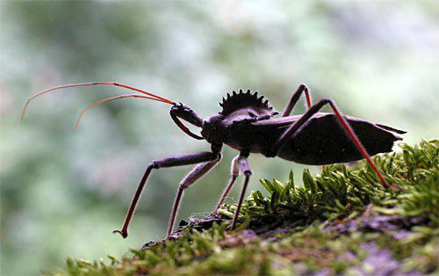
For instance
A client shows you this insect he found on his roses. He complains that it is eating his leaves. You correctly identify the insect as a Wheel Bug

Slide 9
How do you know this is NOT causing the client’s problem?
Think mouthparts!

Slide 10
The Wheel Bug has piercing sucking mouthparts!
He can’t put holes in the leaves!
In fact: he doesn’t even eat leaves – he’s a predator!
►

Slide 11
Top Ten Landscape Foes for Spring

Slide 12
Early Spring Insects to Look Out For!

Slide 13
Fire Ants
Red Imported Fire Ant
stings
worker
mound

Slide 14
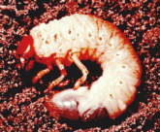
White Grubs

Slide 15
White Grubs – Larvae of these Beetles
White Grubs are the larvae of beetles such as the
masked chafer
green June beetle
Oriental beetle
Japanese beetle

Slide 16
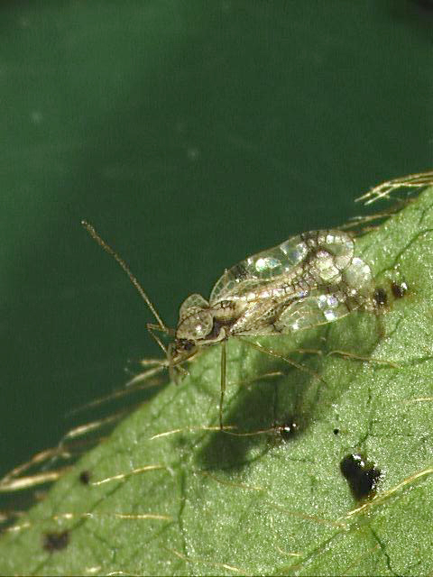
Lacebugs
Azalea
Lantana
Sycamore
Pyracantha
Willow
Photinia
Clemson University - USDA Cooperative Extension Slide Series, , www.ipmimages.org
Notes:
Adult lacebugs are tiny, about 1/8 inch long with transparent wings are held flat on the back. Their wings are lacy with two grayish-brown cross-bands connected in the middle. Nymphs are mostly black and spiny. The flask-shaped eggs are partially embedded in leaf tissue and often are covered with a black tar-like secretion. Lace bug adults and nymphs usually live and feed on the underside of leaves. Deciduous and evergreen azaleas are affected by the more common azalea Lace bug but there are other species of lacebug which feed on Lantana, Sycamore, Pyracantha, Willow and Photinia.
Nymphs and adults feed on plant juices through leaf tissue, causing white stippling of leaves. Nymphs and adults deposit black excrement spots that stick to the bottom surface of leaves. In heavy infestations, plants are aesthetically damaged and may die back.
Look for the first signs of damage on azaleas beginning in March and continuing throughout the summer. Look for white stippling on older leaves. Turn stippled leaves over to find lace bug stages and black fecal spots. Examine lace bug eggs with a hand lens for signs of parasitism (a round hole in the top of the egg) and look for predators.
Plant azaleas in partial shade. Time insecticide applications for the presence of the first generation nymphs. Insecticidal soap or horticultural oil sprays will give adequate control if sprayed on the underside of leaves. Beneficials usually are unable to control this pest when azalea host plants are located in sunny locations.

Slide 17
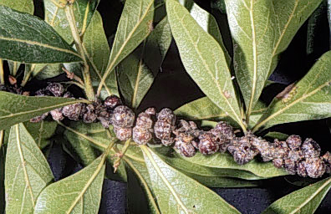
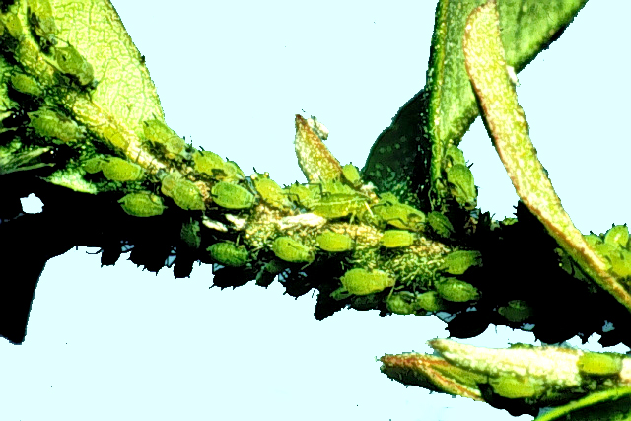
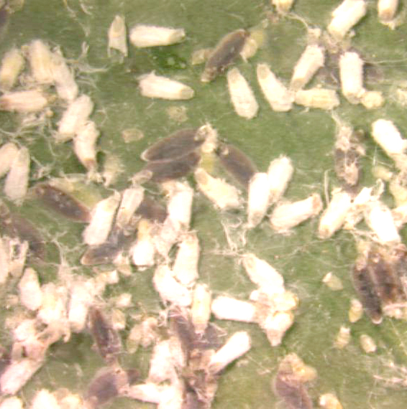
Complex of Sucking Insects that are Associated with Sooty Mold
Azalea lace bug
Aphids
yellow spots
on top of leaf
Armored scale insects

Slide 18
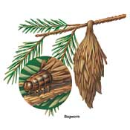
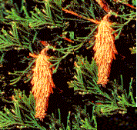
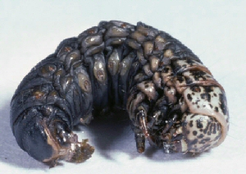
Bagworms on Evergreens

Slide 19
Early Spring Diseases to Watch For

Slide 20
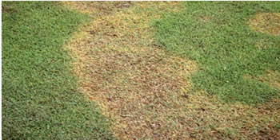
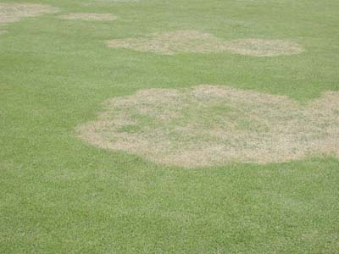
LAREG PATCH ON ZOYSIA
-relatively cool and wet conditions
-early spring and late fall
-commonly associated with turf in shaded or wet areas
-2’ to 20’ irregular patches
-In spring patch symptoms - light brown sunken
-attacks the leaf sheaths near the thatch layer not roots or stolons
-Controlling
avoid excess moisture
correct poorly drained areas
avoid thatch
fungicides only prevent

Slide 21
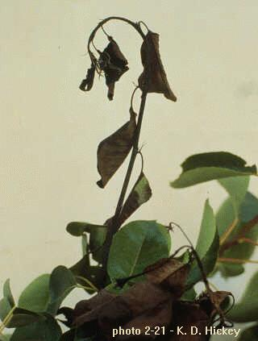
Fire Blight
Affects apple, pear, crabapple, pyracantha, quince, hawthorn, serviceberry, cotoneaster, blackberry and raspberry.
Over winters in cankers
Spread during bloom by
insects

Slide 22
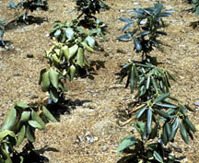
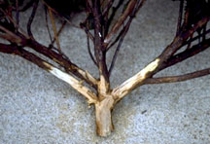
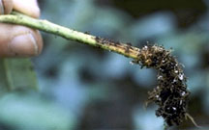
Phytophthora root rot on Azalea and Aucuba
High soil moisture and soil temperatures of 80°F and above
Symptoms consist of retarded growth, slight drooping of the foliage and off-color foliage.
Infected broadleaf species wilt during the heat of the day and recover at night
Roots become discolored and die. Dark or reddish brown discoloration may extend up into the wood of the lower stem

Slide 23
Control
Homeowners
Don’t be tempted to over water
Well drained soil is a must
Chemical control is difficult
drenching soil around the healthy plants with a fungicide
mefenoxam (e.g. Subdue MAXX)
metalaxyl (e.g. Subdue)
fosetyl-Al (e.g. Aliette)
etridiazole (e.g. Truban)
etridiazole + thiophanate methyl (e.g. Banrot)
Follow label rates and treat at four-week intervals during the summer when environmental conditions are favorable for disease.
Resistant plants

Slide 24
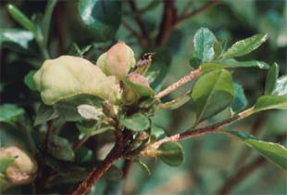
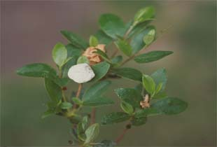
Azalea/Camellia leaf gall

Slide 25
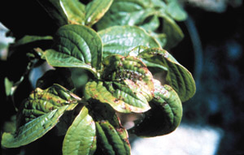
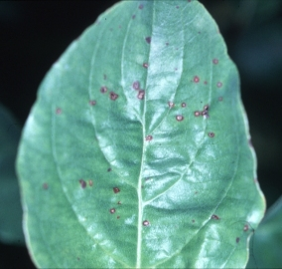
Spot Anthracnose on Dogwood

Slide 26
Any One with a Bad Rap!

Slide 27
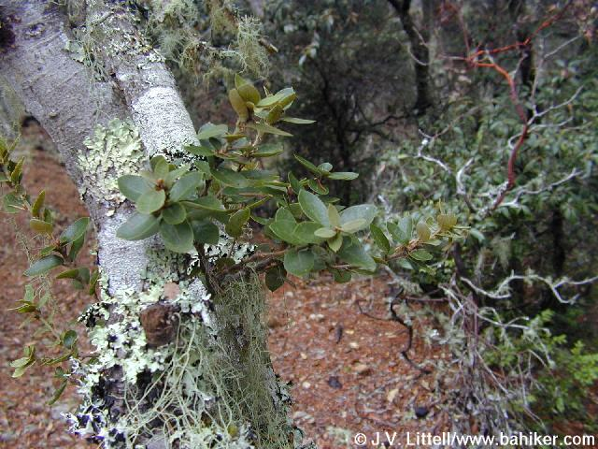
►
◄
►
LICHENS

Slide 28
QUESTIONS?

