Slide 1
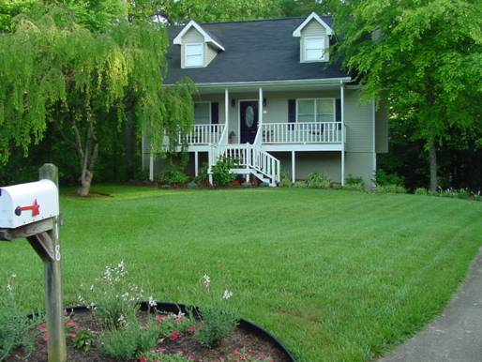
Landscape Benefits
A healthy landscape says welcome to my home or business.
Gives our children a safe place to play.

Slide 2
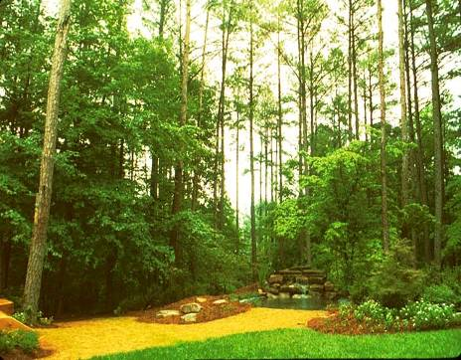
Landscapes…
Produce the oxygen we breathe.
Reduce carbon dioxide.
Moderate air temperatures resulting in lower heating and cooling costs.
One tree can remove 26 pounds of carbon dioxide from the atmosphere annually, equaling 11,000 miles of car emissions.

Slide 3
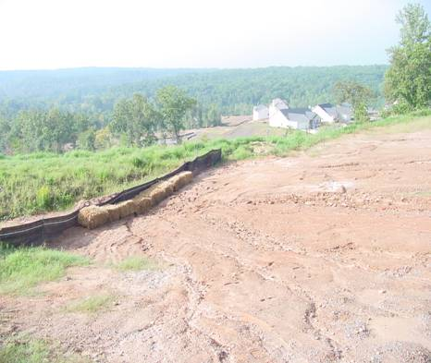
Landscapes…
Filter air and water pollutants, noise and dust.
Reduce stormwater runoff.
Provide groundwater recharge.
thurt@uga.edu

Slide 4
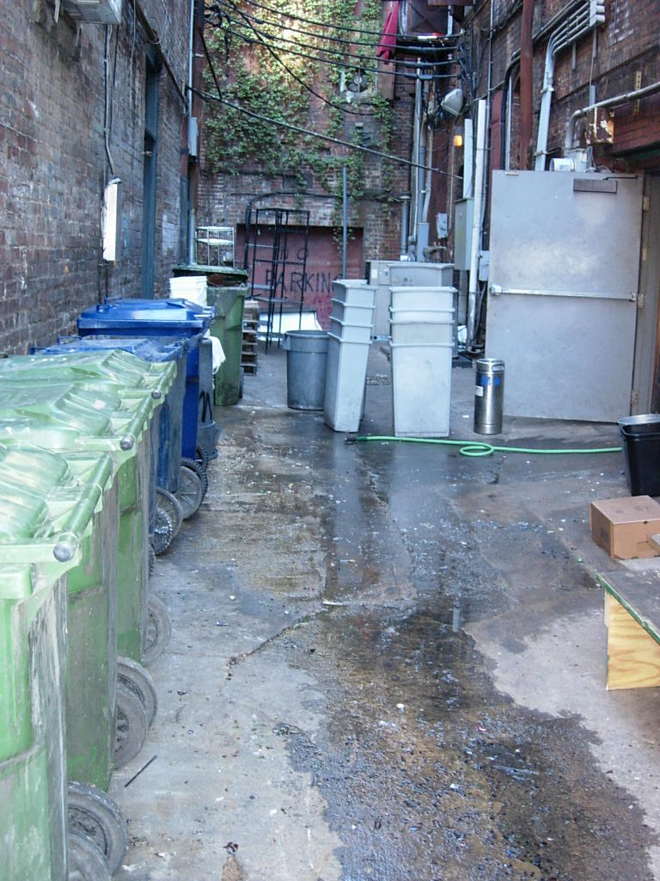
Some Landscapes
May Pollute

Slide 5
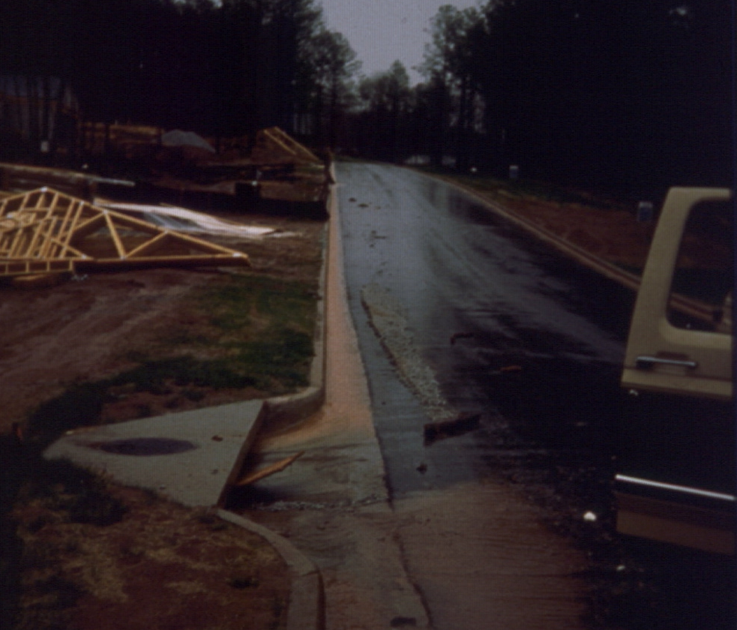
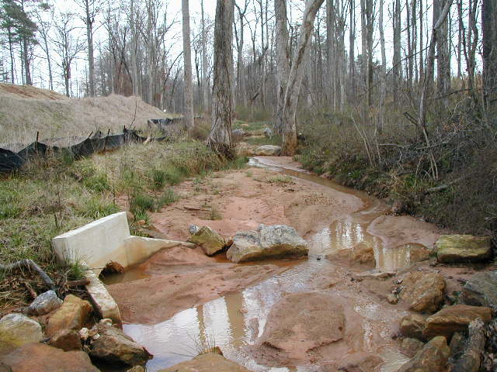
Stormwater’s Destination

Slide 6
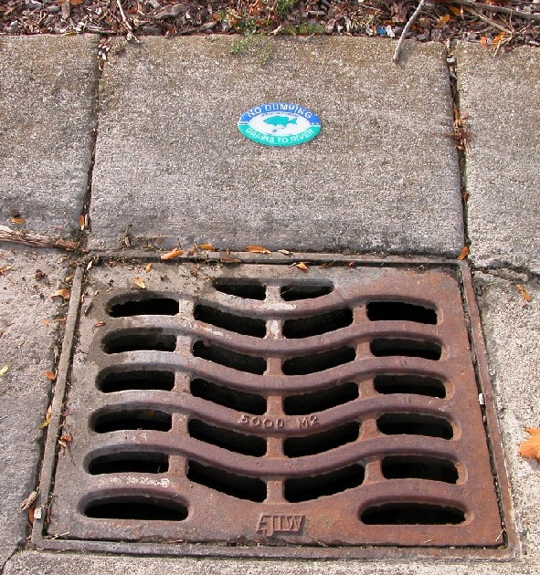
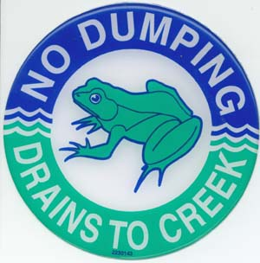
Education

Slide 7
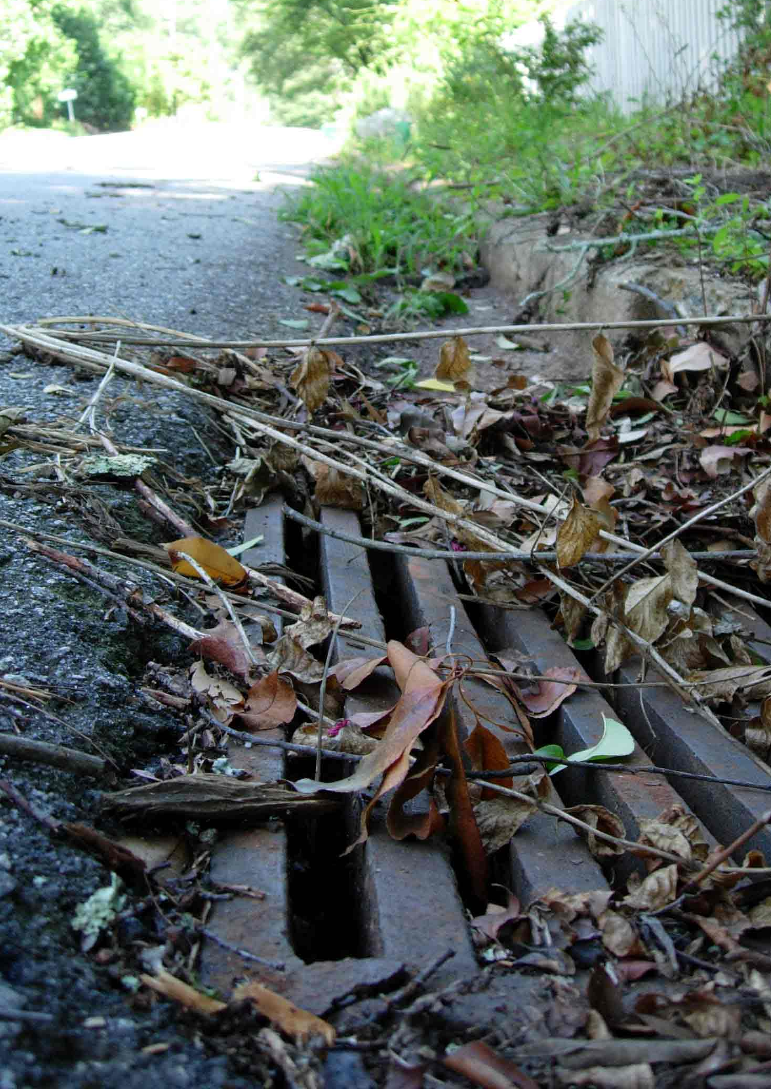
Non-Point Source Pollution
Motor Oil • Sediment • Cooking Grease • Pet Waste Excess Fertilizer • Yard Waste • Litter • Pesticides Household Hazardous Waste • Detergents • Metals
Notes:
Point vs. Non-Point Pollution. Point vs. Non-Point Pollution. Pollution that does not come from a single identifiable source.
Motor Oil • Sediment • Cooking Grease • Pet Waste Excess Fertilizer • Yard Waste • Litter • Pesticides Household Hazardous Waste • Detergents • Metals

Slide 9
http://www.fcs.uga.edu/ext/pubs/hace/HACE-E-46.pdf

Slide 10
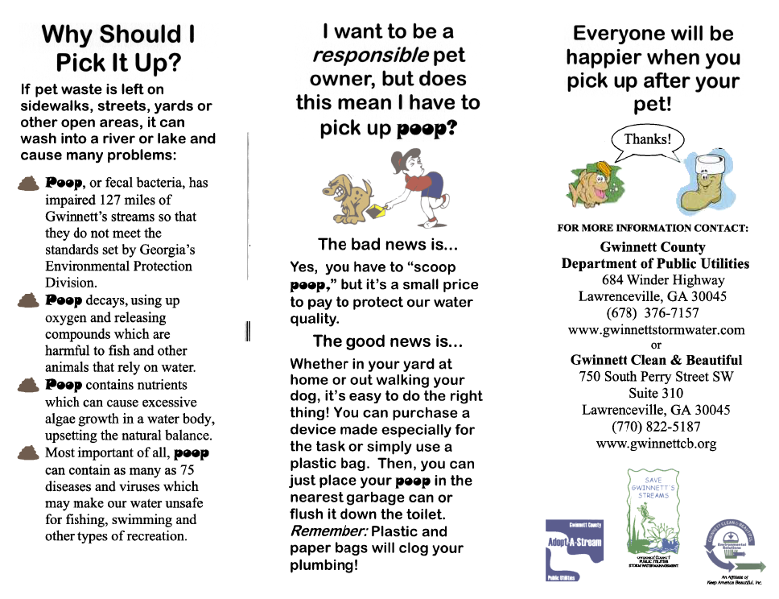
Notes:
Point vs. Non-Point Pollution. Point vs. Non-Point Pollution. Pollution that does not come from a single identifiable source.
Motor Oil • Sediment • Cooking Grease • Pet Waste Excess Fertilizer • Yard Waste • Litter • Pesticides Household Hazardous Waste • Detergents • Metals

Slide 11
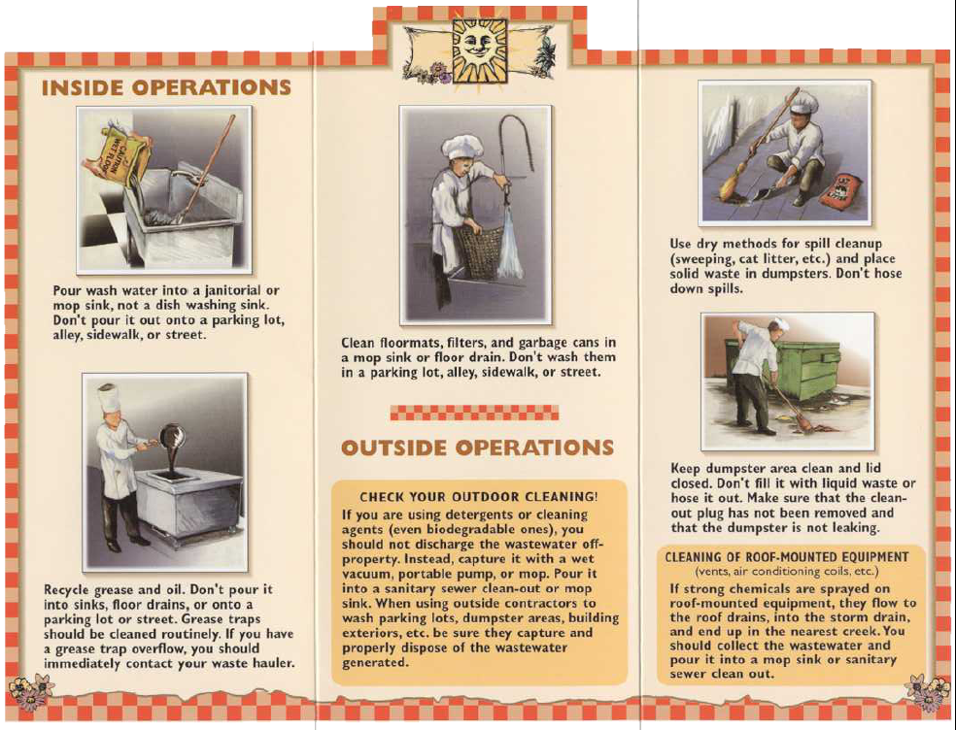
Grease

Slide 12
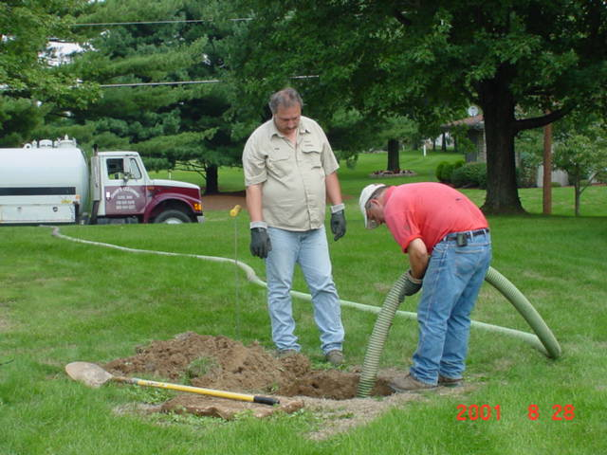
Septic System Maintenance

Slide 13
Septic Tank Maintenance
http://www.fcs.uga.edu/ext/pubs/hace/HACE-E-47.pdf

Slide 16
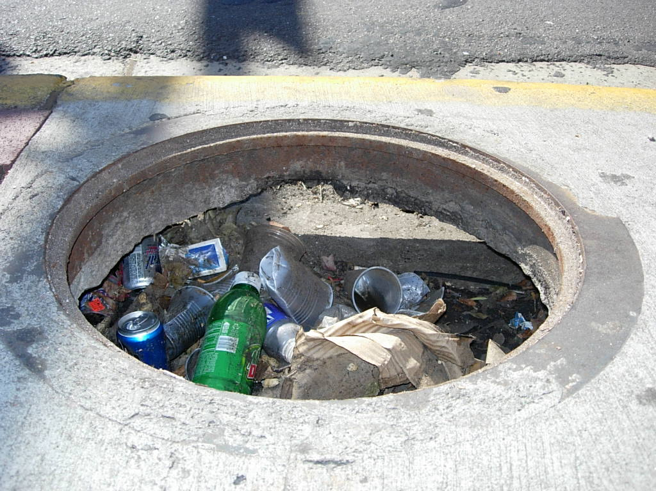

Slide 17
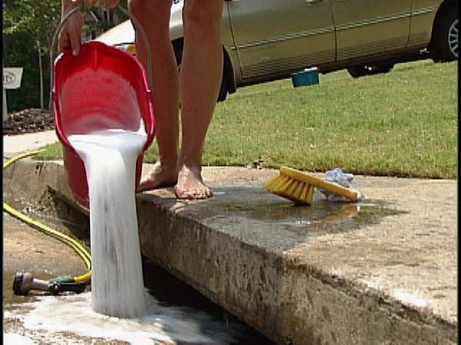

Slide 18
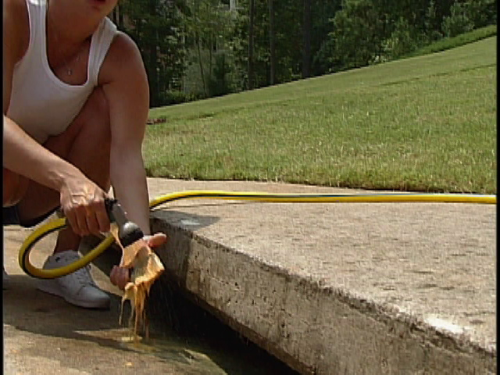

Slide 19
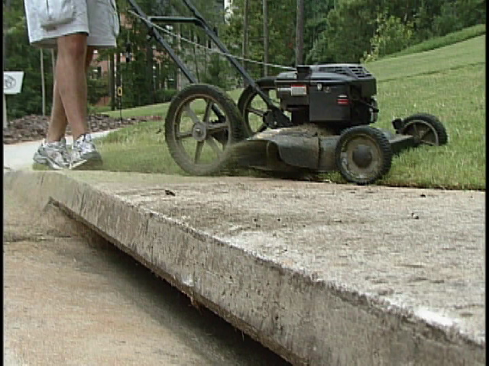

Slide 20
Non-Point Source Pollution
Motor Oil • Sediment • Cooking Grease • Pet Waste Excess Fertilizer • Yard Waste • Litter • Pesticides Household Hazardous Waste • Detergents • Metals
Notes:
Point vs. Non-Point Pollution. Point vs. Non-Point Pollution. Pollution that does not come from a single identifiable source.
Motor Oil • Sediment • Cooking Grease • Pet Waste Excess Fertilizer • Yard Waste • Litter • Pesticides Household Hazardous Waste • Detergents • Metals

Slide 21
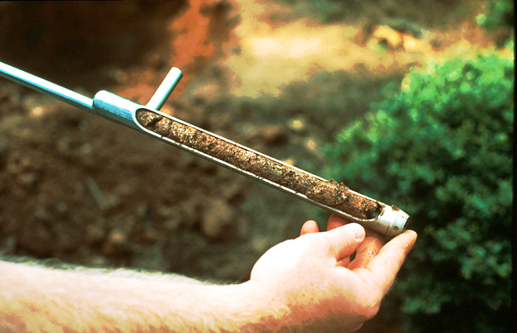
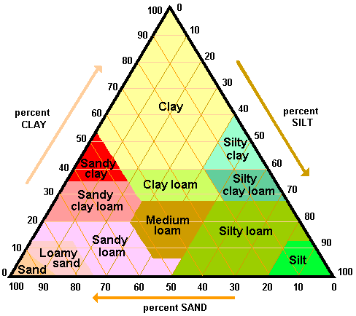
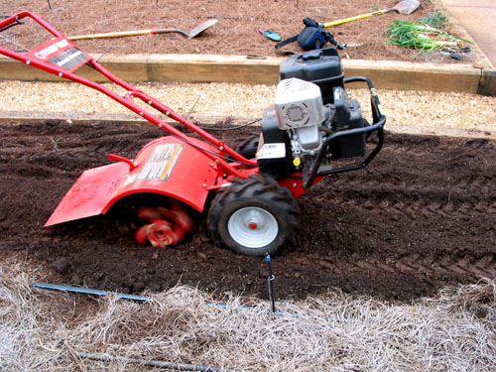
Soil Analysis
Infiltration
Root growth
Slope
Harvest rainfall
Mechanical support
pH
Notes:
Often overlooked. Quality soil preparation – promote infiltration, root expansion and efficient use of irrigation and natural water resources
Woody plants – till a large area. Annuals an perennials add lots of organic matter

Slide 22
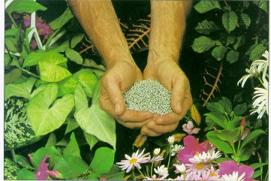
Fertilizer
-Plant selection
- Plant needs
-Timing
-Application rate
-Critical areas
Notes:
Proper fertilization – cold hardiness, insect and disease problems, salt/ water problems
Know plant needs, know availability in soil, know planting area

Slide 23
Non-Point Source Pollution
Motor Oil • Sediment • Cooking Grease • Pet Waste Excess Fertilizer • Yard Waste • Litter • Pesticides Household Hazardous Waste • Detergents • Metals
Notes:
Point vs. Non-Point Pollution. Point vs. Non-Point Pollution. Pollution that does not come from a single identifiable source.
Motor Oil • Sediment • Cooking Grease • Pet Waste Excess Fertilizer • Yard Waste • Litter • Pesticides Household Hazardous Waste • Detergents • Metals

Slide 24
Critical Area Protection

Slide 25
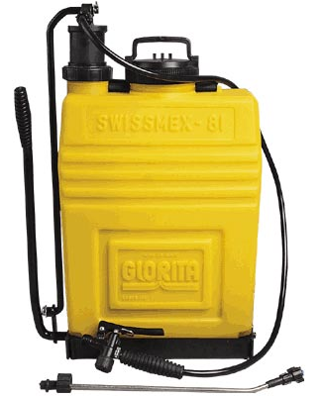
Pesticide Use
-Health
-Effectiveness
-Expense
-Environment
Notes:
Only use what you need

Slide 26
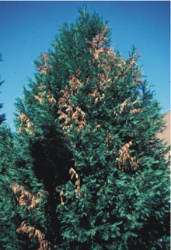
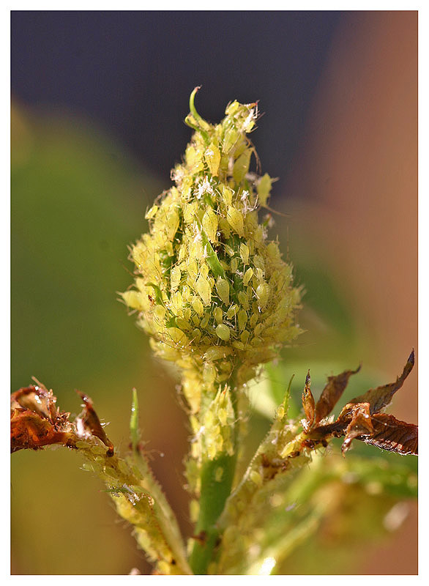
Don’t Plant Problems
Example:
Leyland Cypress
Euonymus
Hemlock
Roses
Notes:
Proper plant in the proper site. Structural, Pest, Invasive, poorly matched to site

Slide 27
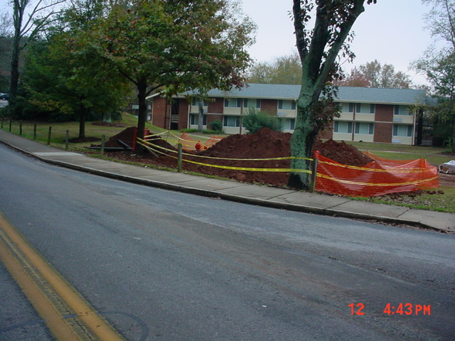
Maintenance
Don’t Create Problems

Slide 28
Using Pesticides
You may not always be able to control certain pests and their damage without using pesticides.
Pesticides include: insecticides, fungicides, miticides, herbicides, nematicides, etc.
Pesticides are classified as chemical or organic.
Pesticides are an important component of an Integrated Pest Management Program.
Notes:
Using Pesticides
You may not always be able to control certain pests and their damage without using pesticides.
Pesticides include: insecticides, fungicides, miticides, herbicides, nematicides, etc.
Pesticides are classified as chemical or organic.
Pesticides are an important component of an Integrated Pest Management Program.

Slide 29
More About Using Pesticides
Select the pesticide and formulation based upon the target pest, application equipment available, hazards of the pesticide and the applicator’s experience with pesticides.
If possible, use chemical pesticides only as a spot application. Blanket coverage may destroy beneficial insects and desirable plants.
No single herbicide, insecticide, fungicide, etc. is appropriate for all landscape pest problems
ALWAYS carefully read and follow all label directions when using pesticides.
Notes:
More About Using Pesticides
Select the pesticide and formulation based upon the target pest, application equipment available, hazards of the pesticide and the applicator’s experience with pesticides.
If possible, use chemical pesticides only as a spot application. Blanket coverage may destroy beneficial insects and desirable plants.
No single herbicide, insecticide, fungicide, etc. is appropriate for all landscape pest problems
-------------------------------------------
ALWAYS carefully read and follow all label directions when using pesticides.

Slide 30
Protecting Water from Pesticides
Avoid unnecessary pesticide treatments.
Calibrate all application equipment.
Apply at proper rates and times per label.
Apply pesticides at the lowest effective rates.
Follow all other label instructions.
Store and dispose of pesticides properly.
Notes:
Protecting Water from Pesticides
Avoid unnecessary pesticide treatments.
Calibrate all application equipment.
Apply at proper rates and times per label.
Apply pesticides at the lowest effective rates.
Follow all other label instructions.
Store and dispose of pesticides properly.

Slide 31
Pesticide Degradation
Ideally, the pesticide stays in the treated area or environment long enough to produce the desired results and then degrades into harmless materials.
Notes:
Pesticide Degradation
Ideally, the pesticide stays in the treated area or environment long enough to produce the desired results and then degrades into harmless materials.

Slide 32
Pesticide Degradation
Three modes of pesticide degradation:
Biological - breakdown by micro-organisms.
Chemical - breakdown by chemical reactions.
Photochemical - breakdown by ultraviolet or visible light.
Notes:
Pesticide Degradation
Three modes of pesticide degradation:
Biological - breakdown by micro-organisms.
Chemical - breakdown by chemical reactions.
Photochemical - breakdown by ultraviolet or visible light.

Slide 33
Pesticide Factors Affecting Water Pollution
Chemical properties of the pesticide.
Formulation of the pesticide.
Rate and method of application.
Pesticide persistence.
Frequency of rainfall; timing of irrigation.
Nearness to ponds, rivers, streams, etc.
Depth to ground water.
Notes:
Pesticide Factors Affecting Water Pollution
Chemical properties of the pesticide.
Formulation of the pesticide.
Rate and method of application.
Pesticide persistence.
Frequency of rainfall; timing of irrigation.
Nearness to ponds, rivers, streams, etc.
Depth to ground water.

Slide 34
Pesticide Pollutants
When pesticides move off-site via runoff or leaching they are then considered to be pollutants.
Runoff is the movement of pesticides across the soil surface into bodies of water.
Leaching is the movement of pesticides through the soil into ground water.
Notes:
Pesticide Pollutants
When pesticides move off-site via runoff or leaching they are then considered to be pollutants.
Runoff is the movement of pesticides across the soil surface into bodies of water.
Leaching is the movement of pesticides through the soil into ground water.

Slide 35
Integrated Pest Management
IPM is a method of controlling pest populations through socially acceptable, environmentally responsible and economically practical methods.
IPM incorporates a variety of cultural, biological and chemical methods to efficiently manage pest populations while lowering the dependence on chemical means of control.
Notes:
Integrated Pest Management
IPM is a method of controlling pest populations through socially acceptable, environmentally responsible and economically practical methods.
IPM incorporates a variety of cultural, biological and chemical methods to efficiently manage pest populations while lowering the dependence on chemical means of control.

Slide 36
Integrated Pest Management
IPM involves using a variety of methods to control pests: cultural, mechanical, biological and chemical.
- Use disease and insect resistant plants.
- Hand destroy if pest numbers not excessive.
- Rotate annuals to reduce reoccurring pests.
- Prune out dead and diseased plant parts.
- Mow lawns and apply fertilizers correctly.
Notes:
Integrated Pest Management
IPM involves using a variety of methods to control pests: cultural, mechanical, biological and chemical.
- Use disease and insect resistant plants.
- Hand destroy if pest numbers not excessive.
- Rotate annuals to reduce reoccurring pests.
- Prune out dead and diseased plant parts.
- Mow lawns and apply fertilizers correctly.

Slide 37
Advantages to Using IPM Practices
Reductions in the potential for pesticide resistance,
Reductions in the costs of pesticides,
Reductions in your exposure to chemicals,
Reductions to other environmental impacts.
Notes:
Advantages to Using IPM Practices
Reductions in the potential for pesticide resistance,
Reductions in the costs of pesticides,
Reductions in your exposure to chemicals,
Reductions to other environmental impacts.

Slide 38
What are Biological Controls?
Biological controls occur naturally.
Diseases, parasites and predators that exist in our landscapes and gardens attack and kill harmful pests.
It is important to conserve and enhance naturally-occurring biological control agents in our landscapes and gardens.
Notes:
What are Biological Controls?
Biological controls occur naturally.
Diseases, parasites and predators that exist in our landscapes and gardens attack and kill harmful pests.
It is important to conserve and enhance naturally-occurring biological control agents in our landscapes and gardens.

Slide 39
More About Biological Controls
Learn to identify biological control agents like beneficial insects and wildlife that are indigenous to your area; and learn to conserve them in your landscape and garden.
Utilize a variety of flowering annual and perennial plants to provide food for beneficials.
Create habitats in your landscape that attract birds and other wildlife that prey on insect pests.
Notes:
More About Biological Controls
Learn to identify biological control agents like beneficial insects and wildlife that are indigenous to your area; and learn to conserve them in your landscape and garden.
Utilize a variety of flowering annual and perennial plants to provide food for beneficials.
Create habitats in your landscape that attract birds and other wildlife that prey on insect pests.

Slide 40
Information on Pesticides
Extension Service has information for:
* Choosing the correct pesticides.
* Using pesticides correctly.
* Storing pesticides.
* Disposing of pesticides.
Notes:
Information on Pesticides
The University of Georgia Extension Service is your best source of information for:
* Choosing the correct pesticides.
* Using pesticides correctly.
* Storing pesticides.
* Disposing of pesticides.

Slide 41
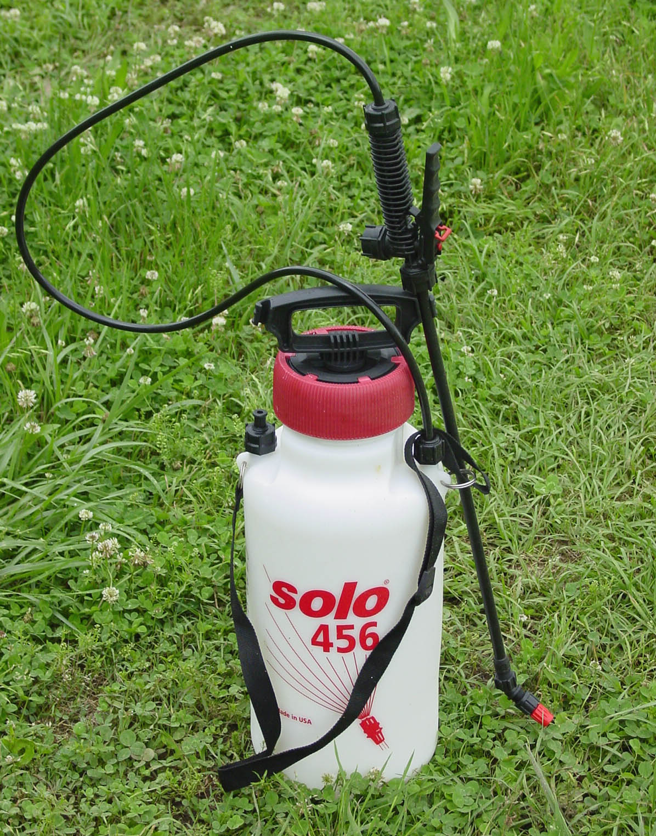
Pesticide Application

Slide 42
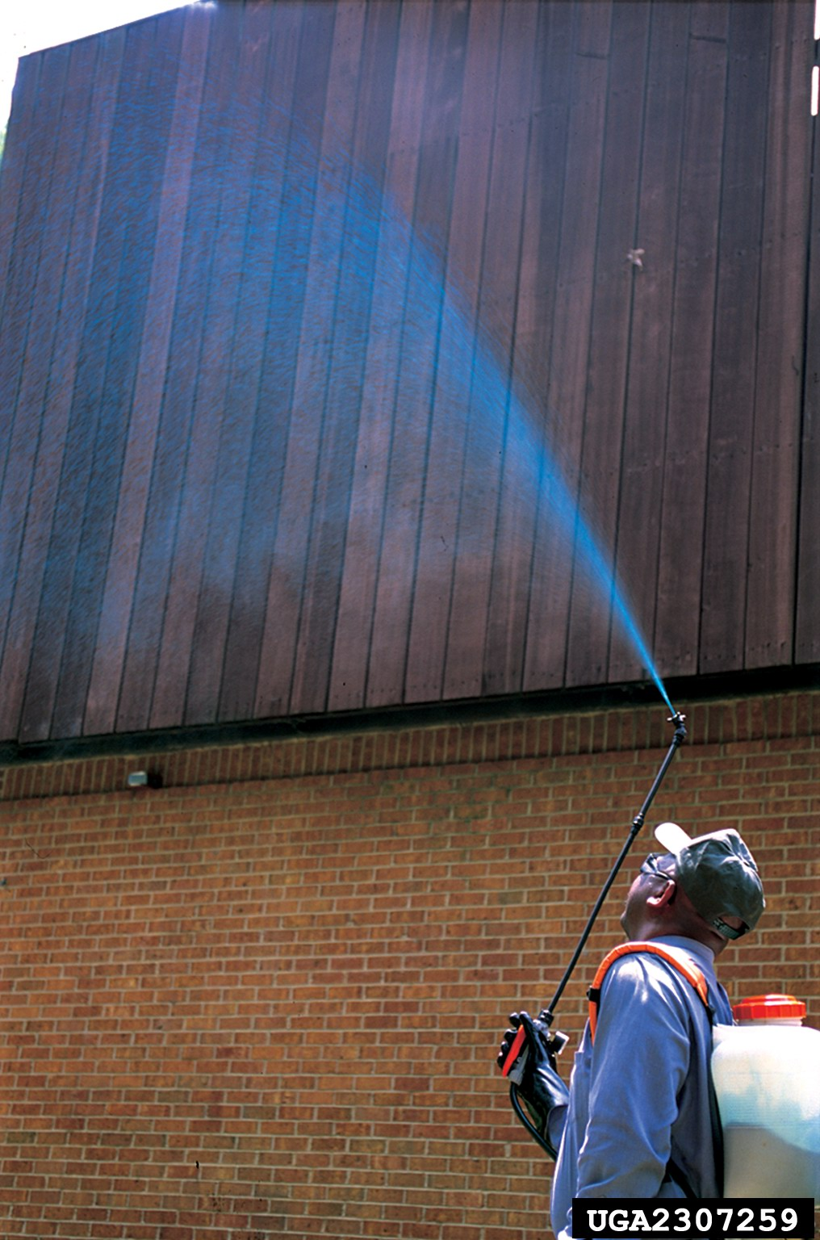

Slide 43
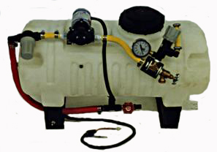

Slide 44
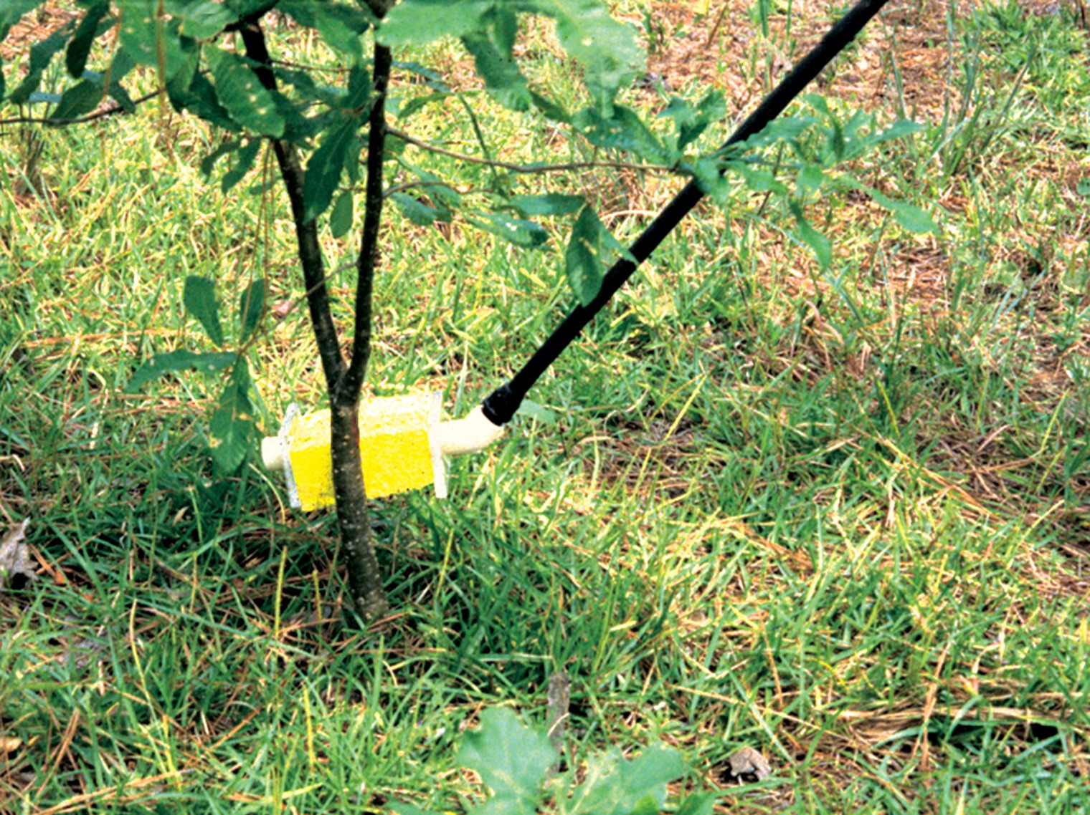

Slide 45
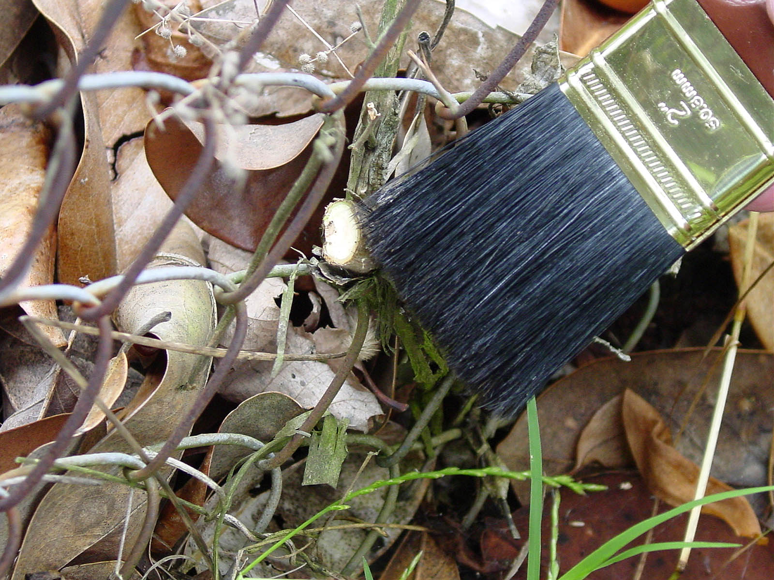

Slide 46
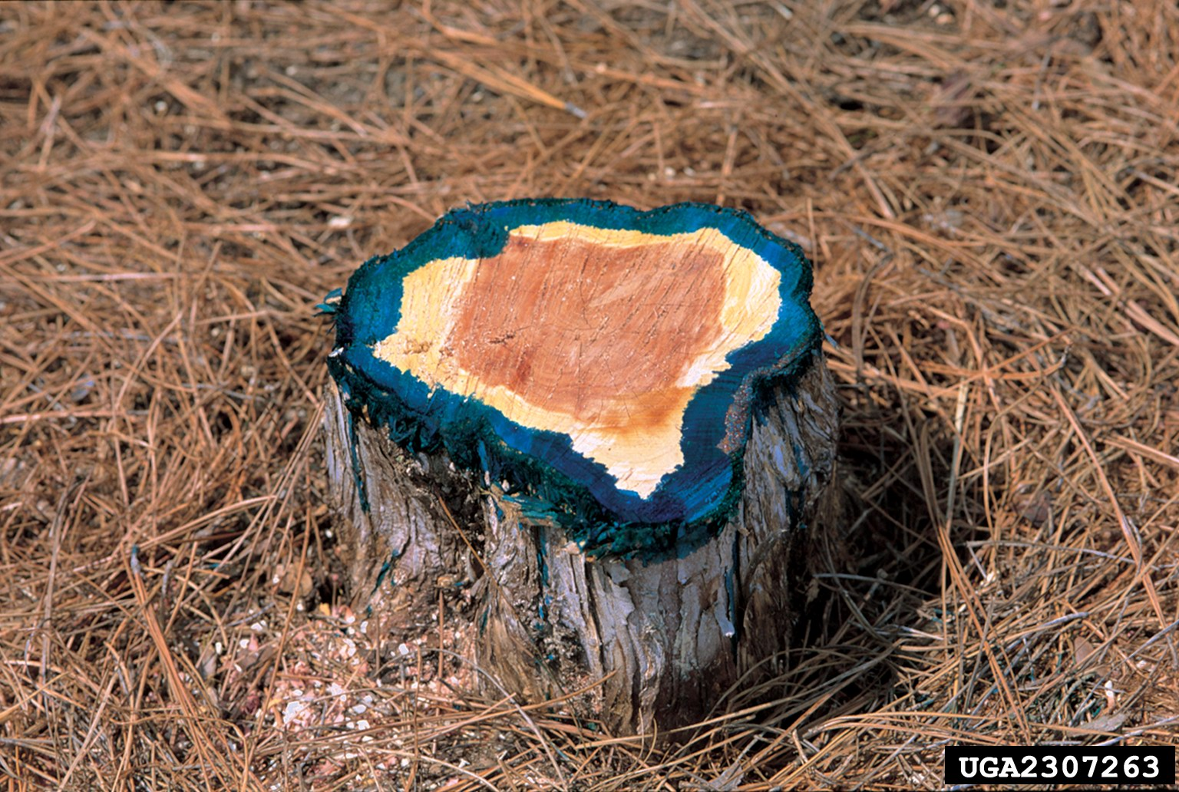
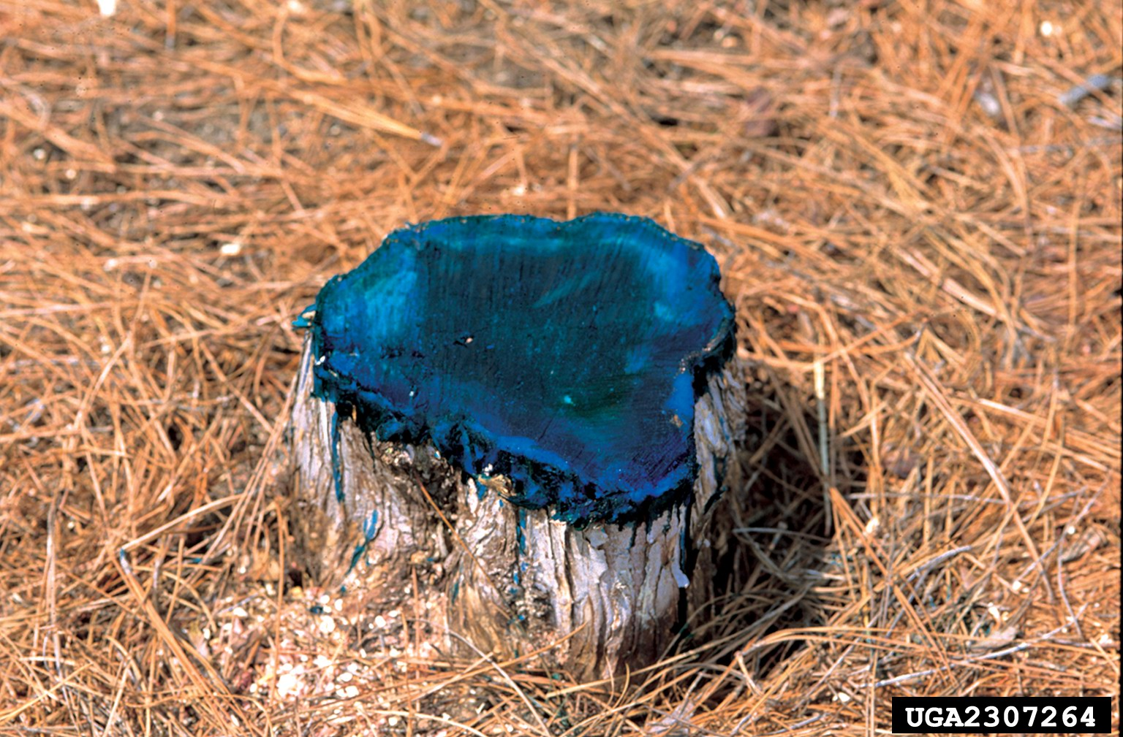

Slide 47
