Slide 1
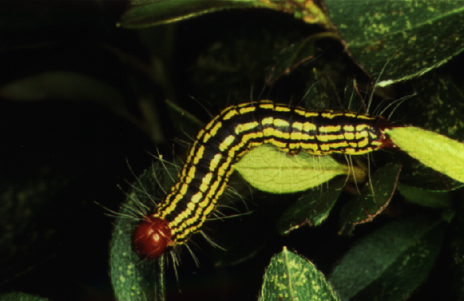
Key Plants and Key Pests in Georgia Landscapes
Todd Hurt
Training Coordinator
Center for Urban Agriculture

Slide 2
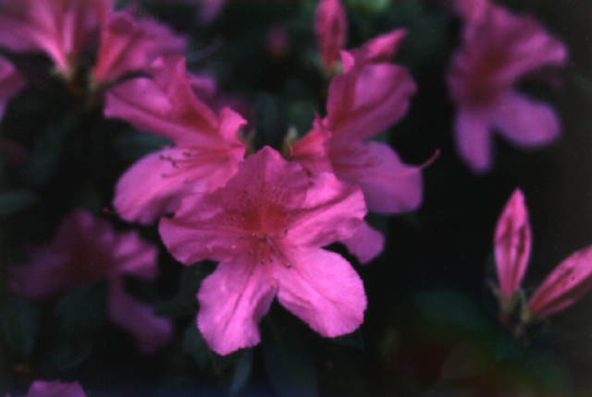
Azalea Rhododendron species

Slide 3
Azalea - Key Pests
Insects
Azalea caterpillar
Azalea lacebug
Azalea leafminer
Rhododendron gall midge
Spider mites
Other
Iron chlorosis
Planting depth
Diseases
Azalea gall
Cercospora leaf spot
Mushroom root rot
Ovulinia petal blight
Wet root rots

Slide 4
Azalea Caterpillar
Defoliation
Groups of caterpillars with red heads and posteriors
Late summer to
early fall
Dantana major

Slide 5
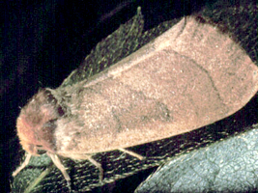
Azalea Caterpillar
Management
Remove and destroy infested branches
Use B.t. or other insecticides
Azalea caterpillar moth and eggs.

Slide 6
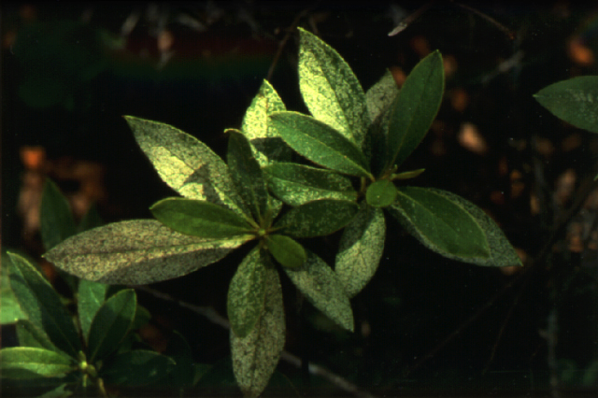
Azalea Lacebug
Stippled silvery leaves
Most severe in full sun locations

Slide 7
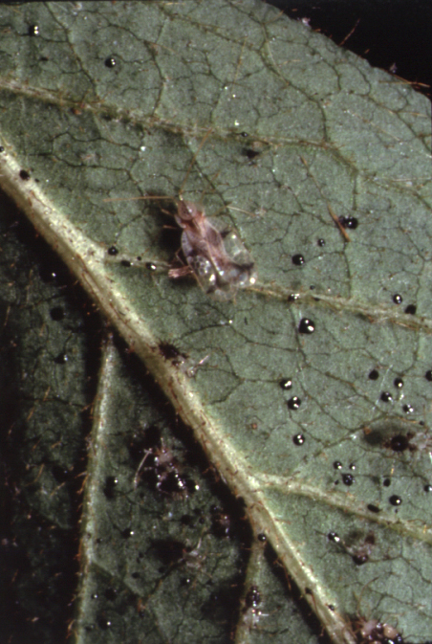
Azalea Lacebug
Insects found on undersides of leaves
Adults black with lacy wings
Nymphs have spines and lack wings
Cool season pest
Stephanitis pyrioides

Slide 8
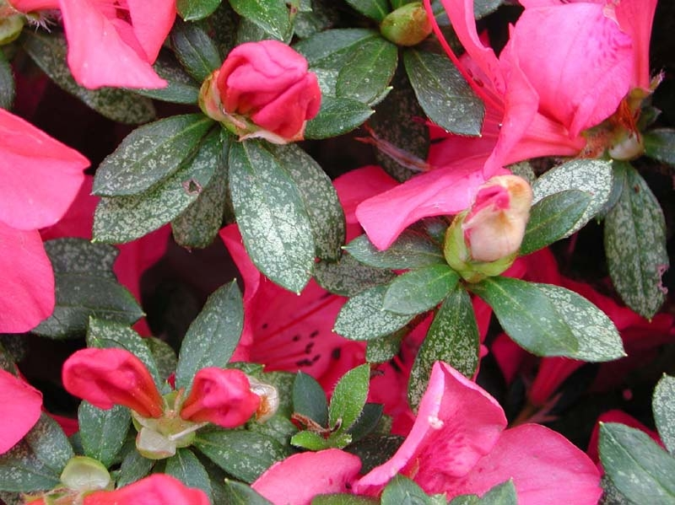
Azalea Lacebug
Management
Monitor populations
Apply insecticides as needed

Slide 9
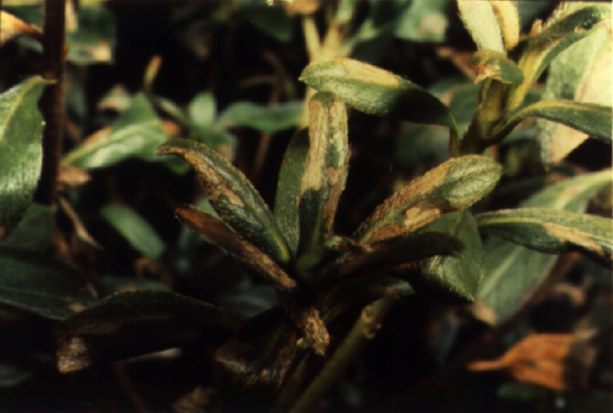
Azalea Leafminer
Dry, brown spots on leaves
Folded leaf tips or margins
Small yellow- brown caterpillars inside
Spring and summer
Caloptilia azalealla

Slide 10
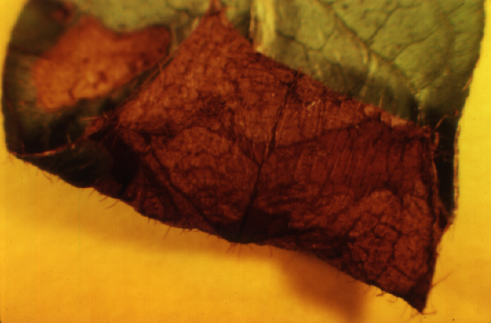
Azalea Leafminer
Management
Use systemic insecticide when infestation occurs

Slide 11
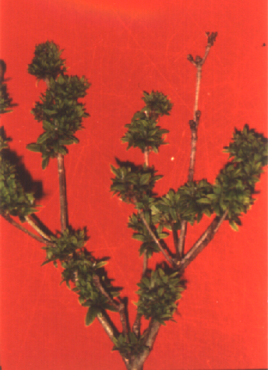
Rhododendron Gall Midge
Leaf curling and distortion of new growth
Witches broom
On new growth in spring
Several generations

Slide 12
Rhododendron Gall Midge
Management
Prune out affected terminals
Apply insecticides at bud break if problem is recurrent

Slide 13
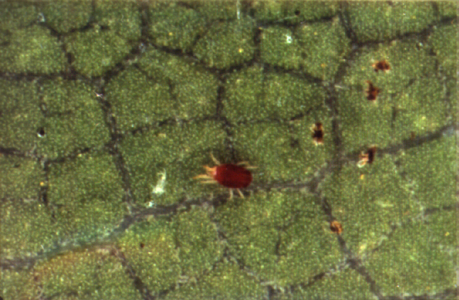
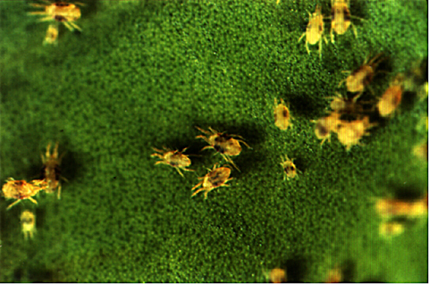
Spider Mites
Stippled or bronzed leaves
Mites, eggs, cast skins, webs visible with hand lens
Warm and dry conditions favor two-spotted mites
Cool and moist conditions favor southern red mite
Southern red mite Oligonychus ilicis
Two-spotted spider mite Tetranychus urticae

Slide 14
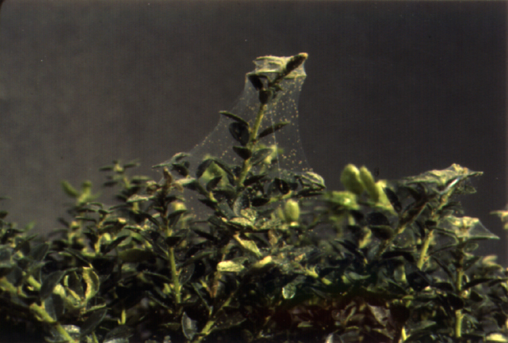
Spider Mites
Management
Biological control - predatory mites
Soaps, oils, miticides

Slide 15
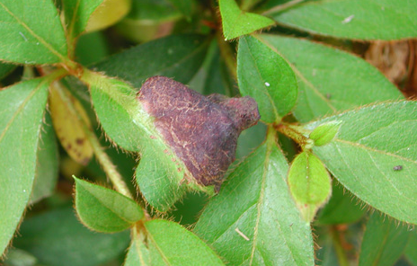
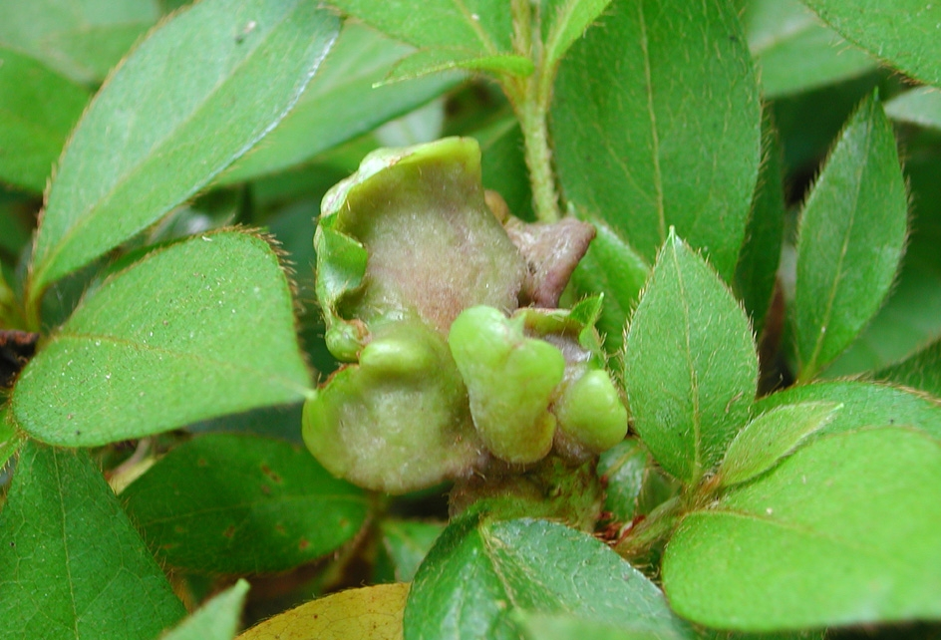
Azalea Gall
Thickened or fleshy leaf galls
Flower parts hard, fleshy or waxy
Galls pale green to white, brown with age
Cool wet spring weather

Slide 16
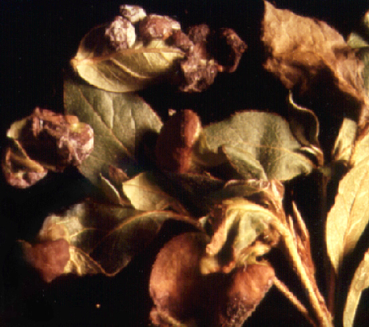
Azalea Gall
Caused by a fungus, Exobasidium vaccinii
Management
Remove galls and destroy
Remove mulch in fall if problem is severe

Slide 17
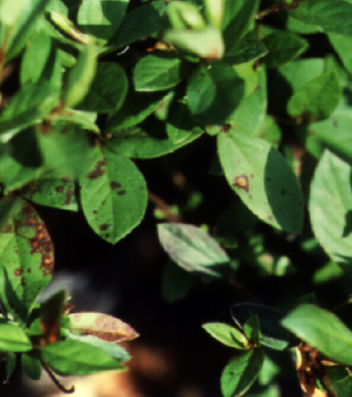
Cercospora Leaf Spot
Circular or angular dark brown spots
Chlorosis and leaf drop
Most prevalent in summer and fall
Warm temperatures, high humidity

Slide 18
Cercospora Leaf Spot
Management
Avoid frequent overhead irrigation
Apply fungicides; cover both leaf surfaces

Slide 19
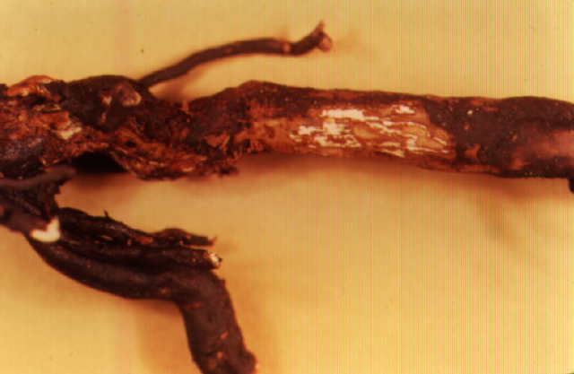
Mushroom Root Rot
Slow decline, thinning of canopy
Desiccation
White mycellium under bark at soil line
Wide host range
Can occur anytime; most symptoms appear in summer

Slide 20
Mushroom Root Rot
Management
Remove diseased plants and roots
Fumigate soil before replanting

Slide 21
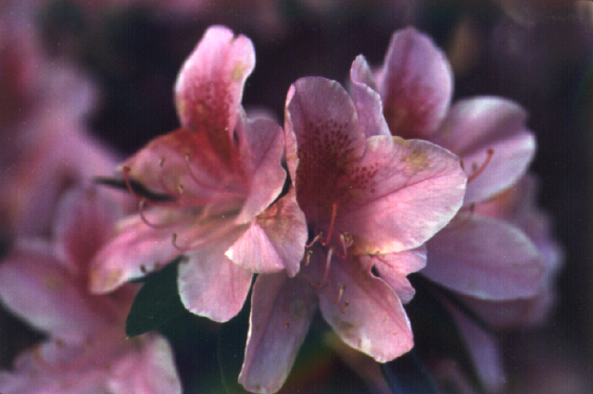
Ovulinia Petal Blight
Small, water-soaked spots on petals
Petals become brown and slimy
Brown flowers remain on plant
Occurs during bloom in spring

Slide 22
Ovulinia Petal Blight
Management
Remove plant litter, use mulch
Fungicides not practical in most cases
Fungicides applied weekly during bloom will reduce disease severity

Slide 23
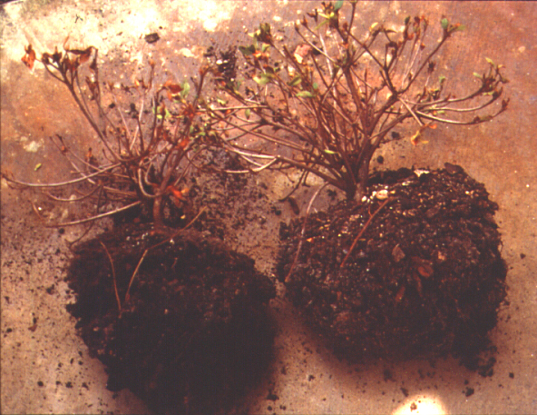
Wet Root Rots
Poor growth, thinning canopy
Yellowing and loss of older leaves
Branch or plant death
Roots dark and rotted, strip off easily

Slide 24
Wet Root Rots
Disease triggered by excessive soil moisture
Contributing factors:
Poor drainage
Over-watering
Planting too deep
Shallow rooting
Other cultural
conditions

Slide 25
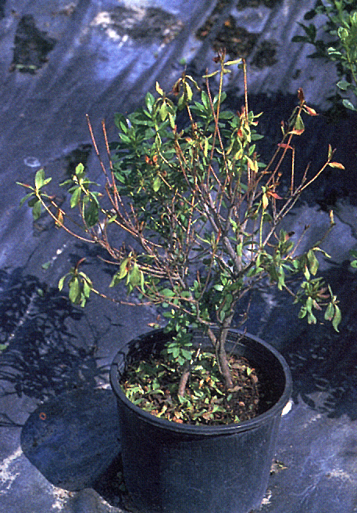
Wet Root Rots
Management
Correct cultural problems
Apply fungicide if diagnosed early

Slide 26
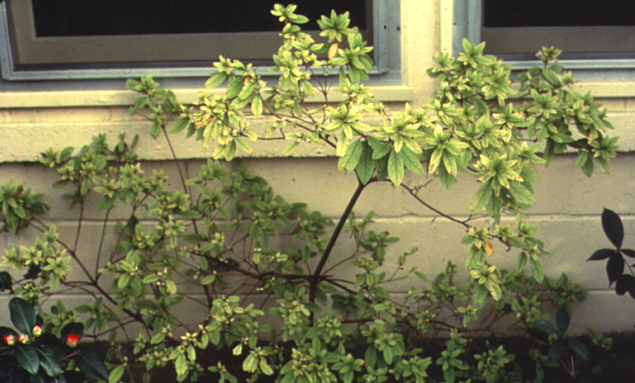
Iron Chlorosis
New leaves turn yellow but veins stay green
Poor soil aeration or root damage
High soil pH
Management
Adjust pH
Apply Iron
Plant selection

Slide 27
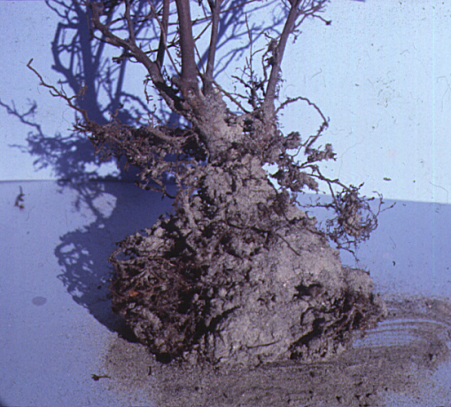
Planting Depth
Chlorosis, slow growth, decline
Soil placed over the root ball at planting
Excessive mulch
Management
Proper planting depth
Pull back or remove mulch

Slide 28
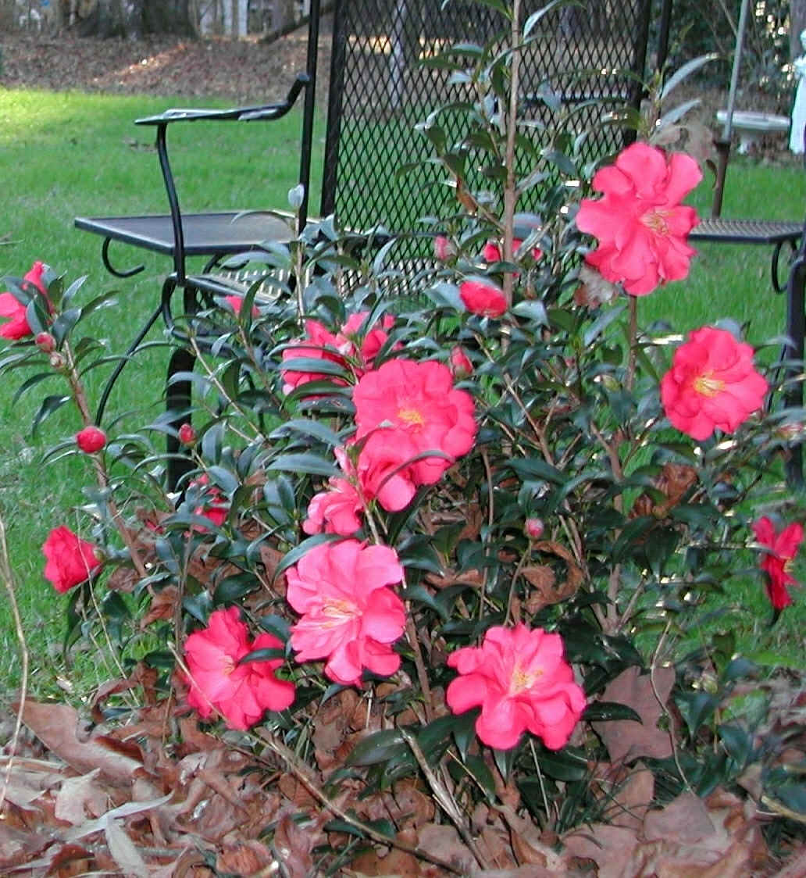
Camellia
IFAS Leon Co.

Slide 29
Camellia
Insects
Tea Scale
Spider Mites
Diseases
Flower Blight
Dieback

Slide 30
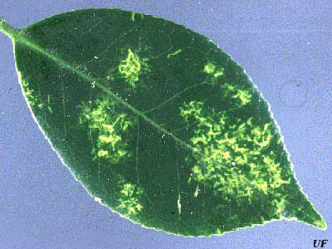
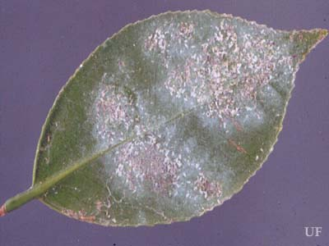
Tea Scale
Armored scale
1/12 to 1/8 in long
Protective waxy covering
Worse in areas of poor air circulation
Heavy infestations result in leaf drop

Slide 31
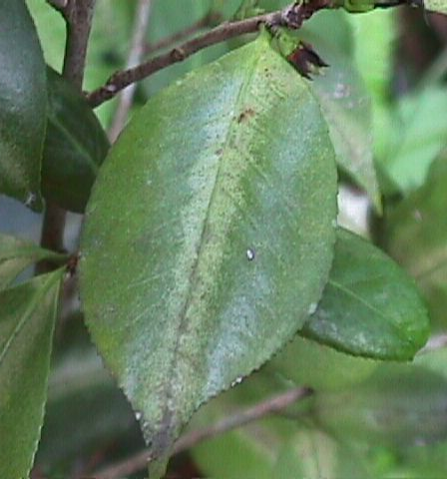
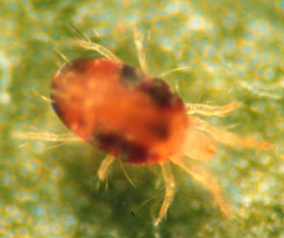
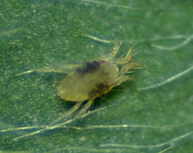
Spider Mites
Leaves have speckled appearance
1/50th of an inch long
Female can lay 50-100 eggs
Red Spider Mite prefers cool weather
Two Spotted Spider Mite prefers hot and dry
Afn.org
Oisat.org
Uky.edu

Slide 32
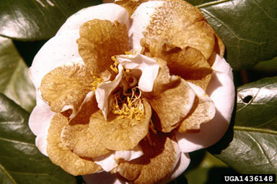
Flower Blight
Ciborinia camellia
Only affects flowers
Starts as small brown spots but rapidly expands
Period of Cold Weather followed by warm conditions required for germination (Dec-March)
Sanitation
Chemical Control is not effective

Slide 33
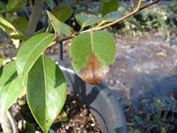
Dieback
Glomerella cingulata
Colletotrichum gloeosporioides
Hot and Humid
Wilting and death of current season’s growth
Berkley.edu
Sudden Oak Death
Phytophthora ramorum
Lesions are usually on the leaf tip or leaf edge, and can be surrounded by diffuse margins or thick black zone lines.

Slide 34
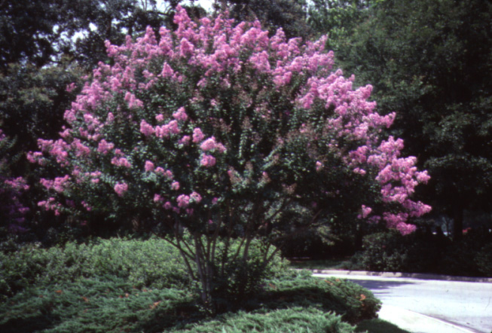
Crape Myrtle Lagerstroemia indica

Slide 35
Crape Myrtle Key Pests
Insects
Crape myrtle aphid
Metallic beetles
Disease
Powdery mildew

Slide 36
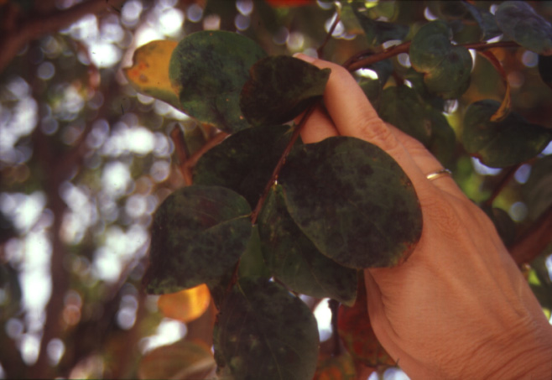
Crape Myrtle Aphid
Sooty mold
Distorted new growth

Slide 37
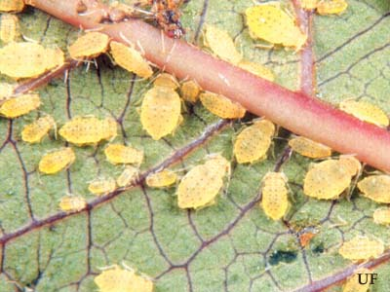
Crape Myrtle Aphid
Yellow, pear-shaped insects with black spots on abdomen.
Unlike most aphids, all adults of this species are winged.
Late summer through fall
Host specific
Sarucallis kahawaluokalani

Slide 38
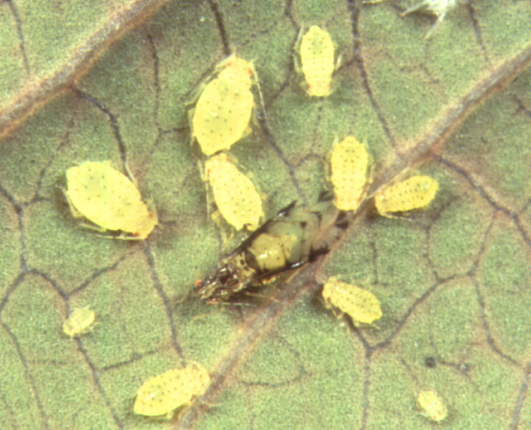
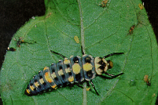
Crape Myrtle Aphid
Lady bug larvae feeding on aphids
Management
Natural biological control
Soaps, oils, insecticides

Slide 39
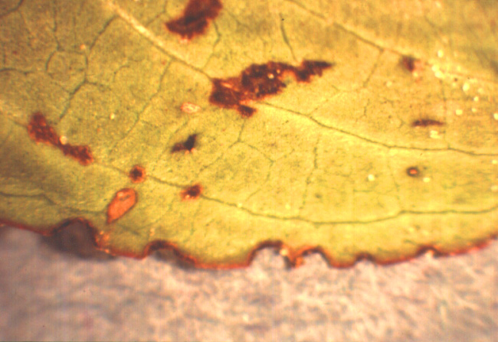
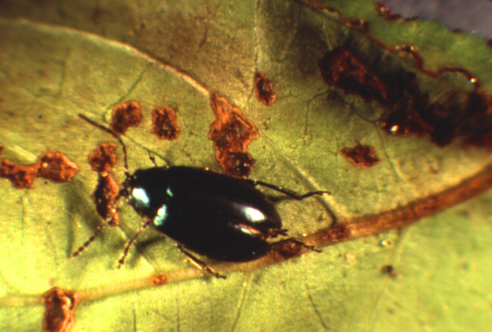
Metallic Beetles
Small blue beetles
Leaf notching
Management
None recommended

Slide 40
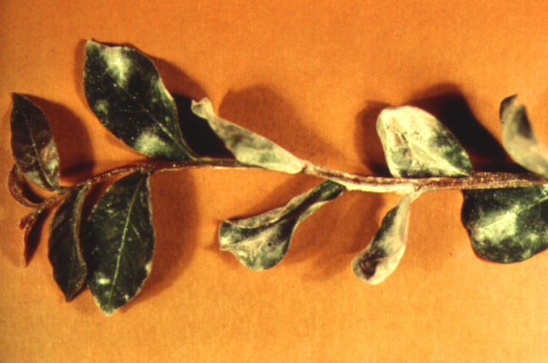
Powdery Mildew
White powdery growth on leaves,
shoots and buds
Growth distortion
Leaf curling
Fungus
Leveillula taurica

Slide 41
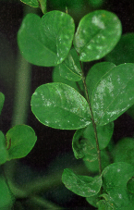
Powdery Mildew
Cool, dry conditions
Most severe in shade
Management
Use resistant varieties
Apply fungicides when needed

Slide 42
Holly Ilex species

Slide 43
Holly - Key Pests
Insects
Florida wax scale
Tea Scale
Diseases
Dieback
Cylindrocladium
Other
Magnesium deficiency

Slide 44
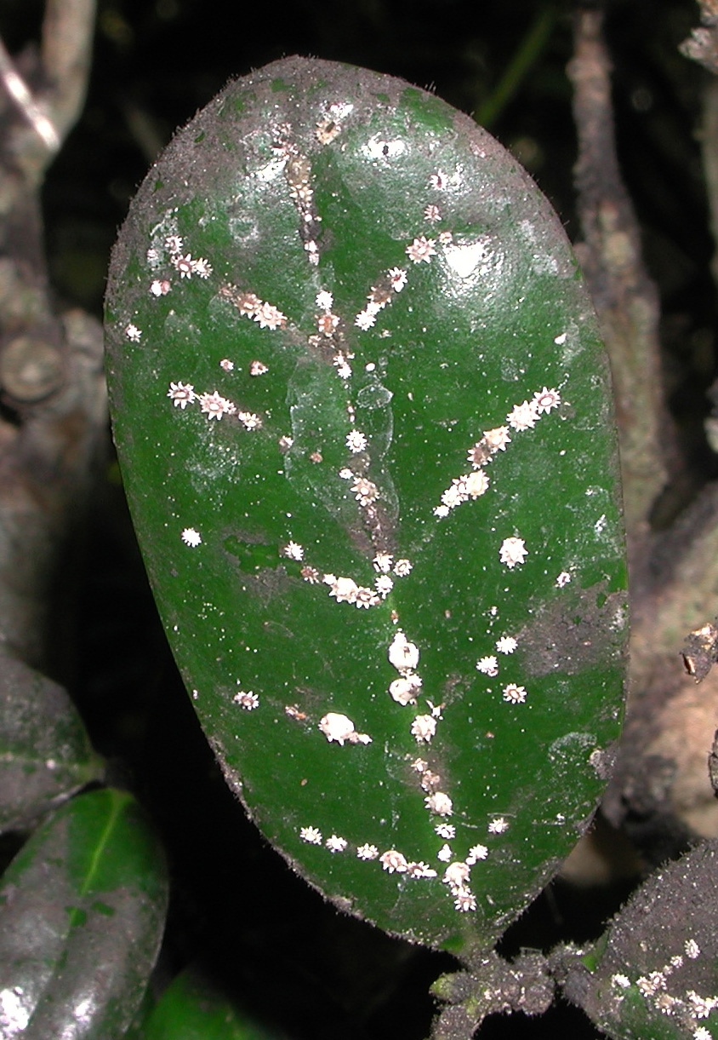
Florida Wax Scale
Creamy, round spots on stems and leaves
Chlorotic spots
Sooty mold
Leaf drop
Immatures black with white fringe

Slide 45
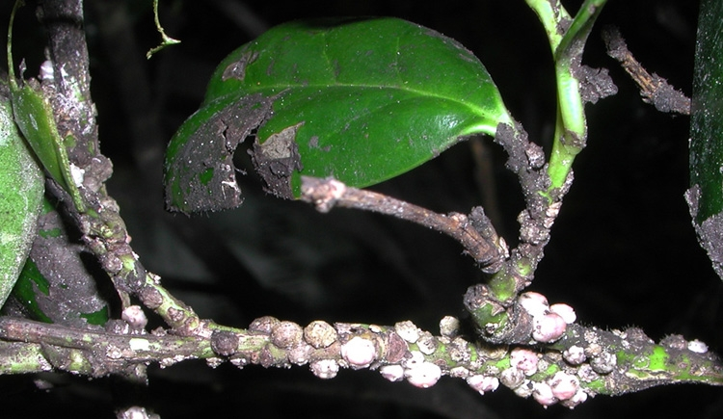
Florida Wax Scale
Mature scale present year round
Monitor crawlers spring - summer
Management
Natural biological control
Soaps, oils, insecticides
Ceroplastes floridensis

Slide 46
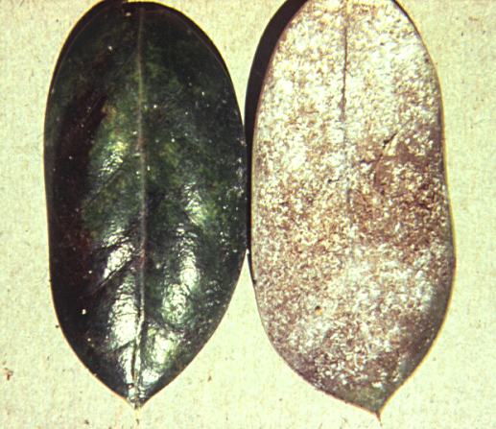
Tea Scale
Chlorotic feeding damage on leaves
Undersides of leaves white with waxy threads
Tiny, armored scales
Mature scale present year round

Slide 47
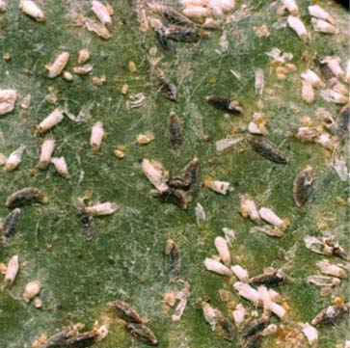
Tea Scale
Management
Conserve natural biological control
Soaps, oils, insecticides
Fiorinia theae

Slide 48
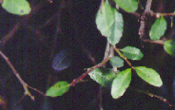
Cylindrocladium Leaf Spot
Dark purple to black circular leaf spots
Leaf drop
Twig dieback
Common on I. vomitoria
Also occurs on I. crenata, I. cornuta,
I. opaca

Slide 49
Cylindrocladium Leaf Spot
Warm temperatures, high humidity
Spreads by splashing water
Management
Adjust irrigation to keep foliage dry
Remove fallen leaves, rogue infected plants
Fungicides

Slide 50
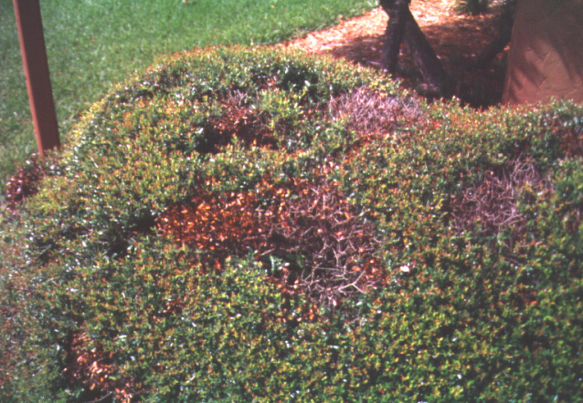
Dieback
Holes or bare areas in plant
Most common in yaupon holly
Spreads by splashing water
Injuries allow points of entry
Occurs most often in dense or excessively sheared plantings

Slide 51
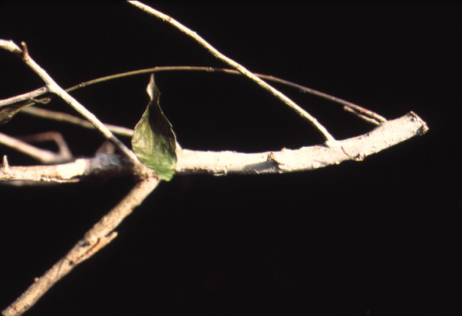
Dieback
Can be caused by several fungi
Fungal signs may not be apparent
Management
Prune out below symptoms
Plant replacement
Fungicides after pruning may limit new infections
Pink limb blight

Slide 52
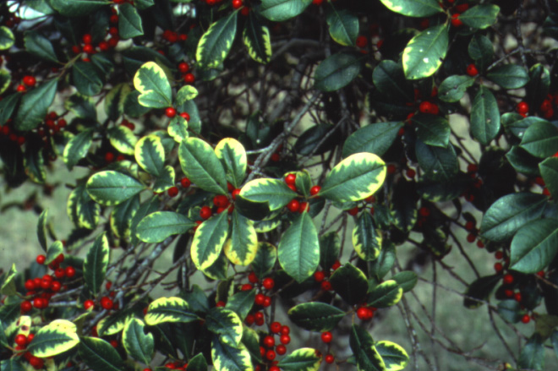
Magnesium Deficiency
Distinct yellow, inverted V pattern
Occurs on mature leaves
Low soil pH
Lack of soil Mg
Management
Check and adjust pH with dolomite
Apply Epsom salts or Mg fertilizers

Slide 53
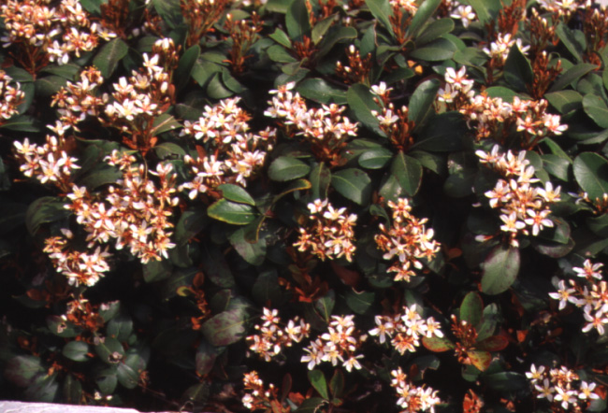
Indian Hawthorn Raphiolepis indica

Slide 54
Indian Hawthorn Key Pests
Insects
Florida wax scale
Diseases
Entomosporium leaf spot

Slide 55
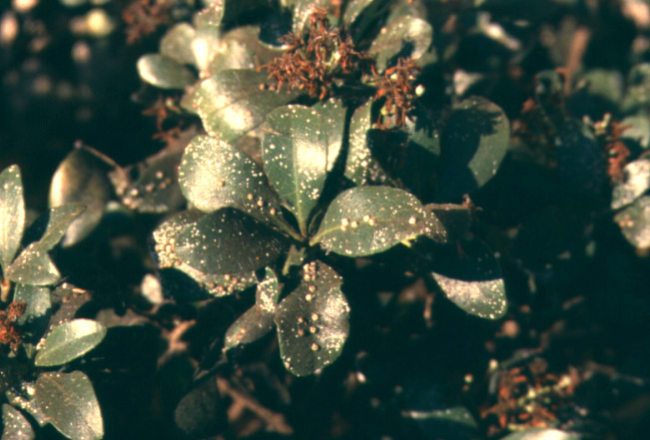
Florida Wax Scale
Mature scale round, convex, creamy
Immatures darker with white fringe
Sooty mold
Chlorotic spots, leaf drop

Slide 56
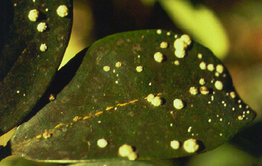
Florida Wax Scale
Present year round
Monitor crawlers spring - summer
Management
Natural biological control
Soaps, oils, insecticides
Ceroplastes floridensis

Slide 57
Entomosporium Leaf Spot
Dark leaf spots with purple borders
Growth distortion
Leaf drop
New growth flushes most susceptible
Optimum temperature 59-77° F
9-12 hours leaf wetness or high humidity

Slide 58
Entomosporium Leaf Spot
Conidia are spread by splashing water
Management
Minimize overhead irrigation, especially at night
Improve air circulation
Maintain low fertility level
Systemic and protectant fungicides

Slide 59
Juniper Juniperus species

Slide 60
Juniper - Key Pests
Insects
Spider mites
Diseases
Mushroom root rot
Rhizoctonia web blight
Tip blight
Wet root rots

Slide 61
Spider Mites
Pale or off-color foliage
Mites, eggs, cast skins, webs visible with hand lens
Two-spotted spider mites (warm and dry)
Southern red mites (cool and moist)
Spruce mites (winter)

Slide 62
Spider Mites
Management
Biological control - predatory mites
Soaps, oils, miticides
Two-spotted spider mite Tetranychus urticae
Southern red mite Oligonychus ilicis

Slide 63
Mushroom Root Rot
Slow decline, thinning of canopy
Gray-green color
White mycellium under bark at soil line
Wide host range
Associated with old plantings

Slide 64
Mushroom Root Rot
Management
Remove diseased plants and roots
Fumigate soil before replanting

Slide 65
Tip Blight
Young plants affected
May follow other stresses
High humidity and cool temperatures (75°F) required for spore germination
Higher temperatures (79-90°F) favor disease development

Slide 66
Tip Blight
Management
Plants usually outgrow the disease
Prune out severe damage
Use approved fungicides on new plantings

Slide 67
Wet Root Rots
Off-color foliage, oldest foliage first
Branch or plant death, may be one-sided
Roots dark and rotted, strip off easily

Slide 68
Wet Root Rots
Disease triggered by excessive soil moisture
Contributing factors:
Poor drainage
Over-watering
Planting too deep
Shallow rooting
Other cultural conditions

Slide 69
Wet Root Rots
Management
Correct cultural problems
Apply fungicide if diagnosed early

Slide 70
Leyland Cypress

Slide 71
Leyland Cypress
Diseases
Seiridium canker
Bot Canker
Insects
Spidermites
Bagworms

Slide 72
Seiridium canker
Seiridium unicorne
Photos: J. Williams-Woodward

Slide 73
Bot Canker
Botryosphaeria dothidea
Lesions are ofter cracked and dark colored
Little or no oozing
These diseases are more prevalent on drought or freeze damaged plants
Sanitation

Slide 74
Ligustrum
L. sinense
(L. LL. japonicum

Slide 75
Ligustrum - Key Pests
Insects
White peach scale
Diseases
Cercospora leaf spot
Corynespora leaf spots
Mushroom root rot
Wet root rots

Slide 76
White Peach Scale
Heavy infestation forms white crust on stems and twigs
Common pest on L. sinense, not L. japonicum
Management
Monitor for parasites
Horticultural soap and oil
Systemic insecticide for severe infestation

Slide 77
Cercospora Leaf Spot
Yellow leaf spots with purple margins; brown raised areas on undersides of leaves
Typical on older plantings of L. japonicum
Poor plant health, dense plantings, shade
Late summer and fall

Slide 78
Cercospora Leaf Spot
Management
Reduce leaf wetness
Avoid excessive pruning
Provide adequate fertilizer and water
Use approved fungicides; spray both leaf surfaces

Slide 79
Corynospora Leaf Spot
Small round leaf spots, red to brown with purple borders
Leaf drop
Warm, moist conditions
Only L. sinense is susceptible
Management
Minimize leaf wetness
Improve air circulation
Use approved fungicides when necessary

Slide 80
Mushroom Root Rot
Slow decline, thinning of canopy
Desiccation
Wide host range

Slide 81
Mushroom Root Rot
White mycellium at soil line
Mushrooms sometimes seen
Management
No control on existing plants
Soil fumigation before planting

Slide 82
Wet Root Rots
Off-color foliage, oldest foliage first
Branch or plant death; may be one-sided
Roots dark and rotted, strip off easily

Slide 83
Wet Root Rot
Disease triggered by excessive soil moisture
Contributing factors:
Poor drainage
Over-watering
Planting too deep
Shallow rooting
Other cultural conditions
Management
Correct cultural problems
Apply fungicide if diagnosed early

Slide 84
Southern Magnolia Magnolia grandiflora

Slide 85
Magnolia - Key Pests
Insects
Magnolia white scale
Diseases
Algal leaf spot

Slide 86
Magnolia White Scale
White armored scales, yellow-brown bodies underneath
Clustered along midrib or scattered on both leaf surfaces
Feeding damage causes yellow spots

Slide 87
Magnolia White Scale
Adults present year-round
Eggs and crawlers visible with hand lens
Also known as False Oleander Scale
Pseudaulacaspis cockerelli
Management
Mature trees usually do not require treatment
Monitor parasitism
Time contact insecticides for crawlers
Systemic insecticides for severe infestations

Slide 88
Algal Leaf Spot
Silvery gray, green or tan raised spots
Most damaging on slow-growing, weakened plants
No fungicides recommended

Slide 89
Pine Pinus species

Slide 90
Pines - Key Pests
Insects
Borers
Pine bark beetles
Pine sawflies
Pine tip moths
Diseases
Fusiform rust
Other
Pine chlorosis and decline

Slide 91
Borers
Branch wilt and dieback
Holes, sap staining or sawdust
Trees weakened or wounded by other factors

Slide 92
Borers
Management
Keep trees healthy to prevent borers
Remove infested or highly susceptible trees
Trunk sprays of insecticides on nearby trees

Slide 93
Pine Bark Beetles
Pitch tubes and/or boring dust on bark
Foliage color changes to yellow to orange-brown
Attracted to weak or wounded trees
Southern pine beetles (SPB) may infect healthy trees

Slide 94
Pine Bark Beetles
Adults bore through bark and construct egg galleries
Larvae tunnel in inner bark

Slide 95
Pine Bark Beetles
Management
Minimize tree stress, avoid root injury
Remove weak or infested trees
Insecticide application to trunk may protect healthy trees from SPB

Slide 96
Pine Sawflies
Larvae look like caterpillars
Large numbers feed on pine needles
Stubby, tufted appearance of pine shoots
Cyclical; 8-10 year intervals
All pine species susceptible

Slide 97
Pine Sawflies
Management
Populations usually controlled by natural enemies
Use approved insecticides during outbreaks
Promote recovery after attack and watch for bark beetles

Slide 98
Pine Tip Moth
Needle drop, dying tips, color change
Webbing and resin at shoot tips
3-5 generations per year
Slash pine most susceptible
Damage occurs most often on young trees

Slide 99
Pine Tip Moth
Management
Damage is mostly aesthetic
Prune out damaged tips if desired
Systemic insecticides on high value trees

Slide 100
Fusiform Rust
Spindle shaped galls on branches or stems
Bright yellow blisters in spring
Fungus must spend part of life on pines, part on oak

Slide 101
Fusiform Rust
Management
Prune branches below galls
Remove trees with galls on branches or main trunks

Slide 102
Pine Chlorosis and Decline
Gradual yellowing of foliage
Thinning of crowns or dieback
Associated with intensive management practices or site disturbances

Slide 103
Pine Chlorosis
Management
Mulch pine stands
Keep maintenance activities and irrigation away
Soil acidification or micronutrients may help
Tree injection in some cases

