Slide 1
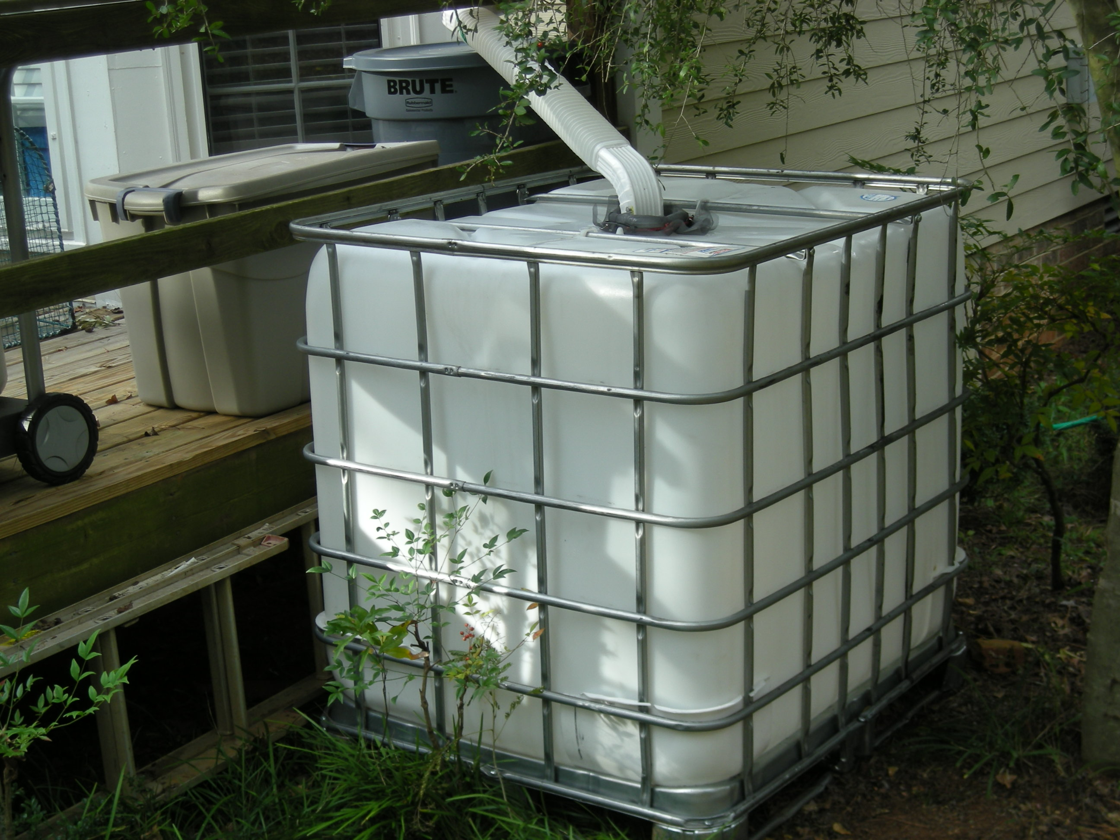
Irrigating with Harvested Water

Slide 2
Rule of thumb for watering
Shrubs: up to once a week - apply one gallon of water per foot of plant height
Lawns: up to once a week -
up to one inch per application
Trees: up to once a week
one inch of water under entire
Canopy (for larger trees don’t
water area within 4 feet of trunk)

Slide 3
How much Water?
Example #1 – lawn area
Low
Low
H
H
Lawn
25’ x 40’ = 1,000 ft²
1” per week = 624 gal.
~2500 gal./month
*Do we need to water lawns?
Notes:
Converted woody plants in natural area into unirrigated low water use zone. Lawn used as a welcome mat, selected drought tollerant
turf that requires minimal water (could convert to a low water use zone if aesthetics acceptable). Groundcover and shrub boarder is
Established and does not require additional irrigation. Added some high water use flower pots in high visibility area near door to add interest

Slide 4
5’
Plant Height (1gal/ft)
2’
3’
Example #2
Low
4’
Low
.5/d
.5/d
3’
Ornamentals
6’
Color: 1 gal./day * 7 days = 7 gal.
2’
+
2’
4’
Shrubs: 43’ of plant = 43 gal.
5’
50 gal./week
200 gal./ month
7’
*Can we harvest & store 200 gal. per month?
Notes:
Converted woody plants in natural area into unirrigated low water use zone. Lawn used as a welcome mat, selected drought tollerant
turf that requires minimal water (could convert to a low water use zone if aesthetics acceptable). Groundcover and shrub boarder is
Established and does not require additional irrigation. Added some high water use flower pots in high visibility area near door to add interest

Slide 5
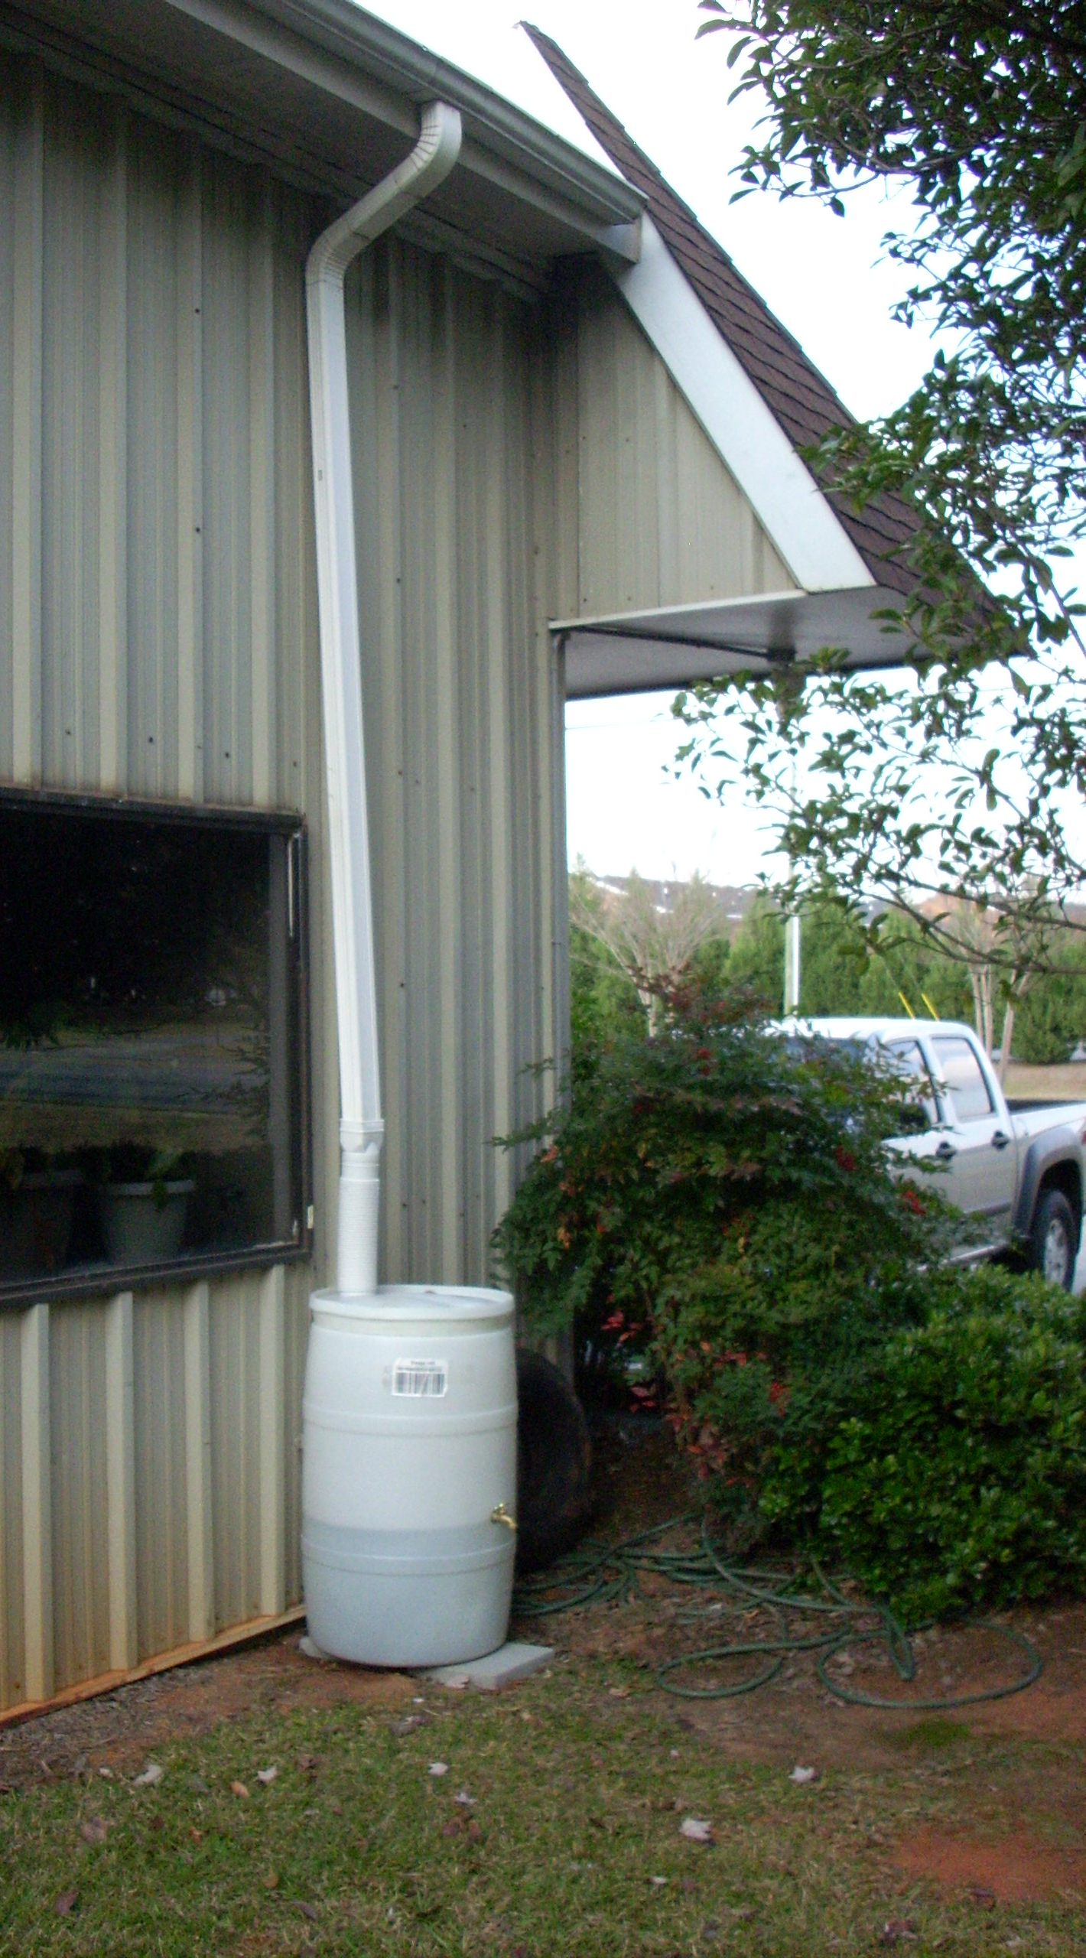
Drought Year Rainfall (2007) Rome, GA
April | 1.36
May | 0.26
June | 4.37
July | 3.42
August | 1.19
September | 1.46
October | 2.89
November | 0.93

Slide 6
Rainfall on a 20 x 50’ roof area (1,000 ft²)
Month | Rainfall (inches) | 624 (gal/in) | Volume (gal)
April | 1.36” | 624 | 849
May | 0.26” | 624 | 162
June | 4.37” | 624 | 2,727
July | 3.42” | 624 | 2,134
August | 1.19” | 624 | 743
September | 1.46” | 624 | 911
October | 2.89” | 624 | 1,803
November | 0.93’ | 624 | 580

Slide 7
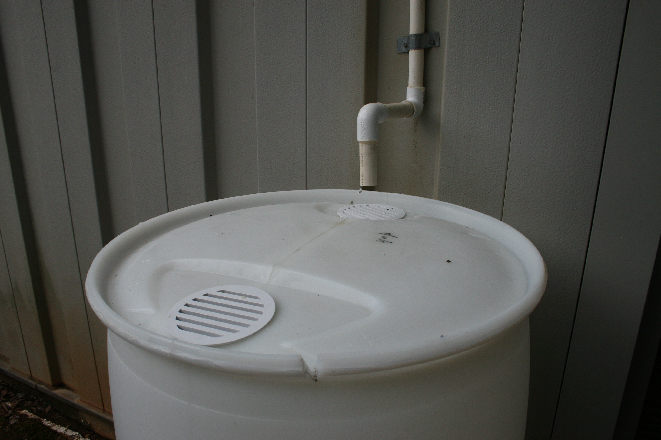
Condensate from Air Conditioners and Dehumidifiers
Home AC can produce over 5 gal./day

Slide 8
Condensate Harvesting Potential
AC production | Example: 10 gpd
Multiply by 7 to convert to gallons per week | 70 gal. per week
Multiply by 4 to convert to gallons per month | ~280 gal. per month
Need ~7+ gpd to get 200 gpm

Slide 9
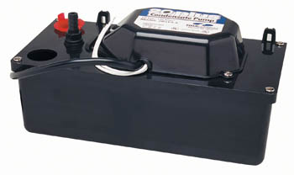
Condensate Pumps
Pump ~25 gph with 15’ head
Cost ~ $50

Slide 10
Rainwater & Condensate Water
Irrigation is not restricted

