Slide 1
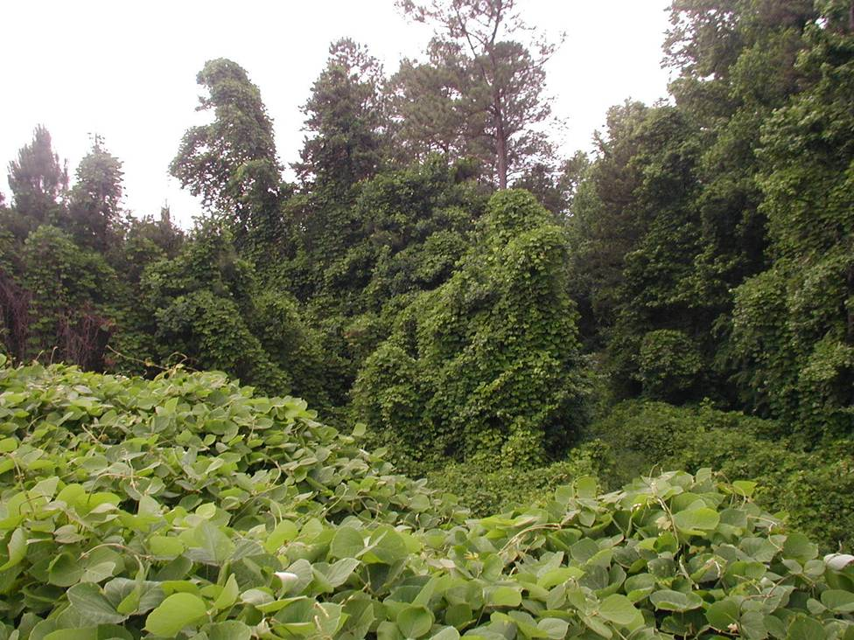
Invasive Exotic Plants
Becoming Part of the Solution
Georgia Exotic Pest Plant Council
Notes:
1. (Introduce yourself and explain the purpose of the program.) This program provides an overview of the Invasive Exotic Pest Plant issue in Georgia, the Southeast and the U.S. and discusses how you can get involved and become part of the solution.

Slide 2
Invasive species defined:
Species that are not native to a given ecosystem and whose introduction to that ecosystem causes or is likely to cause economic or environmental harm or harm to human health
- Executive Order 13112
February 3, 1999
Notes:
2. Invasive species are defined as (read slide). This is the official definition as stated in the Executive Order issued by President Clinton in 1999.

Slide 3
What is an Exotic Plant?
An alien, foreign, or non-native introduced species that occurs in locations beyond its natural range
Chinese wisteria Wisteria sinensis
Notes:
3. An exotic plant is a non-native species introduced from another part of the world. Other terms sometimes used to describe exotic pest plant species, include Foreign, Alien, and Non-native.

Slide 4
Many of the characteristics of invasive plants are the very same ones that make them appealing as landscape plants
Notes:
4. Ironically, many of the characteristics that make invasive plants invasive are the same ones that make them appealing as landscape plants. They are tough, adaptable, quite ornamental, and easy to propagate.

Slide 5
How Did They Get Here?
85% of invasive plants were intentional introductions for ornamental or landscape purposes.
14% of invasive plants were introduced for agricultural purposes.
Most non-native (exotic) plants are NOT invasive. For every 100 plant species introduced, 10 become free-living exotics, while 1 becomes invasive.
Source: Dr. Randy Westbrook, Invasive Plant Fact Book
Notes:
5. How Did They Get Here? (Read slide.)

Slide 6
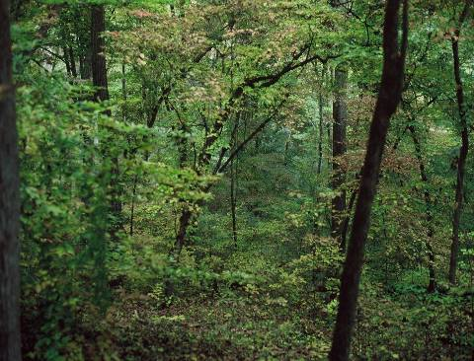
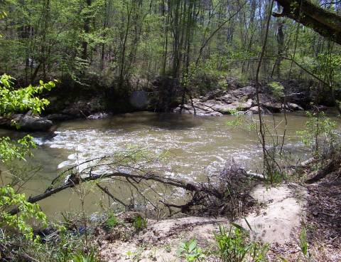
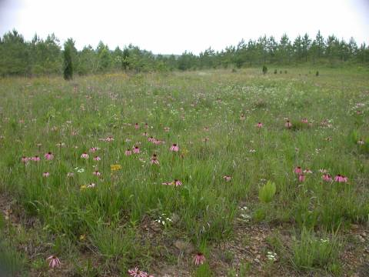
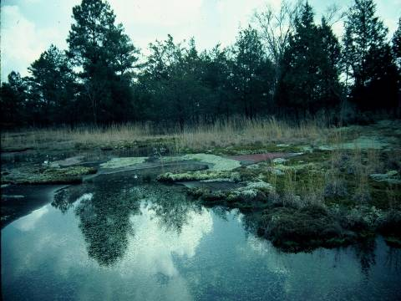
Notes:
6. There are a variety of mature plant communities in Georgia. Upper left is a typical mid-slope forest. Upper right is flood plain/levee forest. Lower left shows a coosa prairie. Lower right is a granite outcrop. A forest, like that shown at the upper left, is less vulnerable to many invaders because the plant community is more stable and there is less natural disturbance, whereas a levee forest is more vulnerable because change is a natural part of the stream system. Stream levels fluctuate and bring in many potential invaders. The Coosa Prairie and granite outcrop are rare plant communities, but they are very sensitive to invaders. These four examples are essentially invasive free.

Slide 7
How Do Invasive Plants Damage the Environment?
Compete with native species
Change the structure of the plant community
Interfere with the natural ways that plant communities evolve
Impact wildlife by altering the diversity of plant communities
Affect the recreational benefits of an area
Notes:
7. Invasive plants damage the environment in a variety of ways.
They compete with native species for light,water, nutrients, etc., and may lead to a decline in numbers and diversity of the natural flora.
They change the structure of the community by eliminating or altering different layers, such as the ground layer, shrubs, understory, and canopy.
They also interfere with the successional process after natural or man-made disturbance by reducing colonization by native species.
They alter the vegetative diversity, decrease food sources and protective cover for wildlife.
They have a negative impact on the recreational benefits of an area by decreasing accessibility and reducing aesthetic values.

Slide 8
Characteristics of Invasive Plants:
Produce lots of seed
Effective dispersal methods
Rapid maturity
Rapid vegetative growth
Long-lived
Highly adaptable to a variety of habitats
Easily established
NOTE: Not all invasive plants have ALL of these characteristics
Notes:
8. Common characteristics of invasive plants. (Read slide.)

Slide 9
Why Are They So Successful?
Absence of natural predators
Most thrive on disturbed soil
Climate is similar to native habitat
Notes:
9. Why are they so successful? Our natural ecosystems have evolved over many thousands of years. While plants and animals have always moved around, their migration has historically been at a slow rate, allowing time for other members of the community to adapt to them. However, as human activity moves species at ever-increasing rates, there is insufficient time for natural plant communities to adapt to such rapid changes. In their new habitat, invasive species lack the natural controls (pathogens, predators and competition from other plants) with which they evolved. This often gives them a competitive edge over the species native to the area.
Many invasive plants thrive on disturbed soil, and out-compete native vegetation.
Furthermore, our southeastern climate is similar to the native habitat from which the invaders came, so they can readily adapt and establish new colonies.

Slide 10
While the problem of invasive plants has been around for decades, we have only recently focused on the issue.
Notes:
10. (Read slide.)

Slide 11
What is being done: National level
Executive Order 13112 (February 1999)
Directs Federal agencies to
Prevent introduction
Detect and respond, monitor, and research
Not authorize, fund, or carry out actions likely to further spread
Establish National Invasive Species Council
Develop National Invasive Species Management Plan
Notes:
11. (Read slide.)

Slide 12
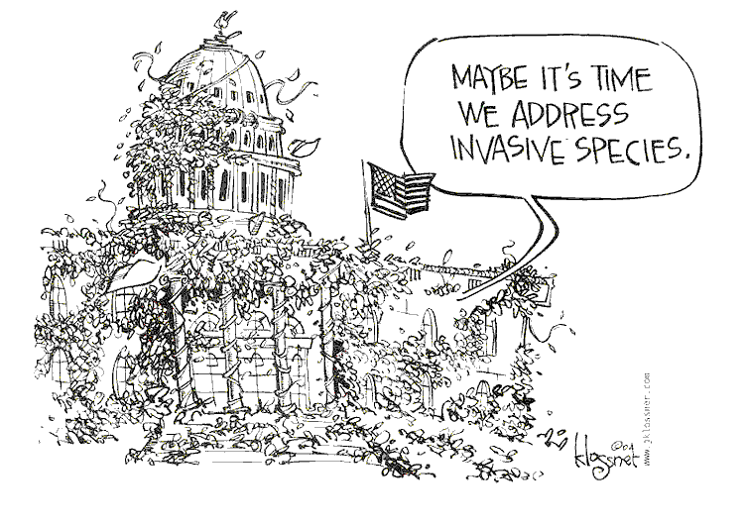
Notes:
12. Unfortunately, not much has been done at the Federal level since the Executive Order.

Slide 13
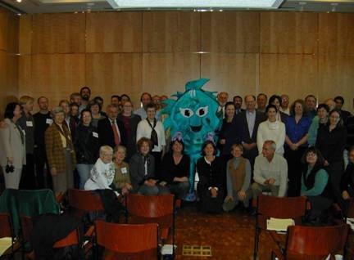
The Invasive Plant Workshop: “Linking Ecology and Horticulture to Prevent Plant Invasions”
First held in St. Louis in 2001 with a second workshop in Chicago in 2002
Attended by professionals concerned with ornamental plants and the issue of invasive plants
In brief, the workshops identified needs and goals to begin addressing the relationship of invasive plants and the horticulture industry.
Notes:
13. In 2001, the first national meeting of industry professionals concerned with invasive pest plants was held at the Missouri Botanical Garden in St. Louis. This meeting was a milestone in the efforts to begin addressing the issue.

Slide 14
Local efforts: Exotic Pest Plant Councils
Georgia Exotic Pest Plant Council (GA-EPPC) was established to provide a forum to focus on the issue of invasive plants, their effects on natural systems, and their controls
Membership includes representatives from county, state and federal agencies, environmental and trade associations, plant societies, as well as other concerned citizens.
Notes:
14. Several states have formed Exotic Pest Plant Councils. The Georgia Exotic Pest Plant Council, GA-EPPC, was formed in the early 90’s and currently includes membership from several county, state and federal agencies, environmental and trade associations, plant societies, as well as other concerned citizens. The Georgia Exotic Pest Plant Council is part of the SE-EPPC, umbrella organization for the region.

Slide 15
Some Invasive Plants in Georgia
Chinese Privet (Ligustrum sinense)
Japanese Honeysuckle (Lonicera japonica)
Kudzu (Pueraria montana var. lobata)
Nepalese Browntop (Microstegium vimineum)
Golden Bamboo (Phyllostachys aurea)
Autumn Olive (Elaeagnus umbellata)
Chinese Tallowtree (Triadica sebifera syn. Sapium sebiferum)
Hydrilla (Hydrilla verticillata)
Mimosa (Albizia julibrissin)
Asian Wisterias (Wisteria sinensis and W. floribunda)
English Ivy (Hedera helix)
Multiflora Rose (Rosa multiflora)
Glossy Privet (Ligustrum lucidum)
Japanese Privet (Ligustrum japonicum)
For a more comprehensive list, see www.gaeppc.org
Notes:
Here are some of the non-native invasive plants in Georgia. For a complete and current list of invasive plants in Georgia, see the Georgia Exotic Pest Plant Council’s web site at www.GAEPPC.org.
Let’s look briefly at some of the characteristics that gained these plants a spot on this list.

Slide 16
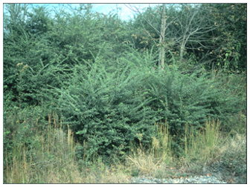
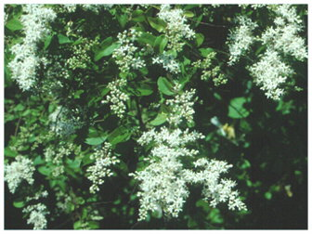
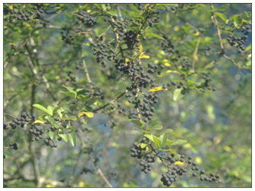
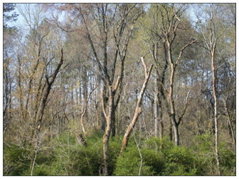
Chinese Privet Ligustrum sinense
Notes:
16. Chinese Privet, introduced from China in the early 1800’s, is considered one of the most aggressive and troublesome invasive plants in Georgia. It forms dense thickets in bottom-lands, stream banks, and along fence rows, thus gaining access to forests, fields and rights-of-way. It is shade tolerant, colonized by root spouts, and its abundant seeds are spread by birds and other animals, as well as waterways. It is nearly impossible to find a floodplain or stream bank in the Southeast which is free from Chinese Privet. This evergreen not only competes with native groundcovers and shrub species, but also hinders the regeneration of canopy trees.

Slide 17
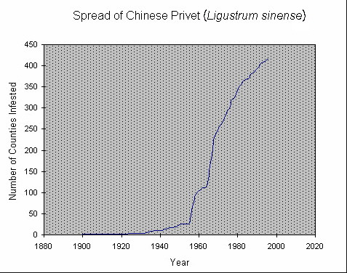
Source: NRCS Plant Guide
Notes:
17. A plant’s invasive potential may not be immediately apparent. For instance, Chinese Privet was introduced into the U.S. from China in 1852 as an ornamental shrub. By 1900, herbaria records show it beginning to escape cultivation. Then, by 1950, its population exploded! Today, it invades over 400 counties in the southeastern U.S.

Slide 18
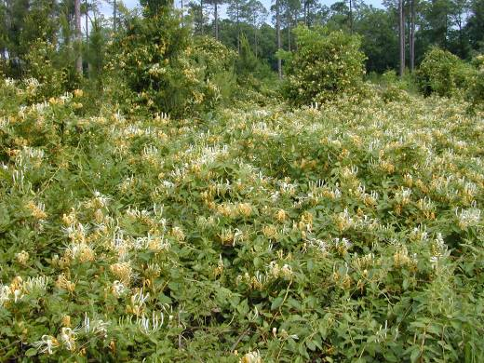
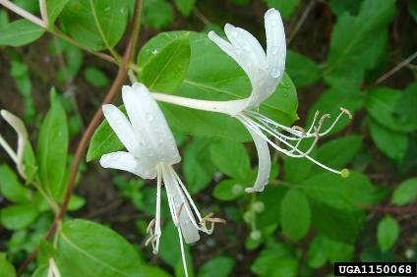
Japanese Honeysuckle Lonicera japonica
Notes:
18. Japanese Honeysuckle was introduced from Japan in the early 1800’s. Today, it covers an estimated 40 million acres of Southeastern forests. Japanese Honeysuckle overwhelms and replaces native flora on a wide range of sites, occurring as dense infestations along forest margins and rights-of-way. It grows within the understory and climbs high within tree canopies. Colonies spread by rooting along nodes and by animal dispersal of seeds. It has been used as a flowering vine for home landscapes, as wildlife habitat, deer browse, and for erosion control.

Slide 19
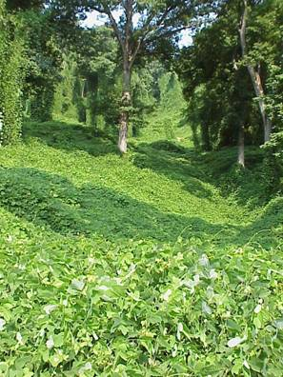
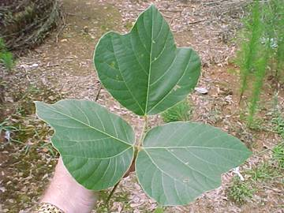
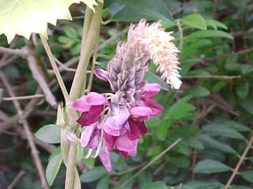
Kudzu Pueraria montana
Notes:
19. Kudzu is probably the most widely recognized invasive plant in the Southeast. It was first introduced in 1876 at the U.S. Centennial Exposition in Philadelphia. By 1900 is was being used as a fragrant, flowering porch vine. Later, it was planted for erosion control and by farmers for livestock fodder. Today it covers an estimated 1 million acres and continues to spread. It forms dense mats over the ground from large underground tubers and engulfs anything in its path, twining around objects and climbing trees and telephone poles. It spreads by creeping along the ground, rooting at its nodes, and to some extent by seed. A single vine may grow 100 linear feet in one growing season.

Slide 20
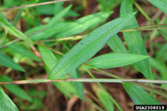
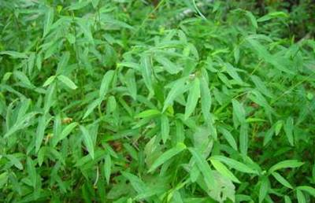
Nepalese Browntop (syn. Japanese Stiltgrass) Microstegium vimineum
Notes:
20. Nepalese Browntop (also called Japanese Stiltgrass) is an annual grass which produces prolific amounts of seed and establishes dense stands in a variety of habitats, where it out-competes native species. Each plant produces from 100 to 1000 seeds that can remain viable in the soil for five or more years. It spreads in a variety of ways, hitchhiking on anything it can attach to. Native to temperate and tropical Asia, it was first discovered in the U.S. in Knoxville, Tennessee in 1919.

Slide 21
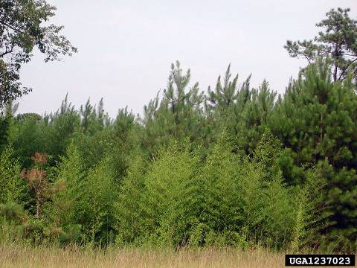
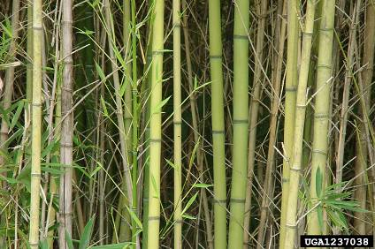
Golden Bamboo Phyllostachys aurea
Notes:
21. Golden Bamboo is common around old homesteads and has escaped from these locations. It colonizes by aggressive underground roots called rhizomes. Native to Asia, it was imported for its ornamental value and is still grown for screening, wind-breaks and fishing poles.

Slide 22
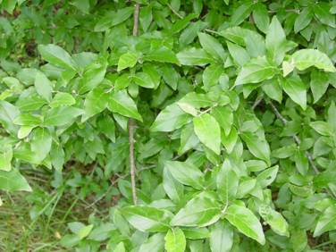
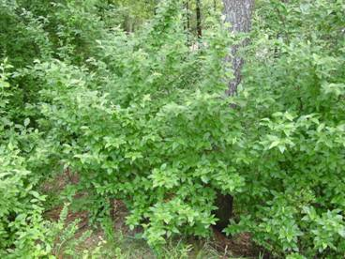
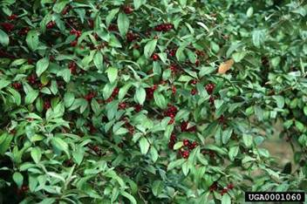
Autumn Olive Elaeagnus umbellata
Notes:
22. Autumn Olive, like Chinese privet, forms dense stands in a variety of Southeastern forests. Its animal-dispersed seeds are widely spread. It was introduced from China and Japan around 1830 and was widely planted for wildlife habitat and food, strip mine reclamation, and shelter belts. It prefers dry sites and is shade tolerant.

Slide 23
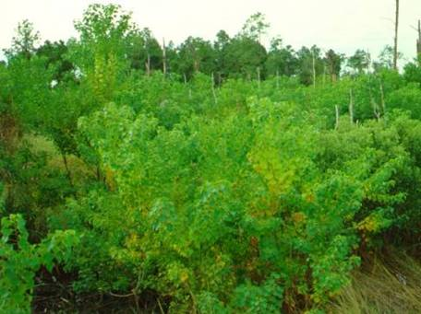
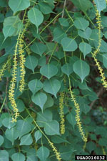
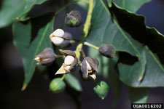
Chinese Tallowtree
Triadica sebifera
(syn. Sapium sebiferum)
Notes:
23. Chinese Tallowtree is a serious pest in Georgia’s Coastal Plain, where it dominates many wetlands. It is frequently called the Popcorn tree since its seeds, bursting from their coverings, look like popcorn. It prefers stream banks, riverbanks and ditches but may also invade upland sites. It is shade tolerant, flood tolerant and has increased widely through ornamental planting. It spreads by birds and water as well as by its prolific root sprouts. It was introduced from China in the 1700’s.

Slide 24
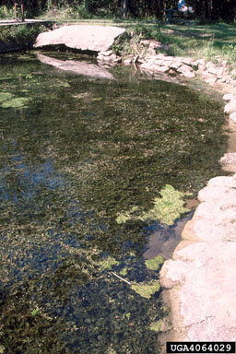
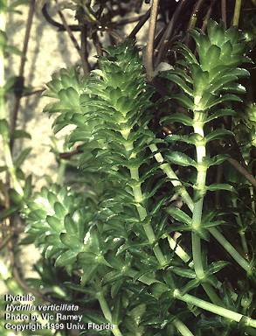
Hydrilla
Hydrilla verticillata
Notes:
24. Hydrilla is an invasive aquatic weed throughout the southern United States. It out-competes native submerged aquatic vegetation and can quickly fill a pond or lake, choking out other vegetation, altering the aquatic ecosystem, and interfering with boating, fishing, swimming and other recreational activities.

Slide 25
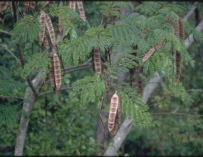
Mimosa Albizia julibrissin
Notes:
25. Mimosa colonizes disturbed areas and forest edges and produces abundant long-lived seeds. As a nitrogen fixer, mimosa can alter the natural fertility of native plant communities. Introduced as an ornamental tree from Asia in 1745, Mimosa forms colonies from root sprouts and spreads by animal and water dispersed seeds.

Slide 26
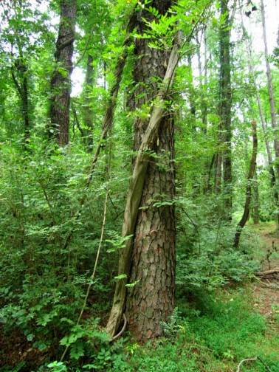
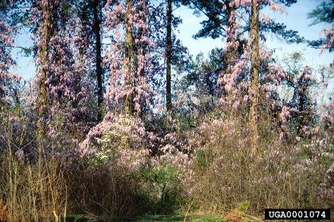
Asian Wisterias (Wisteria floribunda, Wisteria sinensis)
Notes:
26. The massive vines formed by Asian wisterias physically damage trees. There are two common invasive species: Wisteria floribunda and Wisteria sinensis. Their rapid vegetative growth and shade tolerance allow them to spread readily into forested areas. They engulf trees and shrubs, reducing their photosynthesis. Wisterias colonize by rooting at their leaf nodes and by seed dispersal. These Wisterias were introduced from Asia in the early 1800’s as ornamental vines.

Slide 27
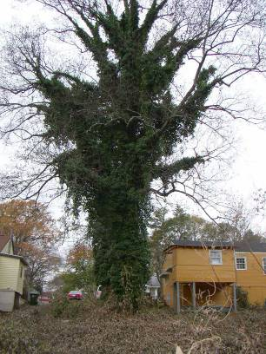
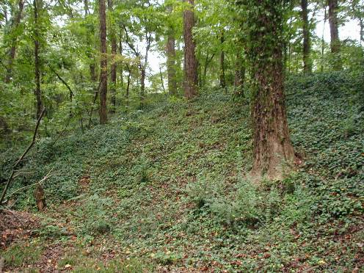
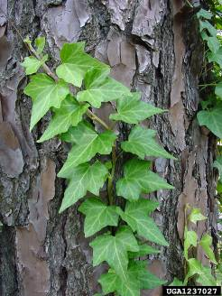
English Ivy Hedera helix
Notes:
27. English ivy was introduced from Europe in colonial times and is still widely planted as an ornamental groundcover. However, when it escapes cultivation, English Ivy can be quite invasive. It thrives in moist, open forest and adapts to a range of moisture, light levels and soil conditions. It spreads by bird dispersed seeds and colonizes by trailing and climbing vines that root along their nodes.

Slide 28
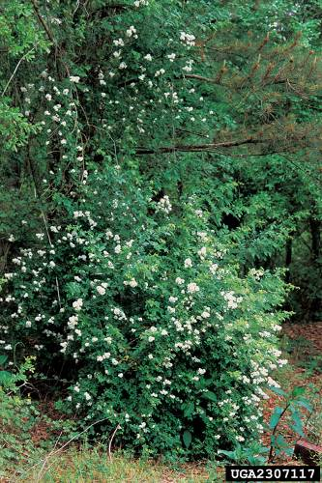
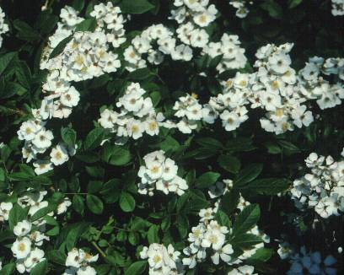
Multiflora Rose Rosa multiflora
Notes:
28. Multiflora rose is an aggressive and tenacious grower, growing over, around, and through other shrubs and trees and forming dense thickets. Large numbers of fruit are eaten and dispersed by birds. The arching canes will root where their tips touch the ground. Native to Asia, the multiflora rose was introduced in 1866 as a rootstock for ornamental roses. Beginning in the 1930’s the plant was promoted as a “living fence” and was used as a crash barrier in the medians of highways, and as a windbreak.

Slide 29
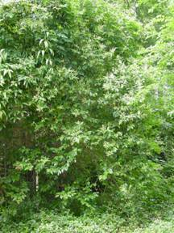
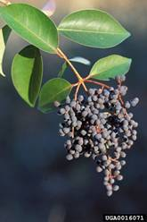
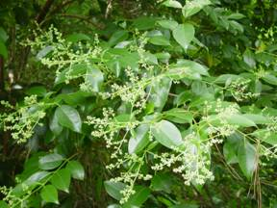
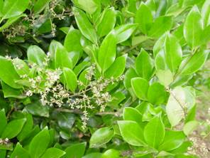
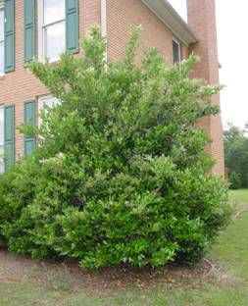
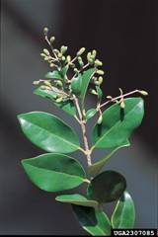
Other Privets
Glossy Privet
Ligustrum lucidum
Japanese Privet
Ligustrum japonicum
Notes:
29. Glossy Privet and Japanese Privet grow as single plants or in thickets. They occur in the same habitats as Chinese Privet, but generally are not as abundant, depending upon location. They invade both lowland and upland habitats, but are usually more prevalent in lowlands. They colonize by root sprouts and dispersal of seeds by animals. Introduced from Japan and Korea in 1845 and 1794, respectively, they were (and still are) widely planted as ornamentals and have escaped to become invasive.

Slide 30
Other Invaders of Importance South Georgia
Giant Reed Grass
Cogongrass
Japanese Climbing Fern
Notes:
30. (Read slide.)

Slide 31
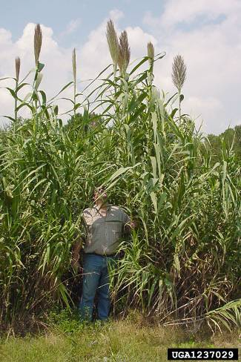
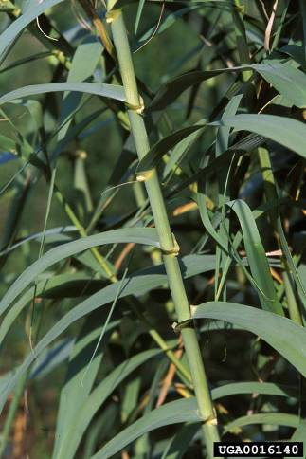
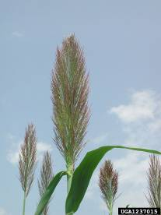
Giant Reed Grass Arundo donax
Notes:
31. Giant Reed Grass is another ornamental plant that has escaped to become a problem. It forms large scattered dense clumps along roadsides and forest margins. Its underground roots are spread by road shoulder grading. A native of India, Giant Reed Grass was introduced in the early 1800’s. It resembles golden bamboo but prefers more upland sites. It is often called “cemetery grass” because it is often planted as an ornamental and for screening in old cemeteries.

Slide 32
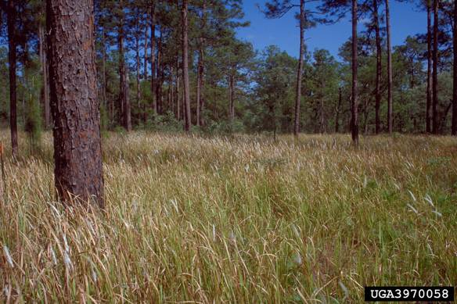
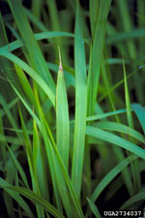
Cogongrass Imperata cylindrica
Notes:
32. Cogongrass is ranked as one of the ten worst weeds in the world. It can only be controlled by constant, expensive, and labor intensive methods. Its branching, underground roots form a dense mat which excludes other vegetation. Wind-dispersed seeds spread it to other areas. It tolerates a wide range of environmental conditions. Cogongrass was introduced from Southeast Asia into the southeastern U.S. in the early 1900’s for soil stabilization. It is now listed as a Federal noxious weed, and as such, is prohibited from being imported or planted. Please report any sighting to the Forest Service or your county Extension Agent.

Slide 33
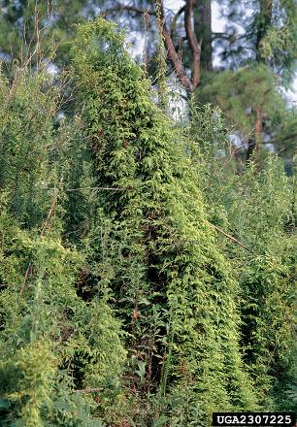
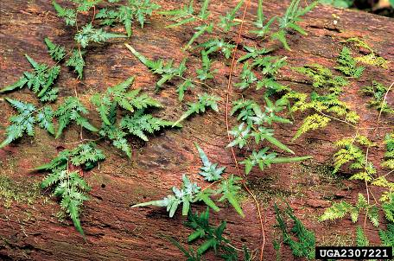
Japanese Climbing Fern Lygodium japonicum
Notes:
33. Japanese Climbing Fern can be found in a variety of areas, from open habitats to forests. It forms a thick, dense mat that smothers shrubs and trees. Tiny wind-dispersed spores, persistent underground stems, and unsuspecting gardeners spread this invasive import. It is commonly spread in baled pine straw. Native to Asia and tropical Australia, it was introduced from Japan in the 1930s as an ornamental vine.

Slide 34
Other Invaders of Importance North Georgia
Princess-tree
Amur Honeysuckle
Oriental Bittersweet
Chinaberry
Tree of Heaven
Miscanthus
Notes:
34. (Read slide.)

Slide 35
Princess-tree
Paulownia tomentosa
Notes:
35. Princess-tree can be found around old home sites, on roadsides, near river banks, and at forest edges. It is a showy but aggressive ornamental that has been in North America since the 1800’s. It spreads by seeds dispersed by wind and water and often invades an area after fire, crop harvesting, or other soil disturbances. Getting rid of a Princess-tree is a problem. It sprouts from buds on its stem and roots. Suckers emerge after fire, cutting, and bulldozing. It thrives in marginal areas, such as rocky slopes, which also are habitats for rare native plants. In the past the tree was promoted for commercial production of fast-growing wood.

Slide 36
Amur Honeysuckle
Lonicera maackii
Notes:
36. Amur Honeysuckle is one of several exotic bush honeysuckles introduced from Asia in the 1700’s and 1800’s. It has been used for wildlife cover, for erosion control, and as an ornamental. Once established, Amur Honeysuckle competes with native plants for soil moisture and nutrients, light, and even pollinators. Its seeds are spread by birds and small mammals. Established plants can colonize an area by root sprouts.

Slide 37
Oriental Bittersweet Celastrus orbiculatus
Notes:
37. Oriental Bittersweet was introduced from Asia in 1736. It is a fast growing vine that covers and kills other plants by preventing photosynthesis, by girdling them, or by weighing them down and thus uprooting them. It mainly inhabits forest edges, but also can be found in forest openings, on roadsides and in meadows. Birds and small animals disperse the seeds. Vines, with their attractive berries, are traditionally collected as home decorations in winter. The discarded decorations are another way that the seeds have been dispersed.

Slide 38
Chinaberry
Melia azedarach
Notes:
38. Chinaberry was introduced in the mid-1800’s from Asia and was widely planted as an ornamental around homesites. It forms colonies from rootsprouts. The long lasting berries are dispersed by birds and are poisonous to humans and livestock.

Slide 39
Tree of Heaven
Ailanthus altissima
Notes:
39. Tree of Heaven is a prolific seed producing plant imported from Europe in 1784 for its ornamental value. It escaped the backyards of cities and suburbs to thrive and replace native plants. Plants as young as two years can produce viable seeds that are dispersed by wind and water. Its roots produce chemicals that discourage the growth of other plants. Removing large female trees is one suggested strategy for controlling this invader.

Slide 40
Miscanthus Miscanthus sinensis
Notes:
40. Miscanthus is widely planted as an ornamental. There are over 20 cultivars in the nursery trade, some of which are highly invasive. Once established, the plant is adaptable to harsh areas, ranging from very wet to very dry sites. When untended along roadsides, at forest margins, and other disturbed sites, it can be a fire hazard. Fire contributes to its dispersal.

Slide 41
How You Can Make A Difference
Plant only non-invasive species.
Remove invasive plants from your land.
Do not trade potentially invasive plants with other gardeners.
Notes:
41. How You Can Make A Difference.
--Plant only non-invasive species. A list of suggested alternatives is currently being developed by representatives from the Georgia Green Industry Association, the Georgia Exotic Pest Plant Council, Georgia Native Plant Society, and other interested groups.
--Removing invasive plants from your land might involve anything from pulling English Ivy growing up a tree to eradicating an entire field of Kudzu.
--Do not trade potentially invasive plants with other gardeners.

Slide 42
How You Can Make A Difference
Design gardens compatible with regional ecosystems.
Help educate your community and other gardeners in your area.
Volunteer to assist in efforts to control invasive plants.
Notes:
42. When designing gardens, select regionally adapted plants that are non-invasive; help educate others in your community about invasive plants; volunteer to assist in efforts to control invasive plants.

Slide 43
Current GA-EPPC Activities
Serves as a source of information on invasive plant species and their control
Identifies research needs
Conducts invasive plant control workshops
Prepares educational presentations and publications
Networks with agencies, societies, and trade associations
Explores policy options
Notes:
43. This is what the GA-EPPC is doing to make a difference. (Read Slide.)

Slide 44
The Georgia Exotic Pest Plant Council (GA-EPPC) encourages your involvement in efforts to address this very serious issue.
Notes:
44. (Read slide.)

Slide 45
Visit the GA-EPPC website at www.gaeppc.org
Notes:
45. Visit the GA-EPPC web site for more information.

Slide 46
Contributing Authors:
Jim Allison, GA Dept. of Natural Resources (retired)
Chuck Bargeron, Dept. of Entomology, UGA
Cilla Cartwright, GA Wildlife Federation
Connie Gray, DeKalb County Parks and Recreation
Russell Hattaway, The Home Depot
Cindy Reittinger, GA State Parks & Historic Sites
John Taylor, USDA Forest Service
Gary Wade, Dept. of Horticulture, UGA
Brighton West, Trees Atlanta
Notes:
46. Credits

