Slide 1

Notes:
UGA Logo

Slide 2
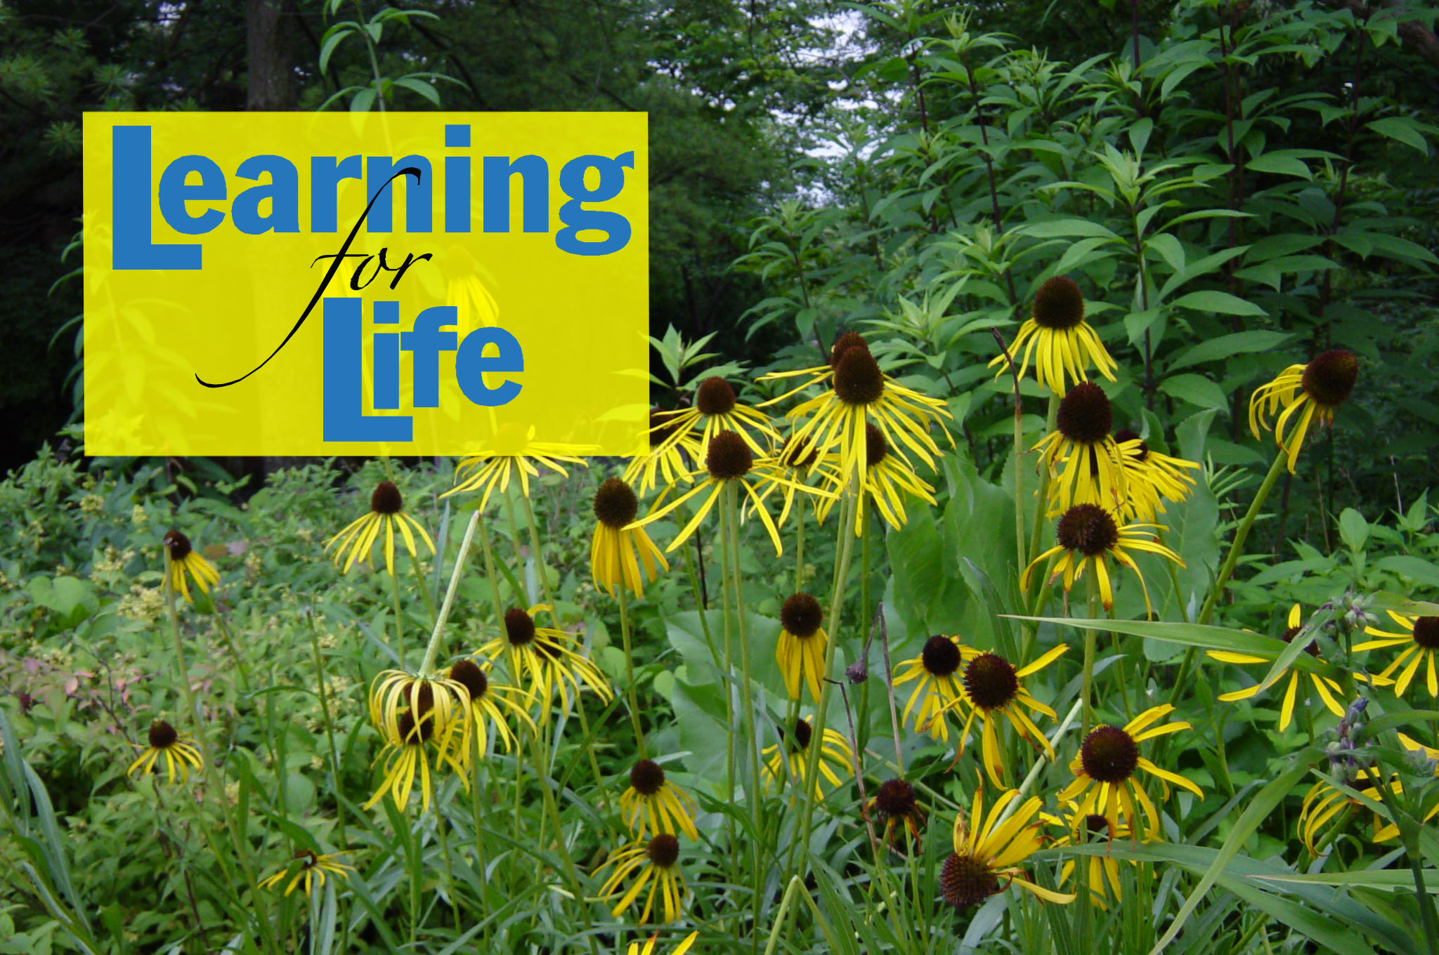
www.ugaextension.com
Notes:
UGA Cooperative Extension Web address

Slide 3

Notes:
Georgia Master Gardener Logo

Slide 4


THE
GEORGIA MASTER GARDENER PROGRAM
Marco T. Fonseca
Extension Consumer Horticulturist
and State Master Gardener Coordinator
Notes:
Title Slide

Slide 5
www.gamastergardener.org
Notes:
Master Gardener Logo & Master Gardeners on the Web Information on the Georgia Master Gardener program may be found on the world wide web at: This site contains resources for Master Gardeners and coordinators as well as upcoming educational and volunteer opportunities. As technology advances, Master Gardeners will find more opportunities to communicate, educate and learn in ways we never dreamed possible.

Slide 6
MISSION STATEMENT
To assist Cooperative Extension
by training
Master Gardener Volunteers
to provide
unbiased horticultural information
through volunteer community service and educational gardening projects using applied research and the resources of the University of Georgia.
Notes:
Mission Statement Our Master Gardener mission statement is: ‘To assist the Cooperative Extension by training Master Gardener Volunteers to provide unbiased horticultural information through volunteer community service and educational gardening projects using applied research and the resources of the University of Georgia.

Slide 7



www.caes.uga.edu
Notes:
University of Georgia College of Agricultural and Environmental Sciences The Cooperative Extension Service is operated primarily in Georgia under the University of Georgia College of Agricultural and Environmental Sciences. The CAES is divided into 3 main areas; Research, Teaching and Service or Extension. Visit www.uga.edu/caes for more information.

Slide 8
Notes:
Cooperative Extension Service The Master Gardener Program is a part of the Extension Service which was established in 1914. The overall objective of the Extension Service is to plan, carry out and evaluate learning experiences that will help people gain the knowledge and skills needed to solve farm, home and community problems. Extension Service programming in Georgia falls mainly under 3 areas: Agricultural and Environmental Sciences, 4-H and Youth, and Family and Consumer Sciences. For more information visit http://www.ces.uga.edu

Slide 9
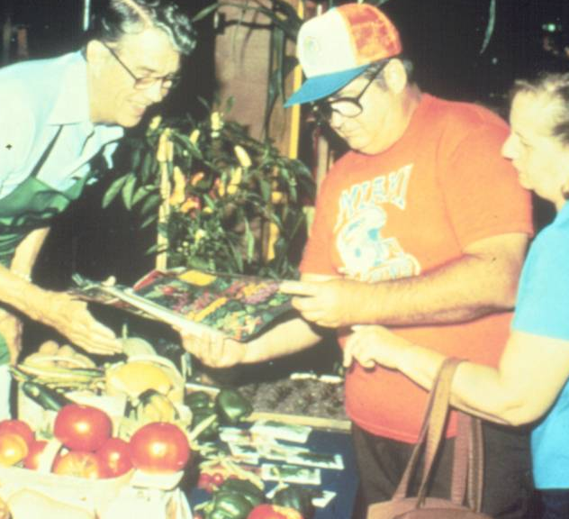
Master Gardener History
Notes:
Master Gardener History In the early 1970's, interest in home gardening was growing and county Extension offices were overwhelmed with requests for horticultural information. A Cooperative Extension Agent in Washington state developed a program to train experienced gardeners to help answer homeowners’ questions. These volunteers came to be known as Master Gardeners.

Slide 10
Georgia MG History
1979 First class- 140 participants from Atlanta area.
1988 First Master Gardener Conference in Athens.
1990 First official GMGA meeting.
2004 25th Anniversary
Notes:
Master Gardeners in Georgia The Master Gardener Program sprouted in Georgia in 1979 with its first group in Metro Atlanta. Other areas of the state quickly followed.

Slide 11
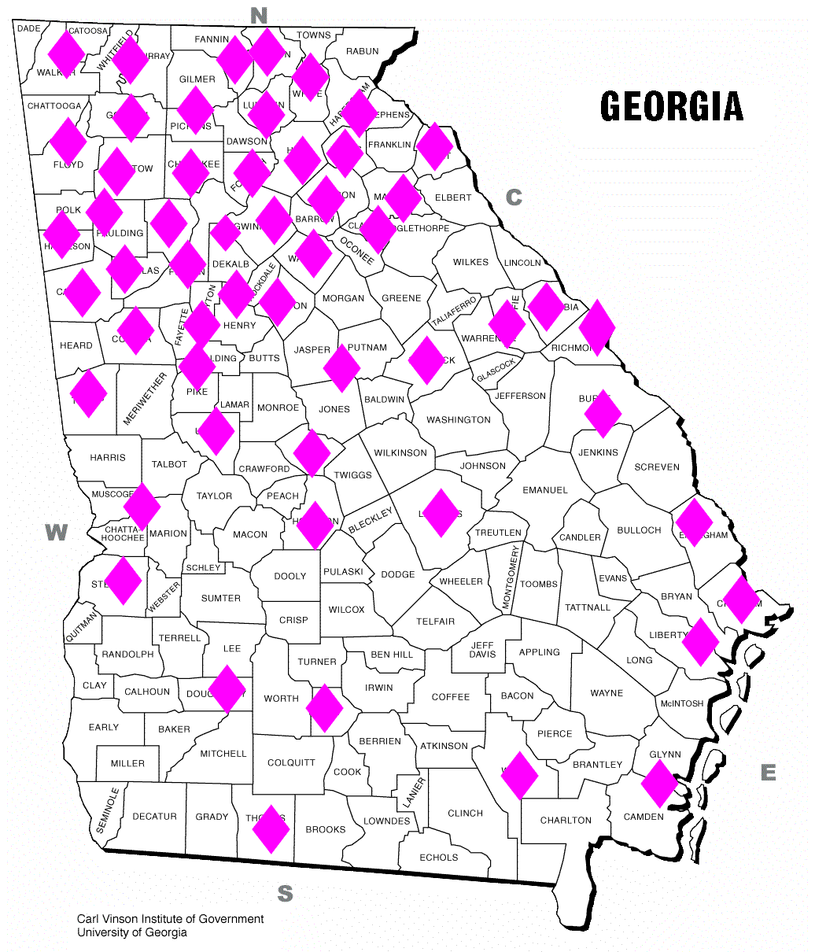
Currently
Over 2500 Active Georgia Master Gardeners
140, 000+ hours of service each year
108 counties participating
Notes:
Currently The program has since grown to over 100 counties of the state with several thousand Master Gardeners trained. In last year’s state annual report 2500 active Master Gardeners recorded over 140 thousand hours of service.

Slide 12

25 years of service to Cooperative Extension and the communities of Georgia.
Notes:
2004-2005 Georgia Master Gardener celebrated 25 years of service to Cooperative Extension and the communities of Georgia.

Slide 13
Becoming a Georgia Master Gardener
You must:
Apply and be selected.
Attend at least 80% of classes.
Pass exams.
Complete Volunteer Service
  1st year- 50 hours of service required.
Notes:
To Become a Georgia Master Gardener Interested gardeners apply through the county in which they live and are selected by the county agent or committee under the agent’s direction. Participants must attend at least 80% of the classes and must pass required exams. After training, “Interns” must complete and document 50 hours of approved service in their county within the year following training.

Slide 14
Logbook
Notes:
Logbook A logbook will be provided for you to record your volunteer service as well as your continuing education. The logbook is designed to be used for more than one year and contains information about what qualifies as volunteer service. At the end of each year, fill out a summary sheet from the back of the book and forward it to your county agent so that you may be certified. Plans are in work to have web-based reporting for volunteer hours in the near future.

Slide 15
To Remain Certified
25 hours of approved volunteer service each year.
Document service and turn in logbook summary at year’s end.
Notes:
To remain a ‘certified’ or ‘active’ Master Gardener Each year, 25 hours of approved service is required to remain a certified Master Gardener.

Slide 16
Goals of Training
Are To-
Provide: Basic training, knowledge and confidence.
Teach: How to answer common questions.
Suggest: Resources for answers to less common questions.
Notes:
Goals of Training The goals of Master Gardener Training are: To provide volunteers with the horticulture-related training, knowledge and confidence to become a certified Master Gardener; to teach volunteers how to answer basic gardening questions and to give suggestions on where to find the information to answer more in-depth questions.

Slide 17
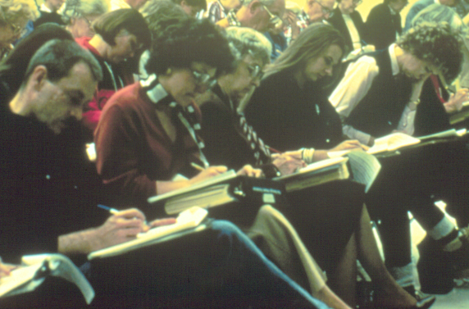
Master Gardener Exams
Notes:
Master Gardener Exam Relax, Master Gardener tests or exams are designed to ensure that participants understand the material being covered. A minimum 70% score is required to pass but tests are not designed to eliminate or intimidate anyone. In class, listen to the speakers, take a few notes and enjoy the class. Before your test, review your notes, handouts and the Master Gardener Handbook and you’ll do fine.

Slide 18
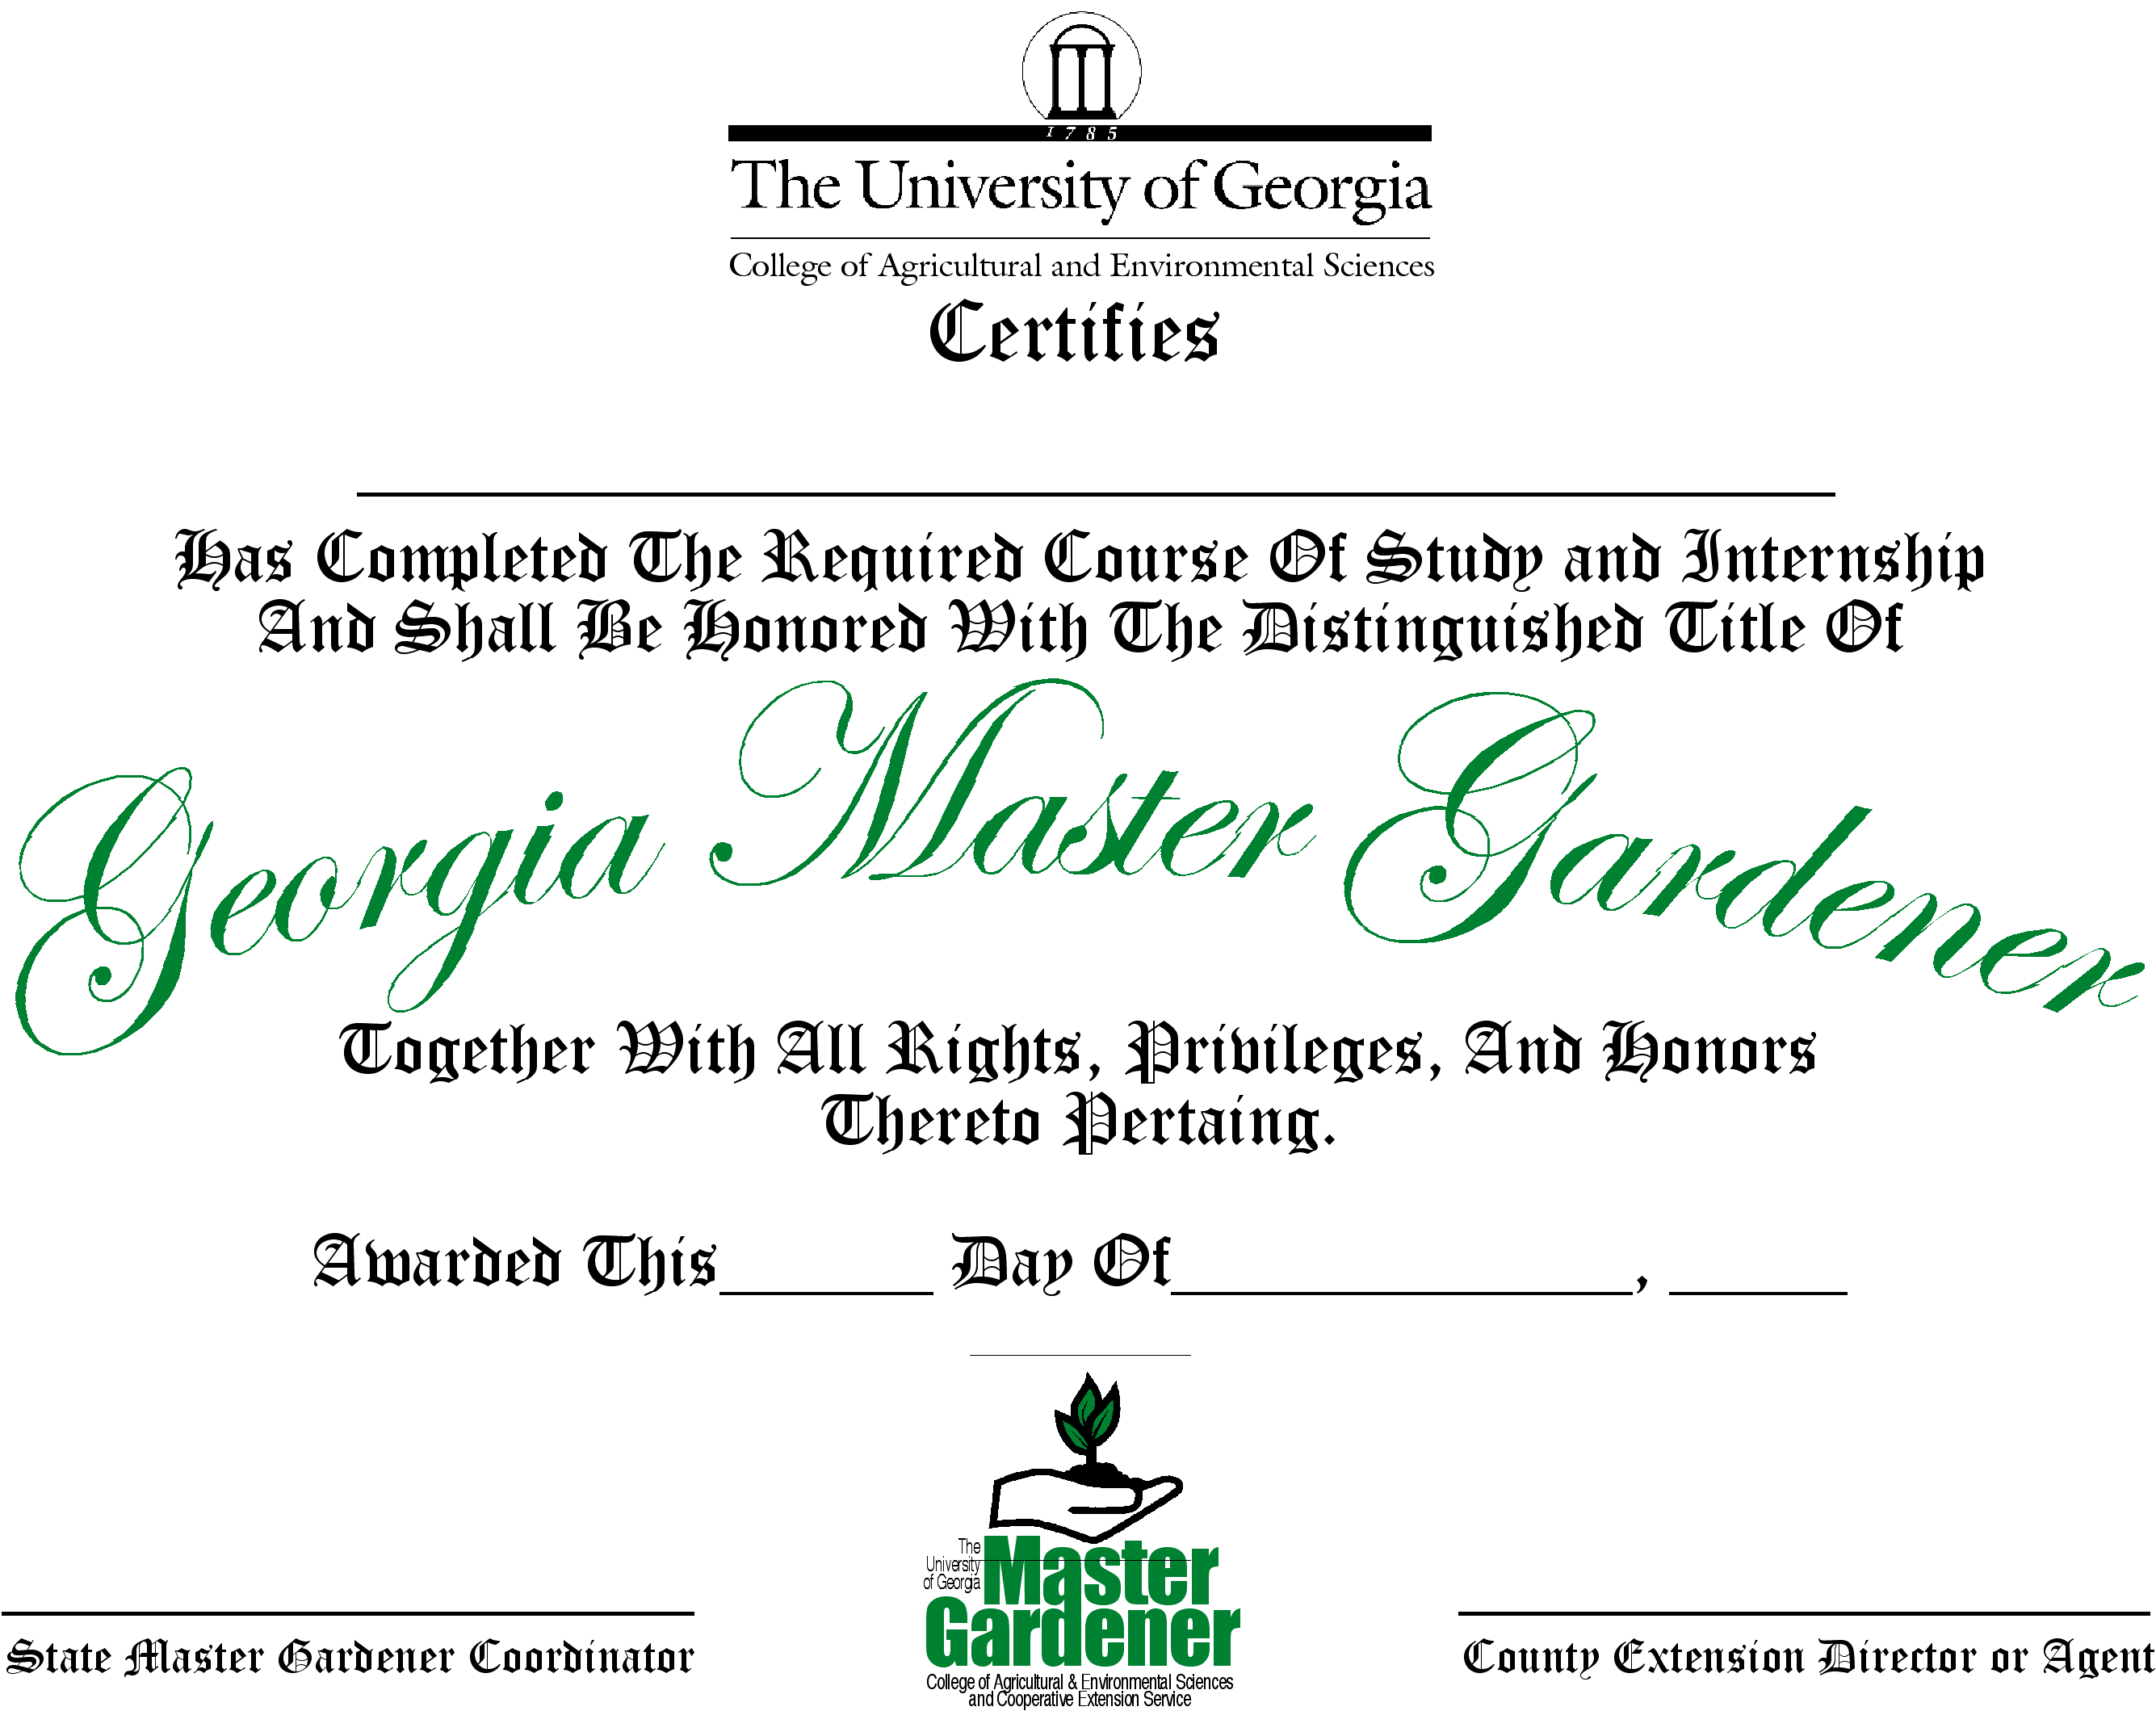
MG Certification
Notes:
Certification The Master Gardener Certificate is awarded when an intern has completed his or her 50 hours of volunteer service.

Slide 19
BENEFITS OF BECOMING A GEORGIA MASTER GARDENER
Regional Conferences
International Conferences
GMGA Membership
Handbook
Badge
Local Group Meetings
Notes:
Benefits of Becoming a Master Gardener For many, the most important benefit of the program is the knowledge gained from having completed the training. Participants are often surprised at how much they continue to learn while completing their required hours of service. Other benefits include:Handbook, Badge, Local Group Meetings, Regional conferences, International Conferences, and GMGA Membership.

Slide 20

Master Gardener Handbook
Notes:
Handbook All Master Gardener program participants receive a comprehensive manual during their initial training. This is considered to be the textbook for the course but will provide useful information for years to come. The book is periodically updated and veteran Master Gardeners are welcome to purchase updated editions.

Slide 21
Master Gardener Badge
Notes:
Badge The Master Gardener Badge is the identification symbol for a well trained volunteer of the Extension and Service and is only to be worn in a volunteer capacity, never to promote a commercial product or business.

Slide 22
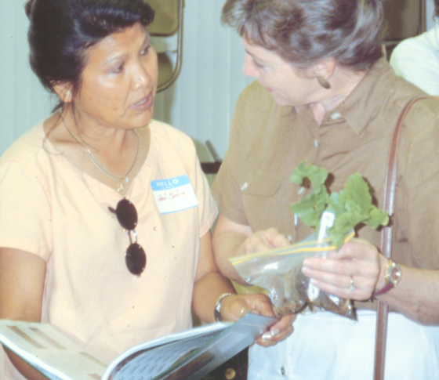
Local Group Meetings
Notes:
Local Group Meetings Local group meeting are a wonderful opportunity to learn about volunteer projects, receive training and horticultural updates and enjoy fellowship with other Master Gardeners in your community.

Slide 23
Regional Conferences
Notes:
Regional Conferences You may have the opportunity to attend a regional Master Gardener Conference. Held every other year, regional conferences are an excellent opportunity to continue learning.

Slide 24

International Conferences
Notes:
International Conferences Held between years of the regional conferences, International Conferences attract Master Gardeners from around the world to hear speakers, attend classes and participate in tours.

Slide 25
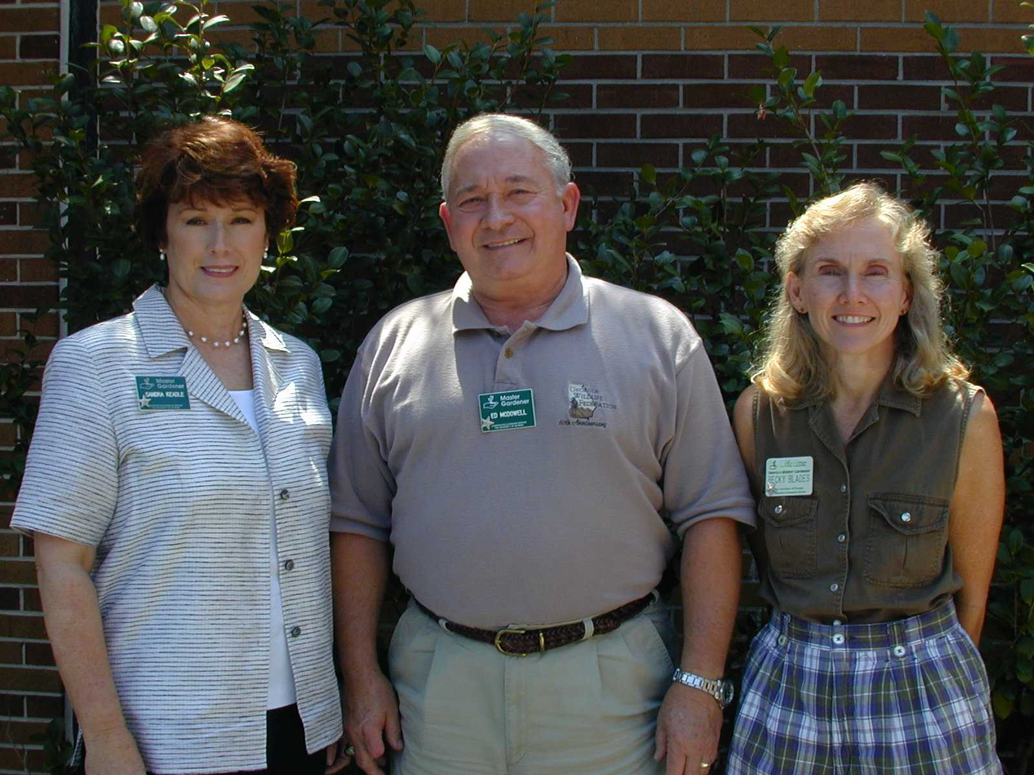

Advanced Training
Notes:
Advanced Master Gardener Training & Certification Certified Master Gardeners in good standing have the opportunity to attend Advanced Training sessions. Master Gardeners who successfully complete five different Advanced Training sessions will receive an advanced certificate and silver star to wear on the Master Gardener badge. Master Gardeners will have the opportunity to become certified at a new level beginning in 2006 though the Gold Star Specialist level.

Slide 26
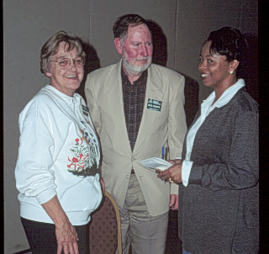
GMGA Membership
Notes:
GMGA Membership The Georgia Master Gardener Association was formed to create an association that would help Master Gardeners communicate, learn and serve the public better. GMGA held its first meeting in 1990.

Slide 27
BENEFITS OF GMGA MEMBERSHIP
The Scoop
Project Funding
State Conferences
Special Events
Notes:
Benefits of GMGA Membership The first year of membership dues are included in the initial training fee. Continued membership is optional. Master Gardeners who wish to renew their association membership may do so directly with GMGA. Members receive the quarterly newsletter, The Scoop as well as an annual membership directory.

Slide 28

Newsletter
Notes:
Scoop Members receive the quarterly newsletter, The Scoop as well as an annual membership directory.

Slide 29
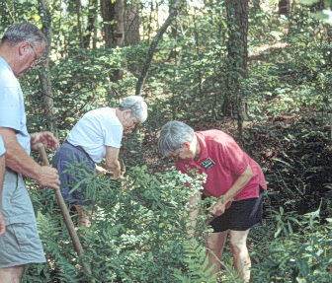
Project Funding
Notes:
Project Funding GMGA helps Master Gardeners educate through Project Funding. Grants of varying amounts for educational projects are awarded through a committee each year.

Slide 30
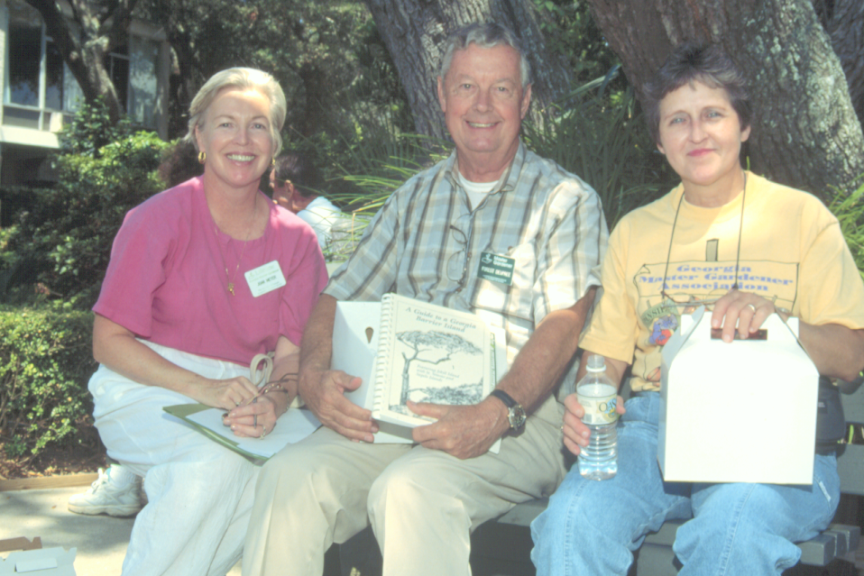
State Conferences
Notes:
State Conferences The association conducts meetings and conferences in varying locations throughout the state each year providing educational opportunities and tours as well as project presentations.

Slide 31
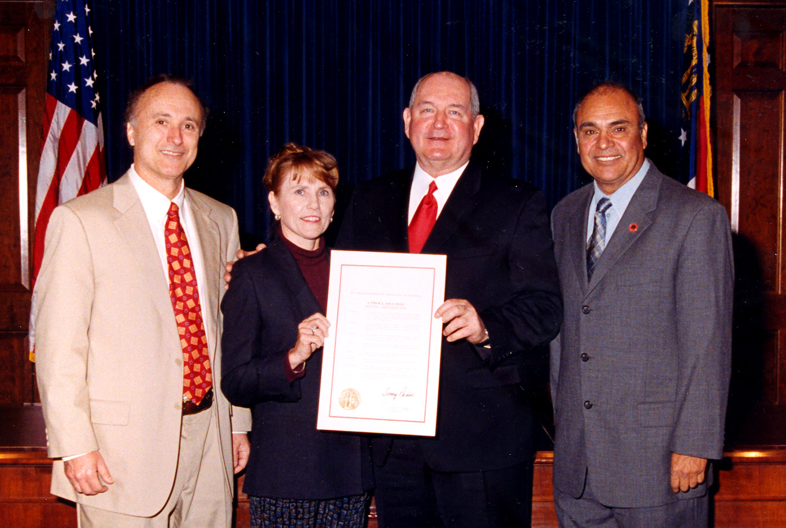
Master Gardener Day
Notes:
Special Events Historically, the third Saturday in March is proclaimed by the Governor to be “Master Gardener Day in Georgia” and is celebrated with plant clinics, classes and community projects. Occasionally, there may be opportunities to participate in plant trials, tours and other special events.

Slide 32
MASTER GARDENER VOLUNTEER PROJECTS
Notes:
Master Gardener Volunteer Projects The possibilities are endless when it comes to the different Master Gardener projects you can be involved in. You should always have your local Master Gardener Coordinator’s approval before beginning any project.

Slide 33
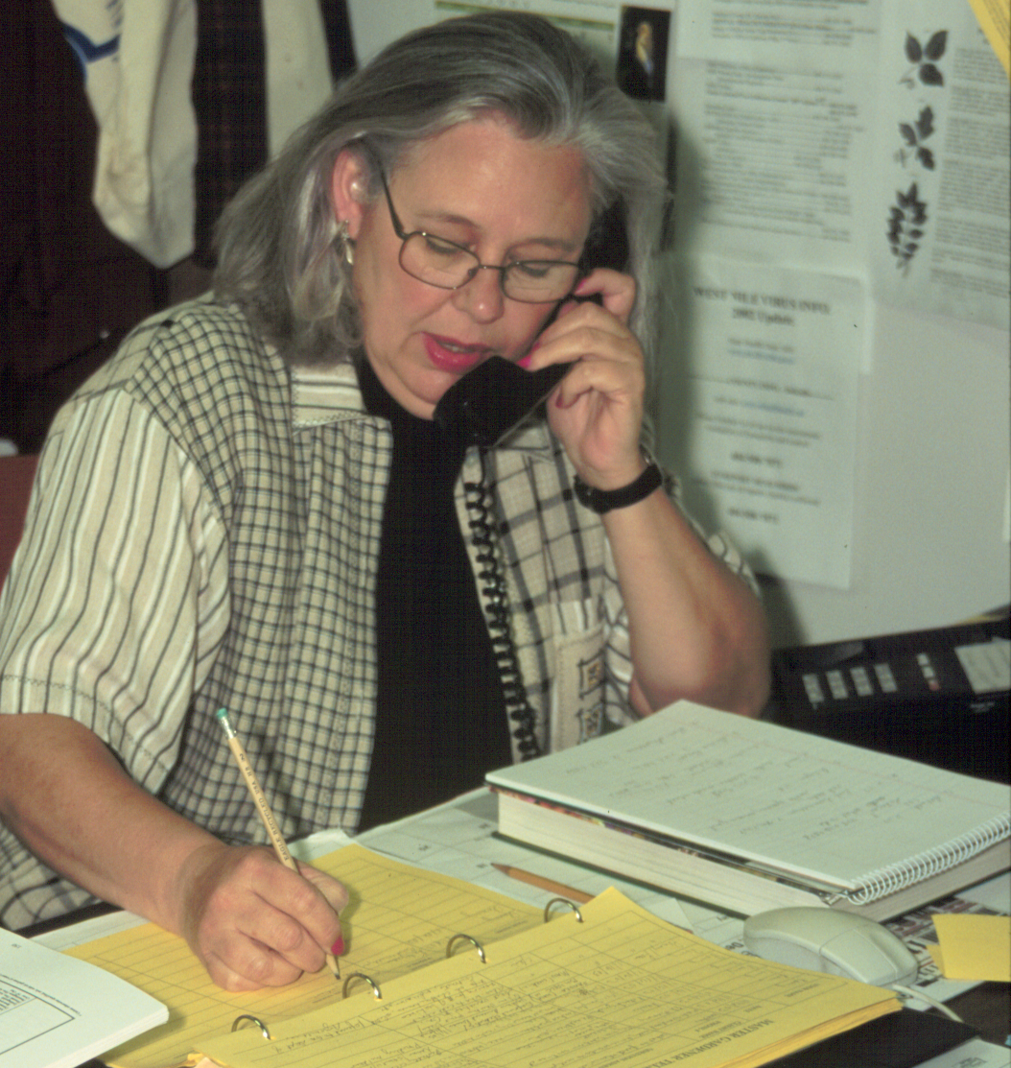
Assisting County Agents
Notes:
Assisting County Agents Helping County Extension Agents is at the heart of the Master Gardener Program. Some counties receive hundreds of calls during the busiest times of year, while others may not receive quite as many. When it’s your turn for phone duty and you get a question you can’t answer, don’t be afraid to say something like “That’s a good question, may I research the answer and call you back?”

Slide 34
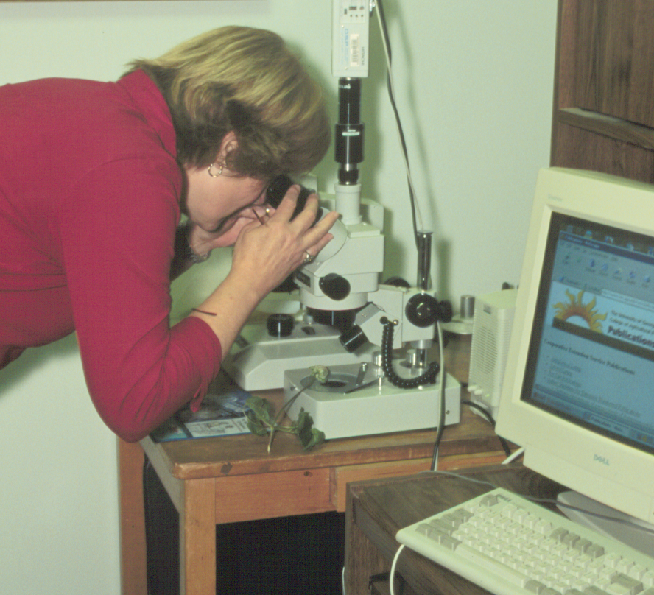
New Technologies
Notes:
New technologies allow Master Gardeners to assist agents in reaching out to the public, providing timely access to information and problem solving.

Slide 35
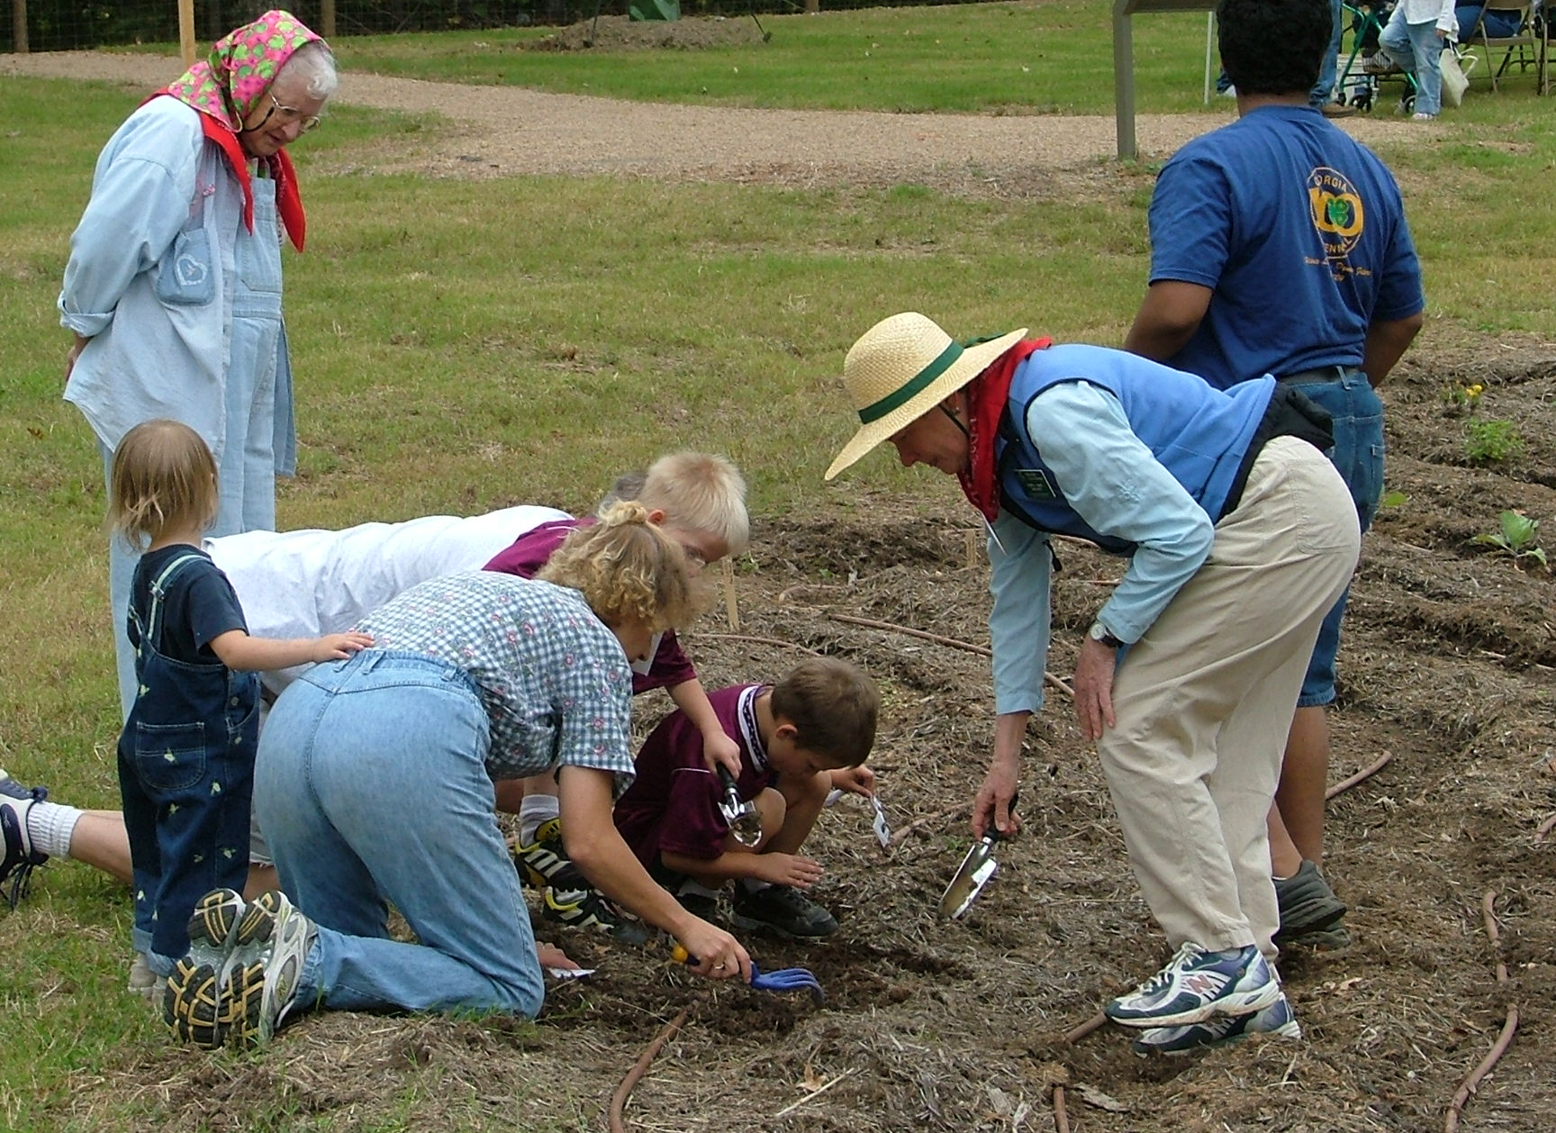
Teaching Classes
Notes:
Teaching Classes Master Gardeners who enjoy speaking in front of groups are sometimes called upon to share their knowledge with community groups as well as teaching the Master Gardener training program.

Slide 36
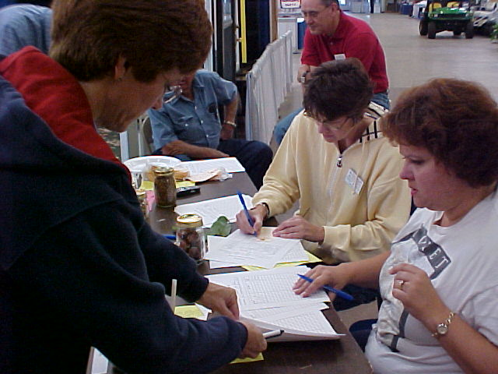
Plant Clinics
Notes:
Plant Clinics Various times of the year Master Gardeners participate in plant clinics where they may diagnose homeowner plant problems, answer questions or accept soil samples.

Slide 37
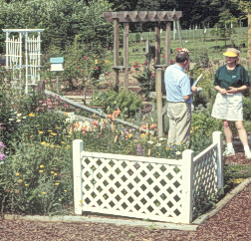
Demonstration Gardens
Notes:
Demonstration Gardens Many Master Gardeners work in the development and maintenance of gardens that demonstrate horticultural best-management practices to the public.

Slide 38
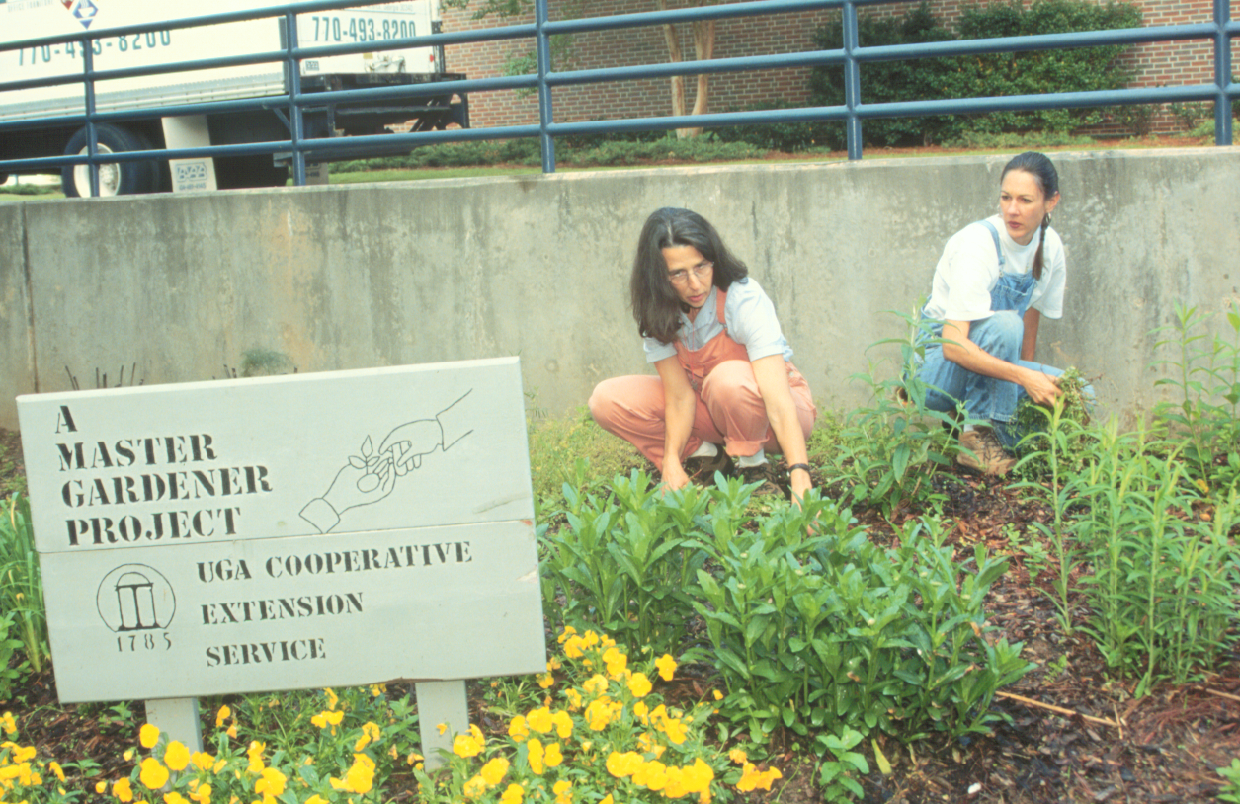
Urban and Community Gardens
Notes:
Urban and Community Gardens Master Gardeners work with community gardens benefiting senior citizens, needy families or gardens that provide green space in urban areas bringing the community together.

Slide 39
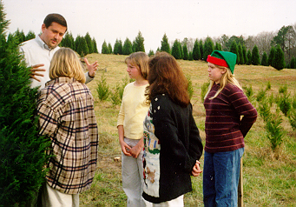

4-H
Notes:
4-H Working with 4-H, another program of the Cooperative Extension Service, Master Gardeners share a love of growing things and plant the seeds that may inspire a young person to study agricultural or horticultural science.

Slide 40
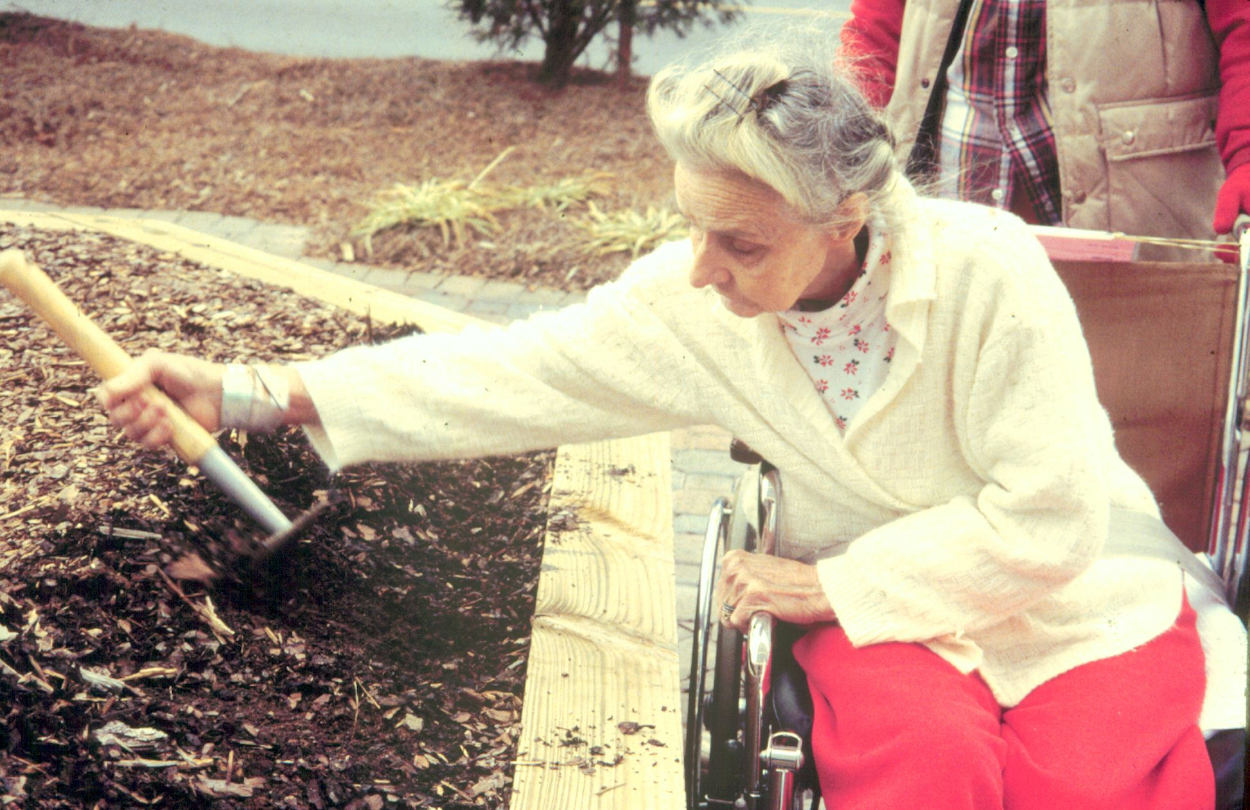
Therapy & Enabled Gardening
Notes:
Therapy and Enabled Gardening Programs operated in conjunction with therapists at hospitals, rehabilitative facilities, and personal care homes allow patients to relearn lost motor skills, stimulate senses, and provide pleasure through adaptive gardening.

Slide 41
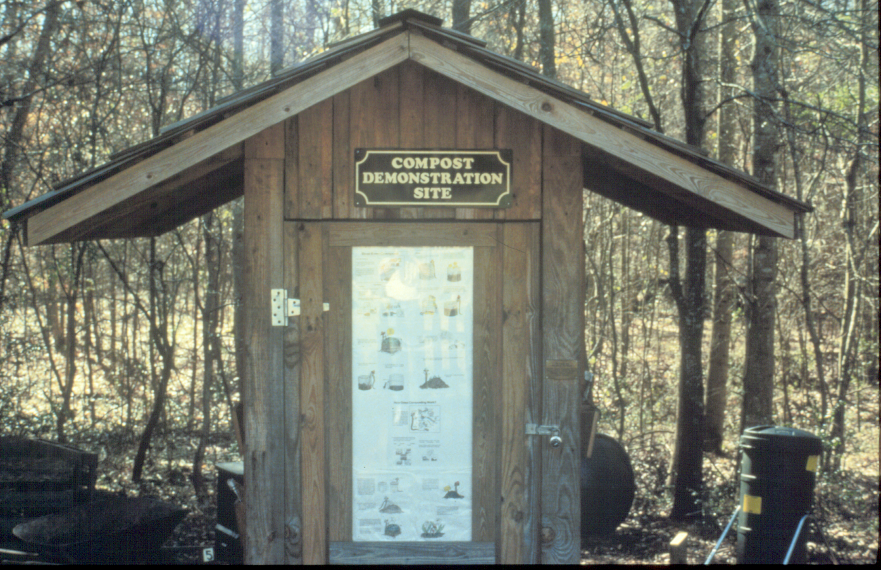
Composting Education
Notes:
36. Composting Education Crowded landfills, record population growth and increased environmental concerns have led Master Gardeners to become composting promoters and educators. County groups have developed composting education sites and programs to share the benefits of composting with their communities.

Slide 42
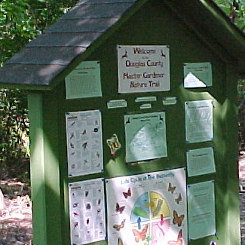
Wildlife Habitats
Notes:
Wildlife Habitats Master Gardeners across the state have helped the Georgia Wildlife Federation in creating wildlife education programs including the Habitat Stewards Program.

Slide 43
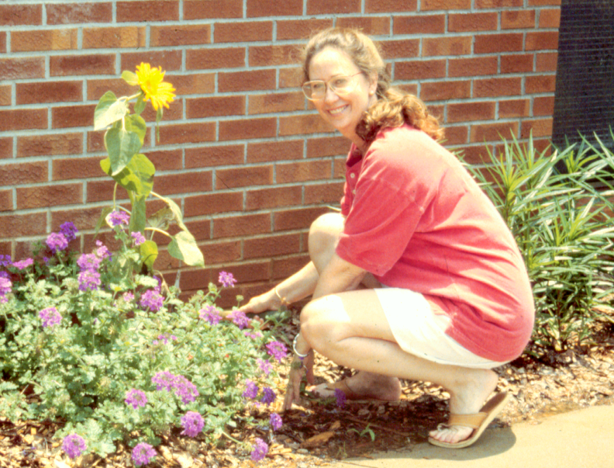
Schoolyard Gardens
Notes:
Schoolyard Gardens Across Georgia, Master Gardeners have helped to create gardens to teach children about gardening and the environment. Butterfly gardens, alphabet gardens, pizza gardens, and native plant gardens thrive through the creativity and love of gardening that Master Gardeners bring to the children.

Slide 44
JMGsm
www.jmgkids.us
Notes:
Junior Master Gardener sm Using materials developed for ages 9-19, Junior Master Gardener sm uses fun activities and community projects to teach horticulture and environmental science concepts and such values as responsibility and community involvement.

Slide 45
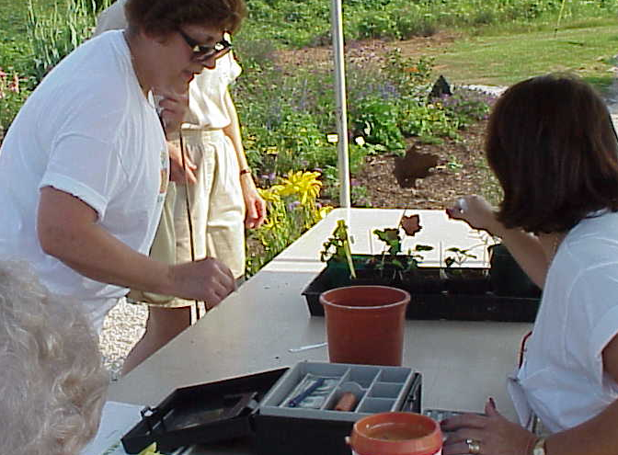
Plant Sales
Notes:
Plant Sales Master Gardener groups may sometimes conduct plant sales to benefit community projects or programs like JMG sm or 4-H.

Slide 46
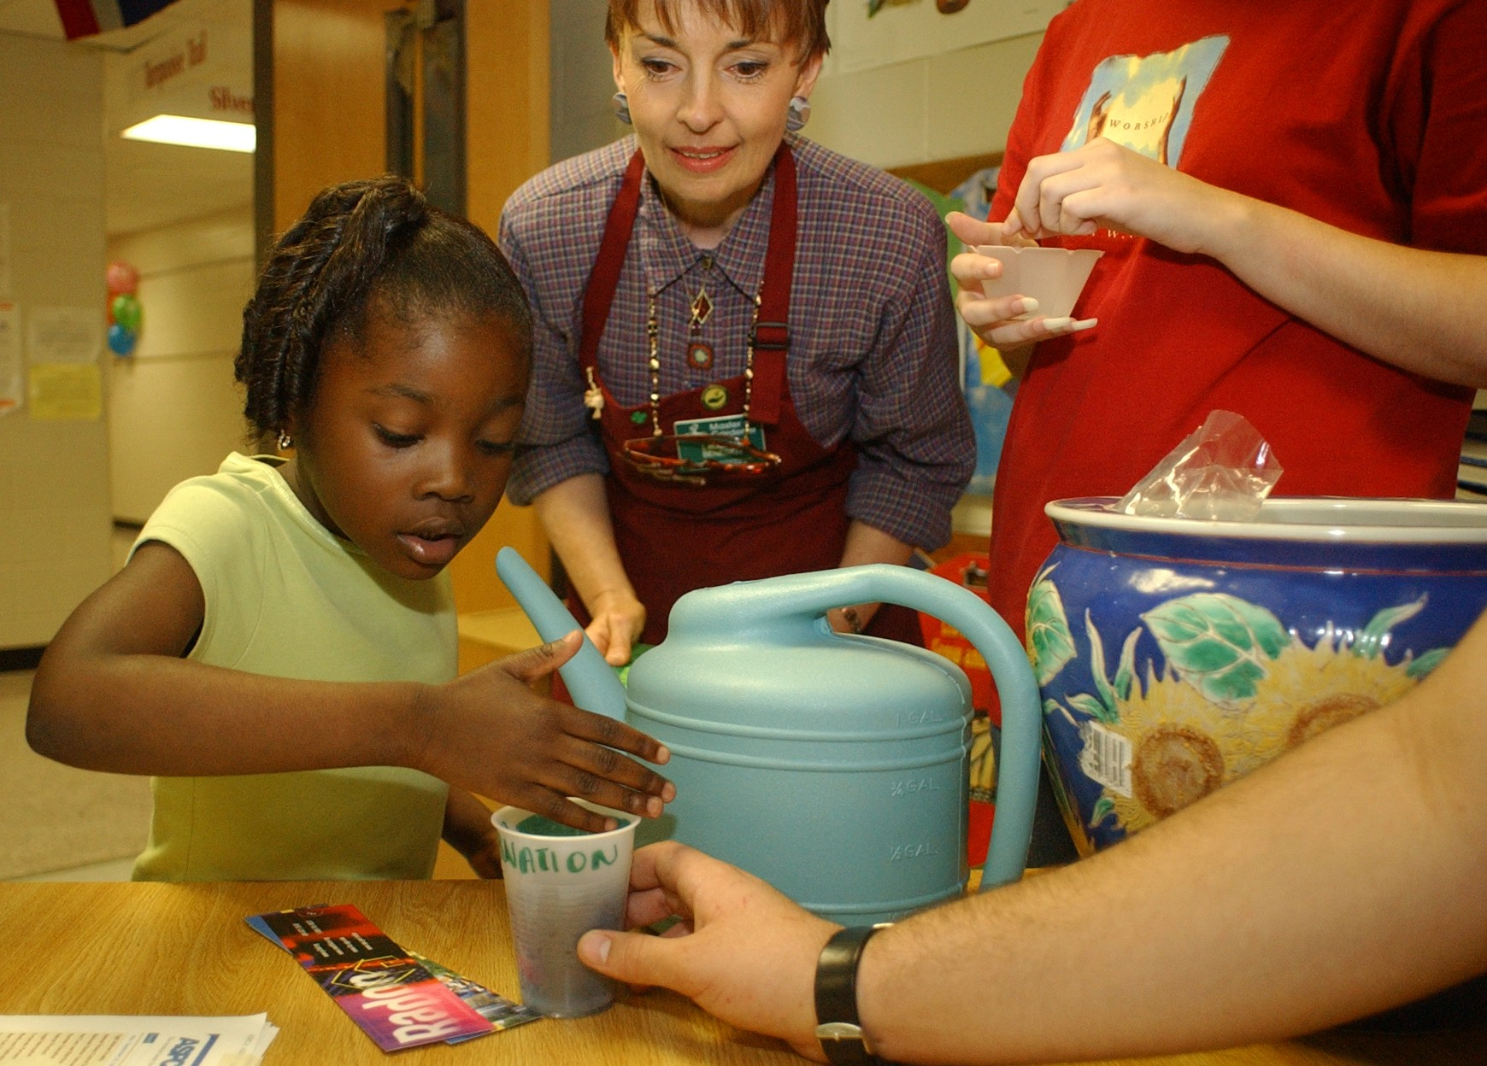
Youth Programs
Notes:
Youth Programs Science, Math or Literature concepts involving gardening are taught by Master Gardeners in schools and community groups.

Slide 47
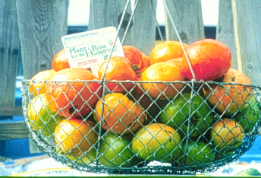
Plant a Row
Notes:
Plant-a-Row The program sponsored by the Garden Writers Association of America, asks gardeners to pledge produce from their gardens for local food banks and other assistance agencies. Master Gardeners participate by growing produce in group gardens and by coordinating donations in their communities.

Slide 48
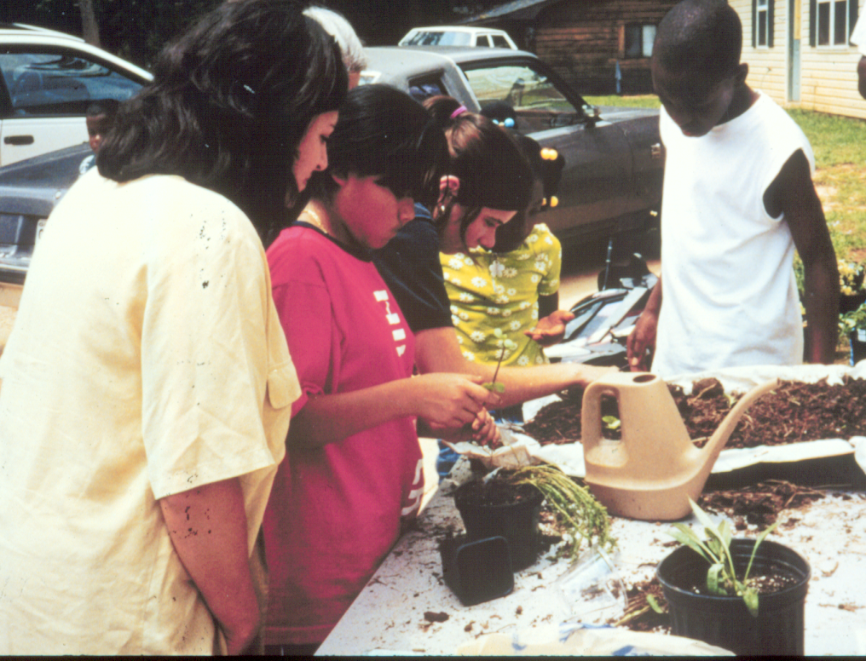
Community Projects
Notes:
Community Projects There are so many ways Master Gardeners can improve their communities through gardening. Improvement and beautification projects are perfect opportunities to involve community members and educate.

Slide 49
... To appreciate beauty, to find the best in others; To leave the world a bit better, whether by a healthy child, a garden patch, or a redeemed social condition; To know that even one life has breathed easier because you have lived. This is to have succeeded.
Ralph Waldo Emerson
Notes:
To appreciate beauty, to find the best in others; To leave the world a bit better, whether by a healthy child, a garden patch, or a redeemed social condition; To know that even one life has breathed easier because you have lived. This is to have succeeded.
§Ralph Waldo Emerson

Slide 50
Upcoming Events
Get your pencils ready--

