Slide 1
Interpreting Georgia Soil Test Reports
By
Brian Maddy
Troup County Extension

Slide 2
Soil Test Reports
Soil test reports provide essential information that help growers make informed decisions that will help maximize production and economic returns.
Interpreting the soil test reports is critical in making those management decisions.
Notes:
Soil test reports provide the data to make decisions concerning fertilization and plant selection.

Slide 3
Soil Test Reports
Soil Samples are sent into the testing labs at the University of Georgia
Results can be sent either through the mail or email.
Email provides quicker results.
Notes:
The turn-around-time for getting results back has decreased substantially. It’s usually dependent on how many samples are received at the lab per day.

Slide 4
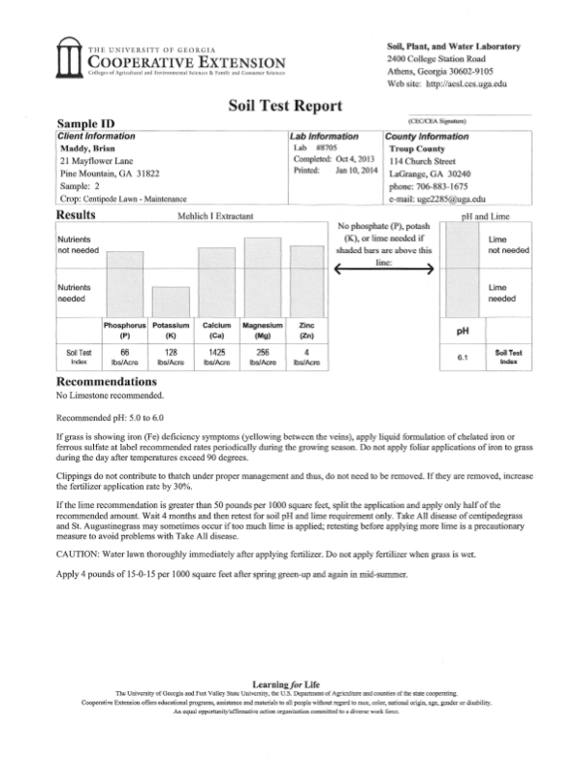
Soil Test Reports
There are three sections to
a soil test report:
Sample ID
Results
Recommendations
Notes:
When you receive your report, make sure it’s yours and the correct crop. The crop can be adjusted by calling the extension office.

Slide 5
Sample Identification

Slide 6
Sample ID
1
2
3
The sample ID has three sections:
Client information
Lab information
County information
Notes:
Make sure all your information is correct, especially the crop.

Slide 7
Results

Slide 8
Results
Primary Nutrients
Secondary
Micro
PH level
This line indicates nutrient levels.
If the bars are below the line, nutrients need to be added.
If the bars are above, nutrient levels are sufficient.
Notes:
If the bar is below the line, nutrients are needed.
Above the bar, nutrients are sufficient.
There are three categories of nutrients, primary, secondary and micronutrients.
The primary nutrients are N, P and K.
The secondary nutrients are S, Mg and Ca.
The micronutrients are Zn, Mn, B, Fe, Mb, Se, Cu and Cl
The line indicates whether there are sufficient nutrients available for that crop.
The pH box indicates pH level and whether lime is needed.

Slide 9
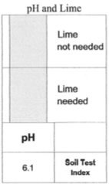
Results
pH levels are very important.
Most crops need a pH of at least 6.0 (slightly acidic) but no higher than 7.0 (neutral).
Blueberries and azaleas thrive at pH’s below 5.5.
pH level
Notes:
The pH level affects the fertilizer availability.
Some plants need a lower pH in order to grow properly
Sulfur may be added to decrease the pH.

Slide 10
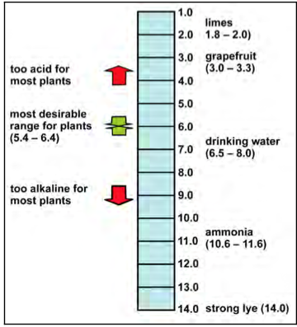
Results
pH Scale
The scale ranges from 0.0 to 14.0.
7.0 is neutral.
Less than 7.0 is acidic.
Greater than 7.0 is alkaline (basic).
Optimal pH range for maximum growth is 5.4 – 6.8.
Notes:
Slightly acidic soils, 6.0 to 6.8 are preferred for most vegetable crops.
Soils in the far west tend to be alkaline in nature, hence the desert environment.
Soils in the mid-west tend to be less acidic than southern soils.

Slide 11
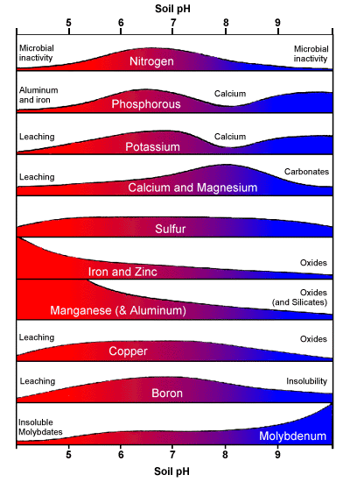
Results
At high pH’s, micronutrients such as Fe, Mn, B, Zn & Cu become less available.
At low pH, they become too available. They may become toxic.
Adapted from Bailey. 1996
Notes:
At lower pH’s, nutrients become toxic to plants.
At higher pH’s, nutrients become less available.
The optimal range is around 6.0.

Slide 12
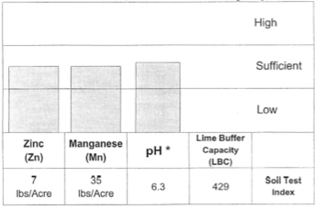
Results
Lime Buffer Capacity Method
Measures the amount of soil acidity that must be neutralized to raise soil pH by one unit.
The higher the LBC, the more lime needed to raise the ph.
The lower the LBC, less lime is needed to lower the pH.
Lime Buffer Capacity
Notes:
The soil pH is a measure of the hydrogen ion activity in the soil solution (active acidity), whereas the exchangeable acidity on the soil exchange sites can be expressed as the Lime Buffer Capacity (LBC), the amount of pure calcium carbonate needed to neutralize the exchangeable acidity.
The objective of liming a soil is t neutralize a portion of the acidity with limestone and replace the exchange sites previously occupied by aluminum compounds or H+ with basic cations, for example, calcium (Ca 2+) and magnesium (Mg 2+). Therefore, as exchangeable acidity is neutralized and replaced by calcium and magnesium, the soil pH will increase.
Two soils may have the same lime requirement but different pH values.
Two soils may have the same pH but different lime requirements.
These differences are primarily related to the amount of clay (texture of the soil) and organic matter present.
Soils high in clay and organic matter require more lime to raise the pH to a specific level than do sandy soils that are low in organic matter.
Crops also have different pH requirements.
Lime should be applied and mixed with the soil as soon as possible after sampling.

Slide 13
Results
Where are the nitrogen results?
A satisfactory routine test has not been developed to accurately predict the amount of available nitrogen in Georgia soils.
Nitrate nitrogen readily leaches out of our sandy soils when rainfall is high.
Nitrogen is stored primarily in organic matter. The rate of release is difficult to predict.
Georgia soils are low in organic matter.
Notes:
Organic matter, temperature, moisture, length of growing season, and other factors make it impractical to predict the amount of nitrogen that will be supplied to a growing crop.
Because Georgia soils are low in organic matter, the amount of nitrogen supplied from organic matter is low.
Nitrogen recommendations for non-legume crops are based on nitrogen rate experiments conducted on soils in Georgia and on similar soils and cultural practices in neighboring state.
A lower rate of nitrogen may be recommended for crops following legumes.
Crop removal and tissue analysis also helps determine nitrogen recommendations.

Slide 14
Recommendations

Slide 15
Recommendations
P & K application rates
Secondary nutrients
Micronutrients
On some crops such as pecans, an additional bar with more specific nutrients is included.
The recommended amounts of Phosphorus and Potassium that need to be applied per acre are indicated.
Notes:
This bar tells exactly how much in pounds per acre that must be applied.

Slide 16
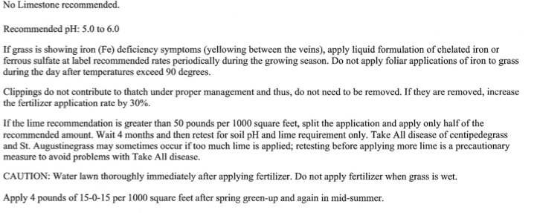
Recommendations
Centipede Maintenance Recommendations
Notes:
Specific directions are given in the recommendations sections.
They will vary by crop, establishment, maintenance and other factors

Slide 17
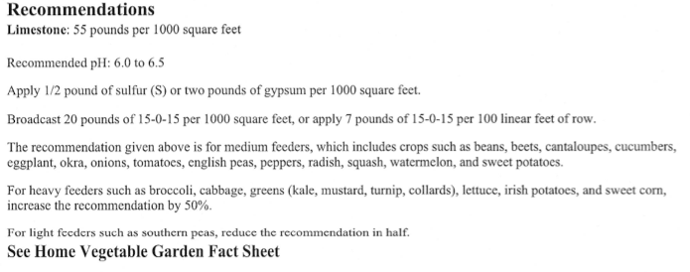
Recommendations
Vegetable Garden Recommendations

Slide 18
Recommendations
The soil testing lab is always trying to improve their recommendations so that the grower understands how to apply the nutrients in the correct amounts.
Notes:
The soil test lab tries to provide the most practical way of applying the plant nutrients.

Slide 19
Summary
There are three sections to a soil test report:
Sample Identification
Results
Recommendations.
Read each section carefully
Apply the plant nutrients according to the recommendations.

