Slide 1
Insects of Trees
Developed By:
Jule-Lynne Macie, Rockdale Extension Agent
In Cooperation with
The University of Georgia
Cooperative Extension Service
Urban Forestry Issue Team

Slide 2
Insects are often blamed for other’s damage:
Sapsuckers
Herbicide damage
Lightning
Too much or not enough water
Squirrels, roof rats
String trimmer
Beaver
Deer
Secondary pests
Ants
Bees
Long horned beetles
Termites
Notes:
All of these problems can mimic insect damage. Identifying the actual pest is the key.
Secondary pests listed are insects people commonly ‘blame’ for their tree’s problems.
Bees and ants are attracted to honeydew producing insects. They are often an indicator of an aphid, scales, mealybug, etc. problem.
Long horned beetles are often ‘heard’ chewing in the heartwood. They do not attack healthy trees (secondary pests).
Termites generally do not attack living plants, but there have been cases documented.

Slide 3
When looking at damage:
Think mouthparts
Holes – chewing
Wilting, yellowing – piercing sucking
Speckling – rasping sucking
Notes:
You can narrow down your pest choices by focusing on the damage.
Insect mouthparts can only cause a certain kind of damage.
Generally, orders of insects have the same types of mouthparts.
IE. All beetles – chewing
All homopterans – piercing sucking
(aphids, cicadas, scales….)
All butterflies and moths –
adults – lapping
larva – chewing
Narrow down your search for an insect by looking at the damage – can the suspected insect actually cause the type of damage seen?

Slide 4
The Real Boring Insects
Chewing mouthparts, so think ‘holes’

Slide 5
Bark Beetles
3 different beetles – southern pine beetle, Ips engraver, Black turpentine
Needles turn yellow from tips back
Larvae feed under bark
Notes:
There are three major pine bark beetles that attack southern pine trees. Southern Pine Beetle, Ips Engraver Beetle and Black Turpentine Beetle.
Southern Pine Beetle adults are 2-3 mm (1/8 inch) long; hind end is rounded, without spines.
Larvae are white, legless grubs with a brown head capsule. Their galleries (tunnels under the bark) are short (5 to 10 mm) and s-shaped.
Pitch tubes, if present, are 6-13 mm (dime size) in diameter; yellowish-white on loblolly pine, runny brown on slash and longleaf pines; more likely to be in bark crevices rather than on bark plates. Attacks generally begin below the lowest branches and may eventually extend from the lower bole up into the lower crown.
Black Turpentine Beetle adults are 5-8 mm (1/4 to 1/3 inch) long, the largest bark beetle in the South; hind end is rounded, without spines.
Larvae feed side-by-side, excavating a cavity in the phloem.
Pitch tubes large, often 25 mm (1 inch) in size.
Attacks generally limited to the lower 8 feet of the tree.
Ips Engraver Beetle adults are 3-4 mm (1/6 inch) long, intermediate in size between the other species; hind end is concave with 5 spines on each side. You might say they have a scooped out ‘knobby’ rear.
Parental galleries often Y- or H-shaped, more angular than southern pine beetle.
Pitch tubes reddish-brown and most likely located on bark plates rather than in crevices.
Attacks on standing trees most likely to be on the upper trunk and the bases of the larger branches.

Slide 6
Southern Pine vs. Black Turpentine Beetles
Size compared to a grain of rice
Notes:
Black Turpentine Beetles are the largest of the three bark beetles (right)
Southern Pine Beetles are the smallest (left)
Ips. Engraver Beetles fall in-between.

Slide 7
Under the Bark
Beetles attack stressed native pine trees
Second generation beetles attack surrounding trees
Blue stain fungus
Galleries
Notes:
Beetles are usually only successful attacking stressed trees. Stress can be due to lightning, drought, etc. The tree gives off a terpene that attracts female beetles. They give off a pheromone (insect perfume) that attracts males. The adults bore under the bark and lay eggs.
Larva feed there – cutting off carbohydrate flow down the tree. A tree is doomed once bark beetles colonize and destroy its inner bark. Without this phloem tissue, the carbohydrates produced in the needles cannot nourish the living cells in the roots. Without living roots to provide water and nutrients to the crown, the needles dry out and die.
After pupation, the second generation adults emerge and fly to surrounding native pines. They do not fly far though.
Blue stain fungus – beetles carry this fungus with them. Adults feed on it. It clogs water conducting tubes. Quality of wood is reduced for lumber. The blue-stain fungus carried by beetles often hastens needle death by growing into the sapwood and plugging the water-conducting cells.
Galleries – (pictured) tunnels made under the bark by feeding of larvae and adults.
Southern pine beetle galleries are ‘s’-shaped. Ips Engraver beetle galleries are ‘I or H’-shaped.

Slide 8
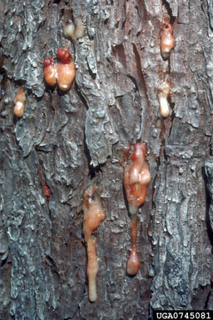
Pitch Tubes
A sign of attack.
Beetles are sometimes ‘stuck’ in pitch
Notes:
Signs of Attack
Popcorn-like pitch tubes on trunk of loblolly pines, brown pitch runs on slash and longleaf pines
1-mm-diam holes in bark
Serpentine egg galleries through the inner bark
Pine needles changing from dark green to light green, to yellow, to red, and then falling to the ground (from tips of branches inward).
Preventing SPB Attacks during Outbreaks
Support the quick detection and treatment of SPB-infested trees
Promote tree vigor (water during drought)
Avoid pruning and other activities that produce pine terpenes and attract beetles
Spray the base of trees attacked by the black turpentine beetle (only beetle a homeowner can really spray for. Others are too high in tree)
Take down trees as soon as beetle evidence is observed.

Slide 9
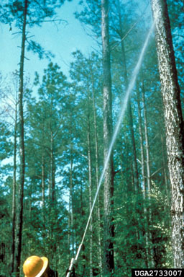
Control for Homeowners
Sanitation!
Homeowners do not have equipment to spray preventatively
Notes:
SPB Control Options
Cut and remove infested trees (Sanitation Salvage), then process logs to kill beetles
Cut and spray trees with approved insecticide
Cut and leave (Spot Disruption) - does not stop beetle dispersal
Do nothing
With regard to systemic insecticides, no research test has ever shown systemics to be anywhere nearly as effective as insecticide sprayed onto the bark. Systemic insecticides apparently do not remain in the phloem tissue in sufficient concentrations to affect beetle attack and colonization.
One case where a homeowner may wish to invest in a protective spray is when lightning, construction, or other injury weakens a tree and it produces terpenes which might attract beetles. In such cases the homeowner must contract a pest control operator who has the appropriate license and equipment for putting a registered insecticide at least 35 feet high on the trunk.

Slide 10
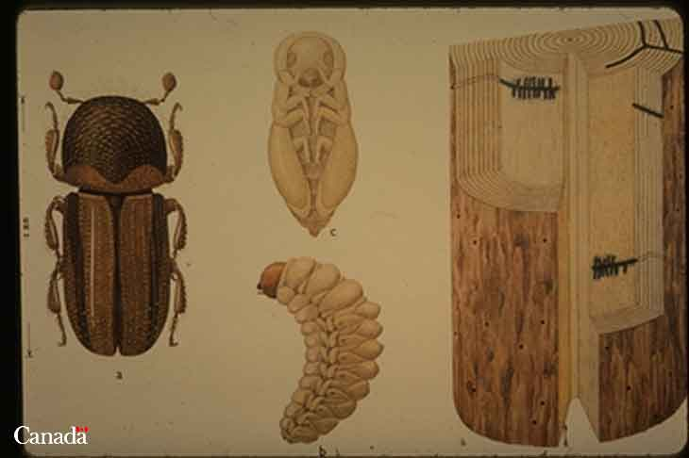
Asian Ambrosia Beetles
Attack smooth bark trees in early spring when leaves expanding
Bore deep into heartwood
Need moist wood
Toothpicks
No good chemical control
Cut down
Notes:
Entered the United States at Charleston, South Carolina about 1974. Now known to attack various trees and shrubs, including pecan, peach, plum, cherry, persimmon, oak, elm, sweet gum, magnolia, fig, buckeye, and sweet potato. It probably will attack other plants on which it has yet to be found.
Description: Adult are approximately 1.5-3.3 mm long; head and body reddish-brown to black; stout robust shape; described as having a ‘hunchback’ appearance Pupa -- similar to adult; creamy white. Larva -- size variable, approximately 2-6 mm long when mature; head light brown to amber orange; body creamy white; legless.
Life Cycle: They are active year-round during warm periods but most adult activity has been observed in March. They mate, lay eggs and rear young within the galleries excavated by the females. They breed in host material from 2 to 30 cm in diameter, although smaller branches are most commonly attacked first. All life stages can be found inside the galleries. When mature, females leave infested plants and fly to new host plants. Males do not fly. There are several generations per year.
Damage: Adults and larvae bore into twigs, branches or small trunks of woody host plants, excavate a system of tunnels in the wood or pith and introduce a symbiotic ambrosial fungus on which they feed. The boring and introduced fungus damage and clog the xylem, ultimately killing all or part of the plant. Infestations normally can be identified by toothpick-like spines of boring dust protruding from holes made in the host plant by females excavating their galleries. The strings or spines of boring dust may be up to 2 to 3 inches long but are fragile and easily broken off by wind or rain. Unlike other scolytids, which normally attack only stressed or damaged plants, Asian ambrosia beetles attack apparently healthy plants. Individual plants may host up to 50 beetles. It is almost impossible to save heavily infested plants.
Control: Infested plants or plant parts should be removed and burned. Homeowner insecticide applications have not been shown to stop an infestations. A severe stem infestation is usually indicative of a dying tree. Promote tree vigor and health to minimize possibility of ambrosia beetle infestation.

Slide 11
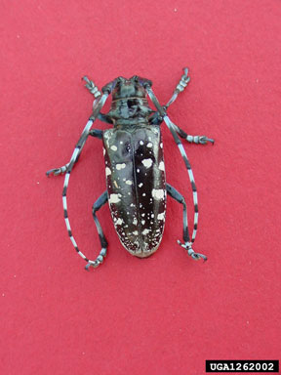
Asian Long Horned Beetle
Pest from China
Attacks maples, birch, willow, poplars and horsechestnut.
Be on the lookout for this pest.
Notes:
Background. The Asian longhorned beetle (ALB), Anoplophora glabripennis, is a woodboring beetle indigenous to Japan, Korea, and China. It is regularly intercepted at ports of entry as it emerges from wood used for pallets and packing materials. In 1996 it was discovered infesting and killing trees in Brooklyn and Amityville, New York. Federal and state agencies quickly initiated an aggressive program to locate, remove, and destroy all infested trees with the objective of eradicating the two populations. In 1998, the ALB was discovered in three communities near Chicago and another expensive eradication program is now underway. New regulations limiting the importation of solid wood packing materials from China will hopefully keep out additional introductions of this exotic pest.
Host trees. The infestation in New York was most serious in maples and horsechestnuts. Other trees infested and killed in the U.S. include ash, poplar, willow, elm, mulberry, and black locust. Many of the same and closely related species occur in Georgia.
Beetle Identification. The large size and distinctive markings of the ALB make it relatively easy to identify (see picture below). Adults are about 1 to 1.25 inches long and, like many beetles in the family Cerambycidae, have antennae that are 1.3 to 2.5 times the length of the body. The ALB is distinguished from similarly shaped beetles by its unique combination of:
a shiny black body with about 20 white spots
antennae with alternating bands of black and white
legs that are bluish-white on the upper surface
The larvae feeds in the heartwood. Sanitation is the only current control.

Slide 12
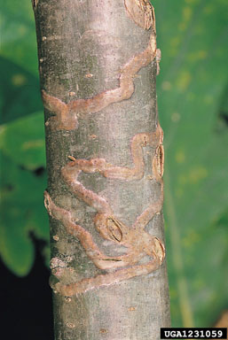
Various Wood Boring Beetles
Attack various trees
Female lays eggs on trunk and larva bore under bark
Notes:
Wood boring beetles and caterpillars are most injurious to trees weakened by transplanting, drought, disease, poor fertility and other stress factors. The larvae of borers are difficult to control because they are protected within the tree during most of their lives. Proper care and maintenance to promote a healthy tree help prevent the attraction and establishment of the borers. Pruning dead or infested wood from trees helps prevent destructive borer populations. When insecticides are used, they act as a protectant, controlling some adults and reducing the risk of egg laying. Applications should be made just prior to the appearance of the adult.
Examples
Poplar borer -- Adults are elongate grayish beetles with long, slender antennae. They emerge during mid summer. The white, legless larvae tunnel in trunks and branches for two to three years.
Ash and lilac borer -- The wasp-like moths are black and yellow to orange and brown and have clear wings. They emerge in late spring (May-June). Leaves on infested branches turn brown; branches die back and break easily.
Bronze birch borer -- The slender adult beetles are olive green to black with metallic bronze reflections. They emerge in late June and can be active until August. Early infestations of trees start in 1 inch diameter branches, later including larger branches and the trunk as the tree's health weakens.

Slide 13
Dogwood Borers
Clear winged moth
Attacks older dogwoods under stress
Larvae bore under bark
Notes:
Control is cultural. Keep dogwoods healthy to start with.

Slide 14
Caterpillars
Chewing mouthparts so think ‘holes’

Slide 15
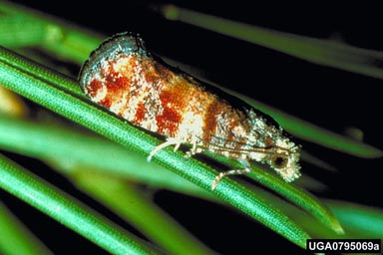
Nantucket Pine Tip Moth
Small orange moth
attacks young pines
causes stunting and deformity. Trees will grow out of it
Notes:
Common Hosts
Loblolly pine Pinus taeda Sand pine Pinus clausa Shortleaf pine Pinus echinata Slash pine Pinus elliottii Spruce pine Pinus glabra Virginia pine Pinus virginiana
Description: Adult - gray head and body; front pair of wings with irregular patches of red, copper, and gray bands; wingspan approximately 13 mm Pupa - size of adult; light to dark brown Larva - size variable, approximately 9 mm long mature; head and body light brown to dark orange
Importance: Severe damage can occur in young natural and planted stands. Growth loss and stem deformity can be considerable, however, infestation rates usually decline as trees reach 3 m in height or crowns grow together.
Biology and Habits: Adult moths emerge from infested branches in the early spring, mate, and females lay eggs on the foliage or buds. The larvae first gouge needles when feeding, then bore into branch tips. Pupation occurs inside the damaged area; overwinter as pupae. Number of Generations: 4 to 5 generations per year.
Signs of Infestation: Foliage discoloration. Dead or dying branch tips. Shepherd’s crooking. Resin beads or flakes and fine silk webbing on branch tips.
Control: Natural enemies, especially insect parasites, and crown closure will lower infestation rates as the stand matures. Plant the best pine species for the site to reduce stress on the trees. Consider planting longleaf pine if the site is appropriate. Longleaf pine is not attacked by the pine tip moths. Prune out infested tips if handwork is feasible.

Slide 16
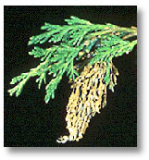
Bagworms
Deciduous and evergreens
Insecticides only if early in season
Fall – move to ends of branch and pupate
Males fly to females
Lay eggs in bag
Prune and discard!
Notes:
Host species: hardwoods and evergreens. However, evergreens are most severely damaged.
Description:
Adult -- male moth sooty black, densely hairy; wingspan approximately 25 mm. Female wingless, no legs, maggot-like; yellowish color; in bag. Larva -- size variable, approximately 25 mm long when mature; head and neck yellow spotted with black, body brownish.
Importance: Severe defoliation may stress trees especially coniferous or softwood host trees.
Signs of Infestation: Loss of foliage. Small bags constructed of small bits and pieces of leaves and twigs; adhering to branches.
Control: Handpick and destroy bags. Approved insecticides only in spring when caterpillars are small and before they have constructed bags.

Slide 17
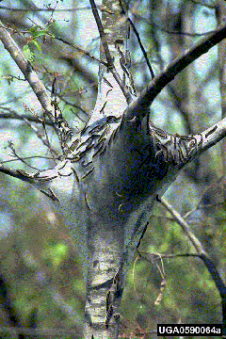
Tent Caterpillars
Spring pest
Tents in interior of tree
Prefer fruit trees
Pretty caterpillars
Capable of total defoliation
Will not kill a tree (usually)
Notes:
Common Hosts
Apple Malus pumila Black cherry Prunus serotina Hawthorn Crataegus spp. Oaks Quercus spp. Pecan Carya illinoensis Plums Prunus spp.
Description: Adult -- light to dark brown head and body; front pair of wings same color plus 4 angled yellowish-white stripes; wingspan approximately 45 mm Pupa -- size of adult; reddish-brown; enclosed in a silk cocoon of yellow powder and white silk Larva -- size variable, approximately 60 mm long when mature; black head, white line on back bordered by reddish-brown and black wavy lines; long fine tan hairs Egg -- Shiny black mass cemented around twigs (may contain 100-300 eggs)
Importance: Trees that experience widely spaced years of defoliation rarely die. Several consecutive years of severe defoliation will cause stress. In combination with other stress factors, death may follow.
Biology and Habits: Adult moths emerge from cocoons in late spring, mate, and females lay eggs on branches. The larvae hatch from the eggs the following late winter-early spring. A common silk nest is made by a group of caterpillars in the center of the tree. Number of Generations: 1 generation per year.
Signs of Infestation: Silk tents enclosing branch crotches. Loss of foliage. Black cylindrical masses wrapped around branches (egg masses). Branch dieback and/or crown thinning.
Similar Damage: FALL WEBWORM: silk nest or tent around entire branches or tree
Control: not usually necessary. Pull down nest with a stick. Do not burn nest! Scout and prune egg masses when you have had previous infestations.

Slide 18
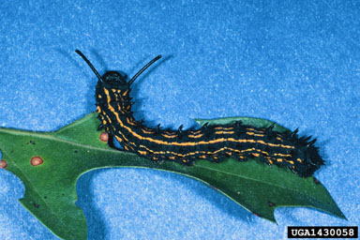
Orange Striped Oakworm
Notes:
Fall pest of oak trees. Caterpillars feed gregariously (together). Caterpillar begins life light green then turns black with yellow stripes running down its back.
Oakworm populations occasionally reach levels that completely defoliate host trees. Most oaks can tolerate one such defoliation with little impact on their health. Repeated defoliations, however, will weaken the trees and lead to infestation by secondary insects and pathogens. Here are some steps for promoting tree vigor and reducing insect populations:
Provide appropriate water and nutrients to the tree throughout the growing season.
Watch for and remove eggs and young colonies from the lower branches.
Prune and discard caterpillars that are easily within reach.

Slide 19
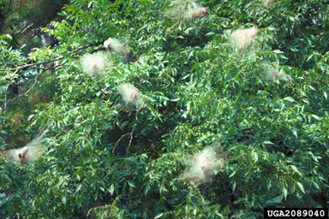
Fall Webworms
The large flimsy nests of the fall webworm are a familiar sight along road sides in later summer. The nests grow larger and larger until entire branches are covered
Notes:
Common Hosts
Baldcypress Taxodium distichum Black walnut Juglans nigra Hickories Carya spp. Pecan Carya illinoenis Persimmon Diospyros virginiana Sweet gum Liquidambar styraciflua
Other hardwoods
Description: Adult -- white head and body; front wings white and with or without black spots; wingspan approximately 30 mm Pupa -- size of adult; brown; enclosed in a thin, transparent cocoon Larva -- size variable, approximately 35 mm long when mature; black or deep orange head, yellow to green body with a black stripe on back and a yellow on each side; long white or brown hairs
Importance: The fall webworm is commonly seen along road sides and in pecan groves. Rarely of importance except aesthetically, however, severe repeated defoliation will cause extreme stress. In combination with other stress factors, death may follow.
Biology and Habits: Adult moths emerge from the soil, mate and females lay eggs in white cottony mats on the undersurface of leaves. The larvae feed together within the silk nests spun around entire branches. Pupate in the soil or leaf litter. Overwinter as pupae. Number of Generations: 3 or 4 generations per year
Signs of Infestation: Nest of silk webbing enclosing branches or an entire tree. Skeletonized leaves. Masses of long-haired caterpillars in the silk nests. Similar DamageEASTERN TENT CATERPILLAR: silk nests in branch crotches.
Control: Natural enemies (wasps, flys, beetles, birds) and unfavorable weather usually keep populations at low levels. Outbreaks do occur, but usually subside in 1 or 2 years. Prune nests from small branches and destroy caterpillars. Promotes tree vigor and health to aid in the recovery from defoliation.

Slide 20
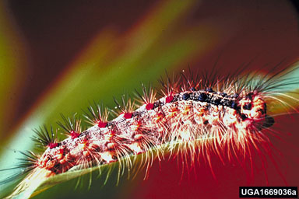
Gypsy Moth
Late instar gypsy moth caterpillar on leaf (note body hairs and rows of red and blue dot pairs on back)
Be on the lookout for this pest
Notes:
Known hosts in other states
Apple Malus pumila Black tupelo Nyssa sylvatica Hawthorns Crataegus spp. Maples Acer spp. Oaks Quercus spp. Willows Salix spp.
Other hardwoods and softwoods
Description: Adult -- male has dark brown head and body; feathery antennae; front pair of wings with blackish bands; wingspan approximately 35 mm. Female almost entirely white; stout abdomen with yellowish hairs; wingspan approximately 50 mm. Pupa -- size of adult; mahogany color; scattered reddish hair. Larva -- variable size, approximately 50 mm long when mature; black and yellow mottled head; double row of 5 blue spots followed by 6 red spots on back; body brownish-gray; tufts of light and dark brown hairs. Egg -- thick buff-colored mat composed of hairs and 75-1000 eggs.
Importance: Few documented infestations have appeared in Georgia, however, the continued southward spread from northern states suggests the likelihood of established populations in the future. Its impact as a public nuisance and on the shade tree and forest resource can be significant.
Biology and Habits: Adult moths emerge from pupal cases by early to midsummer, mate, and females lay eggs on tree trunks or under protective items. The larvae emerge the following spring and readily disperse on silk strands. Older larvae eat entire leaves, feed at night. Pupate by early to midsummer in sheltered areas. Number of Generations: 1 generation per year
Signs of Infestation: Loss of foliage. Falling frass (dark pellet-like) of caterpillar excrement). Caterpillars clustered on lower tree trunks and under leaf litter, rocks, and other objects. Egg masses in sheltered areas. Crown thinning and/or branch dieback.
Control: Gypsy moth outbreaks are not as predictable in duration as native pest insects. Generally, several years may pass before the population crashes. IMPORTANT: NOTIFY YOUR COUNTY AGENT IF YOU SUSPECT THE PEST INSECT IS THE GYPSY MOTH. The Georgia Forestry Commission handles eradication.
Most commonly confused with tent caterpillars and fall webworm.

Slide 21
Sawflies
Feed in groups
A type of wasp
Defense mechanism
Notes:
Hosts: both hardwoods and pines
Sawflies are members of the same insect order (Hymenoptera) that includes ants, bees, and wasps. The larval stage has a caterpillar-like body that may be brightly marked with stripes or spots. Some species change significantly in appearance as they grow, making identification confusing. Large numbers of sawflies can strip the needles from a tree in a short period. There are several species of sawfly.
Larvae feed gregariously. They often all move in the same direction when disturbed. They throw their heads back in unison, making them appear as one large insect rather than individual tasty specimens.
Control: Sawfly populations are usually controlled by combinations of natural enemies, predators, starvation, disease, or unfavorable weather. Outbreaks can occur when natural control does not produce high mortality. Regular inspection of susceptible plants will help to detect sawfly infestations before the larvae reach a size that can cause significant defoliation.
If only a small number of sawflies are present and accessible, they can be handpicked, shaken off, or pruned from the tree and destroyed.
There are several insecticides labeled for sawfly control.

Slide 22
Beetles
Both adult and larvae can cause damage

Slide 23
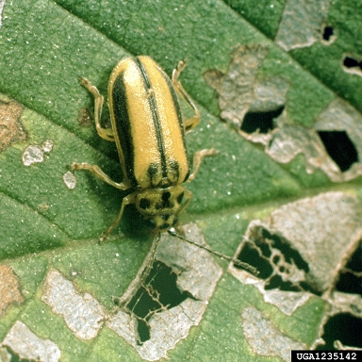
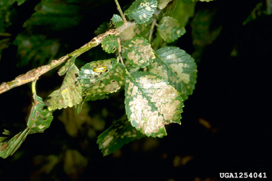
Elm Leaf Beetles
Notes:
Adult elm leaf beetles are about 1/4 inch long and yellow to olive green with a dark stripe down each side of their wing covers. There are usually four dark spots on the pronotum (segment right behind the head).
The eggs are orange, spindle-shaped and the larvae are wormlike, black or black and yellow and up to 1/2 inch long. The pupae are orange-yellow with black bristles.
Adult elm leaf beetles overwinter in protected locations, often in houses or other structures. They emerge in the spring and move to elm trees where they lay their eggs in groups of 5 to 25 on the underside of leaves. The larvae skeletonize the leaves making them appear netlike. Elm leaf beetle larvae often move to the base of the tree in large numbers to pupate. There are two complete generations per year.
The most effective control of elm leaf beetles is accomplished by controlling the larvae or adults while they are still on the tree. They can be controlled using sprays of insecticidal soap, light horticultural oils, and other insecticides. Treat when leaves are first fully expanded in the spring and again in July.

Slide 24
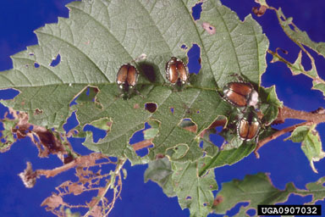
Japanese Beetles
Notes:
Adult Japanese beetles are 7/16-inch long metallic green beetles with copper-brown wing covers. The beetle has a row of white tufts (spots) of hair project from under the wing covers on each side of the body
Adults emerge from the ground and begin feeding on plants in June. Activity is most intense over a 4 to 6 week period beginning in late June, after which the beetles gradually die off. Individual beetles live about 30 to 45 days.
Japanese beetles feed on about 300 species of plants, devouring leaves, flowers, and overripe or wounded fruit. They usually feed in groups, starting at the top of a plant and working downward. The beetles are most active on warm, sunny days, and prefer plants that are in direct sunlight. A single beetle does not eat much; it is group feeding by many beetles that results in severe damage.
Adults feed on the upper surface of foliage, chewing out tissue between the veins. This gives the leaf a lacelike or skeletonized appearance. Trees that have been severely injured appear to have been scorched by fire. Japanese beetles may completely consume rose petals and leaves with delicate veins.
Egg laying begins soon after the adults emerge from the ground and mate. Females leave plants in the afternoon, burrow 2 to 4 inches into the soil in a suitable area, and lay their eggs—a total of 40 to 60 during their life. The developing beetles spend the next 10 months in the soil as white grubs. The grubs grow quickly and by late August are almost full-sized (about 1 inch long). Grubs feed on the roots of turf grasses and vegetable seedlings, doing best in good quality turf in home lawns, golf courses, parks, and cemeteries. However, they can survive in almost any soil in which plants can live.
Control: From a management standpoint, it is important to recognize that both the adults and grubs can cause damage. Moreover, since Japanese beetle adults are capable of flying in from other areas, controlling one life stage will not preclude potential problems with the other.
Plant Selection: Careful selection of plant species when replacing or adding to your landscape is the key to avoiding annual battles with Japanese beetles. Some species and cultivars are highly preferred by the adults and should be avoided where the beetle is abundant. Plants that are especially prone to damage include roses, grapes, lindens, sassafras, “Crimson King” Norway maple, Japanese maple, purple-leaf plum, cherry and others. Many varieties of flowering crabapples are also severely attacked by the beetles, although some cultivars are resistant.
Hand picking: Removing beetles by hand may provide adequate protection for small plantings, especially when beetle numbers are low. The presence of beetles on a plant attracts more beetles. Thus, by not allowing beetles to accumulate, plants will be less attractive to other beetles. One of the easiest ways to remove Japanese beetles from small plants is to shake them off early in the morning when the insects are sluggish. The beetles may be killed by shaking them into a bucket of soapy water. Highly valued plants such as roses can be protected by covering them with cheesecloth or other fine netting during the peak of beetle activity.
Insecticides: A number of insecticides are labeled for use against adult Japanese beetles. Here are some helpful hints: Always follow label directions. Thoroughly treat foliage and flowers. Check to see if the application needs to be repeated at 7-10 day intervals to prevent reinfestation during the adult flight period, or after heavy rains.
Use of a spreader/sticker in the spray mix can increase the duration of effectiveness. Avoid spraying under windy conditions or when honey bees are foraging.
Traps: Japanese beetle traps are sold in many garden centers. Commercially available traps attract the beetles with two types of baits. One mimics the scent of virgin female beetles and is highly attractive to males. The other bait is a sweet-smelling food-type lure that attracts both sexes. This combination of ingredients is such a powerful attractant that traps can draw in thousands of beetles in a day. Unfortunately, research shows that the traps attract many more beetles than are actually caught. Consequently, susceptible plants along the flight path of the beetles and in the vicinity of traps are likely to suffer much more damage than if no traps are used at all. In most landscape situations, use of Japanese beetle traps probably will do more harm than good. If you experiment with traps, be sure to place them well away from gardens and landscape plants.

Slide 25
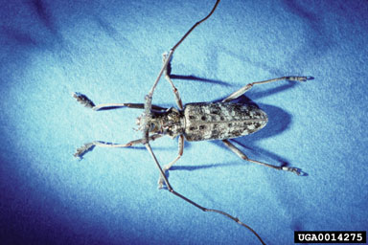
Twig Girdler
Notes:
Common Hosts
Hickories Carya spp. Oaks Quercus spp. Pecan Carya illinoensis Pear Pyrus communis Persimmon Diospyrus virginiana
Description: Adult-- approximately 15 mm long; grayish-brown body with scattered yellowish spots; antennae longer than body. Larvae-- size variable, approximately 18 mm long when mature; dark brown head, yellowish-white body.
Importance: Severe infestations may weaken and distort the shape of ornamental and shade trees.
Signs of Infestation: Foliage discoloration and hanging branches in tree crown. Severed branches on the ground; may be in circles around base of tree. Cut end appears ‘beaver-ish’.
Control: Collect and destroy branches on the ground - these contain the immature twig girdlers.

Slide 26
Sucking Insects
Needle-like mouth so think yellowing, wilting and deformity

Slide 27
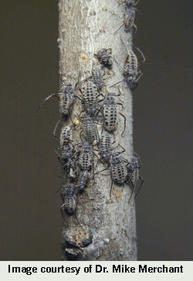
Bark Aphids
Notes:
Common Hosts
Basswood Tilia spp. Hickories Carya spp. Oaks Quercus spp. Pecan Carya illinoensis Sycamore Platanus spp. Walnut Juglans spp.
Description: Adult-- approximately 6 mm long; light to dark brown body; long hind legs; bluish-white bloom on body. Nymph-- similar to adult. Both adult and nymph have two distinct ‘tailpipes’.
Importance: Severe infestations may result in shoot or branch dieback. Honeydew will damage cars parked under infested trees. Sooty mold prevalent.
Signs of Infestation: Foliage discoloration and branch dieback. Underside of branches populated by clusters of many dark large aphids.
Control: Promote tree vigor and health.

Slide 28
Wooly Alder Aphids
Piercing sucking
Suck plant sap
Honeydew
Sooty mold
30 generations a year
Live birth
Wings at times
Notes:
Hosts: elm, silver maple, ash, alder, apple, pear, pine, spruce, hawthorn, and juneberry
Aphids, or plant lice, are small, soft-bodied insects. There are hundreds of different species of aphids, some of which attack only one host plant while others attack numerous hosts. Most aphids are about 1/10 inch long (2.54 mm), and though green and black are the most common colors, they may be gray, brown, pink, red, yellow, or lavender. A characteristic common to all is the presence of two tubes, called cornicles, on the back ends of their bodies. The cornicles secrete defensive substances. In some species they are quite long, while in others they are very short and difficult to see. Aphids feed in clusters and generally prefer new, succulent shoots or young leaves. Some species, known as wooly aphids, are covered with white, waxy filaments, which they produce from special glands.
Woolly aphids (family Eriosomatidae) occur on many hardwood and coniferous tree and shrub species. They are small (2-4 mm [1/8 inch] in length), pear shaped insects, and are often covered with white waxy strands. The wax filaments give this pest a fluffy, cottony appearance, as though they are covered with wool.
Damage: Aphids extract sap from plants and excrete a sweet sticky substance known as honeydew. Black sooty mold grows on the honeydew and, though not directly harming the plant, may block out sufficient light to reduce photosynthesis. Aphids can transmit several viral diseases. Aphids can cause deformity of leaves.
Control: Natural enemies play a very important part in controlling aphid populations. Lady beetles, lacewings, damsel bugs, flower fly maggots, certain parasitic wasps, birds, and fungal diseases all attack aphids. Without them, these pests would be much more destructive. Gardeners should avoid use of insecticides, which are harmful to beneficial organisms in the garden. Gardeners should also strive to keep their plants healthy and growing vigorously since migrating aphids are attracted to the unhealthy, yellow-green color of struggling plants.
Horticultural oil or soap may be used. Insecticides are also available. Soaps and oils are most effective when used when large numbers of over wintering eggs are detected. Again, it is often best to leave control of aphids to natural predators to minimize damage to host plants.

Slide 29
Aphids in general
Clients will often say their problem is ants on their plants
Notes:
Certain ants sometimes protect colonies of aphids. The ants gather aphids or their eggs and keep them through the winter in their nests. In spring, the ants transport these aphids to food plants where they protect them from enemies and, at intervals, transport them to new plants. For payment, the ants collect honeydew, a sweet sticky substance which aphids secrete as a waste product.

Slide 30
Scales – Soft, Armored, Pit, Oystershell, etc.
Piercing sucking
Crawlers
Waxy covering
Systemic insecticides
Sooty mold
Notes:
Importance: Severe infestations may result in branch dieback; death uncommon.
Signs of Infestation: Foliage discoloration and branch dieback. Clumped swellings- the scales - on branches or twigs.
Control: Promote tree vigor and health. Use an approved insecticide for high-value trees or high scale populations.

Slide 31
Other Insects
Miscellaneous damage, but is it really necessary to control?

Slide 32
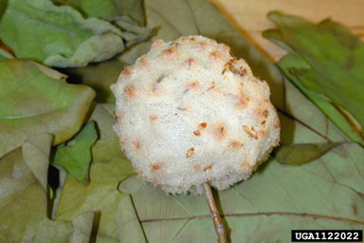
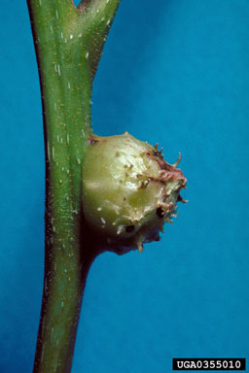
Galls
Notes:
Species: Many species belonging to the following groups: Aphids Beetles Jumping plant lice Midges Mites Moths
Common Hosts: Hardwoods and Softwoods
Description: Most mites and insects are never seen unless deliberately reared or dissected from the gall. Their generally small size (less than 5 mm) and protective shelters serve to hide them well. Identification is usually based on the tree species attacked, the plant tissue utilized, and the form and color of the gall. These characteristics are oftentimes distinctive enough to identify the mite or insect species.
Some typical gall types: Erineum gall (velvety or hair-like) Leaf spot gall Flower gall Bud gall Twig gall Rosette gall Pouch gall Root gall Oak apple gall
Importance: Galls are abnormal vegetative growths or swellings resulting from insect or mite damage, as well as bacteria, fungi, or nematodes. Most galls are physiologically harmless to the tree or shrub. A few species of mites and midges are serious pests of fruit trees and ornamental shrubs. Some gall wasps infest trees to the point that one or more branches may die, but rarely the entire tree. The gall is plant tissue. It may be the result of a chemical secretion of the adult applied while laying eggs or of immature gall-maker while feeding in the plant tissue. Galls also form because of mechanical damage to plant tissues. Regardless, a gall provides shelter and food for the insect or mite as it develops. Abandoned galls also serve as shelters for beneficial insects and spiders who, in turn, feed on the gall-makers.
Biology and Habits: The life cycles are as varied as the number of insects and mites species (over 3,000 species). Many are typical in sequence while others require alternate host tree species and may have several different adult forms. A life cycle may be completed in a matter of weeks or require several years.
Signs of Infestation: Abnormal swellings on any part of the tree. Dissection may reveal small immature insects; mites extremely difficult to see, even with a 10X lens.
Control: Control is very difficult to attain and is often unnecessary. If transplanting, select gall-free specimens. Prune infested material and destroy clippings by burning or removing from property. Rake leaf and twig litter from base of tree and dispose of properly. It is very difficult to achieve proper and effective control with insecticides because timing is critical. Must be applied during a small window to kill emerging adult gall-makers.

Slide 33
Dogwood Club Gall Midge
Causes spindle-shaped swellings
Spray in early spring
Prune later in season

Slide 34
Leaf Miners
Notes:
Species:
Moths Beetles Flies
Common Hosts: Hardwoods and Softwoods
Importance: Leafminers are common on shade trees. Sudden population increases do occur on individual trees or small groups of trees. Several consecutive years of severe infestation may unduly stress a tree. Death is uncommon unless other stress factors become apparent.
Signs of Infestation: Leaves with blotches, mines, or deformity of shape. Small, usually flattened, larvae of various shapes, sizes and color between the upper and bottom leaf layers. Hold a suspected leaf up to the light to see small (3-10 mm long) larvae through semi-transparent damaged areas.
Control: Promote tree health and vigor. Rake fallen leaves and burn to destroy insects that may be present. Use an approved insecticide for high-value trees or especially damaging leafminer populations, but control is hard because applications must be timed exactly to egg laying of female.

Slide 35
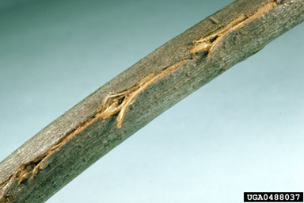
Cicadas
Notes:
Common Hosts: Hardwoods and Softwoods
Description: Adult-- approximately 15-35 mm long; prominent eyes; brownish-green head and body; stout body; transparent wings with conspicuous veins. Loud trilling noisemakers.
Importance: Severe damage by egg-laying habit of the adult females may result in branch dieback or altered growth form. Nymphs feed by inserting sucking mouth parts into roots in the soil.
Signs of Infestation: Foliage discoloration and/or wilt. Branch wounds consisting of a slit surrounded by torn wood fibers through the bark; caused by females laying eggs in the branch. After hatching, nymphs drop to the ground. Nymphal skins (light brown, split insect cases with prominent legs) attached to tree trunks or lower branches. Adults emerge from the skins. Male adults call from tree crowns to attract females.
Control: Protect recently transplanted trees with netting (during 17 year cicada outbreak). Control generally not necessary.

Slide 36
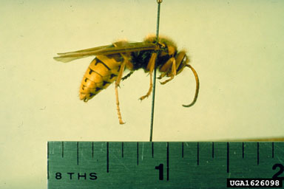
European Hornets
Notes:
The European hornet (Vespa crabro L.) was first reported in North America about 1840 in New York state. Since then, it has spread to most of the eastern United States. This is the largest and, technically, the only true hornet found in the United States.
Description
Adults somewhat resemble yellow jackets, but are much larger (about 1½ in.) and are brown with yellow markings. Nests are typically built in hollow trees, but they are often found in barns, sheds, attics, and wall voids of houses. Unlike its cousin, the bald-faced hornet, European hornets rarely build nests that are free hanging or in unprotected areas. Frequently, the nest is built at the cavity opening, rather than deep within. The outside of the exposed nest will be covered with coarse, thick, tan, paper-like material fashioned from decayed wood fibers. Nests built in wall voids may emit a noticeable stench.
Unlike most other stinging insects, European hornets also fly at night. They may be attracted to lighted windows in homes and may beat into the glass with quite a lot of force causing some people to panic, thinking they are trying to break the glass to attack them. This, of course, is not true. Hornet workers are sometimes noticed collecting from the oozing sap of trees. They have been reported to girdle twigs of numerous trees such as dogwood, birch, rhododendron and fruit trees, probably more for the sap than for the wood fiber. They can also be a minor pest to beehives by preying on worker honey bees.
Control: Control is best achieved by applying a pesticide directly into the nest at dusk. Use any aerosol "Wasp & Hornet" spray that propels the insecticide about 10-15 feet. Direct the spray into the nest opening for 5-10 seconds, then move quickly away from the area to avoid any of the wasps that may emerge from the nest. You may need to repeat the treatment the following evening. When spraying, it is advisable to wear a long-sleeved shirt and long pants. Do not hold a lit flashlight or stand near car headlights or other lights; the wasps may fly towards them. If the nest is in a wall void or other inaccessible area in your home, you may want to hire a pest control company to do the work. Whenever possible, remove the nest from the wall. If the wasps are damaging the twigs of ornamentals or fruit trees, apply an insecticide containing an approved insecticide to the affected areas of the plants. Retreatment may be needed every 7-10 days, depending upon weather conditions.

Slide 37
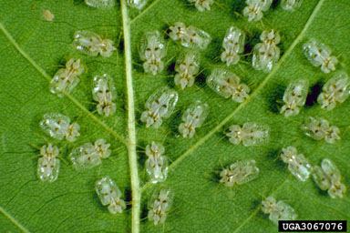
Sycamore Lacebug
Notes:
Common Hosts
Ash Fraxinus spp. Hickories Carya spp. Sycamore Platanus occidentalis
Description: Adult -- approximately 3 mm long; yellowish-green to brown head and body; milky white wings flattened to a lace-like effect, brown spot on each front edge of wings. Nymph -- body color and shape similar to adult, usually darker; wings absent.
Importance: Common on sycamore leaves in the late summer-early fall. Severe lace bud feeding damage may result in premature leaf drop. Several consecutive years of severe damage may unduly stress a tree. In combination with other stress factors, death may occur.
Biology and Habits: Adult lace bugs become active in the spring, mate, and the female lay their eggs on the ribs of leaves, usually the undersides. The nymphs emerge and feed on the leaf undersides as well. Adult and nymph lace bugs have piercing/sucking mouthparts to receive and suck out the contents of plant cells. Overwinter as adults under bark scales and other protective sites. Number of Generations: 3 or 4 generations per year.
Signs of Infestation: Discoloration of foliage - often a yellowing or bronzing. Premature leaf drop, much in advance of the usual fall occurrence. Whitish blotching or stippling on upper leaf surfaces. Dark brown spots and stains (lace bug excrement) on the leaves; insects and cast skins on the undersides of leaves.
Similar Damage: Lace bugs typically exhibit a very strong association with specific tree species. For instance, the sycamore lace bug primarily feeds on sycamore, the HAWTHORN LACE BUG on hawthorns, and the OAK LACE BUG on oaks.
Control: Natural control factors (predators, parasites, diseases) usually keep lace bug populations at low levels. Local population flare-ups do occur occasionally. Promote tree vigor and health to aid in the recovery from defoliation. Use an approved insecticide for high-value trees or for especially damaging lace bug populations.

Slide 38
Acknowledgements
www.forestryimages.org
Florida Division of Forestry
http://eny3541.ifas.ufl.edu/
University of Kentucky Entomology
www.bugwood.org

Slide 39
Acknowledgements
This publication/training was funded in full or in part by the USDA Forest Service Urban and Community Forestry Program as recommended by the National Urban and Community Forestry Advisory Council (NUCFAC).

