Slide 1
Notes:
UGA CAES Logo

Slide 2
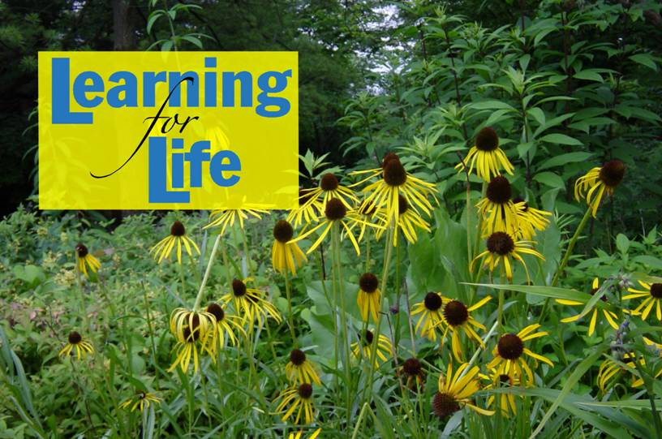
http://www.caes.uga.edu/extension/
Notes:
UGA Cooperative Extension Web address

Slide 3
Notes:
Georgia Master Gardener Logo

Slide 4
Learning Objectives
Insect-related injury in the lawn
Common insects affecting turfgrass in Georgia
Preventing or controlling insect damage to turfgrass
Symptoms of turfgrass diseases
Preventing or controllling turfgrass diseases
Notes:
Be able to recognize insect-related injury in the lawn.
Know some common insects affecting turfgrass in Georgia.
Understand how to prevent or control insect damage to turfgrass.
Be able to recognize symptoms of turfgrass diseases.
Understand how to prevent or control turfgrass diseases.

Slide 5
Insects and Diseases of Turf
Dr. Kris Braman
Dr. Alfredo Martinez
Notes:
Home lawns in Georgia are commonly infested with insects and related pests. Diseases of turf are also common in Georgia as a result of various environmental and cultural factors. In this presentation we will briefly discuss common insect and disease problems of turf.

Slide 6
Turf insect damage
White grub damage
Notes:
Feeding by soil-inhabitants such as white grubs, ground pearls, and mole crickets usually shows up as wilted, dead or dying grass. Torn up sod may be found in areas where wildlife dig up soil-inhabiting pests. Damage to turf by thatch inhabitants such as sod webworms, armyworms and cutworms is apparent when grass is cut off close to the ground. Damage by the chinch bug, another thatch inhabitant, is similar to the kind of damage caused by soil inhabitants. Irregular spots of yellowish turf and dead spots may occur where chinch bug infestations go uncontrolled.

Slide 7
Insect Problems in Turf
Soil Inhabitants
Thatch inhabitants
Notes:
Several insect species cause serious damage while others are simply a nuisance. These pests can be divided into two groups based on where they are found: soil inhabitants and thatch inhabitants. Both groups can destroy turf. A knowledge of pest biologies, life histories and habits is needed before effective control programs can be implemented. Damage to turfgrass from insect pests takes many forms.

Slide 8
Steps to Managing Turf Pests
Prevention
Thatch removal
Early detection
Notes:
Steps to Managing Turf Pests
In Georgia, most insect pests of turf can be controlled when damaging populations are found. However, remember the first step to management of lawn pests is prevention.
Prevention: Good cultural practices are essential to prevent insect pests from destroying turf. Use approved methods of fertilization, watering, mowing, etc., to keep grass healthy and growing vigorously. A healthy lawn can tolerate light insect infestation and insect damage is masked or overcome by rapid growth of plants.
Thatch removal is one means of preventing chinch bug outbreaks. Heavy thatch accumulation, particularly in St. Augustine lawns, provides an ideal environment for chinch bugs. Thatch also interferes with insecticidal control.
Early Detection. The next step to management of turfgrass pests is early detection. This is the weakest link in pest management programs for lawns. Pests are difficult to see until damage is observed. There are, however, several techniques which are useful in detection and monitoring insects in turf grasses.

Slide 9
Sampling: Sweep net
Notes:
The sweep net is a useful tool for finding caterpillars, aphids and chinch bugs. It must be used properly. The net frame should be sturdy. The net bag should be of solid cloth rather than mesh cloth. Sweep the net back and forth across the turf with the rim striking only the grass blades. Sweep in areas where you suspect pests. After several sweeps, turn the bag inside out to dump the contents into a container for inspection.

Slide 10
Sampling: Floatation
Notes:
Floatation uses water to detect the presence of chinch bugs. Remove the bottom from an oil can, coffee can, or similar container. Push the can into the turf (one to three inches deep) in an area of suspected chinch bug in an area of suspected chinch bug infestation. Fill the can with water and hold the water level above the grass by adding additional water for about five minutes. If chinch bugs are present they will float to the top.

Slide 11
Sampling: Irritation
Notes:
Irritation is another method of sampling for turf insects. It is particularly useful in mole cricket surveys. Lemon dish washing detergent is a good inexpensive irritant. Mix the detergent with water and pour over a turfgrass area. The detergent irritates sensitive soil-inhabiting pests causing them to quickly come to the surface. Use one-fourth cup dry or one ounce liquid detergent per gallon of water. Use one gallon of water to sample a one square yard area of turfgrass. Pyrethrin is also a good flushing agent when used at a concentration of one to three percent in water.

Slide 12
Monitor pest populations
Fall armyworm damage
Notes:
Monitor pest populations. Close observations are useful for early detection of potential pest outbreaks. The most critical time for turf damage by chinch bugs is July and August. During this period the turf is frequently under moisture stress and the feeding activity of chinch bugs is greatest. The combined effects of these two stress factors is often more than a home lawn can withstand. Close observation of susceptible turf during early June is critical in detecting chinch bugs before damage occurs. St. Augustine lawns as well as bermudagrass and zoysiagrass should be closely observed for chinch bug especially if the pest has been observed during previous years. Since chinch bugs usually occur in scattered patches, particular attention should be given to areas where damage was observed in previous years.
Damage symptoms on grasses, sod torn up by animals feeding on insects, presence of moths flying over lawn at night, and birds frequenting a particular area of the lawn are all conditions which provide clues concerning lawn pests. By detecting insect pests early, we have sufficient time to correctly identify the pests, choose an appropriate control, and apply controls before the turf is damaged severely.

Slide 13
Correct Pest Identification
chemical damage, not insect…
Notes:
Correct Pest Identification. Insect pests must be identified correctly before the appropriate method of control can be chosen. The biology and life cycle of identified pests may provide information on control methods.

Slide 14
Proper Selection of Control Materials
Notes:
Proper Selection of Control Materials. Materials labeled for insect control on home lawns are available in several formulations: baits, emulsifiable concentrates, wettable powders, soluble powders, and granules. The formulation selected, as well as the specific insecticide chosen, determine the level of control. For example, bait formulations are superior in spring and fall for mole cricket control, whereas summer treatments with sprays or granules give better control. For specific insecticide recommendations on turf consult the current Georgia Pest Control Handbook.

Slide 15
Correct Application Methods
Notes:
Application methods are extremely important in turf insect control. The homeowner may use the most effective insecticide available, but if the method of application is poor, the level of insect control will be disappointing.

Slide 16
When Applying Insecticides Consider:
Distribution
Irrigation requirements
Insecticide formulation
Timing of insecticide application
Target zone of the insecticide application
Notes:
When Applying Insecticides Consider:
Distribution. Liquid materials should be applied as coarse sprays. Sprays with fine particles may drift and evaporate. The volume of water needed will vary with insect pest and thatch build-up. The greater the thatch accumulation, the higher the spray volume needed. In addition, large volumes of spray water are needed for the soil-inhabiting pests, such as mole crickets and white grubs. Generally, use of higher spray volumes results in more uniform distribution of insecticide.
Irrigation Requirements. Timely use of irrigation can help get best results with insecticides for soil-inhabiting pests. During dry weather the turf should be irrigated prior to treatment. This will help the insecticide to penetrate grass blades and dry thatch. An additional half-inch to one inch of irrigation water after treatment will carry the insecticide down through thatch and into the soil to the root zone. Delays in watering-in control materials will greatly reduce the chances of good control.
Insecticide Formulation. Granular formulations should be applied to dry turf. Granules will stick to wet grass blades and may not penetrate into the thatch layer or soil. Rapid watering-in is desirable with granular formulation, however, it is not as critical as with liquid materials. At least one-half inch of water should be applied to activate the material and place it in contact with pests.
Bait formulations are used to attract soil-inhabiting pests to the turf surface where they consume a toxic dose of insecticide mixed in the bait. These materials will be ruined by rainfall or irrigation. Time of bait treatment is also critical. For night-feeding pests such as mole crickets and cutworms, baits should be applied late in the day.
Timing of Insecticide Application. Several insecticides are labelled for turf insect control. Examples include products containing diazinon, chlorpyrifos (Dursban), trichlorfon (Dylox/Proxol), acephate (Orthene), isofenphos (Oftanol), and carbaryl (Sevin). The effectiveness of these materials is somewhat limited due to their short active life. Applications of these materials should be made at a time when pests are most vulnerable. Proper timing is based on an understanding of pest biology and life cycle.
Target Zone of the Insecticide Application. To control insect pests living in the soil, the target zone for the insecticide should be the soil at the root zone. Liquid and granular formulations must be sufficiently watered in to move the insecticide off the surface, through the thatch, and to the root zone. Pre-treatment irrigation will often aid in accomplishing adequate movement of the insecticide when post-treatment irrigation is applied.
To control surface feeding pests, the target zone for the insecticide should be the leaves, stem and thatch. Spray applications of insecticides provide the highest degree of control within the first 24 - 48 hours after application. In general, the initial control with granular treatments is less than that from sprays. Insecticidal activity begins only when the granule absorbs moisture and releases the insecticide.
Spray formulations leave residues that remain on the surface and provide control of thatch inhabitants. Howeer, the residual effectiveness is less than that for granules.
The objective of spray applications is to apply insecticides to the area where the target pest lives and eats. The volume of spray applied should be adequate for uniform coverage of leaves, stems and thatch. Use coarse sprays to reduce drift and penetrate foliage.

Slide 17
PESTS
Identification, Life Cycle and Diagnosis
Notes:
PESTS - IDENTIFICATION, LIFE CYCLE AND DIAGNOSIS

Slide 18
Ground Pearls
Notes:
Ground Pearls
Identification: These are scale insects that live in the soil. The immature stages are spherical and range in size from a grain of sand to about 1/16 inch in diameter. They are usually yellowish-purple in color. The adult female is 1/16 inch long and pink and has well-developed forelegs and claws. Adult males are tiny gnat-like insects.
Life Cycle and Diagnosis: Eggs are laid in the soil during spring. The young (nymphs) hatch and feed on fine grass rootlets. Nymphs cover themselves with hard, globular shells that look like tiny pearls, hence the name "ground pearls." The time required for development from egg to adult is one to two years.
These insects suck juices from underground parts of grass. Centipede grass is most commonly attacked. Severely infested grass turns yellow, then brown.

Slide 19
Mole Crickets
Notes:
Mole Crickets
Identification: Mole crickets are light brown, up to 1 1/2 inches long, have short, stout forelegs, spade-like feet, and large eyes. The young resemble the adults except that they are much smaller, have no wings and are sexually immature.
Life Cycle and Diagnosis: Adults lay eggs in underground cells in the spring. The eggs hatch in 2 to 4 weeks, depending on the weather. Nymphs feed and grow through the summer, and mature into adults in the fall. Mole crickets spend the winter deep in the soil but come to the surface to feed during warm periods. Adult crickets leave the soil on warm spring nights to fly around, sometimes in huge numbers, looking for mates and egg-laying sites. There is one generation per year, and most adults die by early summer.
The most damaging species of mole crickets feed on grass. With other species the majority of turf damage is related to their tunneling activity. Both young and adults burrow beneath the soil and make tunnels similar to those made by moles, but much smaller. This loosens the soil and causes it to dry out quickly, as well as clipping the roots of the grass plants. Left unchecked, mole crickets will build up in an area and completely destroy the grass, leaving bare ground.

Slide 20
White Grubs
Notes:
White Grubs
Identification: These grubs are plump, C-shaped insects. They are whitish with dark areas near the rear. They have a distinct, brown head. The adults are beetles commonly referred to as chafers, May beetles, June beetles, and others.
Life Cycle and Diagnosis: Adult female beetles lay their eggs in the soil. The grubs hatch and spend most of their life beneath the soil feeding on underground plant parts. Most have rather long life cycles with the grub stages lasting from several months to two or three years. In heavy infestations roots are pruned off to the extent that turf can be rolled back like a carpet.
Estimate the grub population in your lawn to determine if treatment is necessary. Fall or early spring is the best time to estimate grub populations. At these times the grubs are near the soil surface feeding at the root zone. Use a spade to cut three sides of a strip one foot square by two or three inches deep. Force the spade under the sod and lay it back, using the uncut side as a hinge. Use a trowel to dislodge soil from the overturned roots. Count the grubs in the exposed soil. Replace the strip of sod. Following the same procedure, cut strips of sod in several other parts of the lawn and count grubs under each strip. Calculate the average number of grubs per square foot of lawn by dividing the total number of grubs by the number of strips. If the average number is four or more grubs, control measures should be taken.

Slide 21
Billbugs
Notes:
Billbugs
Identification: Adult billbugs are weevils 1/5 to 3/4 inch long. The reddish-brown to black adults have a pair of jaws at the tip of a long snout or "bill." The young are white, legless grubs which attain a length of about 3/8 inch.
Life Cycle and Diagnosis: Adults lay eggs near the crown of the plant. The grubs hatch and live in the soil where they feed on roots and underground runners. Adult billbugs burrow in the grass stems near the soil surface. They also feed on leaves. Zoysiagrass and bermudagrass are most often injured, however, feeding may occur on many grasses. In heavy infestations, roots of grass are destroyed and the turf killed in irregular patches

Slide 22
Leaf, Stem and Thatch Inhabiting Insects
Notes:
Leaf, Stem and Thatch Inhabiting Insects

Slide 23
Spittlebugs
Notes:
Spittlebugs
Identification: Spittlebug adults are about 3/8 inch long, dark brown or black, and have two orange stripes across their wings. The nymph is ivory-colored with a brown head. They live inside masses of spittle or froth, hence the name "spittlebug."
Life Cycle and Diagnosis: Orange-colored eggs are deposited in bits of hallow stems and other debris. Nymphs hatch in about two weeks and begin to feed immediately by sucking juices from the grass. They cover themselves with a frothy mass known as spittle. There may be one to several nymphs in each spittle mass. The masses are found from just below the soil surface to a few inches above it. A heavily infested area will feel "spongy" when you walk across it due to numerous spittle masses.

Slide 24
Chinchbugs
Notes:
Chinch Bugs
Identification: Adults are about 1/5 inch long, light in color with small black triangular patches on the wings. The wings are carried folded over the back. The nymphs are from 1/20 to 1/5 inch long and vary in color from a reddish with a white band across the back to black as they near adult size.
Life Cycle and Diagnosis: The eggs are laid in leaf sheaths or crevices in nodes and other protected places. The young develop into adults in four to six weeks. There are 3-4 generations a year. The bugs insert a slender beak into the grass and suck the plant juices. Typical injury appears as spreading patches of brown, dead grass. St. Augustine grass is the most seriously injured, however, other lawn grasses are subject to attack.

Slide 25
Sod Webworms
Notes:
Sod Webworms
Identification: Sod webworms are caterpillars of moths. They grow to a length of nearly 3/4 inch and are light brown. They are covered with fine hairs. The moths are light to dingy brown in color with a wingspan of about 3/4 inch. They fold their wings closely about their bodies when at rest.
Life Cycle and Diagnosis: Moths hide in shrubbery or other sheltered spots during the day. They fly over the grass in early evening. The females scatter eggs over the lawns as she flies.
Sod webworms feed only at night. Damaged grass blades appear notched on sides and chewed raggedly. Irregular brown spots are the first signs of damage. Large areas of grass may be damaged severely. A heavy infestation can destroy a lawn in only a few days.

Slide 26
Armyworms
Notes:
Armyworms
Identification: Armyworms, which attain a length of 1 1/2 inches are caterpillars of moths. Their bodies are greenish when small and dark brown when fully grown. Several stripes are usually apparent, extending from the head to the rear. The adult is a brownish-gray moth with a wingspan of nearly l l/2 inches.
Life Cycle and Diagnosis: Moths lay clusters of eggs on grass blades and other objects near lawns. Caterpillars hatch and begin to feed on the turf. Damaged turf appears ragged with individual blades showing signs of chewing damage. When numerous, they may devour the grass down to the ground. Caterpillars pupate in the soil. The moths emerge within a couple of weeks. They are active mainly at night. There are three to six generations a year.

Slide 27
Cutworms
Notes:
Cutworms
Identification: Cutworms are caterpillars of certain moths. They grow to a length of 1 1/2 - 2 inches. They are dull brown, gray or nearly black and usually appear plump and greasy. The moth stage is gray to brown colored with a wingspan of 1 1/2 - 2 inches.
Life Cycle and Diagnosis: Eggs are laid on grass and weed stems or behind the leaf sheath of such plants. Caterpillars usually remain below the ground surface, under clods, or other shelters during the day and feed at night. Foliage or stems may be cut off (hence the name cutworm) by the caterpillars. Cutworms pupate in the soil. There may be several generations in a year.

Slide 28
Non-harmful Turf Inhabitants
Notes:
Inhabitants that usually do not damage turf

Slide 29
Cicada Killer Wasp
Notes:
Cicada Killer Wasp
Identification: This wasp is about 1 1/2 inches long. It is marked with yellow and black markings on its body.
Life Cycle and Diagnosis: The wasps dig burrows in the ground and mound the soil at the entrance. The female paralyzes a cicada by stinging it, then places it in the burrow and lays an egg on it. When the egg hatches, the larva feeds on the cicada. Cicada killer wasps usually appear in late July and August when adult cicadas are abundant. Although they generally have a mild disposition they can sting if molested. They cause no primary damage to lawns. Their presence is sometimes unnerving and their burrows may detract from the appearance of well manicured turf.

Slide 30
Earwigs
Notes:
Earwigs
Identification: Earwigs are reddish-brown beetle-like insects. They are narrow and elongated. Earwigs have a prominent pair of "pinchers" at the rear of their body.
Life Cycle and Diagnosis: Adult females lay their eggs in nests in the soil. The nymphs are cared for by the mother until they are ready to leave the nest. They may become quite numerous in lawns and begin to enter homes, where their presence is objectionable. Some species feed on young roots of plants, however, their value as scavengers and predators of other insects probably outweighs the harm they do.

Slide 31
Millipedes & Centipedes
Notes:
Millipedes and Centipedes
Millipede (thousand-legged worms) and centipedes (hundred-legged worms) are closely related to insects. They are slender, worm-like creatures that are dark brown and have many body segments. They differ from insects in the number of legs they have (1 to 2 per body segment). Millipedes and centipedes cause no damage to lawns. Occasionally millipedes gather in yards after heavy rains. Their food is chiefly decaying vegetable matter.

Slide 32
Sowbugs & Pillbugs
Notes:
Sowbugs and Pillbugs
Sowbugs and pillbugs are not insects. Like millipedes and centipedes, they are related to insects. Sowbugs and pillbugs and light gray to slated-colored. They are nearly 1/2 inch long with segmented bodies and seven pairs of legs. When disturbed, pillbugs roll up into tiny balls.
Sowbugs and pillbugs are usually found on damp ground under stones, boards, or dead leaves. They feed on organic matter in the soil, and sometimes on grass and other plants.

Slide 33
Questions?
Notes:
This is a good opportunity to take a break-

Slide 34
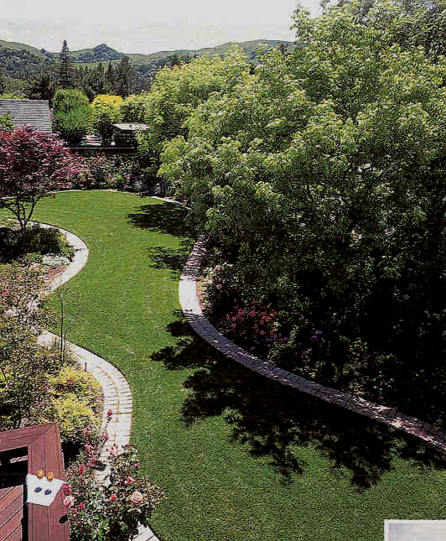
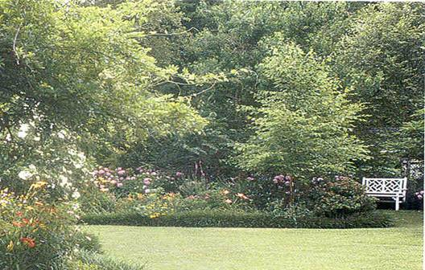
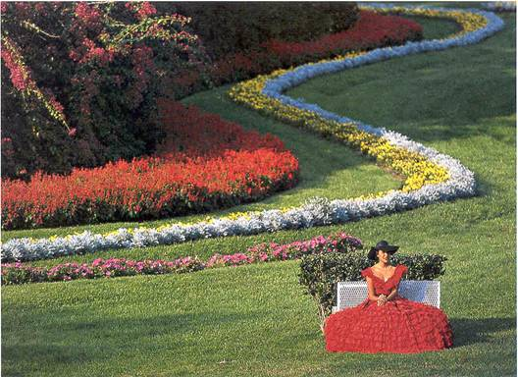
Turfgrass Diseases
Notes:
The most important turf diseases that occur in Georgia will be discussed here. We will go through the distinctive symptoms of the diseases, the conditions which favor their development and ways to prevent them. Before we review specific diseases, we will emphasize key management practices that will help to produce a healthy turf and reduce disease problems in our lawns. Specific chemical recommendations will not be discussed in great detail.

Slide 35
Turfgrass
Adds beauty and value to any property
Versatile and functional plant in the landscape
Most effective plant cover
Reduces soil erosion and surface water run-off
Recharges ground water
Reduces heat (30ºF below that of asphalt area)
Average lawn area has a cooling effect equals 8 ton
of air conditioning
Absorbs dust and other pollutants
Produces oxygen
Notes:
Turfgrasses are an essential part of home landscapes, parks and recreation areas. Attractive lawns make ideal settings for homes, adding beauty to the neighborhood. Turfgrasses also reduce dust, glare, heat and noise, and prevent erosion and surface runoff. Turfgrasses can also increase the value of properties etc.

Slide 36
Diseases
Due to diverse environmental conditions and clientele choices in GA there are a wide variety of turfgrass species grown
Variety of turfgrass pathogens flourish
In 2000, disease losses and control costs account for over $200 million
Notes:
Due to Georgia’s increasing population, the range of climates in the State and the wide variety of turf choices, the popularity of turfgrass has increased tremendously. However, due to the warm and humid weather of Georgia, disease problems can occur in our lawns.

Slide 37
Most turfgrass diseases can be avoided using proper management strategies
Reduction in expenses
Save water resources
Reduce pesticide use
Reduce negative impact on the environment
Notes:
The key to disease control is a healthy plant. Under proper turfgrass management, disease-causing conditions are reduced, and a healthy turf is maintained. Good management practices can reduce expenses, save water resources and reduce pesticide use and reduce negative impact on the environment.

Slide 38
Management practices to reduce turf disease problems
Prepare the soil properly
Take soil samples, remove debris, ensure proper water drainage
Plant locally adapted turf species
Purchase high quality disease-free seed, sod or sprigs
Follow proper irrigation practices
Notes:
The following management practices will help to produce a vigorous, healthy turf and reduce turfgrass disease problems. a) Prepare the soil properly. The key to successful turf establishment is proper soil preparation. Take soil samples to determine proper fertilizer requirements. Remove all debris such as rocks, tree stumps and other wood debris. Provide proper water drainage. The area should be graded to prevent surface water collection. b) Plant locally adapted turfgrass species. c) Purchase high quality disease-free seed, sod or sprigs. Plant material that is certified for purity and freedom from noxious pests is recommended when available. d) Follow proper irrigation practices. The single most cost-effective practice that enhances turf growth is proper irrigation. Apply water only at the first signs of moisture stress. If the soil becomes compacted, loosen it through cultivation such as core aeration, so the water can penetrate into the soil. Irrigate early in the morning. Late afternoon watering will encourage disease development during the night. Irrigation after dew development and before sunrise is most efficient and will not increase disease problems. Irrigate deeply and infrequently.

Slide 39
Apply fertilizer according to soil analysis
Mow at recommended height
Remove excessive thatch
Allow for adequate light and air movement
Follow recommended disease control practices
Notes:
e) Apply fertilizer according to soil analysis recommendations. f) Mow at the recommended cutting height. Mow turfgrasses no more than 1/3 of the plant. If more plant material is removed, the grass will become stressed and more susceptible to disease-causing organisms. Keep mower blades sharp. Dull blades shred leaf tips, causing turf to use more water, undergo undue stress and provide pathogen infection entrances. Raise the mowing height during stress periods such as drought. g) Remove excess thatch. Excess thatch reduces water infiltration, creates shallow-rooted turf, and encourages insect and disease problems. If the lawn is not mowed, irrigated and fertilized correctly, thatch accumulation could create a problem. h) Allow for adequate light and air movement in shaded areas. In heavily shaded areas, excessive moisture on grass blades can be a problem. Prune trees and shrubs and design landscape plantings so humidity is reduced by light penetration and air movement. Raise the mowing height in shaded areas to help the plant absorb the limited light penetrating the tree canopy. Reducing fertilizer amounts by 20 to 50 percent in full areas also helps the grass better cope with the limited light.
i) Follow recommended disease, insect and weed control practices. Chemicals are not the answer to disease problems. Proper management practices will reduce pest problems and reduce the need for chemicals.

Slide 40
Specific diseases
Notes:
Let’s look at the most important turf diseases in Georgia individually.

Slide 41
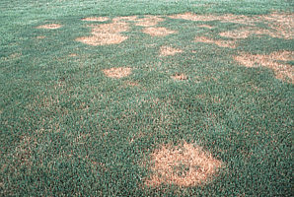
Brown Patch
Caused by the fungus Rhizoctonia solani
Disease symptoms are circular patterns of dead grass
Turf turns brown and grass blades rot off
Most common in
St. Augustine, Zosysiagrass
Bentgrass
Ryegrass
Centipede
Bermuda
Notes:
Brown Patch. The disease is caused by the fungus Rhizoctonia solani. This disease typically causes rings and/or patches of blighted turfgrass. It also causes leaf spots and "smoke rings" which are thin, brown borders around the diseased patches that appear most frequently in the early morning. After the leaves die in the blighted area, new leaves can emerge from the surviving crowns. On wide bladed species, leaf lesions develop with tan centers and dark brown to black margins The disease can infect all species of warm- and cool-season turfgrass in Georgia, including St. Augustine grass, Zoysiagrass, Bentgrass, Ryegrass, Centipede and Bermudagrasses. It is one of the most common turfgrass diseases in the State.

Slide 42
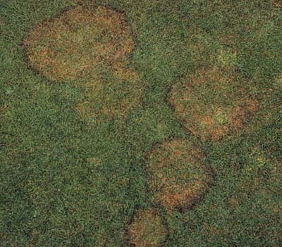
Brown Patch can spread in an area from 1-50'.
New leaves may emerge in the center of the circular patch giving the diseased areas a doughnut-shaped appearance.
BP Accounts for 65% of UGA
Disease Clinic Turf Samples
Notes:
Brown patch can spread in areas from 1 inch to more than 50 feet

Slide 43
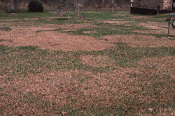
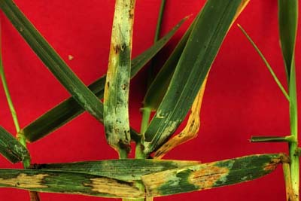
Patches merge to affect
larger areas
Occasionally circular
patterns aren’t evident
Heavy/recent infections
produce foul smell
Leaves/runners
pull out easily
Notes:
Patches merge to affect larger areas. Occasionally, circular patterns aren’t evident.

Slide 44
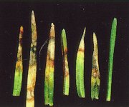
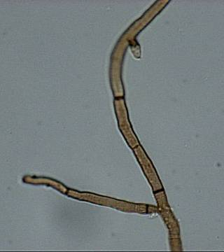
Infection requirements
--Brown Patch occurs from late Spring through Early Fall (temperatures between 65-85 º F)
--High humidity contributes to rapid disease spread
--High Nitrogen
Notes:
Most favorable conditions for disease development usually occur from late April through October. Brown patch favors high relative humidity as well as temperatures of over 80°F during the day and over 60°F at night. It also occurs in areas that experience more than 10 hours a day of foliar wetness for several consecutive days. Heavy nitrogen applications increase the susceptibility of the grasses to fungus infection

Slide 45
Control
1) Scout: Early detection is key for disease prevention/control
Look for abnormal appearance/spots on turf
Look closely for early symptoms/ signs of the disease
Note weather patterns
Keep notes of site changes
History of problems in the site
2) Avoid excessive Nitrogen fertilization
Maintain adequate Nitrogen levels)
3) Water Timely and Deeply (After midnight/before 11 AM)
5-6 inches
Notes:
Management plays the most important role in brown patch control. Scout. Early detection is the key for disease control. Use low amounts of nitrogen, moderate amounts of phosphorous and moderate to high amount of potash. Water early in the morning and deeply

Slide 46
4) Avoid frequent light irrigation to reduce humidity
Allow time during the day to allow plant canopy to dry
5) Increase air circulation
Shrub and tree barriers contribute to shade
and lack of air circulation
6) Reduce thatch (no more than 1 inch thick)
Excessive thatch: restricts water and air movement
Promote shallow root growth
Promotes an ideal environment for pathogens
Notes:
43. Increase the air circulation. Minimize the amount of shade. Irrigate turf early in the day to allow the foliage to dry as quickly as possible. Improve the drainage of the turf. Reduce thatch. Remove dew from turf early in the day.

Slide 47
Chemical control for Brown Patch
There are many fungicides available, become familiar
with the “Georgia Pest Management Handbook
Among others:
Azoxystrobin (Heritage 50 WG)
Propiconazole (Banner)
Triadimefon (Bayleton)
Ipropidione (Chipco 26091)
Trifloxystrobin (Compass)
Thiophanate Methyl (Cleary’s)
Notes:
Chemical control for brown patch. Fungicides are available to control the disease. Consult the current “Georgia Pest Management Handbook”. (Do not discuss the fungicides. Just mention the availability of them. Ask for questions or comments on Brown patch).

Slide 48
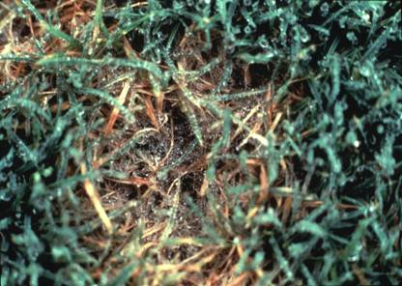
Dollar Spot
Causal agent is Sclerotinia homoeocarpa
White patches up to 2 inches in diameter
All warm and cool season turfgrasses are susceptible.
Notes:
Dollar spot is caused by Sclerotinia homoeocarpa. Dollar spot causes sunken, circular patches that measure up to few inches on turfgrass. The patches turn from brown to straw color and eventually coalesce, forming irregularly shaped areas. Infected leaves may display small lesions that turn from yellow-green to straw color with a reddish-brown border. The lesions can extend the full width of the leaf. Multiple lesions may occur on a single leaf blade. Abundant white fungus growth may be seen in these areas during periods of severe disease development. All cool and warm season turfgrasses are susceptible.

Slide 49
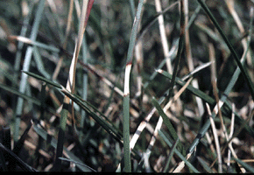
Infection requirements
50ºF - 85ºF (Early Spring Late Fall)
Cool nights/Warm days
>10 hrs leaf wetness/day
Dry Soils
Low Nitrogen promotes growth of the fungus
Notes:
Dollar spot is favored by temperatures between 60°F to 85°F and continuous high humidity and low soil moisture. This disease is particularly favored by warm days, cool nights, and intense dews. It also infects areas with low levels of nitrogen and becomes more severe in dry soils. Dollar spot is more common during the spring and fall months.

Slide 50
Control for dollar spot
Maintain adequate Nitrogen levels (Low Nitrogen)
Avoid drought stress (dry soils promote the disease)
Water deeply (….holding the hose for a few minutes in not watering appropriately)
Notes:
Management practices helpful in controlling this disease include the addition of nitrogen and providing sufficient soil moisture. Use an adequate level of nitrogen, particularly in the spring and early summer. Irrigate turf deeply and as infrequently as possible to avoid drought stress. Irrigate turf early in the day to allow the foliage to dry as quickly as possible.

Slide 51
Avoid extended moisture on leaves /remove dew in morning
Increase air circulation
Mow at recommended height
Notes:
Increase the air circulation. Remove dew from the turf early in the day. Mow grass at regular intervals

Slide 52
Chemical control for Dollar Spot
Use the “Georgia Pest Management Handbook
as reference
Chlorothalonil
Thiophanate-methyl
Iprodione, vinclozolin
Triadimefon, myclobutanil, fenarimol, propiconazole
Notes:
Fungicides can be used to help bring the disease under control once it is established. Consult the current “Georgia Pest management Handbook.

Slide 53
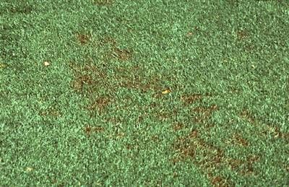
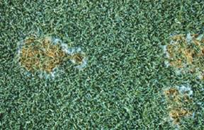
Pythium blight
Causal agent Pythium spp
Disease is characterized small, irregular water-soaked areas. Brown, orange/bronze, light/tan
Numerous spots, merge in wettest areas
Notes:
Pythium root rot is caused by the water mold Pythium spp. Although symptoms of Pythium root rot are typically non-distinctive, this disease can appear as yellow, irregularly shaped patches. Numerous spots merge in wettest areas.

Slide 54
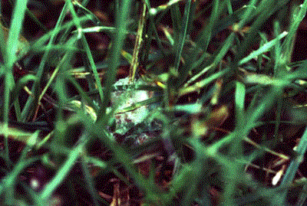
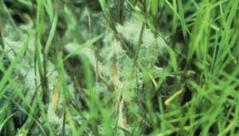
Turf dies rapidly, collapses and appear matted
Infected tissue feels oily to touch
If high humidity present fluffy, cottony white mycelium present (can be seen early in the morning)
Notes:
The affected turfgrass is thin, off-color and slow growing, while the root system is stunted with reduced volume and vigor. Infected tissue feels oily to touch. You can detect the presence of mycelium early in the morning.

Slide 55
Control measures for Pythium Blight
Water management is essential
Correct over watering/drainage problems
Avoid pockets of excessive humidity
Use treated seed when Re-seeding
Do not over fertilize with Nitrogen
Promote light and air penetration
Notes:
Water management is essential. Avoid over-watering. Improve the drainage of the turf Apply optimum amounts of nitrogen, phosphorous and potassium. Apply low amounts of nitrogen in the spring when roots are forming. Minimize the amount of shade.

Slide 56
Chemical control for Pythium
Use the “Georgia Pest Management Handbook
as reference
Notes:
Fungicides are available to control the disease. Consult the current “Georgia Pest Management Handbook

Slide 57
Fairy ring
Different Basidiomycetous fungi
Mushroom (basidiocarp) producing fungi
In Nature, wood-rooting
Circular or semi-circular band
Notes:
Fairy Rings are caused by Basidiomycetous fungi of more than 40 species including Agaricus campestris; Collybis spp.; Hygrocybe spp.; Lepiota sordida; Marasmius spp.; Psalliota spp.; Scleroderma spp.; Tricholoma spp. Etc. Most of them produce mushrooms during fall or wet springs. In nature fairy ring are wood degrading fungi and may be more problematic on new subdivisions were trees have been cut down.

Slide 58
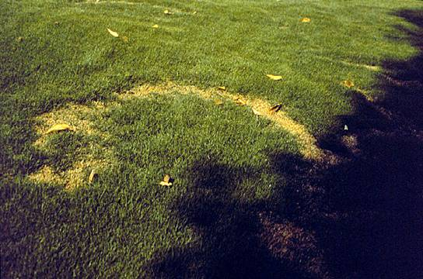
Affects all turf types
Most common and damaging on Centipede, Zoysiagrass and St. Augustinegrass.
Most on sandy soils of low fertility
Also favored by heavy thatch
Sometimes associated with buried debris
Notes:
All species of warm- and cool-season turfgrass are susceptible. The disease is particularly damaging on Centipede and St. Augustinegrass in south and coastal Georgia. The first indication of a fairy ring is a circular or semicircular band of stimulated grass a few inches wide. The band of grass forming the ring is usually greener than the grass in the center. The stimulation of the grass is due to the availability of nutrients resulting from the decomposition by the fungus of organic matter in the soil and various toxins produced by the fungus itself. The most characteristic symptom associated with fairy ring is the presence of mushrooms in the stimulated grass ring during rainy, moist periods, but is not an essential diagnostic character.

Slide 59
Management for fairy ring
Spike or aerate affected areas
If necessary for aesthetic purposes Water heavily
Extra fertilizer where appropriate
Soil replacement
Fungicide treatment
Notes:
Management for fairy ring. Avoid using root zone mixes with high levels of un-decomposed organic materials. Reduce thatch by vertical cutting. Aerate soil. Irrigate deeply.

Slide 60
Fungicides for fairy ring control
Flutolanyl
Several others with marginal effect
Notes:
Fungicides are available to control the disease. Consult the current “Georgia Pest Management Handbook”.

Slide 61
‘Fading’ and ‘melting out’ Curvularia and Helminthosporium sp.
Both fungi are common thatch and soil inhabitants
Can cause disease when K is low and drought stress occurs
Bermudagrass, zoysiagrass, centipedegrass
Common during the past 2 to 3 years
Notes:
Fading Out or Melting Out is caused by Curvularia spp., Drechslera spp. and/or Bipolaris spp. Which can cause disease when K is low and drought stress occurs. Susceptible Turfgrasses inlcude Bermudagrass, Zoysiagrass and Centipede.

Slide 62
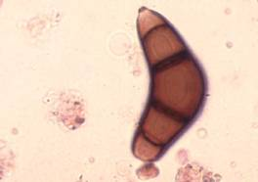
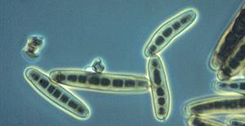
Curvularia:
large overall decline
Helminthosporium:
light colored spots
dark edges
Notes:
Curvularia causes large overall decline while Helminthosporium produces light colored spots surrounded by dark edges.

Slide 63
Factors that promote disease incidence
High Temperature
Drought stress
Low aeration
Low light intensity
Excessive Nitrogen
Notes:
Disease favors temperatures between 40°F and 80°F. It occurs in areas that experience more than 10 hours a day of foliar wetness for several consecutive days. It also favors high amounts of nitrogen and a low mowing height. It also becomes more severe in dry soils.

Slide 64
Management for Curvularia and Helminthosporium diseases
Prevent drought stress to the turf
Water properly
Soil test/insure adequate K
Address excessive thatch
Protectant fungicides available
Consult the GA Pest Management Handbook for proper chemical control
Notes:
Management for Curvularia and Helminthosporium. Reduce turf stress by using lightweight equipment. Increase air circulation to speed turf's drying process. Avoid the application of high rates of water-soluble nitrogen in the spring. Minimize the amount of shade. Irrigate turf deeply and as infrequently as possible. Fungicides are available to control the disease. Consult the current “Georgia Pest Management Handbook”

Slide 65
Gray leaf spot Pyricularia grisea
Notes:
Gray leaf Spot is caused by the fungus Pyricularia grisea

Slide 66
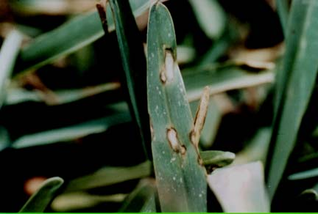
Leaf spot disease
Straw-gray lesions
with purple/brown margins
Rapid spread
Severely affected leaf blades wither and turn brown
Notes:
63. On susceptible grasses gray leaf spot first appears as small, brown spots on the leaves and stems. The spots quickly enlarge to approximately 1/4" in length and become bluish-gray in color and oval or elongated in shape. The mature lesions are tan to gray in color and have depressed centers with irregular margins that are purple to brown in color. A yellow border on the lesions can also occur.

Slide 67
Gray leaf spot
Affects St. Augustinegrass and Tall Fescue
Favored by high N and excess moisture
Optimal temps 77 to 86˚F
Notes:
Gray leaf spot affects San Augustine grass and Tall fescue. The disease is favored by N abd excess moisture . Optimal temperature for disease development 77-86 F.

Slide 68
Management of gray leaf spot
‘Roselawn’ and ‘Tamlawn’ have some resistance
Avoid excessive applications of N
Proper watering practices
Reduce thatch when excessive
Reduce shade
Avoid herbicide use above 85 ˚ F
Protectant fungicides available
Notes:
Management of gray leaf spot. Avoid medium to high nitrogen levels during mid-summer. Irrigate turf deeply and as infrequently as possible to avoid water stress. Allow water to remain on leaves for only a short period of time. Reduce thatch by vertical cutting. Fungicides are available to control the disease. Consult the current “Georgia Pest Management Handbook”.

Slide 69
Take-all root rot
(Gaeummanomyces graminis)
Notes:
Take all root rot is caused by Gaeumannomyces graminins.

Slide 70
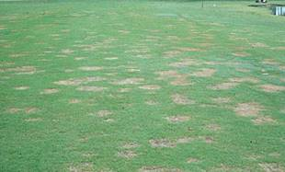
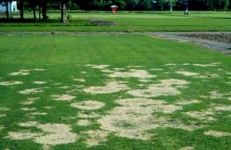
Symptoms
Starts as small light brown-straw colored death patches
Circular (dead spots, few centimeters to
1 or more meters)
During hot dry weather turf appears bronze
to straw in color
Notes:
Take-all root rot causes wilted circular patches that are brown or bronze-colored and measure up to several feet in diameter. Infected plants have dark-brown roots. Take-all patch is common on newly established turf.

Slide 71
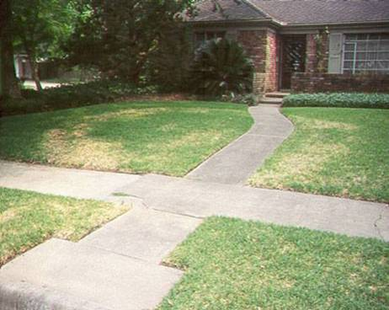
Many cases St. Augustinegrass turns tan, straw colored
Roots and bases of shoots
appear brown to dark
Leaves pull out easily from roots and crown, but entire plants pull out due to lack of roots (or rotten roots)
Dark roots
Yellow leaves
Thinning of turf
Necrotic areas on crown
Notes:
Roots and bases of shoots appear brown to dark in color. Leaves pull out easily from roots and crown, but entire plants may also pull out due to lack of roots. Dark roots, yellow leaves, thinning of turf necrotic areas on crown.

Slide 72
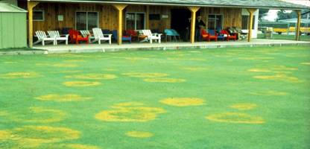
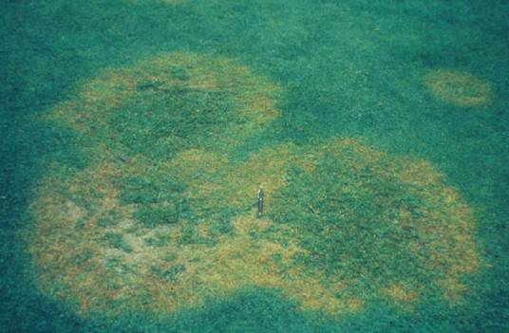
Factors Affecting
Take all root rot
Disease greatly enhanced in soils with high pH (alkaline soils), low organic content and Sandy soils
Unbalanced Fertility
Excessive Thatch
Poorly drained, irrigated soils
Notes:
Take-all root rot typically occurs in wet conditions and in areas with a high soil pH (alkaline)- most severe at pH 6.5 or above. This disease is more severe on less fertile and sandy soils.

Slide 73
Control
Use of acidifying fertilizers
(Ammonium sulfate)
Phosphorous/potassium fertilizer
If liming necessary, use the coarsest ground material
Maintain adequate Nitrogen levels
Water Timely and Deeply (After midnight/before 11 AM)
Allow time during the day to allow plant canopy to dry
Notes:
Management strategies include
Use of acidifying fertilizers
(Ammonium sulfate)
Phosphorous/potassium fertilizer
If liming necessary, use the coarsest ground material
Maintain adequate Nitrogen levels
Water Timely and Deeply (After midnight/before 11 AM)
Allow time during the day to allow plant canopy to dry

Slide 74
Increase air circulation (Shrub and tree barriers contribute to shade and lack of air circulation)
Reduce thatch (Excessive thatch restricts water and air movement. Promote shallow root growth. Promotes an ideal environment for pathogens)
Avoid late summer heavy fertilization
Aerification
Soil pH 5.5 - 6.0
Consult the GA Pest Management Control Handbook for proper chemical control
Notes:
And Increase air circulation (Shrub and tree barriers contribute to shade and lack of air circulation)
Reduce thatch (Excessive thatch restricts water and air movement. Promote shallow root growth. Promotes an ideal environment for pathogens)
Avoid late summer heavy fertilization
Aerification
Soil pH 5.5 - 6.0
Consult the GA Pest Management Control Handbook for proper chemical control

Slide 75
Slime mold
Caused by Physarum spp and Fuligo spp.
There are other species causing slime mold.
Susceptible Turfgrass: Warm season grasses.
Notes:
Slime mold is caused by the fungi Physarum spp. and Fuligo spp. All warm season grasses are “susceptible” to slime mold.

Slide 76
Slime mold
Fruiting bodies of these fungi may suddenly appear on
grass blades and stems in circular to irregular patches
1-30 inches in diameter.
Affected patches of grass do not normally die or turn yellow
Signs of the fungi usually disappear within 1-2 weeks.
These fungi normally reproduce in the same location each year.
The fungi are not parasitic, but they may shade the individual
grass leaves to the extent that leaves may be weakened by
inefficient photosynthesis
Notes:
Symptoms include
Fruiting bodies of these fungi may suddenly appear on
grass blades and stems in circular to irregular patches
1-30 inches in diameter.
Affected patches of grass do not normally die or turn yellow
Signs of the fungi usually disappear within 1-2 weeks.
These fungi normally reproduce in the same location each year.
The fungi are not parasitic, but they may shade the individual
grass leaves to the extent that leaves may be weakened by
inefficient photosynthesis

Slide 77
Conditions Favoring Disease Development
Slime molds are favored by cool temperatures and continuous
high humidity.
An abundance of thatch favors slime molds by
providing food directly in the form of organic matter
Notes:
Slime molds are favored by
Slime molds are favored by cool temperatures and continuous
high humidity.
An abundance of thatch favors slime molds by
providing food directly in the form of organic matter

Slide 78
Control
Remove slime mold by mowing.
Raking and disposing of the slime mold is usually
all that is required.
The slime mold will go away in warm-dry weather
conditions.
Notes:
Remove slime mold by mowing. Raking and disposing of the slime mold is usually all that is required. The slime mold will go away in warm-dry weather conditions

Slide 79
Centipede decline
Disorder not a disease
Improper and excessive fertility
>Light green color
>Can not tolerate high N
>Low maintenance
High pH
Notes:
Centipede Decline is caused by various factors. Factors which contribute to centipede decline include improper nutrition, cultural practices, and soil and water conditions. The nutrient requirements for centipede are quite different from most other turf grasses. As the pH goes above 5.5 the amount of available iron decreases. Iron deficiency causes the grass to become chlorotic or yellow. Centipede naturally is a lighter green than most other lawn grasses. It will become dark green with excessive nitrogen applications, but excess nitrogen usually increases susceptibility to winter injury.

Slide 80
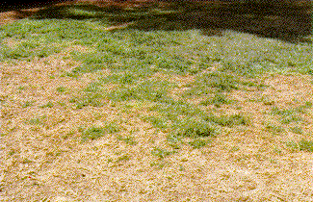
Heavy thatch
Compacted soils
Nematodes
Notes:
Heavy thatch, compacted soils and nematodes can exacerbate centipede decline symptoms.

Slide 81
Management for centipede decline
Soil test
Avoid over or improper fertilization
Use 3-1-2 fertilizer ratio
Aerate to improve root growth
Dethatch
Notes:
Management of centipede decline include Soil test
Avoid over or improper fertilization
Use 3-1-2 fertilizer ratio
Aerate to improve root growth
Dethatch

Slide 82
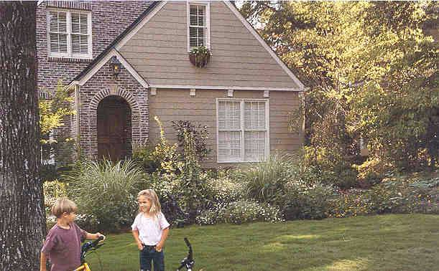
Remember: Most of the diseases in turf can be avoided using proper management strategies
Prepare the soil properly
Proper water drainage
Plant locally adapted turf species
Purchase high quality disease-free
seed, sod or sprigs
Follow proper irrigation practices
Apply fertilizer according to soil analysis
Mow at recommended height
Remove excessive thatch
Allow for adequate light and air movement
Follow recommended disease control practices
Notes:
Remember that turf diseases can be managed by ………………………….
Preparing the soil properly
Ensuring proper water drainage
Planting locally adapted turf species
Purchasing high quality disease-free
seed, sod or sprigs
Following proper irrigation practices
Applying fertilizer according to soil analysis
Mowing at recommended height
Removing excessive thatch
Allowing for adequate light and air movement
Following recommended disease control practices

Slide 83
Questions?
Notes:
DISCUSSION QUESTIONS
1. What is the most common disease of turfgrasses in Georgia developing during periods of high humidity, high temperature and contributed to by high nitrogen applications?
2. Which turfgrass disease occurs in areas with high soil pH (alkaline soils), poor fertility and sandy soils?
3. What is the cause of most plant diseases?
4. Most crown and root rots of plants are caused by what pathogen?
5. What are some methods of scouting for turfgrass pests?
6. List the most common damage symptoms on ornamental plants.
7. What are the categories of insect pests of turfgrasses?
8. List 3 general diseases common to many plants.

