Slide 1
Insects, Diseases & Weeds of Vegetables pp. 532-546
Todd Hurt
CEA Cherokee Co.

Slide 2
Insect Control in Vegetables
Five Basic Steps
Prevention
Early Detection
Correct Id of Pest and Beneficial Insects
Proper Selection of Control
Insecticides normally not used preventatively.
Proper Application

Slide 3
If needed apply insecticides late in the day to avoid killing honey bees.

Slide 4
General Garden Pests

Slide 5
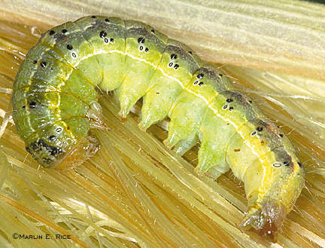
Corn Earworm (Tomato Fruitworm)
1 ¾ in. long
Light green to pink to brown or nearly black
Alternating light and dark stripes running the length of the body
Chews holes in pods or fruit of several vegetables, leaves of corn and tomatoes.

Slide 6
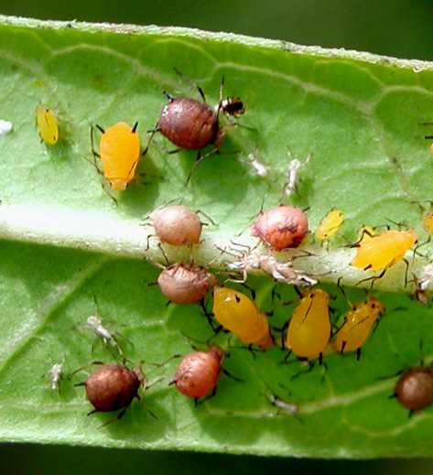
Aphids
Pale green to black 1/8 in long soft bodied insects, with tail pipes.
Mostly found feeding on new growth.
Piercing/sucking
Greatest concern is virus transmission.

Slide 7
Spider Mites
Tiny 8 legged pests that are often found underneath the leaf
Piercing/sucking mouthparts
Leaves appear stippled or bronzed above
Love it hot and dry
Fine webbing may be produced under heavy infestation

Slide 8
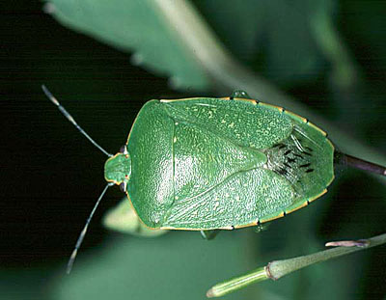
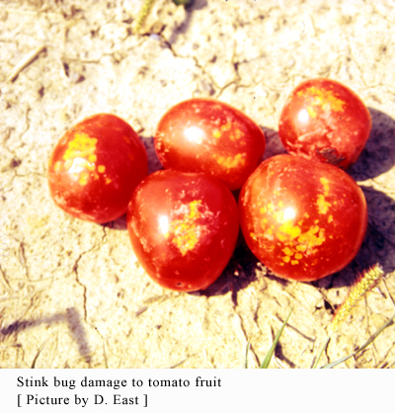
Stink Bugs
5/8 in long, bright green with narrow head
Fowl odor when crushed
Piercing/Sucking
Toxic Saliva
Brown spots on beans/peas, whitish spots on tomato.

Slide 9
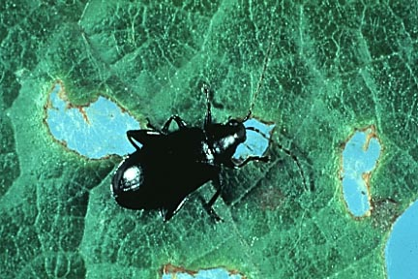
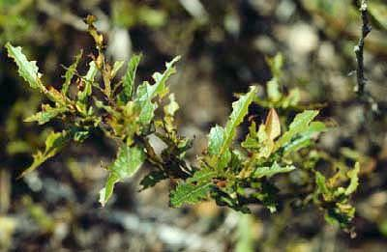
Flea Beetles
1/16 to 1/8 inch long shiny black or striped
Jump when disturbed
Very destructive, often in large numbers
Chewing Mouthparts

Slide 10
Insect Pests of Specific Crops

Slide 11
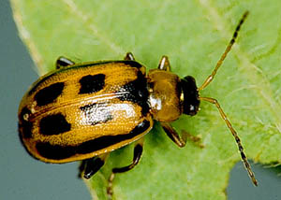
Beans and Peas
Bean Leaf Beetle
¼ in long
Reddish orange, black band around outer margin with 3-4 spots where wings meet
Chewing
Round holes in leaves and stems

Slide 12
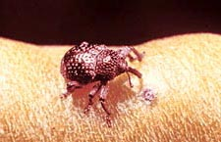
Beans and Peas
Cowpea Curculio
Black, hump-backed, hard-shelled beetles, ¼ in long, long slender snout
Wart like strings on pod surface eggs deposited inside of pod, larvae feed on peas/beans
Must be controlled during flower stage.

Slide 13
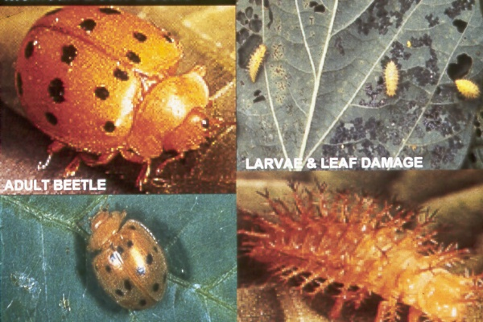
Beans and Peas
Mexican Bean Beetle
Coppery brown rounded beetles, ¼ in long, 16 black spots
Adults and larvae chewing mouth parts

Slide 14
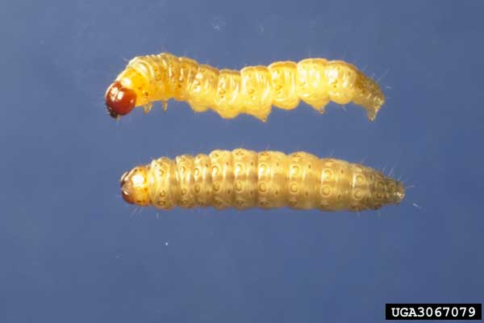
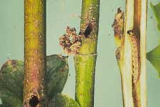
Beans and Peas
European Corn Borer
Larvae 1 in. long flesh-colored with rows of small dark-brown spots. Dark brown head.
Bore into stems and pods which may cause breakage

Slide 15
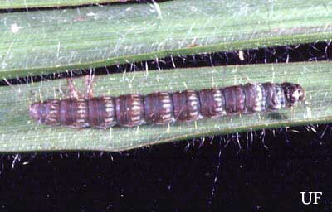
Beans and Peas
Lesser Cornstalk Borer
¾ in. long slender, bluish-green, with brown horizontal stripes
Wilting of plants with girdling or boring into lower portion of stems.

Slide 16
Beans and Peas
Thrips
Slender yellow or brown insects 1/25 in. long
Rasping mouthparts
Distorts flowers, white blotches on leaves

Slide 17
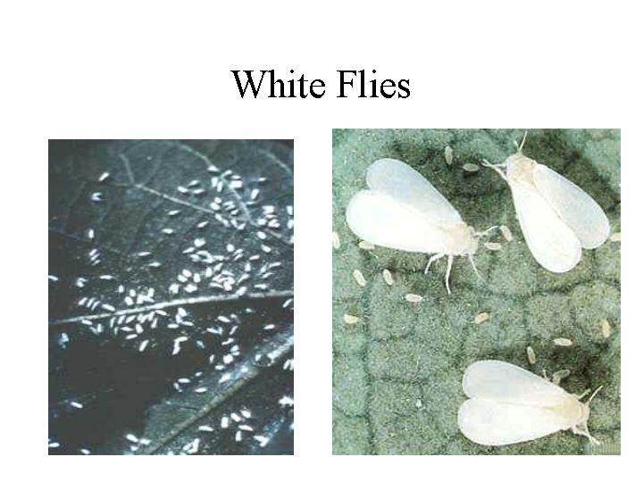
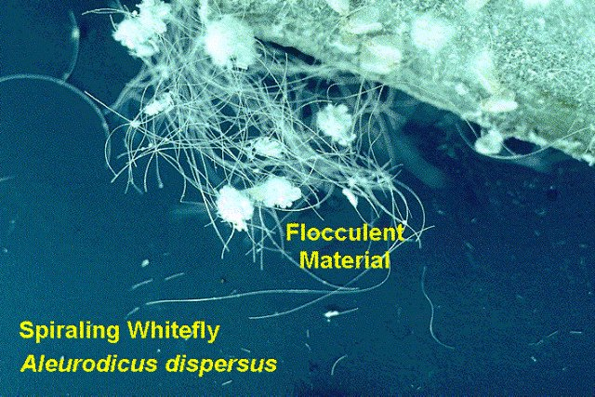
Beans and Peas
Whiteflies
Very small winged insect resembling a moth
Sucking mouthparts
Fly out in a cloud when disturbed
Leaf color loss and drop
Sooty mold

Slide 18
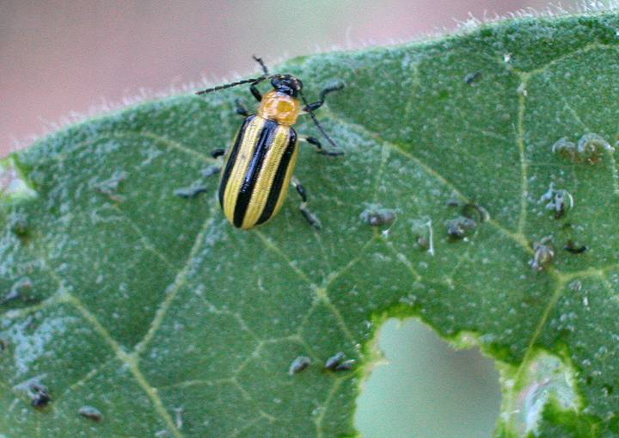
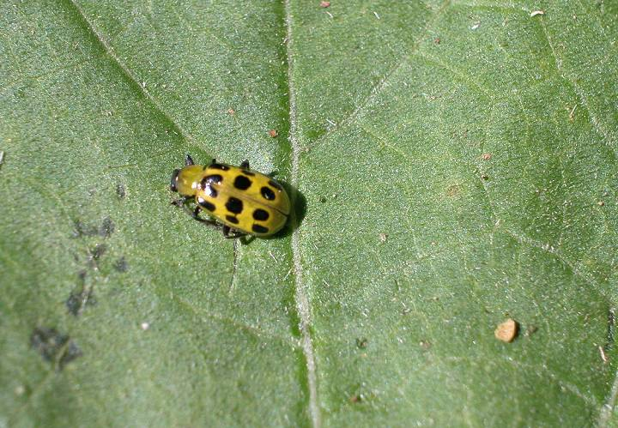
Cucumbers, Melons, Squash & Pumpkins
Cucumber Beetles
¼ in. long
Chewing mouthparts
Spotted CB – 12 black spots - Holes in leaves, flowers, bacterial wilt
Striped CB – 3 vertical stripes, holes in leaves, stems and fruit.

Slide 19
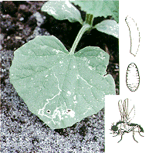
Cucumbers, Melons, Squash & Pumpkins
Leafminers
Adult is a small fly
Larval stage (maggot) feeds on the tissue between the leaf layers weakening the leaves.
Treatment is not practical.

Slide 20
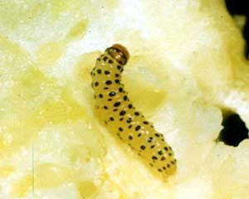
Cucumbers, Melons, Squash & Pumpkins
Pickleworm
Greenish to coppery ¾ in caterpillar with dark spots when young
Burrows into buds, flowers, vines and fruit pushing out green excrement. Fruit rots.

Slide 21
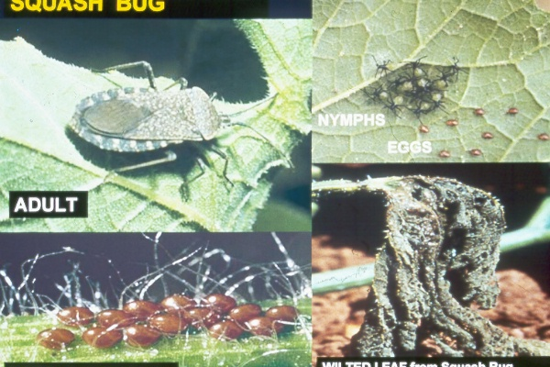
Cucumbers, Melons, Squash & Pumpkins
Squash Bug
Adult is a dingy gray-black and nearly an inch long.
Nymphs are lime green with reddish heads.
Eggs are a bright copper color.
Adults and Nymphs sucking mouthparts, spotty loss of color, severely damaged leaves become crisp and die.

Slide 22
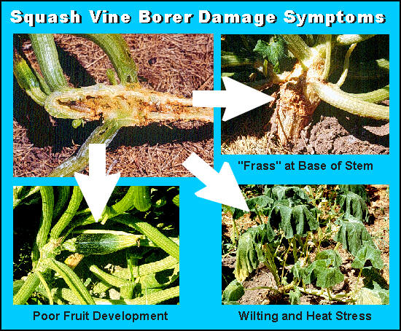
Cucumbers, Melons, Squash & Pumpkins
Squash Vine Borer
Thick, white, wrinkled, Brown-headed caterpillars up to 1 in.
Yellowish brown frass
Usually attack vines at soil-line, vine usually wilt, rot then die.
Fruit is occasionally attacked in late season.

Slide 23
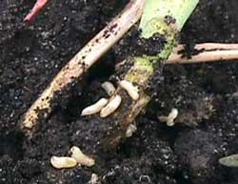
Cabbage, Collards, Broccoli, & Turnips
Cabbage Maggot
Yellowish white legless larvae, blunt rear, pointed at front
Maggot feeds on roots and stems near the soil line.
Wilting and death of seedlings.

Slide 24
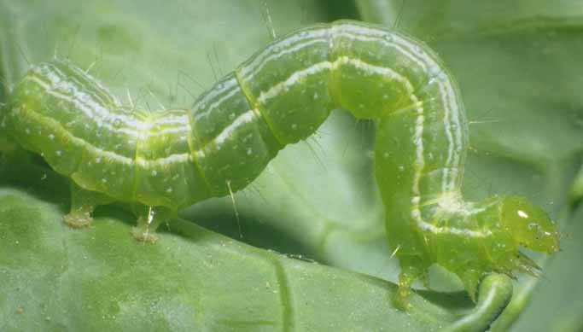
Cabbage, Collards, Broccoli, & Turnips
Cabbage Looper
Pale green, smooth skinned caterpillars up to 1 ¼ in long
Loop as they move.
Chewing mouthparts.
Large holes in leaves.

Slide 25
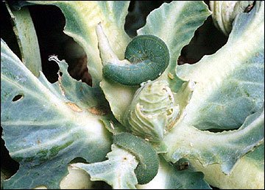
Cabbage, Collards, Broccoli, & Turnips
Imported Cabbageworm
Larvae velvety green with a narrow orange stripe down the middle of the back and broken yellow stripes on sides 1 ¼ in. long.
Chew holes in leaves usually in the center of the plant.

Slide 26
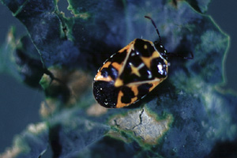
Cabbage, Collards, Broccoli, & Turnips
Harlequin Bug
Shiny red and black, shield shaped 3/8 in. long
Sucking mouthparts.
Leaves develop yellow spots, brown the die.

Slide 27
Sweet Corn
European Corn Borer
Larvae 1 in. long flesh-colored with rows of small dark-brown spots. Dark brown head.
Feeds in tassels and young leaves in a whorl, tunneling to stalk and ears.

Slide 28
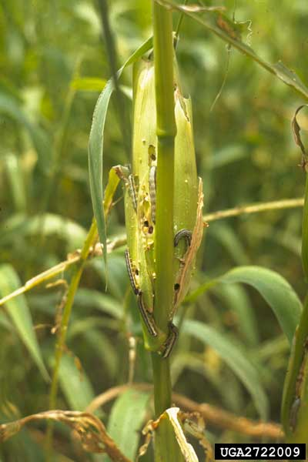
Sweet Corn
Fall Armyworm
Light green to black, striped, black head with inverted white y
Similar damage to corn earworm but will chew through husk to eat kernels.

Slide 29
Tomatoes, Eggplants, & Peppers
European Corn Borer (Peppers only)
Larvae 1 in. long flesh-colored with rows of small dark-brown spots. Dark brown head.
Bore into stems which may cause breakage. May bore into fruit causing fruit drop.

Slide 30
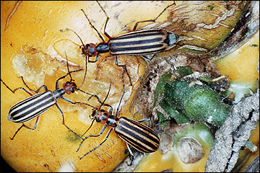
Tomatoes, Eggplants, & Peppers
Blister Beetle
Soft slender beetles 1-½ to 1 ¾ in long. Black or gray with yellow or gray stripes on wing covers
Chewing mouthparts.
Loss of leaves may result in sun scald.

Slide 31
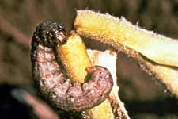
Tomatoes, Eggplants, & Peppers
Cutworms
Plump, smooth skinned, greasy-looking caterpillars up to an inch long
Often curled up at the base of the plant.
Young plants cut down at ground level.
Dr. Dan Brown UGA

Slide 32
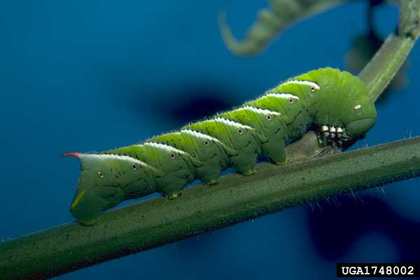
Tomatoes, Eggplants, & Peppers
Tomato Hornworm
Large green caterpillar up to 3-4 in. long, white bars on sides
Long slender horn on posterior.
May defoliate plant and cause sun scald on fruit.
Parasitized by Braconid wasp

Slide 33
Tomatoes, Eggplants, & Peppers
Whiteflies
Very small winged insect resembling a moth
Sucking mouthparts
Fly out in a cloud when disturbed
Leaf color loss and drop
Sooty mold

Slide 35
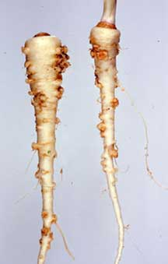
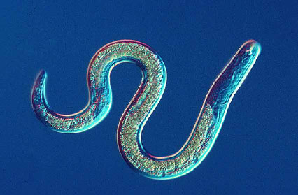
Diseases of Vegetables
Nematodes – microscopic un-segmented roundworms, cause injury to root systems resulting in stunting, poor color, and wilting of plants.
Boil Borne Diseases – Rhizoctonia, Pythium, Fusarium, & Sclerotium
Deep tilling, Soil Solarization, Resistant Plants.

Slide 36
Abiotic Diseases
Cold Damage
Excess or Deficient Nutrients
pH
Ozone
Lightening
Lack of Pollination
Moisture Stress

Slide 38
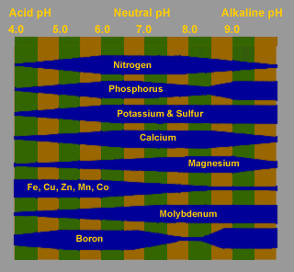
Plant Nutrition
Synergistic
Antagonistic (too much P makes Fe and Zn deficient)
Mobile
Immobile

Slide 39
Vegetable Nutrition Problems
Mg- low pH, older leaves
Mn – high pH
K – cold soil, purpling
B – high pH, High Ca, dry weather, turnips
Mo – not common
Ca – low pH, lack of Ca, irregular watering

Slide 40
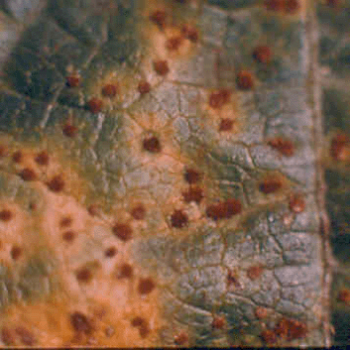
Snap Beans
Rust
Fungus
Spores erupt from pustules and spread to other plants
Defoliation
Resistant cultivars

Slide 41
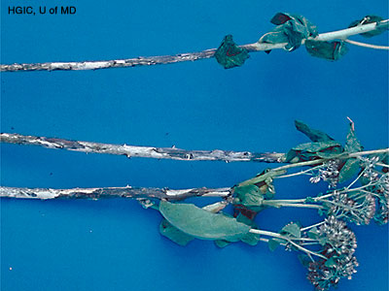
Lima Beans
Stem Anthracnose
Brick red lesions on the stems, leaves or fruit.
Early fruit drop.
Control is often applied too late.
Stem Anthracnose on an ornamental plant

Slide 42
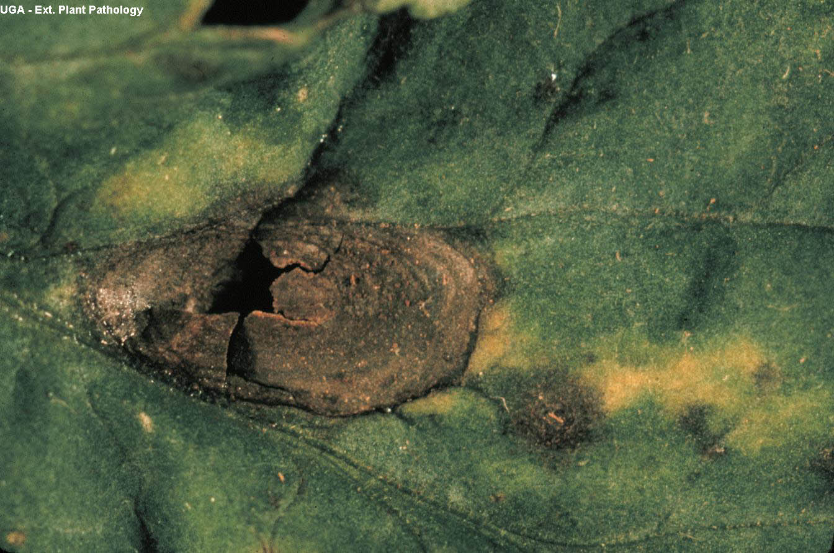
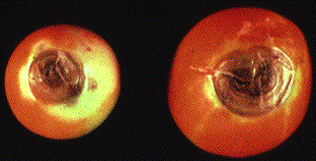
Tomatoes
Early Blight
Fungus – Alternaria
Starts near ground and moves up on leaves and fruit.
Typical target shaped lesions, leaf drop, fruit rot.

Slide 43
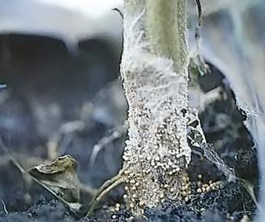
Tomatoes
Southern Blight
Fungus – Sclerotium rolfsii
Attacks stem at soil line.
Plant wilt and death.
Tin foil band
Deep plowing.

Slide 44
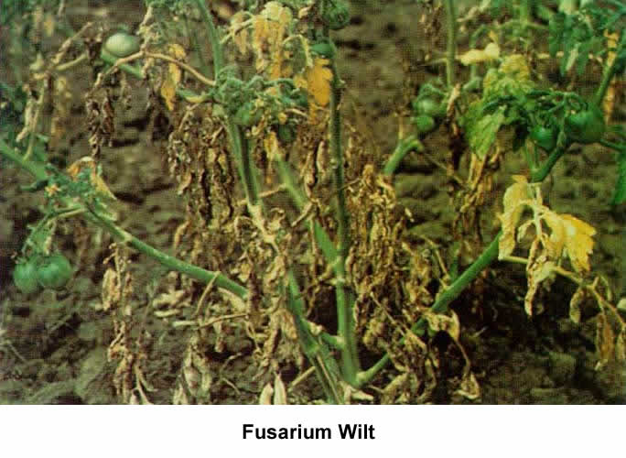
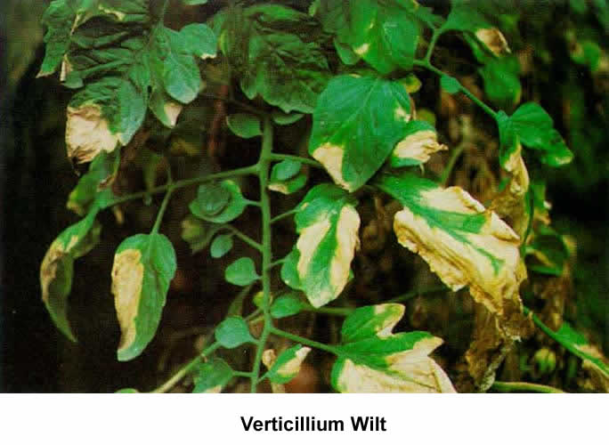
Tomatoes
Verticillium Wilt
Fusarium Wilt
VFN Resistant Cultivars
Verticillium not a problem in Ga. No Control for Fusarium.

Slide 45
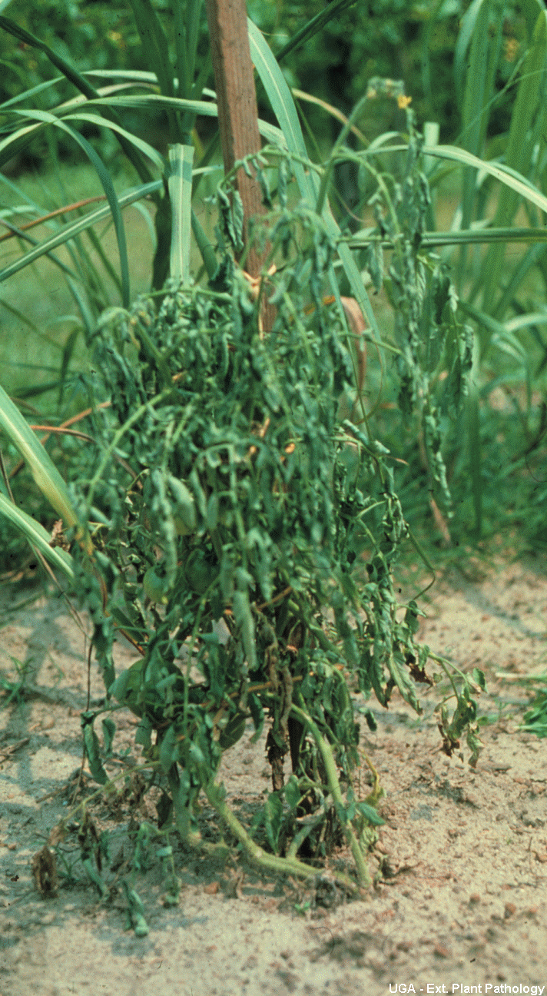
Tomatoes
Bacterial Wilt
Whole plant wilts with green leaves
Soil borne disease
Deep plowing or crop rotation

Slide 46
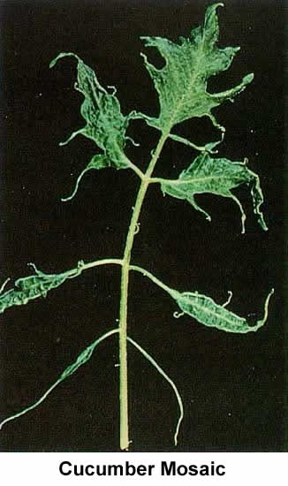
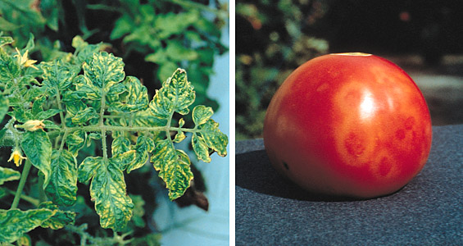
Tomato Viruses
Cucumber Mosaic Virus
Tobacco Mosaic Virus

Slide 47
Tomato
Oedema

Slide 48
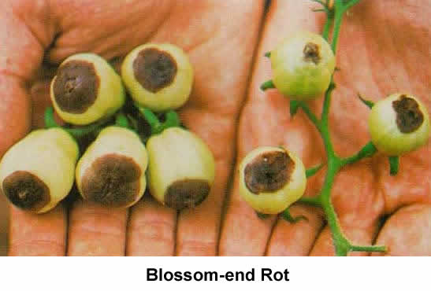
Tomato
Blossom End Rot
Calcium deficiency
Irregular watering

Slide 49
Turnips, Collards & Cabbage
Cercospora | Pale Spot
Anthracnose | Downey Mildew

Slide 50
Squash
Watermelon Mosaic Virus
Normal Variegation

Slide 51
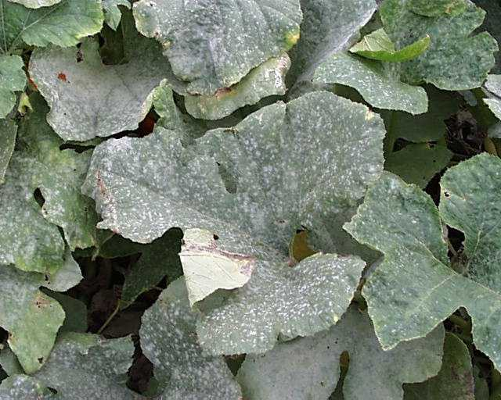
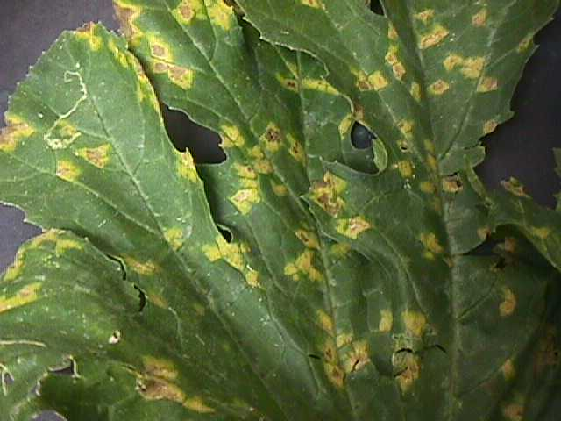
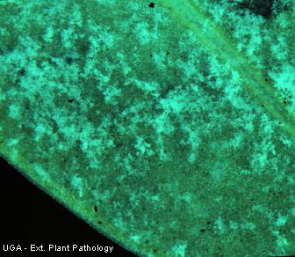
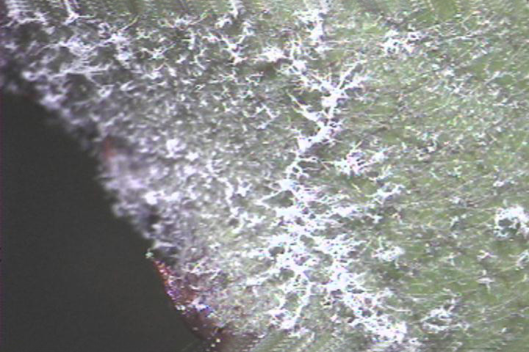
Squash
Powdery Mildew
Downy Mildew

Slide 52
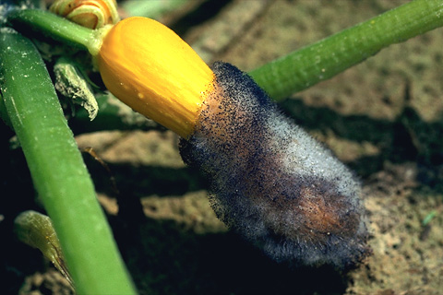
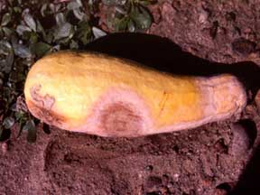
Squash
Phytophthora
Choanephora

Slide 53
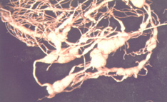
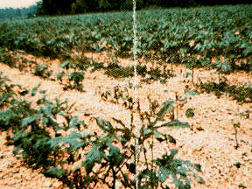
Okra
Root-Knot Nematodes
Fusarium Wilt
Choanephora

Slide 54
Southern Peas
Blackeye Cowpea Mosaic Virus
Fusarium Wilt
Southern Blight

Slide 55
Weed Control in Vegetables
Physical
Cultural
Chemical
Preplant
Preemergent
Postemergent

Slide 56
glyphosate
Round-up, GlyStar, many others
Preplant or preemergence only
Annual and Perennial Weeds.

Slide 57
trifluralin
Preen, Weed Prevent, Weed & Grass Preventer
Preplant, Preemergence, Post Directed (of crop)
Must be incorporated
Controls annual grasses and small seeded broadleaf weeds.

Slide 58
DCPA
Dacthal W-75
Application is crop dependant
Controls annual grasses and small seeded broadleaf weeds

Slide 59
sethoxydim
Poast 1.53 EC
Postemergent over the top control of annual and perennial grass weeds
Not on grass-like crops
Does not control broadleaf weeds or sedges
Must be applied before most grasses reach 6 inches tall.

Slide 60
bentazon
Basagran 4 SL
Postemergent control of Yellow Nutsedge and some broadleaf weeds
Beans and pea crops prior to second trifoliate leaf expansion.
Will not control grasses.

Slide 61
Questions??

Slide 62
Exam Questions
What time of day is the most desirable to apply insecticides to avoid contact with honey bees?
What is the greatest concern from aphid activity on vegetable crops?
Calcium deficiency and or irregular watering of tomatoes cause ______.

Slide 63
Exam Questions
4. According to the 2005 GA Pest Management Guide can Round-up be used in vegetables after the crop has emerged.
5. What fungal disease of tomato causes target shaped lesions on the stems, leaves and fruit. Hint the causal agent is Alternaria and splashes up from the soil then spreads upward?

