Slide 1

Notes:
UGA Logo

Slide 2
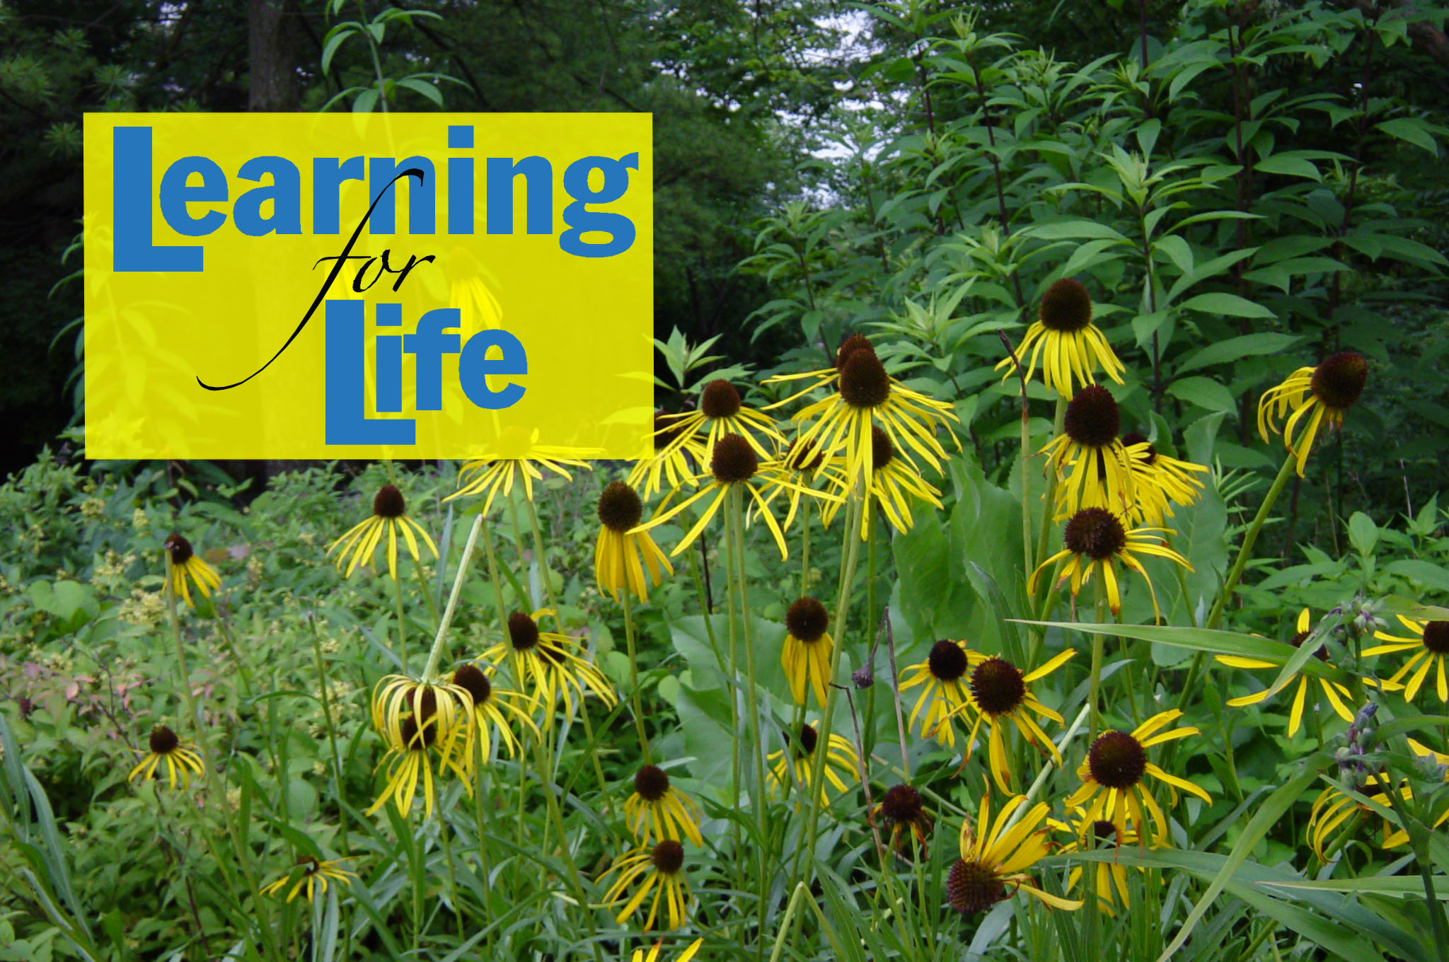
www.ugaextension.com
Notes:
UGA Cooperative Extension Web address

Slide 3

Notes:
Georgia Master Gardener Logo

Slide 4
IPM: Basics of
Integrated Pest Management
Compiled with information from:
Dr. Kris Braman
Dr. Paul Guillebeau

Slide 5
Learning Objectives
Pests & concept of IPM
Scouting for pest problems
Georgia Pest Control Handbook
Pesticide formulations
Pesticide label & Signal words
Pesticide failure
Safely storing pesticides
Natural controls, their benefits and limitations
Notes:
After you complete your study of this chapter you should be able to:
Define pest, IPM and understand the concepts of IPM.
Understand the concept of scouting for pest problems.
Understand what natural controls are available and their benefits and limitations.
Be familiar with the Georgia Pest Control Handbook and how to use it.
Learn the pesticide formulations and be able to read a pesticide label and know what signal words are.
Know factors that can cause pesticide applications to fail to control pests.
Know how to properly clean pesticide equipment, and how to safely store pesticide and the importance of safety equipment.
Be able to recognize pesticide poisoning symptoms and know who to call in a pesticide emergency.
Understand the impact of pesticides on the environment and the role and benefits of beneficial insects in the landscape.

Slide 6
Components of IPM
Pest Identification
Monitoring
Control Guidelines
Methods of Prevention and Control
Notes:
There are four components to an IPM system:
Pest Identification
Monitoring
Control Guidelines
Methods of Prevention and Control

Slide 7
A Pest…
Competes with humans, domestic animals, or desirable plants for food or water
• Injures humans, animals, desirable plants, structures, or possessions
• Spreads disease to humans, domestic animals wildlife, or desirable plants
• Annoys humans or domestic animals
Notes:
A pest by definition is an organism that:
competes with humans, domestic animals, or desirable plants for food or water,
• injures humans, animals, desirable plants, structures, or possessions
• spreads disease to humans, domestic animals wildlife, or desirable plants
• annoys humans or domestic animals

Slide 8
Types of Pests
• Insects
• Insect-like organisms
• Microbial organisms
• Weeds,
Mollusks
Vertebrates
Notes:
Types of Pests
Types of pests include:
• Insects, such as roaches, termites, mosquitoes, aphids, beetles, fleas, and caterpillars,
• Insect-like organisms, such as mites, ticks, and spiders,
• Microbial organisms, such as bacteria, fungi, nematodes, viruses, and mycoplasmas,
• Weeds, which are any plants growing where they are not wanted,
• Mollusks, such as snails, slugs, and shipworms, and
• Vertebrates, such as rats, mice, other rodents, birds, fish, and snakes.

Slide 9
Categories of pests
Continuous pests
Sporadic, migratory,
or cyclical pests
Potential pests
Notes:
• Continuous pests that are nearly always present and require regular control.
• Sporadic, migratory, or cyclical pests that require control occasionally or intermittently.
• Potential pests that do not require control under normal conditions, but may require control in certain circumstances.

Slide 10
Things to know about pests
Physical features
Damage caused
Development & biology
Continuous, sporadic, or potential pests
Control goal
Notes:
In dealing with a potential pest, it important have some background or basic information about the types of pests you may encounter. This information can be found at a variety of sources including Extension publications, or the Master Gardener Handbook. The Master Gardener training program also includes presentations on Insects and Diseases of Ornamentals, Insects and Diseases of Turf and Insects and Diseases of Vegetables.
Some basic information you should be familiar with is:
The physical features of the pests likely to be encountered,
• Characteristics of the damage they cause,
• Their development and biology,
• Whether they are continuous, sporadic, or potential pests, and
• What the control goal is.

Slide 11
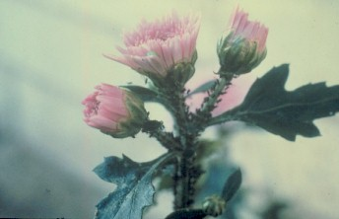
Do you need to control the pest?
Causing or expected to harm?
-more than acceptable level?
Aphids on Chrysanthemum
Notes:
Control a pest only when it is causing or is expected to cause more harm than is reasonable to accept. Decide what injury level is acceptable. Is the damage actually affecting the health of the plant? If not, does the damage make the plant look bad enough to detract from the appearance of the landscape?

Slide 12
Pest Control Goals
1. Prevention — keeping a pest from becoming a problem
2. Suppression — reducing pest numbers or damage to an acceptable level
3. Eradication — destroying an entire pest population
Notes:
Pest Control Goals
In trying to control a pest, try to achieve one of these three goals, or some combination of them:
1. Prevention — keeping a pest from becoming a problem,
2. Suppression — reducing pest numbers or damage to an acceptable level, and
3. Eradication — destroying an entire pest population.

Slide 13
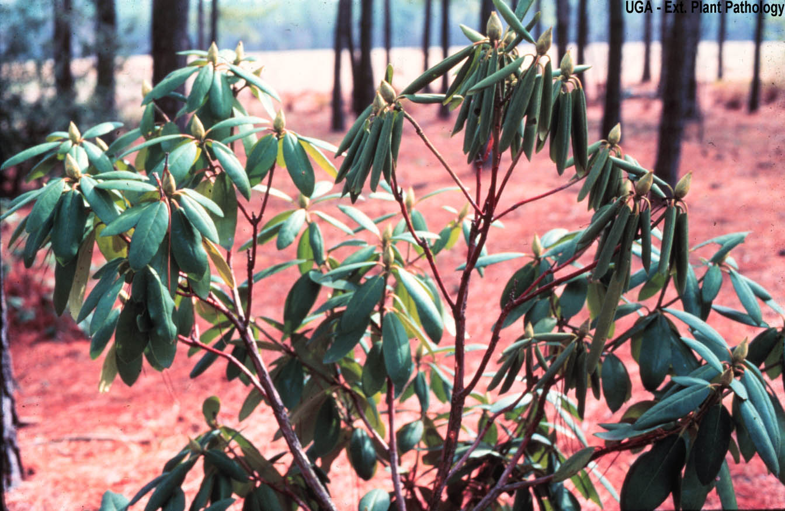
Regular Observation
Notes:
Take 30 minutes a week to observe the landscape including the ornamental plants and turf. Look for anything that looks out of the ordinary. Bring your garden record book with you. Regular observation provides the best information possible for making pest management decisions. Monitoring helps determine if a pest or its natural enemies are increasing or decreasing, or if a control action worked or not. Monitoring of beneficials is important too because it provides information on how well natural controls are working and whether or not to consider other pest suppression actions.
Insect pests are usually easy to see but monitoring for diseases requires a slightly different strategy. Insect populations can be monitored and treated if their numbers are increasing toward damaging levels. Treatments for diseases, however, must often occur before symptoms are observed since most fungicides only work to prevent infection. You can’t do much about the weather but you can always be on the lookout for other factors that may contribute to disease and make adjustments whenever possible.

Slide 14
Scouting - Pest Monitoring
What kinds of pests?
How many?
When is the right time to control?
Have controls reduced numbers of pests?
Notes:
Regular monitoring or scouting can answer several important questions:
• What kinds of pests are present?
• Are the numbers great enough to warrant control?
• When is the right time to begin control?
• Have the control efforts successfully reduced the number of pests?

Slide 15
Monitoring a Landscape
Know your plants
Frequent inspection
Observe general appearance
Slowly scan plant
Identify what you find
Decide what’s acceptable
Select management method
Evaluate
Keep record
Notes:
MONITORING A LANDSCAPE INCLUDES THE FOLLOWING STEPS:
1. Know the botanical names of your landscape plants, and learn about their preferences and common problems.
2. Regularly scout plants in the landscape. Frequent inspection is the best way to discover a problem in its earliest stages, when it can be easier to control. 3. Consider the general appearance of each plant from a short distance, and ask yourself if it looks healthy. Are there dead areas? Is it wilted? Are any leaves discolored or abnormally curled?
4. Stop at each plant and slowly scan it. Watch for movement that might indicate the presence of an insect or mite. Turn leaves over and look at their undersides. Inspect stems, branches, and leaves for insects, holes, webbing, or split areas. Vigorously strike a branch on a white cloth or paper. See if any pests fly or hop away, and inspect the ones that fall off. Look carefully; mites are small and it may take several seconds for them to start moving on the paper.
5. Identify what you find. Some insects are beneficial in the landscape. Use references to learn about the life cycles of insects and diseases you observe.
6. Decide what injury level is acceptable. Is the damage actually affecting the health of the plant? If not, does the damage make the plant look bad enough to detract from the appearance of your landscape?
7. Select a pest management method. Choose a method that is most effective against the pests and least disruptive to other organisms and the environment. Use pest management methods when the pest is most vulnerable.
8. Evaluate the action taken. Did it work? If not, why not? What might work better next time? Could you make changes in the landscape to avoid the problem in the future?
9. Keep a record of the observations you make when monitoring your plants and of the pest management methods you have tried. Records can help you manage landscape plant problems during the current growing season, evaluate management methods, and predict problems in the future.

Slide 16
Tools for pest monitoring
Notebook
Sticky traps
Hand lens 10x or better
White paper on clipboard
Tweezers
Sample jar
Reference books
Notes:
Keep a record of the observations you make when monitoring your plants and of the pest management methods you have tried. Records can help you manage landscape plant problems during the current growing season, evaluate management methods, and predict problems in the future. Insect traps are a continuous monitoring device. They catch a wide variety of pest species in their mobile stages of larvae and adult. Both crawling and flying insects can be caught. The data from the catches can be used to give information on the pest, an indication of their numbers and seasonal cycles and where they congregate. Sticky traps may also trap beneficial insects as well. A hand lens or magnifying glass will help you to get a close look at insects. A hand lens or magnifying glass will help you to get a close look at insects. Beat a branch over a clip board with a sheet of white paper then use the hand lens to identify the insects and count them. Tweezers and a sample jar will come in handy when you need to save the pest for future identification. A preservative like rubbing alcohol will keep the specimen intact. Reference books are helpful though you don’t need to carry an entire library with you, just choose one or two that you find yourself using over and over again.

Slide 17
Steps in Pest Monitoring
Identify the pest.
Identify the current stage in life cycle.
Note the location
Determine the number of insects, weeds or disease infected plants
Inventory the environment surrounding the pest
Identify Key Hosts
Identify existing damage from the pest.
Keep accurate records of findings and controls
Notes:
1. Identify the pest.
2. Identify the current stage in the pest’s life cycle.
3. Note the location(s) of the pest.
4. Determine the number of insects, weeds or disease infected plants.
5. Inventory the environment surrounding the pest, as well as the entire area that might be affected by control actions. This might include chemically sensitive family members or neighbors. Remember to look for beneficial and non-target plants, insects and animals.
6. Identify Key Hosts. These are plants or other hosts that have a history of problems or in some other way indicate the presence of the pest.
7. Identify existing damage from the pest.
8. Keep accurate records of findings and controls, if used. The same problems may appear on the same hosts year after year. Good records will help in timing future control measures.

Slide 18
Solving pest problems
Identify the pest or pests and determine whether control is warranted for each
Determine pest control goal
Know what control tactics are available
Evaluate the benefits and risks
Choose most effective and least harmful strategy
Use each tactic in the strategy correctly
Observe local, state, and federal regulations
Keep a record
Notes:
Solve pest problems:
• identify the pest or pests and determine whether control is warranted for each,
• determine pest control goal(s),
• know what control tactics are available,
• evaluate the benefits and risks of each tactic or combination of tactics,
• choose a strategy that will be most effective and will cause the least harm to people and the environment,
• use each tactic in the strategy correctly,
• observe local, state, and federal regulations that apply to the situation
Keep records

Slide 19
Natural controls
Climate
Natural enemies
Geographic barriers
Food & water
Shelter
Notes:
Natural controls are things that affect an organism’s survival. Climate—Weather conditions, especially temperature, day length, and humidity, affect pest activity and rate of reproduction. Pests may be killed or suppressed by rain, freezing temperatures, drought, or other adverse weather. Natural enemies—Birds, reptiles, amphibians, fish, and mammals feed on some pests and help control their numbers. Many predatory and parasitic insect and insect-like species feed on other organisms, some of which are pests. Pathogens often suppress pest populations. Geographic barriers—Features such as mountains and large bodies of water restrict the spread of many pests. Other features of the landscape can have similar effects. Food and water supply—Pest populations can thrive only as long as their food and water supply lasts. Once the food source — plant or animal — is exhausted, the pests die or become inactive. The life cycle of many pests depends on the availability of water. Shelter—The availability of shelter can affect some pest populations. Overwintering sites and places to hide from predators are important to the survival of some pests.

Slide 20
Applied Controls:
Host resistance
Cultural control
Mechanical control
Sanitation
Chemical control
Biological control
Notes:
Unfortunately, natural controls often do not control pests quickly or completely enough to prevent unacceptable injury or damage. Then other control measures, or applied controls, must be used. Those available include: host resistance, cultural control, mechanical control, sanitation, chemical control, and biological control

Slide 21
1. Host Resistance
Host prevents pest from completing life cycle
Host is more vigorous or tolerant
Host is more difficult to attack
Notes:
Host resistance—Some plants, animals, and structures resist pests better than others. Some varieties of plants, wood, and animals are resistant to certain pests. Use of resistant types, when available, helps keep pest populations below harmful levels by making conditions less favorable for the pests.
Host resistance works in three ways:
1. Chemicals in the host repel the pest or prevent the pest from completing its life cycle.
2. The host is more vigorous or tolerant than other varieties and thus less likely to be seriously damaged by pest attacks.
3. The host has physical characteristics that make it more difficult to attack.

Slide 22
2. Cultural Control
Prevent or suppress an infestation by:
Altering the environment
Altering the condition of the host plant
Altering the behavior of the pest
Notes:
Cultural control—Cultural practices sometimes are used to reduce the numbers of pests that are attacking cultivated plants. These practices alter the environment, the condition of the host plant, or the behavior of the pest to prevent or suppress an infestation. They disrupt the normal relationship between the pest and the host plant and make the pest less likely to survive, grow, or reproduce. Common cultural practices include rotating crops, cultivating the soil, varying time of planting or harvesting, planting trap crops, adjusting row width, and pruning, thinning, and fertilizing cultivated plants.

Slide 23
Cultural practices
Crop rotation
Cultivating soil
Varying time of planting or harvesting
Planting trap crops
Adjusting row width
Pruning, thinning, & fertilizing plants
Notes:
Common cultural practices to control pests include rotating crops, cultivating the soil, varying time of planting or harvesting, planting trap crops, adjusting row width, and pruning, thinning, and fertilizing cultivated plants.

Slide 24
3. Mechanical (physical) control
Traps, screens, barriers, fences, nets
Lights, heat, refrigeration
Notes:
Traps, screens, barriers, fences, and nets sometimes can be used to prevent the spread of pests into an area. Lights, heat, and refrigeration can alter the environment enough to suppress or eradicate some pest populations. Altering the amount of water, including humidity, can control some pests, especially insects and disease agents.

Slide 25
4. Sanitation
Remove crop residues
Use mulches
Clean seeds & transplants
Decontaminate equipment
Notes:
Sanitation—Sanitation practices help to prevent and suppress some pests by removing the pests or their sources of food and shelter. Urban and industrial pests can be reduced by improving cleanliness, eliminating pest harborage, and increasing the frequency of garbage pickup. Carryover of agricultural pests from one planting to the next can be reduced by removing crop residues.
Other forms of sanitation that help prevent pest spread include using mulches, pest-free seeds or transplants and decontaminating equipment, animals, and other possible carriers before allowing them to enter a pest-free area or leave an infested area.

Slide 26
5. Chemical control
Pesticides are chemicals
used to destroy pests, control their activity, or prevent them from causing damage.
Notes:
Chemical control —Pesticides are chemicals used to destroy pests, control their activity, or prevent them from causing damage. Some pesticides either attract or repel pests. Chemicals that regulate plant growth or remove foliage also are classified as pesticides. Pesticides are generally the fastest way to control pests. In some instances, they are the only tactic available.

Slide 27
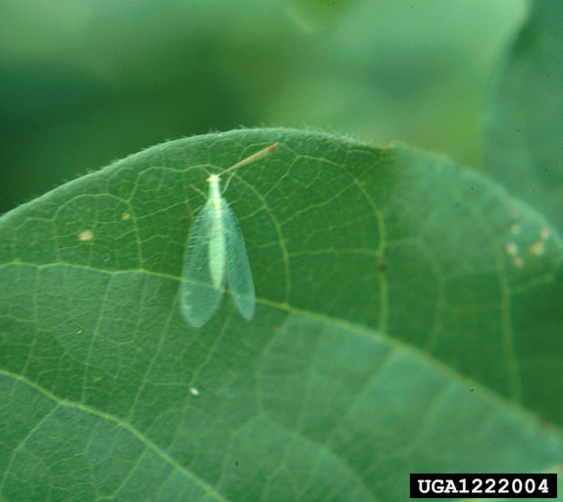
6. Biological control
Parasites
Predators
Pathogens
Green lacewing
Eddie McGriff, The University of Georgia, www.insectimages.org
Notes:
Biological control involves the use of natural enemies — parasites, predators, and pathogens. Supplement this natural control by releasing more of a pest’s enemies into the target area or by introducing new enemies that were not in the area before. Biological control usually is not eradication. The degree of control fluctuates. There is a time lag between pest population increase and the corresponding increase in natural controls. But, under proper conditions, sufficient control can be achieved to eliminate the threat to the plant or animal to be protected.

Slide 28
Pest Control Failures
Notes:
Sometimes even though a pesticide was applied, the pest has not been controlled. Review the situation to try to determine what went wrong. There are several possible reasons for the failure of chemical pest control.

Slide 29
Pest Resistance
Pesticide rarely kills 100% of the target pests
Most susceptible killed
Survivors avoid or adapt- may pass along traits to offspring
Over time, resistance may increase
Notes:
Pest Resistance—Pesticides fail to control some pests because the pests are resistant to the pesticides. Consider this when planning pest control programs that rely on the use of pesticides. Rarely does any pesticide kill all the target pests. Each time a pesticide is used, it selectively kills the most susceptible pests. Some pests avoid the pesticide. Others withstand its effects. Pests that are not destroyed may pass along to their offspring the trait that allowed them to survive.
When one pesticide is used repeatedly in the same place against the same pest, the surviving pest population may be more resistant to the pesticide than the original population was. The opportunity for resistance is greater when a pesticide is used over a wide geographic area or when a pesticide is applied repeatedly to a rather small area where pest populations are isolated. A pesticide that leaves a residue that gradually loses its effectiveness over time will help select out resistance. Rotating pesticides may help reduce the development of pest resistance.

Slide 30
Other Reasons for Failure
Incorrect dose
Incorrect application
Pest not correctly identified
Wrong time
Infestation may have developed later
Notes:
Not every pesticide failure is caused by pest resistance. Make sure the correct pesticide was used and the correct dose and that it was applied correctly. Sometimes a pesticide application fails to control a pest because the pest was not identified correctly and the wrong pesticide was chosen. Other applications fail because the pesticide was not applied at an appropriate time — the pest may not have been in the area during the application or it may have been in a life cycle stage or location where it was not susceptible to the pesticide. Also remember that the pests that are present may be part of a new infestation that developed after the chemical was applied.

Slide 31
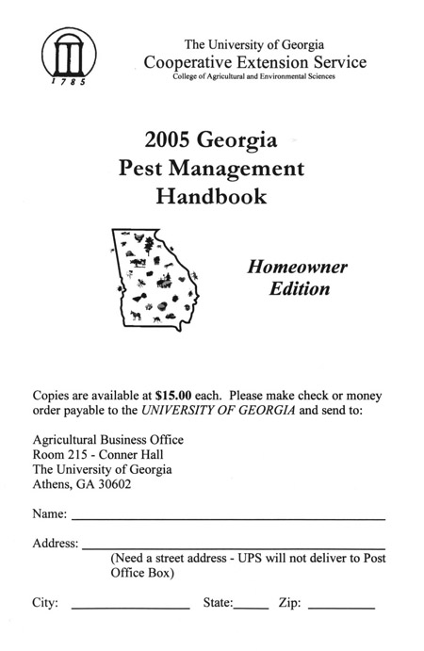
Georgia Pest Management Handbook
Notes:
The Georgia Pest Management Handbook gives current information on selection, application, and safe use of pest control chemicals. The Handbook has recommendations for pest control on farms, around homes, urban areas, recreational areas, and other environments in which pests may occur. Cultural, biological, physical, and other types of control are recommended where appropriate. Recommendations are based on information on the manufacturer's label and on performance data from Georgia research and Extension field tests. Because environmental conditions and methods of application by growers vary widely, suggested use does not imply that performance of the pesticide will always conform to the safety and pest control standards indicated by experimental data. This publication is intended to be used only as a guide. Specific rates and application methods are on the pesticide label. Refer to the label when applying any pesticide.

Slide 32
INTRODUCTION TO PESTICIDES
Notes:
The term “pesticide” is a broad term that refers to any substance used to manage pests. Many pesticides can be identified by the “-icide” suffix. Insecticides control insects. Herbicides control plants. Fungicides control fungi. Not all pesticides carry the “-icide” suffix. Other general names include disinfectants, growth regulators (prevent or enhance development), pheromones (attractants, usually used in traps), and repellents.

Slide 33
Grouping Pesticides Based on the Source
Inorganic
Organic-natural
Organic- synthetic
Microbial
Notes:
Inorganic pesticides come from minerals, such as boron, copper, or sulfur. Other inorganic pesticides, such as lead arsenate, were once widely used in the cotton and fruit production; this practice was discontinued as safer products became available. Compounds made with copper, sulfur, or boron (e.g., boric acid) are commonly used as pesticides today.
Naturally derived organic pesticides are natural compounds that come directly from plants or microorganisms. Pyrethrins, for example, come directly from chrysanthemums. Pyrethrins are active ingredients in wasp and hornet sprays. Neem is another common example of a plant derived organic pesticide. Spinosad is a fermentation product from actinomycete bacteria.
Synthetic organic pesticides are man-made compounds with an organic chemical structure. In some cases, synthetic organic pesticides are based on naturally occurring chemicals. For example, pyrethroids are active ingredients in many common insecticides. Their structure is modeled after pyrethrins.
Microbial pesticides include bacteria, fungi, nematodes, and viruses. Most of these products can be applied with conventional application equipment. In some situations, certain microbials can be established in the lawn or garden. Most of the time, however, repeated applications will be necessary in response to pest problems. B. thuringiensis is the most common microbial pesticide. Various strains are effective against caterpillars, mosquitoes, or beetles. In general, microbials are safer than other types of pesticides. Remember that the effectiveness of a microbial depends on a living organism. Buy fresh products and protect them from extreme temperatures.

Slide 34
Grouping Pesticides
Based on Activity
Protectants
Contact poisons
Stomach poisons
Systemic
Translocated
Selective
Nonselective
Fumigants
Notes:
Protectants are applied to plants, animals, structures, or products to prevent pest injury.
Contact poisons work by simply touching the pest.
Stomach poisons must be eaten by the pest.
Systemics are absorbed by the plant or animal that is being protected.
Translocated herbicides are moved throughout the plant after they are applied to leaves, roots, or stems
Selective pesticides are less likely to harm nontarget organisms
Nonselective pesticides affect a wide range of similar organisms
Fumigants are gases that kill pests when they are inhaled or absorbed.

Slide 35
Grouping Pesticides
Based on Timing
Preplant
Preemergence
Postemergence
Notes:
Preplant pesticides are applied before the crop is planted. Preplant pesticides may be part of a combination product that also contains fertilizer.
Preemergence herbicides are applied before the weeds emerge. Some preemergent herbicides are applied before the crop emerges; some are applied after the crop emerges.
Postemergence herbicides are used after the target plant emerges.

Slide 36
When and Where to Apply Pesticides
Follow label directions
Don’t exceed label rate
Use at correct stage
Treat only intended target
Treat correct area
Don’t treat in adverse weather
Notes:
The timing and placement of pesticide applications are critical. Follow the label directions, the advice of the county Extension agent and the Georgia Pest Control Handbook. Many pesticides work well at the lower recommended rate. There is often great temptation to use more pesticide that the label indicates. It is illegal to exceed the label rate, and damage to non-target plants or animals is likely to occur.
Pesticides work best when they are applied at specific times in the pests’ life cycle. Most pesticides are more effective when the pests are small. Insect growth regulators have little or no effect on adult insects. It is important to be familiar with the pesticide activity and the biology of the pest.
Be careful to treat only the intended target. Some pesticides (e.g., 2,4 D) can harm nontarget organisms at very low concentrations. If an insect or mite pest occurs on the underside of leaves, pesticide applications to the upper side of leaves may be ineffective. Avoid pesticide applications when the wind speed or direction will carry the pesticide from the target area. Some pesticide labels will prohibit applications above a certain wind speed. Some pesticides are likely to leach from sandy soils. Do not apply pesticides when rain is imminent. The pesticide will be less effective, and the pesticide is more likely to run off into waterways or leach into groundwater.

Slide 37
Factors that Affect
Pesticide Activity
Problem correctly identified?
Appropriate pesticide used?
Applied properly?
Right place?
Right time?
Conditions right?
Notes:
Human error is a common reason for pesticide failures. If the pesticide does not provide satisfactory control, review these questions.
Was the problem correctly identified? It may seem reasonable to attribute yellow leaves to an aphid infestation if these insects are present. However, if low soil fertility is causing the problem, an insecticide will not help.
Did you use the appropriate pesticide? Check the label and consult Extension recommendations. Bacillus thuringiensis is very effective against some kinds of caterpillars, but it has little or effect on mites.
Was the pesticide applied properly? Check the pesticide label to be sure you applied the proper rate. Never apply more pesticide than the label directs.
4 &5. Was the pesticide delivered to the target site at the appropriate time? Many weeds are difficult to control if they are large. Some insect and mite pests occur in areas that are difficult to treat effectively (e.g., on the underside of leaves).
6 & 7 Soil type can be an important factor in pesticide decisions. You may need to use higher pesticide rates in soils high in organic matter or clay. Pesticides are more likely to leach from sandy soils. Weather conditions can reduce the effectiveness of pesticides. If it rains before pesticide residues dry, the active ingredient is likely to be carried away. Sunlight breaks down some pesticides (e.g., pyrethrins) quickly. Wind increases the likelihood of drift, and it accelerates the loss of some pesticides.

Slide 38
Ingredients
Active ingredients
Inert ingredients
Notes:
Active ingredients are the substances that control the pest. A product may have one or more active ingredients. The active ingredients are always specified on the pesticide label. Inert ingredients are added to make the pesticide more effective or easier to use. An inert ingredient may be added to make the pesticide mix with water or to retard breakdown by sunlight. Other inert ingredients added to make the pesticide stick or spread on leaves. The inert ingredients are usually not listed on the pesticide label.

Slide 39
Liquid Formulations
  EC Emulsifiable concentrate
      Mixes well
      Less safe
  RTU Ready to Use
      No mixing or measuring
      More expensive
Notes:
Emulsifiable concentrates (E or EC) are the most common liquid formulation. They are mixed with water to form an emulsion. Most EC’s appear oily before they are mixed with water; the resulting water emulsion is usually white. If a number appears before the letter abbreviation, the number indicates the number of pounds of active ingredient per gallon of product. If a number appears before the letter abbreviation, the number indicates the number of pounds of active ingredient per gallon of product. For example, “4EC” indicates four pounds of active ingredient per gallon.
• Advantages: mixes well with water, requires little agitation.
• Disadvantages: more likely to injure some plants, more likely to penetrate the skin directly.
Ready to use (RTU)’s are prepackaged liquid pesticides. They may be a premixed EC or some other formulation.
• Advantages: no mixing or measuring required, easy disposal.
• Disadvantages: very expensive relative to most other pesticide products, many aerosols are flammable.

Slide 40
Dry Formulations
D Dusts
G Granular
WP Wettable Powder
B Baits
Notes:
Dry formulations—Dusts (D) are usually ready to use without mixing or dilution. A powdered dry inert (e.g., talc, clay, or ash) is combined with the active ingredient(s). The amount of active ingredient is usually less than ten percent. The abbreviation “10D” indicates that product has ten percent active ingredient. Do not mix dust formulations with water.
• Advantages: no mixing, little or no waste.
• Disadvantages: leave a visible residue, may easily drift into a person’s breathing zone (wear a dust mask).
Granular (G) formulations are made by combining the active ingredient(s) with coarse granules of an inert (e.g., ground corncobs, clay, or nutshells). The concentration of active ingredient may be as high as 40 percent. The abbreviation “20G” means the product is 20 percent active ingredient. Granules are usually applied dry.
• Advantages: no mixing, spills are usually easy to clean up.
• Disadvantages: applications usually limited to horizontal surfaces or plant whorls.
Wettable powders (WP) are finely ground particles made to mix with water. Most wettable powders are much more concentrated than dust formulations; the active ingredient(s) are commonly more than 50% of the WP formulation. The abbreviation 50WP means the product is 50% active ingredient.
• Advantages: usually safer for plants and man than EC formulations.
•Disadvantages: water mixture requires regular agitation to maintain suspension, leaves visible residue on sprayed surfaces.
Baits (B) combine a pesticide with some food or other attractive substance. Bait products are commonly used for slugs/snails, rats/mice, and some insects. The concentration of active ingredient is usually less than five percent.
• Advantages: less active ingredient usually needed, less area usually treated with pesticide.
• Disadvantages: non-target animals may be attracted to the bait. Pets may eat slug/snail bait, and other rodents may eat baits intended for rats or mice.

Slide 41
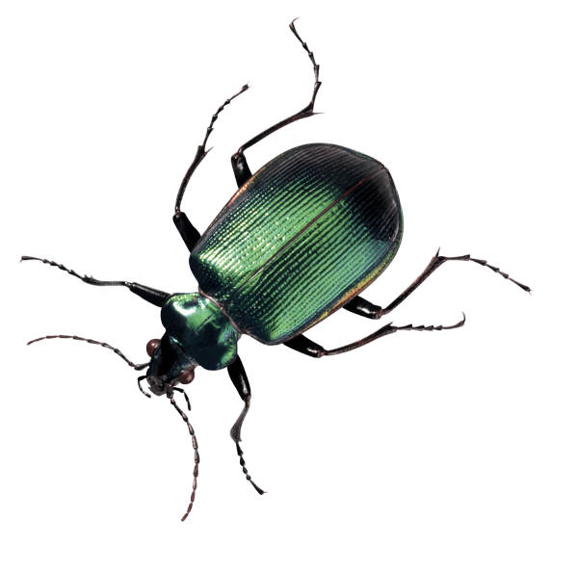
DEADBUG
Garden Insect Killer Spray
KILLS: Aphids, Beetles, Caterpillars on Flowers & Ornamentals
Keep out
of reach
of children
A
ACTIVE INGREDIENTS
*ALYUITIUYN………………….10%
INERT INGREDIENTS
N267Becfmog Dionate …..90%
Caution
B
See back panel for additional precautionary statements
C
D
EPA Registration Number XXX-XXX
D-Binc
NET CONTENTS 16 fl oz.
Notes:
The pesticide “label” is the information attached to the pesticide container. Other information may also come with the pesticide product, or the pesticide label may refer the user to other information. This body of information is the “labeling”. Federal and state regulations require all pesticide users to follow the directions on the pesticide label. Failure to follow label directions increases the risks of the pesticide and may result in civil and/or criminal penalties.
NEVER recommend that a client ignore or deviate from the pesticide labeling.
Sometimes pesticide labeling is confusing. However, it is important to understand all of the labeling information before using a pesticide or before recommending a pesticide to someone else. If one does not understand the labeling, he or she should consult the Extension agent or the Georgia Department of Agriculture. The Georgia Department of Agriculture regulates the sale and application of pesticides in the state.
All pesticides sold in the United States must be registered with the U.S. Environmental Protection Agency (EPA). The EPA requires that certain information must appear on all pesticide products. Consider this information before deciding which pesticide product is appropriate for the situation.
(A) Brand names are the company’s identifier for that particular product. Usually the brand name will be the most prominent word on the product. “RoundUp” is the brand name for one herbicide that contains the active ingredient glyphosate. Other products may have the same ingredients with a different brand name and price.
(B) Active ingredient(s) must be listed on the pesticide label along with their concentration. The ingredients may be listed by a complicated chemical name or a common name (e.g., carbaryl or glyphosate. Regulations do not require identification of the inert ingredients, but the percentage of inerts must be indicated.
(C) The EPA Registration Number tells you that EPA has reviewed the product and determined that it can be used with minimal or low risk if you follow the directions on the label properly. The number is not a stamp of approval or guarantee of effectiveness.
(D) Signal words( Caution, Warning, or Danger) indicate the acute toxicity of the pesticide product.

Slide 42
(D) Signal words
DANGER-POISON (can kill)
DANGER (eye & skin damage)
WARNING (may cause severe injury)
CAUTION (low toxicity. Exposure is much less likely to cause injury)
Notes:
Signal words indicate the acute toxicity of the pesticide product. Acute toxicity is the likelihood that a single overexposure to the pesticide will injure a person or pet. Acute toxicity is related to the weight of a person or animal. The amount of pesticide needed to injure a child or pet may be much less than the exposure that would injure an adult.
“DANGER-POISON” (along with the skull and crossbones) appears on a pesticide product that can kill a person in very low doses. The amount of a DANGER-POISON pesticide required to kill a 180-pound man may be less than 4000 milligrams (one extra-strength headache capsule is usually 500 mg). The amount to kill a child or pet would be much less.
“DANGER” without the word “POISON” indicates a pesticide that can cause irreversible eye damage and/or severe injury to the skin.
Most DANGER-POISON and DANGER pesticides are not available to the general public. The Extension Service never recommends DANGER-POISON or DANGER pesticides for use around the home.
“WARNING” indicates a pesticide of intermediate toxicity. They may still cause severe injury, but greater exposure would be required.
“CAUTION” indicates a pesticide of low toxicity. Exposure is much less likely to cause injury.
The EPA has offered some pesticide companies the option of deleting the CAUTION signal word if the acute toxicity of the product is shown to be very low. These pesticide products will have no signal word.

Slide 43
Garden Insect Killer Spray
E
PRECAUTIONARY STATEMENTS
HAZARDS TO HUMANS AND DOMESTIC ANIMALS-CAUTION Harmful if swallowed. Might cause allergic reactions…
STATEMENT OF PRACTICAL TREATMENT -If swallowed: drink promptly a large quantity of water…
ENVIRONMENTAL HAZARDS - This product is harmful to fish and waterfowl…
PHYSICAL OR CHEMICAL HAZARDS - Do not use or store near open flame…
DIRECTIONS FOR USE -It is a violation of Federal Law to use this producer in a manner inconsistent with its labeling.
FOR OUTDOOR USE ONLY - Shake Well before each use. Apply to leaf surfaces. Spray until surfaces are wet.
FOR USE ON -Roses, flowers, ornamentals…Do not use on garden vegetables or other food crops.
KILLS - Aphids, beetles, caterpillars…
STORAGE AND DISPOSAL
STORAGE-Keep product in its original container
F
G
H
D-B
EPA Registration Number XXX-XXX
Distributed by Dead-Bug, Inc
Notes:
(E) Hazards to Humans (and Domestic Animals) will provide information about specific risks associated with the pesticide. Common statements include “Harmful if absorbed through skin” or “Avoid contact with skin or eyes”. This section will indicate precautions and protective clothing needed to avoid injury. The protective clothing as directed by the pesticide labeling MUST be worn. If one is unable or unwilling to wear the specified protective gear, do not buy that pesticide.
(F) The Statement of Practical Treatment or First Aid instructions will be included on every pesticide label. Be familiar with these directions before using the pesticide. Quick action may be necessary if someone is exposed, and inappropriate action could exacerbate the injury. For example, the label may advise against vomiting is a person swallows the pesticide. This section may also contain important information for medical personnel. Take the label along when taking a victim to seek medical attention.
Environmental hazards will also be specified. This section will caution the user about risks to birds, fish, bees, or other wildlife. The user will also be advised about other environmental concerns, such as potential leaching.
(G) Physical and Chemical Hazards will be indicated for some pesticides. Some pesticides are highly flammable, or they may be corrosive to certain types of metals. Common statements include “Keep away from open flame” or “Do not incinerate”.
(H) Directions for Use will tell the applicator how to use the product safely and effectively.

Slide 44
(H) Pesticide Directions for Use
Where it may be used
How much may be used
How often it may be applied
Other restrictions
Pests that it will control
Storage and disposal
Notes:
Directions for Use contains the following information:
1. Where the pesticide may be used. It is illegal to apply a pesticide to a use site that is not indicated on the label. If a pesticide indicates beans but not corn, that pesticide may not be used on corn even if the same pest is on both crops. Some labels will indicate some specific plants and a generic group (e.g., daffodils and other flowering plants). The product may be legally used on any plant in the generic group; the manufacturer has tested the product on the specified plant. Before spraying a large number of unspecified plants, test the product on one or two plants.
2. How much pesticide may be used. The labeling will tell how to mix the pesticide and indicate a maximum rate. The directions may tell how many teaspoons are needed for a gallon or how many pounds are needed for 100 gallons. An Extension agent can help calculate how much pesticide is needed.
3. How often the pesticide may be applied. The labeling will indicate how often the pesticide may be applied and/or the maximum number of applications.
It is illegal and dangerous to apply a pesticide at a rate or frequency higher than the label maximum. The pesticide may legally be applied at a rate or frequency below the labeling directions, but the pesticide may not be effective. Do not advise a client to use less than the label rate before consulting with the Extension agent.
4. Other restrictions. Most pesticides will indicate a reentry interval and/or a preharvest interval. Do not allow anyone to enter the treated area before the reentry interval expires. If the labeling does not specify a reentry interval, stay out of the treated area until the spray dries completely. Do not consume a food treated with pesticide until the preharvest interval expires. If the labeling does not indicate a preharvest interval, the food may be eaten right away, but it should be washed thoroughly.
5. Pests that the product will control. The labeling will indicate which pests can be expected to be controlled with that product if it is applied at the specified label rate. It is legal to apply the pesticide for pests that are not on the label if the use site is indicated on the label. However, the product may not be effective.
6. Storage and disposal. Some pesticide labels will include information about proper storage and disposal. In many cases, however, the directions provide little specific advice.

Slide 45
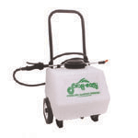
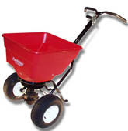

Application Equipment
Sprayers
Notes:
Hand or backpack sprayers for liquid pesticides are relatively inexpensive and easy to operate. Operation of these sprayers is uncomplicated, and most applicators can repair the equipment with parts available through local retailers. Look for a tank with a large opening. Select a tank size that is appropriate for the situation. Remember that a five-gallon sprayer full of water and pesticide weighs about 40 pounds. If it is necessary to mix and carry several gallons of pesticide solution, a backpack sprayer may be a better choice.
Test the sprayer with water at the beginning of each season. Check for leaks and a regular spray pattern. Flush the tank and lines with water after each use. It may be necessary to wash the sprayer out with water and detergent when switching pesticides. Apply the wastewater to a use site indicated on the pesticide label. NEVER dump the wastes down the drain or into a sewer.
Phenoxy pesticides (e.g., 2,4 D) are active in very low concentrations. It is best not to apply other pesticides with sprayer that has been used with phenoxy herbicides. Many people keep one sprayer for phenoxy herbicides, another sprayer for other herbicides, and a third sprayer for insecticides and fungicides.

Slide 46
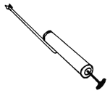
Dusters
Notes:
Dusters may be as simple as a shaker can. Other types of dust application equipment may include a bellows or fan to distribute the dusts. This type of equipment is usually very simple to operate and maintain. Be careful to keep the pesticide dust off of the skin and non-target areas.

Slide 47
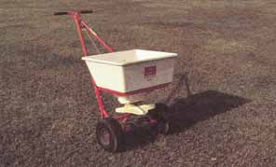
Granular Applicators
Notes:
Granular applicators may be a shaker can or rolling spreader equipment. Drop spreaders distribute pesticide directly below the spreader. Rotary spreaders throw the granules over a wider area.

Slide 48
Pesticide Toxicity
Acute toxicity - single or short term
Chronic toxicity - repeated or long term
Pesticides are most dangerous as concentrates. Be especially careful when measuring and mixing pesticides.
Notes:
Acute toxicity is the likelihood of injury from a single or short-term exposure. If a person becomes ill shortly after applying a pesticide, consider acute toxicity. Common symptoms include nausea, dizziness, and headache. Refer to the pesticide label and consider how the person may have been exposed. It may be necessary to seek medical attention. Poison Control (1-800-222-1222 ) can advise about human or animal exposure
Chronic toxicity is the likelihood of injury after repeated or long-term exposure. One cigarette or a single alcoholic drink is unlikely to cause injury, but long-term exposure can cause serious health problems. Repeated exposure to small amounts of pesticide may cause illness. There is little specific information about the long-term effects of pesticide exposure. The signal word (e.g., WARNING) on a pesticide label is based only on acute toxicity; it provides no information about chronic risks.
Pesticides are most dangerous as concentrates. Be especially careful when measuring and mixing pesticides.

Slide 49
USING PESTICIDES SAFELY
Routes of Exposure
  Skin
  Swallowing
  Inhaling
  Eye injury
NEVER store any pesticide in a food or drink container
Notes:
Routes of Exposure
Skin is the most common route of pesticide exposure. Some pesticide formulations (e.g., emulsifiable concentrates) can penetrate the skin directly, and many pesticides can penetrate through a wound.
Swallowing pesticide can be very serious. NEVER store any pesticide in a food or drink container. Pesticides in soft drink bottles have killed both children and adults. Be sure that implements used to measure or mix pesticides are not confused with kitchen equipment.
Inhaling pesticides can cause serious injury. Keep out of pesticide drift and pay attention to changes in wind direction.
Eye injury can occur very quickly with some pesticides. Always pour pesticides below the waist.
Inattention and poor work habits cause most pesticide exposure. When handling pesticides, always wash hands before eating, drinking, using tobacco, or using the toilet. Keep people and pets out of the spray area. Close house and car windows before applying pesticide. Be careful not to carry pesticide indoors on shoes or clothes.

Slide 50
First Aid for
Pesticide Exposure
Skin - Rinse the exposed area with clean water.
Swallowed - Consult the pesticide label and call Poison Control 1-800-222-1222 immediately.
Inhaled - Move the victim to fresh air.
In eyes - Rinse with clean water for at least 15 minutes
Notes:
Act quickly if someone is exposed to pesticide. Be familiar with the first aid directions on the pesticide label.
• Skin—Rinse the exposed area with clean water immediately. Wash the area with soap and water as possible.
• Swallowed pesticide—Consult the pesticide label and call Poison Control (1-800-222-1222) immediately.
• Inhaled pesticide—Move the victim to fresh air. If the symptoms do not abate right away, seek medical attention.
• Pesticide in eye—Rinse the eye gently with clean water for at least 15 minutes. Seek medical attention.

Slide 51
Protecting the
Body from Pesticides
Wear Protective Clothing
  Gloves
  Boots
  Other –prescribed by label
Shower
Launder clothing separately
Notes:
Protecting the body from pesticides is a vitally important step is as important as the proper use of the pesticide. Clothing—At a minimum, wear a long-sleeved shirt, long pants, shoes, socks, and gloves. Wear a wide-brimmed hat if spraying overhead. Gloves are the most important piece of protective equipment because most pesticide exposure occurs on the hands and forearms. Wear plastic or rubber gloves that are long enough to protect the wrists. Cloth or leather gloves do not prevent pesticide exposure. Keep shirtsleeves outside the gloves unless spraying overhead. When wearing reusable gloves, wash them before removing the gloves.
Wear rubber boots or shoe covers that repel liquids. Leather or cloth shoes will absorb pesticides. Wear pant legs outside of the boots. Wear any additional protective clothing as directed by the pesticide label.
Shower-Wash the entire body with soap and water in the shower after completing a pesticide task. Wash the clothes separately from other laundry and dry them outside. Throw away any clothes that are heavily contaminated with pesticide.

Slide 52
Pesticide Spills
Dry Spills
  Scoop up
Liquid Spills
  DO NOT HOSE DOWN
  Absorbent material (kitty litter)-dispose
  Remove contaminated soil-dispose
Notes:
If you spill pesticide, don’t panic-
Dry spills are relatively easy to clean up. Scoop up the pesticide with a shovel or paper. In most cases, the pesticide can still be used as planned.
Be prepared for spills of liquid pesticide. DO NOT hose down a pesticide spill. For spills on a hard surface, use rubber/plastic gloves and other protective equipment indicated on the pesticide label. An absorbent material, like cat litter, can be used to soak up the spill. Scoop the absorbent material and pesticide into a heavy-duty garbage bag. Clean the contaminated area with detergent and apply the absorbent material again. Scoop the material into the garbage bag. Place the garbage bag into the outdoor garbage can and throw the materials away with other household trash. If a liquid pesticide spills on soil, usually it is not necessary to take any action. Remove the contaminated soil and dispose of it with household trash. If one is unsure of how to clean up a pesticide spill, call CHEMTREC 24 hours a day (800-424-9300) or the local Extension agent.

Slide 53
Pesticide Disposal
Buy only needed amount
Mix only what you need
Share excess
Fill leak proof container with kitty litter and dispose
  Rinse empty bottles
  Discard clean bottles in household trash
Collection days
Notes:
Do not buy more pesticide than needed. Measure pesticides carefully to avoid excessive leftover pesticide mix. Apply the leftover pesticide mix to a site indicated in the pesticide labeling. Do not exceed the label rate. Give excess usable pesticide to someone who will use it properly. The Extension agent may be able to assist with giving away unwanted pesticide. If the pesticide cannot be used by anyone, carefully add some absorbent material (e.g., cat litter) to the container, or pour the pesticide into a leak-proof, disposable container with some absorbent material. When all of the liquid is absorbed, throw away the materials with other household trash.
Rinse containers of liquid pesticides thoroughly. Rinse them at least three times. Add the water to the pesticide spray tank. Empty containers of dry pesticides thoroughly. Dispose of empty, clean pesticide containers with other household trash.

Slide 54
Beneficial Insects
Parasites, Parasitoids
and Predators
Notes:
Beneficial insects are covered in this program for two important reasons. First, any pesticides used in the landscape can affect the local populations of beneficial insects. Second, actively conserving and protecting beneficial insects helps to reduce the need for pesticides by helping keep populations naturally controlled.

Slide 55
Parasites & Parasitoids
Parasite - organism that lives in or on the body of the host during some part of the parasite’s life cycle.
Parasitoid - a special kind of parasite that may consume all or part of the host’s tissues, eventually resulting in the host’s death.
Notes:
Parasites are defined as organisms that live in or on the body of the host during some part of the parasite’s life cycle. Parasitoids are a type of parasite that may consume part or all of its host’s tissues—resulting in the death of the host. The most abundant parasitic insects are flies and wasps. Parasitic insects usually require only one host to complete their development in contrast to predators, which require several. Parasitic insects may be responsible for controlling several pests, however, when they oviposit, or lay eggs, on a number of new hosts.

Slide 56
Predator
Insect, mite or spider that attacks and feeds on its prey
Usually larger than prey
kills and consumes several prey during its lifetime
Notes:
Predators are generally insects, spiders, or mites that must find and kill several prey individuals in order to complete their life cycle. This might be a ladybird beetle that consumes hundreds of aphids as both a larva and an adult, or an insect like the minute pirate bug that feeds voraciously on thrips and insect eggs. Predators are usually larger than the prey they eat, although there are exceptions. Predators that feed on insects also occur among the birds, reptiles, amphibians, mammals, and fish. Some can cause significant reductions in insect numbers. Most often we are talking about invertebrate predators in insect and mite control.

Slide 57
Key Beneficial Insects
Lady beetles
Ground beetles
Tiger beetles
Rove beetles
Syrphid flies
Long-legged flies
Robber flies
Spined soldier bugs
Predaceous damsel bugs
Minute pirate bugs
Predaceous plant bugs
Assassin bugs
Big-eyed bugs
Green lacewings
Brown lacewings
Parasitic wasps
Parasitic flies
Notes:
The first step in being able to more effectively use biological control in landscape management is to be able to correctly identify certain common natural enemies and to know what pests they may be active against. Many natural enemies are generalists feeding on a wide variety of prey or, in the case of parasites, parasitizing several host species. Some, on the other hand are very specialized in the type of prey or host they can successfully overcome. Knowledge of the life cycle is important too. Many natural enemies attack only a particular stage of a pest, perhaps the egg or the larval stage.

Slide 58
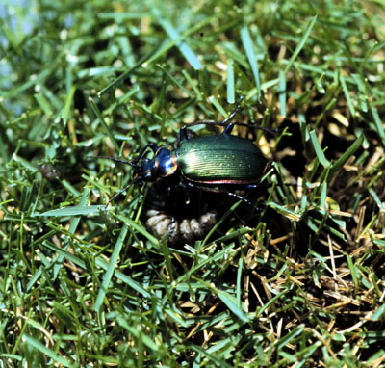
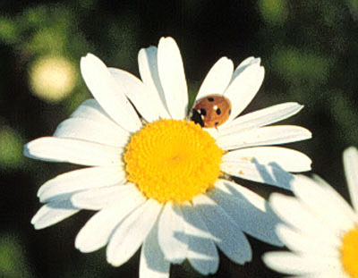
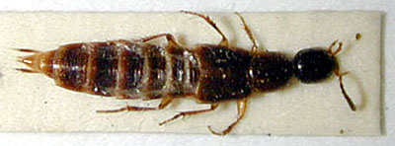
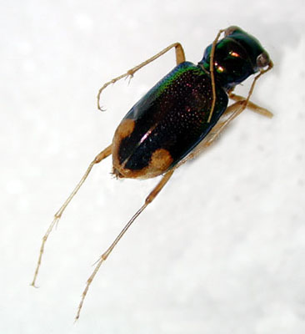
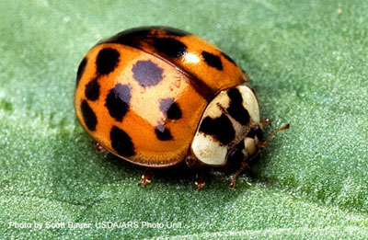
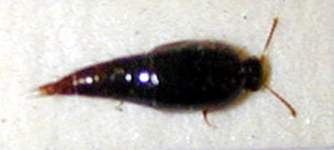
Predatory beetles
Notes:
Ground Beetles (Carabidae) are predaceous as adults and as larvae. There are some seed feeding species. They are active on the ground primarily at night. Adult beetles vary in size from 1/4 to 1 inch or longer. Many species are metallic, while others are plain brown or black. They prey on armyworms, cutworms, small mole crickets and other insects. Lady Beetles (Coccinellidae) are among our most important beneficials. Adults and larvae feed on aphids, scale insects, mites, mealybugs, other soft-bodied insects and their eggs. Lady beetle adults are oval-shaped. Most are orange or reddish with black markings. Lady beetle larvae are elongate, covered with spines, and dorso-ventrally flattened. Often they are brightly colored with spots. Some larvae are covered with white waxy secretion like mealybugs. Adults and larvae are voracious feeders on aphids, a single individual consuming hundreds of aphids during its lifetime. Rove beetles (Staphylinidae) have shortened elytra (wing covers) that leave the segments of the abdomen visible giving these beetles their characteristic
appearance. Most species are slender and elongate from 1/16-1/2 inch long.
Typically they are reddish-brown to black. Many species are predaceous, some
feed on decaying organic matter helping to recycle needed nutrients in the
landscape.
Tiger Beetles (Cicindellidae) are very active, often metallic beetles 1/2-3/4 inch
long. They are difficult to collect because of the speed with which they run or fly.
Larvae live in burrows in the soil and ambush prey as it goes by. Some species are
often well represented in landscape beds.

Slide 59
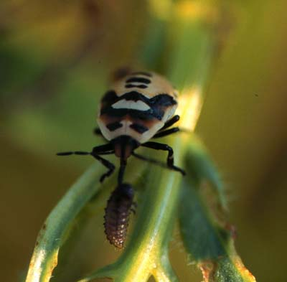
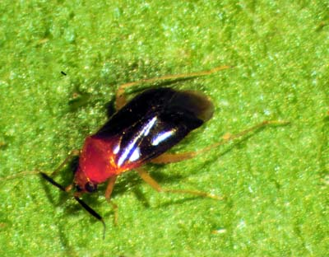
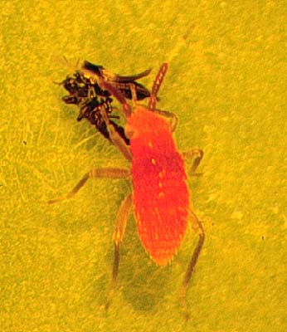
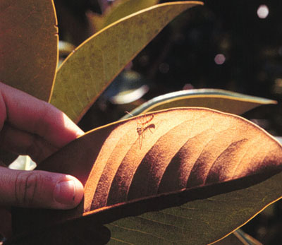
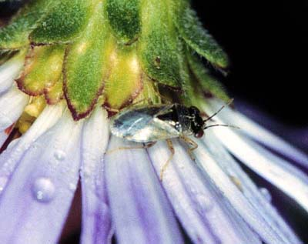
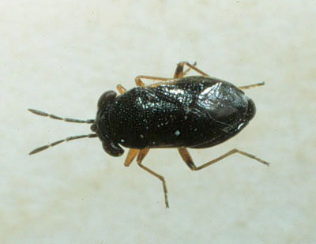
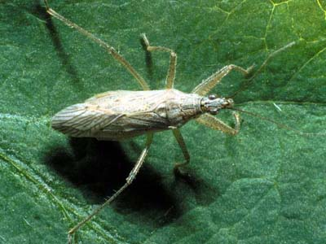
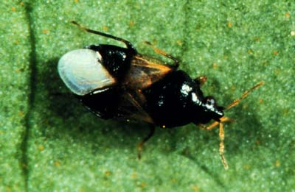
Predators in the “True Bug” group
Notes:
True Bugs (Hemiptera) is a group that contains several generalist predator species. These insects all have piercing-sucking mouthparts which they use to impale their prey and extract fluid. The beak is usually carried beneath the body, but can be pointed forward or downward while feeding. The usual prey for these insects are other soft-bodied insects of small to intermediate size. Representatives of these predators include :
Assassin Bugs (Reduviidae) generally appear oval or elongate and are often black and orange-red or brown. They are larger than most of the other predaceous bugs, especially the giant wheel bug. Assassin bugs have a head that has a particularly long and narrow appearance. They feed on most other insects and will inflict a painful bite if handled Big-Eyed Bugs (Lygaeidae) are stout bodied insects, about 1/8 inch long with prominent eyes that give the insect its name. These insects are slightly larger than chinch bugs. They may have similar coloration, but are always broader across the head than the area just behind (shoulders). Chinch bugs, on the other hand, have a narrow head, never broader than the area directly behind. Often big-eyed bugs can be found with populations of chinch bugs and it is important to be able to distinguish predator from pest. Big-eyed bugs also feed on caterpillars and insect eggs. Minute Pirate Bugs (Anthocoridae) are 1/8 - 1/4 inch long. These insects are black and white as adults and have colorful yellow-orange-brown nymphs depending upon instar. Gardeners notice the painful bite that this small insect produces. It is an effective predator of thrips and the eggs of many insect and mite species. Predaceous Damsel Bugs (Nabidae) are 1/8 - 3/8 inch long and may be cream colored to dark brown to black depending on the species. The most common species are slender, elongate insects that are most active in mid summer. They feed on eggs and immature stages of many pest insects. Predaceous Plant Bugs (Miridae) are less well known than other predaceous true bugs, but have been shown to be active predators of thrips, lace bugs, aphids, moth eggs and other insects of importance in the landscape. Stink Bugs (Pentatomidae) Although many stink bugs are plant feeders, there are some predaceous species including the spined soldier bug. This is a known predator of more than 100 pest species. Adults are about ½ inch long, light brown, and somewhat dorso-ventrally flattened. The shoulders are drawn out into the appearance of a spine, hence the name. Both the more colorful nymphs and the adults feed and may attack prey much larger than themselves. Adults overwinter and become active in the spring when new eggs are deposited. Caterpillars and leaf beetle larvae are common prey items for stink bugs.

Slide 60
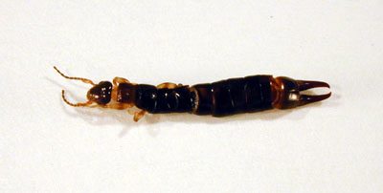
Earwigs
Notes:
Earwigs (Dermaptera) of many species are predaceous. One common species was found to eat 50 chinch bugs per day in laboratory tests. Earwigs vary in size, some of the larger species are 3/4-1 inch long. They are usually brown and may have stripes.

Slide 61
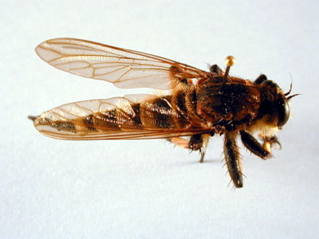
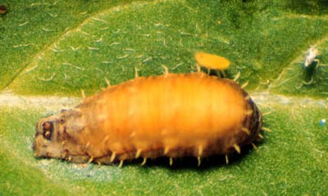
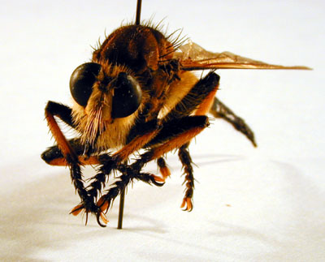
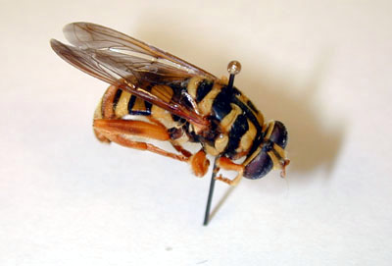
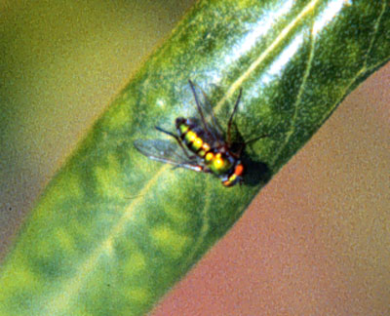
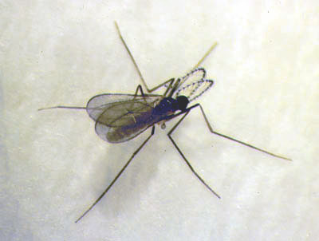
Predatory flies
Notes:
Long-Legged Flies (Dolichopodidae) are small, about 1/4 inch with very long legs in relation to the body and usually metallic blue or green in color. Adults and larvae are predaceous and are often found near woodland streams or other wet areas. Predaceous Midges (Cecidomyiidae) Most members of this group are gall makers on plants but there are some predaceous members of the family that feed on aphids. These larvae look much like syrphid larvae, but smaller. Robber Flies (Asilidae) are 3/4 - 1 1/4 inch long and vary in appearance. Some are quite stout while others are long and slender. The face is usually bearded and the head is hollowed out between the eyes. Adults are predaceous on many kinds of insects and usually capture their prey in the air. Larvae are soil-dwelling and predaceous on such things as white grubs. Syrphid Flies (Syrphidae) are sometimes called flower flies because they are commonly found on flowers or hover flies for their behavior in flight. Most of these flies are yellow with brown or black bands on the abdomen. Some resemble wasps, many mimic bees. Syrphid larvae are maggot-like and predaceous on aphids and other soft-bodied insects. They have no legs or visible head capsule and are translucent.

Slide 62
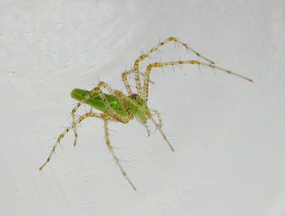
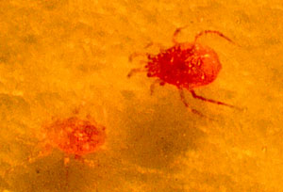
Spiders and mites
Notes:
Spiders are all predators, but have many different lifestyles. Some make webs and wait for prey to come to them while others are active hunters. Spiders are important predators in the landscape and are very common in trees, shrubs, grass, and herbaceous plant beds. Most spiders are general predators, feeding on a wide variety of prey. Their are a number of spider species that may be found in the landscape. All have two body parts, an abdomen and a cephalothorax (combined head and thorax), and eight legs. Spiders tend to avoid people and most are harmless to humans. Spider complexes are believed to be important in reducing several kinds of landscape pests Mites are more closely related to spiders than they are to insects. Mites do not have antennae like insects do, or segmented bodies or wings. They are usually very small and often go unnoticed. Most mites have an egg stage, a six-legged larval stage, and two eight-legged stages before becoming an adult. Phytoseiid mites are the major group of natural enemies that attack certain kinds of pest spider mites. It is especially important to conserve predatory mites in the landscape to prevent pest mite outbreaks. Other insect pests are also eaten by predatory mites including whiteflies, thrips, and certain insect eggs. Most predaceous mites are somewhat pear-shaped and shiny, with noticeably long legs. They may be bright red, yellow, or green depending on what they've been eating and appear "see-through". Predaceous mite eggs are usually oblong instead of spherical like the eggs of pest mite species. Predaceous mites are also much more active and mobile than pest mite species.

Slide 63
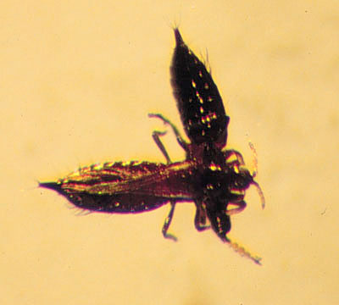
Thrips
Notes:
Thrips (Order Thysanoptera) are very small, narrow insects with fringes on the edges of their wings. Many species are recognized for their plant feeding (pest) habits, but there are many predaceous members of this insect order. These important predators of mites and small, soft-bodied insects are commonly black, yellow or brown as adults and clear or translucent white-yellow as immatures, although some are a distinctive reddish-orange in color.

Slide 64
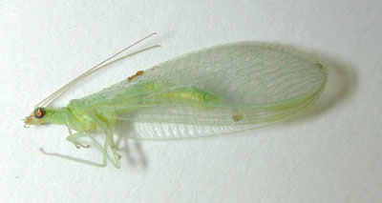
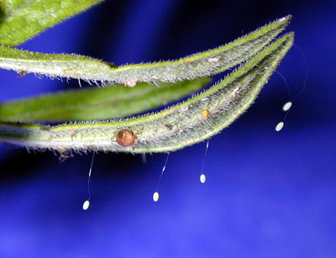
Lacewings
Notes:
Lacewings (Chrysopidae, Hemerobiidae) Both green lacewings and brown lacewings are predators, green lacewings are more common. They are often found on weeds, shrubs, and other cultivated plants. Adult green lacewings are about 3/4 inch, brown lacewings are smaller. Adult and larval brown lacewings and larval green lacewings feed on soft-bodied insects, especially aphids, and mites. Adult green lacewings may be pollen-feeders or they may be predaceous. Most are greenish in color with copper eyes and the network of veins in the wings that gives them their name.
Lacewing eggs are attached to leaves by a long hair-like stalk. This raises the eggs off the surface of the leaf and helps prevent cannibalism when the young predators hatch. Larvae are oblong and soft-bodied, with distinctive sickle-shaped mandibles. They are often called aphid lions, because of their habit of feeding on aphids. Some brown lacewings adhere the skins of their prey and other matter to their backs as a form of camouflage.

Slide 65
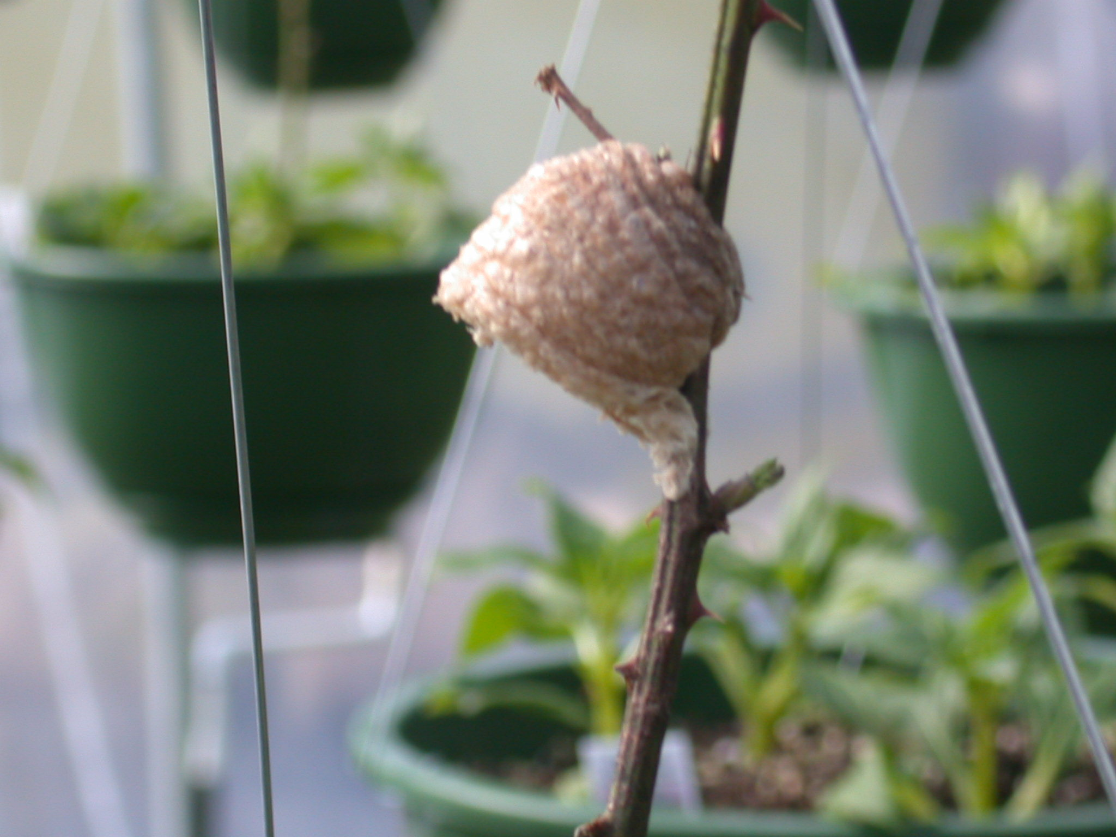
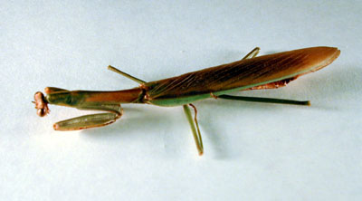
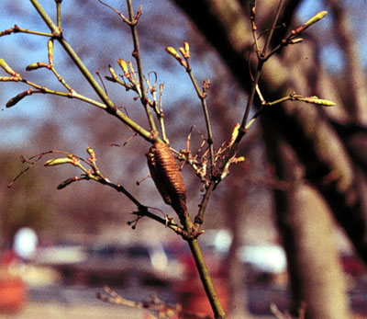
Praying mantids
Notes:
Praying Mantids (Mantidae) are comparatively large insects. Some may be as long as 3 in. Our native species are much smaller, however. Usually they are green, gray, or brown. Their raptorial front legs are covered with stout spines that help them grasp their prey. Mantid egg capsules contain 200 or more eggs neatly arranged in rows. They are deposited on twigs and stems and then the frothy mass hardens. It is very unlikely that praying mantids can suppress key pests in the landscape to the extent necessary.

Slide 66
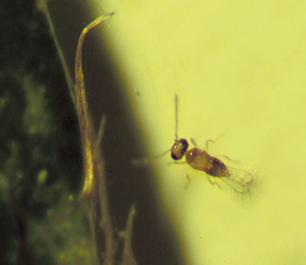
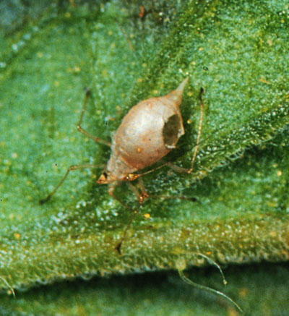
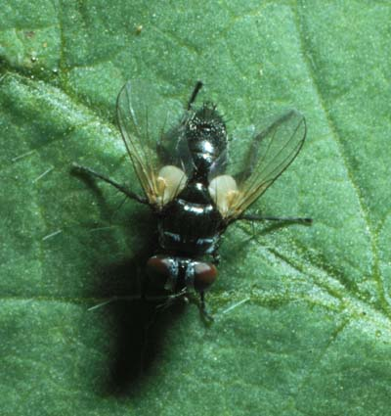
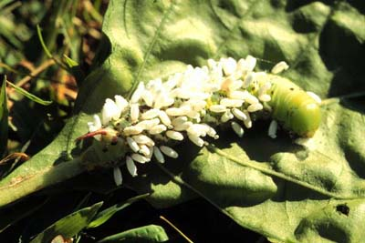
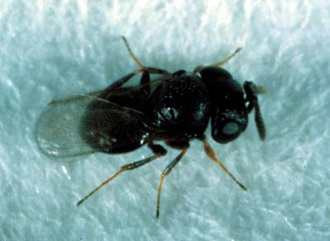
Parasitic wasps and flies
Notes:
Parasitic Wasps are a large group of beneficial insects and are extremely important in biological control. Many wasp families contain representatives of the parasitic life style. Most of these wasps are very small <1/8 inch and are , therefore, rarely seen. A large number in fact attack the egg stage, completing their entire life cycle inside minute insect eggs.
Parasitic wasps lay their eggs in or on the host and the immature stage of the wasp feeds on the hosts tissues. The parasitic wasp may emerge from its host to pupate, or it may pupate within the body of its host. Wasp larvae that develop inside the host are called endoparasitic. They leave evidence of parasitism when they chew a small hole in their host's body to emerge. That small circular hole indicates that parasitism is occurring in the pest population. Insects that you may find parasitized this way include scales, aphids, whiteflies, lace bug eggs, leafminers and caterpillars. Other parasitic larvae live on the outside of the host's body and are called ectoparasites. Both endo- and ectoparasites may spin numerous white cocoons for pupation, another obvious indication of parasitism. Parasitic Flies are abundantly represented by the family Tachinidae, with about 1,300 North American species. They vary tremendously in appearance. Many just resemble a common husefly, while others look like bees or wasps. These flies deposit an egg or in some cases, a live larva, on or near the body of their host. The tachinid larva burrows into its host and consumes the internal tissues. Numerous kinds of insect pests are attacked by tachinids.

Slide 67
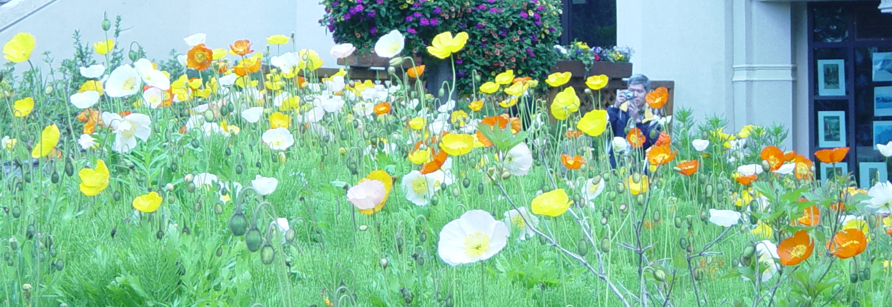
Increase Natural Enemy Populations
Judicious selection and use of pesticides
Design landscapes to feature a variety of plant material
Notes:
Help increase natural enemy populations by using pesticides only when necessary and selecting the ones with the least impact on non-target species. Design landscapes to feature a variety of plant material with careful attention to providing nectar and pollen sources season-long. Those that have been shown to be particularly attractive to beneficials include daisies, Queen Anne’s Lace, yarrow, white alyssum, goldenrod, and clover.

Slide 68
Managing Naturally Occurring Parasites and Predators
Choose selective rather than broad-spectrum insecticides
  May be slower, but long term control is better achieved by using methods that conserve natural enemies
Monitor for beneficial arthropods as you would for pest insects
  If ratio of pests to natural enemies is low, then spraying can be delayed
Notes:
Monitor for beneficial insects and mites the same as for pest insects. Evidence of natural enemy activity includes diseased insects or those that have holes from which parasites have emerged. Determine whether pest numbers are increasing, decreasing, or staying the same. Make the same assessment for associated natural enemies. Predators and sometimes parasites can be sampled in much the same way as pests in the landscape are sampled. A sweep net is useful and foliage can be shaken or beaten over a white tray where dislodged insects and mites become very visible. Direct visual observation is often the most effective sampling method. Insects can be counted as number per leaf or terminal, for example, or number spotted during a three minute observation period. If the ratio of pests to natural enemies is low, spraying should be delayed. Frequent (weekly or biweekly) monitoring is necessary to take fullest advantage of natural control. Stop treating minor pests and focus management on key pests. Keep a garden diary; record what works well. Develop “threshold levels” for treatment; a few insects generally do not merit a pesticide application.

Slide 69
Questions
Notes:
DISCUSSION QUESTIONS
1. What are the four components of an IPM system?
2. Why is pest identification important in an IPM program?
3. Discuss the 3 goals of pest control.
4. What are the steps in pest monitoring?
5. How do natural controls affect pest populations?
6. What are some nonchemical methods of pest control?
7. Explain the action of contact pesticides, systemic pesticides, and translocated pesticides.
8. Name and explain the meaning of signal words and symbols you may see on a pesticide product.
9. Where can you find out how much pesticide to apply?
10. List some information that can be found on a pesticide label.
11. Describe actions that a pesticide user can take to avoid contamination of groundwater.
12. Where should pesticides be stored?
13. How should you dispose of excess pesticides?
14. What is the most common route of pesticide exposure and how can pesticide users protect themselves from exposure?
15. What are the 3 principles of using beneficial insects in reducing pesticide use?
16. List some beneficial insects you might find in the landscape.

