Slide 1
How do streams get impaired

Slide 2
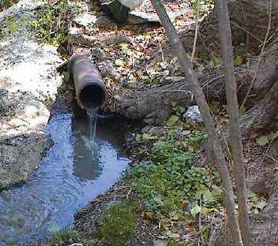
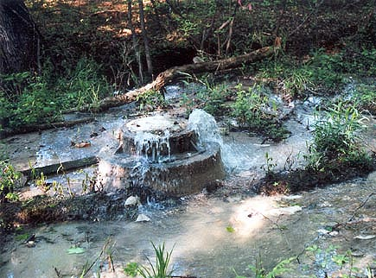
Point Sources
Of Pollution
Sewage
Wash water
Tap water
Industrial
Natural source

Slide 3
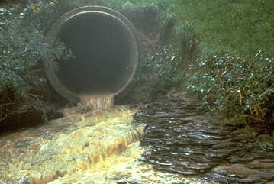
Stream Water Quality
initial focus:
Municipal and industrial discharges

Slide 4
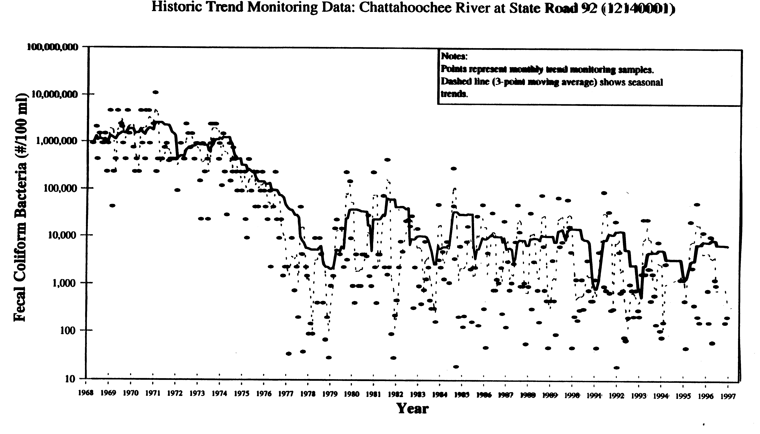
Urban Water Pollution
Before CWA
After CWA
Bacteria still 50 times higher than the impairment standard
Notes:
Clean water act passed in 1972

Slide 5
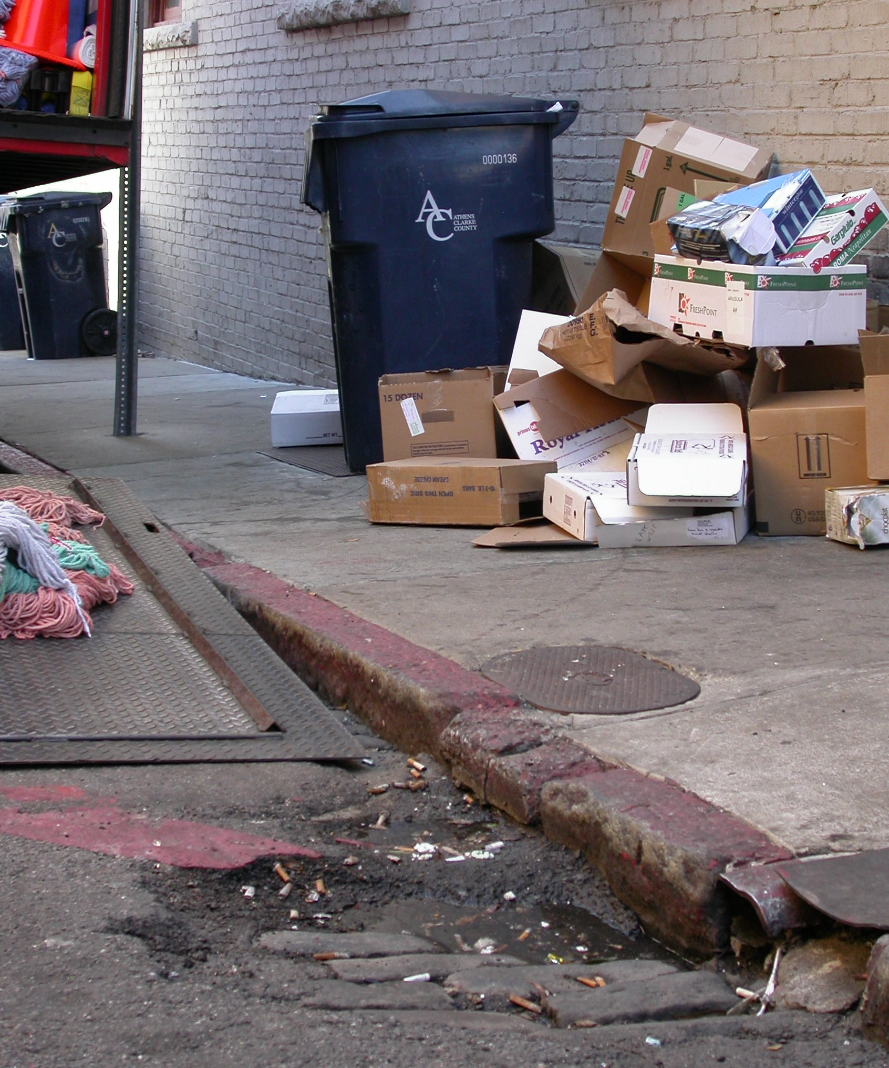
Non-point Source Pollution
Pollution that does not come from a single identifiable source.
Notes:
Point vs. Non-Point Pollution. Point vs. Non-Point Pollution. Pollution that does not come from a single identifiable source.
Motor Oil • Sediment • Cooking Grease • Pet Waste Excess Fertilizer • Yard Waste • Litter • Pesticides Household Hazardous Waste • Detergents • Metals

Slide 6
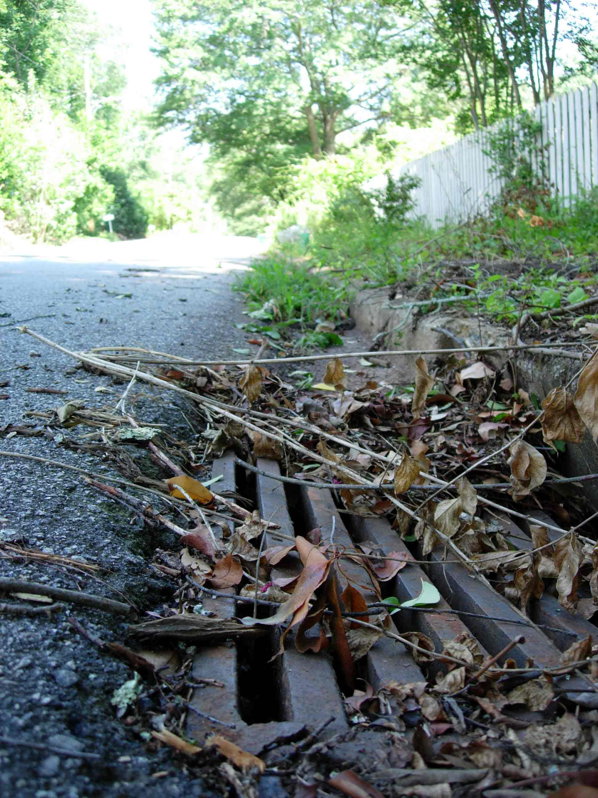
Non-Point Source Pollution
Motor Oil • Sediment • Cooking Grease • Pet Waste Excess Fertilizer • Yard Waste • Litter • Pesticides Household Hazardous Waste • Detergents • Metals
Notes:
Point vs. Non-Point Pollution. Point vs. Non-Point Pollution. Pollution that does not come from a single identifiable source.
Motor Oil • Sediment • Cooking Grease • Pet Waste Excess Fertilizer • Yard Waste • Litter • Pesticides Household Hazardous Waste • Detergents • Metals

Slide 7


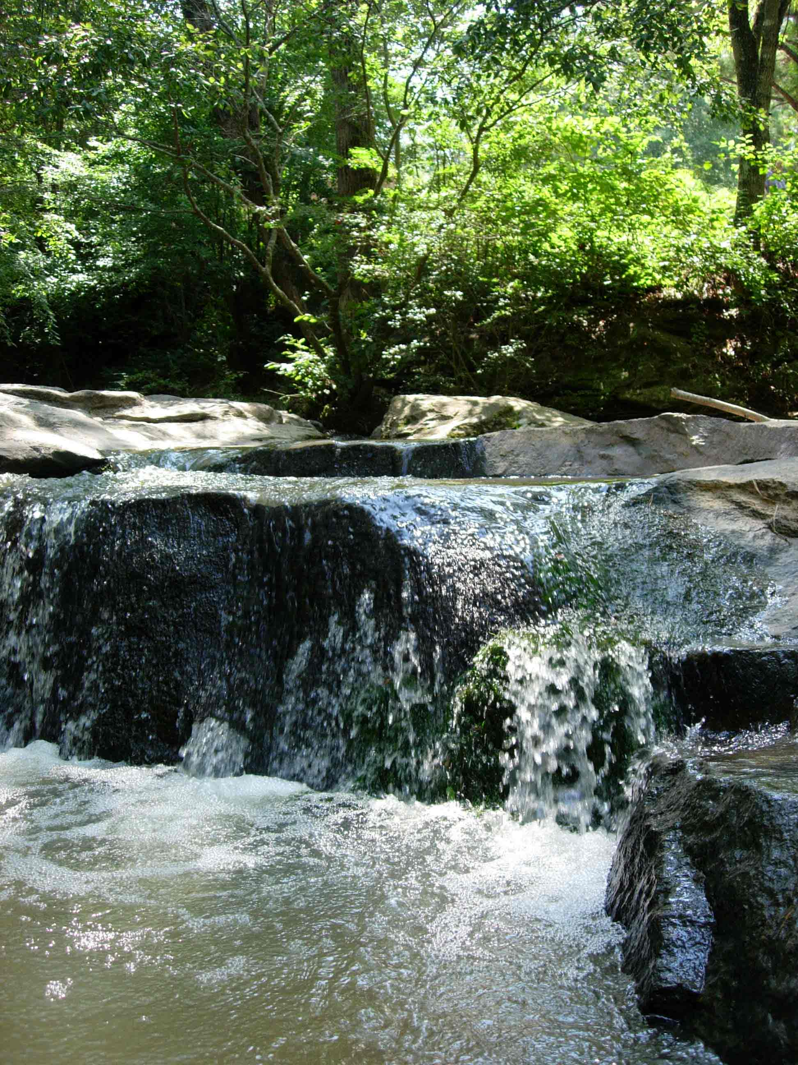
Storwater
Water that runs off of impervious surfaces such as roads, parking lots, or rooftops.

Slide 8
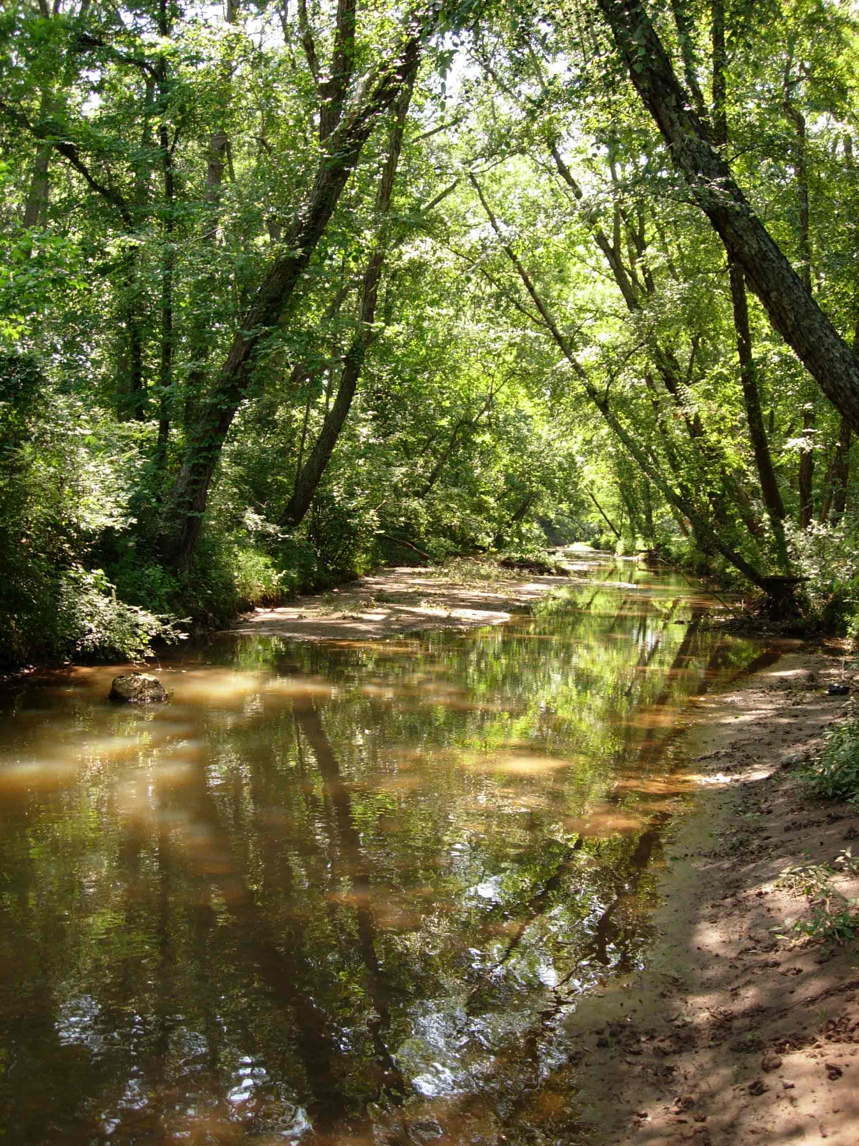
Why manage stormwater?
To prevent flooding during heavy rains.
To keep our rivers and streams healthy.
To meet state and federal requirements.
To provide for future growth and development.

Slide 9
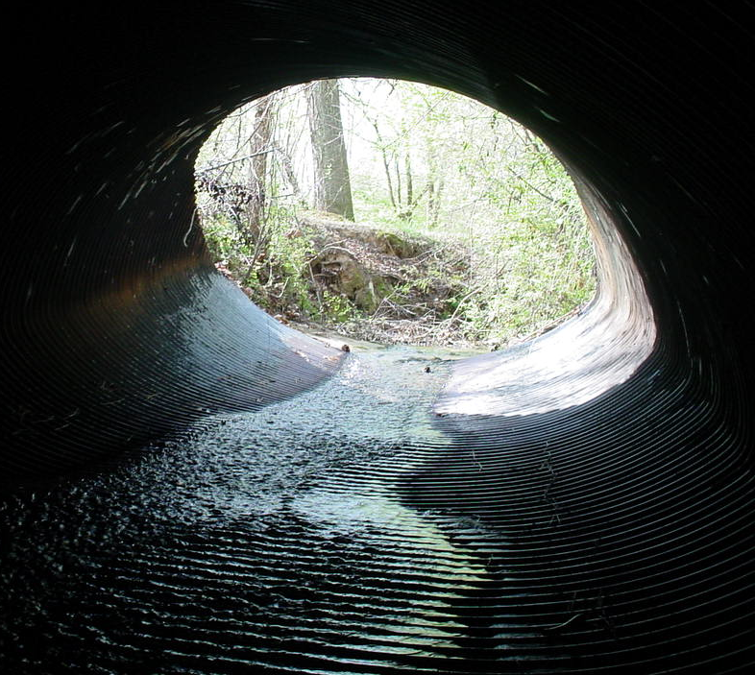
Stormwater & Non-Point Source Pollution
Stormwater runoff carries nonpoint source pollution to our rivers and streams.
Stormdrains lead directly to rivers and streams.

Slide 10

Impervious Surfaces
Materials like cement, asphalt, roofing, and compacted soil that prevent percolation of runoff into the ground.
Indicate intensive land uses that cause pollution
Inhibit recharge of groundwater
Prevent natural processing of pollutants in soil & plants
Provide a surface for accumulation of pollutants
Provide an express route for pollutants to waterways
Notes:
Impervious Surfaces -- not pollutants themselves
The surface is not necessarily a pollutant itself, but it transports pollutants, impedes infiltration, increases the volume of runoff generated, and indicates more intensive & polluting land uses.

Slide 11
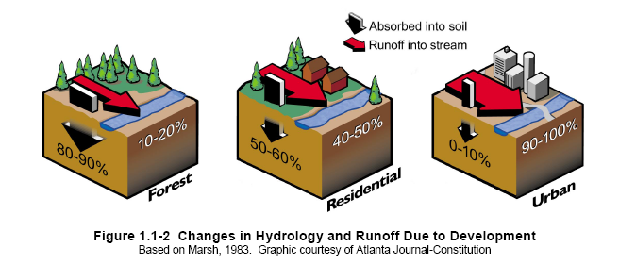
Development

Slide 12


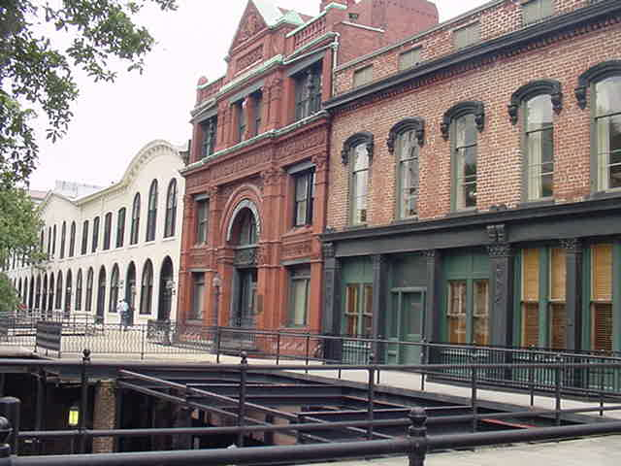

Imperviousness varies by use
0 – 5%
Natural
0 – 15%
Rural
5 - 65%
Suburban
50 - 95%
Urban

Slide 13
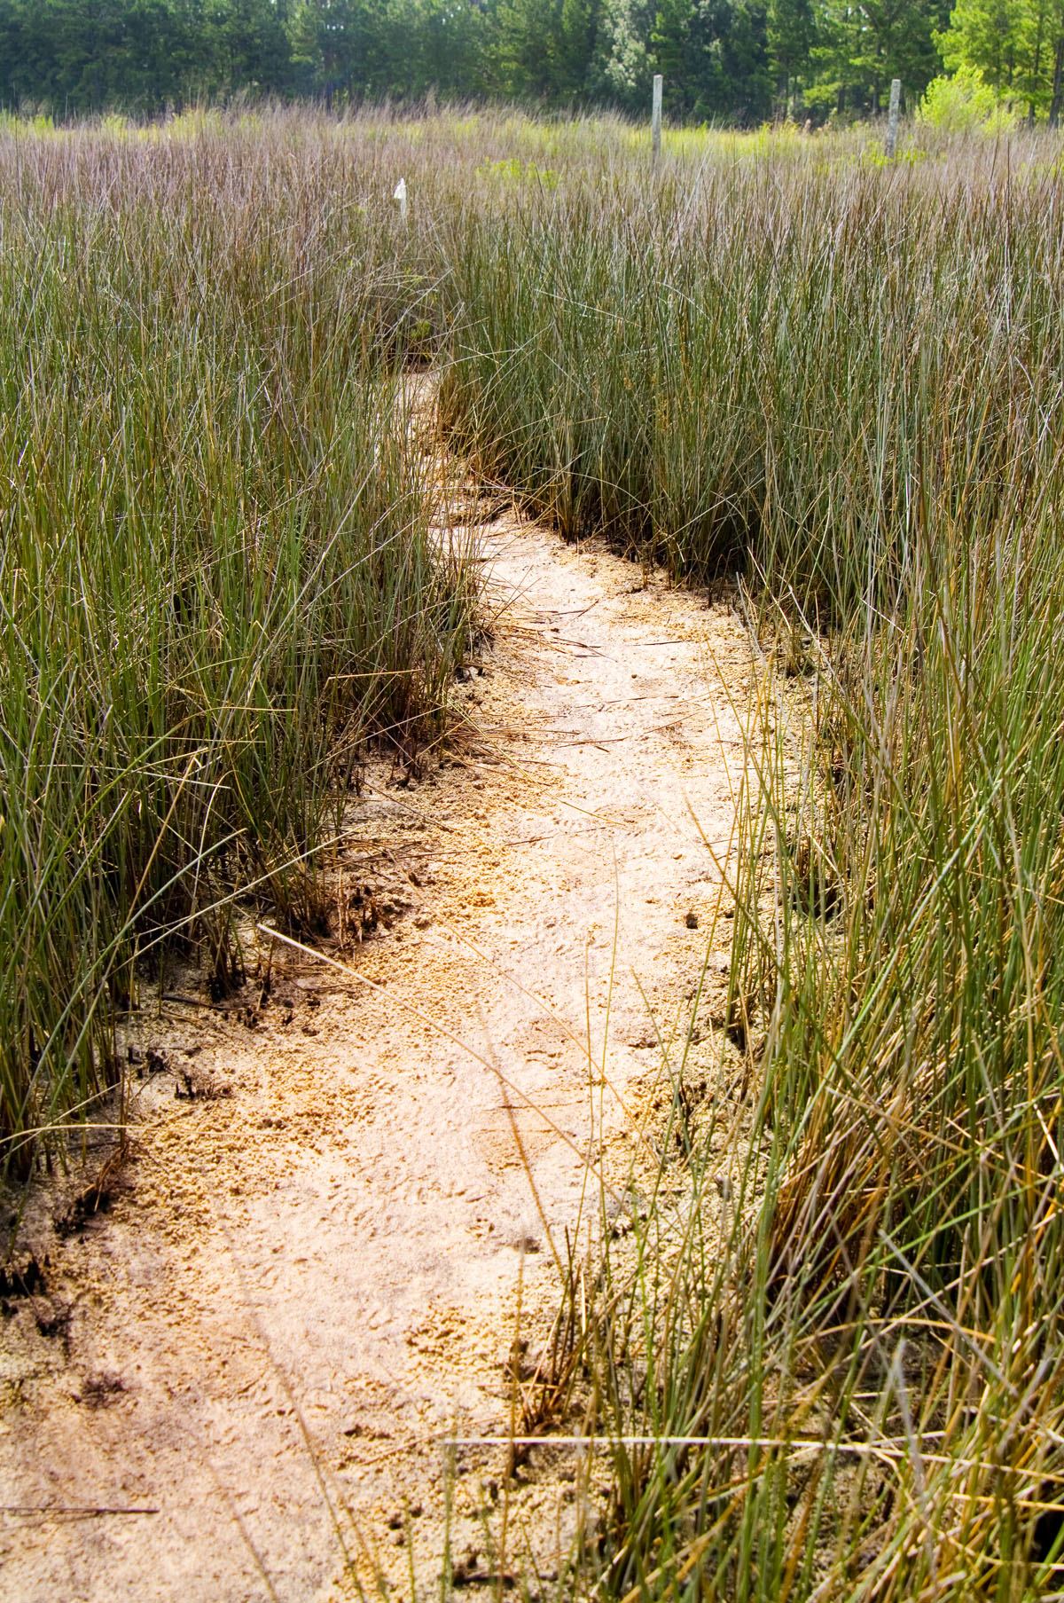
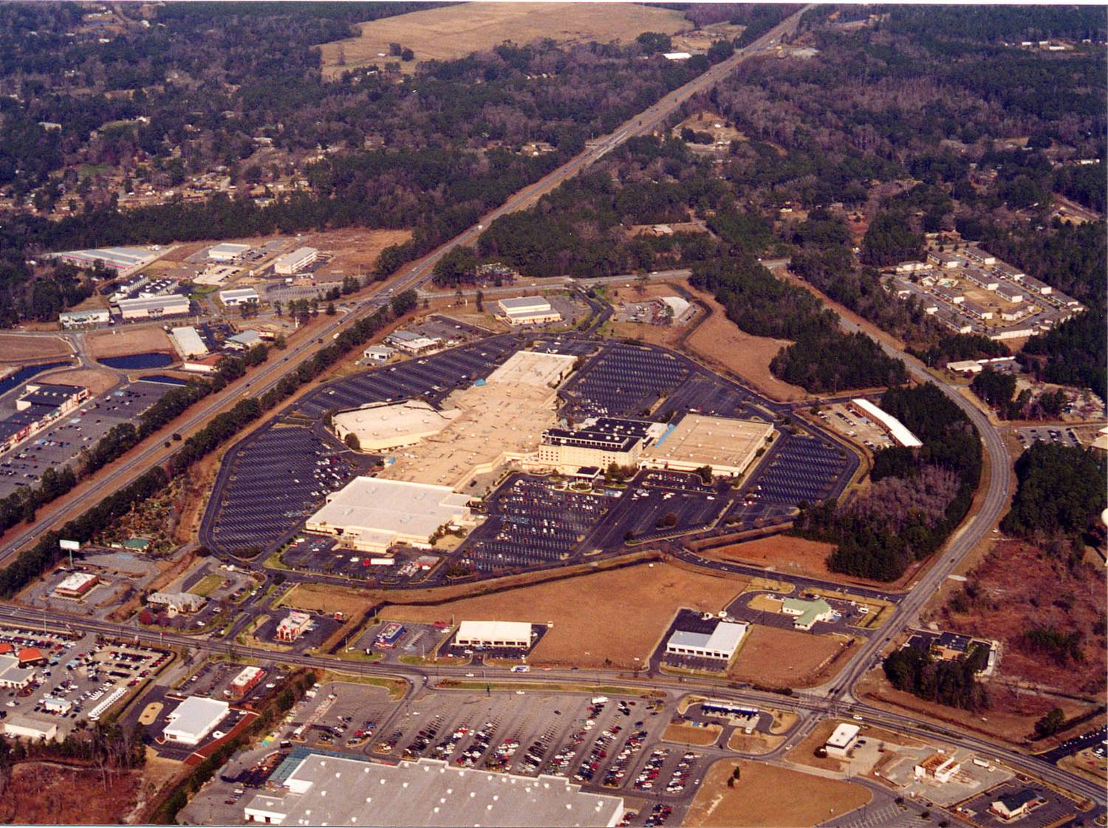

INTENSITY OF LAND USE
AMOUNT OF IMPERVIOUS SURFACE
WATER QUALITY PROBLEMS
Notes:
The Trend Toward Imperviousness
As we move from the less to more intense land covers, the potential water quality problems increase. And the common thread throughout is the increasing amount of impervious surface.

Slide 14

Waterway Health & Imperviousness
Watershed Imperviousness
0% 10% 20% 30% 40% 50% 60%
Protected
Impacted
Degraded
Waterway Health
Adapted from Schueler, et. al., 1992
Notes:
Graph: Relationship between % of impervious cover and water quality degradation
Impervious cover is integrative, in that it indicates overall water quality impacts of urbanization without regard to specific pollutants or resources. Study after study points to common thresholds for water quality degradation at 10 & 25%. Where impervious cover is below 10%, water quality is pretty well protected. (Some studies show that more sensitive habitats may be impacted at lower levels of 7-8%.) From 10% to about 25%, we see impacted water quality. And above about 25%, degradation is unavoidable. Certain measures can be taken to reduce impacts, but water quality is still going to suffer some level of degradation.

Slide 15
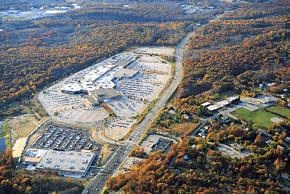
Impervious surfaces
Impedes or prevents infiltration
Prevents natural processing of pollutants in soil and through plants
Inhibits recharge of groundwater
Provides a surface for accumulation of pollutants
Provides an express route
for pollutants to waterways
Notes:
Impervious surfaces are the primary cause of the radical change in the water movement patterns with development and urbanization. Impervious surfaces cover the soil and prevent water from infiltrating. In an undisturbed situation, the soil removes pollutants from infiltrated rainfall and the some of the infiltrated water is used by plants. Both soil and plants purify water that is infiltrated. Without infiltration of rainfall, groundwater does not get recharged. Without groundwater recharge, the base flows of streams are lowered during hot dry periods.
Without infiltration the amount of runoff volume is greatly increased. The runoff builds up faster and moves over impervious surfaces faster than in natural conditions. The impervious surfaces are places where pollutants accumulate when it is not raining, so that once rain begins the pollutants are quickly and easily picked up from the impervious surfaces as the rainfall runs off. As the runoff accumulates, so do the pollutants at first. Typically impervious surfaces are all interconnected to carry stormwater away quickly to natural streams and water bodies. However, this means that pollutants entrained in the runoff are also carried off rapidly into our streams and water bodies. The impervious surfaces become an express route for pollutants of all kinds.
The increased volume of runoff from storms also increases the likelihood of flooding downstream particularly during intense storms.

Slide 16
Two Storm Hydrographs
Short, high volume peak discharge
Increased total runoff volume
Baseline peak discharge
Higher base flows
Pre-development
Post-development
Notes:
Two Storm Hydrographs
While stormwater carries pollutants into natural waterways, the increase in stormwater volume changes the dynamics of water flow in local streams. The graph here shows typical changes that impervious surfaces cause in the flow of streams.
The storm hydrographs that you see here show what a person would see if they stood at a spot by a stream and watched the stream flow rise and fall during a local storm event. To the left the hydrograph starts before the stormwater reaches the stream. As a storm occurs the water in the stream rises as can be seen in the two storm hydrographs here. Then when a storm stops, the stream water level and flow will gradually fall back down to the original stream level before the storm.
The two lines in this graph show how impervious surfaces change the flow regime in streams nearby. The blue hydrograph is for a stream that is in an area with no development, such as undisturbed woodlands. The red hydrograph is for the same stream after development and the amount of impervious surfaces has increased upstream in the watershed. You can see from the difference in the hydrograph shapes the major impacts that increased stormwater volume from impervious surfaces cause
Increased peak volume of stormwater
Increased total volume of stormwater
Peak flow comes faster and with more energy
Low flow rates are reduced
The last impact of low flow rates in streams occurs because the reduction in infiltration due to imperviousness means reduced levels of groundwater. When the groundwater levels are reduced the non-storm flow of streams is also reduced as groundwater is the chief source of water in streams when there storm is over.

Slide 17
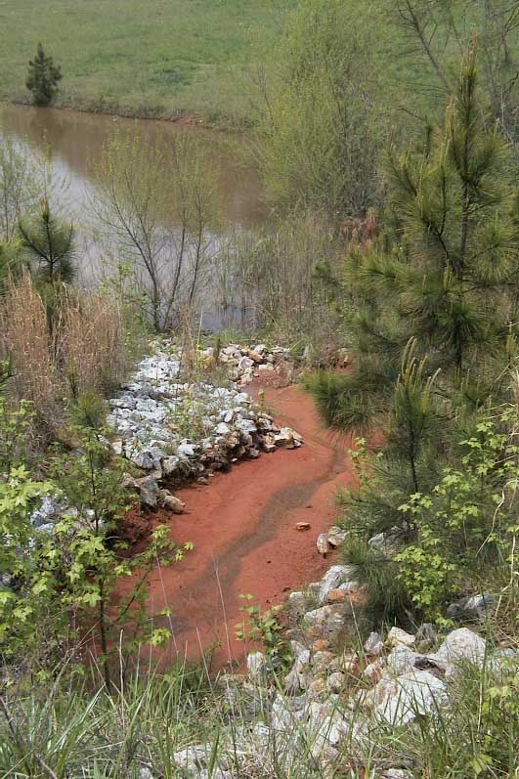
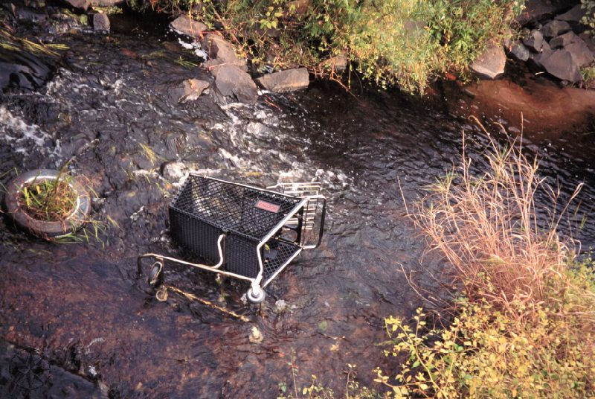
Stream Pollutants from Urban and Developed Land
Nutrients
Pathogens
Sediment
Toxic contaminants
Debris
Thermal Stress
Notes:
The Major Pollutants transported to streams in Urban Stormwater
There are a variety of pollutants that can get into our waters. Many officials know about sediment because there has been a lot of guidance and regulation on sediment and erosion control already. However, it's important to know that sediment is just one of several nonpoint pollutants and what we do to control sediment and erosion does not necessarily control other pollutants.
Typical nutrients in stormwater runoff are nitrogen and phosphorus which may come from fertilizers, animal waste and leaks from septic systems or sewer lines.
Pathogens come from animal waste, both domestic and wild animal wastes, and from failed septic systems or leaking sewer lines.
Toxic contaminants include hydrocarbons, such as fuels and lubricants from cars, and metals that wash off of streets and parking lots.
Debris is any kind of litter. Organic materials, such as yard waste and leaves, washed into streams can reduce the oxygen content of waters by feeding microbial activity in the water. Other litter leaches toxics and metals as it degrades and breaks down in the water.
Thermal stress is considered a pollutant because warmer water holds less oxygen. When stormwater heated up by hot impervious surfaces mixes into cooler stream waters, the water temperature in the stream rises and the oxygen content decreases causing stress and sometimes death of the aquatic biota in the streams.

Slide 18
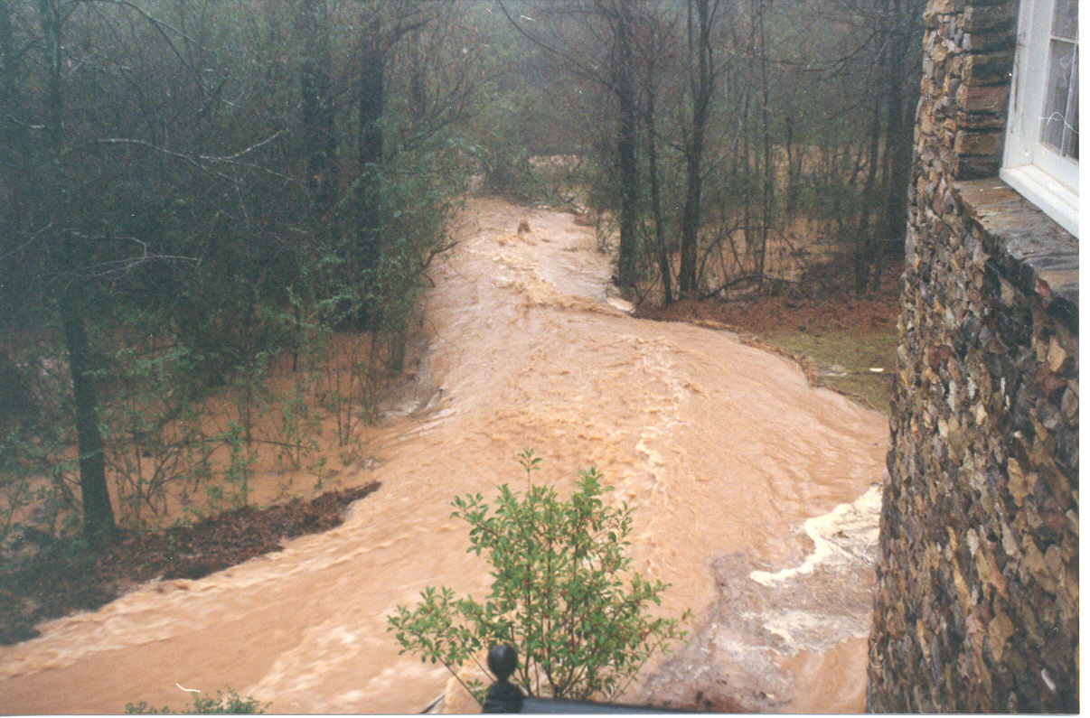
Quality and Quantity

Slide 19
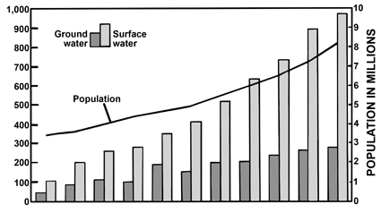
Growth and Water Use in Georgia
1950 - 2000
Notes:
This graph came from Georgia, but is representative of the Southeast

Slide 20
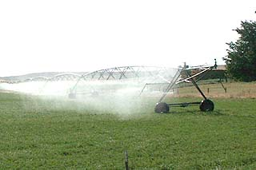
Off-stream Uses
Domestic water supply
Industrial uses
Agricultural uses (including home irrigation)

Slide 21
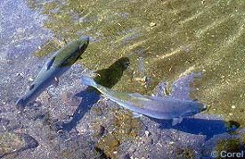
In-Stream Uses
Maintain healthy biotic systems
Assimilate pollutants
Environmental services
Recreation

Slide 22
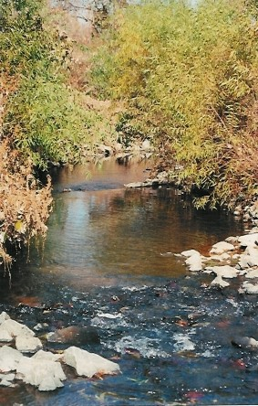
7Q10
Maintain flow for in-stream uses
Lowest flow for a 7 day period that occurs an average of once every 10 years
US Geologic Survey
http://waterdata.usgs.gov/ga/nwis/current/?type=flow& group_key=NONE

Slide 23
Why manage stormwater?
To prevent flooding during heavy rains.
To keep our rivers and streams healthy.
To meet state and federal requirements.
To provide for future growth and development.

Slide 24
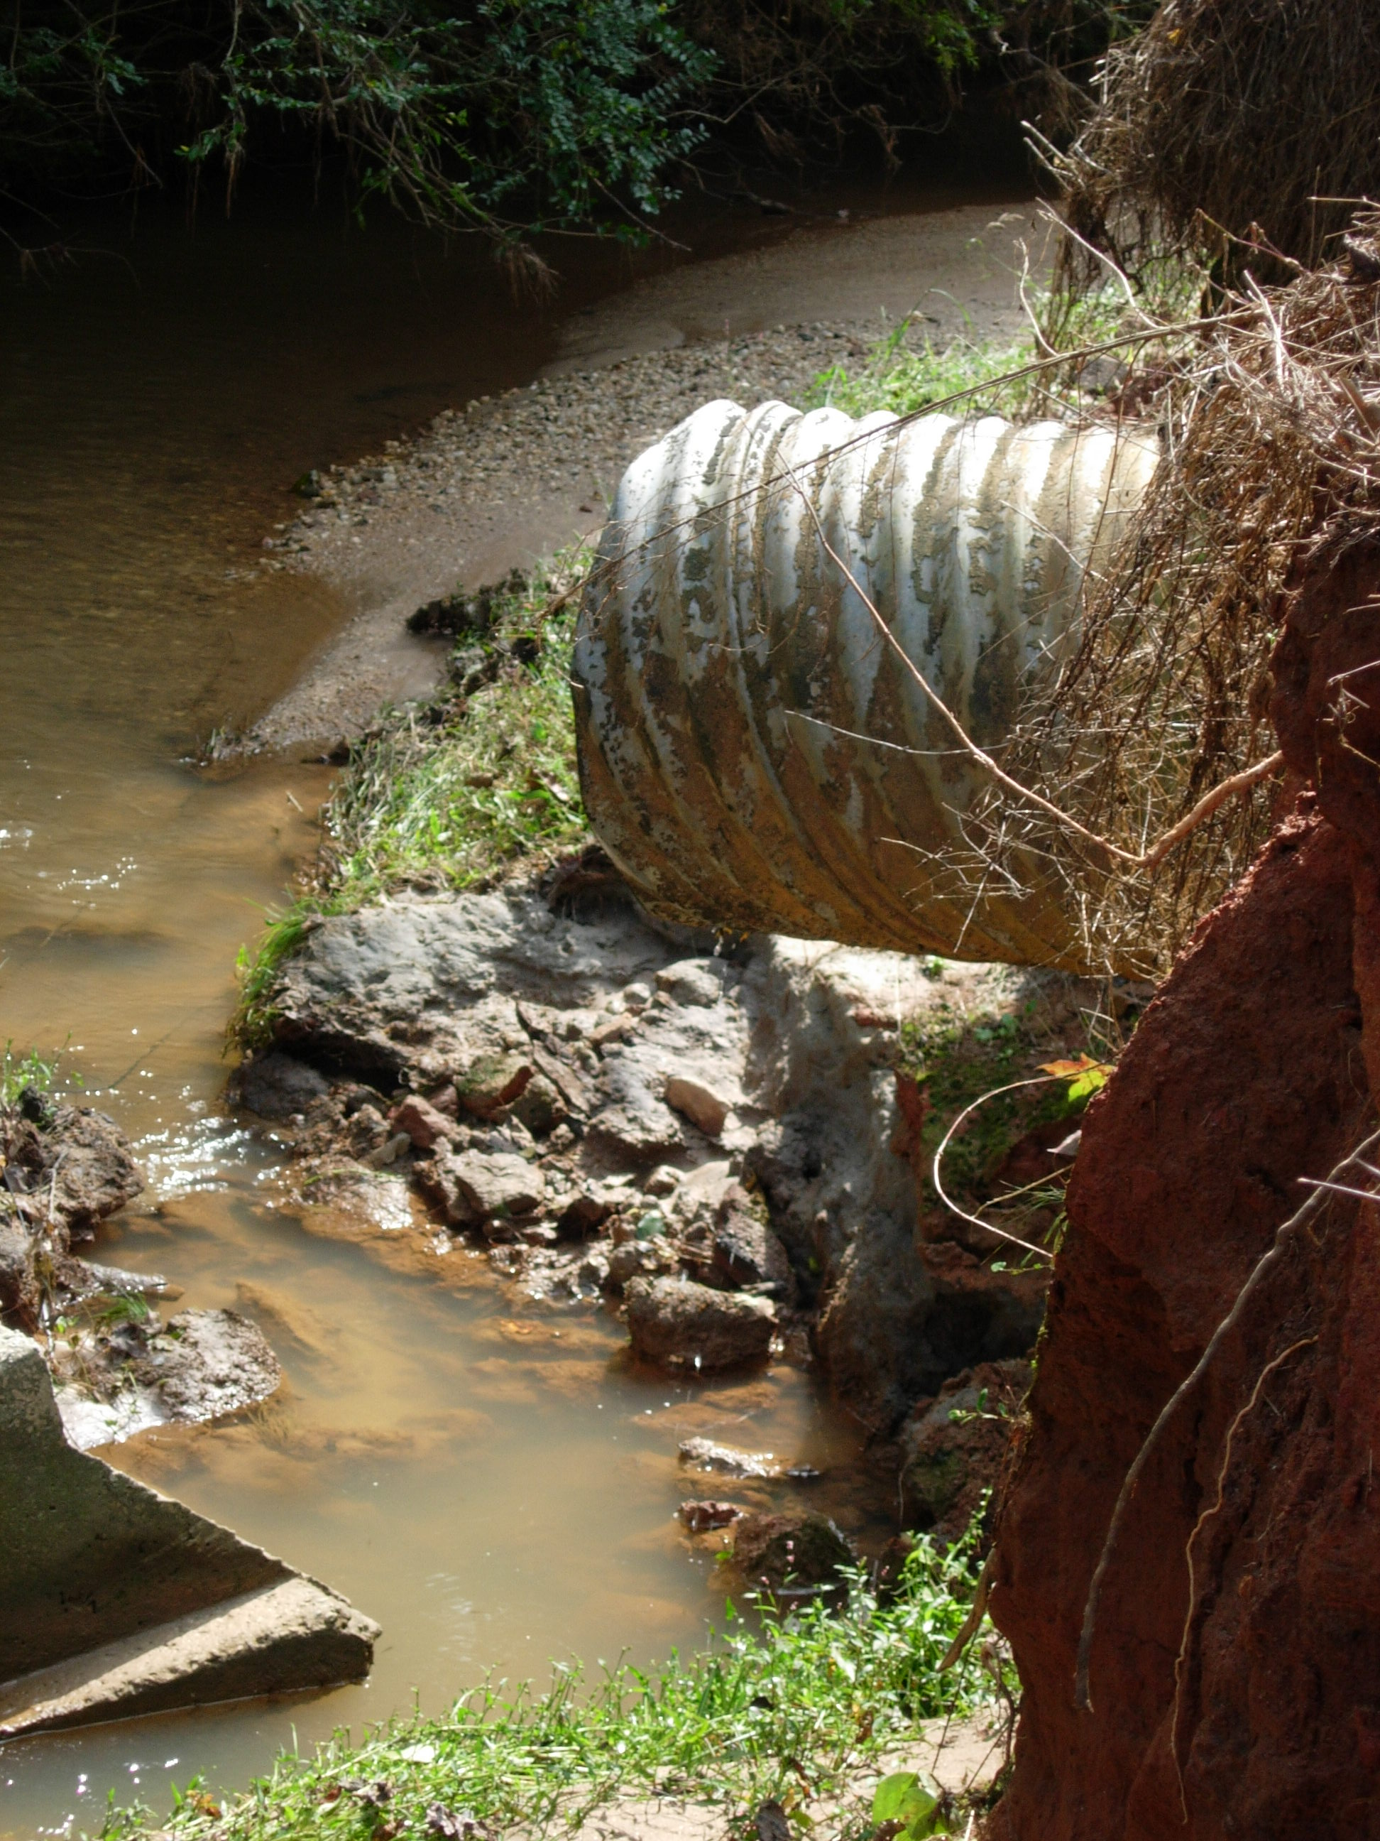
Landscapes & Water

Slide 25
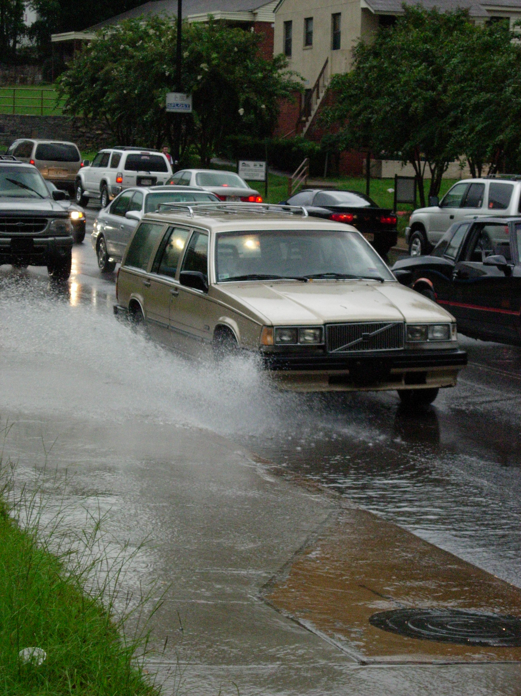
Flooding

Slide 26
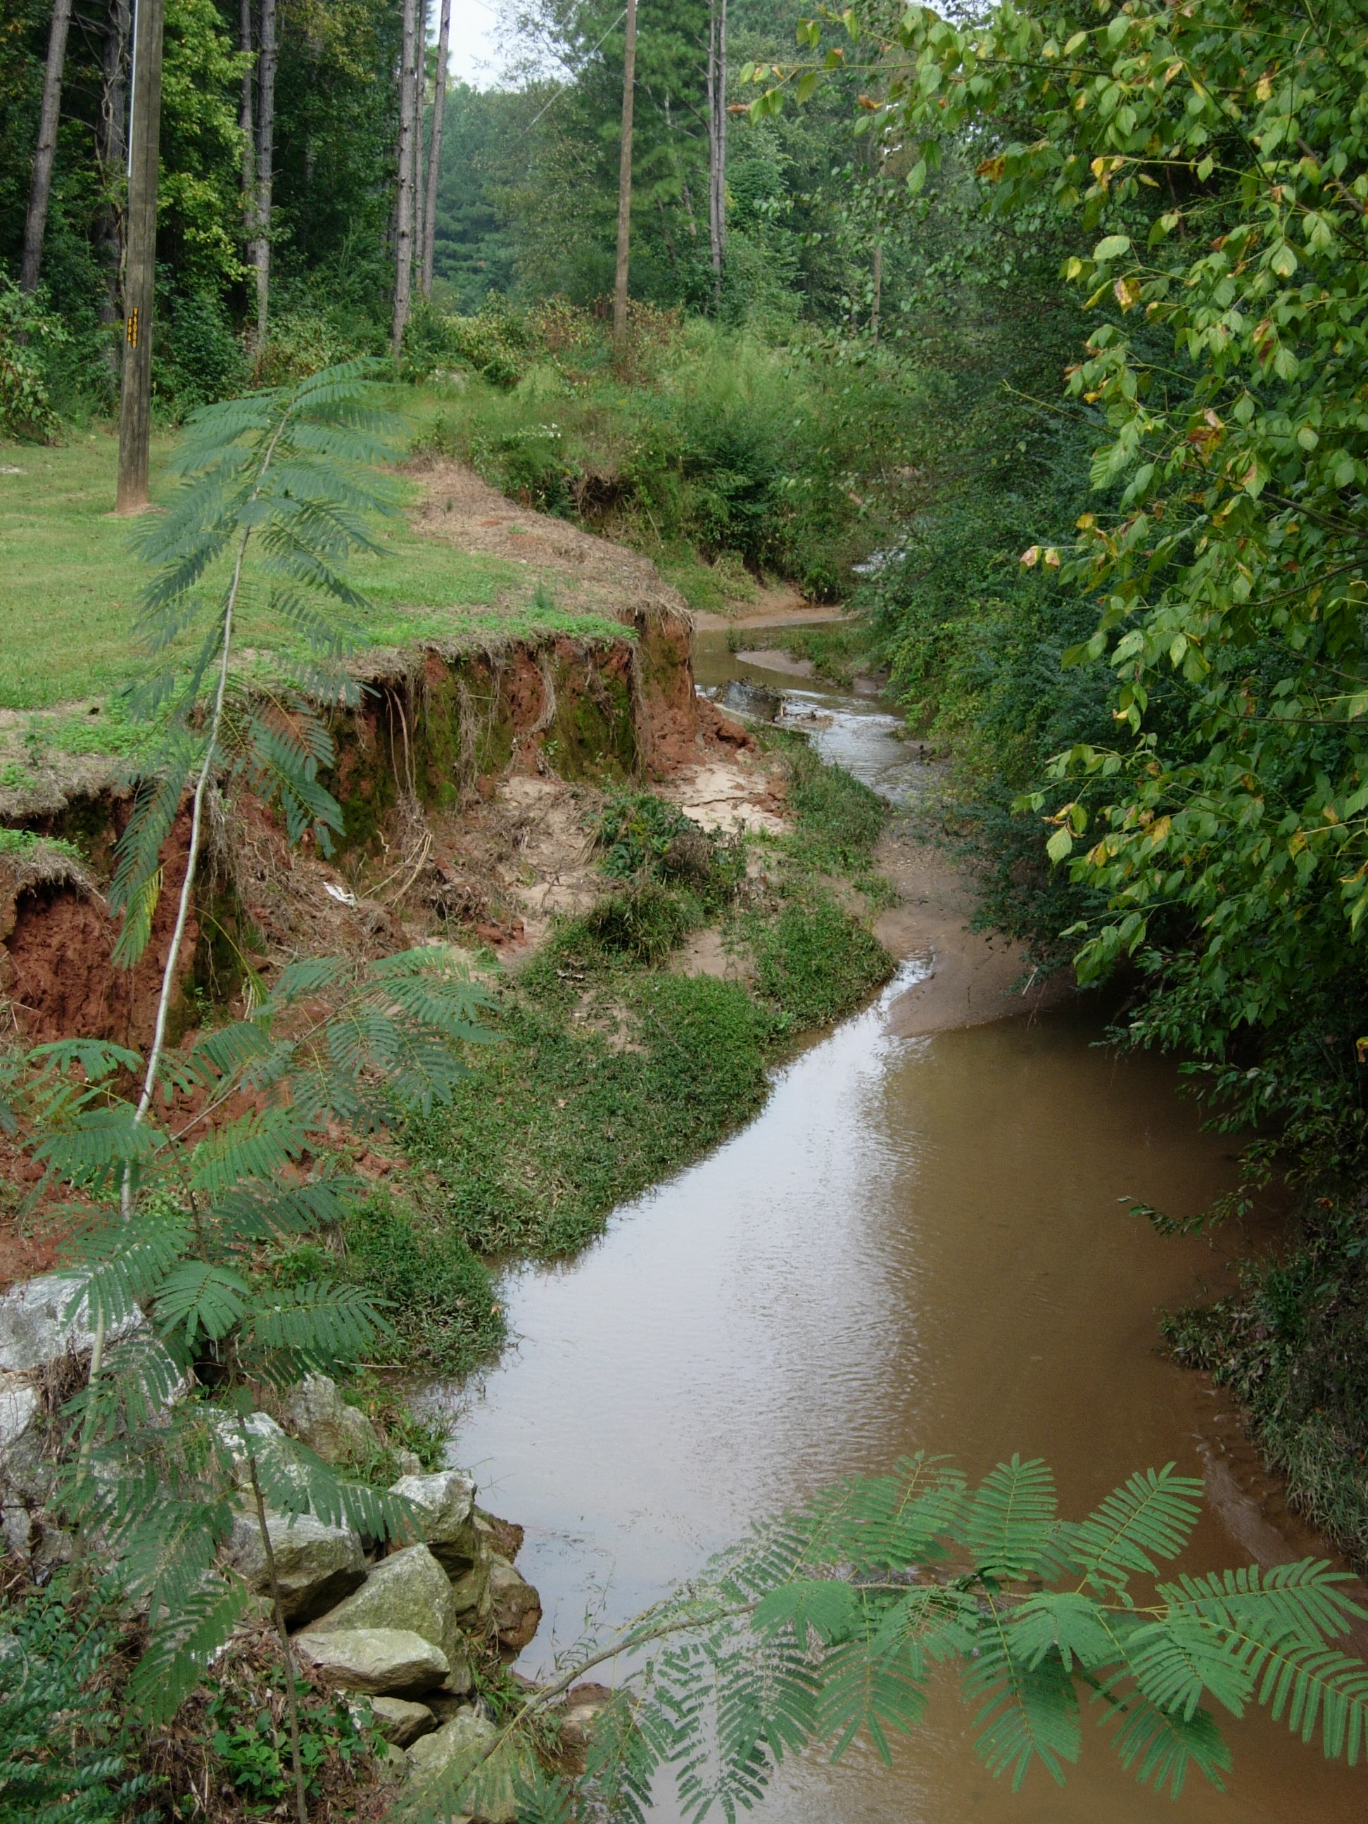
In Stream Erosion

Slide 27
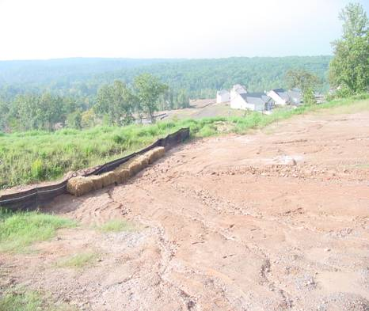

Slide 28
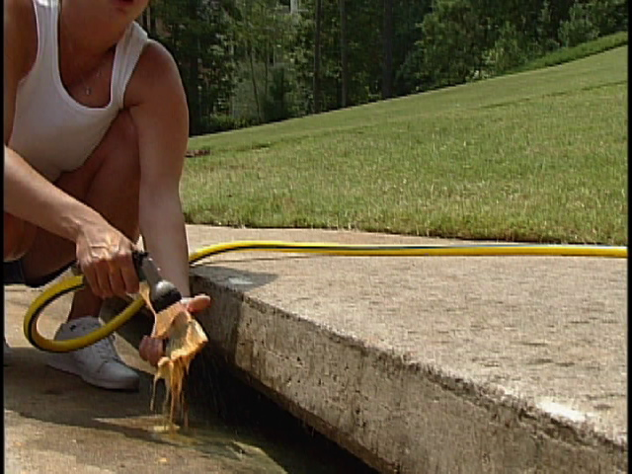
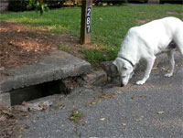
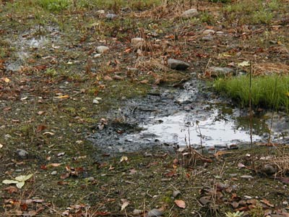
Other Sources of Pollution at
Landscape Level

Slide 29
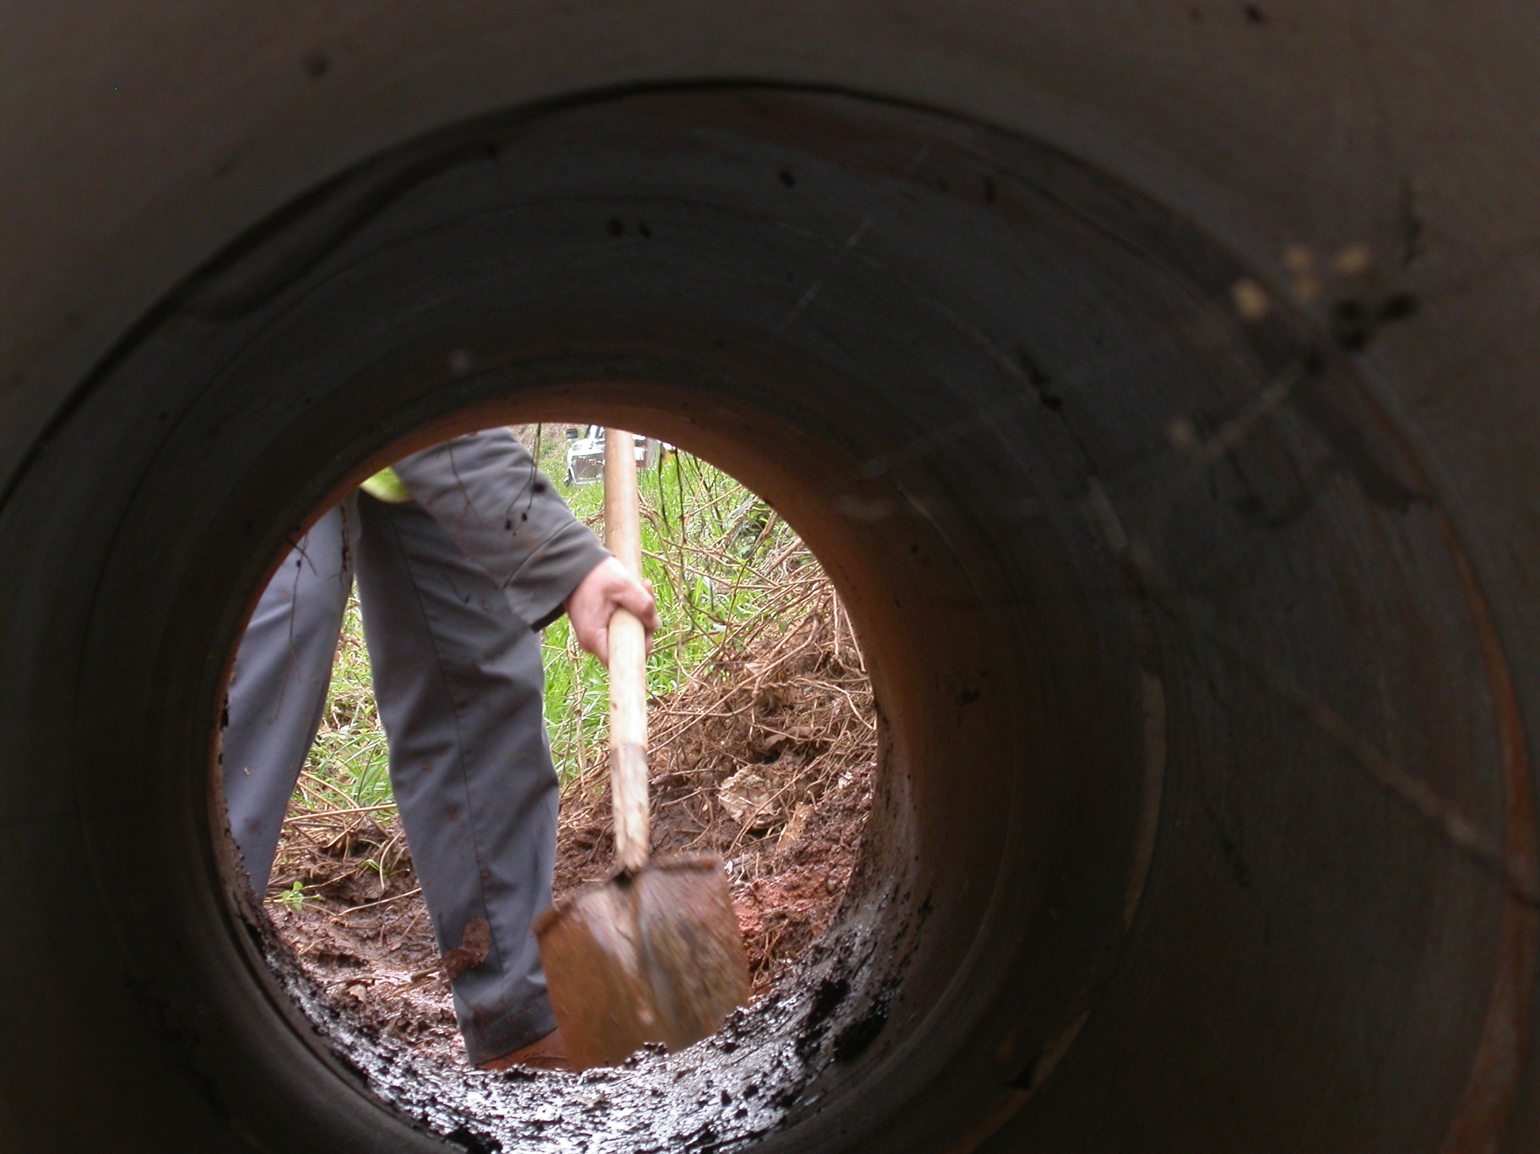
Maintenance
Costs

Slide 30
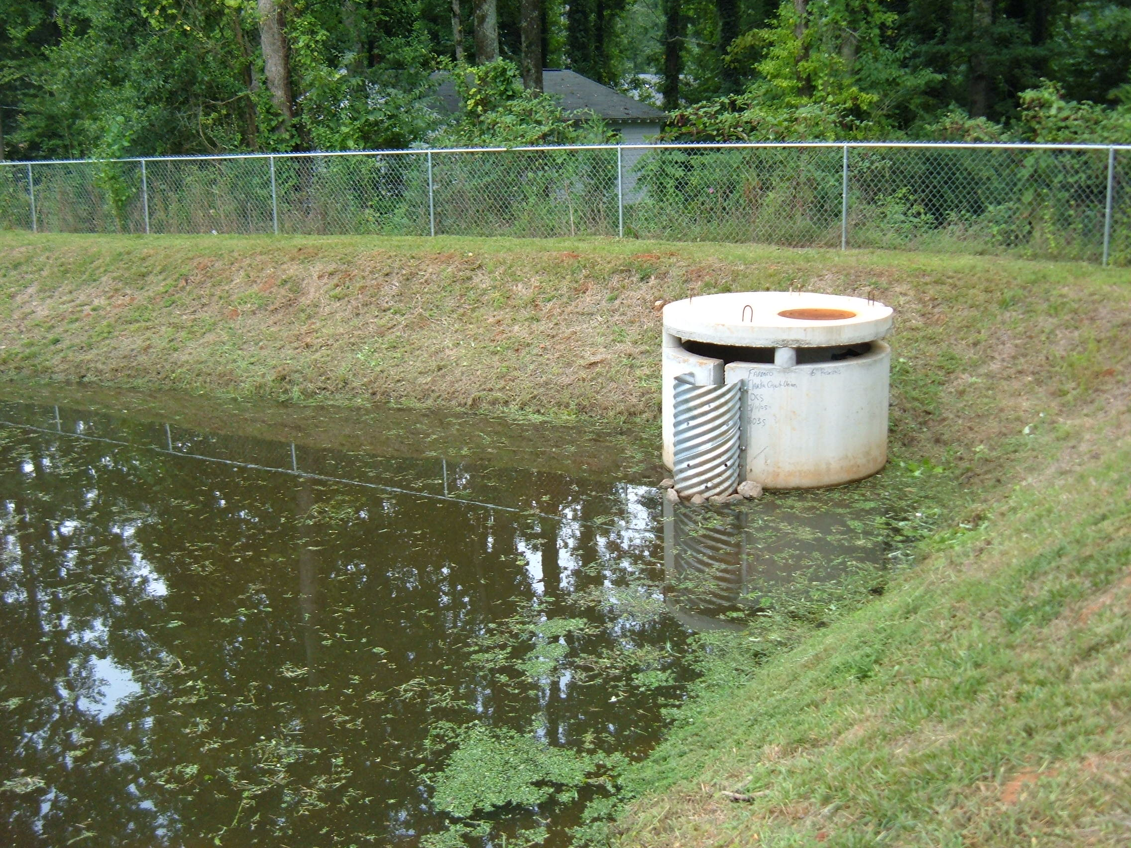
Detention Ponds

Slide 31
