Slide 1
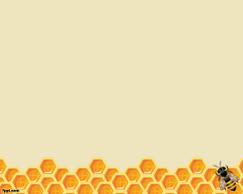
HONEY BEE
GARDENING
Annuals Used
To Attract &
Feed Honey Bees

Slide 2
Honey Bee Gardening
Created by David Linvill

Slide 3
The plants selected in this power point have been selected by various individuals as being honeybee desirable. This list is in no way complete and some plants shown may not grow in your location. Some of plants shown are perennial or biennial but are grown as annuals. Some of the comments on companion plants or medicinal usage are subjective.

Slide 4

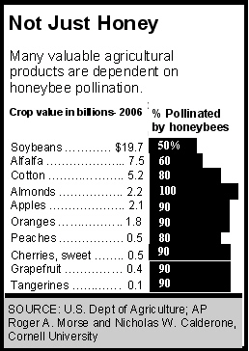
Importance of Bees
*Pollinate 80 percent of our flowering crops which constitute 1/3 of everything we eat
*One Cornell University study estimated that honeybees annually pollinate
$14 billion worth of seeds and crops in the U.S.

Slide 5
1 Hive has Approximately
1 Queen
250 drones
20,000 female foragers
40,000 female house-bees
5,000 to 7,000 eggs
7,000 to 11,000 larvae being fed
16,000 to 24,000 larvae developing into adults in sealed cells

Slide 6
Interesting Bee Facts
*Honeybee can visit between 50-1000 flowers in one trip,
which takes between 30 minutes to four hours
*Without pollen, the young nurse bees cannot produce bee
milk or royal jelly to feed the queen and colony. If no pollen
is available to the colony, egg laying by the queen will stop

Slide 7
Honeybee pollinated flowers have
*Nectar tubes no more than two centimeters
long
*have nectar guides (patterns to direct the bee
towards the nectar)
and often a landing place for bees
*Honey Bees attracted to white, blue, and
yellow flowers

Slide 8
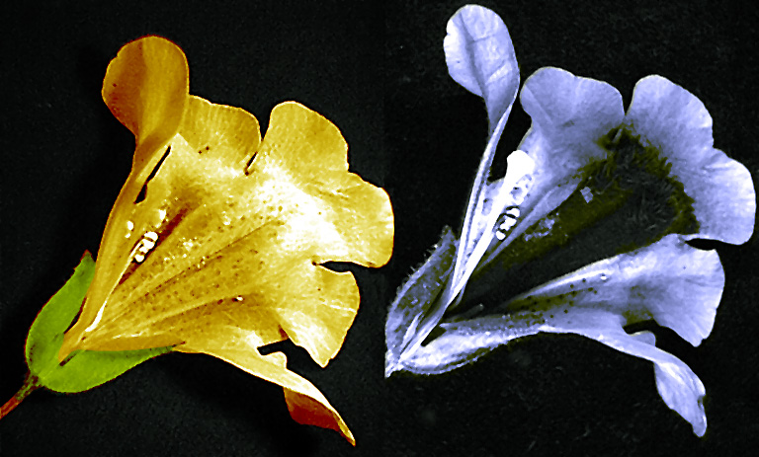
Nectar Guides
Images of a Mimulus flower in visible light (left) and ultraviolet light (right) showing a dark nectar guide, visible to bees but not to humans

Slide 9
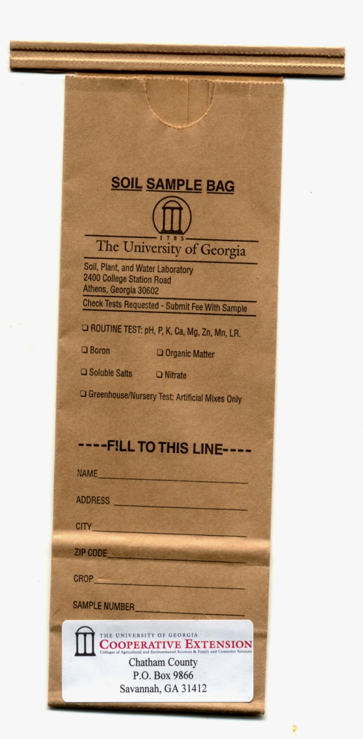
Soil testing is MANDATORY to having any type of successful garden. Contact your local County Agent and ask how to take a soil test

Slide 10
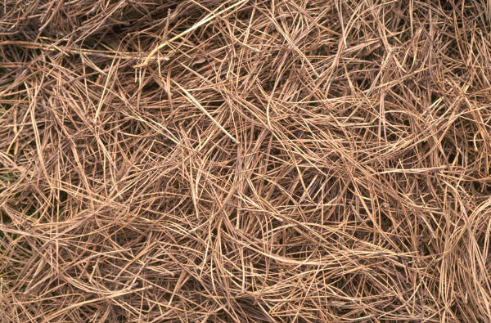
Mulches
Apply a mulch approximately 3 inches thick around the flowers. This helps keep weeds out and water in. It also helps reduces soil erosion and helps keep the nutrients in the soil. Almost any organic mulch will work.

Slide 11
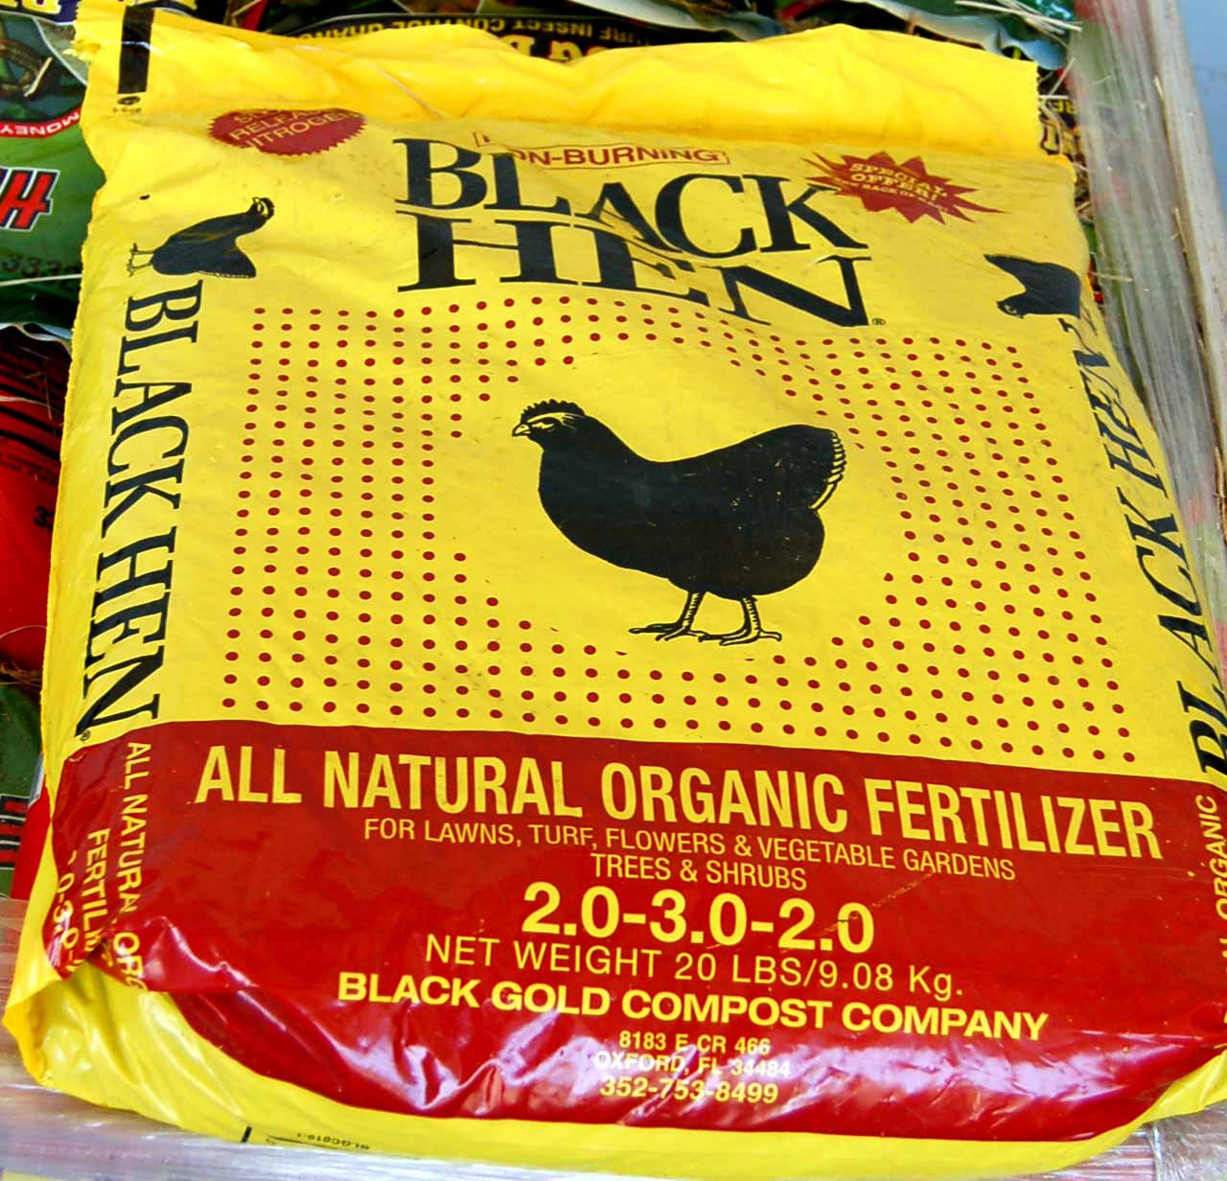
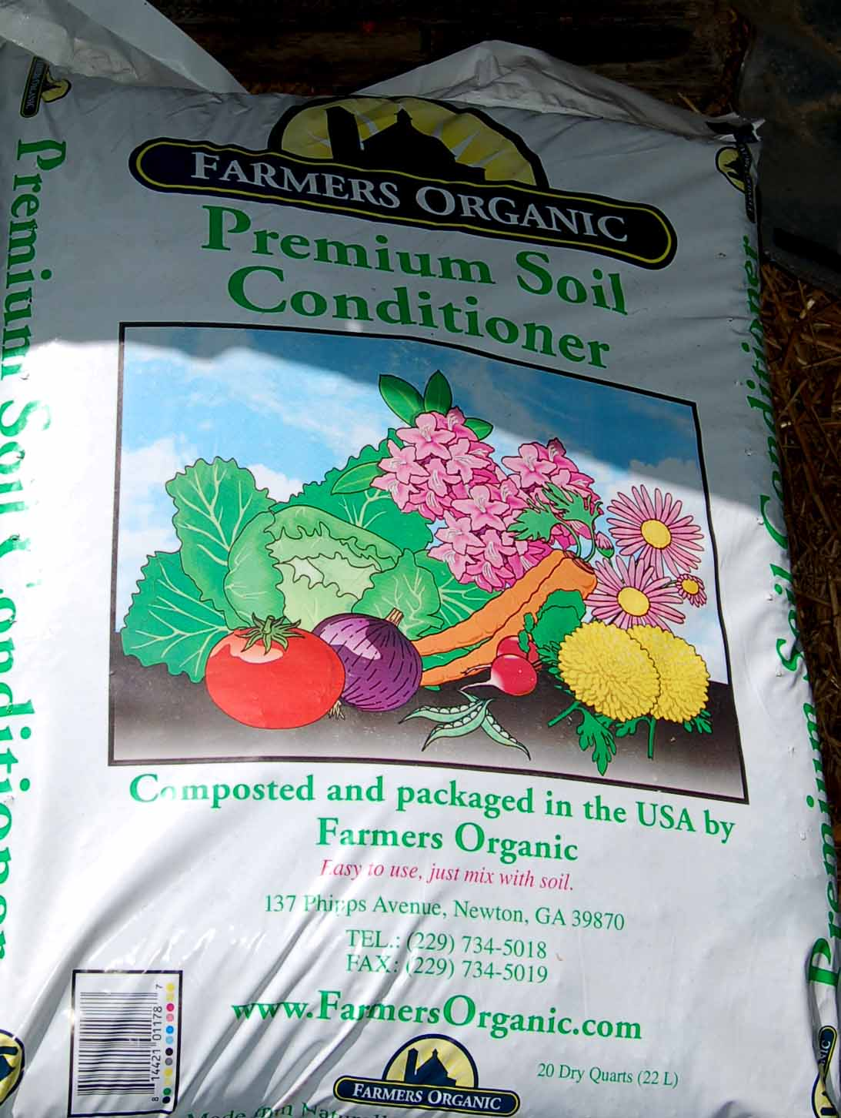
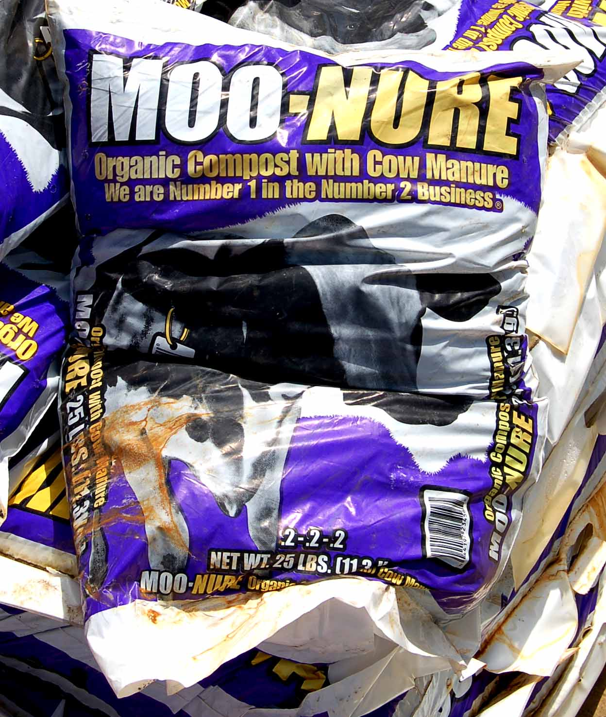
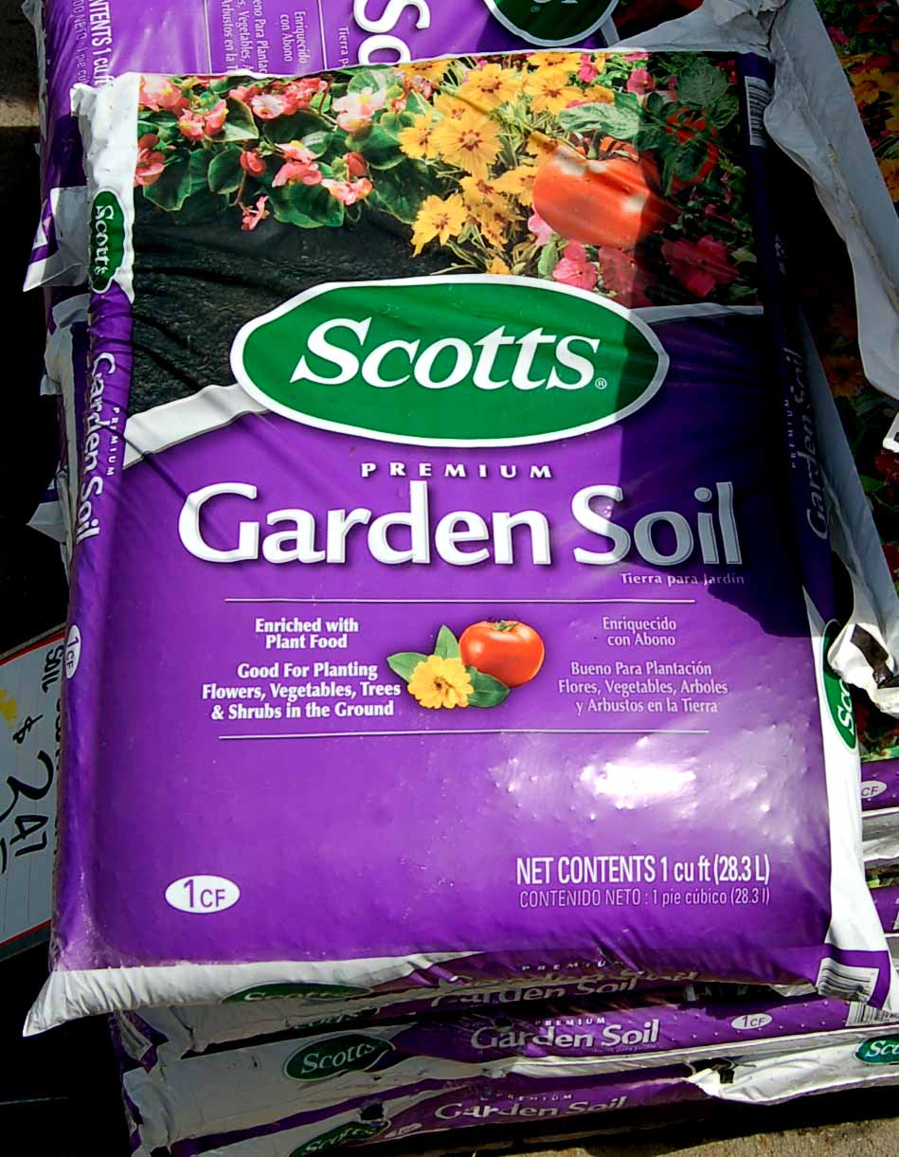
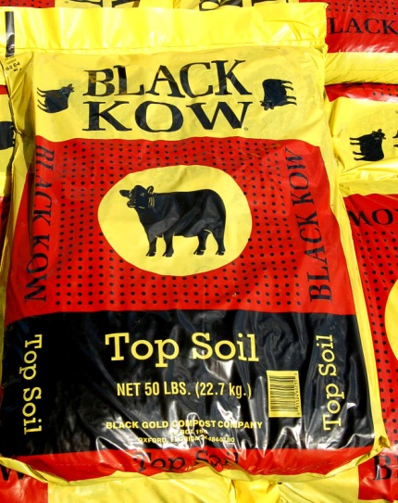

Soil Amendments
Notes:
Almost any organic mulch or soil amendments will help the flowers grow faster and are beneficial for good soil structure.

Slide 12
Incorporate a MINIUM of 3 inches of compost/amendments into the top 12 inches of the soil. One cubic yard of soil amendment will put a 3 inch layer on 100 ft² of garden
One cubic yard = 27 ft³
You will need
9 three cubic ft. bags
or
13 two cubic ft. bags
or
27 1cubic ft. bags
for a 100 ft² garden
(10ft X 10ft)

Slide 13
Keep water off plants to reduce diseases
Use trickle or drip irrigation and also save water and have less weeds
YES NO

Slide 14
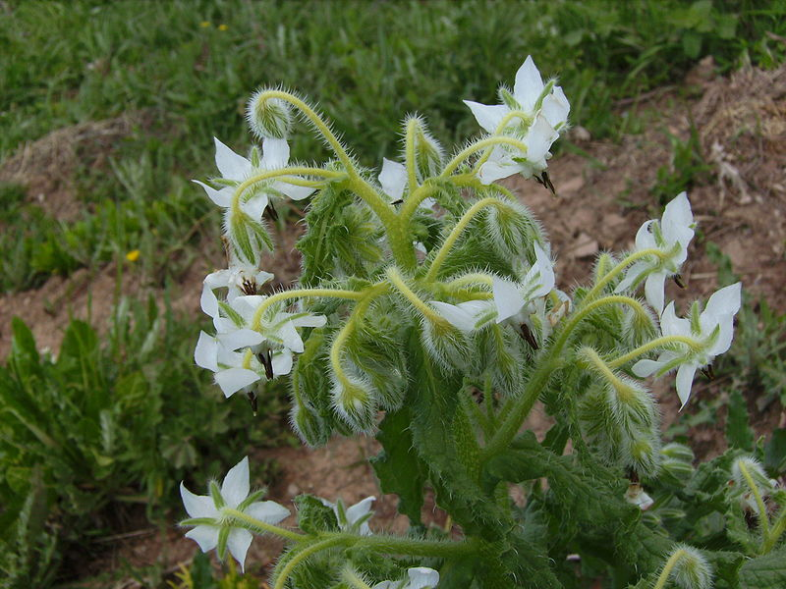
Borage
Notes:
Borage (starflower) is used in companion planting.^{[13]} It is said to protect or nurse legumes, spinach, brassicas, and even strawberries.^{[14]} It is also said to be a good companion plant to tomatoes because it confuses the search image of the mother moths of tomato hornworms
Flowers are most often blue in color, although pink flowers are sometimes observed. White flowered types are also cultivated. The blue flower is genetically dominant over the white flower.[ borage will bloom continuously for most of the year.
Borage production does include use as either a fresh vegetable or a dried herb. As a fresh vegetable, borage, with a cucumber like taste, is often used in salads or as a garnish.^{[4]} The flower, which contains the non-toxic pyrrolizidine alkaloid thesinine,^{[citation needed]} has a sweet honey-like taste and as one of the few truly blue-colored edible substances,^{[citation needed]} is often used to decorate dessert
GROWN AS ANNUAL

Slide 15
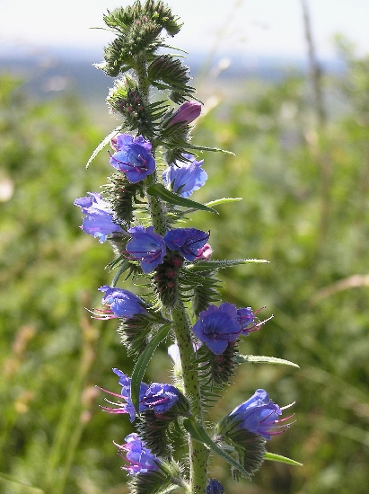
Echium
Notes:
Over 60 species used as ornamental and garden plants. Tropical plant grown as an annual. Some eaten for their tender shoots are eaten boiled or steamed.^{[3]}
Echium species are used as food plants by the larvae of some Lepidoptera species including Coleophora onosmella and Orange Swift.
Height: 6-8 ft. (1.8-2.4 m)
Sun Exposure: Full Sun
Danger: Handling plant may cause skin irritation or allergic reaction
Bloom Color: Purple
Bloom Time: Late Spring/Early Summer Mid Summer

Slide 16
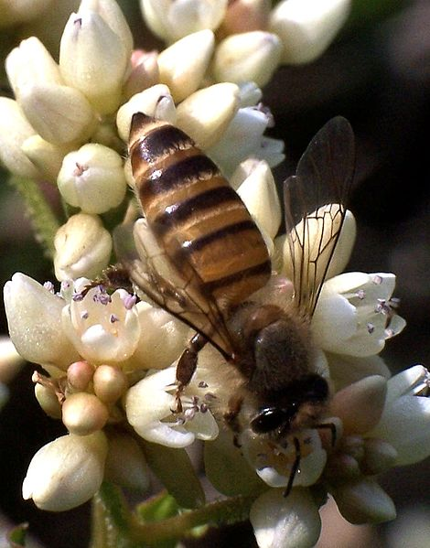
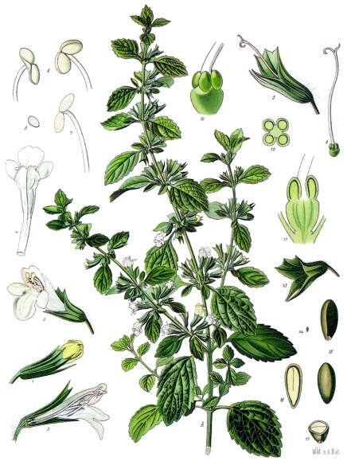
Melissa/Lemon Balm
Notes:
Melissa - comes from the Greek word μέλισσα (melissa), "honey bee",^{[1]} which in turn comes from μέλι (meli), "honey" Melissa also refers to the plant known as lemon balm is a perennial herb in the mint family. During summer, small white flowers full of nectar appear. The leaves have a gentle lemon scent. These attract bees, The crushed leaves, when rubbed on the skin, are used as a repellant for mosquitos.^{[6]}
Perennial Suitable for: light (sandy) and medium (loamy) soils and prefers well-drained soil. Suitable pH: acid, neutral and basic (alkaline) soils. It can grow in semi-shade (light woodland) or no shade. It prefers dry or moist soil and can tolerate drought. Woodland Garden Sunny Edge; Dappled Shade; Shady Edge . 1.25 feet tall

Slide 17
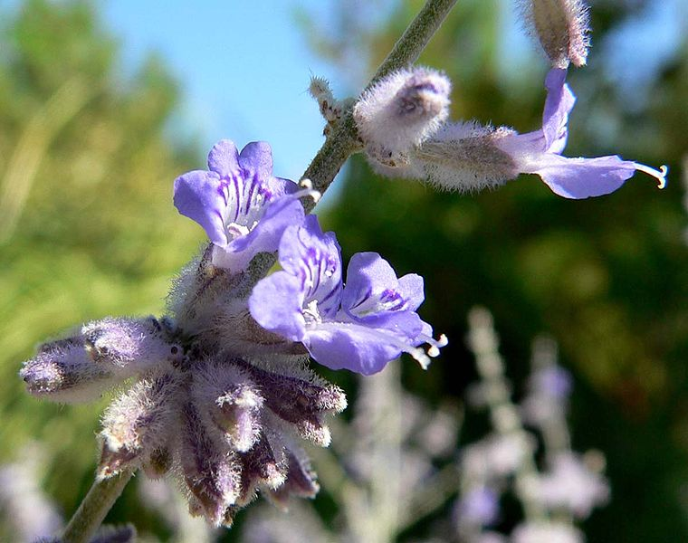
Russian Sage
Notes:
Perovskia atriplicifolia, Russian sage, is a flowering herbaceous perennial plant that is native to central Asia in an area that includes Afghanistan, Iran, Pakistan, and Tibet.^{[1]} Despite its common name, Russian sage is not in the same genus as other Salvias, which are commonly called "sage".
Russian sage grows on upright, grayish white stems that are (3.3 to 4.3 ft) tall, The stems and leaves give off a pungent odor when crushed or bruised. In late summer and autumn, Russian sage produces spires of small, tubular flowers of blue or lavender color. These spires may grow up to 30 cm long, and last up to two or three months. It is considered a sub-shrub.
In its native habitat, the flowers are eaten fresh, and the leaves are smoked like tobacco for its euphoria properties

Slide 18
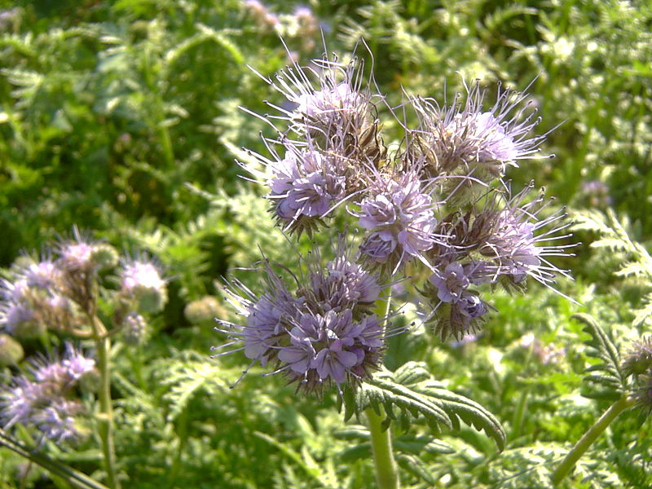
Phacelia -tanacetifolia
Notes:
Phacelia (phacelia, scorpionweed, heliotrope) is a genus of about 200 species of annual or perennial herbaceous plants, native to North and South America
Blooms late Winter/late Spring – survives hottest temperatures
Smells like Bad BO and cause severe rash in some people depending on species
Many species are cultivated as garden plants and honey plants.

Slide 19
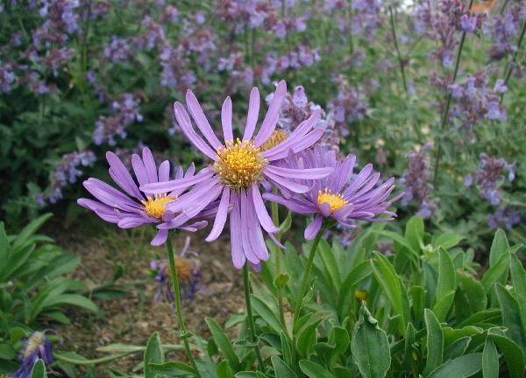
Asters
Notes:
Aster roughly 180 species within the genus, all but one being confined to Eurasia. Many species and a variety of hybrids and varieties are popular as garden plants because of their attractive and colorful flowers. Aster species are used as food plants by the larvae of a number of Lepidoptera species. Flowers Fall a wee or 2 before Mums

Slide 20
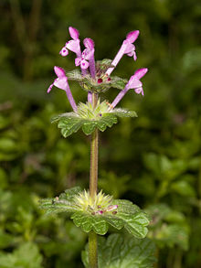
Henbit - Lamium amplexicaule
Notes:
It is a low-growing winter annual plant. The flowers are pink to purple, 1.5-2 cm long.
It flowers early spring it propagates freely by seed and is regarded as a minor weed. Where common, is an important nectar and pollen plant for bees, especially honeybees, where it helps start the spring buildup.

Slide 21
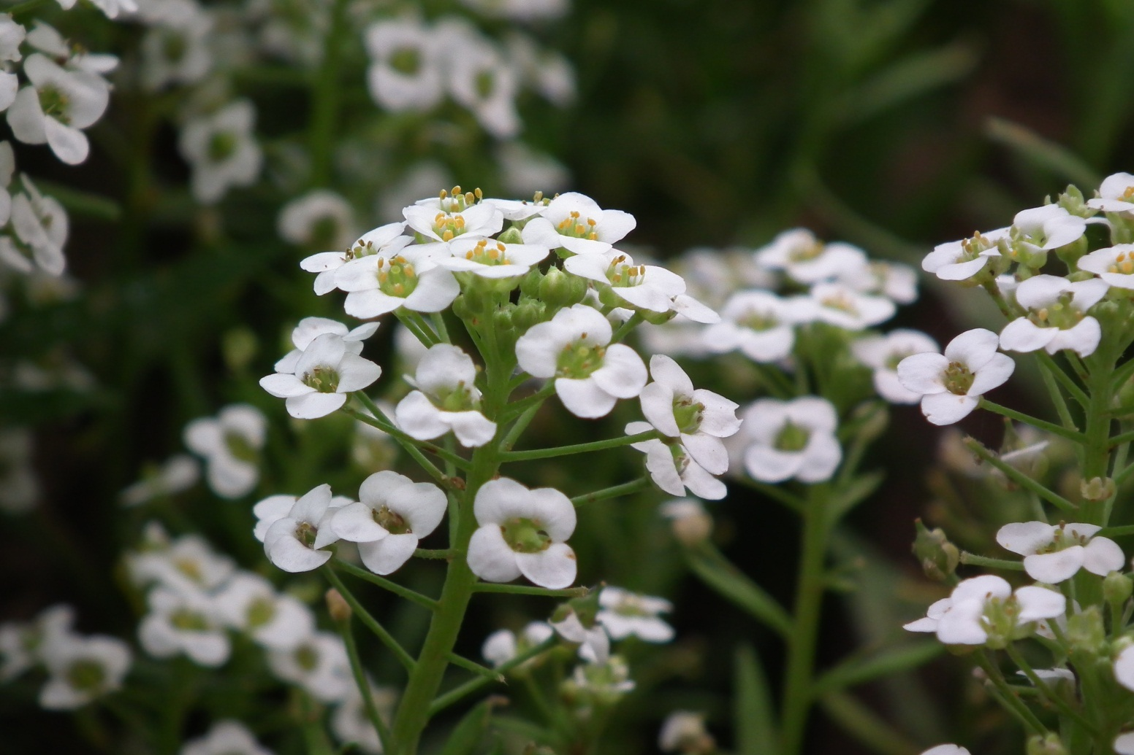
Alyssum
Notes:
Sweet alyssum flower, also known as carpet flower or Lobularia maritima, is a popular annual garden flower valued for its delicate, fragrant flowers and ease of care. Alyssum flowers appear in late spring through first frost in shades of white, pink and violet. The plant grows to a height of 12 inches and creates an attractive, spreading mass over the planting area.
Hardiness Zones: Sweet alyssum flower grows as an annual in zones 3 through 9 and will die back at the first frost. In zones 10 through 11, the plant may survive as a perennial.
Alyssum foliage is used as food by the caterpillars of certain Lepidoptera, including Orthonama obstipata (The Gem). Alyssum is a genus of about 100–170 species of flowering plants in the family Brassicaceae. garden plant of the genus Alyssum having clusters of small yellow or white flowers

Slide 22
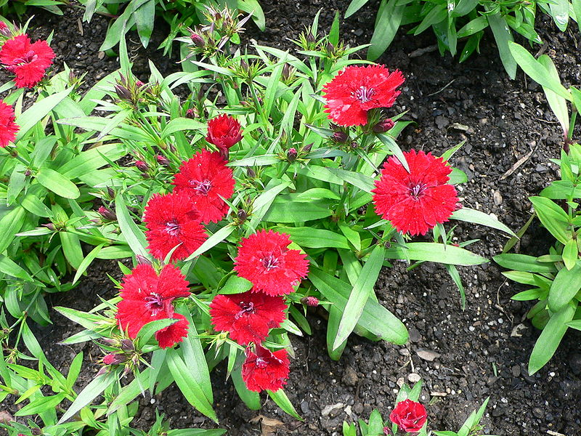
Dianthus
Notes:
The species are mostly herbaceous perennials, a few are annual or biennial, and some are low subshrubs with woody basal stems. Dianthus is a genus of about 300 Common names include carnation,pink, sweet william
Most dianthus have pink, red, or white flowers with notched petals. Sweet Williams are biennial or short-lived perennials covered with bicolor flowers in late spring. Pinks are low-growing dianthus suitable for rock gardens. Carnations are taller and good for bouquets but tend to be less hardy than other dianthus.
Special Features - Multiplies readily, Fragrant, Good for cut flowers, Deer resistant
Select a site with full sun and well-drained soil, preferably with neutral to alkaline soil pH. Dianthus won't tolerate wet soils, especially in winter.

Slide 23
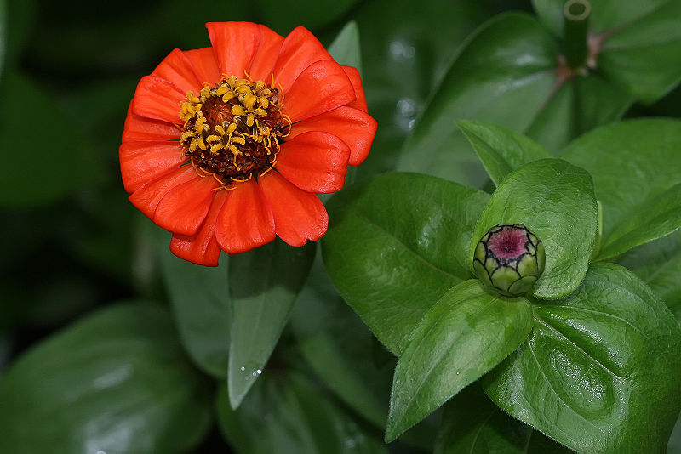
Zinnia
Notes:
Annual & Perennial – full sun, will reseed, 100 cultivars - Red, Pink, Orange, Yellow, Purple, White, Multicolor, Needs to be deadheaded, Blooms in Summer
Companion plants - Their ability to attract hummingbirds is also seen as useful as a defense against whiteflies ?????
Zinnia elegans, also known as Zinnia violacea, is the most familiar species, originally from Mexico and thus a warm–hot climate plant. Its leaves are lance-shaped and sandpapery in texture, and height ranges from 15 cm to 1 meter.
Zinnia angustifolia is another Mexican species. It has a low bushy plant habit, linear foliage, and more delicate flowers than Z. elegans – usually single, and in shades of yellow, orange or white. It is also more resistant to powdery mildew than Z. elegans, and hybrids between the two species have been raised which impart this resistance on plants intermediate in appearance between the two. The Profusion series, with both single and double-flowered components, is bred by Sakata of Japan, and is among the most well-known of this hybrid group.

Slide 24
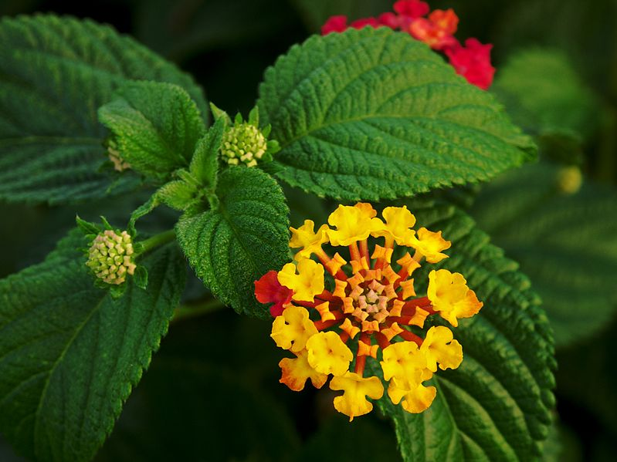
Lantana
Notes:
Lantana is commonly grown as a sun loving flowering annual in South Carolina. A few cultivars are reliably perennial throughout much of the state. More are perennial near the coast. All are tough, resilient plants that thrive in hot weather and bloom profusely from spring until frost.
Lantana's aromatic flower clusters (called umbels) are a mix of red, orange, yellow, or blue and white florets. Other colors exist as new varieties are being selected. Lantana is a genus of about 150 species of perennial flowering plants in the verbena family, Lantana berries are edible when ripe^{[6]} though like many fruit are mildly poisonous if eaten while still green. Extracts of Lantana camara may be used for protection of cabbage against the aphid Lipaphis erysimi.

Slide 25
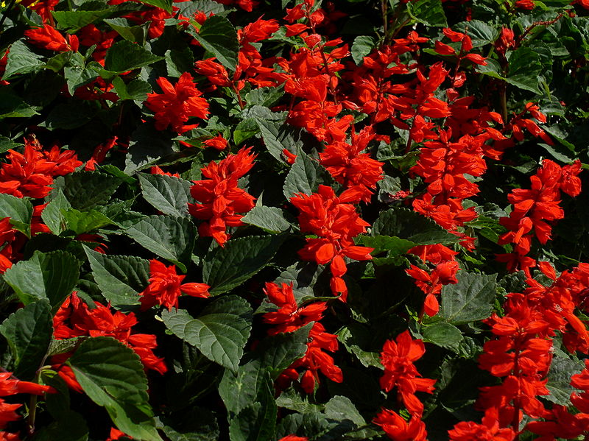
Salvia (Scarlet Sage Shown)
Notes:
Salvia is the largest genus of plants in the mint family, Lamiaceae, with approximately 700–900 species of shrubs, herbaceous perennials, and annuals.^{[2][3]} It is one of several genera commonly referred to as sage.
Salvias (Sages) are very easy to grow, are very durable, and are relatively carefree. All have high tolerances for dry conditions. When you do water, water the soil, keeping moisture off the leaves. Sages bloom in late spring to early summer, with intermittent flowering through the whole summer, if irrigation is available. All but Salvia sonomensis and Salvia spathacea prefer full sun exposures. These two make fantastic drought tolerant groundcovers especially for under native oaks, that should be kept on the dry side through the summer. All the other sage species take blasting heat and sun, though they certainly can tolerate a little shade during the day. Sages can be used as culinary food flavorings or enhancers. And the more fragrant Salvias are useful as bee/honey plants.

Slide 26
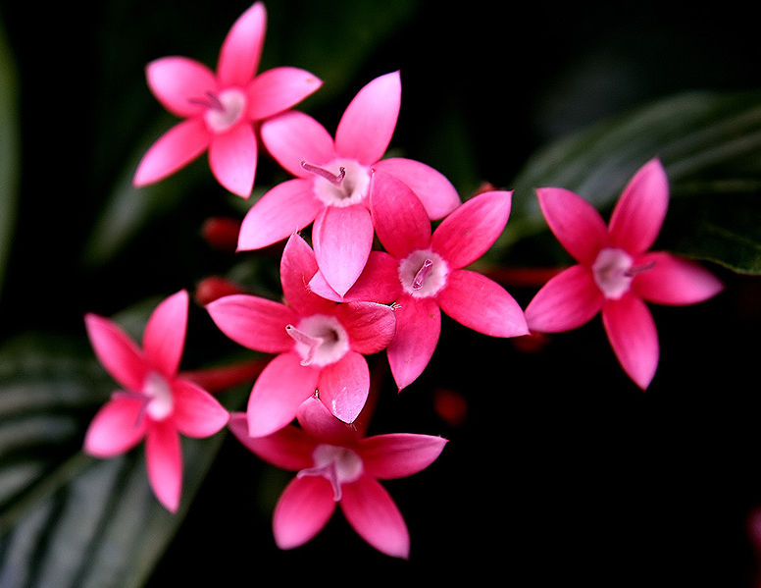
Pentas
Notes:
Pentas is a genus of the Rubiaceae family of flowering plants. Pentas lanceolata is a particularly popular species. Flowers may be red, white, lavender, purple, or shades of pink. Some are two-toned.
Where winters are not too severe, pentas are perennial. They may always be treated as an annual and replanted after danger of frost for long-lasting summer color.
Culture
Likes well worked, moderately fertile soil that retains moisture well.
Light: Sun to shade. Blooms better and is more robust in good sun, but will still bloom in shade and look good!
The flowers are held in terminal clusters and self-deadhead. In warm weather the plant grows fast and stays in bloom constantly.
Red pentas and blue Salvia guaranitica are a good combination and can guarantee visits by hummingbirds, which seem to be drawn magnetically to these flowers!

Slide 27
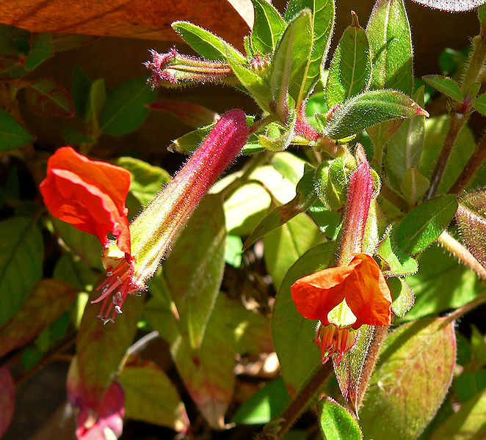
Cuphea
Notes:
Cuphea is a genus containing about 260 species of annual and perennial flowering plants native to warm temperate to tropical regions of the Americas. The species range from low-growing herbaceous plants to semi-woody shrubs up to 2 m (6 ft 7 in) tall. Commonly they are known as cupheas, or, in the case of some species, as cigar plants.
Flower: red, purple, black, reminiscent of a tiny purple bat's face with red ears; blooms spring through fall
Size: 18 - 24 inches tall and wide
Hardiness: USDA Zone 8; treat as annual in lower zones
Culture: Grow in full sun or filtered sun in containers or in the ground. Drought tolerant but best with regular watering.
Comments: Several cultivars are available, such as ‘Tiny Mice', ‘Torpedo', and ‘Totally Tempted' (thumbnail picture). The Flamenco® series (hybrids of Cuphea llavea and the C. procumbens) includes ‘Flamenco Cha Cha' (flowers uniform fuchsia-purple), ‘Flamenco Rumba' (bright, lighter red flowers with purple faces), ‘Flamenco Samba' (burgundy flowers with a deep purple-colored face), and ‘Flamenco Tango' (hot pink or vivid red flowers with lavender faces). Floraplant, S.A. de C.V. of Mexico offers the Vienco® series that features open, showier flowers. Cultivars include ‘Vienco Burgundy', ‘Vienco Lavender', Vienco Purple Pink', ‘Vienco Purple Red', ‘Vienco Red', ‘Vienco Salmon Purple', and ‘Vienco White'.

Slide 28
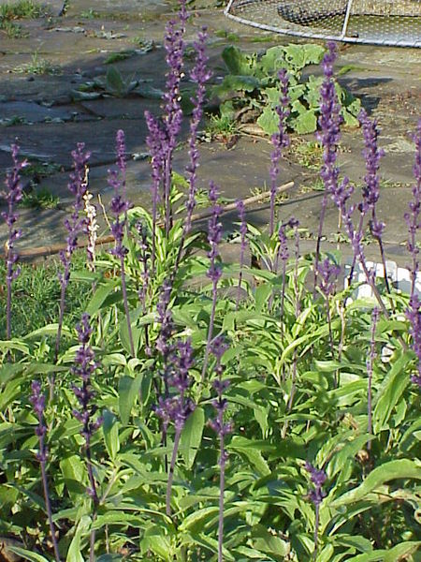
Sage - (Mealycup shown)
Notes:
SAGE – Common name for Salvia is the largest genus of plants in the mint family, 700–900
Salvia farinacea grows from one to four feet tall with blue flowers on many spikes. A perennial, it usually is grown as an annual. Leaves are light green with silvery undersides. Sepals have a mealy white or purple look to them and they are covered with a felt-like hair. Flowers are two lipped and five lobed with a nice sage aroma. Leaves are in clusters and narrow. Bloom season is between April and October.
Growing Guide
This plant prefers to grow in afternoon shade conditions but can stand full sun if planted early in the season. Soil should be lean to average, well drained, with watering during the dry patches of the season. Propagate by seed or by division. Seed will need light to germinate and may require a period of cold-moist stratification prior to sowing. It is hardy in USDA hardiness zones of 8 through 10.
Special Features:
Attracts birds, Deer resistant, Fragrant foliage, North American native, Rabbit resistant

Slide 29
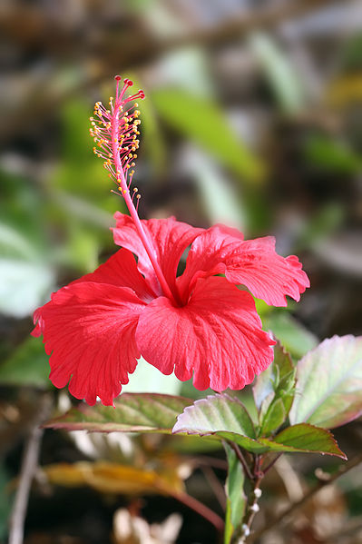
Hibiscus
Notes:
Hibiscus is a genus of flowering plants in the mallow family, Malvaceae. It is quite large, containing several hundred species that are native to warm-temperate, subtropical and tropical regions throughout the world. Member species are often noted for their showy flowers and are commonly known simply as hibiscus, or less widely known as rosemallow. The genus includes both annual and perennial herbaceous plants, as well as woody shrubs and small trees.

Slide 30
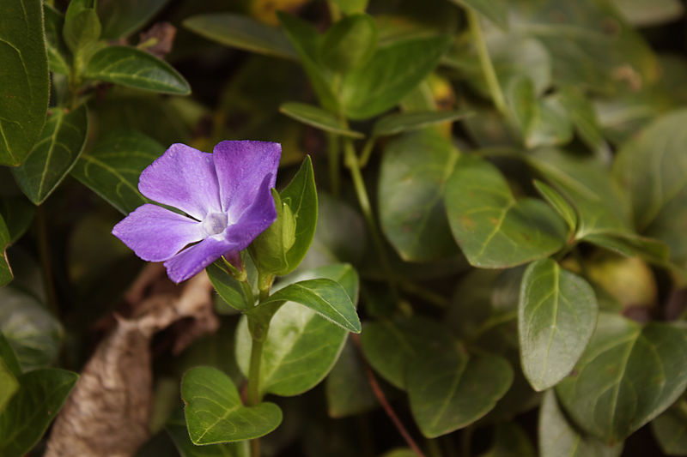
Vinca
Notes:
Vinca is a genus of six species in the family ApocynaceaeTwo of the species, Vinca major and Vinca minor, are extensively cultivated as a flowering evergreen ornamental plant. Because the plants are low and spread quickly, they are often used as a groundcover in garden landscapes and container gardens. Many cultivars are available, with different plant, leaf, and flower - colors, sizes, and habits.
Vinca or Periwinkle is a prolific heat and drought tolerant annual, perfect for hot, dry areas. It's easy to grow, and requires little or no attention. A grower once reported that he has grown Vinca in the same location for 30 years. It successfully reseeded itself each year, with no effort on his part. Flowers bloom all summer, and up to frost. Common colors include white, rose, pink, and red.

Slide 31
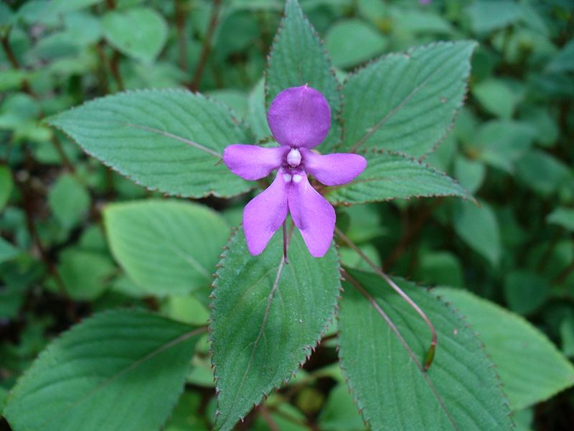
Impatiens
Notes:
Impatiens is a genus of about 850–1,000 species of flowering plants
Like morning sun and afternoon shade
Common names include impatiens, jewelweeds, touch-me-nots, and, for I. walleriana) in Great Britain, "Busy Lizzie", Some species are annual plants and produce flowers from early summer until the first frost, while perennial species, found in milder climates, can flower all year.
The widely grown cultivars of impatiens flowers are typically short plants, attaining a height of not more than 1 foot. Some, such as the 'Super Elfin' series, stay much shorter (thus their popularity -- and their name). Impatiens flowers come in a variety of colors, including white, red, pink, violet, coral and purple. Even a yellow cultivar has recently been developed.

Slide 32
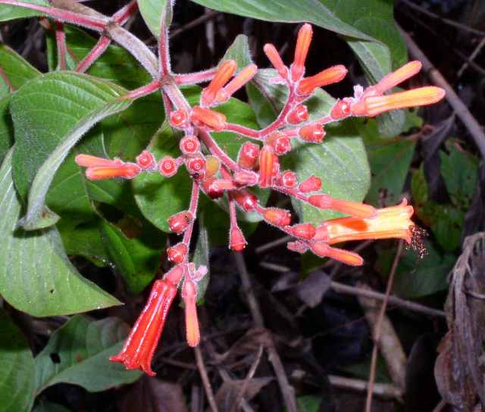
Texas Firebush
Notes:
Firebush - Hamelia patens Long blooming, easy care tropical bedding plant with showy red-orange, tubular flowers. Great hummingbird attractant. Tremendous heat tolerance coupled with good pest resistance.
Exposure: Full sun
Size: Height 3 feet tall, 3 feet wide
Bloom Time: Summer till frost.
Notes:Root-hardy perennial in south Texas.
Will grow in almost any soil, even highly alkaline, heavy clays, as long as they are well drained
Has a very long blooming period (nonstop from June to November)
Is adaptable enough to tolerate partial shade even though it really "struts-its-stuff" in full, hot sun Although a woody perennial in its native habitat, firebush is best utilized as an annual (mature height: 18-30 inches) from central Texas northward.

Slide 33
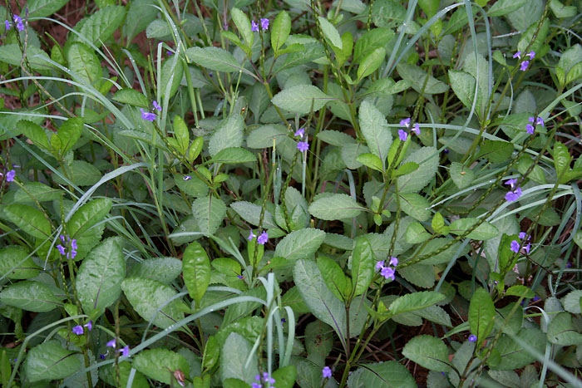
Porterweed
Notes:
Blue Porterweed (Stachytarpheta jamaicensis)
Other common names for this plant include Blue Snakeweed, Jamaica vervain, Brazilian Tea, Devil's Coachwhip. Blue porterweed is a low growing perennial which blooms year round. Often used as a ground cover, While considered as a short lived perennial, blue porterweed is will self seed or can be propagated by stem cuttings. Although the flowers on blue porterweed are small and each flower only opens for one day, it attracts a large number of butterflies.
Stachytarpheta urticifolia, is often confused (and labeled) as blue porterweed. While both plants will attract butterflies, the non-native blue porterweed can spread more rapidly and there is the chance that it will become aggressive.

Slide 34
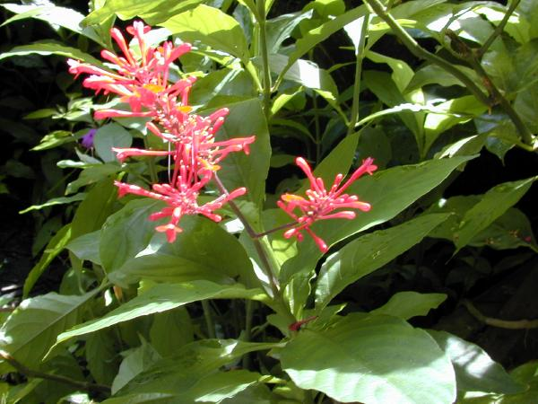
Firespike
Notes:
Firespike (Odontonema strictum) is a shade loving, tender perennial with deep green, glossy leaves. It will be grown for its beautiful foliage in the spring and summer. This beautiful foliage provides a startling contrast to its fire-red late season blooms. Its brilliant spikes of deep red flowers in late summer and fall are cherished by hummingbirds and butterflies. Firespike can be grown as a tropical container plant, an annual which grows about 2 feet the first season, or, if it survives the winter as a protected perennial growing more than 4 feet tall

Slide 35
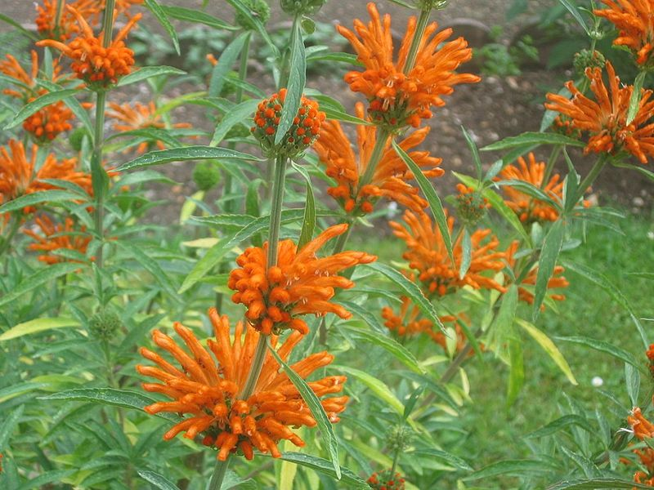
Lion’s Ear
Notes:
Leonotis leonurus, also known as Lion's Tail and Wild Dagga, is a plant species in the Lamiaceae (mint) family. The plant is a broadleaf evergreen It is known for its medicinal and mild psychoactive properties. Suitable as Annual
Leonotis leonurus is cultivated as an ornamental plant for its copious orange blossom spikes and accent or screening qualities for use in gardens and parks. It is a moderate drought tolerant plant, and a nectar source for birds and butterflies in landscape settings.
Sun Exposure:
Full Sun
Danger:
Plant has spines or sharp edges; use extreme caution when handling
Bloom Color:
Scarlet (Dark Red)
Red-Orange
Bloom Time:
Late Summer/Early Fall
Foliage:
Aromatic
Other details:
This plant is attractive to bees, butterflies and/or birds
Drought-tolerant; suitable for xeriscaping

Slide 36
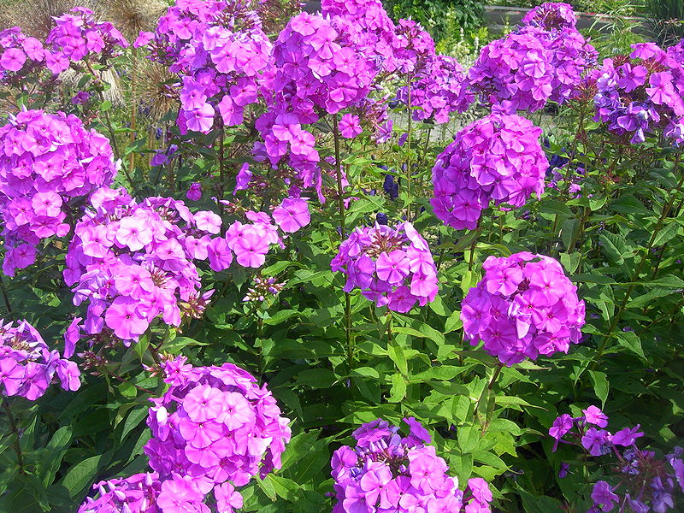
Summer Phlox
Notes:
Phlox is a genus of 67 species of perennial and annual plants in the family Polemoniaceae. Some flower in spring, others in summer and fall. Flowers may be pale blue, violet, pink, bright red, or white. Many are fragrant.
The foliage of Phlox is a food for the larvae of some Lepidoptera species including Dot Moth, Gazoryctra wielgusi, Hummingbird Hawk-moth and Schinia indiana (which feeds exclusively on P. pilosa). Phlox species are also a popular food source for groundhogs, rabbits and deer.
Phlox paniculata. This phlox likes fertile, organic-rich beds with good drainage. I have seen phlox perform well in full sun, but I think a little shade in midafternoon makes a happier plant. Be sure to apply a good layer of mulch after planting.

Slide 37
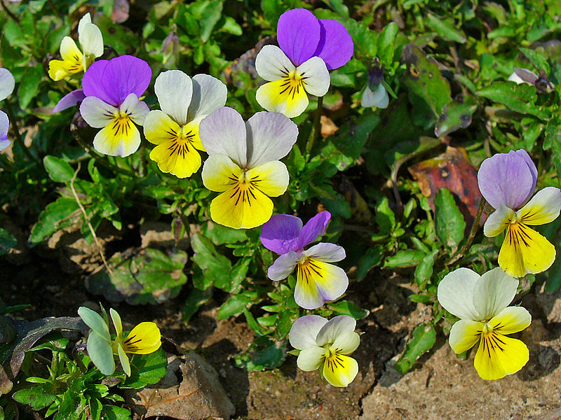
Pansy & Violas
Notes:
The common words "pansy" and "viola" are often confused. Pansies have four petals pointing upwards, and only one pointing down. Violas have three petals pointing up and two pointing down. Thus Viola cornuta is correctly referred to as a pansy. However, modern horticulturalists tend to use the term "pansy" for those multi-coloured large-flowered hybrids that are grown for bedding purposes every year, while "viola" is usually reserved for smaller, more delicate annuals and perennials. The pansy is a group of large-flowered hybrid plants cultivated as garden flowers. Pansies are derived from viola species Viola tricolor hybridized with other viola species, these hybrids are referred to as Viola × wittrockiana^{[1]} or less commonly Viola tricolor hortensis. Some unrelated species, such as the Pansy Monkeyflower, also have "pansy" in their name. Although technically pansies are hardy in USDA Zones 7 and higher, they are very short-lived as perennials and tend to deteriorate after their first year of bloom. Pansies are usually grown as annuals or biennials. However, they can self-seed.
Bloom Period: cool season plant
Spring through early summer, with some repeat bloom in the fall. USDA Zones 7 and above can grow pansies throughout the winter and there are newer varieties, like the ice pansy, bred to withstand light snow.

Slide 38
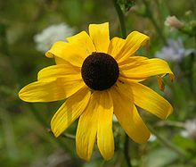
Blackeyed Susan
Notes:
Brown-eyed Susan, common names of: Brown Betty, Brown Daisy (Rudbeckia triloba), Gloriosa Daisy, Golden Jerusalem, Poorland Daisy, Yellow Daisy, and Yellow Ox-eye Daisy. It is a flowering plant in the family Asteraceae. It is an upright annual (sometimes biennial or perennial) native to most of North America, and is one of a number of plants with the common name Black-eyed Susan with flowers having dark purplish brown centers. Full sun Blooming period: June-August

Slide 39
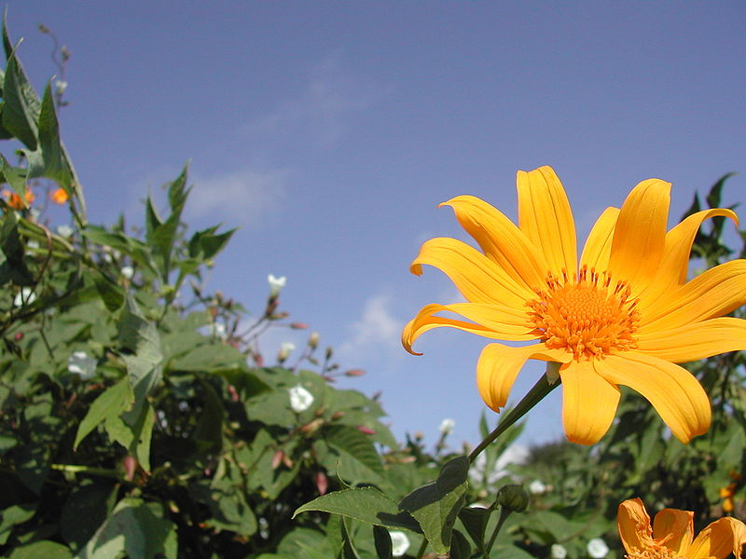
Mexican Sunflower
Notes:
commonly known as the tree marigold, Mexican tournesol, Mexican sunflower, Japanese sunflower or Nitobe chrysanthemum. Depending on the area they may be either annual or perennial, 2–3 m (6.6–9.8 ft) in height with upright and sometimes ligneous stalks in the form of woody shrubs. The flowers are orange. In the southern U.S., Mexican sunflower seeds planted in March or April will produce plants that flower and go to seed in June. Those seeds will fall to the ground, germinate, and produce a second generation of flowers that will mature before the first frost in October!

Slide 40
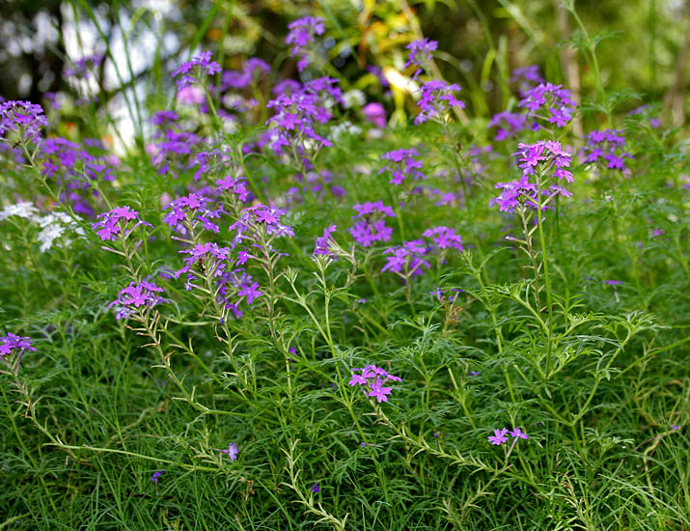
Moss Verbena
Notes:
Moss verbena is a freely branching annual (or a tender perennial) that can get about a foot tall, but usually sprawls over and spreads along the ground. Large clusters of pink, lilac, purple or white flowers 3 in (7.6 cm) across are produced all summer long. Each individual flower is about 1 in (2.5 cm) long and a 1/2 in (1.3 cm) across, with a slender, tubular base that flares abruptly to form a flat corolla with five petal-like lobes. An excellent drought-tolerant variety for arid regions. Prefers light to heavy soils in full sun. A valuable asset for summer color.
Several cultivars have been selected. 'Alba' has white flowers and threadlike leaf segments; 'Tapien Pink' has pink flowers, and 'Imagination' has purple flowers and is available from seed.
Blooming period: March-July

Slide 41
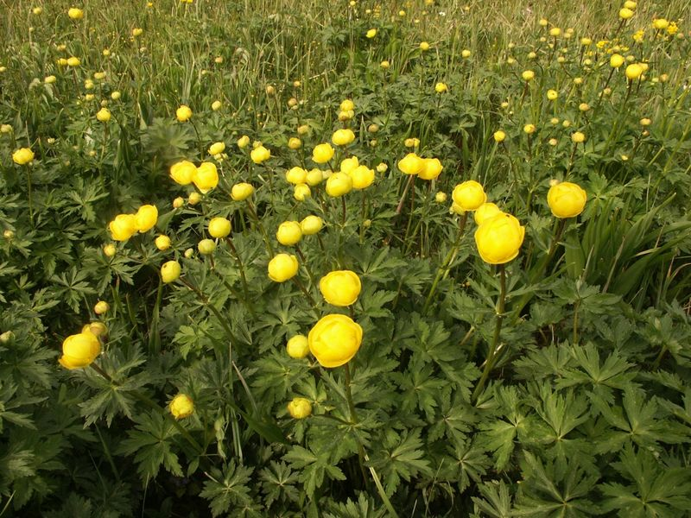
Globe Flower
Notes:
It grows in damp ground in shady areas, woodland and scrub, flowering between June and August. It is slightly poisonous and is purgative and rubefacient when used fresh. Perennial grown as an annual. Elsewhere, they are perfectly suited to rain gardens and boggy areas, and make a good showing in borders where soil does not dry out
Light: Sun, Part SunZones:4-8Plant Type: Perennial Plant Height:9-36 inches tall, depending on variety Plant Width:8-18 inches wide, depending on variety Flower Color: White, yellow, or orange flowers, depending on variety Bloom Time: Blooms late spring to midsummer, depending on variety Landscape Uses: Containers, Beds & Borders Special Features: Flowers, Attractive Foliage, Cut Flowers, Tolerates Wet Soil, Easy to Grow

Slide 42
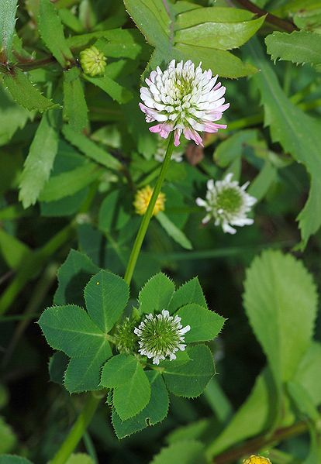
Clovers
Notes:
Clover (Trifolium), or trefoil, is a genus of about 300 species of plants in the leguminous pea family Fabaceae. They are small annual, biennial, or short-lived perennial herbaceous plants. Dense spikes of small red, purple, white, or yellow flowers;
Honeybees can also pollinate clover, and beekeepers are often in heavy demand from farmers with clover pastures. Farmers reap the benefits of increased reseeding that occurs with increased bee activity, which means that future clover yields remain abundant. Beekeepers benefit from the clover bloom, as clover is one of the main nectar sources for honeybees.

Slide 43
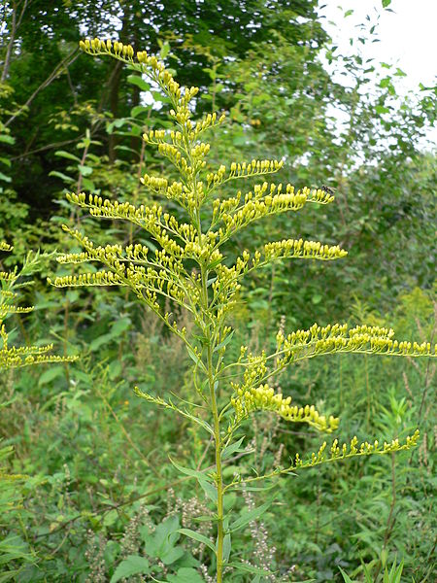
Goldenrod
Notes:
Solidago, commonly called goldenrods, is a genus of about 100 species of flowering plants in the family Asteraceae.^{[1]} Most are herbaceous perennial. The many goldenrod species can be difficult to distinguish, due to their similar bright, golden yellow flower heads that bloom in late summer. Goldenrod is a companion plant, playing host to some beneficial insects, and repelling some pests.^{[citation needed]} They are used as a food source by the larvae of various Lepidoptera species (see list of Lepidoptera that feed on goldenrods

Slide 44
Sources
CoastalScapes
Georgia Coastal Plain Native Plants -For Bees, Beetles,
and Other Non-Lepidopteron
Beneficial Insect pollinators
Coastal Empire Beekeepers Association -www.cebeekeeping.com/
Mother Nature Network - The importance of honeybees
http://www.mnn.com/local-reports/pennsylvania/local-blog/the-importance-of-honeybees
Entomology: UGA Honey Bee Program: Bees, Beekeeping, and Pollination
Pollination: Plants for Year-round Bee Forage
http://www.ent.uga.edu/bees/pollination/plants-year-round-forage.html
Wikimedia Commons. Freely licensed or public domain media

Slide 45
Please email David Linvill
With annual plants that you personally know
That are Honey Bee Attractors
To be added to this presentation
dlinvill@uga.edu

