Slide 1


Home Grown
Tomatoes
Wade Hutcheson
UGA Extension Spalding County
Robert Westerfield,
University of Georgia Horticulture

Slide 2
Tomato -vs- Tomato Tree
Tomato Tomato Tree
Solanum lycopersicum Cyphonandra betacea
Annual vine perennial shrub
Bloom to fruit
Weeks about 3 months
Grows
Most anywhere frost free locations

Slide 3
Tomatoes…just grow’em
Seeds Sets
Start early Buy healthy
Order earlier Plant deep
Seed catalogues Shop local
More varieties
More resistant varieties

Slide 4
Locally found varieties
Seeds Sets
Celebrity Celebrity
Big Boy Big Boy
Better Boy Better Boy
Rutgers Whopper
Mariglobe Heat Wave
Cherry Tomato Early Girl
Homestead
Brandywine

Slide 5
Choosing varieties
Determinate – bloom and bear all about the same time, good for canning
Indeterminate – produce till dead

Slide 6
Some Seed Companies
Harris Seeds – harrisseeds.com
Twilley Seeds – twilleyseed.com
Totally Tomatoes – totallytomato.com
Parks – parkseed.com
Tomato Growers Supply – tomatogrowers.com

Slide 7
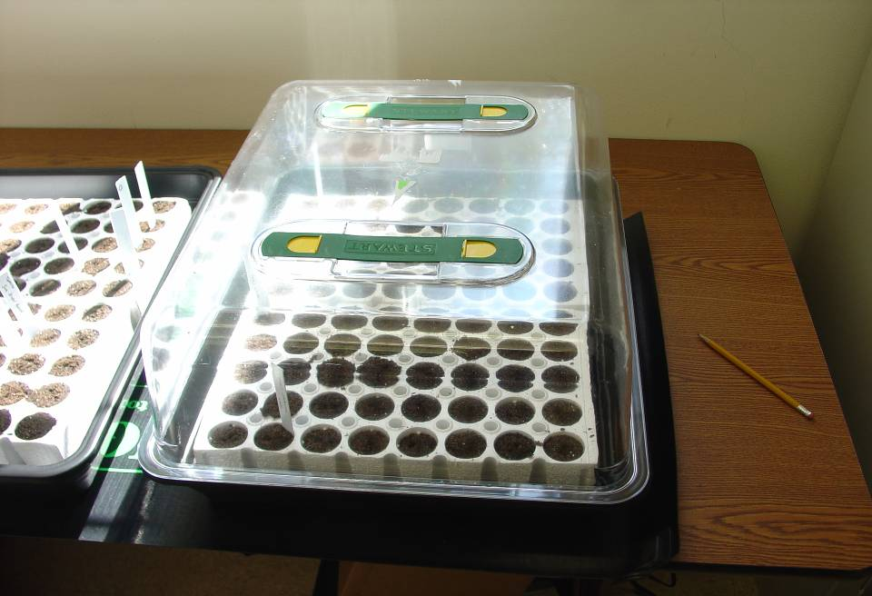
Give seeds Plenty of Light!
Notes:
One problem when starting seed indoors is the lack of good light. This can cause seedlings to stretch and become weak. A south west facing window or a good growers lamp will aid in growing healthy, stocky transplants.

Slide 8
Selecting a Garden Site to Avoid Problems
Six hours of daily sunshine are required.
Avoid trees and hedges.
Use well amended soils.
Select well drained soils.
Consider convenience to house and water.
Notes:
As sunlight is absolutely necessary for vegetable production, the garden site should receive a minimum of 6 to 8 hours of sun per day. Other factors to consider include location of trees and shrubs near the site, drainage and convenience to irrigation. Having the garden close to the house will help insure frequent viists to look for any signs of problems.

Slide 9
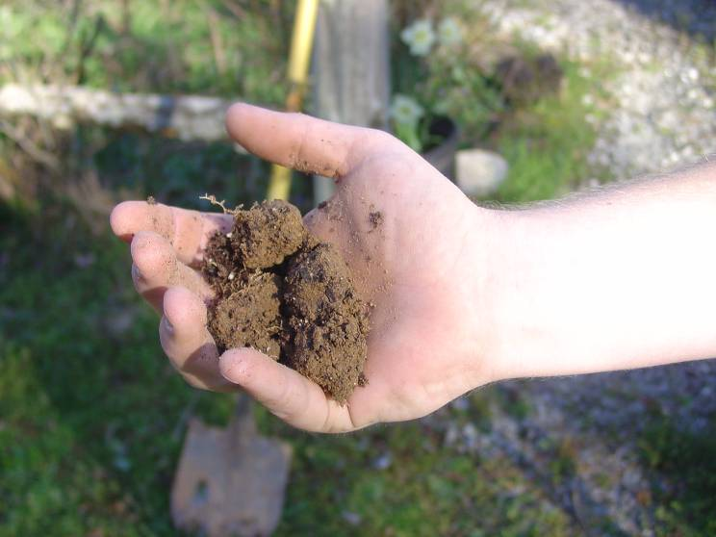

Slide 10
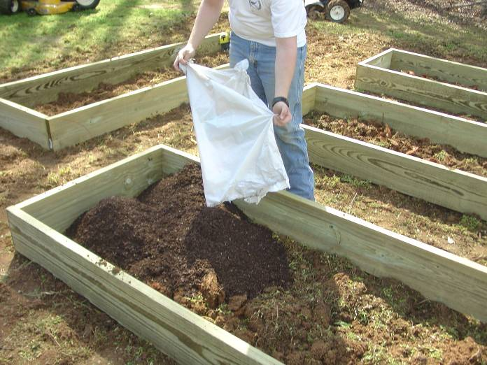

Slide 11
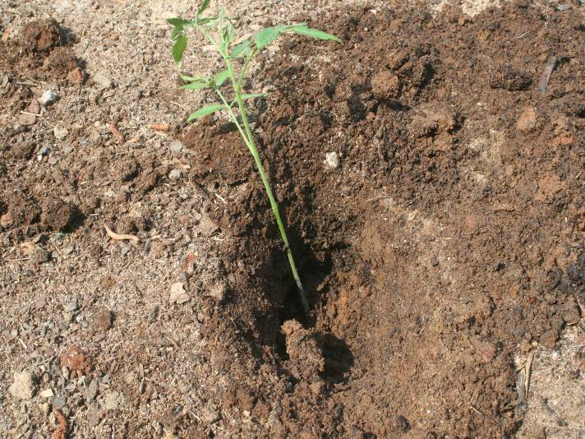

Slide 12
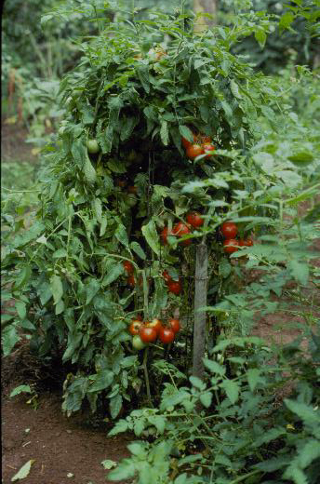
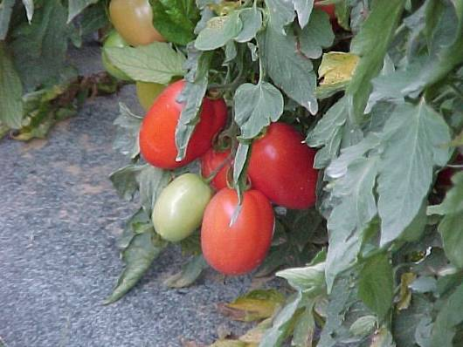
Notes:
Always support tomatoes to keep bushes upright and the fruit off the ground. This plant has not been pruned. Pruning will produce fewer but larger fruit. Pruning is done by removing suckers.

Slide 13

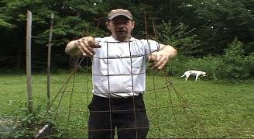



Which cage is Best?

Slide 14
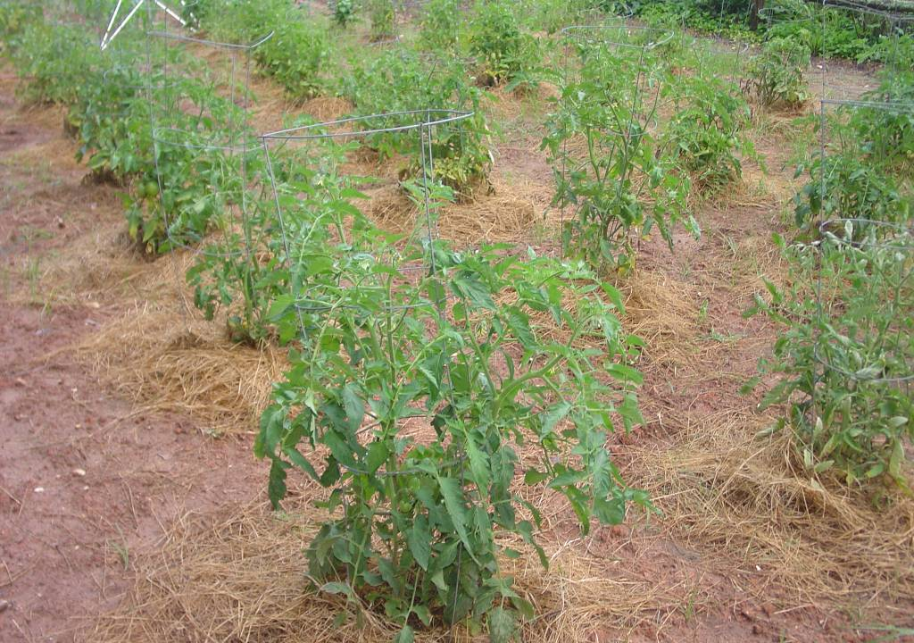
Ventilation
Notes:
Good ventilation is essential to help prevent disease problems from starting. Allow 4 to 5 feet between plants for maximum air flow.

Slide 15
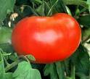
Common Problems Encountered
Notes:
There are several things to consider when troubleshooting tomato problems. Is the plant suffering from a nutritional disorder, disease, insects, virus or some cultural problem.

Slide 16
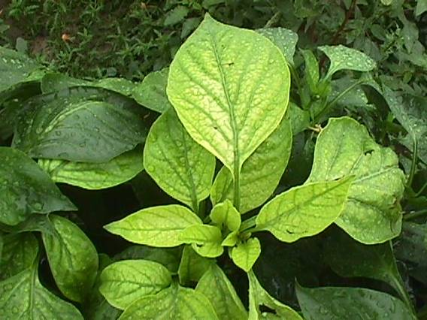
Nutritional Disorders
Notes:
Let’s take a look at nutritional problems to start with.

Slide 17
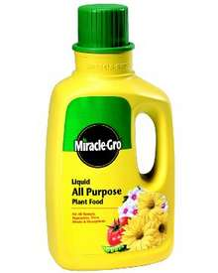
Ten foot tall Tomato Plants?
Notes:
A common problem encountered by county extension agents is the infamous 10 foot tomato with no blooms. The likely cause of this usually relates back to too much nitrogen. More often than not, it also involves folks using liquid fertilizers and appling them at the from rate. It is very hard to calibrate and determine just how much fertilizer to put out with a liquid product. For this reason, it is a good idea to stick to granular applications of fertilizer to better control the rate.

Slide 18
Likely Nutritional Problems
pH – usually too low, but too high is possible
Deficiencies
Nitrogen
Calcium
Magnesium
Iron
Sulfur
Boron
Zinc
Phosphorous
Potassium
Toxicities
Manganese
Aluminum
Boron
Zinc
Chlorine
Sodium
Notes:
In most cases, several nutrients are commonly deficient, while others may be available in toxic quantities. The chart in this slide shows the likelihood of deficiency verses over abundance. The pH of the soil has a huge affect on the availability of nutrients.

Slide 19
pH Level
ALKALINE
8.0
7.0
6.0
5.5
4.0
IDEAL
ACID
VERY ACID
Notes:
Plants differ in their needs or tolerance of soil acidity. Unsuitable soil pH can stunt plant growth, cause fruiting problems, necrosis or death of leaves and other plant parts. Tomatoes and other vegetables prefer a pH that is slightly acidic in the 6.0-7.0 range.

Slide 20
Be Careful about
Wood Ashes!
5 lbs/100 sq ft
25-50/1000 sq ft
Notes:
Many people like to add their wood ashes from their fireplace to the garden. While this is a source of potash or potassium, too many ashes can easily elevate the pH to levels that are unhealthy for the plant. Limit the amount of ashes to approximately five pounds per 100 square feet per season.

Slide 21
Conditions That Effect Nutrients
Soil Type Rainfall/Irrigation
Applied Nutrients Previous Crop
Temperature Organic Matter
Fungicide Applications Runoff
Notes:
Many factors can effect the availability of nutrients in the soil. These must be considered when diagnosing problems in the garden.

Slide 22
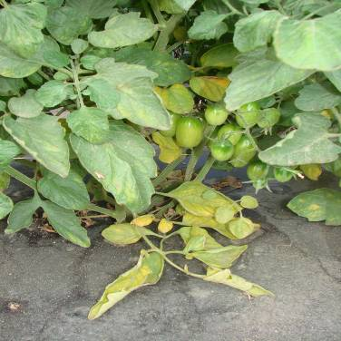
Nitrogen
Deficiency is characterized by a pale color of the leaves. Usually the lower leaves will be more pale than upper leaves.
Too much nitrogen is a common problem in Georgia. Over fertilization is usually the problem.
Notes:
Nitrogen deficiency is fairly common and appears in the lower leaves first. The leaves look pale when in color compared to the upper leaves. Too much nitrogen produces a dark green, tall plant with few blooms.

Slide 23
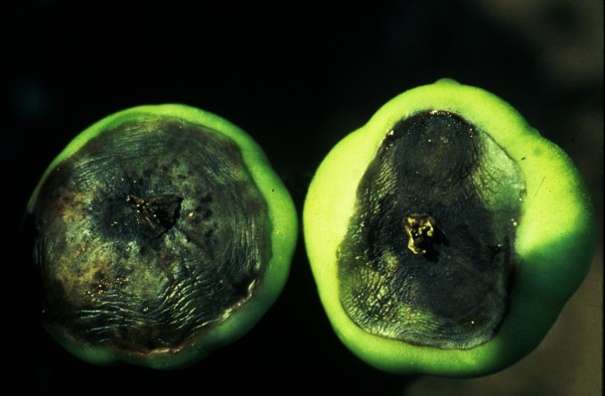
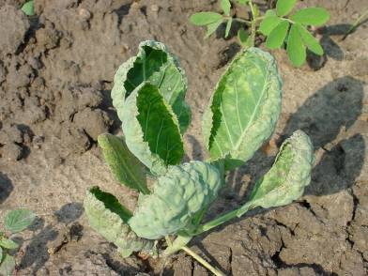
Calcium Deficiency
Calcium deficiency - characterized by cupping of the youngest leaves. Ca deficiency can also lead to
Blossom end rot.
Drought or poor moisture management
Over fertilization
Low pH
Notes:
Cupping of upper leaves and a slight off- color can indicate calcium deficiency. Poor moisture management can cause plant to be deficient in available calcium.

Slide 24
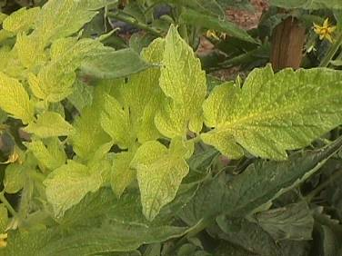
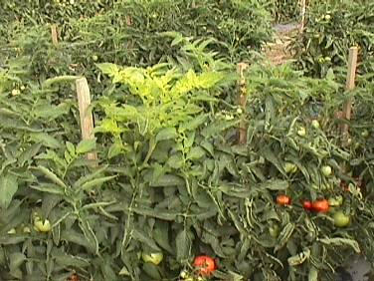
Iron Deficiency
Iron deficiency is characterized by pale color in the
uppermost youngest leaves. Fe deficiency can be seen
particularly on sandy soils with higher pH and in
cold, wet, poorly aerated soils.
Notes:
Iron deficiency looks like about the opposite of nitrogen deficiency with the symptoms appearing in the uppermost leaves first. Sometimes the leaf veins will stay dark green while the rest of the leaf turns pale yellow.

Slide 25
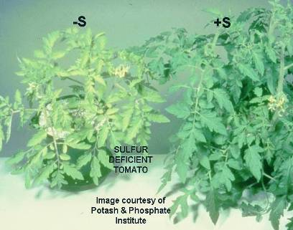
Sulfur Deficiency
Sulfur deficiency is a common problem in sandy soils.
Often confused with Nitrogen deficiency.
First seen on younger tissue, not older.
Usually readily corrected with foliar applications of magnesium
sulfate.
Notes:
Sulfur deficiency occurs more often on sandy soils. Younger leaves are affected first and turn light green to yellowish in color.

Slide 26
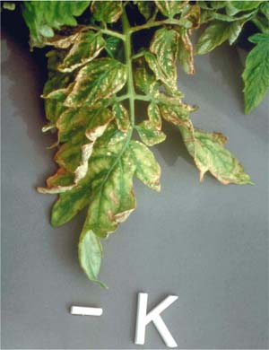
Potassium Deficiency
Occurs mostly on upper leaves.
Can be brought on by excess
rains and leaching.
Necrotic areas close to tips and
margins between veins.

Slide 27
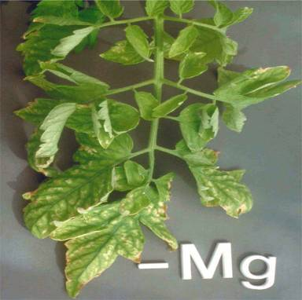
Manganese Deficiency
Notes:
Interveinal yellowing, similar to iron deficiency, occurs first on young leaves. As the stress continues, leaves take on a gray metallic sheen and develop dark, necrotic areas along the veins. Can purchase fertilizer with the micro nurtients in it.

Slide 28
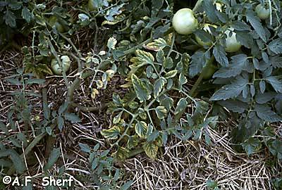
Magnesium Deficiency
Magnesium deficiency can occur with low pH, but it is not
always the case. Occurs frequently on coarse-textured
Soils or sandy soils.

Slide 29
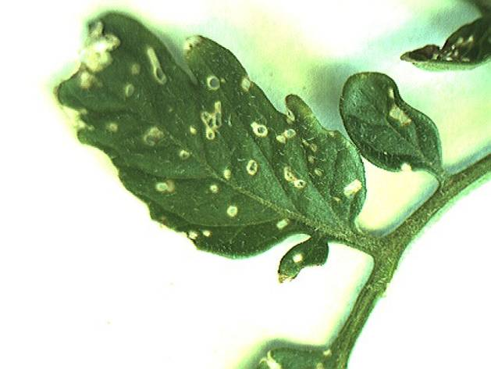
Flea Beetle Damage
Notes:
Flea Beetles are tiny black insects that hop from plant to plant and cause damage to the leaves. Damage appears as small brown spots and holes. Heavy infestations can lead to reduced yield.

Slide 30
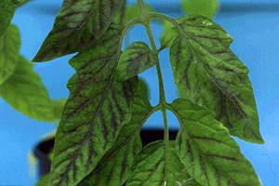
Phosphorous Deficiency
Phosphorous deficiency occurs frequently during the spring and winter months when soils are cold and Phosphorous is less available.
pH either too low or too high can also cause P to be limiting.

Slide 31
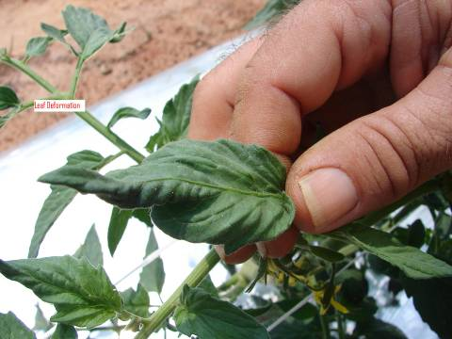
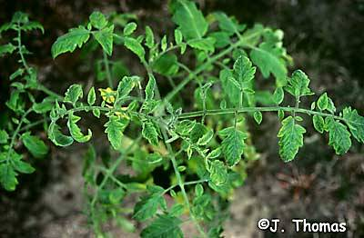
Virus
Notes:
Several viruses can attack tomatoes including Cucumber Mosaic, Tobacco Mosaic and Spotted Wilt Virus. Symptoms typically include distorted foliage and discoloration or mottled leaves. Viruses are usually spread by insects or animals or humans moving through or touch plants while they are moist. Viruses can severely weaken and even kill infected plants. There are no sprays or cures to combat viruses and infected plants should be removed and destroyed immediately. Avoid using tobacco in or near the garden and walking in the garden while it is wet. Resistant varieties are available to help prevent viruses.

Slide 32
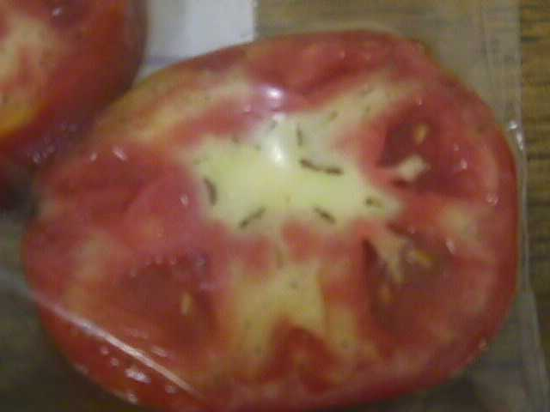
Physiological Disorders
Environmental Disorders

Slide 33
Blossom End Rot

Slide 34
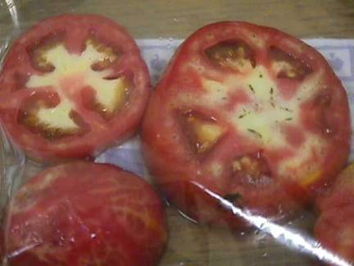
Blotchy Ripening
This condition is more prevalent in older varieties and can
be caused by excess water or drought conditions.

Slide 35
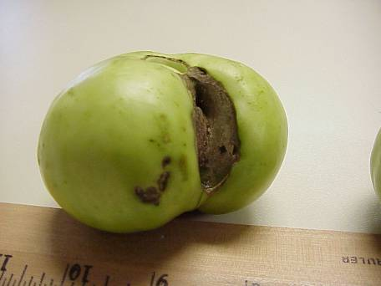
Catfacing
Catfacing is usually the result of blooms sticking to the
fruit and producing an enlarging scar. This is usually
aggravated or caused by cool weather.

Slide 36
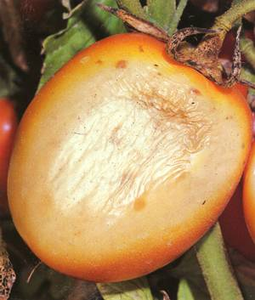
Sun Scald

Slide 37
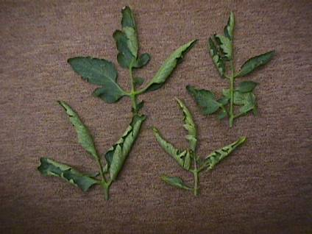
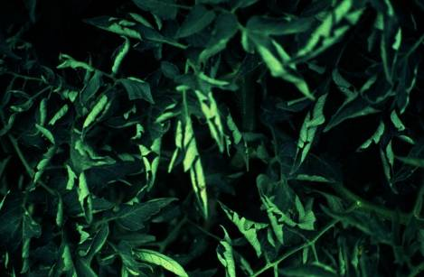
Tomato Leaf Roll
Usually caused by conditions of stress. These may be brought
about by drought, heat, cold or simply having a large fruit load
on the plant. Usually not a limiting condition.

Slide 38
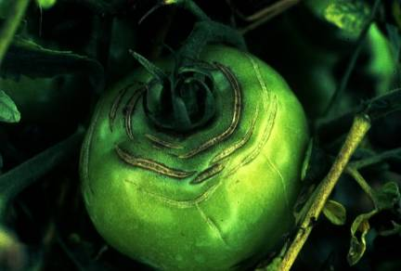
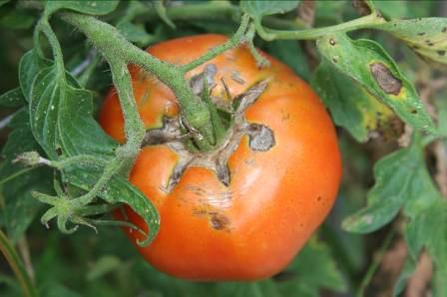
Fruit Cracking
Fruit cracking in tomatoes is variety related.
It can also be caused by sudden wet conditions
after a drought.

Slide 39
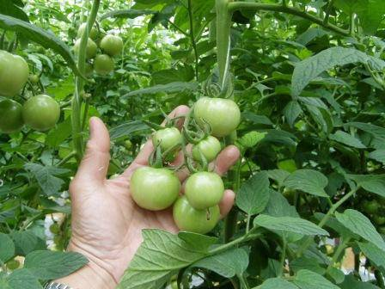

Poor Pollination
Notes:
Small, undeveloped fruit and irregular shaped fruit are possible signs of poor pollination. Poor pollination can occur when we experience frequent rain showers and or windy days. Pollinating insects do not fly much at these times and pollination may suffer. Spraying insecticides early in the day may also kill beneficial pollinators.

Slide 40
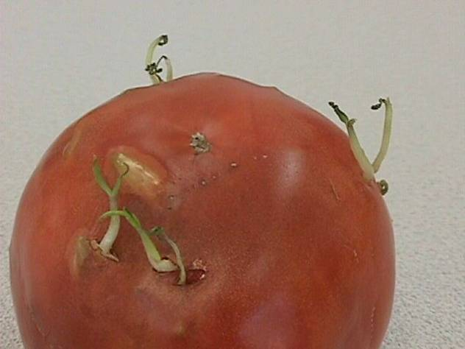
How about this one?
Notes:
This is an unusual situation where the seeds inside the tomato have actually germinated. This can occur when over ripe tomatoes are left in a warm, humid environment.

Slide 41
Weather Related Problems?
Notes:
Weather conditions can affect the performance of our tomatoes.

Slide 42
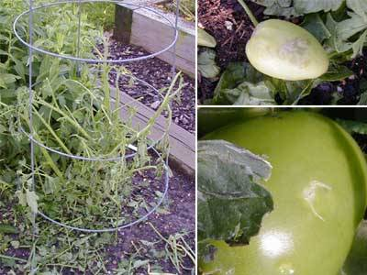
Hail Damage

Slide 43
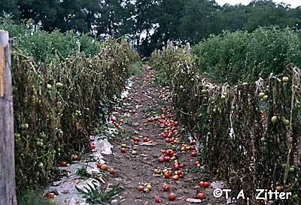
Lightening Damage

Slide 44
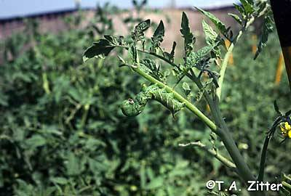
Insects

Slide 45
Insects
Aphids
Whiteflies
Easily seen on underside of leaf.
Strong spray of water, 2x/day, several days.
Insecticides – bifenthrin, cyfluthrin, esfenvalerate, permethrin, spinosad
Insecticidal soap

Slide 46
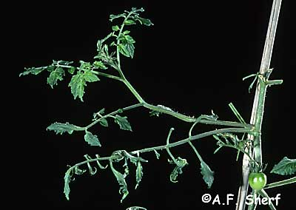
Herbicide- 2,4-D

Slide 47
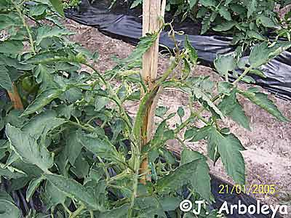
Round-up

Slide 48
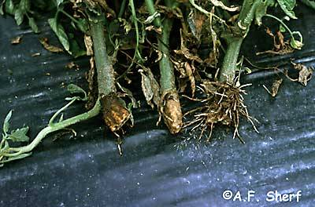
Treflan

Slide 49
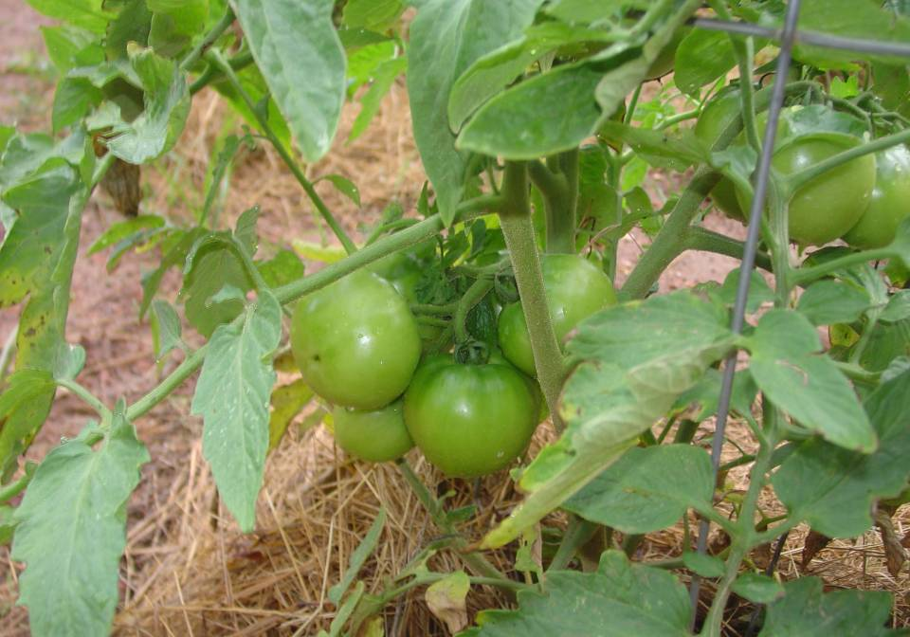
Resistant Varieties
VFFNTATSWV
huh?

Slide 50
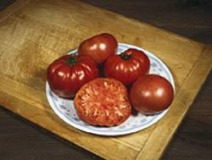
Brandywine- (Heirloom)

Slide 51
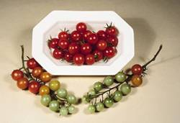
Supersweet 100

Slide 52
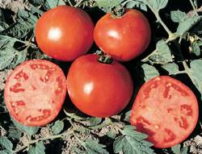
Celebrity- (Indeterminate)

Slide 53
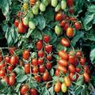
Juliet- (Grape-Indeterminate)

Slide 54
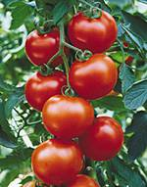
Sweet Cluster- (Indeterminate)

Slide 55
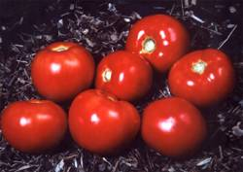
Amelia-(Spotted wilt. resis.)

Slide 56
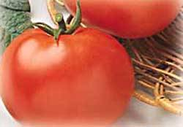
Rutgers Select (Determinate)

Slide 57
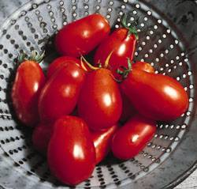
Roma (Determinate)

Slide 58
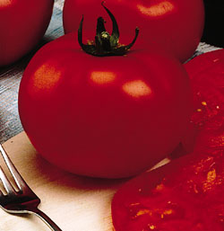
Big Beef- (Indeterminate)

Slide 59

Root Knot Nematode

