Slide 1
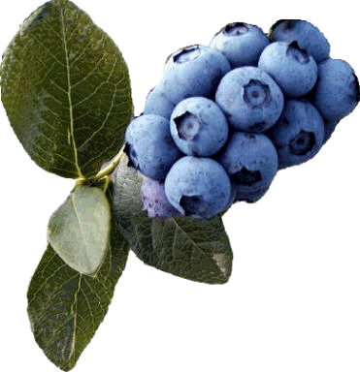
Growing Home Garden Fruit in the Piedmont
Hills and Dales Estate
March 27, 2010
Dr. Gerard Krewer
University of Georgia
Woodbine, Georgia
229-392-1388

Slide 2
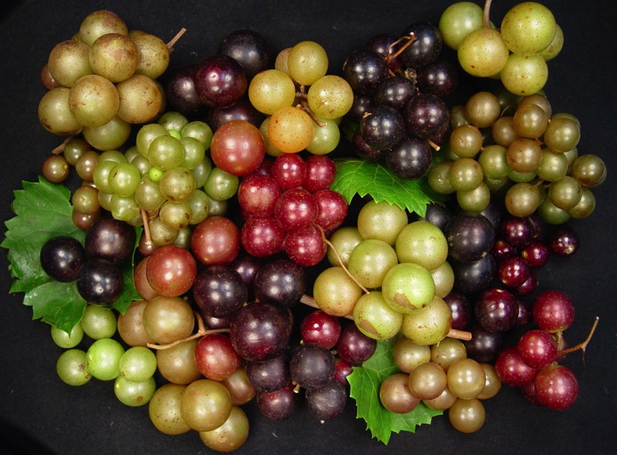
Growing Fruit: A Rewarding Experience
Many types of fruits can be grown in the Piedmont.
Cultivar selection is important for success.
However, regular watering, fertilization and pruning is important in the production of fruits.
Photo: Pat Conner

Slide 3
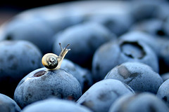
Fruit pesticide requirements
Some need only a few pesticide applications
Many can be grown by the organic method
Apples and stone fruits need to be sprayed every 10-14 days during critical periods to have good quality fruit.

Slide 4
Limited spraying required, maybe even organic
Apples?
Blackberries
Rabbiteye Blueberries
Figs
Jujube
Kiwi
Muscadine Grapes
Pears
Pomegranates

Slide 5
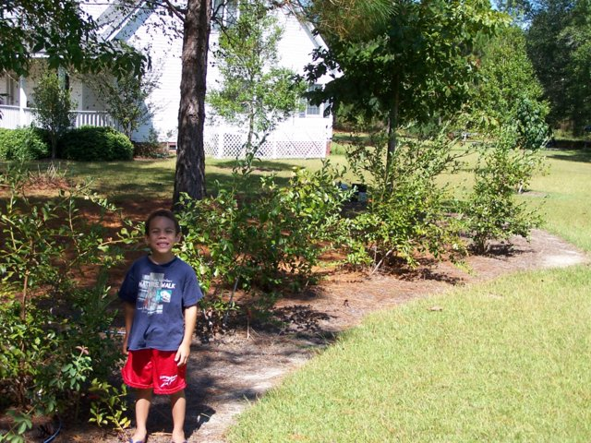
Space requirements
Ideal for gardens with limited space
Most small fruits only need 6 to 8 feet between plants. Some only 2 or 3 feet.

Slide 6
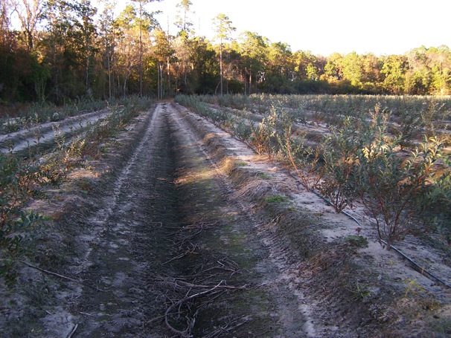
Site Selection
Select a site with good soil drainage for most fruits
Plant on a raised bed if needed
Somewhat tolerant of damp soils: pears, rabbiteye blueberries and blackberries

Slide 7
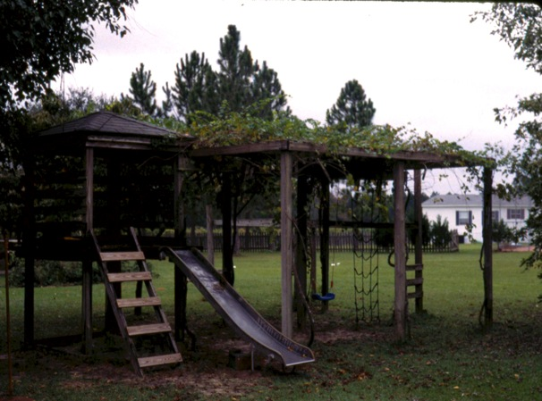
Sunlight requirements
Select a site with sunlight for at least half a day.
Thin limbs on trees that shade the fruit orchard. Cut tree roots annually if needed.

Slide 8
Soil Test
Most fruits-pH 6.0 to 6.5
Blueberries-
Sandy soils: pH 3.8-5.3
Clay soils: pH 4.5-5.3

Slide 9
Soil pH Adjustment
Adjust pH up with dolomitic limestone (contains calcium and magnesium)
Adjust pH down with sulfur (blueberries)
Apply six months before planting blueberries (if possible)
If the soil is low in phosphorus apply before planting (less than 20 pounds per acre)
Rototill or mix by hand if possible into the top 8 inches of soil

Slide 10
Now let’s selection the type of fruit

Slide 11
Can all fruits be grown successfully in all areas of the state?
No
Northern raspberries and northern highbush blueberries do best in a cool climate (move to Blairsville)
Citrus likes a warm climate (move to St. Marys)

Slide 12
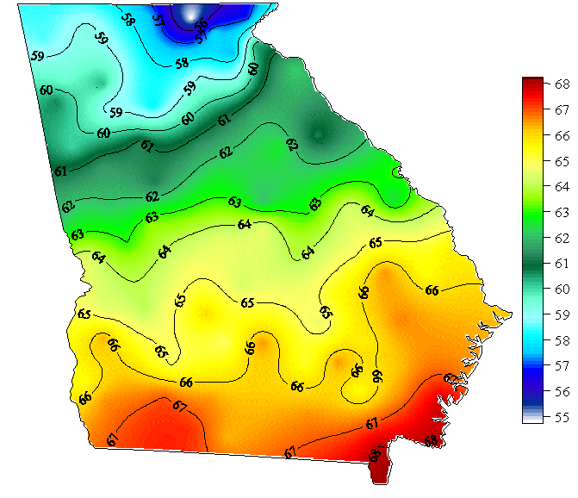
Mean Temperature in Ga. (F)

Slide 13
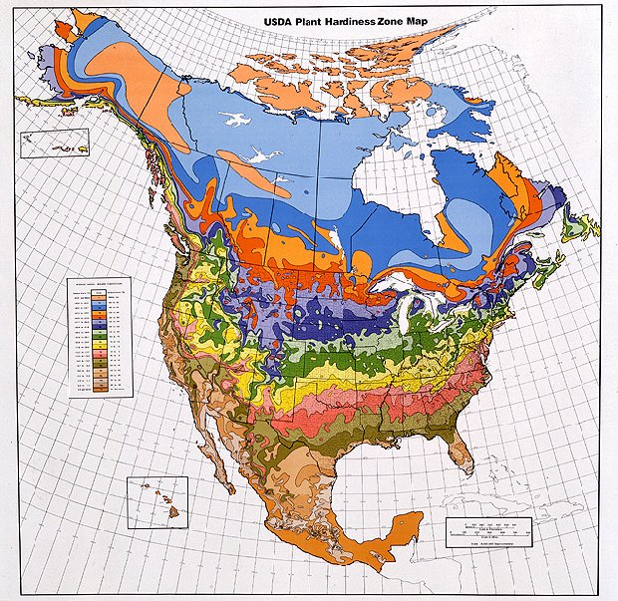

Slide 14
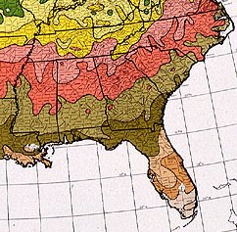
Mean Low Temp in Ga. (F)- determines where m many fruits can be grown- i.e. Figs are hardy to about 0-10 degrees F
Five temperature zones
0-5 F
5-10 F
10-15 F
15-20 F
20-25 F

Slide 15
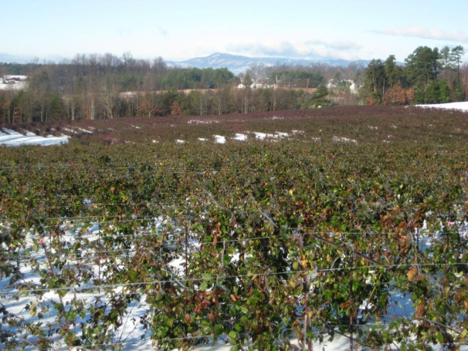
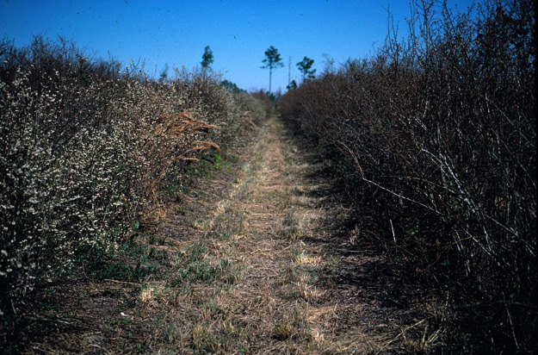
Winter chilling is important
Chilling requirement is the number of hours 45 degree F and below required for normal development in the spring.
Also has a big influence on bloom date.

Slide 16
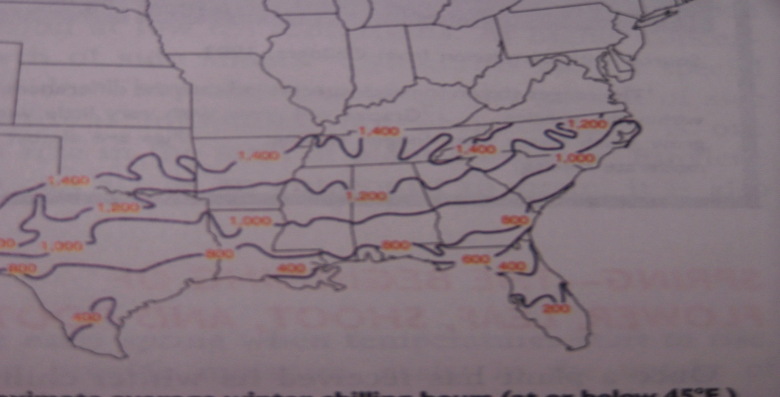
Winter Chilling Map
Hours below 45 degrees F

Slide 17
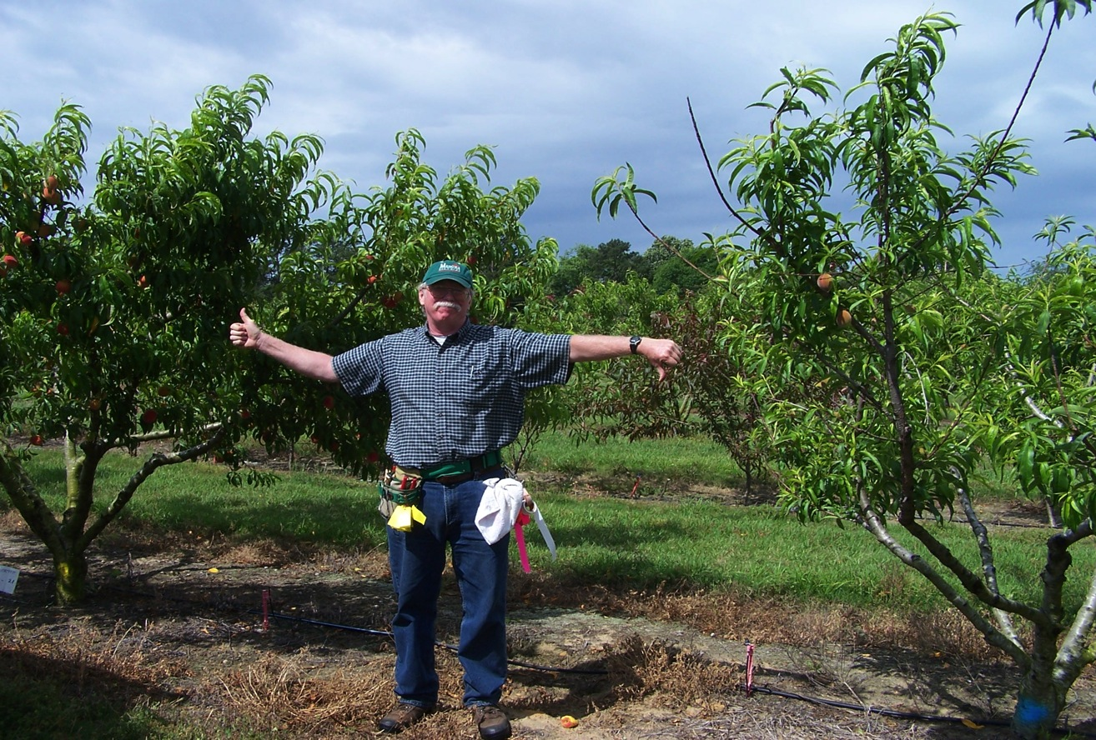
Adequate Winter Chilling is Important in Fruit Production (esp. pears, apples, peaches)
Chilling requirement
satisfied
Chilling not satisfied
“Plucked chicken”

Slide 18
Chill hours ranges available
Apples: 300-1200 hours below 45 F
Blueberries: 100-900
Peaches: 150-1100
Muscadine Grapes: ca. 400 but high heat requirement

Slide 19
Danger of Planting Too Low Chilling Cultivars
Bloom
Occurs
Winter Chilling
Satisfied
Heat Units
Accumulated

Slide 20
Critical temperature for open blooms and small fruit
About 28 degree F if still
If the wind is blowing maybe slightly lower

Slide 21
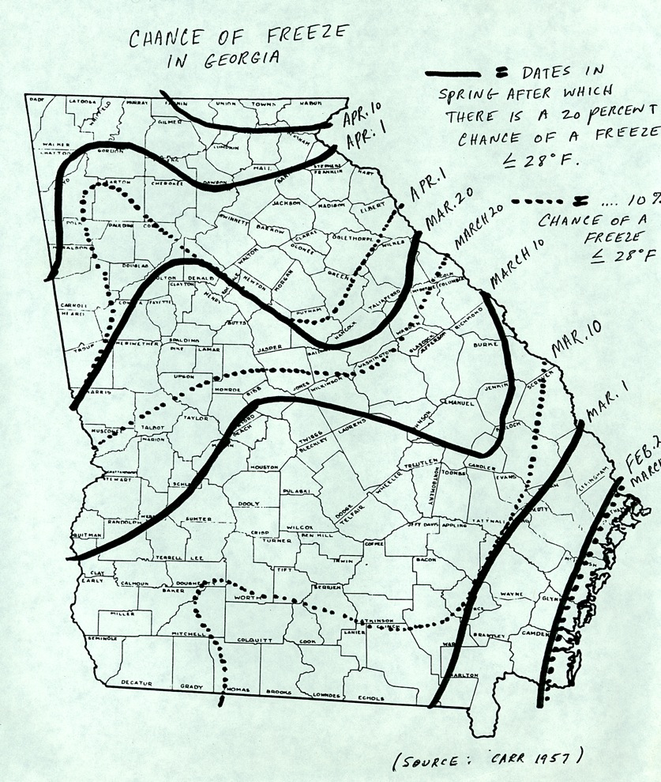
Georgia last date of 28 F or below in the Spring
Feb.20
March 1

Slide 22
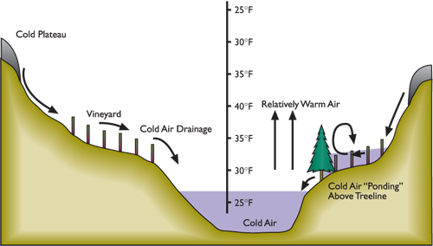
Learn about your site

Slide 23
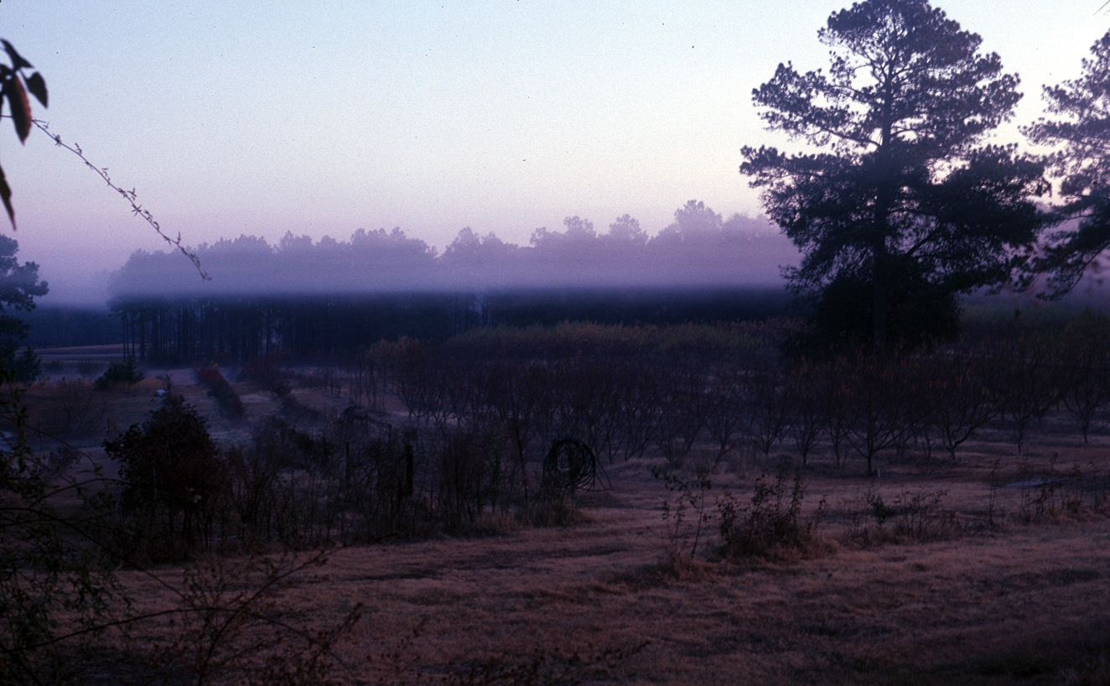

Slide 24
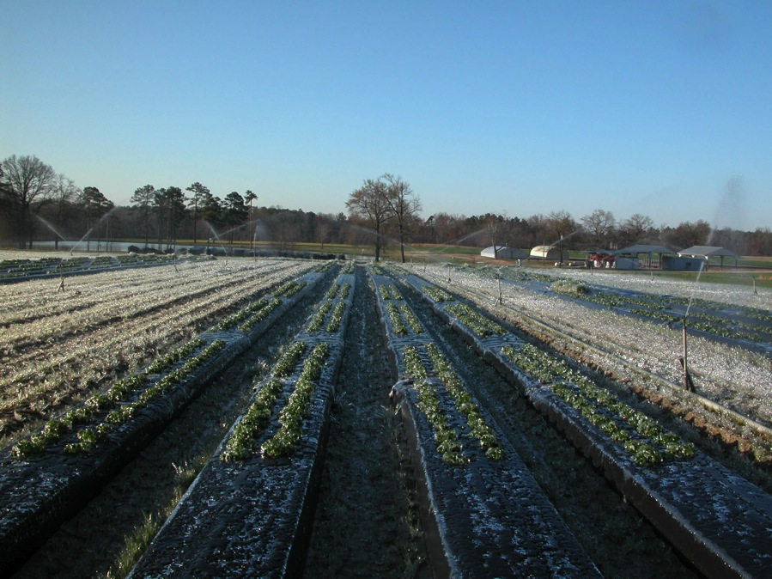
Strawberry freeze protection with water
Slide courtesy of Dr. Barclay Poling

Slide 25
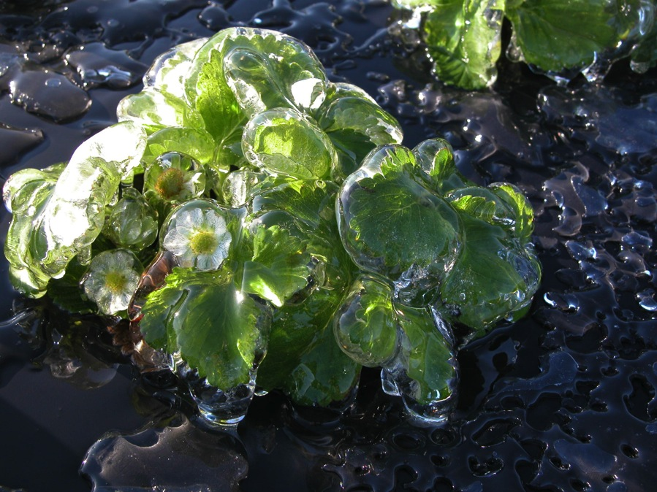
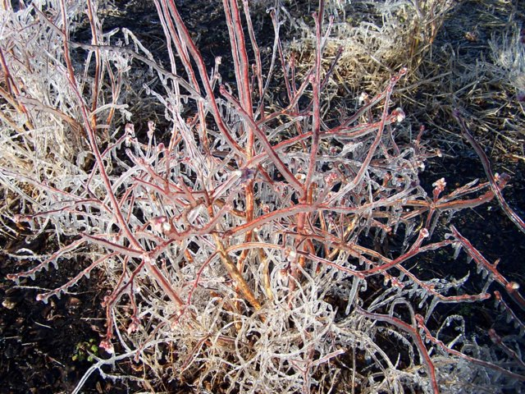
Strawberry and blueberry freeze protection
Slide courtesy of Dr. Barclay Poling

Slide 26
Other Methods of Spring Freeze Control
Plant later blooming cultivars
Use floating row covers on strawberries
Use plastic tunnels on strawberries and blueberries

Slide 27
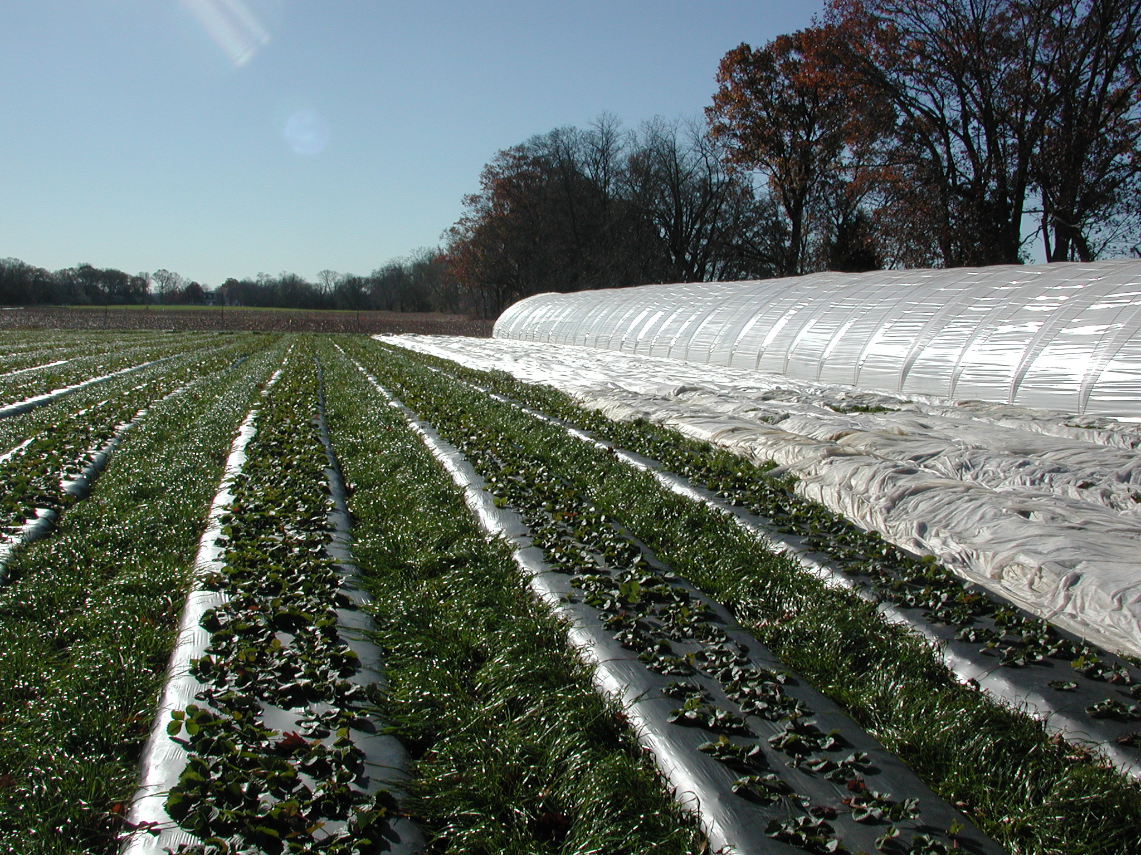
Floating row covers and high tunnels
Slide coutesy of Fumi Takeda

Slide 28
Nematode Control
Root knot nematodes can be a problem on figs, bunch grapes and kiwifruit.
Special nematode resistant rootstocks are available for bunch grapes
You can sample for nematodes or avoid old garden spots likely to have nematode problems.

Slide 29
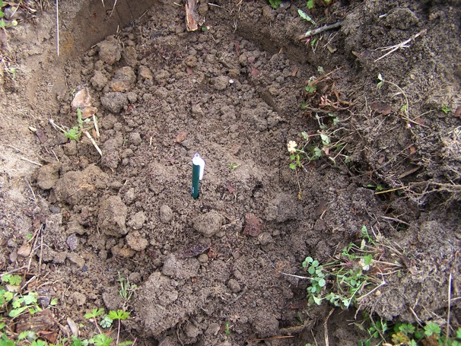
Soil Preparation and Planting Depth
Dig a big hole
18 inches across and 15 inches deep
Break up hard pan
Set plants the same depth they grew in the nursery

Slide 30
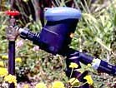
Install irrigation
Drip irrigation is popular
All you need is value, filter, pressure regulator (optional), tubing and emitters
A timer is a good investment (about $35)
Drip systems are often run daily during hot, dry weather

Slide 31
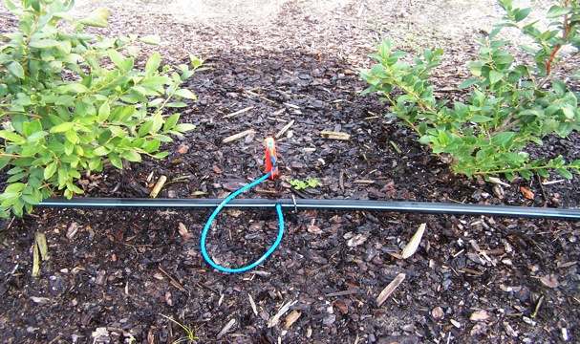
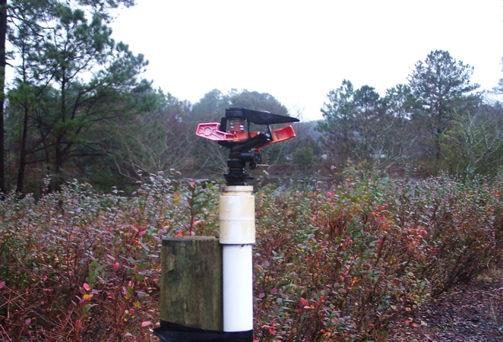
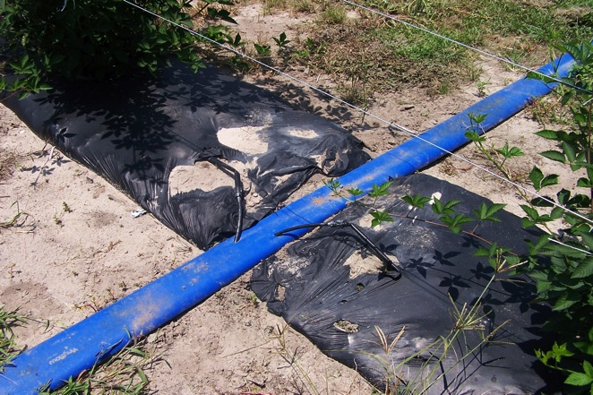
Systems For Irrigation

Slide 32
Sprinkler Irrigation
Sprinkler irrigation is another option. Apply one to 1.5 inches per week during hot, dry weather if no rain is received.
Overhead irrigation can also be used for freeze protection

Slide 33
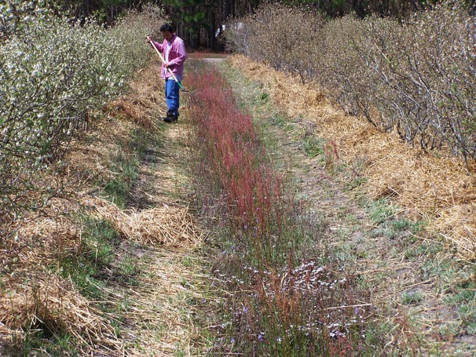
Weed Control in Fruits
A four foot weed-free band on both sides of the plants is needed for best growth
Use shallow cultivation, mulches or herbicides to control weeds
Get an 80-04E nozzle for you sprayer, use low pressure
Finale is a good choice

Slide 34
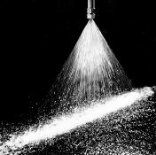
Photo: Fluid Products

Slide 35
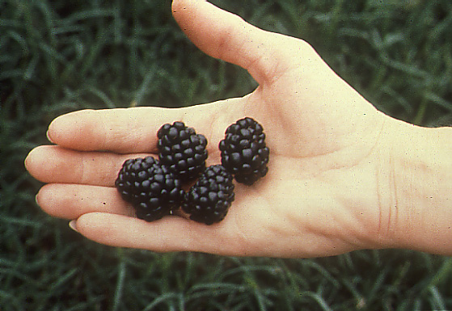
Erect Blackberries
Erect Blackberry Cultivars
Natchez-early, thornless, large
Ouachita-mid-season,thornless
Kiowa-mid-season, thorny
Navaho-mid-late season, non-thorny

Slide 36
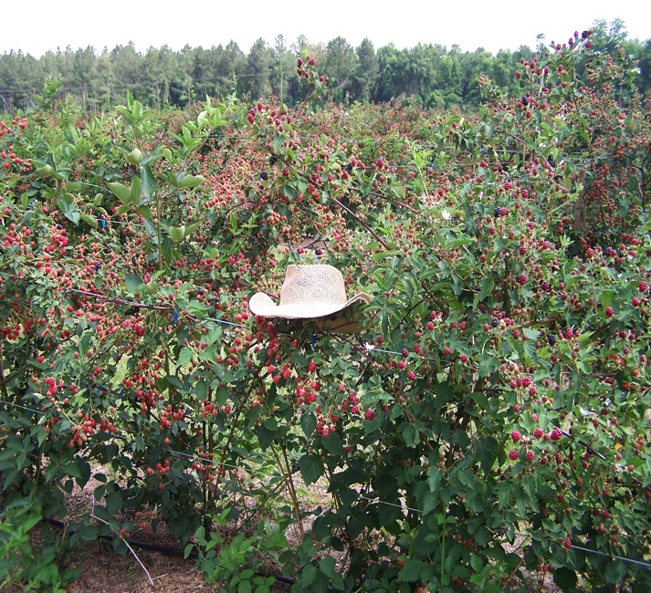
New Cultivars from Arkansas
Natchez
Ouachita
Prime Ark-45

Slide 37
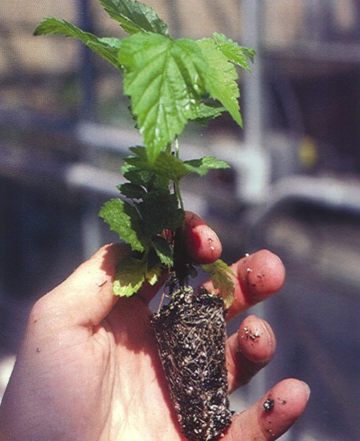
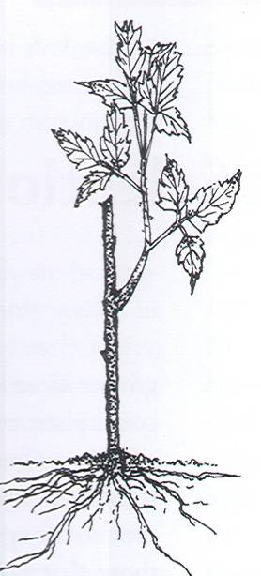
Controlling viruses
Use virus tested tissue culture plants or virus tested 1st generation plants from tissue culture
Virus tested tissue culture plants grown in a screen house are also a good choice

Slide 38
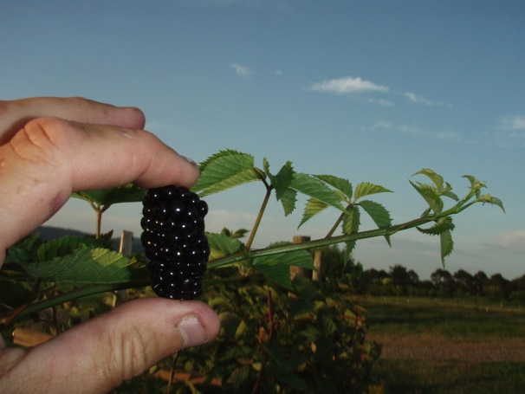

Natchez Characteristics
  Flavor
    Soluble solids averaged 9% compared to 10% for Navaho and Ouachita
    Somewhat tart at times
Notes:
38

Slide 39
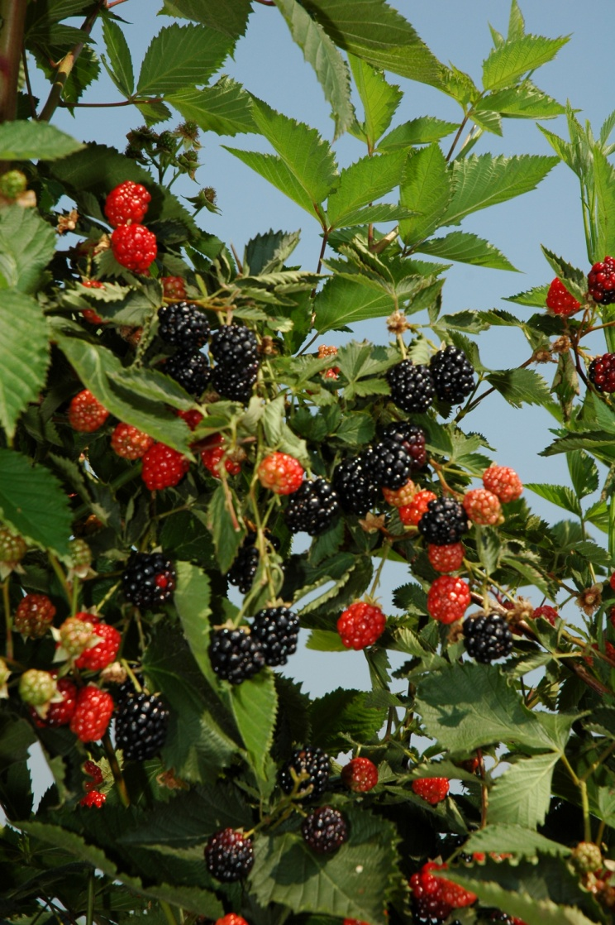
Ouachita- mid season
Notes:
39

Slide 40
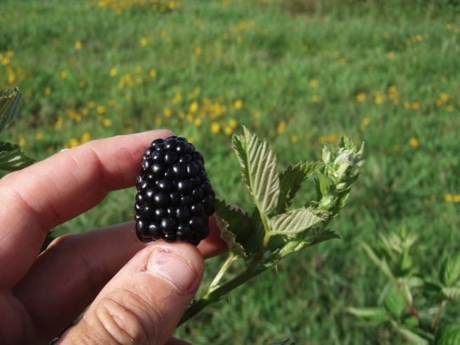
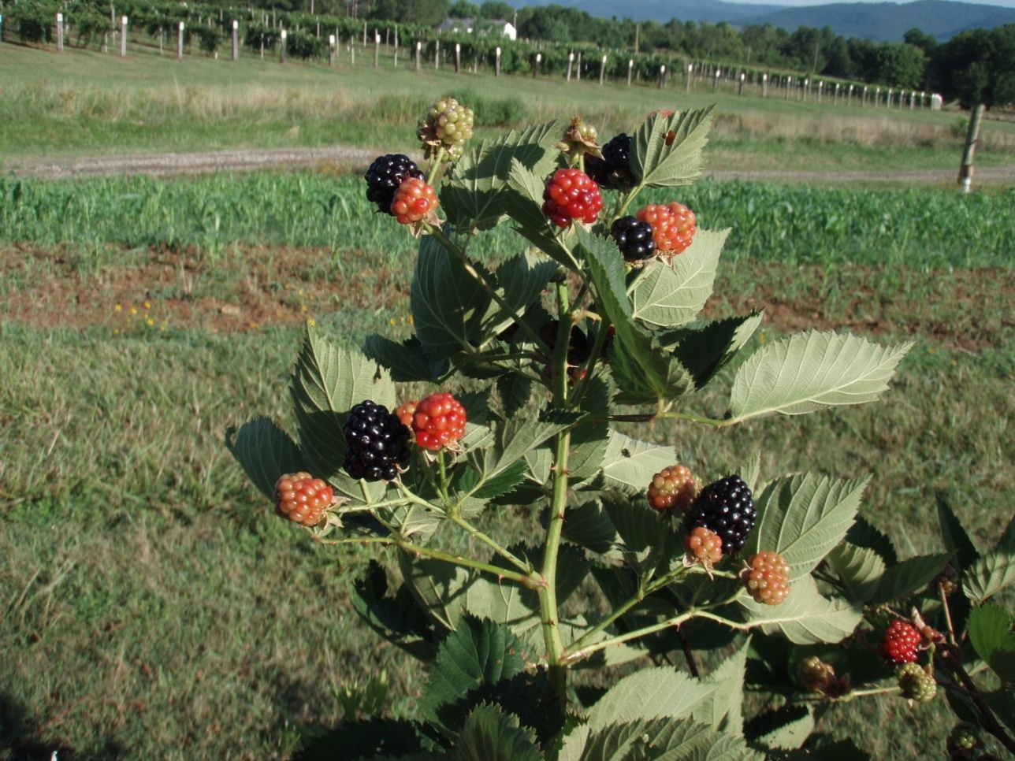
The New Release: Prime-Ark® 45
Thorny, erect
Primocane cropping begins two weeks later than PrimeJim and PrimeJan-Aug. 8 (Clarksville, Ark.)
Mow to ground in winter for primocane cropping
Floricane crop ripens beginning June 6, with Natchez or before (Clarksville, Ark.)
Notes:
40

Slide 41
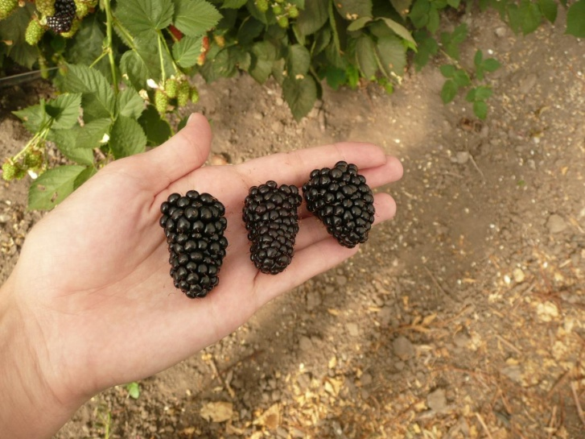
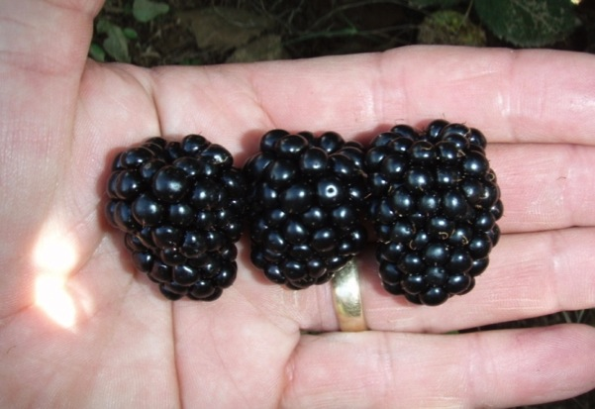
Prime-Ark® 45
Excellent flavor
Berry weight: Primocane 4-5 g, Floricane 6-7g
Floricane crop-Cal.
Primocane-Arkansas
Notes:
41

Slide 42
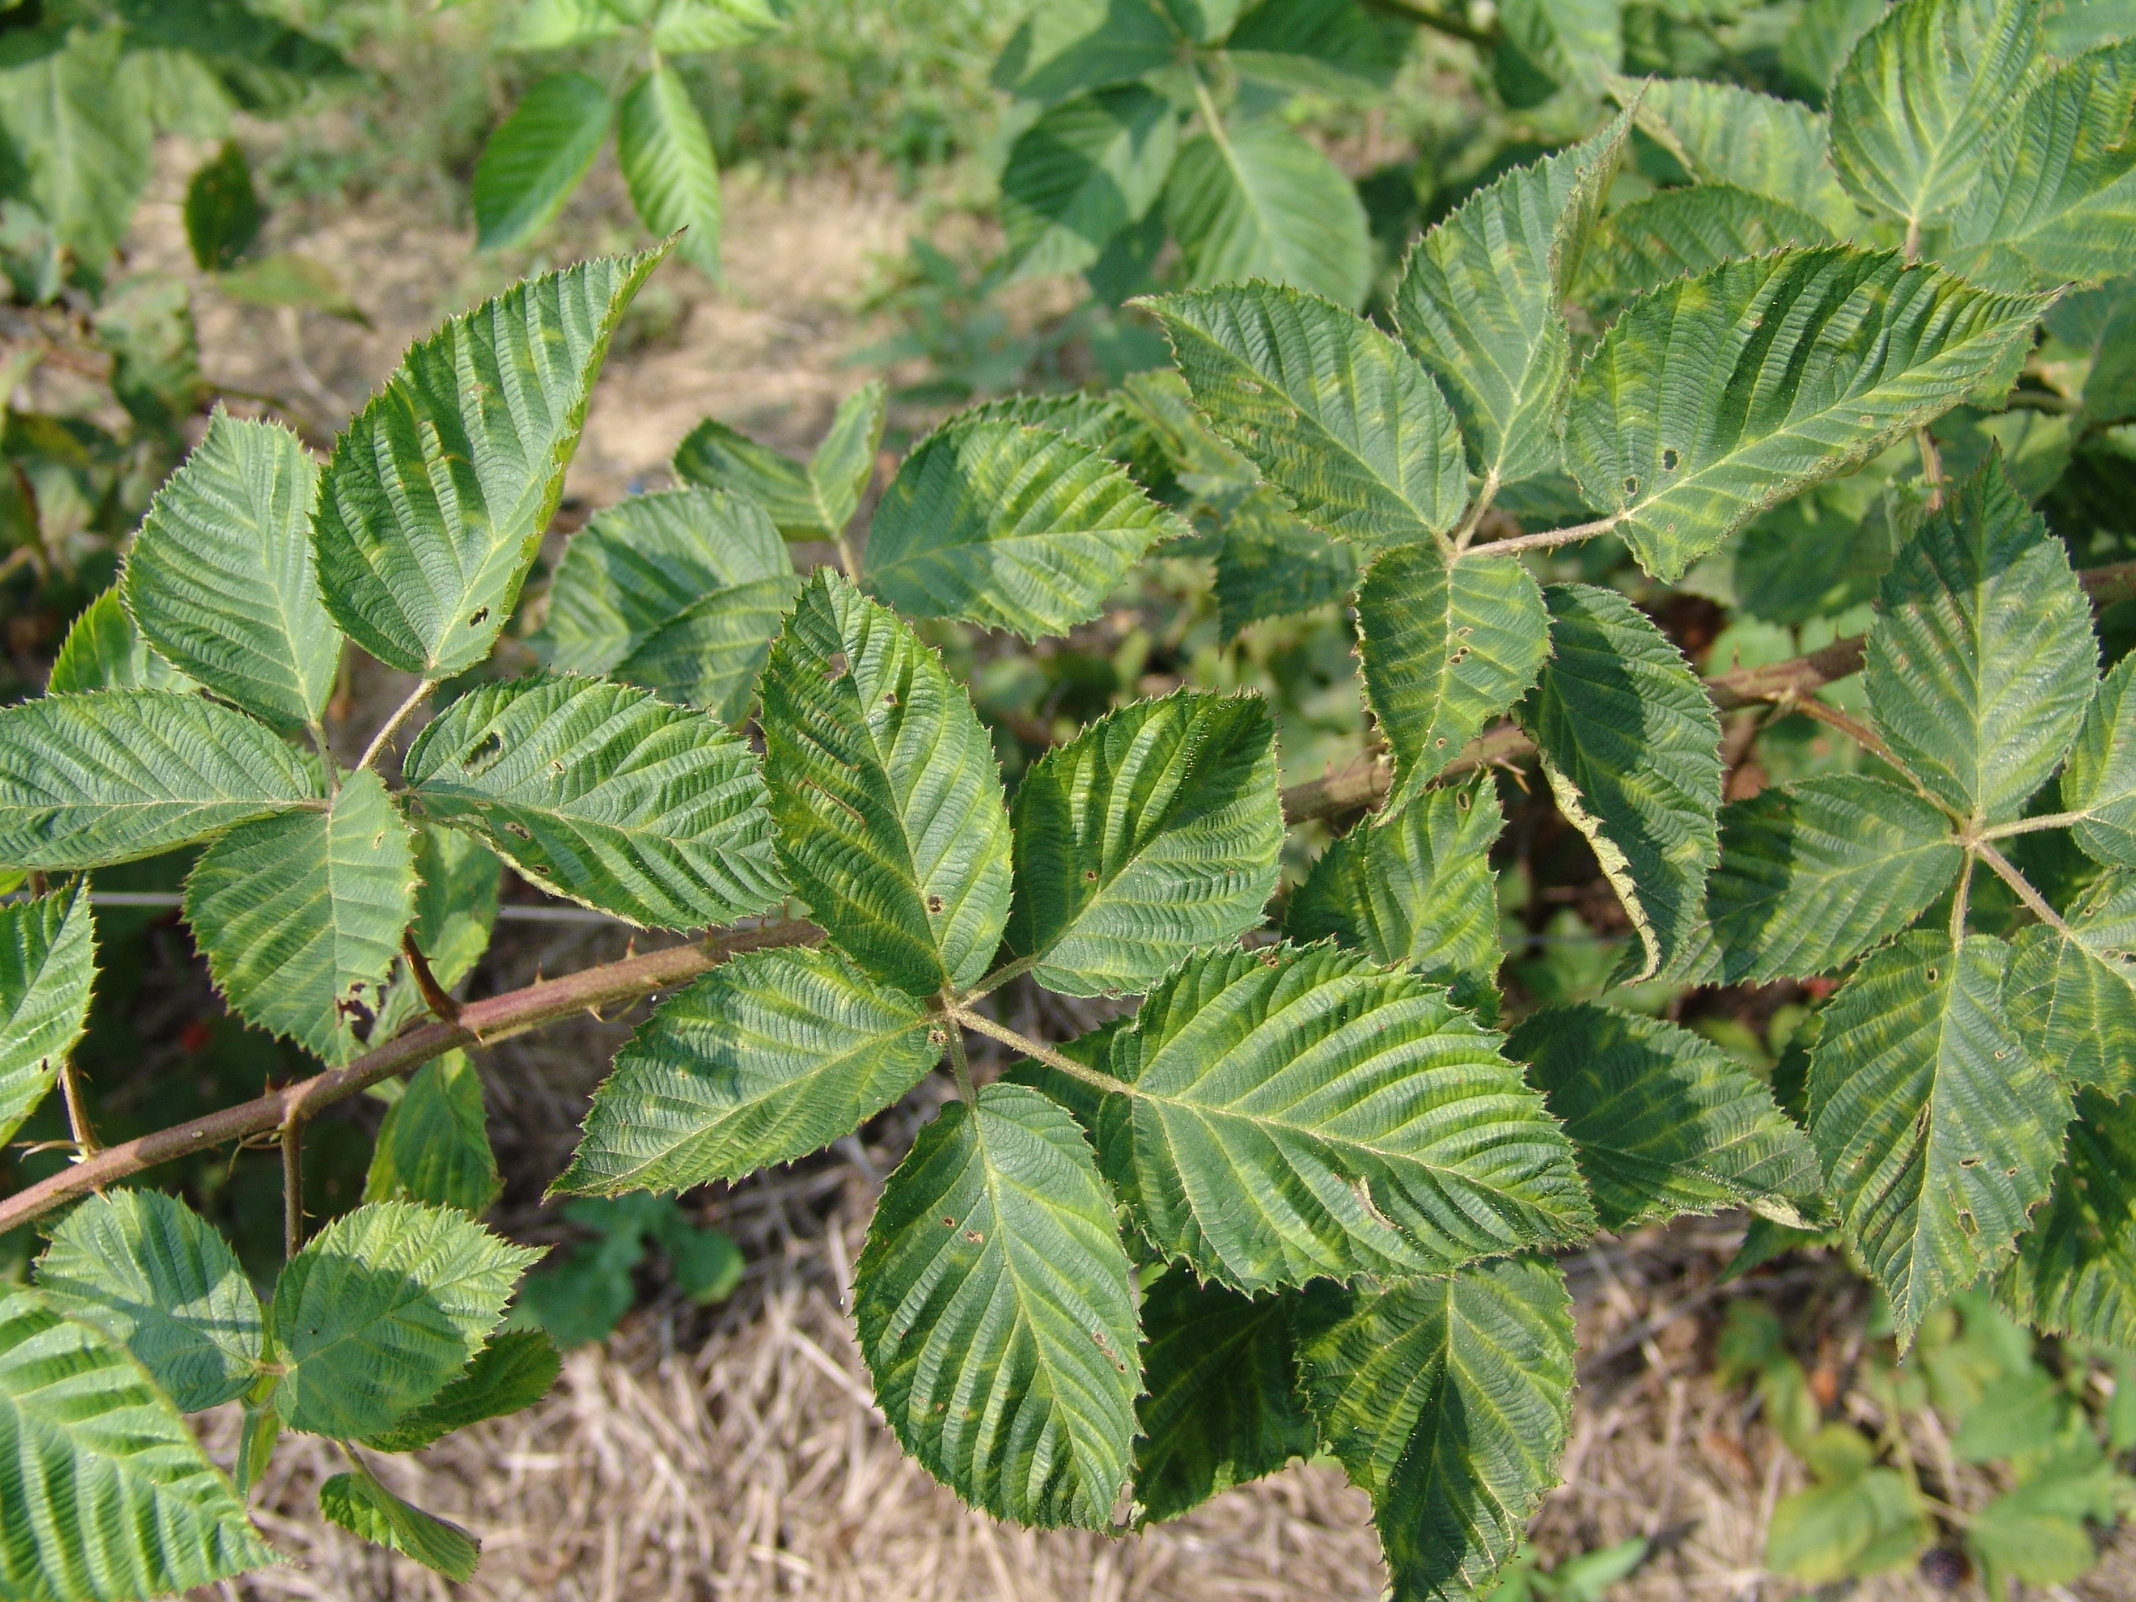
Viruses: The big problem in blackberries
Photo: Phil Brannen

Slide 43
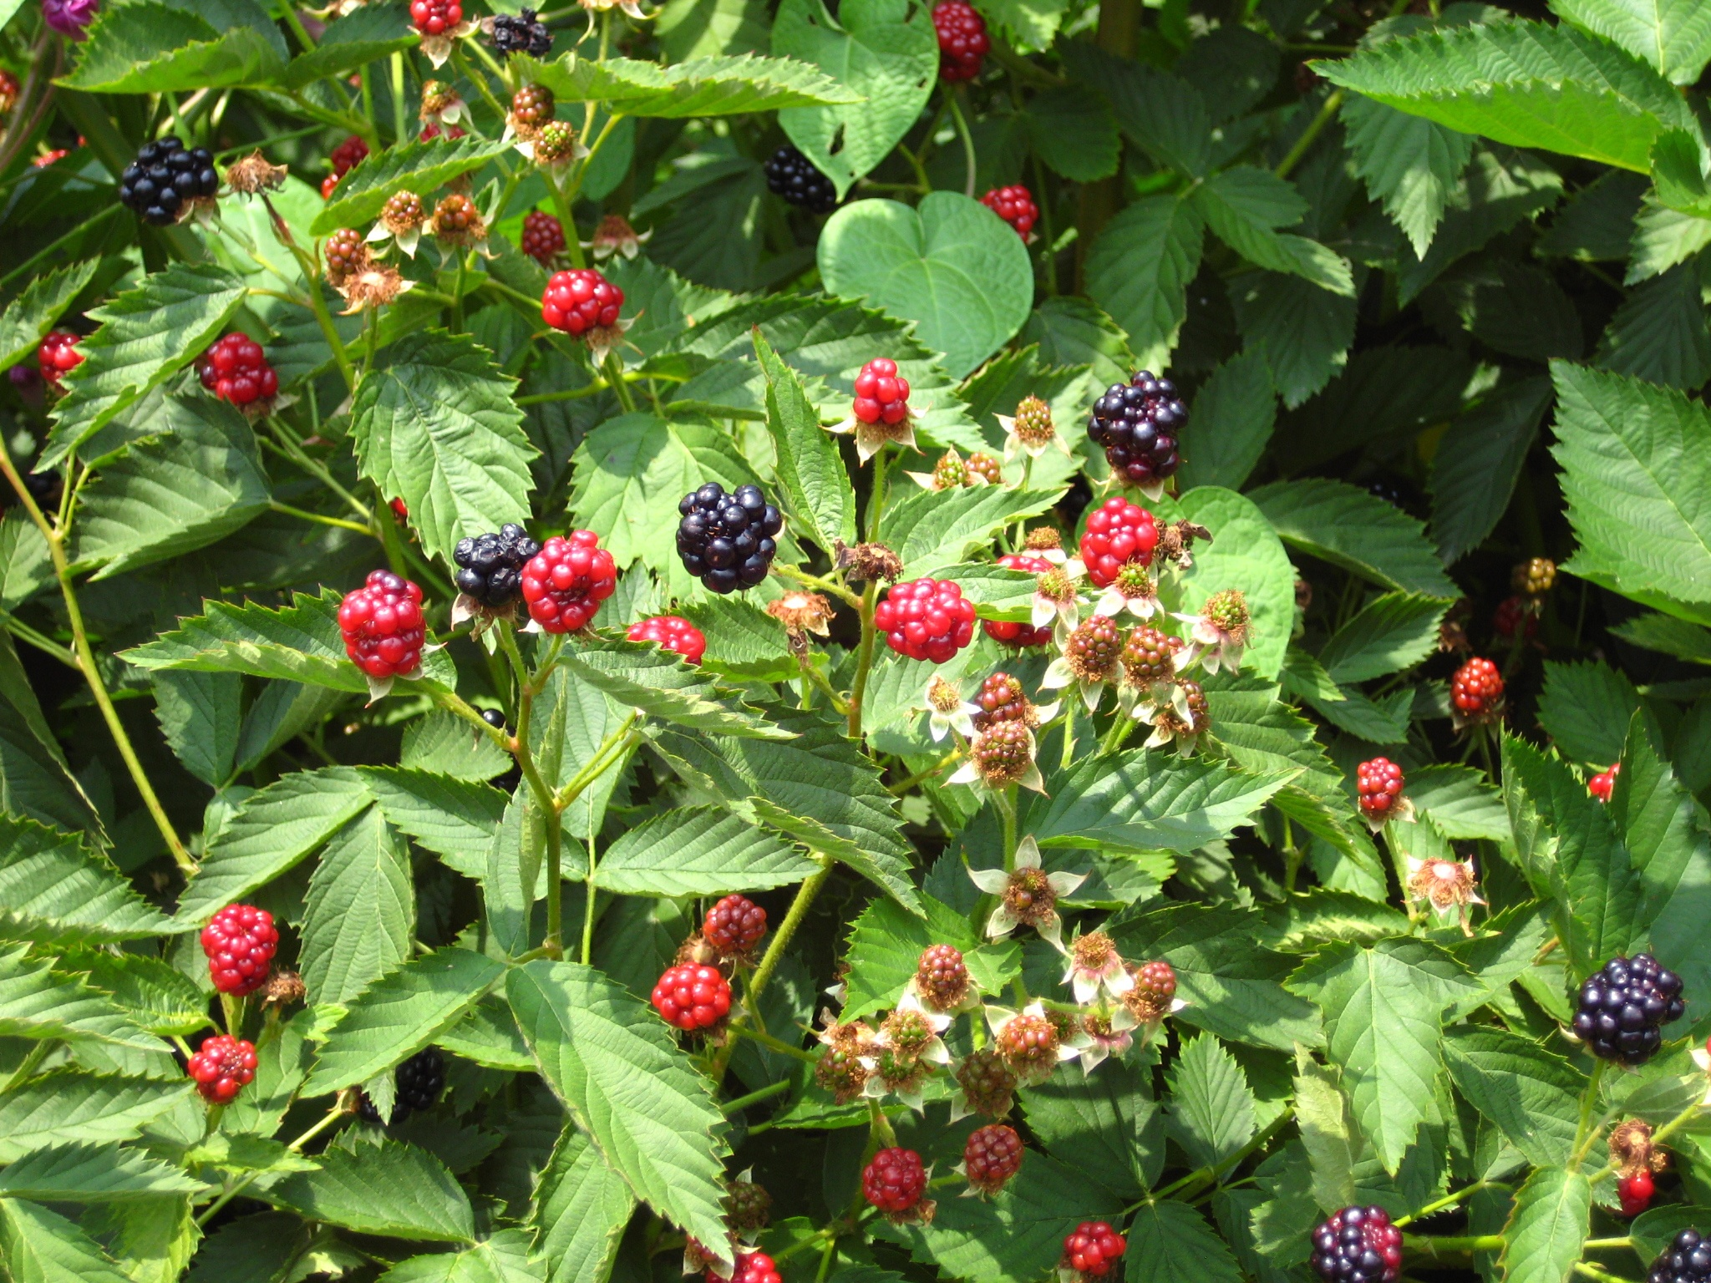
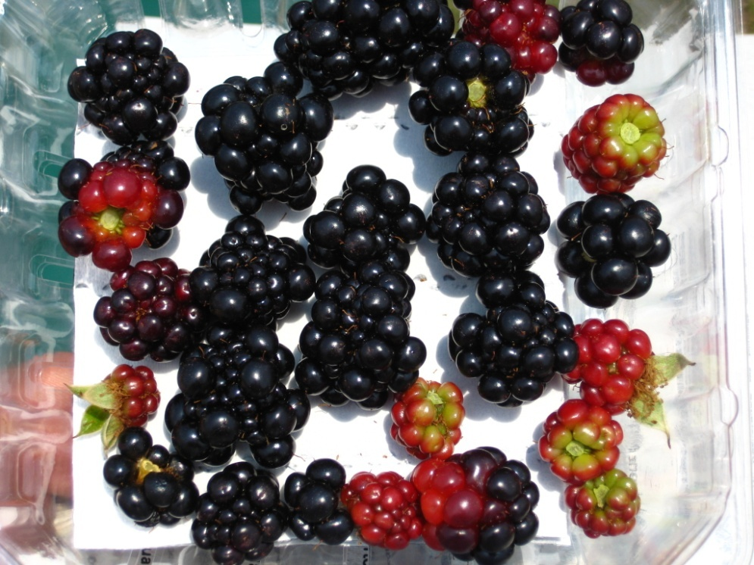
How can you tell infected nursery stock?
Photo: Josh Beam

Slide 44


Slide 45
Erect Blackberry Growth Habit
First year canes are trailing
Second year canes are upright
Each cane lives for two years. Cane grows without fruiting in year one (primocanes), fruits and dies in year two (floricanes)

Slide 46
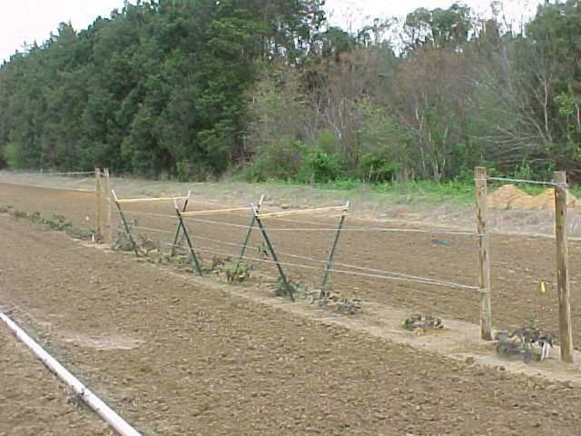
Erect Blackberry Trellises
Trellis are optional for erect blackberries
However, a trellis improves the production and make the planting neater in appearance
A “V” trellis is ideal

Slide 47
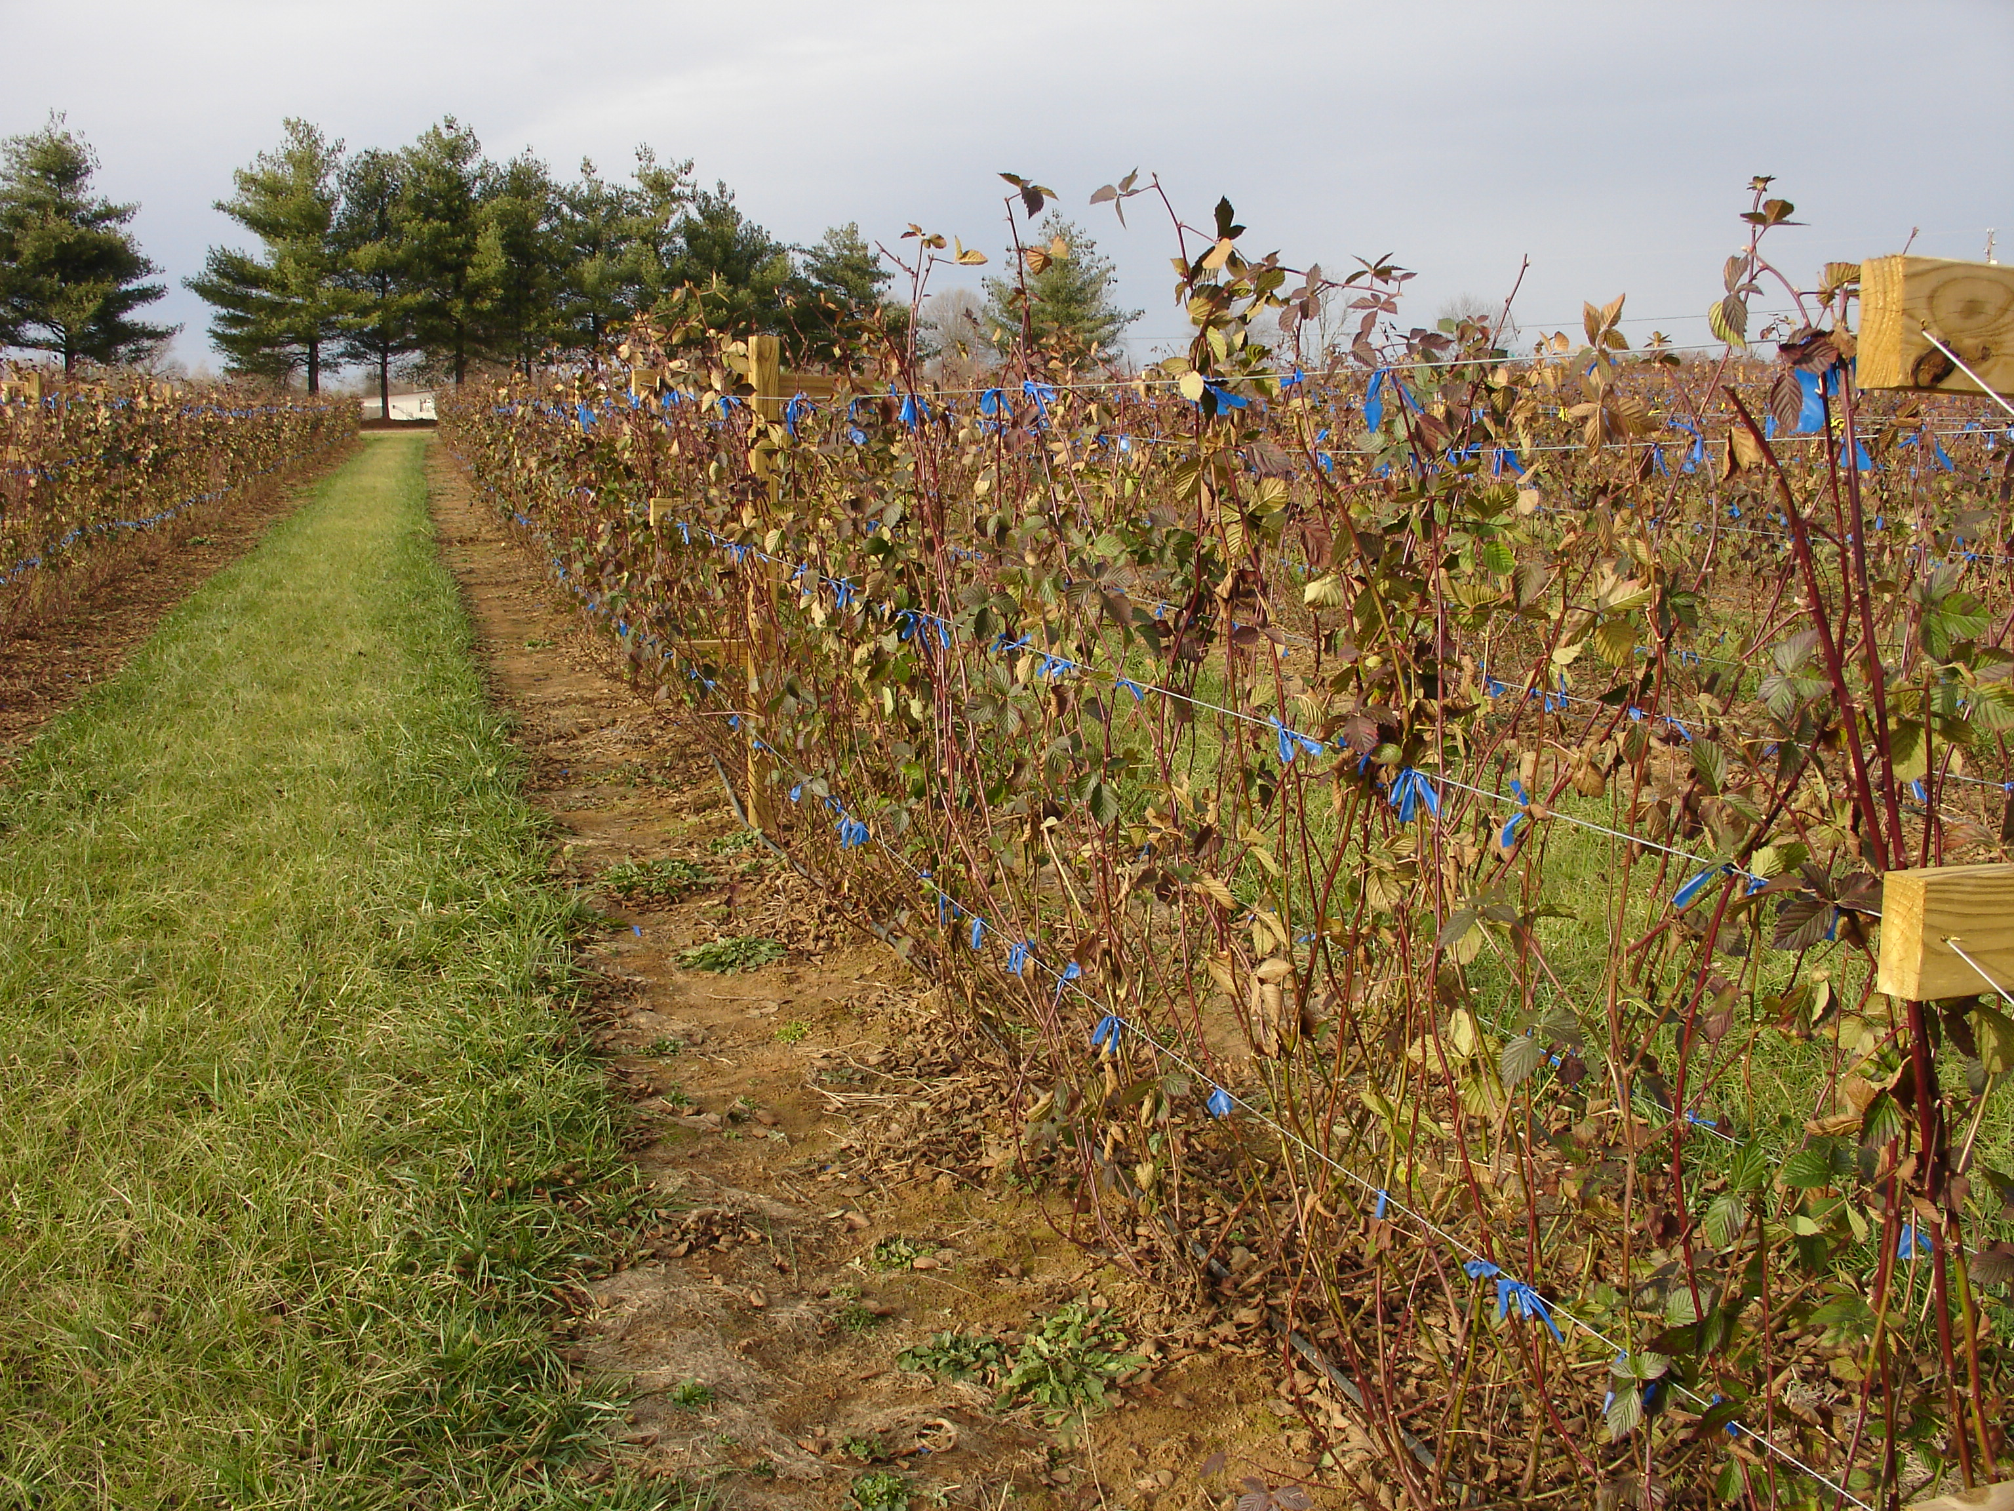
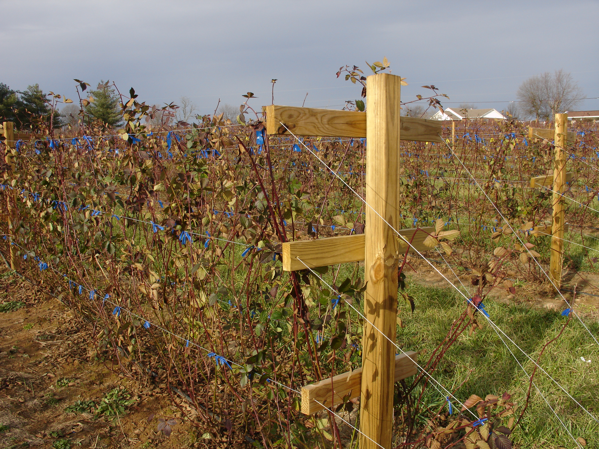
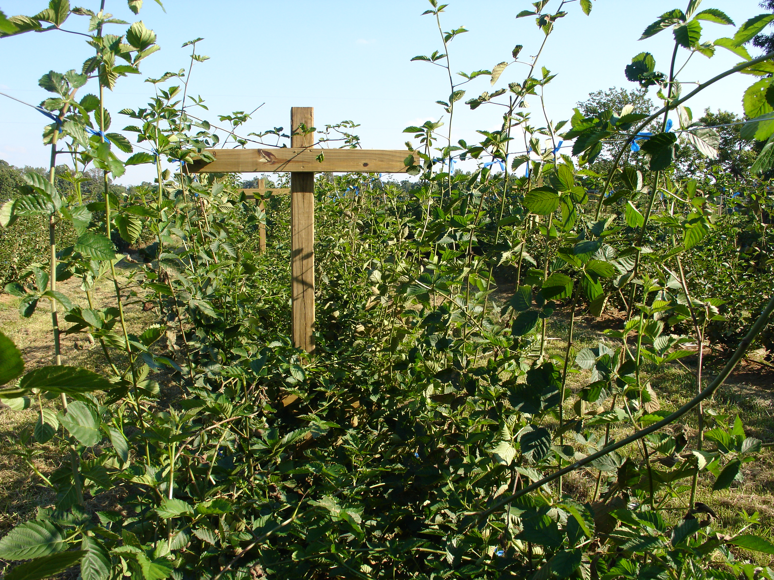
Treated 4’ by 4’ System
Courtesy of Wayne Mitchem

Slide 48
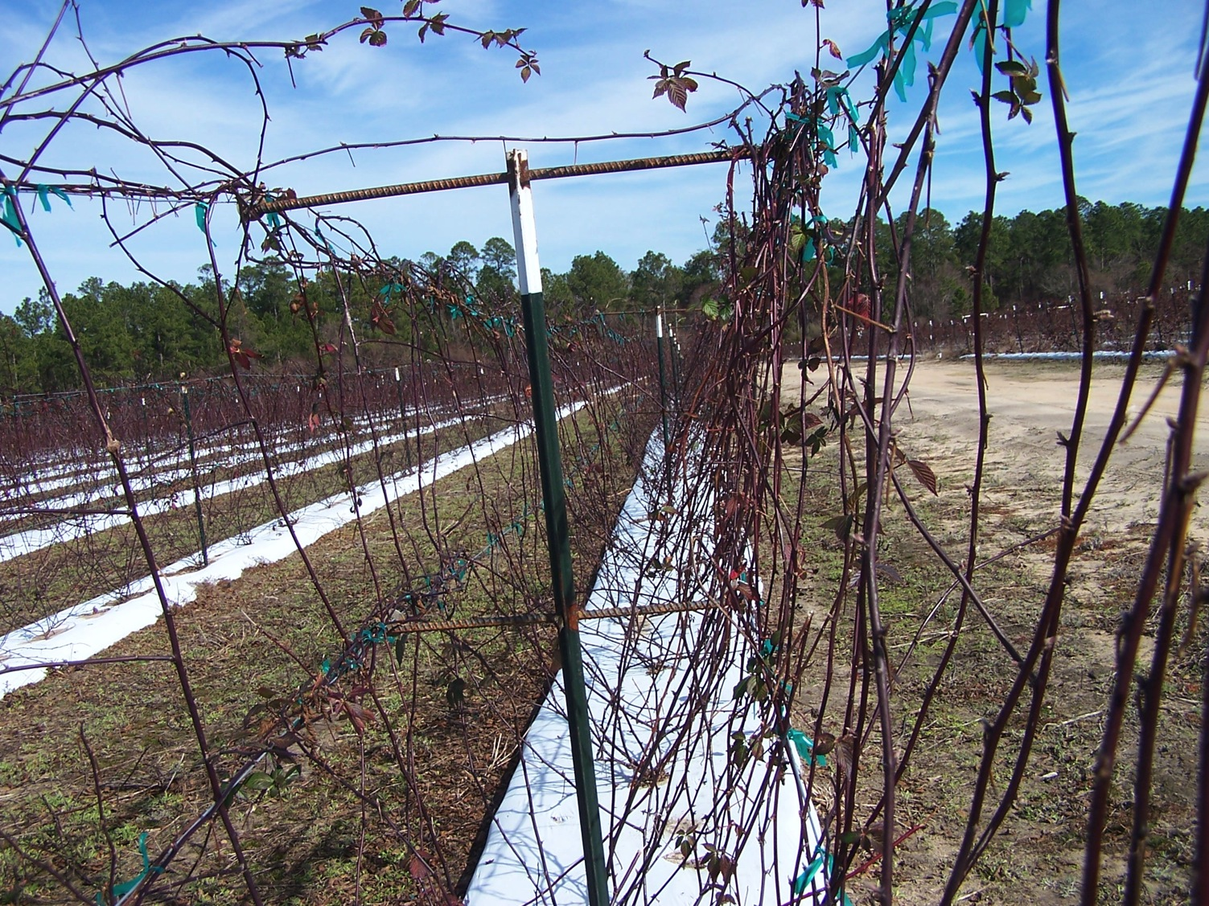

Slide 49
Two types of blackberries
Trailing, set 6-8 feet apart
Erect, set 3-4 feet apart (Erect are really semi-trailing in habit)
Erect types are usually the best in Georgia

Slide 50
Erect Blackberry Pruning (non-primocane fruiters)
Blackberry canes grow in year one, then fruit and die the next.
After fruiting remove all of the old canes (floricanes) and pinch the tips on vigorous current season canes (primocanes) several times during the season to keep the bushes shorter

Slide 51
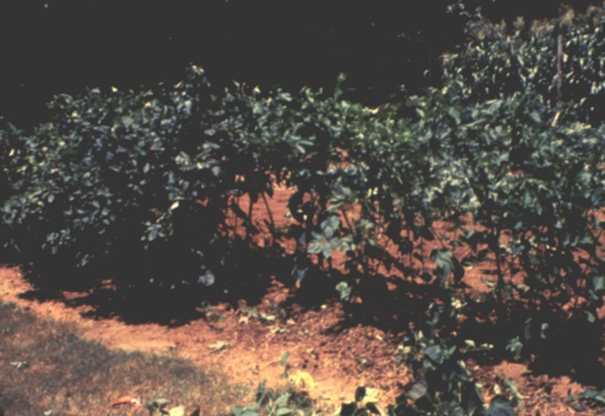
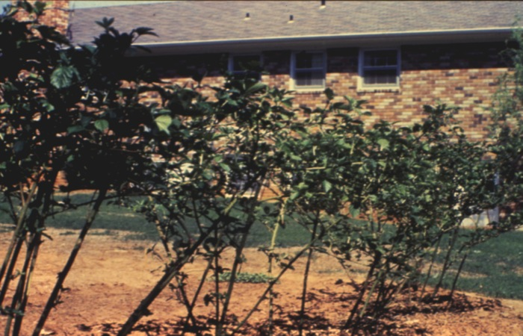
Erect Blackberries
Pruning and training:
Summer tipping of primocanes
Dieing floricane removal

Slide 52
Fertilization
Fertilize twice a year
Fertilization requirements are modest

Slide 53
Raspberry -Hard to grow but everybody has to try
Two types
Primocane fruiting (late summer and fall fruiting on tips)
Floricane fruiting (spring fruiting)

Slide 54
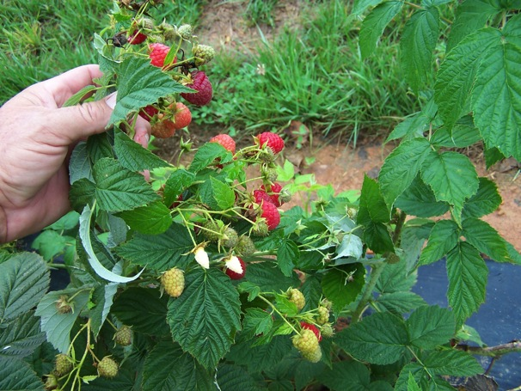
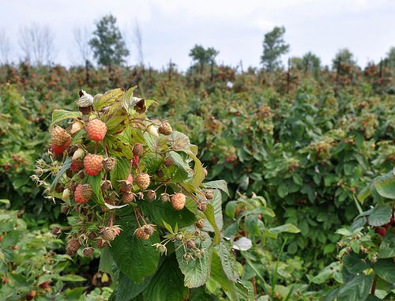
Primocane
Fruit on current season’s growth in late summer and fall on tips
Usually mowed to the ground during the winter
If canes are left they will fruit the following year below the tips

Slide 55
Floricane Fruiting
Bear on second year canes

Slide 56
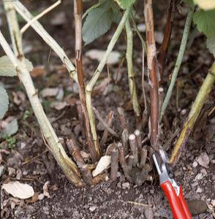
Floricane raspberry pruning
Remove old fruiting canes after harvest
Thin new floricanes to 6-8 per linear foot of row

Slide 57

Raspberry trellises
A V trellis is the best for the floricane types.
New canes come up in the center

Slide 59

Raspberries- Floricane
Dorman Red (most hardy)
Latham
Nova

Slide 60

Floricane Raspberries
Salisbury, NC (photo: Courtesy Dr. Fernandez)

Slide 61

Heritage
Caroline
NC450
Nantahala (NC 451)
Primocane raspberries
Picture: Dr. Gina Fernandez
Notes:
61

Slide 62

Photo: Dr. Gina Fernandez

Slide 63

Nantahala
Late primocane fruiting
Larger than Heritage and Caroline
Yields lower than Caroline
Rated as good or better than others in sensory panel evaluations
Notes:
63

Slide 64

Blueberries
White blooms
Bluefruit
Red fall color on some

Slide 65
Blueberry Species in Ga.
Northern Highbush- Adapted to the Mountains of Georgia.
Southern Highbush- Adapted to all areas of Ga., but climate and cultivars must be matched up (genes from Darrow’s Evergreen Blueberry-many low chill)
Rabbiteye-Best home garden type-adapted to all of SE except highest mountains, grows well in lower Georgia mountains.

Slide 66

The Callaways have a Vision
UGA Board of Regents Member
Mr. Callaway planted blueberries and muscadines at his Bluesprings Plantation in mid-1930’s
Mostly N.J. and W. Fla. Blueberry types

Slide 67

Mr. Callaway produced blueberries and muscadine commercially on his plantation
Lobbied the legislature to create two positions in fruit breeding at UGA
Blueberries-1944
Muscadine-1947

Slide 68

UGA Alapaha Station-1945
Dr. Brightwell looks for a good blueberry site. MSU grad.
Flatwoods site only 25 miles from Tifton. Typical of SE Ga.
Too remote to ever be appropriated for a new building.

Slide 69

Three Generations of blueberry breeders
Dr. Tom Brightwell
Dr. Max Austin
Dr. D. Scott NeSmith
Now Georgia has 12,000 acres of blueberries and 1500 acres of muscadines
Major economic engine in S.E. and S. Central Ga.

Slide 70


Slide 71

Some Southern Highbush Cultivars
Star (Blooms very early)
O’Neal (Blooms very early)
Windsor
Legacy

Slide 72
Rabbiteyes for the Piedmont
Premier (early season)
Vernon (early season)
Alapaha (early season)
Climax (early season)
Brightwell (mid season)
Tifblue (late season)-good fall color
Powderblue (late season)
Ochlockonee (v. late season)

Slide 73


Blueberry
Pollination:
Rabbiteye – long bloom period; use 3 different varieties for best results
Southern highbush – 2 varieties OK

Slide 74
Planting Blueberries
Blueberries grow best at a pH of 4.0 to 5.3 in sandy soils or 4.5 to 5.3 in heavy soils.
Sulfur can be used to lower the pH
See your UGA soil sample print out
Apply at least 6 months before planting for best results
Can be applied post plant at the rate of 300 pounds per acre

Slide 75

Acid organic matter requirements
Rabbiteye grow best in a soil with 2% or more organic matter.
Highbush grow best in a soil with 3% or more organic matter.
Mix wet peat moss or milled pine bark in the planting hole soil or apply strip treatment.
Use a mix of 50% soil and 50% acid amendment
Avoid compost!!!

Slide 76
Planting Blueberries and other Containerized Plants
Break up root ball and tease out the roots
Plant the same depth the plant grew in the nursery

Slide 77
Mulching
Most fruit plants respond well to mulching
Pine bark, pine straw, wheat straw or leaves works well
If soil is soil has a high pH use pine bark.
Occasional problems with voles are seen, be on the look out for these

Slide 78
Blueberry Fertilization
Apply ounce of 10-10-10 per foot of bush height in the early Spring and July on rabbiteyes
Fertilize southern highbush and highbush three or four time a year.

Slide 79

The names of plant parts: Roots, crown, canes, shoots
Pruning slides courtesy of Dr. Mike Mainland- NCSU

Slide 80
Blueberry Pruning
Rabbiteye and Highbush: When the plants are about 6 years old starting removing about 15% of the canopy each year. This is usually one or two canes per year.
Set the height at about 7 feet.

Slide 81
Special Pruning on Southern Highbush and Highbush
These types often set more fruit than rabbiteyes.
Remove twiggy growth during the winter.
Leave strong wood four to six inches long

Slide 82

Weak (poor) fruiting shoots produce small berries that are slow to ripen and have reduced flavor.

Slide 83

Fruiting canes: Productive fruiting canes will have many vigorous fruiting shoots and few or no weak or dead shoots. These shoots should have large flower buds

Slide 84
What would you prune?

Slide 85

Grape Types
1.European bunch grape- Vitis vinfera -Merlot, Syrah, Chardonnay, etc.
2.American bunch grapes- Vitis labrusca -Niagara, Fredonia, Concord, etc.
3.French hybrids. Group 1. x 2. Seyval, Chambercin
4.Other American species- Norton/Cythiana
5. Pierce’s disease resistant hybrids
6. Muscadines- V. rotundifolia

Slide 86
Bunch Grapes
A bacterial disease (Pierce’s Disease) clogs the xylem of the plant and limits where certain bunch grapes can be grown.
Generally American bunch grapes and their hybrids are preferred for home garden production. Less spraying required than with European grapes.
Below 1300 feet Pierce’s Disease resistant cultivars are best.

Slide 87
Pierce’s Disease Resistant Bunch Grapes
Miss Blue-jelly
Blanc Dubois-white wine
Norton / Cynthiana-red wine
Black Spanish-red wine

Slide 88
Planting Bunch Grapes
Generally set about 10 feet in the row and 10 feet between rows.
Single wire trellis or two wire horizontal trellis

Slide 89

Muscadine Grapes
Vitis rotundifolia
Native grape resistant to Pierce’s Disease
Excellent home garden fruit for table, jelly and wine
Table cultivars are one inch diameter plus.

Slide 90

Grape pollination
Bunch grapes are self pollinating
Muscadines: female cultivars need cross pollination
  Scuppernong, Summit, Fry, Jumbo, Hunt
Self-fruitful: Carlos, Cowart, Dixiland, Tara
Plant at least 1/3 self-fertile
Female
Self-fertile

Slide 91

Some muscadine cultivars
Fry (bronze, female, table use)
Summit (bronze, female, table use)
Cowart (black, self-fertile, table/jelly)
Carlos (bronze, self-fertile, white wine)
Nobel (red wine)

Slide 92
Muscadine Grapes
General spacing is 12 between rows and 20 feet in the row.

Slide 93


Grapes
Training and pruning:
Spur vs cane
Spur pruning is typical

Slide 94

Grapes
Train young vines to the wire

Slide 95



Grapes
Bunch grapes
Space spurs 6-12” apart on cordons, leave 2-6 buds
Muscadines: 3-4”

Slide 96


Grapes
Muscadines: turn into kudzu if not pruned

Slide 97
Figs
Figs are an excellent home garden fruit in the Piedmont and Coastal Plain of Georgia
Plant adapted cultivars for best results

Slide 98

Recommended Fig Cultivars for Georgia
Plant only cultivars with closed or sap plugged eyes
Celeste
Alma
LSU Purple
Kadota

Slide 99

‘LSU Gold’
New fig from LSU breeding program
Very productive in Valdosta
Ripens July-Aug. in South Georgia
Just Fruit and Exotics

Slide 100

‘O’rouke’
New release from LSU
Very good for drying and preserves
Ripens mid-July to mid-August in South Georgia
Just Fruits and Exotics

Slide 101

‘Tiger’
New release from LSU
Productive with a fairly tight eye
Ripens mid-July to mid-Aug. in South Georgia
Just Fruits and Exotics

Slide 102
Figs
Plant about 15 feet apart
Avoid areas infested with root knot nematodes
Fertilize in March and July

Slide 103
Fig Pruning
Height can be controlled by pruning back to outward growing limbs
Thin the number major canes to 8 to 10 if needed.

Slide 104

Jujube or Chinese Date (Ziziphus jujuba)
Medium size deciduous tree
Native to China where over 800 cultivars are know.
Cold hardy
Produces a fruit that can be eaten like an apple or dried like a date
Best grafted
Apparently will set without cross pollination

Slide 105

GA 866 Jujube
Cultivar from the USDA station at Chico, Cal.
Sweet, crispy fruit

Slide 106

‘Tiger Tooth’ Jujube
Sweet and flavorful jujube

Slide 107
Kiwi
Kiwi have performed well fairly well from Macon south
Very susceptible to drought and root knot nematodes when young

Slide 108
Kiwi types
Two types
Actinidia chinensis
Common fuzzy grocery store type
Actinidia arguta
Fuzz-less kiwi sold like berries in clam shells

Slide 109

Fuzzy Kiwifruit or Money Peach (Actinidia deliciosa)
Formerly grown commercially to a limited extent in Georgia
Hardy to about 10 degrees F
Best region appear to be the middle Georgia area
Provide trunk production while young
Don’t plant in wet or root know nematode infested areas

Slide 110
Kiwifruit Cultivars
Hayward- Female
Bruno-Female
Matua-male
Tomuri-male
New yellow fruit types available from Auburn

Slide 111

Cold Hardy Kiwi
(Actinidia arguta, others)
Smooth skinned and eaten like grapes
Several cultivars have been grown with success
Anna
Ken’s Red
Lone Star
Just Fruits

Slide 112

Mayhaws (Cratageus aestivalis, opaca and rufula)
Native to the Coastal Plain with concentrations in the lime sinks of SW Georgia.
Typically know as “mayhaw ponds”

Slide 113


Mayhaws
One of the very few spring flowering trees that thrive in wet areas
Produce tart tasting fruit with uses similar to cranberries

Slide 114


Mayhaw

Slide 115


Excellent for jelly and syrup

Slide 116

Cultivars
Recent breeding developments in Louisiana
In Georgia trials ‘Super Spur’, ‘Big Red’ and ‘Turnage 57’ have performed well
Mr. Burl Turnage from Albany, Ga. has been the leading authority in the state

Slide 117

Mulberry (Morus sp.)
Red (rubra) native
White (alba) China
Black (nigra) W. Asian
Large deciduous trees
Excellent for attracting birds
Voted #1 fruit by the Georgia Carwash Owners Association

Slide 118

Georgia and Mulberries
History of Georgia is interwoven with mulberries
The Trustees promoted silk production and thousands of trees were planted
The Queen of England wore gowns made of Georgia silk

Slide 119

Giant Mulberries
Pakistan mulberry
Expert in this field is Dr. A. J. Bullard
Too large for the birds to easily eat
2.5-3.5 inches by 0.4 inches

Slide 120

Wacissa Mulberry
Black mulberry
Selection from North Florida with 1.5 inch long fruit

Slide 121

Pawpaw (Asimina triloba)
Slow growing decidious tree native to Georgia
Needs shade to establishment
Produces rich, custard flavored fruit with slight wet sock odor
Very addicting

Slide 122

Pawpaw
Cultivar trial at the Tifton Experiment Station
Dr. Desmond Layne at Clemson is the expert
Overleese, Sunflower

Slide 123

Asian Pears
Korean Giant
Shinko
Yoinashi
Hybrids:
Kieffer-preserves
Orient-general purpose-canning
Spalding-fresh
Willis Orchards

Slide 124


Slide 125

Asian Pear (Pyrus pyrifolia)
Cold hardy
Best grafted on to Callery pear root stock.
Susceptibility of cultivars to bot canker and fireblight varies greatly
Some limited commercial production in Georgia

Slide 126
Peaches
In the Piedmont plant cultivars with a chilling requirement of 750 hours or more.
Religious spraying is necessary
Back pew gardeners should plant early ripening cultivars….only one generation of worms

Slide 127

Peach cultivars
Many to choose from
Surecrop
Summerprince
Sureprince
Redhaven
Nectar (white)
Majestic
Windblo
Loring
Dixieland
Jefferson
Autumnprince

Slide 128
Plums
Byrongold
Robusto
Rubyprince
Segundo

Slide 129

Japanese or Oriental Persimmon
(Diospyos kaki)
Small deciduous tree
Our native persimmon (Diospyos virginiana) is commonly used as the rootstock.
Most cultivars are female flowered and will set fruit without pollination, but fruit size and retention is better with pollination (seeds)

Slide 130

Fruit Types in Persimmon
Astringent- need to be soft before eating
Non-astringent- eat like an apple, great on salads
Pollen constant- with seeds the fruit is “clear”
Pollen variant- with seeds tannin spots are present

Slide 131
U of Cal

Slide 132

Sheng Persimmon
Astringent but cold hardy
Has performed well in Middle and North Georgia
Very good quality
Just Fruit and Exotics

Slide 133

Saijo Persimmon
Astingent but very high quality
Performs well in South Georgia
Sept. through Oct. in South Georgia

Slide 134

Fuyugaki Persimmon
Fuyu and Jiro are good choices for non-astringent persimmons
Not at cold hardy as Great Wall and Sheng
Produces good quality fruit in Oct.

Slide 135
Pomegranate (Punica granatum)
Large shrub or small deciduous tree
Hardy to about 12 degrees F
Both tart and sweet types are available
Fruit are borne on current season’s growth
Attractive flowers
Flowers can be vase shapes (sterile) or bell shaped (fertile)

Slide 136
Pomegranate History
Persephone was kidnapped by Hades and carried to the Underworld
Her mother begged Zeus to allow Persephone to return
Zeus agreed on the condition Persephone had not eaten any food
in the Underworld. However, she had eaten a few pomegrate seeds
􀁺 So Zeus decreed that Persephone should spend part of each year on earth
(Spring, Fall, Summer), and part in
the Underworld (Winter).
U. Of Cal.

Slide 137


Pomegrantes
Best performing cultivars in South Georgia
Afganski (R-26)
Kaj-Acik-Anor (R-9)
Nikitski Ranni (R-19)
Cranberry
Crab

Slide 138


Slide 139


Slide 140

Strawberry
Two very different types and cultural systems can be used.
Annual hill system with California or Florida cultivars
Matted row with northern cultivars

Slide 141

Strawberry
Annual hill or “plasticulture”

Slide 142


Strawberry
Annual hill or “plasticulture
High yields, good quality, avoids many pest problems
More expensive and time consuming

Slide 143
Annual Hill System
Form raised beds 26 inches wide
Lime and fertilize as needed
Commercial growers use black plastic with drip tape under plastic
Plant in early Oct. if possible
Use only Chandler, Camarosa, Sweet Charlie, Festival, etc. (California and Florida types)
Regular matted row cultivars are not productive
Don’t plant too deep!!
Set plants 12 inches by 12 inches
Use plug plants or cut off leaves if bare root

Slide 144
Annual Hill System
Plants will form branched crowns-a tree like structure
Pick off all dead leaves and flower in late winter
Pick off runners in spring
Fertilize like a vegetable crop in the spring. Keep actively growing all spring, if temperature are moderate you will keeping getting more flowers
Plow up in June
Rotate to another site next year.

Slide 145

Laying Plastic
You can lay plastic manually or use pine or wheat straw as mulch
Be sure to adjust pH (lime) and fertilizer before planting, especially phosphrous

Slide 146

Setting Plants
Containized (plug) plants are best, but bare root can be used.
Cut off the old leaves or very intensive watering is needed
Don’t “J” roots the plants, cut root off at five inches if needed
Don’t bury the growing tip!!!

Slide 147


Spring
Each plant will get the size of a dinner plant by summer
Production can be impressive
Sanitation (removal of dead leaves) is important

Slide 148
Additional information
UGA CAES web site
www.smallfruits.org

Slide 149

Thank you and have a great fruit season!
Questions: Dr. Gerard Krewer
229-392-1388

Slide 150


