Slide 1
Georgia Certified Landscape Professional
Plant Identification List
Notes:
Updated version 09/13/2011 11:15pm

Slide 2
Trees/Shrubs/Vines/Groundcovers

Slide 3
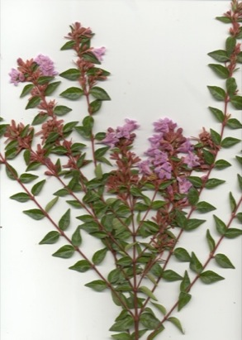
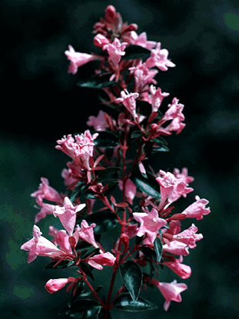
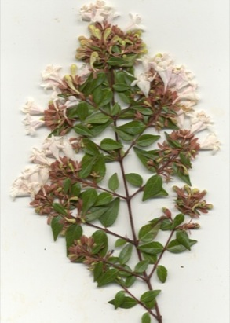
Abelia grandiflora
Glossy Abelia
Notes:
"Leaves are opposite, simple, dentate, glossy,
1/8 inch long petiole; purple-pink flowers are small and bell-shaped; semiglobal plant form; evergreen shrub used as a screen, foundation planting or in mass."

Slide 4
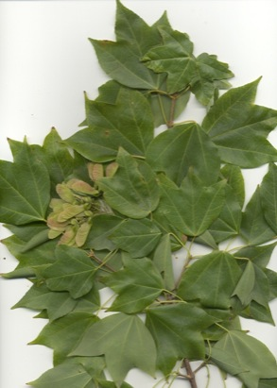
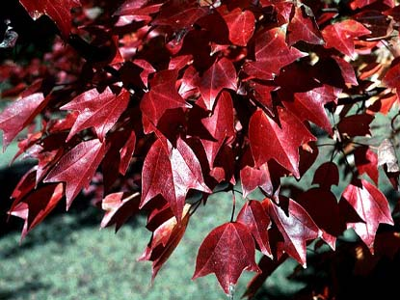
Acer buergerianum
Trident Maple
Notes:
Leaves are opposite, simple, 3 lobed, 1 1/2 to 3 1/2" high and wide. Margins are entire or slightly serrate towards apex of lobes. New growth is rich bronze to purple maturing to glossy dark-green in summer. orange and red fall color. 20-30' small tree. Exfoliating, scaly bark.

Slide 5
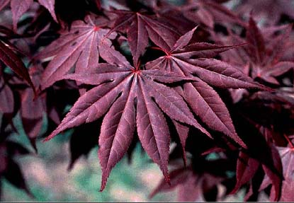
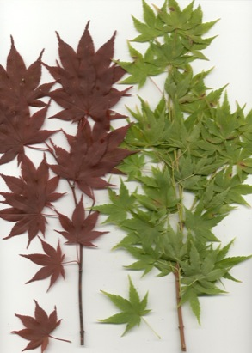
Acer palmatum
Japanese Maple
Notes:
"Leaves are opposite, deciduous, simple, palmately lobed, leaf margin is serrate. Leaf color is green during the summer then turning purplish-bronze in fall.
Fruit is a small purple 1/2-inch long sumara.
Small tree grows 15-25 feet high. This tree lends a aristocratic touch to the landscape."

Slide 6
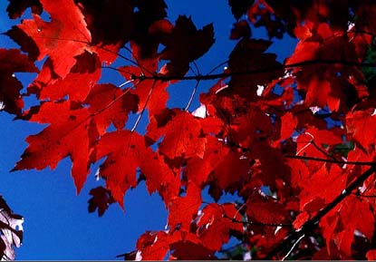
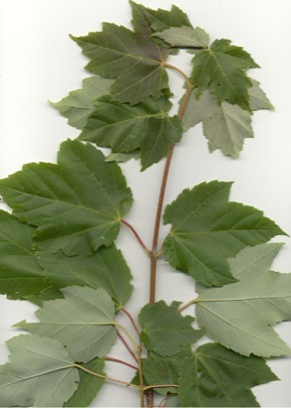
Acer rubrum
Red Maple
Notes:
"Leaves are opposite, simple, triangular and ovate-lobed, red fall color; young bark is smooth and light gray, old bark is rough and dark gray.
Rubrum means red in latin (hence the red foliage and the red stem)."

Slide 7
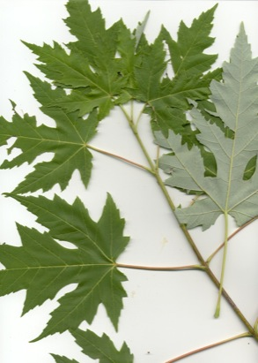
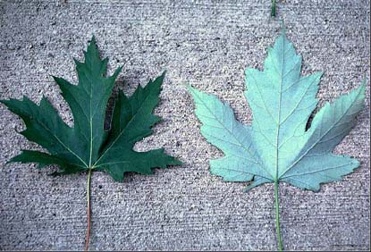
Acer saccharinum
Silver Maple
Notes:
Leaves are opposite, simple, 3 to 6" across, 5 lobed. Deeply and double acuminate lobes, the middle often 3 lobed. Rapid grower 50-70' or more. Fall color, is green-yellow-brown combination.

Slide 8
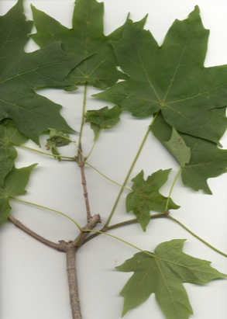
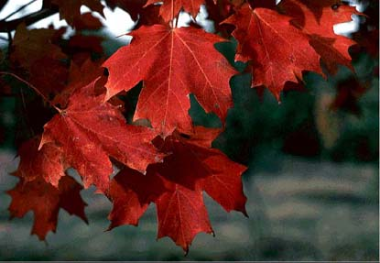
Acer saccharum
Sugar Maple
Notes:
Leaves are opposite, simple, 3 to 5 lobed, fall leaf color is brilliant yellow to burnt orange with red tones. Fruit is 1-2" long glabrous samara. One of the best of the larger landscape trees. Attains a height of 60 to 75 feet.

Slide 9
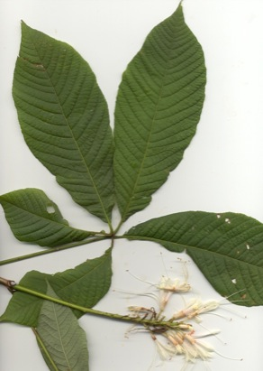
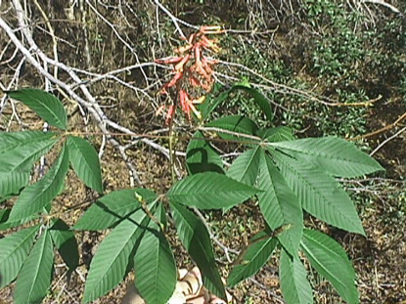
Aesculus pavia
Red Buckeye

Slide 10
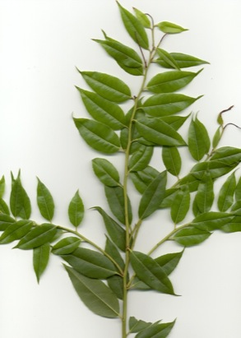
Agarista populifolia
Florida Agarista (Leucothoe)
Notes:
Leaves are alternate, glossy, deep green, lanceolate, 2-3 in (5.1-7.6 cm) long, and taper to an acute tip. The flowers, appearing in late spring, are creamy white, narrowly urn shaped, 1/3 in (0.8 cm) long, and borne in dense clusters that originate in the leaf axils. Pipestem is quite showy and the little flowers are sweetly fragrant.

Slide 11
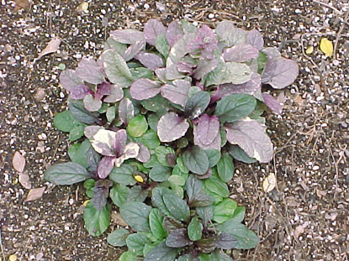
Ajuga reptans
Bugleweed
Notes:
The flowers on its 6” tall spike are two-lipped and tubular. Flowers are generally in hues of blue and purple but can be found in white and red. It is a drought-tolerant evergreen plant prized for its dynamic color that stays compact and thick year round. The oval glossy leaves are 3”-4” long and grow opposite each other in a rosette.

Slide 12
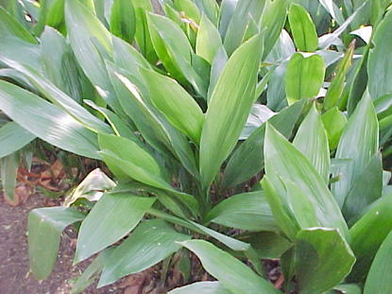
Aspidistra elatior
Cast-iron plant

Slide 13
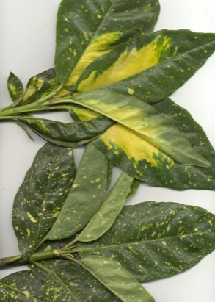
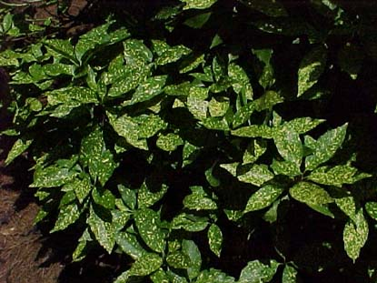
Aucuba japonica
Japanese Aucuba
Notes:
Leaves are opposite, simple, leathery, elliptic-ovate to elliptic-lanceolate, 3 to 8" long, 1 1/2 to 3" wide, acute to acuminate, broad cuneate at base, entire to remotely coarsely dentate toward the apex, glabrous, lustrous dark green above, lighter beneath; petiole - 1/2 to 2" long.

Slide 14
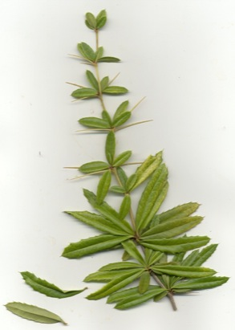
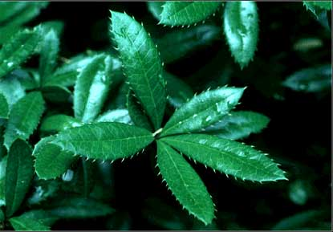
Berberis julianae
Wintergreen Barberry
Notes:
Leaves are alternate and often arranged 5 leaves at a node. Rigid, dark evergreen, narrow-elliptic shape, 2-3" long by 1/3-3/4" wide with spiny-serrate edges. Has sharp spines.

Slide 15
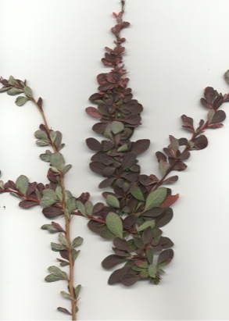
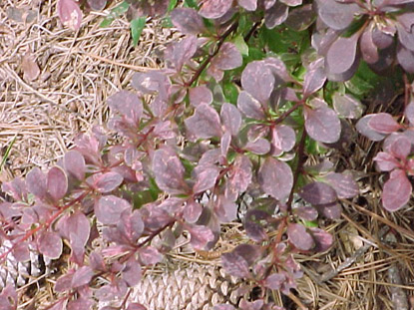
Berberis thunbergii
Japanese Barberry
Notes:
Leaves are alternate, simple and unequal in size, yellow flowers, fruit is a bright red berry in fall, used as hedge plant. Has barbs along the stems.

Slide 16
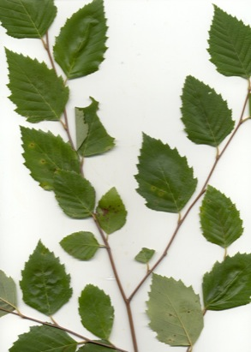
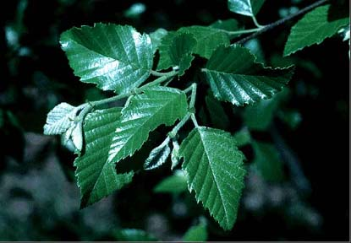
Betula nigra
River Birch
Notes:
Leaves are alternate, simple, sharp-pointed, doubly serrate, bark is brown to cinnamon and peels freely, fruit is a small nutlet. Also known as black birch (nigra means black in latin).

Slide 17
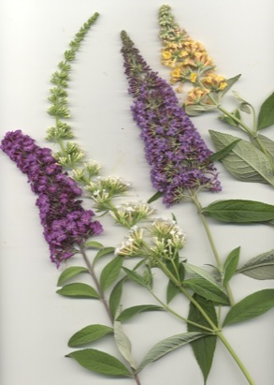
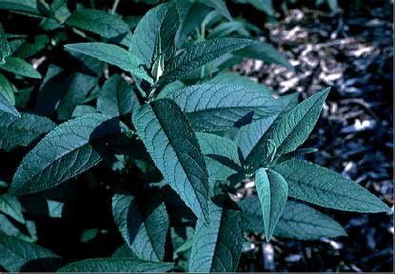
Buddleia davidii
Butterfly Bush
Notes:
Leaves are opposite, simple, ovate, 4 to 10 inches long, serrate, multi-colored flowers, valued for summer flowering.

Slide 18
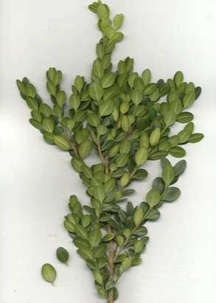
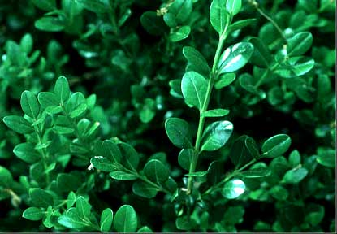
Buxus microphylla var. japonica
Japanese Boxwood
Notes:
Leaves are opposite, simple, obovate and more rounded than sempervirens. lustrous dark green. 3-6' high shrub better adapted to Southeast than sempervirens. Yellowish brown in winter.

Slide 19
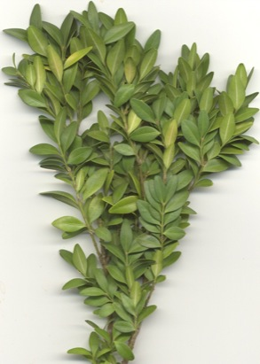
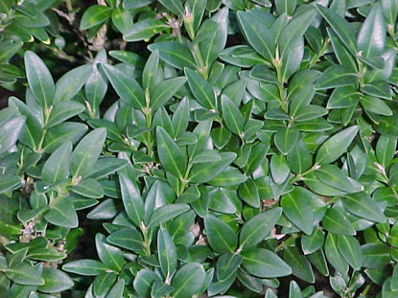
Buxus sempervirens
Common Boxwood
Notes:
Leaves are opposite, simple, ovate to oblong, dark green above, yellowish green below, used as a hedge in formal gardens.

Slide 20
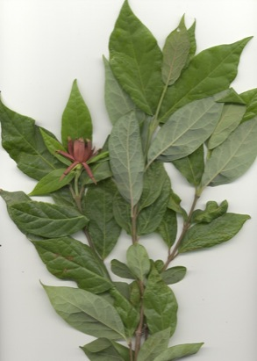
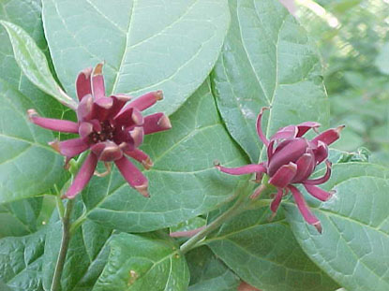
Calycanthus floridus
Sweet Shrub
Notes:
Leaves are opposite, simple, broad-ovate, dark green, entire with dark reddish brown or maroon flowers. Sweet, fruity fragrance. Adaptable to many different environments and very disease resistant.

Slide 21
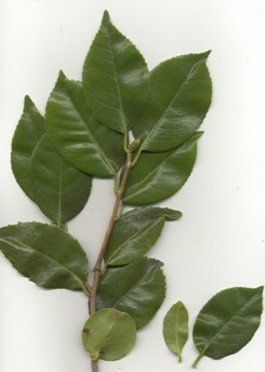
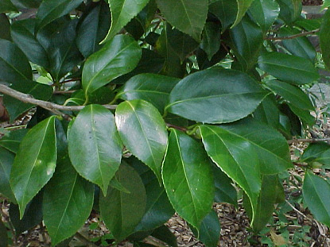
Camellia japonica
Japanese Camellia
Notes:
Leaves are alternate, simple, elliptical to ovate, 2-4 inches long, serrate, dark green, evergreen, non-fragrant flowers.

Slide 22
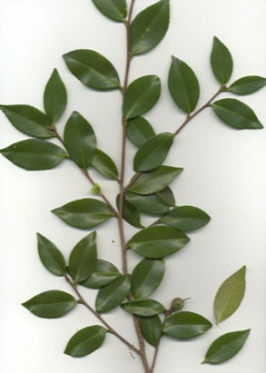
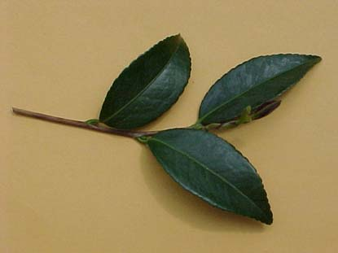
Camellia sasanqua
Sasanqua Camellia
Notes:
Leaves are alternate, simple, elliptical to ovate, 1-3 inches long, serrate, dark green, evergreen, flowers are 2-3 inches in diameter. Sasanqua = Small; the sasanqua variety is literally smaller than the japonica.

Slide 23
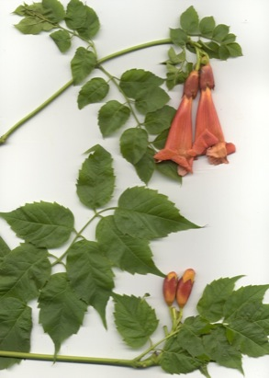
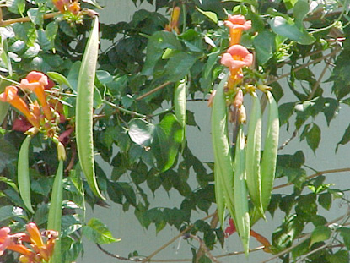
Campsis radicans
Trumpet Vine

Slide 24
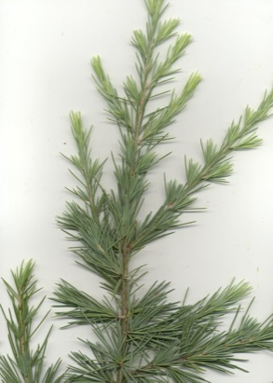
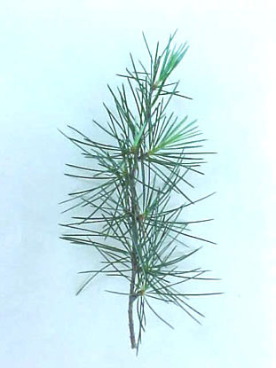
Cedrus deodara
Deodar cedar
Notes:
Evergreen conifer. dark green to slightly silvery foliage. 15-20 1-2" sharply pointed needles per whorl. Pendulous branches.

Slide 25
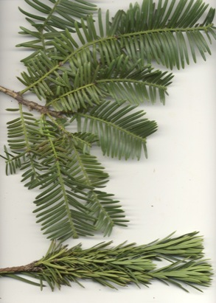
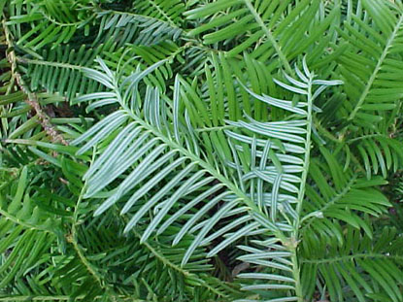
Cephalotaxus harringtonia
Plum yew
Notes:
"Evergreen needle leaves. Coniferous shrub. The needles, in two rows, rise up from the twigs forming a V- shaped trough, and are about 1.5 in (3.8 cm) long, sharp-pointed and slightly curve.
"

Slide 26
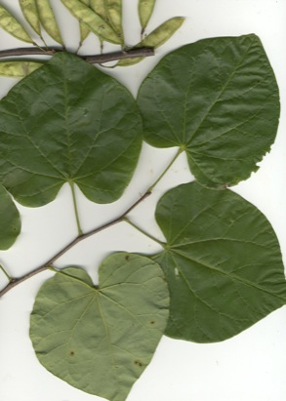
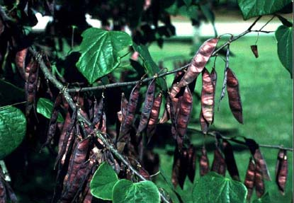
Cercis canadensis
Redbud
Notes:
Leaves are alternate, simple, broad-ovate, 3 to 5 inches across. A deciduous, small tree with rosy-pink flowers. Fruit is a true pod. Think that a heart is red, and the leaf of a redbud is heart shaped. The seeds of a redbud look like green beans!

Slide 27
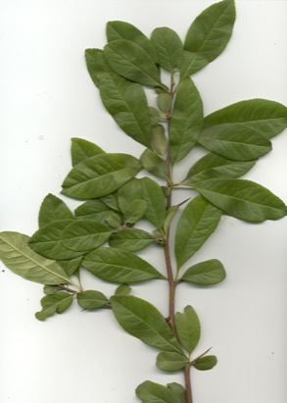
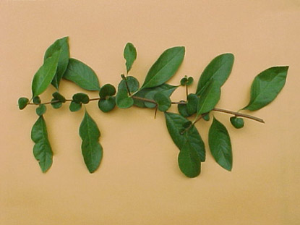
Chaenomeles speciosa
Flowering Quince
Notes:
Leaves are alternate, simple, ovate to oblong,serrate, deciduous, shrub, flowers are red to scarlet.

Slide 28
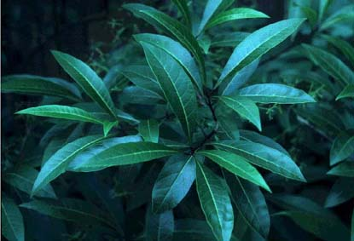
Chionanthus virginicus
Fringe Tree

Slide 29
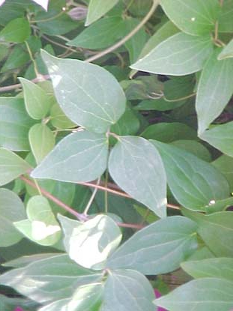
Clematis spp.
Clematis

Slide 30
Cornus florida
Dogwood
Notes:
Leaves are opposite, simple, elliptic or ovate, acuminate, 3-6 inches long and small. Flowers are showy bracts.

Slide 31
Cornus kousa
Kousa Dogwood
Notes:
Opposite, simple, entire, wavy margin, 2-4" long, 3/4" to 1 3/4" wide, dark green upper, lighter beneath, egg shaped, broadest below the middle.

Slide 32
Cortaderia selloana
Pampas Grass
Notes:
Evergreen grass with sharply edged leaves. They are arranged in dense fountainlike clumps that are up to 12' high and 6' wide. Flowers are individually very small, but the panicles may be 1-2' long and 6-12" wide. Flower color varies from silver to creamy white, and cultivars also include pink forms.

Slide 33
Cotinus coggygria
Smoke Tree
Notes:
Small tree or large shrub with alternate, simple, entire, 1 1/2 -3 1/2" long rounded oval to egg shaped leaves. Leaves can be bluish-green or purple. The name smoketree comes from the smoky pink flowers.

Slide 34
Cotoneaster dammeri
Bearberry Cotoneaster

Slide 35
Cryptomeria japonica
Japanese Cryptomeria
Notes:
Evergreen, 50-60' high, narrow, pyramidal conifer. Foliage are spirally arranged, entire, simple, awl-shaped, curve inward and taper to a blunt tip at end. Bright green to bluish-green often bronze in winter.

Slide 36
Cupressocyparis leylandii
Leyland Cypress
Notes:
Evergreen and Conifer.It can grow to 30 meters(100 feet) and has a narrow, conical shape. The leaves of the leylandii are dark green on the top with a paler, yellow-green underside.

Slide 37
Cycas revoluta
Sago Palm
Notes:
The distinctive leaves grow 4-5 ft (1.2-1.5 m) in length and are about 9 in (22.9 cm) in width. Leaves are pinnate and are composed of a rigid midrib with glossy leaflets arranged in a plane along its length. These leaflets are revolute which means that they curl under along their edge - this attribute provides the plant's species name (C. revoluta). New leaves emerge as light green spikes, arranged in a circle around the perimeter of the trunk. They slowly uncoil growing to the ultimate length of the leaf. Then, in a graceful choreography, the individual leaflets unroll away from the midrib and the whole column of new leaves relaxes into a rosette that sits just above the existing crown of leaves.

Slide 38
Cytisus scoparius
Scotch Broom
Notes:
Leaves are alternate, 3-foliate, obovate or lanceolate, 1/4 to 5/8" long, sparingly appressed pubescent, the upper leaves reduced to 1 leaflet, bright to medium green. The stem is slender, finely granular, green, almost winged on the ridges; bright green in summer and winter,; pith - small, roundish, continuous.

Slide 39
Cyrtomium falcatum
Holly Fern

Slide 40
Deutzia gracilis
Deutzia

Slide 41
Elaeagnus pungens
Thorny Elaeagnus
Notes:
Leaves are alternate, simple, oblong-lanceolate to linear-lanceolate, 1 to 3" long, 3/8 to 5/8" wide, dull green and scaly above, silvery-scaly beneath, acute to obtuse, usually broad-cuneate at base; petiole - 1/5 to 1/3" long.

Slide 42
Eriobotrya japonica
Loquat
Notes:
Leaves are alternate, simple, evergreen, variable in size, usually 6 to 9" long, 3 to 4" wide but up to 12" long, and 5" wide, coarsely toothed, wrinkled, strongly set with parallel veins (ribs) about 1/4 to 1/2" apart, lustrous dark green above and glabrous, lower surface covered with a grayish brown tomentum; petiole - short, wooly.

Slide 43
Euonymus alata
Winged Euonymus
Notes:
Leaves are opposite to subopposite, simple, elliptic to obovate, sharply serrate, fall color is brilliant red, stems have 2 to 4 armed corky wings, border, foundation, hedge plant.The stem literally is doubled, like a bird has two wings, the winged euonymus has two wings.

Slide 44
Euonymus fortunei
Wintergreen Euonymus
Notes:
Leaves are opposite, evergreen leaves, usually 1" long or less, with crenate-serrate margins and leaves of dark green color prominently marked with silver veins. A nonfruiting form. This is a variable species because it sports (mutates) so readily and the range of leaf types produced is almost endless.

Slide 45
Euonymus japonicus
Japanese Euonymus
Notes:
Leaves are opposite, simple, evergreen, obovate to narrowly oval, 1 to 3" long, 3/4 to 1 3/4" wide, lustrous dark green, leathery, glabrous, tapered at base, blunt or rounded at apex, serrated except at base; petiole 1/4 to 1/2" long.

Slide 46
Fagus grandifolia
Beech
Notes:
Leaves are alternate, simple ovate-oblong, 2 to 5" long, 3/4 to 2 1/2" wide, acuminate, broad-cuneate at base, coarsely serrate, glossy dark green above and light green and usually glabrous below or with tufts of hairs in the axils of the veins and along the midrib, silky when unfolding; more veins than F. sylvatica (11 to 15 pairs); petiole 1/4" or longer.

Slide 47
Farshedera lizei
Fatshedera

Slide 48
Fatsia japonica
Fatsia
Notes:
Leaves are alternate, simple, evergreen, deeply palmately 7 to 9 lobed, leathery, usually broader than high, 6 to 14" (16") across, cordate, divided beyond the middle into oblong-ovate, acuminate, serrate lobes with rounded sinuses, lustrous dark green above, paler beneath, glabrous; petiole - 4 to 12" long, round and smooth.

Slide 49
Ficus carica
Fig
Notes:
Leaves are alternate, simple, 3 to 5-lobed, 4 to 8" long, and on occasion even larger in length and width, cordate, depth of sinuses variable, lobes usually scalloped into broad rounded teeth, dark green, both surfaces scabrous with short stiff hairs; petiole 1 to 4" long.

Slide 50
Ficus pumila
Creeping Fig

Slide 51
Forsythia intermedia
Forsythia
Notes:
Leaves are opposite, simple, toothed on the upper one-half, ovate-oblong, 3-5 in. long, perfect yellow flowers, a deciduous shrub.

Slide 52
Gardenia jasminoides
Cape Jasmine
Notes:
Leaves are opposite, whorled, simple and lustrous green, obovate to lanceolate; perfect waxy, white, fragrant flowers; orange, ovate, fleshy, 1 1/2 inch long berry.

Slide 53
Gelsemium sempervirens
Carolina Yellow Jasmine

Slide 54
Ginkgo biloba
Ginkgo (Maidenhair tree)
Notes:
Leaves are alternate, simple, fan-shaped, in clusters of 3-5, bright green; orange plum-like malodorus fruit. Think that a maiden carries a fan - the same shape as the leaves.

Slide 55
Hamamelis virginiana
Witch Hazel
Notes:
Leaves are alternate, simple, obovate or elliptic, obtusely short-acuminate or obtusish, narrowed toward the base and subcordate, rarely broad-cuneate, 3 to 6" long, 2 to 3 1/2" wide, coarsely crenate-dentate, medium to dark green, nearly glabrous or pubescent on the veins beneath, with 5 to 7 pairs of veins; petioles 1/4 to 1/2" long pubescent; leaves - thinnish. Older stems are slender, glabrous, smooth, and gray. Younger stems are brownish, pubescent; pith - small, green, and continuous.

Slide 56
Hedera helix
English Ivy
Notes:
It is an evergreen climbing plant, growing to 20–30 meters high. Leaves are alternate, 50–100 mm long, with a 15–20 mm petiole; they are of two types, with palmately five-lobed juvenile leaves on creeping and climbing stems, and unlobed cordate adult leaves on fertile flowering stems exposed to full sun, usually high in the crowns of trees or the top of rock faces.

Slide 57
Hibiscus rosa-sinensis
Chinese Hibiscus

Slide 58
Hibiscus syriacus
Shrub Althea (Rose of Sharon)
Notes:
Leaves are alternate, simple, palmately veined and 3-lobed, ovate or rhombic-ovate, 2 to 4" long, often coarsely toothed with rounded or acutish teeth, broad-cuneate or rounded at base, medium green, often lustrous, glabrous except a few hairs on the veins beneath; petiole 1/4 to 1" long. The stem is rounded, fluted enar the dilated tip, glabrescent, gray; pith - small, white, continuous with green border; leaf scars crowded at tip, half round or transversely ellipitical, raised, shortly decurrent in more or less evident ridges.

Slide 59
Hydrangea macrophylla
Hydrangea
Notes:
Leaves are opposite, simple, obovate to elliptic or broad ovate, 4-8 inches long; broad, flat flowerhead composed of sterile, outer flowers, fertile inner flowers, bluish to pink; a deciduous shrub.

Slide 60
Hydrangea quercifolia
Oakleaf Hydrangea
Notes:
Leaves are opposite, simple, ovate. 3 to 7 lobed leaves that are orange-red-purlish in fall. Flowers are white changing to pink and then brown. A deciduous coarse-textured shrub.

Slide 61
Hypericum calycinum
St. John’s-wort (Aaronsbeard)

Slide 62
Ilex aquifolium
English Holly

Slide 63
Ilex x ‘Nellie R. Stevens’
Nellie R. Stevens Holly

Slide 64
Ilex x attenuata ‘Foster’
Foster Holly

Slide 65
Ilex x attenuata ‘Savannah’
Savannah Holly

Slide 66
Ilex cornuta ‘Burfordii’
Burford Holly
Notes:
Leaves are alternate, simple, evergreen, short-stalked, oblong-rectangular, 1 1/2 to 4" long, 1 to 3" wide with 3 strong almost equal spines at the broad apex and 1 or 2 spines on each side at the base, spines can vary from 5 to 9, or on older plants rounded at the base, lustrous dark green above, yellow-green below, leaves of old specimens show fewer spines, almost plastic in texture extremely lethal to work around; petiole - 1/6" long. Bufordii have lustrous dark green leaves usually have a single terminal spine but on occasion two lateral spines may develop.

Slide 67
Ilex cornuta ‘Carissa’
Carissa Holly
Notes:
Leaves are alternate, simple, ovate, waxy, dark green above, olive green beneath, 2-3 in. long, single terminal spine. Evergreen shrub.

Slide 68
Ilex cornuta ‘Rotunda’
Rotunda Holly

Slide 69
Ilex crenata ‘Compacta’
Compact Holly
Notes:
Leaves are alternate, simple, elliptic to oblong-lanceolate, 1/2 to 1/4 in. long, dull, greenish white flowers, dioecious, fruit is a berry-like black drupe, used for foundation, hedge or mass plantings.

Slide 70
Ilex crenata ‘Helleri’
Helleri Holly
Notes:
Leaves are alternate, simple, evergree, crowded, short-stalked, elliptic or obovate to oblong-lanceolate, 1/2 to 1 1/4" long, 1/4 to 5/8" wide, acute, cuneate or broad-cunate, crenate-serrulate or serrulate, lustrous dark green above, glabrous, of hard texture, dotted beneath with blackish pellucid glands. Helleri is a dwarf, mounded, compact form; 26 year old plant is 4' by 5' with leaves about 1/2" long.

Slide 71
Ilex crenata ‘Rotundifolia’
Bigleaf Japanese Holly

Slide 72
Ilex glabra
Inkberry (Gallberry)
Notes:
Leaves are alternate, simple, evergreen, obovate to oblanceolate, 3/4 to 2" long, 1/3 to 5/8" wide, acute or obtusish, cuneate, with few obtuse teeth nar apex or entire, dark green and lustrous above, glabrous, leaves are very thin compared to I. crenata forms with which it is often confused; petiole 1/8 to 1/4" long. The stem is slender, green, pubescent at first, finally glabrous; normally hold their green color longer than I. crenata types.

Slide 73
Ilex latifolia
Lusterleaf Holly

Slide 74
Ilex opaca
American Holly

Slide 75
Ilex vomitoria
Yaupon Holly

Slide 76
Illicium parviflorum
Small Anise-tree
Notes:
Leaves are alternate, simple, elliptic to lanceolate, yellow-green, 1/2 in. diameter flowers, fruit is a whorl of follicles. An evergreen shrub.

Slide 77
Illicum floridanum
Florida Anise-tree
Notes:
Leaves alternate, simple, evergreen, elliptic to elliptic-lanceolate, 2 to 6" long, half as wide, acute, cuneate, entire, glabrous, lustrous dark green above, pale beneath; petiole - 1/2" long; reddish purple whcih separates it from I. parviflorum; highly aromatic when bruised or crushed.

Slide 78
Itea virginica
Virginia Sweetspire
Notes:
Leaves alternate, simple, deciduous, semi-evergreen or evergreen, elliptic or obovate to oblong, acute or short acuminate, usually cuneate at the base, 1 1/2 to 4" long, 3/4 to 1 1/4" wide, serrulate, glabrous and lustrous dark green above, often sparingly pubescent beneath; petiole 1/8 to 1/4" long, pubescent, grooved on upper side.

Slide 79
Jasminum nudiflorum
Winter Jasmine
Notes:
Leaves are opposite, pinnately compound, 3 leaflets, each leaflet ovate to oblong-ovate, 1/2 to 1 1/4" long, one third to half as wide, narrowed at ends, mucronulate, entire, ciliolate, deep lustrous green; petiole - 1/3" long. Stem is slender, trailing, green, glabrous, angled, almost 4-sided.

Slide 80
Juniperus chinensis ‘Pfitzeriana’
Pfitzer Juniper
Notes:
Leaves of 2 kinds, adult branches with the ultimate divisions about 1/25" in diameter, clothed with 4 ranks of leaves in opposite pairs which are closely pressed, overlapping and rhombic in outline, 1/16" long, blunt or bluntly pointed, the outer surface convex, green with a paler margin marked with a gladular depression on the back; juvenile leaves awl-shaped, 1/3" long, spreading, in whoris of 3 or in opposite pairs, with a green midrib and 2 glauccous bands above, convex beneath, ending in a spiny point, scale-like awl-shaped, bright green, brances emerge at 45 degree angle and the young shoots show a slight pendulous tendency.

Slide 81
Juniperus chinensis ‘Torulosa’
Hollywood Juniper

Slide 82
Juniperus conferta
Shore Juniper
Notes:
Leaves(needles) are crowed, 1/4"-5/8" long, glaucous green tapering to prickly point, cones globose, bluish-black, dense, bushy, evergreen shrub/groundcover. The plant curls off the ground like ocean waves, hence shore juniper.

Slide 83
Juniperus davurica
Parson’s Juniper

Slide 84
Juniperus horizontalis ‘Wiltonii’
Blue Rug Juniper

Slide 85
Juniperus virginiana
Eastern Red Cedar

Slide 86
Kalmia latifolia
Mountain Laurel
Notes:
Leaves are alternate, simple, evergreen, appearing irregularly whorled, elliptic to elliptic-lanceolate, 2 to 5" long, 3/4 to 1 1/2" wide, leathery, entire, acute or short acuminate, cuneate, dark green above, yellowish green beneath; petiole 1/4 to 1" long.

Slide 87
Kerria japonicum
Japanese Kerria
Notes:
Leaves are alternate, simple, ovate-lanceolate, 1 1/2 to 4" long, about 1/2 as wide, acuminate, cuneate, double serrate, bright green and glabrous above, apler and slightly pubescent below on veins; petioles 1/4 to 1/2" long.

Slide 88
Koelreuteria paniculata
Golden Rain Tree
Notes:
Leaves are alternate, pinnate or bipinnately compound, 6 to 18" long, 7 to 15 leaflets, each leaflet ovate to ovate-oblong, 1 to 4" long, coarsely and irregularly crenate-serrate, at base often incisely lobed, rich green and glabrous above, pubescent on the veins beneath or nearly glabrous.

Slide 89
Lagerstroemia indica
Crape Myrtle
Notes:
Delicate paper thin petals; beautiful large blooms in white, pink, red, or purple; lustrous green leaves forming a thick canopy of foliage; smooth, exfoliating bark. The leaves are opposite, simple, with entire margins, and vary from 5-20 cm (2-8 in). While all species are woody in nature, they can range in height from over 100 feet to under one foot; most, however, are small to medium, multiple-trunked trees and shrubs. The leaves of temperate species provide autumn color.

Slide 90
Ligustrum japonicum
Wax Leaf Ligustrum
Notes:
Leaves are opposite, simple, evergreen, entire, lustrous dark green, almost black-green, leathery, glabrous, broad-ovate to ovate-oblong, 1 1/2 to 4" long, 3/4 to 2" wide, obtusely short acuminate or acute to obtusish, usually rounded at base, 4 to 5 pairs of indistinct veins raised below, margin and midrib often reddish; petiole - 1/4" long.

Slide 91
Ligustrum sinense ‘Variegatum’
Variegated Privet

Slide 92
Liquidambar styraciflua
Sweet Gum
Notes:
"There are five letters in SWEET, and usually five points on each leaf. You can think of it as the moon and star tree, since the spiky, spherical fruit looks like a little moon among all the stars, or the leaves.
The fruit is also known as the 'gum ball.'
"

Slide 93
Liriodendron tulipifera
Yellow Poplar (Tulip Tree)
Notes:
Also called cat tree because the leaf pointed upright looks like a cat's face! The bark is brown, and furrowed. The branchlets are smooth and lustrous, initially reddish, maturing to dark gray, and finally brown.The alternate leaves are simple, pinnately veined, measuring five to six inches long and wide. They have four lobes, and are heart-shaped or truncate or slightly wedge-shaped at base, entire, and the apex cut across at a shallow angle, making the upper part of the leaf look square; midrib and primary veins prominent.

Slide 94
Liriope muscari
Clump Liriope
Notes:
Leaves: Big blue lilyturf has arching, strap like leaves. Flowers: This plant has short stems lined with tiny globe shaped flower blossoms. Flowers begin in June and don't stop until August. The flowers are usually a purple color.

Slide 95
Lonicera fragrantissima
Winter Honeysuckle
Notes:
Leaves are opposite, simple, elliptic to broad-ovate, 1 to 3" long, two-thirds to almost as wide, acute, broad cuneate at base, setose-ciliate, dull blue-green to dark green and glabrous above, setose on the midrib; petiole 1/3" long. The stem is slender, glabrous, light, often lustrous brown; pith-white, solid or slightly excavated.

Slide 96
Lonicera japonica
Japanese Honeysuckle

Slide 97
Loropetalum chinense
Loropetalum (Fringe Flower)
Notes:
Leaves are alternate, simple, evergreen, ovate-rounded, 1 to 2 1/2" long, 3/4 to 1 1/4" wide, apex pointed, oblique leaf base, finely toothed to essentially entire, dark green and rough above, paler beneath, pubescent; petiole - 1/2" long, pubescent. The stem is slender, brown, densely pubescent; pith - solid, small and greenish.

Slide 98
Magnolia grandiflora
Southern Magnolia (Bull Bay)
Notes:
Southern magnolia is a large, broad-leafed evergreen tree that can grow 60-90 ft (18-27 m) in height with a trunk up to 2-3 ft (0.6-0.9 m) in diameter. It's trunk is typically straight and erect with spreading branches that form a dense, broadly pyramidal crown. The evergreen leaves are large 5-8 in (13-20 cm) long, leathery and dark glossy green above with rusty, velveteen undersides. Southern magnolia has large, showy white flowers that are 8-12 inches (20-30 cm) in diameter. These have a pleasant fragrance and appear throughout the spring and summer. Fruits are reddish-brown conelike structures, 2-4 inches (5-10 cm) long, with bright red, kidney shaped seeds that hang from little threads when fully mature in autumn.

Slide 99
Magnolia stellata
Star Magnolia
Notes:
Leaves are alternate, simple, entire, obovate or narrow elliptic to oblong-obovate, 2 to 4" long, half as wide, obtusely pointed or obtusish, gradually tapering at base, glabrous and dark green above, light green and reticulate beneath and glabrous or appressed-pubescent on the nerves; petiole - 1/4 to 1/3" long. The stem is slender, brown, glabrous, more densely borne than in M. x soulangiana.

Slide 100
Magnolia virginiana
Sweet Bay Magnolia
Notes:
Leaves are alternate, simple, entire, evergreen, semi-evergreen to deciduous, elliptic to oblong-lanceolate, 3 to 5" long, about one-half as wide, acute or obtuse, broad cuneate at base, rarely rounded, dark lustrous green above and glauccous beneath. Stem is green, slender, glaucous, with prominent diaphragms.

Slide 101
Magnolia soulangiana
Saucer Magnolia
Notes:
Leaves are alternate, simple, 3 to 6" long, half as wide, obovate to broad-oblong, apex narrow and more or less abruptly short-pointed, base taper-pointed, dark green above, pubescent below. The Stem is brown, glabrous, with grayish lenticels, fragrant when crushed, with prominent stipular scars.

Slide 102
Mahonia bealei
Leatherleaf Mahonia
Notes:
Very invasive with large, pinnately compound leaves. It grows in an upright, open and loose, multi-stemmed clump 4-6 feet (1.2-1.8 m) tall and 3-4 feet (0.9-1.2 m) wide. It can get as large as 10 ft (3 m) tall and 8 feet (2.4 m) wide. The erect stems are stiff and unbranched, and the leaves come out in horizontal tiers. The leaves are about 18 in. (46 cm) long with 9 to 13 stiff, sharply spiny, hollylike leaflets. The leaflets are dull grayish blue-green above and pale yellowish green below, and about 2-4 in (5-10 cm) long and 1-2 in (2.5-5 cm) wide. The terminal leaflet is larger than the lateral leaflets. Flowers: lemon yellow and extremely fragrant, appears in March-April. Fruit is a bluish berry maturing in July-August.

Slide 103
Malus spp.
Crabapple (apple)
Notes:
A deciduous tree and shrub, rarely half evergreen; most are between 15 to 25' in height at maturity. Branches alternate, upright horizontal, or drooping, rately with spinescent branches. Buds are ovoid, with several imbricate scales, usually reddish brown with hairs protruding from the underside of the bud scales.

Slide 104
Metasequoia glyptostroboides
Dawn Redwood
Notes:
Leaves are opposite in arrangement, deciduous, linear, flattened, straight or slightly curved, pectinately arranged, 1/2" long and 1/16" broad on mature trees; upper surface is bright green with a narrowly grooved midvein, lower surface bearing obscure lines of stomata, lighter green or slightly glauccous, the midrib slightly raised.

Slide 105
Miscanthus sinensis
Maiden Grass
Notes:
Leaves are narrow blades that are 1/4" across and are green with a white midrib stripe down the center. Blooms are silky tassels of coppery-red flowers in mid-autumn. Winter the leaves turn warm golden yellow and flowers turn cool silvery white.

Slide 106
Myrica cerifera
Wax Myrtle
Notes:
Leaves are alternate, simple, entire; serrate, oblong; oblanceolate; spatulate, pinnate, evergreen; fragrant, 2 to 4 inches, green, no fall color change Waxmyrtle is also known as Southern bayberry or candleberry because early American colonists used the fruit's pale blue, waxy covering to make fragrant bayberry candles. This custom is still carried out today by crafts people here and in other countries. The tree's distinctive, fragrant scent comes from volatile oils contained in tiny glands on the leaves.

Slide 107
Nandina domestica
Heavenly Bamboo (Nandina)
Notes:
Leaves are evergreen (sometimes deciduous in colder areas), 50–100 cm long, bi- to tri-pinnately compound, with the individual leaflets 4–11 cm long and 1.5–3 cm broad. The young leaves in spring are brightly coloured pink to red before turning green; old leaves turn red or purple again before falling. The flowers are white, borne in early summer in conical clusters held well above the foliage. The fruit is a bright red berry 5–10 mm in diameter, ripening in late autumn and often persisting through the winter.

Slide 108
Nerium oleander
Oleander
Notes:
Leaves are opposite or in whorls of 2 to 4, evergreen, simple, linear-lanceolate, 3 to 5" long, 1/2 to 3/4" wide, apex acute, entire, leathery, dark green, with thick midrib and short petiole. Stem is stout, green, glabrous, and shining.

Slide 109
Ophiopogon japonicus
Mondograss
Notes:
Mondo grass resembles liriope; a grass-like plant growing to about 6"-8" high. Its leaves are 1/8" wide, and about 8"-12" long. Plant height is approximately 10 inches and the plant spreads like a carpet.

Slide 110
Osmanthus fragrans
Fragrant Tea Olive (Sweet Olive)
Notes:
The evergreen leaves are leathery, dark green and glossy above, lighter green and downy on underside. It has the most fragrant flowers of the Osmanthus group. A cut branch with tiny white flowers will fill a room with sweet perfume. The opposite leaves are a dark, shiny green and the edges may be finely toothed or smooth with both types present on the same individual.

Slide 111
Oxydendrum arboreum
Sourwood (Sorrel Tree)

Slide 112
Pachysandra terminalis
Japanese Pachysandra
Notes:
Medium-sized, herbaceous perennial, evergreen groundcover. Foliage: 2 to 4 inch, oval-shaped, shiny medium green leaves.

Slide 113
Parthenocissus quinquefolia
Virginia Creeper (Woodbine)

Slide 114
Pennisetum setaceum
Fountain Grass

Slide 115
Photinia x fraseri
Fraser Photinia (Red Tip)

Slide 116
Pieris japonica
Japanese Pieris
Notes:
Leaves are alternate, simple, obovate-oblong,crenate-serrate, dark green, new growth is bronze-purple in color. Flowers are white and weakly fragrant, urn-shaped, 1/5 in. long, borne in 3-6 inch long, on pendulous panicles. A broadleaf evergreen shrub. Excellent large specimen or planted in mass.

Slide 117
Pinus virginiana
Virginia Pine (Scrub Pine)

Slide 118
Pinus strobus
Eastern White Pine
Notes:
Leaves(needles) in 5's, slender, bluish, 3 to 5 inches long, habit of growth is a symmetrical pyrimid, with a "soft" look, 6 to 8 inch long cylindrical cones. Fast growing landscape tree.

Slide 119
Pinus taeda
Loblolly Pine
Notes:
Leaves(needles) in 3's, occasionally 2, 6 to 9 inches long, yellowish-green, finely-toothed. Loosely pyrimidal shape losing its lower limbs with age. Ovid-cylindric cones are 3 to 6 inches long. Fast-growing tree.

Slide 120
Pinus thunbergiana
Japanese Black Pine
Notes:
Two, persisting 3 to 5 years, densely crowded, twisted, more or less spreading, 2 1/2 to 4 1/2" long, 1/12" wide, apex stiff, fine pointed, rigid, margins finely toothed, with stomatic lines on each surface; very lustrous dark green; leaf sheaths 1/2" long, ending in two long, thread-like segments, persistent. Stem light borwn, glabrous, ridged with the scale leaves persisting during the first year; in the second and third year blackish gray.

Slide 121
Pittosporum tobira
Japanese Pittosporum
Notes:
Leaves are alternate, simple, evergreen, obovate, 1 1/2 to 4" long, 3/4 to 1 1/2" wide, blunt or rounded at apex, tapering to a short petiole, glabrous, entire, leathery, lustrous dark green.

Slide 122
Platanus occidentalis
Sycamore (American Planetree)
Notes:
Leaves are alternate, simple, 4 to 9" wide, often broader than long, 3 or sometimes 5-lobed with shallow sinuses and broad-triagular lobes, truncate or cordate, rarely enrtie, floccose-tomentulose when young, at maturity pubescent only along veins beneath, medium to dark green; petiole 3 to 5" long , stipules 1 to 1 1/2" long, entire or toothed. Stem is rather stout, round, smooth or pubescent, shiny yellow-orange-brown, generally zigzag.

Slide 123
Podocarpus macrophyllus
Podocarpus (Southern Yew)
Notes:
Leaves are arranged spirally on stem, evergreen needle like, 1/2 to 2 3/4" long, 1/4 to 3/8" wide, sharply acute, leathery, lustrous waxy dark green above with two side glaucous stomatiferous bands beneath, glabrous; needles give a bottlebrush-like effect. Stems are stout, green, grooved, and glabrous.

Slide 124
Prunus caroliniana
Carolina Cherry Laurel

Slide 125
Prunus laurocerasus
English Laurel (Cherry Laurel)

Slide 126
Prunus serrulata
Japanese Flowering Cherry

Slide 127
Pyracantha coccinea
Scarlet Firethorn

Slide 128
Pyrus calleryana ‘Bradford’
Bradford Pear
Notes:
Leaves are alternate, simple, 2 to 3 inches (5.1-7.6 cm) long, petiolate and shiny with wavy, slightly-toothed margins. The overall shape of the tree is often described as a tear-drop that often spreads out with age. Flowering occurs early in the spring (April to May) before the leaves emerge.

Slide 129
Quercus alba
White Oak

Slide 130
Quercus falcata
Southern Red Oak

Slide 131
Quercus nigra
Water Oak

Slide 132
Quercus palustris
Pin Oak
Notes:
Leaves are alternate, simple, 3 to 6 inches long, 5-7 lobed, dark green, elliptic-oblong. Leaves changing to red, russet or bronze color in the fall. Pyramidal with a central leader. Fruit is a light brown, 1/2 inch long and wide nut. A fast-growing oak that is probably the most widely used native oak for landscaping.

Slide 133
Quercus phellos
Willow Oak

Slide 134
Quercus virginiana
Live Oak (GA State Tree)
Notes:
Leaves are alternate simple, elliptic-ovate, 2-3 in. long, leathery, dark green above, gray green beneath, woolly pubescent having a prominent yellowish-brown midrib. Massive, picturesque, spreading evergreen, magnificent horizontal and arching branches. Slow-growing. Cold tender in northern areas of Georgia.

Slide 135
Raphiolepis umbellata
Indian Hawthorn
Notes:
Leaves are alternate, simple, ovate to broad-ovate, 1 - 1 1/2 inches long, serrated margins, dark green above and extremely leathery, in winter turning a slight purplish tinge. A dense rounded evergreen shrub. White flowers in April with purplish-black to bluish-black berries.

Slide 136
Rhododendron calendulaceum
Deciduous Azalea

Slide 137
Rhododendron catawbiense
Hybrid Rhododendron

Slide 138
Rhododendron indica
Southern Indian Azalea
Notes:
"Azaleas are handsome shrubs with large clusters of pink, red, orange, yellow, purple, or white flowers.
Deciduous leaves."

Slide 139
Rhododendron obiusum
Kurume Azalea

Slide 140
Rhus typhina
Staghorn Sumac

Slide 141
Rosa banksiae
Lady Banks Rose

Slide 142
Rosa hybrida
Hybrid Tea Rose
Notes:
Roses have thorns. Odd pinnate compound leaves have serrated edges.

Slide 143
Rosa laevigata
Cherokee Rose (State Flower)

Slide 144
Salix babylonica
Weeping Willow
Notes:
Leaves are alternate, simple, lanceolate to linear-lanceolate, 3-6 inches long, serrulate, light green above and grayish-green beneath. A graceful refined tree with a rounded crown of weeping branches.

Slide 145
Spiraea x bumalda
Anthony Waterer’ Spirea
Notes:
Leaves are alternate, simple, sharply toothed,1-3 inches long, ovate- lanceolate, pointed apex Leaves are pinkish-red-purple when young, then turning dark green. The flowers are white to deep pink, flat-topped on new growth. A fast-growing plant good as a filler or low massing.

Slide 146
Spiraea x vanhouttei
Vanhoutte Spirea (Bridalwreath)

Slide 147
Taxodium distichum
Bald Cypress

Slide 148
Ternstroemia japonica
Cleyera

Slide 149
Thuja orientalis
Oriental Arborvitae

Slide 150
Trachelospermum asiaticum
Asiatic Jasmine

Slide 151
Trachelospermum jasminoides
Confederate Jasmine

Slide 152
Trachycarpus fortunei
Windmill Palm

Slide 153
Tsuga canadensis
Canadian Hemlock

Slide 154
Ulmus parvifolia
Chinese Elm (Lacebark Elm)

Slide 155
Viburnum opulus
Cranberrybush Vibernum

Slide 156
Viburnum plicatum var. tomentosum
Doublefile Viburnum (Snowball)
Notes:
Leaves are opposite, simple, oblong-ovate, 2-4 inches long that are dark green and glabrous above with 8-12 pairs of nearly straight veins. Grows 8 - 10 feet high. White flowers are borne in flat-top cymes along horizontal stems. One of the most attractive and elegant flowering shrubs for the landscape. Fruit is 1/3 inch long bright red drupe that later changes to black.

Slide 157
Viburnum x pragense
Pragense Viburnum

Slide 158
Vinca minor
Periwinkle
Notes:
Leaves are opposite, simple, entire, 1/2 to 1 1/2 inches long, wide, elliptic and evergreen. Low growing, prostrate, matforming, fast-growing groundcover. Flowers are perfect, lilac-blue, 1" in diameter. Grows well in semi-sunny to shady locations. An excellent groundcover in spite of numerous disease/insect problems.

Slide 159
Vitex angus-castus
Vitex (Chaste Tree)

Slide 160
Weigela florida
Weigela

Slide 161
Wisteria sinensis
Wisteria

Slide 162
Yucca filamentosa
Adam’s Needle Yucca
Notes:
Leaves are sword-like, 1 to 1 1/2 feet long, abruptly narrowed at the apex; curly, thread-like filaments on leaf edges. Low evergreen shrub with 3 to 6 foot high, erect, yellowish-white, conical flowers. A very hardy species. Used in mass.

Slide 163
Zelkova serrata
Japanese Zelkova
Notes:
Alternate, simple, ovate leaves 1 1/2 to 2" long. Sharply serrated with acuminate teeth and 8 to 14 pairs of veins. Dark green 3/4 to 2" wide leaves. Bark is smooth-gray. Vase-shaped tree.

Slide 164
Annuals and Perennials

Slide 165
Achillea spp.
Yarrow

Slide 166
Agapanthus africanus
Lily of the Nile

Slide 167
Ageratum houstonianum
Ageratum

Slide 168
Antirrhinum majus
Snapdragon
Notes:
The blooms are the "dragons" and pinching the sides of the bloom helps them "snap" open and close.

Slide 169
Aquilegia hybrida
Columbine

Slide 170
Artemisia ludoviciana
Silver King’ Wormwood

Slide 171
Asclepias tuberosa
Butterfly Weed (Milkweed)

Slide 172
Asparagus sprengeri
Asparagus Fern
Notes:
Arching 18 to 24-inch stems are covered with bright green, inch-long flat needles.

Slide 173
Astilbe arendsii
Astilbe
Notes:
Foliage color varies from dark green to reddish green. Flowers are produced on erect or arching stems. Flower colors include white, pink, red, and lavender. Astilbe varieties range in height from 6 to 8 inches up to 3 to 4 feet.

Slide 174
Begonia semperflorens
Begonia
Notes:
Leaves are waxy, shiny, and thick with serrated edges.

Slide 175
Caladium spp.
Caladium

Slide 176
Canna x generales
Canna Lily
Notes:
Flowers are composed of three sepals and three petals. They are small and hidden. The broad, flat, alternate leaves, grow out of a stem in a long narrow roll and then unfurl.

Slide 177
Catharanthus rosea
Periwinkle (vinca)
Notes:
The leaves are oval to oblong, 2.5 – 9 cm long and 1 – 3.5 cm broad, glossy green, hairless, with a pale midrib and a short petiole 1 – 1.8 cm long; leaves are arranged in opposite pairs. The flowers are white to dark pink with a dark red center, a basal tube 2.5 - 3 cm long and a corolla 2–5 cm in diameter with five petal-like lobes.

Slide 178
Celosia spp.
Celosia

Slide 179
Ceratostigma plumbaginoides
Plumbago

Slide 180
Chrysanthemum maximum
Shasta Daisy

Slide 181
Coleus x hybridus
Coleus
Notes:
Annual plant offering colorful foliage that can be grown in shady locations. Coleus is a member of the mint family having opposite leaves and square stems.

Slide 182
Coreopsis verticillata
Threadleaf Coreopsis

Slide 183
Delosperma cooperi
Hardy Ice Plant

Slide 184
Dianthus spp.
Dianthus
Notes:
Stems are branched, 3-6" long, linear, powdery grey with white, pink or peach colored 'carnation' type flowers.

Slide 185
Dicentra spectabilis
Bleeding Heart

Slide 186
Digitalis purpurea
Foxglove
Notes:
The leaves are spirally arranged, simple, 10-35 cm long and 5-12 cm broad, grey-green, downy, and with a finely toothed margin; they form a tight rosette at ground level in the first year.

Slide 187
Dryopteris erythrosora
Japanese Autumn Fern

Slide 188
Echinacea purpurea
Purple Coneflower
Notes:
They have large, showy heads of composite flowers. The leaves are normally hairy with a rough texture, The basal leaves and the lower stem leaves have petioles, and as the leaves progress up the stem the petioles often decrease in length. The leaf blades in different species may have one, three or five nerves. Some species have linear to lanceolate shaped leaves, and others have elliptic to ovate shaped leaves. Often the leaves decrease in size as they progress up the stems. Leaf bases gradually increase in width away from the petioles or the bases are rounded to heart shaped. Most species have leaf margins that are entire, but sometimes they are dentate or serrate. The flowers are collected together into single, rounded Heads that terminate long peduncles.

Slide 189
Gaillardia aristata
Blanket Flower (Fiesta Daisy)

Slide 190
Gomphrena globosa
Globe Amaranth

Slide 191
Helianthus angustifolius
Swamp Sunflower

Slide 192
Helleborus orientalis
Lenten Rose
Notes:
Lenten rose is a clump-forming, late winter-blooming perennial which typically grows 1-1.5' tall. Features large, cup-shaped, rose-like, usually nodding flowers (3-4" diameter) with center crowns of conspicuously contrasting yellow stamens. Flowers usually appear in clusters of 1-4 on thick stems rising above the foliage. Flower color is extremely variable, ranging from white to pink to light rose-purple, frequently with interior spotting. Palmate, serrate, leathery, 8-16" wide, glossy, basal, dark green leaves (7-9 leaflets) are evergreen in warm climates but deciduous in extremely cold winters.

Slide 193
Hemerocallis spp.
Daylily
Notes:
Flower consists of three petals and three sepals, collectively called tepals, each with a midrib in the same or a contrasting color. The centermost section of the flower, called the throat, has usually a different and contrasting color. There are six (sometimes seven) stamens, each with a two-lobed anther. Leaves: Arching, strap-shaped, dark green, 30-48 in. long

Slide 194
Heuchera sanguinea
Coral Bells

Slide 195
Hosta spp.
Hosta
Notes:
Broad lanceolate or ovate leaves varying widely in size by species from 1–15 in (3–40 cm) long and 0.75–12 in (2–30cm) broad. They are know for a glaucous waxy leaf coating that gives a blue appearance to the leaf.

Slide 196
Iberis sempervirens
Candytuft
Notes:
Leaves are alternate, simple, linear-oblong, obtuse, 1/2 - 2 inches long, dark green; white flowers in terminals; evergreen groundcover.

Slide 197
Impatiens wallerana
Impatiens
Notes:
Leaves are mostly alternate, although they may be opposite near the top of the plant. The flowers are profusely borne, 2-5 cm diameter, with five petals and a 1 cm spur.

Slide 198
Iris spp.
Iris
Notes:
Sword-shaped leaves and distinctive flowers that consist of three usually erect petals called standards and three outer petals called falls. Iris come in a variety of colors.

Slide 199
Lantana camara
Lantana
Notes:
Very strong, somewhat unpleasant fragrance. Leaves: Medium green, toothed, hairy and rough. Borne in opposite pairs or whorls of 3. Flowers: Small, 5-lobed, salverform, grouped tightly into rounded, flattened or domed, terminal heads. Color choices range from white to yellow, pink, salmon-pink, red, purple or combinations of the colors above.

Slide 200
Liatris spicata
Gayfeather
Notes:
Comes from the Latin “spica” for “spike.” The leaves are green in summer, acicular in shape.

Slide 201
Lobelia cardinalis
Cardinal Flower

Slide 202
Lobularia maritima
Alyssum

Slide 203
Lythrum salicaria
Purple Loosestrife

Slide 204
Melampodium cinereum
Mountain Daisy

Slide 205
Monarda didyma
Monarda (Bee Balm)

Slide 206
Pelargonium hortorum
Geranium
Notes:
Leaves are simple, opposite and palmate. Has a very thick stem.

Slide 207
Perovskia atriplicifolia
Russian Sage

Slide 208
Petunia hybrida
Petunia

Slide 209
Phlox paniculata
Tall Phlox
Notes:
2-4' tall and usually unbranched, except near the apex where the flowers occur. The central stem is light green, round and usually hairless. Sometimes fine purple streaks [Close-up of Flowers] occur along the stem. Leaves are opposite and lanceolate.

Slide 210
Phlox subulata
Creeping Phlox (Thrift)
Notes:
Foliage: 1 foot narrow, sharply pointed light green to gray-green leaves. Flower/Fruit: Trumpet-shaped, red-purple, violet-purple, pink, or white flowers.

Slide 211
Portulaca grandiflora
Moss Rose

Slide 212
Rosmarinus officinalis
Rosemary
Notes:
Leaves are opposite, simple, linear, narrow, 1-2 in. long, lustrous, thick, gray-green color. Very fragrant herb that grows 2 to 4 feet tall. Lavender, pink or white blooms. Easily rooted from cuttings, used in cooking.

Slide 213
Rudbeckia fulgida
Black-eyed Susan

Slide 214
Salvia officinalis
Common Sage

Slide 215
Salvia splendens
Annual Salvia

Slide 216
Salvia farinacea
Blue Salvia

Slide 217
Sedum spp.
Stonecrop

Slide 218
Senecio cineraria
Dusty Miller
Notes:
All are characterized by woolly, silvery-gray foliage; low, moundlike habit of growth.

Slide 219
Solidago spp.
Goldenrod

Slide 220
Stachys lanata
Lamb’s Ear (Woolly Betony)

Slide 221
Stokesia laevis
Stokes’ Aster

Slide 222
Tagetes patula
French Marigold

Slide 223
Thymus vulgaris
Common Thyme
Notes:
is a perennial with a woody, fibrous root. The stems are numerous, round, hard, branched, and usually from 4 to 8 inches high, when of the largest growth scarcely attaining a foot in height. The leaves are small, only about 1/8 inch long and 1/16 inch broad, narrow and elliptical, greenish-grey in colour, reflexed at the margins, and set in pairs upon very small foot-stalks. The flowers terminate the branches in whorls.

Slide 224
Verbena canadensis
Verbena
Notes:
Tough leaves resembling Brazilian Verbena, but it is not tall and upright. It is a twisty trailing clumper about a foot tall and can spread to three feet wide or wider. Leaves - opposite, petiolate, decussate. Petioles to -2cm long, often with decurrent leaf tissue, villous. Blades to +3cm long and broad ovate, pinnatifid, pubescent. Ultimate divisions acute. Stems - Multiple from the base, from a woody caudex and fibrous roots, erect to ascending, herbaceous, to 30cm tall, typically simple, 4-angled, villous.

Slide 225
Veronica longifolia
Veronica
Notes:
upright cultivar forms branched spikes (to 7 inches long) of dark violet-blue flowers. It has glossy and crinkled dark green leaves, and grows to less than 2 feet tall.

Slide 226
Viola x wittrockiana
Pansy
Notes:
Five petals; two large upright petals, and three slightly smaller lower petals. Bloom color and design varies depending upon variety.

Slide 227
Zinnia elegans
Zinnia

Slide 228
Lawngrasses

Slide 229
Cynodon spp.
Bermudagrass
Notes:
Blades are a grey-green color and are short, usually 2–15 centimeters (0.79–5.9 in) long with rough edges. The erect stems can grow 1–30 cm (0.39–12 in) tall. The stems are slightly flattened, often tinged purple in color.

Slide 230
Eremochloa ophiuroides
Centipedegrass
Notes:
Thick sod forming, uniform growing, and medium to light green colored. It has a coarse texture with short upright stems that grow to about 3-5 inches and spread by stolons.

Slide 231
Festuca arundinacea
Tall Fescue grass
Notes:
Individual tillers, or stems, terminate in an inflorescence, reaching 3 to 4 feet in height, and have broad, dark green basal leaves. Leaf blades are glossy on the underside and serrated on the margins. The leaf sheath is smooth and the ligule is a short membrane. Inflorescence is a compact panicle, 3 to 4 inches long with lanceolate spikelets one-half inch or more long. The grass flowers in the spring and seeds mature in early summer. Seed are 4 - 7 mm long, elliptic and awed.

Slide 232
Stenotaphrum secundatum
St. Augustinegrass

Slide 233
Zoysia spp.
Zoysiagrass

Slide 234
Common Weeds

Slide 235
Allium vineale
Wild Garlic
Notes:
"A cool-season perennial with slender, hollow, cylindrical leaves. The leaves develop from an underground bulb which in turn produces offset bulblets. Flowers are
greenish-white, small, on short stems above aerial bulbils. Plants reproduce by underground
bublets, aerial bulbils and seeds. Distinctive odor when crushed."

Slide 236
Andropogon virginicus
Broomsedge

Slide 237
Ambrosia artemisiifolia
Ragweed
Notes:
Stems erect, branched, with long, rough hairs. leaves Leaves are 4 to 10 cm long, egg-shaped in outline and once or twice compound (pinnatifid). Leaves hairy on upper surface and margin, densely appressed on lower surface. Young leaves opposite, becoming alternate with age, dense pubescence over entire leaf surface.

Slide 238
Capsella bursa-pastoris
Shepherdspurse

Slide 239
Chenopodium album
Common Lambsquarter

Slide 240
Cuscuta spp.
Dodder
Notes:
"A parasitic vine twining, usually counterclockwise in direction, branching, and yellowish to reddish-brown in color. Leaves are rarely noticeable.
"

Slide 241
Cyperus spp.
Nutsedge
Notes:
The stems are triangular, usually leafless for most of their length with the slender grass-like leaves at the base of the plant, and in a whorl at the apex of the flowering stems.

Slide 242
Dactyloctenium aegyptium
Crowfootgrass
Notes:
An annual grass that bends and roots at the lower nodes, with tips that may rise to about 2 feet in height. Leaf blades and sheaths are without hair. Leaf margins have long, stiff hairs. Ligule fringed, membranous. Seed head resembles a crow's foot.

Slide 243
Daucus carota
Queen Ann’s Lace (Wild Carrot)

Slide 244
Digitaria sanguinalis
Large Crabgrass

Slide 245
Eleusine indica
Goosegrass
Notes:
Leaf blades are 2-14 inches long, 3-8 mm wide, without hairs or only sparsely hairy, and folded along the midvein. The ligule is 1-2 mm long, fringed, uneven, and membranous. Sheaths are flattened, whitish at the base, and sparsely hairy in the collar region. Flowers: Seedheads composed of 2-13 spikes each 1 1/2 to 6 inches long, 3-7 mm wide, in clusters at the top of stems. Two rows of flattened spikelets occur along each spike. Flattened stems with a distinctive white or silver center. Plants often appear compressed to the soil, as if they have been repeatedly stepped on.

Slide 246
Eupatorium capillifolium
Dogfennel
Notes:
" perennial with finely dissected leaves that may reach 6 1/2 feet in height. Leaves are finely divided into linear segments. Lower leaves may sometimes be opposite, but upper leaves are always alternate. Identifying Characteristics: Erect plants that branch in the upper portions only with finely dissected leaves. Additionally, the leaves and flowers of this weed often emit an unpleasant odor when crushed
"

Slide 247
Euphorbia maculata
Prostrate Spurge

Slide 248
Erigeron annuus
Annual Fleabane
Notes:
A summer annual or sometimes biennial reaching 1 to 2 ft in height with prominent white and yellow daisy-like flowersLeaves: Occur mostly at the stem base. Basal leaves are egg-shaped (ovate) or widest near the middle and tapering to both ends (lanceolate), 2-6 inches long, 1-3 inches wide, and have petioles. Upper leaves are long and narrow (linear) or slightly lanceolate, much smaller than the basal leaves and may occur on short petioles or lack petioles. All leaves are prominently toothed and sparingly hairy.

Slide 249
Geranium carolinianum
Carolina Geranium
Notes:
"Stems: Erect, freely branching near base to 28 inches tall. Stems are usually pink to red in color and densely hairy.
Leaves: Alternate near base, opposite above, and hairy on both surfaces. Leaves (3/4 to 2 1/2 inches wide) are rounded in appearance, and deeply (palmately) divided into 5-9 segments, with each segment also lobed or toothed. Flower: Less than 3 mm long with an elongated beak that gives this structure the appearance of a crane's bill, which is also another common name of this weed."

Slide 250
Hydrocotyle spp.
Pennywort (Dollarweed)

Slide 251
Ipomoea spp.
Morningglory

Slide 252
Lamium amplexicaule
Henbit
Notes:
Winter annual with square stems and pink-purple flowers, reaching 16 inches in height. Leaves: Opposite, reaching 5 inches in length, circular to heart-shaped, with hairs on the upper leaf surfaces and along the veins of the lower surface. Leaf margins have rounded teeth. Lower leaves occur on petioles, while the upper leaves are without petioles (sessile)Flowers: Occur in whorls in the upper leaves without petioles. Flowers are pink to purple in color and are fused into a tube approximately 2/3 inch long.

Slide 253
Oxalis stricta
Yellow Woodsorrel
Notes:
Alternate leaves of this plant are divided into three heart-shaped leaflets (a typical trait of other species of Oxalis) that can grow up to 2 cm wide. Leaves curl up at night

Slide 254
Phyllanthus urinaria
Chamberbitter

Slide 255
Phytolacca americana
Common Pokeweed
Notes:
A large, 3 to 10 ft tall, perennial weed with thick, reddish-purple branched stems and dark purple to black berries. All parts of the plant are poisonous. Leaves: Alternate, 3 1/2-12 inches long, 1-4 inches wide, egg-shaped, petiolated, without hairs, and are smaller in size toward the top of the plant.

Slide 256
Plantago spp.
Plantain
Notes:
The leaves are sessile, but have a narrow part near the stem which is a pseudo-petiole. They have 3 or 5 parallel veins that diverge in the wider part of the leaf. Leaves are broad or narrow, depending on the species.

Slide 257
Poa annua
Annual Bluegrass
Notes:
An erect or clump-forming annual grass that tolerates close mowing, or may reach 11 inches in height. Leaves: Light green in color, especially when compared to the dark green color of other closely related turfgrass species (for example Kentucky Bluegrass, Poa pratensis). Leaf blades are 0.5-5 inches long, 1-5 mm wide, folded in the bud and lack hairs on either surface. Leaves are 'keeled' and have a distinctive boat-shaped tip. The ligule is slightly pointed and membranous. Leaf sheaths are somewhat compressed and flattened, without hairs. Flowers: The seedhead is an open panicle, 3/4 to 2.5 inches long, and pyrimidal in outline.

Slide 258
Polygonum pensylvanicum
Pennsylvania Smartweed
Notes:
A summer annual weed that may reach 3 1/2 feet in height. Leaves: Arranged alternately along the stem, lanceolate to elliptic in outline, approximately 2 to 6 inches long and 1 1/4 inches wide. Older leaves are usually only slightly hairy. Leaves taper to short petioles, which have an ocrea that encircles the stem. Leaves often, but not always, have a purple spot in the middle of the leaf. Flowers: Flowers are clustered in terminal spikes at the ends of stems. Individual flowers are small and usually pink in color but can occasionally be white.

Slide 259
Portulaca oleracea
Common Purslane

Slide 260
Pueraria lobata
Kudzu
Notes:
An invasive perennial vine with trifoliate leaves Each set of 3 leaflets is arranged alternately along the stem. All leaflets occur on petioles, however the lateral leaflets are on very short petioles (less than 1/2 inch), while the center leaflet occurs on a petiole approximately 3/4 inch long. All leaves are ovate in outline, hairy, and lobed. Lateral leaflets are usually lobed on one side only while the center leaflet is usually lobed on both sides.

Slide 261
Pyrrhopappus carolinianus
Carolina False Dandelion
Notes:
Carolina false dandelion is a winter annual or biennial weed common in disturbed sites such as pastures and fields. The hairy leaves are deeply lobed and form a basal rosette with a taproot. The flower stalk can have many branches that end with flowers, unlike common and cat's ear dandelion. The bright yellow flowers appear in the spring and summer. Pointed leaf lobes point away from the center of the plant.

Slide 262
Rubus spp.
Blackberry
Notes:
Erect, prostrate, or climbing perennials with prickly stems and red or black berries. Leaves: Leaves are arranged alternately along the stem, occur on petioles, and are divided into 3 to 7 leaflets. Each leaflet has toothed margins. Flowers: Usually consist of 5 green, hairy sepals and 5 white or pinkish petals.

Slide 263
Rumex acetosella
Red Sorrel

Slide 264
Rumex crispus
Curly Dock

Slide 265
Setaria spp.
Foxtail
Notes:
"A clump-forming summer annual with a seedhead that resembles a fox's tail. Leaves: Leaf blades may reach 12 inches in length and 7 to 12 mm in width, and have long silky hairs at the leaf bases. Auricles are absent and the ligule is a fringe of hairs reaching 2 mm in length.
Flowers: The seedhead is a cylindrical bristly panicle, reaching 6 inches in length and 1/3-2/3 inch in width. Spikelets are approximately 3 mm long, green, and each spikelet has 1-3 bristles that are 5-10 mm long. The bristles turn yellow at maturity, giving the plant it's name."

Slide 266
Smilax rotundifolia
Common Greenbriar
Notes:
The common names of smilax, greenbriar, catbriar, or briar, all refer to a number of closely related species that look similar enough to be grouped together in the following description. All have sharp thorns and are a very prolific vine that climbs both by clinging and with tendrils. The leaves may be of various shapes, but are often ovate, elliptical, or shaped like a fiddle or arrowhead with distinct lobes at the leaf base. They are simple, alternately arranged, and evergreen or deciduous. Leaves are glossy green and smooth above, paler below, and grow from 2" to 5" long and ½" to 4" wide.

Slide 267
Sorghum halepense
Johnsongrass
Notes:
A perennial from rhizomes that may reach 6 1/2 feet in height.Leaves: Rolled in the shoot, without auricles, 6 to 20 inches long by 10 to 30 mm wide, with a prominent white midvein. Leaf blades are usually without hairs (glabrous) on both surfaces, however some hairs may be present at the base of the leaf blade. The ligules are 3 to 4 mm long, membranous, and often toothed at the top. With maturity, some ligules may develop a fringe of hairs in the upper portion of the ligule, and remain membranous towards the base. Flowers: Seedhead a large, open panicle, often with a purplish tint

Slide 268
Stellaria media
Common Chickweed
Notes:
Flowers - Corolla white, rotate, 5-6mm broad. Petals 5, deeply notched and appearing as 10, glabrous, to 2mm long, free. Petal lobes oblong. Leaves - Opposite, ovate(sometimes truncate at base), short-mucronate, petiolate. Blades to +2cm wide, +2cm long, glabrous, green above, lighter green below, entire. Petiole to +2cm long, sometimes winged, pubescent.

Slide 269
Taraxacum officinale
Dandelion
Notes:
A perennial from a basal rosette, tap root, yellow flowers and a 'puff-ball' seedhead. Leaf lobes point toward the center of the plant.

Slide 270
Verbascum thapsus
Common Mullein
Notes:
"A biennial that may reach as much as 7 feet in height with large woolly leaves and a long spike with many showy yellow flowersLeaves: Leaves initially develop as a basal rosette during the first year of growth and then occur alternately along the flowering stem during the second year of growth. All leaves are covered in hairs, to the point that leaves are most often described as being 'woolly'. Rosette leaves are oblong in outline, ranging from 6 to18 inches in length. Leaves become progressively smaller up the flowering stem. Flowers: Many flowers occur in a dense spike at the end of the flowering stem. These spikes may reach as much as 20 inches in length. Flowers are yellow in color, approximately 1 inch in diameter, and consist of five petals.
"

