Slide 1
General Standards Review
Commercial Pesticide Applicator Exam
Aaron Lancaster
University of Georgia
Cooperative Extension Service

Slide 2
Principles of Pest Control
Chapter 1

Slide 3
Pest Identification & Control
Basic Information from Proper Identification
  Life cycle
  Habits & behaviors
  Pest vulnerability = Best time for control
Is the Pest Harmful?
Cost of Control vs. Economic Loss from Pest Damage

Slide 4
Pest Control Objectives
Prevention: Keeping a pest from becoming a problem
Suppression: Reducing pest numbers or damage to an acceptable level
Eradication: Destroying an entire pest population

Slide 5
Non-Chemical Pest Control
Host Resistance
Biological Control
Cultural Control
Mechanical Control
Sanitation

Slide 6
Pesticide Persistence
Persistent: Remains active for a period of time following application, providing continued pest control
Non-Persistent: Quickly degrades following application

Slide 7
Pesticide Mode of Action
Contact: Act when they touch the pest or vice versa
Systemic: Taken into the blood of the host; pest killed as it feeds – host not harmed
Translocated: Kill when absorbed & moved throughout entire pest’s system
  Herbicides

Slide 8
Pest Types
Continuous: Constantly present; control regularly
Sporadic: Do not require routine control
  Migratory
  Cyclical
Potential: Not pests under normal circumstances, but may become so, requiring control in certain situations

Slide 9
Insects
6 legs
3 Body Parts
  Head Thorax Abdomen
Mouthparts
  Chewing … cockroaches, ants, beetles, caterpillars
  Piercing-Sucking… aphids, true bugs, mosquitoes
  Sponging… flies (except stable flies)
  Siphoning… butterflies & moths

Slide 10
Metamorphosis
Series of changes through which an insect grows from egg to adult
Gradual
  Egg … Nymph … Adult
Complete
  Egg … Larva … Pupa … Adult

Slide 11
Insect-Like Organisms
Mites Sowbugs Nematodes
Ticks Water Fleas Snails
Spiders Wood Lice Slugs
Scorpions Centipedes Millipedes

Slide 12
Plant Diseases
Harmful conditions that make plants appear different from normal plants either in appearance or function
Types: Fungi Bacteria Virus
Requirements:
  Susceptible host plant
  Pathogen
  Environment favorable for disease development

Slide 13
Disease Symptoms vs. Signs
Symptoms
Host’s reaction to the disease agent
  Leaf spots Wilts
  Galls Stunted Growth
Signs
Visible presence of the disease agent
  Fungal Spores
  Bacterial Ooze

Slide 14
Weed Life Cycle
Seedling: Small, delicate plantlets
Vegetative: Fast growth; production of stems, roots, & leaves; fast uptake of nutrients & water
Seed Production: Energy directed to producing flowers & seed
Maturity: Little or no energy production or movement of water & nutrients

Slide 15
Threshold Levels
Threshold: Pest population level at which control is necessary to prevent unacceptable damage or injury
*Manage pests before threshold exceeded*

Slide 16
Pest Monitoring
Monitoring: checking / scouting for pests in an area
  what pests are present
  how many of each kind are in the area
  how much damage they are causing..
Determines:
  if the threshold has been reached
  if control measures have been effective

Slide 17
Integrated Pest Management
Integrated pest management: Several pest control tactics combined into a single plan to reduce pests and their damage to an acceptable level
Host resistance
Cultural control and sanitation.
Biological control
Mechanical
Chemical (pesticide) controls

Slide 18
Pest Control Failure
INCORRECT PESTICIDE…
Selection
Application & Timing
Mixing (rate)
PEST
Misidentification
Resistance

Slide 19
Pest Resistance
Caused by repeated applications of the same pesticide (or chemicals containing the same active ingredients)
Complicated by pests with rapid life cycles
Reduced by using integrated pest management and rotating the types of pesticides used

Slide 20
Pesticide Labeling
Chapter 2

Slide 21
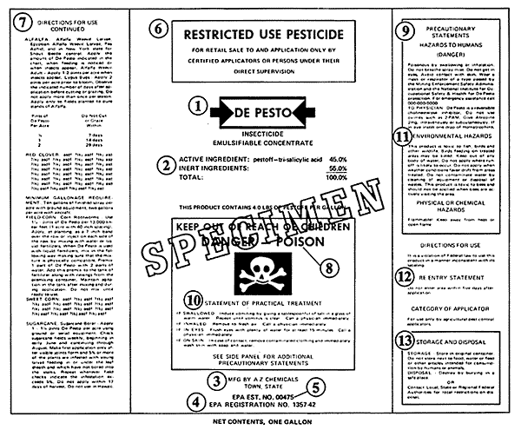
Pesticide Label
Label: information printed on or attached to the pesticide container

Slide 22
Pesticide Names
Chemical Name: Active ingredient
Common Name: Shorter name that EPA recognizes as a substitute for the chemical name of a product
Trade Name: Brand or product name

Slide 23
Pesticide Signal Words
CAUTION: slightly toxic or relatively nontoxic (1+ pint)
WARNING: moderately toxic (1 t – 1 T)
DANGER: highly toxic (taste – 1 tsp)
POISON: highly toxic orally, dermally, or inhaled

Slide 24
Pesticide Toxicity
Check for hazards…
  Humans (and domestic animals)
  Environment
  Physical / chemical
Precautions You Need to Know… Acute effects, delayed effects, allergic effects, and required personal protective equipment

Slide 25
Pesticide Toxicity
Label:
  Acute harmful effects
Labeling:
  Delayed harmful effects
  Allergic effects

Slide 26
Restricted Use Pesticides
"Restricted Use Pesticide" : product has been shown to be likely to harm people or the environment if it is not used correctly
May be purchased and used only by certified applicators and those under their direct supervision
"Restricted Use Pesticide" advisory found in a box at the top of the pesticide label front panel

Slide 27
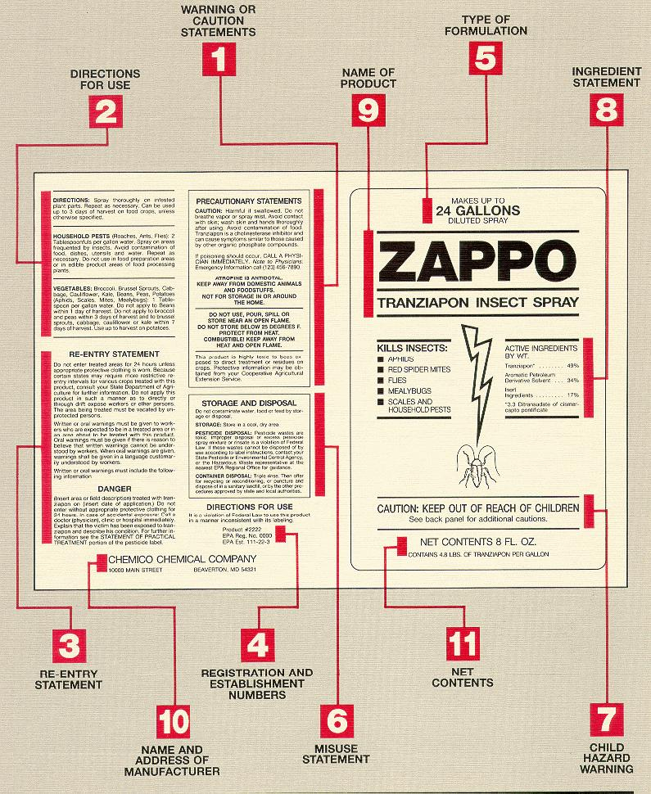
Pesticide Label

Slide 28
Pesticide Label

Slide 29
Pesticide Labeling
Labeling: includes the label, plus all other product information received from the manufacturer when you buy it
Indicates necessary measures for environmental protection
May not contain the detailed instructions
May refer users to another source for complete precautionary information

Slide 30
"It is a violation of Federal law to use this product in a manner inconsistent with its labeling"
Illegal to use a pesticide in any way not permitted by the labeling.
Use only on the plants, animals, or sites named in the directions.
Do not use higher dosages, higher concentrations, or more frequent applications.
Follow all directions concerning pesticide use, safety, mixing, diluting, storage, and disposal.
Wear personal protective equipment

Slide 31
True or False: The pesticide label contains all the instructions and directions for use that you need to use the product safely and legally.
FALSE: Specialized instructions and directions may be found in the label, labeling, or separate documents (found elsewhere)
*Must comply with all instructions and directions -- not just with the label itself *

Slide 32
Formulations
Chapter 3

Slide 33
Pesticide Formulations
Active ingredients: Control pests
Inert ingredients: Added to make the product safer, more effective, easier to measure, mix, and apply, and more convenient to handle
Pesticide = Active + Inert ingredients

Slide 34
Pesticide Additives
Adjuvants increase the effectiveness or safety
Foaming agents & thickeners reduce drift
Spreaders coat the treated surface with an even layer of pesticide
Compatibility agents allow pesticides to combine effectively

Slide 35
Choosing a Pesticide Formulation
Formulation characteristics: advantages and disadvantages for specified application
Proper application equipment?
Safe application?
Will the formulation reach the target and stay in place long enough to control the pest?
Might the formulation harm the target site?
Cost?

Slide 36
Liquid Pesticide Formulations
Ready to Use (RTU): in spray bottle/can, no mixing required
Aerosols: ready-to-use spray in a spray can
Flowable or Liquid-Flowable (F or L): mixed in water, then applied (not as concentrated)
Emulsifiable Concentrates (EC): oil-based liquid mixed into water & applied to plants
Concentrates (C or LC): thick liquid diluted in water, may require agitation
Ultra-Low-Volume (ULV): Concentrated, rationed & mixed by machine

Slide 37
Dry Pesticide Formulations
Dusts (D)
Baits (B)
Granules (G)
Pellets (P or PS)
Wettable Powders (WP or W)
Soluble Powders (SP or WSP)
Microencapsulated (M)
Dry Flowables (WDG or DF)
Fumigants

Slide 38
Fumigants
Serious inhalation hazard to pesticide handlers
Can cause severe skin burns if they are trapped next to the skin by tight clothing or chemical-resistant personal protective equipment

Slide 39
Granules
No drift
No mixing
Not recommended for uneven surfaces

Slide 40
Pesticides in the Environment
Chapter 4

Slide 41
Environmental Concerns
Environment: All surroundings, indoors & outdoors
Natural elements
Manmade objects
Living organisms

Slide 42
Pollution Sources
Point-Source Pollution comes from a specific, identifiable place (point)
  Example: Pesticide spills & runs into a storm sewer
Non-Point-Source Pollution comes from a wide area
  Example: The movement of pesticides into streams after broadcast applications

Slide 43
Common Point-Source Pollution
Mismanagement of wash water and spills produced at equipment cleanup sites.
Improper disposal of containers, water from rinsing containers, and excess pesticides.
Failure to correctly clean up leaks and spills at pesticide storage sites.
Spilling pesticides while mixing concentrates or loading pesticides into application equipment.

Slide 44
“Sensitive Areas”
Sites & living things in environments easily injured by a pesticide
Areas where:
People, ground water, or surface water are present
Animals live, such as endangered species, bees, wildlife, livestock, pets
Crops, ornamental plants, or other sensitive plants grow
Food or feed is processed, stored, or served.

Slide 45
Pesticide Release Considerations
Sensitive onsite and offsite areas in the environment that might be harmed by contact with the pesticide.
Environmental conditions that might cause the pesticide to move offsite.
Altering factors in your application or in the pesticide use site to reduce the risk of environmental contamination

Slide 46
Pesticide Movement
Air: wind or air currents generated by ventilation systems
Influenced by:
    Droplet or particle size
    Height and direction of release
    Whether the pesticide tends to form vapors

Slide 47
Pesticide Movement
Water: runoff or leaching
Liquid pesticide is applied, leaked, or spilled onto a surface
Water contacts a surface containing pesticide residue
Rainfall Irrigation Wash areas

Slide 48
Pesticide Movement
Objects, plants, or animals (including humans) that move or are moved offsite
Adhere to …
  shoes or clothing
  animal fur
  machinery & equipment
  blowing debris (leaves, grass clippings)
Remain on treated products, taken offsite for sale (container plants, mulch / pine straw)

Slide 49
Pesticide Damage to Surfaces
Discoloration
Marking & Staining
Pitting
Corrosion
Obstruction

Slide 50
Special Environmental Concerns
Chapter 5

Slide 51
Pesticide Movement in the Environment
Factors:
Pesticide user practices
Application site surface
Pesticide chemical characteristics
Soil type in the application site
Ground water distance from the surface and the permeability of surrounding geological formations (including sinkholes)
*Excess water (and any pesticides it contains) will likely move downward to the ground water*

Slide 52
Pesticide User Practices
Storage
Mixing
Loading
Application
Cleaning Equipment & Spills
Transportation
Disposal

Slide 53
Application Site Considerations
Type of space or surface to be treated
Surface cleanliness
Current and predicted moisture
Temperature
Humidity
Direct sunlight
Air movement

Slide 54
Pesticide Chemical Characteristics
Solubility -- Dissolve easily in water; likely to move into water systems
Adsorption -- Tightly attached (strongly adsorbed) to soil particles; unlikely to move out of the soil and into water systems
Persistence -- Decompose slowly & remain active in the environment long after application, providing continued pest control; likely to move into ground water

Slide 55
Pesticide-Water Movement in Soils
Fine-textured Soils with Organic Matter: pesticides + water move downward slowly
Coarse, Sandy Soils: pesticides + water move downward rapidly

Slide 56
Prevent Groundwater Contamination
Avoid…
using more pesticide than the labeling directs
application methods that present special risks
back-siphoning pesticides into your water source
Locate…
pesticide storage facilities, mix-load, and equipment-cleaning sites >100 feet from surface water and direct links to ground water
Dispose…
unused pesticides, pesticide containers, and equipment and container rinse water correctly

Slide 57
Endangered Species
Plant or animal in danger of becoming extinct
Habitat: Land, water, and air space necessary for species survival
  breeding sites
  sources of food, cover, and shelter
  area to support normal population growth & behavior
Endangered Species Act: Unlawful to use pesticides in a manner resulting in the death of an endangered species. (Federal)

Slide 58
Biological Diversity
Living creatures are various and diverse
Complex interactions necessary to maintaining ecosystems

Slide 59
Pesticides Harm Endangered Species
Direct contact
Disrupting or destroying sources of food and shelter
Contaminating water ingested by or inhabited by endangered organisms
Accumulating to dangerous levels in creatures feeding on plants / animals with pesticide residue

Slide 60
Harmful Effects & Emergency Response
Chapter 6

Slide 61
Hazard = Toxicity x Exposure
Hazard: risk of harmful effects from pesticides
Toxicity: measures the ability of a pesticide to cause harmful effects
Exposure: total amount of pesticide that gets on or in the body

Slide 62
Pesticide Exposure
Dermal (skin): most common exposure
Ocular (eyes)
Inhalation (nose, mouth)
Oral (mouth, swallowing)

Slide 63
Pesticide Absorption
The amount of pesticide absorbed through the skin (and eyes) and into the body depends on…
Pesticide & pesticide-dilutent
Area exposed on the body
Condition of the exposed skin

Slide 64
Pesticide Exposure
Acute effects: illnesses or injuries appearing immediately (or within 24 hours) following pesticide exposure
Delayed effects: illnesses or injuries appearing later than 24 hours following pesticide exposure
Allergic effects: reaction following pesticide exposure developed by some, but not experienced by most others.

Slide 65
Acute Effects from Pesticide Exposure
Pesticide Poisoning May Cause…
nausea, vomiting, diarrhea, and/or stomach cramps
headache, dizziness, weakness, and/or confusion
excessive sweating, chills, and/or thirst
chest pains
difficult breathing
muscle cramps or body aches
External Irritants May Cause…
redness, blisters, rash, and/or burns on skin
swelling
stinging sensations
burns in eyes, nose, mouth, and throat

Slide 66
First Aid for Pesticide Exposure
Remove source of pesticide exposure ASAP!
Dermal / Ocular Exposure: Flood with water
Oral Exposure: Drink large amounts of water
Inhalation Exposure: Relocate to fresh air

Slide 67
Avoiding & Reducing Exposures to Pesticides
Use safety systems (closed systems & enclosed cabs)
Wear appropriate personal protective equipment (PPE)
Wash exposed areas often
Keep personal protective equipment clean and in good operating condition

Slide 68
Heat Stress
Body cannot cope with the current heat exposure
Possible Symptoms include:
  Fatigue (exhaustion, muscle weakness)
  Headache, Nausea, & Chills
  Dizziness & Fainting
  Severe thirst & dry mouth
  Clammy skin or hot, dry skin
  Heavy sweating or complete lack of sweating
  Altered behavior (confusion, slurred speech, quarrelsome / irrational behavior)

Slide 69
Avoiding Heat Stress
Adjust:
Heat factors
Workload
Personal protective equipment
Amount of water consumed
Work schedule

Slide 70
Possible Pesticide Poisonings
Do not waste time trying to diagnose the problem SEEK MEDICAL HELP
Move the person to a cooler place away from pesticides
Remove skin-contaminating (or overly-warming) personal protective equipment & other clothing
Clean and cool the skin with water
Provide plenty of water to drink

Slide 71
Personal Protective Equipment
Chapter 7

Slide 72
Personal Protection Equipment
Chemical Resistant: Prevents pesticide movement through the material during use
Non-chemically resistant material may become…
Discolored Soft / Spongy Swollen
Dissolved Jelly-like Cracked
Eroded Stiff Brittle
Plastic: most chemically resistant PPE material

Slide 73
Coveralls
For Maximum Protection, Wear Coveralls…
Over another layer of clothing
Loose-fitting so there is a layer of air between PPE & the skin / inner clothing
With tightly constructed seams + snug, overlapping closures (no gaps, not readily unfastened)

Slide 74
Gloves
Wear chemical-resistant gloves whenever using pesticides that may contact your hands (unless directed by pesticide label)
**Hands are the most likely route of pesticide exposure**
Proper Removal during Pesticide Handling:
wash gloves thoroughly before removal
wash & dry hands thoroughly before putting the gloves on again
Replace:
Reusable gloves: Every 5-7 work days
Extra-heavy-duty gloves (butyl or nitrile rubber): Every 10-14 WD
Gloves showing wear, damage, or leaks: IMMEDIATELY

Slide 75
Protective Headgear
WHEN: Wear for risks of overhead pesticide exposure
WHY: Protect your head, neck, eyes, mouth, and face
WHAT: Chemically-resistant hood or wide-brimmed hat
Plastic "safari" hat with a plastic sweatband

Slide 76
Eyewear
Available Protective Eyewear
Goggles
Face shield
Safety glasses with brow and side shields

Slide 77
Respirators
Dust/mist-filtering respirators are masks or cartridges that filter dust, mists, and particles out of the surrounding air.
Vapor-removing respirators use a cartridge or canister to remove pesticide gases and vapors from the surrounding air.
Air-supplying respirators provide you with clean air from an air tank
Storage:
  seal respirator in a clean, airtight container (sturdy zip-closable plastic bag)
  cap cartridge or canister openings

Slide 78
Replacing Filters
Change Filters, Canisters, or Cartridges…
When you have difficulties breathing
After eight hours of work use
If you smell, taste, or feel irritation from pesticide vapors
As instructed by the "service life indicator“
After the time limit set by the manufacturer

Slide 79
Cleaning Personal Protection Equipment
Wear chemical-resistant gloves and apron, especially if handling items
  contaminated on a regular basis
  highly toxic pesticides
Work in a well-ventilated area
Do not inhale steam from the washer & dryer
Highly toxic pesticide concentrates cannot be adequately cleaned from PPE

Slide 80
Legal Responsibility for PPE
By law, you must wear at least the PPE listed on the labeling for handling
May wear additional PPE if wanted

Slide 81
Pesticide Handling Decisions
Chapter 8

Slide 82
Questions for Pesticide Supervisors
Have I read the labeling?
How can I avoid exposure to pesticides?
What personal protective equipment is needed?
Is the equipment ready and safe?
Am I avoiding the accidental spread of pesticides?
Have I instructed the handlers I supervise?
Am I prepared for emergencies?
Are people and animals out of the area?

Slide 83
Consequences of Using Pesticides Incorrectly
Wasted resources
Failure to control the pest
Acute & chronic harmful effects to living beings (including humans), property, and the environment.
Fines as well as legal actions charging you with liability for damages.

Slide 84
Mixing, Loading, & Application
Chapter 9

Slide 85
Mixing & Loading Correctly
Mix-Load Sites:
Keep the water pipe or hose well above the level of the pesticide mixture
Use a device to prevent back-siphoning
Avoid mixing or loading pesticides in areas near water systems

Slide 86
Mixing & Loading PPE
Front protection
Face protection
Protection from dusts & vapors

Slide 87
Pesticide Container Disposal
Rinse containers as soon as they are empty (if rinse-able)
Return all empty pesticide containers to the pesticide storage area or the container holding area when you finish your task.
Crush, break, or puncture empty containers that cannot be refilled, reconditioned, recycled, or returned to the manufacturer.
Dispose of containers in accordance with labeling directions and with any laws or regulations that apply.

Slide 88
Rinsable Pesticide Containers
Glass, metal, and plastic containers
Plastic-lined paper or cardboard containers
Unlined paper or cardboard containers that can withstand the rinsing process

Slide 89
Rinsing Pesticide Containers
Rinsate: liquid resulting from the rinsing of a pesticide container or tank
Collect the rinsate
Reuse it, if possible
Dispose of it as excess pesticide

Slide 90
Triple-Rinse Procedure
To triple rinse a container:
Empty the container into the tank. Let it drain an extra 30 seconds.
Fill the empty container 10-20 percent full of water.
Replace the closure and rotate the container for about 30 seconds. Invert the container so the rinse reaches all the inside surfaces.
Drain the rinse water from the container into the tank. Let the container drain for 30 seconds.
Repeat steps 2 through 4 two more times for a total of three rinses.

Slide 91
Safe Pesticide Mixing
Check the pesticide labeling for pesticides (and other chemicals) known to be compatible with the formulation
Get a compatibility chart, which is available from several sources
Test a small amount of the mixture before mixing large quantities of the pesticides together

Slide 92
Additional PPE Needed
Hand-carrying application equipment or entering the path of the released pesticide.
Walking into a just-treated area or using high-exposure application methods where a pesticide may engulf you.
Applying pesticides in enclosed spaces or adjusting pesticide application equipment.
Applying into or across air currents or applying concentrated pesticides.
Immersing hands and forearms in pesticides.

Slide 93
Applying Pesticides Safely
Deliver the pesticide to the target site
Check the delivery rate & overall appearance
Avoid non-target organisms & surfaces
Operate equipment safely

Slide 94
Site Post-Application Clean-Up
Wash your pesticide equipment and then wash yourself
Return equipment to its designated place
Safely store or dispose of all pesticide materials and other chemicals that you have used
Be sure that your work site presents no hazards to people or to the environment
Record what you have applied and the conditions at the application site

Slide 95
Proper Post-Handling Hygiene
Wash the outside of your gloves before taking them off
Carefully peel back your personal protective equipment to avoid getting pesticides on your skin
Remove any other clothing that has pesticide on it
Shower ASAP or use a mild liquid detergent and warm water to wash your face, hands, forearms, and any other area that may have pesticides on it

Slide 96
Pesticide Recordkeeping
Records can…
  Establish proof of proper use
  Help reduce pesticide misuse and mistakes
Good records may…
  Save you money by improving your pest-control practices & efficiency
  Reduce carryover by showing exactly how much was needed last time

Slide 97
Pesticide Containment Systems
Necessary if…
  Pesticides frequently mixed and loaded in one place
  Equipment cleaned at one location
Closed Mixing & Loading Systems:
  Designed to prevent pesticide from contacting handlers or other persons during mixing and loading
Enclosed Systems:
  An enclosure, such as a cab or cockpit, that surrounds the occupants and prevents them from contacting pesticides outside of the enclosure.

Slide 98
Pesticide Containment Systems
Benefits:
Save time and money
Easier spill cleanup
Reduce pesticide waste
  rinse water and spill cleanup water reused
Prevent the harm that spills and runoff
Reduce environmental & community harm

Slide 99
Applying the Correct Amount
Chapter 10

Slide 100
Correct Calibration Tips
Correct amount of pesticide released
Risk releasing too little or too much pesticide
Check Often:
  Clogging, corrosion, and wear change the delivery rate
  Settings gradually get out of adjustment

Slide 101
Application Rates
Information Sources:
  Directions for Use section of the pesticide labeling
  Consultants
  Industry organizations
  Pest or pesticide specialists
  Cooperative Extension educators
  University specialists
  Pesticide dealers
Pesticide Dispersed / Distance Covered = Application Rate

Slide 102
Diluting Pesticides
Dilute all formulations EXCEPT
  ready-to-use products
  Products intended to be used full strength
Dilution recommendations on pesticide labeling
Necessary to dilute properly:
Mixture amount the equipment holds when full
Mixture amount needed for the job
Mixture amount the equipment applies per unit of area
Size of treatment site

Slide 103
Transportation, Storage, Disposal, Spill Clean-up
Chapter 11

Slide 104
Safe Vehicle Transport of Pesticides
NEVER…
Carry pesticides in the passenger section
Allow passengers or pets to ride with pesticides
Transport pesticides with food, clothing, or other things that will contact with people or animals
Leave vehicles unattended when transporting pesticides in an unlocked trunk or open-bed truck
Transport highly volatile pesticides with other chemicals in the same vehicle or compartment
**Regulated by U.S. Department of Transportation (DOT)**

Slide 105
Protect Pesticide Containers
Pesticide Containers Should Be…
Transported with intact, undamaged, readable labels
Inspected for tightly closed openings and no pesticide residue
Handled carefully
Anchored securely
Protected from moisture (paper and cardboard)
Protected from extreme temperatures.

Slide 106
Create Safe Storage Sites
Keep unauthorized people out
Prevent water damage
Control the temperature
Provide adequate lighting
Use nonporous materials
Prevent runoff
Provide clean water

Slide 107
Maintain Safe Storage Sites
Prevent contamination
Keep labels legible
Keep containers closed
Use original containers
Watch for damage
Store volatile products separately
Isolate waste products
Know your inventory
Consider shelf life

Slide 108
Pesticides in Damaged Containers
Use the pesticide immediately at a site and rate allowed by the labeling.
Transfer the pesticide into another pesticide container that originally held the same pesticide and has the same label still intact.
Transfer the contents to a sturdy container that can be tightly closed; fasten the label to the outside of the new container.
Place the entire damaged container and its contents into a suitable larger container.

Slide 109
Excess Pesticide Materials
Pesticides
  Apply them to a site listed on the labeling; find someone else who can legally use them; return them to the dealer, formulator, or manufacturer
Pesticide Waste
  Dispose in a hazardous waste landfill or pesticide incinerator, or store until disposal is possible.

Slide 110
Spill Management
Three C’s:
Control
  Protect yourself; stop the source of the spill; protect others; stay at the site
Contain
  Confine the spill; protect water sources; absorb liquids; cover dry materials
Clean-up
  Clean up the spill; decontaminate the spill site; neutralize the spill site, if necessary; decontaminate equipment; decontaminate yourself.

Slide 111
Minimize Spill Damage
Contact Info for Assisting Agencies :
Chemtrec
Emergency numbers on pesticide labeling
Police department or highway patrol
Fire department
Public health department
Spill Kit:
Readily available every time a pesticide or pesticide container is handled

Slide 112
Laws & Regulations
Chapter 12

Slide 113
Pesticide Regulations
FIFRA: Federal Insecticide, Fungicide, and Rodenticide Act
  Law passed in 1947
  Amended in 1972, 1975, 1978, & 1988
Administered by the U.S. Environmental Protection Agency (EPA)

Slide 114
FIFRA Provisions
EPA
  Registers pesticides & pesticide users
  Classifies “Restricted Use” pesticides
Pesticides
  Used per labeling directions or incur penalties
Applicators
  Licensed in applicable pest control category to purchase or use Restricted Use Pesticides
  Supervised by a person with such certification

Slide 115
Penalties Under FIFRA
Private Applicators
Civic Penalties: $1000
Criminal Penalties: $1000 and/or 30 days in prison
Commercial Applicators
Civic Penalties: $5000
Criminal Penalties: $25,000 and/or 1 year in prison
**States may establish higher penalties**

Slide 116
Residues & Tolerance
Residue: Any pesticide that remains in or on food or feed
Tolerance: Maximum amount of pesticide residue that may legally remain in or on treated crops, animals, and animal products that are to be sold for food or feed
Monitored by Federal Agencies
Keep Residues Below Tolerance Level by Following Label Instructions

Slide 117
Worker Protection Standard
Employers must provide agricultural workers & pesticide handlers with protection against possible pesticide harm (U.S. EPD, 1992)
Informative displays
Training
Medical assistance
Decontamination sites
Restricted-entry intervals notification & compliance
Protection (equipment, information, instructions)

Slide 118
Field Sanitation Standards
Occupational Safety and Health Administration (OSHA, 1987)
Businesses that…
Employ 10+ workers
Maintain a labor camp
Facilities & Proper Hygiene Information:
Hand-washing
Clean Drinking Water
Waste Elimination (toilet)

Slide 119
Pesticide Recordkeeping
Keep records 2 years Any form acceptable
Required Information for Each Application:
Certified applicator’s name & license number
Restricted use pesticide brand / product name + EPA number
Total amount of product applied
Date (month-day-year)
Location (address)
Target site (specific crop or animal)

Slide 120
State & Federal Regulators
U.S. Department of Transportation (DOT)
  Pesticide shipping & hauling
  Accidents involving pesticide exposure & spills
    Persons require hospitalization
    Persons killed
    Damage exceeds $50,000
Federal Aviation Administration
  Aerial application of pesticides

Slide 121
University of Georgia
Cooperative Extension Service
Aaron L. Lancaster
Bibb County Extension Agent
Agriculture & Natural Resources
736 Riverside Dr. Phone: 478/751-6338
Macon GA 31201 Fax: 478/752-1773
Email: alancast@uga.edu

