Slide 1
General Information
Today’s Speakers:
Steve Brady, Cobb County Extension Agent sbrady@uga.edu
Steve Pettis, Gwinnett County Extension Agent, steve.pettis@gwinnettcounty.com
Today’s Host:
Dr. Richard Ludwig, Gwinnett Technical College Horticulture, RLudwig@gwinnett.tec.ga.us

Slide 2
Upcoming Green Industry events
September 13, 2005 DeKalb Extension Main Office, Decatur 6:30 pm Tuesday GAA - Arborists, - FREE, I hour arborist certification credit Topic: "Insurance Needs for the Arboriculture Industry". Call for more information 404-298-4084.Contact: Gary Peiffer
October 7, 2005 Athens 9 am to 4 pm UGA Ornamental Horticulture Open House. Tours with UGA faculty and research staff of the latest evaluation trials and discoveries. $20 includes lunch and transportation. Call 706-542-2861 for details.
October 13, 2005 Hall County Please call (770)535-8293 MALTA North Georgia Chapter in Gainesville, Dr. Gary Wade with the UGA horticulture department will provide a program on the newest version of Hort Management - a landscape business management CD-ROM designed to aid in job bidding, cost estimating, and record keeping. Dr. Wade will also update us on the GA Certified Landscape Professional Program. For more information, please call (770)535-8293.
October 13, 2005 Rockdate County ; Landscape Safety for Hispanic Employees (en espanol). For details or to register call: Rockdale County Extension Service phone: (770)785-5952 Cost: $10 includes lunch. Contact: J.L. Macie
November 8, 2005 DeKalb Extension Main Office, Decatur 6:30 pm GAA - Arborists, Dr. Gary Wade, "Make a Bid For Success - How to Develop Tree Care Job Bids" Gary Peiffer, 404-298-4084
November 16, 2005 Cherokee/Cobb County 8:00 am till 4:15 pm Nov. 16-17 Business Skills Workshop for Beginning Landscape and Lawn care Professionals, North Metro Tech. Acworth. $100 registration before Nov.2nd includes lunch and breaks. Visit this link or call 706-542-2861 for details http://pubs.caes.uga.edu/caespubs/business-skills
December 7, 2005 Gwinnett Civic and Cultural Center Time (Link below) Georgia Certified Landscape Professional Exam Review Workshop 16. Speakers: Robert Brannen & Steve Pettis Description: Becoming GCLP certified shows your supervisor and customers that your knowledge and skills are superior to those of other landscapers. Being well prepared is necessary to meeting the rigorous standards of the certification process. This workshop is designed to help you prepare to successfully complete the exams and become a Georgia Certified Landscape Professional. Location: Gwinnett Civic and Cultural Center sign up here : http://www.turfgrass.org/Turfinstitute.htm
January 25-27, 2006GGIA- Georgia Green Industry Association conference

Slide 3
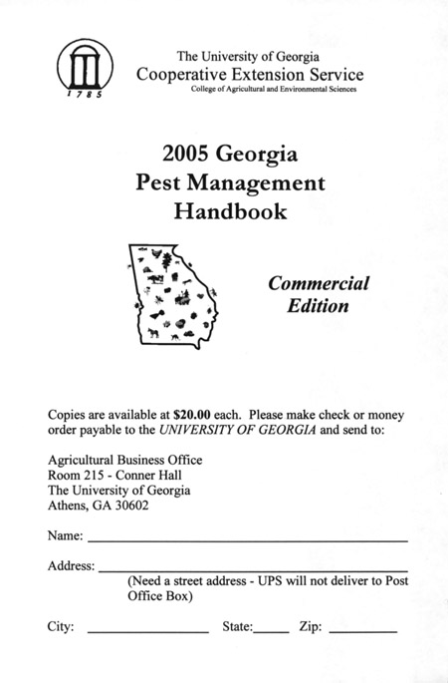
University of Georgia Web Resources
Georgia Turf www.georgiaturf.com
UGA Pest Management Handbook http://www.ent.uga.edu/pmh/
UGA Urban Agriculture Center www.gaurbanag.org
Georgia Weather Monitoring www.georgiaweather.net

Slide 4
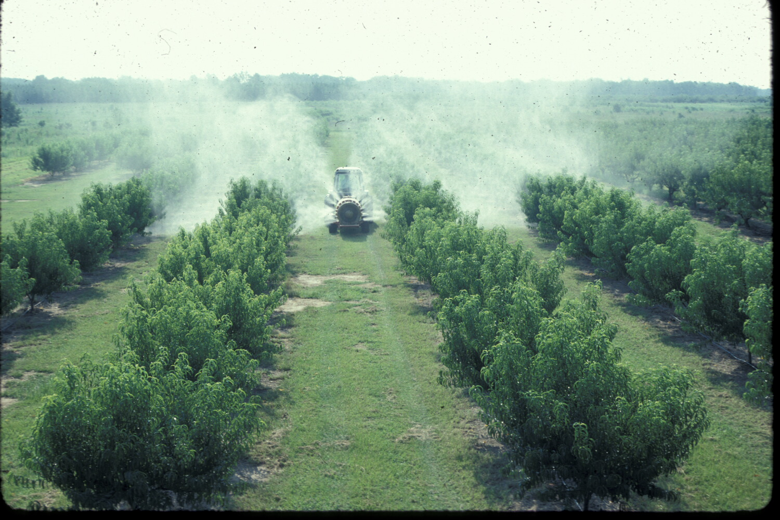
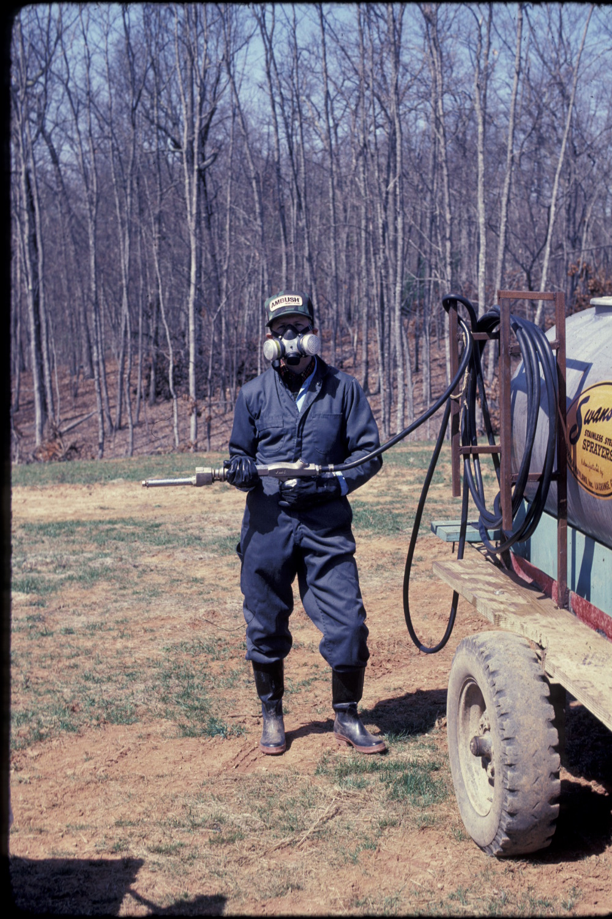
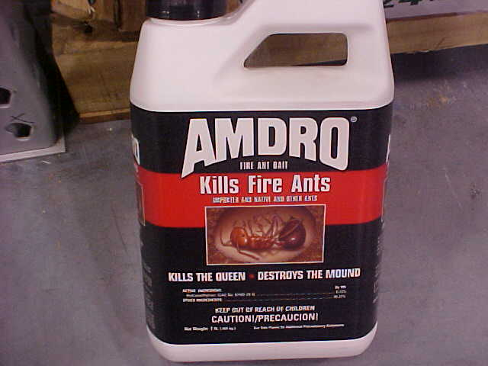
General Standards Review Commercial Pesticide Applicator Exam
Aaron Lancaster, Bibb Co. Extension Agent
Revised by Steve Pettis, Gwinnett Co. Extension Agent

Slide 5
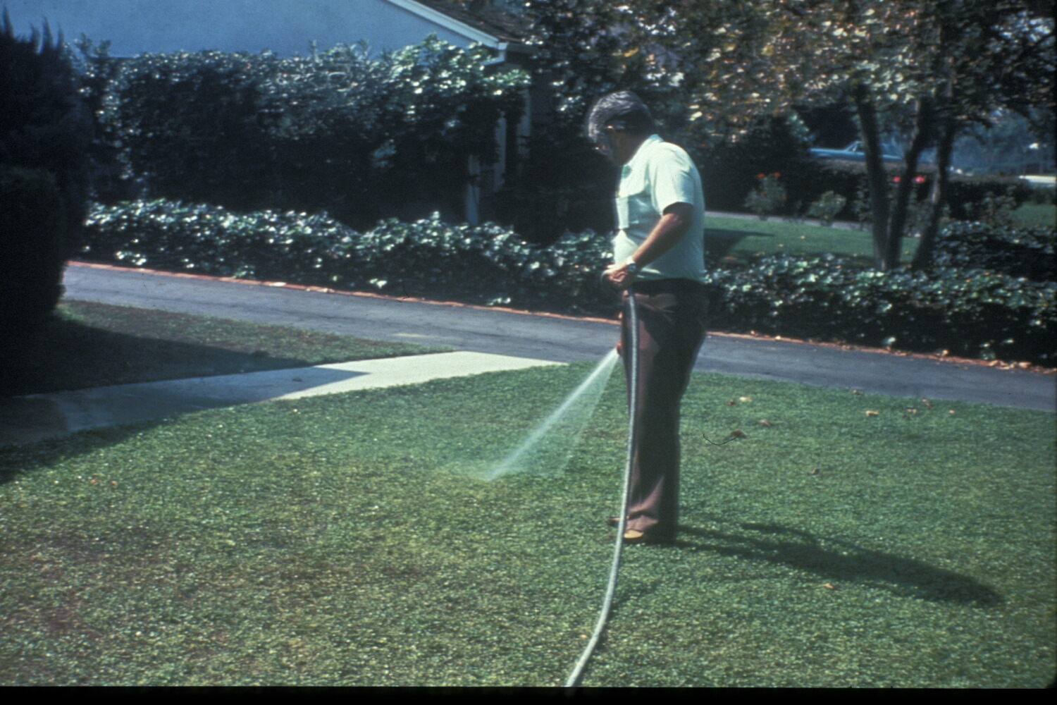
Principles of Pest Control
Chapter 1

Slide 6
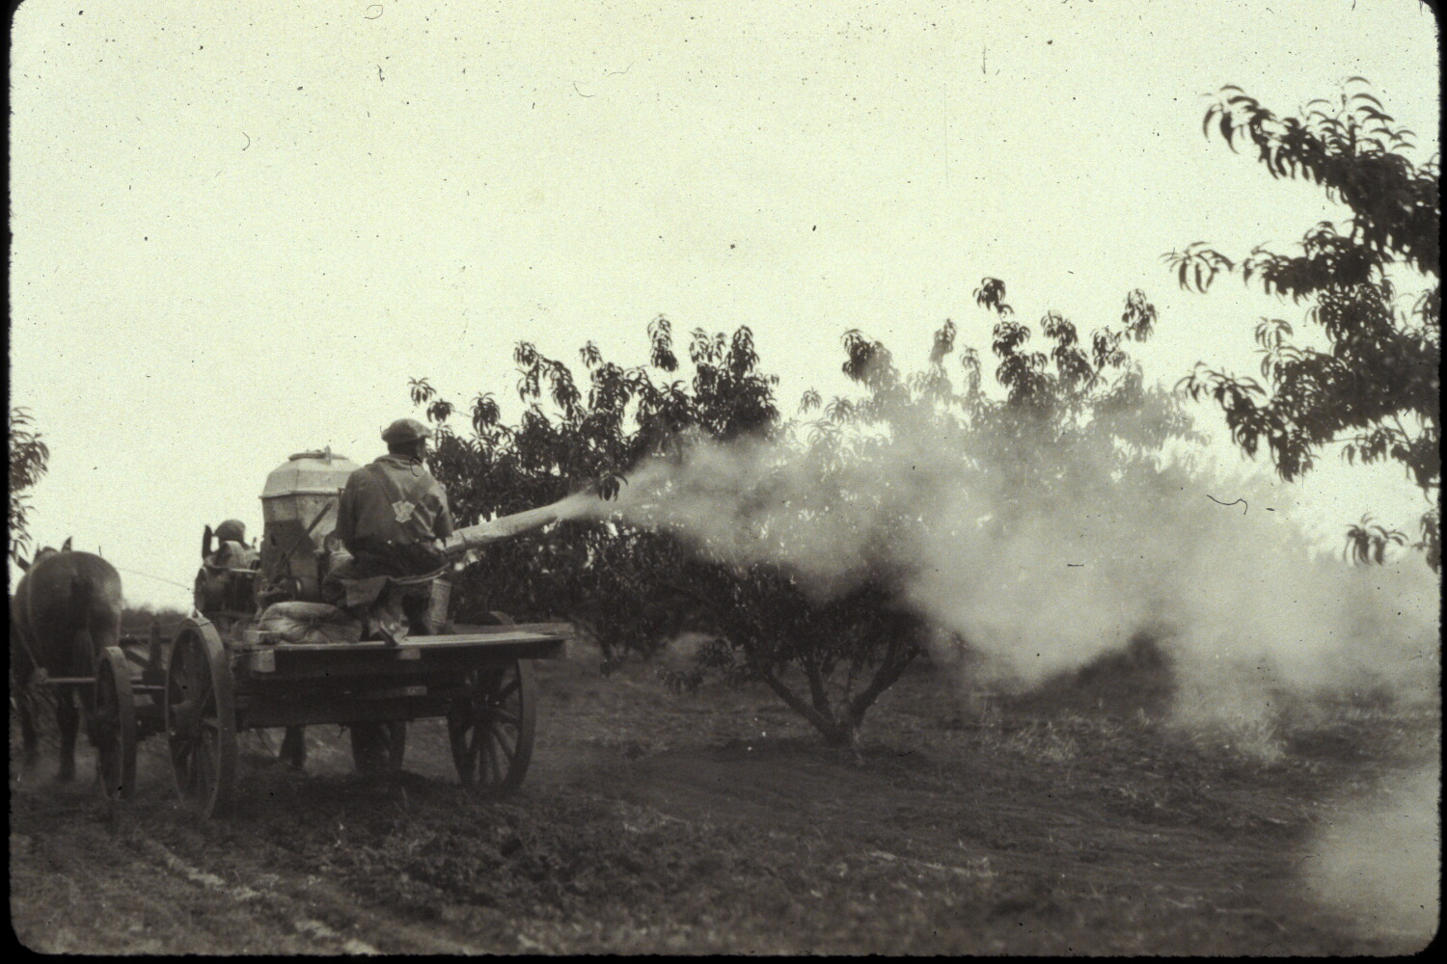

Slide 7
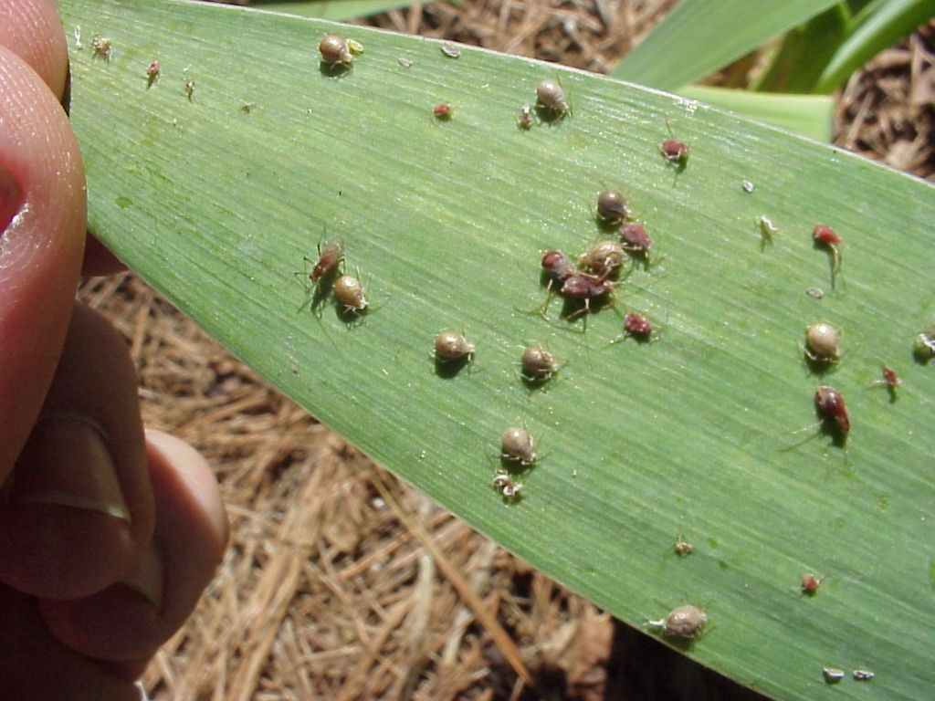
Pest Identification & Control
Basic Information from Proper Identification
Life cycle
Habits & behaviors
Pest vulnerability
= Best time for control
Is the Pest Harmful?
Cost of Control vs. Economic Loss from Pest Damage

Slide 8
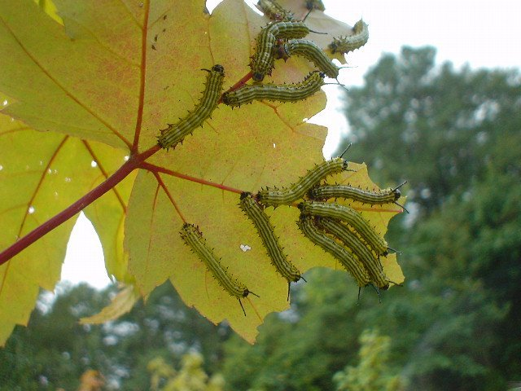
Pest Control Objectives
Prevention: Keeping a pest from becoming a problem
Suppression: Reducing pest numbers or damage to an acceptable level
Eradication: Destroying an entire pest population

Slide 9
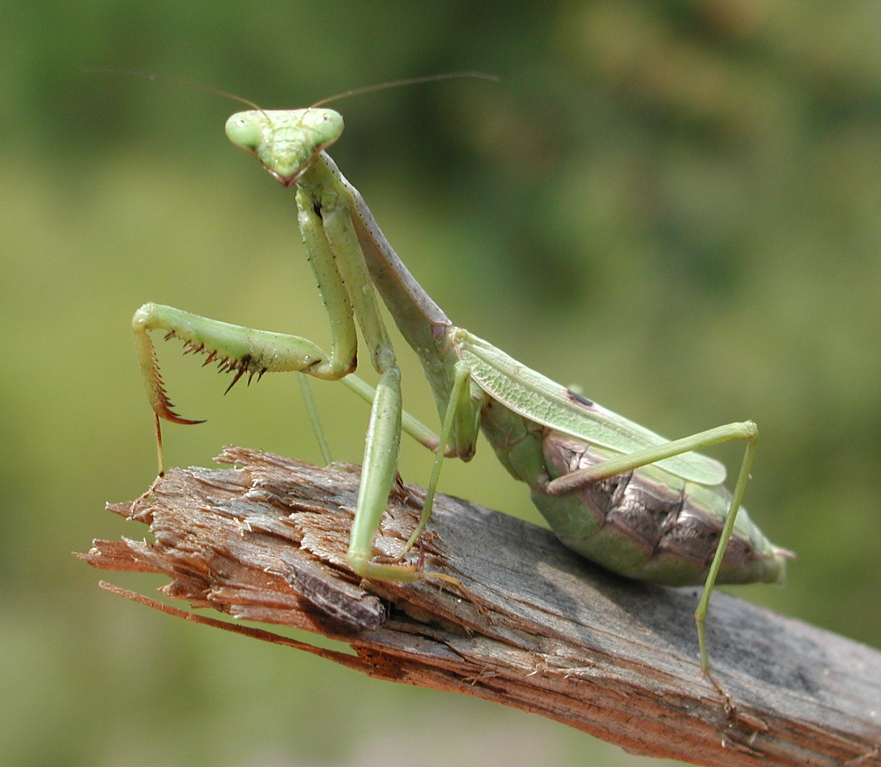
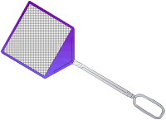
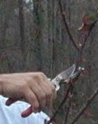
Non-Chemical Pest Control
Host Resistance
Biological Control:
predators and natural enemies
Cultural Control: pruning, thinning
Mechanical Control: traps, screens, fences
Sanitation

Slide 10
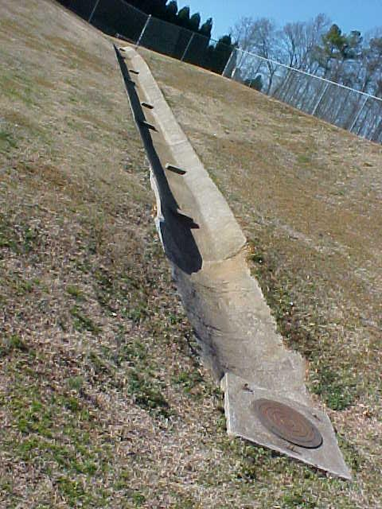
Pesticide Persistence
Persistent: Remains active for a period of time following application, providing continued pest control
Non-Persistent: Quickly
degrades following application

Slide 11
Pesticide Mode of Action
Contact: Act when they touch the pest or vice versa
Systemic: Taken into the vascular system; pest killed as it feeds – host not harmed
Translocated: Kill when absorbed & moved throughout entire pest’s system
Herbicides

Slide 12
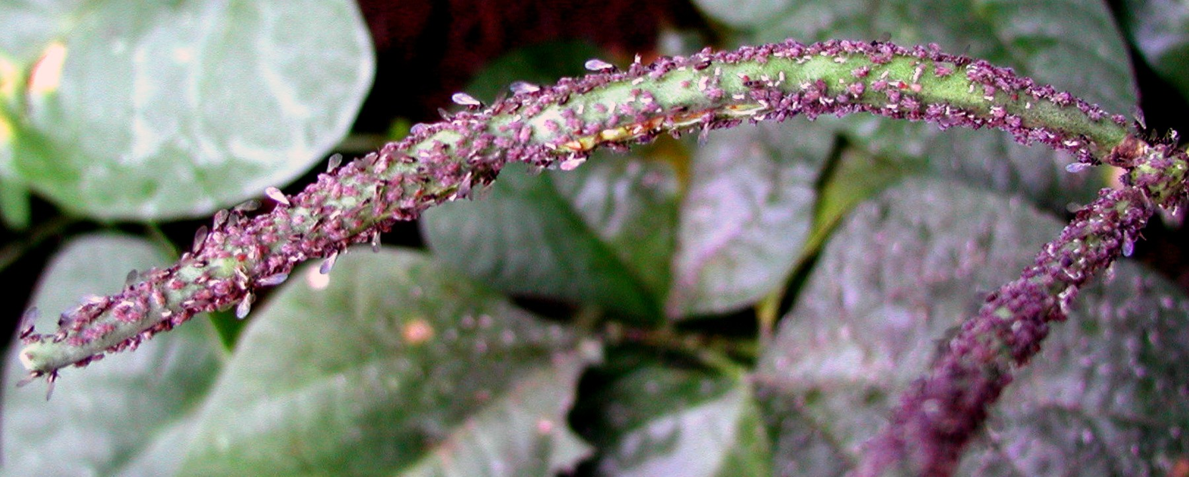
Threshold Levels
Threshold: Pest population level at which control is necessary to prevent unacceptable damage or injury
*Manage pests before threshold exceeded*

Slide 13
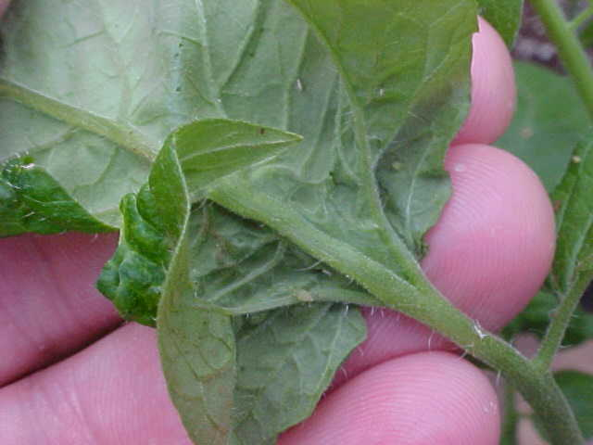
Pest Monitoring
Monitoring: checking / scouting for pests in an area
what pests are present
how many of each kind are in the area
how much damage they are causing..
Determines:
if the threshold has been reached
if control measures have been effective

Slide 14
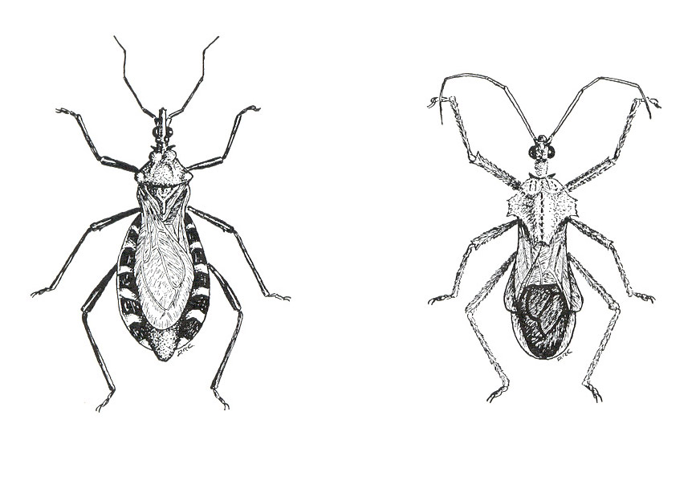
Integrated Pest Management
Integrated pest management: Several pest control tactics combined into a single plan to reduce pests and their damage to an acceptable level
Host resistance
Cultural control and sanitation.
Biological control
Mechanical
Chemical (pesticide) controls

Slide 15
Pest Resistance
Caused by repeated applications of the same pesticide (or chemicals containing the same active ingredients)
Complicated by pests with rapid life cycles
Reduced by using integrated pest management and rotating the types of pesticides used

Slide 16
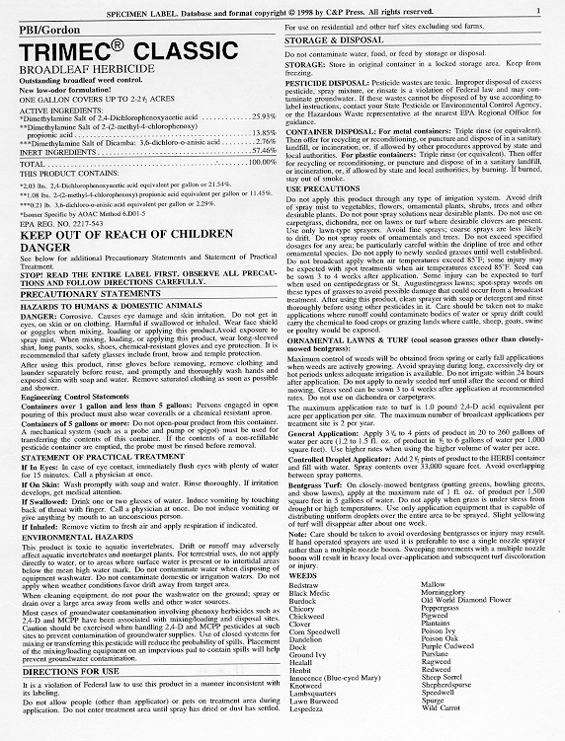
Pesticide Labeling
Chapter 2

Slide 17
Pesticide Label
Label: information printed on or attached to the pesticide container

Slide 18
Pesticide Names
Chemical Name: Active ingredient
(1-naphthyl N-methyl carbamate)
Common Name: Shorter name that EPA recognizes as a substitute for the chemical name of a product
(Carbaryl)
Trade Name: Brand or product name
(Sevin)

Slide 19
Pesticide Signal Words
CAUTION: slightly toxic or relatively nontoxic (1+ pint)
WARNING: moderately toxic (1 t – 1 T)
DANGER: highly toxic (taste – 1 tsp)
POISON: highly toxic orally, dermally, or inhaled

Slide 20
Pesticide Toxicity
Check for hazards…
Humans (and domestic animals)
Environment
Physical / chemical
Precautions You Need to Know… Acute effects, delayed effects, allergic effects, and required personal protective equipment

Slide 21
Restricted Use Pesticides
"Restricted Use Pesticide" : product has been shown to be likely to harm people or the environment if it is not used correctly
May be purchased and used only by certified applicators and those under their direct supervision
"Restricted Use Pesticide" advisory found in a box at the top of the pesticide label front panel

Slide 22
Pesticide Label

Slide 23
Pesticide Label

Slide 24
Pesticide Labeling
Labeling: includes the label, plus all other product information received from the manufacturer when you buy it
Indicates necessary measures for environmental protection
May not contain the detailed instructions
May refer users to another source for complete precautionary information

Slide 25
"It is a violation of Federal law to use this product in a manner inconsistent with its labeling"
Illegal to use a pesticide in any way not permitted by the labeling.
Use only on the plants, animals, or sites named in the directions.
Do not use higher dosages, higher concentrations, or more frequent applications.
Follow all directions concerning pesticide use, safety, mixing, diluting, storage, and disposal.
Wear personal protective equipment

Slide 26
True or False: The pesticide label contains all the instructions and directions for use that you need to use the product safely and legally.
FALSE: Specialized instructions and directions may be found in the label, labeling, or separate documents (found elsewhere)
*Must comply with all instructions and directions -- not just with the label itself *

Slide 27
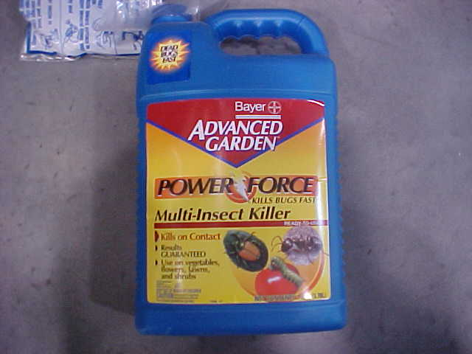
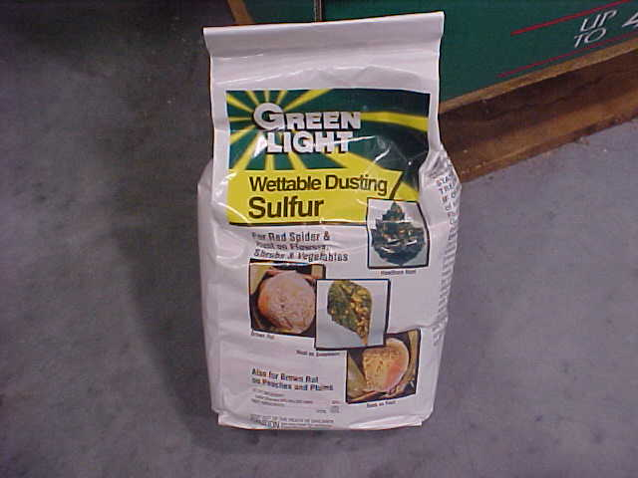
Formulations
Liquid
Bait
Flowable
Powder
Chapter 3

Slide 28
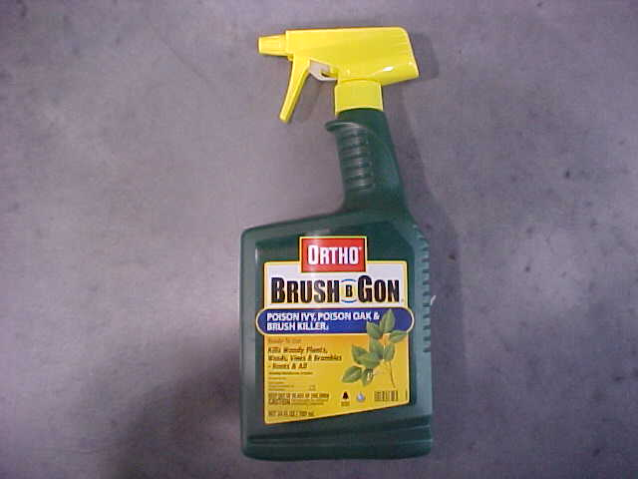
Pesticide Formulations
Active ingredients: Control pests
Inert ingredients: Added to make the product safer, more effective, easier to measure, mix, and apply, and more convenient to handle
Pesticide = Active + Inert ingredients

Slide 29
Pesticide Additives
Adjuvants increase the effectiveness or safety
Foaming agents & thickeners reduce drift
Spreaders coat the treated surface with an even layer of pesticide
Compatibility agents allow pesticides to combine effectively

Slide 30
Choosing a Pesticide Formulation
Formulation characteristics: advantages and disadvantages for specified application
Do I have proper application equipment?
Can I safely apply the product?
Will the formulation reach the target and stay in place long enough to control the pest?
Might the formulation harm the target (plant)?
Cost?

Slide 31
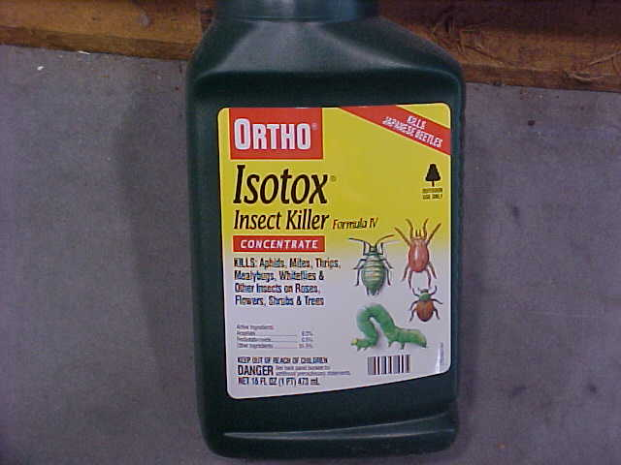
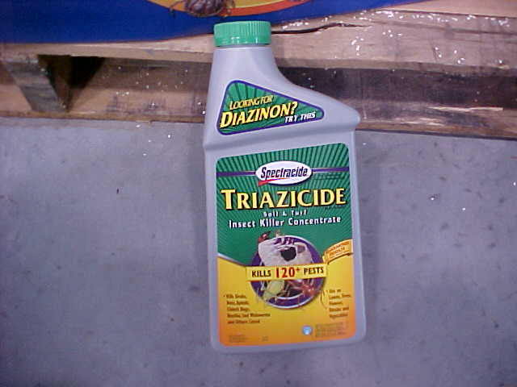
Liquid Pesticide Formulations
Ready to Use (RTU): in spray
bottle/can, no mixing required
Aerosols: ready-to-use
spray in a spray can
Flowable or Liquid-Flowable (F or L):
mixed in water, then applied
(not as concentrated)
Emulsifiable Concentrates (EC):
oil-based liquid mixed into water
& applied to plants
Concentrates (C or LC): thick
liquid diluted in water, may require agitation
Ultra-Low-Volume (ULV): Concentrated,
rationed & mixed by machine

Slide 32
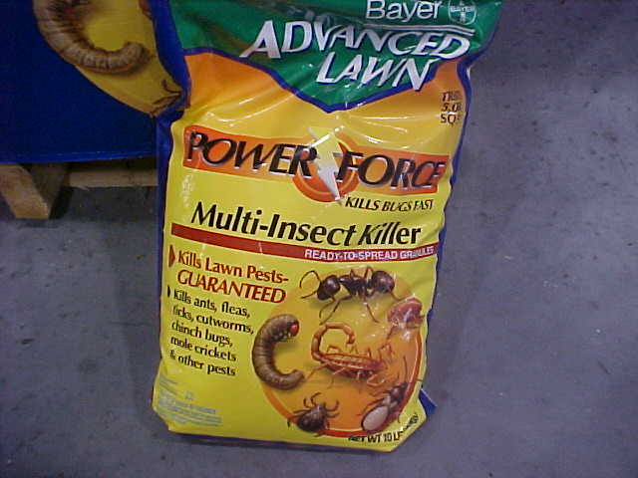
Dry Pesticide Formulations
Dusts (D)
Baits (B)
Granules (G)
Pellets (P or PS)
Wettable Powders (WP or W)
Soluble Powders (SP or WSP)
Microencapsulated (M)
Dry Flowables (WDG or DF)
Fumigants

Slide 33
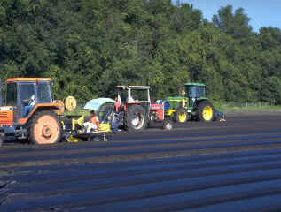
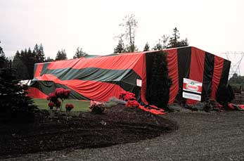
Fumigants
Serious inhalation
hazard to pesticide
handlers
Can cause severe
skin burns if they are
trapped next to the
skin by tight clothing or
chemical-resistant
personal protective equipment

Slide 34
Granules
No drift
No mixing
Not recommended
for uneven surfaces

Slide 35
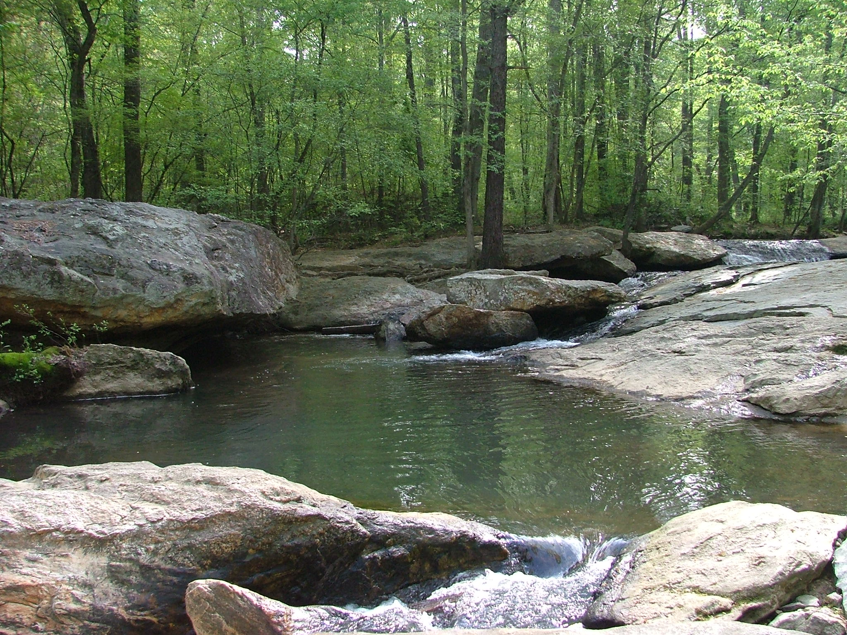
Pesticides in the Environment
Chapter 4

Slide 36
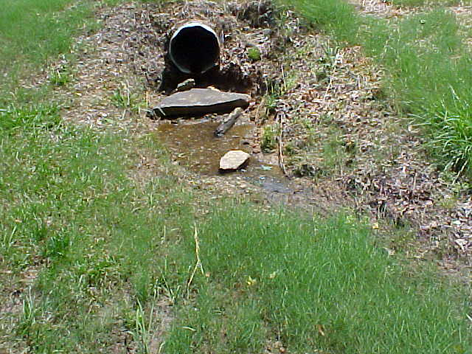
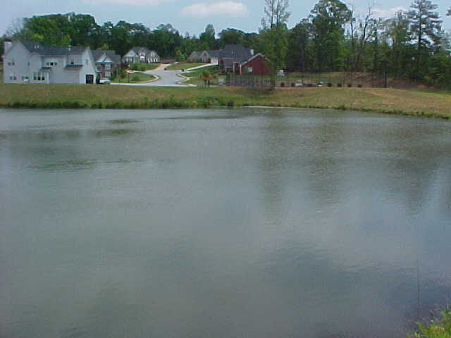
Pollution Sources
Point-Source Pollution
comes from a specific,
identifiable place (point)
Example: pipe discharging directly into stream
Non-Point-Source Pollution
comes from a wide area
Example: The movement of pesticides into streams after broadcast applications

Slide 37
Common Point-Source Pollution
Mismanagement of wash water and spills produced at equipment cleanup sites.
Improper disposal of containers, water from rinsing containers, and excess pesticides.
Failure to correctly clean up leaks and spills at pesticide storage sites.
Spilling pesticides while mixing concentrates or loading pesticides into application equipment.

Slide 38
Pesticide Movement
Air: wind or air currents generated by ventilation systems
Influenced by:
Droplet or particle size
Height and direction of release
Whether the pesticide tends to form vapors

Slide 39
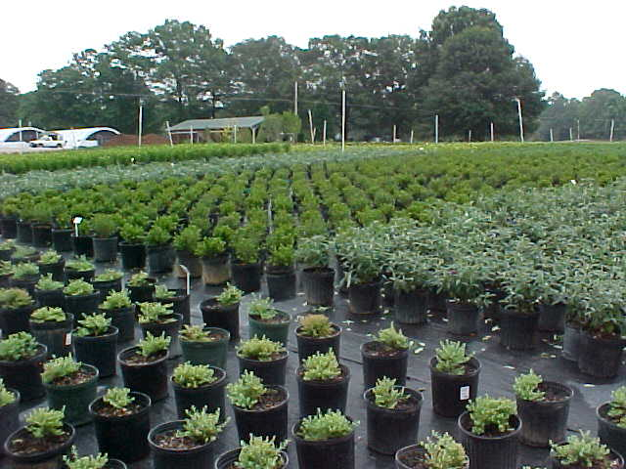
Pesticide Movement
Water: runoff or leaching
Liquid pesticide is applied, leaked, or spilled onto a surface
Water contacts a surface containing pesticide residue
Rainfall Irrigation Wash areas

Slide 40
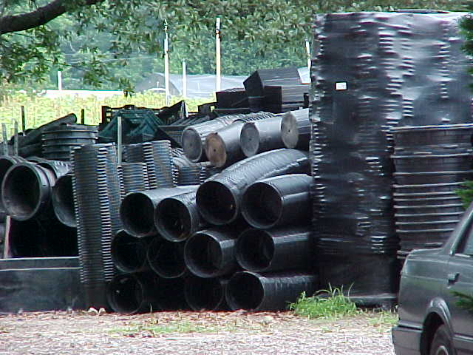
Pesticide Movement
Objects, plants, or animals (including humans) that move or are moved offsite
Adhere to …
shoes or clothing
machinery & equipment
blowing debris (leaves, grass clippings)
Remain on treated products, taken offsite for sale (container plants, mulch / pine straw)

Slide 41
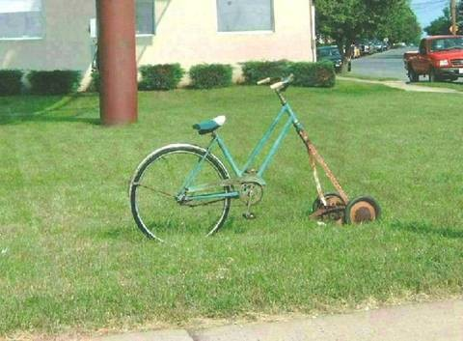
Let’s Take a Break!!!

Slide 42
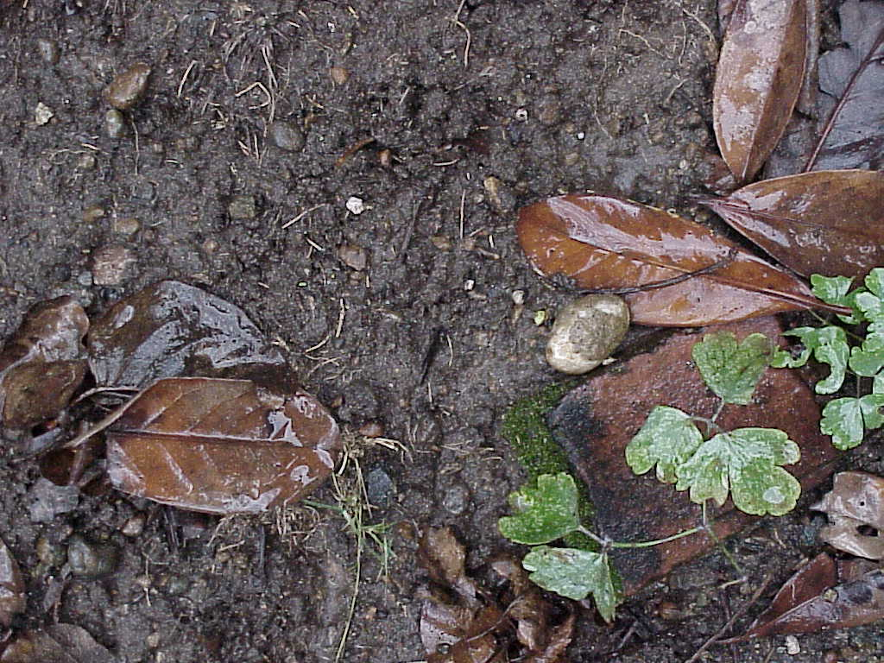
Special Environmental Concerns
Chapter 5

Slide 43
Pesticide Movement in the Environment
Factors:
Pesticide user practices
Application site surface
Pesticide chemical characteristics
Soil type in the application site
Ground water distance from the surface and the permeability of surrounding geological formations (including sinkholes)

Slide 44
Pesticide User Practices
Storage
Mixing
Loading
Application
Cleaning
Equipment & Spills
Transportation
Disposal

Slide 45
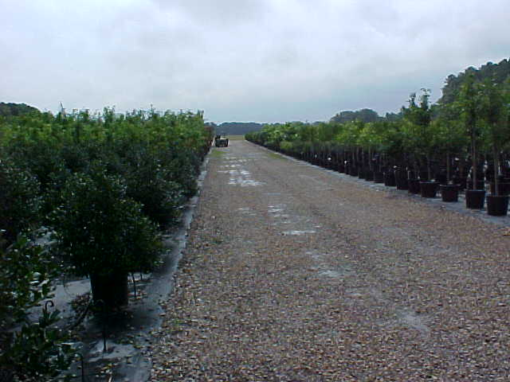
Application Site Considerations
Type of space or
surface to be treated
Surface cleanliness
Current and predicted
moisture
Temperature
Humidity
Direct sunlight
Air movement

Slide 46
Pesticide Chemical Characteristics
Solubility -- Dissolve easily in water; likely to move into water systems
Adsorption -- Tightly attached (strongly adsorbed) to soil particles; unlikely to move out of the soil and into water systems
Persistence -- Decompose slowly & remain active in the environment long after application, providing continued pest control

Slide 47
Pesticide-Water Movement in Soils
Fine-textured Soils with Organic Matter: pesticides + water move downward slowly
Coarse, Sandy Soils: pesticides + water move downward rapidly

Slide 48
Prevent Groundwater Contamination
Avoid…
using more pesticide than the labeling directs
application methods that present special risks
back-siphoning pesticides into your water source
Locate…
pesticide storage facilities, mix-load, and equipment-cleaning sites >100 feet from surface water and direct links to ground water
Dispose…
unused pesticides, pesticide containers, and equipment and container rinse water correctly

Slide 49
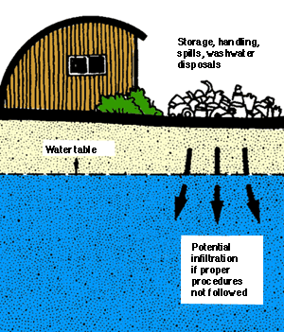
Harmful Effects & Emergency Response
Chapter 6

Slide 50
Hazard = Toxicity x Exposure
Hazard: risk of harmful effects from pesticides
Toxicity: measures the ability of a pesticide to cause harmful effects
Exposure: total amount of pesticide that gets on or in the body

Slide 51
Pesticide Exposure
Dermal (skin): most common exposure
Ocular (eyes)
Inhalation (nose, mouth)
Oral (mouth, swallowing)

Slide 52
Pesticide Absorption
The amount of pesticide absorbed through the skin (and eyes) and into the body depends on…
Pesticide & pesticide-diluent
Area exposed on the body
Condition of the exposed skin

Slide 53
Pesticide Exposure
Acute effects: illnesses or injuries appearing immediately (or within 24 hours) following pesticide exposure
Delayed effects: illnesses or injuries appearing later than 24 hours following pesticide exposure
Allergic effects: reaction following pesticide exposure developed by some, but not experienced by most others.

Slide 54
Acute Effects from Pesticide Exposure
Pesticide Poisoning May Cause…
nausea, vomiting, diarrhea, and/or stomach cramps
headache, dizziness, weakness, and/or confusion
excessive sweating, chills, and/or thirst
chest pains
difficult breathing
muscle cramps or body aches
External Irritants May Cause…
redness, blisters, rash, and/or burns on skin
swelling
stinging sensations
burns in eyes, nose, mouth, and throat

Slide 55
Avoiding & Reducing Exposures to Pesticides
Use safety systems (closed systems & enclosed cabs)
Wear appropriate personal protective equipment (PPE)
Wash exposed areas often
Keep personal protective equipment clean and in good operating condition

Slide 56
Possible Pesticide Poisonings
Do not waste time trying to diagnose the problem SEEK MEDICAL HELP
Move the person to a cooler place away from pesticides
Remove skin-contaminating (or overly-warming) personal protective equipment & other clothing
Clean and cool the skin with water
Provide plenty of water to drink

Slide 57
Personal Protective Equipment
Chapter 7

Slide 58
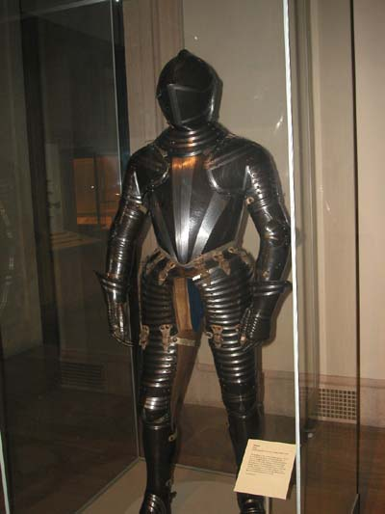

Slide 59
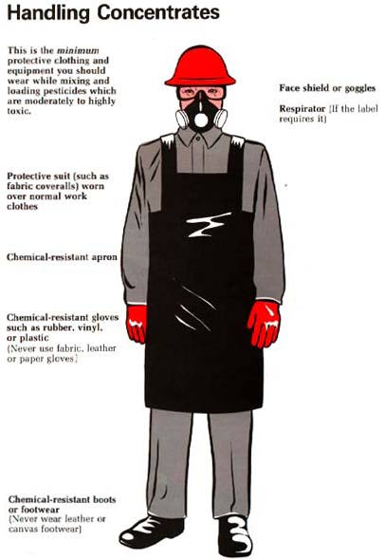
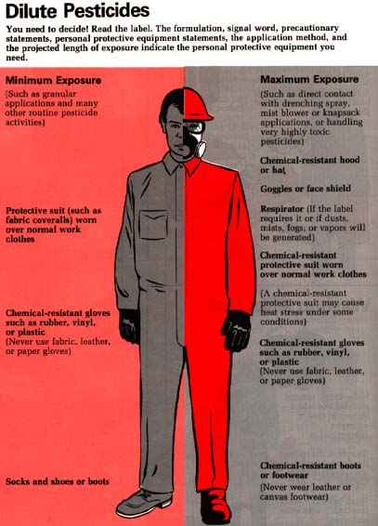

Slide 60
Simply understanding the hazard of the pesticide you are using is not enough. To keep yourself safe, you also must sure to properly use all the recommended protective equipment.

Slide 61
You’re Going to Eat That?
Sugar
Aspirin
Vinegar
Nicotine
Vitamin D
Acetaminophen
Caffeine
Roundup (glyphosate)
Malathion
Sugar 29,700 mg/kg
Roundup 4,320
Vinegar 3310
Malathion 2,800
Aspirin 1,000
Acetaminophen 300
Caffeine 200
Nicotine 50
Vitamin D 10

Slide 62
Personal Protection Equipment
Chemical Resistant: Prevents pesticide movement through the material during use
Non-chemically resistant material may become…
Discolored Soft / Spongy Swollen
Dissolved Jelly-like Cracked
Eroded Stiff Brittle
Plastic: most chemically resistant PPE material

Slide 63
Coveralls
For Maximum Protection, Wear Coveralls…
Over another layer of clothing
Loose-fitting so there is a layer of air between PPE & the skin / inner clothing
With tightly constructed seams + snug, overlapping closures (no gaps, not readily unfastened)

Slide 64
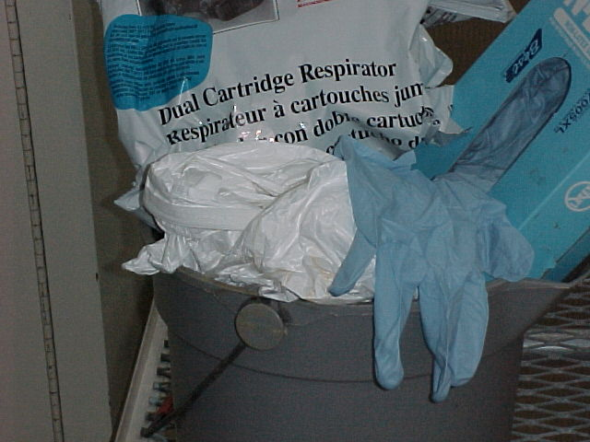
Gloves
Wear chemical-resistant gloves whenever using pesticides that may contact your hands (unless directed by pesticide label)
**Hands are the most likely route of pesticide exposure**
Proper Removal during Pesticide Handling:
wash gloves thoroughly before removal
wash & dry hands thoroughly
before putting the gloves on again
Replace:
Reusable gloves: Every 5-7
work days
Extra-heavy-duty gloves (butyl
or nitrile rubber): Every 10-14 WD
Gloves showing wear, damage,
or leaks: IMMEDIATELY

Slide 65
Eyewear
Available Protective Eyewear
Goggles
Face shield
Safety glasses with brow and side shields

Slide 66
Cleaning Personal Protective Equipment
Wear chemical-resistant gloves and apron, especially if handling items
contaminated on a regular basis
highly toxic pesticides
Work in a well-ventilated area
Do not inhale steam from the washer & dryer
Highly toxic pesticide concentrates cannot be adequately cleaned from PPE

Slide 67
Pesticide Handling Decisions
Chapter 8

Slide 68
Questions for Pesticide Supervisors
Have I read the labeling?
How can I avoid exposure to pesticides?
What personal protective equipment is needed?
Is the equipment ready and safe?
Am I avoiding the accidental spread of pesticides?
Have I instructed the handlers I supervise?
Am I prepared for emergencies?
Are people and animals out of the area?

Slide 70
Consequences of Using Pesticides Incorrectly
Wasted resources
Failure to control the pest
Acute & chronic harmful effects to living beings (including humans), property, and the environment.
Fines as well as legal actions charging you with liability for damages.

Slide 71
Mixing, Loading, & Application
Chapter 9

Slide 72
Mixing & Loading Correctly
Mix-Load Sites:
Keep the water pipe or hose well above the level of the pesticide mixture
Use a device to prevent back-siphoning
Avoid mixing or loading pesticides in areas near water systems

Slide 73
Mixing & Loading PPE
Front protection
Face protection
Protection from dusts & vapors

Slide 74
Rinsing Pesticide Containers
Rinsate: liquid resulting from the rinsing of a pesticide container or tank
Collect the rinsate
Reuse it, if possible
Dispose of it as excess
pesticide

Slide 75
Safe Pesticide Mixing
Check the pesticide labeling for pesticides (and other chemicals) known to be compatible with the formulation
Get a compatibility chart, which is available from several sources
Test a small amount of the mixture before mixing large quantities of the pesticides together

Slide 76
Applying Pesticides Safely
Deliver the pesticide to the target site
Check the delivery rate & overall appearance
Avoid non-target organisms & surfaces
Operate equipment safely

Slide 77
Pesticide Recordkeeping
Records can…
Establish proof of proper use
Help reduce pesticide misuse
and mistakes
Good records may…
Save you money by improving your pest-control practices & efficiency
Reduce carryover by showing exactly how much product was needed last time
KEEP RECORDS FOREVER

Slide 78
Pesticide Containment Systems
Necessary if…
Pesticides frequently mixed and loaded in one place
Equipment cleaned at one location
Closed Mixing & Loading Systems:
Designed to prevent pesticide from contacting handlers or other persons during mixing and loading
Enclosed Systems:
An enclosure, such as a cab or cockpit, that surrounds the occupants and prevents them from contacting pesticides outside of the enclosure.

Slide 79
Applying the Correct Amount
Chapter 10

Slide 80
Proper Calibration includes:
Determining the application rate
Measure and mix accurately
Apply to a specific test site
Check Often:
Clogging, corrosion, and wear change the delivery rate
Settings gradually get out of adjustment

Slide 81
Application Rates
Information Sources:
Directions for Use section of the pesticide labeling
Consultants
Industry organizations
Pest or pesticide specialists
Cooperative Extension Agents
University specialists
Pesticide dealers
Pesticide Dispersed / Distance Covered = Application Rate

Slide 82
Diluting Pesticides
Dilute all formulations EXCEPT
ready-to-use products
Products intended to be used full strength
Dilution recommendations on pesticide labeling
Necessary to dilute properly:
Mixture amount the equipment holds when full
Mixture amount needed for the job
Mixture amount the equipment applies per unit of area
Size of treatment site

Slide 83
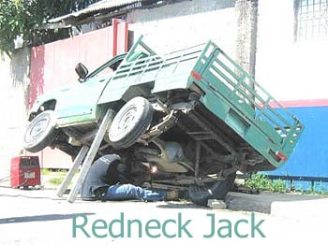
Let’s Take a Break!!!

Slide 84
Transportation, Storage, Disposal, Spill Clean-up
Chapter 11

Slide 85
Safe Vehicle Transport of Pesticides
NEVER…
Carry pesticides in the passenger section
Allow passengers or pets to ride with pesticides
Transport pesticides with food, clothing, or other things that will come in contact with people or animals
Leave vehicles unattended when transporting pesticides in an unlocked trunk or open-bed truck
Transport highly volatile pesticides with other chemicals in the same vehicle or compartment
**Regulated by U.S. Department of Transportation (DOT)**

Slide 86
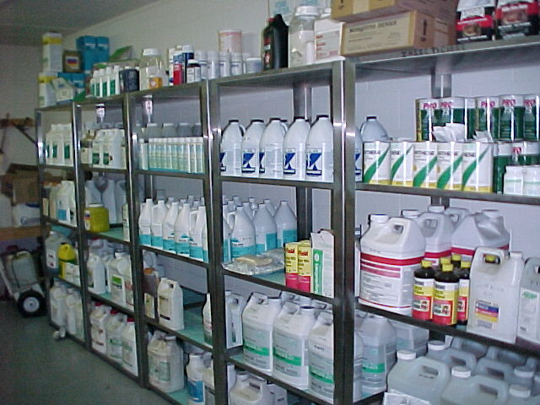
Protect Pesticide Containers
Pesticide Containers Should Be…
Transported with intact, undamaged, readable labels
Inspected for tightly closed openings and no pesticide residue
Handled carefully
Anchored securely
Protected from moisture (paper and cardboard)
Protected from extreme temperatures.

Slide 87
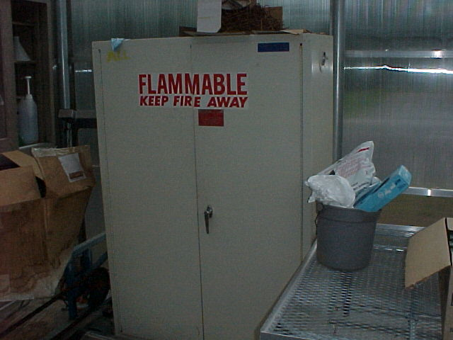
Create Safe Storage Sites
Keep unauthorized people out
Prevent water damage
Control the temperature
Provide adequate lighting
Use nonporous materials
Prevent runoff
Provide clean water

Slide 88
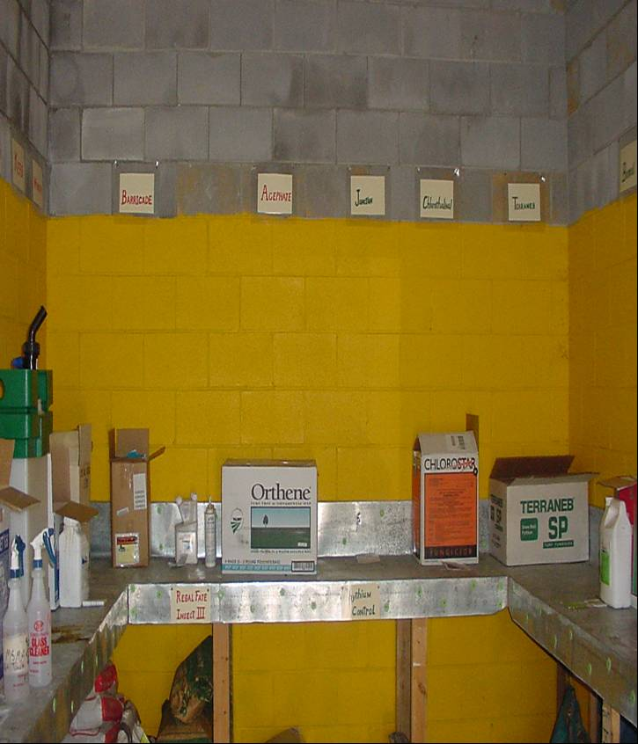
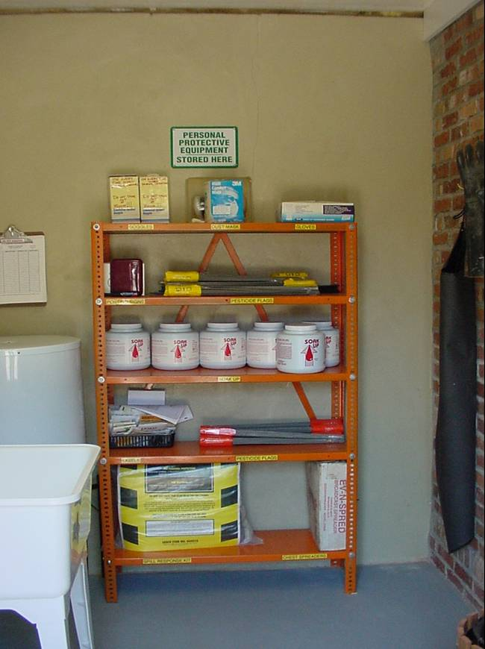

Slide 89
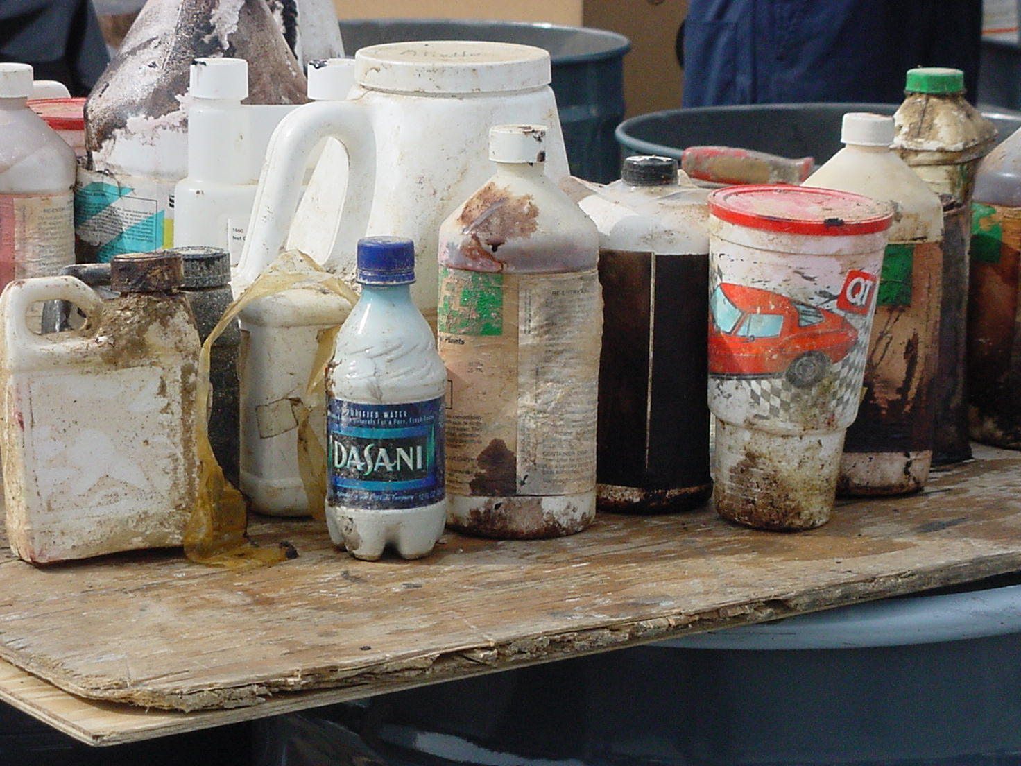

Slide 90
Excess Pesticide Materials
Pesticides
Apply them to a site listed on the labeling; find someone else who can legally use them; return them to the dealer, formulator, or manufacturer
Pesticide Waste
Dispose in a hazardous waste landfill or pesticide incinerator, or store until disposal is possible.

Slide 91
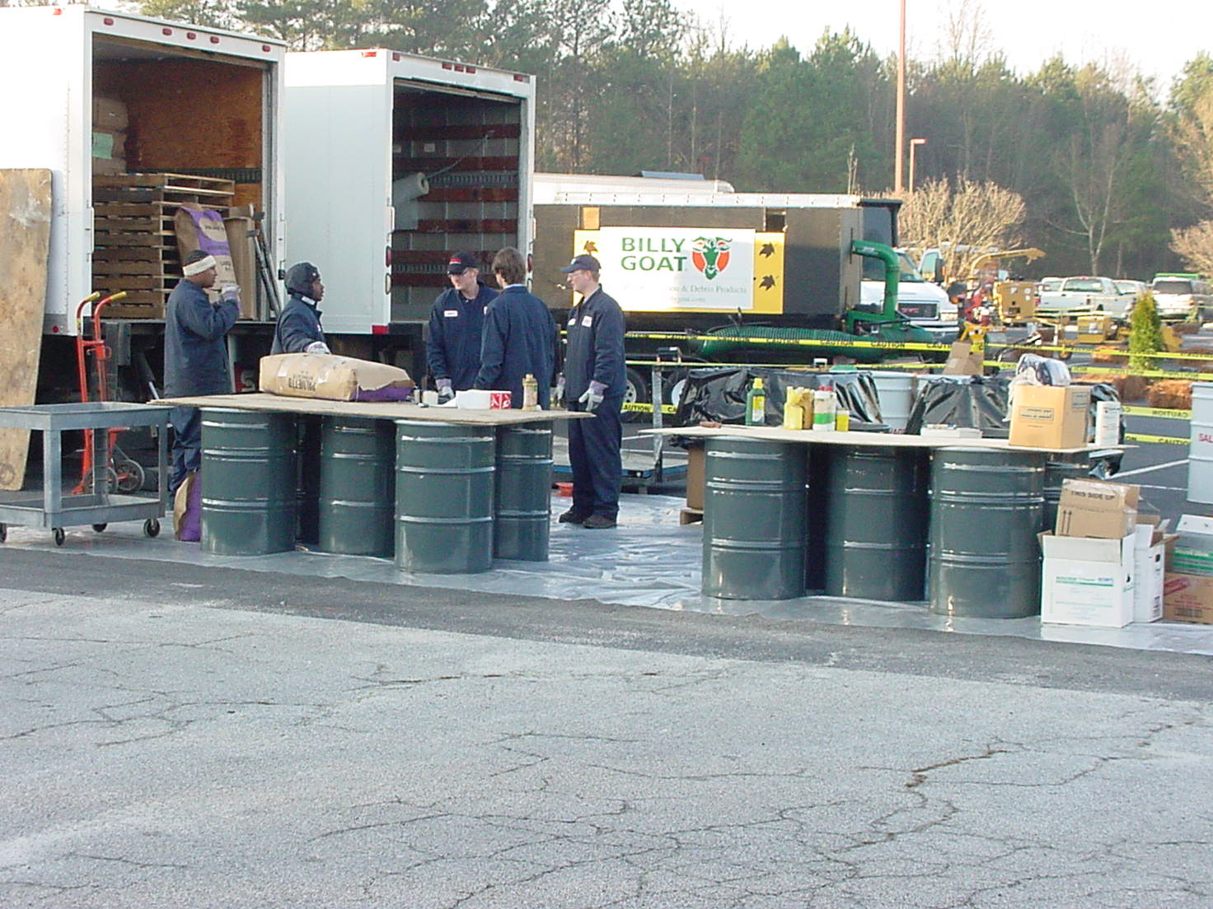
Pesticide Clean Day Program Gwinnett County GA. 2004
Collected over 18,000 lbs.

Slide 92
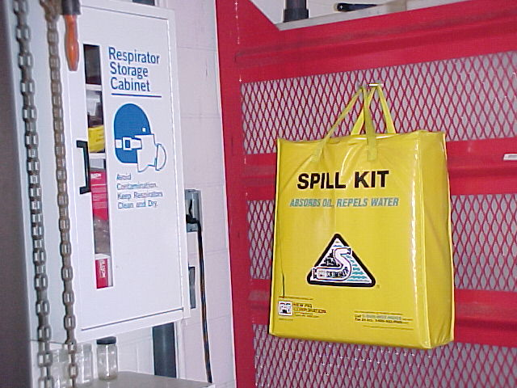
Spill Management
Three C’s:
Control
Protect yourself; stop the source of the spill; protect others; stay at the site
Contain
Confine the spill; protect water sources; absorb liquids; cover dry materials
Clean-up
Clean up the spill; decontaminate the spill site; neutralize the spill site, if necessary; decontaminate equipment; decontaminate yourself.

Slide 93
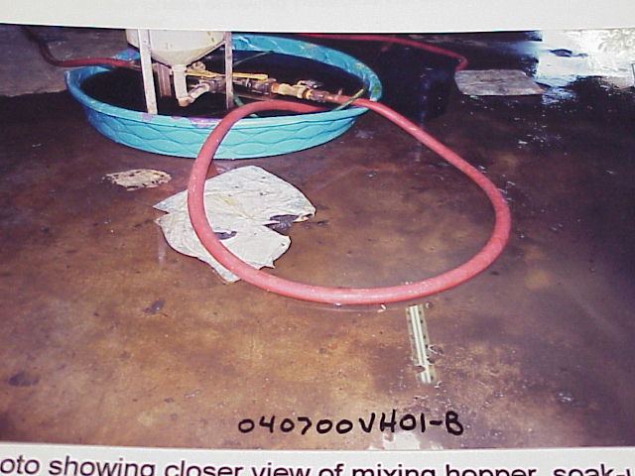

Slide 94
Minimize Spill Damage
Contact Info for Assisting Agencies :
Chemtrec
Emergency numbers on pesticide labeling
Police department or highway patrol
Fire department
Public health department
Spill Kit:
Readily available every time a pesticide or pesticide container is handled

Slide 95
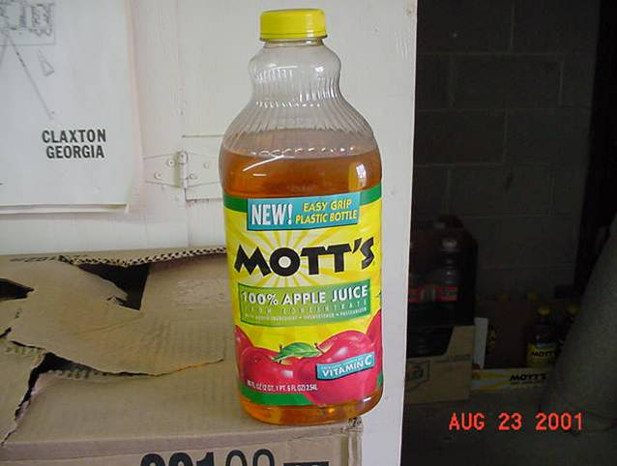
Laws & Regulations
Chapter 12

Slide 96
Georgia Department of Agriculture
Pesticide Division, Room 550
19 M.L.K. Jr. Dr.
Atlanta, GA 30334
http://www.agr.state.ga.us
Phone (404) 656-4958
Fax (404) 657-8378
Cell (404) 535-1614

Slide 97
Pesticide Regulations
FIFRA: Federal Insecticide, Fungicide, and Rodenticide Act
Law passed in 1947
Amended in 1972, 1975, 1978, & 1988
Administered by the U.S. Environmental Protection Agency (EPA)

Slide 98
FIFRA Provisions
EPA
Registers pesticides & pesticide users
Classifies “Restricted Use” pesticides
Pesticides
Used per labeling directions or incur penalties
Applicators
Licensed in applicable pest control category to purchase or use Restricted Use Pesticides
Supervised by a person with such certification

Slide 99
Penalties Under FIFRA
Private Applicators
Civic Penalties: $1000
Criminal Penalties: $1000 and/or 30 days in prison
Commercial Applicators
Civic Penalties: $5000
Criminal Penalties: $25,000 and/or 1 year in prison
**States may establish higher penalties**

Slide 100
Worker Protection Standard
Employers must provide agricultural workers & pesticide handlers with protection against possible pesticide harm (U.S. EPD, 1992)
Informative displays
Training
Medical assistance
Decontamination sites
Restricted-entry intervals notification & compliance
Protection (equipment, information, instructions)

Slide 101
Pesticide Recordkeeping
Keep records 2 years Any form acceptable
Required Information for Each Application:
Certified applicator’s name & license number
Restricted use pesticide brand / product name + EPA number
Total amount of product applied
Date (month-day-year)
Location (address)
Target site (specific crop or animal)

Slide 102
Thanks!!!

