Slide 1
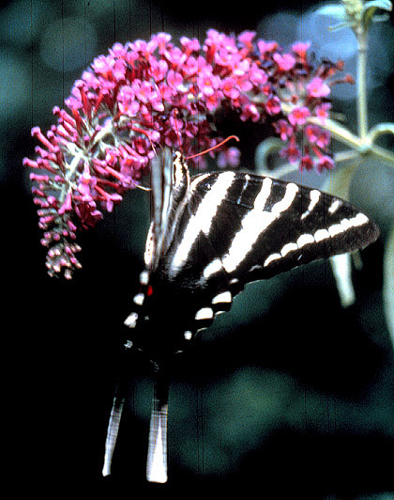
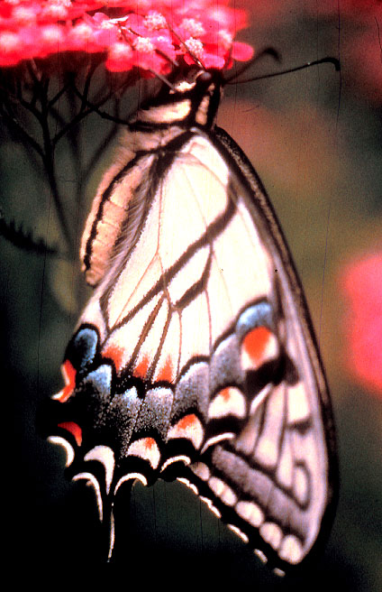
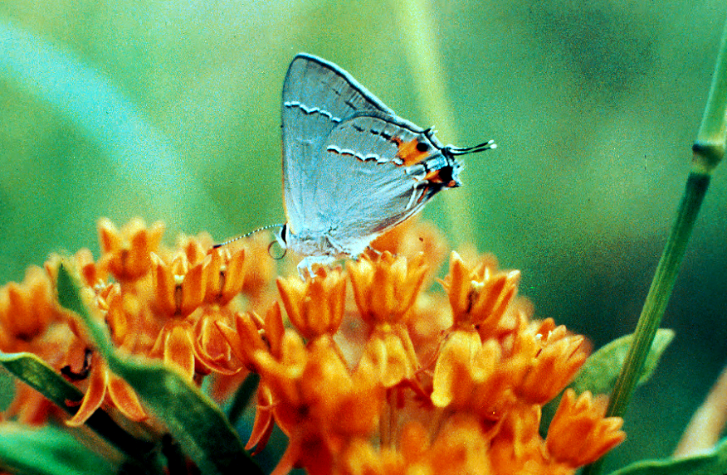
Gardening To Attract Butterflies & Hummingbirds Part 1: Environment, Design & Forage Considerations
By: Paul A. Thomas & Doreen Lubin
Department of Horticulture,
College Of Agricultural and Environmental Sciences

Slide 2
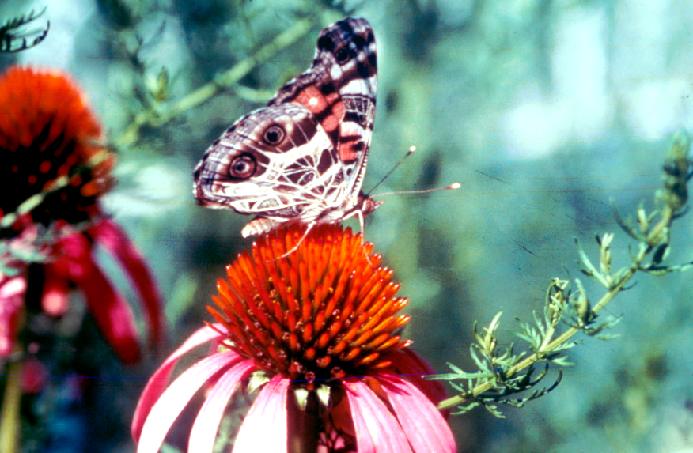
Why Butterfly and Hummingbird Gardens?
Butterflies and hummingbirds are pollinators and play a vital role in the survival of our native wildflowers, trees and shrubs.
Butterflies are second only to bees & wasps in their importance in pollination.
When you provide
butterfly and
hummingbird habitat,
you are contributing
to the well being
of hundreds of species
of native plants.
Painted Lady on Echinaceae

Slide 3
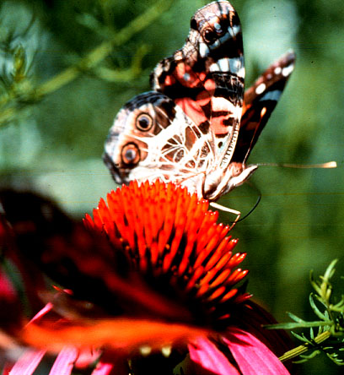
Butterfly Garden Goals
1. Provide nectar from February to November
2. Plant suitable forages for caterpillars of native butterfly species only!
Establish a diversified
selection of nectar sources
Painted Lady on Echinaceae

Slide 4
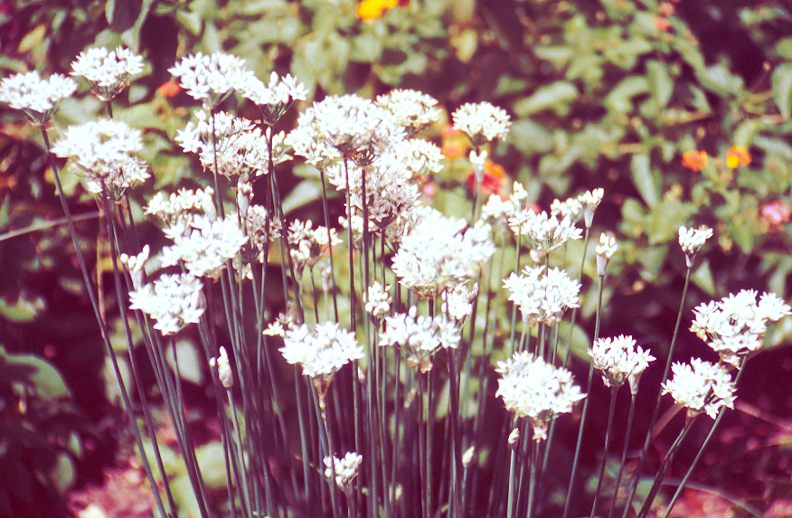
Butterfly Garden Goals
Provide suitable macro-habitat
(more on this later!)
Establish a pesticide
free butterfly habitat
Select plants to attract
specific butterflies
An aesthetically pleasing
garden design is last item
on the list!
Allium species

Slide 5
“Butterfly” Garden Design Concepts
Lawn
Perennials
Annuals
Annuals
Moist Area
Forages
Perennials
Tall Perennials
Tall Perennials
Annuals
To Home

Slide 6
Plant Placement by Final Width
Plan For A Sunny, 325 Sq. Ft. Garden
Plant | Final Size | Number | Total Sq. Ft. | Height
Lantana “Miss Huff” | 9 Sq. Ft. | 3 | 27 Sq. Ft. | 5 Feet
Phlox paniculata | 2 Sq. Ft. | 20 | 40 Sq. Ft. | 2 Feet
Salvia guarantica | 9 Sq. Ft. | 5 | 45 Sq. Ft. | 3 Feet
Tithonia “Torch” | 4 Sq. Ft. | 12 | 48 Sq. Ft. | 6 Feet
Verbena “Homestead” | 9 Sq. Ft. | 12 | 108 Sq. Ft | 1 Foot
Dianthus “Bath’s Pink” | 1 Sq. Ft. | 18 | 18 Sq. Ft. | 1 Foot
Aster “County Garden” | 9 Sq. Ft. | 4 | 36 Sq. Ft. | 4 Feet
Totals |  | 74 | 322 Sq. Ft.
Final Plant Space Requirements

Slide 7
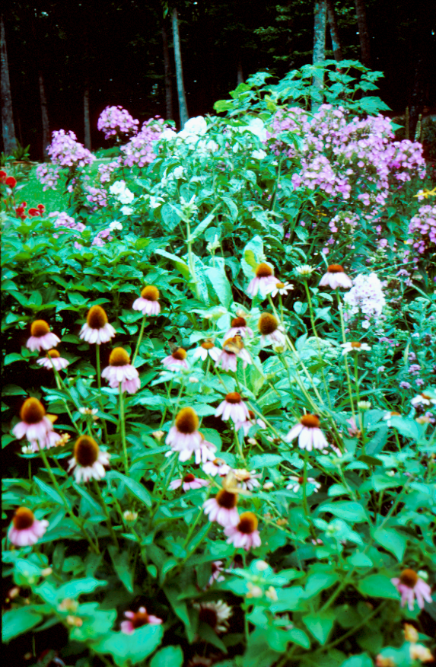
Plant Placement by Final Height
Plants 4 feet to 6 Feet Tall
Plants 2 Feet to 3 Feet Tall
Plants 2 Feet Tall or less
Lawn

Slide 8
High Maintenance Gardens
Essential Elements
Sun-loving perennials
Consistent nectar sources
Drought resistant plants
Phlox and Echinaceae

Slide 9
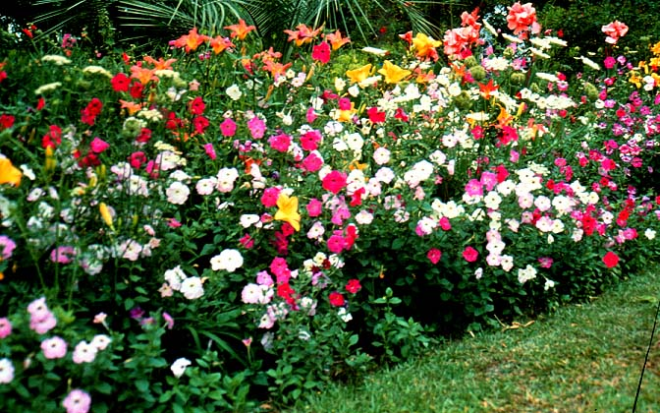
Low Maintenance Gardens
Essential Elements
Drought tolerant forage & nectar sources
Careful (intense) plant spacing
Reseeding annuals
Native perennials
Daylilies, Wild Petunias, Cannas, Queen Anne’s Lace

Slide 10
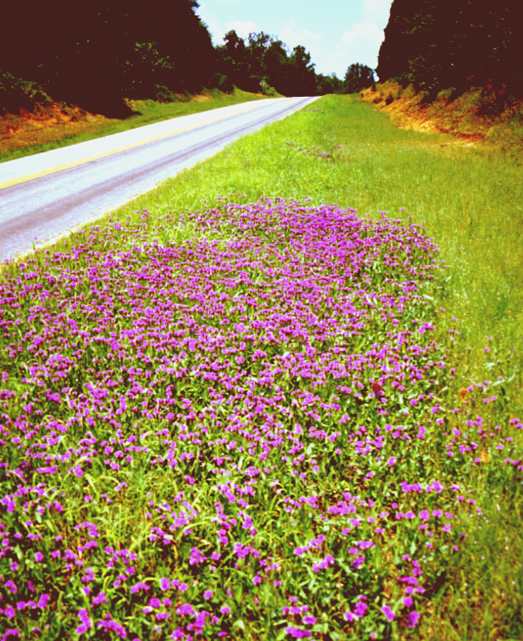
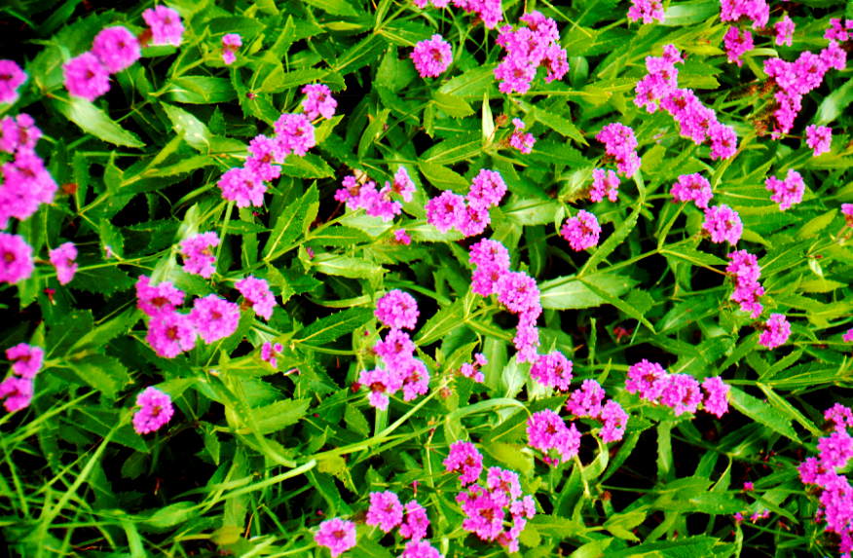
“No” Maintenance Gardens
Essential Elements
Floriferous for long periods
Perennial or self seeding
Resistant to deer grazing
Verbena rigida

Slide 11
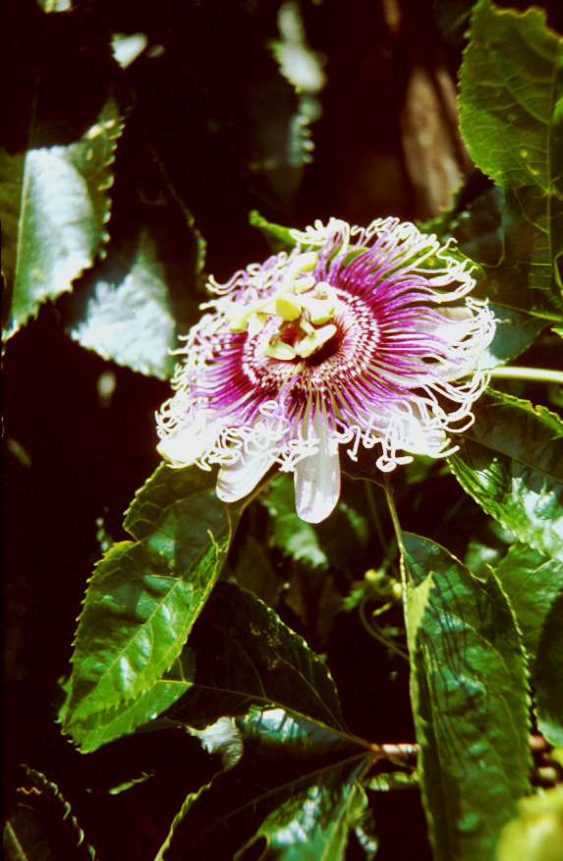
Patio Butterfly Gardens
Essential Elements
Vigorous / rapid growing
Floriferous and fragrant
Perpetual nectar / forages …(Annuals)
Passiflora “Byron Beauty’

Slide 12
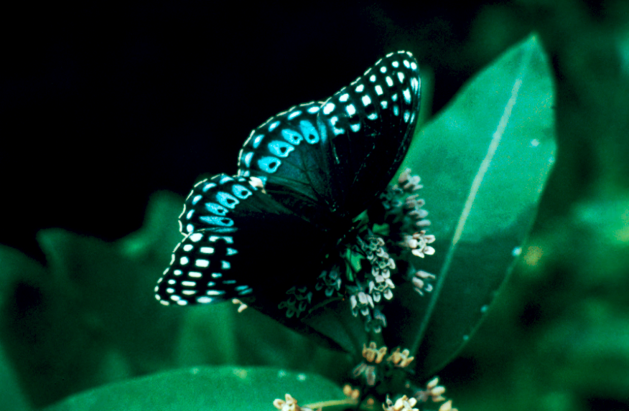
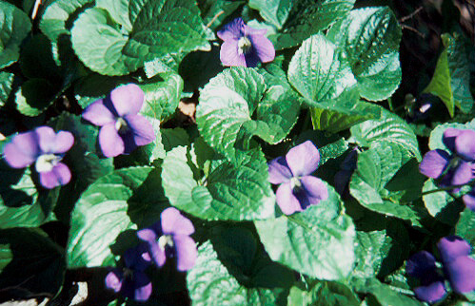
Butterfly Gardens In Shade
Female Diane
Essential Elements
Shade tolerant
Drought tolerant
Resistant to deer
Viola

Slide 13
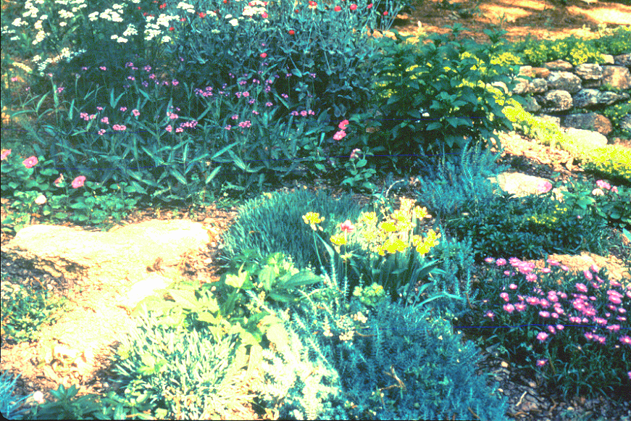
Tracking Sunlight
Place a flag in the center of each sun-patch at the top of the hour and 30 minutes past the hour.
Repeat the process for from 7:00 am until 9:00 pm. May and/or July are good months to do this procedure.
Each flag represents about 30 minutes of sun.
Authors’ shade & rock butterfly garden

Slide 14
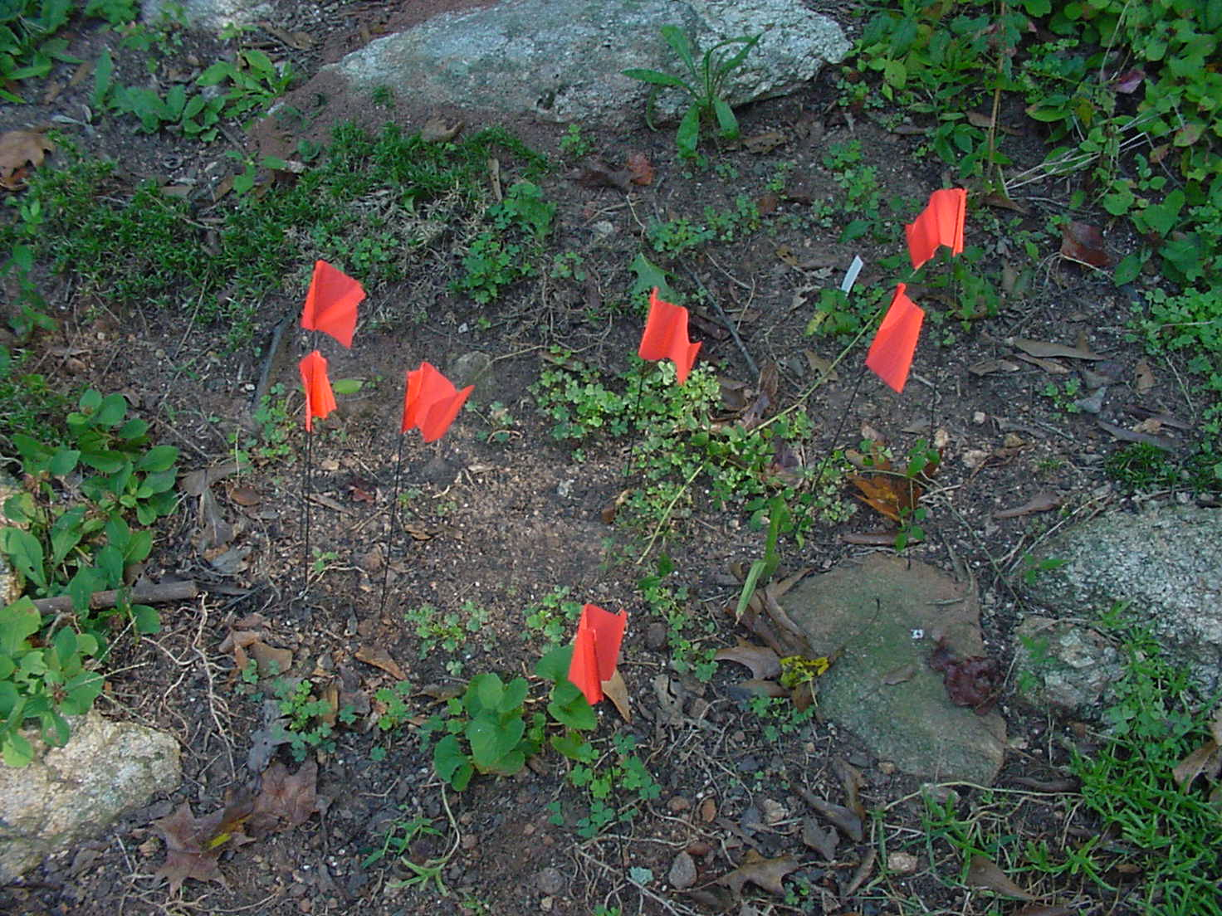
Sun Tracking Procedure
Most perennials and annuals need at least 4.0 hours of
direct sunlight to flower properly.
Plants placed in this
area would receive
approximately 3.5
hours of direct sun.
This is adequate for
plants such as
Hemerocallis, Hosta,
Phlox, Impatiens,
and Ajuga
Where would you place the next flag?

Slide 15
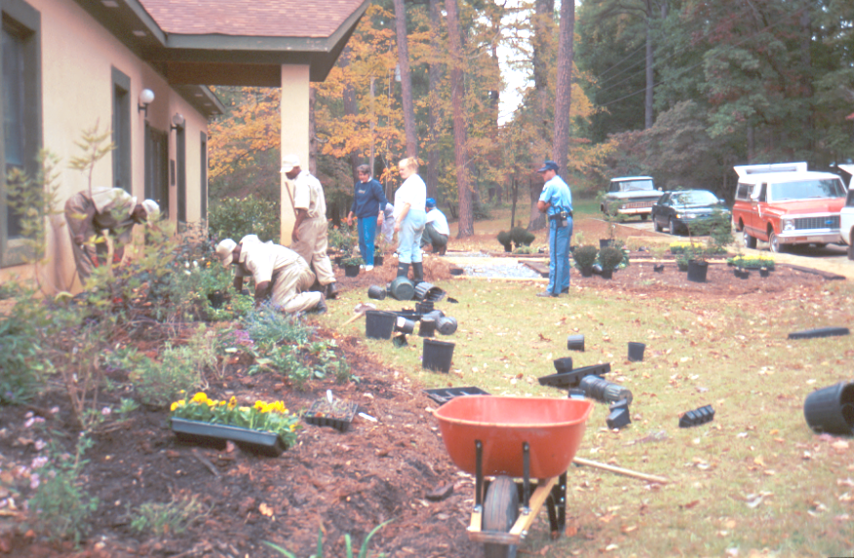
Macro Habitat Components
If you want to have a strong population of active butterflies and hummingbirds, your garden gardens must provide more than just a few nectiferous flowers!
The following must also be provided:
Several nectar sources
Forage plants
Soil Salt sources
Resting areas
Open roaming areas
Water (moisture) sources
Butterfly Garden Project
Rock Eagle, Georgia

Slide 16
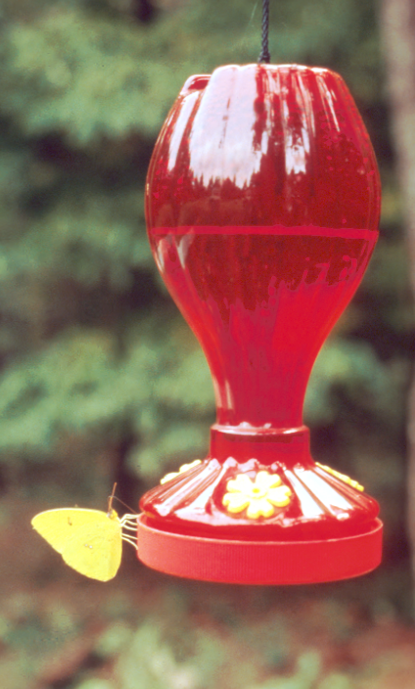
Nectar Sources
Native annuals and perennials
Non-native ornamentals
Vegetable flowers
Native trees & shrubs
Rotten fruit
Artificial feeders
Tree sap
Giant Sulfur
Nectiferous Plants Will Be Covered In Part Two

Slide 17
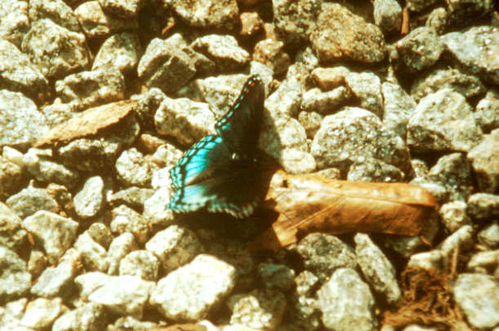
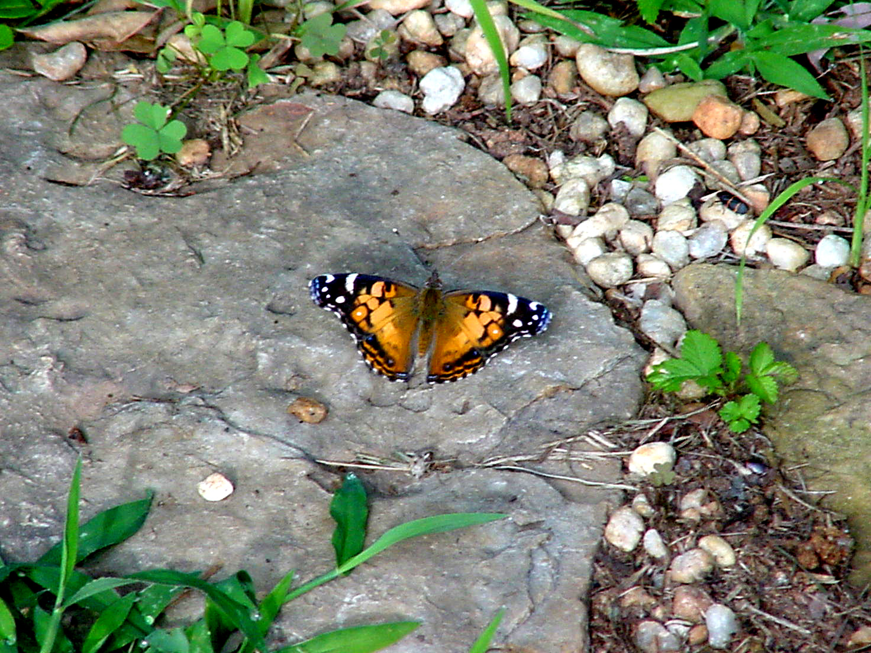
Sunny Resting Areas
Butterflies are cold-blooded and require frequent sunning periods to stay warm and active.
Butterflies prefer open, flat surfaces that are warmed by the sun.
Large boulders and flagstones are excellent sunning areas.
Red Spotted Purple
Painted Lady

Slide 18
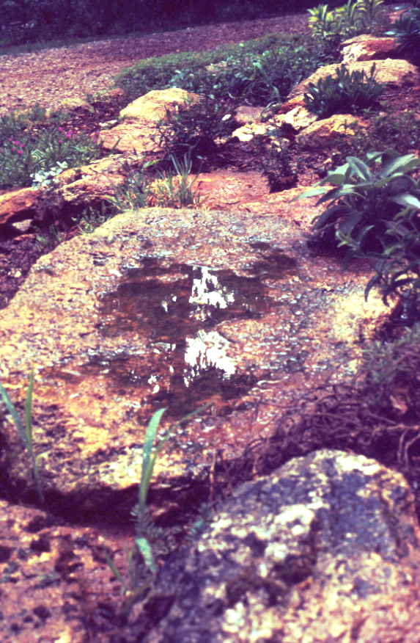
A Constant Sources Of Moisture
Butterflies require water to survive. Providing water during periods of drought is essential.
Butterflies do not like to land on the water’s surface, but do frequent the muddy slopes of creeks, ponds and lakes. You must provide very shallow sources of water for butterflies
A granite “scale’ in one of the authors butterfly gardens

Slide 19
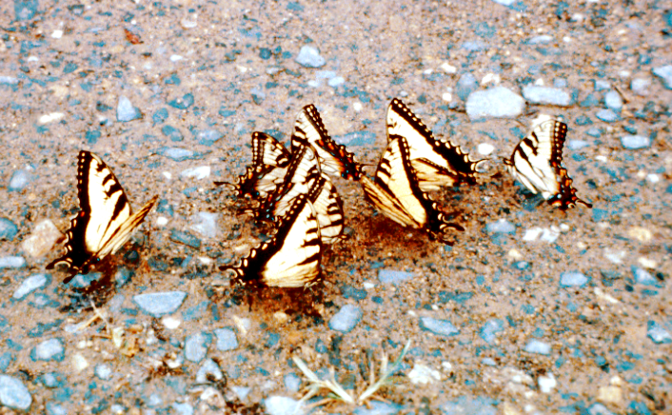
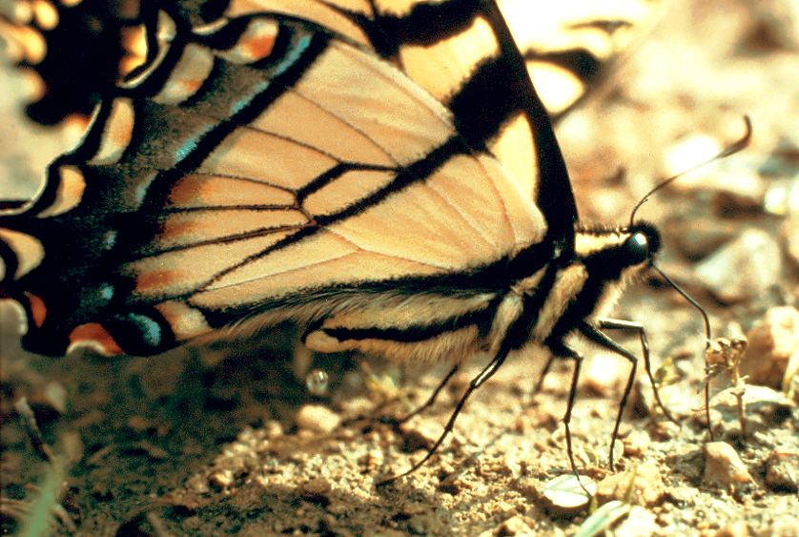
Photos courtesy of Carolina Biological Supply
Puddle Parties
Tiger swallowtail licking salts from the soil

Slide 20
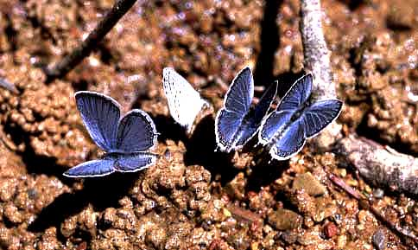
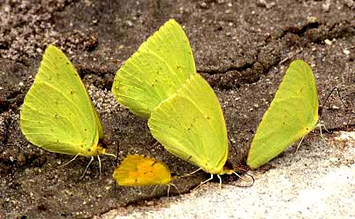
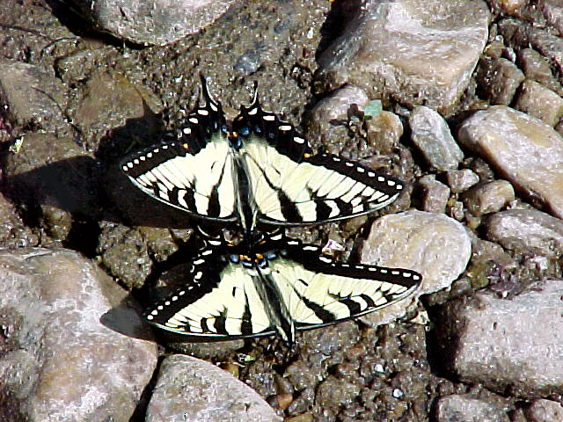
Soil Salts
JA
Many butterflies participate in “puddle parties.” All the butterflies shown are males. Note the different soil types.
Blue Azure
JA
Giant Sulfur w/ Common Sulfur
Tiger Swallowtail

Slide 21
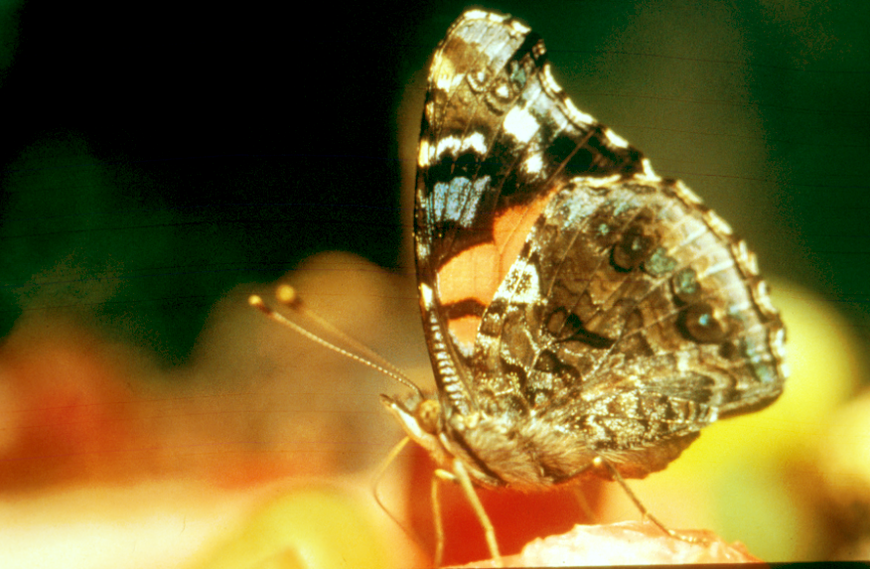
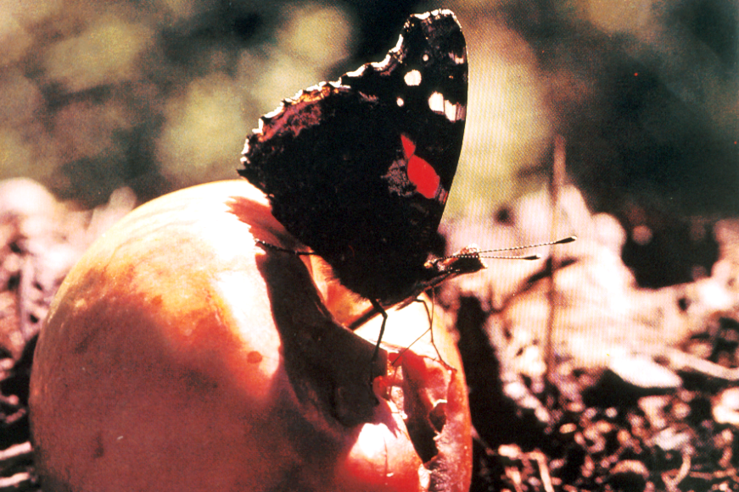
Fruit As Attractors
Butterflies love fruit. It does not matter if it is fresh or very rotten. The butterflies are after the sugars in the fruit juice.
The warmth of the sun releases “esters,” the fragrance of fruit, which can attract large numbers of butterflies for miles around.
KC
Painted Lady on fresh cantaloup
Red Admiral on rotting apples

Slide 22
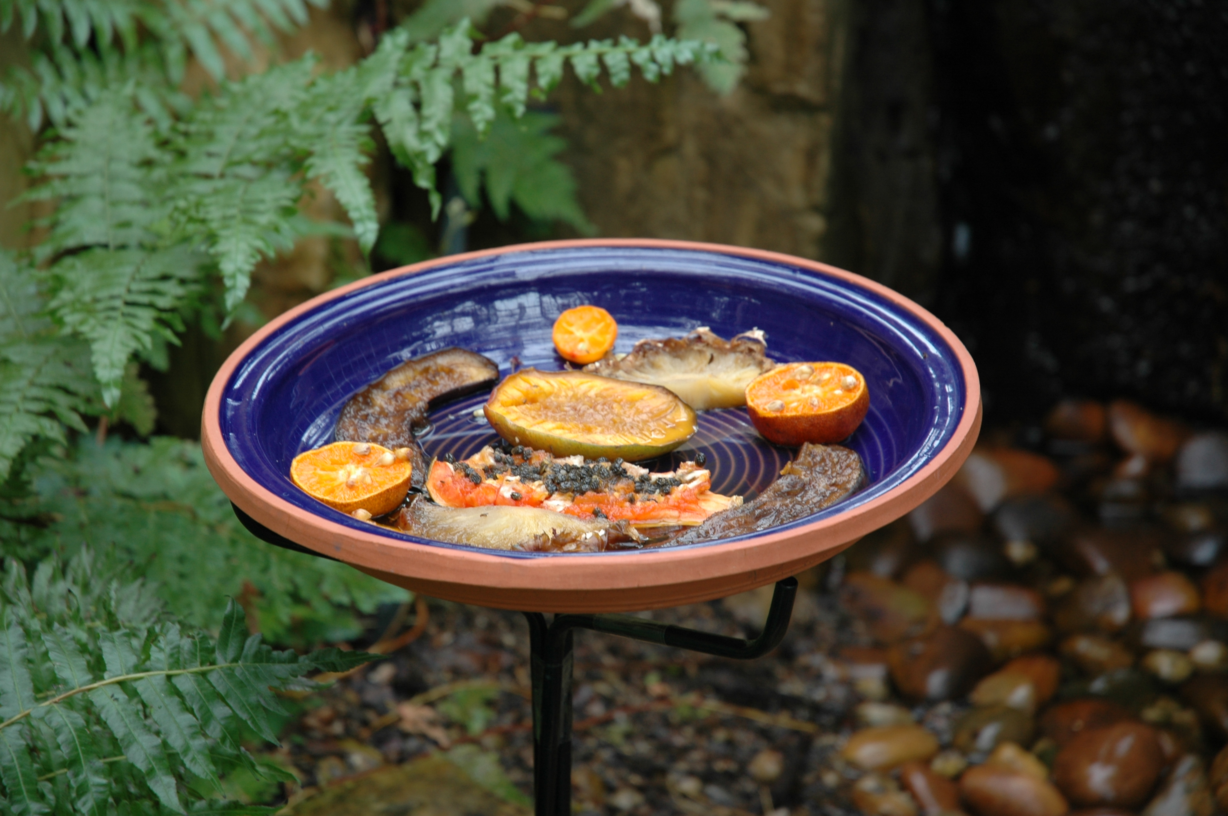
A Butterfly Fruit Feeder

Slide 23
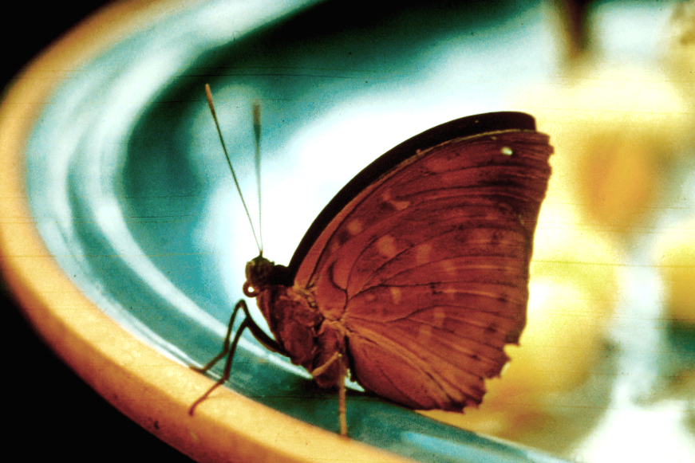
Why Do Butterflies Love Rotten Fruit?
Place ceramic, glass or clay bowls of fruit in sunshine early in the morning. Do not use aluminum or plastic. The best time for attracting butterflies to fruit is July and August.
Each day the fruit will
decompose a bit more
and begin to naturally
ferment.
Now you know!
KC
What’s with this butterfly?

Slide 24
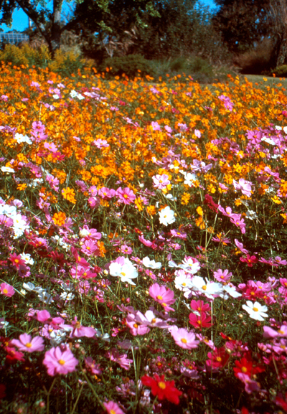
Sunny Space For Soaring / Roaming
Butterflies and Hummingbirds need space to fly. If they are confined to very small spaces, they will not stay for long.
Male hummingbirds, in particular, require open areas to stake out as territory during the mating season.
A field of Cosmos

Slide 25
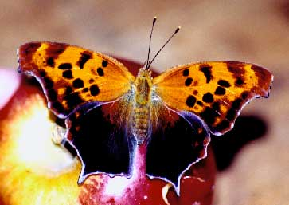
Winter & Hibernation
Many butterflies hibernate, especially in the southeastern portion of the U.S. One of the more interesting habitat requirements you can provide is a place for hibernation.
Butterflies seek areas which can protect them from freezing. This warmth can come from rotting vegetation in compost piles, or air vents from a barn or home.
JC
A Question Mark Butterfly

Slide 26
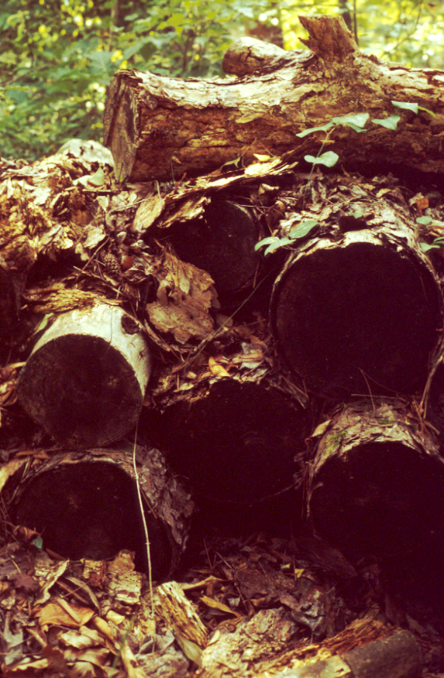
Over-Wintering Shelters
Old log piles make excellent hibernating shelters for butterflies
Warmth from the decomposing logs attract the butterflies deep within the logs.
High humidity is also required so that the over-wintering butterfly avoids dessication.
Here
A 3 year old log stack

Slide 27
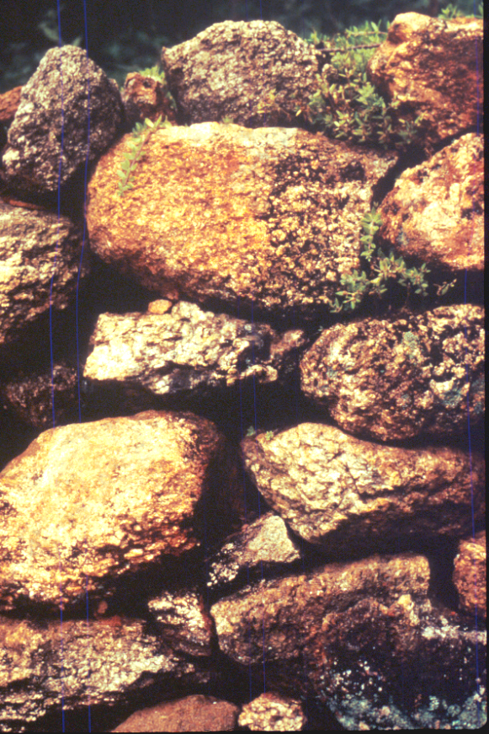
Over-Wintering Shelters
Although not a true form of hibernation, butterflies that over-winter experience a sustained period of quiescence during the winter.
This south-facing wall transfers warmth to the soil behind the rocks on sunny days, which is then slow to cool at night.
A dry-stack rock wall

Slide 28
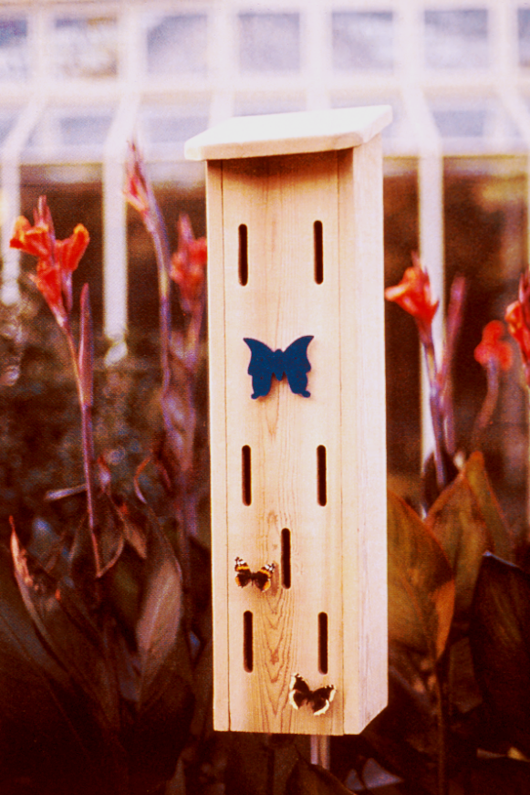
Butterfly Boxes
Butterfly boxes are not suitable for butterflies to over winter in. Butterfly boxes do not provide heat, and thus the butterfly can easily freeze.
Butterfly boxes can be used as summer shelters from storms or overnight shelters, primarily during the spring and fall season.
A Butterfly Box

Slide 29
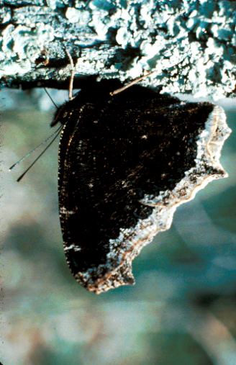
Natures Storm Shelter
During thunderstorms, butterflies seek shelter under large tree limbs or the eaves of homes and barns.
By positioning themselves under the limbs, they can avoid rain drops that may be traveling at 60 miles per hours.
Morning Cloak butterfly hiding
under an small Oak branch

Slide 30
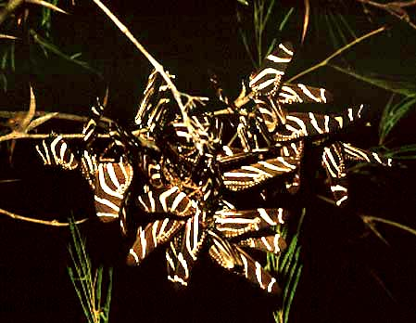
Clustering In Trees At Night
Many butterflies cluster at night.
This is said to help them to conserve heat, but may also gives them some “protection in numbers” to survive night predators
JA
Zebra wings clustering on a shrub.

Slide 31
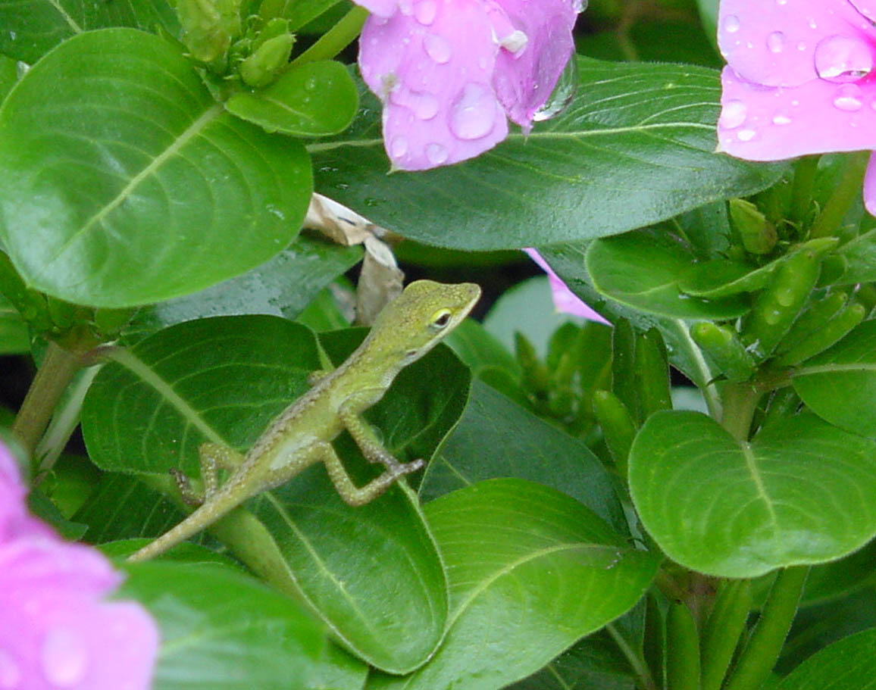
Things That Eat Butterflies
There are many creatures that will eat butterflies and kill hummingbirds. A true gardener will accept the reality that these creatures have their place in the garden.
A student of nature will also recognize how wonderfully diverse and elegant the relationships are between butterflies and their potential predators.
A Green Anole on Vinca.

Slide 32
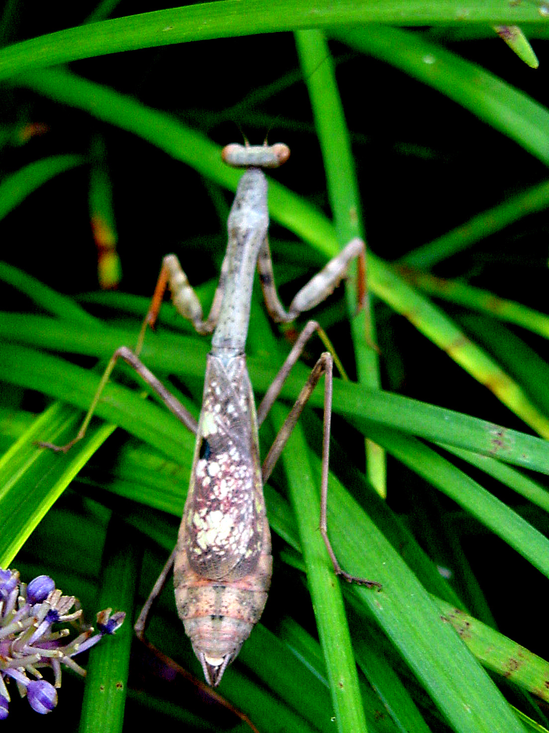
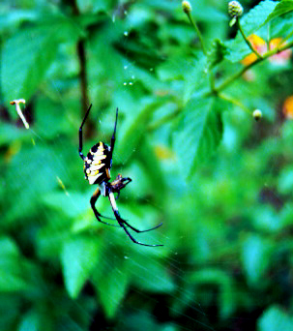
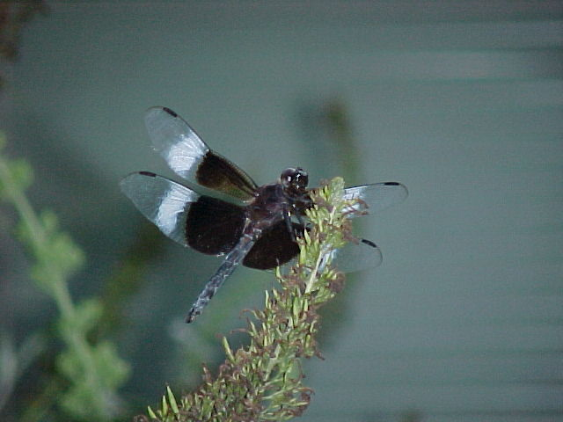
Spiders, Mantisses and Dragonflies
They may eat butterflies from time to time, but their effect on overall populations is minimal, and they are fascinating creatures in their own right.

Slide 33
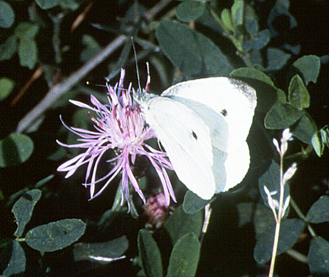
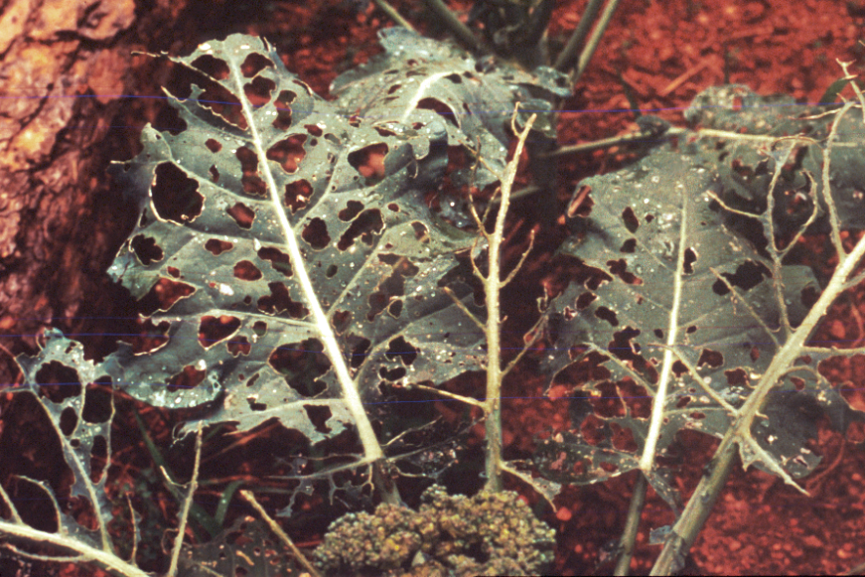
Butterflies Can Be Garden Pests Too
A good example of a butterfly pest is the Cabbage butterfly. This is not a native species, having been introduced from Europe. It can reproduce rapidly and has spread quickly throughout the U.S.
How one addresses the usual bug problems is going to be very different.
Cabbage Buttefly
Authors Wife’s Broccoli

Slide 34
This Cannot Be Your Arsenal!
Many over-the-counter chemical used in gardens are perfectly fine products. However, they are not suitable for use when butterfly or hummingbirds are going to come in contact with the plants.
Many pesticides are systemic, which means they work inside the plant. Eventually, the poison collects in the flower nectar, rendering it very unsafe to feed on.

Slide 35
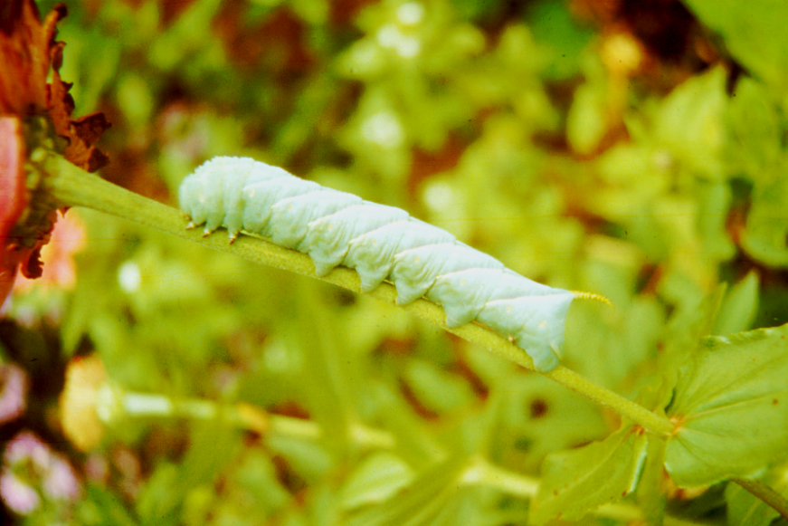
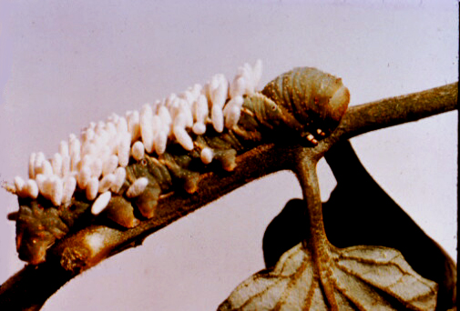
Beneficial Insects
There are many insects that will kill unwanted species of moth and butterfly larvae. The tomato horn worm is a good example.
It is controlled by the Brachniad wasp. The cocoons of the wasp larvae are seen here, indicating the caterpillar has been consumed.
Tomato Horn Worm
Wasp Cocoons
Do not destroy this caterpillar!

Slide 36
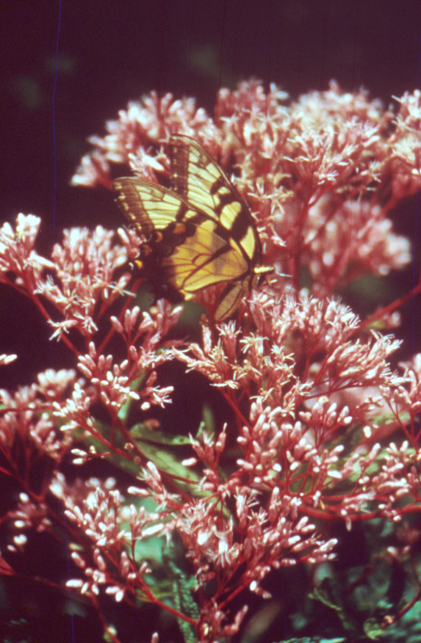
Beneficial Insects Are Essential!
If not exposed to pesticides, populations of beneficial insects can build up to the point where the insect pest species is controlled.
“Beneficials” never kill all the pests, as this is their food source. They reduce the pest populations to a point where the pest does not affect the health of the garden.
Tiger Swallowtail on Eupatorium!

Slide 37
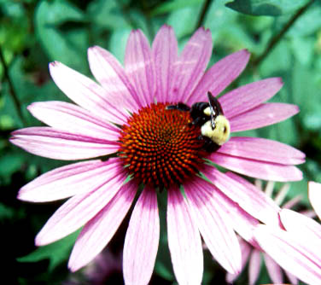
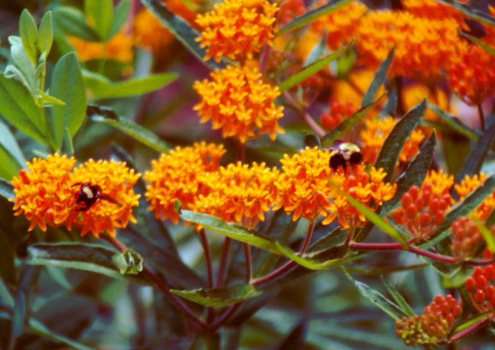
Bumblebees Are Also Essential
You will have bumblebees! People who are allergic to honey bee & bumblebee stings should weigh this carefully before planting a garden.
Bumblebees are great pollinators and are a good “environmental indicator” insects. A strong bumblebee population is indicative of a healthy garden environment.
A Bumblebee on Echinaceae
Bumblebees on Asclepias.

Slide 38
Bloom - Brood Scheduling**
Butterfly | Brood Weeks | Plant | Weeks In Bloom | PercentMatch
Monarch | May 15-Jun 15 | Asclepias | May 25 – Jun 15 | 80%
Black Swallowtail | Apr 10-May 10 Aug 1 – Sept 30th | Ajuga repens Abelia | Apr 15 – May 15 Jun 15–Nov 10th | 100% 100%
Tiger Swallowtail | Apr 1 – May 30th Jul 10- Sept 30th | Verbena Tithonia | Apr 15 - May 30th Jul 1 – Nov 10th | 100% 100%
Ohio Buckeye | Jun15 – Aug30 | Echinaceae | Jun 15-Aug 1st* | 80%
Blue Azure | Apr 1st – May 15th | Baths Pinks Ageratum | Mar 15 –May 1st Apr 15 – Jul 15th | 80% 60%
Checkerspot | Jul 15 – Nov 10th | Helenium | Jul 10 – Aug 10th. | 40%
Gulf Frittilary | Jul 15 – Nov 10th | Passiflora | Jul 15 – Nov 10 | 100%
* Requires deadheading to achieve this bloom period
** For example only – Local dates will vary considerably

Slide 39
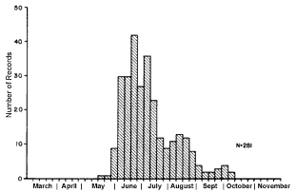
Single Brood Species
Great Spangled Fritillary
41 Recorded
Observations
Peak Population
First Observed
Last Observed

Slide 40
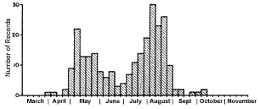
Two Broods Species
Spicebush Swallowtail
Second
Population Peak
30 Recorded
Observations
First
Population Peak
First Observed
Last Observed

Slide 41
Multiple Broods Per Season
Cabbage Butterfly
This pattern of butterfly population clearly shows why Cabbage butterflies are such a serious pest. Their presence is felt in Georgia gardens from early February right through late November. Broods have actually been reported in January during warm winters.

Slide 42
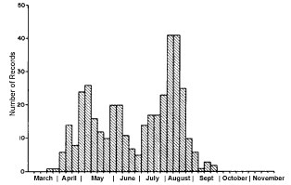
Similar Species Overlap In Population
In Georgia, many of our larger butterfly species have brood cycles that are very similar.
Planning the appearance of nectiferous flowers with this brood cycle in mind is a key gardening skill.
Tiger Swallowtail
Black Swallowtail

Slide 43
Butterfly Distribution
Where butterflies live depends upon many factors including weather.
However, the overriding factor is food sources for the caterpillars.
Many organizations track where butterflies live and have generated maps that show the approximate range of any one species.
Children love to read about butterflies and moths

Slide 44
Some species are widely distributed
across many environments nationwide
The lack of reported sightings accounts for the large gaps in distribution data.
Perhaps our Master Gardeners could fill in the missing data.
USGS / Montana State University
Monarch Butterfly Distribution

Slide 45
Some species are distributed across large but limited regions:
USGS Northern Prairie Project Map
Great Purple Hairstreak

Slide 46
Similar Species May Not Overlap
In Distribution
Some species may have diverged over time and although they look alike, the have distinctly different territories that they inhabit and, in fact, may not interbreed.
USGS Northern Prairie Project Maps
Eastern Tiger Swallowtail
Western Tiger Swallowtail

Slide 47
Some species have very limited areas or environments where they can survive.
USGS Northern Prairie Project Map
Rubytail Swallowtail

Slide 48
Environmental Issues
Involving Butterflies:
There’s Room For Discussion!
Eco-Tourism
Butterfly Farming
Butterfly Weddings
Roadside Herbicides
Butterfly Collecting
BT Corn / GMO’s
Asclepias tuberosa

Slide 49
Hummingbird Gardening Tips
Trumpet Creeper – Campsis radicans

Slide 50
Hummingbird Facts
There are 16 species of hummingbirds in the U.S. Only one, the ruby throated hummingbird is common in the Eastern U.S.
Live average of 5 – 6 years
Wing muscles are 30% of
the bird’s weight.
Wing beat 60 to 200 times
per minute!
Hummingbirds can fly up
to 60 miles per hour.
Immature hummingbird feeding

Slide 51
“Hummingbird” Garden Design Concepts
Tall
Perennials
Tall Perennials
Annuals
Annuals
Moist Area
Perennials
Annuals
Forages
To Home
Annuals

Slide 52
Hummingbird Habitat
Bird Baths
Hummingbirds appreciate bird paths. However, you must have the bath well above the ground and the water must be very shallow (¼ of an inch deep).
The bath should be in full sun. Shallow, dark colored ceramic bowls with rounded edges are best. Tilt the bowl slightly to provide different depths.
Hummingbird on Red Hot Poker Plant

Slide 53
Hummingbird Nectar Sources
There are a great many books that indicate that red, tubular flowers are best for attracting hummingbirds. However, many tubular blue flowers, especially Salvias, are popular.
Young hummingbirds especially appreciate Salvia guarantica, a tough, summer-long blooming perennial that establishes large colonies.
Salvia gauranitica

Slide 54
Hummingbird Menu
Hummingbirds appreciate commercially available feeders. The “food” is a sugar solution made up of 4 parts water and 1 part table sugar, that is boiled for a few minutes and then cooled.
Do not add fruit juices, honey or red dye.
Hummingbirds eat a tremendous amount of mosquitos and gnats that provide protein.

Slide 55
Feeding Hummingbirds
Like feeding dairy cows, once you begin to feed wild hummingbirds, it is essential to continue to do so the rest of the season, especially if a nest has been established in the area, or a large population of birds have come to the area .
A good selection of nectiferous plants will cover for a few days absence, but will not substitute for the feeder.
Salvia “Faye Chappell

Slide 56
Hummingbird Feeders
Feeders should be kept up year round in Georgia. Birds are frequently sited in January. 150 watt spot bulbs can be focused on the feeders at night to keep them above freezing.
Clean all feeders every three to four days. Bacteria and fungi can kill or sicken the hummingbirds.
Multiple birds at a feeder

Slide 57
Hummingbird Territory
Native plants, such as this horse chestnut, are key indicators to male hummingbirds that a particular area is suitable for establishing a territory. These low growing shrubs flowers just a week or so after the males return to Georgia
Aesculus parviflora

Slide 58
Hummingbird Nesting Needs
Hummingbird females look to males to establish nests deep in the branches of trees at the edges of open areas that have nectar sources.
Placing a few feeders in the lower branches of these trees is a very good way to attract females and induce them to stay in your backyard.
.
Woods edge is a perfect location for placing feeders to supply female birds.

Slide 59
Hummingbird Nests
Hummingbird nests are made from spider webs, feathers and lichen.
In northern areas, spider webs are used to tie together materials such as leaf fragments and very thin bark from trees such as birch.
Ruby-Throated Hummingbird Nest made in an 60’ Red Oak tree about 18’ from the ground at the joint of a forked branch

Slide 60
Baby Hummingbirds
The average female hummingbird generally tries to rear one or two baby birds. Two broods per year can occur in the deep south. It is common for one of the chicks to be pushed out of the nest.
Hummingbirds prefer to make their nests at least 15 feet above the ground, usually within 40 to 50 feet of a good food source. When feeders are consistently maintained, nests may be built with feet of the feeder.
JS
Baby hummingbirds at authors home

Slide 61
Georgia State Law Prohibits
Raising Hummingbirds In Captivity
Every year, many baby hummingbirds get pushed out of their nest by siblings. This is nature’s way of ensuring only the strongest survive. However, well intentioned citizens often attempt to
raise the outcasts.
If you find a hummingbird,
contact the Ga. Department
of Natural Resources to get a
listing of non-game bird
sanctuaries and persons
certified to rescue these birds.

Slide 62
Hummingbird Migration
In Spring, hummingbirds
fly across the gulf, over
500 miles in 18 to 22 hours.
In Fall they fly over
land thru Texas.
Why? Perhaps fall
hurricanes!
Athens
3/23
Macon 3/15

Slide 63
Plant Selection Considerations
Chronology & Duration of Bloom
Color Of Bloom
Blues
Reds
Nectiferousness
Invasiveness
Maintenance Requirements
Deadheading
Pinching

Slide 64
Establishing Gardens
Most perennial plants are established in the early fall. This is essential for the development of a good root system. Good roots are essential not only for growth, but to provide water to allow the plant to produce nectar during hot dry weather.
Annuals should be planted as soon after the last average frost day has passed to allow for root growth.
Lantana camara

Slide 65
Establishing Gardens
Remember to prepare the garden soil by tilling and adding amendments.
Most perennials will need to be dug and the bed re-established every three years.
Fertilize beds in April, May and June with 10-10-10 or similar fertilizer products.
Deadheading and midsummer trimming is often required.
Cuphea micropetalum

Slide 66
Top Ten Hummingbird Flowers
Lonicera semperviriens
Salvia guaranitica – Summer Blue Sage
Aesculus glabra – Horse Chestnut
Phlox Paniculata – Summer Phlox
Vitex agnus-castus – Chaste Tree
Aquilegia canadensis - Columbine
Lobelia cardinalis – Cardinal Flower
Monarda didyma – Bee Balm
Kniphophia uvaria – Red Hot Poker Plant
Quamoclit species – Cypress Vines
Lonicera sempervirens – Native Honeysuckle
Lobelia cardinalis

Slide 67
Butterfly Photography
Anyone can take great butterfly pictures by considering butterfly behavior. As butterflies go through that quiescent period when their wings dry, one can gently touch the butterfly’s head with a pencil and the butterfly will instinctually grab on. The butterfly can then be placed on flowers or any other object an photographed with ease.
By tipping the stick or pencil up, the butterfly will turn around and try to get to higher ground.
Pop Quiz: Is this a male or female?

Slide 68
Reading and Library Exploration
Herbaceous Perennial Plants, Allan Armitage
ISBN 0-88192-505-5
Annuals, Biennials and Half-Hardy Perennials - Allan Armitage
ISBN 0-87833-738-5
Tropical Ornamentals – W. Arthur Whistler
ISBN0-88192-448-2
Master Gardener, Doreen Lubin

Slide 69
More Recommended Books
The Hummingbird Book, Donald & Lilian Stokes
ISBN 0-316-81715-5
Butterfly Gardening Geyata Ajilvsgi
ISBN 0-87833-738-5
Audubon Guide To Butterflies – Michael Pyle
ISBN 0-394-51914-0
The Moth Book, W.J. Holland
Dover: 486-21948-8

Slide 70
Websites Worth A Look
http://www.xerces.org
http://www.learner.org/jnorth
http://whyflies.org
http://www.naba.org
http://monarchwatch.org
http://www.butterflybreeders.com
http://www.monarchlab.umn.edu/
http://portalproductions.com/h/resource.html
Aquilegia canadensis

Slide 71
Gardening To Attract Butterflies & Hummingbirds Part 2: About Butterflies, Native Butterfly Species & Nectiferous Plants
By Paul A. Thomas,
Department of Horticulture,
College Of Agricultural and Environmental Sciences

Slide 72
Butterfly Garden Etiquette
Capturing and killing butterflies for collections is not an ideal way to teach children respect for life .
Observing caterpillars on native plant materials and / or in the garden is more appropriate. If you must capture a butterfly, use a cheesecloth net. Once observations are finished, release the insect carefully.

Slide 73
Butterfly Garden Etiquette
If you wish to contain a butterfly, hold it at the base of the wings so as not to damage the fragile edges of the wings. Avoid rubbing off scales or putting force on the butterfly’s legs.
Release the butterfly by removing the cap and setting the jar on it’s side.
Large plastic jars are best as they have a large volume of air

Slide 74
Butterflies and Moths
Phylum: Arthropoda
Class: Insecta
Order: Lepidoptera
Papilionoidae - True Butterflies
Papilionidae - Swallowtails
Pieridae - White and Sulfurs
Lycaenidae - Blues, Hairstreaks, Coppers
Libytheidae - Snouts
Nymphalidae - Fritillaries, Crescents
Satyrs, Milkweed Butterflies
Hesperoidea - Skippers
Hesperioidea - Skippers

Slide 75
The Difference Between
Butterflies and Moths
Butterflies
Moths
Have nobby antennae
Fly during daylight
Make chrysalises
Rest w/ wings closed
Caterpilliars are smooth
Have feathery antennae
Fly at dusk and night
Make cocoons / pupae
Rest with wings open
Caterpilliars are fuzzy

Slide 76
Antennae
Moths antennae are specialized
sensors that pick up scent of the
opposite sex. Male Moths have
very feathery antennae to sense
females that are very far away.
Butterfly antennae are knobby and do not show differences between the sexes.
Male
Female

Slide 77
Tips On Observing Butterflies
Learn the brood cycle
Provide nectar sources
Provide forage plants
Observe early morning
or late afternoons.
Use binoculars
Bring an ID key
Collect sparingly!

Slide 78
Butterfly Checklist
There are over 185 species of butterflies that you may
observe in Georgia.
The Georgia Department
of Natural Resources has
a checklist that can help
you keep track
of your observations.

Slide 79
Butterfly Observations
Butterflies prefer to fly when air temperatures are above 65 degrees, some preferring 80 degrees! Butterflies are best observed between the hours of 8:00 am and 10:00 am. As the day warms up, the
butterfly becomes very active
and skittish.
Each species has a peak
observation period, which
correspond to hatching of
that season’s “brood.”
Hawk moth feeding on
Phlox at sunset.

Slide 80
Don’t Be Fooled
By Differences
Between Sexes
Many species of butterflies have males and females with different wing patterns, which can be confusing.
Montana State University has a website for butterfly ID. Learning to identify butterflies on the wing takes practice.
Female
Male
Eastern Black Swallowtail

Slide 81
… Or Environment Driven Changes
The type of forage or the amount of sunlight can affect insect appearance.
This is especially true of Eastern Black Swallowtails. When their caterpillars feed in shady locations, the caterpillar is dark. The more light available, the lighter green the caterpillar.
This helps the caterpillar avoid predators.
Shade and Part Shade
Bright Sun

Slide 82
Dimorphic Species
Tiger Swallowtails have a very unusual characteristic in that the females can be either yellow with black stripes, or very dark slate grey with deep blue hind wings. Males are always yellow with black stripes.
This was a mystery for many years.
The answer seems to be related to another species of butterfly that lives in the same region.
Eastern Tiger Swallowtail

Slide 83
Pipevine Swallowtail
The Pipevine swallowtail lives in the southern portions of the U.S. and feeds on Aristolochia, a poisonous plant that once eaten, the caterpillar becomes poisonous too.
Pipevine swallowtails can easily be recognized by the beautiful sapphire-blue hind wings. When the sun reflects just right, they are as beautiful as tropical Morphos butterflies.
Pipevine Swallowtail

Slide 84
Pipevine Swallowtail
Aristolochia grows in the southern U.S. and is a fairly beautiful vine. It is slo growing and takes years to establish.
The unusual flowers are called
Dutchman’s Pipe. There are many species including a few native ones that can be used in butterfly gardens.
Aristolochia or
Dutchman’s Pipe

Slide 85
Mimicry May Help Survival
The blue color on the hindwings is apparently seen by birds as a warning sign that this is a poisonous species.
Dark-phase female tiger swallowtails have similar deep blue hind wings. It is thought that this may provide some benefit to these females.
Light female
Dark female

Slide 86
Many Species Use This Method
Pipevine
Swallowtail
Both sexes of spicebush swallowtails, which are not poisonous, have hind wings that are slightly lighter blue, but look surprisingly like a Pipevine swallowtail while in flight.
Both species keep wings in motion when feeding.
Spicebush
Swallowtail

Slide 87
Red Spotted Purple
Even unrelated species, such as the Red Spotted Purple, have adopted the strategy of the Pipevine swallowtail.
What is most interesting is that very northern red spotted purples do not have large areas of the very bright blue hind wings.
These darker butterflies live where the Pipevine swallowtail is rare.
Southern Red Spotted Purple

Slide 88
Dianas
This blue color is apparently so effective that forest dwelling Diana females have also adopted the pattern.
The males are very orange and brown, and resemble gulf fritillaries.
In Georgia, Dianas are not common and are sought after by butterfly checklist
enthusiasts.
Female Diane

Slide 89
Shared Territory
All of the butterfly species mentioned share the same region with the fortunate Pipevine swallowtail
USGS / Montana State
Pipevine Swallowtail
Spicebush Swallowtail

Slide 90
Additional Warning Signs
Caterpillars are often brightly colored or have spines and other appendages to ward off would be predators.
Bright colors, horns and even poisonous spines are common in the caterpillar defense arsenal.
Fritillary Caterpillar
Hickory Horn Devil

Slide 91
Fear Response - Eye Spots
The Ohio buckeye has several large eye spots. It is assumed that these eye spots are “flashed” at a predator when the butterfly is in danger.
The spots apparently startle the bird or mantis, fooling it into thinking a larger creature is there.
Ohio Buckeye feeding on Verbena

Slide 92
Zebra Swallowtail Camouflage
Striped Wing Pattern
Zebra
Swallowtail
Sharp Spring Shadow Pattern

Slide 93
Speed and Agility
Skippers are a large family of butterflies that are small but very, very fast fliers.
Skippers agile, that even spiders and small wrens have difficulty capturing them.
The only insect that seems to be fast enough is the praying mantis.
Fiery Skipper on Tithonia

Slide 94
More Mimicry
The great purple hairstreak lives on Mistletoe.
It holds it’s wings upright when resting and feeding. When seen from the side, the tail appendages and markings resemble the head, legs and antennae. Note the abdomen is very short also.
Birds not recognizing which end was which may only get a mouthful of butterfly tail.
JA
Great Purple Hairstreak

Slide 95
Monarch Mimicry
The mimicry between the monarch butterfly and the viceroy is fairly well known. However, it was always thought that the advantage to the monarch was that it tasted bad, and that the viceroy did not.
This is called Batesian Mimicry
Viceroy

Slide 96
Monarch Mimicry
Recent research showed that both species taste bad and that the mimicry may be a form of converging traits that signal bad taste.
This is called Mullerian mimicry
Monarch

Slide 97
The Butterfly Cycle Of Life
The butterfly life cycle is simple in concept but very complex in execution.
The entire life cycle may take 65 days, or in the case of over-wintering Monarch, up to six or seven months.
Monarch

Slide 98
How The Process Begins
In spring, Eastern Monarch butterflies begin to migrate back into the United States. This migration is perfectly synchronous with the emergence of new leaves on the milkweed.
The soft new growth is perfect food for monarch caterpillars.
A Female Monarch
A Male Monarch

Slide 99
Butterfly Eggs
Butterfly eggs come in many shapes & sizes. Each species has a different strategy. Some lays eggs in large groups so that some may survive predation.
Other lay eggs singly or in pairs to allow adequate food for just one caterpillar

Slide 100
Caterpillars Are Eating Machines!
A butterfly or moth caterpillar can eat a tremendous amount of food.
To survive, a caterpillar must store sufficient food to carry it through metamorphosis and adulthood.

Slide 101
The Miracle of Metamorphosis
A caterpillar locates a safe place to begin the process.
2) The caterpillar attaches itself to the stem and splits the old caterpillar skin at the back of the head.
3) With the outer skin shed, the inner skin hardens and becomes the chrysalis.
1
2
3
Monarch Chrysalis Sequence

Slide 102
Metamorphosis Is Amazing
After two to four weeks a new butterfly emerges.
The real miracles occurred during the previous weeks as a soft fleshy, helpless caterpillar developed into a winged and agile butterfly.
1
2
3
6
5
4

Slide 103
The Mandatory Wing-Drying Period
In order to fly, butterfly wings must first stretch out and dry to become rigid.
The butterfly seeks the highest brightest spot, and then, with it’s back to the sun, pumps body fluid through the wings to stretch them flat. It must then hold them out to dry for about 20 minutes. During this time they are very vulnerable.
Monarch during drying period

Slide 104
Butterfly Quiescence
The butterfly is so passive, that it is oblivious to imminent danger!
This is why all butterflies must try to dry their wings as just quickly as is possible!

Slide 105
The Wonder of Symbiosis
Within a few weeks, the host plant is in full bloom just in time to feed dozens of new adult Monarch butterflies and because of those butterflies, the flowers get pollinated!
2
The host plant grows four branches for each chewed branch.
1
This provides four times the seed and improves survival!
3

Slide 106
Butterfly Migration
Many species of butterflies, including the Painted Lady and the Giant Sulfur, travel great distances to follow warm weather and the growth of their food source.
However, the Eastern Monarch has an extreme migration pattern where adults may travel thousands of miles from Mexico to Canada.
A flock of migrating Monarchs

Slide 107
Monarch Migration
Monarch travel from their winter resting grounds in Mexico and California when forage plants begin to grow in Spring. They wind up in northern prairies and mountain plateaus and begin to migrate south in Fall.
Spring Map
Fall Map

Slide 108
Butterfly Migration
Monarchs may have learned to migrate as the range
of their milkweed food source expanded millions of years ago. The frost free zone in the mountains of central Mexico is the last feeding stop for Monarchs
A Monarch Refuge In Mexico
Milkweed

Slide 109
Butterfly Migration
The amazing part of this migration is that rarely does any one adult travel the entire migration route.
It takes at least two and sometimes three generations to complete one migration cycle.
It is quite amazing that for as small as a butterfly brain may be, they have the capability to travel thousands of miles by instinct.
Monarchs feeding on Asters

Slide 110
Migration
Journey North is a educational website that allows you to see where the Monarch is and allows one to track the entire migration as it happen. This site is a favorite of school children and “butterfliers”
A flock of monarchs

Slide 111
Butterfly Migration
This chart shows Monarch migration sightings in the Spring of 2000

Slide 112
Tagging
Tagging butterflies before they migrate is a way scientists can track the migratory pattern of Monarchs.
Much has been learned by folks turning in tagged Monarch that track their flight and reveal the mysteries of their long migration.
A banded Monarch

Slide 113
Diapause – Puts Reproduction on Hold!
For Monarch migration to work, a very special event must take place.
Newly hatched butterflies may every effort to mate as soon as possible to assure the greatest chance for eggs to be laid and for caterpillars to have first access to fresh food sources.
Spring Monarchs Mating

Slide 114
Diapause, cont.,
However, Monarch that
hatch in late fall do not
mate right away. It turns
out there is little food for
caterpillars to eat within
the over-wintering
grounds in Mexico and
California. The adults
wait to mate until just before they return north, where plenty of natural forages are beginning to grow. This delay in reproduction is called Diapause.

Slide 115
Monarch Habitat Is Shrinking
Sadly, monarch habitat is shrinking. This is due to roadside spraying of herbicides, windshield deaths, increased farming in the central U.S. and loss of habitat in Mexico.
The massive deaths in Mexico caused by the rare winter freeze of 2002 devastated the Monarch population. It is hoped the species will recover. Can we help?
Authors son in a field of oats

Slide 116
What We Can Do For The Next Generation
A female monarch can lay up to 200 eggs. Most eggs are laid in the Southeastern U.S. on Asclepias tuberosa. By providing habitat, and by mowing roadsides instead of spraying them with herbicides, a lot can be done to recover Monarch habitat
.
Things we can do:
Provide Habitat Sanctuaries
Butterfly Forage Reserves
Reduce Roadside Spraying
Reduce Windshield Deaths
Monarch on Butterfly bush

Slide 117
Bad
Butterflies?
Agronomic Damage
Rapid Distribution
Fast Reproduction
Long Garden Presence
Cabbage Butterfly

Slide 118
Native Butterflies

Slide 119
Tiger Swallowtail
Range:
US, Canada,
Alaska
Host Plant(s)
Tulip Popular,
Willow, Ash
Cherry
Attractors
Tithonia
Lantana
Phlox
Joe Pye Weed
Brood Period:
April & July
Comments:
Fast Flier, Some
females are have
dark wings.
Pterourus glaucus

Slide 120
Eastern Black Swallowtail
Range:
Eastern NA
Host Plant(s)
Queen Anne’s Lace
Rue, Fenell, Dill
Attractors
Phlox, Thrift,
Verbena
Tithonia
Buddleia
Brood Period:
April + July
Comments:
This is the common
Parsley/Dill Worm!
Papilio polyxenes

Slide 121
Spicebush Swallowtail
Range:
Eastern NA
Host Plant(s)
Spicebush
Sassafrass,
Perseas
Attractors
Lantana
Buddleia
Phlox
Joe Pye Weed
Brood Period:
April + July
Comments:
Nervous Flier
Papilio troilus

Slide 122
Pipevine Swallowtail
Range:
Southeastern NA
Host Plant(s)
Aristolochias
Attractors
Lantana
Phlox
Honeysuckle
Brood Period:
April + July
Comments:
Very Nervous
Flier. Blue on
hind-wing seen
only at certain
angles.
Battus philenor

Slide 123
Zebra Swallowtail
Range:
Eastern NA
Host Plant(s)
PawPaw and
other Asimina
Attractors
Blueberry
Buddelia
Phlox
Brood Period:
March, July
September
Comments:
Very nervous
Flier. Flies low to
the ground.
Eurytides marcellus

Slide 124
Giant Swallowtail
Range:
Southeastern NA
Host Plant(s)
Orange Trees
Lemons, Rue
Attractors
Pentas
Lantana
Buddelia
Phlox
Brood Period:
April + July
Comments:
Can very fly long
Distances.
Heraclides crespontes

Slide 125
Red Spotted Purple
Range:
Most U.S States
Host Plant(s)
Cherry, Apple,
Poplars, Willow.
Attractors
Lantana
Buddelia
Phlox
Cone Flower
Brood Period:
April, June &
September
Comments:
Loves To “Sun”
Basilarchia astyanax

Slide 126
Diana
Range:
Central and
Southestern NA
Host Plant(s)
Violets (Viola)
Attractors
Milkweed,
Violets, Privet
Brood Period:
May / June
Comments:
Male is orange
black stripes,
Speryeria diana

Slide 127
Monarch
Range:
Widespread
United States
Host Plant(s)
Milkweeds
(Asclepias)
Attractors
Asclepias
Buddelia
Phlox, Ththonia
Joe Pye Weed
Brood Period:
April + July
Comments:
Signifcant
Migration
Danaus plexippus

Slide 128
Great Spangled Fritillary
Range:
Widespread
Host Plant(s)
Violets (Viola)
Attractors
Phlox
Buddelia
Lantana
Pentas
Echinaceae
Brood Period:
June/July
Comments:
Fast Flier, Females
live much longer
than males.
Speyeria cybele

Slide 129
Ohio Buckeye
Range:
Widespread
Host Plant(s)
Plantain
Vervains
Attractors
Verbena
Buddelia
Echinaceae
Echinops
Pentas
Tithonia
Brood Period:
April + July
Comments:
Eyespots may
serve as a defense
Junonia coenia

Slide 130
American Painted Lady
Range:
Widespread
Host Plant(s)
Composites
Attractors
Echinaceae
Tithonia
Scabiosa
Verbena
Brood Period:
June - September
Comments:
Overwinters
Vanessa virginiensis

Slide 131
Painted Lady
Range:
Widespread
Host Plant(s)
Thistle
Asters
Mallows
Attractors
Echinaceae
Buddelia
Phlox
Thistle
Brood Period:
June- September
Comments:
One-Way Migration
Vanessa cardui

Slide 132
Gulf Fritillary
Range:
Widespread
Host Plant(s)
Passiflora
Attractors
Passiflora
Buddelia
Phlox
Tithonia
Echinaceae
Brood Period:
April + July
Comments:
One-Way Migration
Agraulis vanillae

Slide 133
Morning Cloak
Range:
Widespread
Host Plant(s)
Willow
Elm
Poplar
Attractors
Fruit
Buddelia
Phlox
Brood Period:
April + July
Comments:
Loves to sun
Nymphalis antiopa

Slide 134
Red Admiral
Range:
Widespread
Host Plant(s)
Nettles,
Hops
Attractors
Eupatorium
Echinaceae
Thrift
Brood Period:
April + July
Comments:
Overwinters
May Migrate
Vanessa atalanta

Slide 135
Common Sulfur
Range:
Eastern NA
Host Plant(s)
Clovers
Alfalfa
Attractors
Echinaceae
Thrift
Buddelia
Phlox
Brood Period:
April + July
Comments:
Very Common
Colias philodice

Slide 136
Large Wood Nymph
Range:
Sporadic US
Host Plant(s)
Grasses (Poa)
Attractors
Fruit
Blueberry
Buddelia
Phlox
Brood Period:
August
Comments:
Overwinters
Cercyonis pegala

Slide 137
Silvery Crescentspot
Range:
Widespread
Host Plant(s)
Rudbeckia
Asters
Helianthus
Attractors
Helenium
Echinaceae
Buddelia
Phlox
Brood Period:
June, August
Comments:
Helenium in fall
attracts them in
large numbers.
Charidryas nycteis

Slide 138
Snout-Nose Butterfly
Range:
Widespread
Common South
Host Plant(s)
Hackberry
Attractors
4’ Tall, 2’ Wide
Attractors
Blueberry
Buddelia
Phlox
Brood Period:
April + July
Comments:
One way migration
Libytheana bachmanii

Slide 139
Pearly Crescentspot
Range:
Widespread
Host Plant(s)
Asters
Attractors
Helenium
Rudbeckia
Asclepias
Verbena
Tithonia
Brood Period:
April + September
Comments:
Males are aggressive
Phyciodes tharos

Slide 140
Checkered Skipper
Range:
Eastern NA
Host Plant(s)
Mallows
Hibiscus
Hollyhock
Attractors
4’ Tall, 2’ Wide
Attractors
Blueberry
Buddelia
Phlox
Brood Period:
April, July
September
Comments:
Males are territorial
Pyrgus communis

Slide 141
Eastern Tailed Blue
Range:
Eastern NA
Host Plant(s)
Clovers
Beans
Peas
Attractors
Clover
Alfalfa
Asters
Eupatorium
Brood Periods:
March , May
July, September
Comments:
Caterpillars
over-winter in
pea pods
Everes comyntas

Slide 142
Grey Hairstreak
Range:
Widespread
Host Plant(s)
Corn, Oak,
Cotton, Mint
Strawberry
Attractors
Erigeron
Eupatorium
Echinaceae
Asclepias
Tithonia
Brood Period:
April, June,
September
Comments:
Fast Flier
Strymon melinus

Slide 143
Great Purple Hairstreak
Range:
Widespread
Host Plant(s)
Mistletoe
Attractors
Eupatorim
Asters
Phlox
Brood Period:
February, April
Comments:
Difficult to
observe
JA
Atildes halesus

Slide 144
Little Wood Satyr
Range:
Widespread
Host Plant(s)
Grasses (Poa)
Attractors
Eupatorium
Thistle
Verbena
Asters
Erigeron
Brood Period:
March - October
Comments:
Expert at Camoflage
Megisto cymela

Slide 145
Questionmark
Range:
Eastern NA
Host Plant(s)
Nettles, Hops
Elm trees,
Hackberry
Attractors
Blueberry
Buddelia
Phlox
Brood Period:
Spring - Fall
Comments:
Note silver dot next to
the silver crescent
Polygonia interrogationis

Slide 146
Comma
Range:
Eastern NA
Host Plant(s)
Hops, Nettles,
Elm trees.
Attractors
Eupatorium
Asters
Verbenas
Brood Period:
April , July
Comments:
Does not have
the silver dot
next to the
crescent.
Polygonia comma

Slide 147
Silver Spotted Skipper
Range:
Widespread
Host Plant(s)
Wisteria
Locust
Beans
Attractors
Tithonia
Buddelia
Verbena
Pentas
Helianthus
Brood Period:
April + July
Comments:
Fancy Flier
Epargyreus clarus

Slide 148
Zebra Longwing
Range:
Deep South
Host Plant(s)
Passiflora
Attractors
Bougainvillea
Buddelia
Lantana
Brood Period:
July-September
Comments:
Emmigrates from
Florida in late
summer.
Heliconius charitonius

Slide 149
Cloudless Giant Sulfur
Range:
Southern U.S.
Host Plant(s)
Clover
Cassia
Attractors
Salvias
Buddelia
Phlox
Tithonia
Echinacea
Brood Period:
April + July
Comments:
Emmigrates
North
Zerene cesonia

Slide 150
Branded Skipper
Range:
Widespread
Host Plant(s)
Grasses
Attractors
Tithonia
Buddelia
Helianthus
Asters
Brood Period:
April + July
Comments:
Fast Flier
Hesperia comma

Slide 151
Moths
Butterfly gardens are active at night also. There are
Many night-feeding insects that can be observed.
However, not all moths are
Found at night. Georgia has
many species of day-flying
Moths These moths feed on
The very same plants as
butterflies.

Slide 152
Luna Moth
Range:
Widespread
Host Plant(s)
Sweetgum,
Hickory
Persimmon
Attractors
None
Brood Period:
April + July
Comments:
Poor Flier
Adults do not
feed.
Actias luna

Slide 153
Polyphemus Moth
Range:
Eastern NA
Host Plant(s)
Oaks, Birch
Sycamore,
Beech
Attractors
None
Brood Period:
April + July
Comments:
Adults do not
feed.
Telea polyphemus

Slide 154
Cecropia Moth
Range:
Eastern NA
Host Plant(s)
Willow
Maple
Attractors
None
Brood Period:
April + July
Comments:
Poor Flier
Adults do not
feed.
Samia cecropia

Slide 155
Hummingbird Clearwing Moth
Range:
Eastern NA
Host Plant(s)
Spicebush
Attractors
4’ Tall, 2’ Wide
Attractors
Blueberry
Buddelia
Phlox
Brood Period:
April + July
Comments:
Fast Flier
Haemorrhagia thysbe

Slide 156
Eight Spotted Forrester
Range:
Eastern NA
Host Plant(s)
Ampelopsis
Attractors
Vinca
Buddelia
Phlox
Brood Period:
April + July
Comments:
Day Flier
Alypia octomaculata

Slide 157
Sphinx Moth
Range:
Eastern NA
Host Plant(s)
Spicebush
Attractors
4’ Tall, 2’ Wide
Attractors
Salvias
Buddelia
Phlox
Brood Period:
April + July
Comments:
Fast Flier
Celerio lineata

Slide 158
Selected Plants For Butterfly Gardens
The UGA Trial Gardens is a great
place to observe butterfly feeding habits.

Slide 159
Plant Selection Considerations
1. Chronology of Bloom
2. Duration of Bloom
3. Nectiferousness
4. Invasiveness
5. Maintenance
Deadheading
Pinching
Disease
Longevity
Drought Tolerance
Tiger Swallowtail on Yarrow

Slide 160
Native vs Non-Native Plant Species
Just as non-native butterflies can be a pest, so can non - native plants be a pest. Kudzu is visited by butterflies but is a very bad garden selection. It is very invasive.
One should carefully research each species to be sure it is not invasive. Most modern gardening books will mention if a plant is invasive.
Non-Native and
Invasive Honeysuckle.
Native Asclepias.

Slide 161
Match Your Blooms To The Broods!
Your flowers should peak in late April and again in late July
Second
Population Peak
First
Population Peak
In Bloom:
Verbena
‘Homestead
Purple’
In Bloom:
Mexican
Sunflower
Tithonia
rotundifolia
Spicebush Swallowtail
First Flowers
Last Flowers

Slide 162
Annuals For Butterfly Gardens

Slide 163
Vinca
Characteristics:
Nectar source
Drought tolerant
Very floriferous
18-24 inches tall
Location:
Full sun bedding
Plant Spacing:
8-10 inch centers
Care and Feeding:
Low fertility,
Nitrate fertilizer
Deer resistant
Bloom Period:
June – August
Culture Concerns:
Keep foliage dry
Avoid overhead watering
Catharanthus roseus

Slide 164
Moss Verbena
Characteristics:
Nectar source
Drought tolerant
Groundcover
4 – 6 inches tall
Location:
Full sun-bedding
Hanging baskets
Plant Spacing:
8 inch centers
Care and Feeding:
Low fertility
Deer resistant
Bloom Period:
May - December
Culture Concerns:
Spider mites
Verbena tenuisecta ‘Imagination’

Slide 165
Bloodflower
Characteristics:
Nectar source
Drought tolerant
48-60 inches tall
Location:
Full sun bedding
Plant Spacing:
4-6 inch centers
Care and Feeding:
Moderate fertility
Deer resistant
Bloom Period:
June – October
Culture Concerns:
Aphids
Well drained soils
Asclepias currasavica

Slide 166
Running Lantana
Characteristics:
Nectar source
Spreading groundcover
12 – 15 inches tall
Location:
Full sun bedding
Plant Size:
12 inches centers
Care and Feeding:
Moderate fertility
Deer resistant
Bloom Period:
May – October
Culture Concerns:
Well drained soils
Lantana montevidensis

Slide 167
Mounding Lantana
Characteristics
Nectar source
Drought tolerant
18 – 36 inches tall
Location:
Full Sun bedding
Plant Spacing:
1’ -2’ centers
Care and Feeding:
Moderate fertility
Deer Resistant
Bloom Period:
June – October
Culture Concerns:
Mildew
Well drained soils
Lantana camara

Slide 168
Blackeyed Susans
Characteristics:
Nectar source
Drought tolerant
18 – 28 inches tall
Location:
Full sun bedding
Plant Size:
6 – 8 inches tall
Care and Feeding:
Moderate fertility,
No drought
Bloom Period:
June – August
Culture Concerns:
Deadheading
Mildew
Rudbeckia hirta

Slide 169
Mexican Sunflower
Characteristics:
Nectar source
Drought tolerant
Late blooming
36 -78 inches tall
Location:
Full sun bedding
Plant Spacing:
2’ centers
Care and Feeding:
Moderate fertility
Deer resistant
Bloom Period:
July - November
Culture Concerns:
Huge!
Mildew
Tithonia rotundifolia ‘The Torch’

Slide 170
Globe Flower
Characteristics:
Nectar source
Drought tolerant
15 - 48 inches tall
Location:
Full sun bedding
Plant Spacing:
8 inch centers
Care and Feeding:
Low fertility
Deer resistant
Bloom Period:
June – August
Culture Concerns:
Mildew
Well drained soils
Pinch at transplant
Gomphrena globosa

Slide 171
Pentas
Characteristics
Nectar source
15-28 inches tall
Location:
Full sun bedding
Plant Spacing:
8 inch centers
Care and Feeding:
Moderate fertility
No drought
Bloom Period:
June – October
Culture Concerns:
Mildew
Pentas lanceolata

Slide 172
Ornamental Tobacco
Characteristics:
Nectar source
Location:
Full sun bedding
Plant Spacing:
6 inch centers
Care and Feeding:
Heavy fertility
Bloom Period:
June – September
Culture Concerns:
Well drained soils
Declines in drought
Nicotiana alata

Slide 173
Creeping Zinnia
Characteristics:
Nectar source
Drought tolerant
12 – 20 inches tall
Cascading
Location:
Full sun bedding
Plant Spacing:
8- 10 inch centers
Care and Feeding:
Moderate fertility
Bloom Period:
June – October
Culture Concerns:
Mildew
Well drained soils
Zinnia linearis

Slide 174
Scarlet Sage
Characteristics:
Nectar source
18 – 24 inches tall
Location:
Full sun bedding
Plant Spacing:
6 – 8 inches
Care and Feeding:
Heavy fertility
No drought
Bloom Period:
June – August
Culture Concerns:
Defoliates in drought
Salvia splendens

Slide 175
Impatiens
Characteristics:
Nectar source
High color density
18 –36 inches tall
Location:
Full shade
Partial shade
Full sun (if moist)
Plant Spacing:
8-12 inch centers
Care and Feeding:
Moderate fertility
No frought
Bloom Period:
June – August
Culture Concerns:
High organic soils best
Impatiens hybrida

Slide 176
Alyssum
Characteristics:
Nectar source
Groundcover
6-10 inches tall
Location:
Full sun/part shade
Plant Spacing:
4 inch centers
Care and Feeding:
Moderate fertility
No drought
Bloom Period:
Apr-June, Sept/Oct
Culture Concerns:
Declines in heat if dry
Lobularia maritima

Slide 177
Pansy
Characteristics:
Nectar source
Frost resistant
7 – 10 inches tall
Location:
Full sun
Plant Spacing:
4-8 inch centers
Care and Feeding:
Moderate fertility
No drought
Deer protection
Bloom Period:
August-May
Culture Concerns:
Caterpillars
Well drained soils
Viola x wittrockiana

Slide 178
Violas
Characteristics:
Nectar source
Frost resistant
7 – 10 inches tall
Location:
Full sun
Plant Spacing:
4-8 inch centers
Care and Feeding:
Moderate fertility
No drought
Bloom Period:
August-May
Culture Concerns:
Caterpillars
Well drained soils
Viola wittrockiana

Slide 179
Annual & Biennial Dianthus
Characteristics
Nectar source
12 to 15 inches high
Location:
Full sun
Plant Spacing:
6 inch centers
Care and Feeding:
Heavy fertility
No drought
Well drained soils
Bloom Period:
June – August
Culture Concerns:
Trim 2nd year
Dianthus batrbatus ‘Telstar Series’

Slide 180
Passion Vine
Characteristics
Trellis/groundcover
Good nectar source
Location:
Full sun
Plant Spacing:
12 inch centers
Care and Feeding:
Heavy fertility
No drought
Bloom Period:
June – October
Culture Concerns:
Sterile/not invasive
Passiflora ‘Byron’s Beauty’

Slide 181
China Pinks
Characteristics:
Nectar source
Fragrant flowers
15-18 inches tall
Location:
Full sun
Plant Spacing:
4” centers or
random seeding
Care and Feeding:
Moderate fertility
No drought
Bloom Period:
June – August
Culture Concerns:
Fall seeding
Dianthus chinensis

Slide 182
Zinnia
Characteristics:
Nectar source
Cut flower
16-24 inches tall
Location:
Full sun
Plant Spacing:
4 inch centers
Random seeding
Care and Feeding:
Moderate fertility
No drought
Bloom Period:
June – September
Culture Concerns:
Mildew
Zinnia ‘DreamLand Series’

Slide 183
Pigeon Berry
Characteristics:
Nectar source
Shrub-like
30-50 inches tall
Location:
Full sun
Plant Spacing:
24 inch centers
Care and Feeding:
Moderate fertility
No drought
Bloom Period:
June – August
Culture Concerns:
Tender perennial
Duranta erecta

Slide 184
Tall Cigar Plant
Characteristics:
Nectar source
Shrub-like
36-48 inches tall
Location:
Full sun
Plant Spacing:
24-26 inch centers
Care and Feeding:
Heavy fertility
No drought
Bloom Period:
June – November
Culture Concerns:
Aphids
Cuphea micropetalum

Slide 185
Mealy Cup Sage
Characteristics:
Nectar source
Mounding
24-28 inches tall
Location:
Full sun
Plant Spacing:
5-6 inch centers
Care and Feeding:
Moderate fertility
No drought
Bloom Period:
June – October
Culture Concerns:
Well drained soils
Aphids
Salvia farinaceae

Slide 186
Hibiscus
Characteristics:
Nectar source
Shrub-like
30-48 inches tall
Location:
Full sun
Plant Spacing:
26-30 inch centers
Care and Feeding:
Moderate fertility
No drought
Bloom Period:
June – October
Culture Concerns:
Brought indoors
Hibiscus rosa-sinensis

Slide 187
Texas Firebush
Characteristics:
Nectar source
Shrub-like
14-24 inches tall
Location:
Full sun
Plant Spacing:
12 inch centers
Care and Feeding:
Moderate fertility
Deer protection
Bloom Period:
June – October
Culture Concerns:
Well drained soils
Hamelia patens

Slide 188
Dutchman’s Pipe Aristolochia elegans
Characteristics
Nectar Source
Location:
Full Sun
Plant Size:
4’ Tall, 2’ Wide
Care and Feeding:
Mod. Fertility,
No Drought
Deer Protection
Bloom Period:
June – August
Culture Concerns:
Mites
Mildew

Slide 189
Perennials For Butterfly Gardens

Slide 190
Pincushion Flower
Characteristics:
Nectar source
Mounding
15-18 inches tall
Location:
Full sun
Plant Spacing:
8 inch centers
Care and Feeding:
Moderate fertility
No drought
Bloom Period:
April – June
Culture Concerns:
Mites
Well drained soils
Scabiosa caucasica

Slide 191
Russian Sage
Characteristics:
Nectar source
26-40 inches tall
Location:
Full sun
Plant Spacing:
10 – 15 inch centers
Care and Feeding:
Moderate fertility
No drought
Bloom Period:
June – September
Culture Concerns:
Do not crowd with other plants
Perovskia atriplicifolia

Slide 192
Perennial Chrysanthemum
Characteristics:
Mounding
Fall blooming
24-36 inches tall
Location:
Full sun
Plant Spacing:
15 inch centers
Care and Feeding:
Heavy fertility
No drought
Deer resistant
Bloom Period:
August-September
Culture Concerns:
Stalls in drought
Dendranthemum x morifolium ‘Ryan’s Daisy’

Slide 193
Speedwell
Characteristics:
Nectar source
18-30 inches tall
Location:
Full sun
Plant Spacing:
8 inch centers
Care and Feeding:
Moderate fertility
No drought
Bloom Period:
June – September
Culture Concerns:
Deadheading Required
Veronica alpina

Slide 194
Summer Phlox
Characteristics:
Nectar source
Fragrant flowers
22-40 inches tall
Location:
Full sun
Part shade
Plant Spacing:
8 inch centers
Care and Feeding:
Moderate. fertility
No drought
Bloom Period:
May – July
Culture Concerns:
Mildew
Deer
Phlox paniculata ‘The King’

Slide 195
Stoke’sAster
Characteristics;
Nectar source
20 –25 inches tall
Location:
Full sun
Partial shade
Plant Spacing:
12 inch centers
Care and Feeding:
Moderate fertility
No drought
Bloom Period:
June – August
Culture Concerns:
Well drained soils
Stokesia laevis ‘Blue Danube’

Slide 196
Gay Feather
Characteristics:
Nectar source
Drought tolerant
24-36 inches tall
Location:
Full sun
Plant Spacing:
6 inch centers
Care and Feeding:
Moderate fertility
Well drained soils
Bloom Period:
May– June
Culture Concerns:
Scout for bulb rot
Divide @ 3 years
Liatris spicata

Slide 197
Soapwort
Characteristics:
Nectar source
Fragrant flowers
Drought tolerant
12-18 inches tall
Location:
Full sun
Plant Spacing:
12 inch centers
Care and Feeding:
Moderate fertility
Deer resistant
Bloom Period:
June – August
Culture Concerns:
Requires late season
trimming to look neat
Single flowered form
Double flowered form
Saponaria ocymoides

Slide 198
Garden Asters
Characteristics:
Nectar source
Late summer bloom
20-36 inches tall
Location:
Full sun
Plant Spacing:
16 inch centers
Care and Feeding:
Heavy fertility
No drought
Deer resistant
Bloom Period:
August-September
Culture Concerns:
Do not crowd
Aster ‘Country Gardens’

Slide 199
New York Aster
Characteristics:
Nectar source
Fall blooming
40 –54 inches tall
Location:
Full sun
Plant Spacing:
12 inch centers
Care and Feeding:
Heavy fertility
No drought
Deer resistant
Bloom Period:
August-September
Culture Concerns:
Do not crowd young plants
Aster Novi-belgii

Slide 200
Mexican Heather
Characteristics:
Nectar source
30-54 inches tall
Location:
Full sun
Plant Spacing:
8-12 inch centers
Care and Feeding:
Heavy fertility
Deer resistant
Bloom Period:
August-September
Culture Concerns:
Do not crowd young plants
Salvia leucantha

Slide 201
Ornamental Onions & Garlic
Characteristics:
Nectar source
Drought tolerant
10 to 48 inches tall
Location:
Full sun
Plant Spacing:
2-3 bulbs in small groups, depending on plant size
Care and Feeding:
Moderate fertility
Deer resistant
Bloom Period:
June – August
Culture Concerns:
Some species may reseed
Allium schoenoprasum

Slide 202
Tickseed
Characteristics:
18-28 inches tall
Location:
Full sun
Plant Spacing:
8-12 inch centers
Care and Feeding:
Moderate fertility
No drought
Deer resistant
Bloom Period:
May – June
Culture Concerns:
Mites
Deadheading required
Coreopsis grandiflora

Slide 203
Swamp Sunflower
Characteristics:
Nectar source
Drought tolerant
72-96 inches tall
Location:
Full sun
Plant Spacing:
24 inch centers
Care and Feeding:
Moderate fertility
Deer resistant
Bloom Period:
August-October
Culture Concerns:
Huge!
Spreads
Helianthus angustifolius

Slide 204
Blue Sage
Characteristics:
Nectar source
Drought tolerant
24-54 inches tall
Location:
Full sun
Plant Spacing:
12-15 inch centers
Care and Feeding:
Heavy fertility
Deer resistant
Bloom Period:
June – October
Culture Concerns:
Mid-summer and late summer trimmings help
Salvia guaranitica

Slide 205
Hardy Lantana
Characteristics:
Nectar source
Drought resistant
48-70 inches tall
Location:
Full Sun
Plant Spacing:
36 inch centers
Care and Feeding:
Heavy fertility
Deer resistant
Bloom Period:
June – August
Culture Concerns:
Do not cut frosted branches until late spring, mound with leaves until April
Lantana camara ‘Miss Huff’

Slide 206
Autumn Joy Sedum
Characteristics:
Nectar source
Drought tolerant
18-30 inches tall
Location:
Full sun
Plant Spacing:
8-10 inches
Care and Feeding:
Moderate fertility
Deer resistant
Bloom Period:
July - August
Culture Concerns:
Well drained soils
Sedum ‘Autumn Joy’

Slide 207
Goldenrod
Characteristics:
Nectar source
Drought tolerant
24 to 56 inches tall
Location:
Full sun
Plant Spacing:
6 inch centers
Care and Feeding:
Low fertility
Deer resistant
Bloom Period:
July – September
Culture Concerns:
Can be invasive
Solidago ‘Peter Pan’

Slide 208
Butterfly Weed
Characteristics:
Nectar source
Drought resistant
18 to 30 inches tall
Location:
Full sun
Plant Spacing:
10 inch centers
Care and Feeding:
Moderate fertility
Deer resistant
Bloom Period:
June – August
Culture Concerns:
Comes up late – mark location
Asclepias tuberosa

Slide 209
South American Verbena
Characteristics:
Nectar source
Drought resistant
36-48 inches tall
Location:
Full sun
Plant Spacing:
8-12 inch centers
Care and Feeding:
Moderate fertility
Deer resistant
Bloom Period:
June – October
Culture Concerns:
Mites
May reseed
Verbena bonariensis

Slide 210
Rigid Verbena
Characteristics:
Nectar source
Drought resistant
12-15 inches tall
Location:
Full sun
Plant Spacing:
6 inch centers
Care and Feeding:
Low fertility
Deer resistant
Bloom Period:
June – August
Culture Concerns:
Invasive
Verbena rigida

Slide 211
Purple Cone Flower
Characteristics:
Nectar source
Drought tolerant
24-36 inches tall
Location:
Full sun
Plant Spacing:
8-10 inch centers
Care and Feeding:
Heavy fertility
Deer resistant
Bloom Period:
May – August
Culture Concerns:
Deadheading is essential
Echinaceae purpurea

Slide 212
Black Eyed Susans
Characteristics:
Nectar source
Drought tolerant
Location:
Full sun
Plant Size:
36-50 inches tall
Care and Feeding:
Moderate fertility
Deer resistant
Bloom Period:
July – September
Culture Concerns:
Mildew
Rudbeckia triloba

Slide 213
Bee Balm
Characteristics:
Nectar source
Drought tolerant
18-36 inches tall
Location:
Partial shade
Full sun if moist
Plant Spacing:
10-12 inch centers
Care and Feeding:
Moderate fertility,
Deer resistant
Bloom Period:
June – August
Culture Concerns:
Spreads quickly
Mildew
Monarda didyma

Slide 214
Woodland Phlox
Characteristics:
Nectar source
Spring color
12-18 inches tall
Location:
Full sun
Plant Spacing:
12 inch centers
Care and Feeding:
Moderate fertility
Bloom Period:
May - June
Culture Concerns:
Mites
Keep moist
Phlox stolonifera

Slide 215
Verbena canadensis
Characteristics:
Nectar source
5-8 inches tall
Location:
Full sun
Plant Spacing:
8-12 inch centers
Care and Feeding:
Heavy fertility
No drought
Deer resistant
Bloom Period:
March & October
Culture Concerns:
Water and fertilize in summer heat. Trim when leggy
Verbena canadensis ‘Homestead Purple’

Slide 216
Bugle Weed
Characteristics:
Nectar source
Spring flowers
Location:
Full sun to
Full shade
Plant Spacing:
4-6 inch centers
Care and Feeding:
Low fertility
No drought
Deer resistant
Bloom Period:
April-May
Culture Concerns:
May melt out in summer heat
Ajuga repens

Slide 217
Monkey Grass
Characteristics:
Nectar source
Border planting
Drought tolerant
12-15 inches tall
Location:
Full sun
Partial shade
Plant Spacing:
5-8 inch centers
Care and Feeding:
Moderate fertility
Deer resistant
Bloom Period:
July- August
Culture Concerns:
Slow growing
Liriope muscari

Slide 218
Thrift
Characteristics:
Nectar source
Drought tolerant
3-6 inches tall
Location:
Full sun
Plant Spacing:
4 inch pots on
8 -10 inch centers
Care and Feeding:
Heavy fertility
Well drained soils
Bloom Period:
March-April
Culture Concerns:
Mites
Phlox subulata

Slide 219
Cheddar Pinks
Characteristics:
Nectar source
Drought tolerant
Good winter foliage
8-12 inches tall
Location:
Full sun
Plant Spacing:
4 inch pots on
8 -10 inch centers
Care and Feeding:
Moderate fertility
Deer resistant
Well drained soils
Bloom Period:
May-June
Culture Concerns:
Root rots
Dianthuis gratianopolitanus

Slide 220
Joe Pye Weed
Characteristics:
Nectar source
Drought tolerant
24-54 inches tall
Location:
Partial shade
Full sun
Plant Spacing:
12-18 inch centers
Care and Feeding:
Moderate fertility
No drought
Deer resistant
Bloom Period:
July - August
Culture Concerns:
Young plants may need staking
Eupatorium purpureum

Slide 221
Azaleas Rhododendron species and hybrids
Characteristics
Nectar Source
Location:
Full Sun to Shade
Plant Size:
3’ Tall, 3’ Wide
Care and Feeding:
Mod. Fertility,
No Drought
Deer Protection
Bloom Period:
April – May
Culture Concerns:
Mites
Drought
Azaleas

Slide 222
Credits:
Many Thanks To:
The Annenberg Foundation
Journey North Project for use
of migration diagrams / photos.
http://www.learner.org/jnorth/
The USGS & Montana State
University and Dr. Paul Opler
for use of diagrams and photos.
http://www.butterfliesandmoths.org/
Dr. James Adams, Professor and
noted butterfly photographer
for permission to use credited photos.
http://www.daltonstate.edu/galeps/
The Carolina Biological Supply Company for permission to use several photos
Most plant and butterfly photographs by Paul A. Thomas, with contributions from Master Garderners Doreen Lubin, Art Schomberg, Sid Bensen, H. Jensen, H. Saunders, Kathleen Casses, Jay Shuler and retired UGA photographer, James Strawser.
And many, many thanks to the many Master gardeners whom encouraged us to put this project together over the years.

