Slide 1

Georgia Landscape Professional
Certification Training
Dixie Choppers, Poodles
& Other Mishaps
Todd Hurt,
Training Coordinator
UGA Center for Urban Agriculture
Notes:
(Note to presenter: This is an animated presentation. The symbol (#) throughout the script indicates when to click your mouse button to change the animation within a slide).
1. This is a review of Chapter 7, Landscape Tools and Equipment: Selection, Safety and Maintenance.

Slide 2


Two Year Bumper to Bumper Warranty
I-Pod Holder
74” Cutting Deck
Blade Speed 18,000 fpm
Travel Speed 15 MPH

Slide 3

Toy Poodle
Maximum Ht. 11 inches
Weight > 5 lbs.
Speed – not fast enough

Slide 4
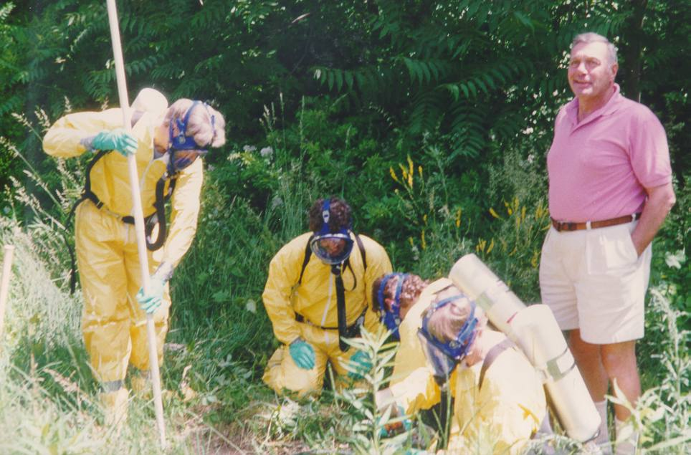
Workplace Safety – The instructor
Notes:
4

Slide 5
LAWN MOWER FACTS
According to Consumer Product Safety Commission (CPSC), 25,300 people are injured by lawn mowers each year:
Of those, 75 are killed, 15 of which are children
Two most common injuries: amputations and injuries from thrown objects
The speed of debris coming out of the discharge chute has been clocked at 200 miles per hour
Push mower should be mowed across a slope; riding mower up and down a slope
200 MPH
Energy produced =
21 lb. ball dropped from 100 ft.
Or
3 times the power of a .357 revolver.
Notes:
13

Slide 6
MOWING SAFETY
Know how to operate equipment - Read owner’s manual. Know where controls are and what they do
Dress properly - Wear long pants, sturdy shoes, and safety glasses
Handle gas carefully - Fill up while engine is cold. Don’t spill when you fill. Store gas in approved container in cool ventilated area. Never smoke around gasoline

Slide 7
MOWING SAFETY
Clear area before you start - Pick up rocks, twigs, cans hoses, anything that can be thrown by mowing equipment
Keep children and pets away from mowing area - Never allow children to operate a mower. Never carry children on mowers
Follow recommended procedures - Always turn off engine and disconnect spark plug before unclogging or working on equipment
Keep hands and feet from moving parts - Never remove or tamper with safety devices or labels. They are for your protection

Slide 8
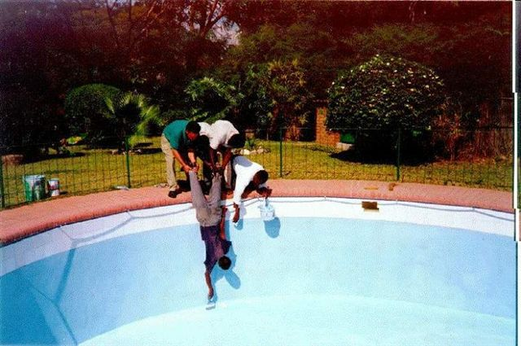
Ingenuity

Slide 9
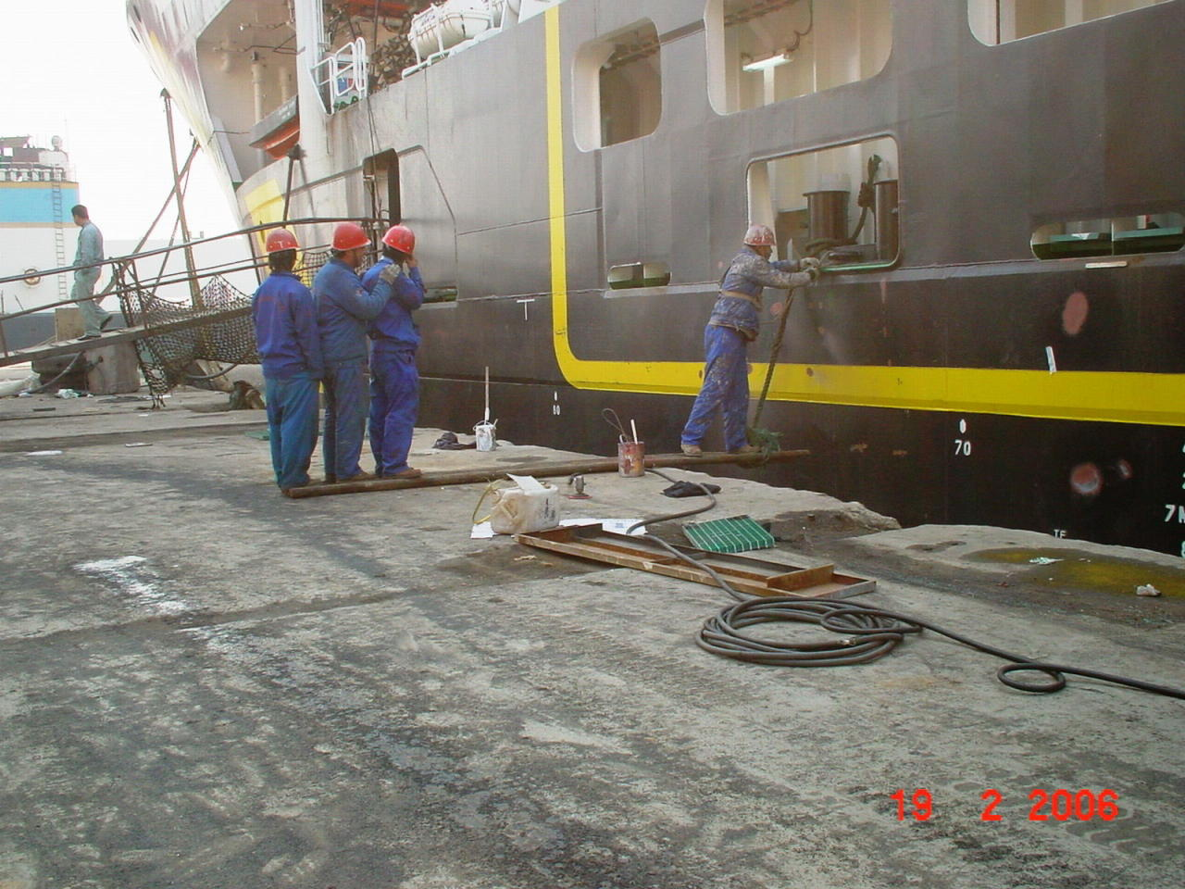
Co-Workers

Slide 10
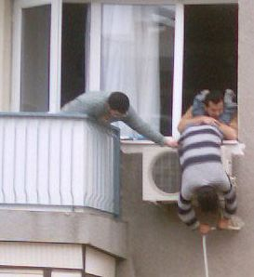
Neighbors

Slide 11
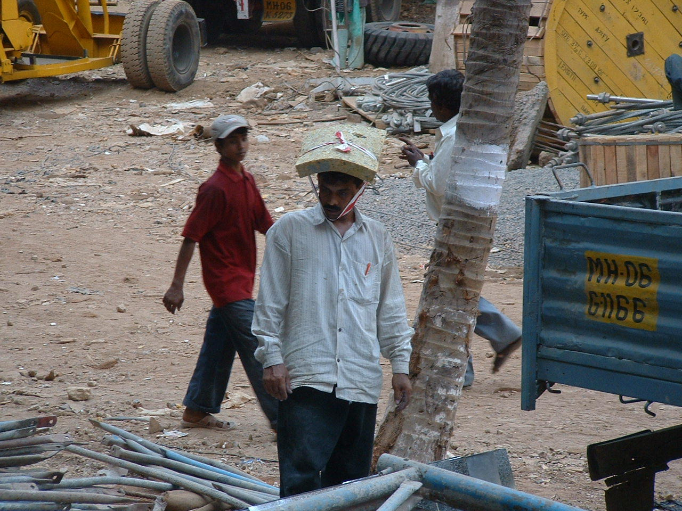
Never mind.Here is your sign.

Slide 12

Equipment Safety

Slide 13
Landscape & Horticulture Services
Source: Bureau of Labor Statistics
Fatality Total (2003): 154
Average number of injuries per year, (1995-2000) 13,025
Demographics of worker
  Sex
    95.7% men
  Age
    21.9% ages 20-24
    38.3% ages 25-34
    22.7% ages 35-44
    17.1% other
  Length of service with employer
    49.6% less than one year
    32.3% 1-5 years
    18.1% more than 5

Slide 14
Landscape Tools
Shovels, hoes, forks, rakes, axes, pruners, shears, clippers, etc.:
  Check handles and replace if cracked, split, or broken
  Inspect metal parts for rust, stress cracks, or excessive wear and discard tool if condition presents unsafe operation
  Check cutting tools for loose parts and replace as needed. Insure they are kept sharp and free of rust
Power tools:
  Ensure blades or tines are sharp and not broken or twisted
  Ensure all guards are in place, in good repair, and working properly
  Check all chains, belts, and shafts for signs if wear and replace if worn excessively

Slide 15
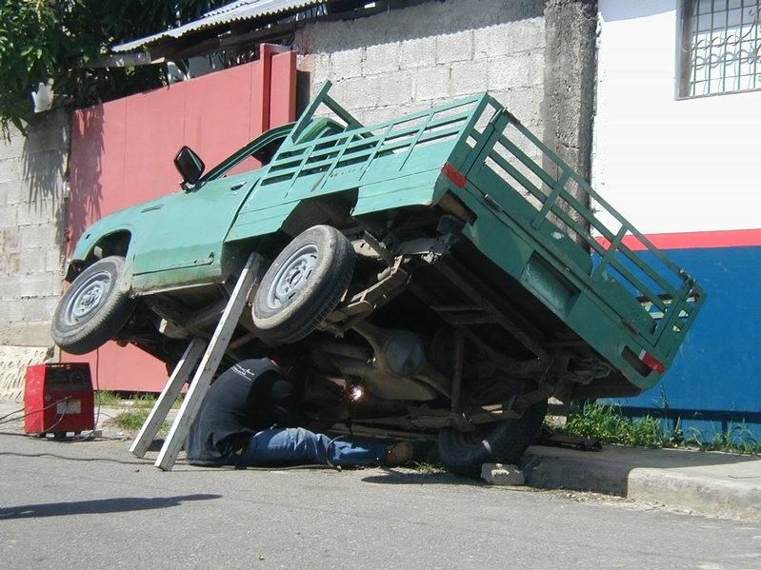
Government Issued Jack Stands

Slide 16
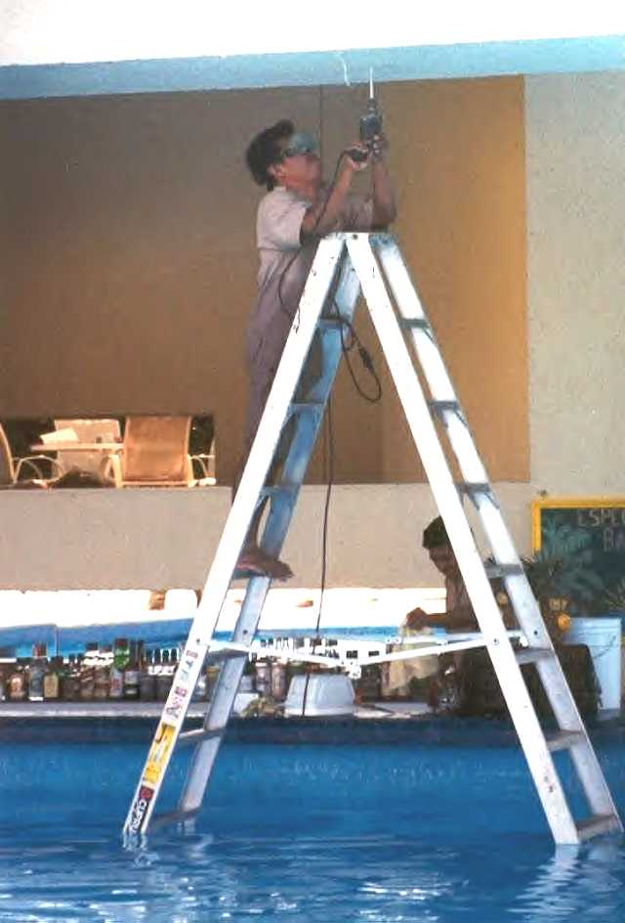
Wait… I’m sorry, I guess I would like that drink.
Notes:
16

Slide 17
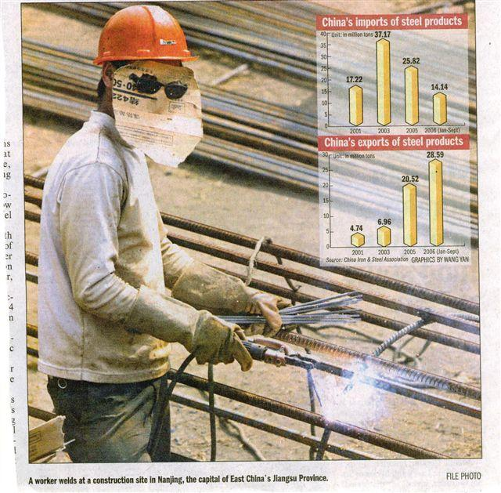
The Welder

Slide 18
EYE SAFETY
Eye injuries are usually not repairable
Checklist for eye safety:
  Is eye protection conveniently available
  Is it suitable for the work being performed
  Is eye protection clean & in good repair
  Keep eye wash solutions handy

Slide 19
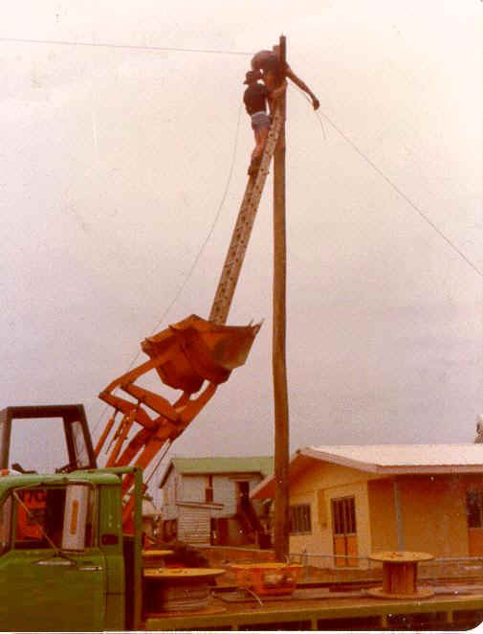
Don’t Laugh, You’ve thought about it.
Notes:
19

Slide 20
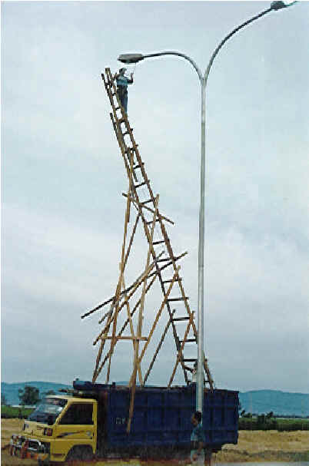
Just the right height
Notes:
20

Slide 21
CHAIN SAW ACCIDENTS
63,000 persons are treated annually for chain saw accidents
Each year 18 - 20 deaths are caused by chain saws
The most serious accidents are associated with kickback (the chain - usually the nose - snags on an object and causes the saw to kick back on the operator)
Buy saws with antikickback features ( nose guard, low kickback chain, low kickback bar design, hand guard, chain break, etc.)
Read the owners manual thoroughly and comply with its instructions & warnings

Slide 22
LINE TRIMMER & EDGER
KNOW HOW TO OPERATE THE EQUIPMENT - Read owner’s manual. Know where the controls are and what they do.
DRESS PROPERLY- Wear long pants, sturdy shoes, safety glasses, and hearing protection.
KEEP CHILDREN AND PETS AWAY FROM TRIMMING AREA (a little girl was killed when a piece of the string went through her temple and into her brain)
WATCH FOR FLYING DEBRIS - high rpms can hurl rocks and other debris like uncontrolled missles. Be aware of your surroudings.

Slide 23
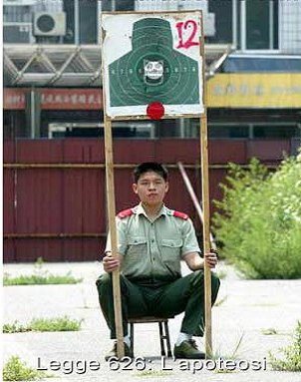
Do WHAT Boss?

Slide 24
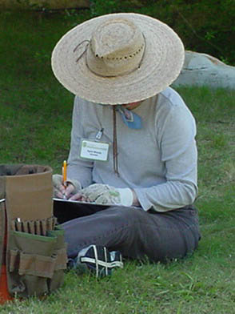
When all else fails, take a break.
Most accidents occur when we are tired and frustrated

