Slide 1
“Fall” into Scouting IPM Basics, Do you have a designated Scout?
Todd Hurt
Training Coordinator
UGA Center for Urban Ag

Slide 2
IPM and Scouting
Brief Overview of IPM
Nursery Scouting Methods & Tools
Landscape Scouting Decision Model
Scouting Exercise

Slide 3
IPM Scouting Definition:
The use of Integrated Pest Management Practices in combination with routine scouting to produce quality agricultural crops.
Internal Scout – Works for company
External Scout – Not a direct employee.

Slide 5
Cultural
Irrigation
Fertilization
Light
Temperature
Air circulation

Slide 6
Chemical
Pesticides
Soaps
Oils
Other

Slide 7
Mechanical
Squishing
Squashing
Burning – Hot water scald of weeds
Blasting – High pressure removal w/water
Discarding

Slide 8
Biological
Predators – Eat them
Parasites – Use them
Fungi - Trichoderma
Bacteria – B.T.

Slide 9
Ok. Enough of the Gobbley Gook.
Does IPM Work?
Let’s See.

Slide 10
Predators
Green Lacewing
Beneficial Mites & Thrips
Video courtesy of
Dr. Lance Osborn, MREC

Slide 11
Parasites
Biology Parasitoid development from egg to adult takes about 3 weeks at a temperature of 77°F. Full development of the parasitoid is inside the mealybug. Adult parasitoids feed themselves by piercing young instars of the mealybugs and sucking from their bodies. By doing this they can extend their lifespan to about 2 months. This feeding behaviour kills the young mealybug-instars. Storage: 2 days at 50-59 degrees F.
Anagyrus fusciventris parasitic wasp against longtailed mealybug
www.entocare.nl

Slide 12
Beneficial Bacteria
Agrobacterium radiobacter (K84)
GALLTROL - A Controls Crown Gall by out-competing A. tumefaciens
Bacillus subtilis (GB03)
4 strains available (specific to soil or foliar applications) Powdery mildew, peach rot
Bacillus thuringiensis
B.t. aizawai (B.t.a.)-wax moth larvae in honeycombs
B.t. israelensis (B.t.i.) is effective against mosquitoes
B.t. kurstaki (B.t.k.)-lepidopterous insects
B.t. san diego- boll weevil.
Streptomyces griseus – (streptomycin)
Agri Mycin – (1958) Fireblight

Slide 13
Beneficial Fungi
Beauveria bassiana
Botanigard, Naturalis - is a fungus which grows directly through the cuticle to the inner body of their host. Here the fungus proliferates throughout the insect's body, producing toxins and draining the insect of nutrients, eventually killing it. (mites, thrips, whitefly, aphids, caterpillars, mealybugs, fungus gnats)
Myrothecium verrucaria – Kudzu & Sicklepod Control
Colletotrichum gloeosporiodes
Trichoderma harzianum (T-22)
Root Shield, Plant Shield -Fusarium, Rhizoctonia, Sclerotium, Sclerotinia and Botrytis species. Mycoparasitic and colonizes rootsystem.

Slide 14
Beneficial Nematodes
Ornamentals | Root weevils | H. bacteriophora, H. megidis
 | Wood borers | S. carpocapsae, H. bacteriophora
 | Fungus gnats | S. feltiae
Turf | Scarabs | H. bacteriophora
 | Mole crickets | S. riobravis, S. scapterisci
 | Billbugs | H. bacteriophora, S. carpocapsae
 | Armyworm, Cutworm, Webworm | S. carpocapsae

Slide 15
Now lets look at a Scouting Program

Slide 16
Scouting
The routine monitoring of a crop to aid in early detection of an insect, disease or other problem.

Slide 17
Benefits of Scouting
More efficient pest management program
Apply only when needed
Appropriate chemical for the pests present and its life cycle

Slide 18
More Benefits
Can detect lack of control due to:
Poor coverage
Improper chemical selection
Possible resistance developed
Mortality time frames differ with each pesticide

Slide 19
Even More Benefits
1 – Allow the use of Biologicals
2 – Detect phytotoxicity
3 – Timely sample submission
4 – True sense of security
5 – Allows you to be a good steward of the environment while promoting a positive image of agriculture to the general public.

Slide 20
Myths of IPM’s
1 – You’ll spray less
2 – It’s not effective
3 – Uses biological controls only

Slide 21
Realities
1 – You’ll need to determine a damage threshold
2 – Must be committed to scouting and accurate record keeping
3 – It is a combination of chemical/biological control tactics

Slide 22
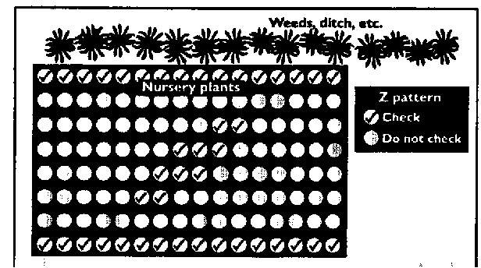
Routine Scouting For Container Nurseries
Z Pattern

Slide 23
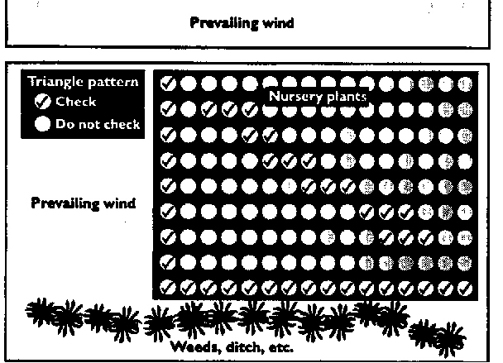
Routine Scouting For Container Nurseries
Triangular Pattern

Slide 24
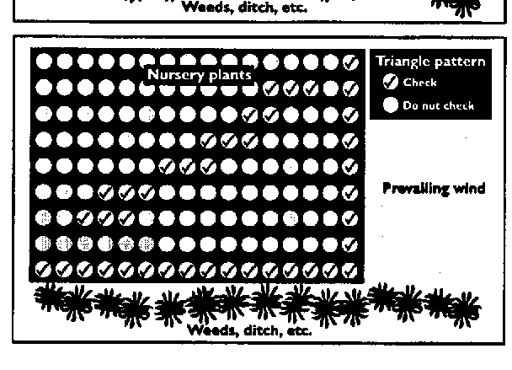
Routine Scouting For Container Nurseries
Triangular Pattern

Slide 25
Scouting Efficiently
Monitor Long Cycle Crops Weekly to Biweekly
Spend approximately 10 mins inspecting 20 or more plants for every 1000 sq. ft. (or block)
Include time to observe pest control application and monitor for efficacy

Slide 26
Tips for Scouts
Enter each block looking for abnormal plant symptoms
Lift a few suspect plants out of the pot (check moisture level and for decaying roots)
Examine foliage for trouble, both new and old growth and top and bottom surfaces.
Determine rough count of plants per block with symptoms.

Slide 27
Tips for Scouts
Look for problem areas (I.e. weeds, irrigation problems or plant spacing)
Do the symptoms form a pattern?
Flag problem areas (remember however the flagged areas may receive extra attention by the applicator)
Record Number and stage of pests present and any beneficial insects present.

Slide 28
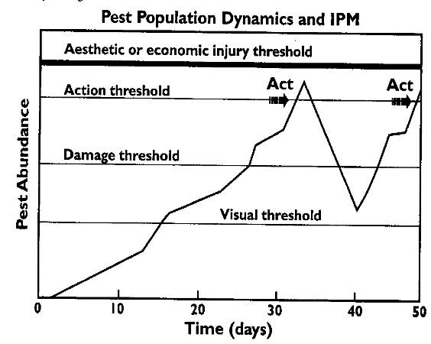
Determine Threshold Levels

Slide 29
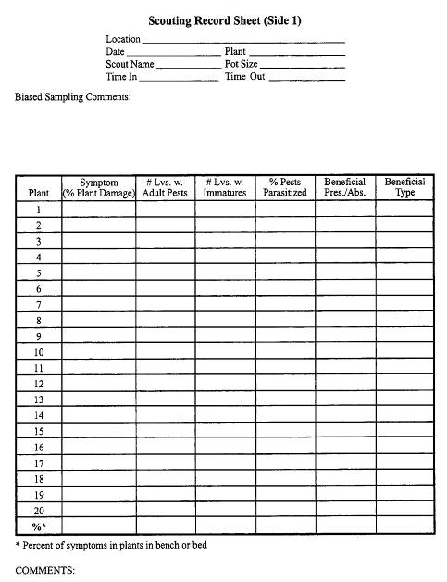

Slide 30
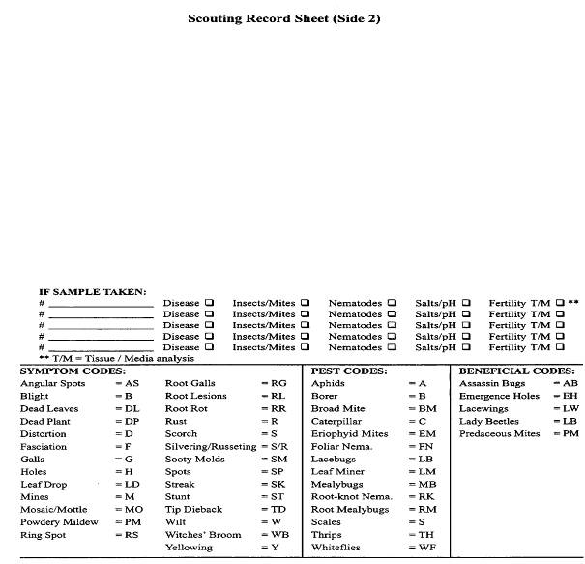

Slide 31
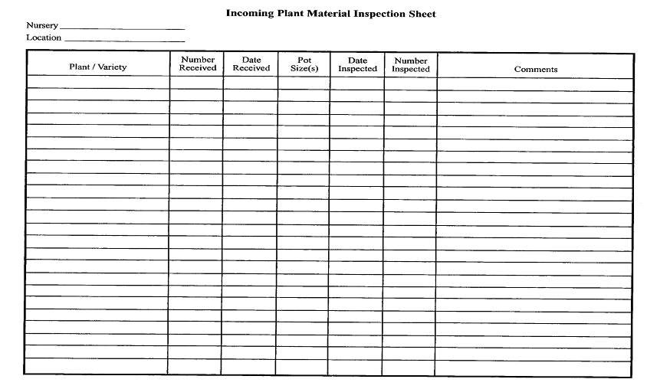
Incoming Plant Material

Slide 32
Situational Scouting
Nursery Design
Nursery Maintenance
Water Source and Quality
Nursery Media
Nursery Containers and Storage
Fertilization
Plant Propagation
Plant Production

Slide 33
Scouting Landscapes
Don’t Jump to conclusions, be methodical.
Plant Pathologist/Entomologist
Start Big then Work Small
Plant Problems are rarely the result of a single factor

Slide 34
Basic Questions
What plant species are being effected?
Is more than one species damaged?
How many plants are involved?
Is the damage found on all of the plants or is it localized?
Is the damage even or progressive?
How long have they been planted?
How are they being watered?

Slide 35
Basic Questions
When did you first notice the problem?
Has it spread?
Have you applied anything to try to solve the problem?
Foliar Burn? Also ask about other recent work (i.e. painting, pressure washing)

Slide 36
Now Focus on the Individual Plant
Are the symptoms on one side of the plant?
Inside of the canopy or out on the tips?
Lower leaves or new growth?
Entire Plant – suspect chemical damage, root/water problems, soil borne diseases
Check Planting Depth
Observe Root System
Damage at soil line or trunk

Slide 37
Insects and Diseases
Soft Bodied Insects note color then preserve in rubbing alcohol
Disease sample in active margin (halo)
Take a large enough sample to show progression
In turf note size and shape of damaged area.
Keep sample cool in a ziplock bag. Do not add water.
If root disease is suspected sample in separate bag.

Slide 38
Ready for Your Scouting Exercise?

