Slide 1
Fall Gardening
Springs Church – July 30
Billy Skaggs
County Extension Agent
UGA Cooperative Extension – Hall County
Notes:
Vegetable Gardening in Georgia

Slide 2
Learning objectives
Proper Harvest
Fall Garden Prep (lime, organic matter, etc)
Green Manuring (use of cover crops)
Warm season veggies which can be replanted
Cool season vegetables
Notes:
Learning Objectives
After you complete your study of this chapter you should be able to:
Understand the factors to consider in site selection.
Have an appreciation for the benefits of organic matter/soil amendments.
Understand the difference between warm and cool season vegetables.
Understand the concept of crop rotation.
Understand the concept of intercropping
Understand considerations of raised bed and container gardening, soil mixes, special cultivars, irrigation requirements.
Understand the concept of succession planting.
Understand the benefits of using cover crops.
Become familiar with basic vegetable gardening techniques such as transplanting, cultivation, fertilization, harvesting.
Become familiar with the different vegetables and herbs typically grown in Georgia.
Learn about some new vegetables for Georgia.

Slide 3
When to Harvest
Texture, fiber and consistency of all vegetables are greatly affected by the stage of maturity at harvest, by post-harvest handling and by the time interval between harvesting and serving.
Some vegetables are more highly-perishable than others. Sweet corn and English peas are difficult to maintain in an acceptable fresh state for even a very short time, while other vegetables have a much longer shelf life.

Slide 4
When to Harvest
Harvesting most vegetables when they are young and storing them properly will help extend their shelf life. Lowering the internal temperature also helps to slow both the respiration process and quality decline.
Harvest vegetables early in the day before the heat from the sun has warmed them. After the harvest, most vegetables should be kept cool and out of direct sunlight until they are either processed or consumed.

Slide 5
When to Harvest
While harvesting too soon may result in only a reduction in yield, harvesting too late can result in poor quality due to development of objectionable fiber and the conversion of sugars into starches.
A late harvest can also cause plants to terminate, or stop producing as they complete their reproduction process.
Fully-mature vegetables left on the plant also attract more disease and insect problems.

Slide 6
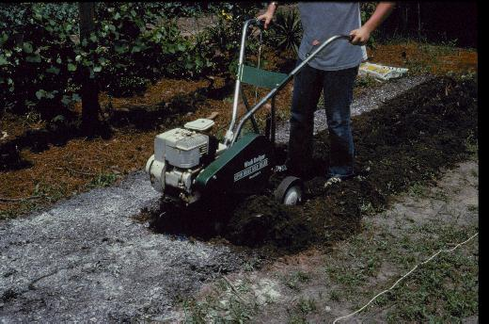
As lime reacts slowly in the soil, fall is a good time to apply it. Always incorporate it when possible so that the soil pH is raised uniformly throughout the soil profile.
Notes:
(Broadcast Lime) It is best to apply dolomitic limestone 2 to 3 months before planting. It can be broadcast over the soil surface and then worked in with a rototiller or some other implement. Normally, dolomitic limestone reacts slowly in the soil. By mixing the lime with the soil, the reaction is more uniform throughout the root zone.

Slide 7
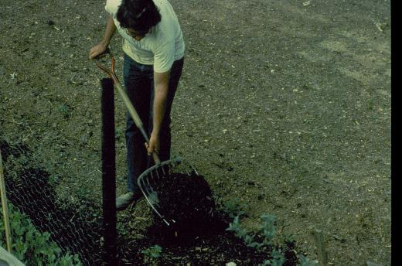
Organic matter improves soil tilth, conserves soil moisture, and aids root development. Fall is a great time to incorporate additional O.M.
Notes:
(Compost) Almost any soil can be improved by the addition of organic matter. Increasing soil organic matter increases the soil's ability to hold nutrients and water. It also tends to improve soil tilth to improve plant root growth.

Slide 8
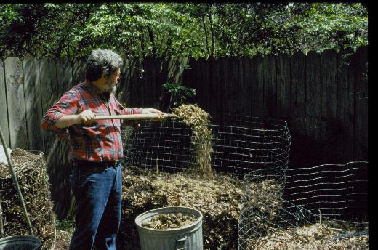
COMPOST
Notes:
(Compost pile) Most home gardeners can have a ready source of organic soil amendment if they will create a compost pile. Compost is decayed plant material. A compost pile can be made using grass clippings, leaves, vegetable kitchen scraps and non-diseased plants out of the garden Once these are well rotted, the compost can be added to the garden as a mulch or worked into the soil. Do not compost fat, bones, or meat products as these components may attract animals to the compost pile. Compost can also be made in bags or in trenches dug in the garden.

Slide 9
Notes:
(Organic Matter Table) Compost is not the only organic matter that can be added to the garden. Many other materials can be used to increase the soil organic matter levels. Here are some sources and the rates at which they can be added to the soil. As organic materials decompose, they use nitrogen. Some sources of organic matter, such as sawdust, can cause nitrogen deficiencies as they decompose. Therefore, avoid using sawdust to prevent this problem. ALL ANIMAL MANURES SHOULD BE PROPERLY COMPOSTED A MINIMUM OF 120 DAYS BEFORE USING TO PREVENT POTENTIAL HUMAN DISEASE TRANSMISSION.

Slide 10
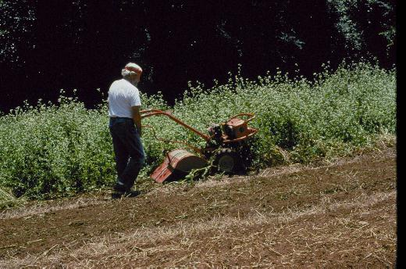
Green manuring is another method of adding organic matter to the soil. A crop is seeded and allowed to grow to maturity. The crop is then either killed with a herbicide and plowed under, or plowed under prior to seed development.
Notes:
(Green Manure) Green manuring is another method of adding organic matter to the soil. A crop is seeded and allowed to grow to maturity. The crop is then either killed with a herbicide and plowed under or just plowed under.

Slide 11
Utilize green manure crops
Crop | Season | Seed (lbs/A) | Type | Nitrogen (lbs./ton dry material)
Buckwheat | Summer | 75 | Nonlegume | 14
Crimson clover | Winter | 15 | Legume | 45
Rye | Winter | 75 | Nonlegume | 21
Southernpea | Summer | 90 | Legume | 60
Soybean | Summer | 75 | Legume | 46
Sudan grass | Summer | 25 | Nonlegume | 28
Vetch | Winter | 30-50 | Legume | 62
Wheat | Winter | 75 | Nonlegume | 20

Slide 12
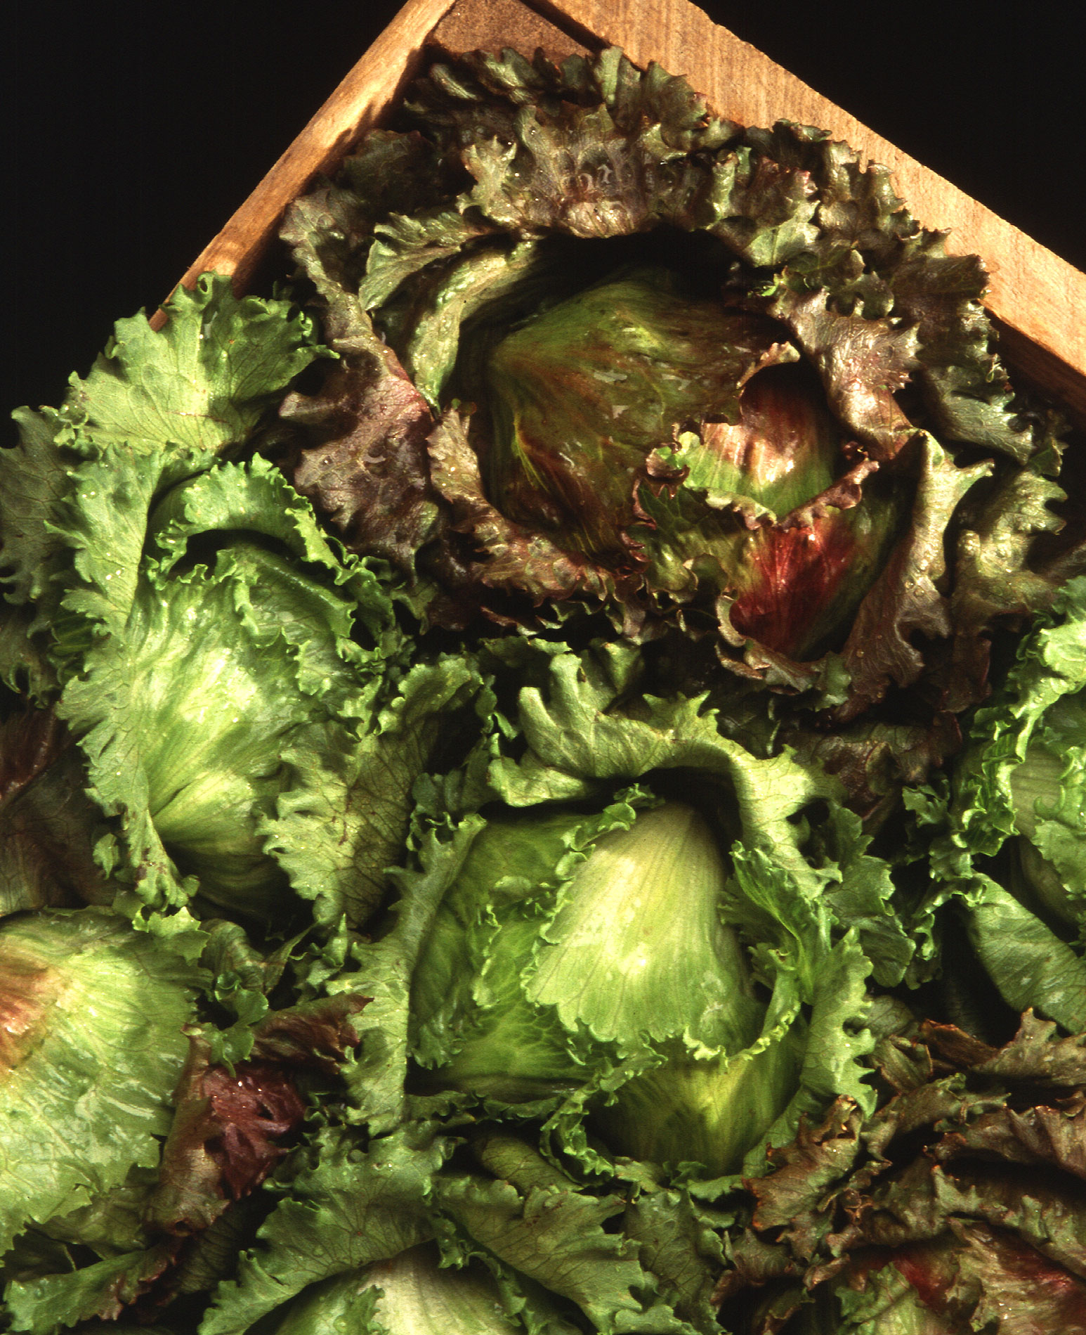
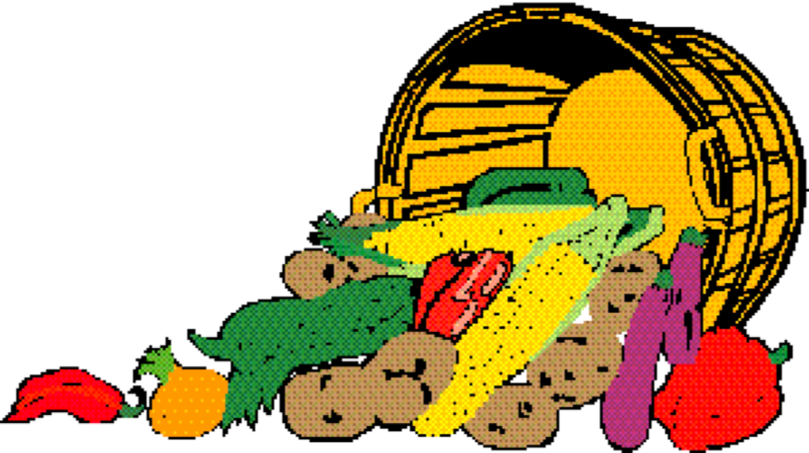
Fall Garden Planting
Notes:
Insect & Disease Control. Insect and disease control is easier if problems are addressed early. Learn to spot diseases before they become rampant. Watch the garden closely and monitor insect levels.

Slide 13
Fall Garden Planting
Many vegetables are well adapted to planting in the summer for fall harvest. Planting a fall garden will extend the gardening season so you can continue to harvest fresh produce after earlier crops have finished.
Many cool-season vegetables, such as carrots, broccoli, cauliflower, and Brussels sprouts, produce their best flavor and quality when they mature during cool weather. Vegetables, such as lettuce and spinach, tend to bolt or develop bitter flavor when they mature during hot summer weather.
July and August are the main planting times for the fall garden. Vegetables that have a 60 - 80 day maturity cycle should be planted around August 1 in our area. Planting of quick maturing vegetables, such as turnips and leafy greens, can be delayed until September.

Slide 14
Seeds vs. Transplants
Direct seeding for crops such as broccoli, cabbage, and collards is often used in the fall. Success depends on having adequate water to keep the seedlings actively growing after germination. If irrigation is not available, buy vegetable transplants.
Seeds should be planted deeper in the fall because the moisture level is lower in the soil and the surface temperature is higher. In many cases, the planting depth may be 1 1/2 to 2 times as deep as for spring planting of the same crop.
You may need to cover the seeded area with burlap cloth, newspapers, or boards to keep the soil cool and moist. Shading the soil or using a light mulch over the seed row will help keep the temperatures down. The shading material must be removed as soon as the seeds begin to germinate.

Slide 15
Frost Protection
You can extend the season of tender vegetables by protecting them through the first early frost.
In Georgia, we often enjoy several weeks of good growing conditions after the first frost.
Cover growing beds or rows with burlap or a floating row cover supported by stakes or wire to keep the material from directly touching the plants.
Individual plants can be protected by using milk jugs, plastic cylinders, or water-holding walls.

Slide 16
Warm Season Crops (which can be replanted)
Vegetable | Days to Maturity | Planting Date
Beans, bush | 50-60 | August 10
Beans, pole & lima | 65-75 | August 1
Cucumber | 50-65 | August 15
Bell peppers | 65-80 | Aug 10
Squash | 40-55 | August 25
Tomato | 70-90 | July 15

Slide 17
Notes:
(Cool season vegetable) Because of its usually mild winters, cool season crops are grown in the deep South from late summer through spring.

Slide 18
VEGETABLES GROWN FR0M VEGETATIVE PORTIONS
Asparagus
Irish potatoes
Onions (sets)
Rhubarb
Sweet potatoes
Notes:
Several important cool season vegetables can be grown vegetatively, that is by planting vegetative parts instead of seed or transplants.

Slide 19
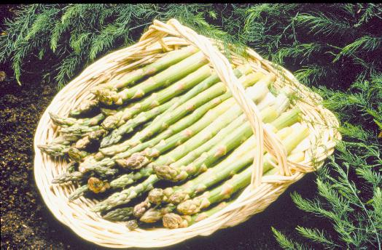
Asparagus
Truly perennial
Pick location carefully; cannot plow or till around it
Start from 1-year old crowns
Plant in November & December
Don’t harvest too early; spears need to develop strong root system
Notes:
(Asparagus) Let us take a look at some of the more common cool season vegetables grown in Georgia gardens. Asparagus is one of the few perennial crops that we grow in the garden, and should be placed where it can remain for several years. Keep asparagus from the middle of your garden because you cannot plow it with the rest of the garden. Asparagus normally is started from rooted one year old crowns. There are also newer varieties available from seed that are also male sterile, thus not producing seed. Don't cut the spear during the first year; let the spears grow and develop a strong root system.

Slide 20
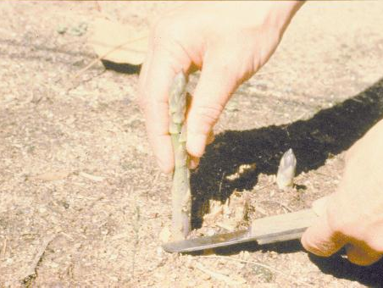
Spears are harvested for approx 2 weeks in year 2; 4 weeks in year 3; never longer than 8 weeks.
Cut spears at 4 inches long
Heavy feeder
Notes:
(Asparagus) Spears can be harvested for approximately 2 weeks in the second year. Harvest for 4 weeks the third year. The harvest should never exceed 8 weeks in any year. Cut spears when they are 4 inches long. Asparagus is a heavy feeder and will respond to heavy rates of fertilizer and to organic matter if added at the time the crowns are set. A good mulch should be used around asparagus for weed control. Thc tops of the asparagus plant are called ferns, and the ferns that develop after the harvest should be allowed to grow until late fall or winter until the tops turn completely brown. At that time they should be removed and composted.

Slide 21
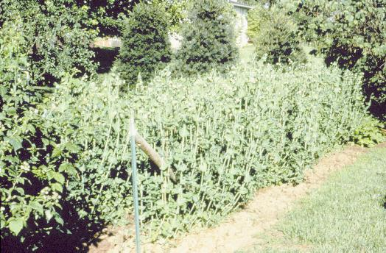
English peas are very easy to grow; can be planted in late winter – Jan & Feb; tolerant of light frost.
Notes:
(English Pea Pod) English peas are one of the earliest crops you can plant. They can be planted in the garden as early as the soil can be worked in the spring. Peas will germinate and come up when soils are quite cold and will stand a considerable amount of cold weather and even light frost.

Slide 22
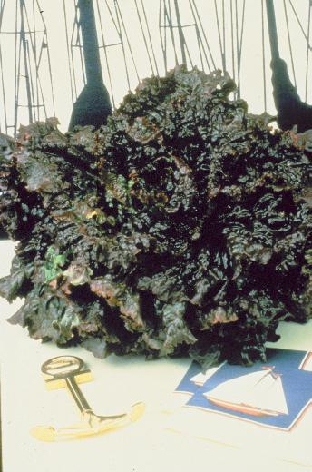
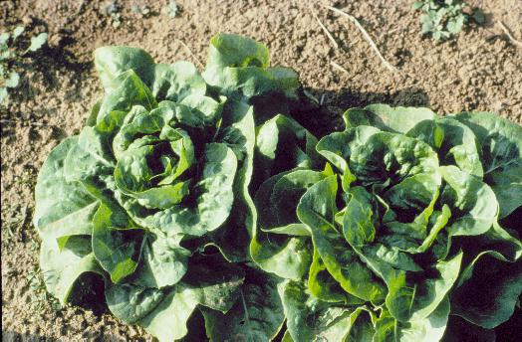
Lettuce
Fall planting - September
Iceberg lettuce is not recommended
Many other varieties are available.
Red Sails
Buttercrunch
Notes:
(Leaf lettuce. Red Sails) Early spring is the ideal time in the deep South to plant lettuces. While iceberg lettuce is not recommended, many leaf lettuce varieties grow well in cooler spring temperatures.

Slide 23
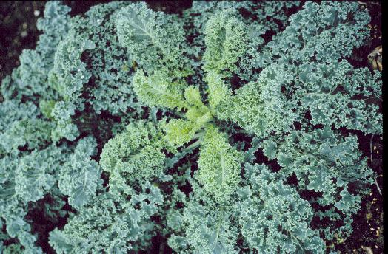
KALE
- Dwarf Siberian, Blue Armor, Blue Knight
Siberian Kale is coarser green & higher in vitamins, tasting much like collards. Siberian Kale and its curly leaf cousins are both edible and decorative in the garden.
Days to maturity: 50-70 depending on variety; plant in August.
Notes:
(Siberian Kale) Siberian Kale is a coarser green high in vitamins and tasting much like collards. Siberian Kale and its curly leaf cousins are both edible and decorative in the garden.

Slide 24
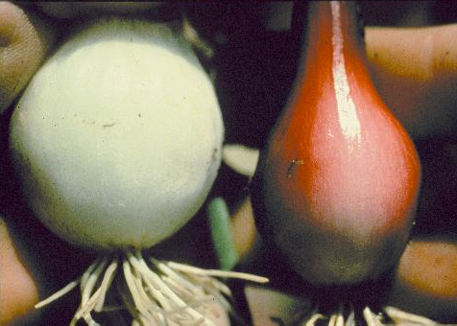
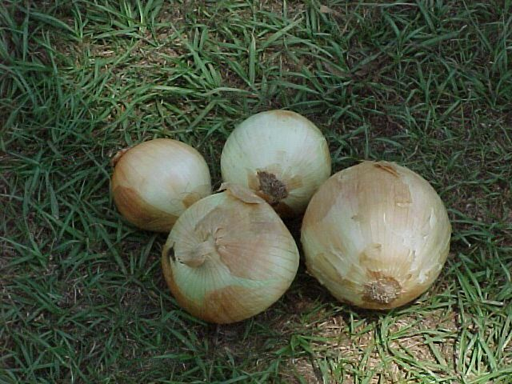
- Onions tolerate cool weather very well.
- Can be started from plants, sets, or seed.
- Onions planted in the fall and grown over winter make the largest onions such as the Vidalia.
- Green onions are planted Sept 1 – Dec 31; bulb onions can be planted in Oct and early Nov.
Notes:
(Two Onions) Onions should also be started early in the season. They will tolerate a considerable amount of cool weather. Onions come in yellow, white or red varieties. You can start these from plants, from sets, or from seed. Onions planted in the fall and grown over the winter often make the largest onions such as Vidalia onions.

Slide 25
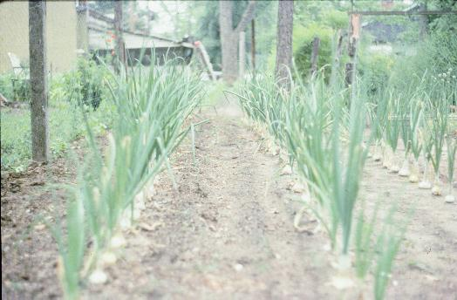
Onions that are direct seeded will have more of their bulb exposed compared to those started from transplants or sets.
Notes:
(Onion Bulb) Onions generally grow at or near the surface of the ground. Onions that are direct seeded will have more of their bulb exposed compared to those from transplants or sets.

Slide 26
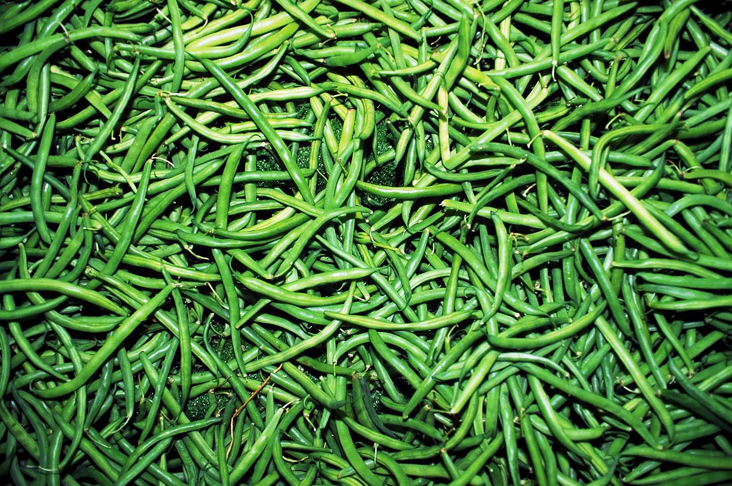
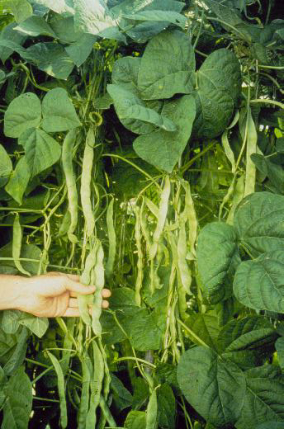
Beans
Thrive in cool weather but will not tolerate frost; plant by Aug 10
Grow as bush, half runners or climbing depending on the variety
Color varies: green, purple, or yellow.
Most of the bush types will give about four harvests over the season.
Notes:
(Beans) Beans are one type of vegetable that thrives in cool weather but will not tolerate frost. Beans grow as bush type, half runners or climbing types according to the variety and can vary in color appearing green, purple, or yellow. Most of the bush green-podded types if hand picked, will give about four harvests over the season.

Slide 27
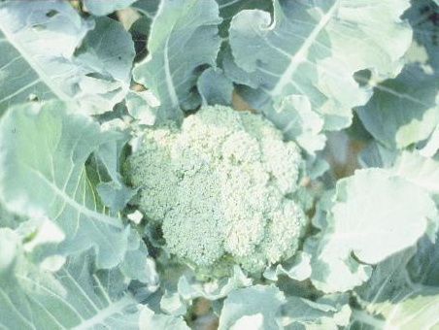
Broccoli
Broccoli can be planted in August & early September.
60-80 days to reach maturity.
Cut heads before any of the blooms start to open up; about 4 in of stem should be cut along w/ head; side shoots may develop.
Notes:
(Broccoli Head) Another cool season crop that does well in Georgia is broccoli. Broccoli will tolerate some light frost if the plants are well conditioned. Here is the central head of the plant. Cut heads before any of the blooms start to open up. About 4 inches of stem should be cut along with the head. Once you cut the central head, side shoots will develop in the axis of the leaves and these also can be harvested.

Slide 28
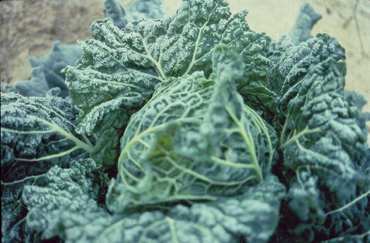
Cabbage
Plant when nights are fairly cool and days warm but not hot; mid Aug thru Sept
Side-dress with nitrogen periodically
Cabbage (& broccoli, collards, turnips) have a high boron requirement; either supply in fertilizer or via Borax (2 tsp/100ft row)
Notes:
(Cabbage) Cabbage is a cool season crop and should be planted when the nights are fairly cool and days warm but not hot. It should be side dressed with nitrogen as it grows, Cabbage, broccoli, collards and turnips also have a high requirements for boron. Supply it in the fertilizer or apply it as side dressing of 2 teaspoons of Borax detergent per 100 foot of row. This can be dissolved in water and poured over the row.

Slide 29
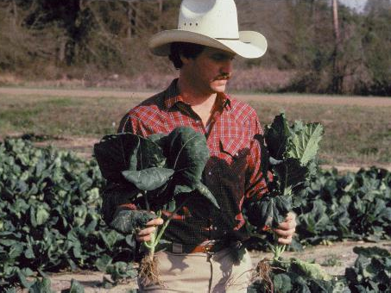
Collards: Set out transplants when weather cools – Aug & Sept; spacing plants 12 inches apart in the row (6 inches if greens to be cut fairly small)
Varieties: Blue Max, Georgia Southern, Hevi-Crop
Notes:
(Collards) Collards are grown for their foliage and can be started from transplants or direct seeded. Set out transplants while weather is cool, spacing plants 12 inches apart in the row. If you want to cut collards fairly small, then the seeding rate can be increased, growing a plant every 6 inches in the row.

Slide 30
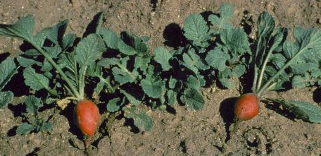
Radishes mature very quickly; plant Sept 1 – October 15; only 4-5 weeks from planting to harvest; tubers get old rapidly, so plantings should be staggered 7-10 days apart to extend harvest.
Notes:
(Radish) Radishes are one of the most quickly maturing vegetable crops that you can grow in the garden. About 28 days is required from the time you plant the seeds until they are ready to harvest. Once the radish becomes mature, it gets old rapidly, so stagger plantings every week to 10 days to assure a new crop all season.

Slide 31
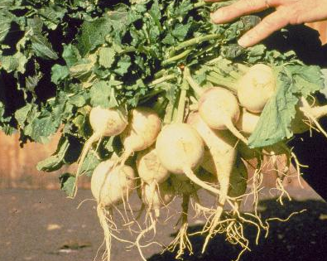
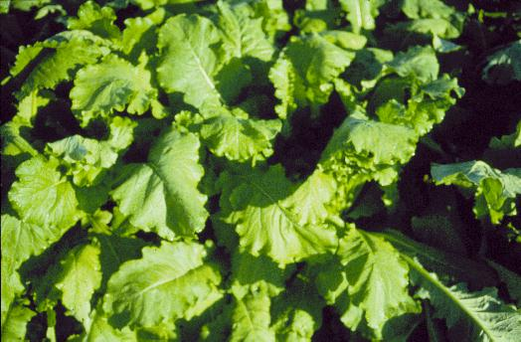
Turnips
Grown for greens or roots
Likely have better results growing turnips for greens as a spring crop and growing the turnips for roots as a fall crop
Plant Aug 10 – Sept 15
Varieties: Purple Top, Royal Crown
Mustard greens are often grown together with turnip greens.
Notes:
(Turnip Greens) Turnips can be grown for greens or roots. In north Georgia you may have better results growing turnips for greens as a spring crop and growing the turnips for roots as a fall crop.

Slide 32
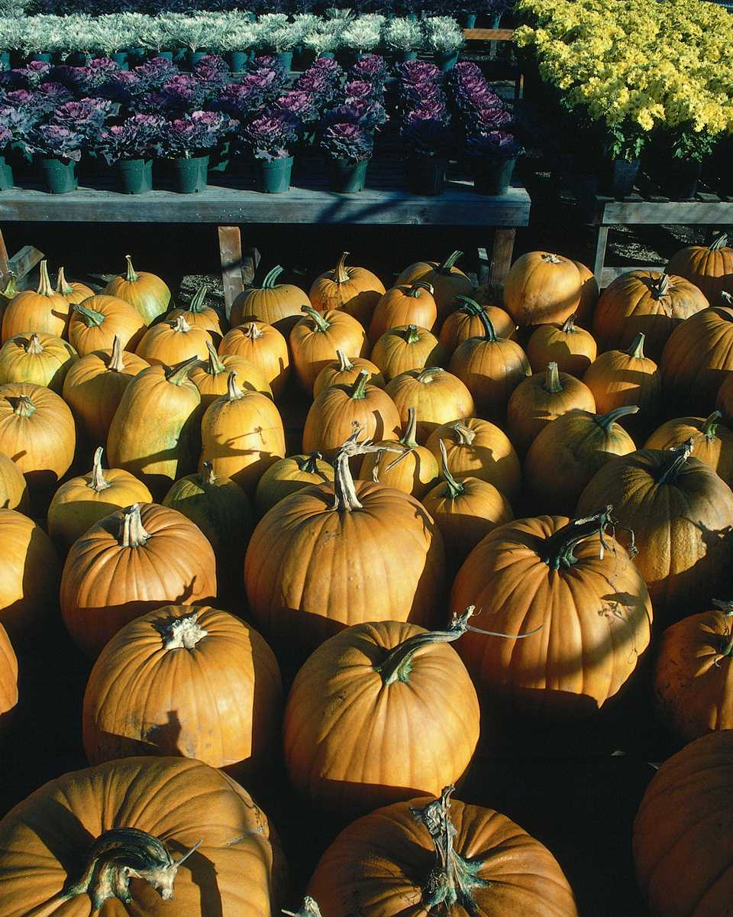
Fall maturing crops such as pumpkins and melons need to be planted in early summer for harvest in August and September.
Notes:
Fall maturing crops such as pumpkins and melons need to be planted in early summer for harvest in August and September.

Slide 33
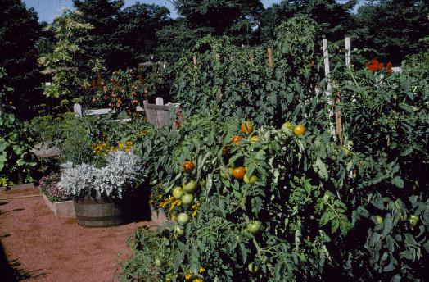
Notes:
(Home gardens are fun for all ages) They provide recreation, exercise, and good nutrition also. However, a poorly planned garden can waste money and effort. Plan ahead, enjoy a bountiful harvest of fresh, nutritious vegetables, and join the thousands of home gardeners who learn more each year from their own home gardening experience.

Slide 34
Any Questions?
Thank you!
Notes:
Any questions?
Review QUESTIONS
Name 2 important criteria in site selection for a vegetable garden?
Why is planning and record keeping so important to successful gardening?
What is the difference between succession planting and rotation?
Name 3 warm season and 3 cool season vegetables for Georgia.
Why are legumes so important to soil fertility?
What part of the vegetable cauliflower, snap bean, cabbage, and watermelon are harvested?
Name a perennial vegetable crop?
What is the final step in producing a quality transplant?

