Slide 1
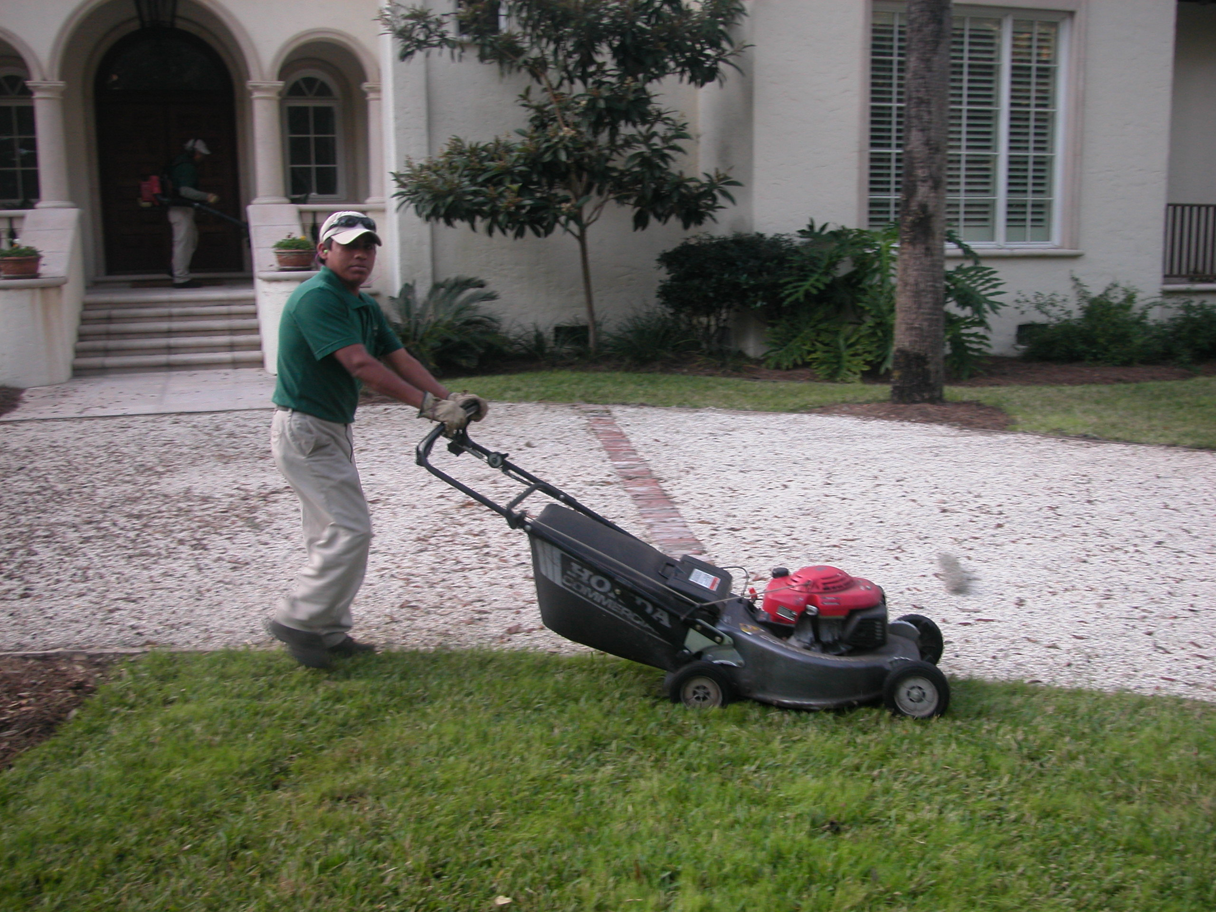
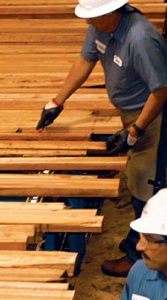
EXPLORING CULTURAL DIFFERENCES AND OVERCOMING
COMMUNICATION PROBLEMS WITH YOUR
HISPANIC/LATINO WORKFORCE

Slide 2
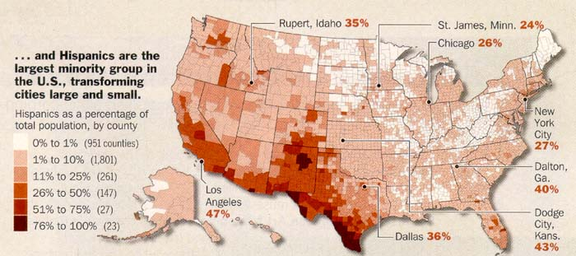
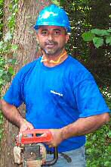
Dynamics and Importance of Hispanic Workforce
Nationwide Green Industry uses Hispanics/Latino as backbone work force
In Georgia 75% of work force in the green industry (landscape, golf courses, nursery, greenhouse) industry employs Hispanic / Latino workforce
Landscape companies (Georgia) are based on Latino workers
Potential clients?

Slide 3
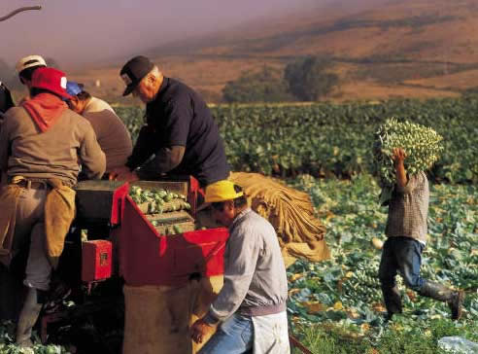
Notes:
Slide 10. Impacts on horticulture/agriculture
In the Green Industry, the fastest growing industry in the state, Hispanics are key to maintenance and installations, production, processing and retail.
This year (2002) purchasing power of the 39 million Latinos has grown to $580.5 billion. In Georgia the figure is $11.3 billion.

Slide 4
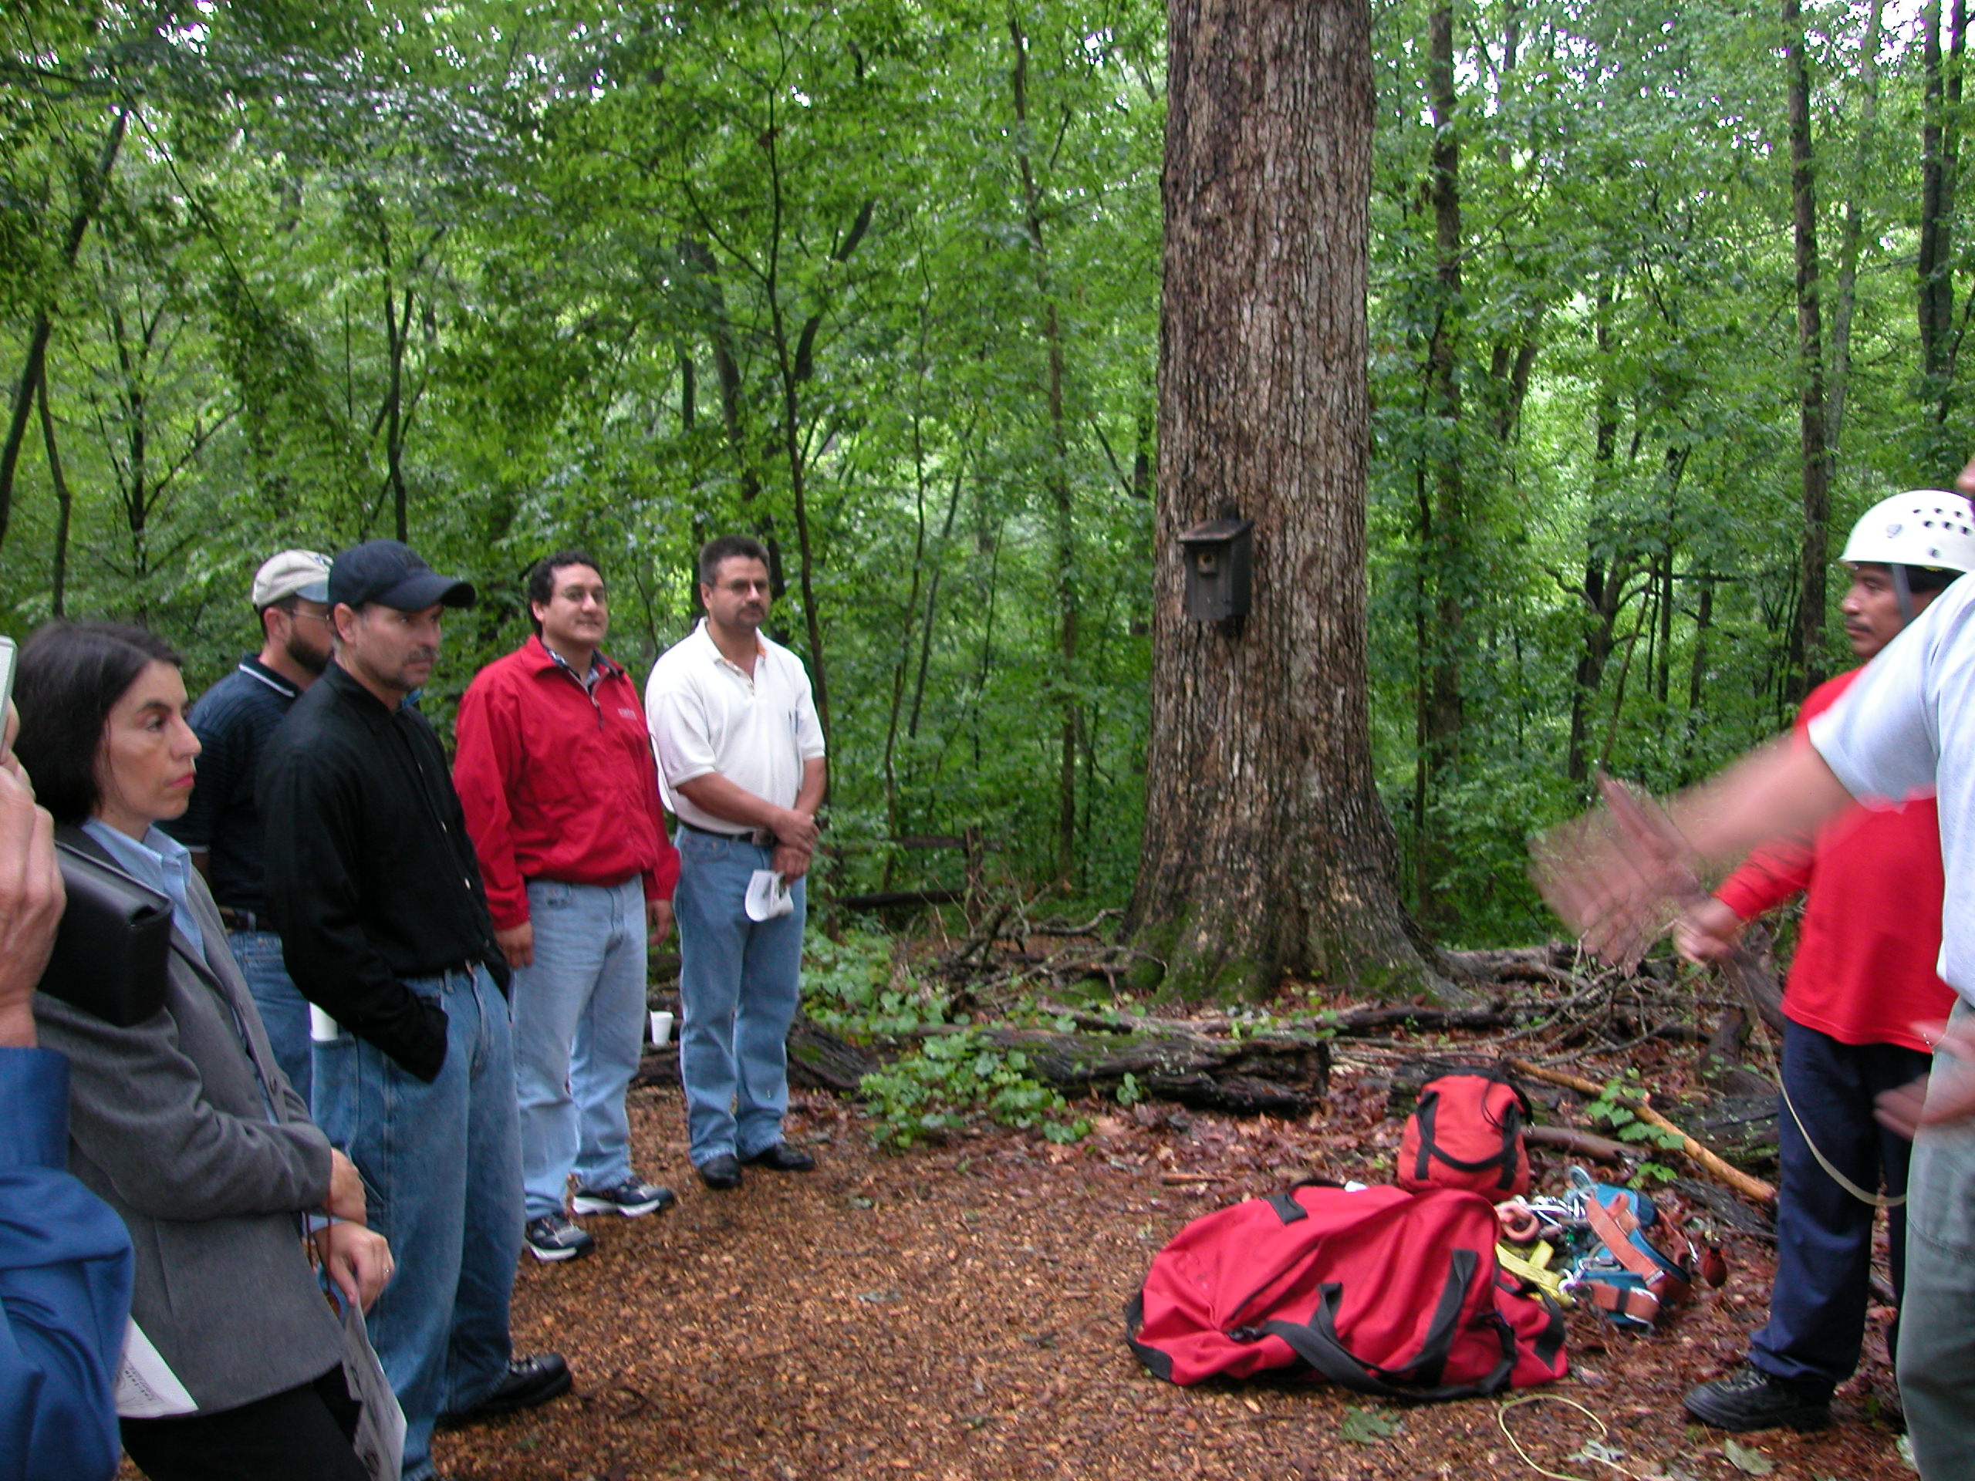
FACTORS TO TAKE INTO CONSIDERATION
AND THAT INFLUENCE THE HISPANIC WORKFORCE
HOW CULTURE, EDUCATION RELIGION AND OTHER FACTORS
INFLUENCE THE MANAGEMENT OF HISPANIC
WORKERS

Slide 5
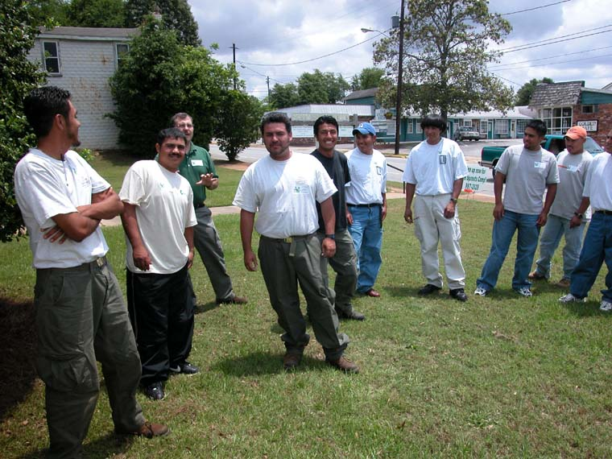
SOME CHARACTERSITICS OF HISPANIC WORKFORCE
Hispanic/Latino=
Hispanic (a person from or descending from Spanish speaking countries)
Latino (a person from Latin America-Geographical)
Mostly Mexican (60%)
Young (Less than 35 years old)
Hard working
Loyal
Education level is vary variable
Eager to learn
Pleasing

Slide 6
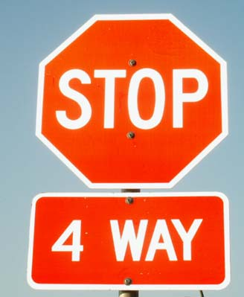
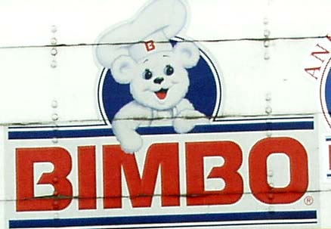

Slide 7
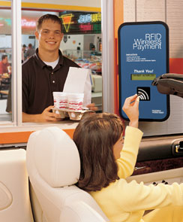
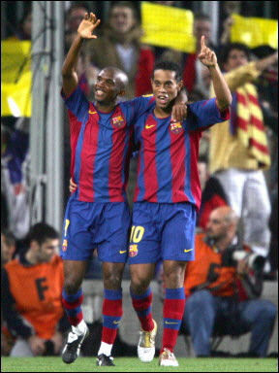
THIS IS FOOTBALL
(FUTBOL) FOR HISPANICS

Slide 8
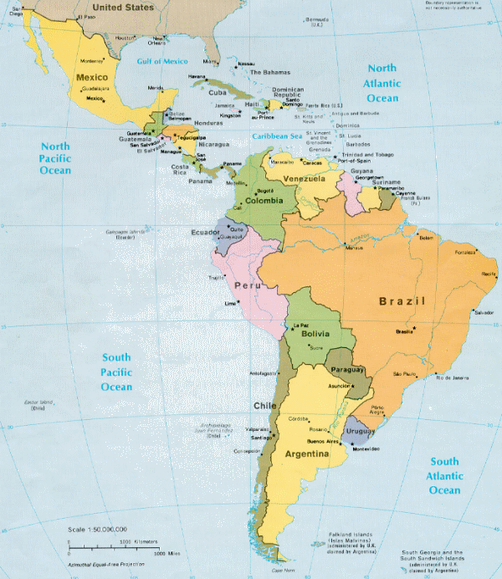
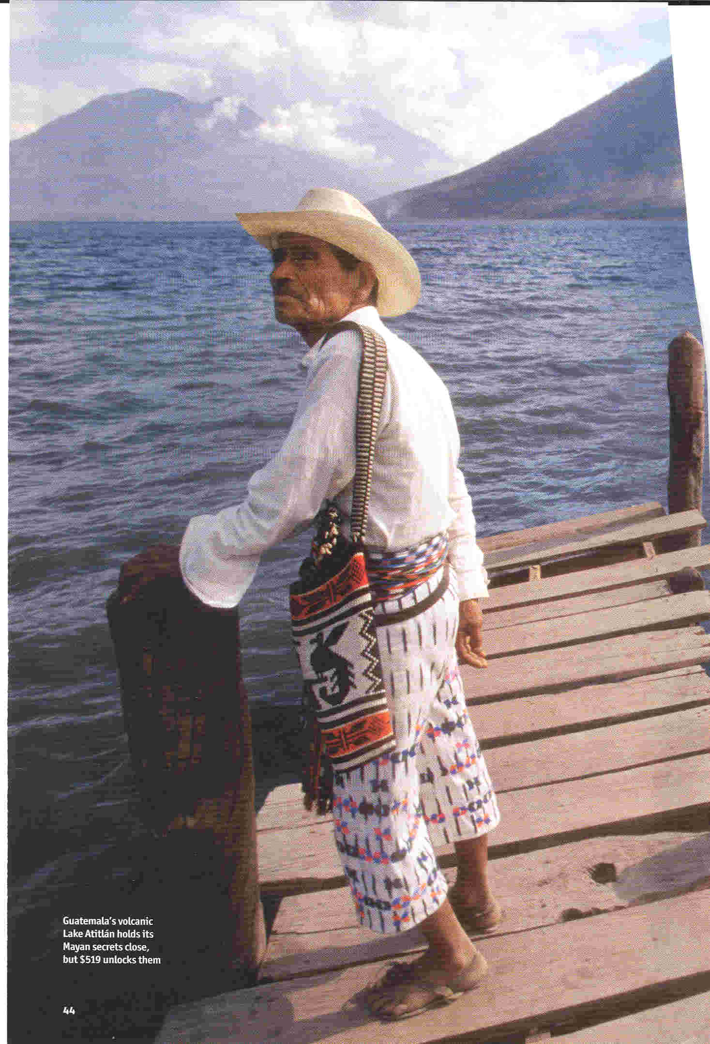
HISPANIC/LATINO VS MEXICAN, GUATEMALIAN ETC…
(Where they come from)
Juntos pero no revueltos
(together but not mixed)
Own nationality
Commonalities
Differences in customs
Some language regionalisms

Slide 9
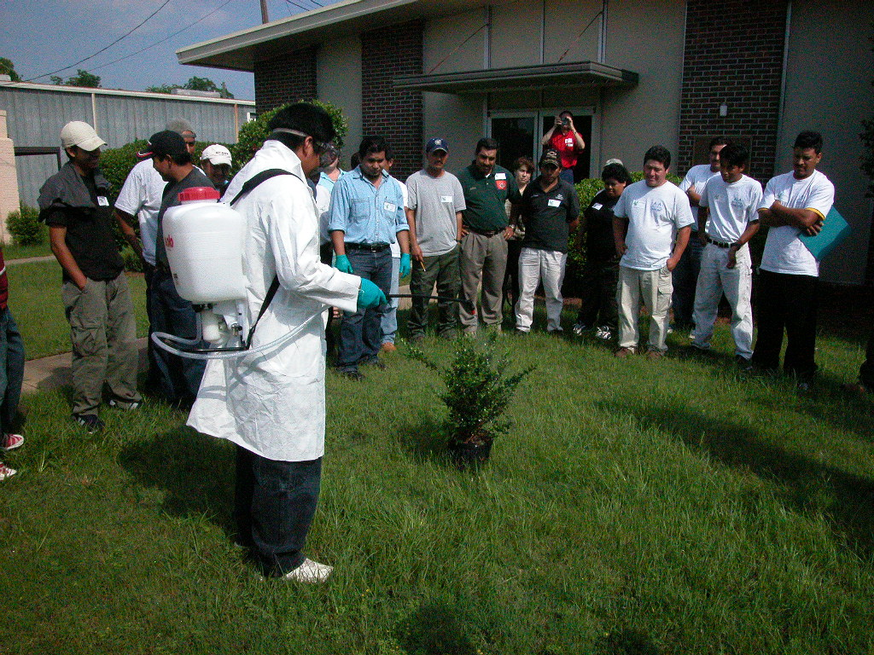
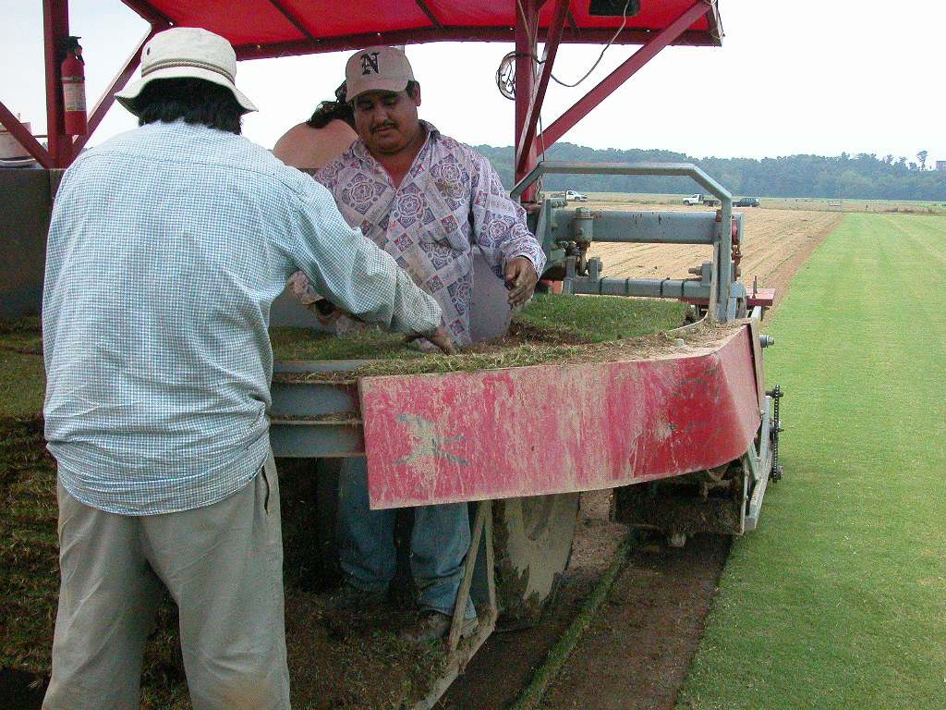

Slide 10
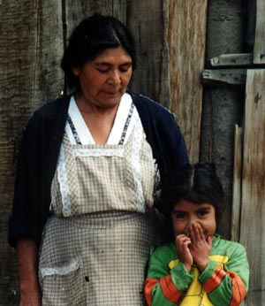
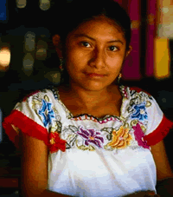
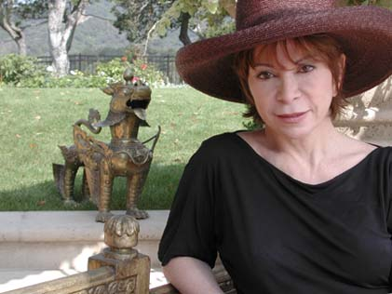
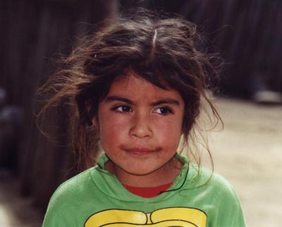
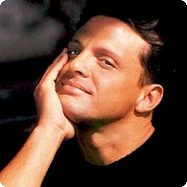
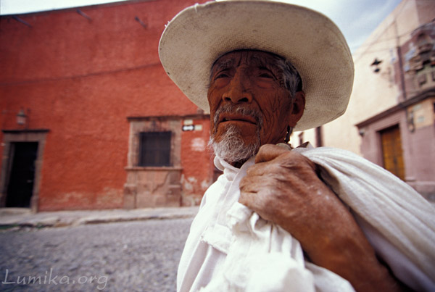
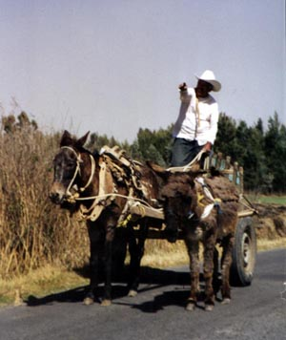
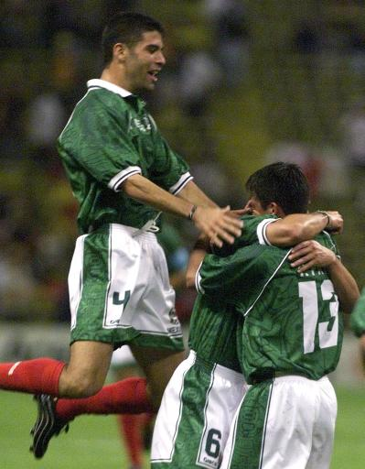
People
Mestizo (Amerindian-Spanish) 60%,
Amerindian or predominantly Amerindian 30%,
white 9%, other 1%

Slide 11
MESTIZAJE= BLEND OF SPANIARDS / NATIVES
NO RACES TO SPEAK OF
MOSTLY SPANISH SPOKEN
SEVERAL/MANY INDIGENOUS LANGUAGES STILL SPOKEN
FEW HAVES, MILLIONS HAVE NOT’S

Slide 12
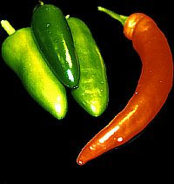
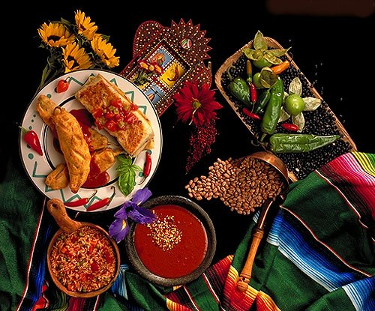
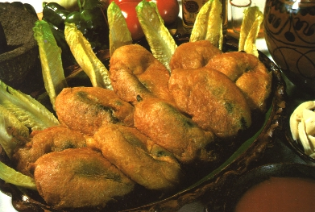
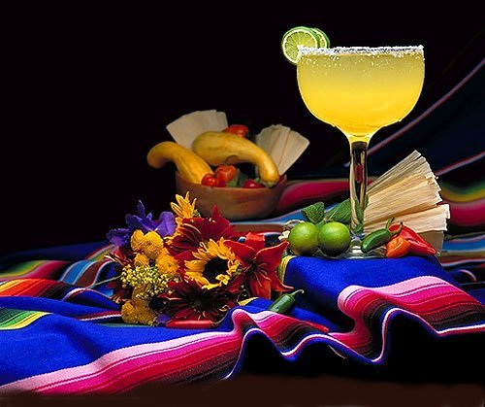
Food
Food

Slide 13
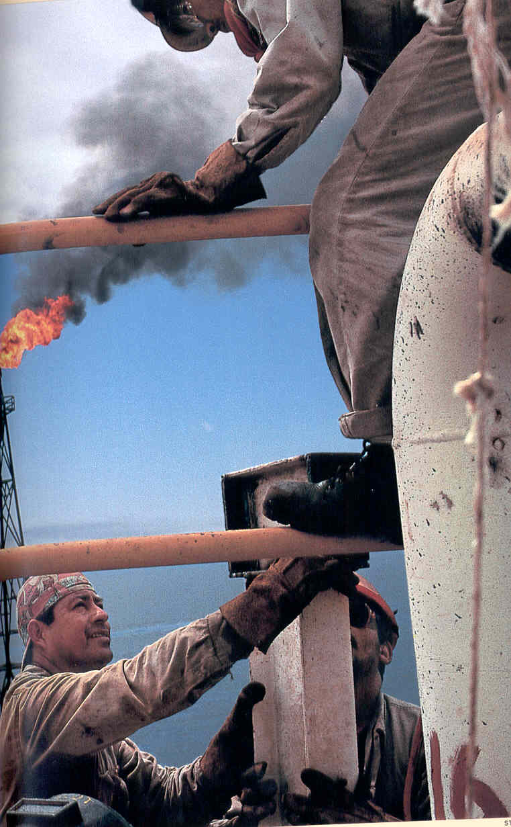
UNIQUE SUSCEPTIBILITIES
Language barriers
Adoption of a new lifestyle
High stress at work, school and in the social environment
New rules, regulations
Apprehension due to Legal status
Imagine yourself in other country

Slide 14
La Familia -The family-
Is the center of Hispanic Life
Strong ties
Direct Family
Extended Family
Support system
Based on strong religious beliefs

Slide 15
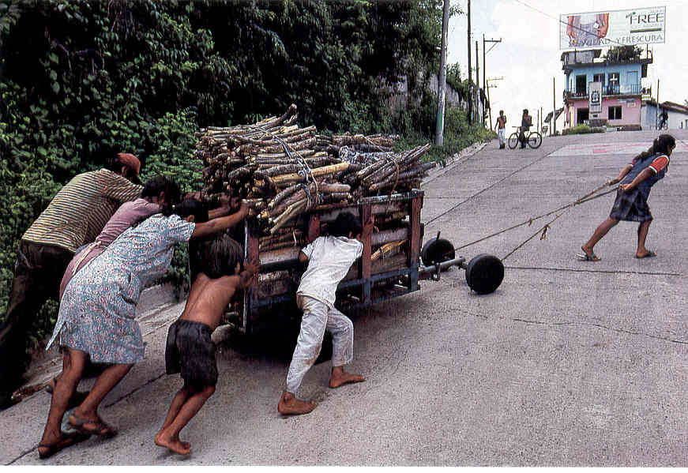
FAMILY
Mexico US
Family first priority Mostly, work first priority
Extended family Nuclear family
Children Sheltered Children independent
Parental control Parental involvement limited
Wife domestic role Wife dual role
Very limited mobility Mobility is common

Slide 16
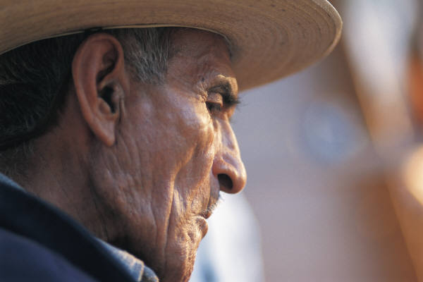
The father or oldest male (direct relative) holds the greatest power in most families and may make decisions for others in the family.
Work related-examples
Older person in the crew
Most seniority
Paternal figure

Slide 17
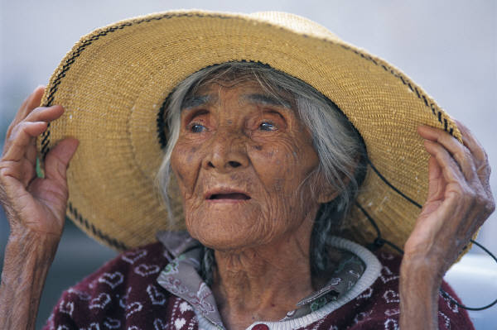
The woman is expected to be the primary force holding the family and home
primary caregiver and
responsible for most of the parenting.
Changing roles

Slide 18
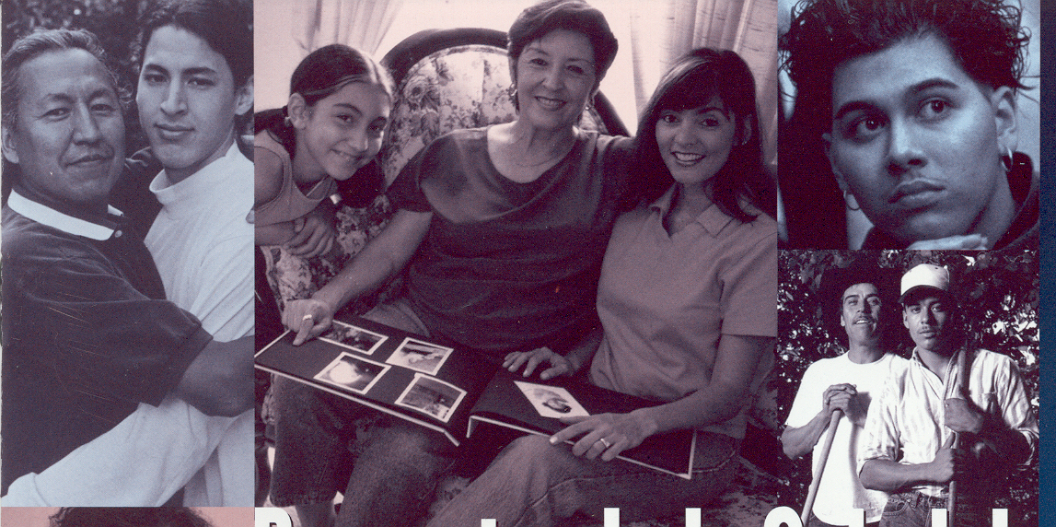
Individuals have a moral responsibility to aid family members who
experience financial problems, unemployment or poor health conditions.
Families gather together to celebrate holidays, birthdays, baptisms,
first communions, graduations and weddings.

Slide 19
Families instill in their children good manners and respect for authority and the elderly.
Families care for their ill, injured, disabled or aging relatives.
If traveling to another town or city, families stay with relatives.
For an outsider, it is the highest honor to be considered
“como de la familia” –like family-

Slide 20
Why is it important to know about
the family structure?
Consider
In many cases-family is thousands of miles away
Communicating-talking to their family is vital to them
Economic support for their families-sending money home

Slide 21
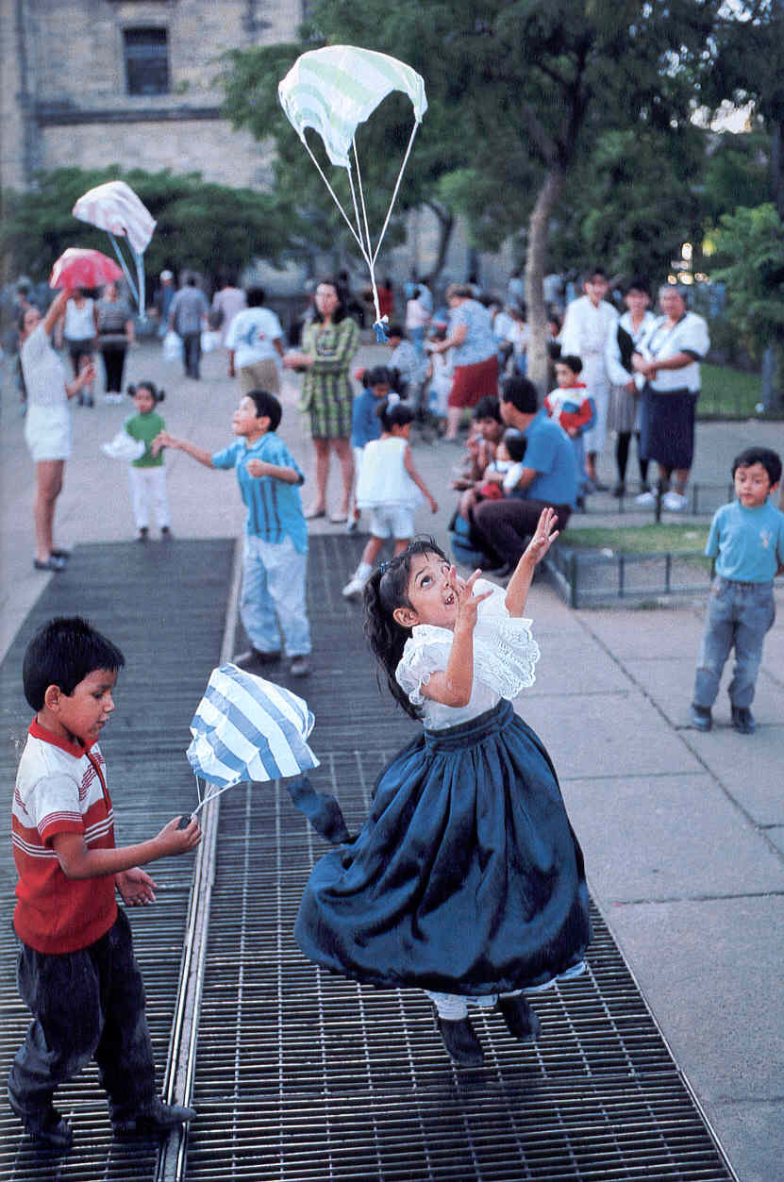
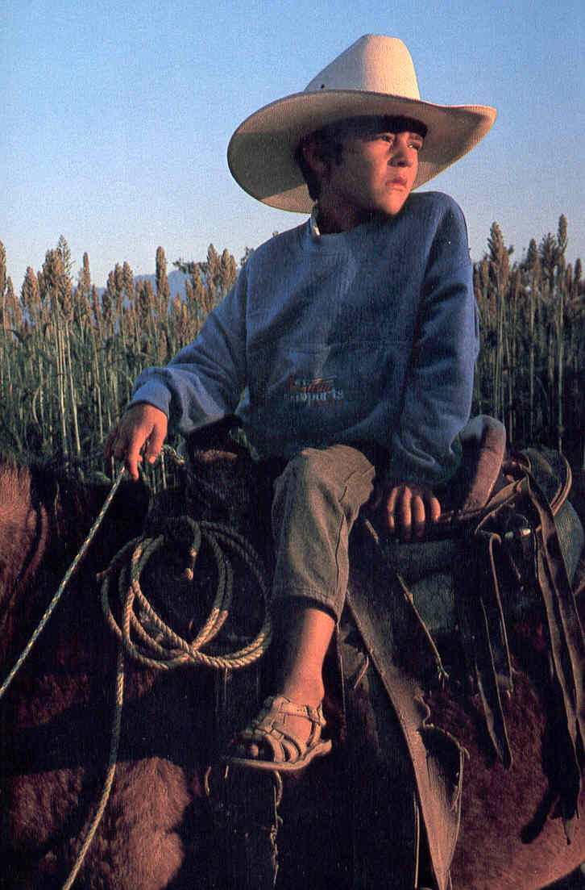
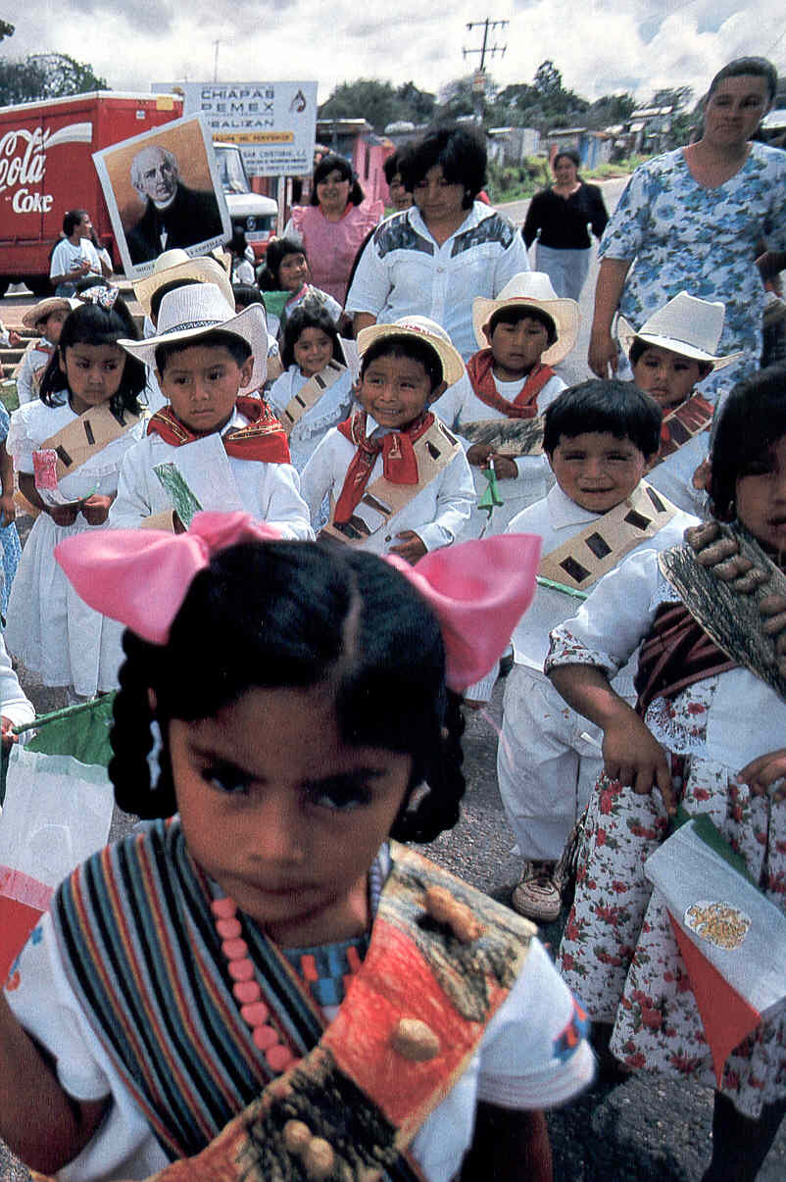
Sons/daughters the most
important

Slide 22
How to Maximize Communication, Trust, Relations
Be genuinely interested on them and family
Make it easier for them to communicate with their families
La tarjeta (the phone card)/El telefono (the phone)
Internet for younger people
Be interested in their families back home
Names, Town
Place a Map of country of origin, learn and talk about it

Slide 23
Investigate information on how, where, proper procedures,
for cashing a check, how to send money home
(in many cases they are subject to abuse)
El giro postal (postal money order)
Banks
Bring a Spanish-speaking bank employee to talk to them
Locate sources of community information in Spanish
(Yellow pages, newspapers, associations, churches)
Translate important company information (insurance, safety etc)

Slide 24
Avoid “la nostalgia”-homesickness- due to missing the family
Encourage a sport-(Soccer games, Baseball games)
Rent a movie
Use “persuasive” tactics positively in important issues such as
punctuality, safety, health, drugs, alcohol-using for example
“hazlo por tus hijos”
“Do it for your kids”
THE BOTTOM LINE

Slide 25
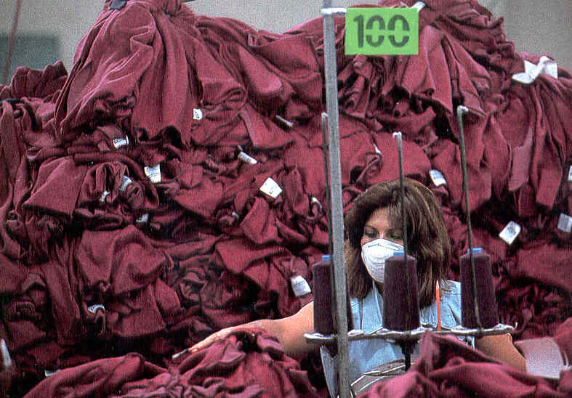
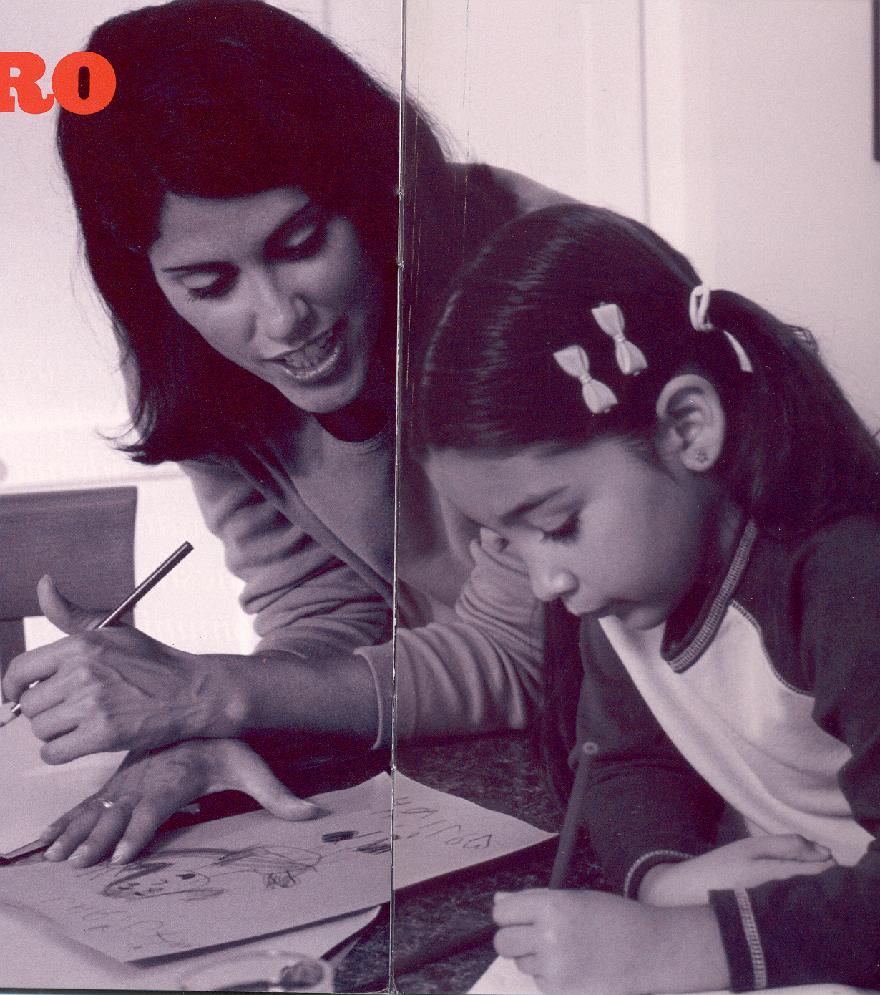
Authority roles
Gender roles
“Ask for permission”
Take inconsideration

Slide 26
Consider Gender Roles
Might be easier to have an elder person or a woman to talk
about health issues to them.
Women ( and Men) would fit better in designs (landscape)
monetary issues, administrative roles
If training women, it might be necessary to “ask for permission” of their husbands.

Slide 27
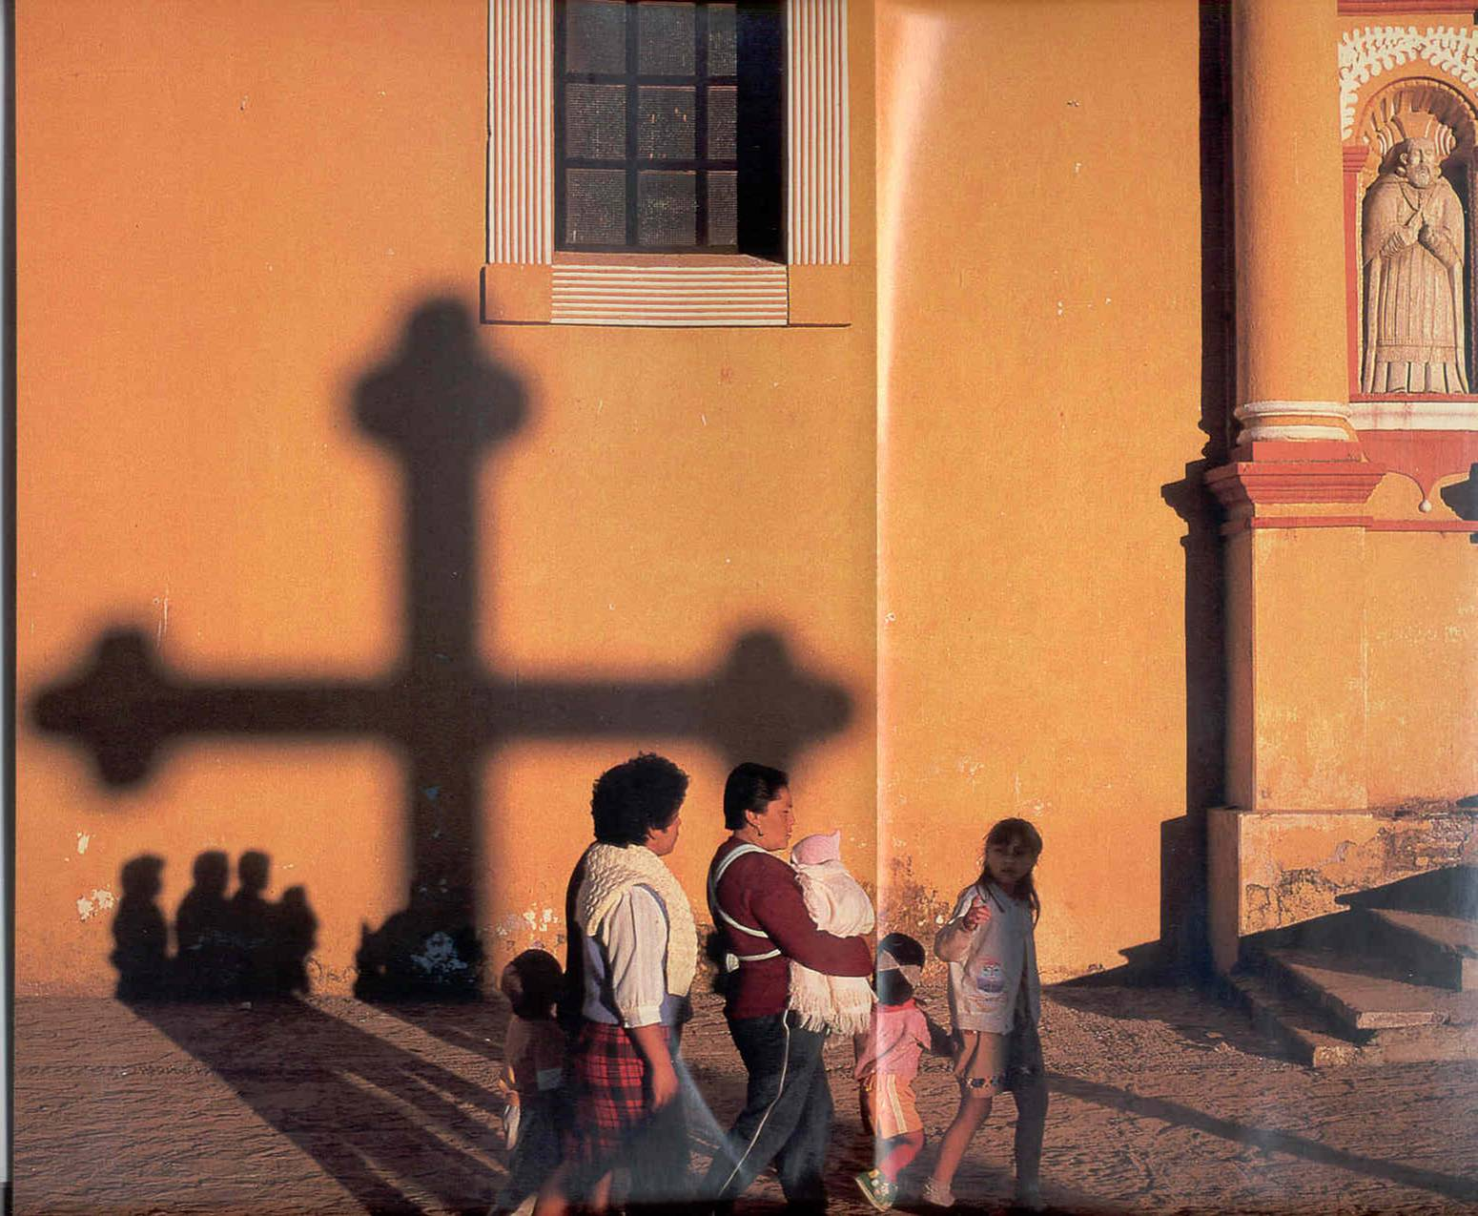
Religion
Traditionally has played
a significant role in the
Hispanic way of life
Faith in God plays a significant role on their behavior and perception
Catholicism 70-90% in Latin America
Other religions professed-Evangelical Christians, Main Protestant
Denominations (Methodist, Baptist, Jehovah’s Witness, Mormon, etc)
Mexicans=
Virgen de Guadalupe (Virgin Mary –Guadalupe)
December 12th (National Holiday)
Santa Claus vs Three Kings (January 6th )
Dia de los Muertos (Day of the Dead)/ Holy Week (March-April)

Slide 28
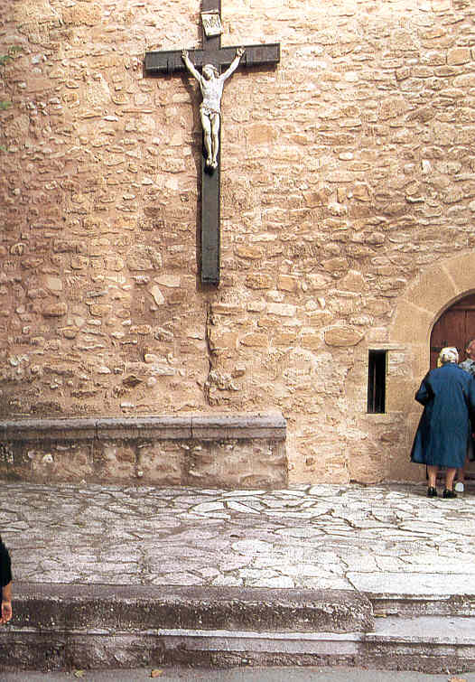
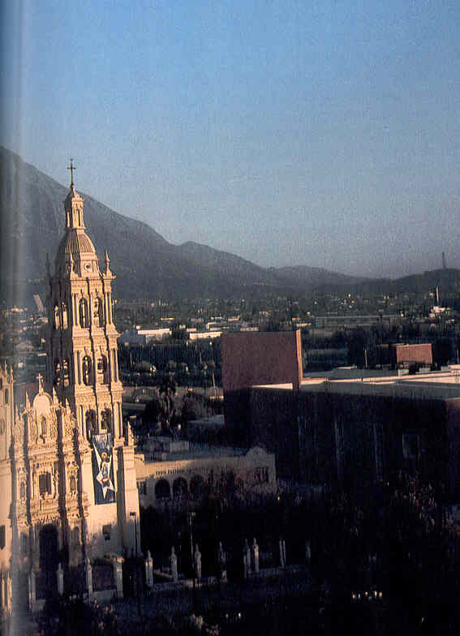
Unyielding Faith in God
Influences workplace in terms
of safety, goals and deadlines.
I will finish on time “si dios quiere” (if it is God’s will).
Expect as many kids as “GOD sends in”.
Que sea lo que dios quiera” I’m (safe, alive, etc) if god is willing (it has being termed “fatalism”).

Slide 29
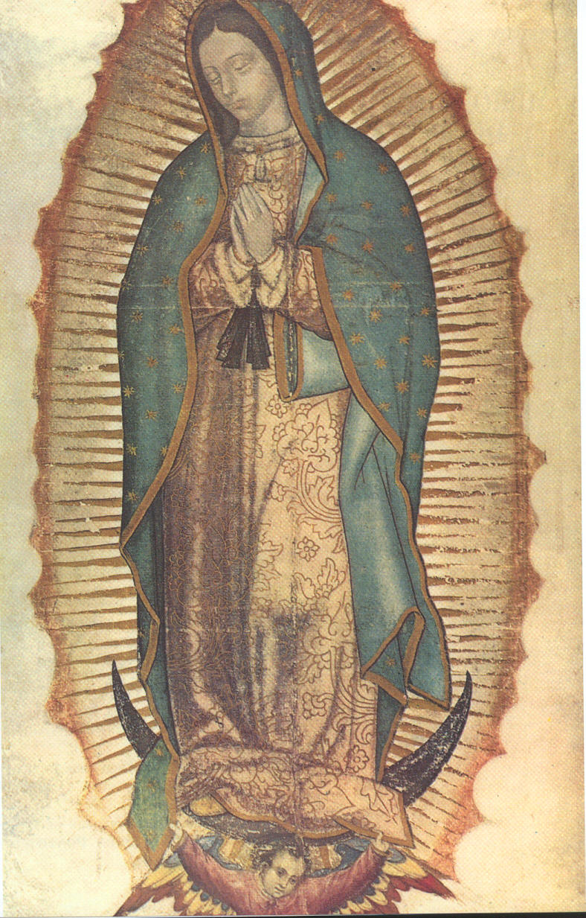
MEXICAN HOLIDAY
Virgen de Guadalupe (Virgin Mary –Guadalupe)
December 12th (National Holiday)

Slide 30
Church can be central to the life of the
family and community, can be important resources
in planning and delivering services.
Make available information on Church addresses and denominations, pastor names and groups of service.
When talking about safety, consider “the role of fatalism”.
There are church groups that offer help on several issues (English classes, support groups, etc).
Be informed about religious holidays in their countries.

Slide 31
COMMUNICATION
LIMITED ENGLISH LANGUAGE KNOWLEDGE
PRONUNCIATION
Consider:
Use of Gestures
Use of space
Time perception
Use a normal tone of voice. Watch your body
language. Hispanics who don't speak English fluently will listen and learn from the tone of voice used and body language.
Clear orders, Follow up questions (Not only did you do it, but
How you did it)

Slide 32
Education
Educational Background may
differ due to country of origin:
Costa Rica=0-1% illiteracy
Mexico= 15% illiteracy
(North Mexico vs South Mexico)
Honduras-El Salvador=15-40 %
illiteracy
Primary School (Elementary) 1-6th
Secondary School (Middle) 7-9th
Preparatory (High school) 10-12th

Slide 33
Notes:
Slide 16. Education
Based on memorization. Teacher has all the information
One textbook for the whole country, often outdated and not sufficient copies for each student. Teacher dictates the information

Slide 34
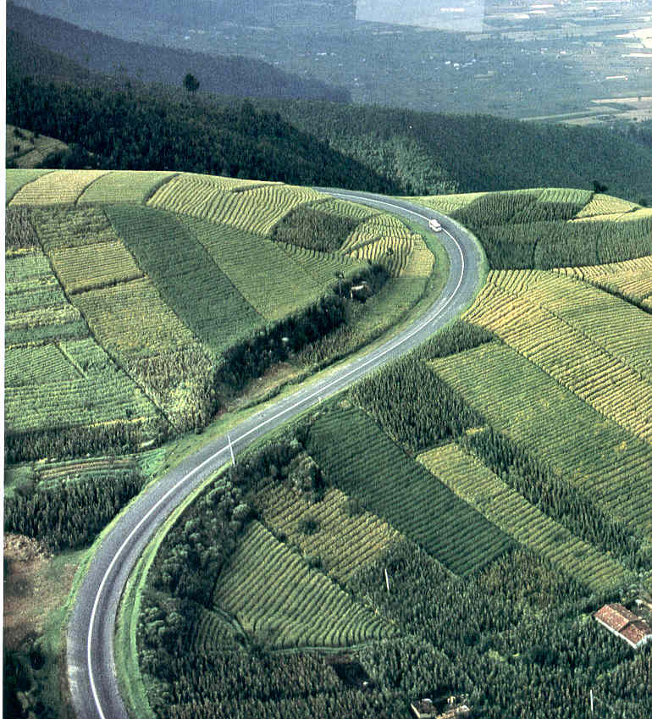
Regardless of their background and socio-economic status,
most of them value education highly.
In many countries students have to travel several miles to
get to school (access is difficult).
Teachers may have to teach two or three grades simultaneously.

Slide 35
Education for employees
Not an expense-it is an investment
Trainings (in Spanish if available while they are
learning English)
Eager to learn new methods
Build self esteem
Talk frankly about mistakes
Avoid to pressure to much to be used as example
Failing in front of others

Slide 36
What they value the most:
EDUCATION FOR THEIR SONS AND DAUGHTERS
Provide information about schools:
Schools with ESOL (English Secondary to
other Languages)
Requirements for enrollment
Where to get required immunizations
After-school programs
Special aid
Cafeteria requirements

Slide 37
Notes:
Slide 17. Management issues
Time: there is always plenty of time, “say yes but not when”
Fatalistic view of the future, men at the fate of nature/god
Competition: Latinos avoid personal competition in the work place. In the U.S. emotions and sentiments are not part of business. A superior’s public reprimand is not considered personal, just part of the daily work. Work can be criticized but not an employee personally. Not so in the Latino culture. Work criticism is taken personally. A public stern criticism for errors done during work can be very personal and serious. Often Latinos are considered “thin-skinned” because of their sensitivity to work criticism.
Delegation of authority is not a common practice. Supervisors do not delegate and subordinates wait for specific instructions. In the U.S; a take charge attitude is desired; make mistakes, correct them and move on.
Mobility and access to improvements in LA are very similar to the south. The good old boy system protects its members. Family and political connections lead to improvements and access to better jobs.

Slide 38
TIME MANAGEMENT
US
Time is money
Punctuality (reliable and efficiency)
Life controlled by the clock (business and pleasure)
Appointment book
Mexico
Time is relative –a suggestion-
A bit late is better, impolite to arrive very early
I will finish the job when I finish the job
Politeness over efficiency
Easygoing approach to life

Slide 39
Individualistic versus Group
US
Healthy competition, stimulus of competition
Competitive environment since childhood
Employee of the month, Teacher of the year, Most valuable player
Business need to bring people to advise to “team building”
“I” did vs “WE” did
Mexico
Group oriented
Loyalty to the group
Comes from extended families
Group is a “family”
LANDSCAPE COMPANY FORMING TEAMS

Slide 40
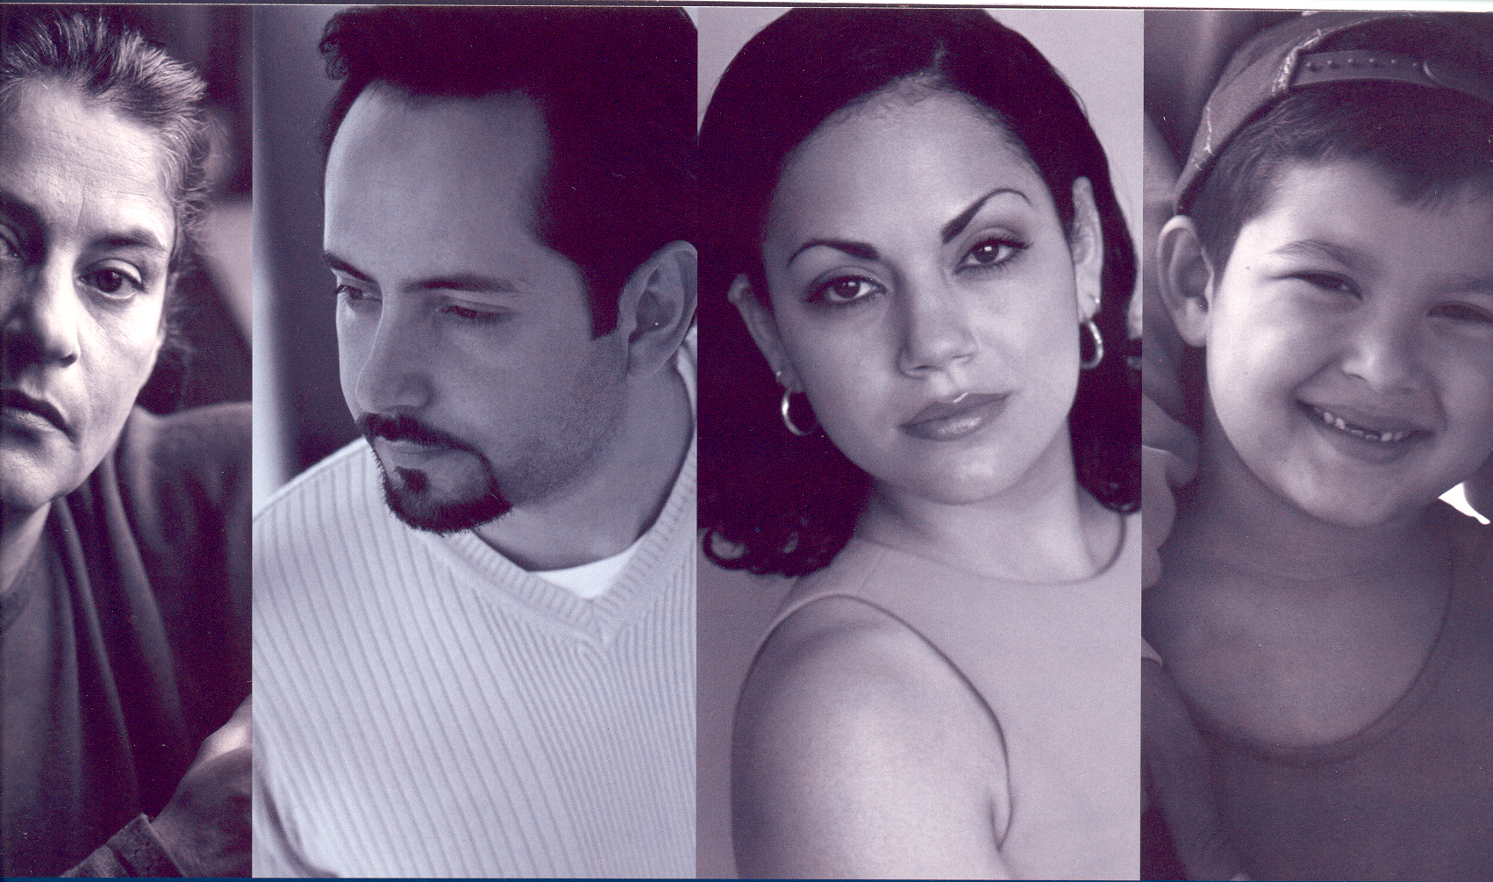
Health Issues
Health of a Hispanic worker
can be influenced by:
Level of education
Proximity to health care facilities
Poverty in their native country
May affect the current health status of many immigrants.
The Health System is very different in the US than in many Latin
American Countries.

Slide 41
Mexico's Health System has evolved into a combination of socialized and privatized medicine.
The Social Security institutions (43%), which include the Mexican Social Security Institute (IMSS) and the Social Security Institute for Government Employees (12.5% of income).
2. Secretary of Health (SSA), which provides the Public Health services.
The employees in the private sector and self-employed people are covered by IMSS, which is financed with contributions from employees, employers and the Federal Government.
3. Private Sector

Slide 42
HEALTH INSURANCE
FOREING CONCEPT
NOT AVAILABLE IN MOST CENTROAMERICAN COMPANIES AND
MEXICO
HARD CONCEPT TO UNDERSTAND
PAYING FOR A NON EXISTANT SERVICE
USE REAL LIFE EXAMPLES OF BENEFITS
EXPLAIN BENEFITS USING FAMILY MEMBERS

Slide 43
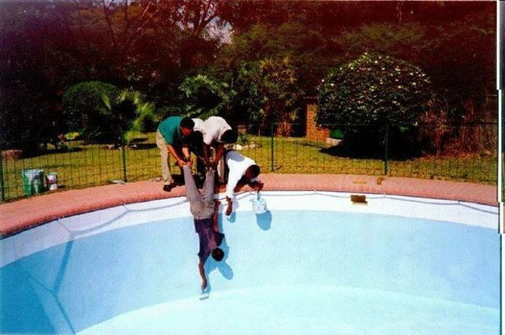
New cultural problems require creative solutions
Notes:
A new cultural problem requires creative solutions

Slide 44
You are a Latino if you…
1- use your lips to point something out
2- dance “merengue” and salsa without music
3- cannot imagine anyone not liking spicy food
4- are in a 4 passenger car with 8 people in it and someone is shouting, “Get in. There is room! You fit!
5- light a candle to the Virgin Mary on the night of a lotto drawing
6- mom packs your “lonchera” every day even though you just turned 32
7- don’t need any explanations; you know you are truly a Latino!!
Notes:
Slide 25. 10 ways to tell you are Latino
If you…
1- use your lips to point something out
2- dance “merengue” and salsa without music
3- have at least 30 cousins not including Julio working at McDonalds
4- cannot imagine anyone not liking hot sauce
5- are in a 4-passenger car with 8 people in it and someone is shouting “get in there is room! You fit!
6- call your sneakers “tenis”
7- rub “Vicks” all over your chest and nose whenever you feel under the weather
8- light a candle to the Virgin Mary on the night of a lotto drawing
9- mom packs your “lonchera” every day even though you just turned 32
10- don’t need any explanations, you know you are truly a Latino!!

