Slide 1
Notes:
1. UGA Logo

Slide 2
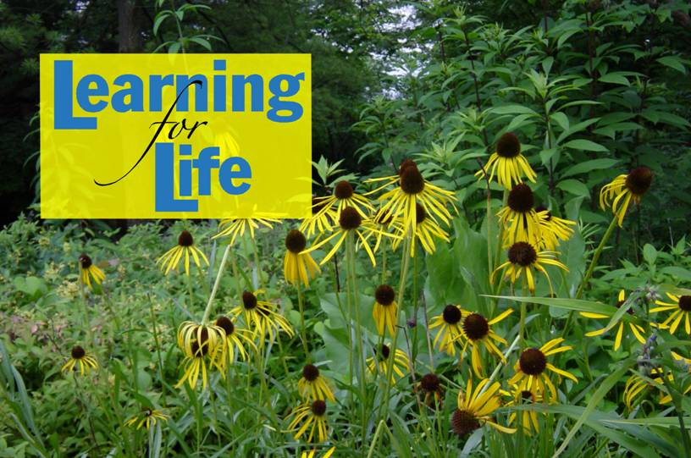
www.ugaextension.com
Notes:
2. UGA Cooperative Extension Web address

Slide 3
Notes:
3. Georgia Master Gardener Logo

Slide 4
Part 1: Diseases of Vegetables
J. Danny Gay
Extension Plant Pathologist
Adapted to PowerPoint by
George Boyhan
Extension Horticulturist
Notes:
Part 1: Diseases of Vegetables
J. Danny Gay, Extension Plant Pathologist
Adapted to PowerPoint by George Boyhan, Extension Horticulturist
For internal use only

Slide 5
Learning Objectives
General vegetable diseases
Specific diseases of vegetables
General insects of vegetables
Insect pests of specific vegetables

Slide 6
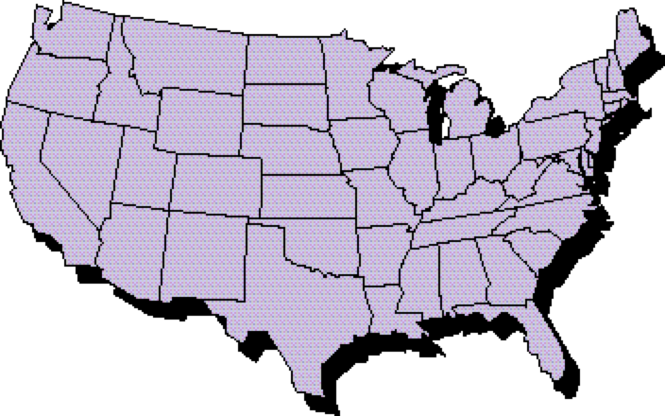
30,000 Diseases
On Economic Plants
In U.S.
Notes:
Plant Pathology is the study of plant diseases. There are over 30,000 diseases on economic plants in the United States.

Slide 7
CAUSES OF PLANT DISEASES
Unfavorable Growing Conditions.
Bacteria
Fungi
Viruses
Nematodes
Notes:
The causes of plant diseases are unfavorable growing conditions, bacteria, fungi and viruses. This presentation will include diseases caused by bacteria, fungi, viruses and nematodes. Unfavorable growing conditions will be mentioned, but emphasis will be placed on the major organisms causing plant diseases. There are three factors responsible for disease development. These are environment, hosts and causal agent

Slide 8
ENVIRONMENT
Notes:
Of the three factors, environment probably is most important. The most important factors associated with the environment are temperature and moisture.

Slide 9
CAUSAL
AGENT
Notes:
The causal agent is the pathogen, parasite or the cause of a plant disease. This can be the virus, nematode, bacteria or fungus.

Slide 10
HOST
Notes:
The third factor for disease development is a susceptible host. This is the plant which the disease is manifested.

Slide 11
causal agent
host
environment
Disease
Notes:
When these three factors merge, a disease will develop. By alternating any one of these factors, a disease can be prevented. If, for example, the temperature and moisture were changed drastically, a disease may not develop. A resistant host would prevent disease development, and of course, if there were no disease-causing organism present, a disease would not develop.

Slide 12
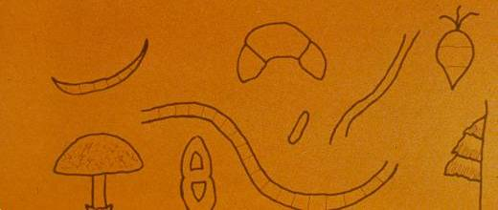
FUNGI
Simple plants that lack the ability
to produce their own food
Notes:
Fungi are simple plants that lack chlorophyll and thus lack the ability to produce their own food. Fungi are usually microscopic organisms; however, there are some fungi which are quite large such as mushrooms. Not all fungi are bad. We depend on penicillin, for example, to produce the antibiotic penicillin used by humans to prevent disease. Most fungi reproduce seed bodies called spores.

Slide 13
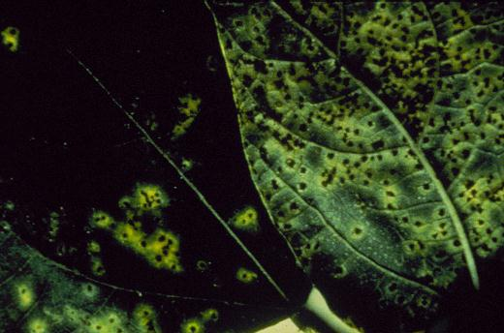
Bean Rust
Notes:
Fungi cause diseases affecting the roots of plants. They also cause diseases which affect the leaves of plants. A common fungus disease on snapbeans is known as bean rust. If left uncontrolled, this disease can defoliate the plant in a few days.

Slide 14
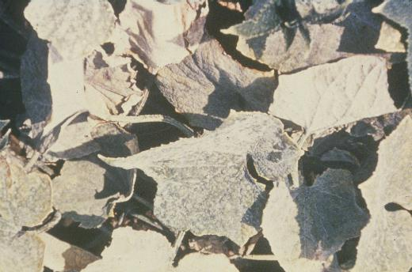
Powdery Mildew
Notes:
Powdery mildew fungus on cucumber.

Slide 15
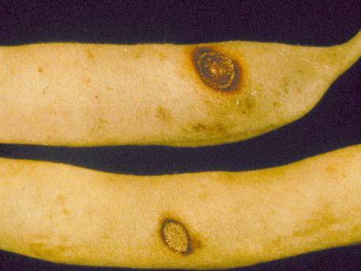
Anthracnose
Notes:
Fungi also affect the fruit of plants. Here is an example of anthracnose on snapbeans. A typical fungus disease affecting the fruits of vegetable plants.

Slide 16
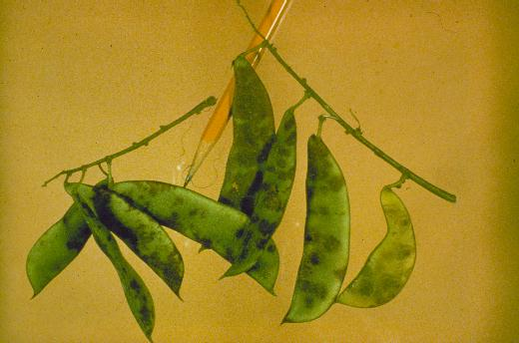
Lima Bean Anthracnose
Notes:
The most common disease associated with lima bean is lima bean anthracnose. The brick-red lesions on the outside of the pods, stems and the leaves causing abortion of the young fruit and discoloration of the resulting seeds inside.

Slide 17
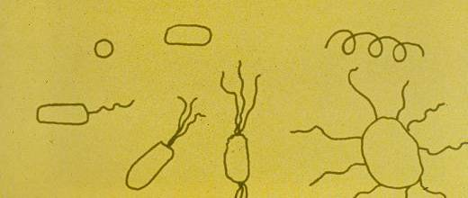
BACTERIA
Minute, one celled plants which lack
the ability to make their own food
Notes:
Another group of organisms responsible for disease are bacteria. These are one-celled organisms. Most vegetable diseases caused by bacteria are caused by rod-shaped bacteria. These bacteria vary in size and in shape. Some have flagella which enables the organism to move through aqueous solution. One characteristic diagnostic tool is the number of flagella associated with a particular Bacterium.

Slide 18
70 BILLION
BACTERIA
Ideal Conditions
12 hours
Notes:
Bacteria reproduce very rapidly. They are one-celled organisms and reproduce by simple cell division. Under ideal conditions, one Bacterium can develop to 70,000,000,000 bacteria cells in twelve hours.

Slide 19
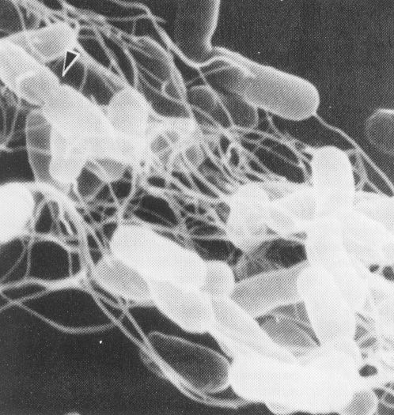
Notes:
This is a photomicrograph of a single bacterial cell showing the multiple flagella which enables the microorganism to move through an aqueous solution.

Slide 20
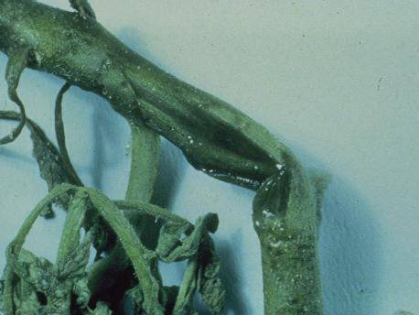
Bacterial Canker
Notes:
This is a tomato stem affected by a bacterial disease known as bacterial canker. Bacterial usually cause watery soft-rot type diseases, in many cases with a distinct odor.

Slide 21
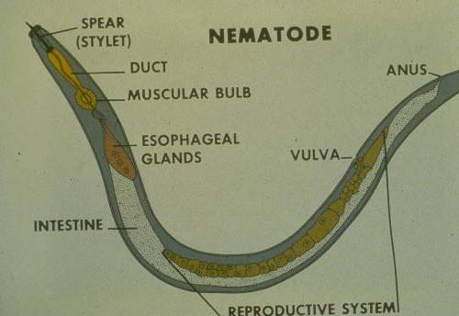
Notes:
The next group of organisms causing disease to be discussed are nematodes. Nematodes are small, ell-like worms which live in soil and feed on roots of plants. Not only do they impair the root system so the plant is unable to pick up water and nutrients, but causes avenues of entry for other diseases.

Slide 22
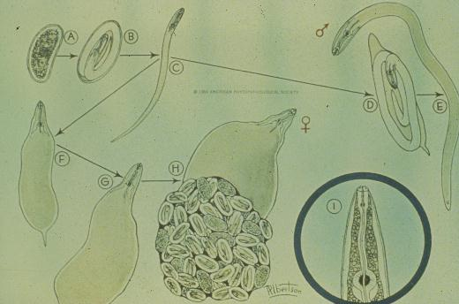
Notes:
The life-cycle of root-knot nematode shows the egg, four larval stages and the adult. The adult female is capable of laying four to five hundred eggs every thirty days under ideal conditions. Nematodes require a film of water around the bodies at all times. Note the gelatinous mass around the egg sac associated with the female nematode.

Slide 23
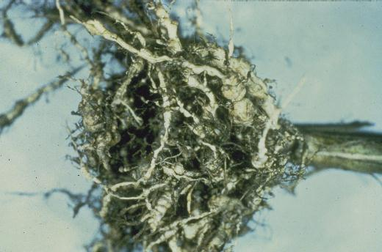
Root-knot Damage
Notes:
On okra plant showing serious root-knot damage. Note the physical damage done to the root system and also the avenue of entry for other diseases.

Slide 24
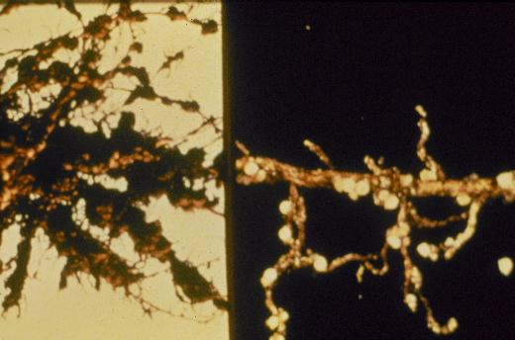
Cyst Nematodes
Notes:
This is a root system showing cyst nematode. Cyst nematodes affect only snapbeans and is a known pathogen of soybeans. This slide is to show the pearl-white nematodes associated with the root system.

Slide 25
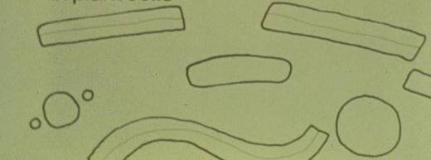
VIRUSES
Complex molecules that infect,
multiply, mutate, and otherwise act
like living organisms while living
in plant cells
Notes:
Viruses are complex molecules that multiply, mutate and act like living organisms while living in plant cells. They are sub-microscopic which requires the use of an electron microscope to view the particles. Virus particles come in various shapes - spirals, rods, cylindrical, and it has been theorized that a virus particle may have been the first living organism on earth.

Slide 26
Watermelon Mosaic Virus
Alton N. Sparks, Jr., The University of Georgia, www.insectimages.org
Notes:
This is a squash fruit infected with watermelon mosaic virus. Note the green, yellow, mottled effect along with the bumpy surfaces associated with the virus infection. This virus usually enters the squash plant by viruliferous aphids. Aphids are the number one vector of watermelon mosaic virus to squash plants. Other insect, like leaf miners, have been shown to transmit the squash virus.

Slide 27
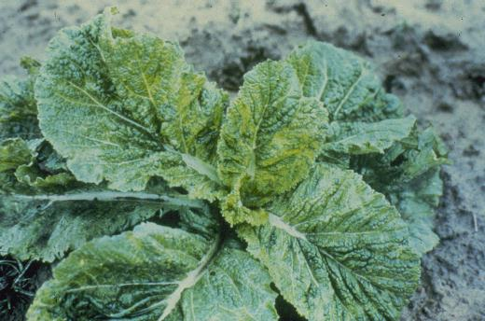
Turnip Mosaic Virus
Notes:
Turnip mosaic virus.

Slide 28
MOSAICS
NECROSIS
YELLOWS
CRINKLING
EXTERNAL SYMPTOMS
VEIN
BANDING
RINGSPOT
STREAKING
VEIN
CLEARING
Notes:
Typical symptoms of virus diseases include necrosis, crinkling, vein banding, vein clearings, streaking, ring spots, yellows and the most typical and most commonly observed is mosaic.

Slide 29
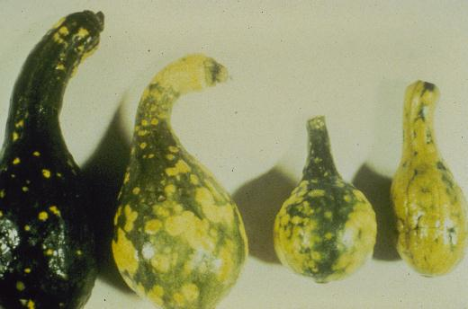
Notes:
This is a squash fruit infected with watermelon mosaic virus. Note the green, yellow, mottled effect along with the bumpy surfaces associated with the virus infection. This virus usually enters the squash plant by viruliferous aphids. Aphids are the number one vector of watermelon mosaic virus to squash plants. Other insect, like leaf miners, have been shown to transmit the squash virus.

Slide 30
VIRUS TRANSMISSION
MECHANICALLY
SEED
VECTORS (insects, etc.)
GRAFTING AND BUDDING
POLLEN
PARASITIC PLANTS
Notes:
Viruses are able to move from one location to another by mechanical means -that is, physically touching an infected plant, getting the particle on your hand and touching a new plant. This can be done by equipment or walking through a plant causing enough injury to acquire virus particles and transmit them to a healthy plant. Some seeds are infected with viruses. A good example of a seed-borne virus is the cowpea mosaic virus associated with knuckle-purple hull southern peas. Vectors such as aphids and leafhoppers are a primary source of infection and are able to transmit viruses from one plant to another. Otherwise, a virus can be transmitted. Some viruses are transmitted by pollen, while others are transmitted by parasitic plants such as dodder.

Slide 31
DO I HAVE A
NEMATODE
PROBLEM?
Notes:
To take a realistic look at diseases caused by root-knot nematodes, we will begin discussing root-knot nematode, diagnosis and control. It is necessary to establish if a root-knot problem exists. The best method to detect a root-knot problem is to observe the last year's planting and to take a soil sample for assay. The best date to take a nematode assay is during the months of July, August and September. During these months, nematode populations are highest and their recovery is more accurate.

Slide 32
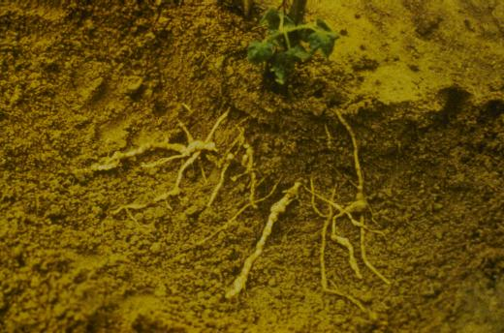
Notes:
A typical example of a root-knot infected plant is one which appears sick. Naturally, if this plant were pulled through the soil, many of the galled roots would be stripped off and the cause could be misdiagnosed. It is always wise to loosen the soil around a sick plant and observe the entire root system to determine if the roots are swollen from the root-knot nematode injury. Do not confuse swollen roots with the nitrogen-fixing nodules associated with legume plants like southern peas and lima beans.

Slide 33
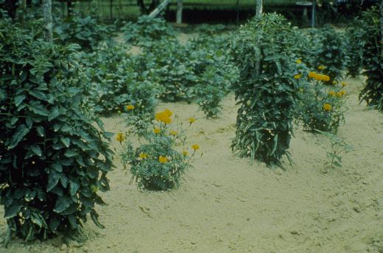
Notes:
It is generally agreed that marigolds do control nematodes; however, they do not control nematodes if planted alternated down the row or even in the same hole. The nematodes will feed on the susceptible root system and not feed on the marigold root system.

Slide 34
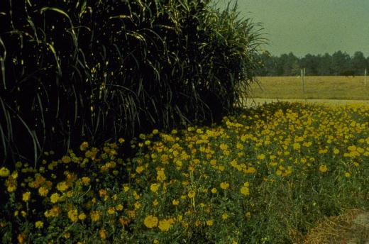
Notes:
The only method by which the nematodes can be controlled with marigolds is to plant them broadcast to a location. Marigolds should be planted in early Spring and left in the location until Fall, at which time they can be removed. The marigolds act as a trap crop. The best variety of marigold to use is the dwarf French marigold. Nematodes are best controlled by utilizing cultural practices along with nematicides. Cultural practices include repeat disking in the Fall during the hot, dry months where the nematodes are brought to the surface and killed by the hot, dry sun, using resistant varieties and removing old crop debris from the soil.

Slide 35
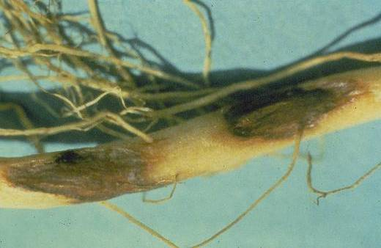
Rhizoctonia
Notes:
There are some diseases specific to snapbeans. Seedling diseases are a major problem in snapbean production. This is an example of a common seedling root-rot associated with snapbeans. This disease is Rhizoctonia. Note the red, sunken lesions in the lower stem of this snapbean seedling.

Slide 36
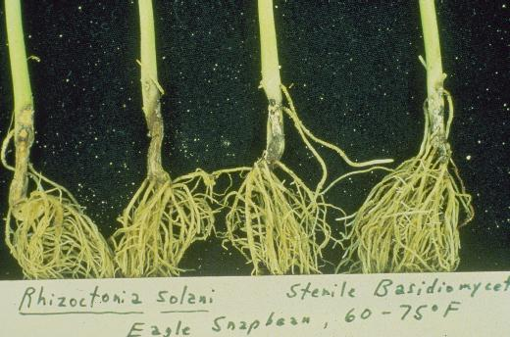
Notes:
Rhizoctonia causes very serious lower stem deterioration. Note the damage done to these bean seedlings by Rhizoctonia. The plants are unable to pick up moisture and nutrients due to the deterioration of the lower stem.

Slide 37
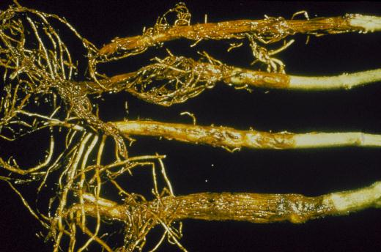
Notes:
Fusarium causes serious root-rot in snapbeans. There are many species of Fusarium in all soils. Usually, cool, wet conditions enhance Fusarium development.

Slide 38
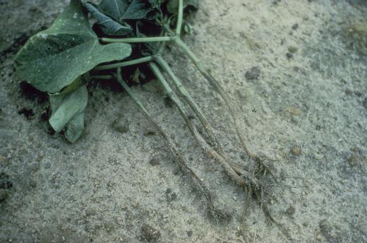
Pythium Damping-off
Notes:
There are some warm weather fungi that causes serious damping-off to snapbeans. This is an example of Pythium damping-off. In most cases, Pythium will attack a bean stand about ten days after emergence. Note the extensive water-soaked lesion extending up the bean seedlings caused by Pythium damage. In some cases, it has been practical to throw an inch of soil up on these stems to enhance the secondary root system which is necessary for plant survival.

Slide 39
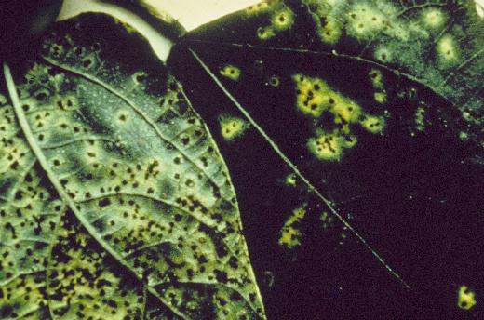
Notes:
The only foliage disease that causes major problems on beans in Georgia is bean rust. Bean rust begins as tiny, yellow spots on the leaves which later develop into pustules. Note the pustules which have erupted producing many seed bodies or spores capable of infecting new tissue without a resting period. This is about the only disease that can be observed and controlled after it has become established.

Slide 40
Bean Rust
Sulfur
Daconil 2787
Notes:
The best materials to use to protect against rust are Daconil 2787 or sulfur. Usually one or two applications will usually eliminate the problem under normal weather conditions

Slide 41
Stem Anthracnose
Symptoms
Leaves
Stems
Pods
Brick Red
Blotches
Notes:
Lima beans are a major garden crop in Georgia. The most serious disease attacking lima beans is stem anthracnose. It is characterized by the brick red blotches which appear on leaves.

Slide 42
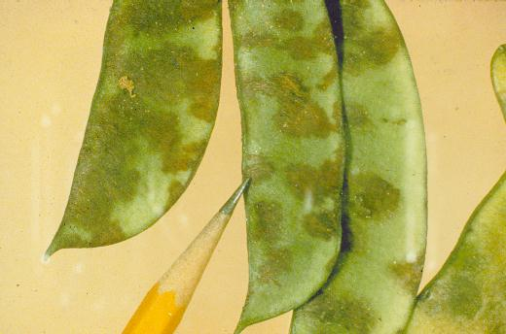
Notes:
Leaves, stems and fruits are affected by anthracnose. Once this disease progresses so that it can be seen, it is usually too late to prevent major damage. This disease occurs some 14 days before visible symptoms appear. Lima bean pods affected with anthracnose have brick-red lesions associated with the pod surface. In most cases the beans never survive to mature. However, if they do, the resulting seeds inside will also be discolored. Be sure that lima bean seeds are not saved from the home garden.

Slide 43
Anthracnose
Control
Western Grown Seed
Rotation
Notes:
Anthracnose is best controlled by prevention. If you have not seen the disease by the time the flowers appear, a preventive application of a recommended fungicide should be applied. Plant lima beans to an area that has not had lima beans the previous year. Purchase new western grown seeds and spray with copper (Top Cop).

Slide 44
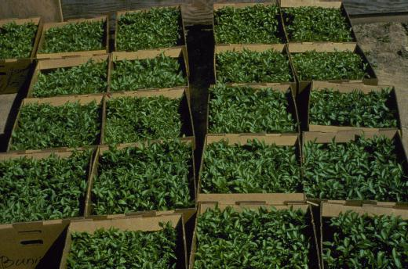
Notes:
Tomatoes are sometimes referred to as King of the Garden. Most successful tomato producers either grow their own transplants or purchase healthy disease-free certified transplants. Certified plants are identified by a label from the state of origin indicating certified transplants.

Slide 45
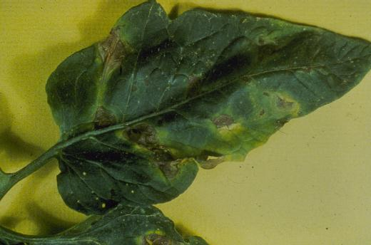
Early Blight
Notes:
A common disease of tomato is early blight. This disease usually starts on the lower leaves and works its way to the top of the plant if the plant is not protected by a fungicide. The disease is sometimes referred to as target-spot because of the concentric lesions produced on the leaves.

Slide 46
Early Blight
Daconil 2787
Maneb + Zinc
Notes:
Early blight is best prevented by using Maneb plus Zinc or Daconil 2787.

Slide 47
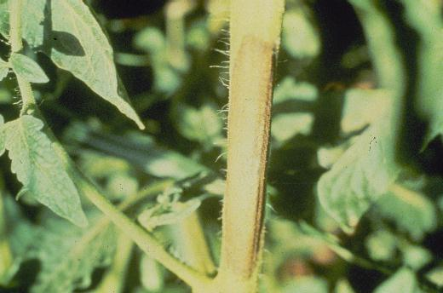
Alternaria
Notes:
Alternaria can also cause a more serious disease in young seedlings and young plants known as collar-rot. This is Alternaria, which affects the stems. The stems become brittle and often break off. This is a serious problem in Fall production since the seedlings are produced in warmer weather more conductive to attack by Alternaria. Make sure that young seedlings to be planted for Fall crops do not contain collar-spot lesions on the stems.

Slide 48
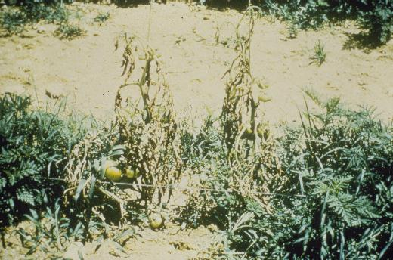
Notes:
Fusarium wilt is a major problem in tomatoes. To prevent Fusarium wilt, use varieties that have the letters VFN at the end of the name indicating Fusarium wilt/root-knot resistance. A typical tomato plant dying from Fusarium wilt. The disease clogs the vascular tissues of the plant thus restricting the amount of water and nutrients that can be transported to the top of the plant causing a slow death of the plant. Root injury caused by mechanical means or root-knot nematodes enhances Fusarium wilt development in tomatoes.

Slide 49
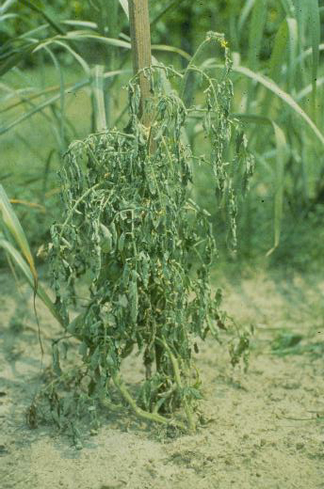
Bacterial wilt
Notes:
A more serious disease of tomato is known as bacterial wilt. Bacterial wilt can not be controlled once it enters the garden site. The plants appear as if hot water has been poured on the plant because of the sudden wilt. The plant does not turn yellow as in the case of Fusarium. The whole green plant simply wilts as a result of stem deterioration. Once bacterial wilt enters the garden site, it remains there for years. There is no effective control for bacterial wilt in tomatoes. The only method of preventing it is to never acquire plants or infect the garden site by walking in areas where bacterial wilt plants exist.

Slide 50
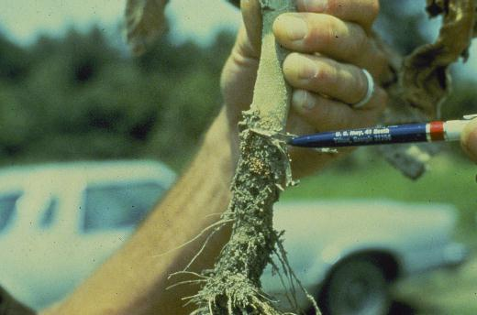
Southern blight
Notes:
Southern blight caused by Sclerotium rolfsii is a major problem on egg plants, peppers and tomatoes. Southern blight is an oxygen-loving fungus which operates on organic matter near the soil surface. It always attacks plants at or just below soil surface because of the oxygen requirement. One method of preventing southern blight is to destroy the litter by turning it deeply and not allowing it to resurface during future cultivations.

Slide 51
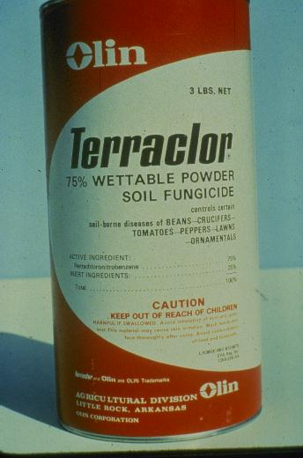
Notes:
One effective chemical for controlling southern blight in tomato is Terraclor. It is purchased in a 3 lb. container. Mix 3-5 pounds of Terraclor per 100 gallons of water. Use 1 pint of the solution when transplants are planted. This will prevent southern blight. Be careful not to throw excessive soil up on the stems as non-treated contaminated soil can enhance southern blight development.

Slide 52
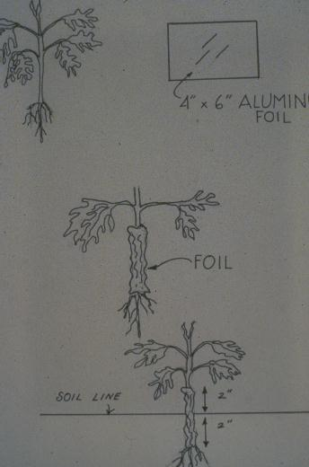
Notes:
For those wishing not to use chemicals, an effective method of preventing southern blight is the use of aluminum foil.

Slide 53
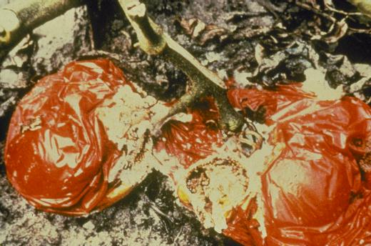
Notes:
Fruit rots cause major problems in home gardens and commercial fields in Georgia. The best method of preventing fruit rot is to prevent this fruit from touching the soil.

Slide 54
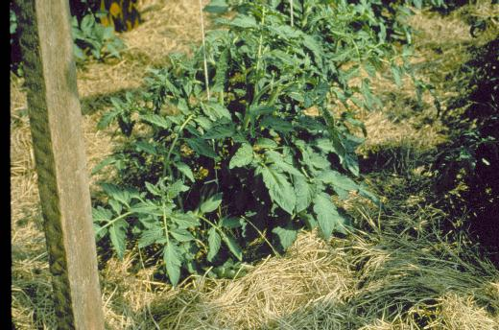
Notes:
The best method of preventing fruit from touching the soil is to stake the plants and use a mulch. The best mulch to use is pine straw. It is clean and disease-free. The pine straw mulch does things other than create a buffer between the fruit and the soil. It conserves moisture, moderates soil temperature, and helps control weeks. It also aids in reducing early blight infections.

Slide 55
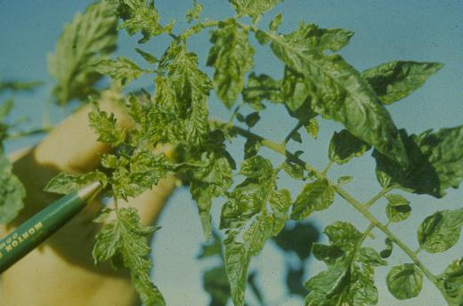
Tobacco Mosaic Virus
Notes:
Tobacco mosaic virus is a serious problem in tomato. It is acquired by insect transmission and largely by handling any form of tobacco and then touching the plants. Be sure not to use tobacco which transplanting tomato plants. If one uses tobacco, it is wise to dip his hands in sweet milk or use a strong detergent on his hands before touching the tomato transplant after using any form of tobacco.

Slide 56
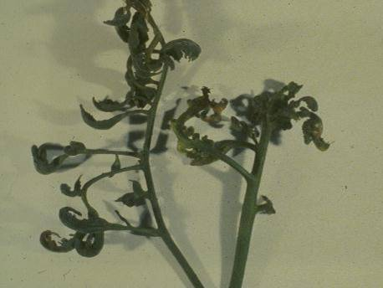
Cucumber Mosaic Virus
Notes:
Cucumber mosaic virus can look identical to a common problem known as 2,4-D injury. This plant is suffering from cucumber mosaic virus injury. It is wise to pull these plants from the garden site. Do not touch other plants after touching this plant as the disease can be transmitted. Insects also can feed on a cucumber mosaic infected plant and transmit the problem to a healthy plant. Plant removal is essential in the case of cucumber mosaic infection.

Slide 57
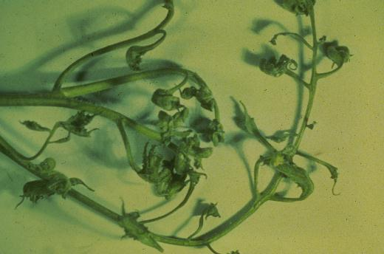
2,4-D Injury
Notes:
This problem is almost indistinguishable from cucumber mosaic virus; however, it is 2,4-D injury. This occurs in many urban areas in the Spring when people are spraying 2,4-D type materials to control broadleaf weeds in lawns. Be careful to spray for broadleaf when the air movement is at a minimum.

Slide 58
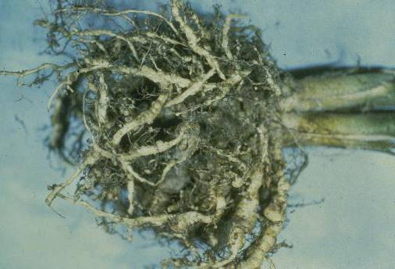
Root-knot Nematode
Notes:
Okra is a favorite of home gardeners. There are a couple of diseases which can affect okra. A major disease affecting okra is root-knot nematode. The plant is a long-lived crop. It grows from Spring until frost, thus providing a good food base for root-knot nematodes if they are in the area. Root-knot nematodes do serious damage to okra plants. In addition to limiting the ability to pick up water nutrients, they cause a disease to get into the plant known as Fusarium wilt.

Slide 59
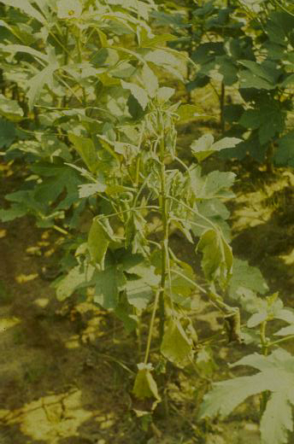
Fusarium wilt
Notes:
An okra plant suffering from Fusarium wilt. Note the similarity between the death of this plant and the Fusarium wilt in tomato. It causes a chronic slow death because of the stopped-up vascular system necessary for transporting water and nutrients.

Slide 60
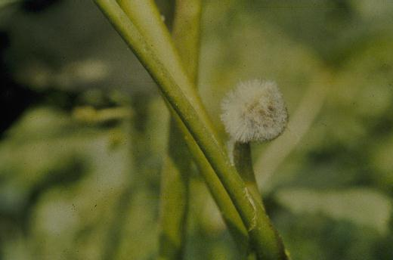
Choanephora Pod Blight
Notes:
There is a problem associated with some okra pods known as Choanephora pod blight. This fungus is common to most areas and will cause blight on old blossoms and young fruit under ideal weather conditions. This disease is usually associated with warm, humid conditions and is sometimes growing on pods which were never fertilized. In some cases, okra blooms will open during a rainy period and the water inside the bloom interferes with complete pollination, thus causing the ovules to not expand and ultimate abortion of the young pod. If the young pod does not fall off, then the bearded type fungus will grow on that as a result of the lack of pod expansion and normal growth.

Slide 61
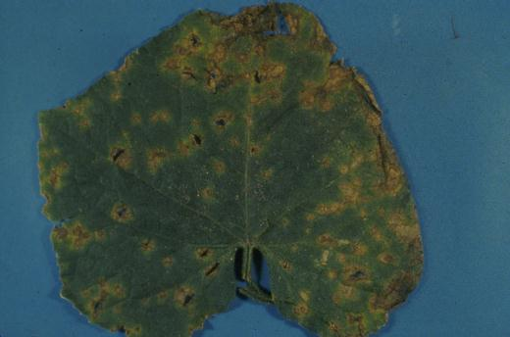
Anthracnose
Notes:
Cucumbers are susceptible to a number of foliage and root diseases that can reduce the quality of home garden-grown cucumbers. A foliage disease affecting cucumber that can be devastating is Anthracnose. Anthracnose causes spots on the leaves with characteristic star-shaped splits associated with older spots.

Slide 62
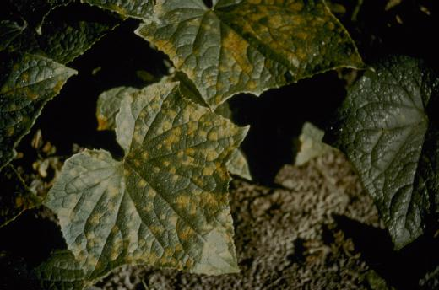
Downy mildew
Notes:
Downy mildew is a common problem to cucumbers. Some varieties carry down mildew-resistance. Downy mildew is a fungus disease that attacks the underneath side of the leaf. Control measures include good coverage of both upper and lower surfaces of leaf tissues.

Slide 63
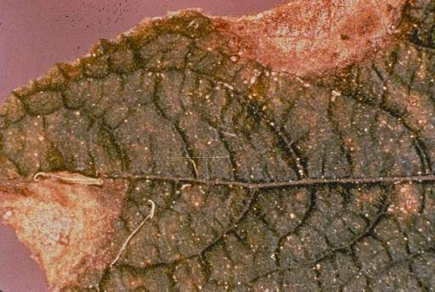
Gummy Stem Blight
Notes:
Gummy stem blight can be a major problem and can be seed-borne. Therefore, it is necessary to get new western-grown seeds each year. Gummy stem blight causes leaf spots and runner wilting of cucumbers.

Slide 64
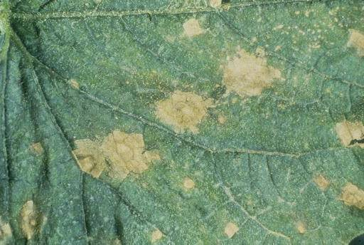
Target-spot
Notes:
Target-spot is a sporadic disease of cucumber causing leaf spot and leaf deterioration. Target-spot is caused by Corynespora and can be devastating in cool, moist weather. Most cucumber diseases affecting the foliage of leaves are enhanced by cool, moist weather conditions

Slide 65
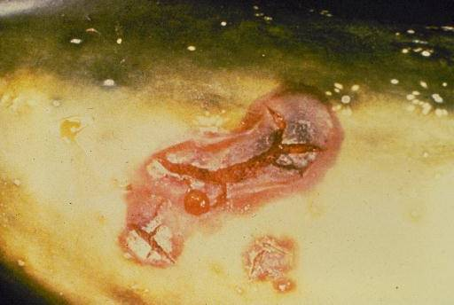
Belly-rot
Notes:
A common fruit-rot on cucumber is referred to as belly-rot. The underneath side of the fruit deteriorates where it contacts the soil surface. Soil fungi like Pythium, Rhizoctonia and southern blight, as well as Fusarium, may cause lesions on the lower side of cucumbers when the fruit is allowed to touch infested, moist soil.

Slide 66
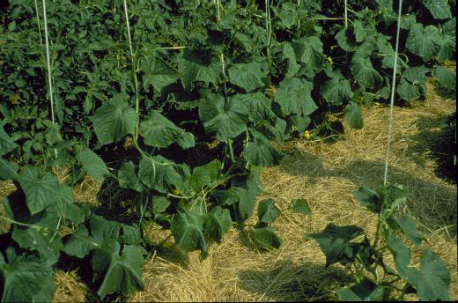
Notes:
The best method of preventing fruit-rots in cucumbers is to trellis the cucumber and mulch underneath the plant. This has proven to be a very effective method for producing cucumbers, both commercially and in home gardens.

Slide 67
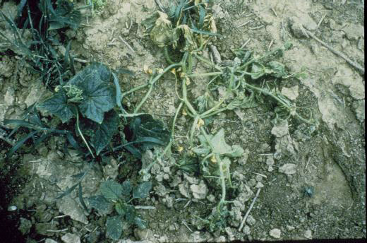
Bacterial Wilt
Notes:
Bacterial wilt is a disease which causes ultimate death of the entire plant. Bacterial wilt is caused by a Bacterium which is spread by the spotted and stripped cucumber beetle. Beetle activity is usually worse in early spring in cool weather. The only control for bacterial wilt is to control the spotted and stripped cucumber beetles. The bacterial wilt affecting tomatoes does not affect cucumber. It is a different Bacterium.

Slide 68
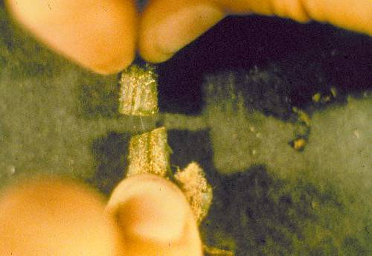
Notes:
To diagnose bacterial wilt in cucumber, cut a section of diseased or wilted stem, stick the two ends together and note - after repeated contact - a gummy, webby exudate will occur. Contrast this to a healthy stem which appears to be water-like and will not develop the webby exudate.

Slide 69
Powdery mildew
Notes:
One of the most common foliage diseases of squash is powdery and downy mildew. Powdery mildew looks like talcum powder dusted on the leaf surface and if left uncontrolled, will cause leaf necrosis and destruction.

Slide 70
Squash Mosaic
Notes:
The most devastating disease affecting squash in Georgia is known as squash mosaic. Note the mottle in these squash leaves. The virus enters the squash by vectors. Do not plant squash plants close to watermelon, gourd or pumpkin. It is much more difficult to prevent squash mosaic in the Fall due to the viruliferous insect population, primarily the aphid.

Slide 71
Viruses Spread by
Seedborne
Tobacco
Insects
Notes:
All fruits produced by virus-infected squash appear green and yellow mottled and, in some cases, distorted with bumps.

Slide 72
Notes:
Viruses are spread by insects in seeds and using tobacco. Squash mosaic virus is not normally seed-borne. The major viruses in Georgia in squash are watermelon mosaic virus and zucchini yellow mosaic virus and are not seed-borne in squash. Be sure to purchase virus-free western grown squash to prevent mosaic and to control insects.

Slide 73
Mosaic Virus
Notes:
Southern peas are an all-time favorite of home gardeners. The most devastating disease affecting home garden production of southern peas is mosaic virus. There are several viruses affecting peas. The virus shown here is cowpea mosaic virus which is a seed-borne virus.

Slide 74
Cowpea Mosaic Virus & Southern Bean Mosaic Virus
Notes:
One or more viruses may infect southern peas. This is an example of cowpea mosaic virus in combination with southern bean mosaic virus. Note that the symptoms are much worse with multiple infections.

Slide 75
Notes:
There is a virus-resistant southern pea on the market. It is called Worthmore. These pods are purple at maturity and an average of 18 seeds per pod. The peas are a semi-crowder; in fact, the pea inside appears very much like the seeds of Mississippi Silver.

Slide 76
Downy Mildew
Notes:
There are serious diseases affecting leafy greens including turnips and mustards and collards. A major disease affecting the leafy green crops is downy mildew. Here you see the downy mildew fungus on the underneath side of the leaf. Turnips grow upright, very dense, and since it is very difficult to get fungicide underneath the leaves, it is necessary to prevent this disease rather than try to eradicate it once it is established.

Slide 77
Cercospora leafspot
Pale-spot
Anthracnose
Notes:
Other diseases affecting the quality of leafy greens is: the extreme right -anthracnose with the characteristic star-shaped split. The center leaf is infected with pale-spot and the left leaf is infected with Cercospora leafspot. Top Cop may be used to help control these diseases.

Slide 78
Crater-rot
Notes:
Irish potatoes are one of the first vegetables planted in the home garden. Since Irish potatoes are planted early, usually in cold, wet soil, seed pieces need to be treated to prevent damage. There are several cultural practices used to reduce Irish potato diseases. Crater-rot is a common problem of Irish potatoes. Crater-rot can be reduced by planting Irish potatoes in areas where limited organic matter exists. Crater-rot causes the classic craters shown on this Irish potato.

Slide 79
Part 2: Vegetable Insects
Burton R. Evans
Extension Entomologist
Adapted to PowerPoint
George E. Boyhan
Extension Horticulturist

Slide 80
Notes:
Insect pests are capable of destroying every kind of vegetable grown in the home garden. Vegetables may be completely ruined or their cosmetic appearance may be reduced. Stand reductions, foliage loss, yield reductions, reduced pod set, pod drop and fruit rots are but a few examples of insect damage to garden vegetables.

Slide 81
Preventive Insecticide Treatments
Notes:
Preventive Insecticide Treatments. For most insect pests, preventive treatment of vegetables with insecticides is not recommended. Most insect pests can be detected early enough to take corrective measures before serious damage results. There are, however, some exceptions. The cowpea curculio, a pest of Southern peas, is one exception. This pest enters stands of peas at first bloom and is difficult to detect in time to prevent serious damage to pods. A similar preventive program is needed for control of soil insect pests which attack sweet potatoes. Early pest detection is difficult if the edible portion of the vegetable, which is being attacked by pests is below ground. Preventive insecticide treatments are often good insurance for protection of root crops from certain soil insects.

Slide 82
Extension
Publications
Notes:
Specific insecticide recommendations for home garden vegetables in Georgia are listed the Homeowner Edition of the Georgia Pest Management Handbook.

Slide 83
Pests
Damage
Identification
Control
Notes:
Pests - Damage, Identification and Control

Slide 84
General Pests
Notes:
General pests of garden vegetables.

Slide 85
Corn Earworm
Clemson University - USDA Cooperative Extension Slide Series, , www.insectimages.org
Notes:
Fully grown corn earworm (tomato fruitworm) larvae are up to 1 3/4 inches long; variable in color from light green to pink to brown to nearly black marked with alternating light and dark stripes running lengthwise on the body. The head is yellow and unspotted.

Slide 86
Corn earworms
Alton N. Sparks, Jr., The University of Georgia, www.insectimages.org
Notes:
Corn earworms will feed on a wide range of vegetables including beans, peas, sweet corn, okra, tomatoes, cabbage, eggplant and pepper.

Slide 87
Corn earworms
Notes:
On sweet corn, earworms chew buds and leaves in the whorl resulting in large ragged holes as the leaves unfold and may cause plants to be stunted.

Slide 88
Notes:
They later feed on the silks and kernels from the tip of the ear downward. There is seldom more than one corn earworm found in each ear since they are cannibalistic.

Slide 89
Tomato Fruitworm/Corn Earworm
Notes:
On tomatoes, corn earworms chew holes in leaves, blossoms and fruit. The larva is rather restless and may feed on several fruits causing them to rot.

Slide 90
Aphids
Notes:
Aphids (Plant lice)

Slide 91
Aphids
Notes:
Aphids are small, soft-bodied, yellow or pale green to black insects about 1/8 inch long with two tail pipes (cornicles). These pests begin damaging vegetables early in the spring when colonies or clusters can be found near growing points and under leaves. They may be found throughout the entire growing season.

Slide 92
Aphids
John A. Weidhass, Virginia Polytechnic Institute and State University, www.insectimages.org
Notes:
Adults and young suck plant juices; leaves thicken, wrinkle and turn yellow or brown, small plants may be severely weakened or killed. Aphids also vector (carry) plant viruses from diseases to healthy plants.

Slide 93
Spider mites
Notes:
Spider mites are tiny (barely visible) red, orange, yellow or green pests that suck juices from the undersides of leaves. As large populations develop during hot, dry weather, leaves of infested plants become covered with fine webs resembling spider webs. Cool weather spider mites are often Southern Red Spider Mite and warmer dry weather usually brings the Two Spotted Spider Mite.

Slide 94
Spider mite damage
Notes:
Spider mite damage: In periods of dry, hot weather, the leaves of beans and other vegetables become blotched with white or pale yellow to brown spots ranging from small specks to large areas. This damage results when mites withdraw plant juices.

Slide 95
Stink Bug
Notes:
Southern Green Stink Bug - Adult stink bugs are shield-shaped, flat, bright green insects about 5/8 inch long with wings and a narrow head. When crushed, stink bugs give off a foul odor.

Slide 96
Stink Bug
Notes:
The young or nymphs resemble the adults in shape but are somewhat more rounded than shield-shaped. Nymphs are wingless and green-orange and black in color.

Slide 97
Stink Bug Damage
Okra pods
Notes:
Characteristic damage to fruit varies with type of vegetable. On lima beans, there is little evidence of feeding on outside of pods but when stink bug damaged beans are removed from within they are shriveled and spotted with slick brown stains. Okra pods damaged by stink bugs become distorted with wart-like growths or pimples where feeding occurs.

Slide 98
Stink Bug Damage
Notes:
The fruit of tomatoes express signs of stink bug feeding as white spots on immature fruit and whitish yellow spots on mature (red) fruit.

Slide 99
Flea Beetles
Notes:
Flea beetles are very small, black, or striped shiny insects 1/16 to 1/8 inch long. These pests jump readily when disturbed. They will feed on the leaves of potato, tomato, pepper, eggplant, greens, and others.

Slide 100
Flea Beetles
Notes:
Injury to vegetables by flea beetles consists of very small, rounded or irregular holes eaten in leaves. Feeding usually results in a shot-hole appearance in leaves. This picture is of old damage; the tiny holes get larger as the leaf continues to grow.

Slide 101
Beans and Peas
Notes:
Insect Pests of Specific Vegetable Crops: Beans and Peas

Slide 102
Cowpea Curculio
Notes:
The Cowpea Curculio is a black, hump-backed, hardshelled beetle, nearly 1/4 inch long, with a slender snout and prominent round punctures (dimples) on the back. Larva - whitish, legless grub inside the pods.

Slide 103
Cowpea Curculio Damage
Notes:
Adults cause black wart-like stings on surface of pods by feeding and egg-laying activities.

Slide 104
Cowpea Curculio Damage
Notes:
Larvae develop from eggs deposited inside pods.

Slide 105
Mexican Bean
Beetles
Notes:
The Mexican bean beetle is a coppery-brown rounded beetle about 1/4 inch long, with sixteen black spots on the back. Adult spends the winter in rubbish and weeds. Young - yellowish, soft-bodied and fuzzy. Clusters of yellow eggs are laid under the leaves.

Slide 106
Mexican Bean Beetles
Notes:
Leaves appear lacy from adults and young chewing on the undersides.

Slide 107
Lesser Cornstalk Borers
Notes:
Lesser Cornstalk Borers are slender, bluish-green, brown-striped caterpillars about 3/4 inch long when full grown. These larvae are often found associated with silken tubes beginning at the soil line. Stand reduction may occur from plant death as a result of larvae boring into stems. Damage is more severe on dry, sandy soil.

Slide 108
Thrips
Notes:
Thrips – Adults are extremely small (1/25 inch long); yellow or brown winged insects that are very active. Nymphs are similar to adults but smaller and wingless. Thrips often feed on weeds in and around the garden.

Slide 109
Thrip damage
Notes:
Adults and larvae suck plant juices and cause whitish blotches and distortion of the leaf.

Slide 110
Cucumbers, Melons, Squash and Pumpkins

Slide 111
Spotted Cucumber Beetle
Alton N. Sparks, Jr., The University of Georgia, www.insectimages.org
Notes:
Cucumber Beetles - Spotted Cucumber Beetle - Description; Adult - greenish yellow, 12 black spots on wings, black heads; slender, about 1/4 inch long. Adults overwinter at the base of plants which are not entirely killed down by the frost. The beetles eat holes in the leaves and flowers and carry bacterial wilt. May attack young seedlings even before they emerge.

Slide 112
Striped Cucumber Beetle
Whitney Cranshaw, Colorado State University, www.insectimages.org
Notes:
Cucumber Beetles - Striped Cucumber Beetle
Adults are pale yellow to orange, three black stripes on wings, black heads; about 1/4 inch long. Larvae are white, brownish at the ends; slender.
Adults feed on the leaves, stems and fruit and transmit bacterial wilt. Larvae sometimes feed on underground stems and roots of cucumbers and related plants.

Slide 113
Pickleworm
Clemson University - USDA Cooperative Extension Slide Series, , www.ipmimages.org
Clemson University - USDA Cooperative Extension Slide Series, , www.ipmimages.org
Notes:
The pickleworm is a yellowish white caterpillar with dark spots when young;. Older larvae are greenish or coppery; up to 3/4 inch long. Pickleworm overwinters in south Florida and moves northward each year. Cucumbers, cantaloupes and squash may be seriously injured; watermelons rarely; and pumpkins not at all. Burrows into buds, blossoms, vines and fruit. The larvae push out small masses of green, sawdust like excrement from holes in the fruit causing rotting and loss of fruit. Plant as early as the weather will allow

Slide 114
Squash bug
Notes:
The squash bug adult is dingy gray-black and nearly an inch long with a narrow head. Adults and nymphs have a very disagreeable odor when crushed.

Slide 115
Squash bug
Notes:
Nymph - Resembles adult in general shape. Newly hatched nymphs have reddish heads and legs and green bodies. Later they become darker, the head and legs turning black and the body light to dark gray.
Damage: Adults and young suck plant juices. Young plants can be severely weakened or killed. Older plants often have one or more runners damaged. Leaves on damaged runners wilt and become crisp and dark brown.

Slide 116
Squash Vine Borer
Clemson University - USDA Cooperative Extension Slide Series, , www.insectimages.org
Notes:
Squash Vine Borer - Description: Thick, white, wrinkled, brown-headed caterpillars, up to 1 inch long. Produces yellowish, sawdust-like excrement from holes in the vines.

Slide 117
Squash Vine Borer
Alton N. Sparks, Jr., The University of Georgia, www.insectimages.org
Notes:
Damage: Infested vines are often completely girdled and usually become rotten and die beyond the point of attack. Late in the season, some tunneling in and damage to fruit may occur.

Slide 118
Cabbage, Collards, Broccoli, and Turnips

Slide 119
Cabbage Maggot
Cornell Cooperative Extension
Notes:
Cabbage maggots can be very destructive pests of early-season plantings of cole crops: cabbage, cauliflower, broccoli, and brussels sprouts. Additional hosts include beet, radish, turnip, and celery. Cabbage Maggot - Description: Yellowish white; legless larva; blunt at the rear end and pointed at the front; about 1/4 to 1/3 inch long. The adult fly lays eggs in the soil around the base of the plants, and the eggs hatch into the maggots that burrow down to adjacent roots. Damage: The maggots are destructive in seed beds and in young transplants. They feed on the roots and stems just below the surface; seedlings wilt, turn yellow and die. Infested cabbage rarely produces a head. Maggots are also reported to introduce

Slide 120
Cabbageworms – Cabbage Looper
Notes:
Cabbageworms - Cabbage Looper - Description: Pale green, smooth-skinned worms up to 1 1/4 inches long, which make a loop in the middle portion of the body as they move along the plant. Brown pupae are attached to one side of a plant leaf during the growing season.

Slide 121
Cabbage Looper Damage
Notes:
Damage: Large holes are eaten in leaves. So much leaf tissue may be consumed that plant growth is interfered with. Larvae may be present in the heads and go unnoticed until cooking.

Slide 122
Cabbage Looper Control
Cultural
Destroy Crop Residue
Chemical
Sprays or dusts
Biological
Bacillus thuringiensis
Notes:
What to do: It is very important to control these larvae while small, as the larger ones are quite difficult to control. Conventional chemical insecticides often fail. Applications of Bacillus thuringiensis (Dipel or Thuricide) are usually needed to keep populations under control.

Slide 123
Cabbageworm – Diamondback Moth Caterpillar
Clemson University - USDA Cooperative Extension Slide Series, , www.ipmimages.org
Notes:
Cabbageworm - Diamondback Moth Caterpillar. Description: Greenish-yellow with black hairs; slightly pointed at both ends; wiggles rapidly when disturbed and hangs from a silk thread; about 1/3 inch long.

Slide 124
Cabbageworm – Diamondback Moth Caterpillar
Notes:
Diamondback Moth Caterpillar overwinters as a pupa in the leaves of the host plant. Damage: Larvae chew holes in all parts of the plants, but prefer bud area. What to do: Clean up old plants after harvest to destroy pupae. Apply a recommended insecticide.

Slide 125
Cabbageworms - Imported Cabbageworm

Slide 126
Cabbageworms - Imported Cabbageworm
Notes:
Imported cabbageworm larvae are velvety green with a narrow orange stripe down the middle of the back and a broken yellowish strip along each side; about 1 1/4 inches long. Larvae chew holes in the leaves. Overwinters as pupae in the leaves of the host plant or other objects nearby.

Slide 127
Cabbageworms - Imported Cabbageworm-Eggs
Notes:
Cabbageworm eggs are yellow and laid singly on end.

Slide 128
Harlequin Bug
Notes:
Harlequin Bug - Description: Adult - shiny red and black; flat, shield shaped; about 3/8 inch long. Nymph - red and black, oval, no wings. Adults overwinter around trash and old plants in and around the garden. Bug has a disagreeable odor.

Slide 129
Sweet Corn

Slide 130
European corn borer
Notes:
The European corn borer is thought to have been introduced into North America about 1917; it is a major pest of corn and attacks over 200+ plant species. Description: Flesh-colored larvae with rows of small, round, dark-brown spots; dark-brown head; up to one inch long. Overwinters as a caterpillar in the stalk.

Slide 131
European corn borer
Notes:
Damage: European corn borer feeds in tassels and young leaves in the whorl, soon moving to tunnel in the stalks and the ear; may enter the ear at the base, side, or tip. Broken tassels and stalks, shredded leaves, sawdust castings outside small holes in the stalk and ear are signs of the borer.
What to do: Remove old plants after harvest to reduce borers. Apply a recommended insecticide when the corn borers are first seen in the whorl, and before they enter the stalk and ear.

Slide 132
Onions

Slide 133
Onion Maggot
Notes:
The most damaging insect pests of onions are the onion maggot, which feeds on the bulbs, and onion thrips, which suck sap from the leaves. Description: Small white maggots without legs or distinct head, about 1/3 inch long that bore through the underground stems and bulbs. Damage: Thinning of stand often results from plant death caused by the maggots tunneling in small bulbs. If they are not totally destroyed in the garden, damaged bulbs will rot in storage.
What to do: Avoid planting onions in an area that is high in partially decomposed organic matter. Cull onions should be removed from the garden after harvest.

Slide 134
Thrips
Whitney Cranshaw, Colorado State University, www.ipmimages.org
Alton N. Sparks, Jr., The University of Georgia, www.ipmimages.org
Notes:
Thrips - Description: Adult - extremely small (1/25 inch long), yellow or brown winged insects; very active. Nymph - similar to adult but smaller and wingless.
Damage: Adults and larvae suck plant juices and cause whitish blotches. Tips of leaves may become distorted and die back. Entire plants may wither and fall over with severe infestations.
What to do: Weeds in and around the garden should be removed to reduce build-up of thrips. Beginning when thrips are numerous enough to cause scarring of leaves, two or three applications of a recommended insecticide should be made at weekly intervals.

Slide 135
Thrips
Notes:
Damage: Adults and larvae suck plant juices and cause whitish blotches. Tips of leaves may become distorted and die back. Entire plants may wither and fall over with severe infestations.
What to do: Weeds in and around the garden should be removed to reduce build-up of thrips. Beginning when thrips are numerous enough to cause scarring of leaves, two or three applications of a recommended insecticide should be made at weekly intervals.

Slide 136
Potatoes
Irish and Sweet

Slide 137
Colorado Potato Beetle
Notes:
Colorado Potato Beetle - Description: Adult - yellow and black striped, hard-shelled beetle about 3/8 inch long. Larva - brick-red, humpbacked, soft-bodied larva with rows of black spots along each side of the body. Eggs - orange; barrel shaped eggs laid on the leaves.
Damage: Adults and larvae eat holes in leaves, especially damaging to small Irish potato plants.
What to do: Adults, larvae, and the eggs may be handpicked from plants and destroyed. Apply a recommended insecticide as soon as adult beetles are observed.

Slide 138
Leafhopper
Notes:
Leafhopper - Description: Small, very active, greenish, slender, wedge-shaped jumping insects up to 1/8 inch long.

Slide 139
Leafhopper
Steve L. Brown, The University of Georgia, www.insectimages.org
Notes:
The Potato Leafhopper, shown here on a peanut leaf, is a pest on many crops including peanuts, potatoes and alfalfa. Potato Leafhoppers winter in the Gulf States and migrate northward in spring. After mating, eggs are laid inside the veins on the underside of leaves. A female leafhopper lives about a month, producing one to six eggs daily. Eggs hatch in about 10 days, and the nymphs mature in about 2 weeks. Mating occurs approximately 48 hours after maturation. Damage: The leafhopper sucks sap from undersides of leaves causing leaf tips to turn brown, followed by the browning and curling of entire leaf margins.

Slide 140
White Grub
Notes:
White Grub - Description: Several species. White or light yellow; hard brown heads; curved; 1/2 to 1 1/2 inches long when full grown. White grubs live in soil and are larvae of May beetles. They require 3 years to mature. Adults lay eggs in grassy areas.

Slide 141
White Grub
Notes:
Damage: Larvae feed on roots and underground parts of potato and many other plants. Adults feed on foliage of trees and ornamentals.

Slide 142
Grub Control
Weeding
Plowing
Treating soil with chemicals
Notes:
Grub Control: Avoid planting potatoes in an area that has been in sod for the past 2-3 years. Dig up the soil in the fall and again about 2 weeks before planting in the spring to reduce white grubs. Keep weeds out of the garden. Use a recommended insecticide prior to planting.

Slide 143
Wireworm
Steve L. Brown, The University of Georgia, www.insectimages.org
Notes:
Wireworm - Description: Shiny, slick, reddish-brown, tough, 6 legged worms up to 1 1/2 inches long.

Slide 144
Wireworm Damage
Notes:
Damage: The wireworm tunnels through tubers, making deep, more or less cylindrical burrows. What to do: Avoid planting potatoes in an area that has been in sod for the past 2-3 years. If such an area must be used or if damage from wireworms has resulted in the past, preventive treatments of a recommended soil insecticide should be made before planting.

Slide 145
Tomatoes, Eggplants
And Peppers

Slide 146
European Corn Borer
Notes:
Initial feeding on peppers by newly hatched European corn borer larvae occurs on leaf surfaces or under the fruit cap. Later, as borers mature, they tunnel into stems and fruit leaving behind a tiny circular opening at the entrance site. These openings provide entry for bacterial and fungal pathogens which subsequently cause stems to collapse and fruit to rot. Description: Flesh-colored; rows of small, round, dark-brown spots; dark-brown head; up to 1 inch long. Damage: Larvae bore into the stems of plants and cause breakage. Heaviest damage occurs late in the season. In addition, larvae may enter the fruit by boring under the calyx (small green leaves under the flower). Tunneling in fruit often causes premature fruit drop. Plant as early as the weather permits; apply a recommended insecticide when larvae are first found.

Slide 147
Cutworms
Clemson University - USDA Cooperative Extension Slide Series, , www.insectimages.org
Notes:
Cutworm - Description: Plump, smooth-skinned, greasy looking caterpillars up to 1 inch long often found curled up at the base of plants.
Damage: Young transplants may be cut down at ground level, or branches may be removed from larger plants. Some damage to small fruit may occur on older plants.

Slide 148
Hornworm
Notes:
Hornworm - Description: large, green caterpillars with white bars; up to 3 or 4 inches long with a slender horn projecting from near the rear end. Hornworm feeds on leaves, consuming large amounts of foliage. Leaf loss may result in stunting and fruit scald. Handpicking and destruction are often easily accomplished because of size. If large numbers or hornworms or plants are involved, use a recommended insecticide.

Slide 149
Whiteflies
Whitney Cranshaw, Colorado State University, www.insectimages.org
Notes:
Whiteflies - Description: Adults - very small sucking insects with two pairs of broadly rounded wings covered with a snow white waxy powder. They look like tiny moths and fly out in a cloud when disturbed. Larvae (nymphs or crawlers) - very small, flat, scale-like insects, difficult to see. All stages feed on the undersides of leaves and excrete honeydew. Whiteflies can be difficult to control, so it is especially important to check transplants when you purchase them. If they have whiteflies don’t buy them.

Slide 150
Whiteflies
David Riley, The University of Georgia, www.ipmimages.org
Notes:
Damage: Whiteflies suck plant juices causing leaf discoloration and leaf drop and stunting of plants. A sooty mold grows on the honeydew causing a black unsightly appearance on the leaves. Recent findings suggest that whiteflies, along with thrips, may be vectors for viruses.

Slide 151
Any Questions?

