Slide 1
Developing a Water Wise Landscape
Notes:
NOTE: If you are showing this slide set via a Power Point presentation, the symbol (#) throughout the script indicates when to press your mouse button to change the animation within a slide.
1. Title Slide

Slide 2
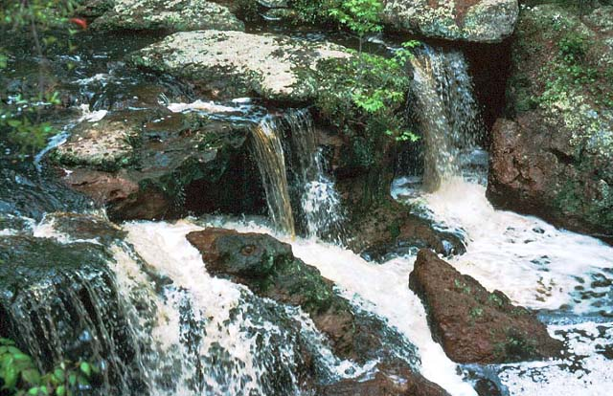
Notes:
2. WATER FALL. WATER.... It’s one of our most precious natural resources - a resource we can’t live without... a resource we so often take for granted. It’s also the basis for one of the most prominent environmental issues facing us today.

Slide 3
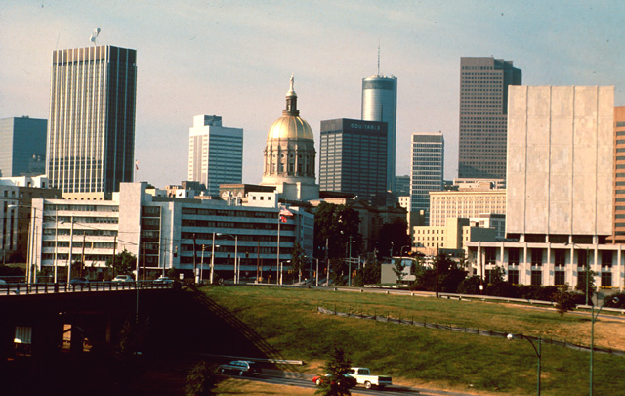
Notes:
3. CITY SCENE. As our urban centers continue to grow and develop, new industries, businesses and housing developments place an ever-increasing strain on available water supplies.

Slide 4
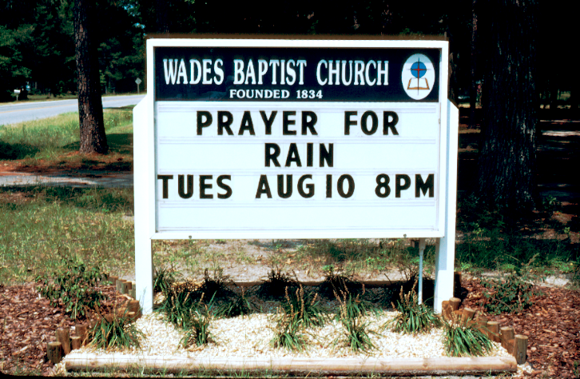
Notes:
4. PRAYER FOR RAIN. Periodic drought makes the problem even more pronounced, causing reservoir and river levels to drop and often forcing water authorities and elected officials to place restrictions or bans on outdoor water use in an effort to conserve available water supplies.

Slide 5
Facts About Water
We have the same amount of water on earth today as we did when the earth was created.
Of all the earth’s water, 97% is salt water located in the oceans and seas.
2% of the earth’s water is tied up in polar ice caps.
Only 1% of the earth’s water is fresh water available for drinking, bathing and cooking.
Notes:
5. FACTS ABOUT WATER. Let’s begin by looking at some facts about water. (#) We have the same amount of water on earth today as we did when the earth was created. Water is not manufactured...it is simply recycled. (#) Of all the earth’s water, 97% is salt water located in the oceans and seas. (#) Another 2% of the earth’s water is tied up in the polar ice caps is unavailable. (#) Only 1% of all the earth’s water is fresh water available for drinking, bathing and cooking. This water is found in rivers, lakes, streams, reservoirs, and underground aquifers.

Slide 6
Facts About Water
61% of our drinking water in the U.S. comes from surface water supplies (streams, lakes, rivers) while 39% comes from groundwater (underground aquifers).
In Georgia, 75% of our drinking water
comes from surface water, while 25%
comes from ground water.
Notes:
6. FACTS ABOUT WATER. Sixty-one percent of our drinking water in the U.S. comes from surface water supplies, such as streams, lakes and rivers, while 39% of our water comes from groundwater (underground aquifers). (#) Georgia gets approximately 75 % of its drinking water from surface water supplies and only 25% from ground water sources.

Slide 7
Facts About Water
We only need about 15 gallons of water per day per person for drinking, bathing and cooking, yet per capita water consumption in the U.S. exceeds 100 gallons/day.
If every household in the U.S. saved just
1 gallon of water a day, we would save 120
million gallons of water per day, enough
water for a city the size of Jacksonville, FL.
Notes:
7. FACTS ABOUT WATER. Ironically, we only need about 15 gallons of water per person each day for drinking, bathing and cooking, yet per capita water consumption in the U.S. exceeds 100 gallons per day. Now you might say you don’t use that much water, but think about all the ways you use water each day. Twenty to forty gallons, for instance, are often used during a daily shower. (#) Nevertheless, if each household in the U.S. saved just 1 gallon of water per day, we would save 120 million gallons per day, enough water to supply the daily needs of a city the size of Jacksonville, Florida.

Slide 8
Worldwide
Global Demand for fresh water will double every 20 years
Notes:
8. WORLDWIDE. On a global perspective, demand for fresh water is projected to double every twenty years.

Slide 9
Worldwide
12 billion people by the year 2100. Fifty percent of the population will reside in mega cities of 12 to 15 million.
Demand for land, fresh water and other resources will escalate.
Notes:
9. WORLDWIDE. By the year 2100, it is projected that there will be 12 billion people on earth. Approximately half of the world’s population will live in mega cities of 12 to 15 million. (#) As a result, the demand for all resources, including land and fresh water will increase.

Slide 10
Worldwide
Renewable water resources available per person decreased by 50% between 1960 and 1998.
Another 50% reduction is projected by 2025.
Notes:
10. WORLDWIDE. On a global basis, renewable water resources per person decreased by 50% over a 38 year period from 1960 to 1998. Another 50% reduction is projected by the year 2025.

Slide 11
In the United States, over two-thirds of the population resides in metropolitan areas.
In Georgia, over half of our state’s population resides in just 24 of our 159 counties.
Notes:
11. U.S. POPULATION. In the United States, over two-thirds of our population lives in metropolitan areas in and around urban centers. (#) In Georgia, over half of our state’s population resides in just 24 of our 159 counties.

Slide 12
Notes:
12. PROJECTED WATER DEMAND IN FOUR COUNTIES. Increasing water demand is not limited to large urban counties. All counties in Georgia project an increasing demand for water in the years ahead. This graph shows the projected demand for water in Barrow, Clarke, Jackson and Oconee counties in the years 2000, 2020 and 2050. This increasing demand parallels projected increases in population and industrial development.

Slide 13
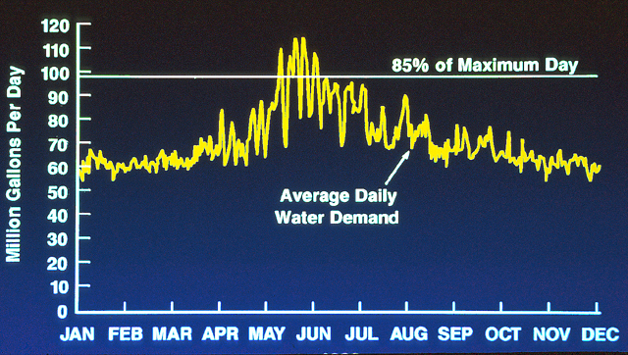
Water Demand for Cobb Marietta Water Authority
2000
Notes:
13. WATER DEMAND THROUGHOUT THE YEAR. Water demand increases during the summer months when residents are watering their outdoor landscapes, as this graph provided by the Cobb Marietta Water Authority shows. When demand for water exceeds 85% of the maximum daily pumping capacity of the utility, restrictions on outdoor water use are imposed by the Authority.

Slide 14
Average residential water use increases 30% - 50% during the summer months when citizens turn on their outdoor irrigation systems
Notes:
14. AVERAGE RESIDENTIAL WATER USE. Average residential water use increases as much as 50% during the summer months when citizens irrigate their outdoor landscape. Unfortunately, much of this water is used unnecessarily to irrigate plants that may not need water, and some of it is simply lost to evaporation when irrigation is done during mid-day.

Slide 15
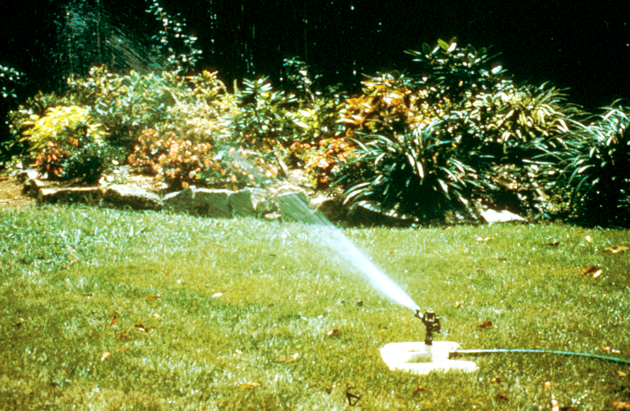
Notes:
15. LAWN SPRINKLER. We can save a lot of water simply by learning when to water, how to water, how much water to apply, and the most efficient ways to apply water. We also need to recognize that plants in the landscape require different amounts of water, and we don’t need to water all plants the same. A single oscillating lawn sprinkler, like the one shown here, will typically use 6 gallons of water per minute or 360 gallons per hour of operation.

Slide 16
One portable lawn sprinkler operating 1 hour uses 360 gallons of water
This is equivalent to:
14 five-minute showers
26 runs of the dishwasher
72 flushes of the toilet
9 full loads of laundry
Notes:
16. 360 GALLONS OF WATER EQUIVALENCE. (#) On a comparative basis, 360 gallons of water is equivalent to (#) 14 five-minute showers, (#) 26 runs of the dishwasher, (#) 72 flushes of the toilet, (#) or 9 full loads of laundry (based on standard industry fixtures and appliances - the numbers will be higher when using low-flow fixtures and energy-efficient appliances). Therefore, we need to make a conscious decision where we are going to allocate our potable water supplies. Will we use them for healthful indoor purposes or outdoors to maintain a lush green environment? If we don’t use our water resources wisely, we will be forced to conserve through higher water prices, water-use restrictions or perhaps total bans on outdoor water use.

Slide 17
Water Conservation Measures
Summer Surcharge: Rate increases 25% to 100% when use exceeds average winter consumption.
Rationing: Odd/Even outdoor watering
Bans on Outdoor Use
EDUCATION
Notes:
17. WATER CONSERVATION MEASURES. Water authorities across the state have various water conservation measures, techniques or incentives for conserving water. (#) For instance, many utilities will apply a summer surcharge to water bills during the summer months when usage exceeds the average winter consumption. In some counties, water cost may double during the summer months when a customer’s water use exceeds his average winter use. (#) Restrictions on outdoor watering is another water conservation technique whereby the customer is allowed to irrigate only on selected days of the week and only during designated hours. (#) When water supplies become severely limited, total bans on outdoor water use may be imposed. (#) However, the best long-term solution to water conservation is EDUCATION - educating ourselves and others about wise water use.

Slide 18
Coined in Colorado
in 1981
From the Greek Word “Xeros”, which
means dry
(Pronounced
Zera-scape)
Notes:
18. XERISCAPE. Xeriscape, pronounced Zera-scape, is a concept or technique for developing a quality landscape that requires significantly less water than a conventional landscape. It stems from the Greek word “Xeros” which means “dry”. The term and concept were coined in Colorado back in 1981 in response to a drought in that state, and it has since been adopted throughout the U.S.

Slide 19
Seven Steps of Xeriscape
Planning and Design
Soil Analysis
Appropriate Plant Selection
Practical Turf Areas
Efficient Irrigation
Use of Mulches
Appropriate Maintenance
Notes:
19. SEVEN STEPS OF XERISCAPE. The concept of Xeriscape involves seven steps. These include (#) Planning and Design, (#) Soil Analysis, (#) Appropriate Plant Selection, (#) Practical Turf Areas, (#) Efficient Irrigaition, (#) Use of Mulches, (#) and Appropriate Maintenance. Collectively these are called Xeriscape...the more of them you implement, the more water efficient your landscape will be. Bear in mind that you don’t have to totally renovate your landscape to develop a Xeriscape. You may be able to save a significant amount of water just by changing your irrigation habits, or by converting a high water use area to a natural ground cover, like pine straw or wood chips. In other words, you don’t have to invest a lot of money to develop a Xeriscape.

Slide 20
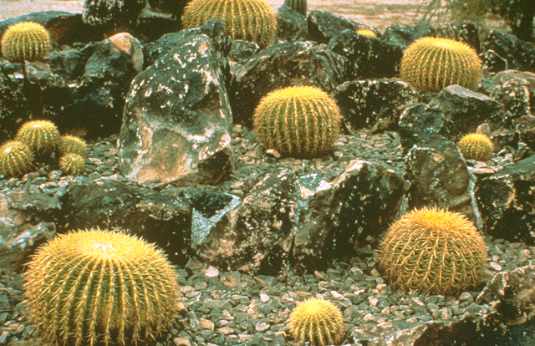
Notes:
20. CACTUS GARDEN. Because Xeriscape originated in the arid region of the United States, it is sometimes associated with cactus gardens, but this is not what Xeriscape is.

Slide 21
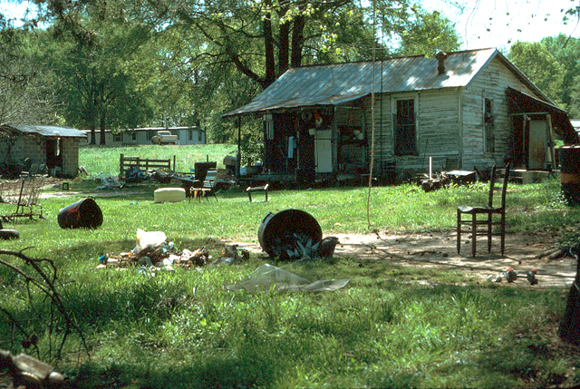
Notes:
21. RURAL HOME. This is a Zero-Scape, not a Xeriscape. This too is not what the concept is about. Although this landscape probably is not irrigated, it is not a quality landscape and therefore is not a Xeriscape.

Slide 22
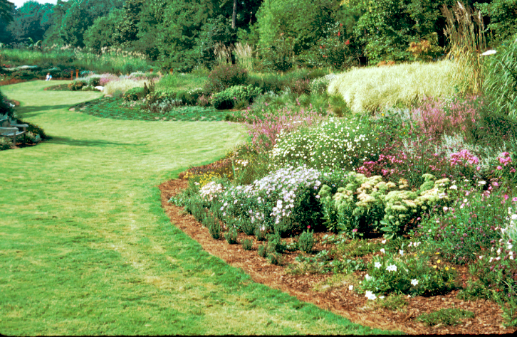
Notes:
22. XERISCAPE. This is a Xeriscape at Post Vinings in Atlanta. It’s a quality landscape that receives very little supplemental irrigation. In fact, over two-thirds of the landscape is not irrigated at all. It was installed on a drainage easement to take advantage of the natural drainage of the site. All seven steps of Xeriscape are well illustrated in this landscape.

Slide 23
Seven Steps of Xeriscape
Planning and Design
Soil Analysis
Appropriate Plant Selection
Practical Turf Areas
Efficient Irrigation
Use of Mulches
Appropriate Maintenance
Notes:
23. PLANNING AND DESIGN. Now let’s examine each of the seven steps of Xeriscape in more detail. Any landscape, whether it is a conventional landscape or a Xeriscape, starts with good Planning and Design.

Slide 24
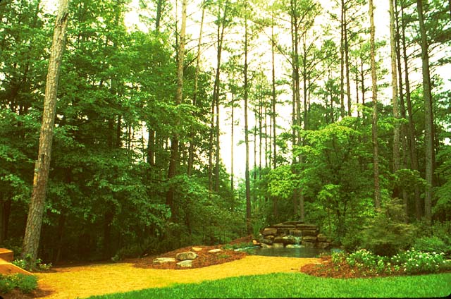
Notes:
24. NATIVE AREA INCORPORATED INTO LANDSCAPE. If you are designing a new landscape, think of ways you can incorporate natural vegetation on the site into the design. Incorporating native areas that require no supplemental irrigation into the design is a great first step toward water conservation.

Slide 25
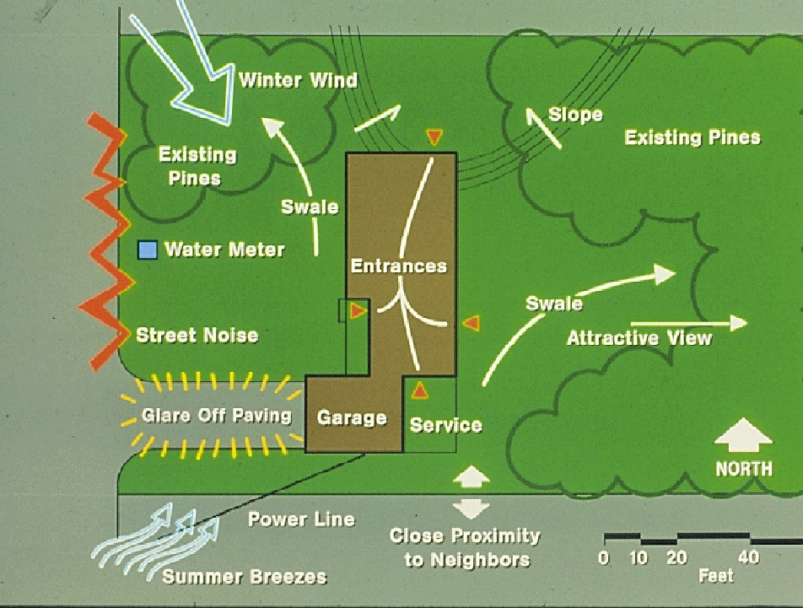
Notes:
25. SITE ANALYSIS. Site analysis is a critical step in any landscape process. Whether you are designing a new landscape or adding to an existing landscape, site analysis will help you determine how you might change the site to fit the type of plants you want to grow, or which plants are best for each location in the landscape. There frequently are considerable differences in soil type, sunlight pattern and drainage characteristics in an individual landscape which need to be cataloged. For instance, shade-loving plants are best located on the east side of the home or building where they are shaded from the afternoon sun. Tender, cold-sensitive plants are best placed on the south or east side of a building where they are protected from the cold northwestern winds, while more cold-hardy plants are situated on the north or northwest side of the property because they can tolerate the cold winter winds. By putting plants in their preferred environment, they will be more healthy and more low-maintenance than plants forced to grow in harsh, unfriendly environments.

Slide 26
Divide the Landscape into Three
Water-use Zones
High Water-use Zone (Oasis Zone)
Moderate Water-use Zone (Transition Zone)
Low Water-use Zone (Xeric Zone)
Notes:
26. THREE WATER-USE ZONES. In Xeriscape design, plants are assigned to one of three water-use zones. (#) A High Water-use Zone or Oasis Zone, (#) a Moderate Water-use Zone or Transition Zone, or (#) or a Low Water-use or Xeric Zone. There may be several of each of these zones in an individual landscape.

Slide 27
High Water-use Zone (Oasis Zone)
Small “high-impact” or high visibility area of the landscape where plants are provided their optimum water requirement at all time
Entrance to the home or business
Notes:
27. HIGH WATER-USE ZONE. The High Water-use Zones are small, highly visible, high-impact areas of the landscape where plants are watered routinely to encourage their optimum growth and performance. (#) This zone is usually limited to the entrance to the home or business.

Slide 28
Moderate Water-use Zone
(Transition Zone)
Plants are watered during establishment. Then, once established, they are watered only when they show signs of water stress.
Azaleas, dogwoods, redbuds,
herbaceous perennials
Notes:
28. MODERATE WATER-USE ZONE. In the Moderate Water-use Zones, plants are watered routinely during establishment, then they are watered only when they show signs of moisture stress by turning a gray-green color or by wilting. (#) Typical landscape plants located in this zone would include azaleas, dogwoods, redbuds and herbaceous perennials.

Slide 29
Low Water-use Zone (Xeric Zone)
Once established, plants are provided no supplemental irrigation, except during periods of extreme drought
Juniper
Crape Myrtle
Yaupon Holly
Oaks
Native Areas
Notes:
29. LOW WATER-USE ZONE. Plants in the Low Water-use Zones are not irrigated once they are established, except during extreme drought. A large number of our common landscape plants will adapt to the low water-use zones, (#) including junipers, crape myrtle, yaupon holly and oaks. Native, undisturbed areas would also be treated as low water-use zones.

Slide 30
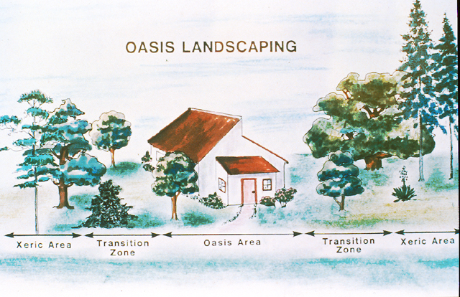
10% of the landscape is irrigated regularly
30% of the landscape is irrigated on demand
60% of the landscape is not irrigated
Notes:
30. OASIS LANDSCAPING. Another way of visualizing the various water-use zones is by thinking of the highly visible area as the oasis area where plants are grown for their optimum beauty. Then, as one moves outward from the entrance, the transition or moderate water-use zones are irrigated selectively on demand. These flow into the xeric zones or low water-use zones that are not irrigated.(#) Ideally, only 10% of the total landscaped area should be high water-use zones which are irrigated regularly, (#) not over 30% of the total area should be zoned for moderate water-use and watered on demand, (#) while 60% or more should be placed in xeric or low water-use zones and not irrigated at all.

Slide 31
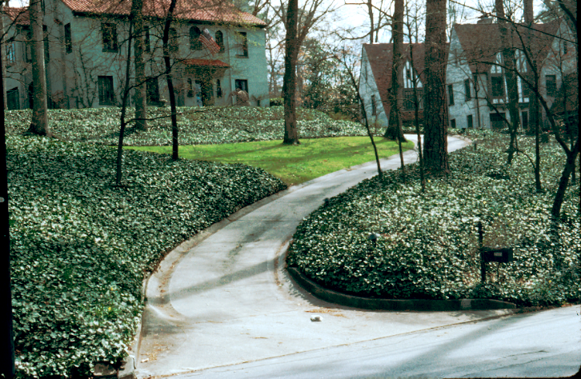
Notes:
31. ENGLISH IVY ENTRANCE. High visibility, high impact areas do not have to be high water-use and do not have to be planted with water-demanding plants. This entrance, having large beds of English Ivy, is mostly low water-use. Only the small area of turfgrass is in the high water-use zone.

Slide 32
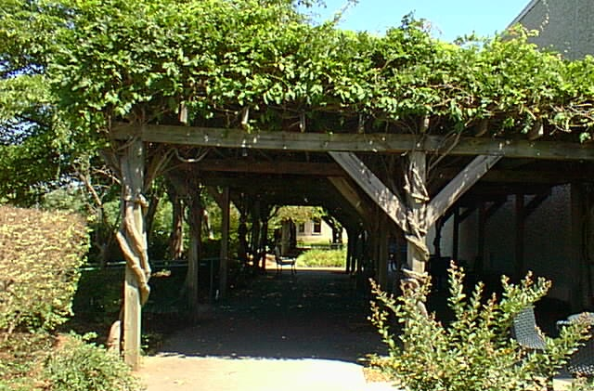
Shade helps reduce water loss in the landscape
Notes:
32. SHADE REDUCES EVAPORATIVE WATER LOSS. Shade is a design element that keeps the landscape cooler and reduces evaporative loss of water. A shaded landscape may be 10 to 15 degrees cooler than an adjacent landscape in full sun. Garden structures and trees are commonly used to provide shade in landscapes.

Slide 33
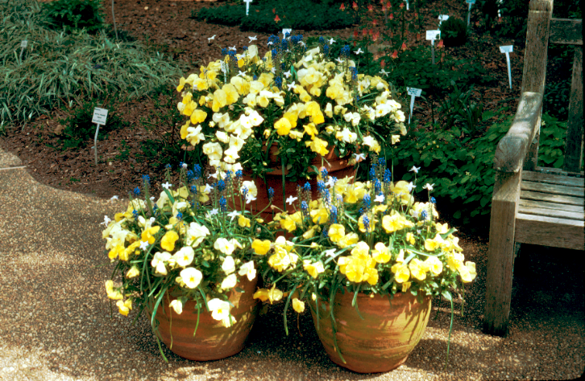
Notes:
33. CONTAINERIZED COLOR. An alternative to beds of seasonal color that require a great deal of water are seasonal color containers strategically placed in the high-impact area of the landscape. You can vary the size and shape of the containers and their arrangement and can be creative in plant combinations. Although the containers are high water use, you can concentrate your watering and save a significant amount of water over ground beds.

Slide 34
Goal of Water Wise Landscapes
Reduce and minimize the size of the area irrigated and the frequency of irrigation
Notes:
34. GOAL OF A WATER-WISE LANDSCAPE. Your goal in a water-wise landscape is to reduce and minimize the size of the area irrigated and the frequency of irrigation. You can do this by shifting as much of the landscape as possible into low water-use zones and by converting high water-use areas to moderate water use, thereby reducing irrigation frequency. The key is to make this conversion without sacrificing the quality of the environment. It can be done by following the seven steps of Xeriscape.

Slide 35
House
Spirea
Azaleas
Nandina
Little Gem
Magnolia
Fatsia
Driveway
Turfgrass
Native Trees
Native Oak
N
Street
Notes:
35. TYPICAL GEORGIA RESIDENCE. Let’s look at an example retrofit of what might be a typical residential landscape. The house is bordered by a good combination of foundation shrubs. The azaleas are planted on the east side of the home where they get morning sun and afternoon shade, which is good. Fatsia is used at the front door as an accent plant. Nandina is used along the remainder of the front, with a Little Gem Magnolia used to soften the corner. Spirea is used along the foundation on the north side of the home. There are a few native trees on the north side of the property and a native oak in front. The remainder of the landscape is turfgrass.

Slide 36
Low
Moderate
Low
High Water-use Zone
Notes:
36. RESIDENCE - WATER USE ZONES. Now let’s look at the existing water-use zones of this property. (#) The azaleas are irrigated “as needed” and are in a moderate water-use zone. (#) The Nandina and Magnolia have very good drought tolerance once established and can be placed in a low water-use zone, (#) as can the spirea. (#) The turfgrass was irrigated regularly to maintain optimum growth and beauty and therefore is a high water-use zone.

Slide 37
Daffodils/Siberian Iris/Daylilies
Pinestraw
Pinestraw
Ornamental
Grasses
Annuals
Year 1
Notes:
37. RESIDENCE RETROFIT. Now let’s look at a way we might modify this landscape to reduce its water requirement. (#) First, lay garden hose in the sun and allow it to become flexible, then use it to create some new bed lines. In this case, we are creating a bed that includes the native oak in the front. Once we are satisfied with the shape of the new bed outline, we use baking flour or hydrated lime to mark the line. (#) Then we move the garden hose to the native trees on the north side of the property and incorporate them into another bed. Again, we use flour or lime to mark the line. Then we spray the turfgrass within the beds with Round-Up herbicide to kill the existing turfgrass. It would not be wise to cultivate under the native trees or bring in topsoil because the root system of the trees can be damaged. (#) Once the Round-Up dries on the foliage, we spread pinestraw within the bed and under the native trees on the north side of the property. But we are not finished with the entrance bed. Simply filling this bed with pinestraw might look monotonous, (#) so we will create a small raised bed adjacent to the street using some good topsoil or compost. (#) This bed will be planted with annual flowers. (#) Another bed will be made near the walkway entrance. Here we will plant some herbaceous perennials, including daffodils, Siberian iris and daylilies. (#) Finally, we will place three ornamental grasses in the front bed to add textural interest to the entrance bed, (#) then we will spread pinestraw throughout the remainder of the bed.

Slide 38
Low
Moderate
Low
Moderate
Low
High Water-use Zone
Low
High
Year 1
Notes:
38. RESIDENTIAL RETROFIT WATER ZONES. Looking at the water use zones again, we see that we have reduced the size of the high water-use zone significantly. (#) The mulched area under the native trees has been shifted to a low water-use zone (#) as has the mulched area near the entrance. (#) The herbaceous perennial bed is watered on-demand, so it becomes a moderate water-use zone, (#) and the seasonal color bed is a high water-use zone.

Slide 39
Liriope
Mulch
Hybrid Bermuda
Year 2
Notes:
39. RESIDENTIAL RETROFIT CONTINUED. Now, let’s look at the same landscape one year later. (#) This year we decide to invest a little more money and plant the area under the trees with liriope to prevent having to re-straw each year. Once we define this area with green plants, (#) we get out garden hose again and think of a way to aesthetically expand the natural mulch area. The local municipality provides mulch to local citizens by the truckload, so we are going to take advantage of the excellent mulch source and use it in this area. Once again, we kill the existing vegetation with Round-Up herbicide before putting down the mulch. (#) Hybrid bermuda grass was sodded in the turfgrass area because it is one of the most drought tolerant warm-season turfgrasses.

Slide 40
Low
Low
Low
Moderate
Low
Moderate
Moderate
Low
Low
Moderate
Water-use Zone
Low
High
Year 2
Notes:
40. RESIDENTIAL RETROFIT WATER ZONES (YEAR 2). Looking at the water-use zones, we have shifted another 1/3 of the landscape to a low water-use zone with the bed of mulch. (#) The bermuda grass, once established, becomes a moderate water-use zone and is watered only when it shows signs of moisture stress. (#) The liriope bed becomes a moderate water-use zone during the first growing season after establishment.

Slide 41
Dwf Yaupon
Holly
Gaura
Year 3
Notes:
41. RESIDENTIAL RETROFIT (YEAR 3). By the third year, (#) we decide to add a few shrubs to the entrance bed, so we plant dwarf yaupon hollies. (#) Adjacent to the ornamental grasses in the front yard, we plant gaura, a herbaceous perennial plant from the arid regions of Texas. It blooms all summer, is low-maintenance and water thrifty.

Slide 42
Low
Low
Low
Moderate
Low
Moderate
Low
Low
Low
Moderate
Water-use Zone
Moderate
High
Year 3
Notes:
42. RESIDENTIAL RETROFIT WATER ZONES (YEAR 3): Now we once again look at the shift in water-use zones, (#) the liriope has become well established after one year in the ground, so it is shifted to a low water-use zone. (#) The newly planted area under the native oak at the entrance now becomes a moderate water-use zone and is watered on demand during the first growing season.

Slide 43
Low
Low
Low
Moderate
Low
Moderate
Low
Low
Low
Moderate
Water-use Zone
Low
High
Year 4
Notes:
43. RESIDENTIAL RETROFIT (YEAR 4). By year 4, (#) the entrance bed is shifted to a low water-use zone because the plants installed are drought tolerant and can survive periods of limited rainfall. So you see in this example we have shifted almost two-thirds of the landscape from high water-use to low water-use and another 1/4 of the area from high water use to moderate water- use, leaving just a small area in the high water-use zone.

Slide 44
HardwoodMulch
Seasonal Color in Container
Prince of Wales or Sargent’s Juniper
Liriope
Pinestraw
Asiatic Jasmine/ Daffodils
Hybrid
Bermuda
Notes:
44. RESIDENTIAL RETROFIT (ANOTHER EXAMPLE). Creativity, good design and personal preferences are important elements in developing a Xeriscape-type landscape. Let’s look at another way we might retrofit this residential landscape for improved water conservation. (#) We once again plant liriope as a groundcover under the native trees on the side of the property. (#) This time, however, we sod with hybrid bermuda grass in a small area from the street to the entrance, using it as a welcome mat to the home. (#) Next we use the garden hose again to design a smooth, flowing bed in the front yard that connects the turfgrass with the liriope bed. In this bed we’ll plant Asiatic jasmine under-planted with daffodils which will emerge up through the groundcover in spring for seasonal interest. (#) Another bed will be laid out just above the first one in which we will plant either Prince of Wales juniper or Sargent’s juniper, depending on which are readily available in the local trade. (#) Our seasonal color will be limited to a container at the entrance. The remaining areas (#) will be mulched with pinestraw and hardwood mulch.

Slide 45
Low Water Use
High Water Use
Moderate Water Use
Moderate
Low
Moderate Water Use
Moderate Water Use
Moderate
Notes:
45. RESIDENTIAL RETROFIT, EXAMPLE #2: WATER ZONES. The water use zones following this retrofit look like this.... The mulched areas, as you might expect, are low-water-use zones. (#) The turfgrass, once established, becomes a moderate water-use zone. (#) The junipers likewise are watered on demand during their first growing season and are therefore considered moderate water-use, (#) as are the Asiatic jasmine and daffodils. (#) The liriope planted under the native trees is also treated as a moderate water-use zone as it is getting established during the first growing season. (#) The only high water-use zone in this landscape is the container of seasonal color at the entrance.

Slide 46
High Water Use
Low Water Use
Moderate Water Use
Low
Low
Low Water Use
Low Water Use
Moderate
Notes:
46. RESIDENTIAL RETROFIT (EXAMPLE 2, YEAR 2). By year two, (#) the turfgrass area remains a moderate water-use zone and is watered on demand. However, (#) the juniper (#) and the Asiatic jasmine should be well-established and can be shifted into a low water-use zone. (#) Likewise, the liriope under the native trees can also be shifted into a low water-use zone. So in this example over two-thirds of the landscape becomes low water-use once established, which will result in considerable savings in water and money each year. The maintenance requirements of this landscape are also considerably less than before the changes were made. Although significant changes were made in these landscapes, this does not mean that you have to invest a lot of money or make drastic changes in your landscape to reduce its water needs. Simple changes, such as converting irrigated areas to beds of mulch, or simply changing your existing watering habits, can result in considerable water savings.

Slide 47
Seven Steps of Xeriscape
Planning and Design
Soil Analysis
Appropriate Plant Selection
Practical Turf Areas
Efficient Irrigation
Use of Mulches
Appropriate Maintenance
Notes:
47. SOIL ANALYSIS: Soil analysis is the next step toward developing a water-wise landscape.

Slide 48
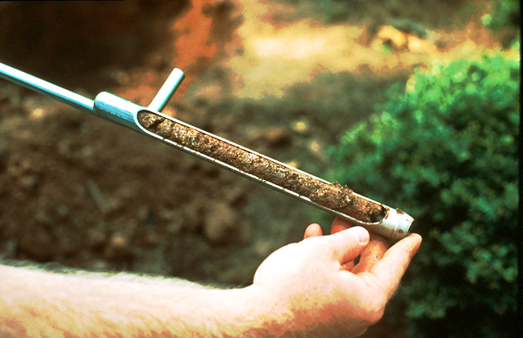
Don’t Guess…Soil Test!
Notes:
48. DON’T GUESS...SOIL TEST! This involves knowing the physical and chemical characteristics of your soil. Use a shovel or auger, like the one shown here, to check the structure and texture of the soil in different spots throughout the landscape. Some soils have a layer of clay (called hardpan) beneath their surface that inhibits soil drainage Others may have rock beneath the surface that prevents drainage. Soil structure and texture can vary tremendously throughout a landscape. A soil test, available through your local county Extension office for a nominal fee, will tell you the pH and nutrient content of the soil and will help you determine whether lime is needed to improve nutrient availability of the soil.

Slide 49
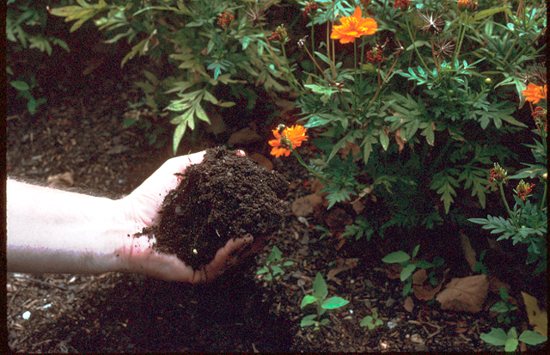
Notes:
49. RICH ORGANIC SOIL. Organic matter benefits most well-drained soils by improving their water and nutrient holding capacity. Organic matter also improves the structure of hard, compact soils.

Slide 50
How Much Amendment to Use?`
25% by Volume
3 inches incorporated to a 12 – inch depth
1 cu. yd. / 100 sq. ft. = 3 in. on soil surface
1 cu. yd. = 27 cu. ft. = Nine 3 cu. ft. bags or 13 – 2 cu. ft. bags / 100 sq. ft.
Notes:
50. HOW MUCH AMENDMENT TO USE? However, to realize a benefit from organic matter, you must add (#) at least 25% by volume. (#) This is equivalent to applying 3 inches of organic matter on the soil surface and incorporating it to a 12-inch depth. (#) One cubic yard of organic amendment applied over a 100 square feet area will provide about 3 inches on the soil surface. (#) Since 1 cubic yard is equivalent to 27 cubic feet, you will need nine 3-cubic feet bags or thirteen 2-cubic feet bags for each 100 square feet of bed area. At this application rate it may not be economically practical to apply organic matter to all planted areas. Preference should be given to annual flower beds, then herbaceous perennials, then trees and shrubs.

Slide 51
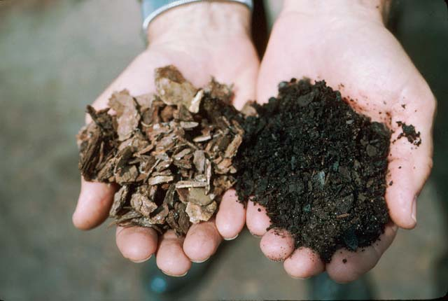
Use only decomposed organic material (right) as a soil amendment
Notes:
51. USE ONLY DECOMPOSED ORGANIC MATERIAL. Organic matter added to the soil as an amendment should be well rotted, like that on the right. Never incorporate undecomposed organic matter into the soil right before planting because the pH and nitrogen content of the soil may drop dramatically as micro-organisms work to break down the organic matter. As a result, plants may look anemic and stunted as they compete with the micro-organisms for nutrients.

Slide 52
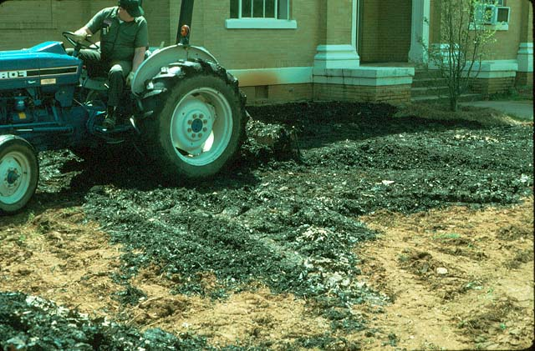
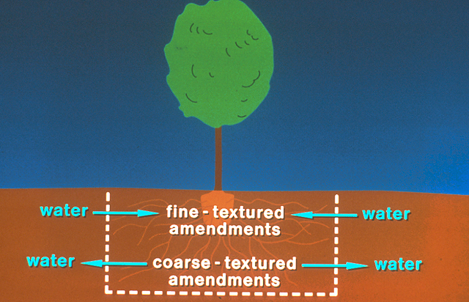
Incorporate organic matter uniformly into the top 12 inches
Notes:
52. INCORPORATE ORGANIC AMENDMENTS UNIFORMLY INTO THE SOIL INSTEAD OF INTO PLANTING HOLES. Best results from organic matter will be obtained when it is incorporated uniformly into the soil. (#) Sometimes organic matter added to the planting hole will act like a sponge in a bathtub, holding too much water and promoting root rot. Another problem in adding rich organic matter to the planting hole is that it encourages the roots of the plant to stay within the hole instead of exploring the surrounding soil. On the other hand, coarse-textured amendments added to the planting hole in an effort to improve drainage may cause the hole to dry out more rapidly than the surrounding soil and may lead to drought stress during periods of limited rainfall. (#) Therefore, it’s best to incorporate organic amendments into the top twelve inches of soil instead of placing them in individual planting holes.

Slide 53
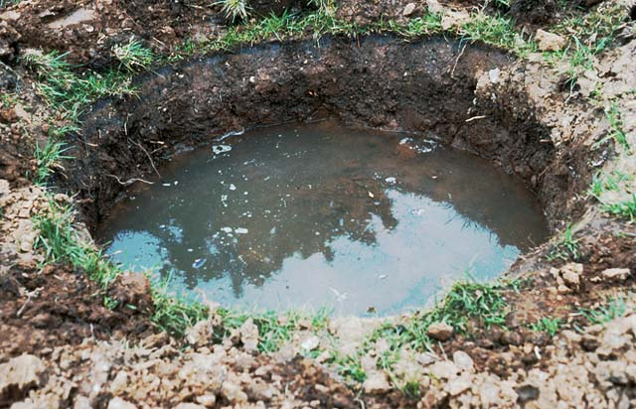
More plants are killed in Georgia from over-watering than from drought
Notes:
53. PERCOLATION TEST. Poorly drained soils are a leading cause of plant problems in many areas of Georgia. Some soils have a hard clay-like layer a short distance from the surface that prevents water from draining after rain or irrigation. (#) Ironically, more plants are killed in Georgia each year from over-watering than from drought. Standing water will suffocate roots and cause plant stress. To check drainage, simply dig a hole two to three feet wide and two to three feet deep and fill it with water. If a substantial amount of water remains in the hole two hours later, a drainage problem exists.

Slide 54
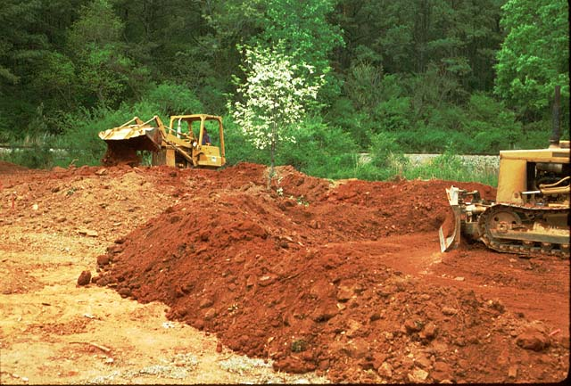
Possible Solutions to Poorly-drained Soils
Plant on raised beds
Deep cultivation
Install sub-surface drainage
Select appropriate plants
Notes:
54. POSSIBLE SOLUTIONS TO POORLY-DRAINED SOILS. There are several possible solutions to poorly drained soils. (#) One is to change the grade of the site and plant on raised beds. (#) Another possible solution is to cultivate deeply to break apart a hard-pan layer under the surface. (#) Sub-surface drainage systems, such as porous PVC pipe may be required in some soils to help carry the water off the site. (#) Still another possible solution is to select plants adapted to the drainage characteristics of the site. Place moisture-sensitive plants at higher elevations and moisture-requiring plants at lower elevations. Often a combination of these solutions are needed to overcome a drainage problem on a landscape site.

Slide 55
Seven Steps of Xeriscape
Planning and Design
Soil Analysis
Appropriate Plant Selection
Practical Turf Areas
Efficient Irrigation
Use of Mulches
Appropriate Maintenance
Notes:
55. APPROPRIATE PLANT SELECTION. Appropriate Plant Selection is the third step to a water-wise landscape.

Slide 56
Select Plants Adapted to the Site and the Stresses of the Environment
Drought tolerance is important, but also consider potential insect and disease problems, sunlight and soil requirements.
Notes:
56. SELECT ADAPTED PLANTS. As stated previously during the discussion of site analysis, it is critical that you select plants adapted to the site and the stresses of the local environment. However, it’s a mistake to select plants on the basis of one criteria alone. (#) Drought tolerance, for instance, is important, but one should also consider potential insect and disease problems as well as the sunlight and soil requirements of the plant.

Slide 57
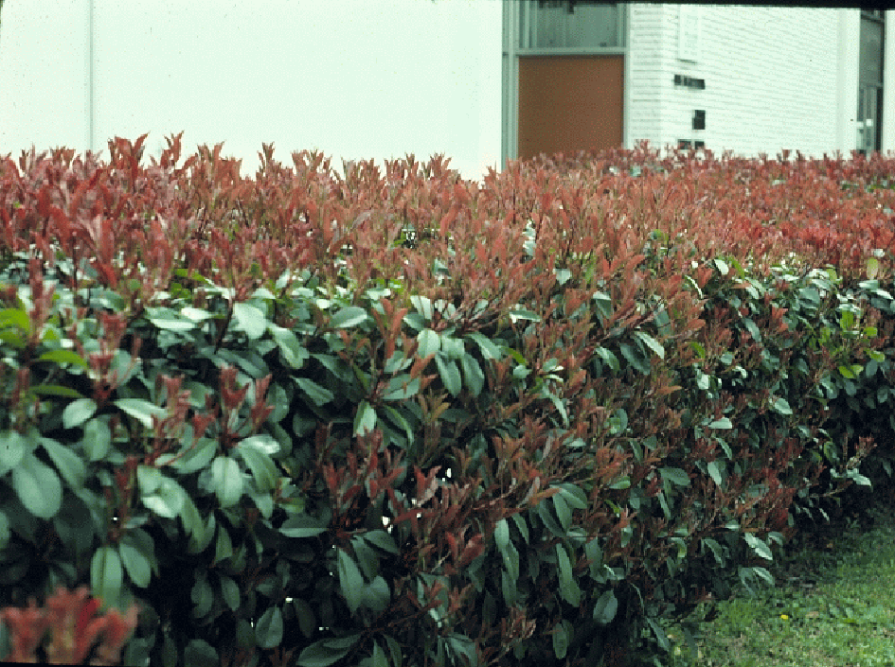
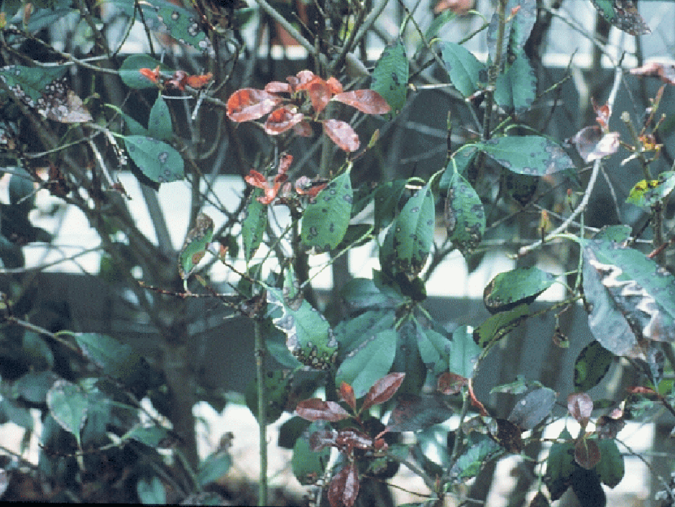
Red-tip Photinia
Notes:
57. RED-TIP PHOTINIA EXAMPLE. Red-tip Photinia, for example, is extremely drought tolerant, (#) but it also is very susceptible to a leaf-spot disease that will sometimes defoliate it in summer. The disease appears to be more pronounced on plants growing on drought-prone sites or sites that stay too wet after rain or irrigation.

Slide 58
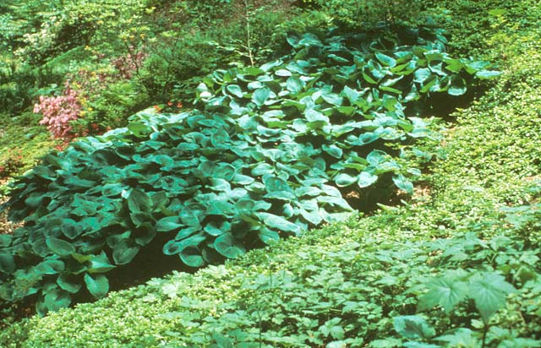
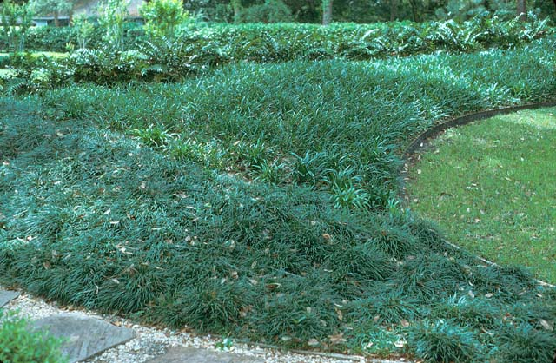
Azalea
Shade
Hosta
Japanese Pachysandra
Lenten Rose
Liriope
Mondograss
Notes:
58. EXAMPLES OF PLANTS FOR SHADY SITES. If shade is a factor, then select plants adapted to the shade. Here are some excellent examples of plants that perform best under shaded conditions....Azalea, Hosta, and Japanese Pachysandra. (#) Other excellent alternatives to turf grasses in shaded areas are (#) Liriope and (#) Mondograss.

Slide 59
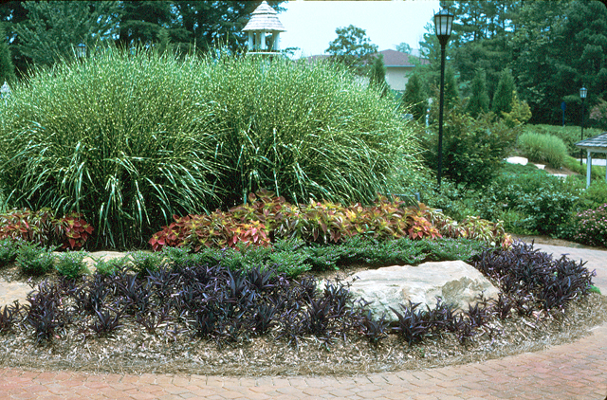
Sun
Zebra Grass
Sun Coleus
Mexican Heather
Purple Passion
Notes:
59. EXAMPLES OF PLANTS FOR SUNNY SITES. Here is an example of a great combination of plants for a full sun site: Zebra Grass, Sun-loving Coleus, Mexican Heather and Purple Passion (also called Setcreasea). The ornamental grass can survive long periods without water and would be a good choice for a low water-use zone, while the coleus, heather and purple passion would be good selections for moderate water-use zones.

Slide 60
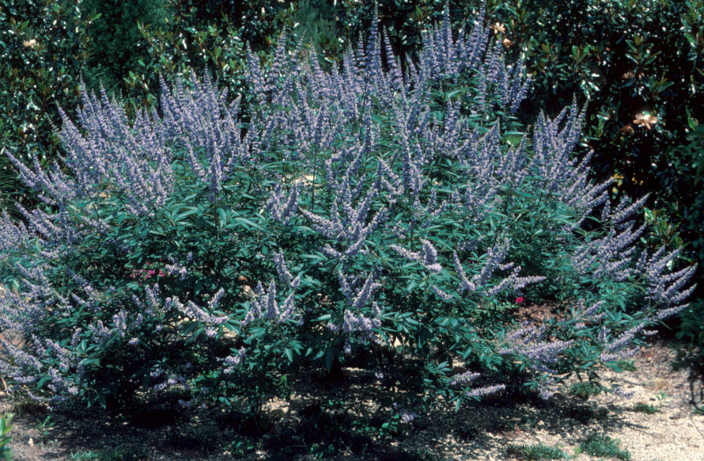
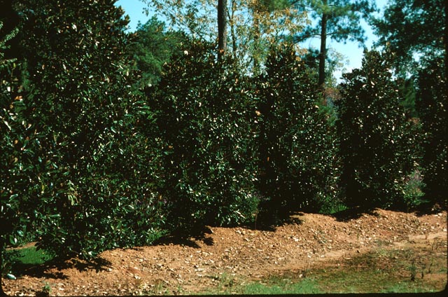
Chinese Pistache
Hollies
Japanese Zelkova
Chastetree
(Vitex agnus-castus)
Trees
Lacebark Elm
Trident Maple
Crape Myrtle
Little Gem Magnolia
(Magnolia grandiflora ‘Little Gem’)
Notes:
60. EXAMPLE OF TREES FOR DRY, SUNNY SITES. Here are some great trees for sunny low water-use zones. Chastetree (also called Vitex or Summer Lilac) is grown widely in the hot, arid regions of the desert Southwest and is an excellent choice for hot, dry sites in the southeast too. It bears light blue flowers in May and June and has pest-free foliage. Little Gem Magnolia is a tough as nails plant for dry, sunny sites. It’s a dwarf magnolia, growing about 20 feet tall and eight feet wide at maturity and is a great hedge plant along the side of a property or a specimen plant to soften the corner of a building. Other good tree choices include (#) Chinese Pistache, a wide variety of hollies, Japanese Zelkova, (#) Lacebark Elm, Trident Maple and Crape Myrtle.

Slide 61
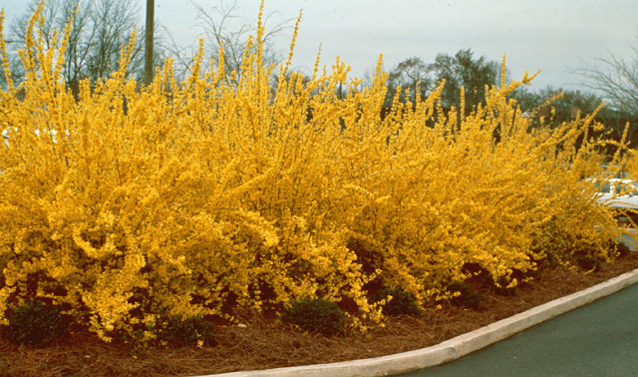
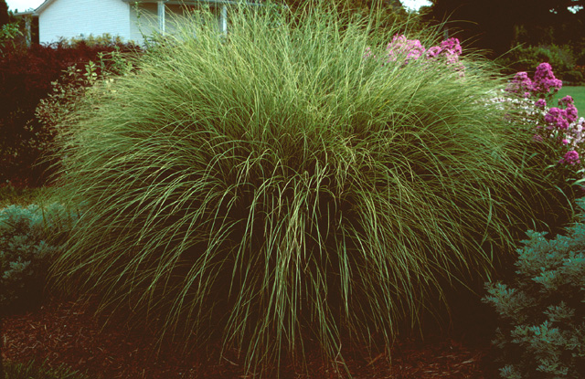
Spirea
Mahonia
Dwarf Yaupon Holly
Forsythia
(Forsythia intermedia)
Shrubs / Ornamental Grasses
Aucuba
Barberry
Chinese Holly
Maidengrass
(Miscanthus sinensis)
Notes:
61. EXAMPLES OF SOME TOUGH SHRUBS AND ORNAMENTAL GRASSES. There are a number of good shrubs and ornamental grasses for sunny, low water-use zones. Some of the proven performers include Forsythia and Maidengrass. Other possible choices are (#) Spirea, Mahonia, Dwarf Yaupon Holly, (#) Aucuba, Barberry and Chinese Holly. Once established, these plants can survive weeks without supplemental rainfall or irrigation and seldom show stress on even the harshest sites.

Slide 62
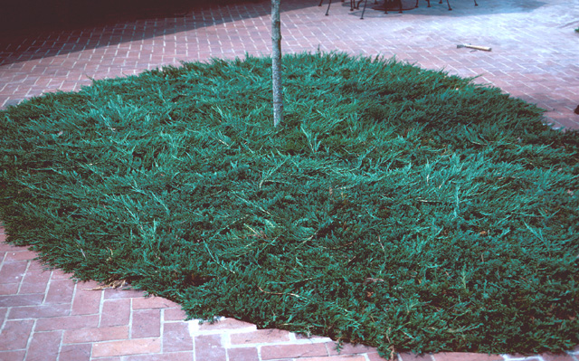
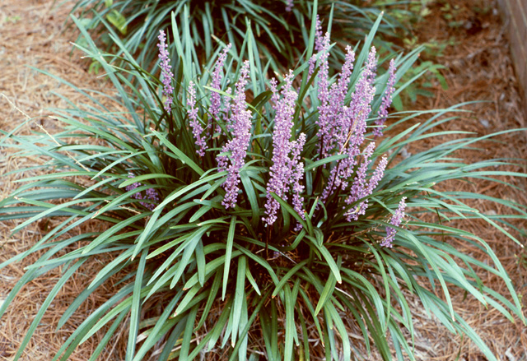
Asiatic Jasmine
Daylily
St. John’s Wort
Blue Rug Juniper
(Juniperus horizontalis ‘Blue Rug’)
Ground Covers/Vines
Honeysuckle
Carolina Jessamine
Wintercreeper Euonymus
Liriope
(Liriope muscari)
Notes:
62. EXAMPLE GROUND COVERS FOR LOW WATER-USE AREAS. The list of possible ground covers for hot, dry low water-use areas is extensive. Some excellent choices include Blue Rug Juniper and Liriope. (#) Other great choices are Asiatic Jasmine, Daylily, St. Johns Wort, (#) Honeysuckle, Carolina Jessamine and Wintercreeper Euonymus.

Slide 63
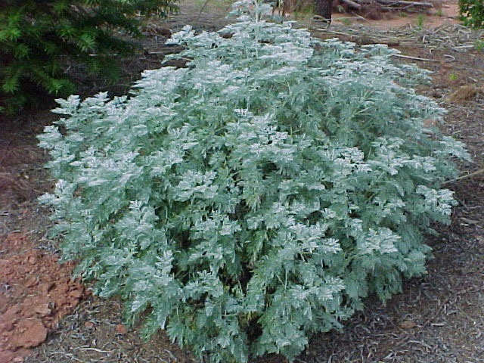
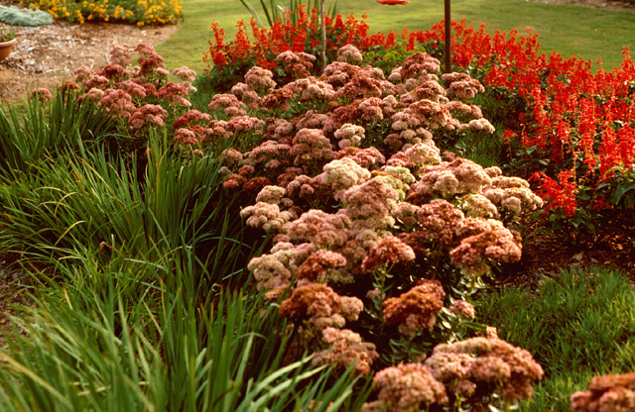
Gaura
Black-eyed Susan
Russian Sage
Wormwood
Artemisia “Powis Castle”
Herbaceous Perennials
Red Hot Poker
Rosemary
Agave
Sedum ‘Autumn Joy’
Notes:
63. EXAMPLES OF LOW WATER-USE HERBACEOUS PERENNIALS. There are also a number of herbaceous perennials known for their durability in low water-use zones. Among them are Wormwood and Autumn Joy Sedum. (#) Other good low water-use selections include Gaura, Black-eyed Susan, Russian Sage, (#) Red Hot Poker, Rosemary and Agave.

Slide 64
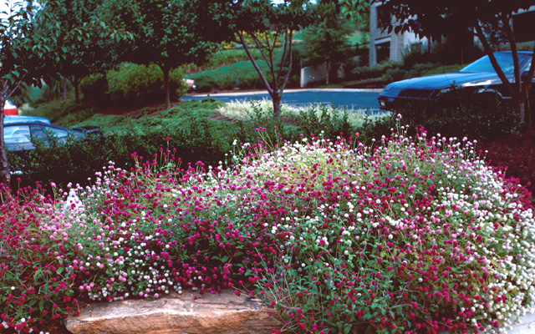
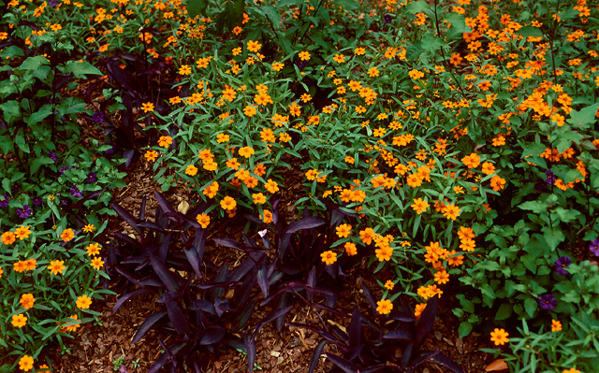
Baby’s Breath
Verbena
Annual Periwinkle
Globe Amaranth
(Gomphrena globosa)
Annuals
Dusty Miller
Gazania
Portulaca
Creeping Zinnia
(Zinnia linearis)
Notes:
64. EXAMPLES OF LOW WATER USE ANNUALS. Although summer annuals seldom perform to their optimum in low water use zones of the landscape, there are several that perform well in hot, dry locations and can be grown in moderate water-use zones where they are watered when they show signs of moisture stress. These include Globe Amaranth and Creeping Zinnia. Other good choices include (#) Baby’s Breath, Verbena, Annual Periwinkle, (#) Dusty Miller, Gazania and Portulaca.

Slide 65
Drought Tolerance of Turfgrasses
Hybrid Bermuda
Zoysia
Centipede
Fescue
Most
Least
Notes:
65. DROUGHT TOLERANT TURFGRASSES. Turfgrasses vary widely in their ability to tolerate drought. Hybrid Bermuda is one of the most drought tolerant of the warm-season turfgrasses. Fescue, a cool-season turfgrass commonly grown in the northern half of the state, has poor drought tolerance.

Slide 66
For Help Selecting Adapted Plants
Visit your local nurseryman
Contact your local county Extension office
Visit the following web site:
www.ces.uga.edu
Click on Departments, then Horticulture, then Publications
Look for:
Coping with Watering Restrictions in the Landscape
Xeriscape: A Guide to Developing a Water Wise Landscape
Landscape Plants for Georgia
Lawns in Georgia
Notes:
66. FOR HELP IN SELECTING ADAPTED PLANTS. If you need help selecting adapted plants for your area, (#) visit your local nurseryman or (#) contact your local county Extension agent. (#) The Cooperative Extension Service also has several publications on the Internet that can help you select regionally adapted plants. Look for (#) Coping with Watering Restrictions in the Landscape, Xeriscape: A Guide to Developing a Water Wise Landscape, Landscape Plants for Georgia, and Lawns in Georgia.

Slide 67
Plants Don’t Save Water
People Save Water !
Notes:
67. PLANTS DON’T SAVE WATER. Remember, however, that plants themselves don’t save water..... (#) PEOPLE SAVE WATER! Select plants adapted to the site and water them according to their needs.

Slide 68
Seven Steps of Xeriscape
Planning and Design
Soil Analysis
Appropriate Plant Selection
Practical Turf Areas
Efficient Irrigation
Use of Mulches
Appropriate Maintenance
Notes:
68. PRACTICAL TURF AREAS. The next step toward a water-wise landscape is to use practical turf areas.

Slide 69
Use Turfgrass for a Purpose
Aesthetic Value (Welcome Mat)
Recreational Surface
Erosion Control
Minimize the amount of irrigated turfgrass
Notes:
69. USE TURFGRASS FOR A PURPOSE. Turfgrass is a very functional plant in the landscape. However, just as we use ornamental plants to add color, texture and interest to the landscape, turfgrass should be used for a purpose. (#) A well-manicured turfgrass area provides a green welcome mat to the home. (#) Turfgrass also provides an excellent recreational surface for outdoor activities, (#) and it can be used effectively for erosion control. (#) Our goal in Xeriscape is to minimize the amount of irrigated turfgrass, just as we try to minimize the amount of irrigated area in general.

Slide 70
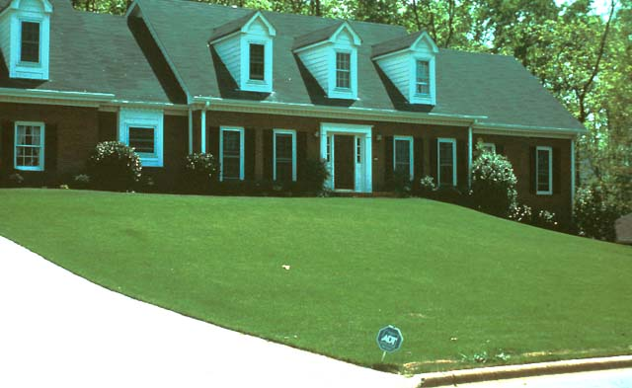
Avoid Using Irrigated Turfgrass Just to Fill Space
Notes:
70. AVOID USING IRRIGATED TURFGRASS JUST TO FILL SPACE. Unfortunately, in a typical landscape, turfgrass frequently receives the highest amount of supplemental irrigation of any plant in the landscape. If water conservation is your goal, then avoid using irrigated turfgrass just to fill space.

Slide 71
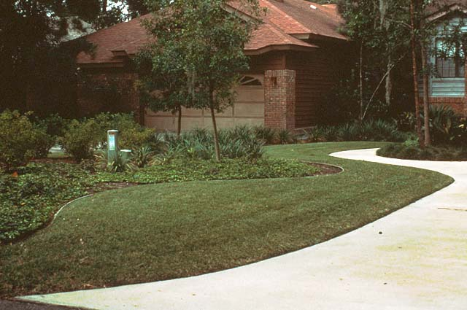
Notes:
71. TURFGRASS USED AS A WELCOME MAT. In this landscape, turfgrass serves as a welcome mat to the home. It is irrigated on demand and is considered a moderate water-use zone. In a Xeriscape, no more than 20% of the landscape should be irrigated turfgrass.

Slide 72
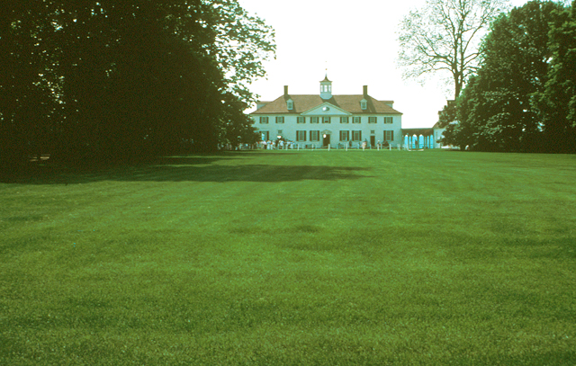
Notes:
72. MT. VERNON: EXTENSIVE TURF AREA. Our fascination with extensive turfgrass areas dates back to colonial times. George Washington used expansive areas of turfgrass at his Mt. Vernon estate, but it was not irrigated. In fact, lawnmowers had not been invented in Washington’s day.

Slide 73
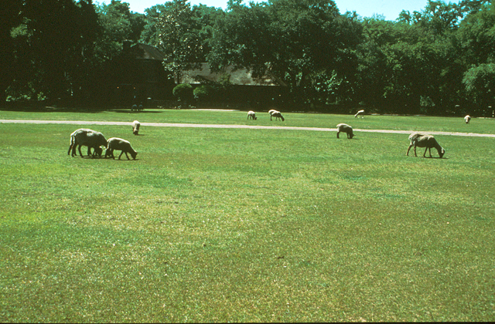
Notes:
73. FOUR-LEGGED LAWN MOWERS. Four legged lawnmowers were readily available. They also applied an organic fertilizer as they mowed. Although we have become more mechanized and more sophisticated, the same concept would work in the modern American landscape. Imagine, if you will, tethering a sheep to a rope in your turf area and letting it mow a circular area.

Slide 74
Recommended Number of Sheep per 3,000 sq. ft. of Lawn Area
Desired Height # of Sheep
1- inch 3
2-inches 2
3-inches 1
Notes:
74. RECOMMENDED NUMBER OF SHEEP. You’ll find that the number of sheep needed is inversely proportional to the height of the cut. The closer the cut, the more sheep per unit area you’ll need. (Ha, Ha).

Slide 75
Questions?
Notes:
75. QUESTIONS. Enough of this silliness, (#) let me pause here and ask if you have any questions on anything I’ve covered in the first portion of this program.

Slide 76
Let's Take
A Break!!!!
Notes:
76. LET’S TAKE A BREAK!

Slide 77
Seven Steps of Xeriscape
Planning and Design
Soil Analysis
Appropriate Plant Selection
Practical Turf Areas
Efficient Irrigation
Use of Mulches
Appropriate Maintenance
Notes:
77. EFFICIENT IRRIGATION. Using Efficient Irrigation is the next step to a water-wise landscape.

Slide 78
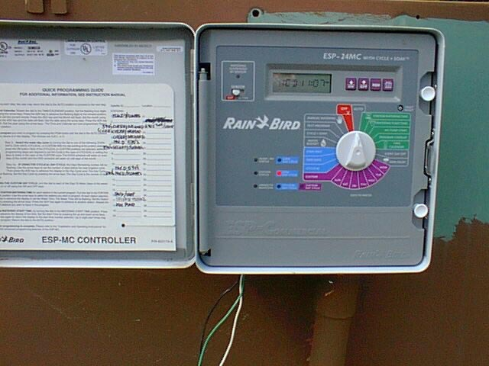
Adjust timers frequently according to changes in rainfall patterns
Notes:
78. ADJUSTING THE TIME CLOCK. If your landscape has an automated irrigation system, remember to adjust it according to changes in rainfall patterns. Don’t just set it and forget it.

Slide 79
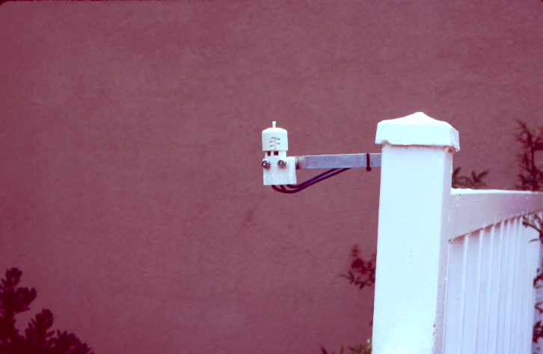
A low-cost rainfall sensor will prevent the irrigation system from running during rain
Notes:
79. RAINFALL SENSOR. A rainfall sensor is a smart investment for an automated irrigation system. This device senses rainfall and prevents the irrigation system from running during rain.

Slide 80
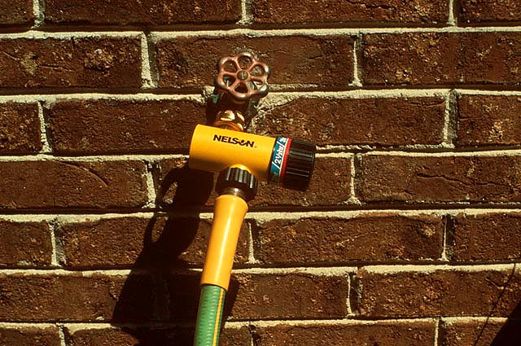
Notes:
80. TIMER FOR FAUCET CONNECTION. If you use a portable lawn sprinkler, a low-cost timer connected at the faucet can be set to turn the sprinkler off after a designated period of time. This will prevent you from over-watering an area.

Slide 81
Target irrigation to plants that show signs of stress
Gray/green Color
Wilting
Dying Branches
Use a hand-held hose with water breaker or sprinkler can to target irrigation to plants that need water
Notes:
81. TARGET IRRIGATION TO PLANTS THAT SHOW SIGNS OF STRESS. Not all plants in the landscape have the same requirement for water, so target your irrigation to plants that show symptoms of moisture stress. (#) Plants will tell you when they need water by turning a gray/green color or by wilting. Some trees and shrubs will shut down selected branches in an effort to conserve moisture. (#) Use a hand-held hose with an attached water breaker or a sprinkler can to target irrigation to plants showing moisture stress.

Slide 82
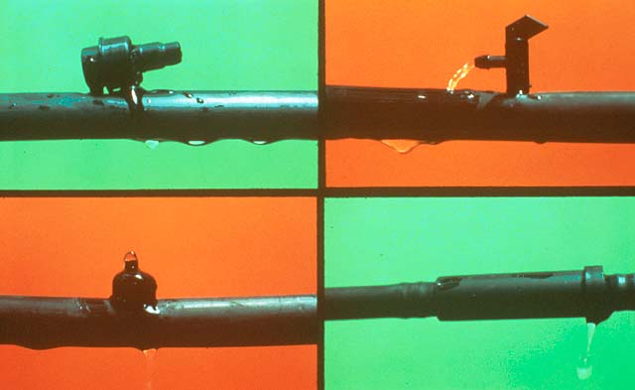
Drip Irrigation
Uses 30% to 50% less water than sprinkler irrigation
Avoids spraying foliage so diseases are less likely to occur
No spray drift
Only need to water 25% of the root area
Notes:
82. DRIP IRRIGATION. Drip or low-volume irrigation is an efficient way to irrigate ornamental plants. With these systems, water oozes or drips from tubing at a rate of 1 to 2 gallons per hour. (#) It uses 30 - to 50 % less water than sprinkler irrigation. (#) By applying water to the root area of plants, the foliage remains dry, thereby keeping foliar diseases to a minimum. (#) There is no spray drift with drip irrigation like you sometime get with sprinkler irrigation, particularly on a windy day. (#) And only a portion of the root system needs to be irrigated to absorb all the water a plant needs. Water is very mobile in the plant. So once it is absorbed, it is transferred readily throughout the plant.

Slide 83
For most efficient use of water, irrigate between 9 pm and 9 am to avoid evaporative loss of water.
Avoid light, frequent irrigation because it encourages shallow rooting and increases water demand of the plant.
Notes:
83. WATER BETWEEN 9 PM AND 9 AM. Less evaporative loss of water will occur if irrigation is applied from late evening to early morning. Research has shown that as much as 50% of the water applied during mid-day can be lost to evaporation. Night-time watering does not encourage plant disease because the foliage is usually wet from the night-time dew anyway. (#) Avoid light, frequent irrigation because it encourages a shallow root system which causes the plant to demand more water.

Slide 84
Seven Steps of Xeriscape
Planning and Design
Soil Analysis
Appropriate Plant Selection
Practical Turf Areas
Efficient Irrigation
Use of Mulches
Appropriate Maintenance
Notes:
84. USE OF MULCHES. Use of mulches around ornamental plants is an important step in developing a water-wise landscape.

Slide 85
Benefits of Mulch
Prevents evaporative water loss from the soil
Prevents soil-borne diseases
Insulates the roots of plants from extreme heat and cold
Reduces weed competition
Notes:
85. BENEFITS OF MULCH. Mulch provides a number of benefits to the landscape. (#) From the water conservation standpoint, mulch prevents evaporative water loss of water from the soil. (#) It also prevents certain soil-borne diseases by acting as a barrier between the soil and the plant. (#) It insulates the roots of plants from extreme heat and cold, (#) and it reduces weed competition by blocking light and preventing some weed seeds from germinating.

Slide 86
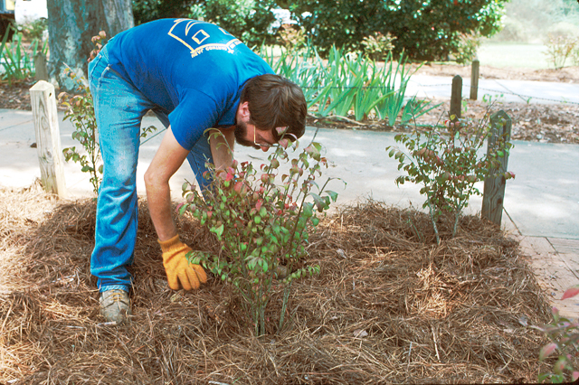
Best Mulch
Organic
Fine-textured
Non-matting
Notes:
86. BEST MULCH. Generally, the best mulch for the landscape is one that is organic, fine-textured and non-matting. Examples include pine straw, pine bark mini-nuggets, shredded hardwood mulch or cypress mulch. Inorganic mulches, such as rock or gravel, are not good mulches in the South because they absorb and re-radiate heat around the plant canopy and increase evaporative loss of water from the plant. Fine-textured mulches, such as mini-nuggets or shredded hardwood, do a better job of holding moisture in the soil than more porous coarse-textured mulches.

Slide 87
How Much Mulch To Apply?
3 to 5 inches is sufficient
1 bale of pine straw covers approximately 50 sq. ft.
9 - 3 cu. ft. bags or 13 – 2 cu. ft. of bark mulch will cover 100 sq. ft. to a 3-inch depth
Notes:
87. HOW MUCH MULCH TO APPLY? To realize the benefits from mulch, (#) apply it at a depth of 3 to 5 inches. (#) If you purchase pine straw, 1 bale will cover approximately 50 square feet when applied a 3- to 5-inch depth. (#) If you purchase bagged bark mulches, you will need nine 3-cu. ft. bags or thirteen 2-cu. ft. bags for each 100 square feet of mulched area.

Slide 88
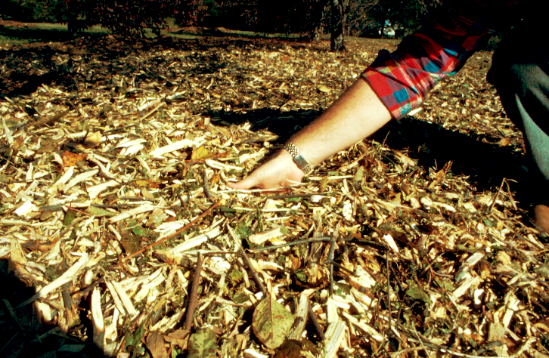
Notes:
88. USE RECYCLED MULCH. Many municipalities in Georgia are now collecting woody brush and grinding it into mulch for use in public parks and municipal landscapes. Some local governments also offer this mulch free or at low cost to local citizens. Check with your local municipality on the availability of this material.

Slide 89
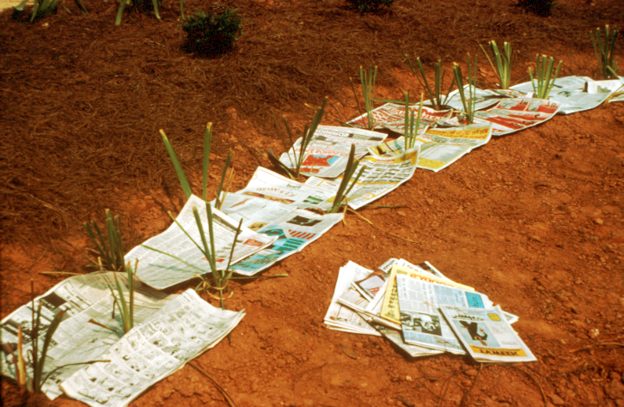
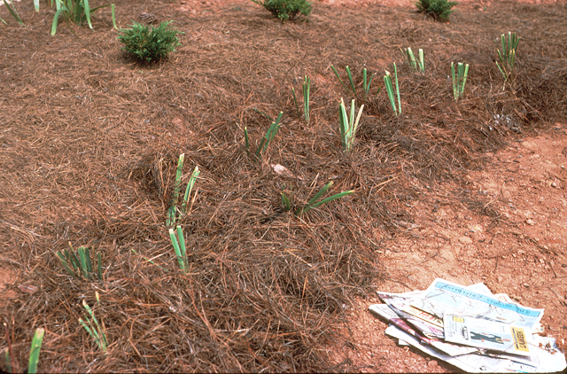
Newspaper placed under mulch, 2- to 3-sheets thick, helps provide an added barrier to moisture loss.
Notes:
89. USING NEWSPAPER UNDER MULCH TO CONSERVE MOISTURE. When installing new plants in low water-use zones, consider adding newspaper, two to three sheets thick, over the soil surface to serve as an added barrier to moisture loss. This is a great way to recycle and reuse newspaper while conserving moisture in the soil. (#) Once in place, cover the newspaper with an organic mulch to hide it and hold it in place. The newspaper will gradually decompose and add organic matter to the soil.

Slide 90
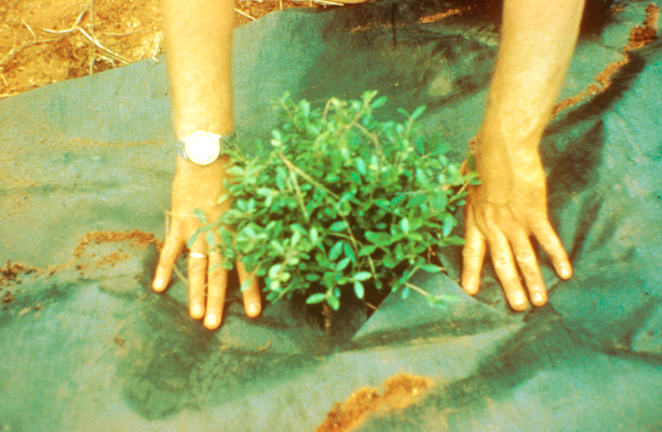
Landscape fabrics under mulch helps prevent weeds and conserves moisture in the soil
Notes:
90. LANDSCAPE FABRIC. Many garden centers sell landscape fabrics for controlling weeds and conserving moisture in the soil. Just like newspaper, landscape fabrics provide an extra barrier to moisture loss and are excellent for use around new plantings in low water-use zones.

Slide 91
Seven Steps of Xeriscape
Planning and Design
Soil Analysis
Appropriate Plant Selection
Practical Turf Areas
Efficient Irrigation
Use of Mulches
Appropriate Maintenance
Notes:
91. APPROPRIATE MAINTENANCE. Last, but certainly not least among the steps to a water-wise landscape is Appropriate Maintenance. Now that you have applied the first six steps to develop a water-wise landscape, it’s important to also manage the landscape with water conservation in mind. This means doing everything possible to assure good health while minimizing plant stress and water demand.

Slide 92
Avoid Frequent Flushes of Vegetative Growth Brought on by:
Fertilization
Pruning
Irrigation
Notes:
92. AVOID FREQUENT FLUSHES OF NEW GROWTH. Try to avoid promoting frequent flushes of new growth on plants through #) fertilization, (#) pruning (#) and irrigation. New growth not only increases the water demand of the plant, but also increases maintenance requirements by increasing the frequency of pruning.

Slide 93
Fertilization
Target fertilization to plants that need it. Established trees and shrubs may not need to be fertilized annually.
Use slow-release forms of nitrogen (Urea formaldehyde, IBDU, Sulfur-coated urea)
Use low rates of fertilizer
Limit fertilization during dry periods
Notes:
93. FERTILIZATION. Fertilization, like pruning and watering, promotes new vegetative growth and increases water demand of plants. (#) Target fertilization to plants that need it, such as annuals, herbaceous perennials or newly planted ground covers. Established trees and shrubs may not need to be fertilized annually. (#) When selecting fertilizer, look for slow-release forms of nitrogen, such as urea formaldehyde, IBDU or sulfur-coated urea. These forms of nitrogen are released slowly and evenly to the plant throughout the growing season.(#) Use low rates of fertilizer. Again, the goal is to maintain plant health, not promote optimum growth. (#) Finally, and most importantly, limit fertilization during dry periods. Fertilizers are chemically salts and can dehydrate roots and cause plant stress.

Slide 94
Too Much Nitrogen
Increases pest problems
Increases top growth
Reduces root growth
Increases pruning requirements
Increases run-off into groundwater
Notes:
94. TOO MUCH NITROGEN. Research has shown that a high rate of nitrogen can be detrimental to the plant.(#) It encourages new vegetative growth that is attractive to pests. (#) It increases top growth of the plant, and when top growth increases, (#) root growth decreases. As result, the roots have an increasingly difficult time supporting the top of the plant. (#) And when top growth is accelerated, pruning requirements increase. (#) Excess nitrogen also increases the likelihood of elevated nitrate levels in groundwater which can pose a public health problem.

Slide 95
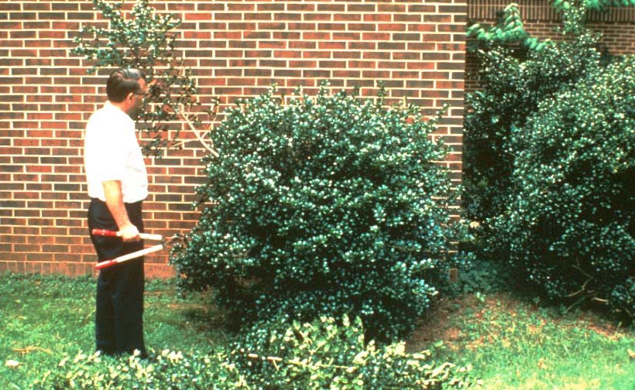
Prune by selective thinning instead of shearing
Notes:
95. SELECTIVE THINNING. Whenever possible, prune plants by making selective thinning cuts instead of shearing them. Thinning opens up the plant canopy, increases air circulation around the foliage and helps prevent diseases. It also results in a more natural growth form. Shearing, on the other hand, stimulates an abundance of new thick, dense growth at the tips of the canopy. As a result, air circulation within the canopy decreases, insect and disease problems are encouraged, and pruning requirements increase.

Slide 96
Grasscycling
Let the Clips Fall Where they May
Clippings
Help Hold
Moisture
in the soil
Clippings
Add
Nitrogen
Back
to the
Soil
Clippings DO NOT Cause Thatch
Notes:
96. GRASSCYCLING. Grasscycling, the practice of letting lawn clippings fall back on the lawn when mowing, is a proven cultural practice with many environmental benefits. (#) From the water conservation standpoint, clippings recycled back to the turf save water by acting as a mulch at the base of the grass blades. (#) Clippings DO NOT cause thatch build-up in turfgrass. Thatch results from an accumulation of fibrous stems and roots. (#) Grasscycling also recycles nutrients back to the turf and reduces the lawn’s requirement for fertilizer. The key to successful grasscycling is to mow frequently enough so that no more than one-third of the total plant height is removed at each mowing. Small clippings decompose quickly.

Slide 97
Seven Steps of Xeriscape
Planning and Design
Soil Analysis
Appropriate Plant Selection
Practical Turf Areas
Efficient Irrigation
Use of Mulches
Appropriate Maintenance
Notes:
97. SEVEN STEPS OF XERISCAPE. So you see, Xeriscape is nothing more than seven common-sense practices that result in water conservation. The more of them you implement, the more water-wise your landscape will become.

Slide 98
Notes:
98. NICE XERISCAPE. Quality landscapes that save water and protect the environment.... that’s what Xeriscape is all about. By following the steps outlined in this presentation, you too can have twice the landscape for half the water.

Slide 99
Notes:
99. CHILDREN PLAYING IN WATER FOUNTAIN. Water....it’s a resource we can no longer take for granted. As urban areas continue to grow and competition for water increases, we simply are not going to have as much water in the future as we’ve had in the past. We all must do our part to conserve this resource so that our children and future generations can continue to enjoy the same quality of life that we appreciate today.

Slide 100
Make Every Drop Count !
Our Future
Depends On It
Notes:
100. MAKE EVERY DROP COUNT. It’s up to each of us to MAKE EVERY DROP COUNT! (#) Our future depends on it.

Slide 101
Author
Gary L. Wade, Ph.D.
Extension Horticulturist
University of Georgia
Department of Horticulture
Notes:
101. CREDIT SLIDE.

Slide 102
Consider the Economic Benefits of Water-wise Landscapes
Notes:
Addendum
Author Note: People are often reluctant to change existing practices unless they can justify the economic benefit. The following material discussing the economic benefits of Xeriscape may be useful for selected audiences, but it may be too technical for general audiences. Therefore, it can be included or left out, depending on the audience.
102. CONSIDER THE ECONOMIC BENEFITS OF WATER-WISE LANDSCAPE. Xeriscape not only saves water, it saves money, as you will see from the following example.

Slide 103
Water/Sewage Rates in Athens/Clarke County
Water: $1.83/100 cu. ft.
Sewage: $1.41/100 cu. ft.
100 cu. Ft. x 7.45 = 745 gallons
$1.83 = x
745 gal. 1,000 gal.
Water: $2.46/1000 gallons Sewage: $ 1.89/1000 gallons
Notes:
103. ATHENS/CLARKE COUNTY WATER AND SEWAGE RATES. First, let’s look at the water and sewage rate structure for Athens/Clarke County. Similar information is available from the utility department in any municipality. (#) In Athens, water is billed at $1.83 per 100 cubic feet (2001 rate structure). (#) Sewage costs $1.41 per 100 cubic feet. Sewage is billed according to water use.(#) One hundred cubic feet of water is equivalent to 745 gallons.(#) A simple algebraic equation can be used to calculate water and sewage costs per 1,000 gallons.

Slide 104
Assumptions
1 inch of water = 600 gal./1,000 sq. ft.
High Water-use Zones:
1 in. water 4 times/mo: Mar. -Oct., then 1 in. water 1 time/mo: Nov. -Feb.
Moderate Water-use Zones:
1 in. water 2 times/mo: March - Oct;
then no water: Nov. -Feb.
Low Water-use Zones:
No supplemental irrigation
Notes:
104. ASSUMPTIONS. To use these costs to make economic comparisons, we need to make certain assumptions. (#) First, we know that 1 inch of water equals 600 gallons per 1,000 square feet. (#) Let’s assume the High Water-use Zones receive approximately 1-inch of irrigation water 4 times per month (approx. once per week) from March to October, then 1 time per month from November to February. Of course this will vary with rainfall patterns, but this is a realistic assumption. (#) The Moderate Water-use Zones would be watered only on demand and would receive considerably less irrigation than the high water-use zones. Let’s assume they get 1 inch of irrigation water twice a month from March to October, then no irrigation from November through February. (#) The Low Water-use Zones would not be irrigated.

Slide 105
Projected Water Cost/1000 sq. ft.
Water Zone | Water Cost | Sewage Cost | Total Cost
High Water-use Zone | $53.14 | $40.82 | $93.96
Moderate Water-use Zone | $23.62 | $18.14 | $41.76
Total : $135. 72
Notes:
105. PROJECTED WATER AND SEWAGE COSTS. Using the previous assumptions, we can then calculate the cost of water and sewage for each 1,000 square feet of irrigated areas in each of the water-use zones. In this example, water and sewage cost for each 1,000 square feet of landscaped area in the high water-use zones would be $93.96. Irrigation and sewage costs for each 1,000 square feet in the moderate water-use zones would be $41.76. If a landscape consisted of 1,000 square feet in the high water-use zones and 1,000 square feet in moderate water-use zones, total water and sewage costs would be $135.72 per annually.

Slide 106
Potential Savings
Convert 1/3 of a ½ acre lot from High to
Low Water Use,
SAVE $588.18/yr.
Convert 1/3 of a ½ acre lot from Moderate
to Low Water Use,
SAVE $266.42/yr.
Total Potential Savings: $849.59/yr. on water and sewage
Notes:
106. POTENTIAL SAVINGS. Now let’s look at some potential savings. (#) If we convert one-third of a half-acre lot from high water-use to low water-use, potential savings on water and sewage is $588.18 per year. (#) If 1/3 of a half-acre lot is shifted from moderate water-use to low water-use, savings on water and sewage would be $266.42 per year. (#) So the potential savings realized by shifting two-thirds of the landscape to low water-use would be $849.59 per year.

Slide 107
Comparative Cost of Converting 1000 sq. ft. of Irrigated Area to Mulch or Groundcover Plants
Pine Straw @ $3/bale
1 bale covers approx 50 sq. ft to a 3-inch depth
20 bales/1000 sq. ft. X $3/bale = $60
Asiatic Jasmine Groundcover @ 24-inch centers
Liner plants (2 ¼-inch pots) @ $0.75/pot
250 plants/1000 sq. ft. x $0.75/plant = $187.50
+ 20 bales of pine straw (2-inch depth) @ $3/bale = $60
Total Cost = $247.50
Notes:
107. COMPARATIVE COST OF CONVERTING 1,000 SQ. FT. TO MULCH OR GROUNDCOVER PLANTS. Now let’s take this cost analysis one step further and look at the comparative costs of converting 1,000 square feet of irrigated landscape area to mulch or groundcover. (#) Average retail cost of pine straw is $3 per bale. One bale covers approximately 50 square feet to a 3-inch depth. Therefore, 20 bales will be required per 1,000 square feet at a cost of $60. (#)(#) As an alternative, you may choose to plant a groundcover, such as Asiatic Jasmine. If we planted them two feet apart and purchased small liner plants at a cost of 75 cents per pot, plant costs could be $187.50. In addition, 20 bales of pine straw would be required to mulch the planting, so total cost of this retrofit would be $274.50 per 1,000 square feet. Bear in mind that the plants would need to be watered on demand the first growing season, then shifted to the low water-use zone in year 2.

Slide 108
Comparative Cost of Converting 1000 sq. ft. of Irrigated Area to Mulch or Groundcover Plants
Juniper Groundcover @ 4 ft. centers =
63 plants/1000 sq. ft.
63 plants @ $4/plant = $252
+ 20 bales of pinestraw @ $3/bale = $60
Total Cost = $312
Notes:
108. COMPARATIVE COST OF CONVERTING 1,000 SQ. FT. TO MULCH OR GROUNDCOVER PLANTS. A third scenario might be to plant a spreading juniper as a groundcover. In this case, the plants would be placed on 4 ft. centers, which would require 63 plants per 1,000 square feet. If we paid $4 for 1-gallon plants, plant cost would be $252. Then we would need to mulch them with pine straw at a cost of $60. So the total cost of this retrofit would be $312 per 1,000 square feet.

Slide 109
Comparative Cost of Converting 1000 sq. ft. of Irrigated Area to Mulch or Groundcover Plants
Pine Straw | $60.00
Asiatic Jasmine | $ 247.50
Juniper | $312.00
Water + Sewage (high water-use zone) | $93.96
Notes:
109. COMPARATIVE COST OF CONVERTING 1,000 SQ. FT. TO MULCH OR GROUNDCOVER PLANTS. So if we compare the cost of installing pine straw, Asiatic Jasmine or juniper to the potential savings in water and sewage cost, we see that we can easily pay for the pinestraw and can realize a return on investment in the Asiatic Jasmine in two years and in three years on the juniper.

Slide 110
Xeriscape not only saves water…
It Saves Money!
Notes:
110. XERISCAPE NOT ONLY SAVES WATER....IT SAVES MONEY. Hopefully this example has shown that simple changes in the landscape can result in considerable long-term savings. As competition for water grows, water and sewage costs will likely increase and the economic incentives for developing water wise landscapes will become more evident.

