Slide 1

Notes:
1. UGA Logo

Slide 2
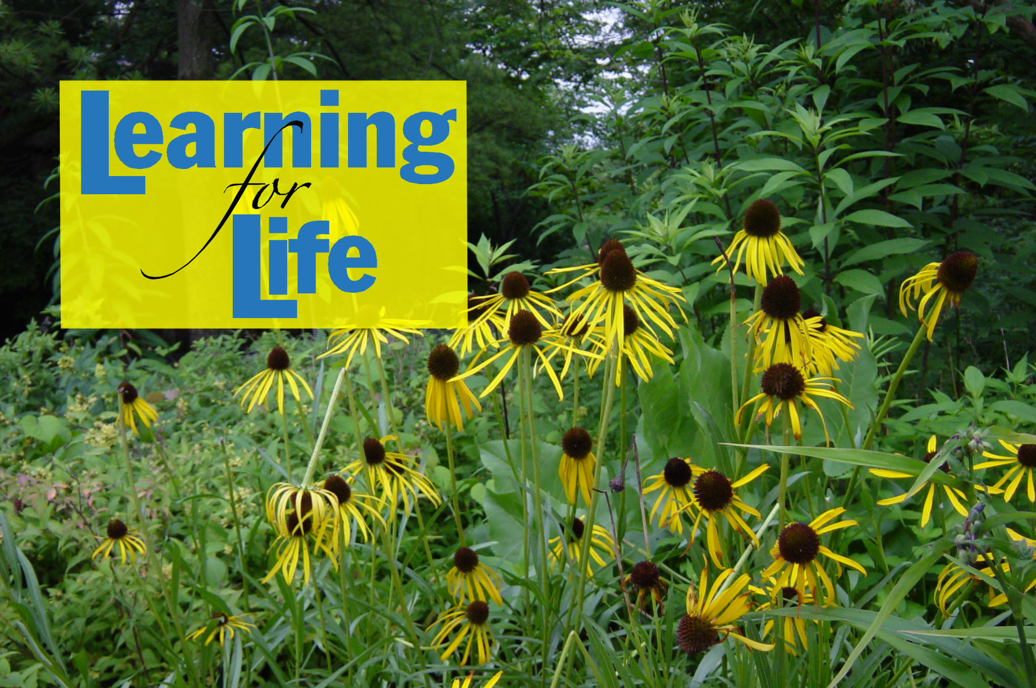
http://www.caes.uga.edu/extension/
Notes:
2. UGA Cooperative Extension Web address

Slide 3

Notes:
3. Georgia Master Gardener Logo

Slide 4
DEALING WITH
NUISANCE WILDLIFE
MICHAEL T. MENGAK, Ph.D., CWB
WILDLIFE SPECIALIST
WARNELL SCHOOL OF FOREST RESOURCES
Notes:
4. Title Slide
Many species of urban wildlife receive little attention from homeowners. They are present in such numbers that they become part of our everyday life. Often times we actively promote the presence of wildlife near us for personal or aesthetic purposes. Millions of people put out bird feeders to attract wildlife to their backyards, for example. Maintaining intimate contact with wildlife in this way helps humans retain a sense of their interconnection with the natural environment.
In some cases, however, the interaction with wildlife is unintentional and unwanted. Raccoons in garbage cans or bats in attics are not-so-welcome visitors in our home environment.

Slide 5
Learning objectives
Common perceptions and myths related to wildlife control
State laws relating to wildlife control
Common nuisance wildlife
Notes:
5. After you complete your study of this chapter you should be able to:
Understand common perceptions and myths related to wildlife control.
Be familiar with state laws relating to wildlife control.
Be familiar with some common nuisance wildlife.

Slide 6
Learning objectives
Why some animals become nuisance pests
Discourage wildlife damage to home, landscape and gardens
Basic guidelines for dealing with nuisance wildlife in and around the home and garden
Notes:
6. Learning objectives continued-
Develop knowledge of why some animals become nuisance pests.
Learn ways to discourage wildlife damage to home, landscape and gardens.
Learn some basic guidelines for dealing with nuisance wildlife in and around the home and garden.

Slide 7
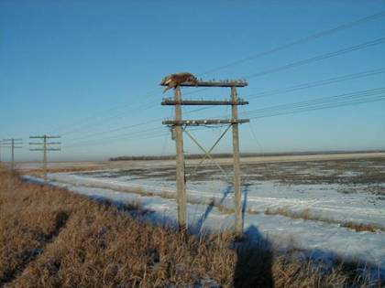
Notes:
7. Sometimes wildlife is a nuisance. Overabundant white-tailed deer often create conflicts with humans. The objective of wildlife damage management is to resolve conflicts between humans and wildlife.

Slide 8
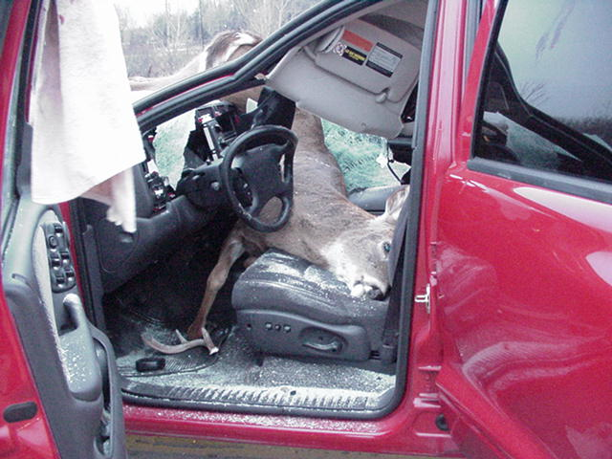
Notes:
8. Deer-vehicle collisions cause millions of dollars in property damage each year in Georgia and throughout the United States. Human injury and fatalities can occur. It is estimated that only one-half of all deer-vehicle collisions are reported to police and insurance companies.

Slide 9
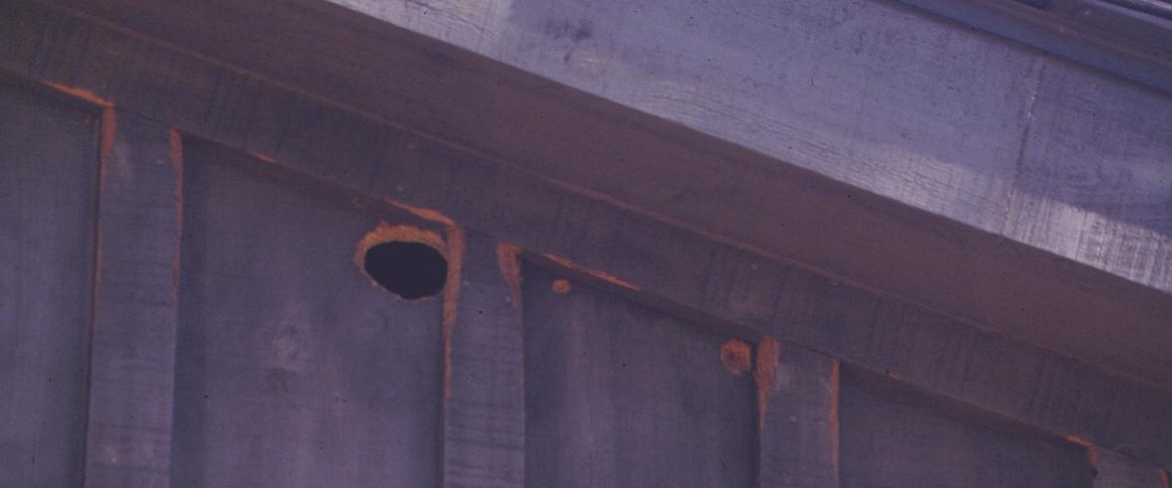
Notes:
9. Not all damage is due to deer. Here a flying squirrel has gnawed a hole in the side of a nice house.

Slide 10
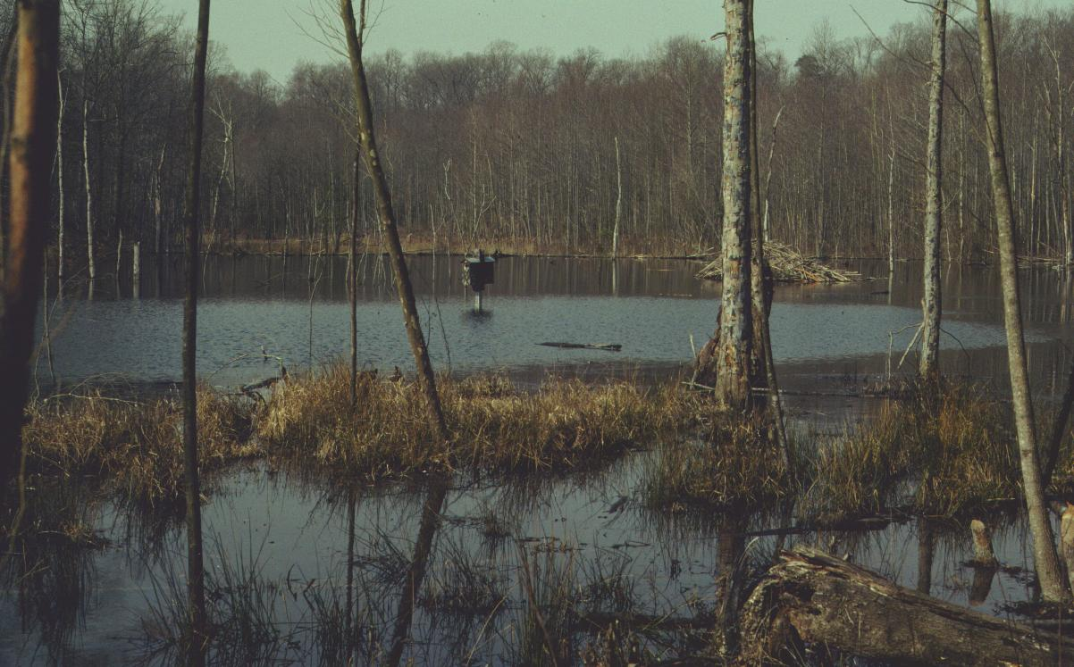
Notes:
10. Beaver can build dams on creeks. This could be damage but some people may see this as a beneficial impact. Flooded roads, timber, or crops is certainly damage. However, in this photo the beaver have created valuable wildlife habitat. Habitat for frogs, salamanders, wood ducks, woodpeckers, otters, mink, and fish.

Slide 11
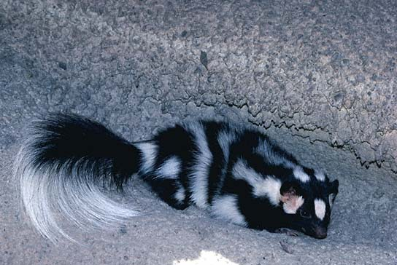
Notes:
11. This spotted skunk is not causing any damage. However, when the skunk is under your house or in your chicken coop and the potential for damage is present.

Slide 12
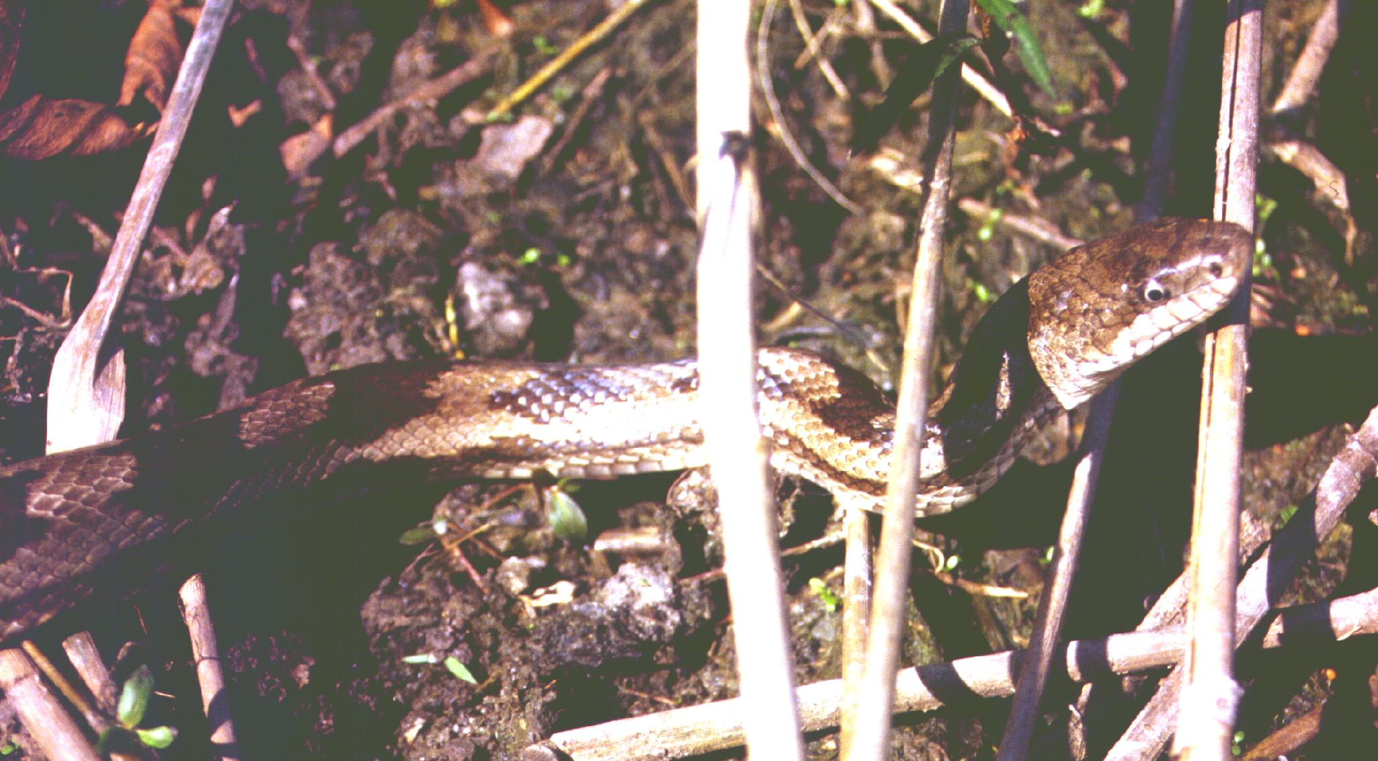
Notes:
12. All non-venomous snakes are protected in Georgia. They are very beneficial in their role of predator. However, they can cause a wildlife – human conflict situation for some people.

Slide 13
Outline
Definitions – Discussion of Problem
Role of Government – Legal Issues
Decision Model - HERL
Review a few species
Notes:
13. In this program we will discuss the following topics:
Definitions – Discussion of Problem
Role of Government – Legal Issues
Decision Model - HERL
Review a few species

Slide 14
Wildlife
Positive values
  Utility – sport, food
  Monetary – fur, lease, tourism
  Food
  Ecological – intrinsic value
  Recreational – bird watching, photography
Notes:
14. Positive values associated with wildlife include: Utility – use for sport and food, monetary (fur, lease, or tourism), as a food source, ecological by its intrinsic value, and recreational including bird watching, photography.

Slide 15
Wildlife
Negative values
  Crop damage
  Damage to buildings
  Disease
  Vehicle collision
  Predation
Notes:
15. Some of the negative values associated with wildlife include: Crop damage, damage to buildings, spread of disease, vehicle collisions and predation (usually on livestock and pets).

Slide 16
Wildlife Management
Wildlife management – scientific discipline that deals with animals whose movement and behaviors are not controlled by humans.
Wildlife damage management – sub-discipline of wildlife management
Wildlife Management
Damage Management
Notes:
16. Wildlife management is what humans do to ensure that wildlife species serve whatever ecological, commercial, recreational, or scientific purposes state law or public interest determines. The techniques of wildlife management run the gamut from manipulating wildlife habitat to establishing hunting and fishing seasons and regulations and from collecting wildlife population data to educating the public about wildlife conservation.
Wildlife management is concerned with all wildlife species - both game (those pursued for sport) and nongame.
Wildlife damage management is a sub-discipline of wildlife management

Slide 17
Wildlife Management
Traditional wildlife management has been concerned with increasing game species for hunters
Overabundant wildlife are often the result of good game management gone too far
  Canada Geese
  Deer
  Beaver
Notes:
17. Much of traditional wildlife management has been concerned with increasing game species for hunters. In some cases wildlife species were managed too well. Examples of species that thrived under management are the Canada Goose, Whitetail deer and the beaver which now present a nuisance problem in many areas.

Slide 18
Nuisance Wildlife
Wildlife that occurs in a place where it is unwanted
Wildlife that causes damage to valuable plants or structures
Notes:
18. As we urbanize the land, radical changes occur to sources of food, water, and shelter for wildlife. Some animals respond very well to the changes urbanization brings. Many species of urban wildlife receive little attention from homeowners. They are present in such numbers that they become part of our everyday life. Often times we actively promote the presence of wildlife near us for personal or aesthetic purposes. Millions of people put out bird feeders to attract wildlife to their backyards, for example. Maintaining intimate contact with wildlife in this way helps humans retain a sense of their interconnection with the natural environment.
In some cases, however, the interaction with wildlife is unintentional and unwanted. Raccoons in garbage cans or bats in attics are not-so-welcome visitors in our home environment or deer browsing on crops and landscape plants.

Slide 19
Wildlife Damage Management
Seeks to increase the positive value of wildlife by reducing the negative values
Needs of People
Needs of Wildlife
Balance
Notes:
19. Wildlife damage management is an activity that seeks to balance the needs of human activity with the needs of wildlife to the mutual enhancement of both.
Sometimes the solution to an animal-human conflict requires the human to change his or her behavior. Other times, the solution is to change the animal's behavior. Various tools and strategies are used to reduce human-animal conflict, such as behavior modification, repellents, exclusion, habitat modification, relocation, lethal control etc.

Slide 20
Wildlife Damage Management
Ultimately, to reduce damage we need to find a way to co-exist
  But this can be a gross oversimplification
Consider this quote from a rancher upon hearing about research on fertility control of coyotes --
  “You want to sterilize coyotes? Perhaps you don’t understand the problem: the coyotes are killing my sheep. They are not mating with them!”
Notes:
20. Wildlife damage management is an increasingly important part of the wildlife management profession because of expanding human populations and intensified land-use practices. Along with the growing need to reduce wildlife-people conflicts, public attitudes and environmental regulations are restricting use of some of the traditional tools of control such as toxicants and traps. Agencies and individuals carrying out control programs are being more carefully scrutinized to ensure that their actions are justified, environmentally safe, and in the public interest. Wildlife damage management must be based on sound economic, ecological, and sociological principles and carries out as positive, necessary components of overall wildlife management programs.

Slide 21
Wildlife Damage Management
Wildlife damage management has been a part of wildlife management from the beginning
  Office of Economic Ornithology
  Predator Control – varmints; bounty system
Today – overabundant human population is often the problem
  Humans encroach on wildlife; move to wildlife habitat; create habitat attractive to wildlife; we need to balance needs of wildlife and humans
    Neither one is going to disappear
Notes:
21. Wildlife damage management has been a part of wildlife management from the beginning but today it is becoming a much larger part of wildlife management because of growing human population moving into wildlife habitat.
Early wildlife damage management was focused on farming-The Office of Economic Ornithology was one of the first government attempts to assist farmers reduce crop loss to birds – specifically blackbirds. Other wildlife damage management methods included predator control for varmints; wolves were once considered varmints. The bounty system was a way to encourage hunters and farmers to reduce populations. Today overabundant human population is often the problem. Humans encroach on wildlife; move to wildlife habitat; create habitat attractive to wildlife; we need to balance needs of wildlife and humans. Neither one is going to disappear

Slide 22
Role of Government
Wildlife is common property “owned” by society.
Can not be controlled by one person for their sole benefit.
Individuals/corporations own land and can restrict access.
Notes:
22. Wildlife is held in the public trust by states and the federal government. No one entity owns a wildlife species. States retain primary authority over resident wildlife. The ruling governments of various nations agree to cooperate in the conservation and management of those migratory wildlife species that move freely across common borders. In the United States, one can find wildlife species that fall into both management jurisdictions.

Slide 23
Wildlife Law
27-1-3 – Georgia Code
(b)The ownership of, jurisdiction over, and control of all wildlife, as defined in this title, are declared to be in the State of Georgia, in its sovereign capacity, to be controlled, regulated, and disposed of in accordance with this title. Wildlife is held in trust by the state for the benefit of its citizens and shall not be reduced to private ownership except as specifically provided for in this title. All wildlife of the State of Georgia is declared to be within the custody of the department for purposes of management and regulation in accordance with this title. However, the State of Georgia, the department, and the board shall be immune from suit and shall not be liable for any damage to life, person, or property caused directly or indirectly by any wildlife.
Notes:
23. According to law, wildlife is a public resource held in trust by the sovereign State of Georgia.

Slide 24
Wildlife Law
27-1-28. Georgia Code
(a) Except as otherwise provided by law, rule, or regulation, it shall be unlawful to hunt, trap, fish, take, possess, or transport any nongame species of wildlife, except that the following species may be taken by any method except those specifically prohibited by law or regulation:
(1) Rats;
(2) Mice;
(3) Coyotes;
(4) Armadillos;
(5) Groundhogs;
(6) Beaver;
(7) Fresh-water turtles;
(8) Poisonous snakes;
(9) Frogs;
(10) Spring lizards;
(11) Fiddler crabs;
(12) Fresh-water crayfish;
(13) Fresh-water mussels; and
(14) Nutria.
(b) The nongame species enumerated in subsection (a) of this Code section may be taken by any method except those specifically prohibited by law or regulation.
(c) Nothing in this Code section shall be construed to authorize the taking of any species which is protected under the federal Endangered Species Act of 1973, P.L. 93-205, as amended, or under any state law which has as its purpose the protection of endangered or threatened species.
Notes:
24. The law grants a few specific exceptions in that the species listed here have no legal protection from harvest. Local ordinances may restrict local activities.

Slide 25
Wildlife Law
Birds – All birds (except 3) are federally protected
  Migratory Bird Treaty Act
  http://laws.fws.gov/lawsdigest/migtrea.html
Strict liability law
  No need to prove “intent”
  Enforcement is absolute and not discretionary
May not pursue, hunt, take, capture, kill or possess at any time any bird, any part, nest or egg.
Notes:
25. All birds are federally protected because they can cross state and international boundaries. Only the English house sparrow, European starling, and rock dove (pigeon) are not federally protected. DO NOT EVER KILL ANY BIRD unless you have a hunting license and are in season or have a federal damage permit.

Slide 26
WDM - Sources of information
Extension Service
  Provides advice and technical assistance
  Lend traps
  Provide printed material
  Provide workshops or training
Notes:
26. The county agents, state specialists and this program provide advice on damage management issues. The Cooperative Extension Service does not conduct wildlife control operations. Generally the problem is referred to a private business person who is an independently licensed nuisance wildlife control operator (NWCO) for technical assistance when it involves working with landowners and actively treating a nuisance problem.

Slide 27
WDM - Sources of information
Georgia Department of Natural Resources
Wildlife Resources Division
  http://www.georgiawildlife.com/
    Permits Office – Scott Frazier
      770-761-3044
      Social Circle, GA
Notes:
27. An excellent source of information relating to wildlife damage management is the Georgia Department of Natural Resources. DNR offices offer information and education; in a few instances a biologist/conservation officer may conduct a wildlife control operation. DNR offices are listed in the government pages of the phone book or information is available online at www.georgiawildlife.com
For permits other than regular hunting licenses contact the special permits office in Social Circle, Georgia at Special Permit Unit at (770) 761-3044.

Slide 28
WDM - Sources of information
USDA APHIS WS – 706-546-2020
  Technical Advice – instruction; printed material; rent/loan traps or other devices
  Operation Control – contract for their biologists to conduct management operations; $$$
USDA National Wildlife Research Center
  Ft. Collins, CO
  http://www.aphis.usda.gov/ws/nwrc/
Notes:
28. The US Department of Agriculture – Animal Plant Health Inspection Service\Wildlife Services (USDA-WS) can provide technical assistance for free or operational control for a fee with nuisance wildlife issues on a large scale. Their office is located in Athens, GA.
Also a part of the USDA’s APHIS Wildlife Services, the National Wildlife Research Center provides scientific information on wildlife, its habitat, and its relationship to agriculture and public safety. Here at the Center and in the field, specialists conduct scientific inquiries into the problems of wildlife damage and look for solutions to these problems. The NWRC seeks to protect wildlife from the adverse effects of human activities while also reducing the damage and hazards that wildlife causes to agriculture, forests, industry, and other areas of human involvement.

Slide 29
WDM - Sources of information
Nuisance Wildlife Control Operators (NWCO)
  Pronounced – “new . co”
  NOT termite control or county “dog catcher” (Animal Control Officer)
  For profit business
Notes:
29. Nuisance Wildlife Control Operators, pronounced “new-co” are private licensed for-profit business. Licensed by Ga DNR; they have passed a test but there is no formal training at this point except “on the job” training. A list (by county) is available from DNR or State Wildlife Specialist.

Slide 30
Rules of Thumb
RULE #1
  When dealing with wild animals there are no rules
RULE #2
  Animals can’t read
RULE #3
  There is no ‘magic powder’ or ‘magic bullet’ or magic. Just hard work and perseverance.
RULE #4
  If it sounds too good to be true --- IT IS!
Notes:
30. Many people with nuisance animal problems are very anxious to have their ‘problem’ solved and will often resort to desperate or ill-thought out schemes to get rid of the offending animal. They often believe that using things like ultrasonic repellants or mothballs to drive the moles or snakes away will work. Some rules of thumb to keep in mind when advising clients are:
RULE #1 When dealing with wild animals there are no rules
RULE #2 Animals can’t read
RULE #3 There is no ‘magic powder’ or ‘magic bullet’ or magic. Just hard work and perseverance.
RULE #4 If it sounds too good to be true --- IT IS!

Slide 31
Rules of Thumb
Wildlife need
  FOOD WATER SHELTER
Remove any one of these and offending animal will go somewhere else.
RULE #5
  TREAT THE PROBLEM – NOT THE SYMPTOM
Notes:
31. To control urban wildlife populations, one must manipulate one of the habitat factors: food, water, or shelter. Wildlife cannot survive unless their habitat needs are met. If one of these habitat requirements is absent, wildlife will either migrate to another area capable of providing their needs or die. For long-term wildlife management, habitat manipulation is far more effective than direct population reduction. In areas that meet a species’ habitat needs, an animal population’s birth and survival rates will increase, ultimately replenishing losses caused by direct population reduction.

Slide 32
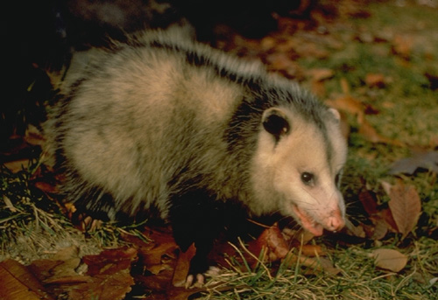
Example No. 1
Photo Courtesy of The Wildlife Services Image Collection http://images.fws.gov/
Notes:
32. Example No. 1- Opossum in shed/garage eating dog/cat food
Wrong Answer: Trap opossum and relocate
In a few days another hungry animal finds the food.
Right Answer:
1 - Seal the pet food in container with tight fitting lid
2- Seal openings to shed
3- Relocate opossum
This removes the problem (available food) and the symptom (hungry opossum).

Slide 33
Example No. 2
Example 2: Moles digging up your yard
  Wrong answer: Trap the mole. Kills one mole
  Right Answer:
    Treat yard for grubs
    Trap mole
    Reduce watering
Learn the biology of the animal; moles eat insects and earthworms
Solution may require several weeks of effort!
Notes:
33. Example 2: Moles digging up your yard
Wrong answer: Trap the mole. Kills one mole
Right Answer
Treat yard for grubs
Trap mole
Reduce watering
Learn the biology of the animal; moles eat insects and earthworms
Solution may require several weeks of effort!

Slide 34
Animal Sign
To diagnose problem – look for sign
  Droppings
    Fresh ones are black, shiny and moist
    Old ones are dry, brown, gray
  Black and white
  Size matters
    Rats, mice, toads, chipmunk
    Rabbit
    Deer
Notes:
34. If you think you have a nuisance animal problem, there are ways to determine what the offending animal is without actually seeing the animal. One way is by looking for droppings or ‘scat’. Fresh droppings are black shiny and moist. Older droppings are often dry and brownish or gray. Droppings of birds and lizards is often black and white; lizards are like birds, they make uric acid and that is why their scat always has a little white cap on one end.
Rat, mice, toad and chipmunk droppings are about the size of a grain of rice while rabbit droppings are about the size of a green pea. Deer droppings are a bit larger, about the size of a navy bean and somewhat oval; they may be in a clump.

Slide 35
Animal Sign
Digging
  Dirt mound present
    Woodchuck, turtle, armadillo, coyote, dog
  No dirt mound
    Chipmunk, skunk, mole, vole
  Tunnels near surface
    Mole, Vole
Notes:
35. If the animal sign is digging, the presence of a mound may indicate that the digger is a turtle, armadillo, woodchuck, dog or coyote. If there is no dirt mound present, it may be a mole, vole, skunk or chipmunk. Tunnels near the soil surface may be have been excavated by either a mole or vole.

Slide 36
Apple Test
Moles eat insects, grubs, earthworms
Voles eat plants, tubers, bark, roots, bulbs.
Apple Test
  Piece of apple in tunnel
  Wait
  If apple is eaten – VOLE
  If apple not eaten - MOLE
Notes:
36. To find out for sure who dug the tunnel, do the apple test. Place a cut piece of apple in tunnel under a board and wait 2-3 days. If the apple is eaten, it’s a vole; if the apple is not eaten, it’s likely a mole.

Slide 37
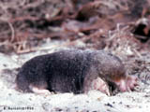
MOLE
Dark brown – black
Naked snout
Broad feet
Large claws
Nearly invisible eyes/ears
Notes:
37. Moles-There are 2 species of mole found in Georgia. Moles are mammals have a stout body with short legs. Moles have tiny eyes covered by skin and can only distinguish between light and dark; therefore, moles are confined to their underground burrows. They are well adapted for underground life. Moles literally swim through soft earth with powerful hand-like front feet that are equipped with long, flattened toenails.

Slide 38
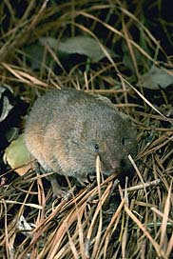
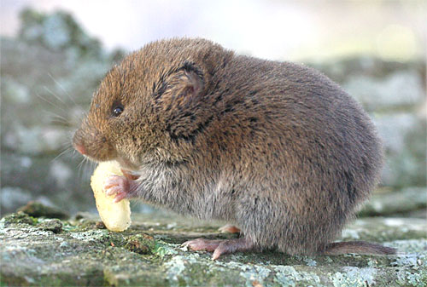
VOLE
Rich brown
Mouse-like feet
Tail ¾ to 1 ½ inches
Ears very small
Eyes visible
Furry nose
Notes:
38. Voles are small rodents that look like mice. They have blunt noses and short tails. In the Eastern United States the common species are the Meadow vole and the Pine vole. The pine vole has very short, fine fur and small indistinct eyes as compared to the meadow vole, which has coarse fur, and larger eyes. In Georgia, the meadow vole is rare but the Pine vole, also known as the orchard mouse, is locally common in many parts of Georgia. The name is a misnomer—they are not particularly attracted to pines.

Slide 39
Animal Sign
Gnawing
Deer lack upper incisor
  Plants have ragged end
Plants clipped clean
  Vole, chipmunk, squirrel, beaver, rabbit, woodrat
Branches are cut
  Squirrel, rabbit
Height
  4 ½ to 6 feet – deer; rabbits, woodchuck ~ 1 foot
  Close to ground - vole
Notes:
39. If landscape plants are showing signs of animal damage, there are a few clues that can lead you to the culprit.
Gnawing--First, is the damage above or below ground? If roots are chewed, and tooth marks are 1/16 inch wide and large roots are chopped through, a pocket gopher is the culprit. Ifthe tooth marks are very fine, a millimeter wide or less, then it’s the pine voles. Pine voles may also chew bark above ground up to a height of two or three inches. If your tree loses vigor, leaves wilt, and it wobbles in the hole, check the roots. Something may be eating them. The culprit is not a mole. They don’t chew wood; they eat only insects and worms. If only the bark on small trees is chewed within 12 inches of the ground and tooth marks are 1/16 of an inch wide, suspect a cotton rat. If tooth marks are 1/16 to 1/8 inches wide, suspect a rabbit, especially if the chewing extends 12 to 20 inches above the ground.
Rabbits will also clip off pencil-sized stems sharply, at an angle, as with a knife. If such stems are broken off bluntly, blame deer or livestock. Deer and cows leave broken ends because they do not have upper front teeth. They must pinch and pull to break sprouts or twigs.
Nipped twigs or plates of bark chewed off several feet above ground might indicate squirrels. If something with big teeth bit chunks of bark from tree trunks six or seven feet above ground and left claw marks, it was a bear. If trees are balled and debarked by some coarse toothed chewer, it was a beaver. Birds may also leave their mark on trees. Horizontal rows of small holes indicate sapsuckers. Pileated woodpeckers make rectangular holes big enough to admit the end of a two-by-four stud.
There are other chewers that leave their mark on trees or shrubs. Nearly all can be identified if you know what to look for.

Slide 40
Animal Sign
Noise
  Inside wall – mice
  Attic or crawl space – mice, bats, squirrels, raccoons, skunk, opossum, birds
  Chimney – squirrel, raccoon, birds, bats
  Attic noise at night – mice, bats, flying squirrel
  Attic noise during day – gray squirrel
Notes:
40. Often noises indicate to a homeowner that there’s an animal in the house. Noises that emanate from inside of a wall usually are the sounds of mice. Noises that come from the attic or crawl space could be mice, bats, raccoons, squirrels, skunks, opossums or birds. Chimneys that are not properly capped can become home to squirrels, bats, birds or raccoons. If the noises you hear coming from the attic occur primarily at night, there are probably nocturnal animals mice, bats or flying squirrels up there. Gray squirrels often nest in attics but they are active during the daytime and sleep at night.

Slide 41
Animal Sign
Time of Day
Nocturnal (night active)
  Woodrat, raccoon, skunk, opossum, deer
  Causes holes, gnawing to appear overnight
Diurnal (day active)
  Squirrel, chipmunk, woodchuck, crow,
Either
  Dog, cat, armadillo
Notes:
41. The time of day in which the damage appears to have occurred can give you clues to who’s doing the damage. Squirrels, chipmunks, woodchucks and crows are active during daylight hours. Night active animals like skunks, opossums, deer, woodrats and raccoons work under the cover of darkness or in the late evening and early morning hours. Dogs, cats and armadillos can be active day or night.

Slide 42
CITIZEN
OPTIONS FOR
NUISANCE
WILDLIFE
ISSUES
Notes:
42. We must first understand what species is causing the problem, how many are involved, and the amount of loss. We must understand the life history, biology and behavior of the species. We need to know what control methods are available, including exclusion methods (such as fencing), frightening devices, toxicants, repellents, and harvest. All of these are not options for every species. Generally, combinations of control methods are more effective than use of only one method. This can be termed integrated wildlife damage management.

Slide 43
ACTION MODEL
H-E-R-L
  H – Habitat Modification
  E – Exclusion
  R – Removal or Repellent
  L – Lethal Control
Notes:
43. Both the Warnell School of Forest Resources and Cooperative Extension recommend a 4-step procedure to Master Gardeners and landowners for dealing with nuisance wildlife. The program is known by its acronym – HERL. The letters represent the steps for dealing with human-wildlife conflicts in a landscape setting. The goal is to effectively reduce human-wildlife conflict in the most efficient way possible.

Slide 44
H – Habitat Modification
Notes:
44. Step one involves altering the environment around the property to make it less attractive to nuisance wildlife. Be sure to clean up debris piles, cut grass and brush, remove hiding places attractive to the wildlife species causing the damage.

Slide 45
Habitat Modification
Activities to make habitat unattractive are opposite actions taken to create backyard habitat.
Difficult or impossible to create habitat for some species and remove habitat to discourage wildlife.
  They can’t read; they can’t tell the difference!
Wildlife needs habitat
  NO COVER = NO MICE = NO SNAKES
  NO COVER = NO BIRDS!
Notes:
45. Activities to make habitat unattractive are the opposite of actions taken to create backyard habitat.
It is difficult or impossible to create habitat for some species and remove habitat to discourage wildlife. Animals can’t read; they don’t know that they’re not welcome!
Wildlife needs habitat
NO COVER = NO MICE = NO SNAKES
NO COVER = NO BIRDS!

Slide 46
Habitat Modification – Homeowner remedies
Mow tall grass
  Pest species like mice prefer weedy areas; this attracts predators like snakes, hawks, owls
Remove piles
  Brush piles
  Log piles
  Firewood piles
  Rock piles
  Debris and Trash – bricks, stone, concrete, buckets, cars, toys, tires.
Notes:
46. To discourage nuisance wildlife, keep grass cut with frequent mowing. This discourages mice which are food sources for owls, hawks and snakes. Remove piles of debris, brush piles, log piles and debris.

Slide 47
Habitat Modification – Homeowner remedies
Spray Herbicide
  Remove tall weeds, briars, vines
  Roundup®, Spectricide®, Weed-B-Gone®
  Follow label restrictions
Cut dead limbs and trees
  Eliminates roosting places for bats, flying squirrels, woodpeckers
  Removes food for woodpeckers
Notes:
47. If necessary, cut down vines, briars or tall weeds or use a registered post-emergent herbicide. Dead trees and limbs are attractive roosting places for bats, flying squirrels and woodpeckers.

Slide 48
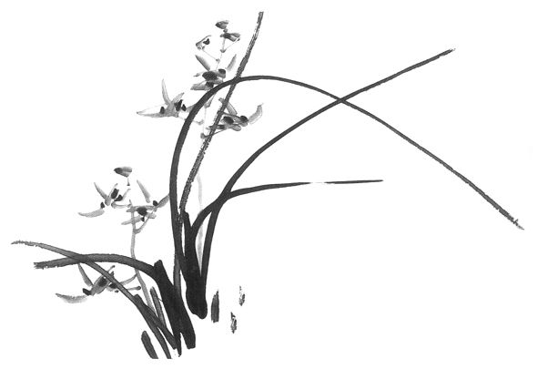
E – Exclusion
Notes:
48. Fences work to exclude many animals. Keep fencing in good order and conduct home repairs as necessary to prevent nuisance wildlife from gaining entry to the property and home. This includes locating and sealing all points of entry into a home, shed, barn or other structure.

Slide 49
Exclusion – Homeowner remedies
Use fencing or other solid material to create physical barrier
Large animals
  Hog wire – 2” x 4” mesh; 48” – 60” tall
  Eight to ten feet tall for deer
  Chain link
  Stake to ground
Notes:
49. Use appropriate fencing material to exclude the undesired animal. Fences to exclude deer must be 8-10 feet tall since deer are good jumpers.

Slide 50
Exclusion – Homeowner remedies
Small animals
  Bury to discourage burrowers
  Use chicken wire, hardware cloth or electric fence
    Chicken wire – 2’ tall; bury 6-12” for rabbits, skunks, opossums, armadillos
    Hardware cloth – ¼” to ½” mesh; bury for chipmunks, voles, moles
Electric fence – hot wire; battery or solar; peanut butter to attract and deliver mild shock
Notes:
50. If small animals are gaining access to the property, make sure that fence material holes are small enough to exclude the animal and that the fence is buried 6-12 inches. Electric fences can be useful in keeping deer out; train the deer by putting a small amount of peanut butter on the hot wire.

Slide 51
Exclusion – Homeowner remedies
Chimney
  Capped to exclude raccoons, bats, squirrels, birds
Soffit vents
  Good repair; entry for insects, bats, flying squirrels
Gable
  Good repair; hardware cloth; entry for bats, flying squirrels, many birds
Notes:
51. Being handy around the house can help discourage nuisance animals too. Be sure that chimney caps are present and in good working order to exclude raccoons, bats, squirrels and birds. Soffit vents that are not in good repair can admit bats, flying squirrels or insects into the attic. Gable vents should be in good repair and hardware cloth may be needed to exclude bats or flying squirrels. They can squeeze through most louvered gable vents.

Slide 52
Exclusion – Homeowner remedies
Windows/doors
  Close, seal, repair screens
Dryer vents
  Screen
  CAUTION – clean lint regularly to prevent fire
  Seal around opening with expanding foam
Pipes, wire, cable
  Seal around opening with expanding foam
  Snakes, mice can enter through dime size opening
Notes:
52. Windows and doors can admit animals into the home as well as hot or cold air. Be sure that screens are well-fitting and intact. Dryer vents are favorite nesting places for some species of birds. Caution must be used to make sure the vents are clean and working properly. Many have a door flap to help keep animals out or the home; check to be sure that the flap is working properly. Also, use expanding foam to seal openings where pipes, wires and cable enter the house. Snakes and mice can enter through dime size opening. Don’t forget that pets doors can let more than just the pet animals in!

Slide 53
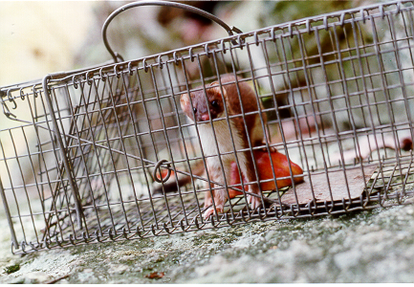
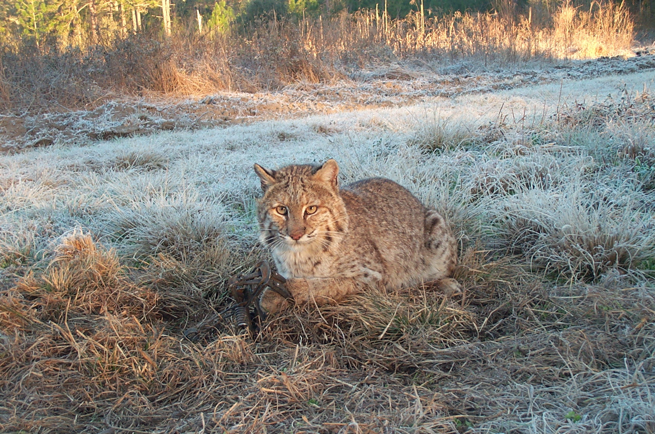
R – Removal or Repellent
Notes:
53. Step 3 – R-REMOVAL or REPELLANT Use registered repellants in a manner consistent with product labeling to discourage unwanted wildlife. The choice of repellants is based on experience and personal preference, but remember that many products on the market have not been rigorously tested in a scientifically controlled manner. Often, if it sounds too good to be true it probably is. Many repellants have limited efficacy. The product washes off in rain, breaks down in sunlight, or the animals simply become accustomed to the product. The landscape should be regularly monitored and repellant applied a needed and in accordance with all labeling precautions.

Slide 54
Removal or Repellent
Removal – trap offending animal and move ½ to 5 miles away.
  Permission
  Safety of trapper
  Disease
  Legality?
Addresses symptom – does not solve problem
Notes:
54. Trapping should not be attempted unless adequately trained. It is generally illegal to release animals onto someone else’s property including state and federal land. So, the question is really – what to do with a captured nuisance animal? There are only a few options. Often lethal removal is the best course of action for the animal and the landowner. Relocated animals nearly always die in a few weeks from predators, stress, disease and unfamiliarity with their new surroundings.

Slide 55
Removal or Repellent
Better to solve problem using a humane but lethal trap.
If choosing live trapping several traps are available
  Hav-A-Hart
  Tomahawk
  Glue boards – release technique
  Box traps
Notes:
55. Animals can be safely and harmlessly removed from a glue board by pouring cooking oil on the board to neutralize the glue. Oil should be cool or room temperature – NOT HOT! Live capturing animals is not recommended for persons without prior training.

Slide 56
Removal or Repellent
DO NOT HANDLE OR CAPTURE SNAKES
unless you can positively identify the animal
Place a bucket over the animal and slide cardboard under bucket; turn over and secure for transport
Net for frogs, birds, small animals from garden ponds
Notes:
56. Do not handle or capture snakes unless you can positively identify the animal! The best way to capture is to place a bucket over the animal and slide cardboard under bucket; turn over and secure for transport. Use a net to remove frogs, birds, small animals from garden ponds

Slide 57
Removal or Repellent
REPELLENTS
  “If it sounds too good to be true, IT IS!”
Snakes can’t smell – sulphur powder, moth balls, garlic does not work
  Snakes do “taste” the air with their tongue and some products may not “taste” good so snake avoids the area
  Snakes can’t hear – sonic repellents are useless
Notes:
57. As with most things in life-- “If it sounds too good to be true, IT IS!” Snakes can’t smell so sulphur powder, moth balls, garlic do not work. Snakes do “taste” the air with their tongue and some products may not “taste” good so snake avoids the area but many of these substances are not good for the environment or other creatures. Don’t waster your money on sonic repellents; since snakes can’t hear – sonic repellents are useless

Slide 58
Removal or Repellent
Effective repellents work with fear, taste, odor
  Taste repellents render a plant unpalatable
  Fear stimuli elicit instinctual response
  Odor repellents smell bad
Many repellents work in some situation and not other; may work for short term; may work sometimes and not others
Fertilized plants or young plants are damaged more
Notes:
58. The most effective repellents work with fear, taste, and odor. Taste repellents render a plant unpalatable; many contain hot pepper or bitter substances. Fear stimuli elicit instinctual response. Many animals are frightened by large eyes or shiny moving things. Odor repellents smell bad such as rotten eggs-the main ingredient in many deer repellent sprays. Remember, many repellents work in some situations and not others; some may work for the short term. Some may work sometimes and not others. Fertilized plants or young plants are attractive to animals so are usually damaged more.

Slide 59
Removal or Repellent
FEAR
  Plantskydd® - tree seedlings; reapply frequently
  Hinder® - edible fruit/veggies;water soluble;cheap
  BGR® - egg solids; do not use on food crops
These products mimic the smell of a predator and are reported to scare the animal.
Notes:
59. Repellents work by emitting an odor that animals associate with predator activity, repelling the animal before it nibbles on plants. Many of these fear odor-based repellents are contain dried blood, ammonium soaps of fatty acids or putrified egg solids. Once animals are attracted to an area and begin feeding, it is more difficult to discourage them from returning.

Slide 60
Removal or Repellent
TASTE
  Ropel® - systemic; do not use on edible crops
  Deer Stopper® -egg and oils;do not use on edible crops
  This-1-Works-Bitrix®; woody plants; weather resistant
  Goose Chase – derivative of Concord grapes; water soluble
Notes:
60. Most taste repellents work best after the animals begin feeding. Ropel® is a systemic product; do not use on edible crops. Deer Stopper’s ® active ingredients are egg and oils. This product is also not for use on edible crops. The active ingredient in This-1-Works-Bitrex®, is recognized as one of the bitterest substances known. These products work best on woody plants and are weather resistant. To repel Canada Geese, a product is available. Goose Chase contains derivative of Concord grapes and is water soluble for mix and spray.

Slide 61
Removal or Repellent
ODOR
  Deer-Off® - use on food crops; insoluble
  Milorganite® - processed sewage sludge; mild fertilizer; very promising; inexpensive
    Numbers in this table show the % of plants eaten by deer
  DAY 0 4 7 10 13 17 21
  Control 18 49 58 92 96 98 98
  Treatment 0 1 1 1 1 2 3
Notes:
61. This is from a recent study at UGA – WSFR showing how Milorganite kept deer from eating soybeans. On the control (untreated) fields an average of 98% of the plants were gone by Day 21 but on the treatment (240 pounds of Milorganite per acre) field only 3% of the soybean plants were eaten during the same time period.

Slide 62
Removal or Repellent
BARRIER
  Nix-A-Lite – metal spikes to deter perching pigeons
  Bird Netting – fine mesh to protect berries, shrubs
  Bird Repellent – sticky, non-toxic to repel birds
  Electric fence – solar, portable, Hot-Tape
Notes:
62. Barriers are often effective in preventing animal damage in the garden and landscape and around buildings. Barrier options for Roosting Birds:
Eliminate horizontal resting places, such as designing 45° angle ledges or constructing beams in barns for catwalks so cats can patrol bird roosts.
Apply porcupine wire (metal prongs) or sticky repellents (bird glue) on ledges or rafters. Covering the ledge with masking tape before applying the bird glue makes removal of the sticky substance easier.
Cover high value crops, such as fruit trees and shrubs, with plastic bird netting.
Deer
Many kinds of fences have been designed to exclude deer and each has advantages and disadvantages. Consider factors such as cost, appearance, the size of the area to be enclosed and the degree of control required. Few fences are 100 percent effective.
For a small garden patch, a four-foot high fence, or snow fence will work because deer avoid small, fenced-in areas. Circles of 6-foot chicken wire can also be staked around saplings and young trees to protect them from deer nibbling and antler damage.
For a larger lawn or garden, a fence made of wire angled away from the yard creates both a psychological and physical barrier. Deer hesitate to jump over something in which they fear they may become entangled. The fence should be six feet high and have a 30 degree angle to be effective. A fence angled toward the yard is no psychological barrier. Deer can jump a vertical fence eight feet high.
Electric fencing is used frequently by orchardists and managers of tree nurseries. Strips of aluminum foil smeared with peanut butter affixed to electric fencing lure deer to the fence where they lick the peanut butter and get a shock. Electric fences attached to a higher voltage charger can deter deer because they can hear the hum of the charge through the wires without touching them. However, electric fences may not be suitable for urban uses, especially when children are present.
Eight foot plastic mesh fencing is also available to exclude deer. This fencing works especially well in wooded areas where it can be attached to trees. In this setting, from a short distance, the mesh is virtually invisible. The mesh is sturdy and lasts up to 10 years. However, a fast running deer can break through it , and rabbits and other rodents often chew holes in the mesh, especially in winter.

Slide 63

Removal or Repellent
OTHER
  Tactile – water spray →
    www.deerbusters.com
  Light – motion activated; strobe and lasers
  Scare – eye balloon; Mylar tape; silhouette on window; pyrotechnics
Notes:
Other repellents that have limited success are motion-activated devices that make noises, spray water or light up. The keys to success in using these scare devices or tactics are to move them around, to keep the animal from getting comfortable with having them around.

Slide 64
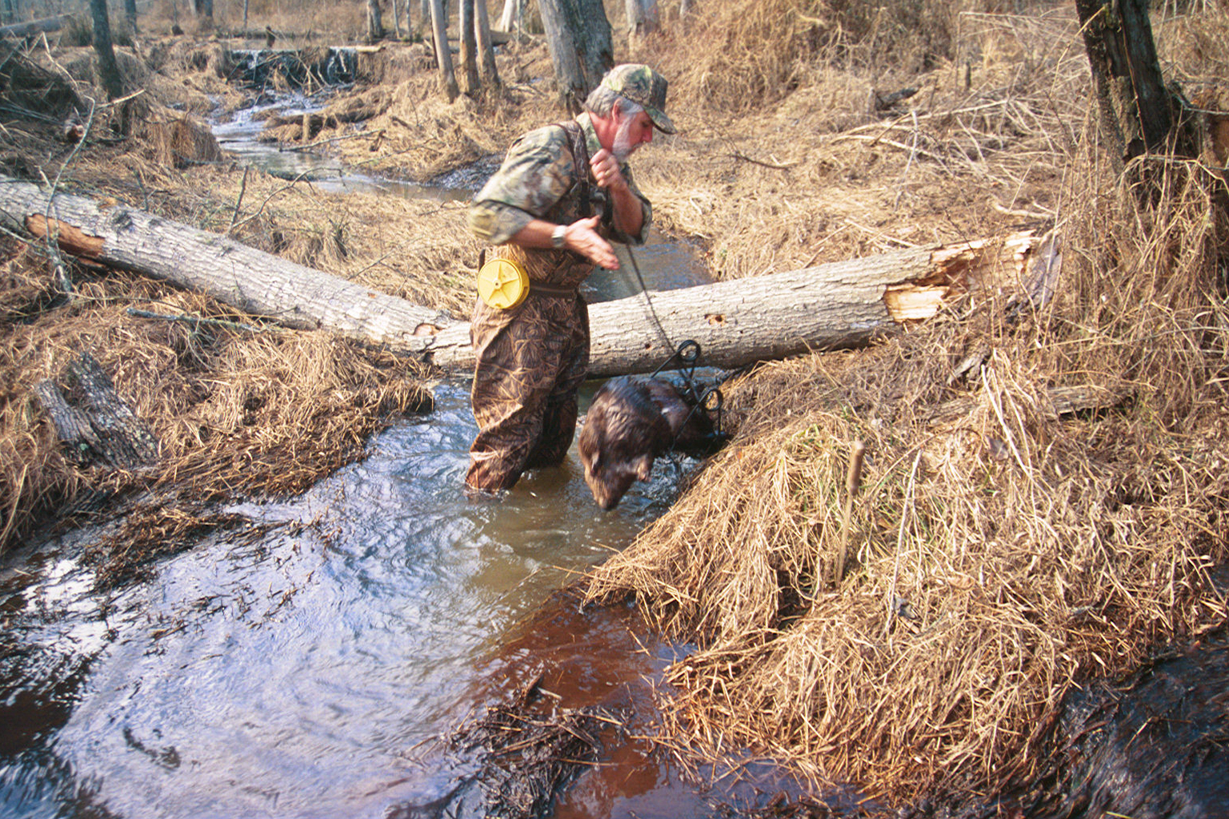
L – Lethal Control
Notes:
64. Lethal control is often a last resort as shown here for beaver removal.

Slide 65
Lethal Control
“Last step”
Be realistic
Notes:
65. The last step in the model is lethal control.
Be realistic- Homeowners who routinely kill “bugs” and spiders and spray once or twice per year for termites (costly) and use all manner of insecticides in their garden will not kill a mouse. Defies logic.

Slide 66
Lethal Control
If lethal control is indicated or is the last resort, then…
Remember, trapping is NOT recommended for homeowners due to danger of being bitten, exposure to disease (rabies), injury to animal or non-target species
Species like raccoons, cats, coyotes, dogs, snakes
  Contract with a licensed NWCO
For mice, chipmunks, rabbits, moles, voles ….
Notes:
66. Problems with large animals should be referred to DNR, Wildlife Service or a licensed Nuisance Wildlife Control Operator (NWCO).

Slide 67
Lethal Control
Trap placement
  Place near burrow entrance
  Face into opening
  Cover the trap with a box
  Protect from children and pets
Notes:
67. Proper trap placement is essential in successfully eliminating a nuisance animal.
Place the trap near the burrow entrance
Face the trap into the burrow opening or path of travel
Cover the trap with a box
Protect from children and pets non-target wildlife.

Slide 68
Lethal Control
Bait
  Use simple bait or natural foods
    No acorns for squirrels in autumn
  Peanut butter, sliced apples, sardines, PB/oatmeal balls, pecans, banana slices.
Mouse and Rat Traps
  PB (better than cheese)
  Place perpendicular to the wall
Notes:
68. Often traps are baited and set out a time or two without being set to snap. Some animals are wary and this may improve the chances of catching them. Use simple bait or natural foods. Acorns for should not be used for squirrels in autumn. Peanut butter, sliced apples, sardines, PB/oatmeal balls, pecans, banana slices are excellent baits. Mouse and rat traps are best baited with peanut butter (crackers are optional) and placed perpendicular to the wall. Rats and mice usually move along a wall rather than across an open expanse of floor.
See diagram on the next slide.

Slide 69
Mice travel along the wall – use this behavior to improve trap success.
Bait Pan
Wall
Correct
Incorrect Incorrect
Notes:
69. Be sure the trap is placed so the rat or mouse will have to pass by the bait pan as he passes along the wall.

Slide 70
Lethal Control
Multi-catch traps for mice, pigeons
Place mouse traps in shoe box with 2 holes cut in it – mice prefer to move in dark spaces
Caution: Use of Poison Baits
  Children, pets; Do Not Use near children or pets
  Poisoned animals may die behind a wall or in other inaccessible space and stink.
  Use only outside the home.
Notes:
70. Other types of traps are multi-catch mousetraps; pigeon traps with swinging, one-way doors and numerous other designs. Consult a nuisance wildlife operator for details. Placing bait inside a shoe box that has had 1 or 2 holes cut in it will encourage mice into a dark, safe area for feeding. Many homeowners can use a poison bait to control rats and mice or other small rodents. These baits are sold at home improvement stores, lawn and garden stores or hardware stores. Place bait in areas where animals are active -- look for droppings, nest material or food caches. Always use caution with poison baits. Animals do not die immediately -- it may take several feedings. The animal may die in an inaccessible place (attic, duct work, crawl space, inside a wall) and produce unpleasant odors. Some animals, like chipmunks, may hoard the bait thus leaving a homeowner to think the bait is ineffective. Be patient or try trapping. Protect children and pets from poison baits. Baits are best used in an outside building or under careful observation.

Slide 71
Resources
http://www.ces.uga.edu
http://wildlifedamage.unl.edu
Other State Extension web pages
  NC State http://www.ces.ncsu.edu/nreos/wild/wildlife/
  Cornell http://www.dnr.cornell.edu/ext/wildlifedamage/
Notes:
71. There are numerous resources available on the Internet including facts sheets, publications and photographs.

Slide 72
Resources
Adler, B. 1992. Outwitting Critters: A Humane Guide for Confronting Devious Animals and Winning. The Lyons Press. New York.
California Center for Wildlife. 1994. Living With Wildlife. Sierra Club Books, San Francisco.
Harrison, K. and G. Harrison. 1985. America’s Favorite Backyard Wildlife. Simon and Schuster, Inc., New York.
Humane Society of the United States. 1997. Wild Neighbors: The Humane Approach to Living with Wildlife. Fulcrum Publishing, Golden, Colorado.
Logsdon, G. 1999. Wildlife in the Garden. Indiana University Press, Bloomington, IN.
Prevention and Control of Wildlife Damage. 1994. Third Edition. Cooperative Extension Service, University of Nebraska. Lincoln, Nebraska
Notes:
72. There are also many excellent publications on nuisance wildlife available from your local library or bookseller.

Slide 73
Species
Recommendations
Notes:
73. Consult the Georgia Master Gardener Handbook 6th edition for more information and species recommendations.

Slide 74
Squirrels
May damage forest or landscape trees by chewing bark or cutting branches
May damage pecan orchards and nut crop
May enter house and nest in attics
Eat from bird feeder
Live trap and relocate
Predator guard; slick pole; cut back branches
Notes:
74. Squirrels can be a real nuisance in the garden and landscape. In yards they will chew bark on ornamental trees or shrubbery. In nut orchards, squirrels can severely curtail production by eating nuts prematurely and by carrying off mature nuts. Both fox and gray squirrels can cause losses in pecan orchards and fox squirrels may chew bark of various orchard trees. In residential areas, squirrels sometimes travel power lines and short out transformers. They may gnaw wires and enter buildings. They will gnaw the aluminum tie wire on chain link fences. Often squirrels take food at bird feeders. Sometimes they chew to enlarge openings of birdhouses and then enter to eat nestling songbirds. Flying squirrels are small enough to enter most birdhouses and are especially likely to eat nestling birds and eggs. In gardens squirrels may eat planted seeds, mature fruits, or grains, such as corn.

Slide 75
Squirrels
Exclusion
  18-24 inch metal collar around poles and trees
  Trim trees to prevent access to roof
  Wires – install 2-foot sections of lightweight pipe
  Close openings with heavy ½ inch hardware cloth
Notes:
75. Exclusion—Prevent squirrels from climbing isolated trees and power poles by encircling them with an 18-24 inch wide collar of metal 3-4 feet of the ground. Attach metal using encircling wires held together with springs to allow for tree growth. Trim trees appropriately to prevent squirrels from jumping onto roofs. Close openings to buildings with heavy ½-inch wire mesh or make other suitable repairs.

Slide 76
Squirrels
Repellents – Thiram painted on trees
Toxicants – Zinc phosphide 5% tracking gel (RUP)
Fumigants – None registered
Traps – Leg hold, box, cage, conibear
Shooting – where legal; BB or .22-cal w/ rat shot
Squirrels cycle – efforts in some years with high density may prove futile
Notes:
76. Repellents—Thiram painted on plant stems or bark may reduce or prevent chewing. Using toxicants is not recommended in residences; it may result in undesirable odors from animals that die in out-of-the-way places. There are no fumigants registered for controlling tree squirrels. A variety of traps will catch squirrels; including No. 0 or 1 leg hold trap, box traps, and cage traps. Regular rat size snap traps will catch flying squirrels. Glue traps for rats will catch small squirrels. Good baits are slices of orange and apple, walnuts or pecans removed from the shell, and peanut butter. Other foods familiar to the squirrel may also work well; for example, corn or sunflower seeds.
It is important to “pre-bait” live traps so squirrels will become accustomed to the trap before actual trapping begins. Wire the door open and place bait inside until squirrels freely feed inside. They may then be trapped one at a time and removed.

Slide 77
Chipmunks
Burrow under walls, driveway, sidewalk
Clog downspouts
Dig flower beds
Eat bulbs, tubers, bird seed, nuts, cat/dog food
Notes:
77. Chipmunks can create havoc in a landscape or garden. They often dig seeds from the garden, feed on flower bulbs, and burrow into lawns and flower beds. Many calls from homeowners are to request advice about a poison. While it is possible to poison any creature, it is not the best way to eliminate a chipmunk. Chipmunks are hoarders and may hide poisoned food for later consumption. Unlike many other squirrels, chipmunks have cheek pouches. They can carry a lot of food in them. Their burrows, which may be 30 feet long, have side branches leading to little “rooms” which they use for pantries. Using rodent poisons in backyards can be hazardous to children and pets.

Slide 78
Chipmunks
Exclusion
  ¼ inch hardware cloth around (and buried) gardens and flower beds
  Cover down spouts
Habitat modification
  Wood piles, mulch, plants located away from structures
Notes:
78. A better method for dealing with chipmunks burrowing into flowerbeds is exclusion. Create a barrier using ¼ inch hardware cloth around gardens. Cover downspouts and move woodpiles and brush piles away from the house or garden shed.

Slide 79
Chipmunks
Repellents
  Taste – Thiram, Bitrex, ammonium soaps of higher fatty acids
  Naphthalene – 4-5 lbs/2000 sq. ft.; cabins-unoccupied
Toxicants – none registered
Fumigants – not practical
Trapping – rat traps, cage traps (Tomahawk)
Shooting – BB gun, .22-cal with rat shot
Notes:
79. For chewing, taste repellents can be used. Mothballs make keep chipmunks out of unoccupied cabins though the cabins will have to aired out prior to occupying them. Using standard mousetraps baited with peanut butter is an excellent strategy for control. Place a plastic flower pot with a “door-hole” over the trap to keep other animals from springing the trap. Cats can be effective in controlling chipmunks. However, cats may also kill a great many songbirds.
Even after trapping, the potential for chipmunk pests remains. A good habitat may support 10 to 15 chipmunks per acre, and chipmunks have three to five young per litter. They mature in about three months. With such over production, a chipmunk-less yard in will soon be recolonized. Continue control efforts all year. In the south, chipmunks may hibernate for only a short time period.
In some years chipmunks aren’t a problem. Chipmunk populations are always rising and falling. Although a chipmunk has been known to live eight years, the average chipmunk is likely to die within the year. Predators like foxes, bobcats, snakes and hawks are likely to catch them. In the backyard, housecats, disease or food shortage may eliminate them.

Slide 80
Moles
Exclusion
  not practical except garden; bury ¼” mesh hardware cloth
  reduce soil moisture and use insecticide to kill grubs
Frightening – not effective
Repellents – none registered
Toxicants – Strychnine alkaloid
Shooting – not practical
Notes:
80. Moles are most common in areas of well drained loam or sandy soil throughout the state.
Moles spend much time in a deep burrow system a foot or more underground. They have one or more little rooms where they build nests. When a mole is hungry, it moves through tunnels to the upper few inches of soil. There it travels the shallow burrow system to a productive feeding area and begins to plow new ground. Raised areas in lawns and gardens may be indicative of runways. Tunnels in lawns and landscapes are unsightly and may cause roots of grass and plants to dry out.
Overwatering lawns may force worm and grubs to near the surface where the mole hunts for them. Reduce watering and kill grubs in order to have some success at mole control. If the thought of killing the mole is unbearable, try starving it out. Use insecticides, like a grub killer, sparingly in feeding areas to diminish the food supply. This method may have slow and uncertain results.

Slide 81

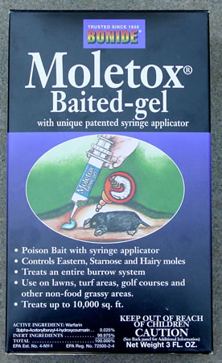
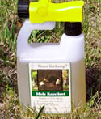
Moles
http://www.deerbusters.com/
Notes:
81. There are a variety of mole poison products available on the market. Trapping is the most effective and practical method of mole control. Trapping success is greatest in the spring and fall, especially after rain. In the summer and winter, moles are active in deep soil and more difficult to locate. Three types of mole traps are especially effective: harpoon, scissor-jaw, and choker loop. To ensure safe and humane deployment, be sure to follow printed instructions.
Check the yard for active mole runways. Use your foot to press down all the runways at intervals of several feet. Place a bottle cap or other marker at those exact spots. The next day check these locations. If the mole has not passed through and the molehill is still flat, pick up the marker. If the mole has raised the hill up again, put a second marker. After four or five days, it will be apparent which runways the mole uses every day. This is where the traps should be placed. Remember that these are lethal traps and you will need to dispose of the mole after you have trapped it.
Remedies such as chewing gum, broken glass, castor oil and ultrasonic repellers have not been proven effective in getting rid of moles.

Slide 82
Summary
Notes:
82. In general, when dealing with nuisance wildlife, often several techniques used together work best. Patience is often necessary as well as some imagination. Animal populations are cyclical in nature

Slide 83

Questions?
Notes:
83. DISCUSSION QUESTIONS
1. What are the basic principles of the HERL model in dealing with human-wildlife conflicts?
2. Where can a land- or homeowner find a listing of licensed Nuisance Wildlife Control Operators?
3. Beavers may create what kinds of damage for landowners?
4. Why is poisoning not an effective way to get rid of nuisance chipmunks in the landscape?
5. When is the best time to begin using deer repellents?
6. Name the signs that indicate mice or rats may be present in the home, garage, or shed?
7. Why are snake repellents not effective?
8. What are the indications that a tree squirrel may be living in an attic?
9. How would one begin to identify an animal responsible for damage in the landscape?

