Slide 1

Cutting the Clutter, Basic Shrub Identification
Todd Hurt
Training Coordinator
UGA Center for Urban Agriculture

Slide 2
Identifying Landscape Plants
Scientific Names → Ultimately based on fruit and flower characteristics
However, we may identify plants by:
  Leaf → form, arrangement, odor, petiole, margin, veination, texture etc.
  Bark → color, texture, etc.
  Bud → size, shape, number, etc.
  Whole plant characteristics → form, branching habit, and location

Slide 3
What Questions do I ask?
Evergreen or Deciduous
Leaf Arrangement – Alternate, opposite, other
Leaf Margin – Entire or lobed
Leaf Margin – spines, toothed, smooth
Plant form, spreading, bush, tree, rounded, columnar, etc.

Slide 4
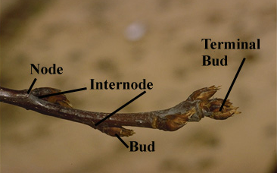
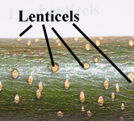
Plant Identification
Bud - A compressed, undeveloped shoot. Buds may be lateral or terminal.
Node - point on the stem where leaf or bud is borne. The space between two nodes is an internode
Lenticel - a "breathing pore" in the skin or bark of a stem.

Slide 5
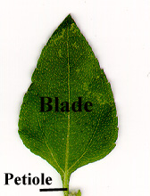
Plant Identification
Simple Leaf
  Petiole - the stalk of a leaf. A leaf without a petiole is sessile
  Blade - the flat, expanded portion of the leaf

Slide 6
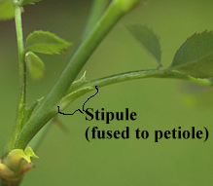
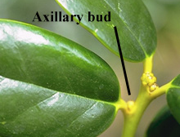
Plant Identification
Simple leaf
  Stipule - flat, often leaf-like flap below a leaf. Not all leaves have stipules. Stipules can be highly modified into tendrils, spines, scales, ect.
  Axillary bud - the bud in the axil - the angle between the leaf and stem.
Notes:
Thallophyta and Bryophyta are the simplest plants . Thallophyta are not differentiated into roots, stems or leaves and lack conducting tissue. The Bryophyta may be differentiated into leaves and stems but lack true roots and conductive tissue.

Slide 7
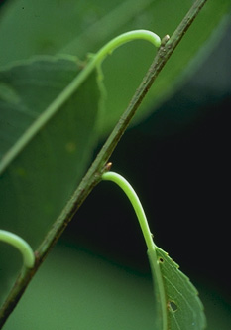
Plant Identification
Leaf arrangement
  Alternate - leaves
  arranged one per node
Notes:
The spermatophytes provide most of our familiar cultivated plants
Gymnosperms are cone-bearers,
Seed enclosed in an ovary borne in a flower

Slide 8
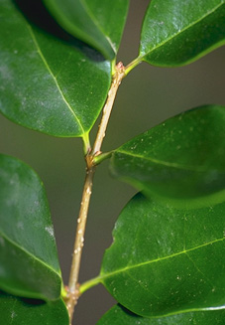
Plant Identification
Leaf arrangement
  Opposite - leaves
  arranged two per node
Notes:
The spermatophytes provide most of our familiar cultivated plants
Gymnosperms are cone-bearers,
Seed enclosed in an ovary borne in a flower

Slide 9
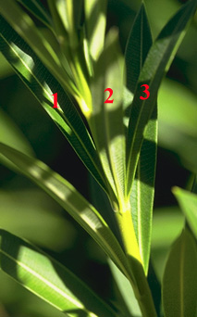
Plant Identification
Leaf arrangement
  Whorled - arranged two
  or more per node
Notes:
The spermatophytes provide most of our familiar cultivated plants
Gymnosperms are cone-bearers,
Seed enclosed in an ovary borne in a flower

Slide 10
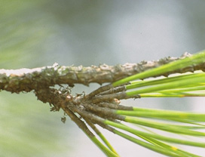
Plant Identification
Leaf arrangement
  Fascicled - leaves grouped in small, tight bundles
Notes:
The spermatophytes provide most of our familiar cultivated plants
Gymnosperms are cone-bearers,
Seed enclosed in an ovary borne in a flower

Slide 11
Plant Morphology -
Plant Identification
Simple and compound leaves
  Simple - the blade is all in one piece, though it may be lobed, toothed, etc.
Helpful Hint: In trying to decide where a leaf begins, look for the axillary bud. Everything above the axillary bud
is all one leaf.

Slide 12
Plant Morphology -
Plant Identification
Simple and compound leaves
  Compound - the blade is divided all the way to the midrib (rachis) into two or more pieces.

Slide 13
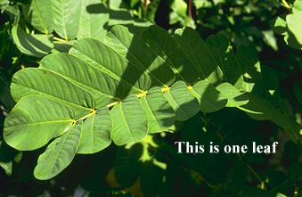
Plant Morphology -
Plant Identification
Compound leaves
  Once pinnately compound - leaflets arranged along one undivided main axis. (odd or even number of leaflets)

Slide 14
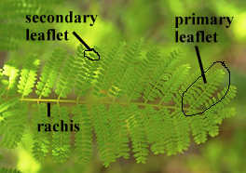
Plant Morphology -
Plant Identification
Compound leaves
  Twice pinnately compound - main axis (rachis) with two or more branches and the leaflets arranged along the branches. The branch divisions are primary leaflets and the ultimate divisions are secondary leaflets. There can also be thrice-pinnately compound leaves,etc.

Slide 15
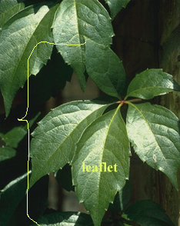
Plant Morphology -
Plant Identification
Compound leaves
  Palmately compound -leaflets all arising from one point at the base of the leaf.

Slide 16
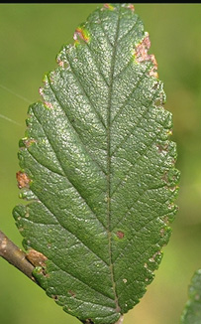
Plant Identification
Leaf venation
  Pinnate - with a main midvein and secondary veins arising from it at intervals

Slide 17
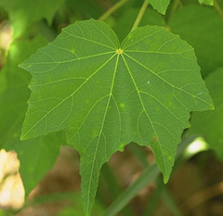
Plant Identification
Leaf venation
  Palmate - with the main veins all arising from one point at the base of the leaf.

Slide 18
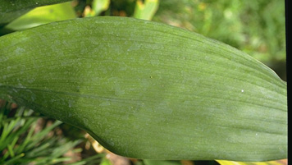
Plant Identification
Leaf venation
  Parallel - with all the main veins parallel (usually also parallel to the sides of the leaf.)

Slide 19
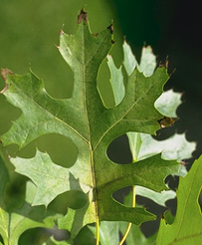
Plant Identification
Leaf lobing
  Pinnately lobed - with the lobes arising along the length of the mid-line of the leaf.
        Palmately lobed - with the lobes all arising from one point at the base of the leaf.

Slide 20
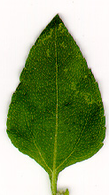
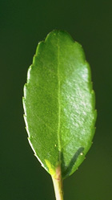
Plant Identification
Leaf shapes
  Ovate - egg-shaped with the larger end at the bottom.
        Elliptic - shaped like an ellipse, tapered at both ends and with curved sides.

Slide 21
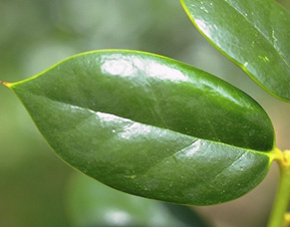

Plant Identification
Leaf shapes
  Oblong - tapered to both ends, but with the sides more or less parallel.
        Lanceolate - shaped like the tip of a lance

Slide 22
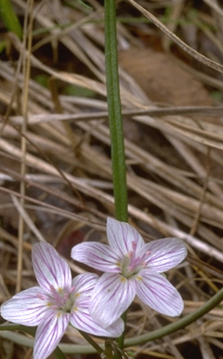
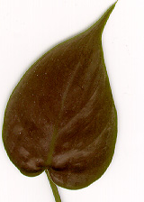
Plant Identification
Leaf shapes
  Linear - very long and thin, with the sides parallel
        Cordate - heart-shaped with the wide part at the bottom

Slide 23
Plant Identification
Leaf margins
  Entire - smooth, with no teeth or lobes

Slide 24
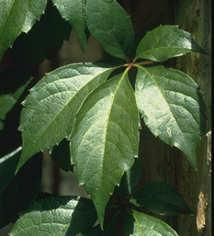
Plant Identification
Leaf margins
  Serrate - with sharp, forward-pointing teeth

Slide 25
Plant Identification
Leaf margins
  Doubly serrate - with teeth which have smaller teeth on them

Slide 26
Plant Identification
Leaf margins
  Crenate - with low, rounded scallop-like teeth

Slide 27
Plant Identification
Leaf margins
  Lobed, parted, divided, cut, etc. - A number of terms describe the various degrees of lobing.

Slide 28
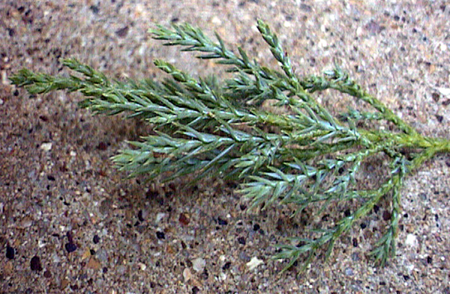
Scale or Awl- Like Foliage

Slide 29
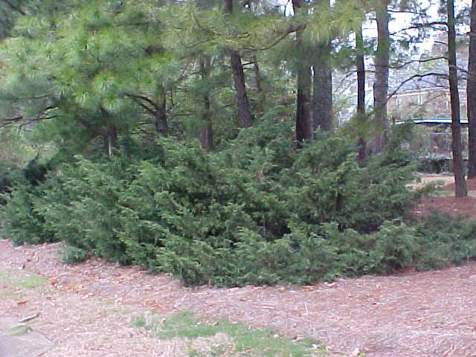
Putting it all Together
Form
Leaf shape and Margin
Leaf Arrangement

Slide 30
Plant ID: Junipers, Hollies and Similar Plants

Slide 31
What Questions do I answer?
Evergreen or Deciduous
Leaf Arrangement – Alternate, opposite, other
Leaf Margin – Entire or lobed
Leaf Margin – spines, toothed, smooth
Plant form, spreading, bush, tree, rounded, columnar, etc.

Slide 32
Plants that look like hollies
Osmanthus (opposite leaves)
Boxwoods (opposite leaves, no spines)
Mahonia (compound leaves)
Illicium (long narrow leaves smell like licorice no spines)
Cherry laurel (wood smells like cherry)
Wax myrtle (leaves smell like wax myrtle)

Slide 33
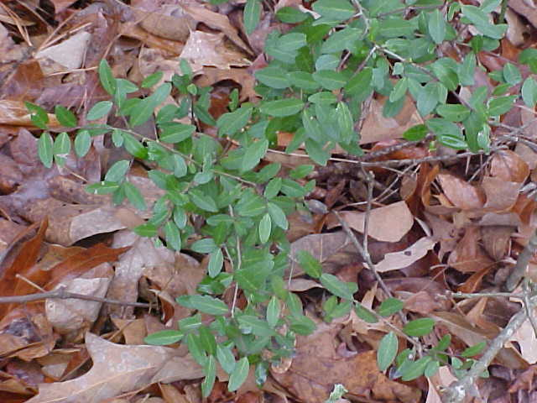
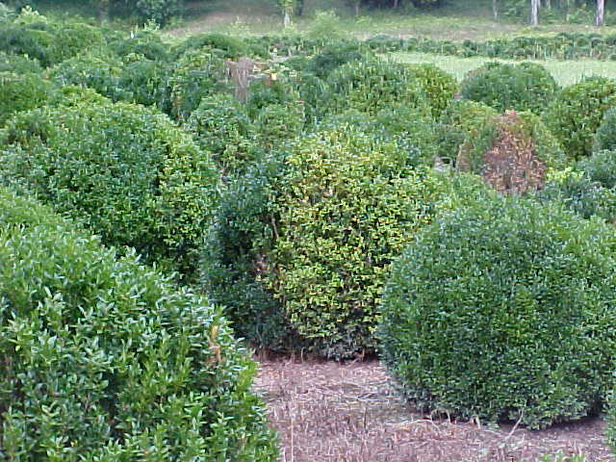
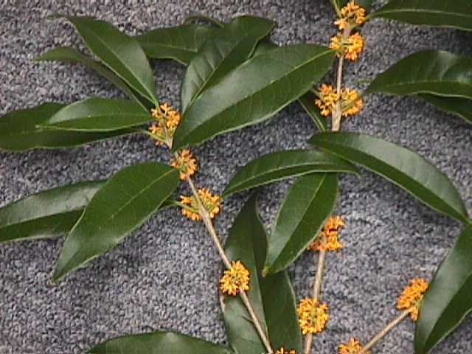
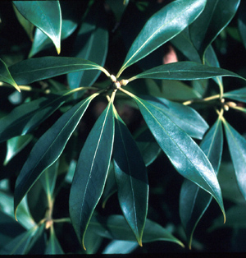
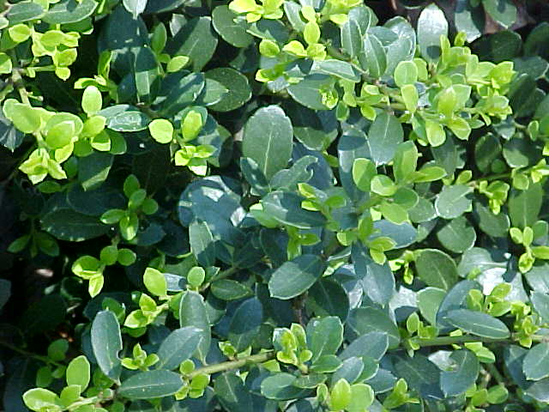
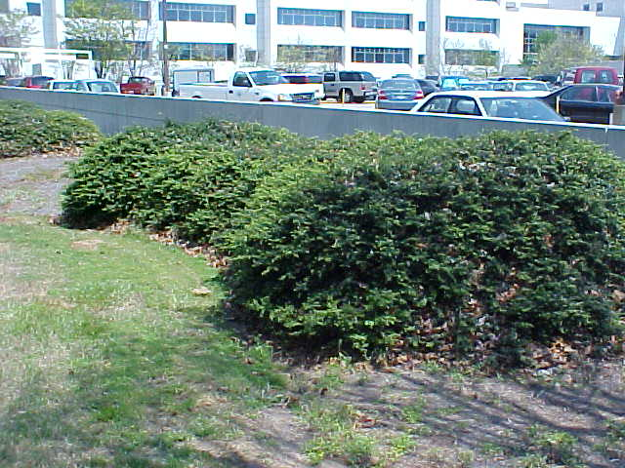
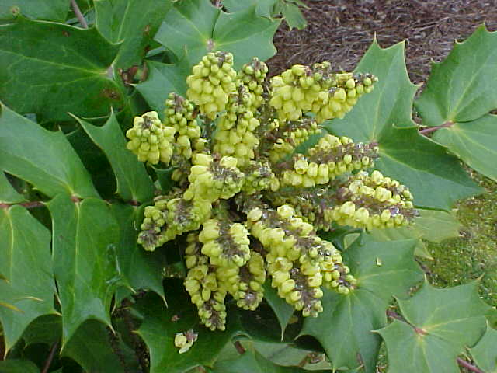
Hollies look alike and like many other plants!

Slide 34
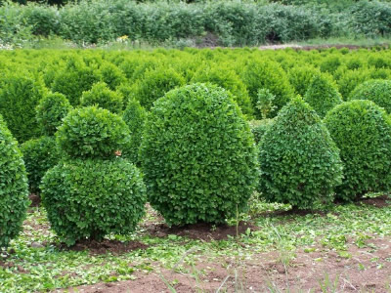
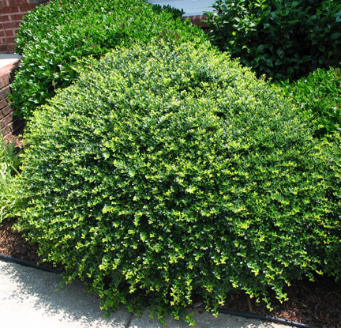
Boxwood or Holly

Slide 35
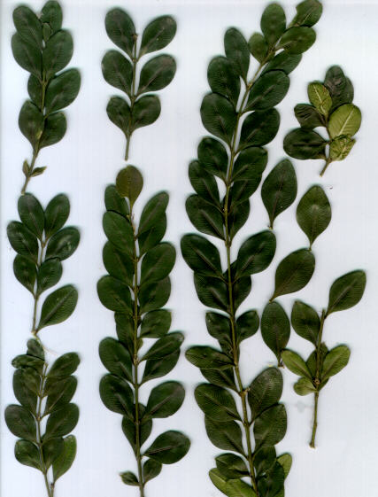
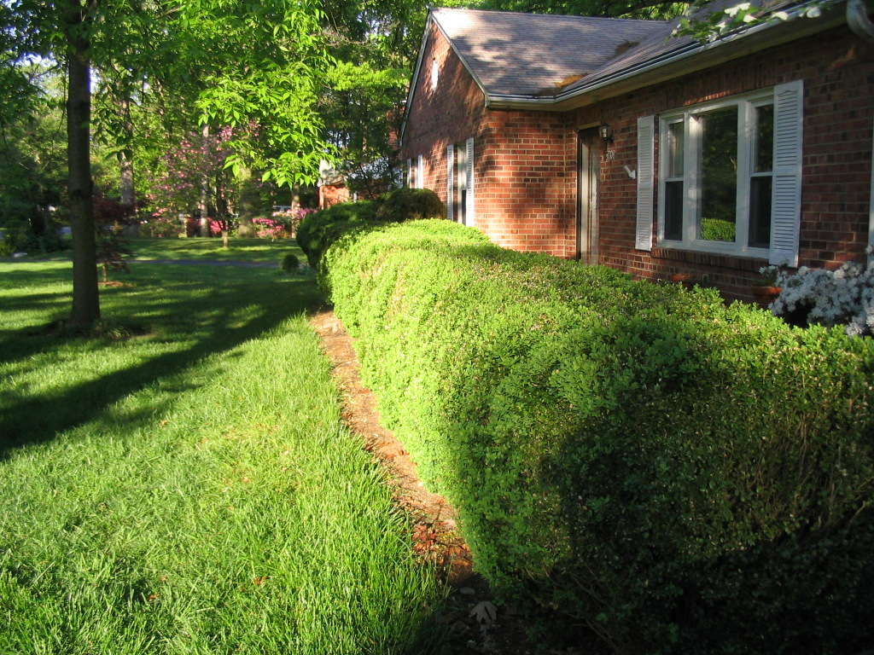
Buxus microphylla (Boxwood)
Form: 3-4 feet rounded
Foliage: opposite, simple, entire, 1/3 to 1 in. long
Other: leaf is broadest in the middle, not a holly.

Slide 36
The Holly Species (400+)
Ilex cornuta Chinese Holly (21 cultivars)
Ilex crenata Japanese Holly (60)
Ilex glabra Inkberry (8)
Ilex latifolia Lusterleaf Holly
Ilex opaca American Holly
Ilex verticillata Winterberry Holly
Ilex vomitoria Yaupon Holly (13)

Slide 37
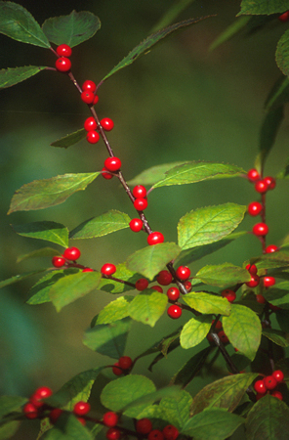
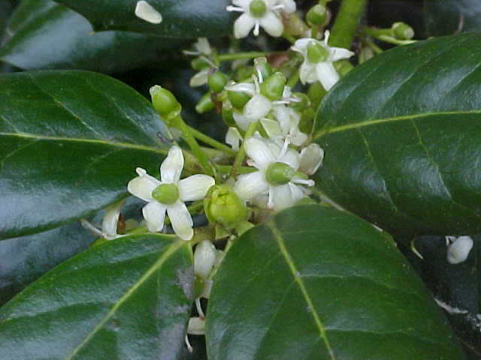
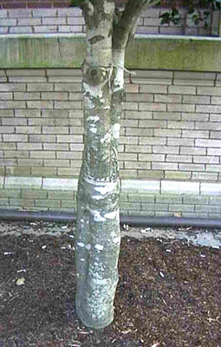
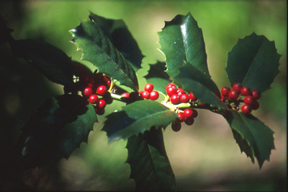
What makes it a holly?
Red fruit
Creamy white flowers
(Dioecious)
Alternating leathery leaves
with points
Smooth gray bark

Slide 38
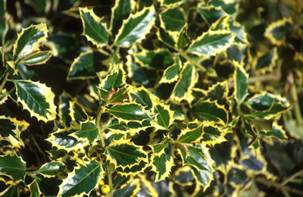
Ilex aquifolium
English Holly
Form: 30-50’, pyramidal
Foliage: undulating
spiny margins
Bark: gray

Slide 39
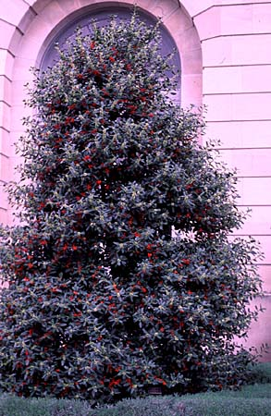
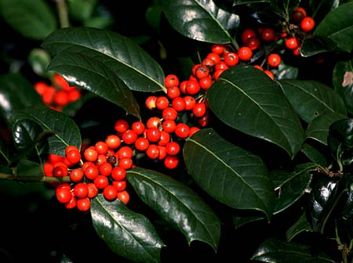
Ilex x ‘Nellie R. Stevens’
Nellie R. Stevens Holly
Form: 15-20’, upright pyramidal
Foliage: four to six points
Bark: gray, smooth
(cross between English and Chinese, M.D nursery owner

Slide 40
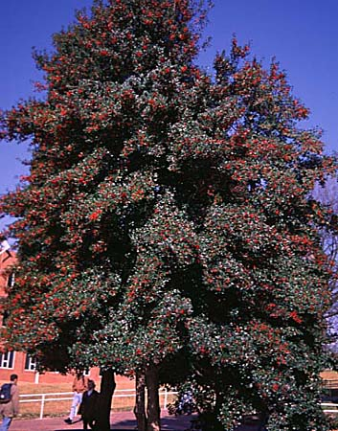
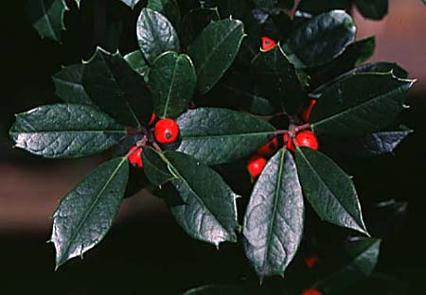
Ilex x attenuata ‘Fosteri’
Foster’s Holly
Form: dense, compact pyramidal, 20-30’
Foliage: narrow, 3 spikes
Bark: smooth gray
(cross between cassine and opaca)

Slide 41
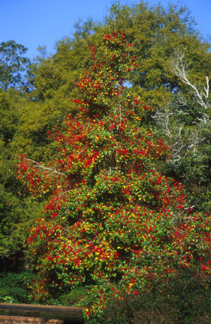
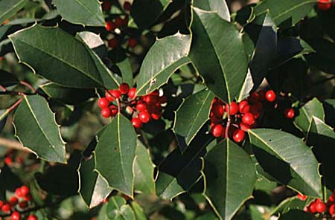
Ilex x attenuata ‘Savannah’
Savannah Holly
Form: upright pyramidal, 25-30’
Foliage: 10-12 points, 2” long; always yellow!
Bark: smooth, gray
(one of the Foster Hybrids)

Slide 42
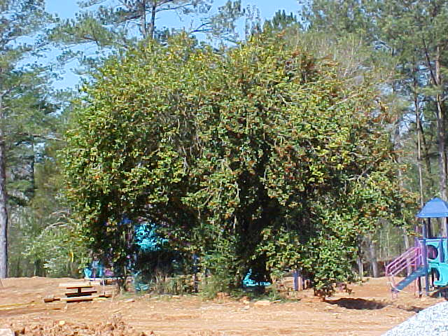
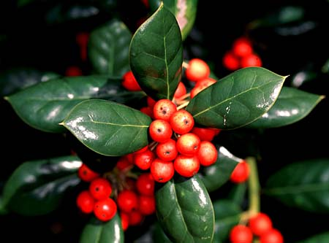
Ilex cornuta ‘Burfordi’
Burford Holly
Form: rounded, dense, 10’
Foliage: single spine
Bark: smooth gray
(Westview Cemetary, Atlanta 1900; cornuta=chinese)

Slide 43
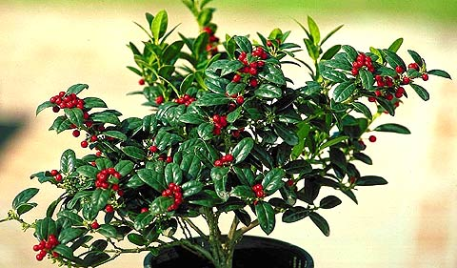
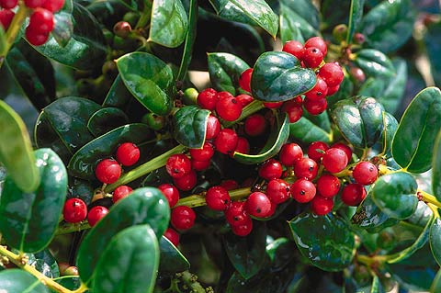

Ilex cornuta ‘Burfordi Nana’
Dwarf Burford Holly
Form: small round, 5-10’
Foliage: smaller single spined
Bark: smooth gray

Slide 44


Ilex cornuta ‘Carissa’
Carissa Holly
Form: small round, 5’
Foliage: single point, tapering, soft, yellow rim
Bark: smooth gray
(selection of Rotunda)

Slide 45


Ilex cornuta ‘Rotunda’
Rotunda Holly
Form: dense round 3-4’
Foliage: five viscous spines
Bark: smooth gray
(impenetrable)

Slide 46


Ilex crenata ‘Compacta’
Compact Japanese Holly
Form: rounded, 6’
Foliage: flat, ¾”, crenate margin
Bark: smooth gray
(topiary)

Slide 47

Ilex crenata ‘Helleri’
Helleri Japanese Holly
Form: dwarf, rounded, compact, 4’
Foliage: tiny, ½”, less lustrous green
Bark: smooth gray

Slide 48


Ilex crenata ‘Rotundifolia’
Bigleaf Japanese Holly
Form: upright rounded, 8-12’
Foliage: 1” long
Bark: smooth gray

Slide 49



Ilex glabra
Inkberry
Form: upright, open, 6-8’
Foliage: long, narrow, 3 delicate serrations near tip
Bark: green stems fade to gray
(native to Georgia)

Slide 50


Ilex latifolia
Lusterleaf Holly
Form: upright pyramidal tree, 25’
Foliage: largest holly, 4-8” long
Bark: smooth gray
(good in shade)

Slide 51


Ilex opaca
American Holly
Form: pyramidal and dense aging to openess, 50’
Foliage: distinct points
Bark:smooth gray
(Georgia native)

Slide 52



Ilex vomitoria
Yaupon Holly
Form: upright, irregularly branced, 20’
Foliage: ovaland tapered, 1”
Bark: purplish new growth fading to gray
(Georgia Native)

Slide 53



Ilex vomitoria ‘Nana’
Dwarf Yaupon Holly
Form: compact, rounded, 3-5’
Foliage: ½”
Bark: purplish new growth fading to gray

Slide 54
Juniper Species (70)
Juniperus chinensis Chinese Juniper (71)
Juniperus communis Common Juniper
Juniper conferta Shore Juniper (6)
Juniperus horizontalis Creeping Juniper (56)
Juniperus procumbens JapgardenJuniper (4)
Juniperus sabina Savin Juniper (12)
Juniperus scopulorum Colorado Redcedar (28)
Juniperus virginiana Eastern Redcedar (22)

Slide 55






Junipers look alike and like many other plants!

Slide 56



What makes it a Juniper?
Trees or shrubs
dioecious
Males- catkins
Females- bluish globeose cone
Leaves Opposite
Awl or Scale
Awl-like leaves opposite, sharp, upper side with blue band)
Grayish bark that peels to reveal red cedar color
Evergreen
Bluish cones (gin)

Slide 57
Scale or Awl- Like Foliage

Slide 58


Juniperus conferta
Shore Juniper
Form: dense low growing ground cover, 1’
Foliage: prickly, overlapping 1” awls
Bark: shaggy brown
(Blue Pacific - green blue leaves)

Slide 59



Juniperus horizontalis ‘Wiltonii’
Blue Rug Juniper
Form: spreading, 4-6” x 6-8’, prostrate
Foliage: silver-blue, scale-like not prickly
Bark: brown scaly
(lowest growing)

Slide 60




Juniperus virginiana
Eastern Red Cedar
Form: upright pyramidal, 40-50’
Foliage: scale-like in 4 ranks overlapping ending in point
Bark: white/gray, shredding to show red
(Georgia Native, strong smell)

Slide 61



Juniperus chinensis ‘Torulosa’
Hollywood Juniper
Form: upright, 15-20’
Foliage: compressed scales
Bark: twisted, gray

Slide 62


Cryptomeria japonica
Awl shaped, 4-angled, .25 to .75 in long, 1st leaves of the year shorter than later, curving inwards, points forward.
http://www.flickr.com/photos/99245765@N00/2954971245/

Slide 63


X Cupressocyparis leylandi
Leyland Cypress
Scale-like, closely pressed together, pinted, dark green, branchlets flattened

Slide 64


Thuja occidentalis
Arborvitae
Scale-like, 1/12 in long, abruptly pointed
Branchlets alternate, compressed, flat, horizontal sprays
http://commons.wikimedia.org/wiki/file:Thuja_occidentalis_June2008.JPG

Slide 65
Acknowlegements
Special thanks to Steve Pettis, CEA Gwinnett Co. for the holly and juniper slides and to Dr. David Berle, UGA - Horticulture for the plant morphology slides.
Descriptive text from from M. Dirr and R. Bishop.

