Slide 1
Crape “Murder”
Gary W. Knox, UF-Monticello
and
Edward F. Gilman,
UF-Gainesville

Slide 2
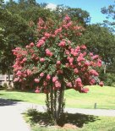
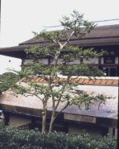
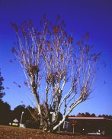
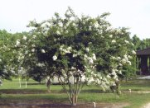
What’s the
“right” way
to prune?

Slide 3
Crape “Murder”:
Crape Myrtle
Growth, Flowering and Maintenance as affected by Three Pruning Methods

Slide 4
Plants Used:
Natchez (L. indica x fauriei)
Carolina Beauty (L. indica)
38 of each were planted Feb. 1994
Unpruned

Slide 5
Plants Used:
All trees pruned to thin main stems and remove crossing branches in March 1998
Pruning treatments applied March 1998, 1999, 2000 and 2001

Slide 6
Questions to Answer:
How much work does each pruning method require?
How much after-care is needed during the summer?
What is the impact on flowering and growth?

Slide 7
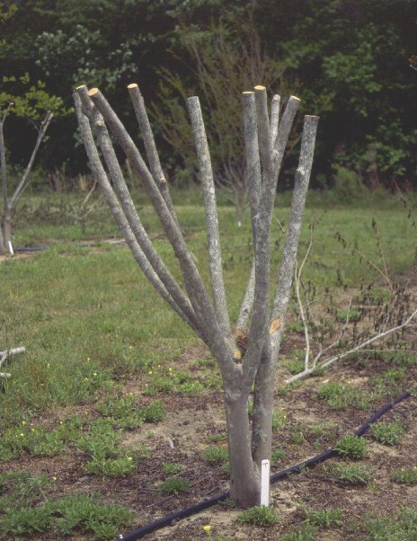
Pruning Treatments:
Topped “crape murder” Year 1

Slide 8
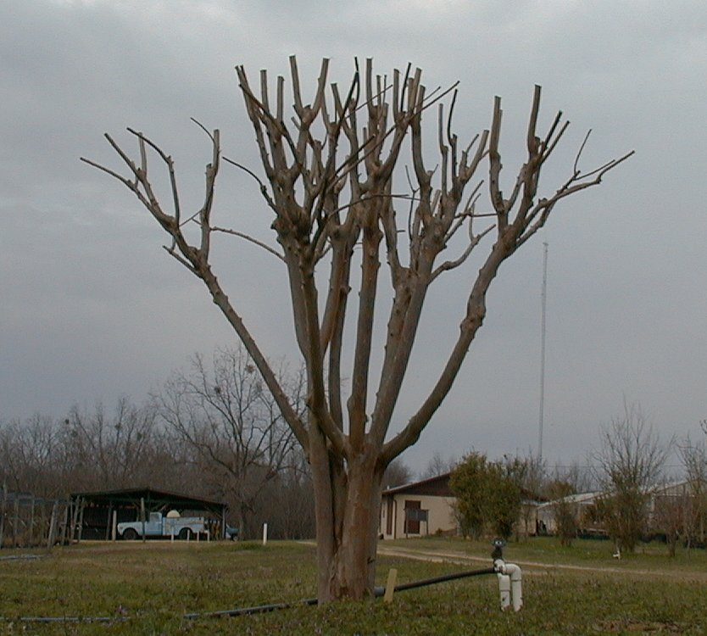
Pruning Treatments:
Topped “crape murder” Year 3

Slide 9
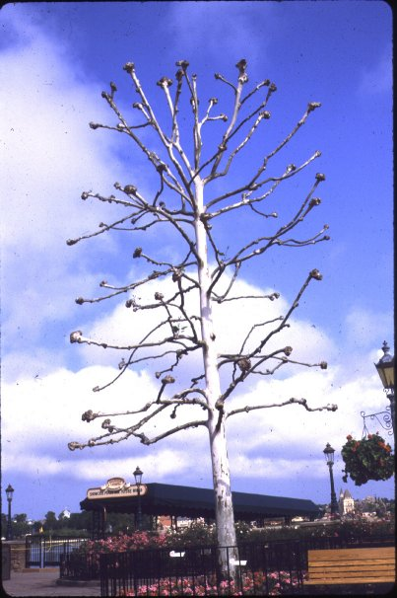
Pruning Treatments:
Pollarded

Slide 10
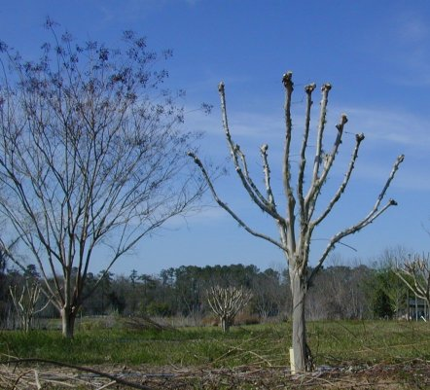
Pruning Treatments:
Pollarded Year 1

Slide 11
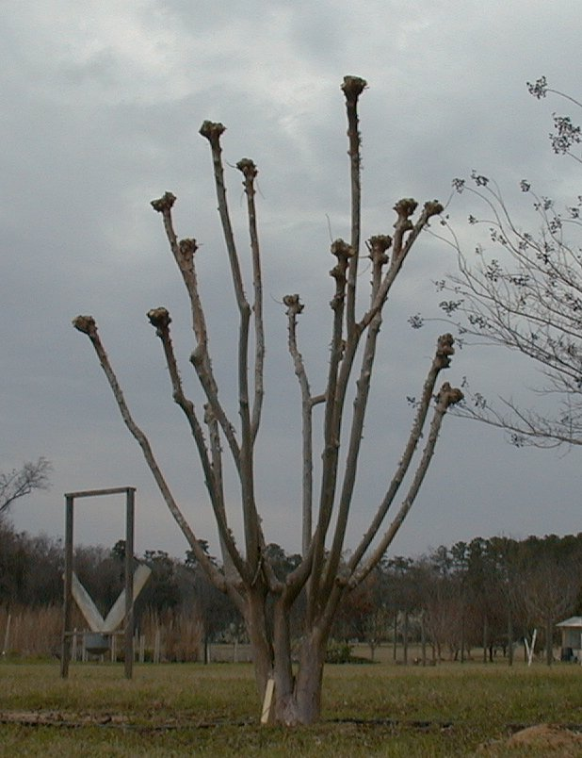
Pruning Treatments:
Pollarded Year 3

Slide 12
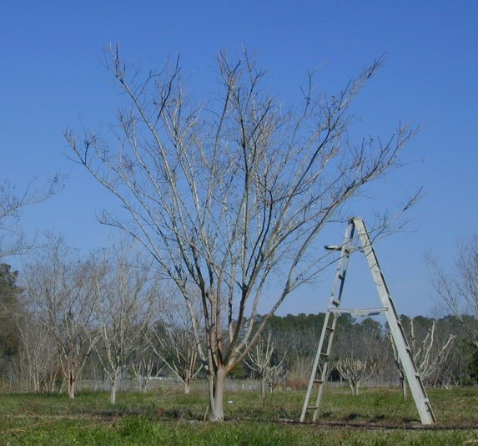
Pruning Treatments:
Pencil- pruned

Slide 13
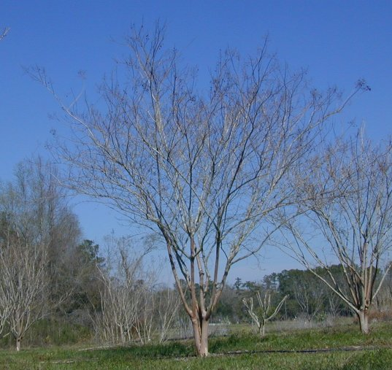
Pruning Treatments:
Unpruned

Slide 14
Pruning Treatments:
Topped “crape murder”
Pollarded
Pencil-pruned
Unpruned

Slide 15
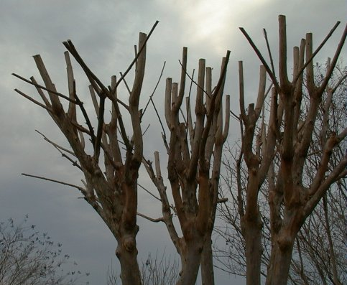
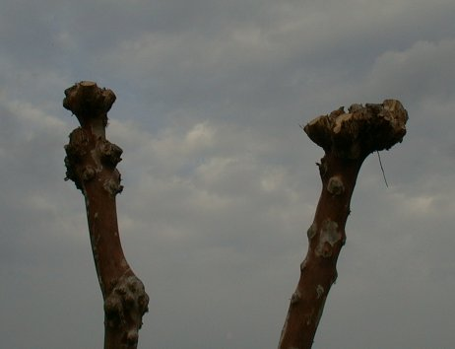
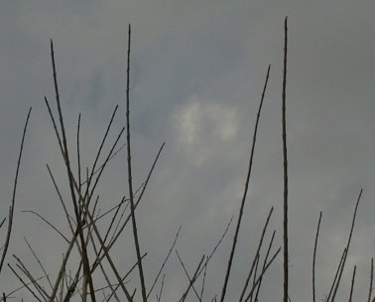
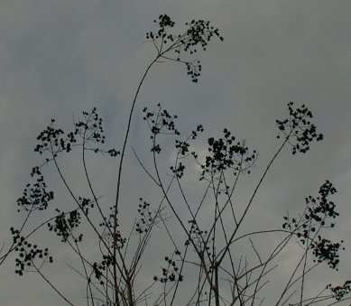
Topped
Pollarded
Pencil-pruned
Unpruned

Slide 16
How much work does each pruning method require?
Data collected:
Time to perform pruning
Number of cuts made
Average diameter of pruning cuts

Slide 17
Time and Number of Cuts for each Pruning Treatment, 1999
Data for both cultivars

Slide 18
How much after-care is needed during the summer?
Data Collected:
Number of stem, basal and root sprouts in June/July and August/September
Time required to remove sprouts

Slide 19
Number of Sprouts and Time to Remove Sprouts by Pruning Treatment, 1998
From sprout pruning performed July and September 1998; Data for both cultivars

Slide 20
Number of Basal, Root and Stem Sprouts, September 1998
Data for both cultivars

Slide 21
What is the impact on flowering and growth?
Data Collected:
Date of first flower and duration of flowering
Number of flower panicles per week
Size of flower panicles at peak bloom
Regrowth

Slide 22
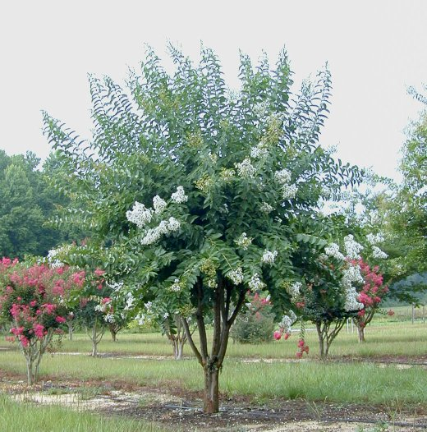
Topped Natchez

Slide 23
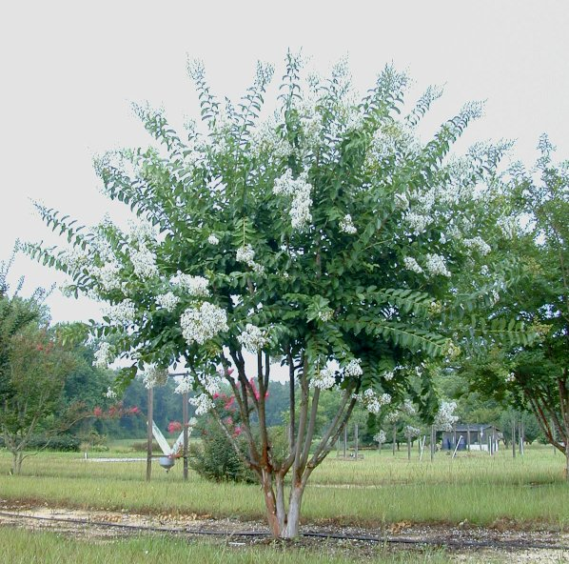
Pollarded Natchez

Slide 24
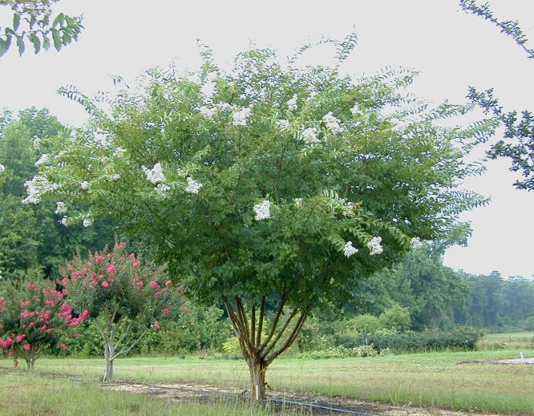
Pencil-pruned Natchez

Slide 25
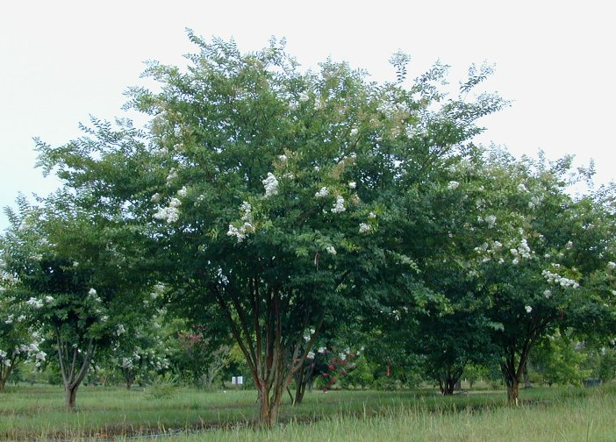
Unpruned Natchez

Slide 26
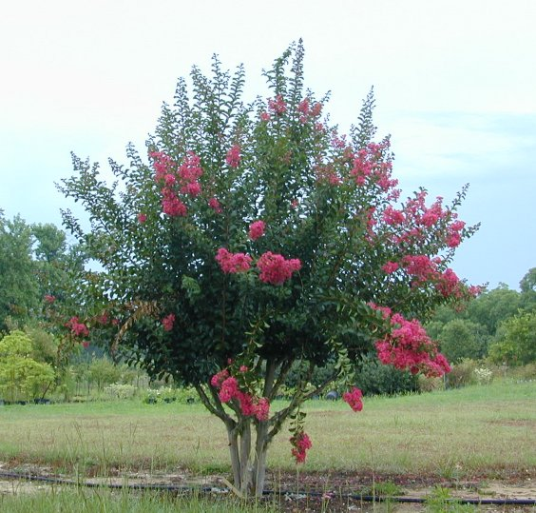
Topped Carolina Beauty

Slide 27
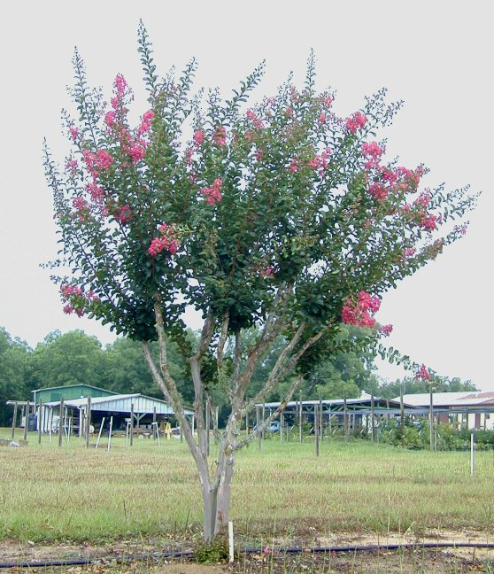
Pollarded Carolina Beauty

Slide 28
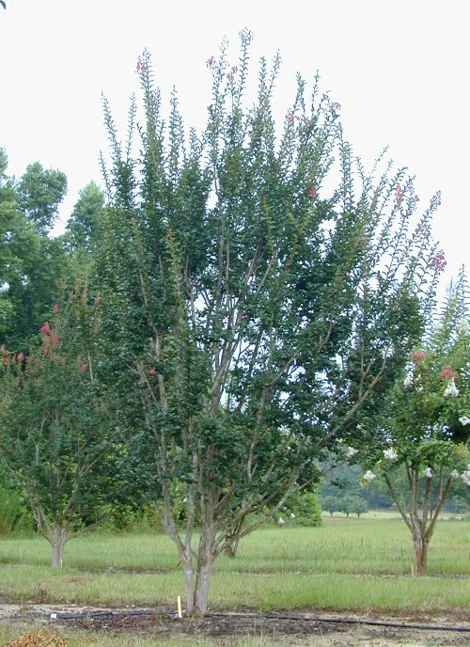
Pencil-pruned Carolina Beauty

Slide 29
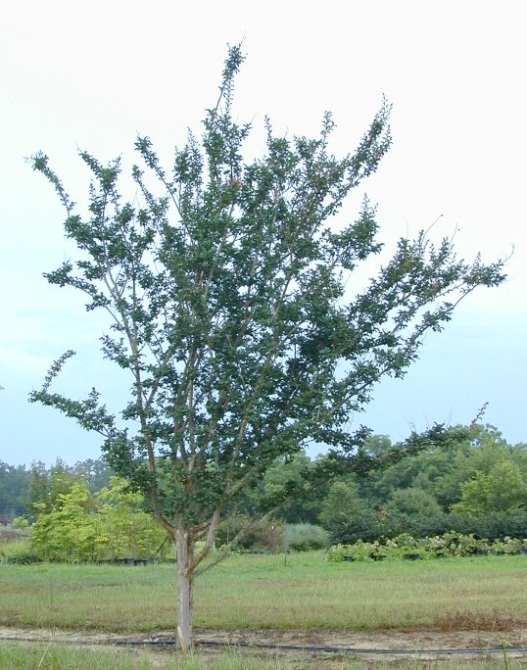
Unpruned Carolina Beauty

Slide 30
Topped
Pollarded
Pencil-pruned
Unpruned

Slide 31
Topped
Pollarded
Pencil-pruned
Unpruned

Slide 32
pencil
pruning
control
Natchez - Summer 1999
Number of flower panicles
topped
pollard

Slide 33
pencil
pruning
control
Carolina Beauty - Summer 1998
Number of flower panicles
topped
pollard

Slide 34
Natchez
Flower size (cm³)

Slide 35
Carolina Beauty
Flower size (cm³)

Slide 36
Generalizations Thus Far:
Unpruned trees require the least overall “work”
Pencil-pruning and Pollarding take more time than Topping
Topping and Pollarding stimulate more sprouts; I.e., the harder you prune, the more you stimulate sprouting

Slide 37
Generalizations Thus Far:
The harder you prune, the more you delay flowering
Natchez: Hard pruning reduces number of flowers and slightly increases flower size
Carolina Beauty: Pruning had no clear effect on number of flowers; topping reduced flower size

Slide 38
What’s the “right” way to prune?
It depends on:
Amount of time available for winter pruning
Skill of the the worker
Desired plant size
Preferred winter appearance

Slide 39
Topped
Pollarded
Pencil-pruned
Unpruned

Slide 40
What’s the “right” way to prune?
It depends on:
Amount of time available for winter pruning
Skill of the the worker
Desired plant size
Preferred winter appearance
Preferred summer appearance

Slide 41
Topped
Pollarded
Pencil-pruned
Unpruned

Slide 42
What’s the “right” way to prune?
Recommendations:
To avoid constant, severe pruning, plant the right-sized cultivar for the plant’s location in the landscape
To minimize plant structural damage and risk of disease, leave plants unpruned
Otherwise prune according to your preferences for winter appearance and summer appearance

Slide 43
Crape “Murder”
Gary W. Knox, UF-Monticello
and
Edward F. Gilman,
UF-Gainesville

