Slide 1

Notes:
1. UGA Logo

Slide 2
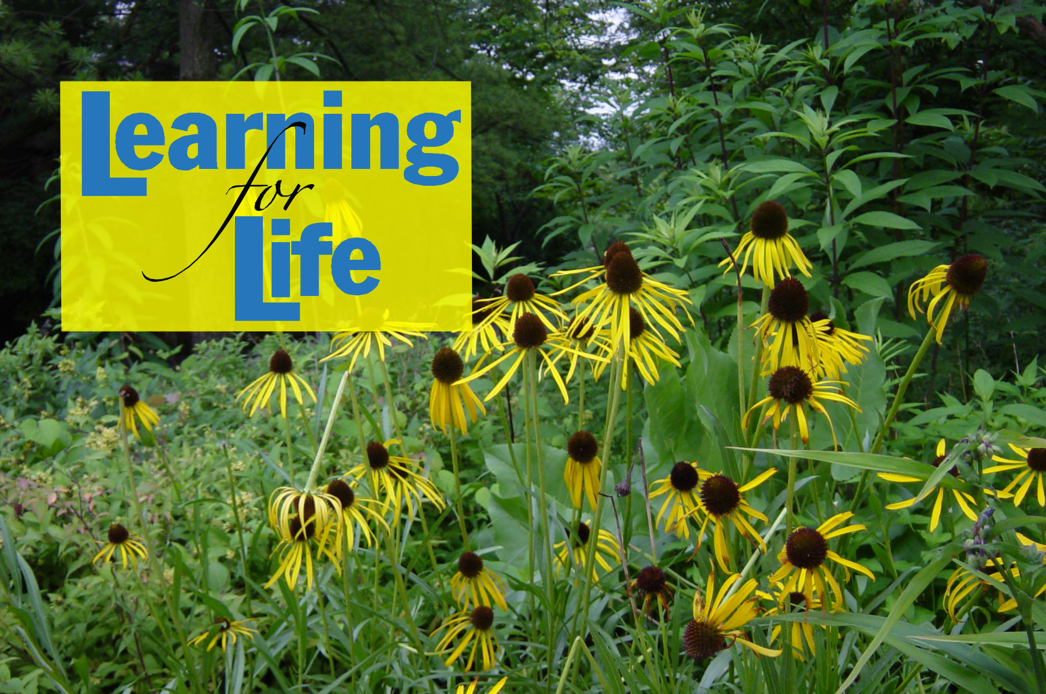
http://www.caes.uga.edu/extension/
Notes:
2. UGA Cooperative Extension Web address

Slide 3

Notes:
3. Georgia Master Gardener Logo

Slide 4
Composting, Grasscycling and Mulching at Home
Prepared by:
Robert R. Westerfield
The University of Georgia
Cooperative Extension Service
and the Atlanta Regional Commission
Notes:
4. Title/Intro Slide Today’s class will primarily cover composting, but will also take a snapshot look at two other types of yard waste recycling ; mulching and grasscycling.

Slide 5
Learning objectives
Why composting is important
How the decomposition processes work
How to construct and maintain a compost pile.
Notes:
5. Learning Objectives
After you complete your study of this chapter you should be able to:
Understand why composting is important in reducing organic waste materials.
Be familiar with how the decomposition processes work.
Know how to construct and maintain a compost pile

Slide 6
Benefits and drawbacks of composting structures
Using composted materials in the landscape and garden
How organic materials can be used in amending the soil
How organic materials can be used as mulch in the landscape and garden
Notes:
6. Learning Objectives continued…
Be familiar with benefits and drawbacks of various composting structures.
Know benefits and potential drawbacks of using composted materials in the landscape and garden.
Know how organic materials can be used in amending the soil.
Know how organic materials can be used as mulch in the landscape and garden.

Slide 7
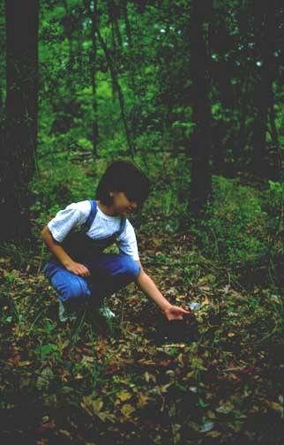
Nature Recycles Leaves & Plants
In a forest, leaves and plants fall forming a layer of mulch that absorbs rainfall and protects the soil.
Over time this layer decomposes into nutrients for the forest.
Notes:
7. In a forest situation, nature has the ability to handle all of the leaf and plant debris through a natural composting process. This process adds valuable nutrients and humus (organic matter) to the native soil.

Slide 8
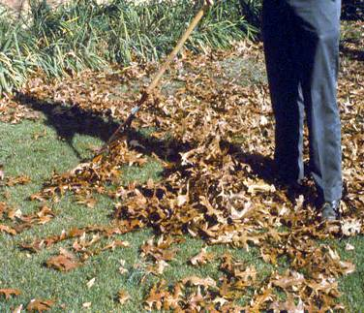
People Remove Natural Mulch
In our suburban and urban landscape, we like to rake up and remove this plant material.
Soils are robbed of the natural soil amendments & nutrients.
Notes:
8. People tend to be most concerned with the appearance of a clean lawn and most often look at yard waste as a nuisance.

Slide 9
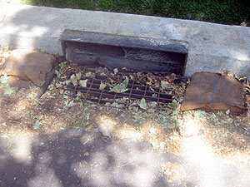
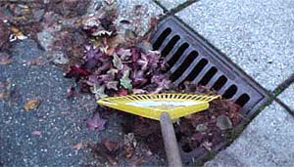
Excessive Nutrients From Leaves
Excessive grass clippings and leaves dumped or blown into the street, drainage ditch or stream bank are sources of water pollution.
Notes:
9. Leaves, grass clippings and other yard waste can carry nutrients (fertilizers) and pesticides (insecticides and herbicides) that were used in the landscape and carry them down streets, drainage ditches and storm drains into rivers, lakes and streams. Too many nutrients in a waterway can cause Algal Blooms.

Slide 10
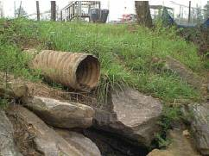
Where Does Stormwater Go?
Stormwater flows across streets, down street gutters, drainage ditches and storm drains into rivers, lakes and streams
untreated.
Notes:
10. Every time it rains, rainwater runs off the land and picks up pollutants and debris such as litter, pesticides, chemicals, pet waste, and sediment. It flows off rooftops, lawns, down driveways and streets then flows into storm drains and directly into our rivers, lakes and streams.

Slide 11
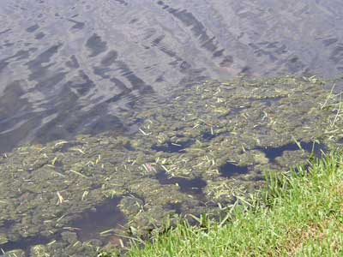
Grass Clippings
Good on lawn
Bad in streets and down storm drains.
Carry excessive nutrients and pesticides into waterways.
Notes:
11. Grass clippings piled on the street can easily lead to high levels of nutrients and possible chemicals in our waterways.

Slide 12
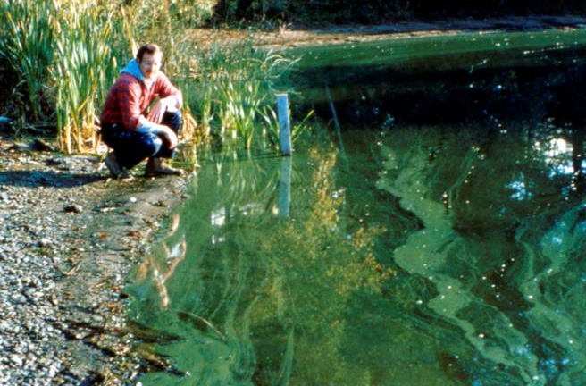
Too much nutrients may cause….
Algal blooms, fish kills, loss of other aquatic life, eutrophication
Notes:
12. Algal blooms
Typically, algae are present in low concentrations although under some environmental conditions they may proliferate - otherwise known as an algal 'bloom'. Algal blooms may discolor water, create unsightly scums, clog water treatment filters, and lead to unpleasant tastes and odors, which affect the quality of water for drinking, irrigation or recreation. Additionally, the decomposition of algae (especially following an algal bloom) results in reduced dissolved oxygen that can kill fish. Algal blooms may occur in water bodies for several reasons, including warm water temperatures, poor water circulation and high nutrient levels (especially phosphorus and nitrogen).
Waterways in urban and rural areas have an increased risk of algal blooms as they typically receive nutrient-enriched stormwater runoff. People can help to reduce algal blooms in a number of ways including applying fertilizers sparingly, disposing of garden wastes thoughtfully and washing cars and boats on the grass (as opposed to pavements or driveways where detergents are more likely to enter the drainage system and our waterways).

Slide 13
What’s In Our Garbage
Courtesy of GA DCA
Notes:
13. Organic wastes such as yard trimmings and vegetable & fruit scraps make up 28% our waste stream. Recycling organic waste is a natural way to reduce the amount of wastes going to landfills and it conserves natural resources. Yard trimmings have been banned from municipal solid waste landfills since 1996, though they are still regularly ground up and dumped in unlined, inert landfills.

Slide 14
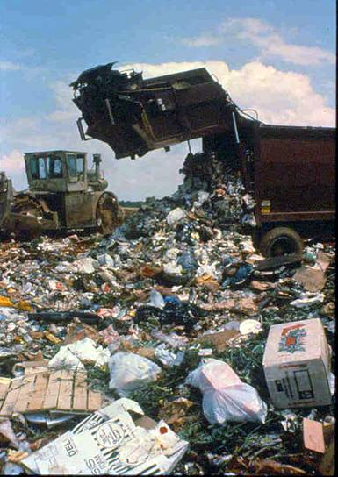
Managing Solid Wastes
Local governments offer
yard waste collection
but 149 of them
disposed of yard waste
in inert landfills in 2002.
Recycle yard waste at
home and keep it out of
the landfill.
Notes:
14. All jurisdictions in Georgia restrict yard waste from being dumped in landfills. The level and type of solid waste, recycling and yard trimmings collection service provided throughout the state varies greatly depending upon a community’s size and demographic profile.
Based upon the municipal solid waste disposal rates reported in 2003, the state has approximately 25.6 years of permitted MSW disposal capacity. In our area, that number drops to 20.8 years. The Georgia Department of Community Affairs annually surveys local governments to determine how they collect, process and use yard trimmings generated within their communities. In 2002, 66 cities and 41 counties statewide reported collecting yard trimmings for diversion from MSW landfills. Over 153 local governments disposed of yard waste to INERT landfills in 2002 - not a municipal solid waste (MSW) landfill. It is legal to send yard trimmings to an inert landfill, but it's illegal to send it to an MSW landfill. In 2002, yard trimmings were sent to 149 inert landfills.

Slide 15
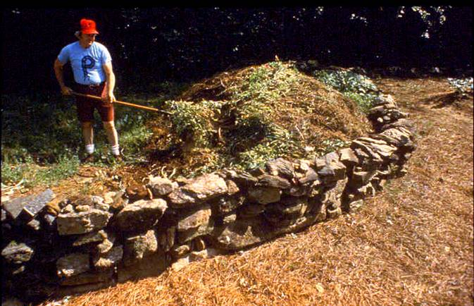
…Where to put it.
Yard Waste…
Notes:
15. Consider recycling yard waste as an alternative to piling leaves, grass clippings and other yard waste across your property. There are three key ways to recycle yard waste, they include: ….

Slide 16
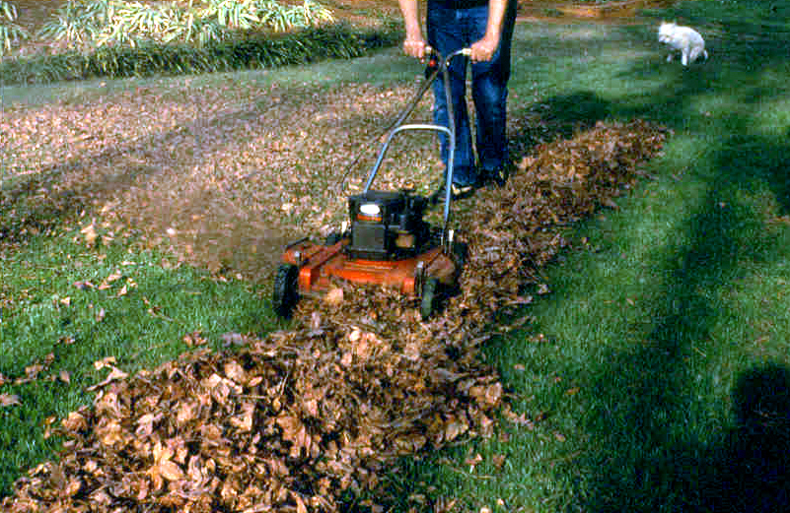
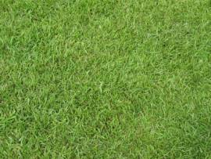
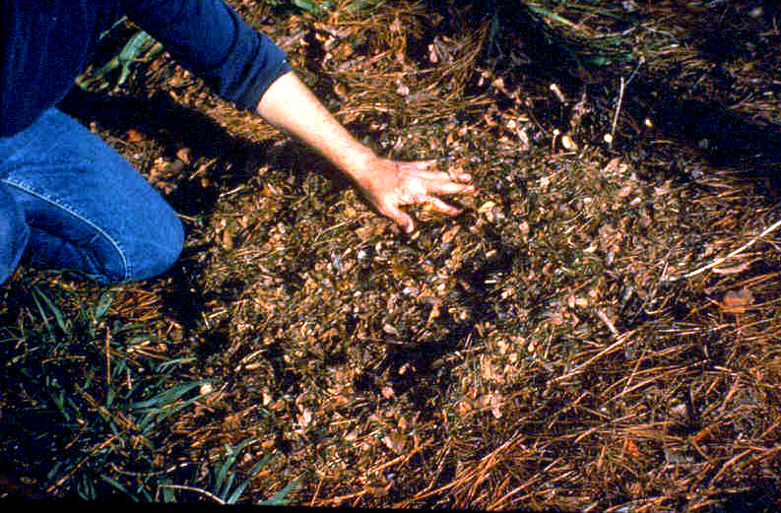
Recycling Options
Mulching
Grasscycling
Composting
Notes:
16. There are three types of yard waste recycling options that will be covered in today’s workshop. They are: mulching, grasscycling and composting.

Slide 17
Mulching
Notes:
17. Mulching is the use of some form of partially composted organic material around our plants in the landscape. It is one of the simplest and most beneficial practices you can use in the garden. Mulch is simply a protective layer of material that is spread on top of the soil.

Slide 18
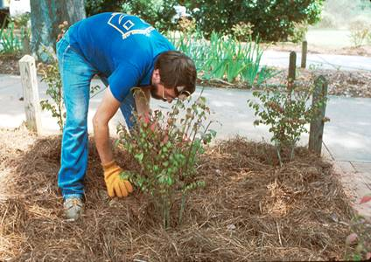
Benefits of Mulch
Saves water & reduces amount of runoff
Insulates roots
from heat & cold
Helps control weeds &
disease
Organic mulches add nutrients to soil
Notes:
18. There are many benefits to using mulch. Mulch:
Saves water and reduces the amount of runoff
Insulates roots from heat & cold
Helps to control weeds & diseasies
Adds nutrients to the soil
Protects the soil from erosion
Reduces compaction from impact of heavy rains
Maintains a more even soil temperature
Keeps fruits and vegetables clean
Provides a “finished” look to the garden
Replaces natural soil amendments

Slide 19
Mulch Basics
Apply anytime, best in the late fall
Identify mulch materials & quantity
Use mower to make your own mulch
Do not apply directly in contact with plants. Leave an inch or more of space (prevents diseases).
Remove weeds before
applying
Do not bury or dig in
Notes:
19. When to Apply- Mulches used to moderate winter temperatures can be applied in the late fall to protect tender root systems of plants.
Identify the type of mulch materials and quantity needed. We are going to take a look at the different types of mulch material that can be used.
How much mulch to use- Mulch can be applied 2-4” deep on top of your soil. Remember not to bury or dig in the mulch. Just keep it on the surface. Mulch is measured by cubic feet. If you have an area 10’x10’ and you wish to apply 3” of mulch, then 25 cubic feet are needed.
Make your own mulch-use a mower. Mulching mowers cut up leaves and grass into finer pieces so that it decomposes quickly but you can grasscycle or mulch with any mower if you scoop up leaves or grass to be mulched and run over it several times.
-Apply on in landscaped areas around trees, shrubs, in flower beds and on bare spots.
-Remove weeds before applying.
-Mulch can be applied to 3-5” deep on top of your soil.
-Do not bury or dig in mulch
-Just keep it on the surface.

Slide 20
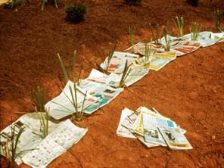
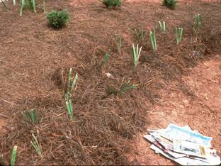
Mulch Material
Leaves (chopped)
Newspaper- Applied 3- 4 sheets thick and covered with organic mulch
Bagged material-Pine straw, pine bark, and cypress chips
Compost material
Materials to avoid- nut shells, fresh hardwood wood chips, straw, hay, grass clippings, sawdust, rocks .
Notes:
20. -Leaves- Whole leaves tend to compact if wet or blow away if dry. Chopping reduces the volume. Mulch materials can be found in your own yard. Lawn clippings make excellent mulch, they may not be attractive for a flower bed, but they work well in vegetable gardens. The fine texture allows them to be spread evenly around small plants.
-Newspaper, as mulch, works especially well to control weeds. Newspaper should be anchored with mulch material.
-Bagged Material, Pine straw makes a great mulch but breaks down rather quickly and has to be re- added often. Pine bark and pine nuggets are a good durable alternative that last longer than pine straw but are somewhat more expensive. Cypress chips are both attractive and long lasting but come with a higher price tag.
Composted material makes a wonderful mulch if you have a large supply. Compost not only improves the soil structure but provides an excellent source of plant nutrients.
-Avoid these, - Nutshells may contain nematodes that would be harmful to plants.
-Fresh wood chips should be set aside for a few months prior to use to avoid burning tender plants from evaporating resigns.
Straw and hay are ok to use around vegetables but avoid using them around landscape plants. They may harbor weed seed that can germinate in the landscape bed. Grass clippings may become matted and too moist causing anaerobic conditions possibly leading to disease.
Tip: Mulches that break down slowly improve the soil slowly, but do not need to be reapplied as frequently. In contrast, mulches that break down more quickly provide better soil benefits, but need to be applied more regularly. For sites with poor soils, selecting a mulch with a shorter longevity may be the best option.

Slide 21
Grasscycling
Notes:
21. Grasscycling is a simple alternative to bagging clippings. Simply leave the clippings on your lawn. Once cut, grass clippings first dehydrate, then decompose, quickly disappearing (in 7 to 14 days) from view. The clippings act as top-dressing fertilizer and help keep your lawn green and healthy. Research has shown that lawns can generate approximately 300 pounds of grass clippings per 1,000 square feet annually. This can be as much as 6 1/2 tons per acre each year!

Slide 22
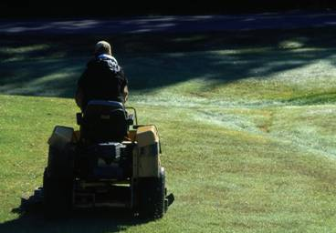
Grasscycling
Mow frequently enough so that no more than 1/3 of the length of the grass blade is cut in any one mowing.
Grasscycling is not dumping leaves on streets and into storm drains.
Notes:
22. Does it cause thatch build up? No! Research has shown that grass roots are the primary cause of thatch build up, not clippings.
Do I need a special mower? No! Mulching mowers cut up grass into finer pieces so that it decomposes quickly but you can grasscycle with any mower if you follow proper mowing techniques.
Proper mowing techniques: Cut grass when the surface is dry and keep mower blades sharp. Mow your lawn frequently enough so that no more than one-third of the length of the grass blade is cut in any one mowing.
Does Grasscycling Spread Lawn Disease? No! Improper watering and fertilizing have a much greater impact on disease spread than grasscycling. If a desirable environment for turf grass disease is present, infestation will occur whether clippings are collected or not!
Will Grasscycling Make My Lawn Look Bad? No! If a lawn is properly mowed, watered, and fertilized, grasscycling can actually produce a healthier looking lawn. It is important to cut the lawn frequently to produce small clippings that will decompose quickly. If a lawn is not cut frequently and clippings are left on the lawn, it will produce a "hay-like" look which can be unsightly.

Slide 23
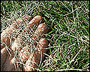
Grasscycling Benefits
Saves Landfill Capacity
Saves Time
Saves Water and is Better for the Environment
Saves Money
Notes:
23. Benefits of Grasscycling
Saves Time- (no more bagging and raking)
Saves Money- (less fertilizer is needed and no garbage bags)
Encourages a Healthy Lawn-(Clippings contain valuable nitrogen and also works as a mulch layer to conserve moisture )
Reduces Yard Waste While saving landfill space- (clippings stay on your lawn)
Grass clippings add beneficial organic matter to the soil, which provides free fertilizer and produces healthy, green lawns. Grasscycling reduces turf grass fertilizer and water requirements, which can minimize toxic runoff entering storm drains and polluting rivers, lakes and streams.

Slide 24
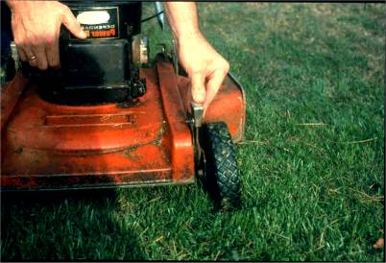
Grasscycling (Mowing Heights)
Suggested Mowing Heights for Various Types of Grasses
Bermuda (Hybrid)- ¾”
Bermuda (Common)-1”
Zoysia -3/4” to 1”
Centipede-2”
St. Augustine-2”-3”
Fescue, Ryegrass- 2-1/2”-3”
Notes:
24. Just as proper cutting height is important, so is the frequency at which your lawn is cut. Ideally, the frequency between mowing should be as long as possible to allow the plant to recover from the first cutting. Leaf growth rate and the use of the lawn will to a large degree, dictate mowing frequency. A single mowing should not remove more than 1/3 of the leaf surface.
Before we leave this section, I wanted to share a few extra ways you can use grass clippings. You can:
Use them around vegetables and trees as a surface mulch
Add to your compost pile for extra nutrients (no more than 1/3 of pile).

Slide 25
Composting
Notes:
25. Composting is an easy way to transform your landscape trimmings and your fruit and vegetable kitchen scraps into a dark, crumbly, sweet-smelling soil amendment. This substance, called compost or humus, is a wonderful conditioner for your soil. Compost is the useable material which is the end product of the decomposition process.

Slide 26
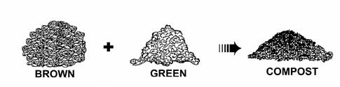
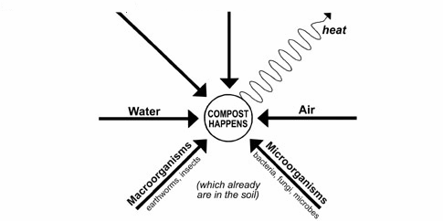
How Compost Happens
(leaves & pine needles)
(grass & vegetable scraps)
Notes:
26. Brown material (leaves, straw, shredded wood) along with green materials (grass, vegetable scraps) in combination with water and air and high temperatures creates an environment for yard debris, grass clippings and vegetable scraps to break down. Macro organisms, such as earthworms and insects as well as microorganisms such as bacteria, fungi and microbes help to further break down the compost pile.

Slide 27
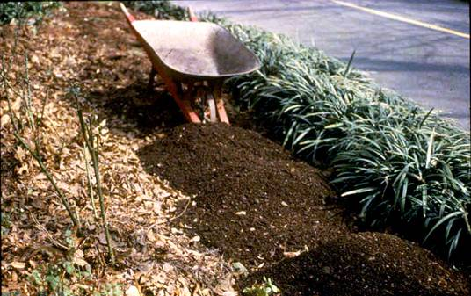
Benefits of Composting
Saves money
Helps improve
soil fertility
Protects the
environment
Notes:
27. Composting…
Saves you money
Helps your garden and container plants by improving the fertility and tilth of the soil.
Saves water by helping the soil hold moisture and reducing water runoff.
Protects the environment by recycling valuable organic resources and reducing the use of fuel to transport yard trimmings off-site and process them on a large scale.
Another benefit is the timeless education children receive from composting. Kids can be a big help in making compost happen at your home. A fun and educational chore to assign your young children is carrying the house bucket full of vegetable scraps outside to the compost bin. This activity brings the wonders of science and nature to life, as they see last week’s leftovers soon becoming rich soil.

Slide 28
Choosing the best compost system
Piles- no special tools or bins
Holding bins- neatly contain materials, ward off animals, and keep in moisture
Tumbling systems- designed for quick, hot composting.
Notes:
28. When thinking of composting, it’s best to decide what structure you want to use to compost your yard clippings and trimmings in. Also keep in mind that there are some homeowners associations that do not permit piles of yard waste, check with your association before you start to compost. A container creates a neat and tidy structure that retains heat well, is visually pleasing and serves as a reminder for you to compost.
Here are a few of the different types of composting structures…

Slide 29
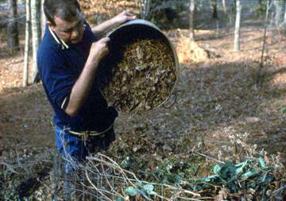
Heap Composting
(No container necessary)
Simple
Piled on top of each other directly on the ground.
Materials can be added immediately or stockpiled.
Notes:
29. Traditionally, a pile of 3’x3’x3’ is recommended.
A higher pile of at least 6’x6’ and preferably larger is ideal for decomposition, but unmanageable for people less than 6 feet tall. A small pile tends to remain at a lower temperature and the heating process can be hindered. The peak height of the pile should be in the 5 to 6 foot range for the best of both worlds.
Heaps tend to sprawl and shrink to short mounds. To organize your compost, consider a simple enclosure.

Slide 30
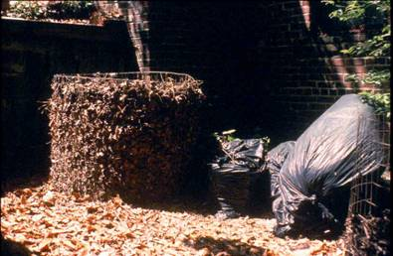
Compost Hoops
(Homemade or Store bought)
Usually made from dog or hog wire.
Are easy and fairly inexpensive to build.
Help keep your compost pile tidy.
Notes:
30. Secure the hoop with hooks or twists of wire. To speed composting, undo the hoop, set it up next to the pile, and turn the pile back into the cage in its new location.

Slide 31
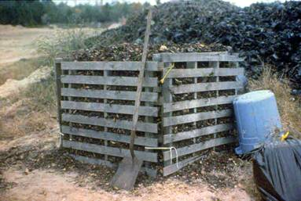
Wooden Compost Structure
(Homemade or store bought)
Bins-Neatly contain
yard trimmings and vegetable/fruit scraps.
Can be homemade
or store bought.
Notes:
31. Like plastic bins, wooden ones can neatly contain yard trimmings. They can be build with recycled wood, old pallets and some wire and provide an inexpensive compost structure. Many styles are also commercially available and are easy to construct or can be purchased ready made. These are low-cost containers that you can use to reduce the pile.

Slide 32
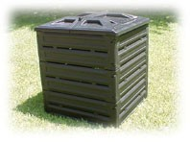
Plastic Compost Bins
(Store bought)
Keep optimum size of pile
Store anywhere
Hide wastes
Cover Material
Notes:
32. This model is an open air bin with air vents along the sides. They are usually constructed of recycled plastic. This model is referred to as a biostack.
Other plastic bins are named Presto Composter, Garden Gourmet, Yard Guard, Soil Saver and GreenKeeper. There are even plastic closed air bins. The closed bins retain moisture and heat inside its walls, and some oxygen is introduced each time the lid is opened and through the soil at the bottom.

Slide 33
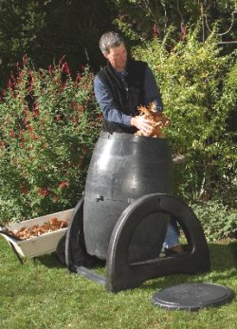
Tumbler
(Homemade or store bought)
Ease to tumble and keep compost mixed up
Low maintenance
Pest proof
Avoids odor
Make compost faster
Keeps damp in dry conditions & warm in winter
Notes:
33. There are also rotating drums. They are raised, drum shaped units which rotate and create compost quickly. The materials are thoroughly mixed inside, and quicker breakdown occurs. Yard clippings and vegetable scraps are placed inside a convenient door and turned every day. To assist the process and increase the number of microorganisms in side, throw in a few handfuls of finished compost, compost starter or garden soil at the start. In about a month, the compost will be ready for your garden.
The first time you fill your bin with leaves and grass, you might wonder if the bin is too small. Don’t worry. The pile will start to decrease in volume by 35-50% after seven days. You can fill it again and again and the same reduction in mass will occur.

Slide 34
Compost in a Trash Can
(Homemade bin)
Use an extra plastic trash can to put leaves and grass in.
Cut off the bottom with a saw or knife.
Place unit into the soil.
Drill 24-48 1/4-inch holes in the sides of the can to increase airflow.
Notes:
34. Even a trash can be converted into a composter!

Slide 35
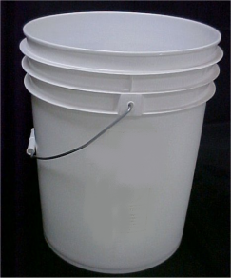
Buckets
(For Small Space Composting)
A way for apartment-
dwellers or people
living in small spaces
to compost food wastes
inside or outside.
Notes:
35. Composters don’t need to be large to work. A simple bucket can get you started if space is an issue. It can be kept on an outside balcony or porch.

Slide 36
How to Compost
Instructions, Methods and Basic Recipe
Notes:
36. How to Compost.

Slide 37
Compost Ingredients
-What to Compost
-Browns vs. Greens
-What to Avoid
-Basic Recipe
Notes:
37. While composting is easy, there are a few things to consider to speed the process and avoid problems.

Slide 38
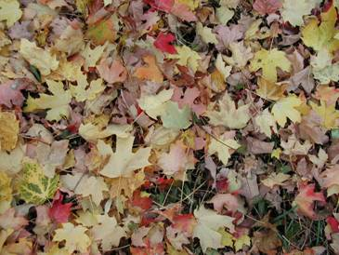
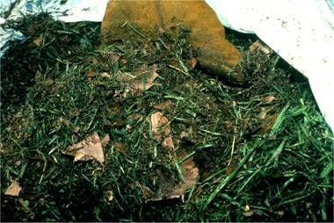
What to Compost
Grass Clippings
Leaves
Shrub Prunings
Flowers
Sawdust
Fruit & Vegetable Scraps
Coffee grounds/tea bags
Small amounts of uncoated paper
Notes:
38. There are many items that can be turned into compost.
Grass Clippings
Leaves
Shrub Prunings
Flowers
Sawdust
Fruit & Vegetable Scraps
Coffee grounds/tea bags
Small amounts of uncoated paper

Slide 39
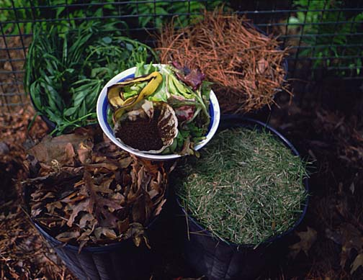
Brown vs. Green Ingredients
Browns- dry plant parts (leaves & pine needles) source of carbon
Green- fresh (grass clippings, vegetable scraps, weeds, source of nitrogen.
Notes:
39. Brown material is essentially dry matter and a source of carbon. Green material is fresh matter and a source of nitrogen.

Slide 40
Do Not Compost
Butter
Bones
Cat Manure
Cheese
Chicken
Dog Manure
Fish Scraps
Vegetable Oil
Lard
Mayonnaise
Meat
Milk
Oils
Peanut Butter
Salad Dressing
Sour Cream
These items can all attract pests, rodents, and create foul odors.
Notes:
40. All of these items can attract pests, rodents, raccoons, and create foul odors.
Butter
Bones
Cat Manure
Cheese
Chicken
Dog Manure
Fish Scraps
Vegetable Oil
Lard
Mayonnaise
Meat
Milk
Oils
Peanut Butter
Salad Dressing
Sour Cream

Slide 41
Do Not Add (cont.)
Lime- experts find it unnecessary and not beneficial to the environment.
Wastes that attract pests
Disease/Insect ridden plants
Troublesome weeds (e.g. seed heads, rhizomes)
Notes:
41. Please do not add lime. Some people like to add a sprinkle of lime but experts find it unnecessary and not beneficial to the compost process. The addition of lime to the pile will convert ammonium-nitrogen to ammonia gas and hasten the loss of nitrogen from the pile. Research shows that initially, the microorganisms prefer an acid environment in the break down of the organic matter. Over time, the pH of finished compost is usually 6.5-7.0 on the pH scale.

Slide 42
Basic Compost Recipe
Chop compostables.
Mix 2/3 dry brown material with 1/3 moist green
Add water as you build your pile.
Notes:
42. Chop Compostables- The more you chop, the faster the decomposition process will take place.
Mix two-thirds dry brown material (leaves, straw, shredded wood) with one-third moist, green materials for a balance of nutrients, air and water.
Add water as you build your pile and maintain its moisture. Keep it as damp as a wrung-out sponge.

Slide 43
Methods of Composting
-Dump and Run/ Slow
-Fast Method
-Small Space
Notes:
43. Methods of Composting.

Slide 44
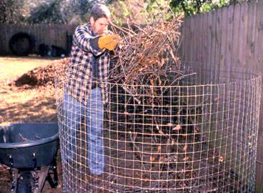
Dump & Run Method (Slow Method)
Add leaves and other compostable materials as they become available.
When adding new materials,
it is best to blend them into
the core.
This method takes 6 months- 2 years to yield compost.
Notes:
44.
Effortless
Takes up little work time, but 6 months to two years to yield product.
Easiest method is to build compost bin in layers of ingredients.

Slide 45
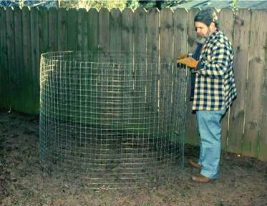
1. Set Up Bin or Heap
(Slow Compost Method)
Select a spot that receives partial shade.
Out of the way but convenient
Places to set-up bin
  near your garden
  back corner of the yard
  location close to a source of water
Notes:
45. A 4 x 4 x 4-foot area out of direct sunlight is ideal for your compost pile. Locating the bin in full sun with wind exposure will slow the process down as it will require more moisture. Locate the bin out of view from neighbors. Composting can begin any time of the year, but many people start in the fall when leaves are abundant.

Slide 46
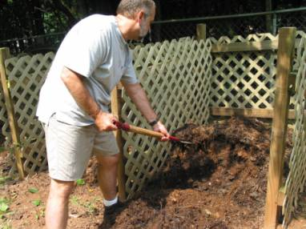
2. Mixing & Adding to the Pile
(Slow Compost Method)
Add materials to the bin or pile
No need to check for moisture
Pile is not mixed in this method
Build pile with greens & browns as they become available
Notes:
46.
No need to check for the proper mix or moisture in this method of composting. You build the pile with green or brown materials as they become available.
If you add vegetable or fruit scraps, it must be buried deep in the pile. Dig a hole in the top or side of the pile and cover the scraps with several inches of brown material or active compost. Foods left on the surface may attract pests or cause odors.
After 6 months or more, finish compost will be found at the bottom or oldest sections of the pile. It may be collected and used as it is produced.

Slide 47
Fast Composting
Notes:
47.
Although it is more labor intensive, there are some ways to speed up the composting process.

Slide 48
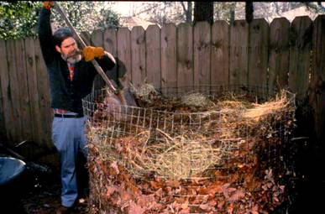
Fast Composting
Build a “hot” heap, hoop or bin.
Requires frequent turning and moisture
Temperatures can reach 120-150°F
Ingredients- layered yard trimmings, fruit & vegetable trimmings
Notes:
48. The fastest way to compost is to build a “hot” heap, hoop or bin. This requires frequent turning of the pile to get plenty of oxygen to the organisms that are hard at work, breaking down the materials and creating heat. Temperatures can reach 120-150°F when “fast” composting is taking place and this assures that weed seeds and pathogens are killed. For accurate temperature readings, use an extended-length thermometer which can be bought at your home garden center. The ingredients to use are yard trimmings, fruit & vegetable trimmings, and water as needed.
Directions:
Layer and mix fresh green with dry brown materials alternately until you have at least a cubic yard (3x3x3 foot) pile.
Keep pile as moist as a wrung-out sponge.
Cover the pile with a sheet of plastic, a piece of carpet or a 1” layer of soil
Turn the pile one to three times a week to give it the air it needs for fast composting.
The compost is ready to use when it has degraded into a rich dark humus, which usually takes between 1-3 months.

Slide 49
Layering Illustrated
Notes:
49. Layering the different compost materials will result in the fastest break down process.

Slide 50
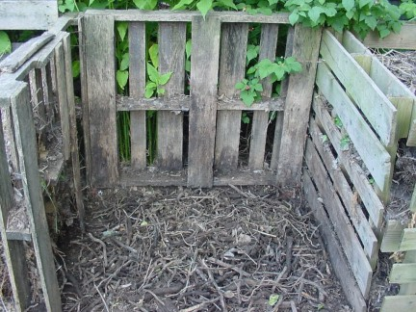
(Layering Method)
The first step is to add a bed of twigs and small branches to promote air circulation.
Notes:
50. Create a coarse lower base of the pile to allow for air circulation and drainage

Slide 51
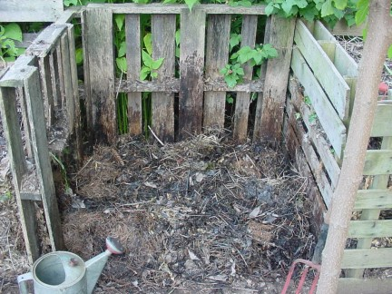
(Layering Method)
Add a layer of browns. Water between layers to evenly distribute moisture.
Notes:
51. Now add a layer of carbon or brown material.

Slide 52
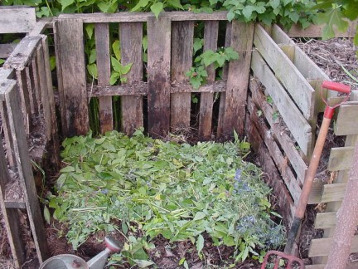
(Layering Method)
Next, add a layer of fresh greens
Notes:
52. Greens will now be added to provide a nitrogen source.

Slide 53
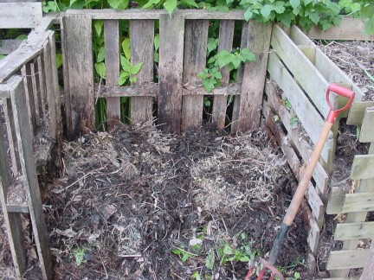
(Layering Method)
Add water & another layer of browns
Notes:
53. Add a shovelful or two of soil or finished compost to the layer. This will get the pile off to a fast start.

Slide 54
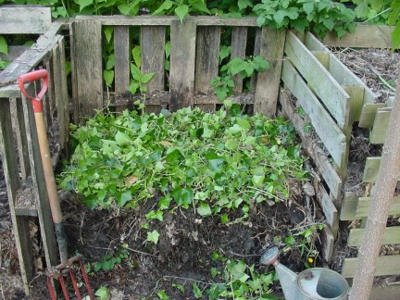
(Layering Method)
Add next layer of greens from prunings or clippings
Notes:
54. Continue to alternate layers of brown and green material.

Slide 55
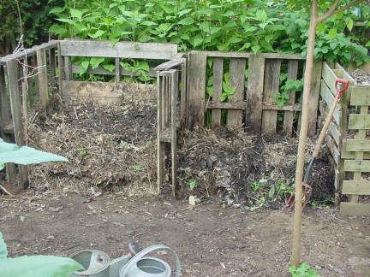
(Layering Method)
Keep extra browns and greens stored separately in other bins for use in compost pile later
Notes:
55. More material can be added later as the pile shrinks through the composting process. The pile should be turned frequently. Multiple bins can be used to turn material over to allow for several stages of the composting process.

Slide 56
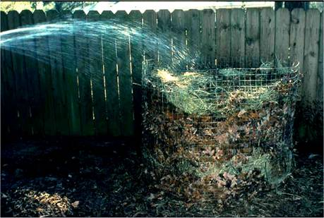
Add Water To The Pile
(Layering Method)
Use a squeeze test to be sure your pile has the right amount of water.
Adding moisture will help to break down materials faster.
Sprinkle water to adjust the moisture level or add brown material to lower moisture content.
Notes:
56. Water so compost is kept as moist as a wrung-out sponge. In months, the material at the bottom and center of the pile will be dark, crumbly compost. Sift and use composted material to start a new batch. Covering your bin or pile helps to control its moisture content by either retaining moisture during hot summer months or repelling water during rainy months.
-Use the squeeze test to check for proper moisture. Grab a handful of compost from the center of the pile and squeeze it. If the material stays in a ball rather than falling apart, and if very little or no water drips from the ball, your moisture content is roughly 55% to 65%. If it does not form a ball because it is too dry, then your moisture content is below 55%. If it is very moist and drips heavily when squeezed, your moisture content is above 65%.

Slide 57
Small Space Composting
-Bucket
-Worm Boxes
Notes:
57. There are two types of small space composting, -bucket and worm boxes.

Slide 58
Bucket Compost
(Small Space Composting)
Compact way to compost vegetable/fruit scraps.
Use a 5 gallon bucket
Ingredients: kitchen scraps, dry material (soil, sawdust, peat moss, straw)
Chop scraps and mix an equal amount of dry material once a week.
Notes:
58. Directions: (1) Chop kitchen scraps and mix an equal amount of dry material at least once a week using a trowel or small spade. If too wet, stir in more dry material. (2) Stir thoroughly each time you add materials. (3) When bucket is ¾ full, let stand 1-3 months, mixing it every week or two.
Use finished compost in garden or planters as it is produced.

Slide 59
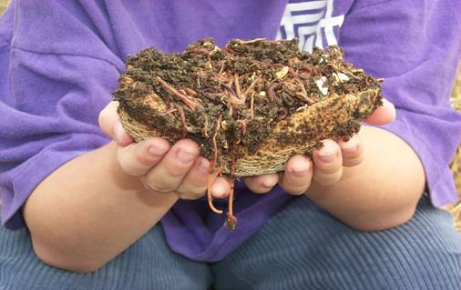
Worm Composting (Vermicomposting)
(Small Space Composting)
What is Vermicomposting?
Different from Composting
Vegetable & Fruit Waste
Notes:
59. “Vermi" is the Latin word for worm, and worms like to feed on slowly decomposing organic materials (e.g., vegetable scraps). The "end" product, called castings, is full of beneficial microbes and nutrients, and makes a great plant fertilizer. Vermicomposting is the practice of using worms to make compost simply by feeding them your vegetable/fruit waste and resulting in a rich fertilizer and soil amendment. . The reason vermicomposting is becoming popular is because worms are very efficient eating machines. They eat over half their body weight in organic matter per day! This is a popular form of composting for school projects or people with no yards.
Ingredients: Fruit and vegetable trimmings, newspapers, and red worms. To start, use a 2:1 worms to food weight ratio (e.g., 2 lbs. Worms to 1lb. food waste)
Directions: (1) Shred and moisten old newspapers (including junk mail and cardboard) and layer them 6” deep in a well-ventilated plastic or wooden box. Use black and white pages of the newspaper only. The paper is for the carbon component, moisture absorption, odor control, and to keep flies at bay.
(2) Add worms and begin feeding them your kitchen scraps (no meat products). (3) Add fresh food waste as it becomes available.
Worm compost can be harvested in 3-6 months. The compost may be harvested by moving it all to one side of the bin and adding fresh bedding to the empty side. Then begin burying new food waste in the new bedding. The worms will migrate to the fresh bedding, allowing you to harvest the compost they produced.

Slide 60
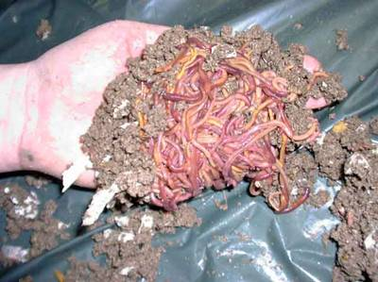
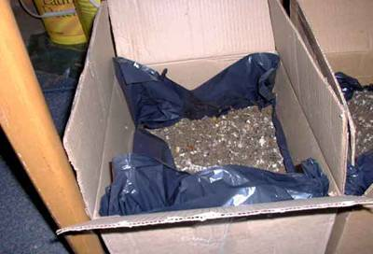
Worm Boxes
(For Small Space Composting)
Can be used to compost vegetable & fruit wastes inside or outdoors.
For small spaces
Give off very little odor
They eat only food waste
Notes:
60. A small sturdy cardboard box can serve a an excellent container for vermicomposting. Worms can be purchased via mail order or from local bait shops.

Slide 61
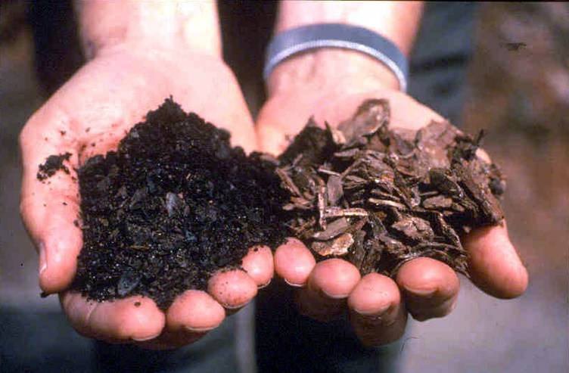
Finished Product
Notes:
61. Can you tell which hand has the ideal compost material ready to be used?
As you can see here the dark and crumbly handful is on the left. The newly chopped compost material is on the right.

Slide 62
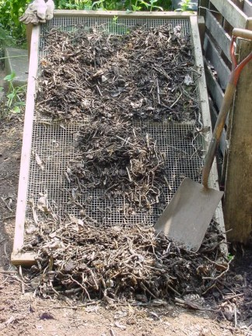
Improving the Finished Product
Finished compost can be improved by sifting through a screen to remove oversized pieces.
Notes:
62. Getting the finest compost can be achieved through sifting out larger particles. This process is only for those who have a lot of time on their hands!

Slide 63
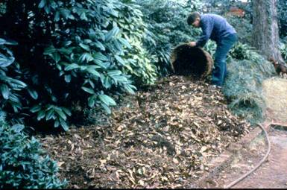
How To Use Compost
Soil Amending
Mulching
Potting Mix
Notes:
63. Compost is ready to use when compost materials are reduced to a dark, rich humus. If some larger pieces are not decomposed, you can sift those out and use them to start a new batch. One way to test if compost is finished is to seal a small sample in a plastic bag for 24 to 48 hours. If no strong odors are released when you open the bag, the compost is done.
Compost can be added to the soil at any time to help keep plants healthy. It improves soil structure, holds moisture, provides plant nutrients, and introduces beneficial organisms into the soil.

Slide 64
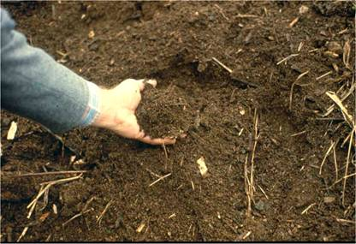
(How To Use Compost)
Soil Amending
Mix 4-6 inches of compost into newly reclaimed or poor soils
Mix 1-3 inches into annual garden beds, or into soil under and around new trees & shrubs before planting.
Notes:
64. Compost makes a great soil amendment. Be sure to use fully finished compost when mixing it into the native soil.

Slide 65
Mulch
(How To Use Compost)
Spread 2-3” over the soil around plants, trees, shrubs
Use on exposed slopes to suppress weeds
Keeps plant roots cool and moist & conserves water
Maintains a loose & porous surface helping to prevent soil erosion.
Notes:
65. Mulching-Apply mulch or semi-finished compost material around base of plants & trees. Reduces water requirements and protects them from freezing and drought. Mulch is one of natures best weed controls.

Slide 66
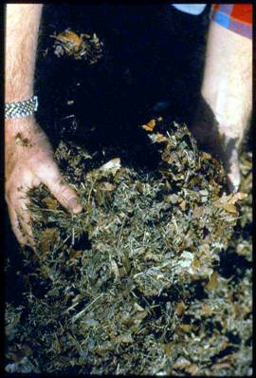
Potting Soil
(How To Use Compost)
1/3 Compost
1/3 Coarse Sand
1/3 Ground Pine Bark
Notes:
66. Potting Mix- A potting mix can be made by mixing one part sand, one part compost material and one part ground pine bark. Be sure compost is fully decomposed (black and crumbly) before using it.

Slide 67

Composting FAQ’s
Can compost replace petroleum based fertilizers?
How long does it take to produce compost?
Notes:
67. Can compost replace petroleum-based fertilizers?
In some cases, generous amounts of rich compost can supply needed nutrients for healthy plant growth. In addition, planting green cover crops such as clover or vetch can boost nitrogen levels in the soil. Some heavy feeding plants may require additional fertilizer.
Compost can be produced in as quickly as 30 days and as long as 24 months.

Slide 68
Troubleshooting
Symptoms Problems Solution
Bad Odor Too wet Add browns
Bad Odor Not enough air Turn pile
Center is Dry Not enough water Moisten & turn
Only Warm Pile too small Mix into larger pile
in Middle
Will Not Heat Up Lack of nitrogen Mix in N Source
Notes:
68. Too wet- Too much water is not generally a problem, but it may cause the center of the pile to compact and resulting in an ammonia or rotten egg odor (an alcohol odor is possible). Add browns and turn to mix thoroughly.
Too much green material- An ammonia, rotten egg or alcohol odor is a clear indication that all of the oxygen has been used up. Add more brown material and turn.
Insufficient air- Turn the pile
Center is dry- moisten the pile and turn
Compost is damp & warm in the middle, but outside is dry- (Pile is too small) Collect more compostable material (both green & brown) and mix the new material thoroughly with the existing compost in your bin or pile. You need about 1 cubic yard (a pile 3’ x 3’ x 3’).
Heap is damp- (lack of nitrogen)- Mix nitrogen source like fresh grass clippings, trimming waste from fruits and vegetables or ammonium sulfate.
Rodents or other vermin- (cause=meat)- Rodents are attracted to meat or other foods and the warmth of the pile. Do not add oils, fats or dairy products. Cover each addition of vegetable scraps with a layer of finished compost.
Flies in the compost- (Cause=Meat)
Spiders- (cause=attracted to moist, dark places with easy sources of prey). Always check for spiders before sticking your hand in. Most spiders are harmless, although there are several poisonous species. Always wear gloves when working with your compost.
It is taking a lot longer to compost than you thought it would- Too dry, not the right mix of greens and browns or not enough air.

Slide 69
Recap Benefits
Preventing leaves from entering streets and storm drains helps to prevent stormwater pollution.
Recycling yard waste saves you money, time and efforts.
Composting helps to turn garbage into gold.
Notes:
69. Remember… Every time it rains, rainwater runs off the land and picks up pollutants and debris such as litter, pesticides, chemicals, pet waste, and sediment. It flows off rooftops, lawns, down driveways and streets then flows into storm drains and directly into our rivers, lakes and streams.
Leaves, grass clippings and other yard waste carry nutrients (fertilizers) and pesticides (insecticides and herbicides) that are used down streets, drainage ditches and storm drains into rivers, lakes and streams, where they where they become pollutants. Too many nutrients in a waterway can lead to heavy algal blooms.
Make sure you practice the 3Rs of managing yard materials for a healthy yard & garden:
Reduce yard waste: Grasscycle, mulch, or compost.
Reuse yard waste: Use leaves, chipped or shredded wood, and other materials for mulch and weed control.
Recycle yard and vegetable & fruit waste: Compost to produce mulch or soil conditioner.

Slide 70

QUESTIONS?
Notes:
70. Questions?
Suggested Discussion Questions
1. What is compost?
2. Does compost have any value as a fertilizer?
3. Can compost be used as a substitute for fertilizer in the garden?
4. Is it necessary to add lime (calcium) to the compost pile?
5. Is it necessary to add inoculum to the compost pile to activate the composting process?
6. What are the best materials for composting?
7. Is it necessary to shred materials for the compost pile?
8. How often do compost piles need turning?
9. What causes compost piles to have offensive odors?
10. When is compost ready to use?
11. How can compost be used in the landscape and garden?

Slide 71
Additional Information
www.cleanwatercampaign.com
www.ces.uga.edu
www.mastercomposter.com
www.compostingcouncil.org
Notes:
71. Resources

Slide 72
Additional Resources (cont.)
www.compostinfo.com/cn/index.htm
www.compostinfo.com/tutorial/faq/FAQ1.htm
www.dep.state.pa.us/dep/deputate/airwaste/wm/recycle/Compost_sum/Home.htm
Notes:
72. Resources

Slide 73
Sources
www.dca.state.ga.us GA Department of Community Affairs
www.dep.state.pa.us (Pennsylvania Dept. of Environmental Protection)
http://aggie-horticulture.tamu.edu/extension/ (Texas A&M Horticulture Extension)
www.compostinfo.com (Florida’s Compost Info)
www.cleanairgardening.net (Clean Air Gardening)
www.marquisproject.com (Marquis Project)
www.ces.uga.edu
Backyard Composting (Harmonious Press, 1992)
Notes:
73. Sources of information.

Slide 74

Thank you
The University of Georgia
Cooperative Extension Service
www.ces.uga.edu
www.cleanwatercampaign.com
Notes:
74. Credit slide.

