Slide 1
Category 24
Turf and Ornamentals
Chapters 1, 2, 5, 6 & 9
T&O Culture and Diseases
Todd Hurt
Training Coordinator
Georgia Center for Urban Agriculture

Slide 2
Certification Requirements
You need to be licensed if you are paid to apply any pesticide to the property of others (this includes RoundUp).
Passing the exam. . . 70% on General Standards and 70 % on Category 24
$25 Check paid to Dept of Ag for Exam.

Slide 3
Certification Exams
For locations and times of certification training and exams, log onto http://agr.georgia.gov Pesticide Division
or call (404)-656-4958
Exams can be re-taken 4 times per year but must be completed in 1 year.

Slide 4
Certification Exam
You need:
1. a government photo ID (like a driver’s license)
2. a calculator
3. a pencil

Slide 5
Recertification Requirements
You need 10 hours of CEUs every 5 years.
Must complete CEUs 90 days prior to expiration.
You get credits at seminars*, field days*, and workshops.*
*(pre-approved for Category 24)

Slide 6
Part 2
Intro to Pest Management in Turfgrass and Ornamentals
Notes:
1

Slide 7
Intro to Pest Management
Chapter 1
(page 15)
BASIC PRINCIPLES OF IPM
WHAT’S THE PROBLEM?
ACTION CHOICES
PESTICIDE APPLICATION AND MIXING

Slide 8
Intro to Pest Management
BASIC PRINCIPLES OF IPM (page 17)
Produce healthy plants that resist pests
Identify the problem
Expect some pests and tolerate some damage
: threshold
Use pesticides as a last resort (page 18)
The goal is not to
eliminate every pest,
but to keep damage
to an acceptable level.
Notes:
Right plant right place. Do not plant grass in the shade. Do not put azaleas in full sun.
Is the damage from environmental conditions or insects and diseases.
Threshold is the amount of damage that can be tolerated before a pesticide is justified.

Slide 9
Intro to Pest Management
WHAT’S THE PROBLEM?
(page 18)
Learn about symptoms
Use a hand lens
  Carry an index card (to detect mites)
Recognize indicator plants
(page 19)
Keep Records
(For example, check roses for Japanese beetles)
Notes:
Symptoms are the plants expression of a problem such as yellow leaves, wilting, leaf spots, etc.
Signs are seeing the actual insect or fungus (i.e. powdery mildew)

Slide 10
Intro to Pest Management
ACTION CHOICES . . . (page 19)
Control Options
Cultural
Chemical
Biological
Mechanical
Notes:
Once the plant symptoms are recognized and action is warranted control options need to be considered. Keep in mind problems are usually a combination of conditions. Treating a plant with a fungicides for root rot will not help until drainage or watering is corrected.

Slide 11
Intro to Pest Management
Pesticide Application and Mixing
(page 19)
Drift = off-target pesticide movement through air
Particle drift
= droplet or dust
Vapor drift
= gas
MINIMIZE DRIFT Buffer Zone

Slide 12
Intro to Pest Management
Pesticide Application and Mixing
(page 19)
(page 20)
Protect People, Pets, and Places
Avoid Resistance
(observe reentry
period)
Evaluate Tank Mixes
(avoid phytotoxicity
= plant damage)
Recognize Formulation Effects
Be Aware of Rapid Pesticide Breakdown
(when same pesticide
is used over and over)
(EC’s may burn plants, WP’s may leave residues.
Liquids for above ground pests, Granulars for below
ground pests)
Notes:
Reentry period is the length of time that must pass before anyone can enter a treated área.
Slow resistance by using pesticides only when necessary and alternating pesticides from different chemical classes.
ECs are more likely to burn plants, wps or flowables leave a residue.

Slide 13
Cultural Management for Turfgrasses
(Chapter 2, page 25)
Turfgrass Selection
Site preparation
Proper mowing, thatch removal, and aerification
Correct watering and fertilizing

Slide 14
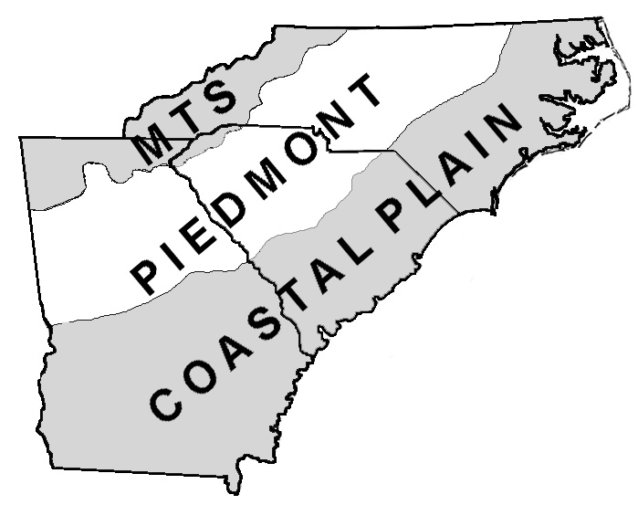
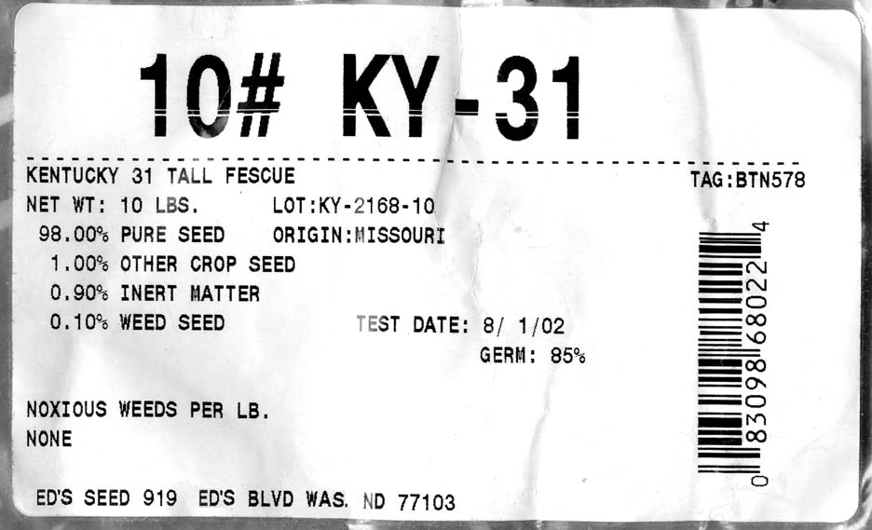
Cultural Management for Turfgrasses
Turfgrass Selection
Cultivars and Pest Management page 26
Site use
Geographic Region
RESIDENTIAL
ATHLETIC FIELDS
GOLF COURSES
CAMPUSES
Cool-season Warm-season
tall fescue bermudagrass
fine fescues centipedegrass
perennial rye bahiagrass
KY bluegrass St. Augustine
bentgrass zoysiagrass
Select
certified
seed
Notes:
Certified seed must meet standard for low number of weed seed.
Cultivars are genetically different groups within a species.

Slide 15
Cultural Management for Turfgrasses
Site Preparation page 26
Remove weeds before planting
Consider air flow, humidity, and shade
Add fertilizer & lime based on soil test
Assure adequate drainage

Slide 16
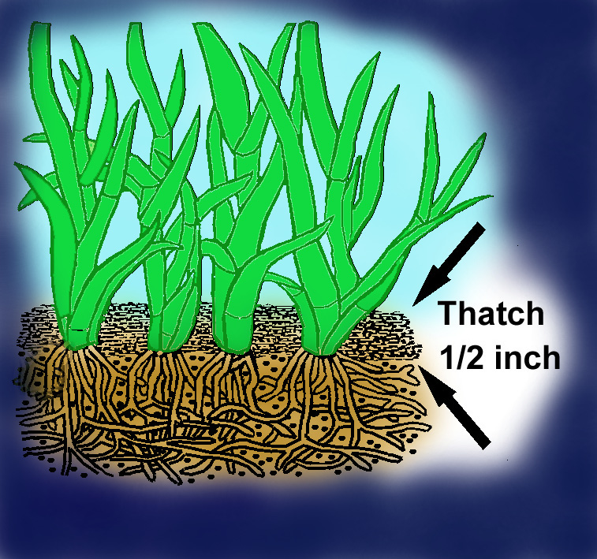
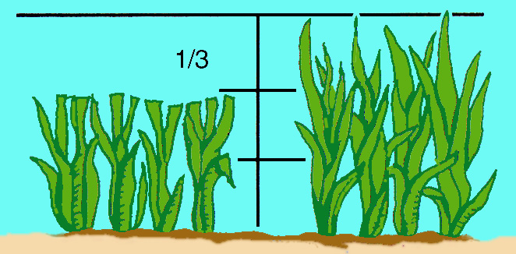
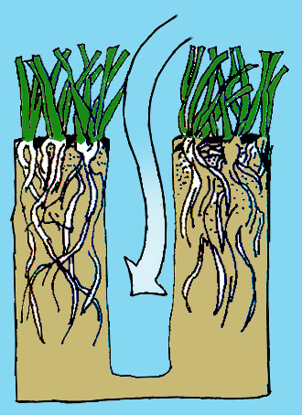
Cultural Management for Turfgrasses
Cultural Practices for Healthy Turfgrass
(page 27)
Fertilizing
Proper Mowing
Aerating
Remove 1/3 height or less
Not too much or too little. Test the soil every 2 or 3 years.
Irrigation
Wet the soil to just below the root depth.
Dethatching
Don’t let thatch get more than ½ inch thick.
Coring machines
work the best.
page 28
Notes:
Too much fertilizer contributes to a thatch problem and disease issues.
Too little fertilizer can leave turf thin and susceptible to weeds.
Low nitrogen levels favor rust and dollar spot problems.

Slide 17
Cultural Management for Ornamental Plants
Match the Plant and the Site
(Chapter 6, page 75)
Starting with Bedding Plants
How to Plant Trees and Shrubs
Care of Newly Installed Plants
Care of Established Trees and Shrubs
Mulch
Watering Plants
Pruning Shrubs and Trees
Recognizing and Preventing Tree Problems

Slide 18
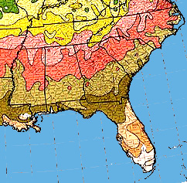
Cultural Management for Ornamentals
Match the Plant and the Site page 77
USDA Hardiness Zones
A hardy plant can tolerate the
lowest average temperature
that occurs in a zone.
Microclimates page 78
Sunlight and Shade
Soil Moisture and Drainage
Soil pH
Lime makes pH go up,
and sulfur, iron sulfate
or aluminum sulfate
make the soil pH go
down.
Pest Susceptibility
page 77
Inspect Plants
Notes:
Microclimate is the condition in the immediate vicinity. North side of buildings colder and more shady.
Full sun is 6 or more hours of direct sun.
Avoid using plants that are susceptible to problems (i.e entomosporium on red tips)
Inspect plants for problems at purchase especially roots.

Slide 19
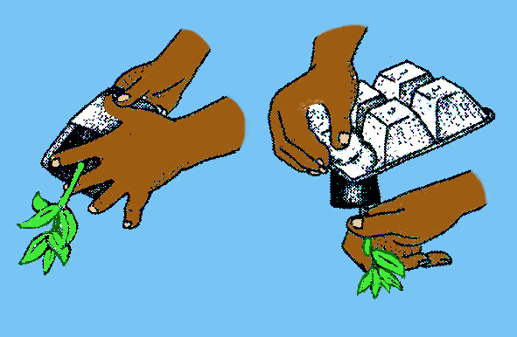
Cultural Management for Ornamentals
Starting with Bedding Plants (page 79)
Fertilizing
Fertilize and lime according to soil tests.
(page 80) Transplanting
Use proper transplanting
techniques:
space 6 to 8 inches apart
mulch (1/2 in at base of plant;
2 to 3 inches between plants
Notes:
Cell packs should be watered thoroughly and allowed to drain before planting. Wet root balls hold together better.

Slide 20
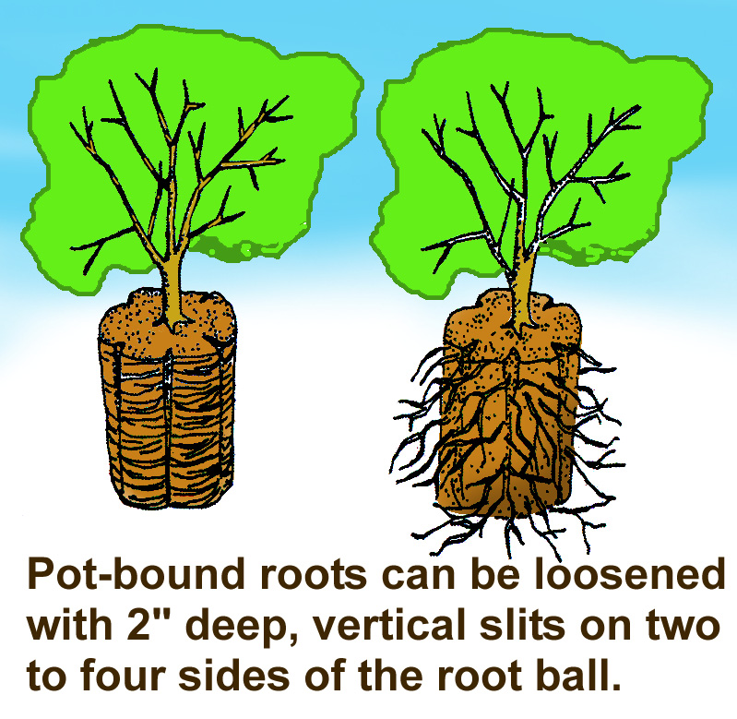
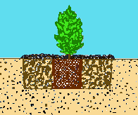
Cultural Management for Ornamentals
How to Plant Trees and Shrubs page 80
Plant no deeper than root ball
Hole 2 to 3
times wider
than root ball
Notes:
When planting on porrly drained sites set the plant so the top of the root ball is 1/3 above grade and cover with soil.
Fall and early spring are best times to plant for root development.
B&B material should be removed from the top third of the rootball.

Slide 21
Cultural Management for Ornamentals
Care of Newly Installed Plants (page 82)
Watering (don’t allow root ball to dry out)
Pruning (remove entire small branches sparingly)
Fertilizing (wait until plant/tree gets established)
Tree Wraps
Notes:
Fertilize spring planted trees and shrubs in 6-8 weeks Fall planted in Spring.
Tree wraps may protect thin barked trees from sun scald but should be applied in fall and removed in spring.

Slide 22
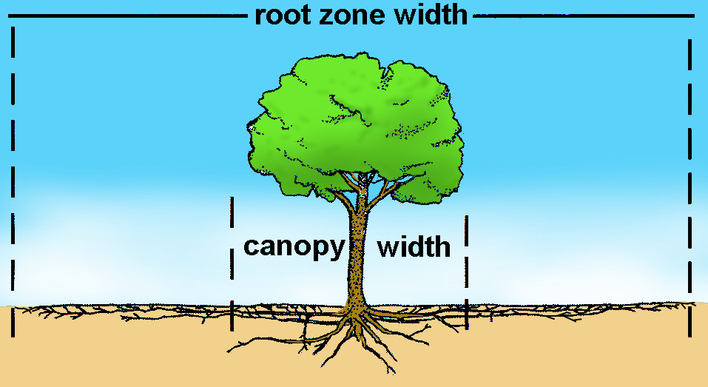
Cultural Management for Ornamentals
Care of Established Trees and Shrubs (page 82)
Fertilizing (not necessary every year)
Fertilizer Rate (varies by plant type, age,
location & growth rate)
(page 83)
Time and Method of Application(do not apply from mid-August until first killing frost. Spread evenly over entire root zone)
Notes:
Root zone is 2-3 times the width of the branches.

Slide 23
Cultural Management for Ornamentals
Mulch (page 83)
Provides nutrients (some)
Improves Appearances
Reduce weeds
Keep roots cooler
Conserves Moisture
Notes:
Keep organic mulches several inches away from trunks to help prevent rot and voles.
2-3 inches of mulch after settling is adequate.
Replanting in inorganic mulches (i.e. rock) can be difficult.

Slide 24
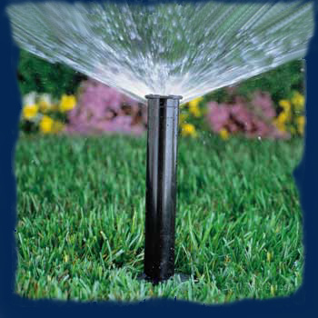
Cultural Management for Ornamentals
Watering Plants (page 84)
When to Water . . . (page 85)
Infrequently, but deep.
Water evaporates during the day.
Late afternoon means leaves are wet longer and diseases may be a problem.
The suggestion for Landscapes:
9:00 PM to 9:00 AM

Slide 25
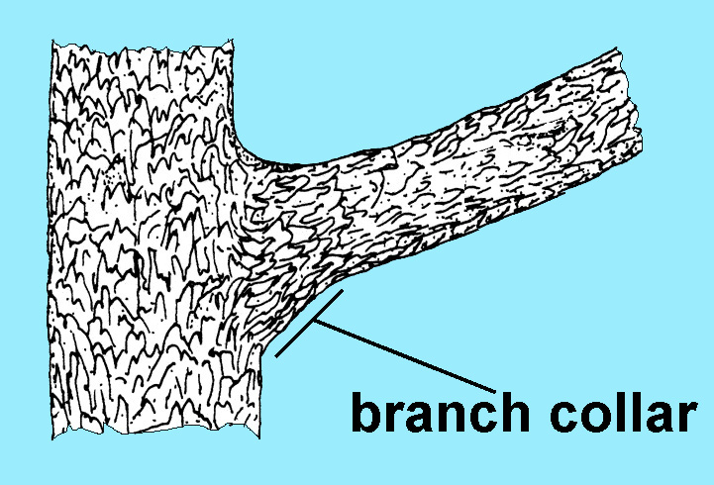
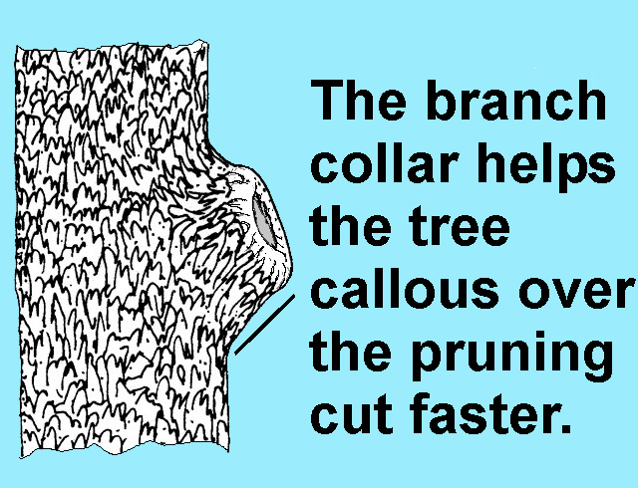
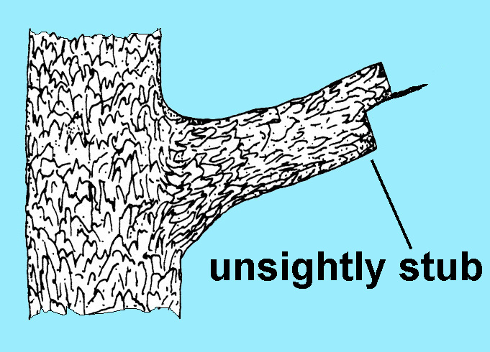
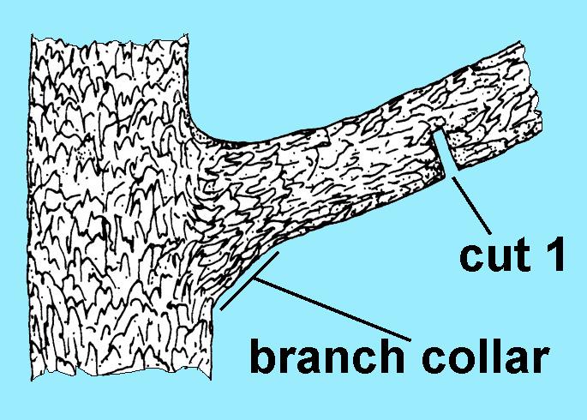
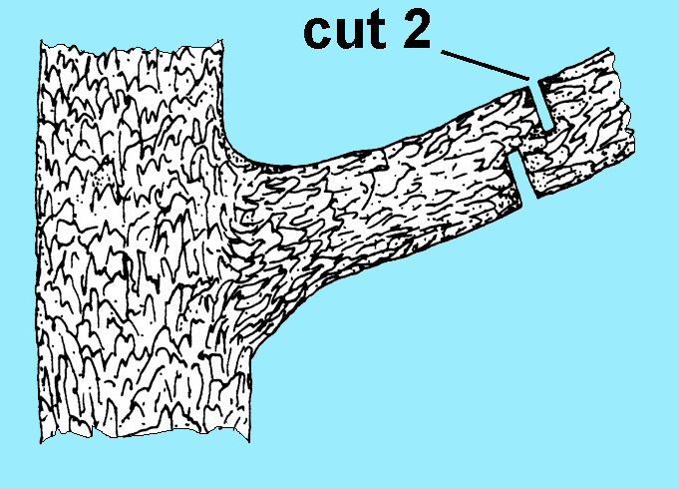
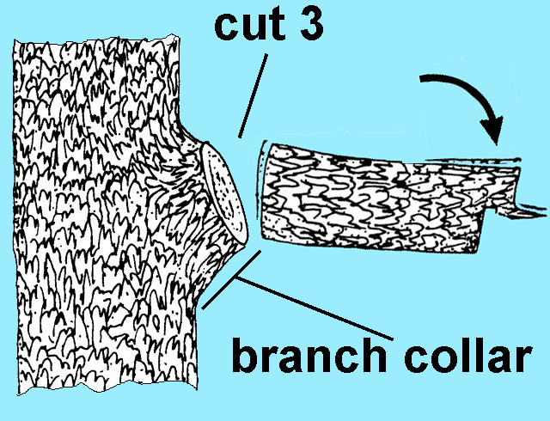
Cultural Management for Ornamentals
Pruning Shrubs and Trees (page 83)
Notes:
Three cut method for large branches to avoid tearing.
Pruning paints are no longer recommended.

Slide 26


Cultural Management for Ornamentals
Recognizing and Preventing Tree Problems
(page 86)
Prevent Lawn Mower and Weed-trimmer Damage
Don’t nick or injure tree bark with weed-trimmer!
Use mulch to keep mowers and weed-trimmers away from trunk.
Damaged
roots
Cool, moist,
undamaged
roots

Slide 27
Part 5
Disease Management in Turfgrass and Ornamentals
(Chapters 5 and 9)
Notes:
1

Slide 28
Diseases of Turfgrasses
Chapter 5, page 59
Disease Development
  Managing the Host
  Managing the Environment
  Managing the Pathogen
Signs and Symptoms
Common Diseases
  Nematodes

Slide 29
Diseases of Turfgrasses
(page 61)
Terms to Know: Disorders and Diseases
  Disorders --
  Irregular plant development caused by unfavorable growing conditions. Non-infectious (does not spread from plant to plant).
  Diseases --
Plant problems caused by pathogens (fungi, bacteria & viruses) which can spread from plant to plant.

Slide 30
Diseases of Turfgrasses
To have a disease you need
all four of these.
Environment
Time
Pathogen
Host
The “Disease Pyramid”

Slide 31
Diseases of Turfgrasses
Integrated Disease Management
  Managing the Host
(page 62)
  Select a cultivar that is well-adapted to the site.
  Consider planting a mixture of compatible cultivars.
  Apply fertilizer when needed.
  Use sharp blades & proper mower height.

Slide 32
Diseases of Turfgrasses
Integrated Disease Management
  Managing the Environment
  Irrigation
  -- Deep and infrequent.
  Airflow
  -- Prune or remove trees.
  Drainage
  -- Improve water-logged soils.
  Compaction
  -- Aerify from time to time.
  Thatch
  -- Half inch or less.

Slide 33
Diseases of Turfgrasses
Integrated Disease Management
  Managing the Pathogen
  Protectant Fungicides
  Broad spectrum and less problems with resistance.
  But can be washed off by rain or mowed off.
  Reapply every 5 to 10 days when conditions are right for disease.
  Systemic Fungicides
  Longer protection, but resistance problems are more likely.
Notes:
Systemic fungicides act in a very specific way against a pathogen and resistance is likely to develop after repeated use.

Slide 34
Diseases of Turfgrasses
Symptoms are the
visible responses
of plants to a
pathogen.
Signs are visible
structures of
the pathogen.
(page 64)
Signs and Symptoms
stand symptoms
plant symptoms
spots
leaf spots & lesions
circles
patches
stem lesions
rings
foliar blight
foliar dieback
crown and root rot
Notes:
Stand symptoms are evident from a distance
Plant symptoms are evident on individual plant parts.

Slide 35
Diseases of Turfgrasses
Signs and Symptoms
fungus
mycelial growth
(Look fluffy, like cobwebs or like
pink gelatin)
mushrooms
white powdery mildew
red or black pustules
(Look like tiny
red or black spots)

Slide 36
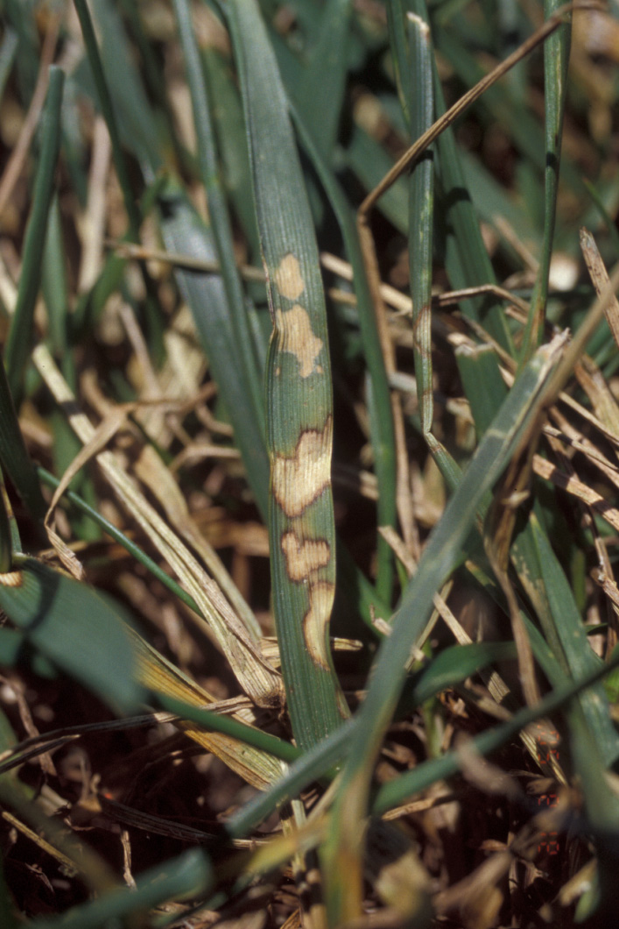
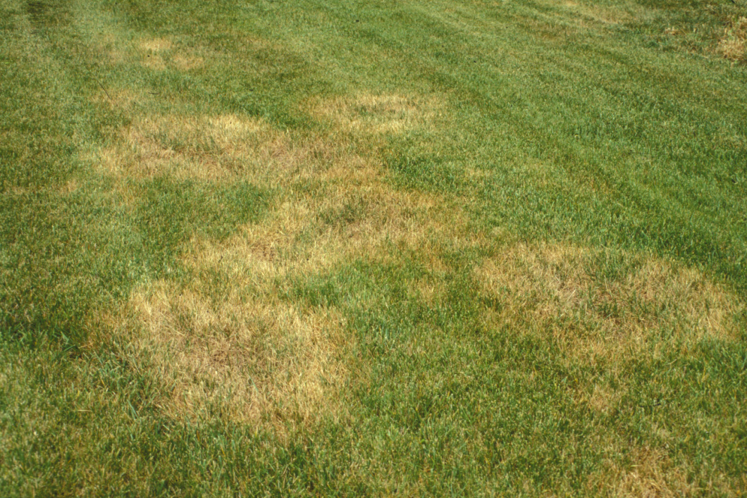
Diseases of Turfgrasses
    Brown patch
(page 65)
    Most common disease of fescue
    Cool-season grasses: warm, humid weather
    Warm-season grasses: cool, wet weather
    Avoid high nitrogen
    Avoid excessive water
    Fungicides can help
Notes:
Rhizoctonia solani 60 degree nights)
Tan lesions with dark brown borders

Slide 37
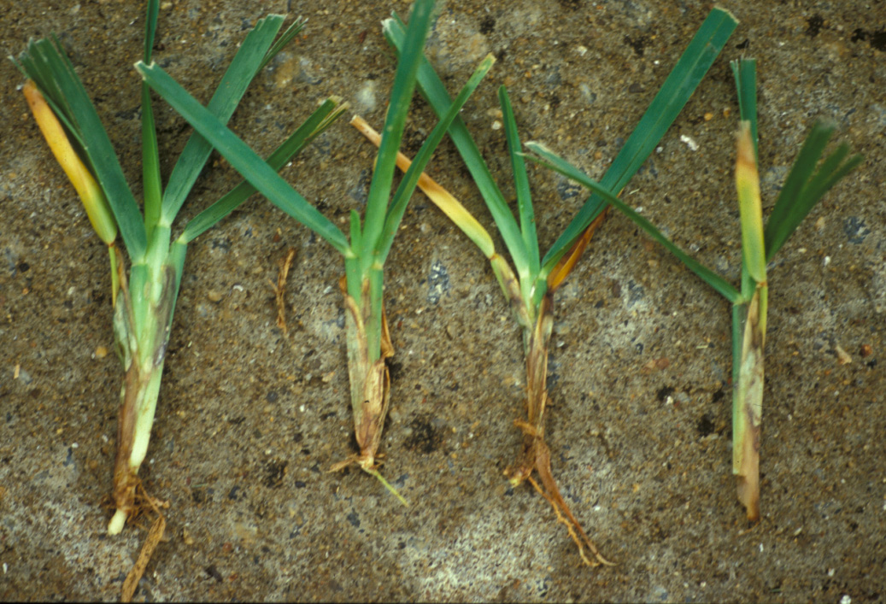
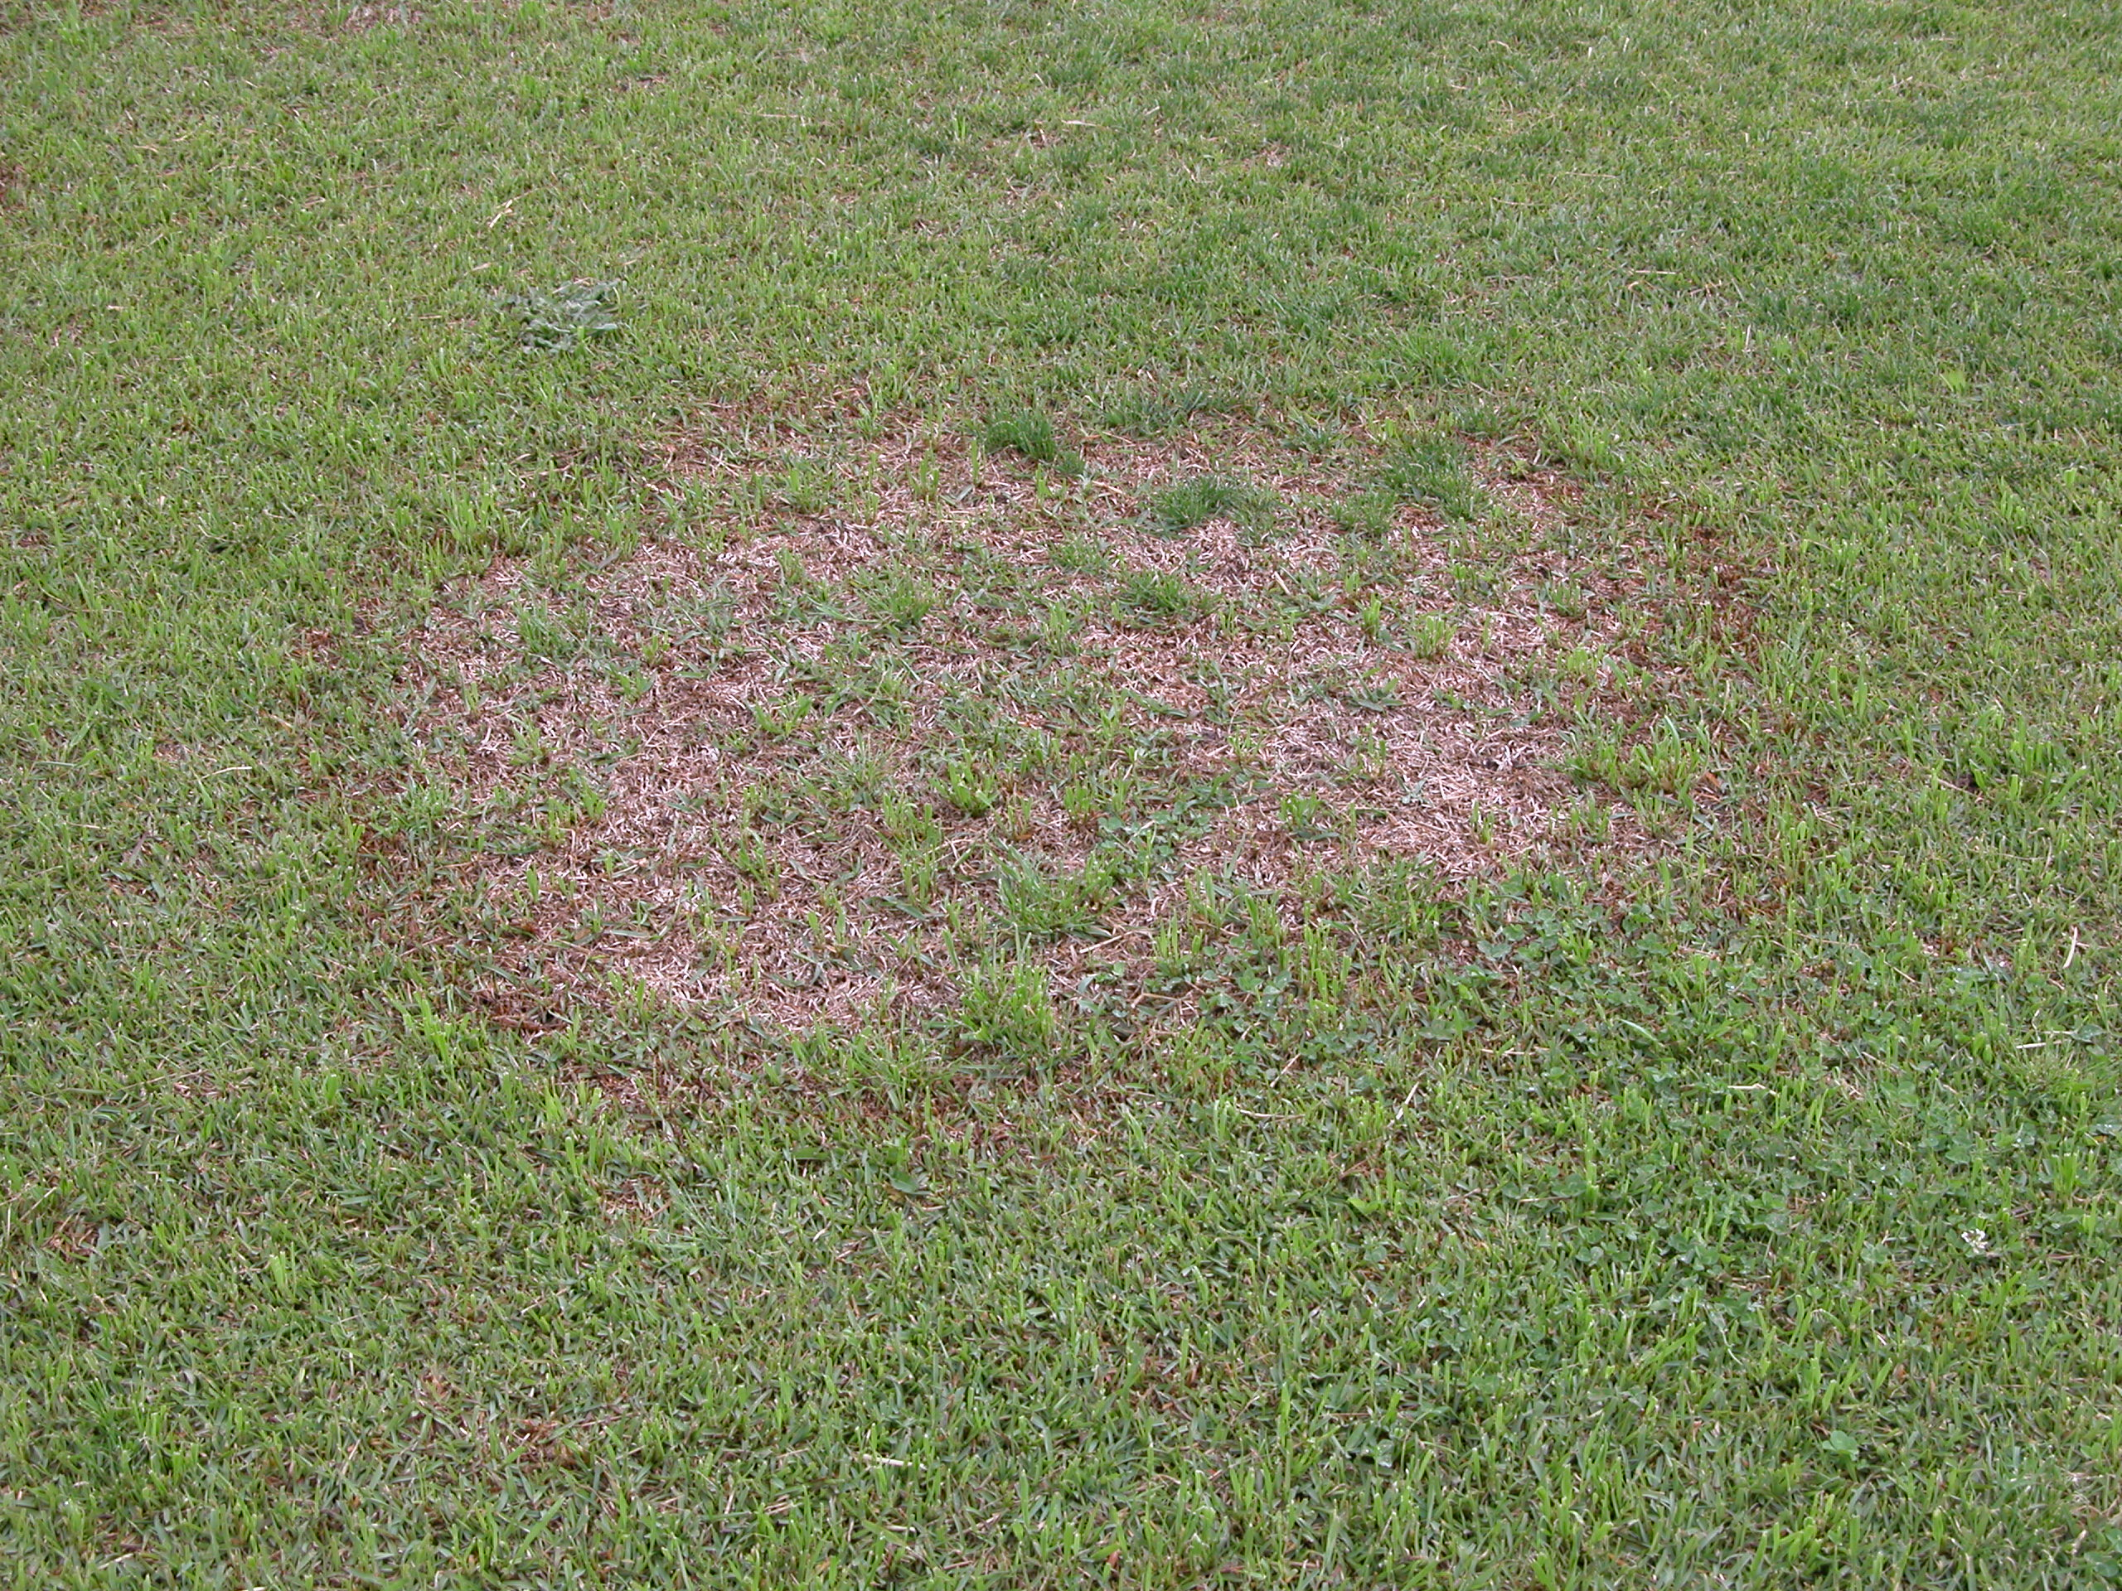
Diseases of Turfgrasses
    Large patch
(page 66)
    Disease of warm-season grasses
    Brown, yellow, or orange patches that get huge.
    Cool, wet weather
    Don’t fertilize in late summer
    Keep thatch below ½ inch
    Fungicides may help in the fall
Notes:
Reddish brown lesions on leaf sheaths only

Slide 38
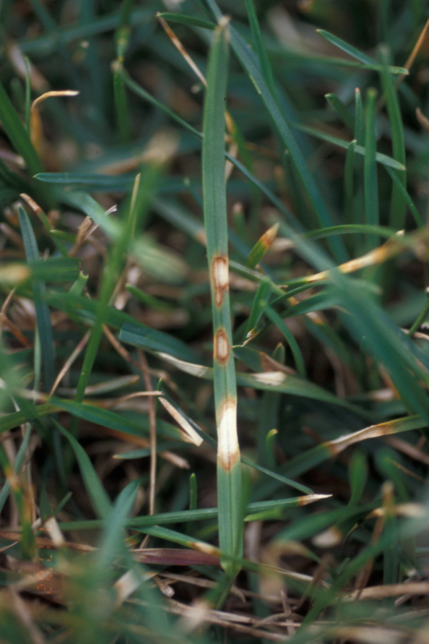
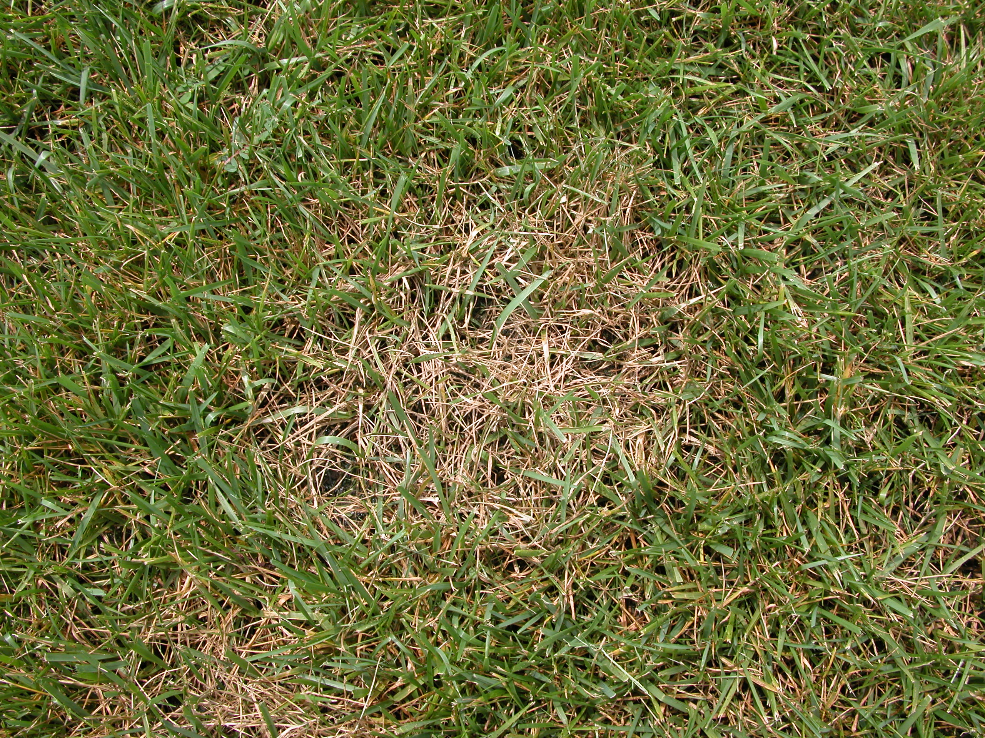
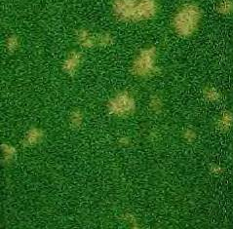
Diseases of Turfgrasses
(page 66)
    Dollar Spot
    Warm, humid weather
Ky bluegrass
dollar spot on tall fescue
    Nitrogen starved turf
    White, cottony mycelia first thing in morning
    Use resistant turfgrass
    Apply nitrogen correctly
    Mow correctly
    Fungicides usually needed on
    golf courses, but not on home lawns
dollar spot on bentgrass
Notes:
Lesion may girdle the leaf even if the tip is green.

Slide 39
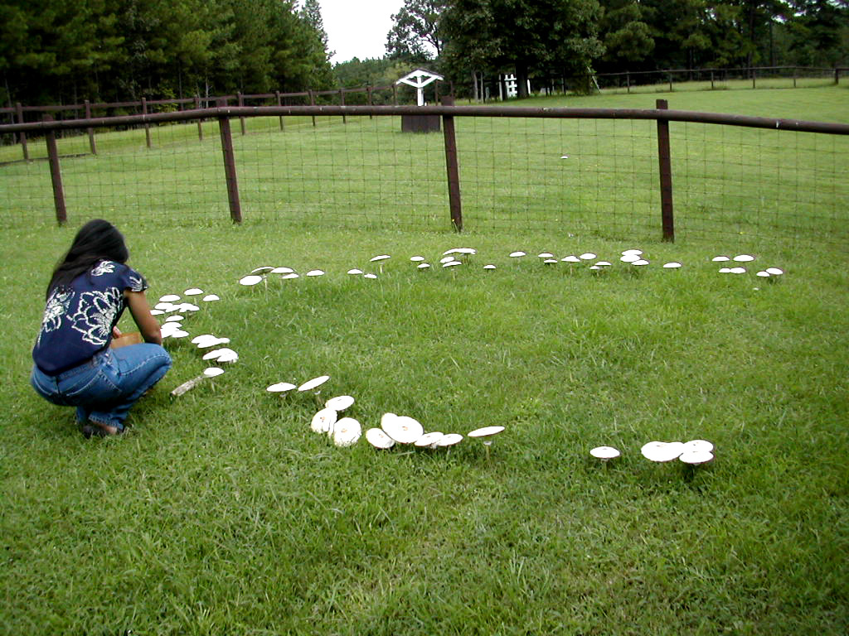
Diseases of Turfgrasses
    Fairy Rings
(page 67)
    Several kinds of mushrooms & puffballs
    Hard to control
    Rings may brown out in hot, dry weather
    Remove stumps and roots before planting
F H Baker
    Irrigation and proper fertilization help

Slide 40
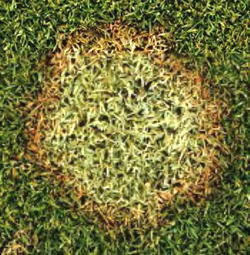
Diseases of Turfgrasses
    Microdochium Patch (pink snow mold)
(page 68)
    Cool season grasses
    Too much fertilizer
    Cool, wet weather
    Pink or gray edges
    Fertilize and lime properly
    Mow frequently at right height
    Don’t fertilize in cold weather
    Fungicides may not help
Notes:
Circular patches 2-6 inches in diameter.
Grass on outer edge water soaked.

Slide 41
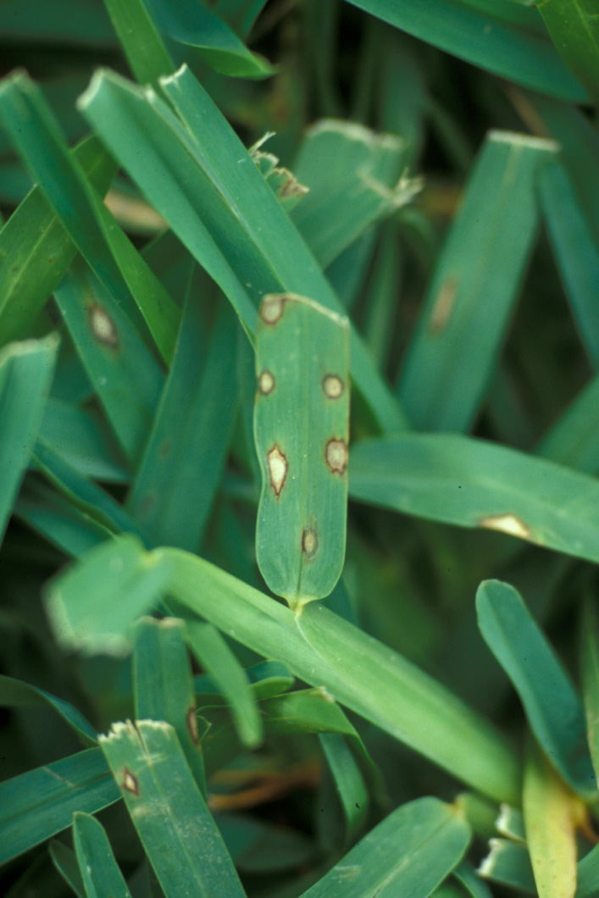
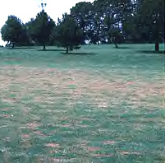
Diseases of Turfgrasses
    Gray Leaf Spot
    St Augustine (+ fescue)
    Very hot, wet weather
    looks scorched & ragged
    Mow correctly and frequently
    Improve airflow
    Irrigate early in day
    Don’t fertilize in hot weather
    Fungicides help for a little while
Notes:
More severe on new turf, poor air movement or shade
Small brown to tan spots with brown to purple border.

Slide 42
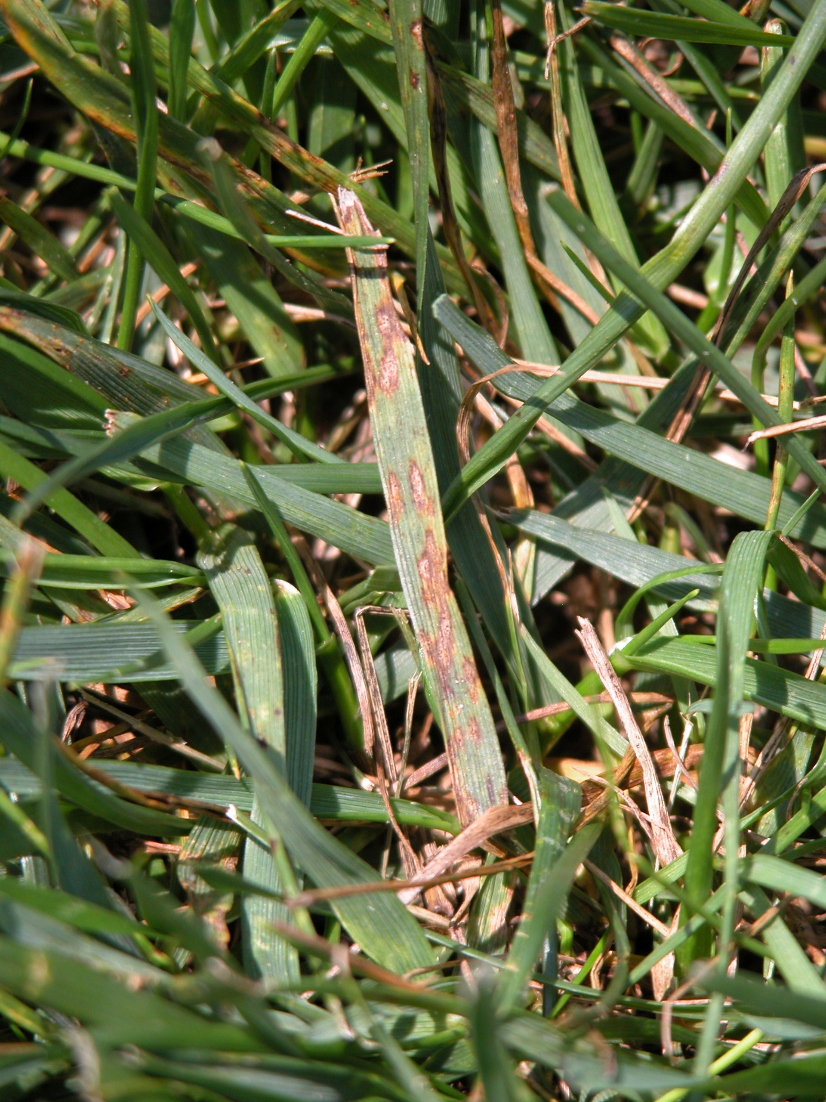
Diseases of Turfgrasses
    Helminthosporium Diseases
    (Also called Melting Out, Leaf Spot, Net-blotch, Crown and Root Rot)
(page 69)
    Wet or very humid weather
    Attacks all turf types
    Starts as leaf spot and goes to crown and root rot
    Avoid high nitrogen fertilization
Notes:
Proper irrigation
Fungicides may be necessary on high quality turf.

Slide 43
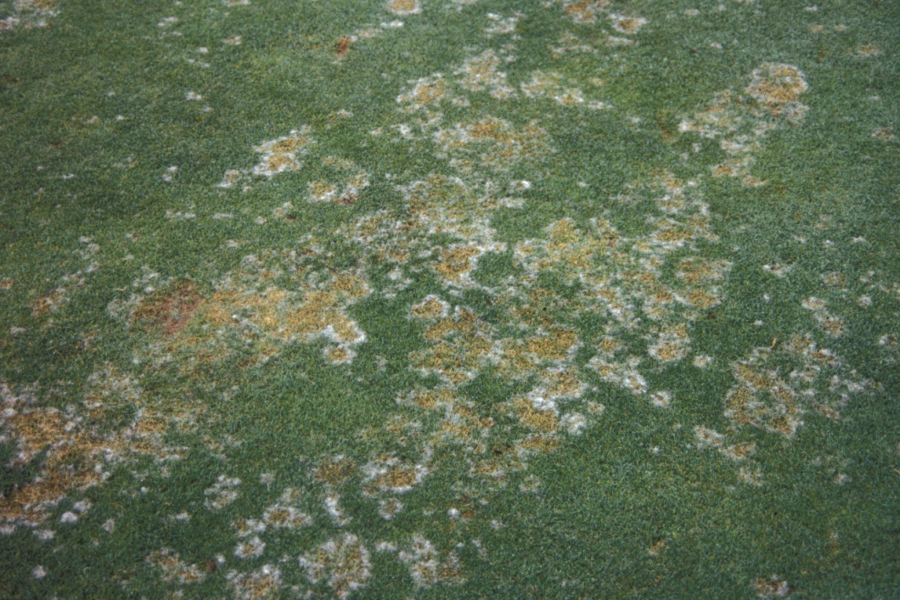
Diseases of Turfgrasses
    Pythium Blight
    (Also called Cottony Blight and Greasy Spot)
(page 70)
    Hot and wet or very humid weather
    Attacks all cool-season grasses
    Can damage large areas overnight
    Provide good drainage
    Increase light penetration and air movement (such as fans on greens)
Notes:
When night temps exceed 65 degrees
High humidity mycelia may be present
1 inch to several inches in diameter
Leaves are water soaked and slimy to the touch
Center of diseased patch usually completely dies

Slide 44
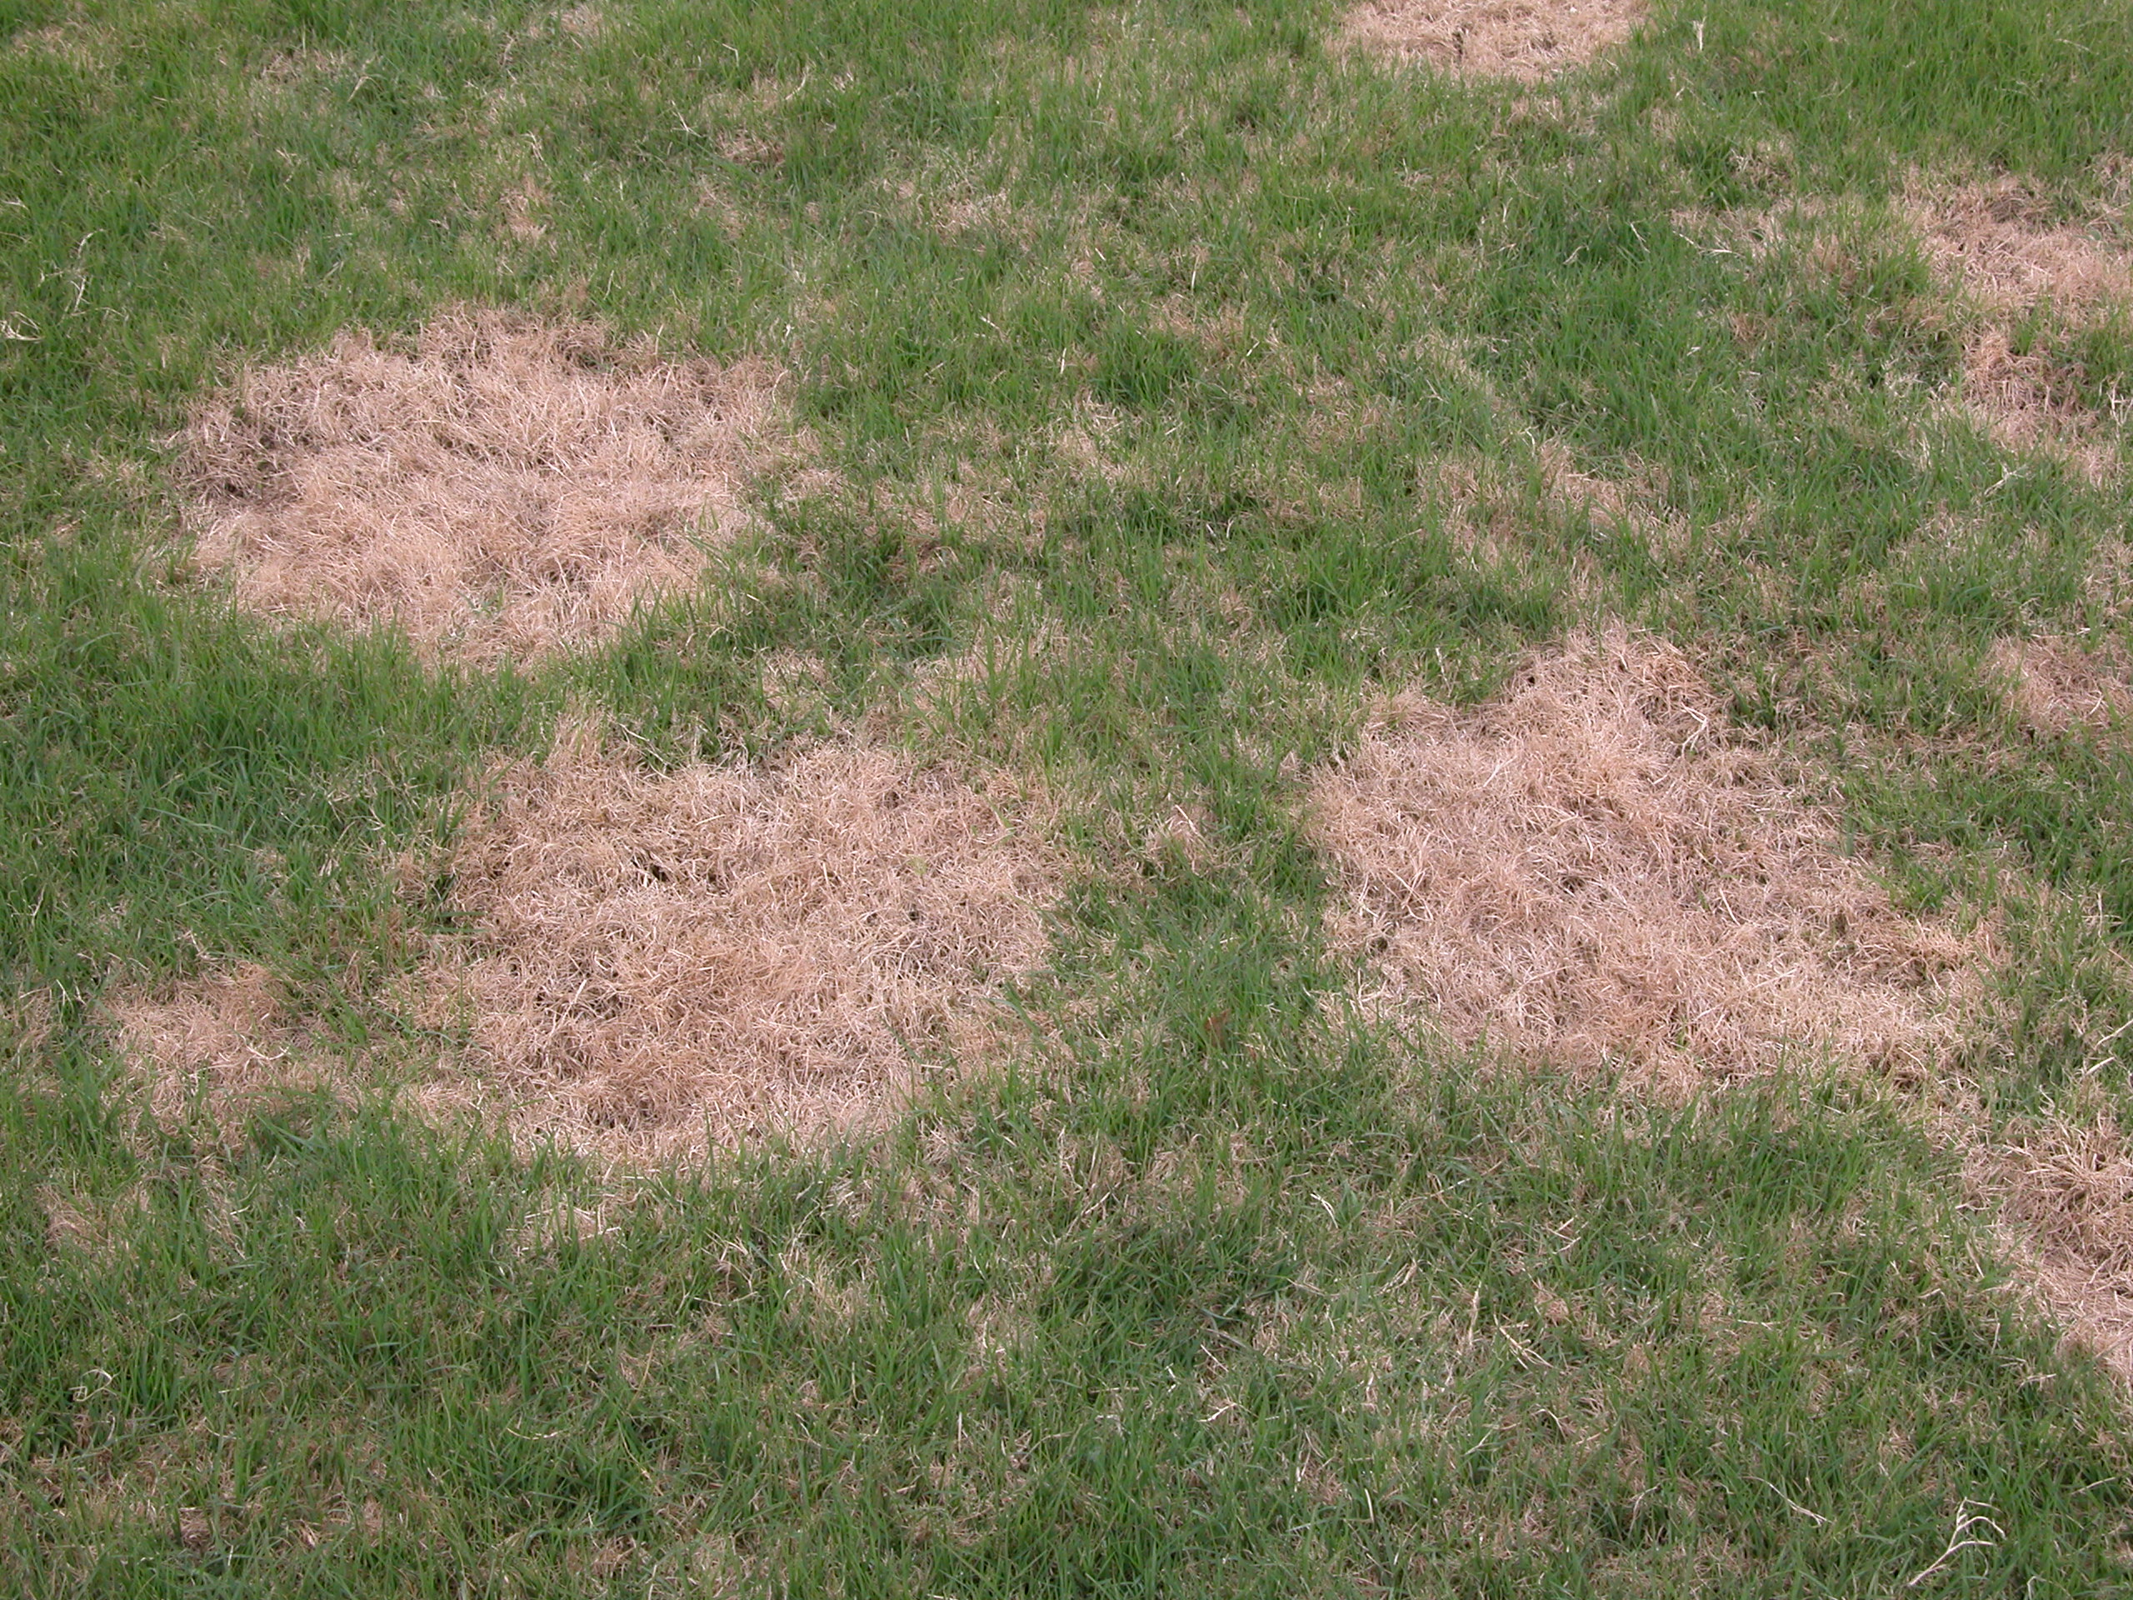
Diseases of Turfgrasses
    Spring Dead Spot
(page 71)
    Attacks bermudagrass in “Transition Zone”
    More common on sterile hybrids
    Thatch promotes disease
    Dead patches up to 3’ across
    Plant cold tolerant bermudagrass
    Aerify and dethatch regularly
    Avoid applications for preemergence crabgrass control
    Fungicides not always effective
Notes:
Several fungi are responsible
Usually appears on bermuda that is 6 or more years old with a thatch problem
Areas 2-3 feet in diameter remain dormant at spring green up and eventually die.

Slide 45
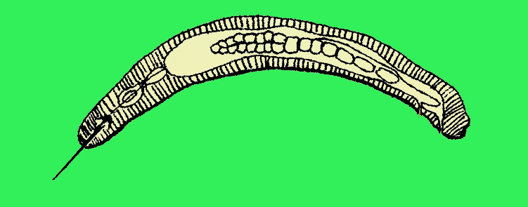
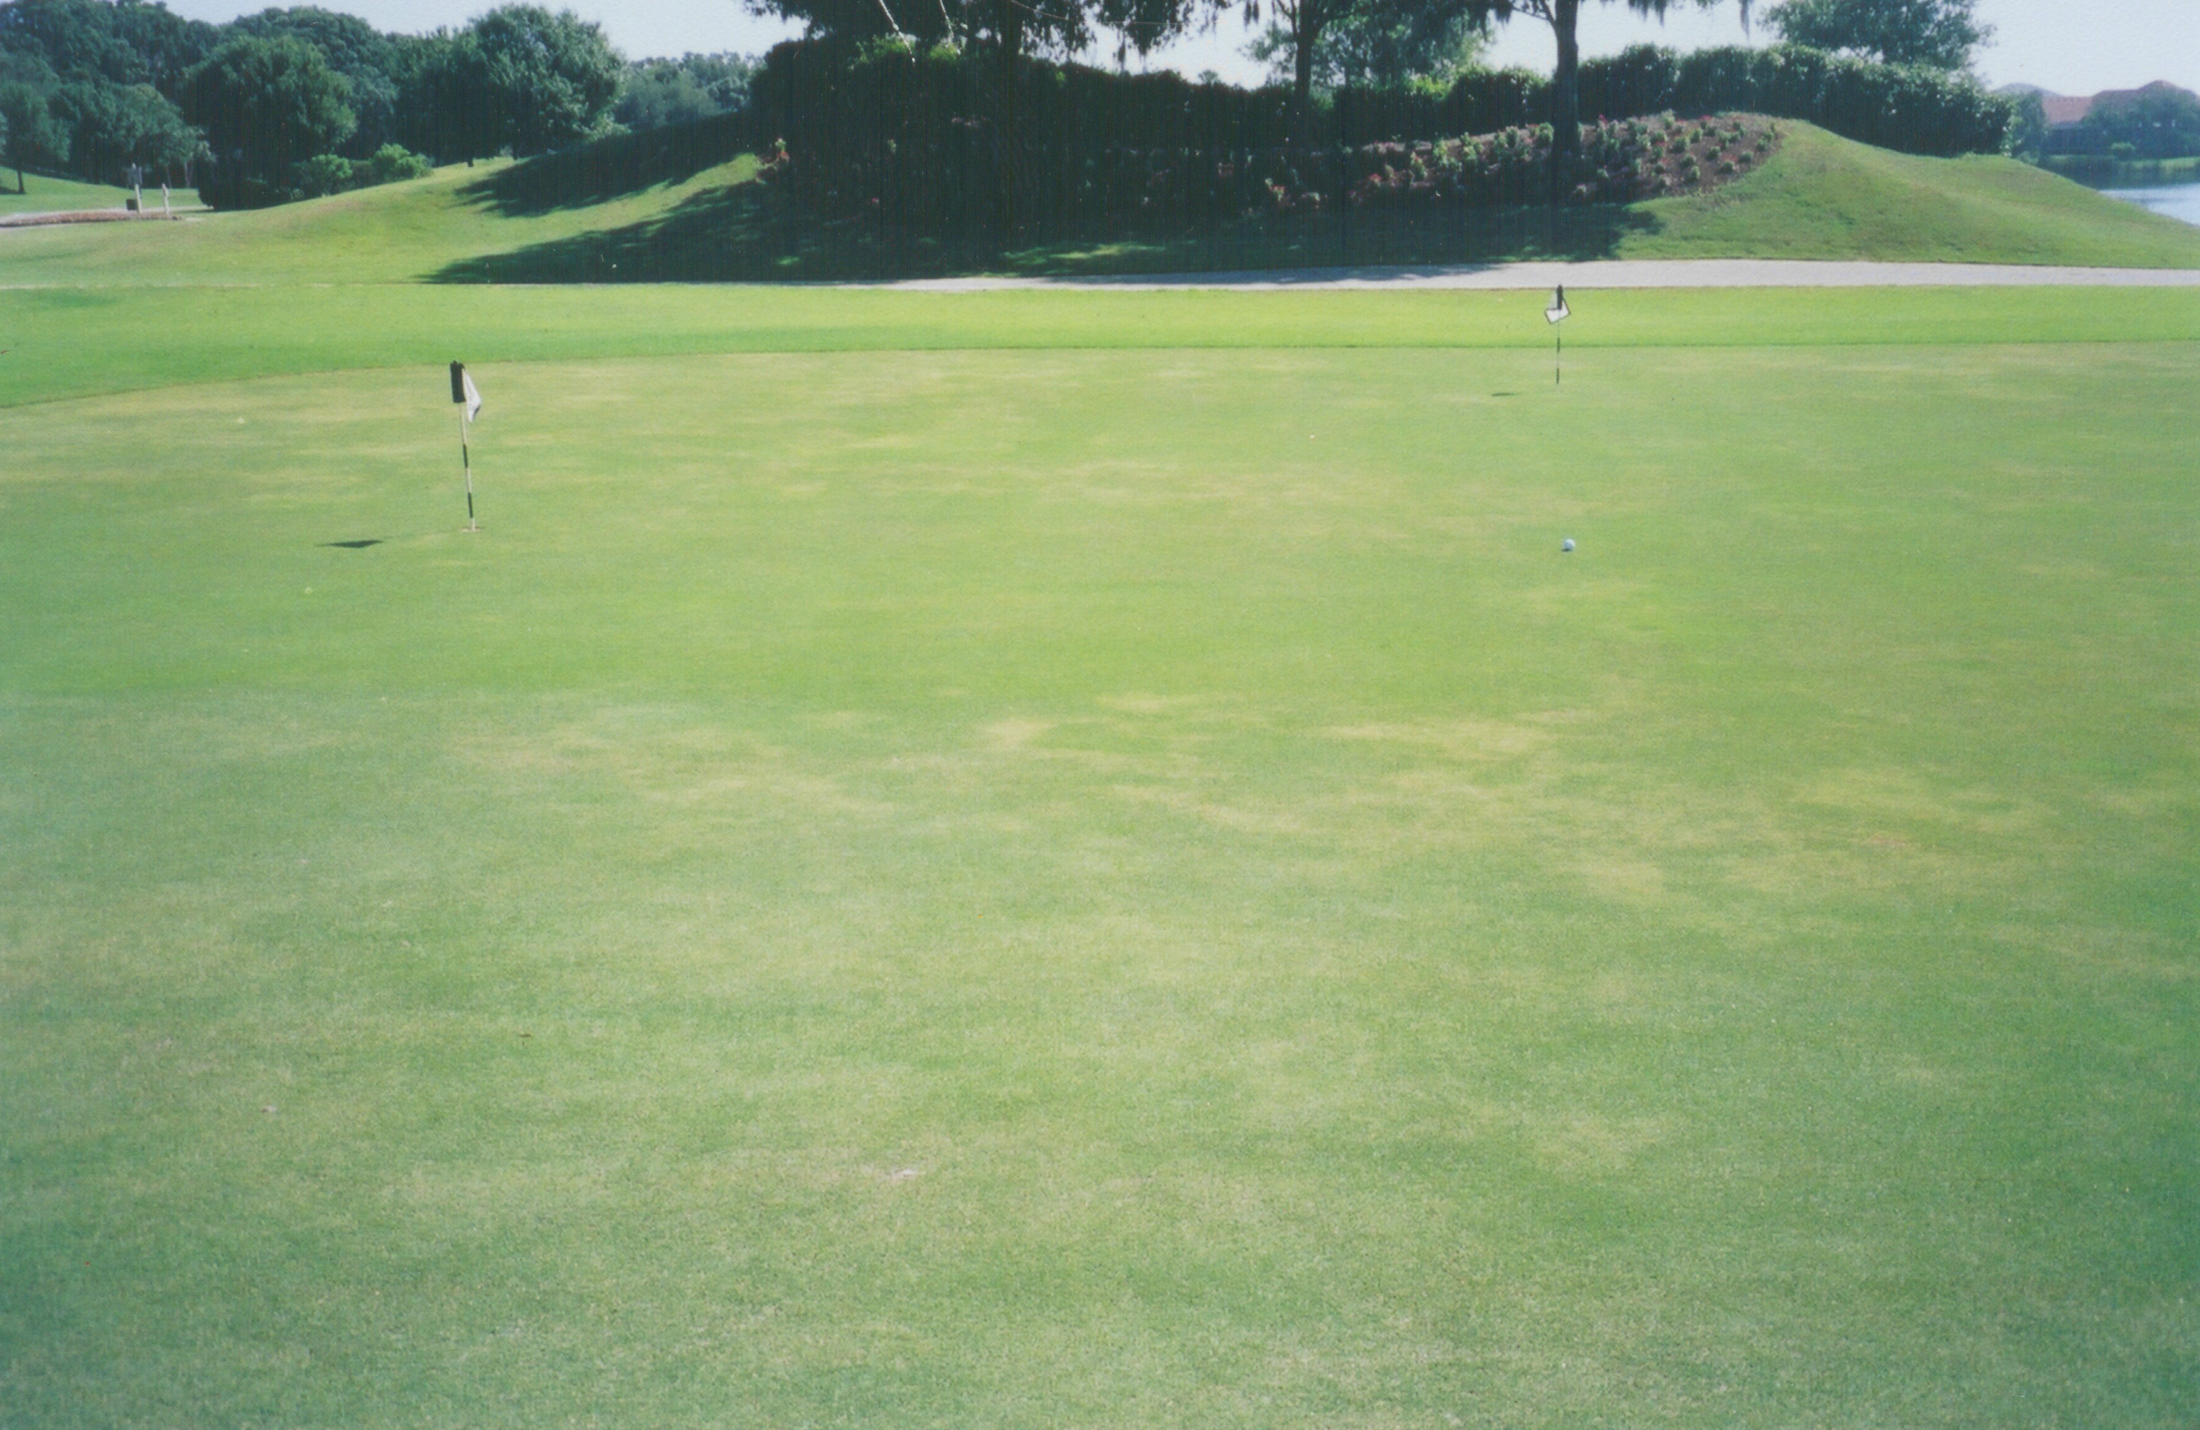
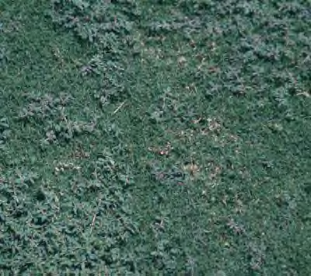
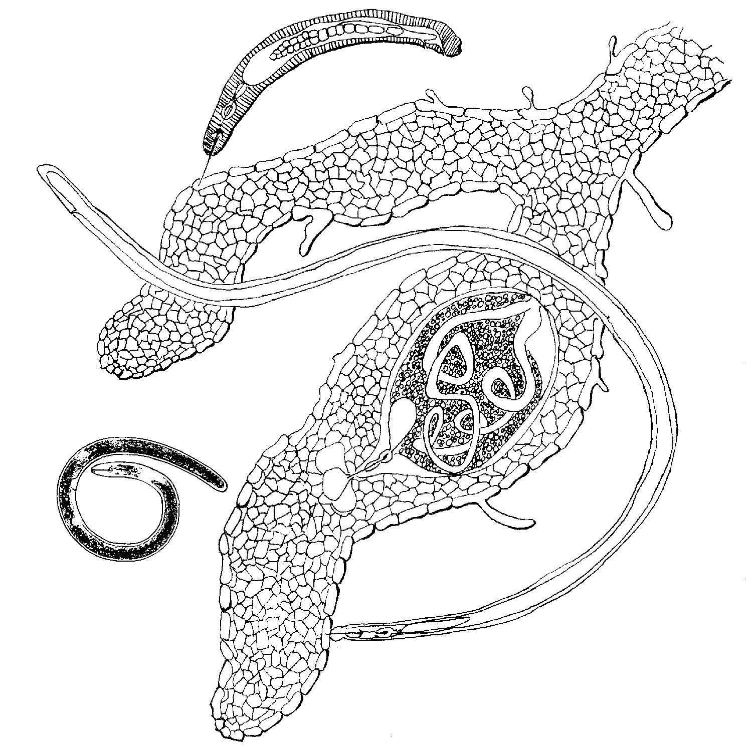
Diseases of Turfgrasses
stylets
Nematodes
(page 72)
    Turf thins out
    Weeds invade weak turf
ring
sting
lance
Notes:
Thinning turf, poor color, wilty/poorly rooted.

Slide 46
Diseases of Ornamental Plants
Chapter 9 (Page 109)
Types of Pathogens and Pesticides
Fungicide Basics
Types of Disease

Slide 47
Diseases of Ornamental Plants
(Page 111)
Types of Pathogens and Pesticides
Fungi
cause leaf spots, wilts, dieback, root rots, and cankers.
Bacteria
cause shoot blights, leaf spots, soft rots, and galls.
Viruses
cause stunting, discoloration, and malformation.
cause root galls, stubby roots, low vigor, and discoloration.
Plant Parasitic Nematodes
Notes:
Fungi are most responsible for plant diseases in the landscape. Most need a microscope to see but some can be seen with naked eye like powdery mildew.
Bacteria are microscopic one celled organisms
Viruses can not be seen with most microscopes, no chemals available, insects usually are the vector.

Slide 48
Diseases of Ornamental Plants
Fungicide Basic s (page 112)
  Protectant Fungicides
    less likely to cause resistance
    broad spectrum
  Systemic Fungicides
    local penetrant
    protected from washoff

Slide 49
Diseases of Ornamental Plants
More Fungicide Basics (page 113)
  Fungicide Resistance
    if the mode of action is narrow, resistance is likely.
  Soil Fumigants
    used as a last resort
    usually toxic to seeds, plants, and insects.
    useful for preplant preparation.

Slide 50
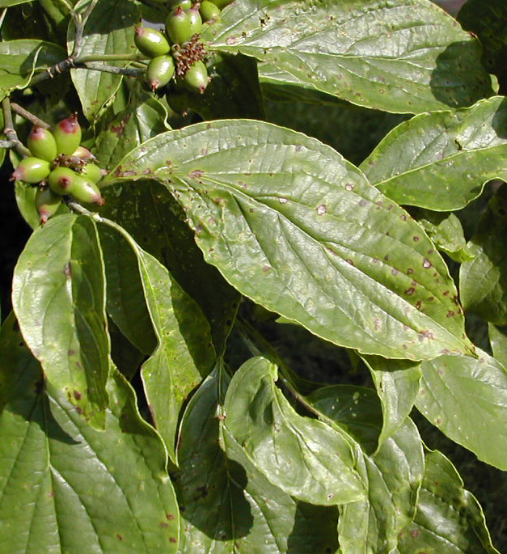
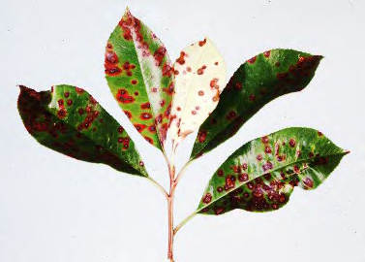
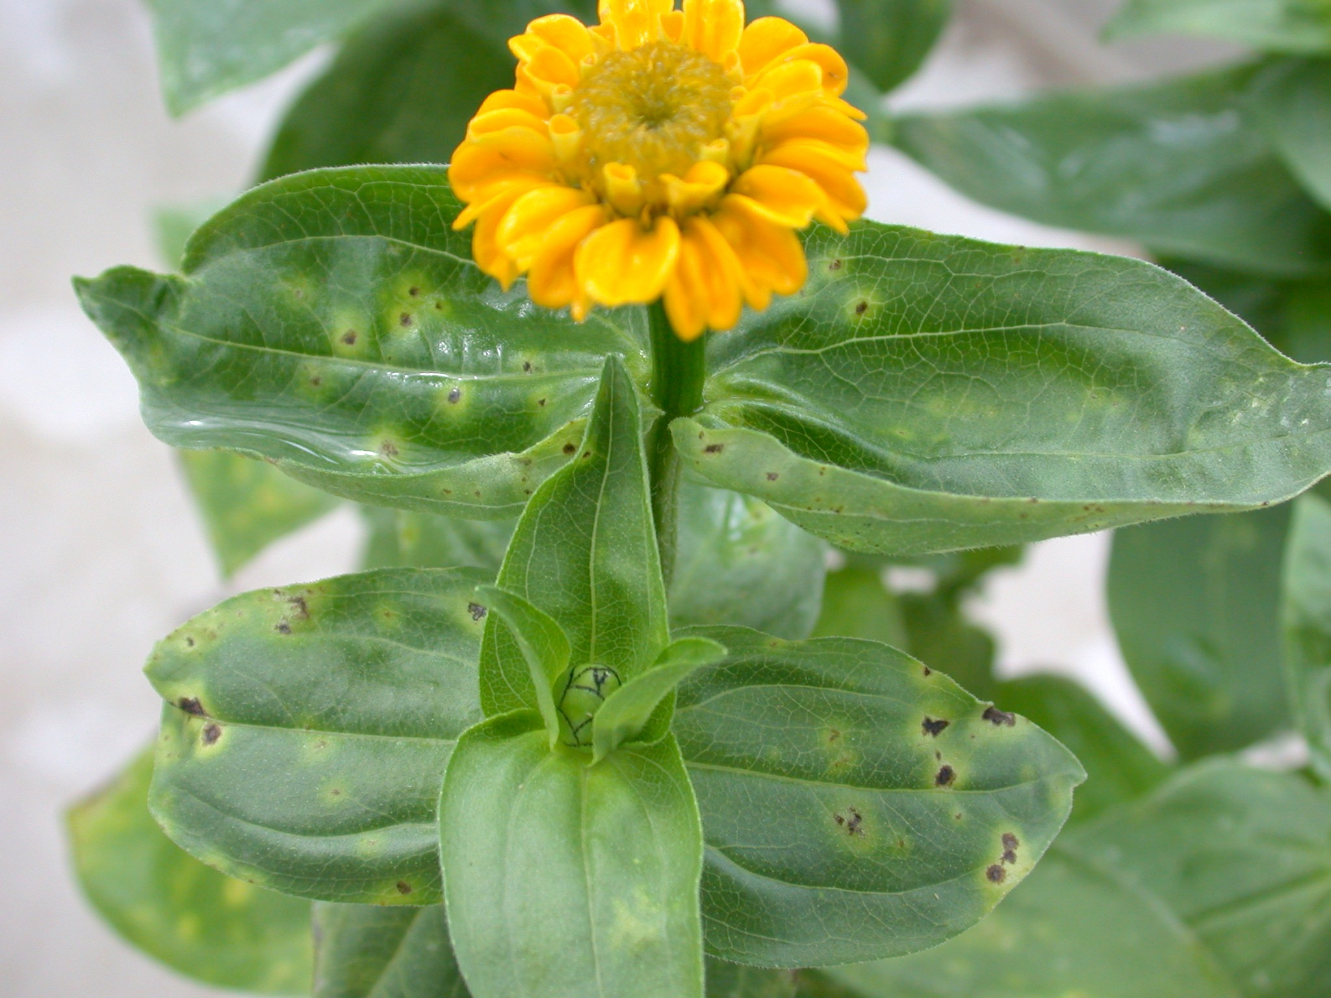
Diseases of Ornamental Plants
Types of Diseases (page 114)
    Leaf Spots caused by Fungi
    Entomosporium leaf spot of redtip
    Spot anthracnose of dogwood
    Leaf Spots caused by Bacteria
    Bacterial leaf spot on zinnia
    Keep foliage dry as practical
    Space plants for good air circulation
    Fungicides and bactericides in warm, wet weather
C W Warfield

Slide 51
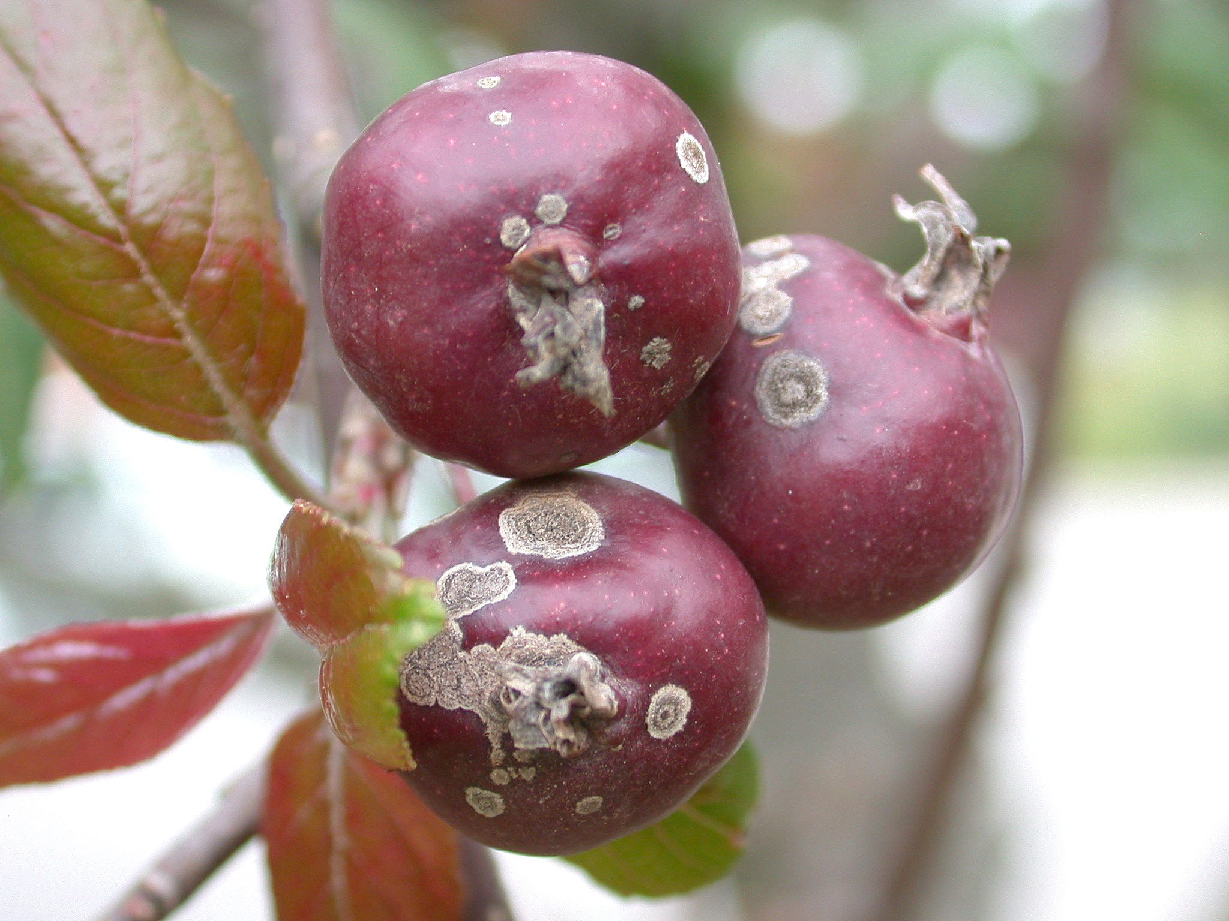
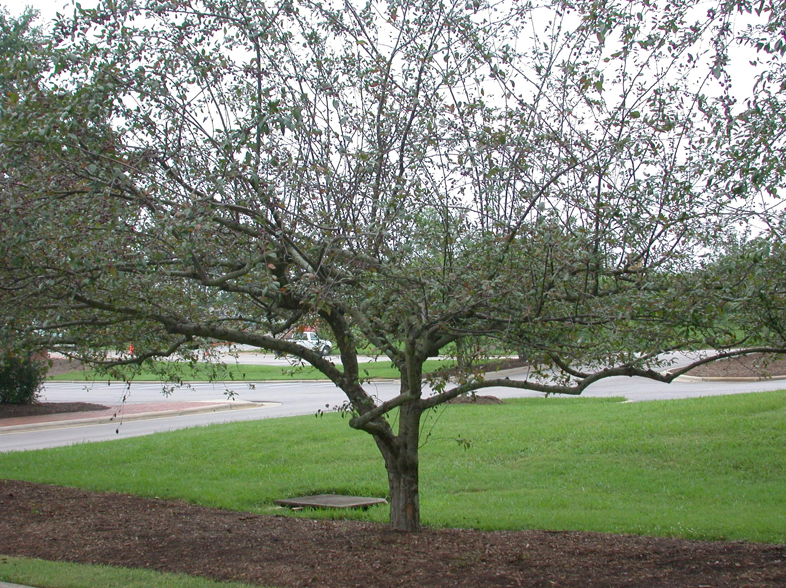
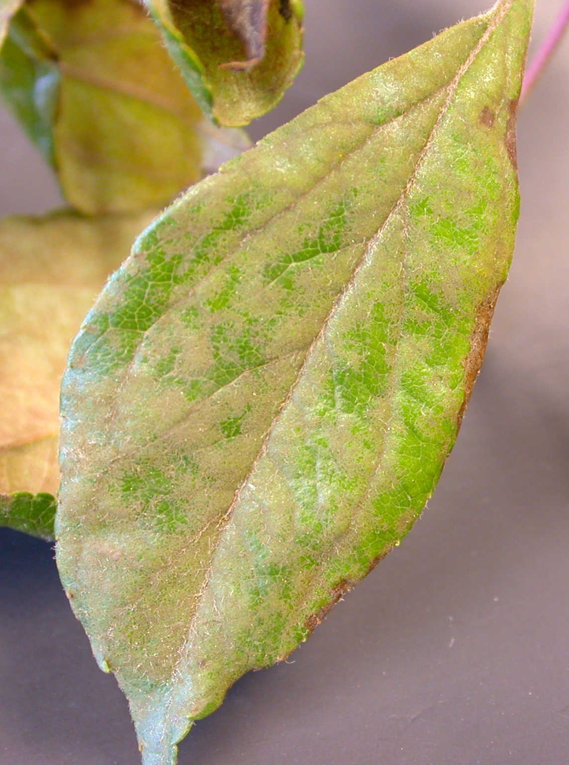
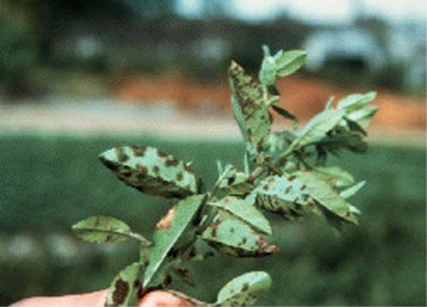
Diseases of Ornamental Plants
Scab
    Scab on crabapple
    Scab on pyracantha
    Use resistant cultivars
C W Warfield
    Rake & destroy fallen leaves and fruits
C W Warfield
    Fungicides in spring until warm, dry weather
Univ. Illinois
C W Warfield

Slide 52
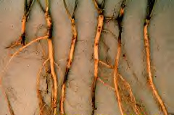
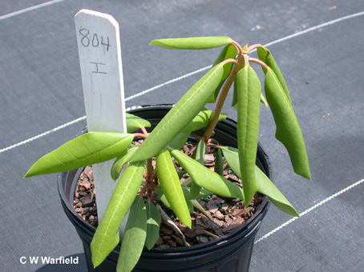
Diseases of Ornamental Plants
Root Rots
  Phytophthora root rot of azaleas etc.
  Leaves curl and wilt
  Use resistant cultivars
  Use healthy plants
  Consider raised beds amended with pine bark

Slide 53
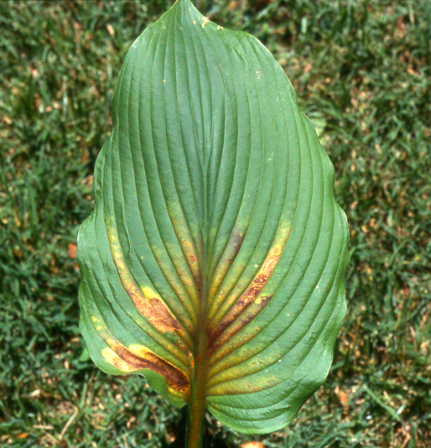
Diseases of Ornamental Plants
Nematodes
(page 116)
Foliar nematodes
Root-feeding nematodes
Use nematode- resistant cultivars
Soil sterilization where practical

Slide 54
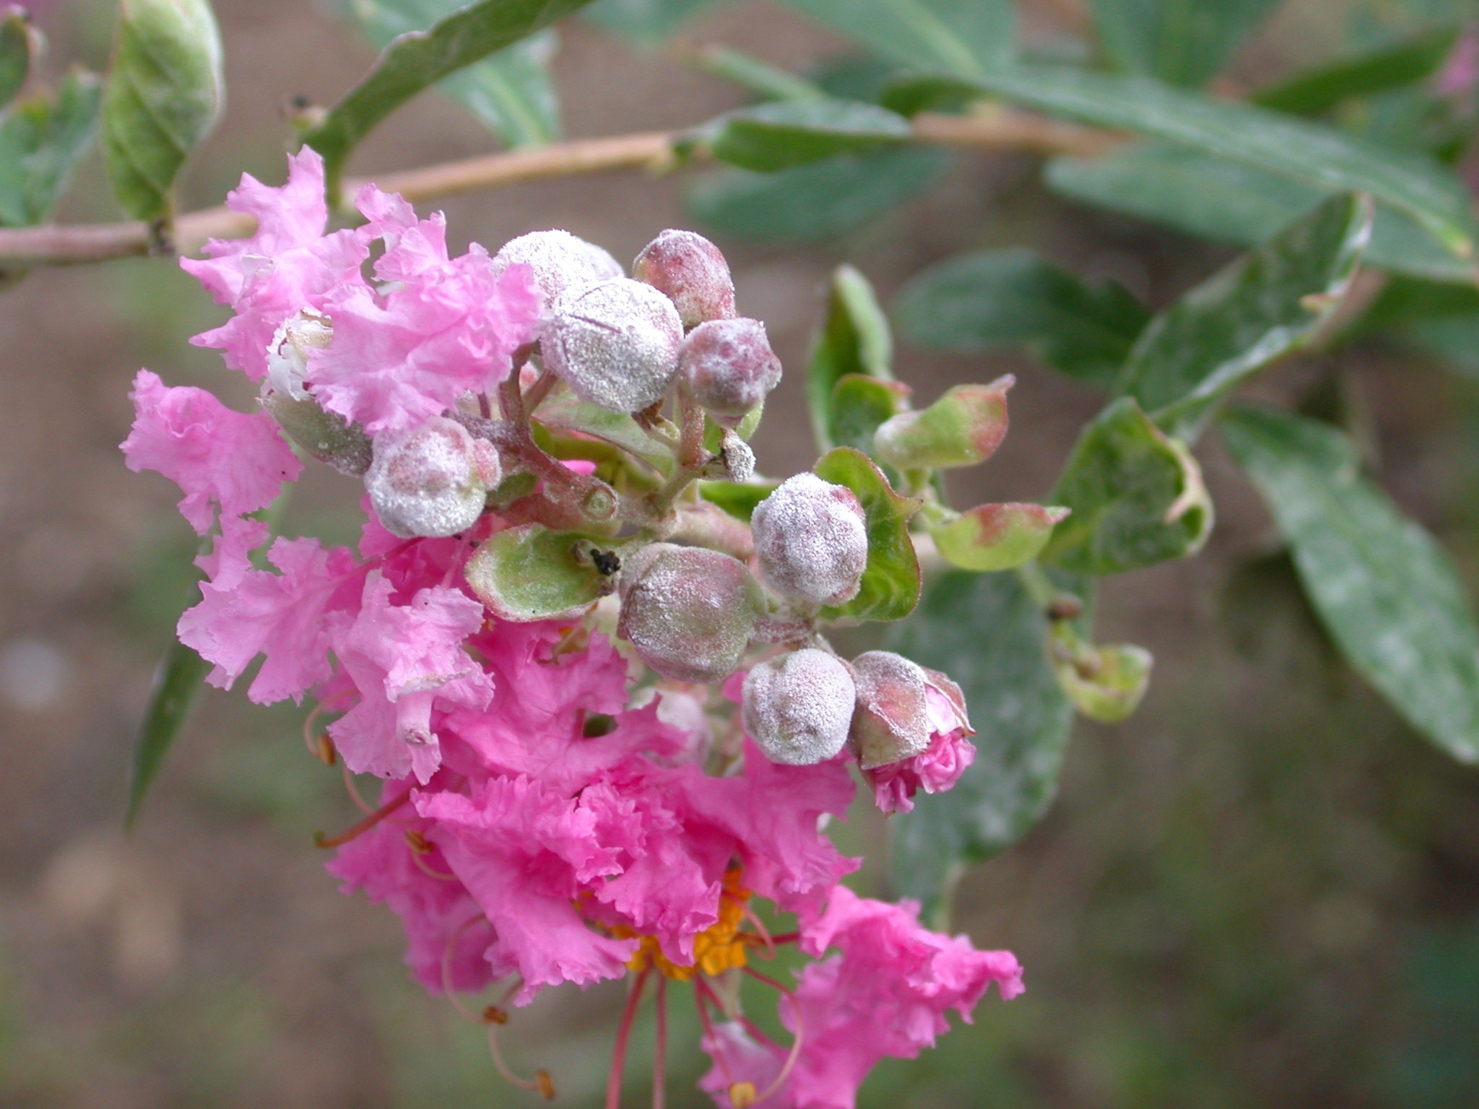
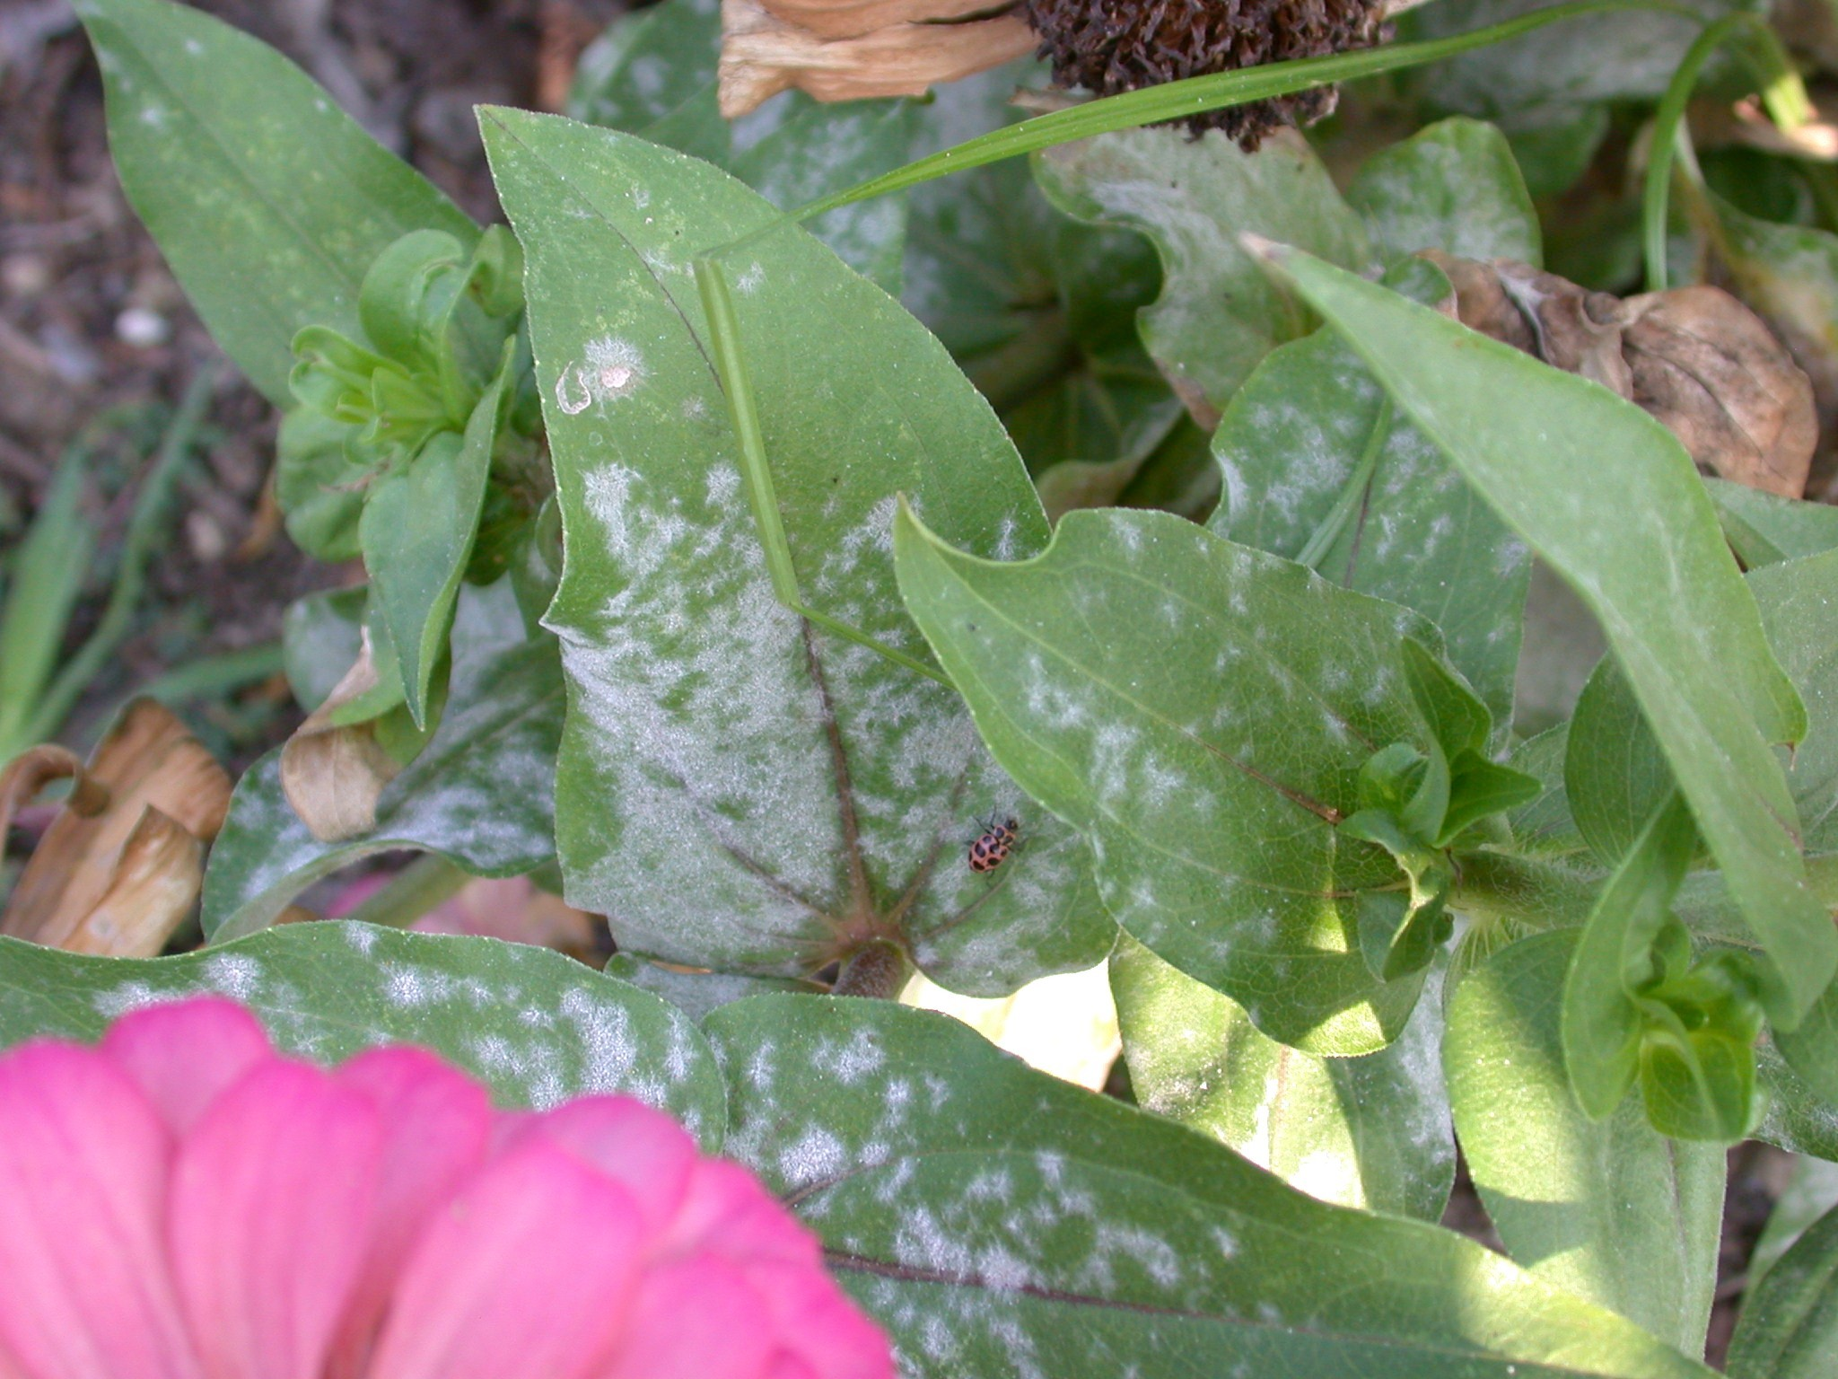
Diseases of Ornamental Plants
    Powdery Mildew
(page 117)
    Crabapples
    Crapemyrtle
    Dogwood
C W Warfield
    Euonymus
    Zinnia
    Selective pruning
    Select resistant cultivars
    Fungicides help
C W Warfield

Slide 55
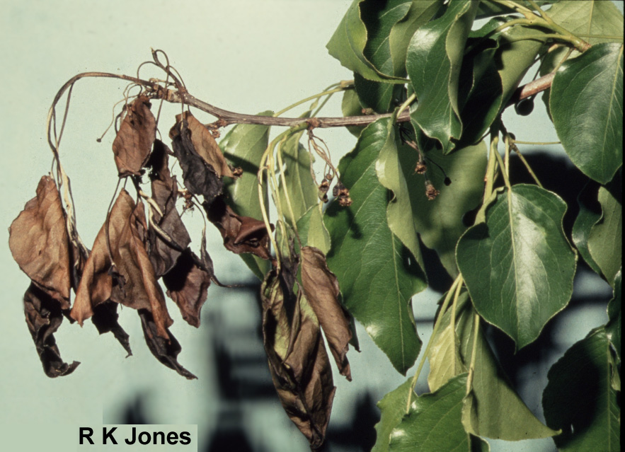
Diseases of Ornamental Plants
    Bacterial Blights
Fireblight on crabapple
Also infects pear, hawthorn, pyracantha, cotoneaster, and Amelanchier.
Plant resistant cultivars and prune out infected branches

Slide 56
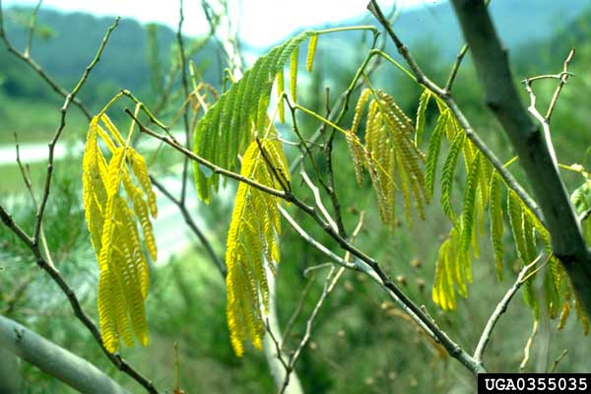
Diseases of Ornamental Plants
    Vascular Wilts
    (page 118)
    Fusarium wilt of Mimosa
    Plant some other tree

Slide 57
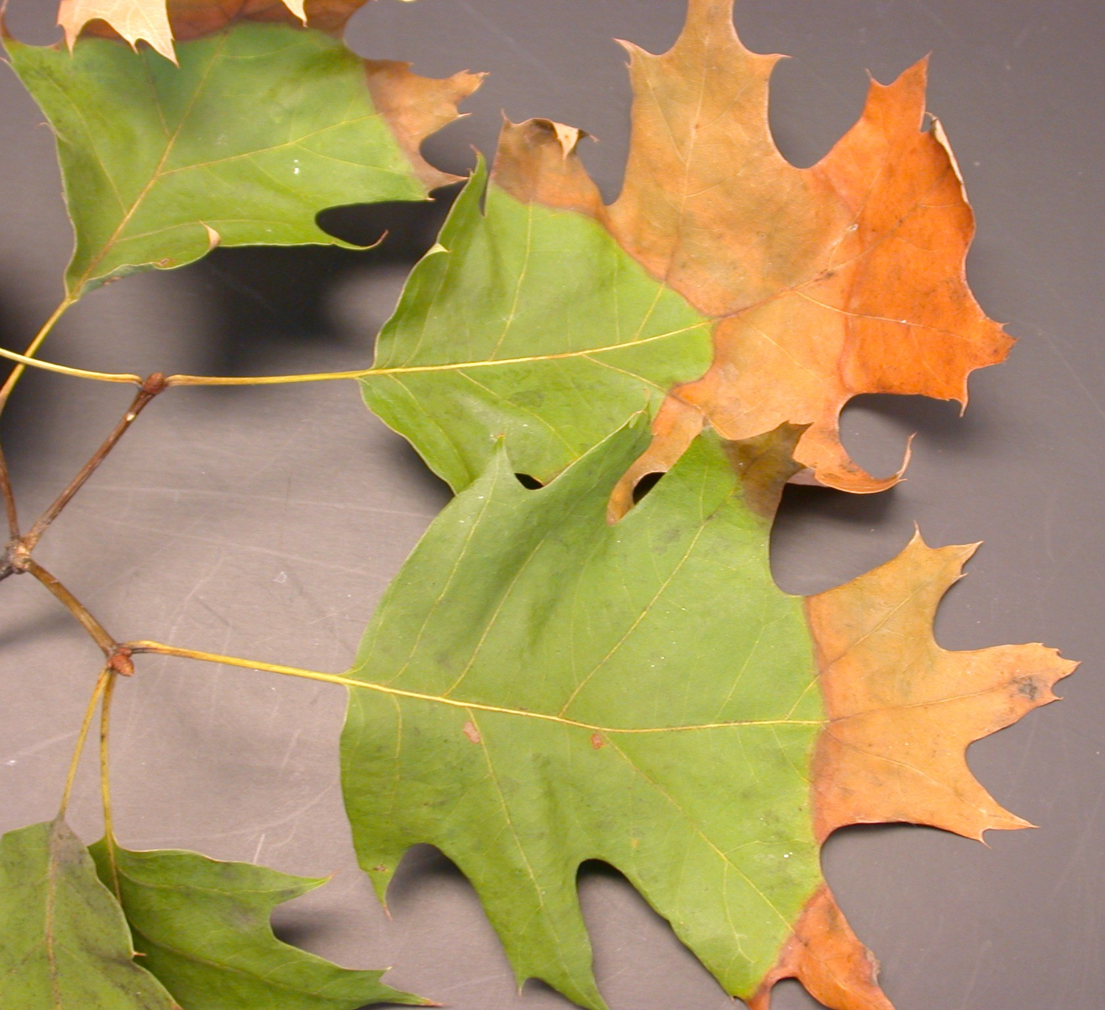

Diseases of Ornamental Plants
    Vascular Wilts
Affects oaks,
sycamore, and
other trees.
    Fusarium wilt of Mimosa
    Wilts caused by Xylella
    Bacterial leaf scorch
Replace with non- susceptible tree

Slide 58



Credits:
Wayne Buhler,PHD
James Baker, PHD
Steve Pettis, MPPPM
The Georgia Department of Agriculture
Tommy Irvin Commissioner
Notes:
1

