Slide 1


Careers Opportunities in Horticulture
http://www.caes.uga.edu/departments/hort/

Slide 2
Future of Horticulture Industry
Horticulture is a recession-proof industry
Increasing demand for services
  Population growth increasing
  Recent shift in U.S. population to the “sun belt” South
Metro-Atlanta is the #1 business relocation site
Decreased leisure time for working families
Gardening is #1 leisure activity among retirees
Increases real-estate value, home sales
Increases employee productivity
Horticulture is fastest growing agricultural commodity in Georgia worth over $2.9 Billion
  Ranked 2nd largest agricultural commodity in Georgia

Slide 3
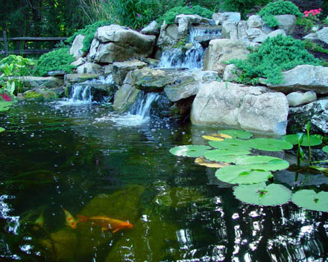

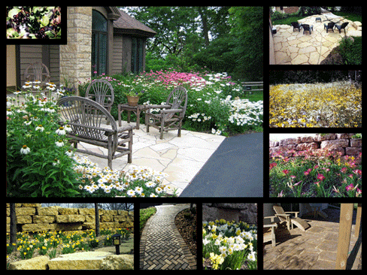
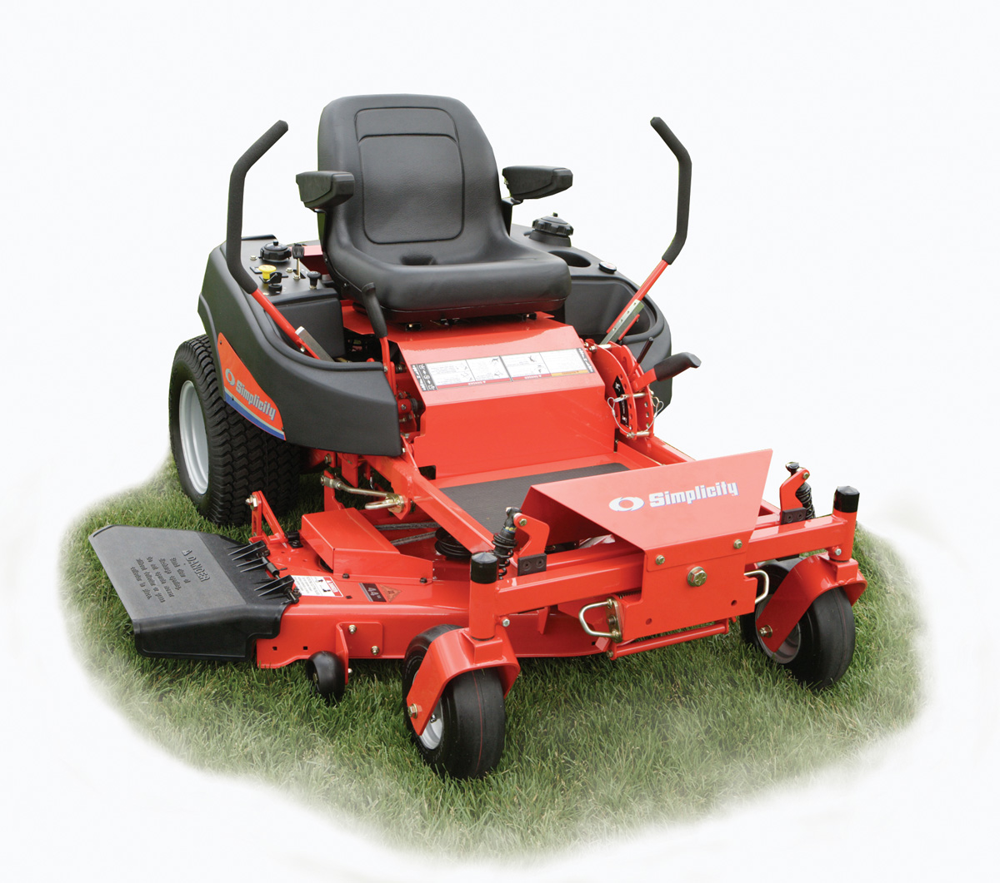
Landscaping
Installation
Softscaping
Hardscaping
Maintenance
Troubleshooting

Slide 4
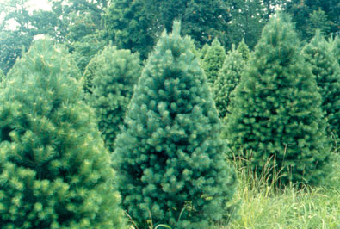
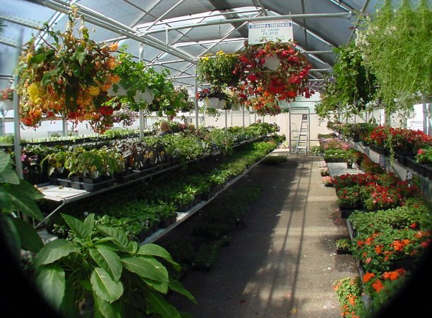
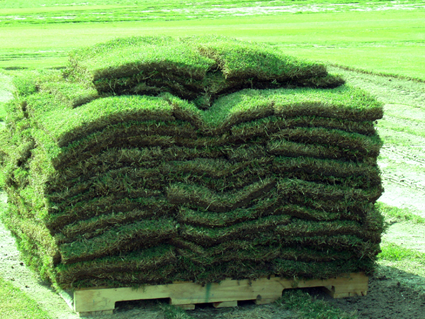
Plant Production
Vegetable/Fruit/Nut production
U-pick farms
Field/Container Nurseries
Greenhouses
Turfgrass farms
Christmas Trees

Slide 5
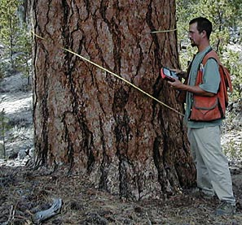
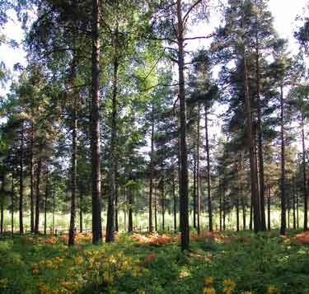
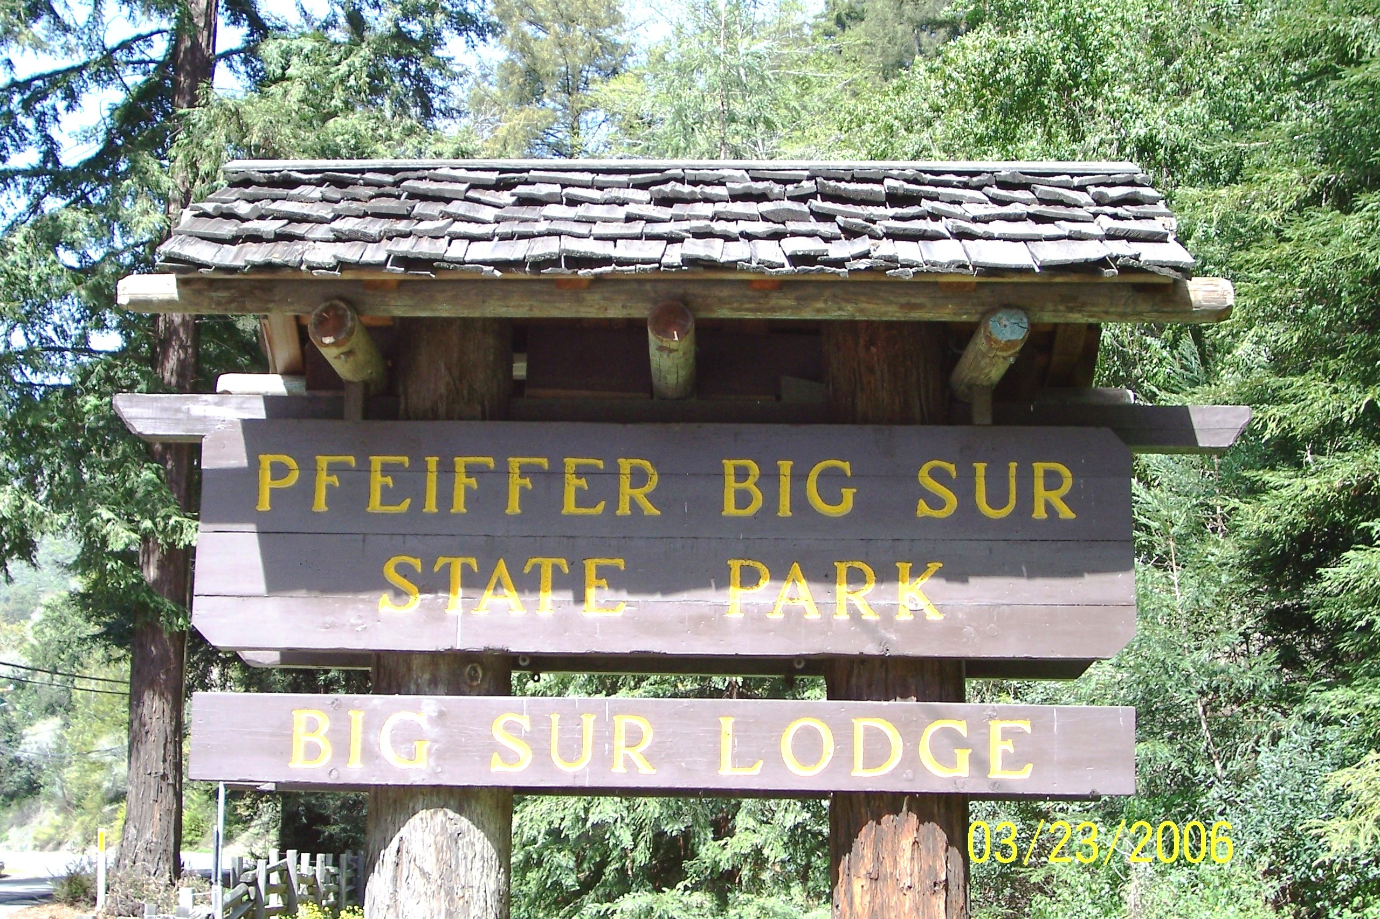
Forestry
Foresters
Timber cruising
Wildlife Management
Arborists

Slide 6
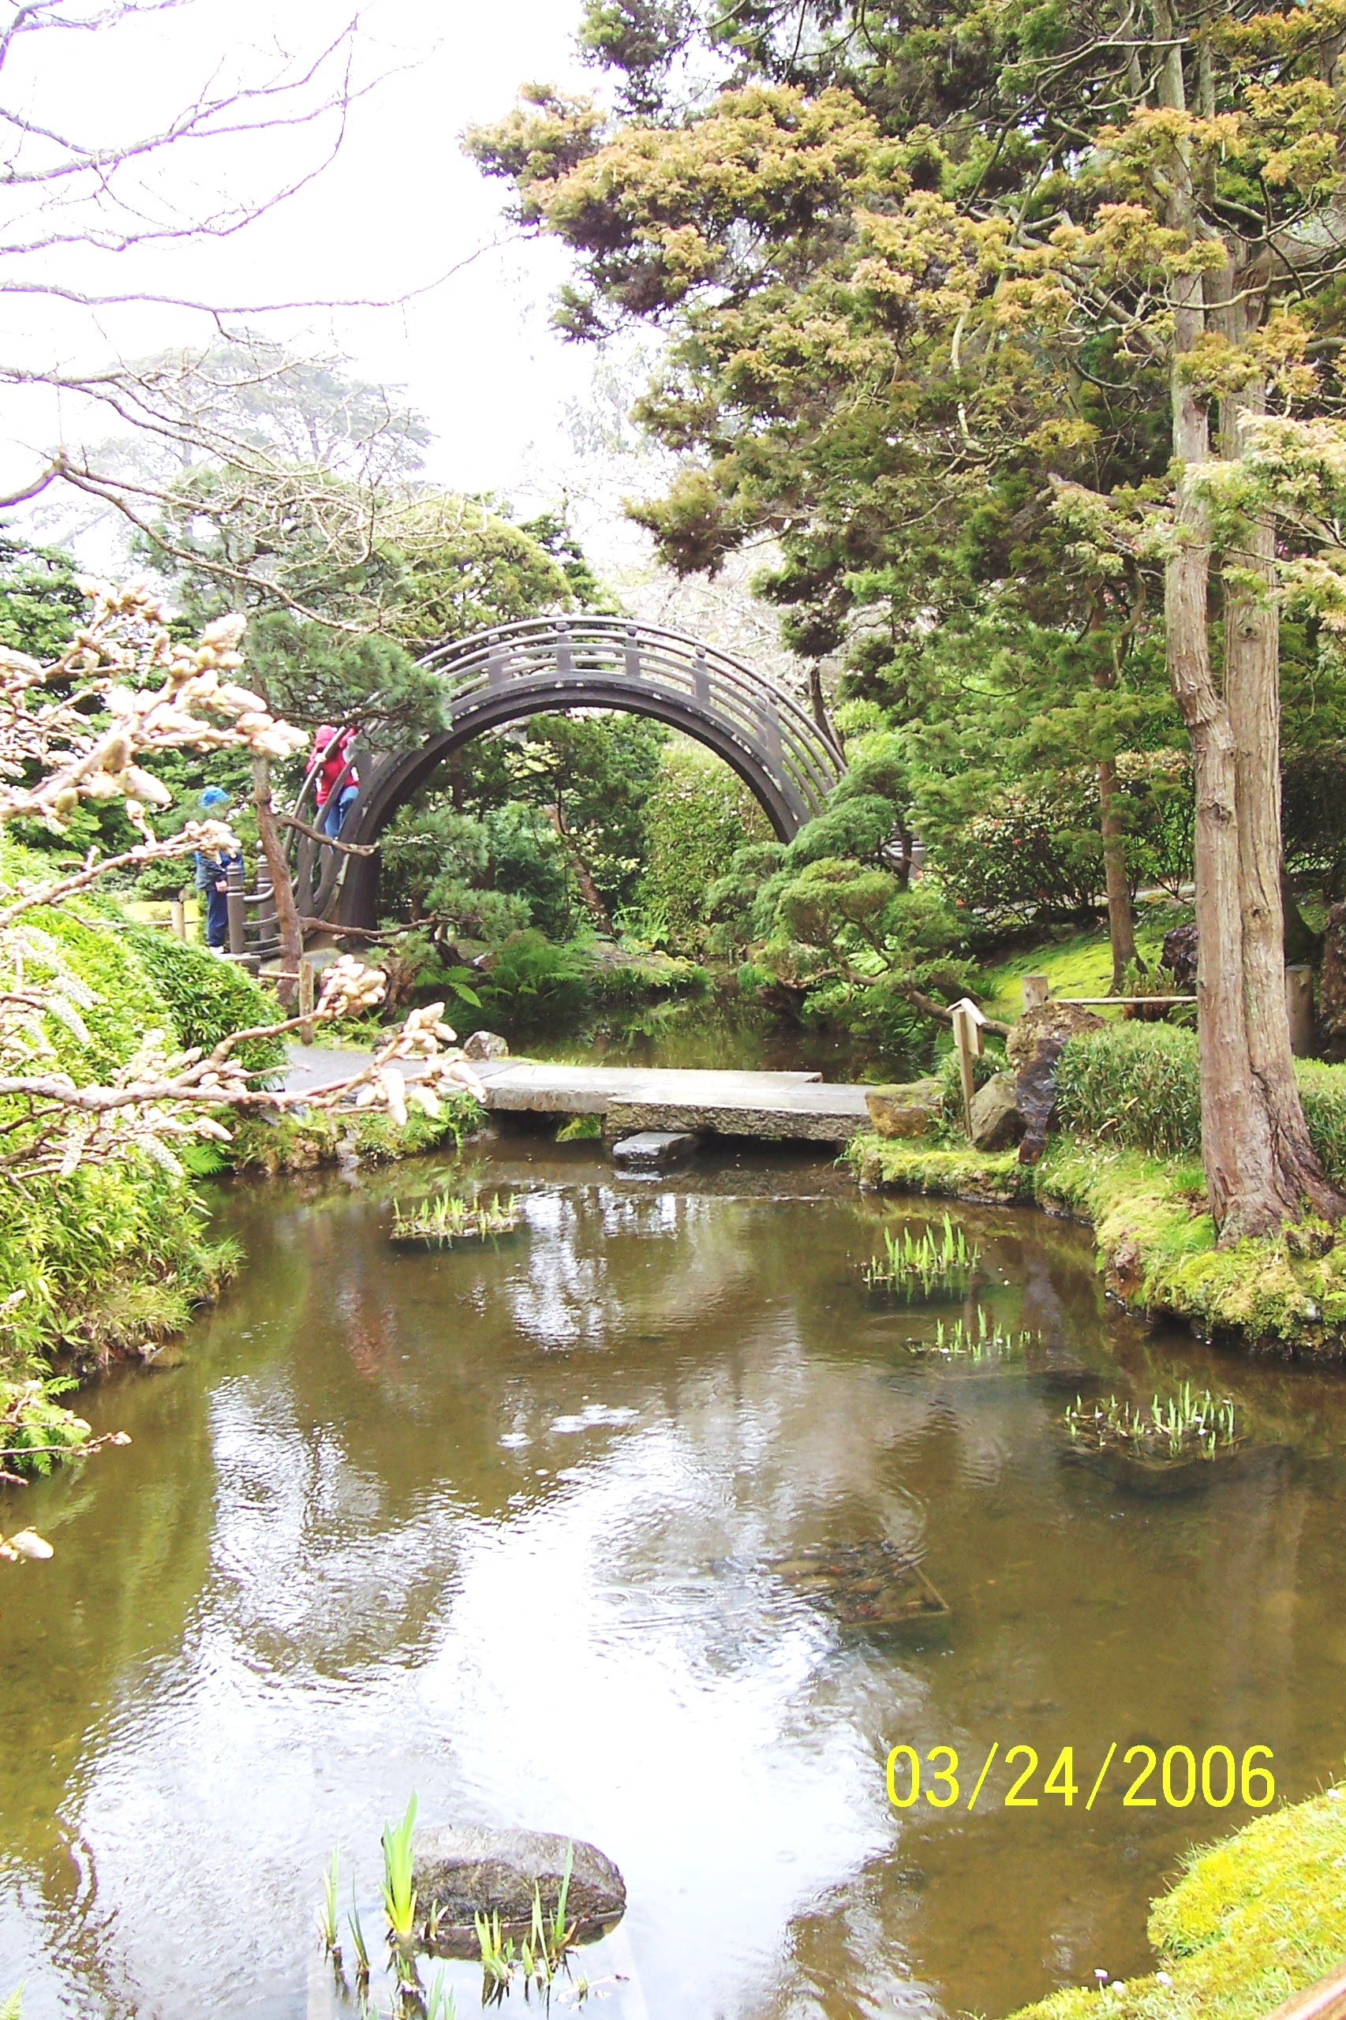
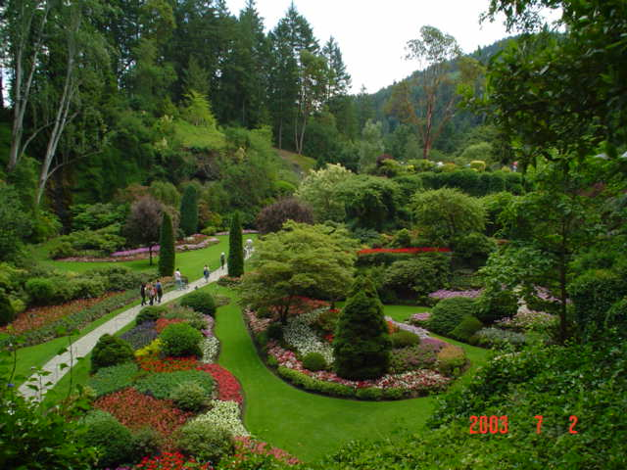
Parks & Recreation
Botanical Gardens
Arboretums
State Parks
Horticulture Therapy

Slide 7
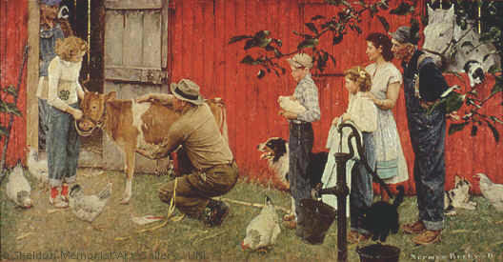
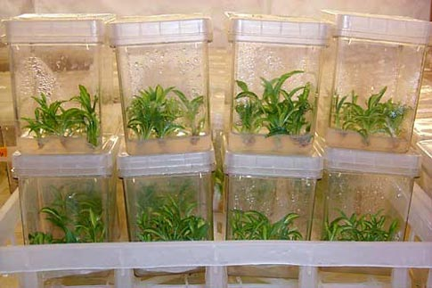

Education/Research
Extension Agents
Vocational Teachers
Plant Breeders
Research scientists

Slide 8

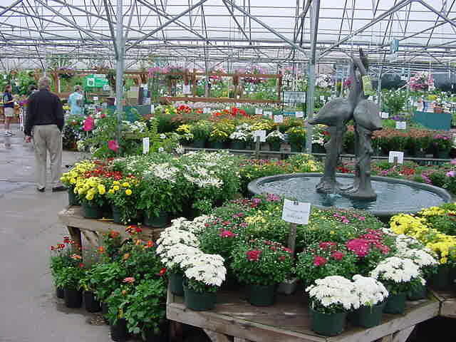

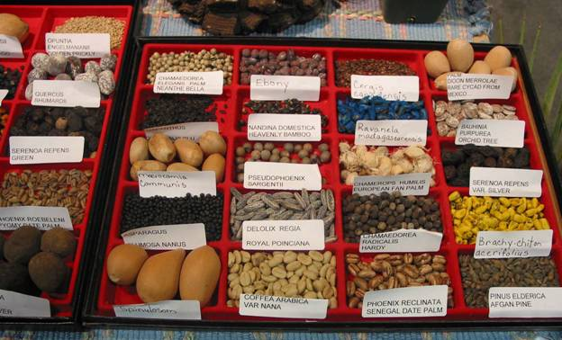
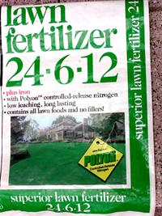
Marketing & Sales
Chemical Dealers
Equipment Sales
Plant & Seed Sales
Retail
Wholesale

Slide 9


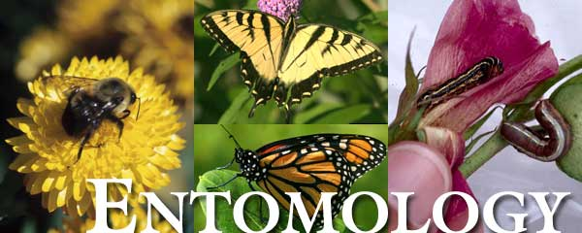
Crop Consultants
Entomology
Plant Pathology
Weed Science
Integrated Pest Management

Slide 10

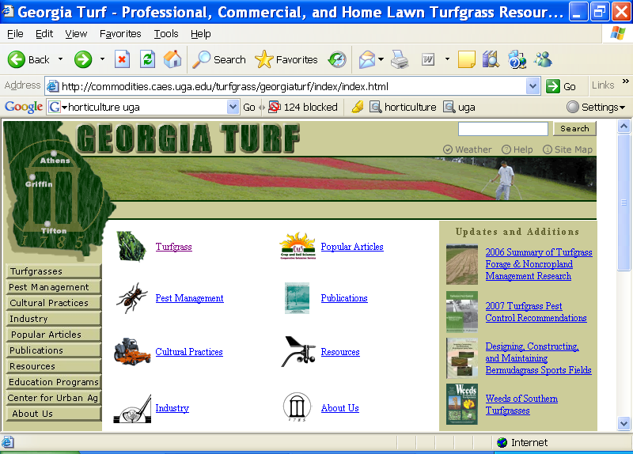
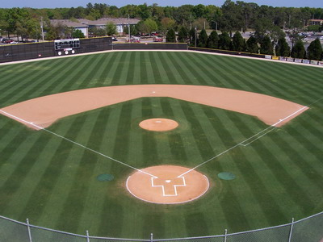

Turfgrass Management
Sports fields
Golf Courses

Slide 11

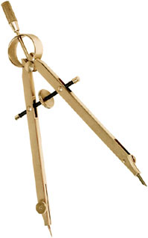

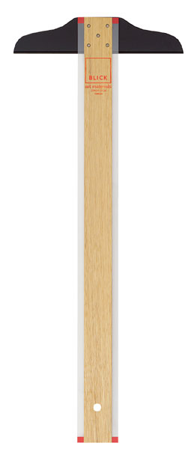
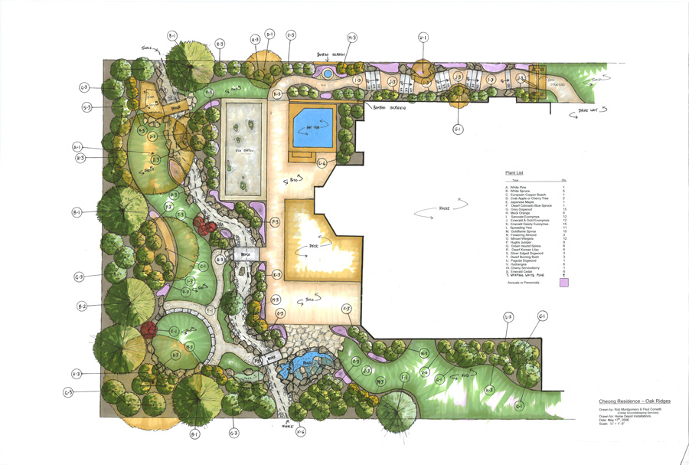
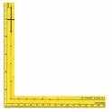
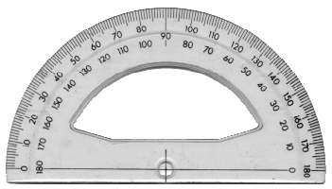
Landscape Design
Landscape designers
Landscape architects
Interiorscapers

Slide 12






Regulatory/Government
USDA Plant Protection and Quarantine
Georgia Department of Agriculture
Environmental Protection Agency
Georgia Forestry Commission
Department of Natural Resources

Slide 13


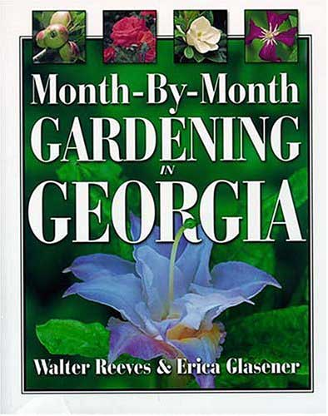
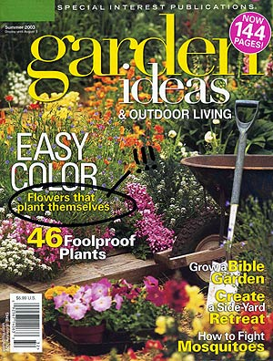
Communication
Garden book writers
Magazine columnist
Industry lobbyists
Television shows
Talk radio

Slide 14
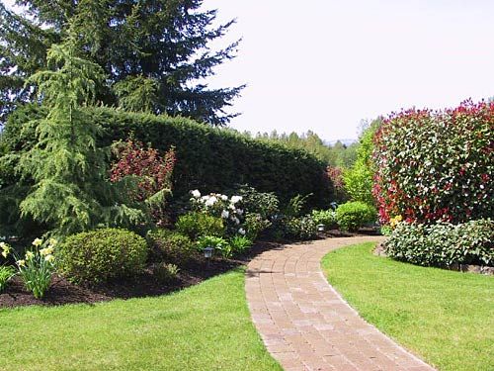

Career Path in Horticulture
Get practical hands-on experience
  Internships
  Shadowing/Interviews
  Job work experience
Post-Secondary Education
  Technical Schools
  Undergraduate Colleges/Universities
  Graduate Schools
Professional Certifications
  GGIA Certified Plant Professional
  Georgia Certified Landscape Professional
  ISA Certified Arborist
Get involved with Trade Associations

