Slide 1
Best Management Practices for Turfgrasses
Keith Mickler – Floyd County Todd Hurt – Cherokee County
University of Georgia Extension Service,

Slide 2
Warm-season grasses
Bahiagrass
Bermudagrass
Centipedegrass
St. Augustinegrass
Zoysiagrass

Slide 3
Warm-season grasses
Best time to establish in spring or summer
Winter dormancy induced due to lower temperatures and reduced daylength
Most establish vegetatively (sod, sprigs, stolons, rhizomes)

Slide 4
Components of best management practices
Fertility practices
Irrigation practices
Mowing practices
Pesticide application

Slide 5
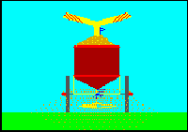
Fertilization
Minimizing environmental impacts
Producing healthy, stress-tolerant turfgrass

Slide 6
The Fertilizer Bag 16-4-8
Numbers refer to percent nitrogen, phosphorous, potassium in the bag
Example: 16-4-8 has 16% N, (or 8 lbs. in a 50 lb. bag) 4% P, 8% K
Nutrient sources also listed

Slide 7
Turfgrass Fertility Considerations
Application amount
Application timing
Fall fertility
Fertilizer source (quick-release vs. slow-release)
Nitrogen
Phosphorous
Potassium

Slide 8
Application Amount
Depends on percentage slow-release N
No more than ½ lb. N 1000 ft² if quick-release
Up to 1 lb. N 1000 ft² if slow-release
Better to apply smaller amounts more frequently

Slide 9
Application Timing
Remember, warm-season grass growth cycle- based on temperature AND daylength
In general, greatest fertilization needs during spring growth
Watch N applications during summer growth

Slide 10
Fall Fertility
What the heck is that “winterizer fertilizer” about, anyways?
Watch fall N!!
Fall K can be beneficial

Slide 11
Fertilizer Source
Water-soluble or “quick release nitrogen”
“Slow release nitrogen”
Combinations of the above

Slide 12
Nitrogen
Needed in greatest quantity by turf
Promotes shoot growth
Enhances green coloration
Excess N depletes carbohydrate reserves → → → leaves turf vulnerable to stresses

Slide 13
Nitrogen
Amount applied on a yearly basis determined by:
level of desired lawn quality
ability to maintain lawn
turf species

Slide 14
Phosphorous
Traditional advisories 16-4-8 ….Is this what we really need?
P required in these amounts for newly established lawns until root growth becomes established
Otherwise, P fertilization should be based on soil test results

Slide 15
Potassium
Functions in water relations – helps turf maintain turgor pressure and hydration status
Functions in cellular activities – photosynthesis and energy relations
Provides increased tolerance to many stresses

Slide 16
It’s raining out- should we leave the sprinklers on?
An efficient watering program must include:
when to water
how much to water
time of day to water

Slide 17
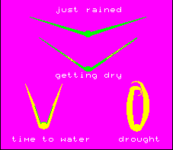
When to Water
The most efficient way is to apply water when turf begins to show signs of stress:
bluish gray color
footprints remain
leaf blades folded in half

Slide 18
How Much to Water
An efficient watering only wets the turfgrass root zone, does not saturate the soil and does not allow water to run off.
Apply 3/4” to 1” when turf shows symptoms of wilt and do not apply any more until water stress symptoms are again noticeable.

Slide 19
Influence of Irrigation on Root Depth
Short, frequent irrigations
Longer, less frequent irrigations

Slide 20
Time of Day To Water
Wet grass = disease opportunity
Dew point should not be extended – grass must dry out
Best time to water is just before or at sunrise

Slide 21
Mowing
Don’t mow grass when wet
Keep mower blades sharp!

Slide 22
Mowing
Mow at highest recommended height for species – leave as much shoot tissue on as possible
Don’t remove more than 1/3 of the leaf blade at any one time
Leave clippings on the ground
Increase mowing height under any environmental stress (shade, drought, etc.)

Slide 23
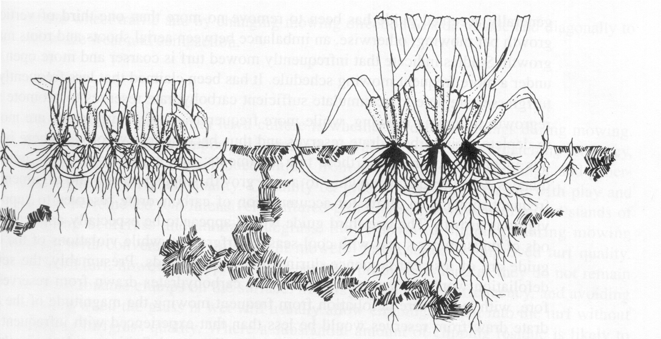
Influence of mowing height on rooting depth

Slide 24
About Shady Situations….
Multiple problems:
Reduced light quantity for some or all of the day
Altered light quality, which affects growth responses
Competition from tree roots

Slide 25
About Shady Situations….
Mow at highest recommended height
Less irrigation required
Less fertilizer required
Watch other stresses (traffic, insects, water)
Can K help?

Slide 26
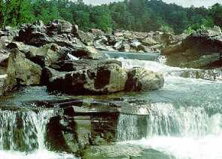
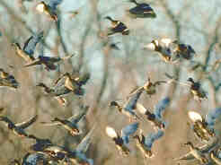
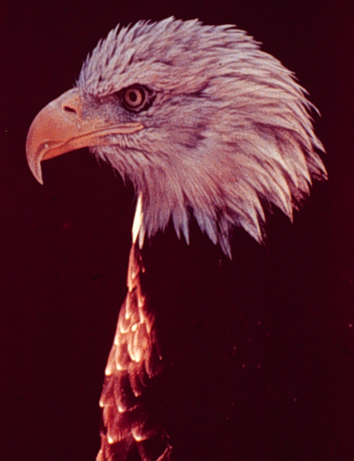
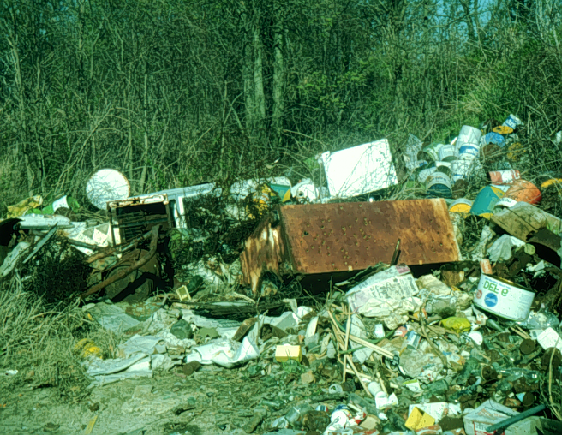
Environmental Concerns for Pesticide Applicators

Slide 27
Pesticides May Harm the Environment by:
Runoff into surface waters
Leaching into groundwater
and...

Slide 28
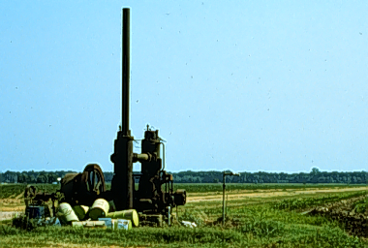
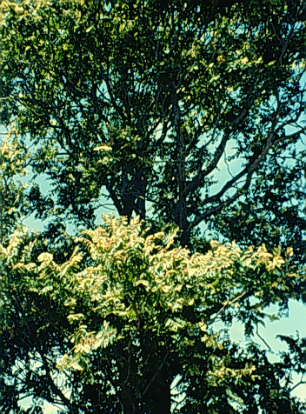
Improper
disposal
Movement to non-
target areas (drift)

Slide 29
Pesticide Properties that Affect movement
Adsorption (how tightly the pesticide sticks to soil particles)
Solubility in water (the more soluble it is, the more it moves with water)
Volatility (if it is a volatile formulation it can move readily as a gas)
Degradation/Persistence (how long before it breaks down in the environment)

Slide 30
Consequences of Groundwater Contamination
Restricted use of water
Difficult to correct
More restrictions on pesticides.

Slide 31
Pesticides May Reach Groundwater by:
Backsiphoning or spills
Leaching through the soil
Subsurface flow from streams

Slide 32
Reduce Groundwater Contamination Risk
Follow proper application procedures (wind speed, rates, gpa, etc.).
Identify vulnerable areas (sand blows, sinkholes, streams, wells, etc.).
Select safest products when possible.
Prevent pesticide spills

Slide 34
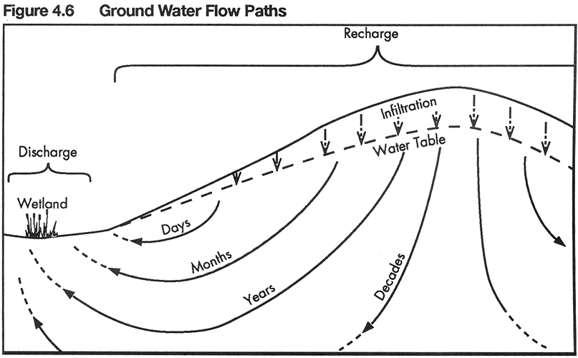
Wetlands and Groundwater in the United States; Stone & Stone

Slide 35
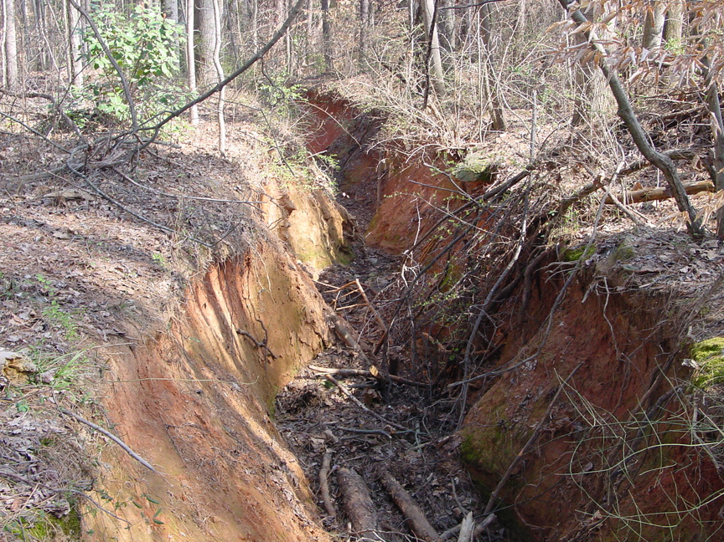

Slide 36
Environmental Hazards
Read Environmental Hazards Box before purchase.
Identify vulnerable areas
Communicate the importance of protecting natural resources with your applicators.
ENVIRONMENTAL HAZARDS
This product is highly toxic to aquatic invertebrates. Do not apply directly to water, or to areas where surface water is present…

Slide 37
Effects of Pesticides on Fish and Wildlife
Drift into aquatic environment - can kill fish and invertebrates.
Contamination of food supply (acute and chronic effects).
Remember that eroded sediment can also act as a carrier.
Pesticides end up in the food chain and can accumulate which causes problems for predatory species.

Slide 38
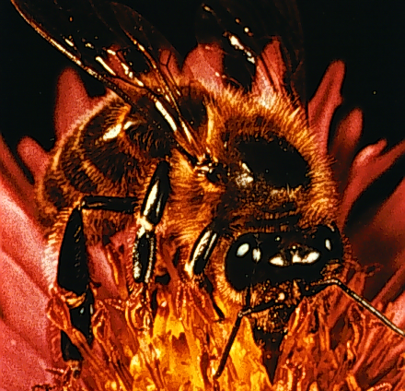
Minimize Insecticide Poisoning of Bees
Follow label directions.
Make applications when bees are inactive - early morning or late afternoon.
Do not spray during bloom if possible.
Treat only problem sites.
Use non-hazardous insecticides.
Prevent drift from contacting bees/beehives.

Slide 39
Best Management Practices
Pesticide Applications
Pesticide Mixing and Loading
Pesticide Storage
Pesticide Disposal

Slide 40
Pesticide Application
Calibrate your Equipment
Use Pesticides with a solubility of 5 ppm or less.
Time well in advance of irrigation or unfavorable weather.
Do not use overhead irrigation to chemigate

Slide 41
Relative Solubility of Preemergence Herbicides

Slide 42
Pesticide Mixing and Loading
Mix and load on an impervious surface with a roof and curbing
Use anti-siphon devices
Mix load sites should be a minimum of 100 feet from any well.
Rinse water should be properly stored and used in following batch mixes where possible.

Slide 43
Pesticide Storage

Slide 44
Pesticide Storage
Store all pesticides in their original containers.
Keep pesticides secure and isolated from the surrounding environment.
Do not store PPE inside chemical room but readily available.
Adopt 1st in 1st out principle.
Maintain an inventory with current MSDS information.

Slide 45
Pesticide Disposal
Spray excess solution on labeled crop sites.
Triple rinse and puncture jugs immediately after emptying,
Dispose of empty containers in recycling programs or as indicated on the label.

Slide 46
Questions

