Slide 1
Sports Fields Management
Bermudagrass
Clint Waltz, Ph.D.
Extension Turfgrass Specialist
The University of Georgia

Slide 2
Turfgrass Selection
Adaptation & Species

Slide 3
Considerations
Usage & Expectations
Traffic
Wear
Soil Compaction
Soil Stabilization
Roadsides
Turf Quality
Bahia is not a high quality turf

Slide 4
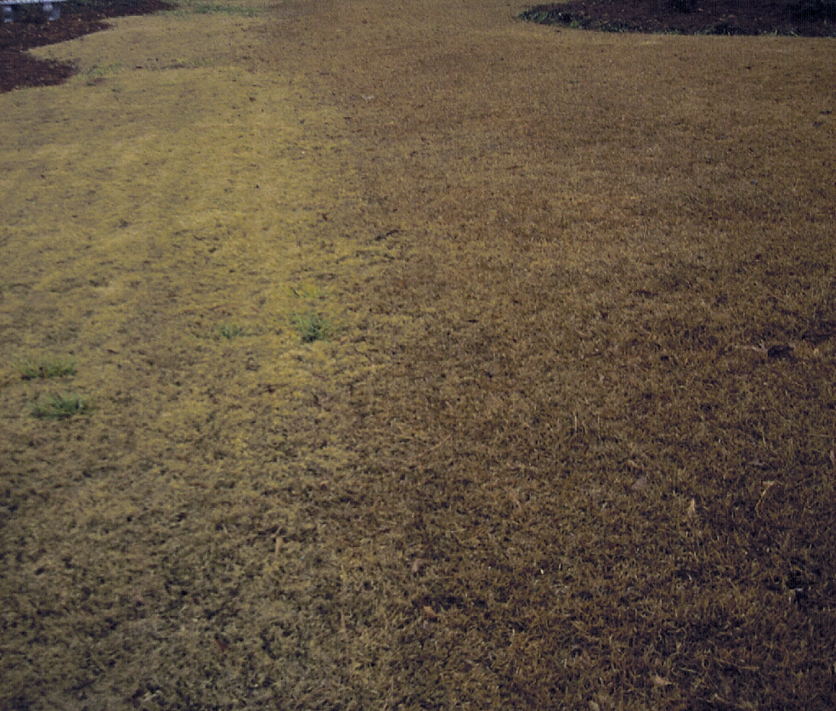
Adaptation
Warm Season
Active Growth – 80° to 95° F
Dormancy – 50° to 55° F
Cool Season
Active Growth – 60° to 75° F
Reduced Growth – Winter & Summer
Bermuda
Centipede

Slide 5
Adaptation Zones - Georgia
Warm Humid Zone
S. Florida to Virginia
E. Coast to E. Texas
Transition Zone
N. Georgia to Kentucky
Virginia to Arkansas
Notes:
Warm Humid Zone:
- Average July temp for entire zone is 80° F
- High humidity and adequate rainfall (30”)
- Bermuda, Zoysia, Bahia, St. Augustine, Centipedegrass, Carpetgrass, & Seashore Paspalum
Transition Zone:
- Too hot for cool-seasons & too cold for warm-seasons, therefore both are prevalent
- Bermuda, Zoysia, Tall Fescue, bentgrass, & Kentucky Blue

Slide 6
Adaptation & Selection
Climatic Zones & Microclimates
Zone 6b
0 to -5° F
Zone 7a
5 to 0° F
Zone 7b
10 to 5° F
Zone 8a
15 to 10° F
Zone 8b
20 to 15° F
Notes:
Average Annual Minimum Temperatures

Slide 7
Adaptation & Selection
Microclimates
Environmental
Precipitation
Light (sun vs. Shade)
Soil Factors
pH
Fertility
Moisture Holding (sandy vs. clayey)

Slide 8
Warm-season Turfgrasses

Slide 9
Bermudagrass for Sports Fields
Vegetative
Tifway ‘419’
most used hybrid
TifSport
New Cold Hardy Hybrid
Non-preference to mole crickets

Slide 10
Bermudagrass for Sports Fields
Vegetative
Others
Bull’s Eye (MS Choice)
GN1

Slide 11
Bermudagrass for Sports Fields
Vegetative - Advantages
Color – dark green
Density - high
Texture - fine
Recuperative potential
Wear tolerance

Slide 12
Bermudagrass for Sports Fields
Seeded
Common
Coarse Textured
Low maintenance areas
Improved
Finer textured
Low maintenance areas

Slide 13
Bermudagrass for Sports Fields
Seeded - Improved
Cost
Princess 77
Color, texture & density
purchased as sod
Others

Slide 14
Bermudagrass for Sports Fields
Winter-kill
Cold tolerant cultivar
Midlawn, Patriot, Vamont, Quickstand, others
Survival primary issue
Deep & robust rhizomes
Better fall color & green-up

Slide 15
Seashore Paspalum (Paspalum vaginatum)
Positive Attributes
Perennial
Vigorous
Deep Rooted
Dark green color
Adapted to most soils
Excellent salt tolerance
Lower fertilizer requirement
Establishes rapidly
Few pest problems
Notes:
Although not common in most of the United States, this grass is used and best adapted for coastal regions due to its very high salt tolerance. Seashore paspalum has a natural, dark green color that will “stripe-up” like many of the cool-season grasses. This is a characteristic that some find attractive, especially those that have moved into southern coastal regions from northern regions and were accustom to the appearance of Kentucky bluegrass.

Slide 16
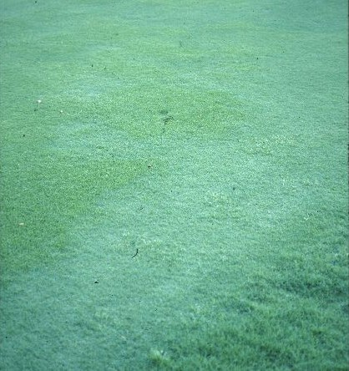
Seashore Paspalum (Paspalum vaginatum)
Negative Attributes
Poor cold tolerance
Thatch
Weeds
no selective control for bermudagrass encroachment
Diseases
Bermudagrass infestation in Seashore Paspalum
Notes:
Much like bermudagrass, this grass relatively few pest problems, but broadleaf and grassy weed, and brown-patch disease can be problematic.

Slide 17
Seashore Paspalum
Vegetatively Established
Older selections
Adalayd / Excaliber, Futurf
Newer selections
Salam, Sea Isle I, Sea Isle Supreme, & others
Notes:
Seashore paspalum can only be established by vegetative means, sodding and plugging are most common, and a commercially available cultivar for lawn use is ‘SeaIsle 1’.

Slide 18
Zoysiagrass for Sports Fields
Vegetative
Meyer - medium
Emerald - fine
El Toro - coarse
Empire - medium
Zeon - fine
Palisades - fine
Others

Slide 19
Cool-season Turfgrasses

Slide 20
Cool-Season Grasses
Uses & Adaptations
Overseeding
Winter Color
Bermudagrass

Slide 21
Cool-Season Grasses
Overseeding – early transition
Improved bermudagrass cover
Consecutive years
Herbicide aids
sulfonylureas
pronamide - restricted
Revolver – 17 fl oz / A
Gelernter and Stowell, 2005

Slide 22
Cool-Season Grasses
Ryegrasses
Annual
Lower Turf Quality
Coarse texture
Temporary cover
Perennial
Treat as an annual
Better Turf Quality
Good wear tolerance

Slide 23
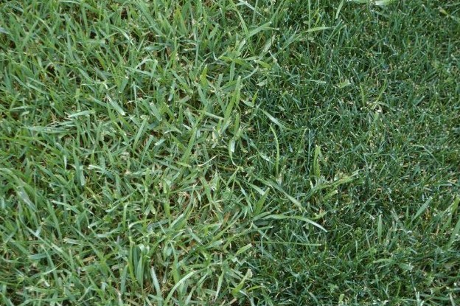
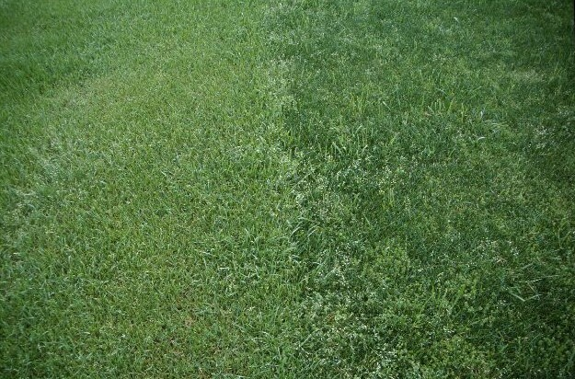
Lolium sp.
Annual Ryegrass (21)
Rolled in the bud
Auricles – long & claw
course texture & light green
Perennial Ryegrass (20)
Folded in the bud
Auricles – short, not clasping

Slide 24
Turfgrass Establishment Methods

Slide 25
Establishment
Vegetative Methods
Sodding
Sprigging
Plugging
Seeding
Seed Mat

Slide 26
Establishment
Sodding
Instant
Soil Stabilization
Greater Cost
Differing Soil Types
Washed Sod

Slide 27
Establishment
Sodding
Slabs
width: 10” to 16”
length: 12 to 24”
Small Rolls
length: 24 to 80”
Big Rolls
width: 30 to 48”
length: 100 feet

Slide 28
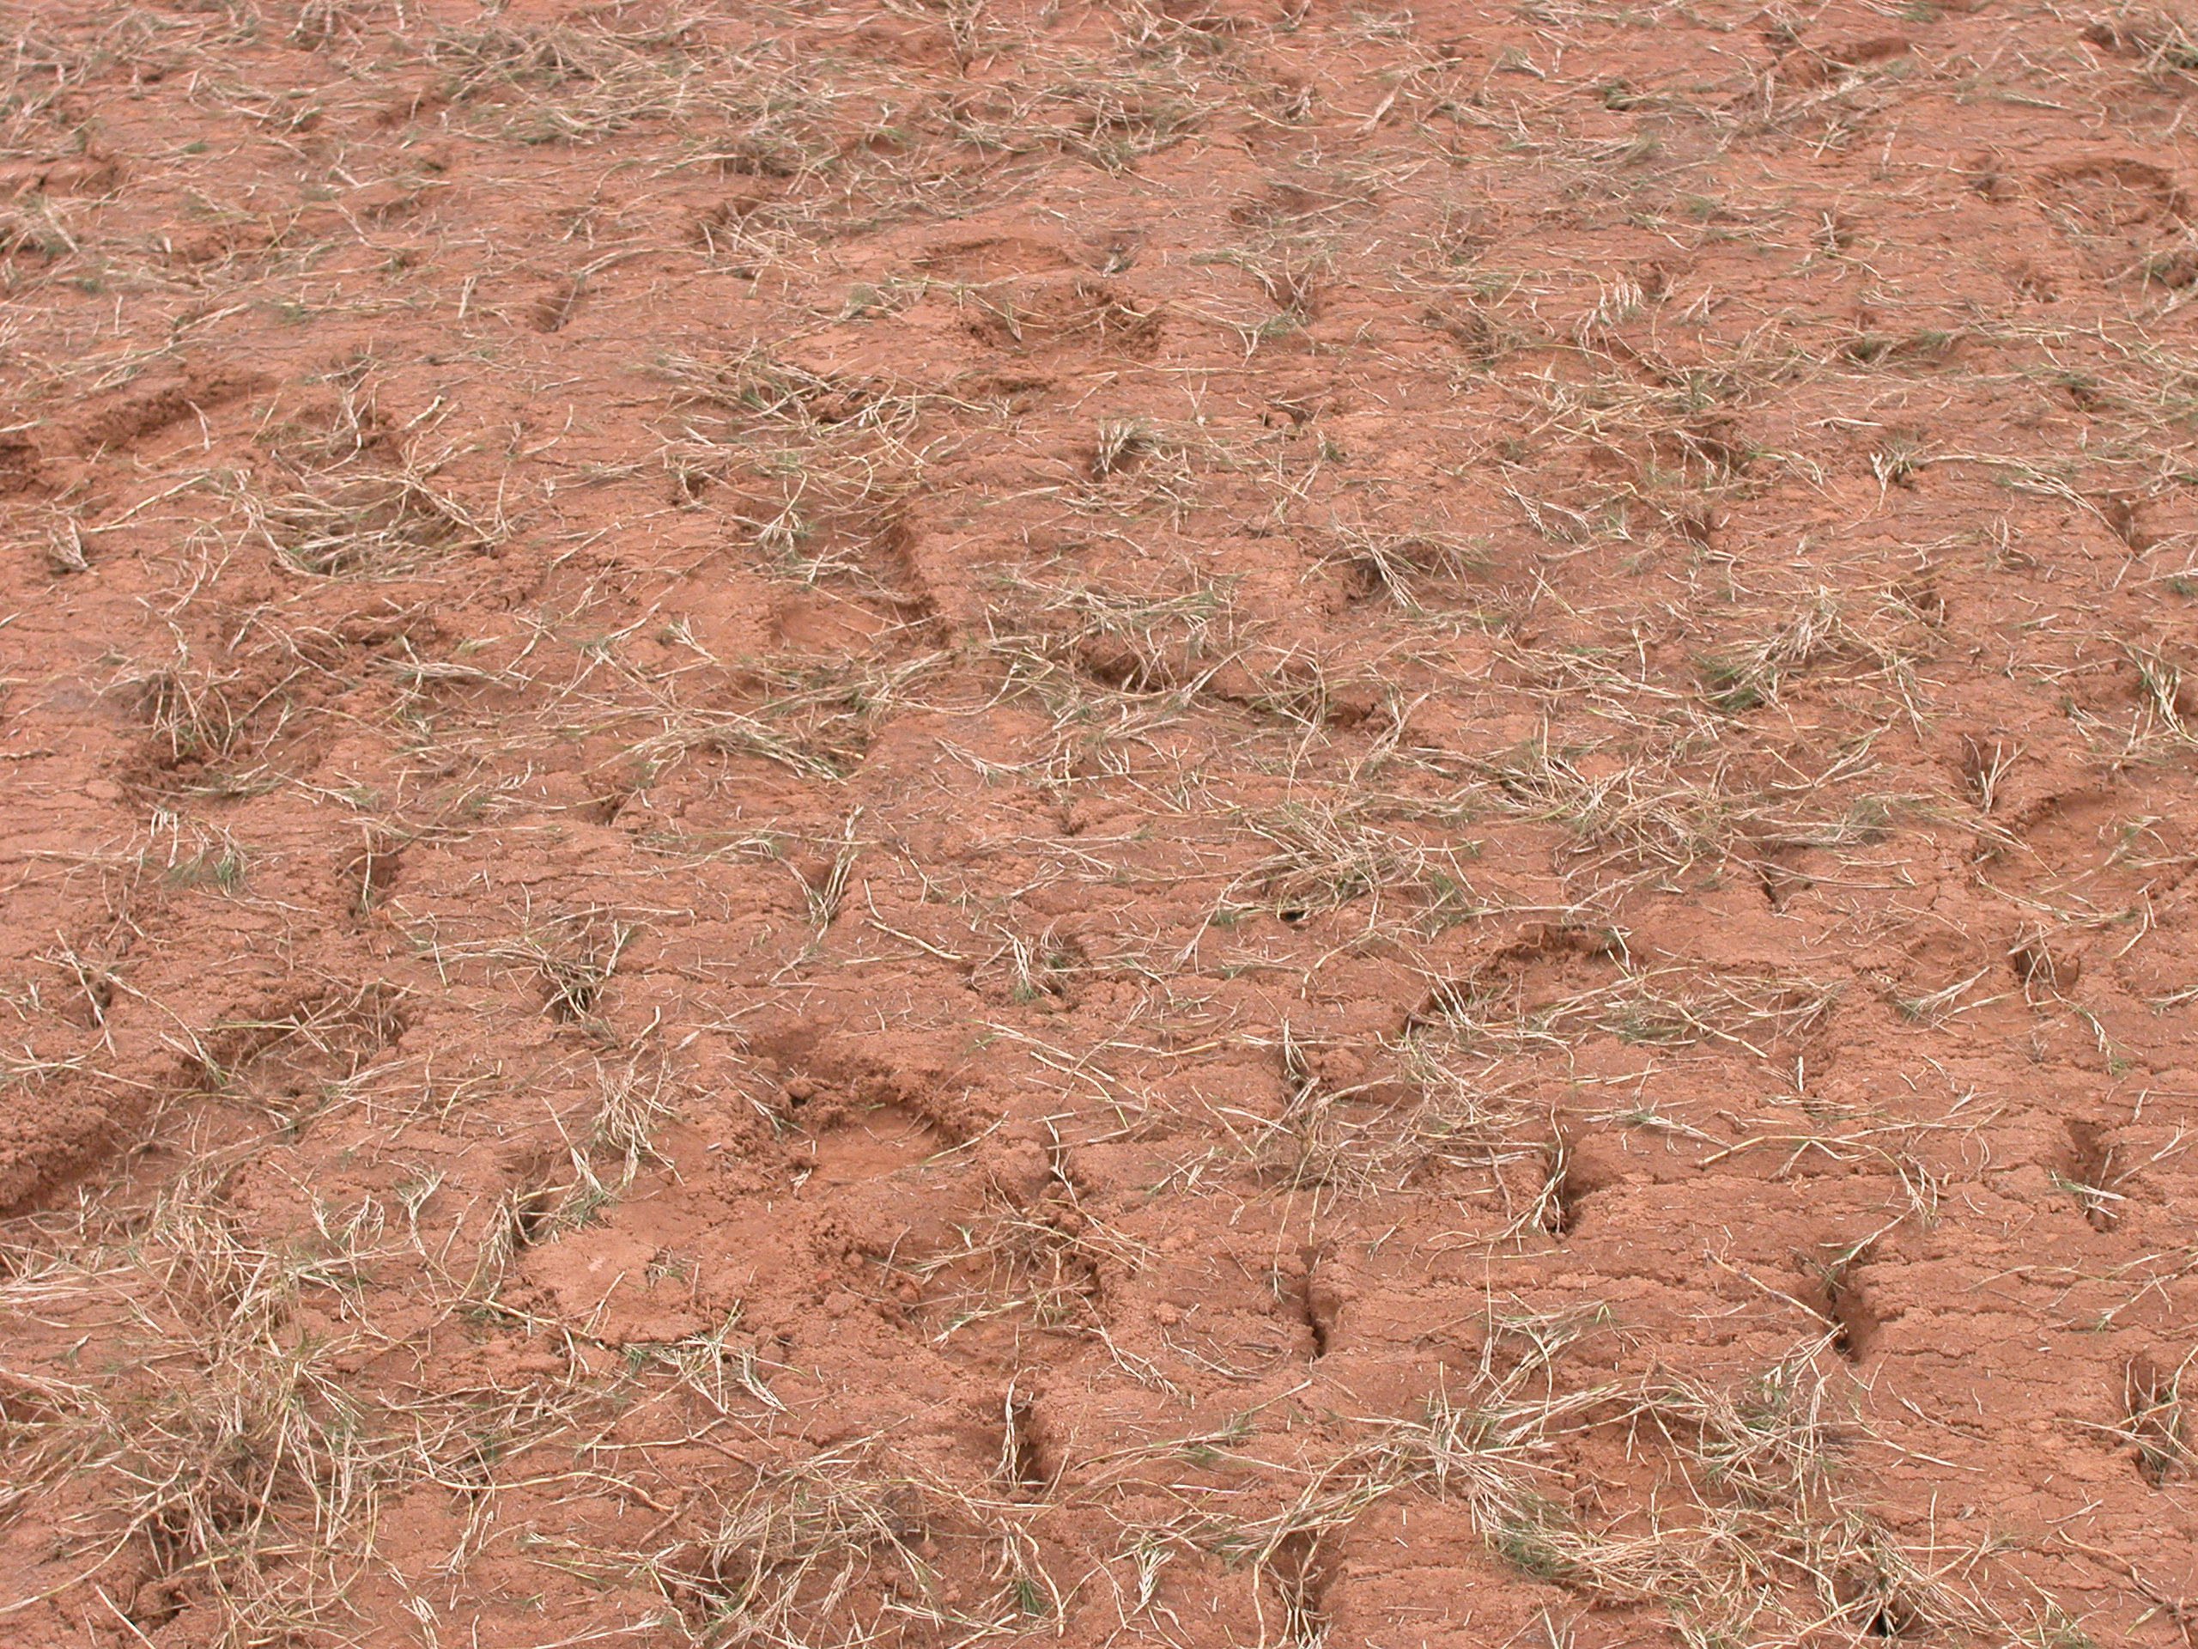
Establishment
Sprigging
Rhizomes & Stolons
Uniform Turf Stand
Little soil associated
Economical
Longer for establishment

Slide 29
Sprigging Rates
Turfgrass | Sprigging Rate
 | ------ Bushels / acre ------
Hybrid Bermudagrass
Lawns / Fairways | 400 to 600
Golf Greens | 400 to 675
Centipedegrass | 50 to 200
St. Augustinegrass | 75 to 200
Zoysiagrass | 50

Slide 30
Establishment
Plugging
Less aggressive species
Centipedegrass
St. Augustinegrass
Zoysiagrass
Seashore Paspalum
Soil associated
6 to 12” centers

Slide 31
Grow-In
Vegetative Establishment
Irrigation
predawn hours
moisten soil surface
Avoid excessive irrigation
Fertilization
1-2-2 ratio incorporated
1 lbs N / 1000 ft²
Re-apply after 2nd mowing

Slide 32
Blends and Mixtures
Blends
two or more cultivars from the same species
(Millennium & Plantation Tall Fescue)
Mixture
combination of two or more species
(Tall Fescue & Poa trivialis)

Slide 33
Important Dates in 2006
Winter Green – Jan. 25 - 28
Green-up 2006 – Feb. 16
Southeastern Turf Conference – May 1 & 2
UGA Turfgrass Field Day – August 15

Slide 34
Important Dates in 2006
GCSAA Conference & Show – Feb. 6 – 11
Atlanta – www.GCSAA.org
TPI Midwinter Conference – Feb. 13 – 17
Savannah – www.TurfGrassSod.org

Slide 35
Thank You
Visit
www.GeorgiaTurf.com
and
www.TurfgrassWater.com

Slide 36
Cultural Practices
Mowing
Irrigation
Fertilization
Aerification
Overseeding
Pest Control

Slide 37
Mowing

Slide 38
Mowing
Positive Affects
Density
Texture
Color
Uniformity
Smoothness
Appearance

Slide 39
Mowing
Negative Affects
Root growth
Nutrient acquisition
Water uptake
Vigor
Persistence of stand
Stress tolerance
Weed & Diseases

Slide 40
Mowing
Nebraska – Steinegger & Shearman, 2001
Dull blades
increased disease
water use decreased
Sharp blades
33% more water used
22% reduction in fuel

Slide 41
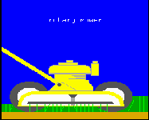
Cultural Practices
Mowing
1/3 rule
Rotary vs. Reel
Sharp blade
Recycle (leave or compost)

Slide 42
Rotary vs. Reel (advantages)
Rotary Mowers
Fewer man-hours
Lower maintenance
Grasscycling
Reel Mowers
High quality of cut
Infinitely adjustable
Lower heights
Minimal scalping
Striping

Slide 43
Rotary vs. Reel (disadvantages)
Rotary Mowers
Low quality of cut
No low heights
1-inch minimum
No striping
Reel Mowers
Higher maintenance
More man-hours

Slide 44
Mowing Calculations
Desired Height | Mow when Turf is
---------- inches ----------
1 | 1 3/8
1 1/2 | 2
2 | 2 5/8
3 | 4

Slide 45
Mowing
Vegetative Establishment
Mowing
1st mow at 130 to 150%
Proper Mowing Height
Avoid mowing when wet

Slide 46
Proper Mowing Height
Species | Mower | Height (in) | Frequency (days)
Bermuda
Common | Rotary or Reel | 1 to 2 | 5 to 7
Hybrid |  | 0.5 to 1.5 | 3 to 4
Centipede | Either | 1 to 2 | 5 to 10
St. Augustine | Rotary | 2 to 3 | 5 to 7
Zoysia | Reel | 0.5 to 2 | 3 to 7
Tall Fescue | Rotary | 1.5 to 3 | 5 to 7

Slide 47
Turfgrass Fertilization

Slide 48
Cultural Practices
Fertilization
When - soil test
What to use – Soil Test
How Much - rarely exceed 1 lb N per 1000 ft²
Application - uniform (2 directions)

Slide 49
Fertilization
Behind the Numbers
N – P – K
N = % nitrogen
P = 43% P₂O₅
K = 88% K₂O

Slide 50
Fertilization
Phosphorous (P₂O₅)
43% P
Slowly soluble
Super Phosphate (0-18-0)
Triple Super (0-45-0)
Promotes Rooting
Till into soil

Slide 51
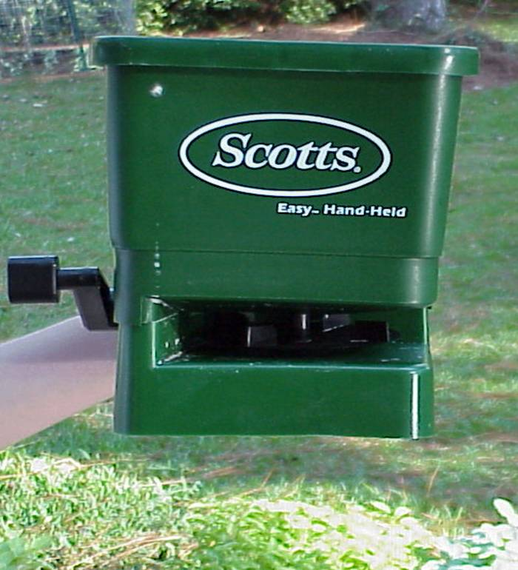
Fertilization
Potassium (K₂O)
83% K
“Health” element
Promotes Rooting
Stress preconditioning
Till into soil
N:K (2:1)
Part of last application (1:1)

Slide 52
Fertilization
Lime
Slowly soluble
Raise pH
6.0 to 6.5 – St. Augustine, Bermudagrass, Tall Fescue, & Zoysiagrass
5.5 to 6.5 – Centipedegrass
5.0 to 5.5 – Bahiagrass

Slide 53
Turf Type Tall Fescue
Fertilization
2 to 4 lbs N per 1000 ft²
Lower N rates = lower water needs

Slide 54
Available Sources of N
Plants use inorganic N
Nitrate (NO₃⁻)
easily leached
Ammonium (NH₄⁺)
lowers soil pH

Slide 55
Origins of N
Organic
Natural Organics
thatch / crop residue
sewage sludge
poultry feather meal
bone meal blood
manure

Slide 56
Organic N
Benefits
low turf burn potential
uniform N release
little effect on soil pH
low leaching losses

Slide 57
Organic N
Suggested Benefits
may enhance plant metabolism & disease resistance
contain sulfur, iron, & trace elements

Slide 58
Organic N
Disadvantages
low N content
1 to 8%
$$ per pound of nutrient
low N release cool weather
microbe dependent
temperature mediated

Slide 59
Organic N
Disadvantages (cont.)
objectionable odor
salts, heavy metals, weed seeds
increased insect populations
black turfgrass ataenius

Slide 60
Origins of N
Synthetic Organics
water soluble
urea
rapid release
urea formaldehyde
slowly soluble
isobutylidene diurea
temp dependent

Slide 61
Origins of N
Inorganic
Synthetic Inorganics
ammonium nitrate
ammonium sulfate
calcium nitrate
potassium nitrate
nitrate of soda

Slide 62
Fertilization Calculations
To apply 1 pound of N / 1000 ft²
16 - 4 - 8 (using ½ NH₄NO₃ & ½ UF)
6.25 pounds of material
8 - 4 - 0 (using organic)
12.5 pounds of material

Slide 63
Bermudagrass Fertilization
Suggested N Application
April - ½
May - ½ to 1
June - ½ to 1
July - 1
August - 1
September - ½

Slide 64
Environmental Affects
High N Fertilization
Susceptibility to pests
diseases
Susceptibility to environmental stresses
drought

Slide 65
Phosphorus Fertility
Phosphorus (P)
Granular P ferts. are 90 to 100% water- soluble
Dissolve rapidly in moist soil
Hydrolysis of water-soluble P increase when temps. increased from 41° F to 95° F
At field capacity, 50 – 80% water-soluble P will move out of granular in 24 hours; 20 – 50% at 2 – 4% soil moisture.

Slide 66
Proper Fertilizer Usage
Common Sense
Proper rate
Application (sidewalks)
Calibration
Timing

Slide 67
Cultural Practices
Adjusting pH (5.5 to 6.5)
According to soil test
Lime
increase pH
Sulfur & some Ferts.
lowers pH
NH₄⁺

Slide 68
Thatch Management

Slide 69
Cultural Practices
Thatch
Spongy collection of living & dead material
Not all bad
natural cushion (endure wear & tear)
retains moisture
insulates soil from temp. extremes

Slide 70
Advantages of Thatch
Approx. ½ inch
Adds resiliency to the turf
Increases wear tolerance
Increases impact absorption

Slide 71
Disadvantages of Thatch
Greater than ½ inch
Harbors insects & disease
Limits root penetration
Reduces water infiltration
Limits seed establishment
Affects field performance

Slide 72
Thatching of Common Grasses
Thatching Tendency | Turfgrass
Moderate to Heavy | Bermudagrass Zoysiagrass Kentucky Bluegrass
Low to Moderate | Buffalograss
 | Creeping Red Fescue
Low (or nonthatching) | Tall Fescue Perennial Ryegrass
Puhalla et al., 1999

Slide 73
Cultural Practices
Thatch
Actively growing
Removal
Aerification
Vertical mowing
Topdressing

Slide 74
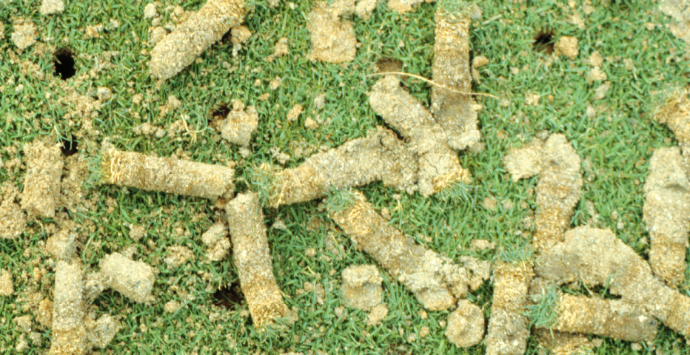
Cultural Practices
Aerification
When - turf actively growing
Remove thatch and organic layer
Equipment -
solid vs. hollow tines
rental

Slide 75
Core Aerification
Common Questions
Solid or Hollow?
Hollow increased macropores
Duration?
3 weeks

Slide 76
Core Aerification
3 times per year
Spring Green-up
Early Summer
After Playing Season

Slide 77
Topdressing
Reasons
Thatch management
Surface leveling
Soil amendment
Improve drainage
Assist in overseeding

Slide 78
Topdressing
Procedures
Light & frequent
1/16 to 3/8”
Reaching soil surface
mow turf low
broom or rub-in

Slide 79
Topdressing
Material
Similar to existing
Chemically
Physically
Prevent layering

Slide 80
Common Spring Problems & Management

Slide 81
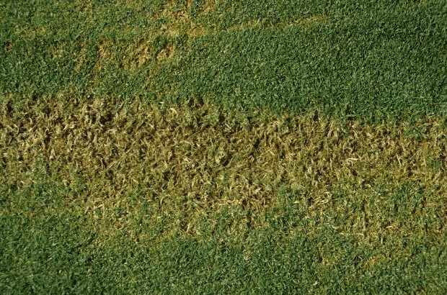
Green-up Problems
Possible Causes
Mowing Height
Scalping
½- to 1½-inches
a mowing rule
Scalping

Slide 82
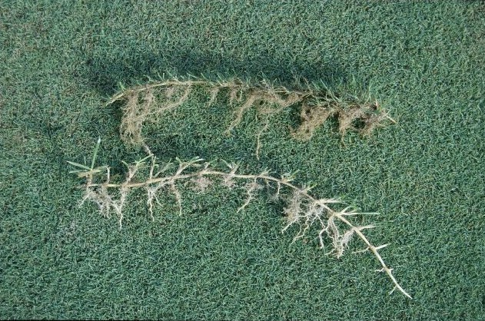
Green-up Problems
Possible Causes
Fertility
2 pounds N / year
Thatch
excessive nitrogen
over watering
Bermudagrass invasion
Bermudagrass Stolon
Zoysiagrass Stolon

Slide 83
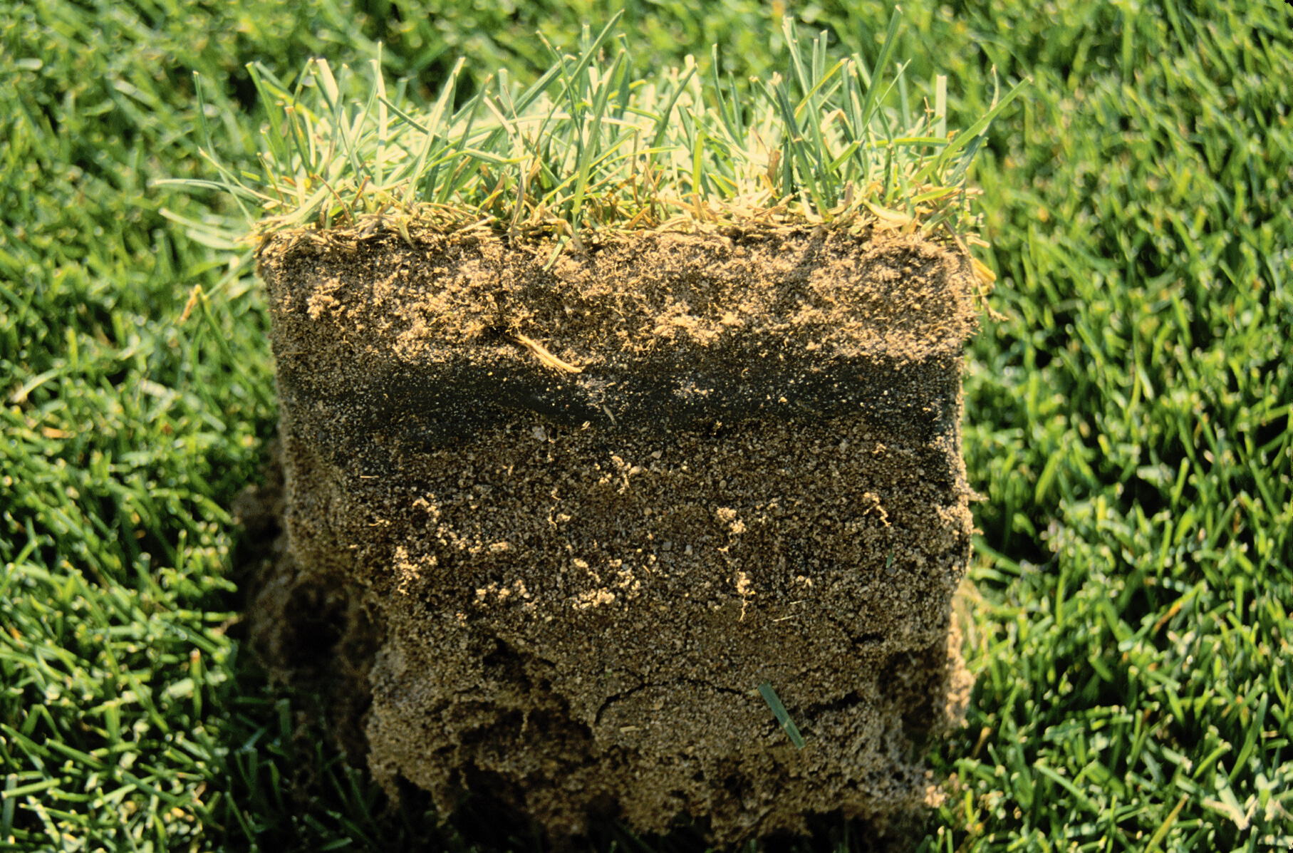
Green-up Problems
Possible Causes
Thatch
Likely above 2” HOC
Excessive nitrogen
Excessive irrigation
Increase disease incidences
Thatch
Sod layer
Rootzone
Kentucky Bluegrass

Slide 84
Green-up Problems
Possible Causes
Water
Too much
over stimulate growth
disease
Too little
slow growth

Slide 85
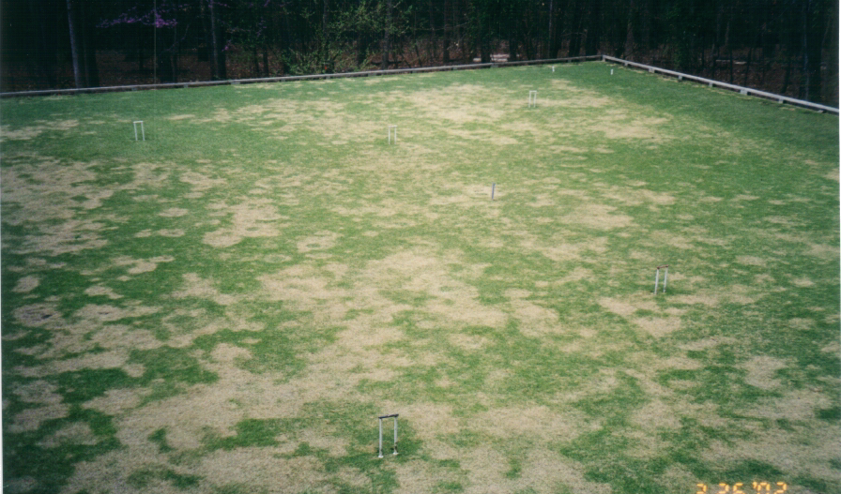
Green-up Problems
Possible Causes
Disease – Large Patch
Night Temperatures
50° to 60° F
Fall & Spring
flutolanil
azoxystrobin
Nitrogen Fertility
Large Patch on zoysiagrass

Slide 86
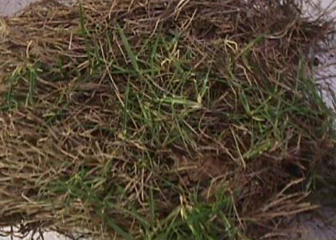
Green-up Problems
Possible Causes
Cool Temperatures
Slow green-up typical
Early Spring Temps.
Soil Temp. Guideline
65° F
Slow to green-up zoysiagrass

Slide 87
Green-up Problems
Possible Causes
Microclimate
‘Emerald’ in N. Atlanta
Low temperatures
Shades sites
Lack of winter sun
Shaded zoysiagrass

Slide 88
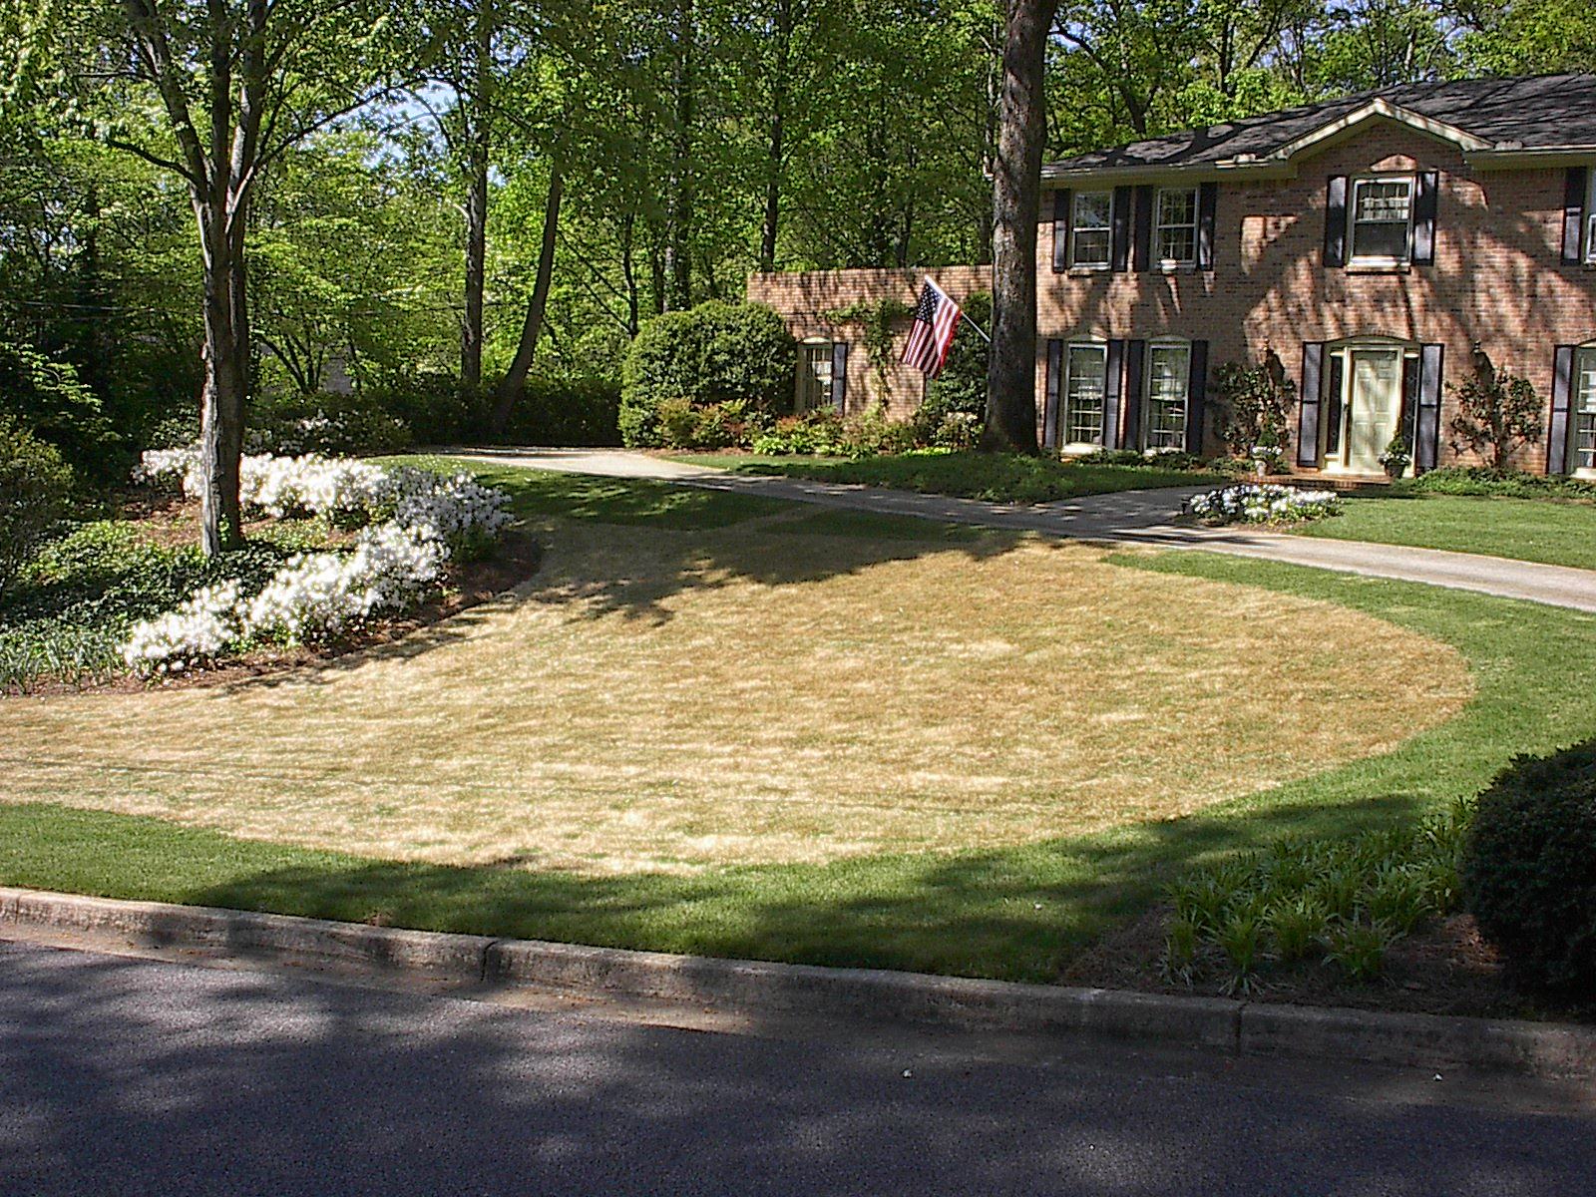
Green-up Problems
Possible Causes
Varietal Differences
‘Emerald’ in N. Atlanta
unknown
work ongoing
Unexplained

Slide 89
News for 2004 Pesticides

Slide 90
2004 Pesticide Update
Insecticides
Diazinon
Loss of material (Dec. 31)
residential uses
fire ants
chinch bugs

Slide 91
2004 Pesticide Update
Insecticides
Sevin (carbaryl)
Loss of material (July 1)
broadcast applications of home lawns
Spot treatment (< 1000 ft²) allowed
golf courses, commercial lawns, & sod farms

Slide 92
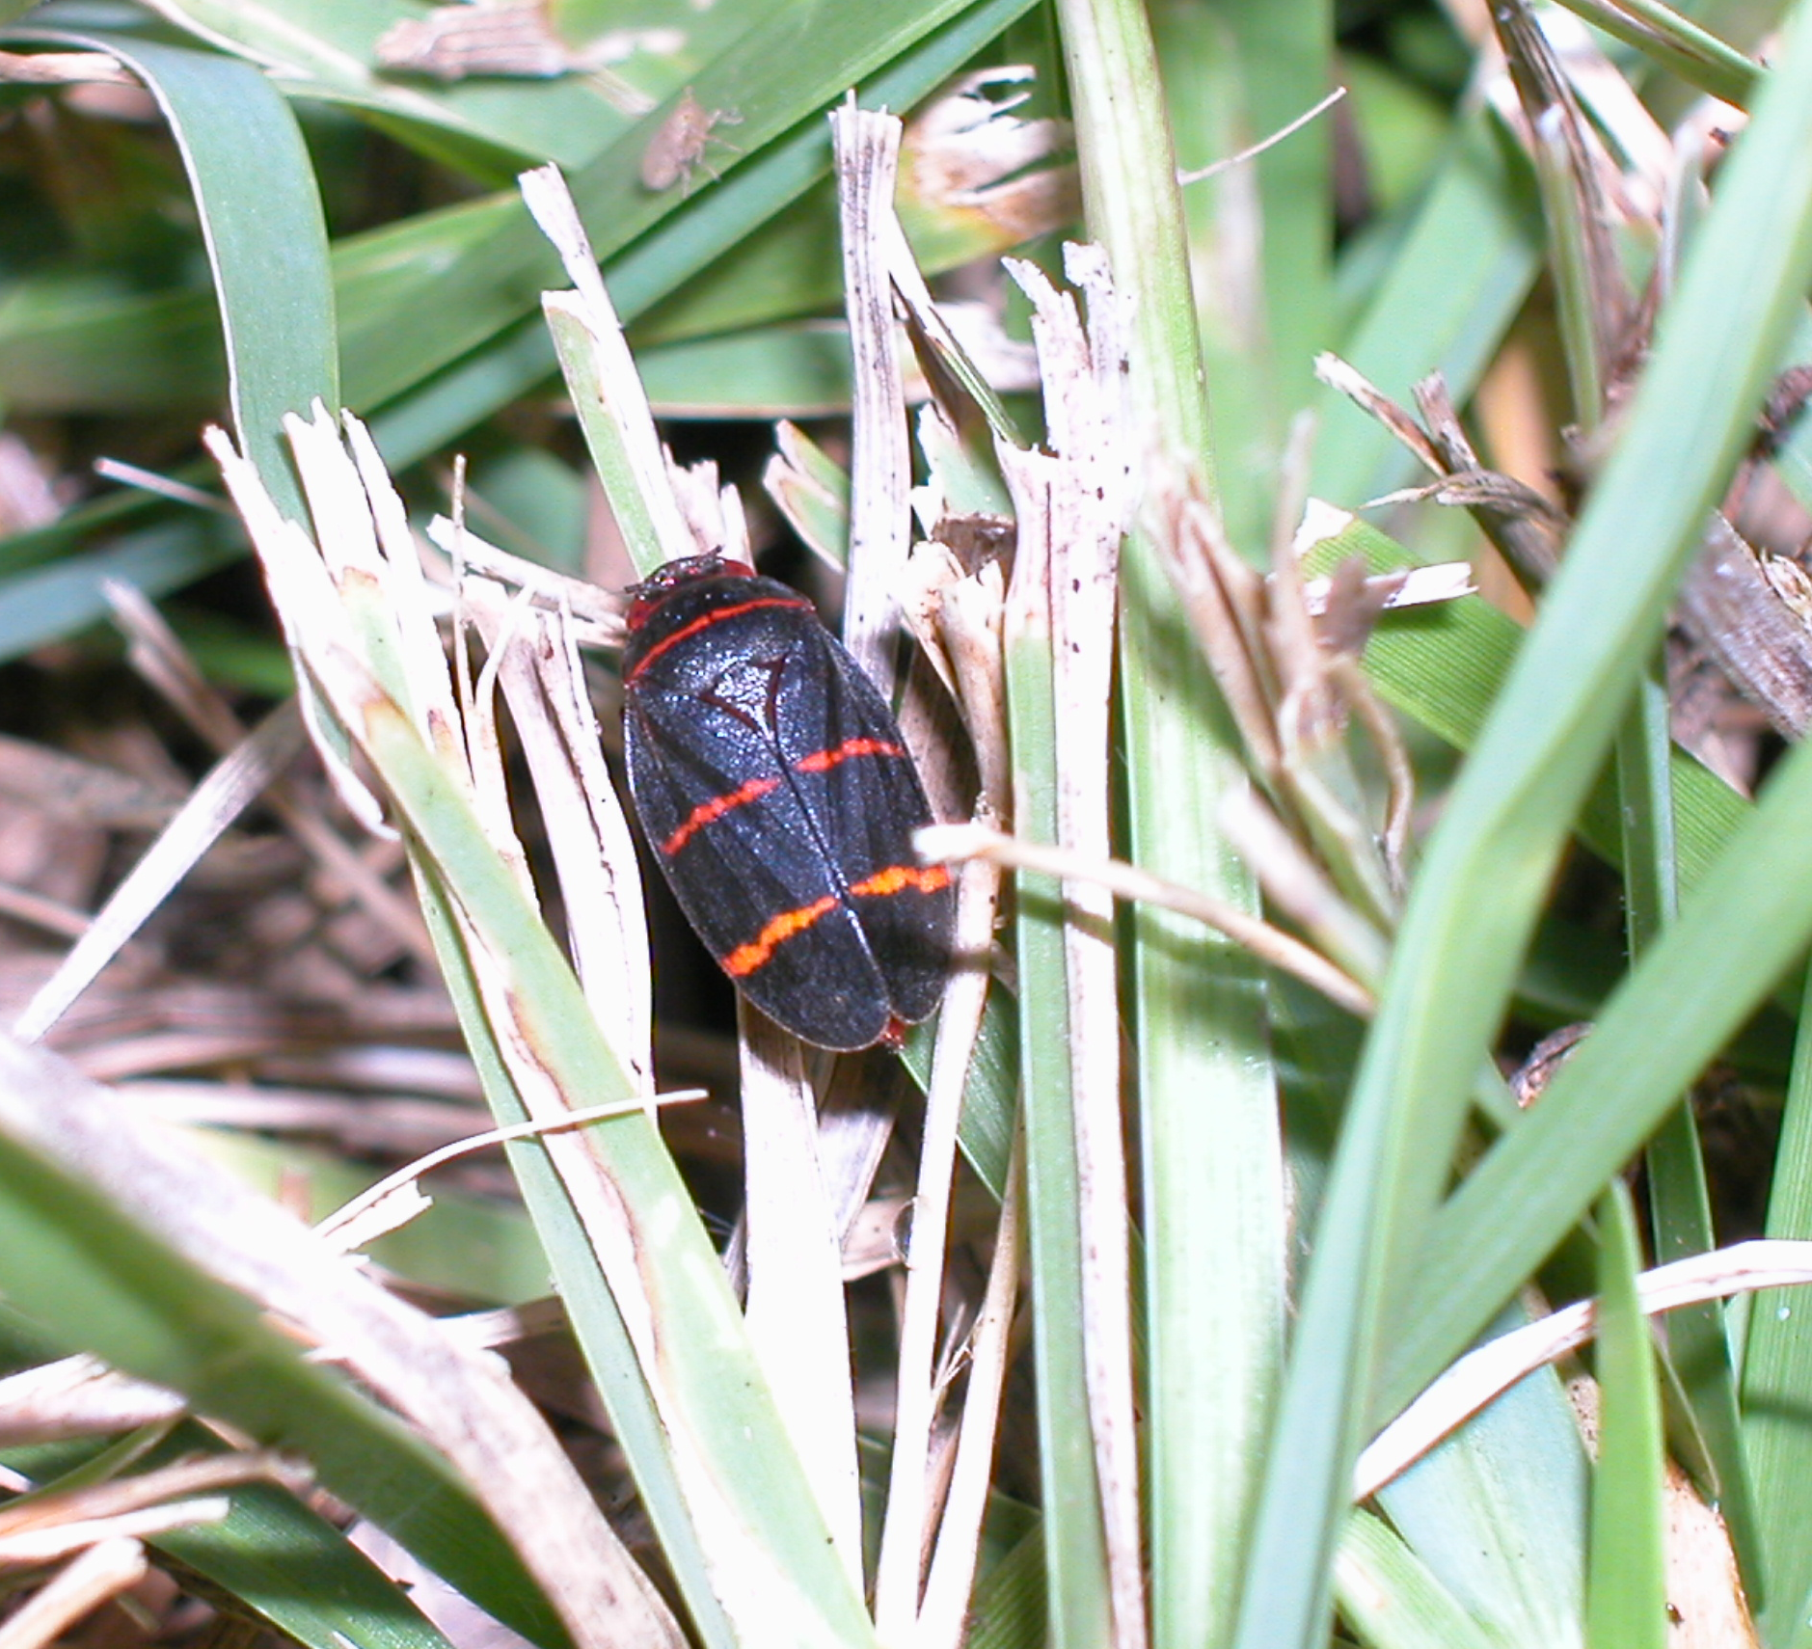
2004 Pesticide Update
Insecticides
Mach 2 (halofenozide)
white grubs
caterpillars
Merit (imidacloprid)
white grubs
Spittlebug on Centipedegrass

Slide 93
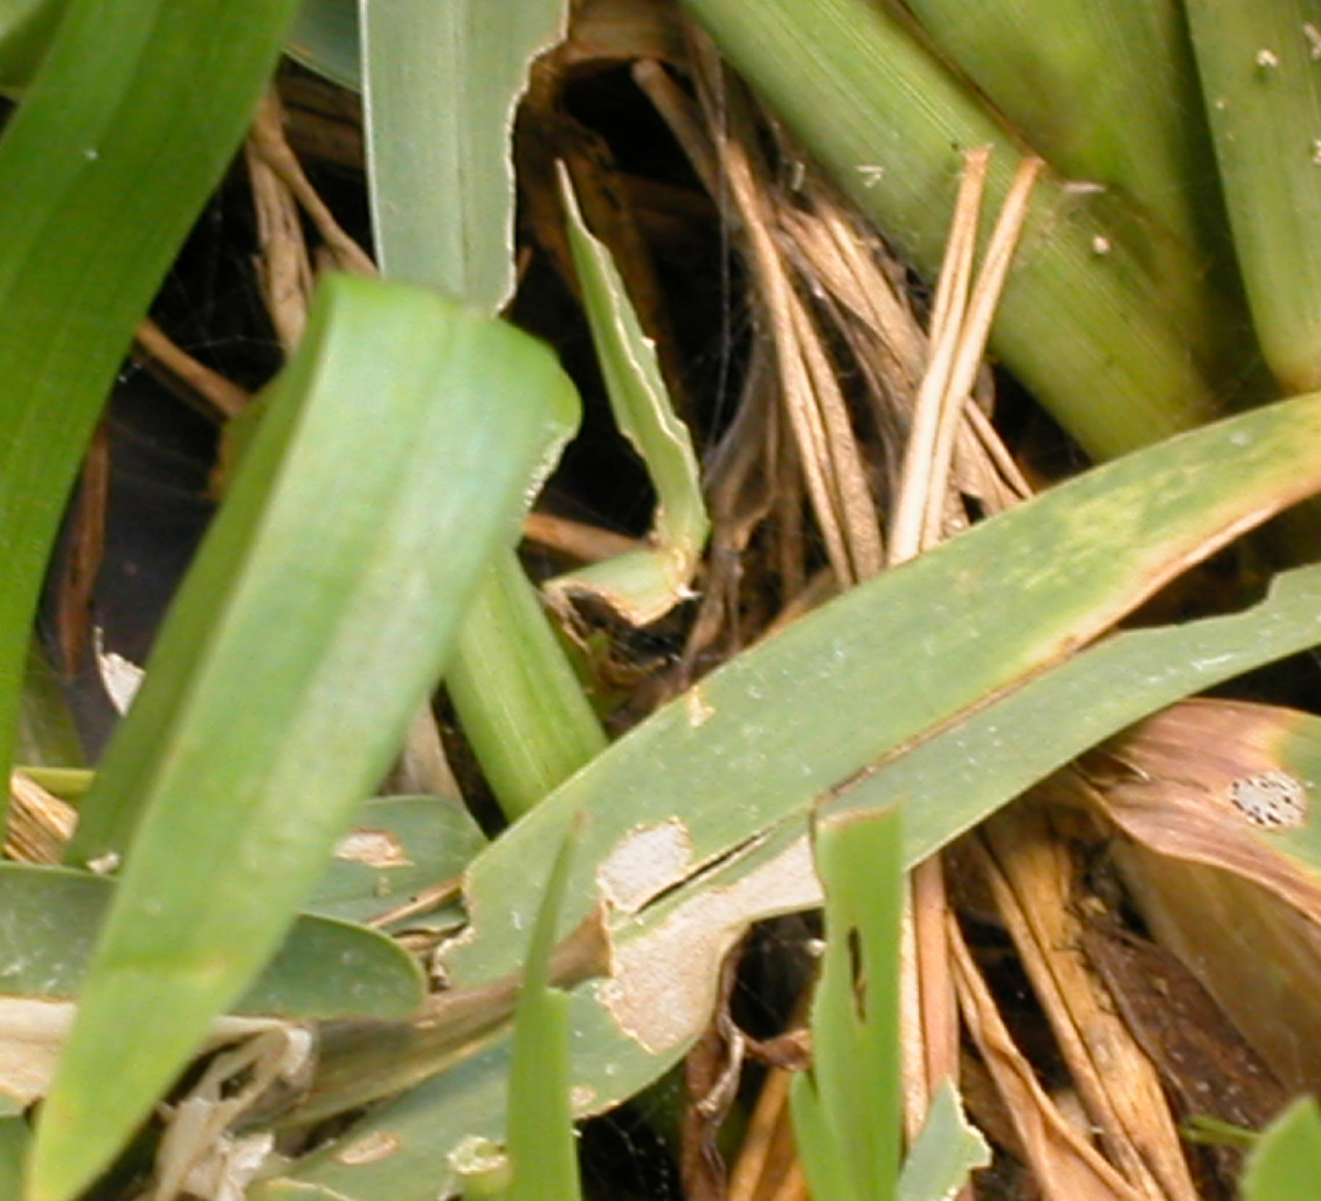
2004 Pesticide Update
Insecticides
Top Choice (fipronil)
mole crickets & fire ants
Conserve (spinosin)
caterpillars
armyworms
sod webworms
cutworms
Sod Webworm on St. Augustinegrass

Slide 94
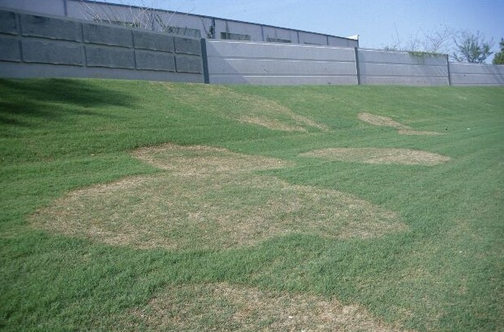
2004 Pesticide Update
Fungicides
Endorse
Brown Patch
Medallion (fludioxonil)
Brown Patch
Yellow Patch
Take-all Patch
Large patch disease on common bermudagrass

Slide 95
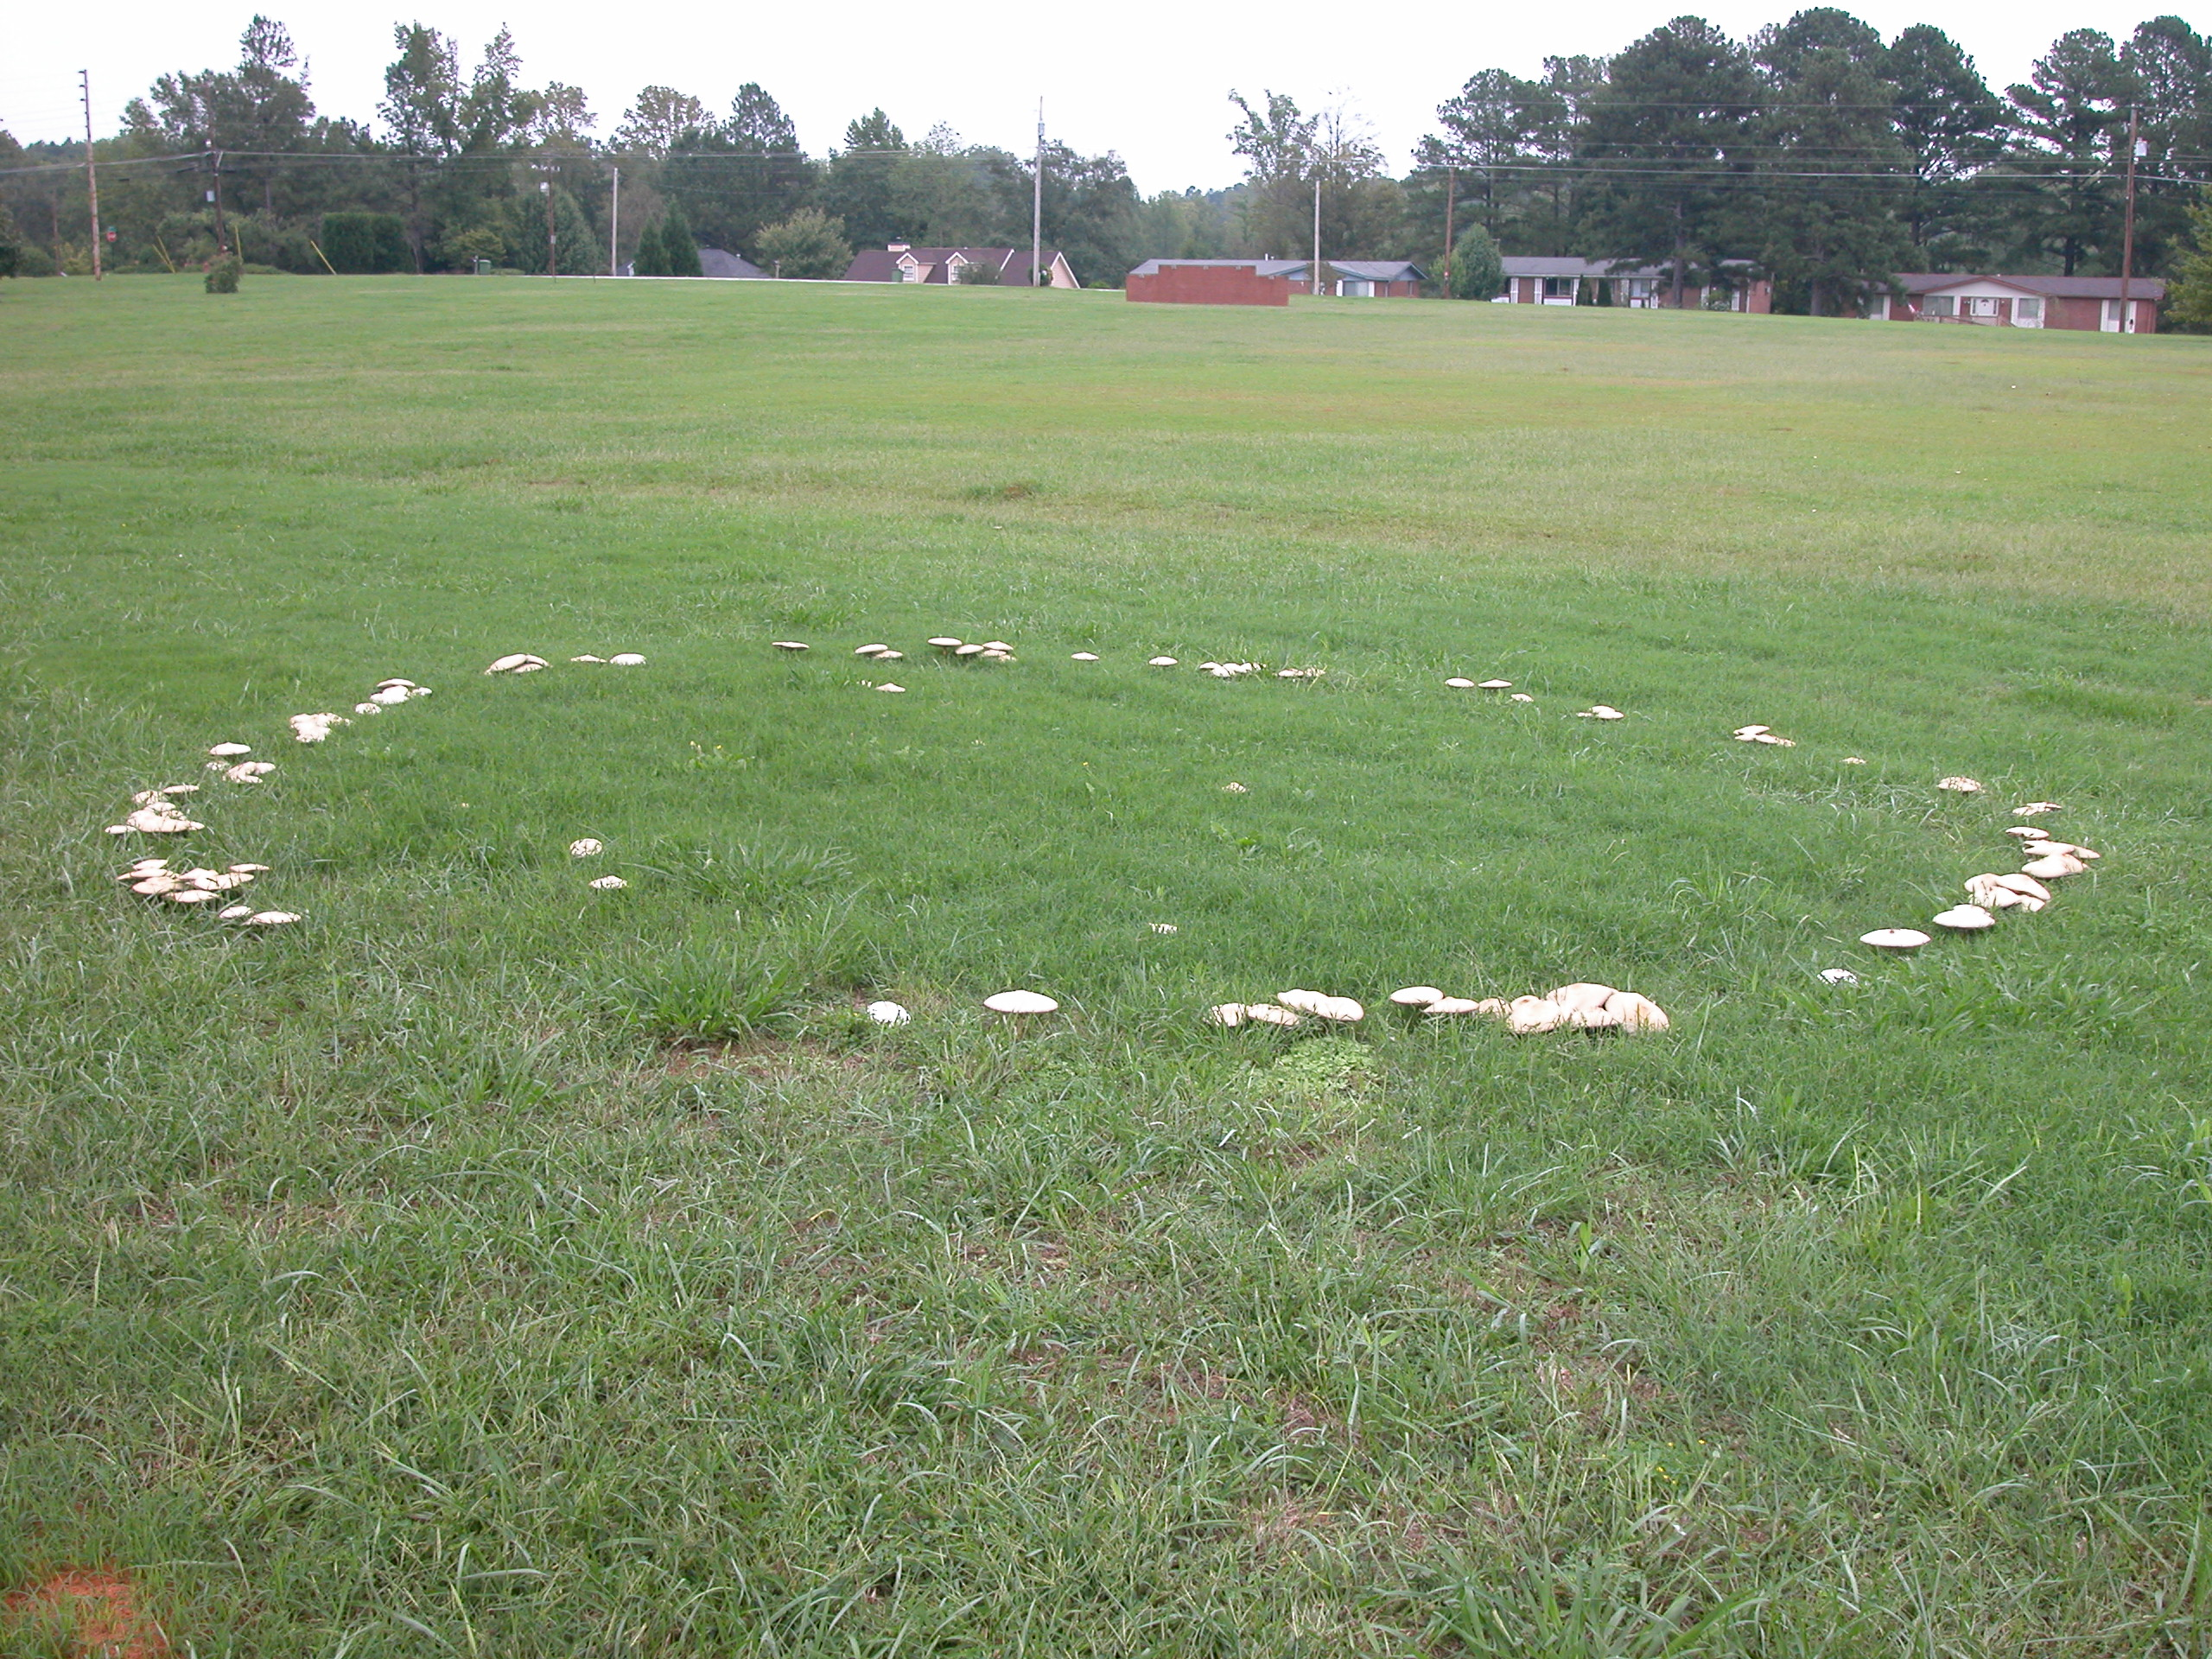
2004 Pesticide Update
Fungicides
Emerald (boscalid)
Dollar Spot
Bentgrass Dead Spot
Signature, Magellan, Vital, & Alude (phosphite)
Pythium
Fairy Ring on common bermudagrass

Slide 96
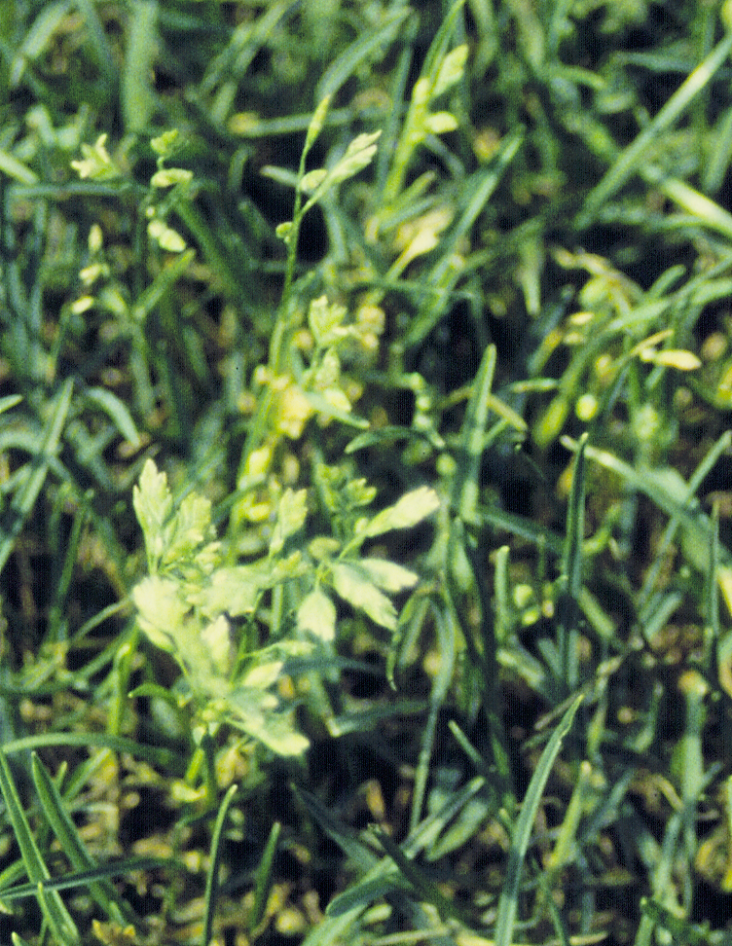
2004 Pesticide Update
Herbicides
Velocity (bispyribac-sodium)
Poa annua
Overseeded ryegrass
Monument (trifloxysulfuron)
registration pending
TranXit (rimsulfuron)
Annual Bluegrass

Slide 97
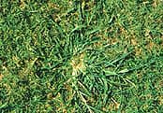
2004 Pesticide Update
Herbicides
Revolver (foramsulfuron)
Fall – Poa annua
Spring – transition
Summer - goosegrass
Katana (flazasulfuron)
Fall – Poa annua
Spring - transition
Goosegrass

Slide 98
Evapotranspiration & Drought Resistance

Slide 99
Evapotranspiration
Combined loss of water
Evaporation of water from the soil
Plant transpiration

Slide 100
Turfgrass ET Classification
Classification | ET Rate (in / d)
Very Low | 0.16
Medium | 0.24 – 0.27
Very High | 0.35
Beard, 1985

Slide 101
Turfgrass ET Rankings
Turfgrass | Mean ET (in / d) | Drought Resistance
Common Bermuda | 0.12 b | VH
Tifway Bermuda | 0.12 b | VH
Raleigh St. Augustine | 0.13 ab | H
Meyer Zoysiagrass | 0.14 ab | M-L
Rebel II Tall Fescue | 0.14 ab | M-H
K-31 Tall Fescue | 0.15 a | M
Centipedegrass | 0.15 a | H
Carrow, 1995

Slide 102
Turfgrass Irrigation

Slide 103
Irrigation Guidance
Water application based on soil or plant moisture status is more efficient than applying water based on a set schedule

Slide 104
Irrigation Guidance
Evapotranspiration (ET)
Soil water potential
Soil volumetric moisture status

Slide 105
Water Balance Eqn.
Estimates amount of moisture lost through ET
Irrigation applied to compensate for lost amount
Effective at conserving water resources when properly calibrated

Slide 106
Water Balance Eqn.
Soil Water = Rainfall + Irrigation – Runoff – ET – Drainage
Measure Runoff & Drainage???
Needs to measure ET
Weather station

Slide 107
Probe Guidance
Water Potential
Tensiometers
Volumetric Water Content
TDR & Capacitance Probes

Slide 108
When to Irrigate?
1st signs of water stress
Visual Symptoms
Guidance
Avoid Schedules

Slide 109
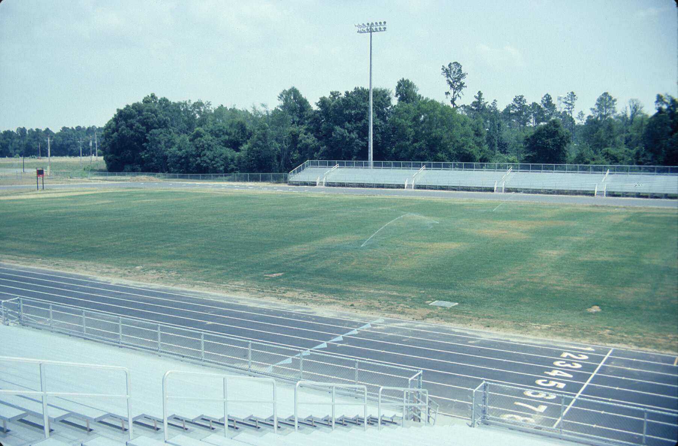
How Much to Irrigate?
Wet 6 to 8 inch depth
clay soils (1 to 1¾ inches per week)
sandy soils (½ inch, 3 times a week)

Slide 110
Water to Wet to a Depth

Slide 111
Cultural Practices
Proper Irrigation
only wets the turfgrass rootzone
does not saturate the soil
does not allow water to run off

Slide 112
Overseeding & Interseeding

Slide 113
Overseeding & Interseeding
Soil To Seed Contact
Existing vegetation
Soil Preparation
Fertilizer & Lime
Rake smooth
Firm soil surface

Slide 114
Overseeding & Interseeding
Timing – Environmental Window
Soil Temperature
70º F at 4 inches
4 – 5 consecutive days
Cool-season germination
Warm-season slow growth

Slide 115
Overseeding & Interseeding
Timing – Early Seeding
More rapid germination
Warm-season competition
More disease pressure
Problems with heat and desiccation

Slide 116
Overseeding & Interseeding
Ensuring Success
Raise mowing height
Leave clippings
Mow dry turf
Mark sprinkler heads, invisible dog fences, & etc.

Slide 117
What to do during in the off-season?
Planning
learn / read
mower repair
calibration
scouting
soil sampling

