Slide 1
Notes:
UGA Logo

Slide 2
www.ugaextension.com
Notes:
UGA Cooperative Extension Web address

Slide 3
Notes:
Georgia Master Gardener Logo

Slide 4
Basic Plant Pathology
Department of Plant Pathology
University of Georgia
Notes:
Author: Mila Pearce
Introduction Slide

Slide 5
Learning Objectives
Define plant pathology
Economic importance of plant diseases
Pathogenic and Non-pathenogenic diseases
Disease triangle
Fungal diseases, fungi reproduction and fungal infection
Viruses and how viruses are spread
How diseases are caused by nematodes
Notes:
Learning Objectives
After you complete your study of this chapter you should be able to:
Define the term plant pathology.
Understand the economic importance of plant diseases.
Understand the difference between Pathogenic and Non-pathenogenic diseases.
Understand the definition and concept of the disease triangle.
Have a basic understanding of how diseases are caused by fungi.
Know how fungi reproduce and factors necessary for fungal infection.
Have a basic understanding of how diseases are caused by bacteria and how bacterial caused diseases are spread.
Have a basic understanding of how diseases are caused by viruses and how viruses are spread.
Have a basic understanding of how diseases are caused by nematodes.

Slide 6
Disease Triangle
Host
Pathogen
Disease
Environment
Notes:
A convenient way of thinking about plant diseases is by using a concept called the "Disease Triangle". Disease represents the interaction between three factors (the three corners of the triangle): a susceptible host, a pathogen (disease causing organism) and a favorable environment. If all of these factors are present, disease results; if one or more of the factors is not present, then disease does not occur. Methods of disease control (which we'll discuss in greater detail later) can be thought of as modifying the disease triangle by reducing or eliminating one of the corners of the triangle. For example, if you use resistant ornamental varieties in your garden (e.g., a powdery mildew resistant phlox variety), you are eliminating the "susceptible host" and can thus reduce or prevent disease. Similarly, for some diseases, by removing diseased plant material, you can reduce or eliminate disease because you are eliminating the pathogen. Finally, you can reduce or eliminate a "favorable environment" for disease by doing something as simple as not over-watering in your garden.

Slide 7
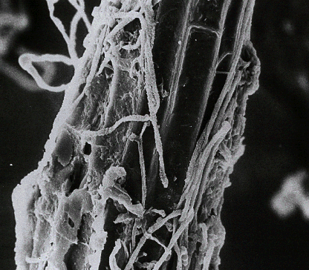
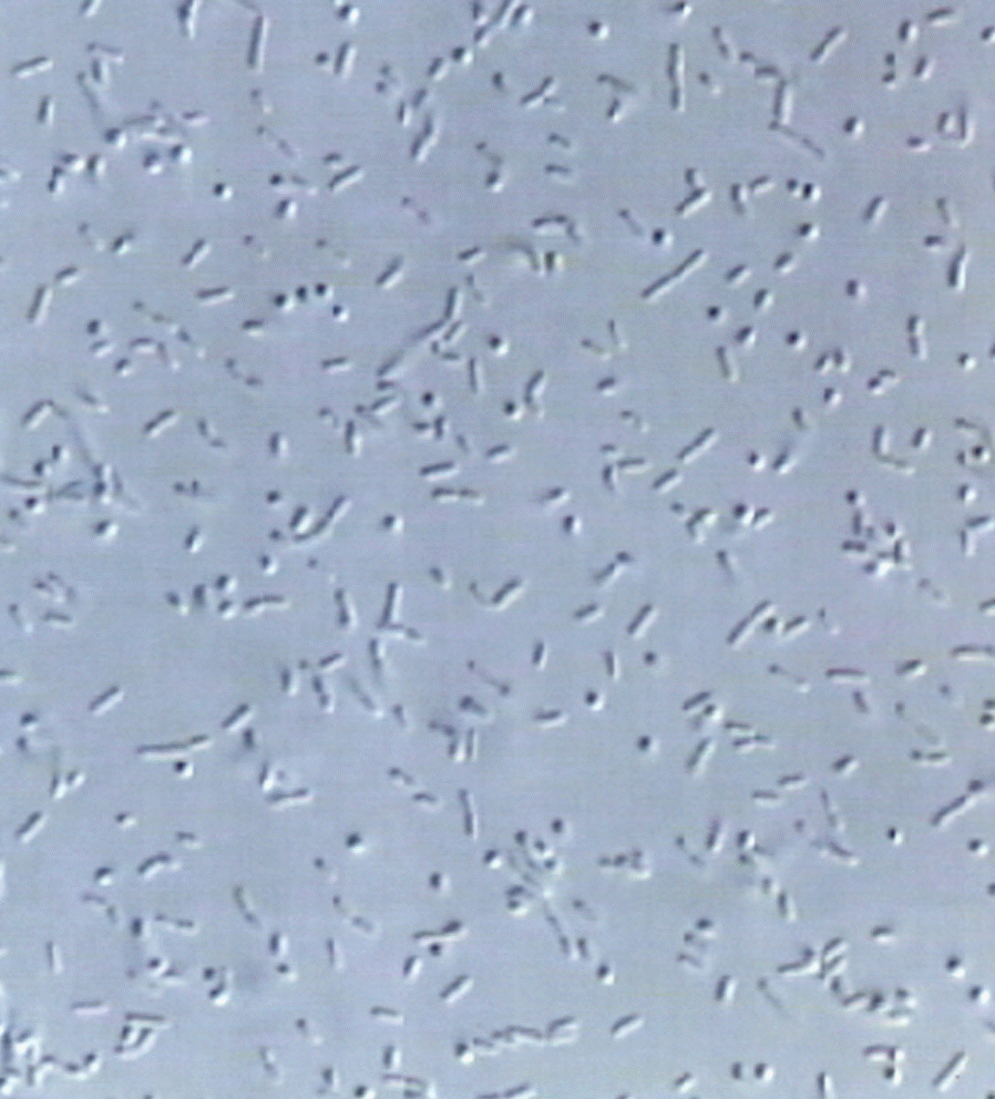
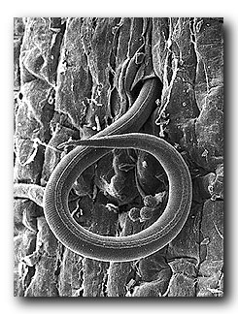
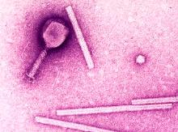
1
2
3
4
Notes:
Causes of plant diseases can be divided into two major categories: BIOTIC and ABIOTIC. BIOTIC causes of plant diseases are those that are biological in origin. There are four major biotic causes of plant diseases. These are the 1)fungi, 2)bacteria, 3)viruses, and 4)nematodes. ABIOTIC causes of plant diseases are non-biological in origin. Examples include things like adverse weather conditions or environmental pollutants. Often the affects of abiotic factors on plants are referred to as INJURIES. We'll now proceed to discuss in more detail each of the four biotic causes of plant diseases, as well as biotic causes.

Slide 8
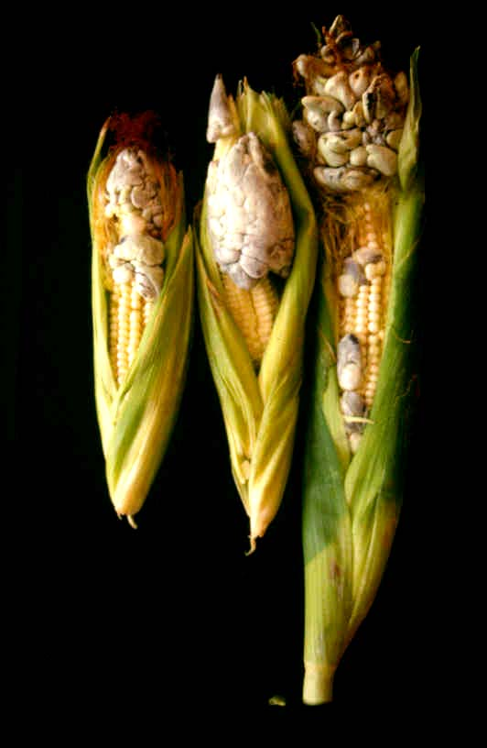
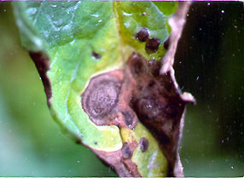
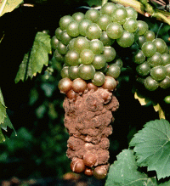
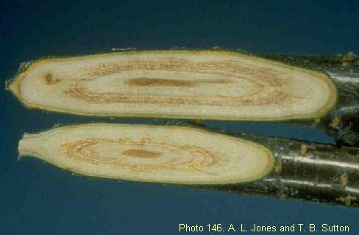
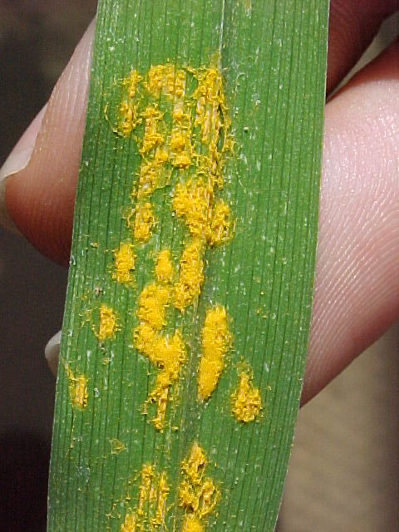
Notes:
Fungi are by far the most important group of plant pathogens. There are over 200,000 known species of fungi and over 8,000 species can cause plant diseases. Note that the majority of fungi are NOT plant pathogens. These fungi, which primarily survive on non-living organic material, are called SAPROPHYTES. Many fungi (including some plant pathogens) can be seen with the naked eye. Typically however, you are not seeing the major "body" of the fungi, but simply a reproductive structure (e.g., a mushroom). The non-reproductive "body" of most fungi (called the vegetative phase) is composed of a mass of a fungal threads called HYPHAE (singular = HYPHA). This mass of hyphae is called a MYCELIUM (plural = MYCELIA). While an individual hypha is microscopic, mycelia are often visible with the naked eye. Fungi reproduce by production of spores that can be a variety of shapes and colors. They are produced in a wide variety of reproductive structures that, in general, are referred to as FRUITING BODIES. Most fungal plant pathogens (except for a few that produce mushrooms) form fruiting bodies that are microscopic in size. Because characteristics of fungal spores and fruiting bodies are what help us identify fungi, accurately diagnosing a fungal disease without a microscope can be difficult, if not impossible.

Slide 9
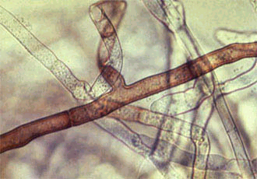
Notes:
HYPHAE (singular = HYPHA) are the threadlike structures that comprise the major body of a fungus. You can think of a hypha as a long tube. Many hyphae in a mass are called MYCELIUM (plural = MYCELIA). Most fungi produce hyphae, as the one shown here, that have CROSS WALLS (partitions dividing the tubes into individual cells). Noting the presence or absence of cross walls can be important in distinguishing and identifying some plant pathogenic fungi. The location of the cross walls can also be diagnostic. In this example the cross walls at a branch in the hyphae are offset a bit (see the arrow) giving the resulting cell a T-shape. This configuration of cross walls is characteristic of the fungus Rhizoctonia, which is a common root rot fungus.

Slide 10
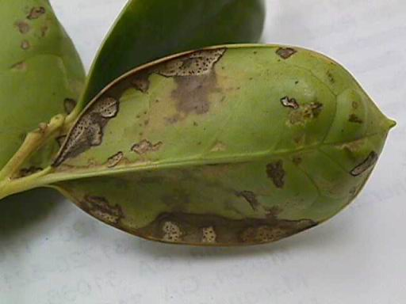
Notes:
Fungi produce a wide range of reproductive structures (generically called FRUITING BODIES). The small black blobs in this photo are fruiting bodies (called pycnidia in this case). Within fruiting bodies, a fungus produces spores. Some fruiting bodies are asexual in nature. The spores produced in these fruiting bodies are NOT the result of recombination of genes from more than one fungal "parent". The spores are produced by a single fungal "parent" and thus when these spores germinate, they produce "offspring" that are genetically identical to the "parent" fungus.

Slide 11
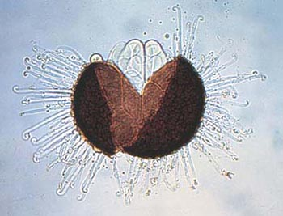
Notes:
While some fruiting bodies are asexual in nature, others are produced sexually. The fruiting body in this photo is called a cleistothecium, and is the sexual fruiting body of a powdery mildew fungus called Uncinula. The spores produced in sexual fruiting bodies result from the recombination of genes from two fungal "parents". When these spores germinate, they produce "offspring" that are genetically different from both "parents"

Slide 12
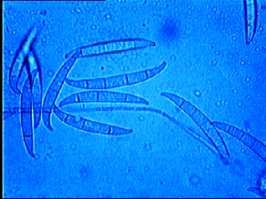
Notes:
In addition to being interested in the kind of fruiting bodies produced by plant pathogenic fungi, diagnosticians are also very interested in the types of SPORES that are produced in these fruiting bodies. Fungal spores can be thought of as the "seeds" of the fungus, although spores are much less complex that true seeds. Fungal spores come in all shapes and sizes. Some, like these spores of the fungus Fusarium, are multi-cellular (have more than one cell) and are colorless. The canoe or banana shape of these cells is also characteristic of this particular fungus.

Slide 13
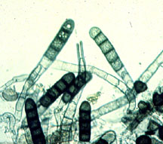
Notes:
Other fungi, such as the fungus Thielaviopsis in this photo, produce spores that are multi-cellular, but darkly pigmented. Dark pigmentation is thought to enhance the ability of spores to survive exposure to adverse environmental conditions, such as exposure to ultraviolet light, and to ward off attack by other parasitic soil fungi and bacteria.

Slide 14
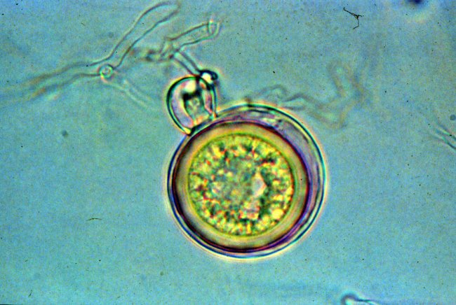
Notes:
Spores typically function as a means of reproduction and dispersal for a fungus. They can also serve as a means of survival during periods of unfavorable environmental conditions. The spores (called oospores) in this photo are those of a common root rot fungus called Pythium. Note that these spores have very thick walls that help prevent loss of water, and serve as a barrier to prevent attack by other microorganisms. Spores of this type have been reported to survive for 40 years in soil.

Slide 15
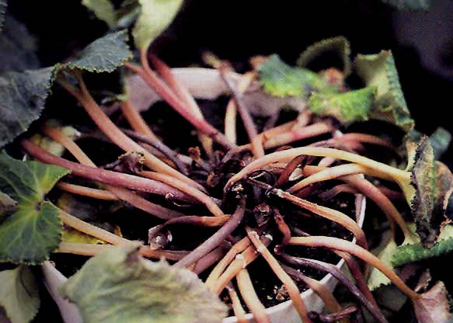
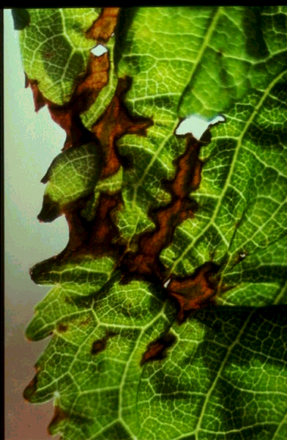
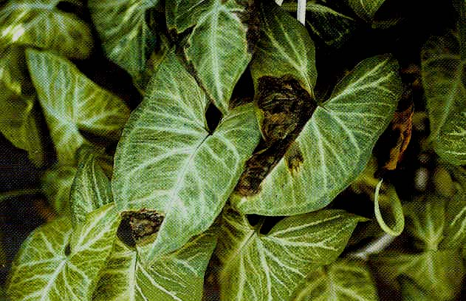
Notes:
Bacteria are arguably the second most important group of plant pathogens. There are approximately 200 pathogenic species. Unlike fungi, bacteria are not visible to the naked eye and can only be seen using a microscope. Also, compared to fungi, bacteria are extremely simple. They are unicellular (single-celled), although certain bacteria have cells arranged in structures that are physically (but not functionally) similar to fungal hyphae. Reproductively, bacteria are also very simple. They do not form complex fruiting bodies, but reproduce by the process of BINARY FISSION. In this simple process, existing cells enlarge, and then divide in half. The two cells that result from this process are genetically identical to each other and to the parental cell from which they have arisen. Bacterial diseases are virtually impossible to identify definitively based on symptoms. Typically, in order to identify bacterial pathogens, the bacterium must be isolated from diseased tissue and then grown on specialized media. Alternatively, bacteria can also be identified using immunological techniques.

Slide 16
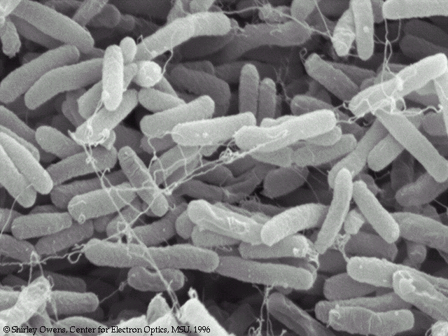
High magnification 400X
Very High magnification
Electron microscopy
Notes:
Bacterial cells are extremely small. Even when magnified to 400 times their normal size (as they are in this photo) they are difficult to distinguish as individual objects. Often one must stain the cells (as in this photo) to see them. In general, bacterial cells tend to be either spherical or rod-shaped (as these are). Most plant pathogenic bacteria produce rod-shaped cells.

Slide 17
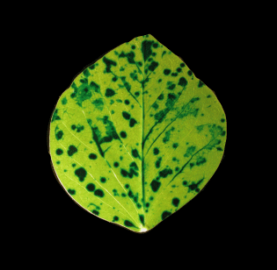
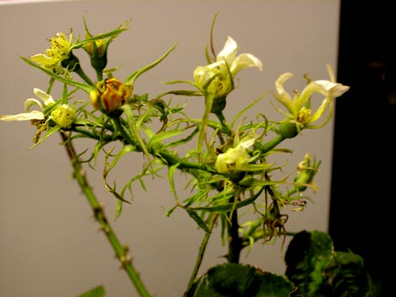
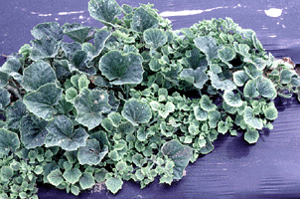
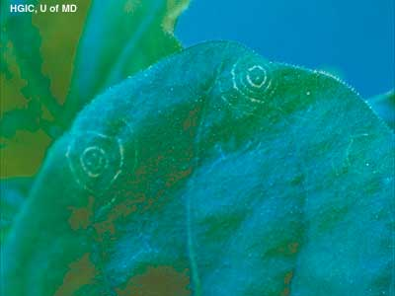
Notes:
Viruses are another very common and very important cause of plant diseases. While bacteria are small, viruses are even smaller. Bacteria can be seen with a light microscope, but viruses can typically only be seen using an electron microscope. Viruses are also much simpler structurally than bacteria. Bacteria have true cells. Viruses do not. Most viruses are composed of a piece of genetic material with a protein coat. Viral genetic material can be either deoxyribonucleic acid or DNA (the same kind of genetic material found in human cells), or ribonucleic acid or RNA. Most known plant viruses contain RNA. Because viruses are so simple, they do not have the "machinery" necessary to reproduce. Thus after infecting a cell, they "hijack" the cell and force it to produce viral particles. Viruses can be transmitted (moved from plant to plant) in several ways. Many are mechanically transmitted. These viruses can be moved about by a grower handling an infected plant, then handling a healthy plant, or simply by two plants rubbing together. Other viruses are transmitted by insects (these insects are called VECTORS). These viruses are picked up by the insects as they feed and then are moved from plant to plant as the insects move from plant to plant. Some insect-transmitted viruses actually reproduce in the insect vector as well as in the plant host

Slide 18
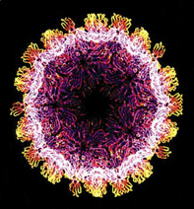
Notes:
As noted previously, viruses can only really be seen using an electron microscope. This photo shows a viral particle magnified about 100,000 times. Plant viruses can also be rigid or flexuous (flexible) rods

Slide 19
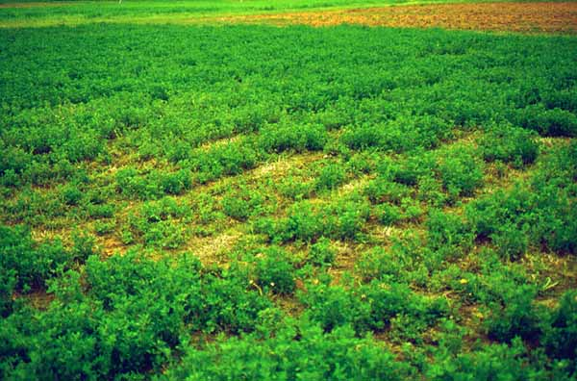
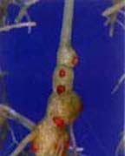
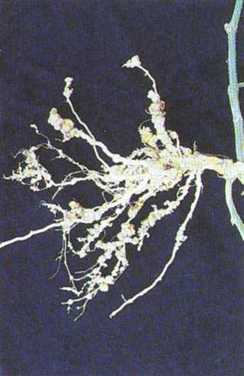
Notes:
Nematodes represent the final, major group of plant pathogens, and these organisms rival, if not exceed, fungi in their complexity. Nematodes are very large compared to other pathogens and can be readily seen with a light microscope and on occasion with the naked eye. They have sensory, digestive, and reproductive organs. Nematodes reproduce through production of eggs, and go through several juvenile phases prior to becoming adults.

Slide 20
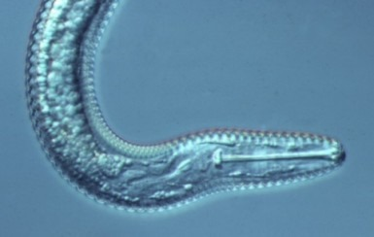
Notes:
With proper training, nematodes can be easily identified once they have been extracted from soil or infected plant material. The major problem in identification is that plant pathogenic nematodes are often intermixed with non-plant pathogenic nematodes. Typically, non-pathogenic nematodes dramatically outnumber pathogenic nematodes in such a mix. In order to help distinguish pathogenic from non-pathogenic nematodes, look for a STYLET. A stylet is a modified tooth that helps a nematode puncture and feed on plant tissue

Slide 21
Plant Problems Not Caused by Disease
Cultural
Environmental
Notes:
Many plant problems which initially appear to be disease-related often turn out to be cultural or environmental problems.

Slide 22
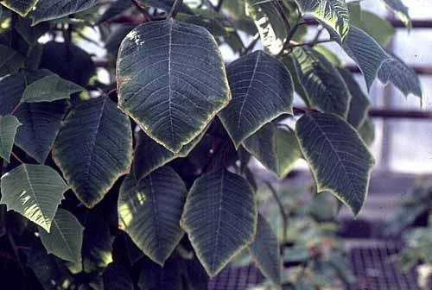
Notes:
Often nutrient abnormalities show up as DISCOLORATIONS of foliage. Common discoloration symptoms include YELLOWING or CHLOROSIS, and REDDENING. Noting the pattern of yellowing or other discoloration can sometimes provide clues as to the type of abnormality. In this photo of a poinsettia, yellowing has occurred along the margins of the leaf and is due to a lack of molybdenum, a minor plant nutrient. General yellowing of foliage may indicate a lack of nitrogen. If leaf veins remain green, and leaf blades turn yellow, then an iron or manganese deficiency may be the problem. Reddening of foliage may indicate a phosphorus deficiency.

Slide 23
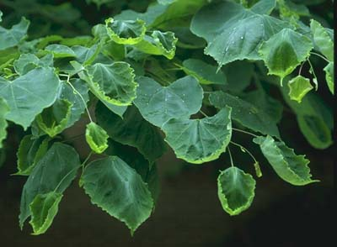
Notes:
With an increase in the number of herbicides being used on lawns by homeowners and lawn care professionals, the incidence of accidental exposure of non-target plants to these herbicides has also increased. Common symptoms of herbicide exposure include CURLING and CUPPING.

Slide 24
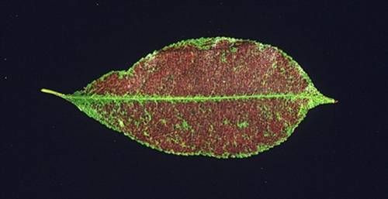
Notes:
Contaminants in water or the air can also affect plant health. These pollutants can cause a wide range of symptoms, many of which may look like damage caused by nutrient abnormalities or even insect damage. In this photo, the reddening symptoms of this Prunus are due to severe ozone injury.

Slide 25
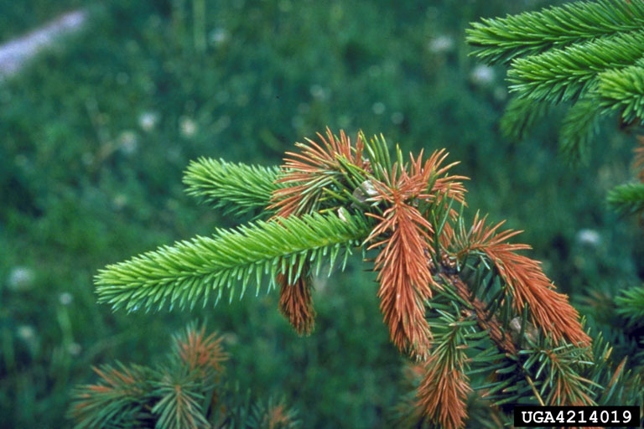
Notes:
Extremes of weather can also lead to plant injury. Common weather-related injuries include COLD INJURY shown in this photo on spruce. As the new branch tips (candles) began to expand, the tree experienced a period of cold that was severe enough to kill the growing tips. To correctly diagnose this kind of injury, you must remember to ask a grower when during the season symptoms first appeared and whether any unusual weather occurred just before the onset of symptoms.

Slide 26
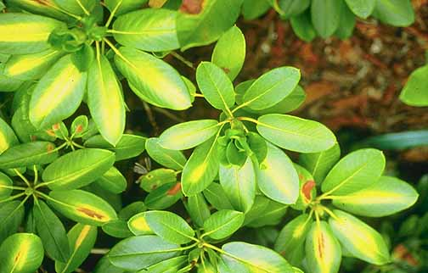
Notes:
On the other end of the spectrum are HEAT INJURIES. In this case, the temperature and sun on the rhododendron got high enough to lead to tissue damage. As with COLD INJURY, knowing the weather conditions prior to the onset of symptoms can be critical in identifying the cause of this disorder.

Slide 27
Cultural Disease Controls
Avoiding the pathogen
Buy seed from a reputable source
Inspect plants prior to purchase
Control alternate hosts
Notes:
DISEASE CONTROL - CULTURAL CONTROL
Typically the most common way in which homeowners attempt to control plant diseases is through the use of CULTURAL CONTROLS. Cultural controls involve ways in which you can modify how you grow your plants in order to reduce or eliminate disease. One general area of cultural control is to avoid the pathogen.
AVOIDING THE PATHOGEN
Pathogen avoidance may seem difficult, but there are several straightforward ways in which you can accomplish this.
BUY SEED FROM A REPUTABLE SOURCE.
Many plant pathogens, particularly viral and bacterial pathogens are carried on seed. Therefore using clean seed to start can help minimize disease problems later on. If possible, buy seed that is certified as disease or pathogen-free. Certification doesn't guarantee that there are absolutely no pathogens in the seed, but does indicate that the seed has been produced in a manner that will minimize the likelihood of pathogens being present. Often certified seed is produced in dry areas (e.g., in the western USA) where pathogens typically don't grow well. Certified seed is also tested for pathogens during the certification process and meets some set of standards for the percentage of seeds that may be infected with a given pathogen. If you buy certified seed, you should ask for information on where the seed was produced, what pathogens it has been tested for and what the testing standards are.
INSPECT PLANTS PRIOR TO PURCHASE
When buying transplants, check before you buy to make sure that the plants look healthy. Do not buy obviously diseased or unthrifty plants. In addition to looking at leaves, stems and branches, try to get a look at the plants’ root systems. Look for root browning that might be an indication of a root rot or nematode problem.
CONTROL ALTERNATE HOSTS
Many pathogens are able to attack more than one host. If you have chronically had problems with a particular disease, check to see if the causal pathogen has other hosts. Do not plant any host for the pathogen in the affected area of your garden. Also learn about potential weed hosts and keep these under control. Control of alternate hosts will prevent the build-up of a pathogen and can often reduce the time that you need to wait before replanting a desirable ornamental back into a problem spot

Slide 28
Cultural Disease Control
Avoiding conducive environmental conditions
Moderate soil moisture
Reduce humidity
Fertilize plants properly
Be aware of activities surrounding your plants
Notes:
AVOIDING CONDUCIVE ENVIRONMENTAL CONDITIONS
Recall that a favorable environment is one of the three sides of the disease triangle. Eliminating a favorable environment can eliminate or dramatically reduce disease. Once again, you may not feel that you have much control over environmental conditions. However there are several, easy techniques that you can use to modify the environment in your garden so that it is less favorable for disease development.
MODERATE SOIL MOISTURE
Perhaps the most common disease problem seen in the Plant Disease Diagnostics Clinic is that of root rot. While you can't stop the rain from coming, you do have control over how often and how much you water during dry periods. DON'T OVER-WATER. Provide enough moisture to prevent your plants from experiencing water stress, by don't continue to water once plants have received what they need. In addition, be careful not to over-mulch. Mulch tends to help retain water and a layer greater than three inches thick is not needed or recommended, and can be detrimental.
REDUCE HUMIDITY
Infection by many plant pathogens is favored during periods of high humidity, which in turn leads to extended periods when leaves are wet. The longer the leaf wetness period, the more likely infection will occur. Moderation of soil moisture is one way of reducing humidity. Less water in the soil means less water evaporating and contributing to air humidity. Also, don't plant ornamentals too close together. Crowded plants tend to reduce air movement, which in turn tends to lead to higher humidity and longer periods of leaf wetness.
FERTILIZE PLANTS PROPERLY
Balanced nutrition can have a big impact on plant health. Plants with nutrient deficiencies tend to be more susceptible to infection than those with a proper nutrient balance. On the other hand, be careful not to over-fertilize, particularly with nitrogen. Plants with excess nitrogen tend to produce fast-growing, succulent growth, and this tissue can be more susceptible to infection by some pathogens.
BE AWARE OF ACTIVITIES SURROUNDING YOUR PLANTS
Be aware of any potential sources of pesticides or environmental pollutants that might adversely affect your plants. Take action to minimize the impact of these factors

Slide 29
Cultural Disease Controls
Sanitation
Disinfest tools
Remove diseases plants promptly
Remove scenescent plant parts promptly
Notes:
SANITATION
Keeping your garden, work areas and tools clean is a fundamental and important means of pathogen/disease control. DISINFEST TOOLS
In general, you should make a habit of cleaning and disinfesting your gardening tools when moving from area to area in your garden. This can be particularly critical when you have been working in an area where you have historically had disease problems. It is also important to disinfect pruning shears as you move from tree to tree or from shrub to shrub. Sometimes you may even want to disinfest pruning shears between cuts on the same tree or shrub. By disinfesting your tools, you reduce the chance of moving pathogens from place to place in your garden.
To disinfest tools, use a 10% bleach solution, alcohol or another disinfectant. Often people ask whether Lysol spray will work. It should because the major ingredient is alcohol.
REMOVE DISEASED PLANTS PROMPTLY
Diseased plants can serve as a source of inoculum for other plants. Therefore removing infected plants can reduce disease by reducing inoculum.
REMOVE SCENESCENT (DYING) PLANT PARTS PROMPTLY
Several pathogens (in particular Botrytis, a common fungal pathogen on ornamentals) have difficulty directly infecting healthy plant tissue. They can however, readily infect scenescing (dying) tissue. In particular, petals that are withering and falling off are prime targets for infection. Once these pathogens have a foothold in senescing tissue, they can then much more easily infect healthy tissue. Greenhouse growers often see Botrytis leaf infects where a withered petal has fallen onto a leaf. The fungus is able to infect the withered petal, then uses this as a food base to attack the leaf. Removal of senescing tissue can significantly inhibit development of this disease, by preventing initial infections.

Slide 30
Chemical Disease Control
Fungicides, bactericides, nematicides
Protectants
Systemics
Fumigants
Notes:
Another method of controlling plant diseases is by use of chemical pesticides such as fungicides (for control of fungi) and bactericides (for control of bacteria) and nematicides (for control of nematodes). Viruses cannot currently be controlled using chemical pesticides. Fungicides and bactericides fall into two major groups.
PROTECTANT fungicides are those that are applied to the surface of a plant and must coat the surface to be effective. Protectant fungicides are NOT absorbed by the plant. They form a chemical barrier between the pathogen and the plant. Good coverage is critical for protectant fungicides to be effective.
SYSTEMIC fungicides are absorbed by the plant and redistributed internally. Thus even coverage is not as critical as with protectant fungicides. Systemic fungicides tend to remain effective for a longer period than protectant fungicides, because they are less likely to wear or wash off the plant, and have less exposure to environmental factors that may lead to degradation.
FUMIGANTS are another type of compound used for control of pathogens, particularly pathogens found in soil. Fumigants are general biocides. They are toxic to all kinds of biological organisms including pathogens, non-pathogens, insects, weeds, and even desirable plants and animals. I do not recommend use of fumigants in urban settings.

Slide 31
Resistant Plants
ASK QUESTIONS!!!!
Which disease?
Are diseases in your area?
Has it been tested?
PLANTS MAY LOSE RESISTANCE
Notes:
While common in agricultural settings, disease resistant plants are less common in ornamental crops. When disease resistant varieties are available, choose them carefully. Ask questions. To which diseases is this variety resistant? You want to choose varieties that are resistant to the diseases common in your area. How was the resistance tested? You should look for disease resistance that has been tested in several sites, over several years and under a variety of weather conditions. Plants tested in this manner are more likely to be resistant in your garden, under your environmental conditions, than those tested for a single year and in a single site. Keep in mind that disease resistance is relative. Some plants that are resistant under certain environmental conditions will not be resistant under other, more extreme environments. Prime examples are powdery mildew resistant Phlox varieties. In a normal year, these varieties exhibit a high level of powdery mildew resistance. However, during extremely wet years, these varieties may not perform that differently from powdery mildew susceptible varieties. Also keep in mind that resistance is not forever. Varieties that are resistant today, may not (and probably will not) be resistant many years down the road. Pathogens are very plastic. Once resistant varieties are introduced, these varieties tend to select for variants (sub-populations) of the pathogen that can overcome the resistance. Fighting diseases using resistant varieties is an ongoing battle.

Slide 32
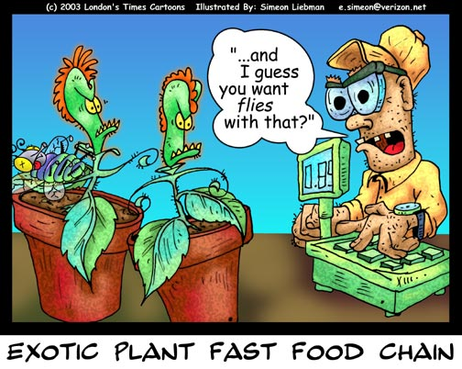
Notes:
The End with a cartoon.

Slide 33
Questions
Notes:
Discussion Questions
1. How can Plant Pathology be defined?
2. What are the two types of plant diseases?
3. What three factors are required for a pathogenic disease?
4. What are the properties of fungi?
5. Describe the reproductive process of fungi.
6. What are some ways in which a fungus enters a plant?
7. How do bacteria differ from fungi?
8. How are viruses spread?
9. What are nematodes and how can they cause plant disease?
10. How can plant diseases be controlled?

