Slide 1
Notes:
UGA Logo

Slide 2
www.ugaextension.com
Notes:
UGA Cooperative Extension Web address

Slide 3
Notes:
Georgia Master Gardener Logo

Slide 4
Basic Botany
The Science of Understanding Plants
Their Classification, Form and Function
Information prepared by
Jim Midcap, Extension Specialist
University of Georgia
Notes:
Basic Botany
Welcome to the Basic Botany Section
We will be talking about Basic Botany, the science of understanding plants. Botany includes plant classification, form, function and more.

Slide 5
Learning objectives
Basic plant parts -types of plant parts
Vascular tissue & function
Cambium & function
Dicots & monocots
Binomial nomenclature
Notes:
Learn to identify the basic plant parts and types of plant parts: stems, leaves, buds, flowers, fruit, and roots.
Understand what the vascular tissue is and its function in the plant.
Understand what the cambium is and its function in the plant.
Understand the difference between and dicots and monocots.
Develop an appreciation for the necessity and benefits of binomial nomenclature.

Slide 6
Basic Botany Areas
Plant Taxonomy
– Plant identification, naming and classification
Plant Morphology
– Plant form and anatomy
Plant Physiology
– Plant functions and reactions
Notes:
Basic Botany Areas
The basic areas of botany include the following.
Plant taxonomy deals with plant identification, their names and classification. Plant taxonomists are frequently called upon to identify unknown plants. They must put a name on the plant. Names can include common names as well as botanical names. We often want to know how closely plants are related to each other.
Plant morphology deals with the many forms of plants and their parts. The many different forms of the stems and roots are included as well as the differences in groups of cells. We frequently deal with differences in flowers, fruits, roots, shoots, leaves and seeds. These differences are easy to see.
Plant Physiology examines the functions of the plant parts as well as their chemical reactions. Photosynthesis is the production of plant food that keeps the plants alive as well as the rest of our world.

Slide 7
Common Names - Nomenclature
Common Names – Easy to use & remember
Here is the Tulip Tree with flowers shaped like tulips
Also called Saucer Magnolia and Japanese Magnolia
There are several names for the same plant
Magnolia × soulangeana
Notes:
Common Names - Nomenclature
Plant Nomenclature deals with naming plants and their classification.
We commonly use common names when discussing plants. Common names are given to plants over time and passed along to others until they become accepted. Common names are easy to use and remember because they are associated with some character of the plant.
The photo shows the flowers of a plant called tulip tree, named because of the shape of the flowers. This plant bloom early in spring before the leaves. It is susceptible to spring frosts and frequently the flowers are killed and turn brown.
The tulip tree is also called saucer magnolia in the Northeast and Japanese magnolia in south Georgia. We have a plant (Magnolia x soulangeana) with three common names. Therefore, I may have to learn more than one name for a particular plant. If I visit other areas or countries, they may have a different name for this plant.

Slide 8
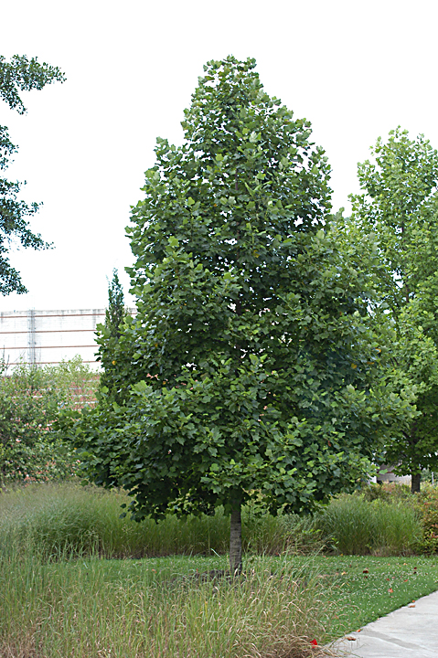
Common Names - Nomenclature
Here is another Tulip Tree with leaves shaped like tulips
Other common names are Yellow Poplar & Tulip Poplar
There are two different plants with the same common name
There are no rules to determine which name is correct
However, each has only one botanical name
Liriodendron tulipifera
Notes:
Common Names - Nomenclature
You may also know the tree in the photo as tulip tree. It is one of our common native trees. The leaves are shaped like tulips and the late spring flowers are orange with yellow spots in the high tops of large trees.
This tree is also called yellow poplar and tulip poplar. It has three common names.
Now we have two different plants with the same common names. How do we determine which is correct? How do we decide on a single name for each plant?
The problem is that there are no rules or guidelines to standardize common names. We are stuck with all the names and can choose which one we want to use. However, the other names will still be used .
The solution when we need to be specific in naming a plant is to use the one botanical name for the plant. I often need to be specific when ordering a plant, when developing a landscape plan, or when seeking information on plant care or pest control.

Slide 9
Botanical Names - Nomenclature
Botanical Names – Applied by botanist using the International Code of Botanical Nomenclature
They seem difficult to learn & use since they are written in Latin
They are precise – one name for each plant following the International Code
The names also reflect the classification of the plants, or how they are related
They follow the binomial system of nomenclature
Notes:
Botanical Names - Nomenclature
Botanical names are applied by botanist using a set of international rules, so that the same name is applied world wide. They use a set of rules called the International Code of Botanical Nomenclature that specify how the names are developed and applied.
These botanical names are Latin names as specified in the rules. They seen difficult to learn and use at first. They seem very difficult to pronounce.
These botanical names are precise, since there is only one correct name for each plant. Botanical names occasionally change, as new botanists review the rules and find they were not applied correctly in the past.
The botanical names also reflect the classification or the relationships between plants. All the oaks are placed together as well as the maples, birches and members of the olive family.
Botanical names follow a binomial system of naming as specified by the International Code. This system is used for all plants.

Slide 10
Binomial System of Nomenclature
Binomial – Two name system of naming plants
Genus is first name
Species is second name
Botanical Name – Fothergilla major
Based on Species Concept – Populations of interbreeding plants
Fothergilla major
Notes:
Binomial System of Nomenclature
The binomial system of nomenclature is a system of applying two parts to each complete name. It works like people names except, last name first.
The genus is the first name and the plural is genera. The genus is the broadest and can contain many species, the second name. The botanical name is made up of these two parts, the genus and species. The photo shows the plant known as Fothergilla major. The genus is capitalized and italicized while the species in not capitalized but is still italicized. Both must be used together to name a plant.
The plants that are included in a species must be very similar and satisfy the species concept. This concept is based on populations of plants that are capable of inter breeding. If they don’t interbreed, they are generally considered a separate species.
Fothergilla major (common name big leafed fothergilla) is a native of Georgia and is becoming a common landscape plant. It is a deciduous shrub, four to six feet tall, fragrant, white spring flowers, gray green summer foliage, with red-orange-yellow fall color.

Slide 11
Classification of Plants
Families are made up of groups of related genera
Each genus is made up of species
Each species is a group of similar plants that are capable of interbreeding
Oak Family – Fagaceae Includes
Quercus alba – White Oak
Quercus rubra –Red Oak
Fagus grandifolia – Beech
Castanea dentata – American Chestnut
Notes:
Classification of Plants
Gardeners usually are interested in the family classification of plants, as well as the genus and species. Plants is the same family often share similar characteristics. Many members of the rose family are susceptible to fire blight.
The oak family is called Fagaecea and is made up of the genera Quercus (oak), Fagus (Beech) and Castanea (Chestnut) which are all related. Each genus is made of different species such as Quercus alba and Q. rubra. And of course the plants is a species group are similar in appearance and are capable of interbreeding. All the plants of a species are not exactly the same. There can be quite a bit of variation between plants in a species.

Slide 12
Hybrids & Their Nomenclature
Inter-specific Hybrids – crosses between species Example: (Clematis lanuginosa × C. viticella) Cross Named: Clematis × jackmanii Common Name: Jackman Clematis
Inter-generic Hybrids – crosses between genera Example: (Cupressus macrocarpa × Chamaecyparis nootkatensis) Cross Named: × Cupressocyparis leylandii Common Name: Leyland Cypress
Notes:
Hybrids & Their Nomenclature
Occasionally hybrids develop between species and genera. This may happen in nature, gardens or due to efforts of plant breeders. It is rare between species and very rare between genera. Special rules apply for the naming of these hybrids.
Inter-specific hybrids occur as crosses between species, for example Clematis lanuginosa is crossed with C. viticella. The resulting hybrids are given a new species name proceeded with a multiplication sign, indicating a crossing of two parents. The new plants were named Clematis × jackmanii or Jackman clematis.
The inter-generic hybrids occur as crosses between genera, for example Cupressus macrocarpa has crossed with Chamaecyparis nootkatensis. The resulting hybrids were given a new genus and species name. The new genus is proceeded with a multiplication sign, indicating a generic cross. The new hybrids were named × Cupressocyparis leylandii, called Leyland Cypress. The genus name is a combination of the parents generic names.

Slide 13
Cultivars – Cultivated Plants
Cultivars are developed, named & maintained by man
Using the International Code of Botanical Nomenclature for Cultivated Plants
Cultivar names are fancy names (non-Latin names)
Made up of one, two or three words
Cultivar plant names include genus, species & cultivar
Acer rubrum ‘October Glory’
Notes:
Cultivars – Cultivated Plants
Today we lots of cultivars (cultivated varieties) in the nurseries and garden centers. These cultivars were developed and named by nurserymen, plant breeders and even gardeners. New cultivar plant names must be published and applied according to the International Code of Botanical Nomenclature for Cultivated Plants.
The plant on the right, Acer rubrum ‘October Glory’, is one of Georgia’s most planted shade trees that has outstanding fall color. The cultivar name in not Latin, and can be made up of one, two or three words. Each word is capitalized and all are included in single quotes. The botanical name for October Glory maple must include the genus, species and cultivar names.

Slide 14
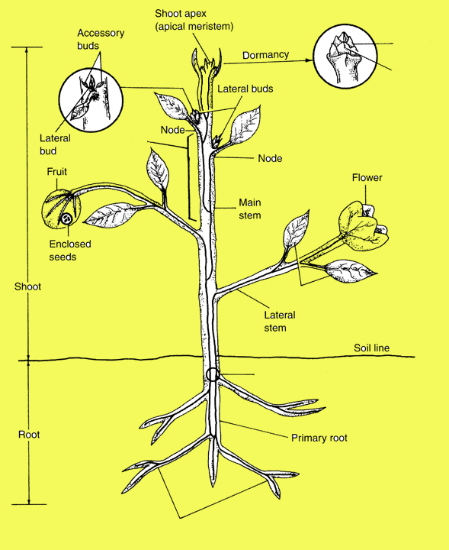
Plant Form & Functions
Terminal Bud
Identify the plant parts from the illustration
Terminal Bud
Bud Scales
Internode
Leaves
Lateral Roots
Bud Scales
Internode
Leaves
Lateral Roots
Notes:
Plant Form & Functions
Each plant is made up of the shoot and root. The shoot is made up of many different organs. Lets review the basic stem parts by asking the Master Gardeners to identify each of these parts. The terminal bud (click for name to appear), bud scales (click mouse), Internode area (click mouse), leaves (click mouse) and lateral roots (click mouse).
The terminal bud contains a compacted shoot with a new shoot, leaves, buds and sometimes flowers.
The bud scales protect the bud from the climate and pests.
The internode is the stem area between nodes. Nodes are the stem area where the leaves and buds are attached.
The leaves provide the surface for light interception and food production.
The lateral roots are secondary roots that function to take up water.

Slide 15
Stem & Root Form & Function
Stems support leaves, flowers and fruits; transports food, water and nutrients
Leaves make food and transpire water
Buds produce new stems, leaves and flowers
Flowers produce fruits and seeds
Roots adsorb nutrients and water, anchor the plant, and can store food
Notes:
Stem & Root Form & Function
The stems of the plants function to support the leaves, flowers and fruits. The vascular system of the stem moves the food produced to feed all the living cells in the plant. It also moves the water and nutrients from the roots up to the leaves.
The leaves use the water and carbon dioxide to make carbohydrates (plant food). The leaves also transpire water through the stomata to cool the plant and pull water up the stems.
The buds produce new stems, leaves and flowers. Not all the buds grow at the same time. Some are held if reserve, and used at a later time if needed to produce new shoots.
Flowers are the plants means of survival. They produce fruits and seeds. The seeds are the plants means of producing new plants for the next generation.
Roots anchor the plant in place while adsorbing nutrients and water for the plant. Roots often store food to be used by perennial plants.

Slide 16
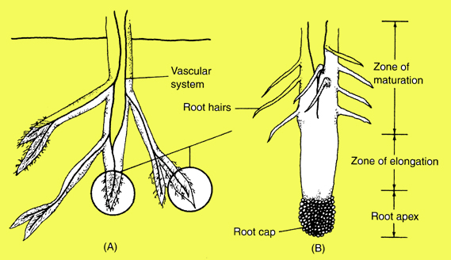
Root Form & Function
Root Tips
The root cap protects the meristem, the area of cell division at the root tips
Root hairs absorb most of the water and are concentrated in the maturation zone
Roots transport water & nutrients in their vascular system
Notes:
Root Form & Function
The end of root tip is covered with a root cap, that protects the meristem. The meristem is the area where cells divide and increase in number. These cells increase in length in the zone of elongation, pushing the root tip through openings in the soil.
The root hairs are very small, composed of only a single cell. They effectively adsorb most of the water taken up by the plant. They are concentrated in the zone of maturation. They are easily lost under adverse conditions.
The vascular system of the roots work to move water and soil nutrients from the root tips up to the stems vascular system.

Slide 17
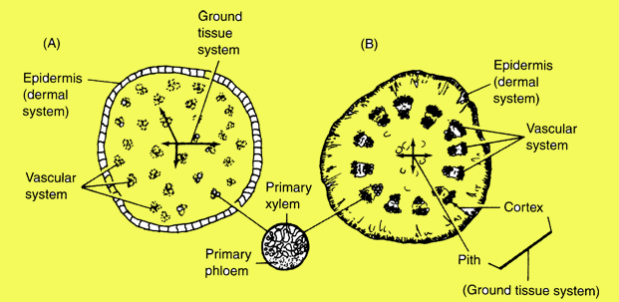
Vascular Tissue Form & Function
Stem Cross Section
Vascular tissue in monocots (grasses) are scattered in the stem (A), on left.
Vascular tissue in dicots (broad leafed plants) are arranged in a circle inside the stem (B), on right
The xylem tissue conducts water upward while the pholem conducts food from the leaves downward.
Notes:
Vascular Tissue Form & Function
One of the differences between monocots (grasses) and dicots (broad leafed plants) is the arrangement of the vascular tissues in the stems. In monocots the vascular bundles are scattered through the central stem. In dicots they are arranged in a circle near the outer surface. In the vascular bundles, the xylem is on the inside while the phloem is on the outside. The cambium is located between the xylem and phloem, and produces new cells in both directions.
The xylem moves water upward while the phloem conducts food from the leaves downward. In woody plants the xylem becomes the wood while the phloem become the bark.

Slide 18
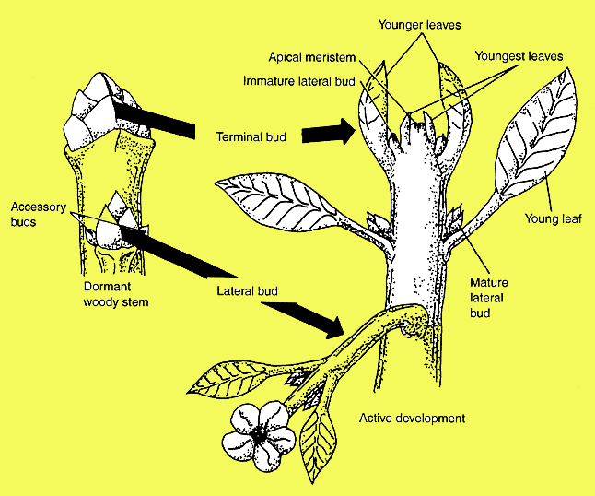
Bud Form & Function
Terminal buds develop into terminal shoots, leaves & buds
Lateral buds develop into lateral shoots, leaves & buds
Flowers may be produced by both
Notes:
Bud Form & Function
One terminal bud will develop into one terminal shoot with its leaves, buds and sometimes flowers. All these tissues are compressed inside this bud and develop by expanding the compressed tissue. Miniature leaves expand to become full sized.
Lateral buds develop into lateral shoots with their leaves, buds and sometimes flowers. Not all lateral buds develop and many remain dormant

Slide 19
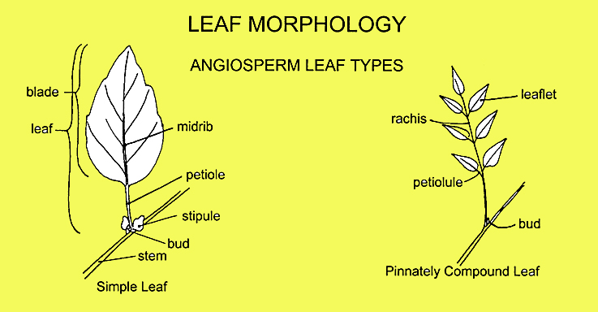
Leaf Form & Function
A simple leaf is made up of the petiole and blade. Stipules are leafy appendages at the base of the petiole
A compound leaf has many leaflets & a central rachis. Each leaflet can have a short petiolule
Notes:
Leaf Form & Function
There are two basic leaf forms, simple leaves and compound leaves. The simple leaf is made up of the petiole and blade. The leaf is attached just below a bud on the stem. Some plants will have a leafy appendage on the stem below the leaf attachment called a stipule. The stipule may help produce food while the leaf is developing. Most drop off during the first season.
A compound leaf has three to many leaflets attached to a central rachis. The rachis is attached to the petiole which is attached to the stem below an existing bud. Each leaflet can have a short petiolule. The difference between a simple leaf and a leaflet can be determined by looking a the location of the buds. There is a bud at the base of a simple leaf, and no bud an the base of a leaflet.

Slide 20
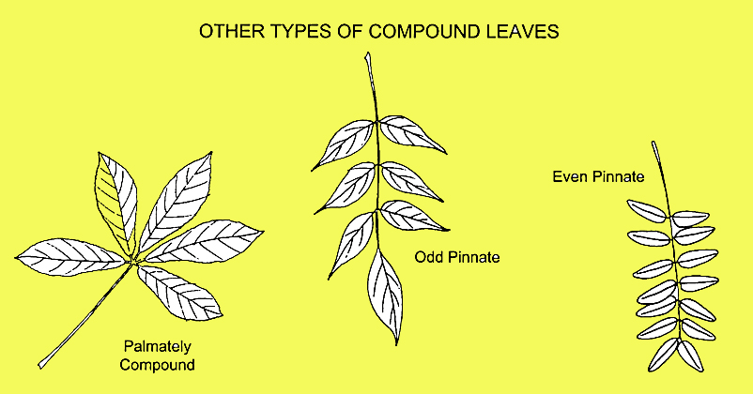
Leaf Form & Function
Pinnately compound leaves have opposite leaflets, they are even or odd in number
Palmately compound leaves have leaflets meeting at the top of the petiole
Notes:
Leaf Form & Function
Compound leaves are either pinnately compound where the leaflets are opposite each other, or palmately compound where the leaflets meet at the top end of the petiole. The pinnately compound leaves are called odd pinnate or even pinnate depending upon the number of leaflets.

Slide 21
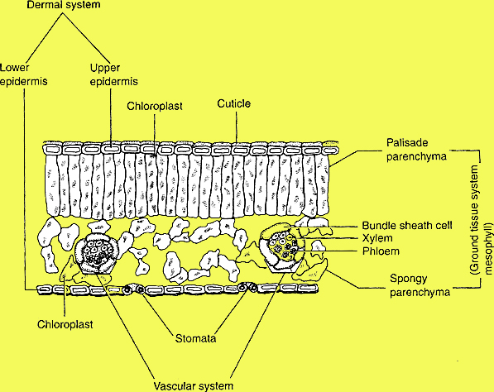
Leaf Form & Function
Cuticle is waxy & holds moisture in
Chloroplasts intercept light and make plant food
Stomata open to let oxygen out and CO₂ in
Vascular system moves food & water
Leaf Cross Section
Notes:
Leaf Form & Function
A cross section of a typical leaf shows all the internal cells. The upper layer of cells is the epidermis which is covered with a waxy cuticle which functions to help keep moisture inside of the plant.
The parenchyma cells, both the palisade parenchyma and spongy parenchyma, contain chloroplasts that intercept light and manufacture carbohydrates, the food of the plants that supports all the plant cells.
The stomata are found on the bottom of the leaf. They open and close to regulate air and moisture exchange. Oxygen, a by product of food production, is let out while carbon dioxide, a resource needed for food production, is let in. The release of moisture, transpiration, helps to cool the leaves.
The xylem and phloem make up the vascular system, and functions to move water and food through the plant. This vascular system in the leaves are called veins and are visible on the upper and lower surface of the leaf.

Slide 22
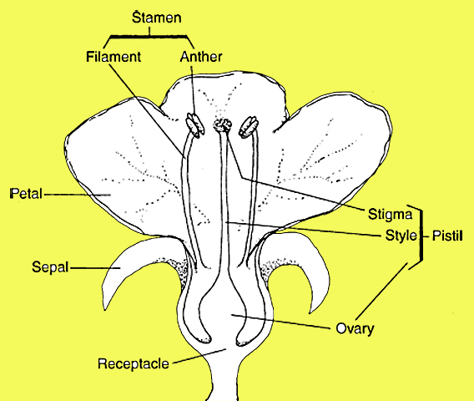
Flower Form & Function
The male stamen is made up of the anther and filament
The female pistil is made up of the stigma, style and ovary
A perfect flower has both, a functional pistil and stamens
Typical Flower
Notes:
Flower Form & Function
The typical flower has many male stamens that are made up of the anther and filament. The anther, when mature, is filled with pollen that is released and pollinates the pistil. The pollen lands on the stigma, germinates and grows down through the style to reach the ovary where fertilization occurs. The female pistil includes the stigma, style and ovary. The fertilized ovary develops into the fruit and seeds.
A perfect flower contains both a functional pistil and stamens. If either of these organs is missing, the flower is called imperfect. If all the flowers on a plant contain only male or female flowers, the plants are called dioecious. Plants like holly are dioecious, with male plants and female plants. Only the female plants are capable of producing red holly berries.

Slide 23
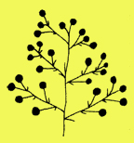
Flower Form & Function
Identify these flower inflorescence types
Single
Head
Spike
Raceme
Panicle
Panicle
Single
Single
Raceme
Head
Spike
Notes:
Flower Form & Function
Ask your audience to help identify each of the inflorescence types. Ask them to identify a single flower, and then click the mouse to reveal the correct choice. Continue down the list including single, head, spike, raceme and panicle.
The single has a single flower at the end of the peduncle. The head has many flowers at the end of the peduncle. A spike has flowers attached directly to the stem. The raceme has short stalks (pedicels) attached to the stem. The panicle has many branched stems with flowers at the terminals.

Slide 24
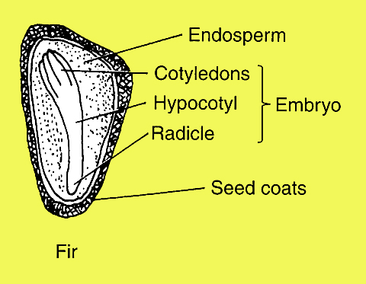
Seed Form & Function
Seeds develop to allow reproduction
Identify the function of these seed parts
Endosperm – Energy
Embryo - New Plant
Cotyledons - Seed Leaves
Hypocotyl - Transition
Radicle - Root
Seed Coats - Protection
Notes:
Seed Form & Function
Seeds develop in the flower after fertilization of the ovary. The development of seeds allow a plant to reproduce and develop new plants. The basic parts of the seed are shown in the illustration. Ask you audience to help identify the functions of these seed parts. Click the mouse to show each function.
The endosperm provides a source of energy for seed germination and new plant growth.
The embryo is a miniature complete plant that is made up of the cotyledons, hypocotyl and radicle. The cotyledons are called seed leaves as they grow and increase in size. They store or produce food for the developing plant as the stem and true leaves develop. The hypocotyl usually contains transition stem cells while the radicle is a miniature root ready to burst into growth.
The seed coats provide protection for the embryo. They can be very hard on legumes and many nut trees.

Slide 25
Review Basic Botany
Plant Taxonomy deals with (1) identification, (2) naming & (3) classification
Problems with common names - not precise and no rules for naming
Botanical names are precise and reflect classification
Inter-specific and inter-generic hybrids are designated with a multiplication sign ( × )
Notes:
Review Basic Botany
Now for a quick review of some of the major points covered.
Plant taxonomy deals with three areas, proper plant identification, naming and the classification of plants. Classification deals with the understanding of how plants are related to each other.
Common names are widely used but have several problems. These names are not very precise and there are no rules for developing common names.
Botanical names are more difficult but they are precise and reflect the classification.
Hybrids between species and genera can occur. There are special rules for naming these hybrids. They are designated with a multiplication sign.

Slide 26
Review Basic Botany
Cultivars are selected, named and maintained by man
The chloroplasts in the leaves make the food necessary for plant cell survival
The vascular tissues move the water, nutrients and plant food through out the entire plant
A perfect flower contains a pistil & stamens
The embryo of the seed grows to produce an entirely new plant
Notes:
Review Basic Botany
Cultivars are special plants that are selected, named and maintained by man. Cultivars are generally lost when nurserymen or gardeners no longer reproduce them.
The chloroplasts in the leaves intercept light and manufacture plant food. This food is necessary for plant cells to survive. Plants with out chloroplasts and chlorophyll, usually die unless they can live off of other plants (parasites).
The xylem and phloem make up the vascular tissues. They move the water, nutrients and plant food through out the entire plant.
A perfect flower contains both a pistil and stamens. An imperfect flower is missing one or the other.
The embryo is the most important part of the seed. This tiny plant grows to produce an entire new plant and insures survival of the plant species.

Slide 27
Questions?
Notes:
DISCUSSION QUESTIONS
1. Discuss why plant nomenclature might be important to a gardener.
2. Discuss the differences between monocots and dicots.
3. In which areas of a plant does growth originate?
4. Name some examples of modified root structures and their purposes.
5. Plants with which kind of root system are easier to transplant and why?
6. What purposes does the plant’s stem serve?
7. Discuss the purpose of a leaf and the types of leaves a plant might have.
8. What are the 3 types of buds?
9. Discuss the difference between monoecious and dioecious plants?
10. What is a “perfect flower”?

Slide 28
Basic Botany Conclusion
Thanks for your attention
Lights Please
Information prepared by
Jim Midcap, Extension Specialist
University of Georgia
Notes:
Basic Botany Conclusion
Lights Please

