Slide 1
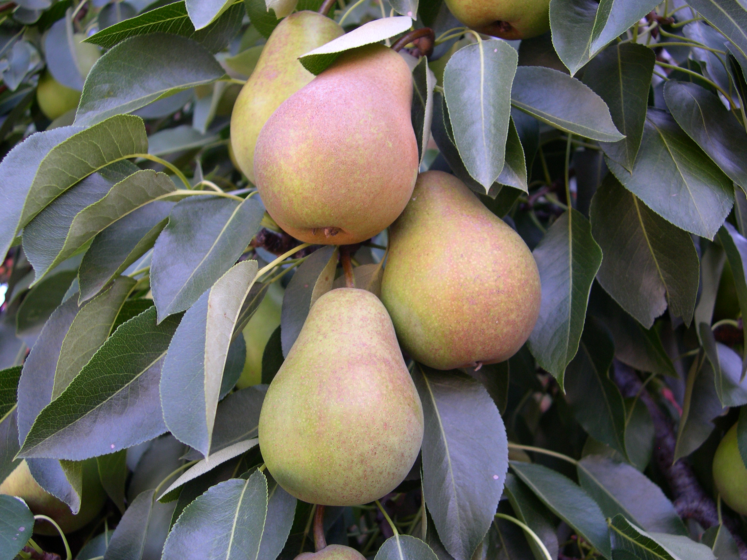
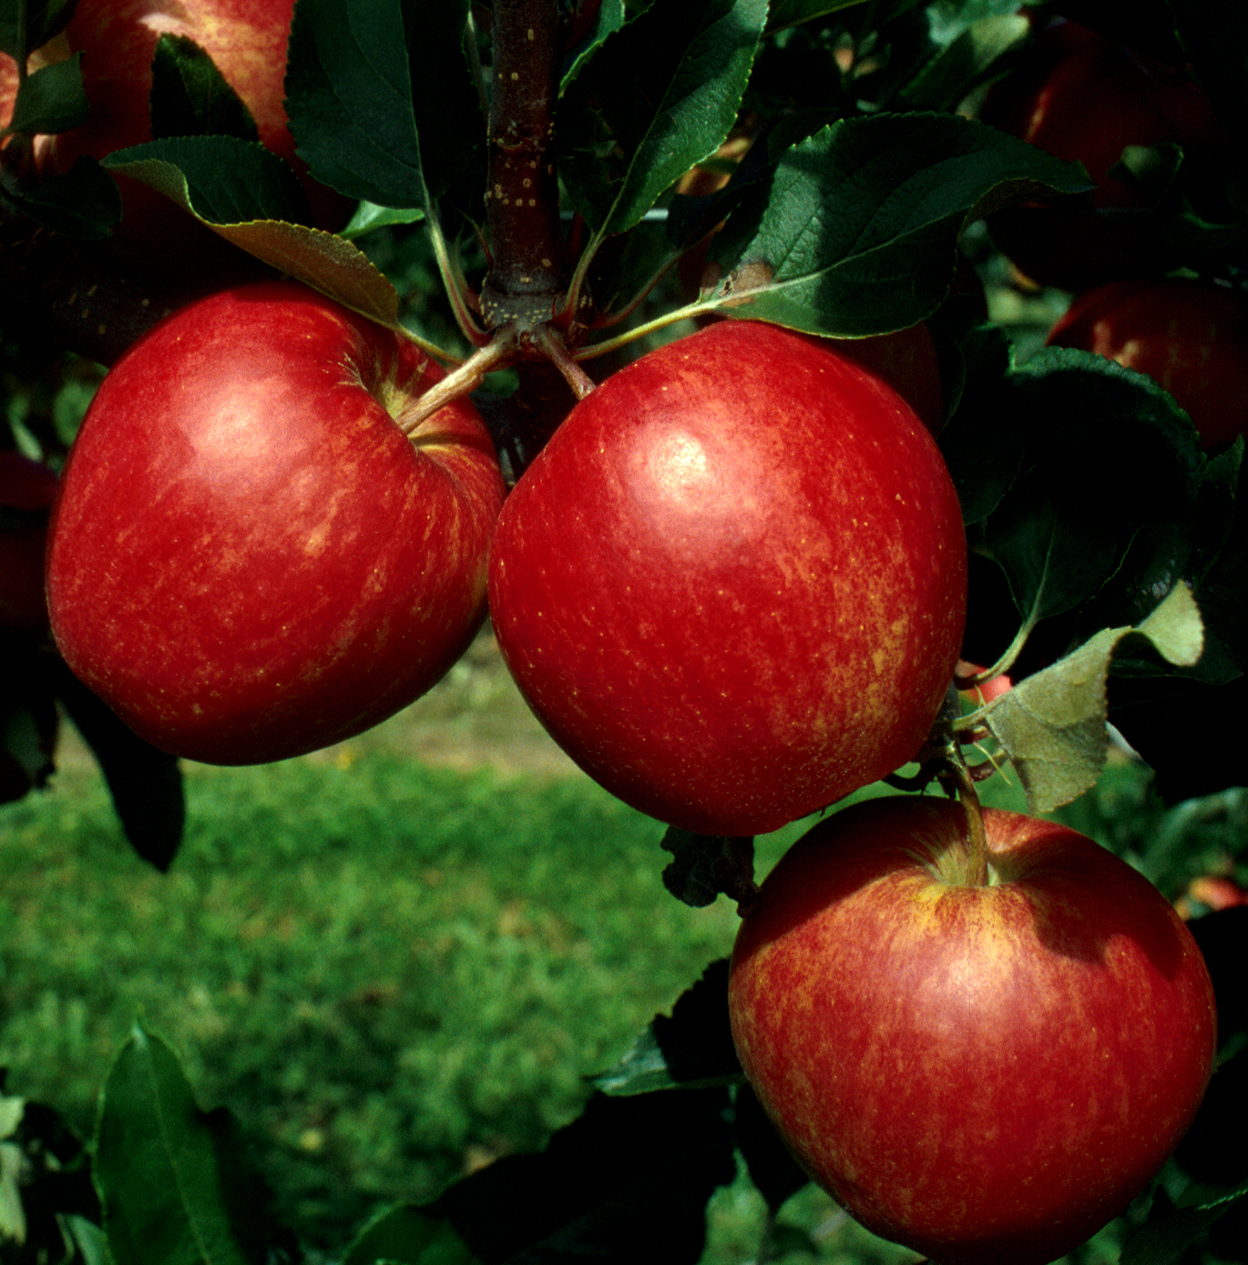
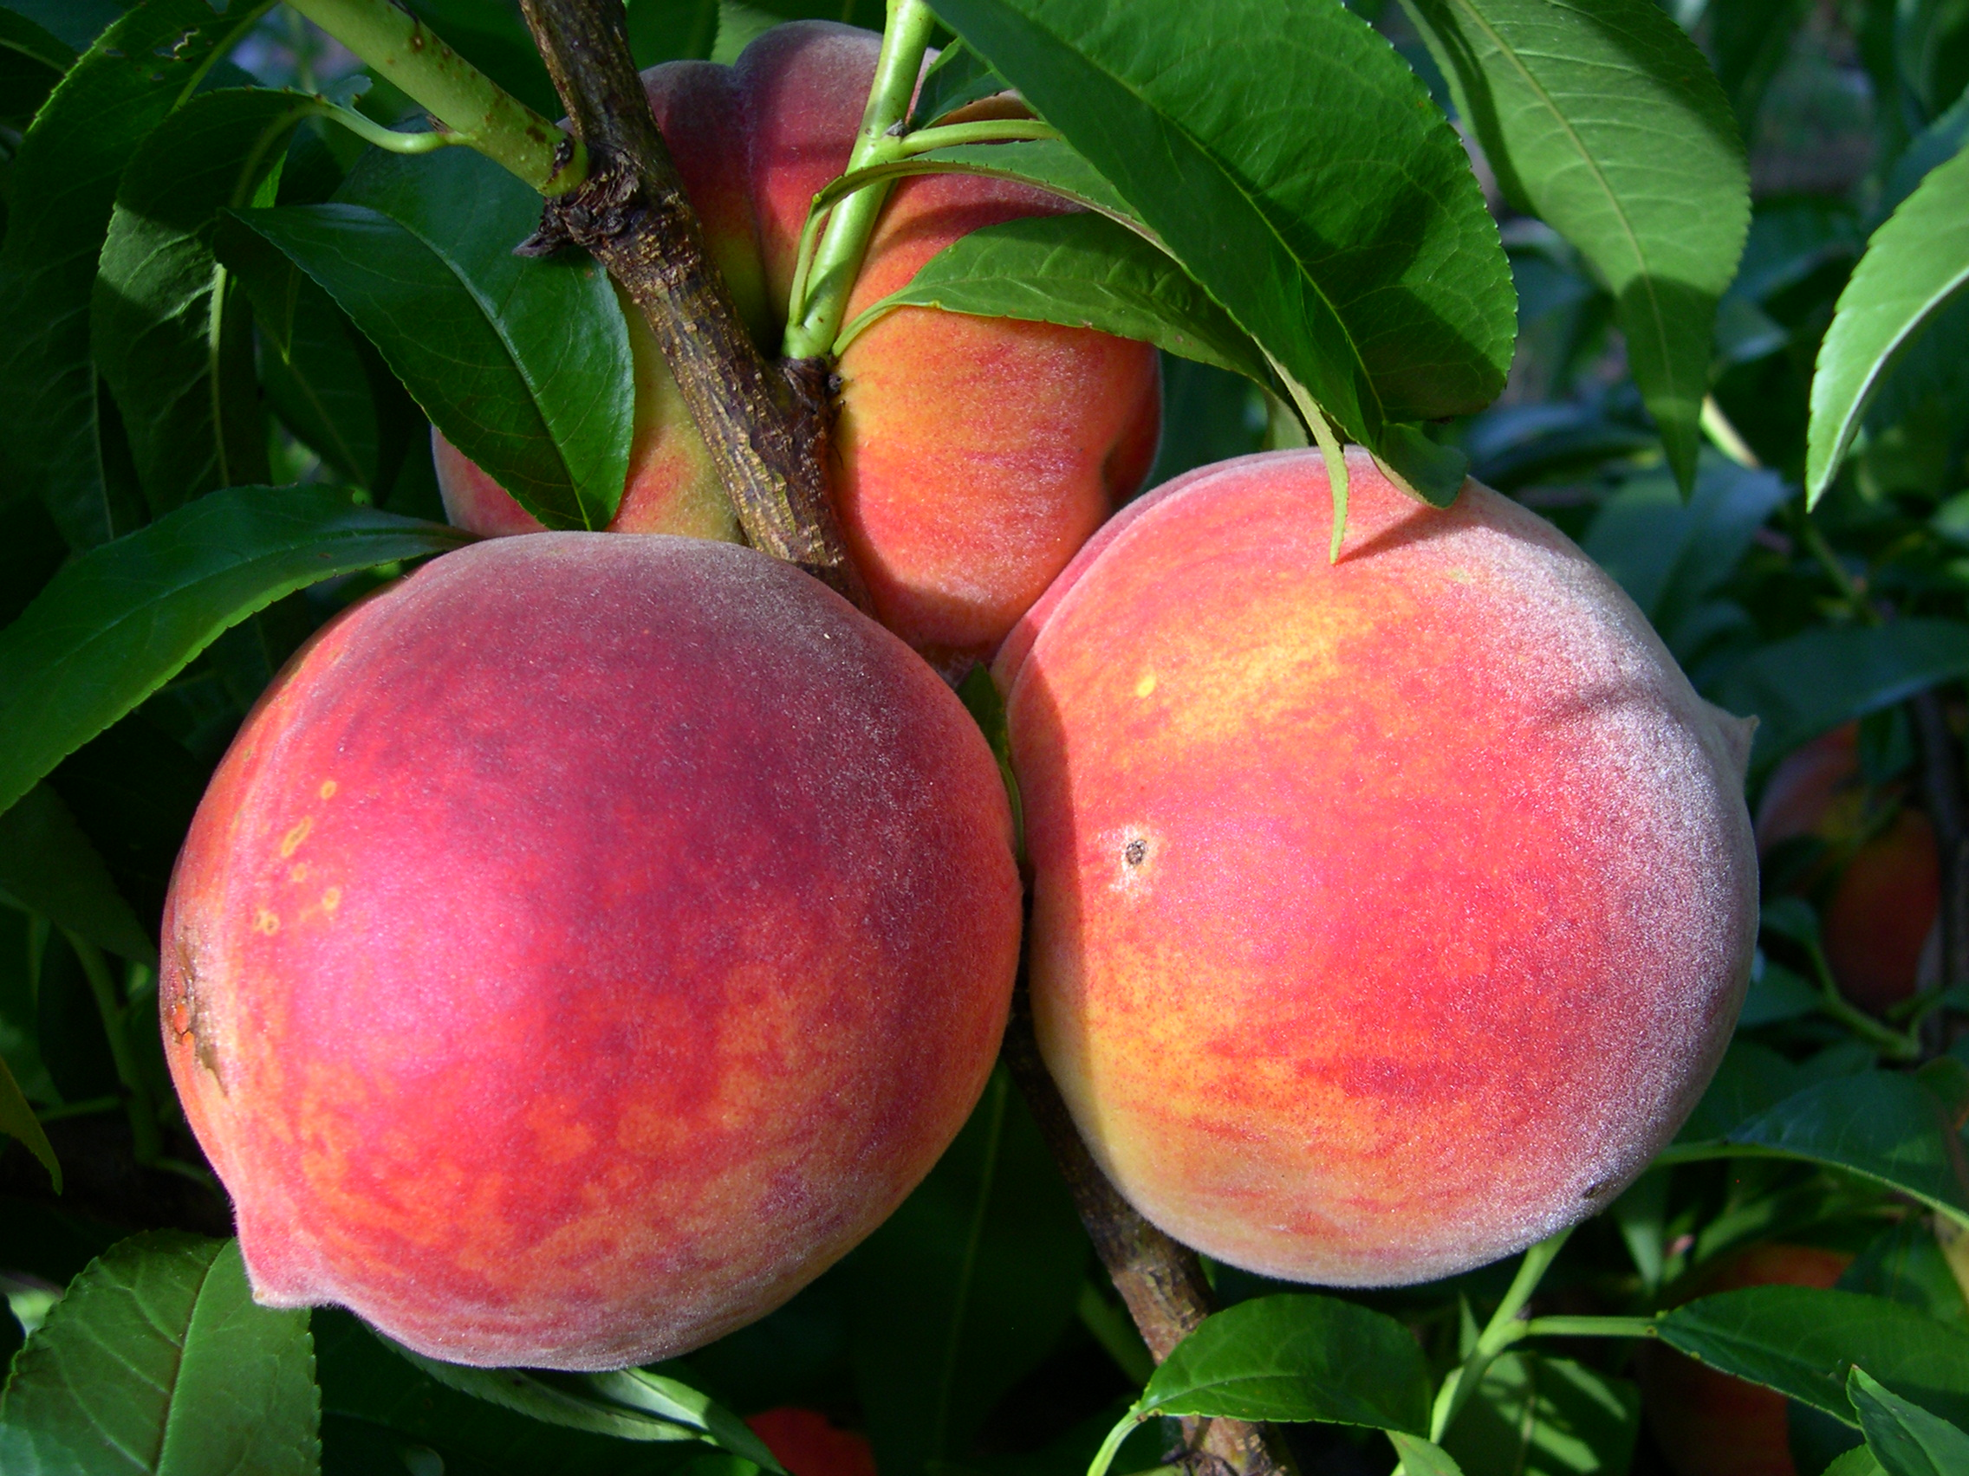
Backyard
Tree Fruit

Slide 2
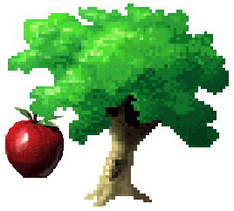
Tree Fruit: The Gardener’s Challenge!
Frost susceptible
Pollination requirement
High pest pressure
Insects, fungi, bacteria, and weeds
High maintenance requirement
training
pruning
thinning
mulch & fertilizer

Slide 3
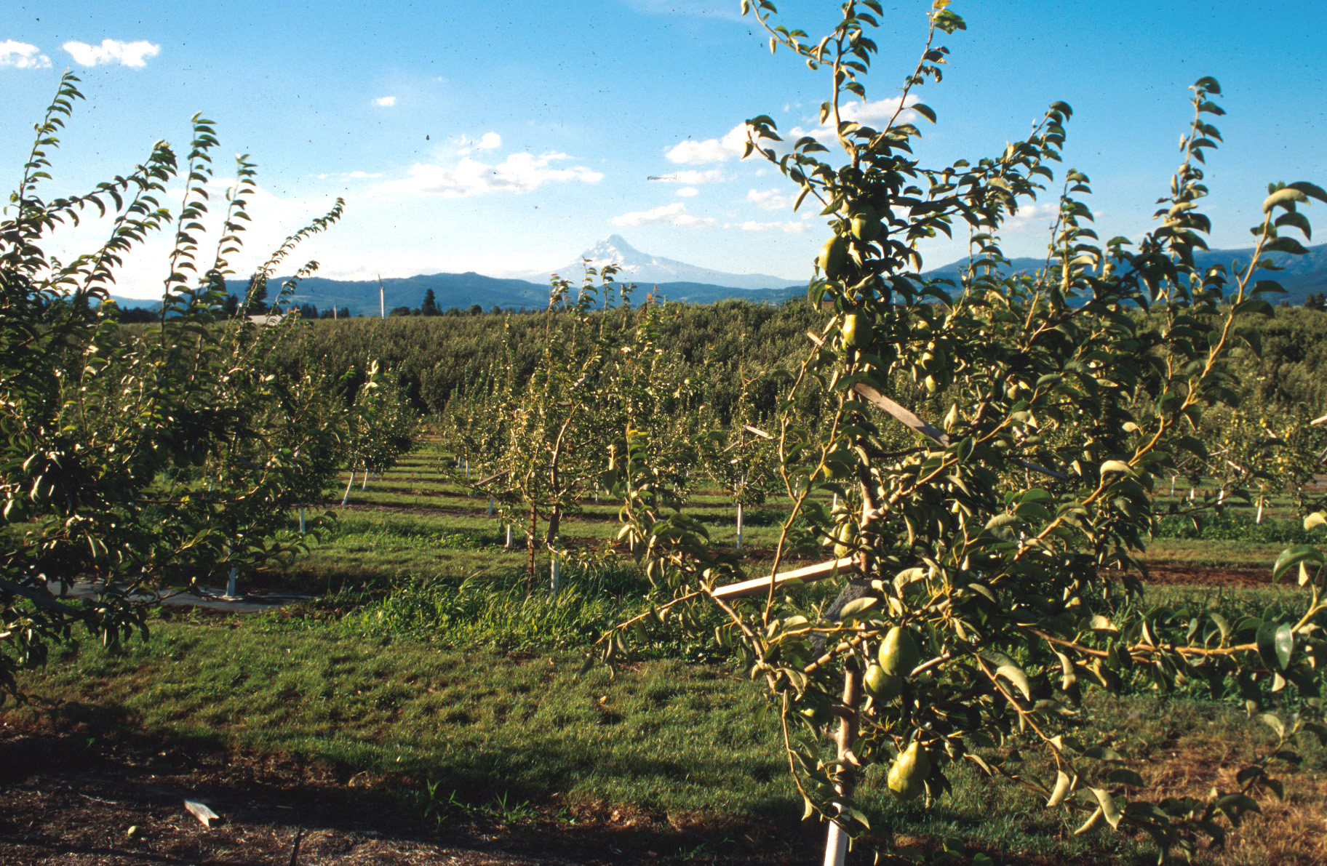
Site Requirements
Full sun
Photosynthesis, fruit color
Quick drying of rain/dew = less disease
Soil: well-drained, loamy, pH 6.5
Good air drainage, movement
frost & disease avoidance

Slide 4
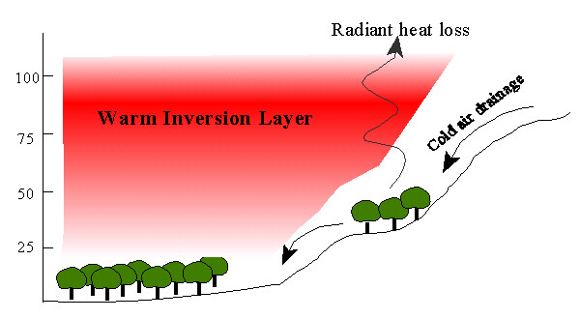
Avoid low “frost pockets”

Slide 5
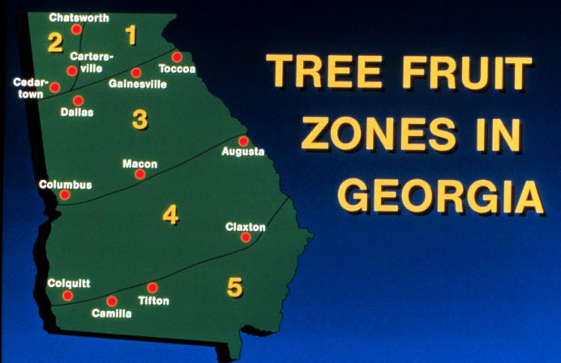

Slide 6
Cross pollination – 2 varieties
Self pollination – same variety

Slide 7
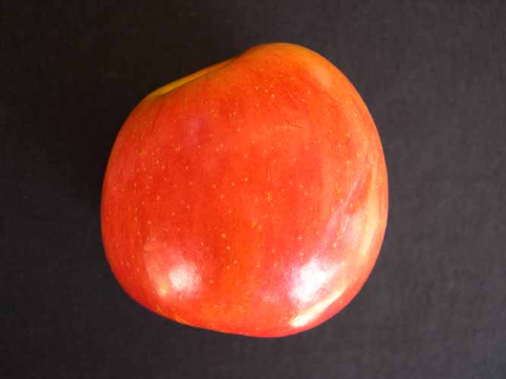
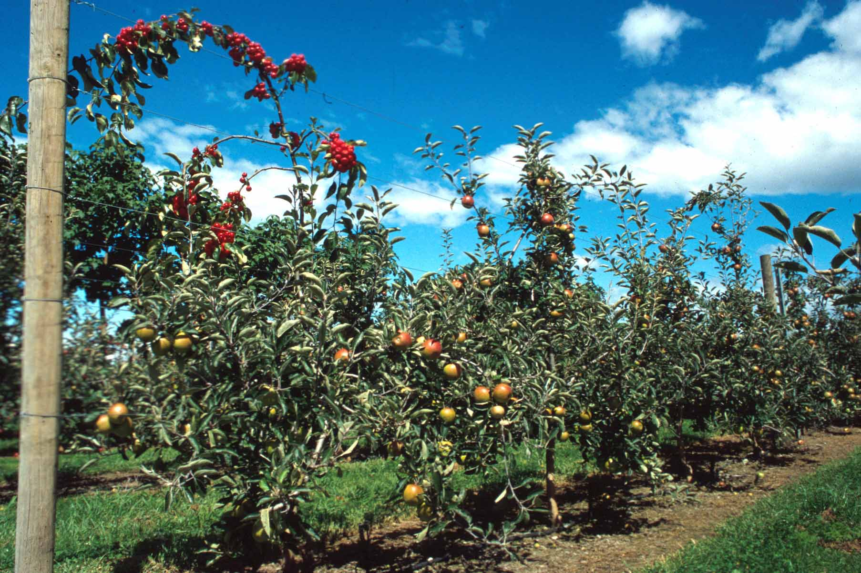
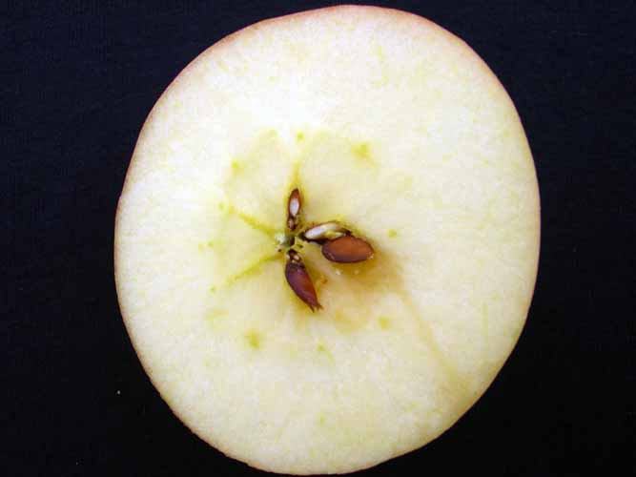
POLLINATION REQUIREMENTS
SELF-FRUITFUL
Peaches
Nectarines
SELF-UNFRUITFUL
apples
pears
plums

Slide 8
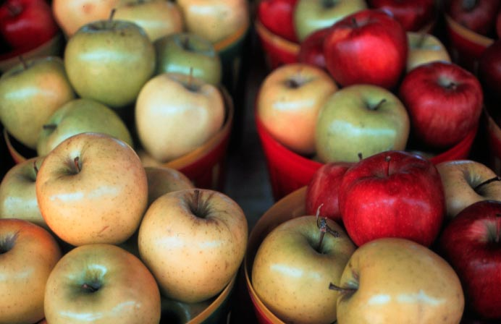
A wide variety of apples can be
grown in Georgia, including store-bought varieties

Slide 9
Apple Varieties | Zone | Uses | Pollination Code
Anna | 5 | Early, dessert, red blush | A
Dorsett Golden | 5 | Early, dessert, yellow | A
Jerserymac | 1,2,3 | Fresh, sauce and pies | B
Redgold | 1,2,3 | Dessert | B
Priscilla | 1,2,3 | Sub-acid dessert | C
Mollie’s Delicious | 3,4 | Fresh, sauce and pies | B
Ozark Gold | 1,2,3 | Dessert, yellow | C
Red Delicious | 1,2,3,4 | Sweet, fresh, or salads | B
Golden Delicious | 1,2,3,4 | Sub-acid, yellow, all purpose | C
Stayman | 1,2,3 | Tart, all purpose | C-sterile
Yates | 1,2,3,4 | Small, subacid, mellow, juicy | B
Granny Smith | 1,2,3,4 | Yellow green, all purpose | C
Jonagold (C) and Mutzu (B) are also pollen sterile

Slide 10
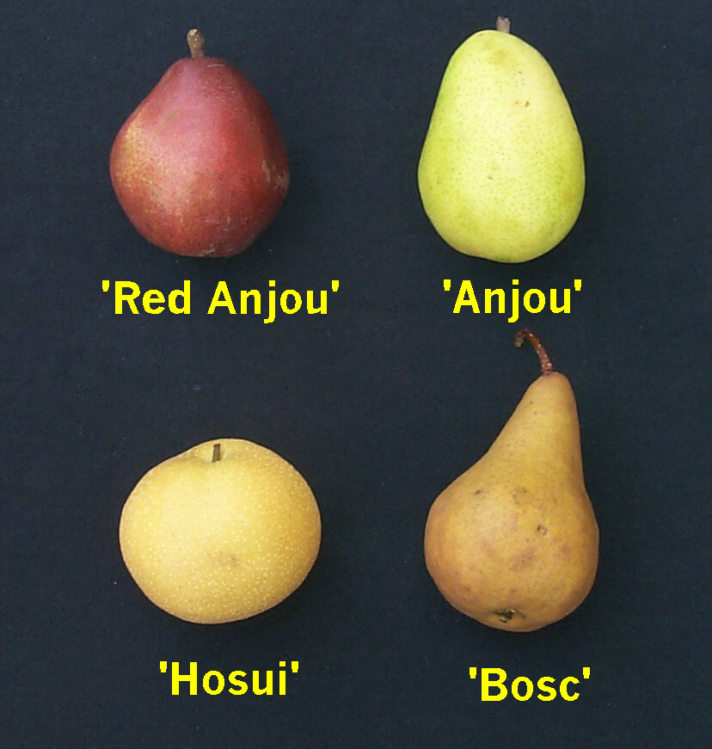
PEARS
Types For Georgia?
European- No
Hybrid- Yes
Asian- Some

Slide 11
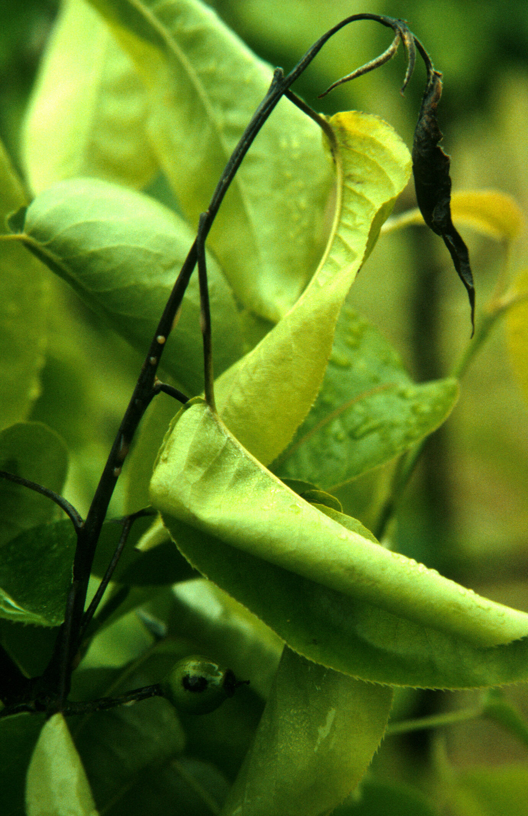
PEAR VARIETIES
Fire Blight Susceptible
Fire Blight Resistant
Bartlett, Bosc, Anjou
Orient Carrick
Waite Kieffer
Hood Flordahome
Magness Baldwin
Dawn Maxine
Warren Spalding
Moonglow
Shinko Chojuro
Hosui Kosui

Slide 12
ASIAN PEARS
Variety Pollinizer Characteristics
Shinko 3
Chojuro 1,3
Hosui 1,2
Kosui 2,3
Golden, russeted fruit
Brown orange fruit
Golden brown fruit
Green yellow fruit

Slide 13
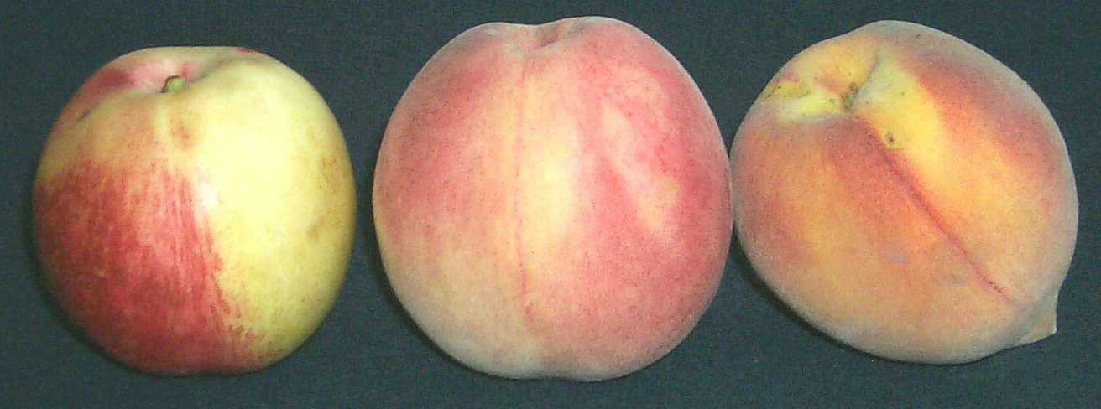
Nectarine
White-fleshed
peach
Yellow-fleshed
peach
Georgia ranks 3rd in peach production, but
that doesn’t mean they’re easy to grow!

Slide 14
PEACH VARIETIES

Slide 15
NECTARINE VARIETIES
Higher disease pressure (no fuzz)

Slide 16
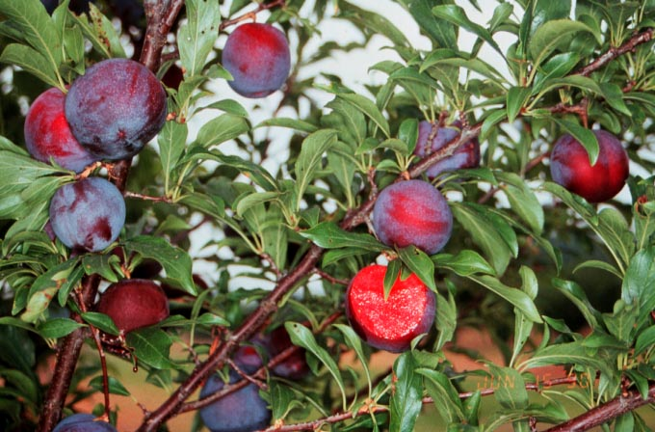
HYBRID plum varieties
are adapted to Georgia’s climate
NOT European
NOT pure Japanese
PLUMS

Slide 17
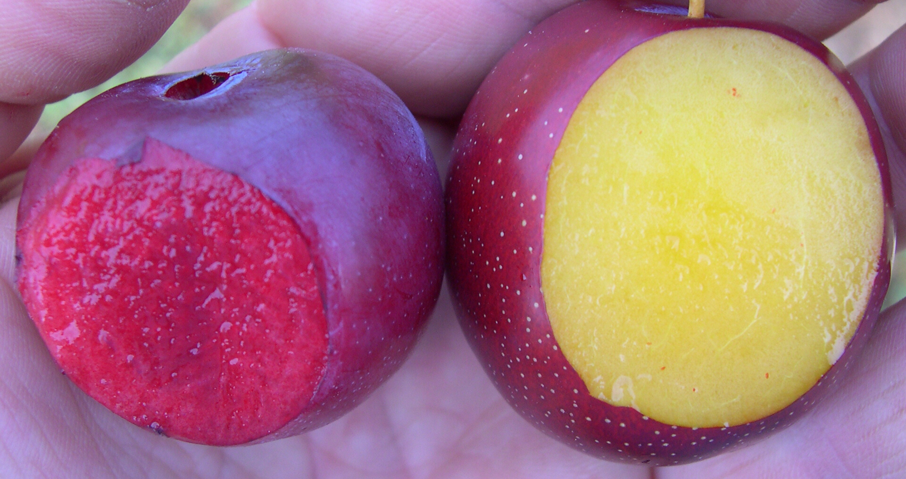
Plum Varieties | Zone
Methley (self-fruitful) | 1, 2, 3, 4, 5
A.U. Releases: Amber Rosa Roadside Homeside Rubrum | 1, 2, 3, 4, 5
Morris | 1, 2, 3, 4
Ozark Premier | 1, 2, 3, 4
Wade | 1, 2, 3, 4
Frontier | 1, 2, 3, 4
Byron Gold | 1, 2, 3, 4
Crimson | 1, 2, 3, 4
Plums need cross pollination

Slide 18
Scion
Bud union
Rootstock

Slide 19
Basic Process

Slide 20
APPLE ROOTSTOCKS
Rootstock Zone
Seedling 1,2,3,4,5
MM106 1,2,3,4
MM111 1,2,3
M7 1,2,3
M26* 1,2,3
M9* 1,2,3
*Fire Blight susceptible
% of Standard Comments
100 18-20’ tall
70 15-18’ tall
70 15’ tall
60 12’ tall
50 Requires support
30-40 Requires support

Slide 21
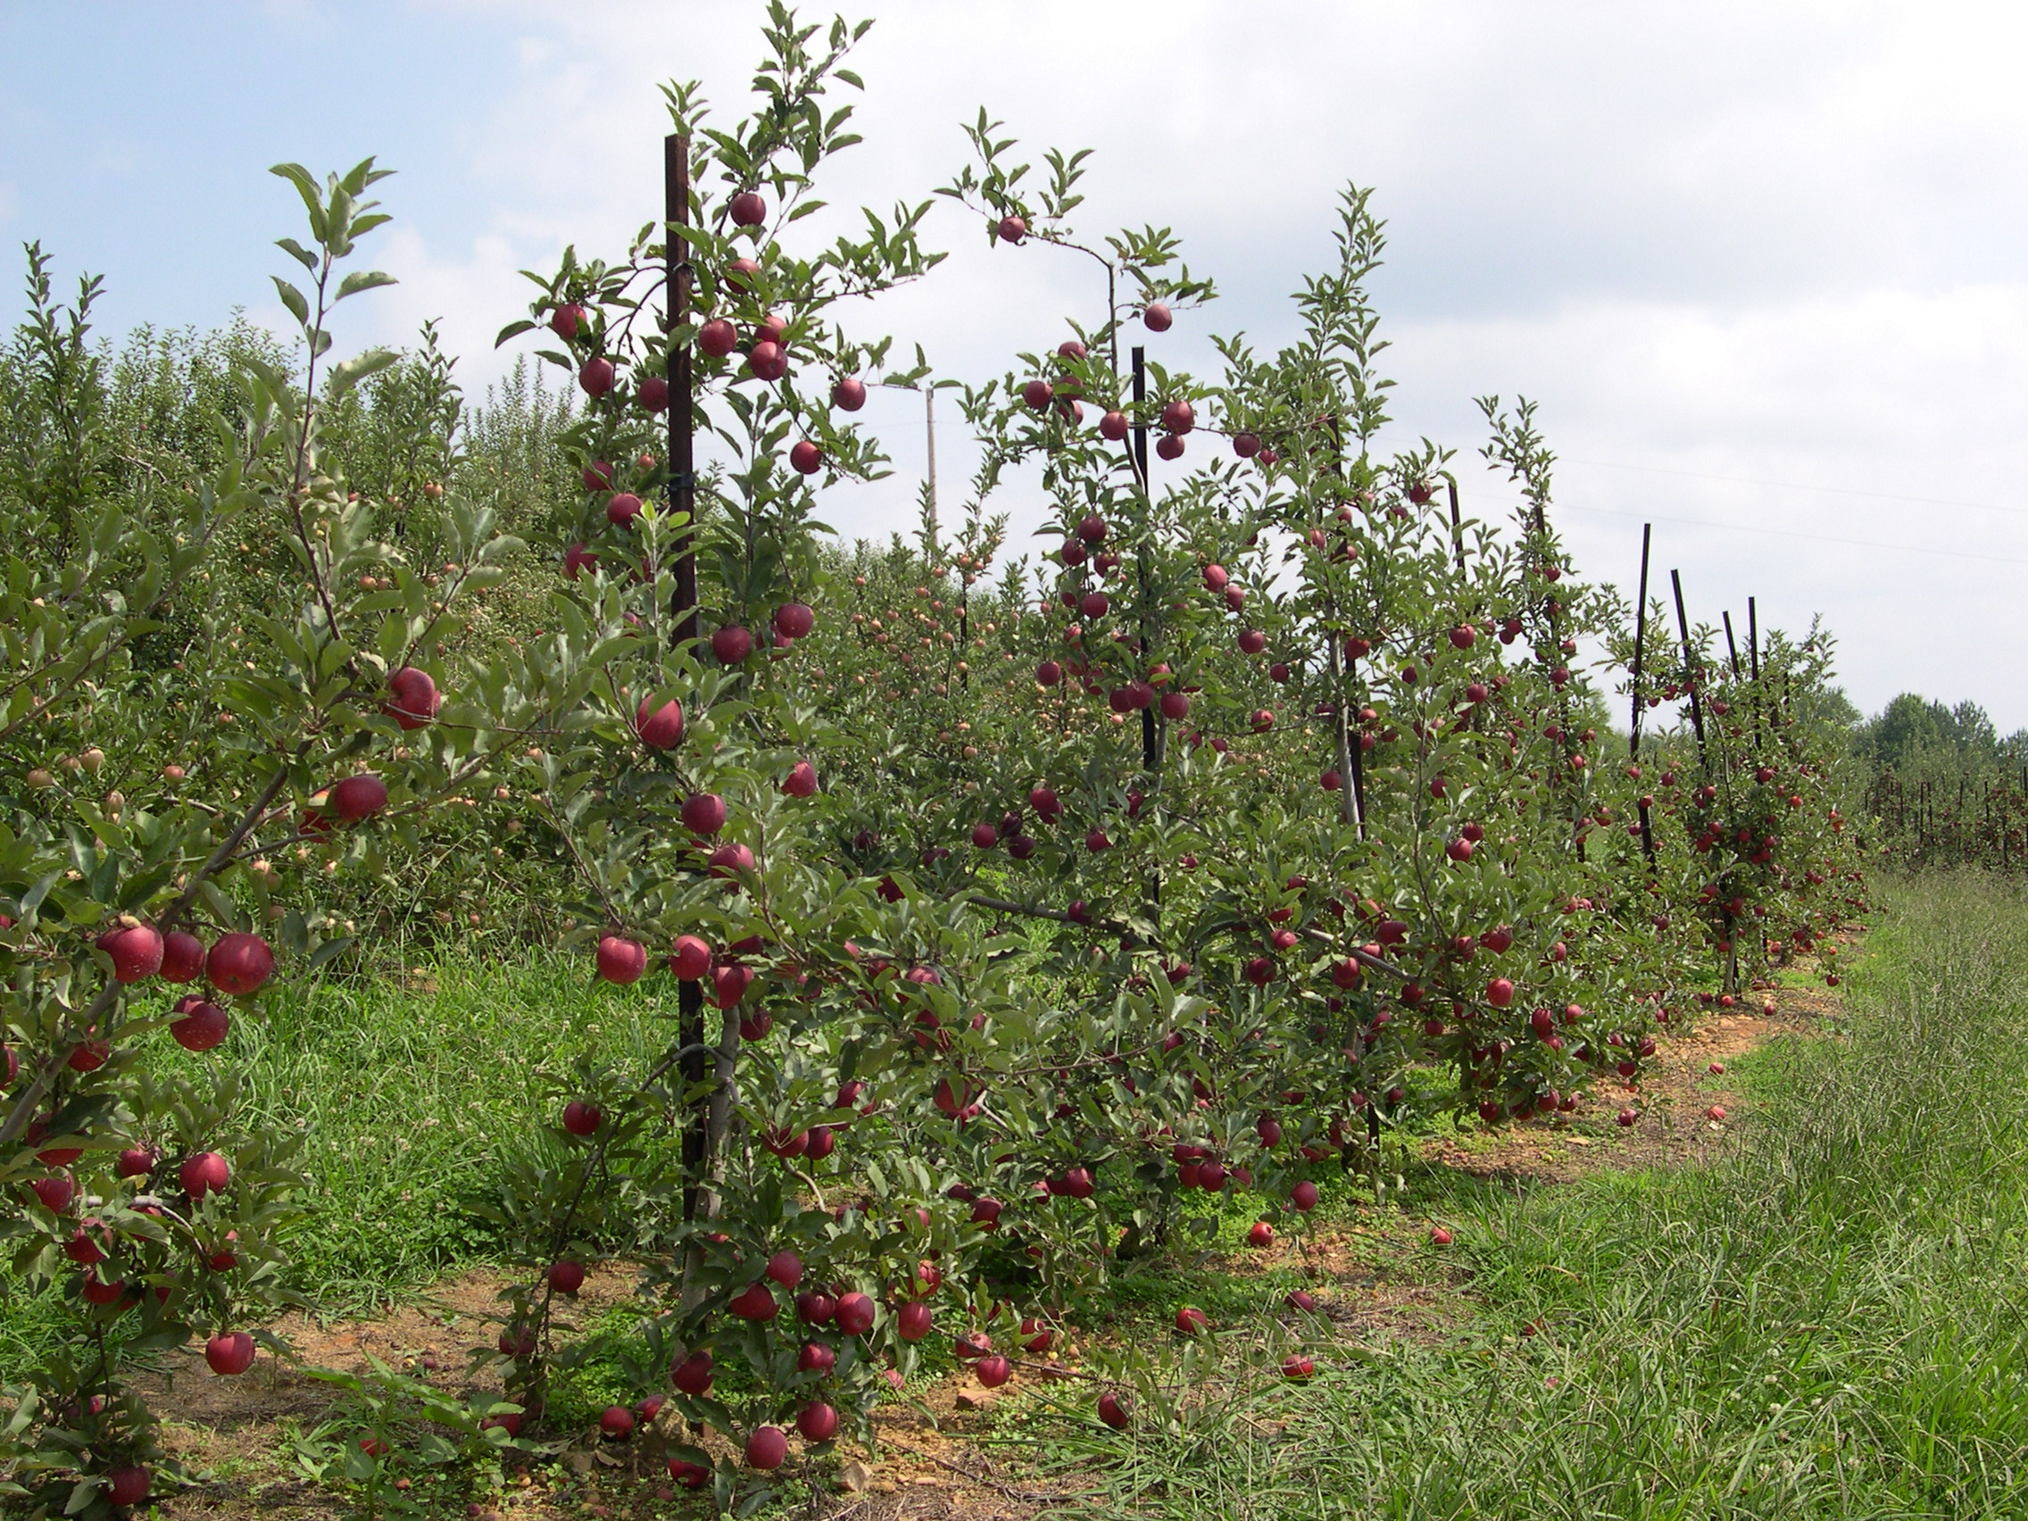
Dwarf trees:
Less space
Precocious
Easy to manage
Less disease
Better color
More expensive
M7 is best dwarfing stock for apples in Georgia

Slide 22
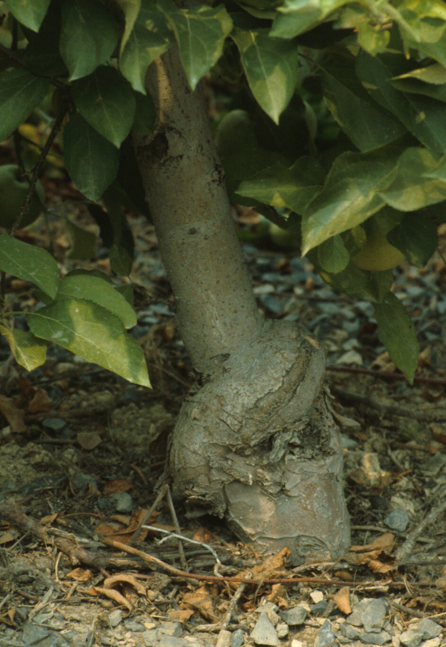
Other Rootstocks
PEACH
Lovell
Nemaguard
Guardian
Halford
PLUM
Lovell
Nemaguard
PEAR
Calleryana seedling
Old Home selections

Slide 23
Dig holes 2X width and 1X depth of root system

Slide 24
Place tree in hole at same
depth as in nursery

Slide 25
Water thoroughly!

Slide 26
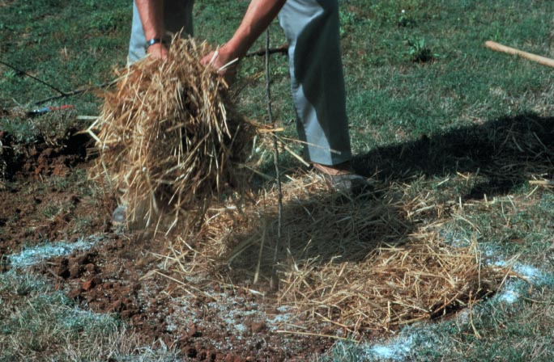
Mulch to drip line

Slide 27
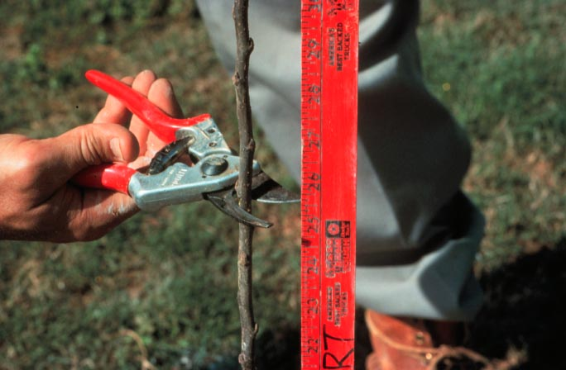
Begin training
right-away!

Slide 28
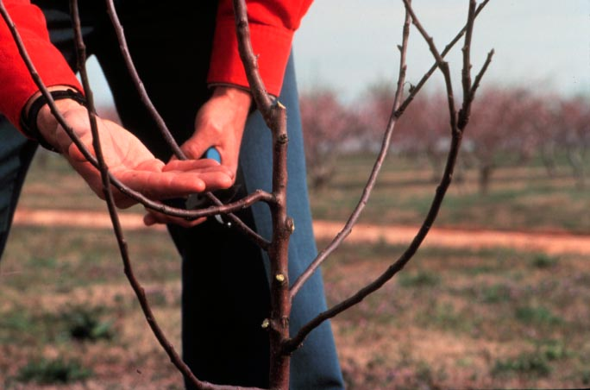
Central Leader: Apple & Pear

Slide 29
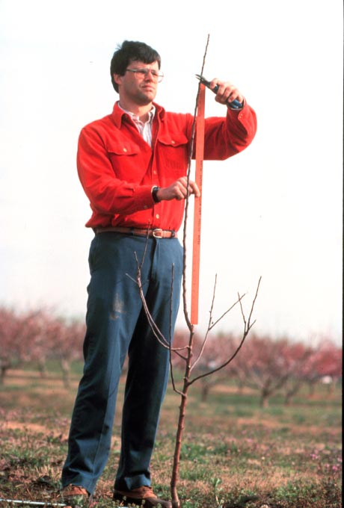
Head the leader 8-10” above the area where new laterals are desired

Slide 30
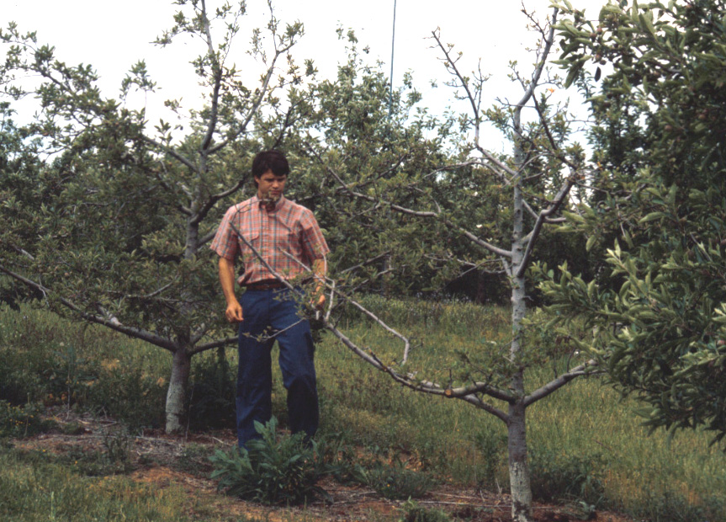
Maintain lower
scaffolds longer
than upper
May need limb
spreaders

Slide 31
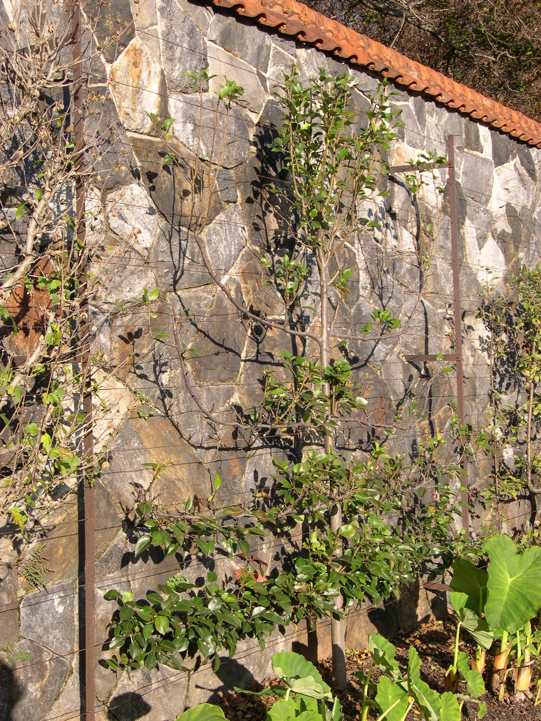
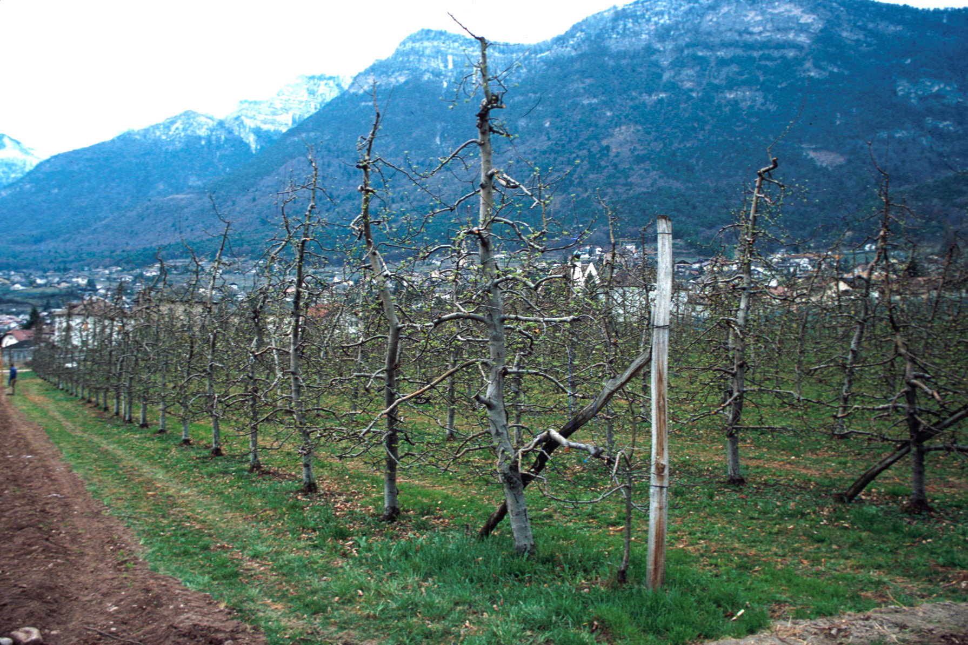
Variations on the
Central leader

Slide 32
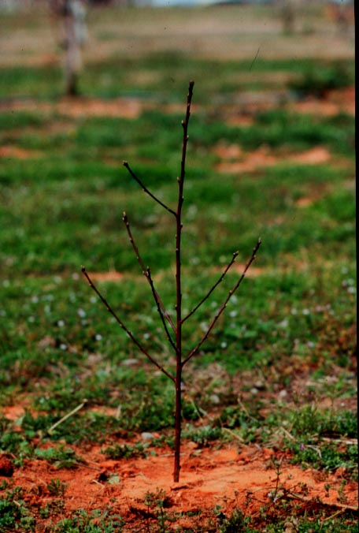
Open Center
System:
Peach, plum,
nectarine

Slide 33
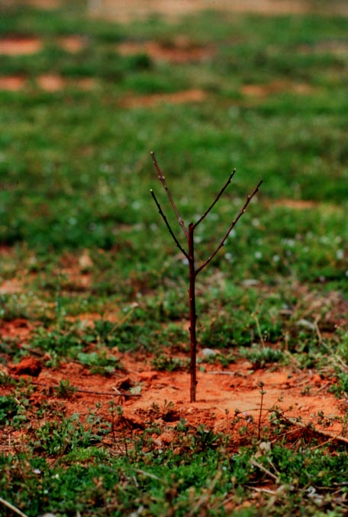
Pick 4 scaffolds
Pointing in different
Directions, head
back to several
buds

Slide 34
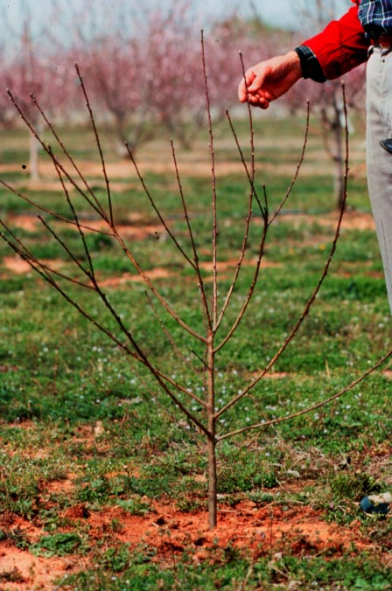
After 1st year

Slide 35
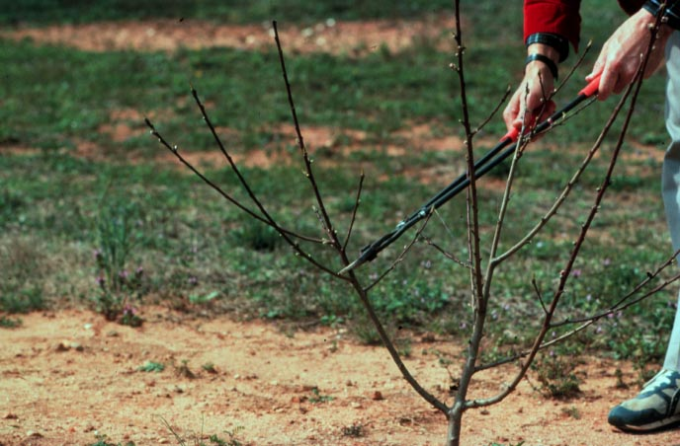
Outward growing shoots encouraged, upright
shoots removed to “open up” tree

Slide 36
Same concepts apply to mature trees

Slide 37
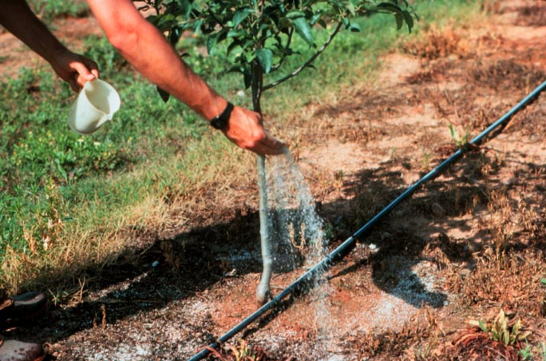
1st and 2nd year trees
One cup 10-10-10
3’ diameter
March
One cup ammonium
nitrate in May or June

Slide 38
Bearing tree fertilization
6-8 cups of 10-10-10 per year, spread evenly
If crop load high, need more
If soil type poor, need more
If average shoot growth is < 15”, apply more;
if > 24”, apply less
If crop lost to frost, disease – don’t fertilize
If severely pruned – don’t fertilize

Slide 39
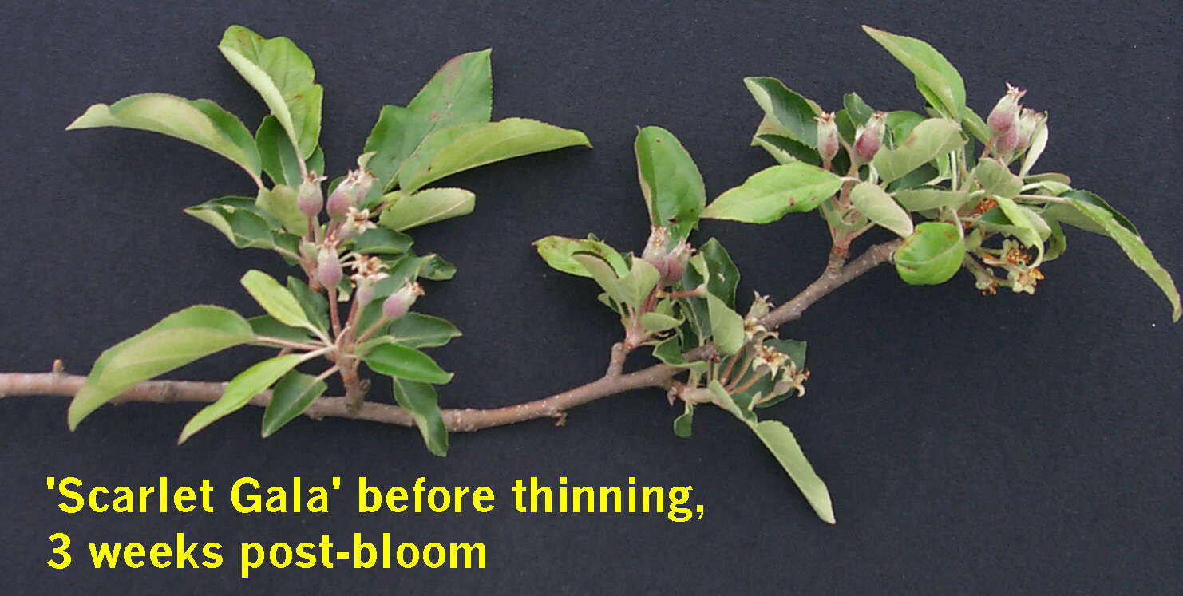
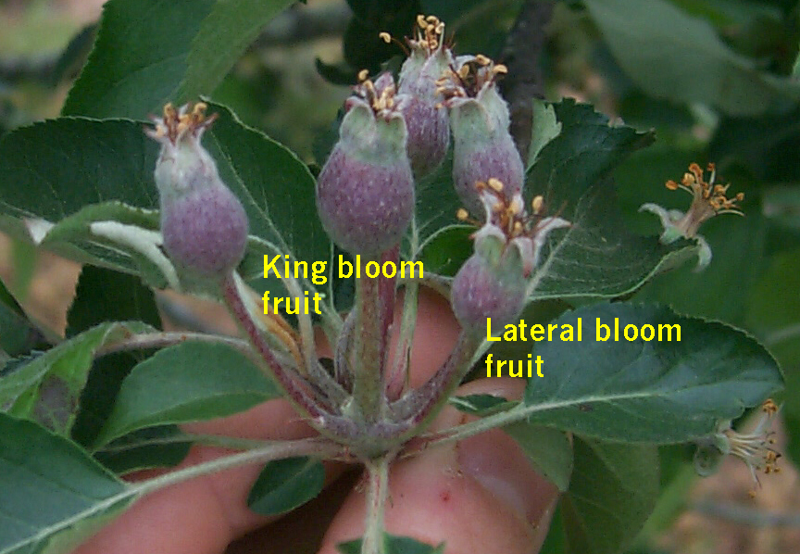
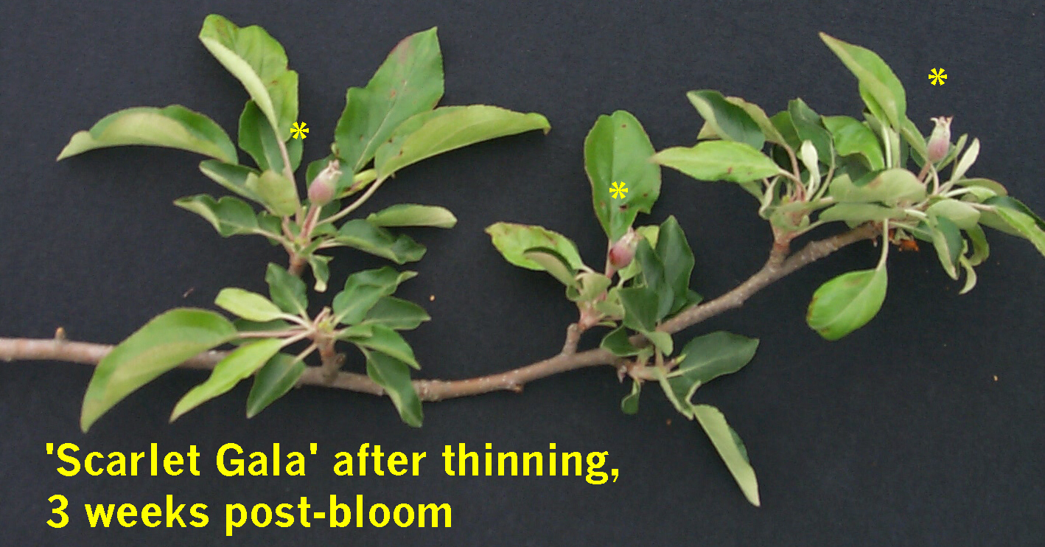

Slide 40
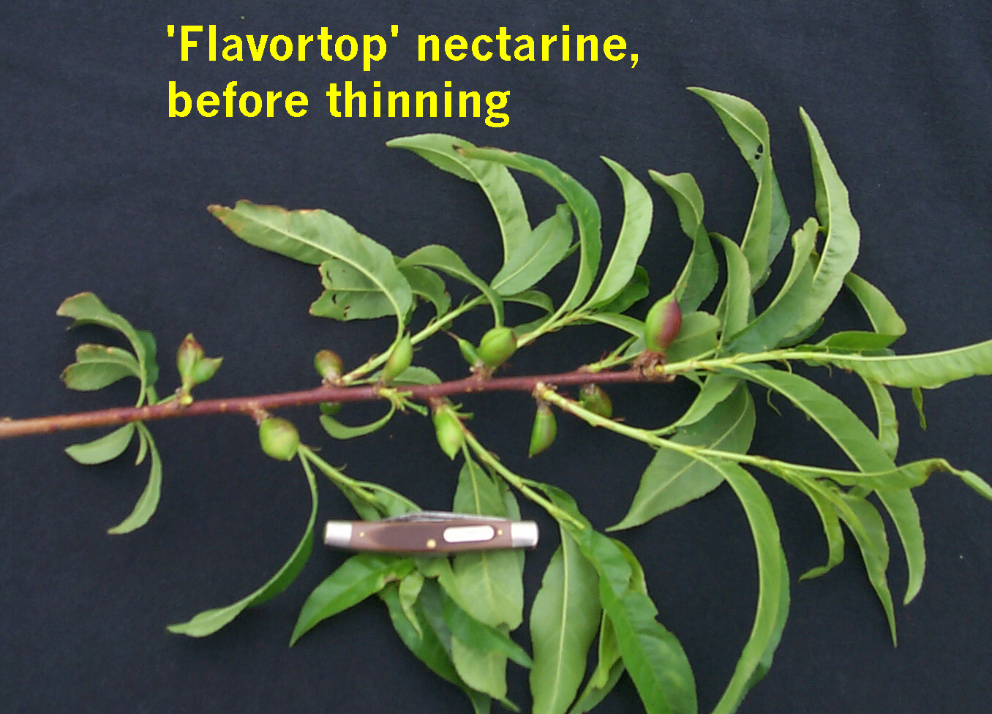
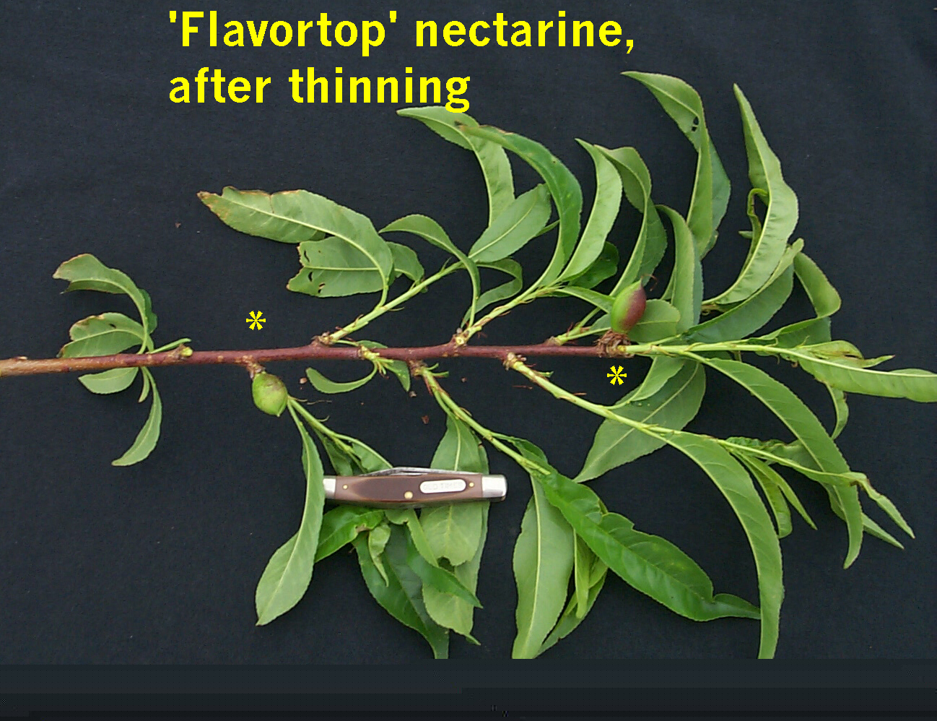
Peach, nectarine,
and plum – space
6” apart

Slide 41
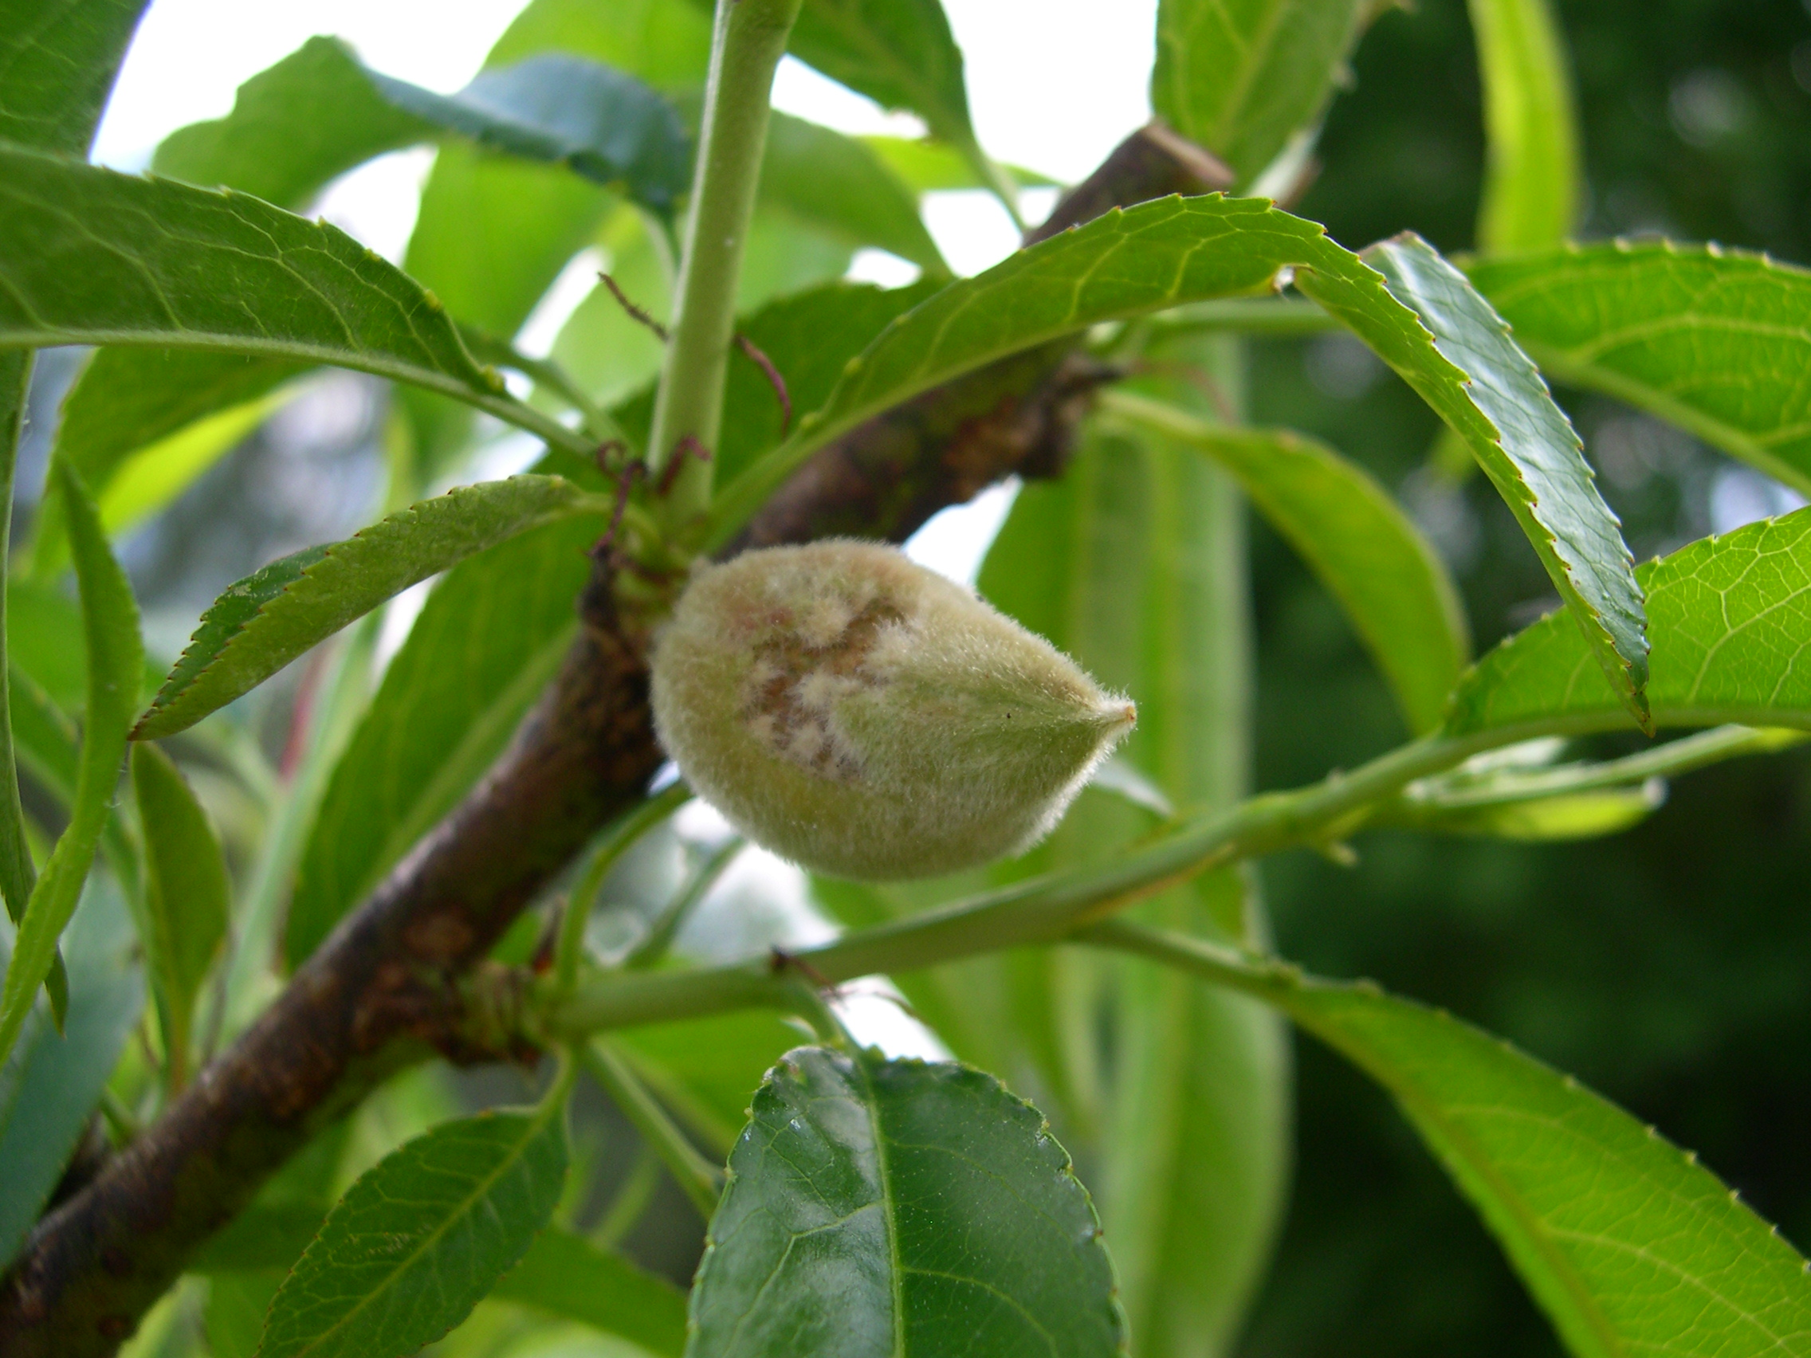
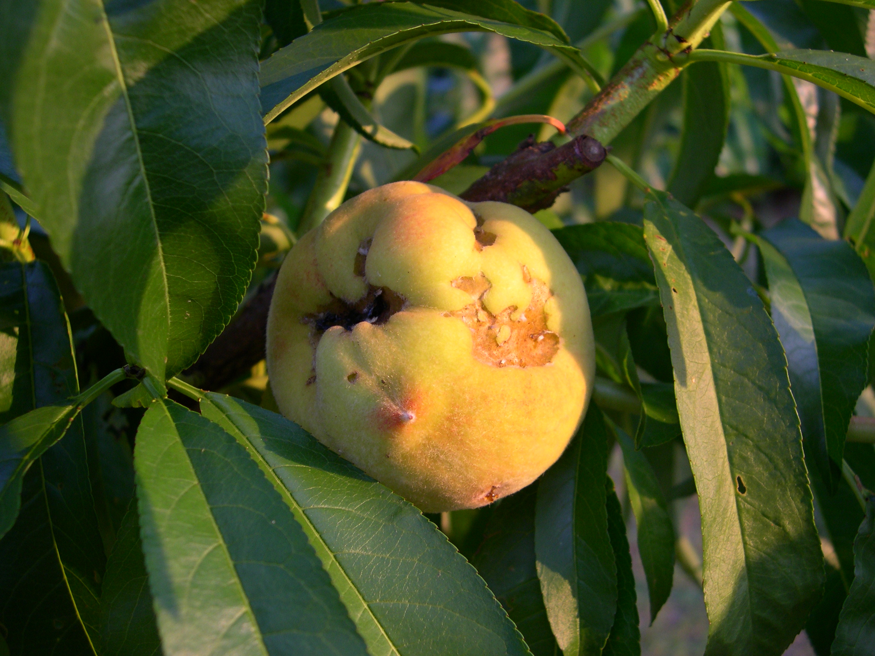
Remove damaged fruit throughout the season – thinning effect

Slide 42
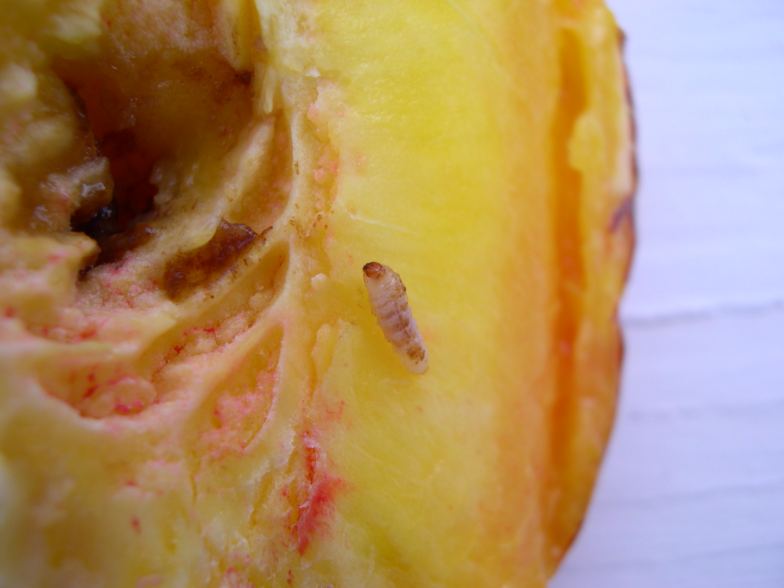
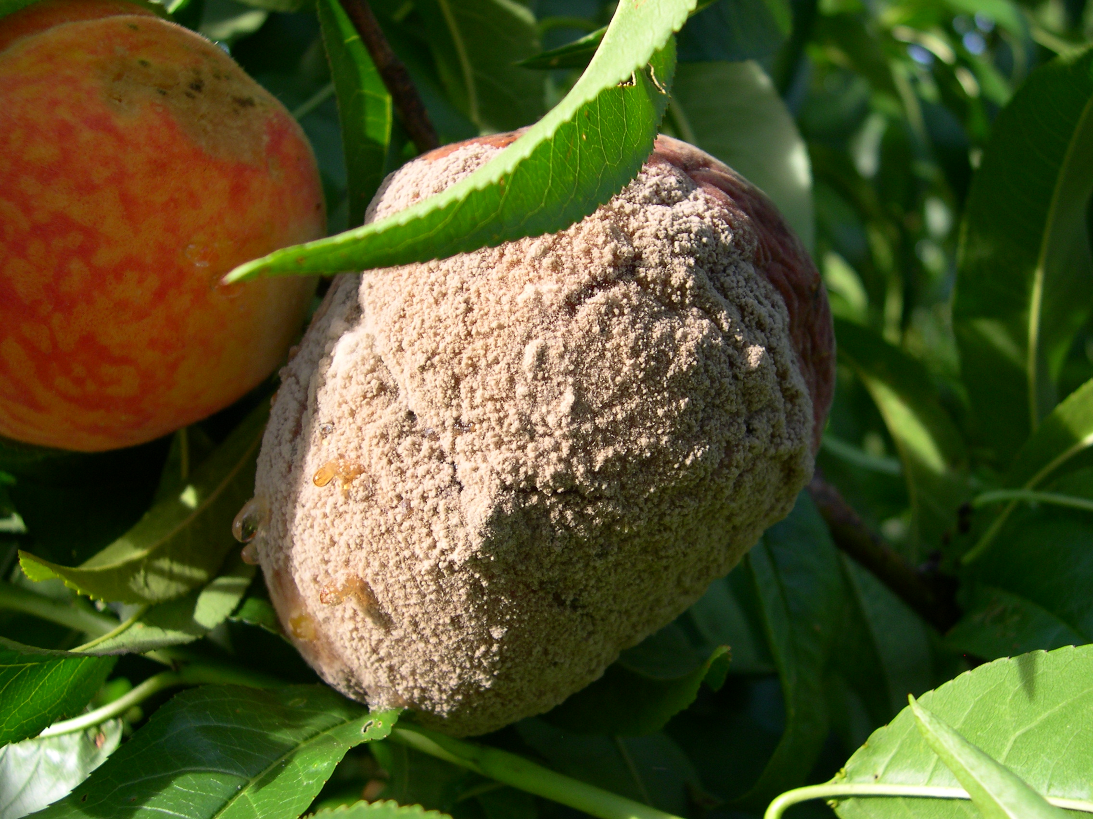
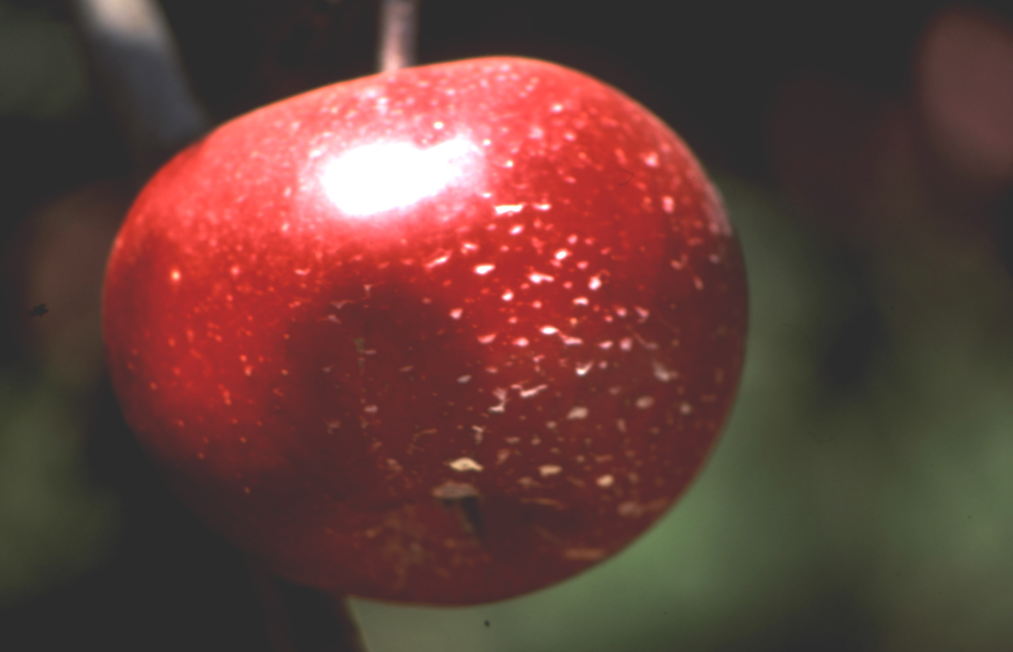
Pests!
Poor results in tree fruit without sprays

Slide 43
General Pest Control – tree fruit
Fungal diseases of fruit, leaves | Fungicide, dormant oil | Pre-bloom and post-bloom sprays
Fruit deforming/invading insects | Insecticide | Post bloom, each 2 weeks until mid-May
Fruit rot, fruit-feeding insects | Insecticide & fungicide | 6-8 weeks up to 2 weeks pre-harvest
Trunk, limb borers (peach, plum, nectarine) | Insecticide | Spray trunk and lower limbs 1 Sept

