Slide 1
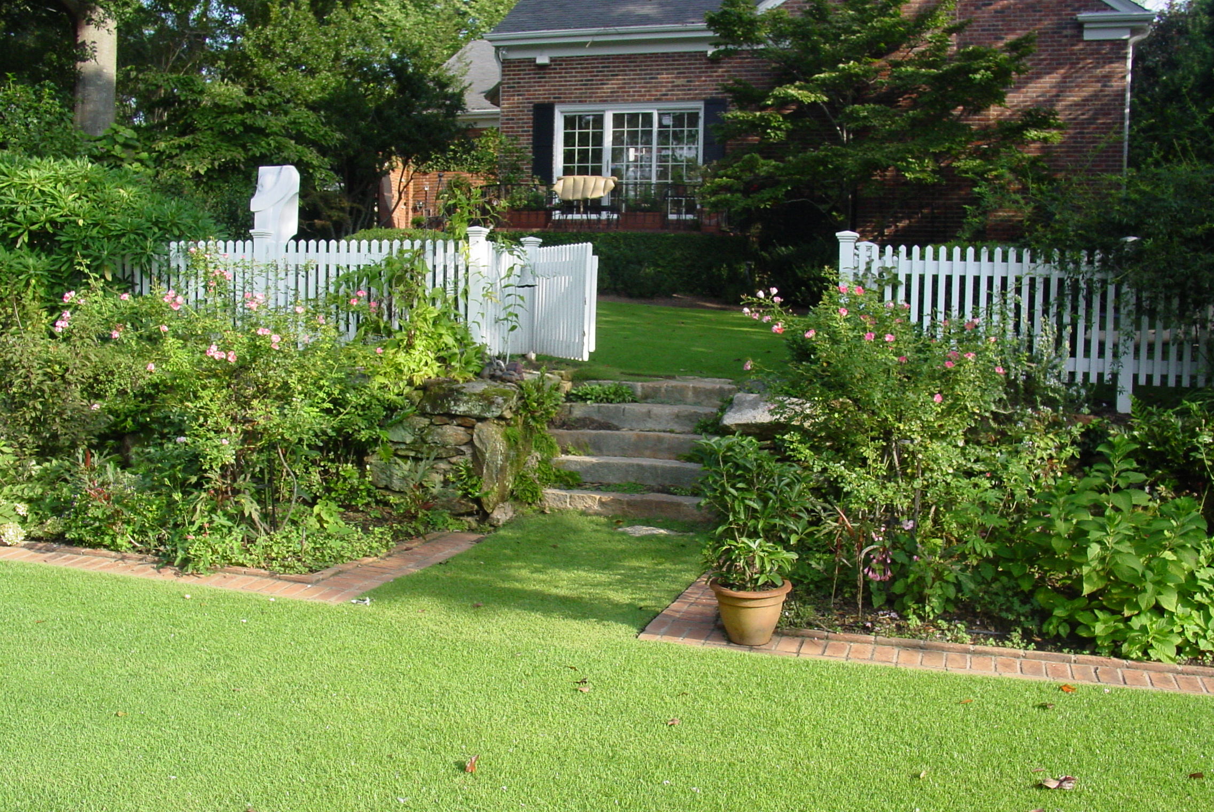
BMPs for Water Conservation

Slide 2
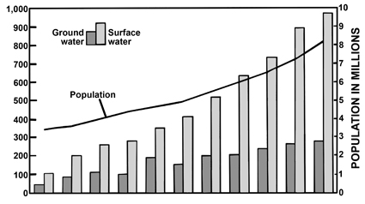
Population Growth & Water Use
- GA Water Use increased 20% between 1990 – 2000 (EPD, 2007)
- 16% increase in population projected for 2000 – 2010 (Bachel, 2003)

Slide 3
Urban Areas
1/2 population in
12 urban counties
2/3 population
in 40 counties

Slide 4
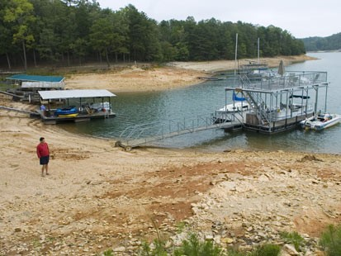
Water Restrictions
Rapid population growth in Southeast
Demand for water is increasing
Water is not unlimited
Lack of water can harm
-wildlife
-landscapes
-business

Slide 5
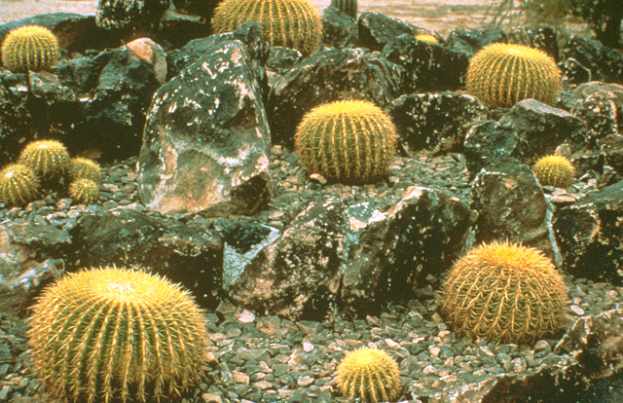
Landscape Design?
Notes:
To many people, Xeriscaping implies cactus gardens or barren landscapes! A Xeriscape is not a dry, prickly cacti garden.

Slide 6
Design BMPs for Water Conservation
Develop a design
Preserve established vegetation
Consider light conditions in plant selection
Select plants that tolerate site temperatures
Select plants adapted to area rainfall
Group plants according to water needs
Reduce root competition – spacing
Reduce or utilize surface drainage
Small, concentrated, high impact seasonal color
Efficient irrigation
http://apps.caes.uga.edu/urbanag/pubs/bmp_watercon.pdf

Slide 7
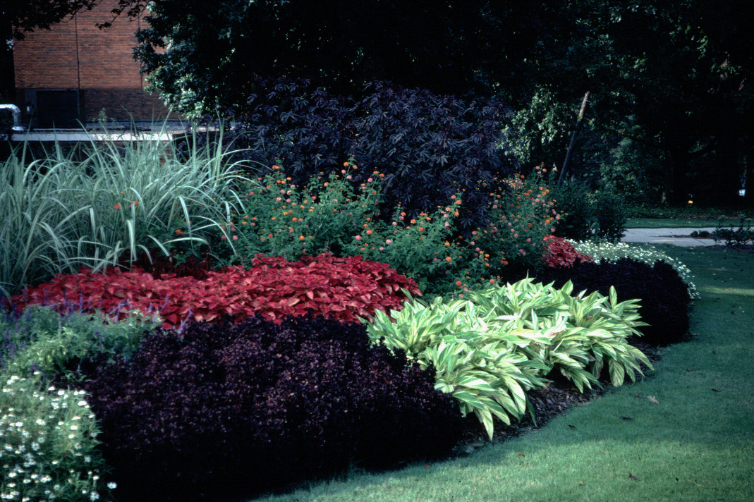
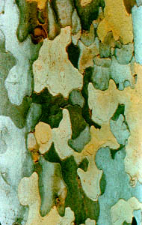
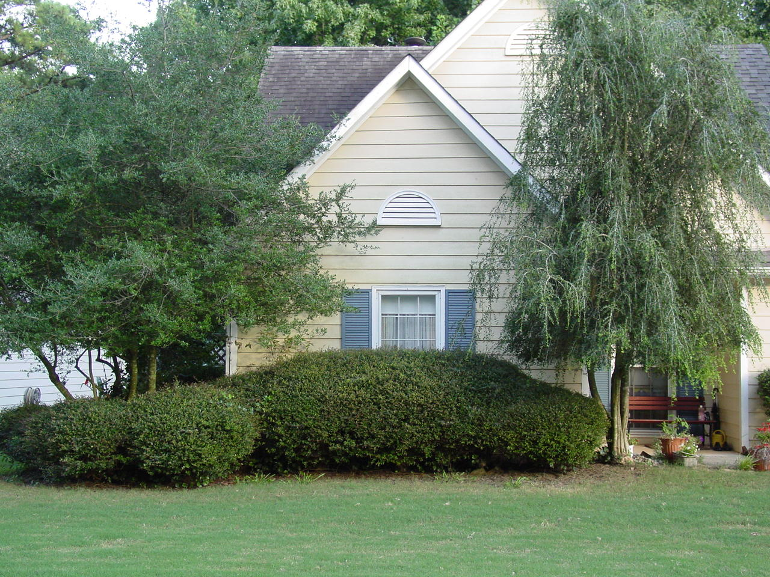
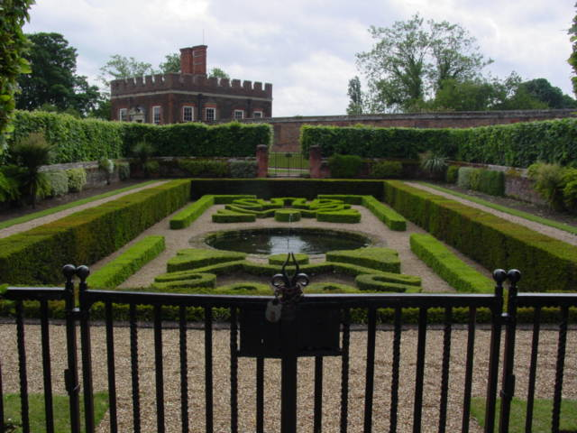
Traditional Design
considerations
Color
Texture
Form
Arrangement

Slide 8
Why Not Include Plant Water Use
In Design
Notes:
If you don’t know what you want then it’s likely that is what you will get

Slide 9
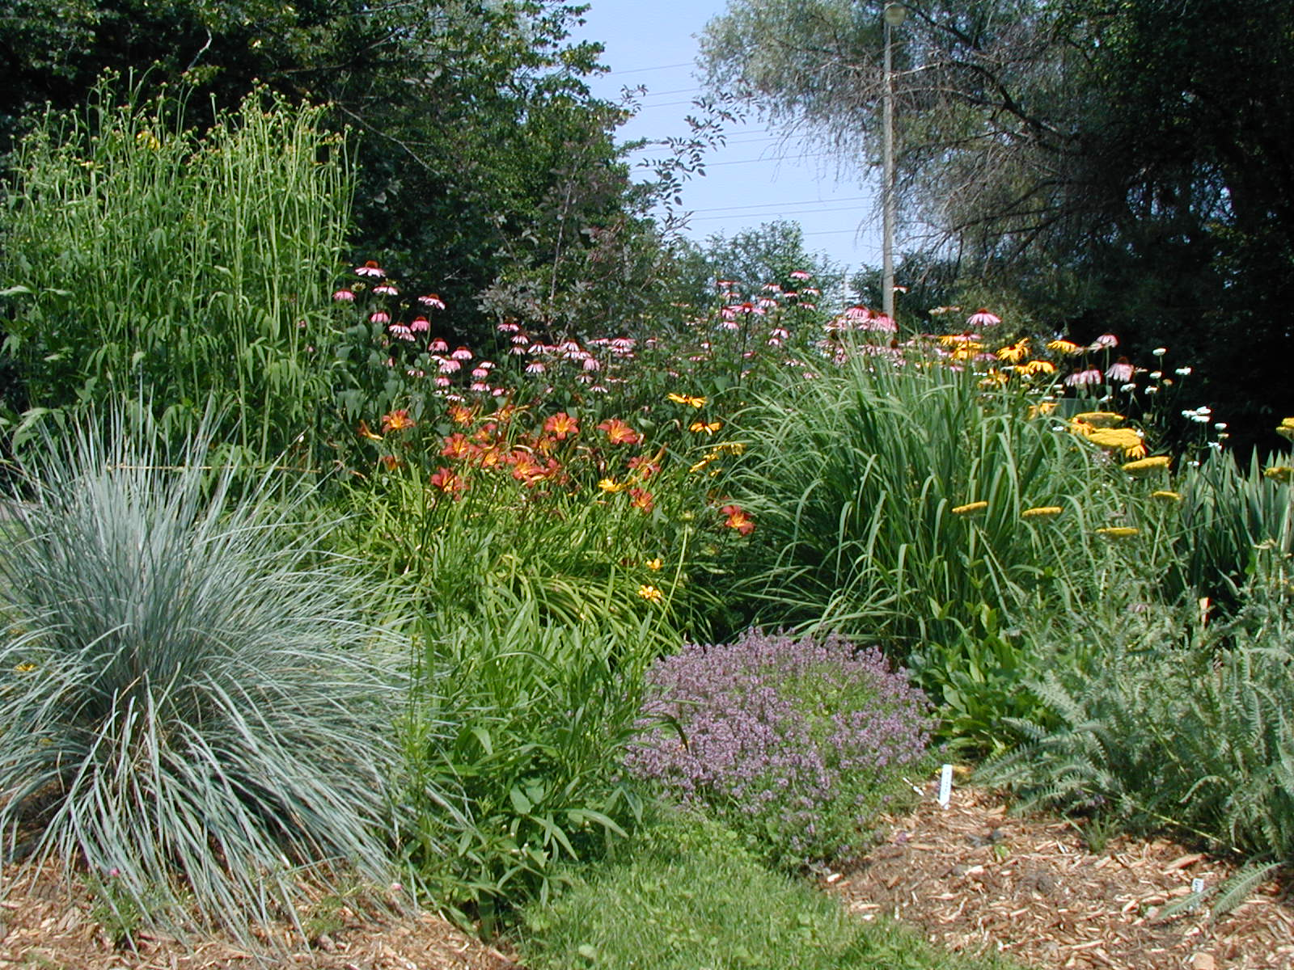
Plant for Water Conservation

Slide 10
Installation BMPs for
Water Conservation
Plant in fall and winter
Prepare planting bed – infiltration, water holding
Appropriate soil amendments
Soil testing – proper lime and fertilizer
Mulch
http://apps.caes.uga.edu/urbanag/pubs/bmp_watercon.pdf

Slide 11
Timing of Installation
*Average from 1953 to 1992
**Average from 1971 to 1992
Start Here!
Evaporative Water Loss - Inches
*
**
Notes:
Evaporation Chart: In Georgia, summer evaporation rates can be quite high and newly planted perennials may not be able to keep up with the heavy water demand. This may also cause a homeowner to use much more water than is necessary in a well-planned perennial planting. Note how the evaporation rates, and hence the water demand, drops off in October. This is the best time to plant!

Slide 12
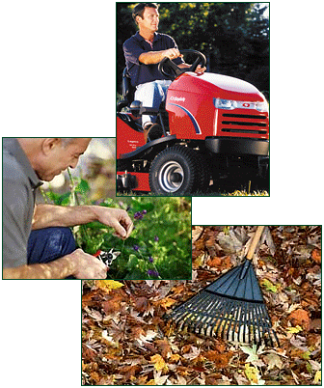
Maintenance

Slide 13
Maintenance BMPs for
Water Conservation
Proper liming and fertilization
Relieve compaction, improve infiltration
Pest control – weeds, insects, fungus, vertebrates
Mowing height
Proper pruning – selective vs. sheering
Mulching or topdressing

Slide 14
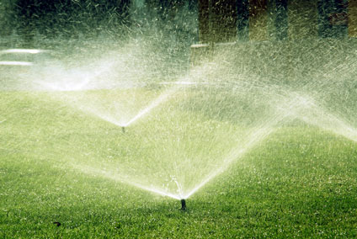
Irrigation BMPs

Slide 15
Irrigation
Design – deliver the correct quantity
Frequency – soil moisture or plant stress
Time of day
Efficiency – uniform, leaks, overspray, evaporation
Quantity – encourage deep roots

Slide 16
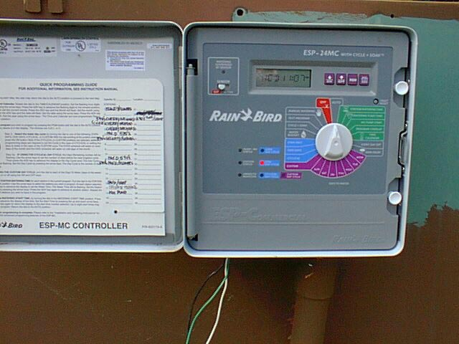
Automatic Timer
More difficult to set
Automatically turns irrigation on
Automatic shutoff
Notes:
78. ADJUSTING THE TIME CLOCK. If your landscape has an automated irrigation system, remember to adjust it according to changes in rainfall patterns. Don’t just set it and forget it.

Slide 17
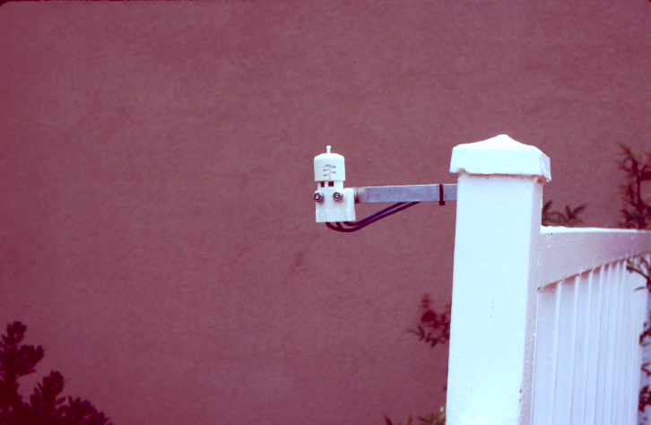
Rain Cutoff
Don’t water in the rain-
Install an automatic rain cutoff device

Slide 18
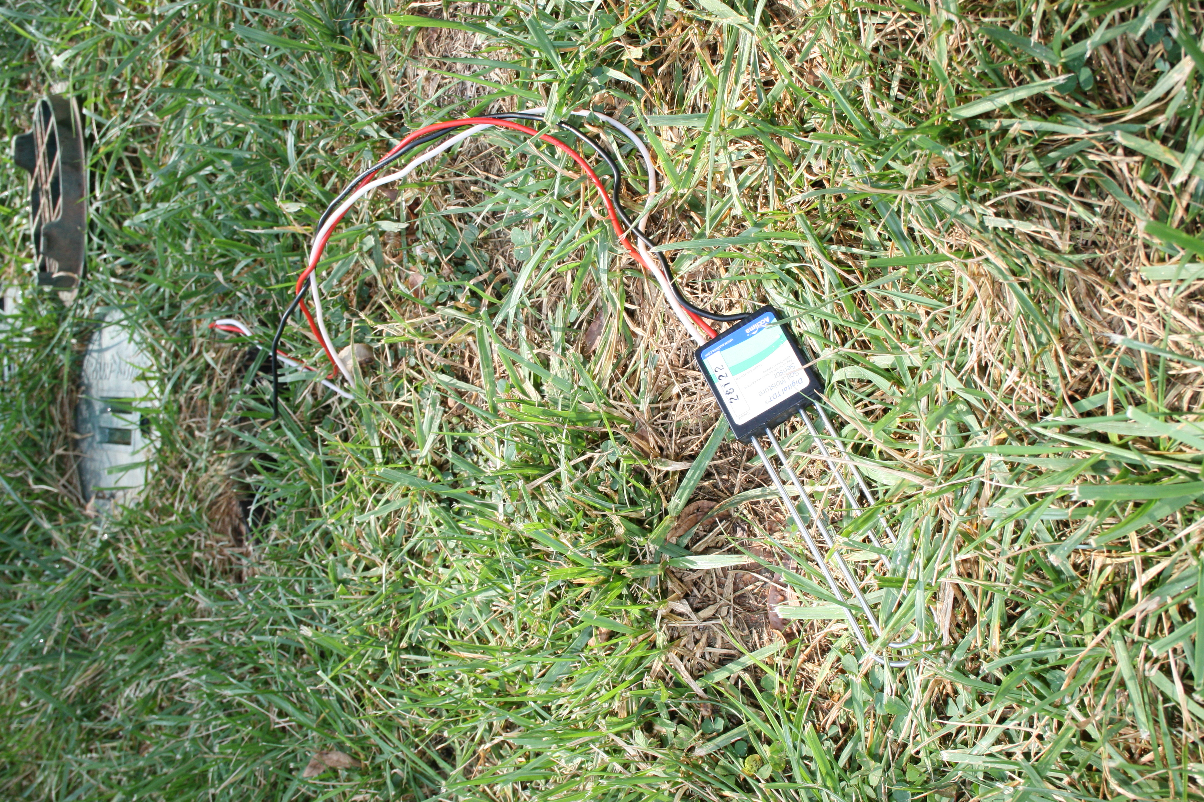
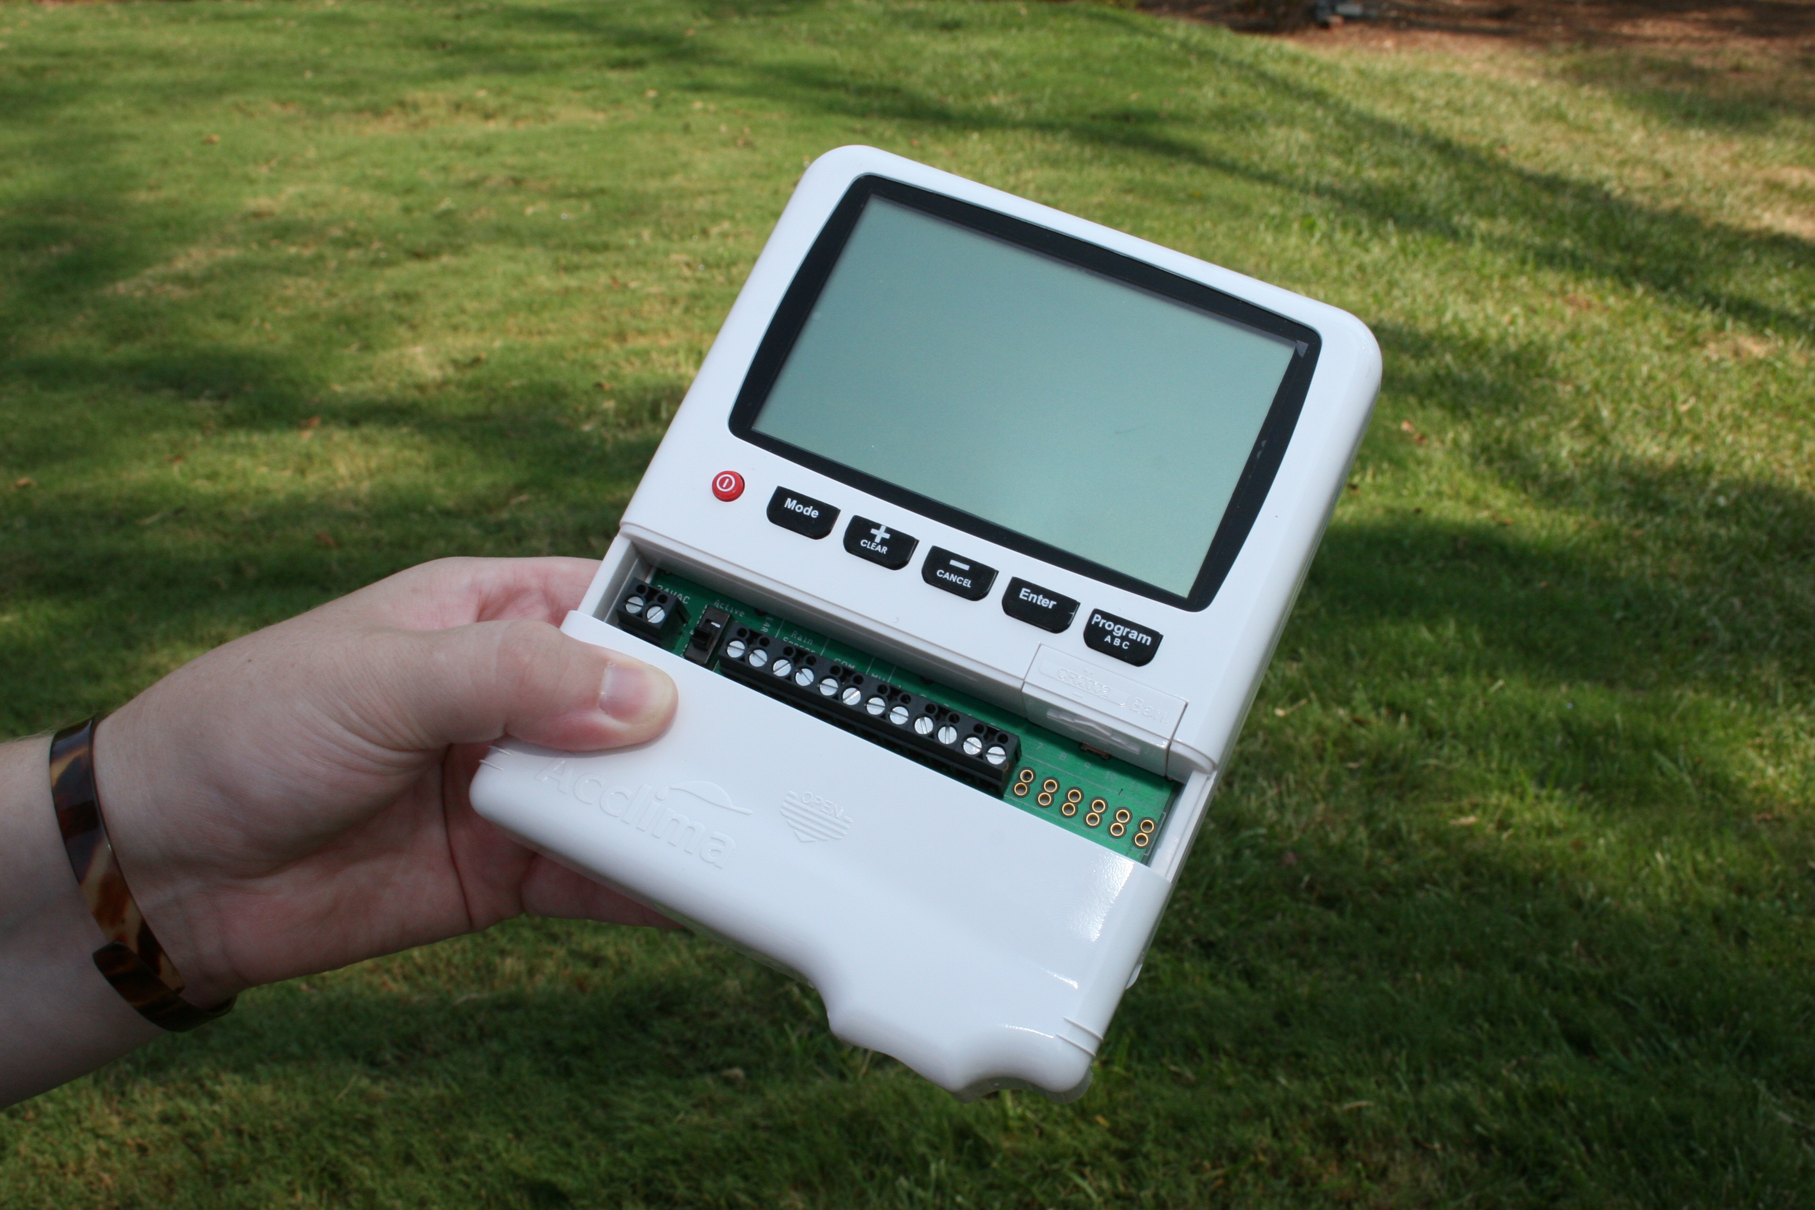
Soil Moisture
Sensors
Water savings of 46 to 88% reported in Florida
compared to systems with rain sensors
(Lailhacar et al., 2005)

Slide 19
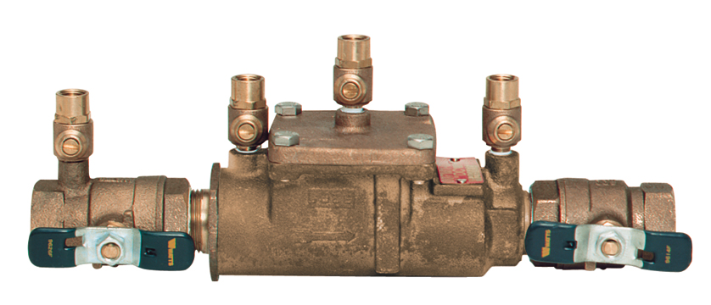
Check your Ordinances
Backflow Prevention may be required to prevent your
irrigation system from contaminating water supplies
Watts.com

Slide 20
Irrigation Scheduling
When are you allowed to irrigate?
What days?
What hours?
Don’t get fined

Slide 21
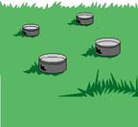
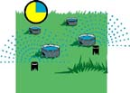
How do I know how long
I need to irrigate?
Set out tuna cans randomly throughout
your lawn
2. Turn on irrigation for 15 minutes
check to be sure irrigation is uniform adjust heads if irrigation isn’t uniform
3. Measure how much water
was applied and calculate how
long it will take to apply the water you need

Slide 22
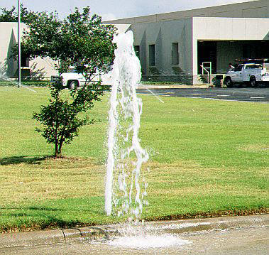
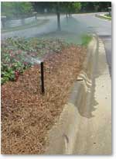
Check for leaks
Don’t water the
pavement

Slide 23
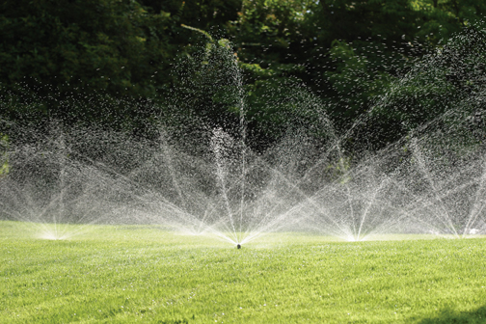
Spray Irrigation
Used to irrigate large uniform areas

Slide 24
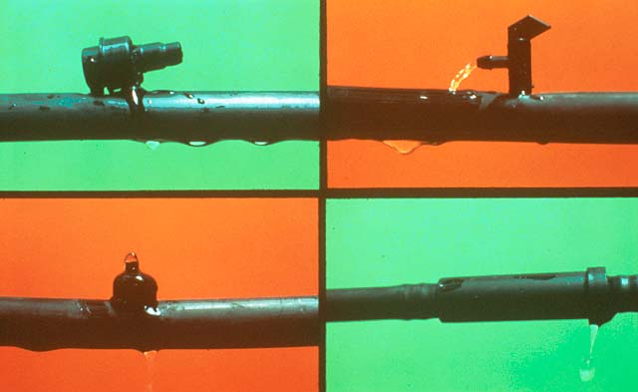
Drip Irrigation
Used to water individual plants
Notes:
4. PRAYER FOR RAIN. Periodic drought makes the problem even more pronounced, causing reservoir and river levels to drop and often forcing water authorities and elected officials to place restrictions or bans on outdoor water use in an effort to conserve available water supplies.

Slide 25
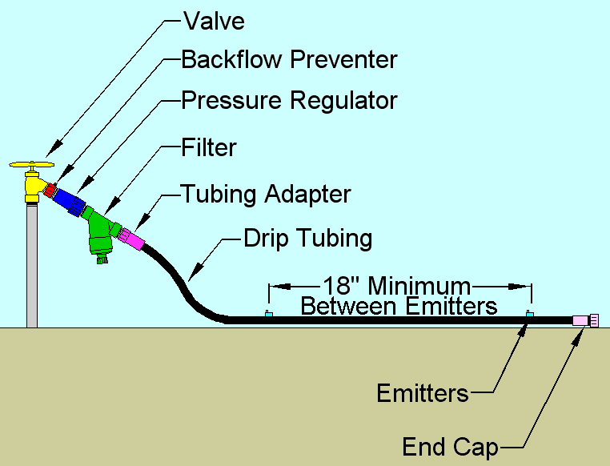

Slide 26
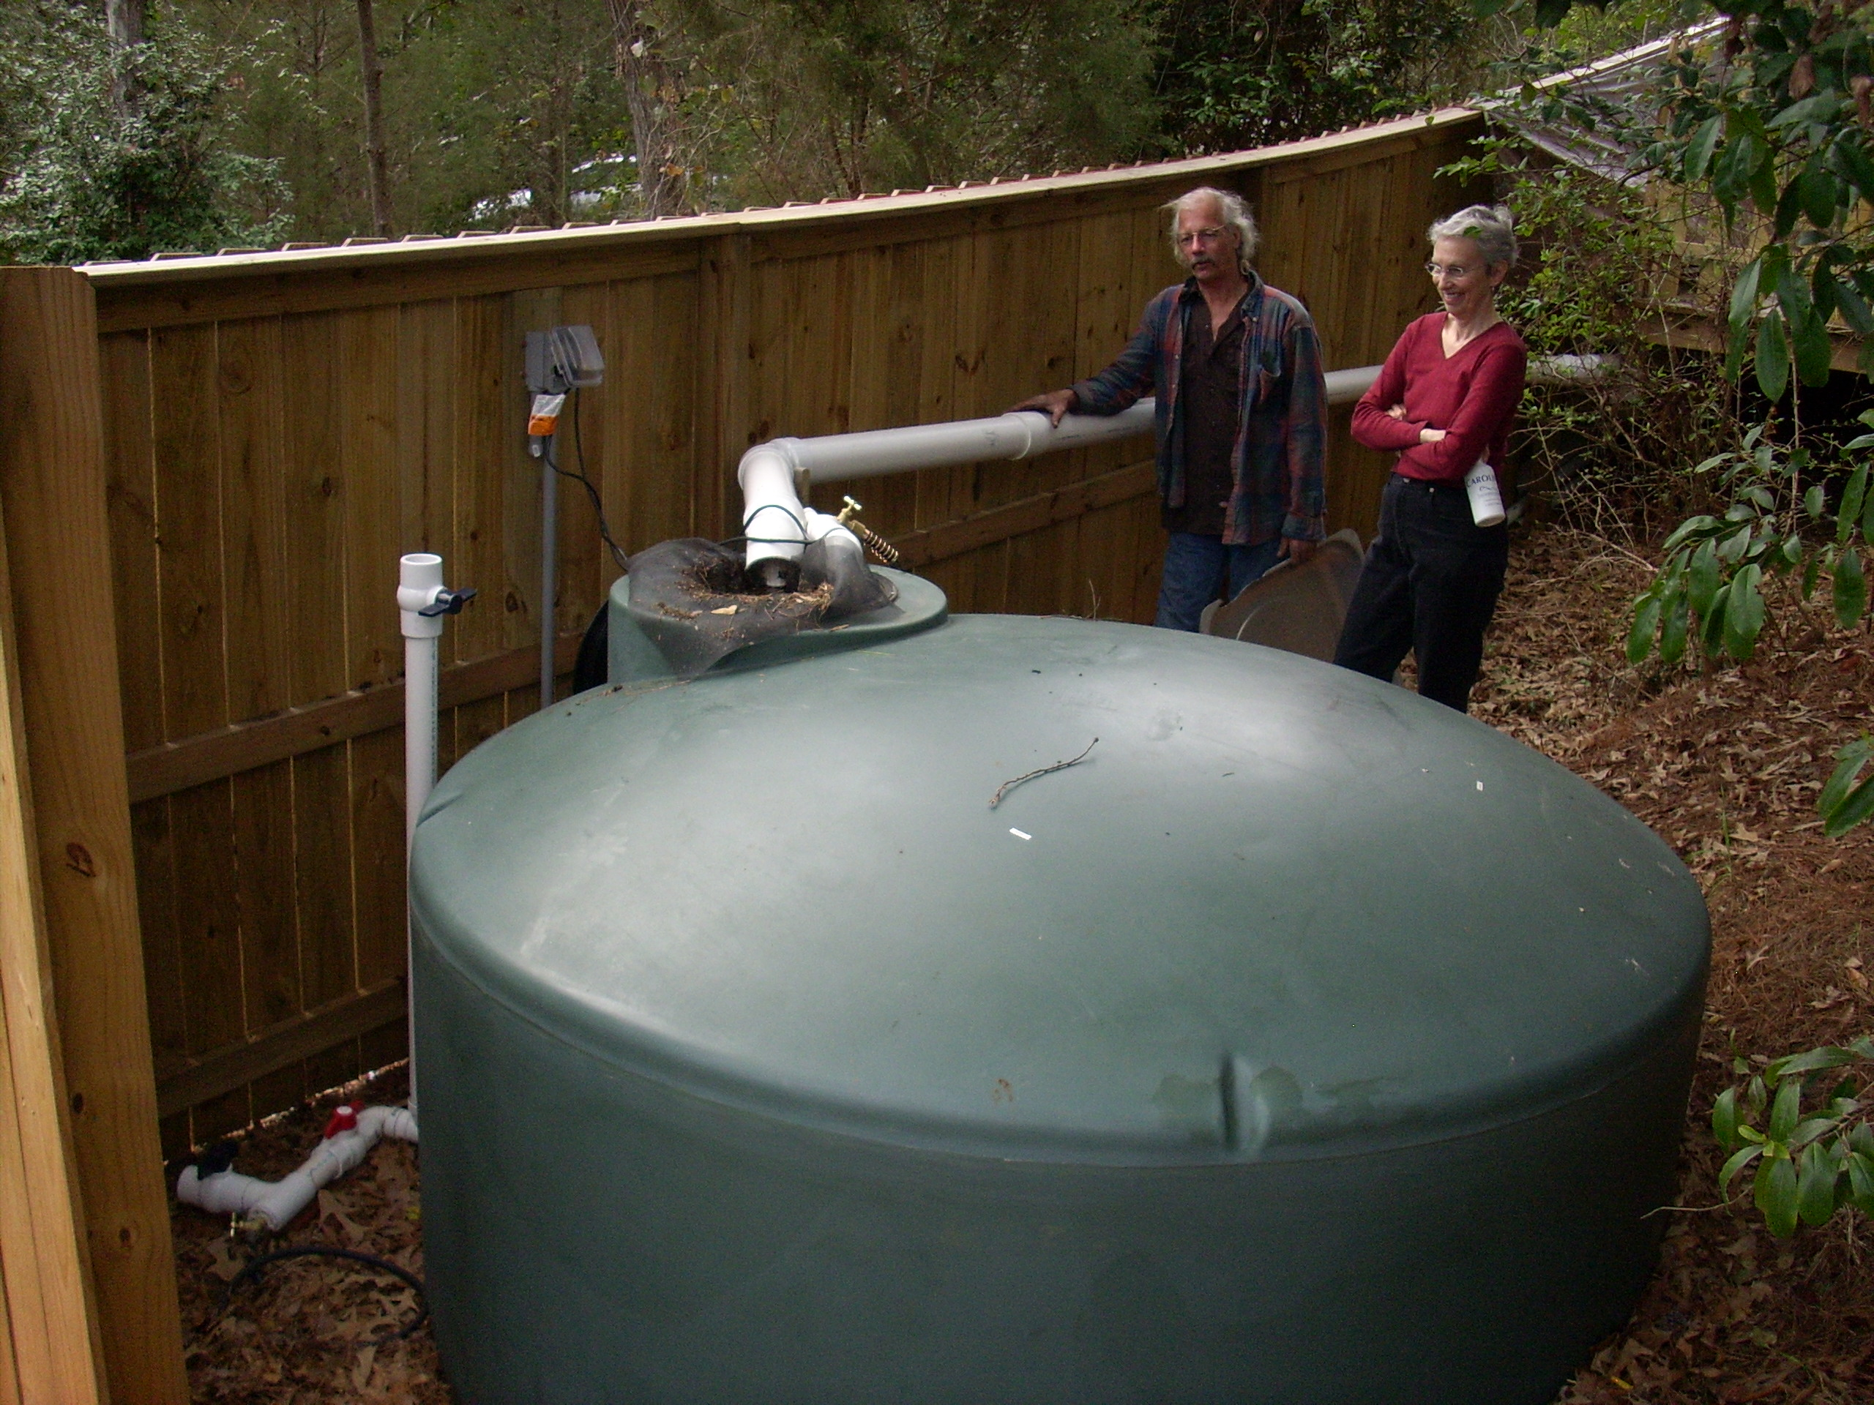
Rainwater Harvesting

Slide 27
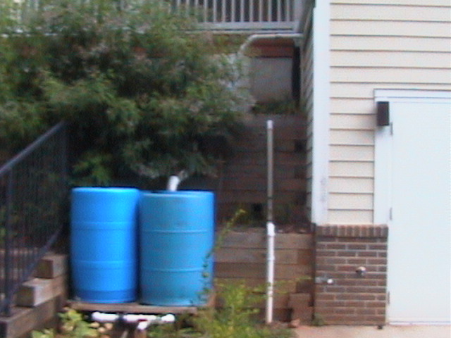
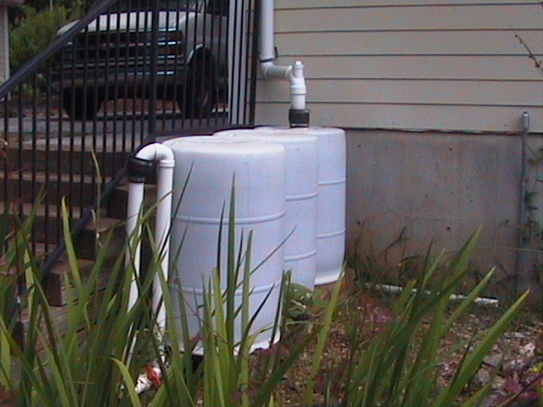
Rain Barrels
Notes:
Rain Barrels
(2 pictures)

Slide 28
Rain Barrels and Rain Harvesting
Rain barrels are one of many techniques we can use to make our landscapes more environmentally friendly.
Notes:
Rain Barrels and Rain Harvesting
Rain barrels are one of many techniques we can use to make our landscapes more environmentally friendly.

Slide 29
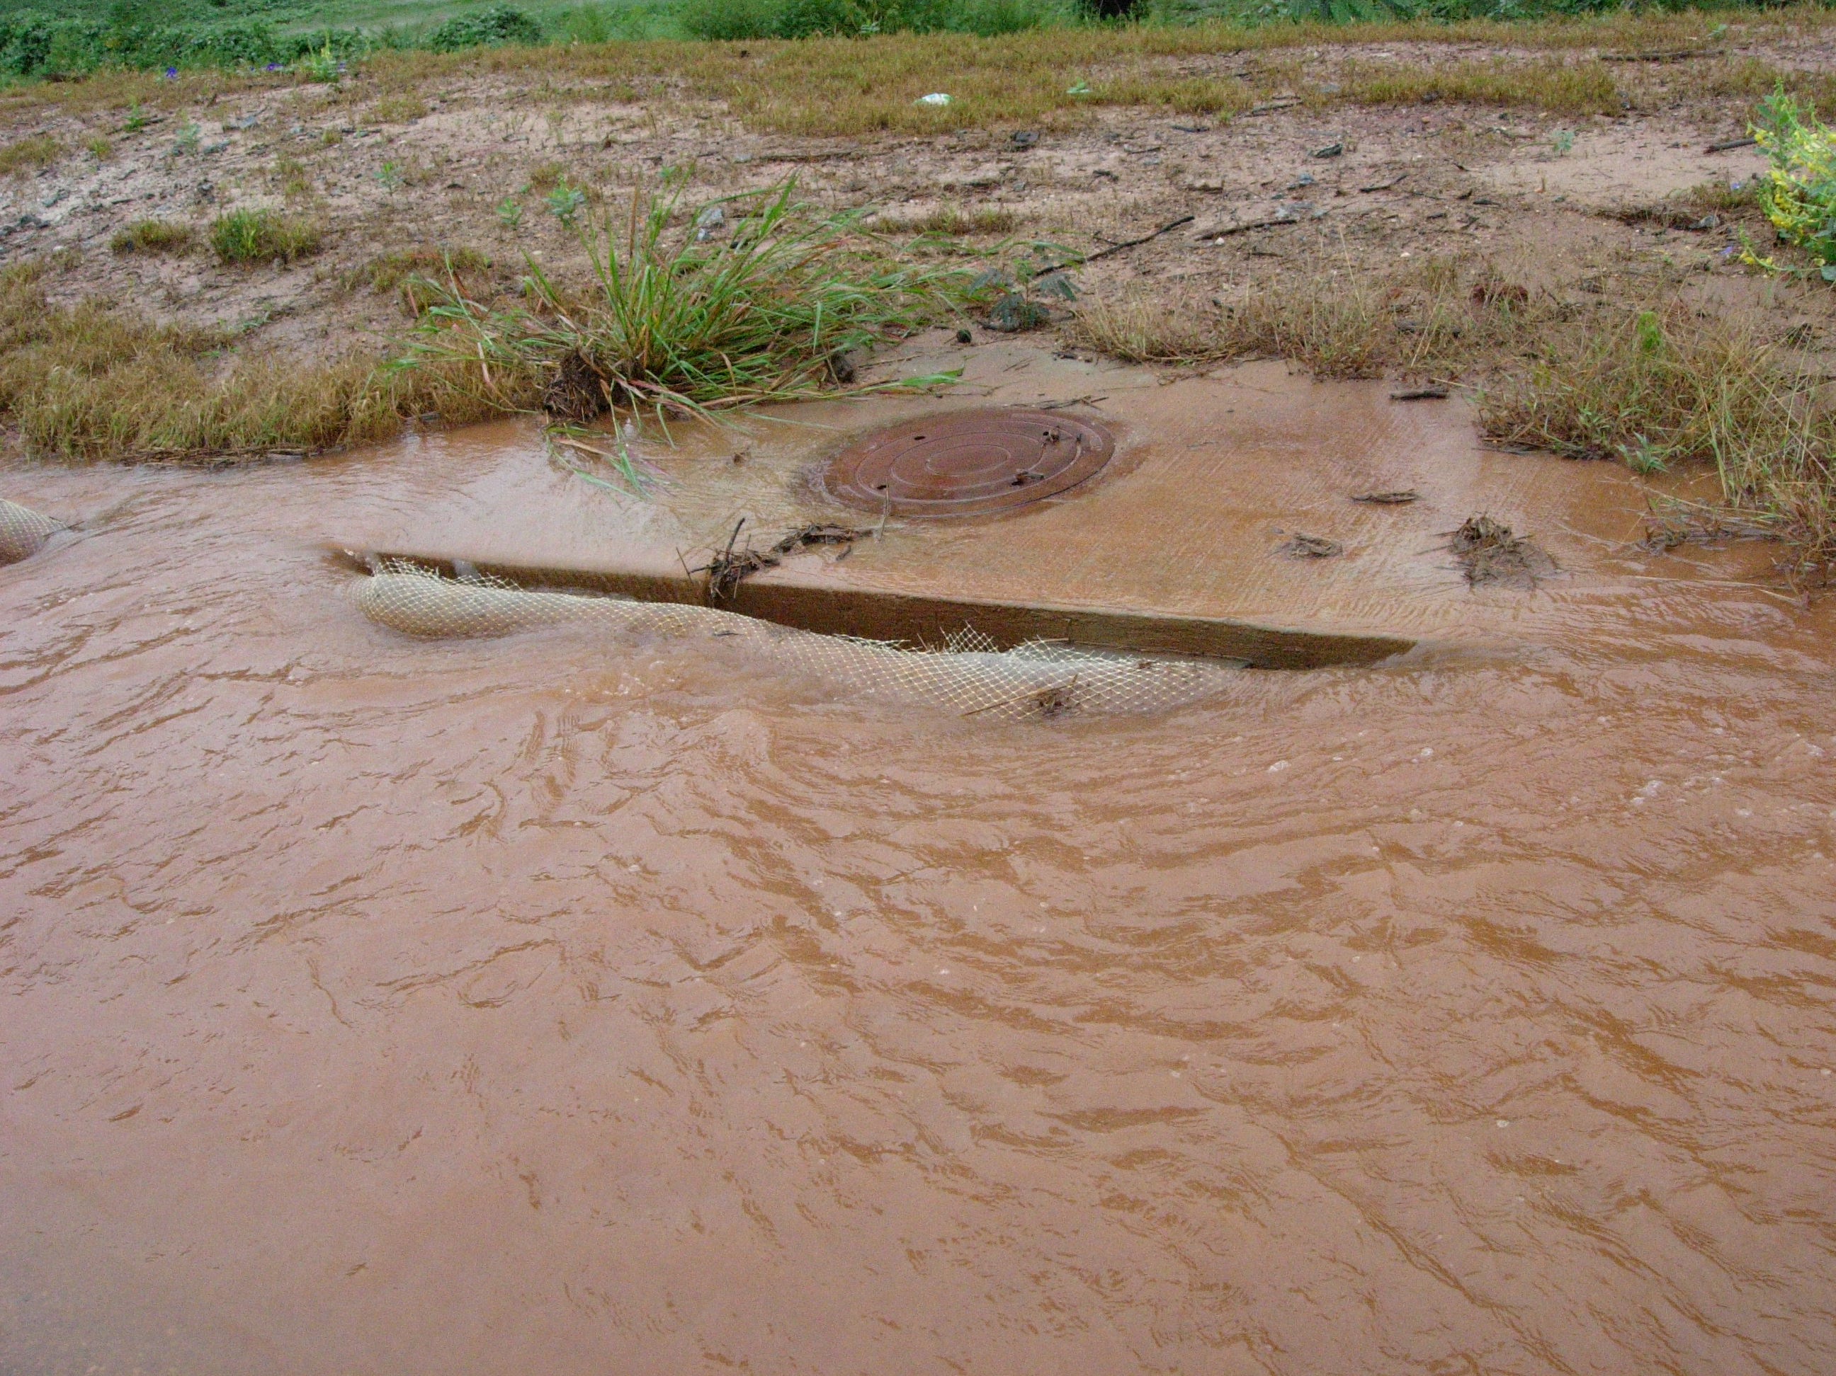
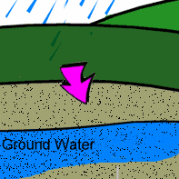
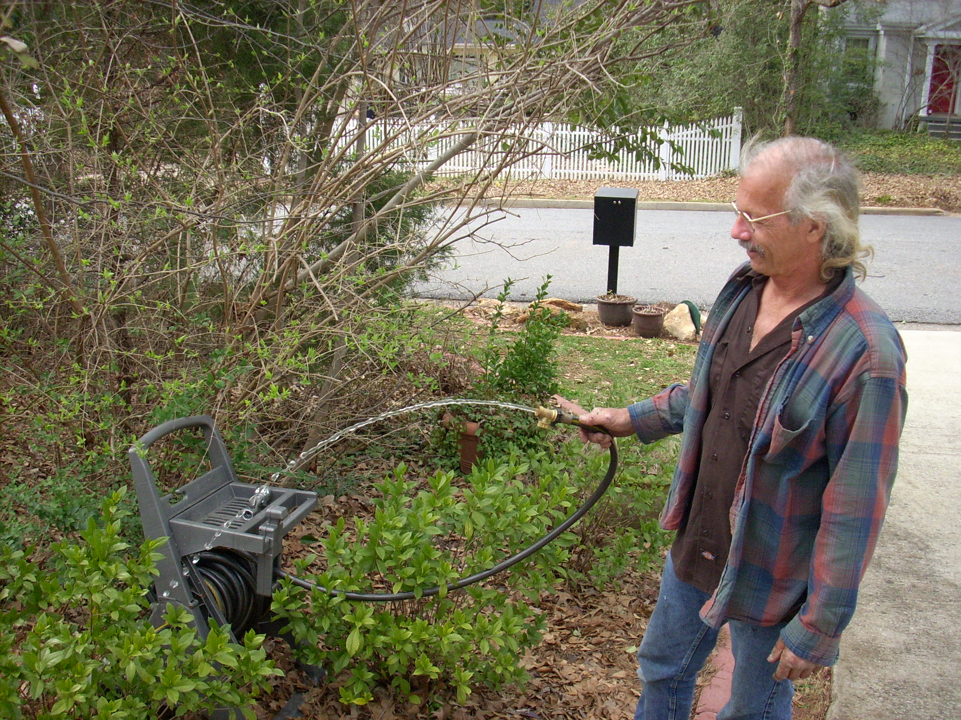
Environmental Benefits
increase infiltration
reduce erosion
reduce water use

Slide 30
How Can I Harvest Rainwater?
Harvested water for landscape uses does not require chemical and biological clean up.
Components of rain harvesting system:
- Collection area
- Transport system
- Filtration
- Storage
- Delivery and Distribution
Notes:
How Can I Harvest Rainwater?
Harvested water for landscape uses does not require chemical and biological clean up.
Components of rain harvesting system:
- Collection area
- Transport system
- Filtration
- Storage
- Delivery and Distribution

Slide 31
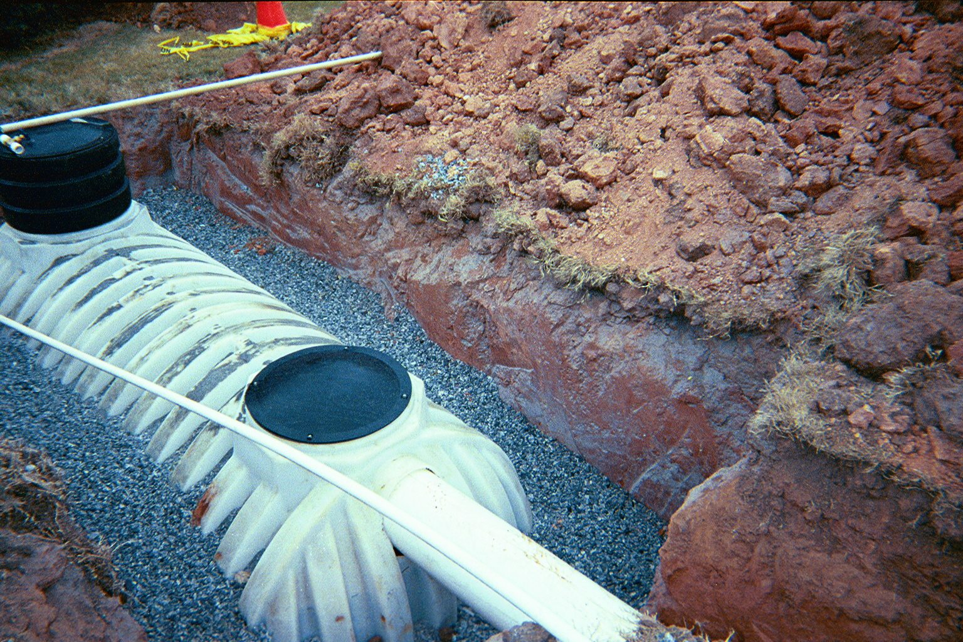
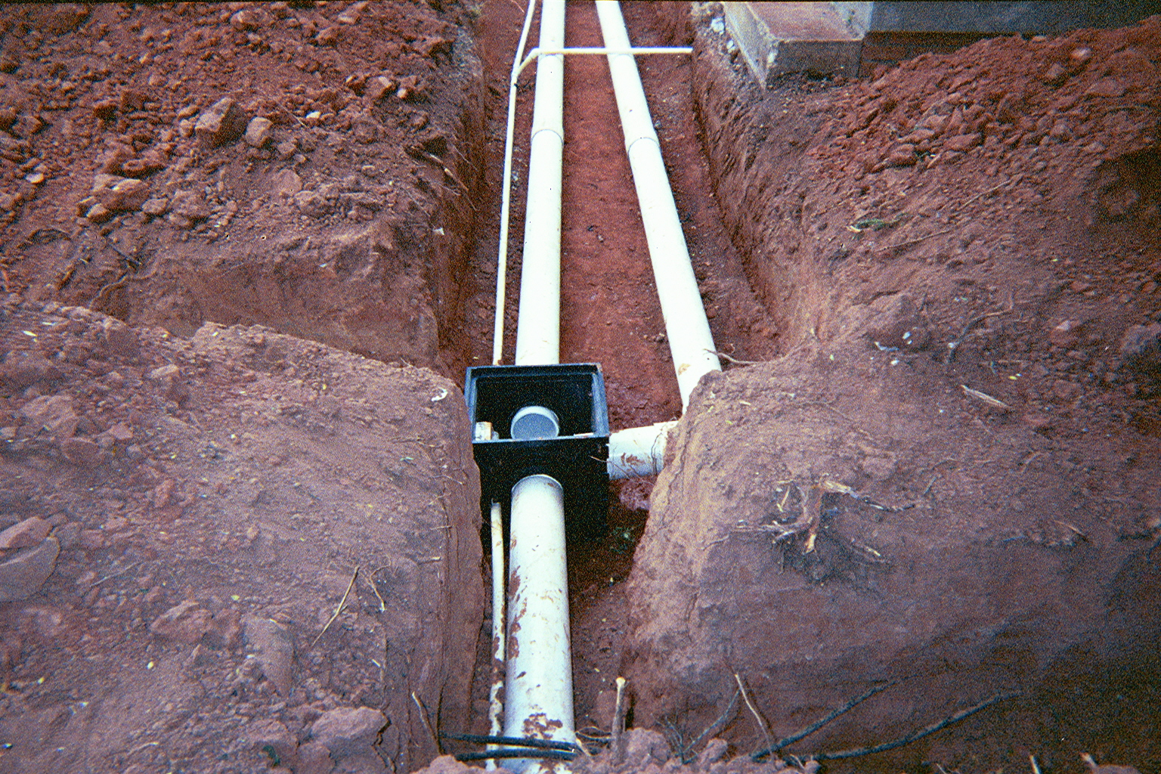
Collection Area and Transportation
Collection is most often rooftops.
Other impervious areas.
Turf areas and planting beds.
Transportation carries water from collection area to storage.
Gutters
Underground pipes
Notes:
Collection Area and Transportation
Collection is most often rooftops.
Other impervious areas.
Turf areas and planting beds.
Transportation carries water from collection area to storage.
- Gutters
- Underground pipes

Slide 32
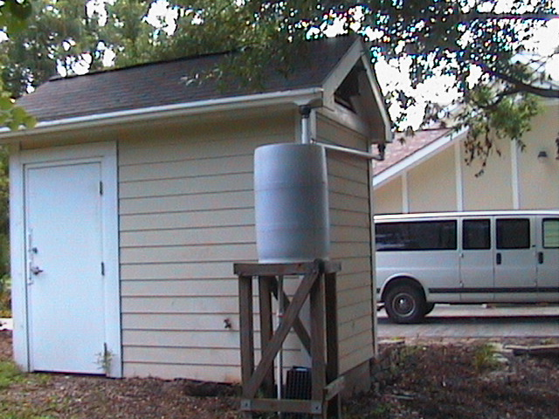
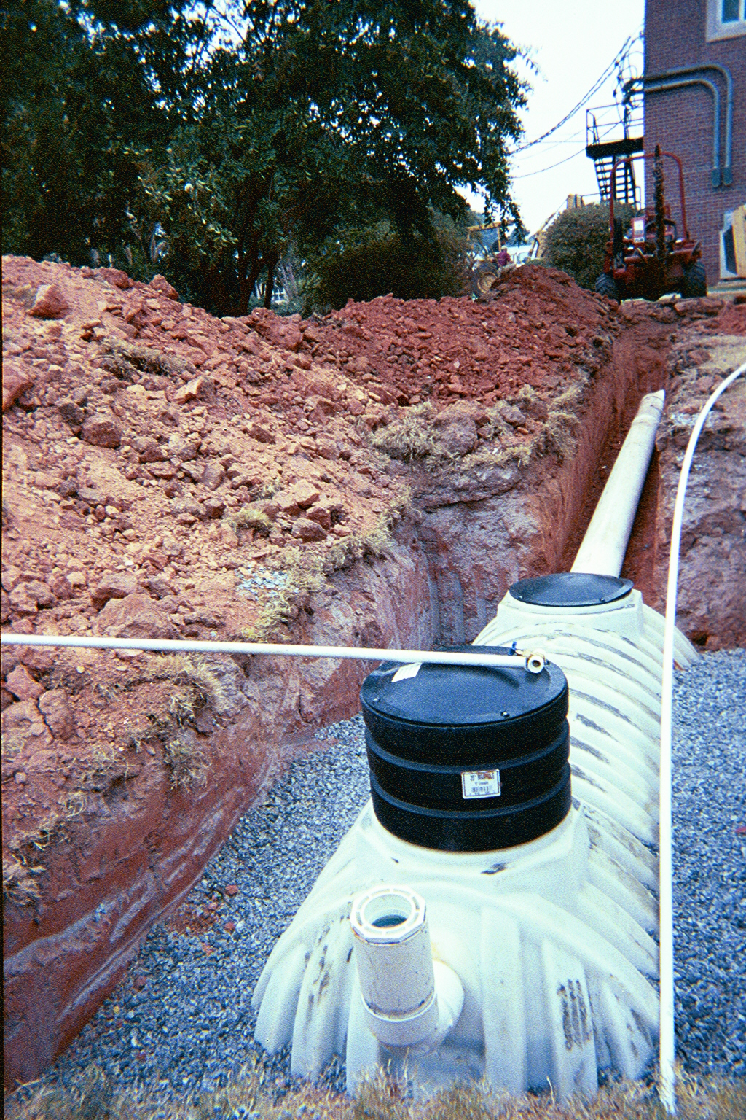
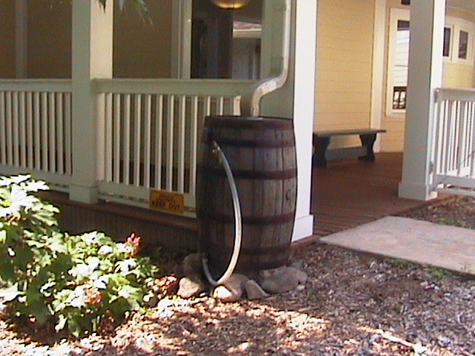
Filtration and Storage
Storage needs to be closed to keep out mosquitoes OR
Storage may be a pond where native ecosystem would provide mosquito control
Notes:
Filtration and Storage
Storage needs to be closed to keep out mosquitoes OR
Storage may be a pond where native ecosystem would provide mosquito control

Slide 33
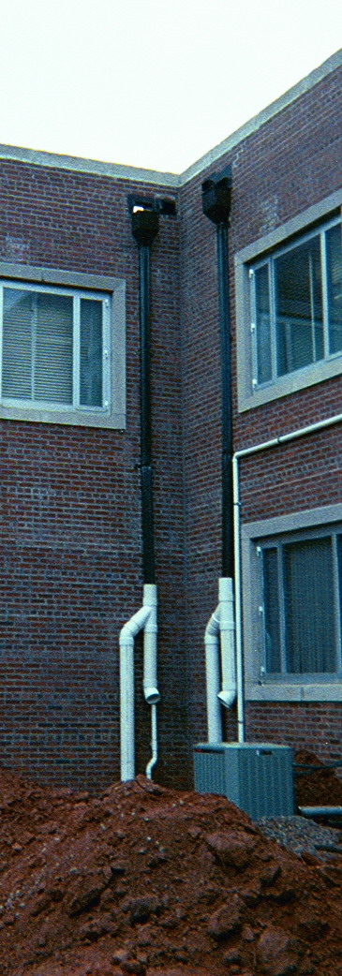
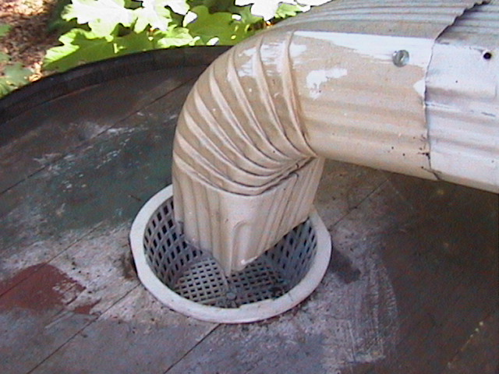
Filtration
Filtration needs depend on the particular collection area and any dirt or sediments that it would contribute.
Notes:
Filtration
Filtration needs depend on the particular collection area and any dirt or sediments that it would contribute.

Slide 34
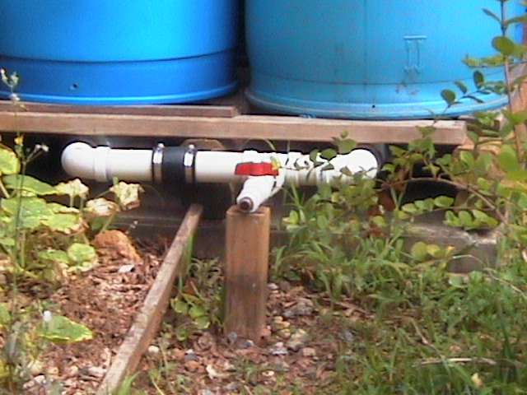
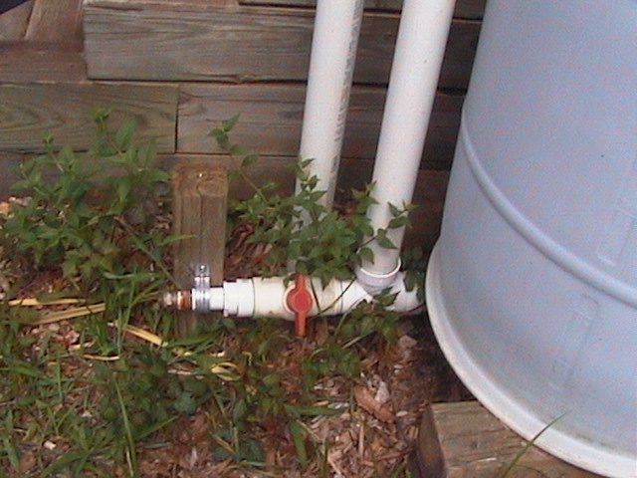
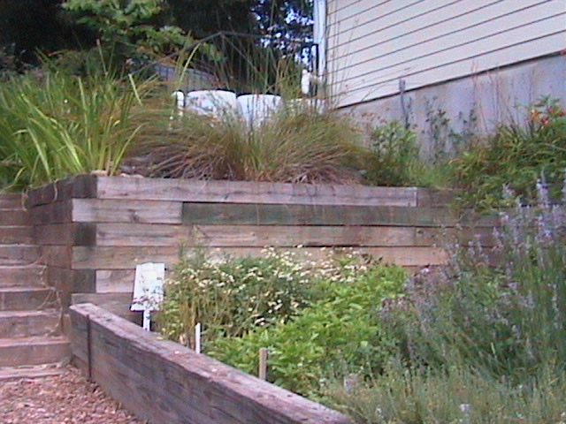
Distribution
After filter
Pressurized
Will require a pump and energy
Pipes and applicators must fit with the pressure the pump creates
Most likely drip applicators
Non-pressurized
Gravity flow
Use spigots and hose
Elevation of storage
is critical
Notes:
Distribution
After filter
Pressurized
- Will require a pump and energy
- Pipes and applicators must fit with the pressure the pump creates
- Most likely drip applicators
Non-pressurized
- Gravity flow
- Use spigots and hose
- Elevation of storage is critical

Slide 35
Storage Overflow
Cisterns and barrels can only hold so much rain.
Must have an overflow.
Notes:
Storage Overflow
Cisterns and barrels can only hold so much rain.
Must have an overflow.

Slide 36
Maintenance
Clean filters.
Wash and clean out above ground barrels yearly.
Keep roof gutters clean to minimize trash in storage.
Notes:
Maintenance
Clean filters.
Wash and clean out above ground barrels yearly.
Keep roof gutters clean to minimize trash in storage.

Slide 37
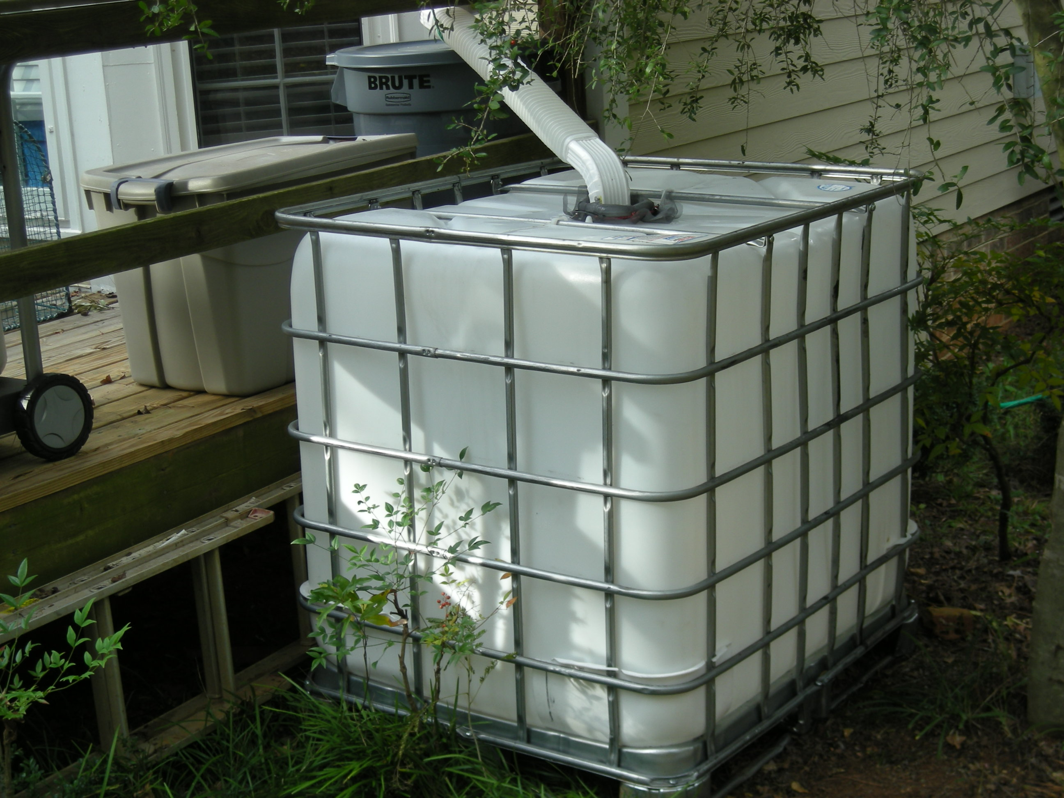
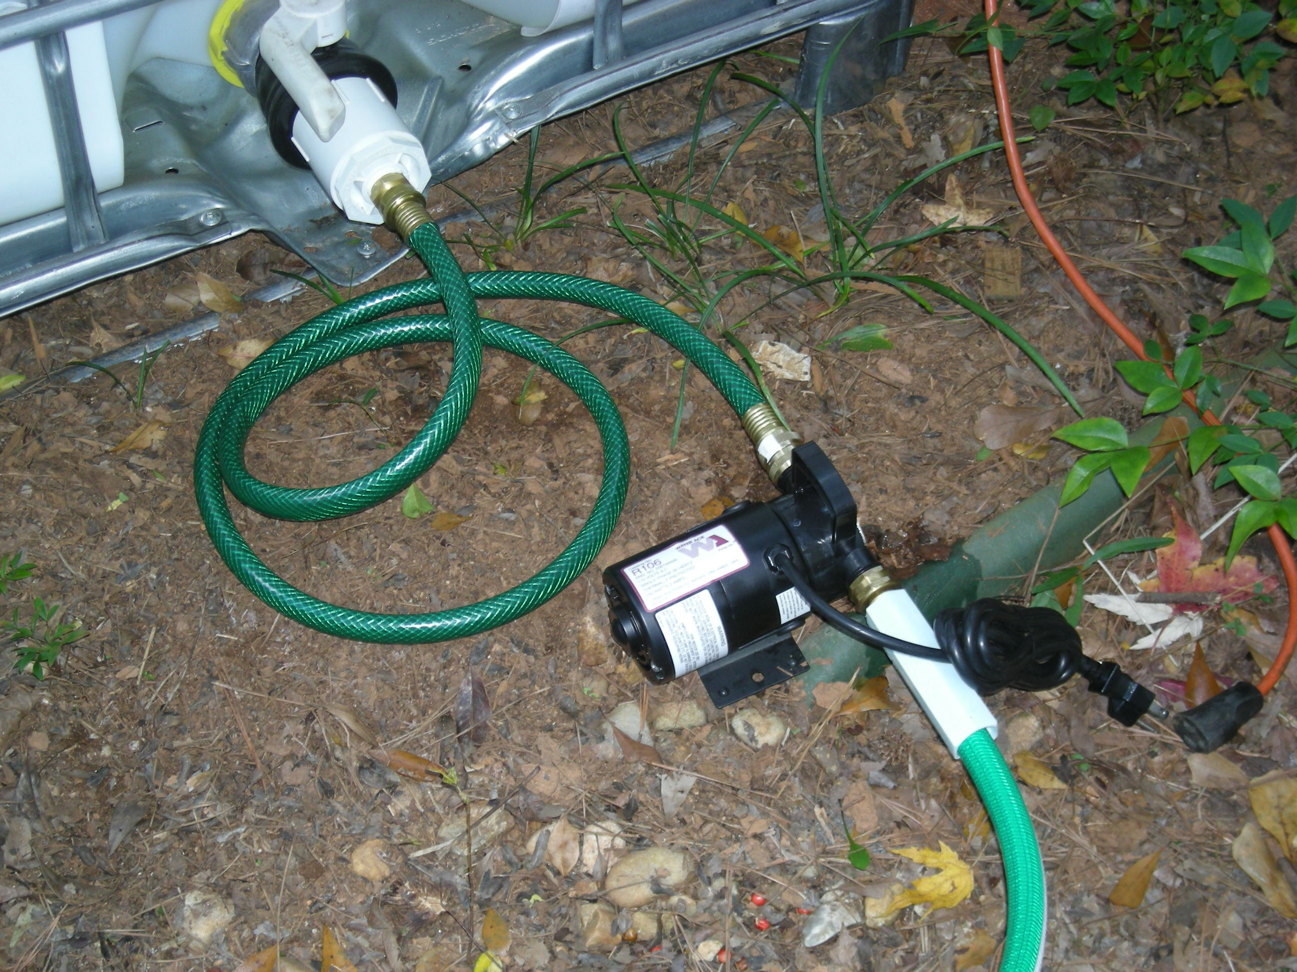
Rainwater & Condensate Water
Irrigation is not restricted (ban proof)
Large quantities can be harvested
- May be enough to meet landscape needs

Slide 38
1. How much water is needed for irrigation?
2. How much water can be harvested?
3.How much water can be stored?
?
?
?
needs
supply
storage

Slide 39
Rules of thumb for irrigation
Shrubs: up to once a week - apply one gallon of water per foot of plant height
Lawns: up to once a week -
up to one inch per application
Trees: up to once a week
one inch of water under entire
canopy

Slide 40
Area based
water use
Low
Low
H
H
Lawn
25’ x 40’ = 1,000 ft²
1” per week = 624 gal.
~2500 gal./month
Do we need to water lawns?
Notes:
Converted woody plants in natural area into unirrigated low water use zone. Lawn used as a welcome mat, selected drought tollerant
turf that requires minimal water (could convert to a low water use zone if aesthetics acceptable). Groundcover and shrub boarder is
Established and does not require additional irrigation. Added some high water use flower pots in high visibility area near door to add interest

Slide 41
Drought Tolerance of Turfgrasses
Hybrid bermudagrass
Zoysiagrass
St. Augustinegrass
Centipedegrass
Tall Fescue
Most
Least
Notes:
41
As you can see not all turfgrass species are created equally. In Georgia we are lucky to be in a transition area where many different species of turf can be grown. Please consider choosing a turfgrass based on its drought tolerance.

Slide 42
7’
7’
Water use based on
Plant Height
3’
4’
3’
6’
Ornamentals
50’ of plant = 50 gal.
4’
3’
50 gal./week
200 gal./ month
6’
7’
*Can we harvest & store 200 gal. per month?
Notes:
Converted woody plants in natural area into unirrigated low water use zone. Lawn used as a welcome mat, selected drought tollerant
turf that requires minimal water (could convert to a low water use zone if aesthetics acceptable). Groundcover and shrub boarder is
Established and does not require additional irrigation. Added some high water use flower pots in high visibility area near door to add interest

Slide 43
Can we harvest & store enough water?
(50 gallons per week, or 200 gallons/ month)

Slide 44
Step 1. How much Rainwater can be harvested?
Draw house footprint
Divide roof into areas that go to each gutter (delineate catchments)
Measure each catchments dimensions (length & width)
Calculate catchment area for each gutter

Slide 45
Roof area calculations:
Area = Length x Width
Example:
50’
Yellow roof area
Length = 50’
Width = 15’
50 x 15 = 750 sq. ft.
15’
Notes:
You can connect rainbarrels together or simply divert excess water

Slide 46
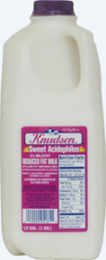
How much water is available
To harvest?
25’
For every inch of rainfall:
624 gallons per
1,000 square feet
40’
0.624 gallons per
square foot
>

Slide 47
Harvesting Potential for 1 inch rain
Square feet of roof catchment area | 50’ * 15’ 750 ft²
Multiply by 0.624 gal/ft² (converts ft² to gallons per inch of rain) | 750 ft² *0.624 gal/ft² = 468 gallons
*Multiply by roof harvest potential (0.75 to 0.95)ª | 468 * 0.75 = 351 gal 468 * 0.95 = 445 gal
Storage conversion Ex.) 55 gallon barrel | 351 / 55 = 6.4 445 / 55 = 8.1 rainbarrels
ª 75% - 95% harvest potential for rooftops, Arizona Dept. of water resources data

Slide 48
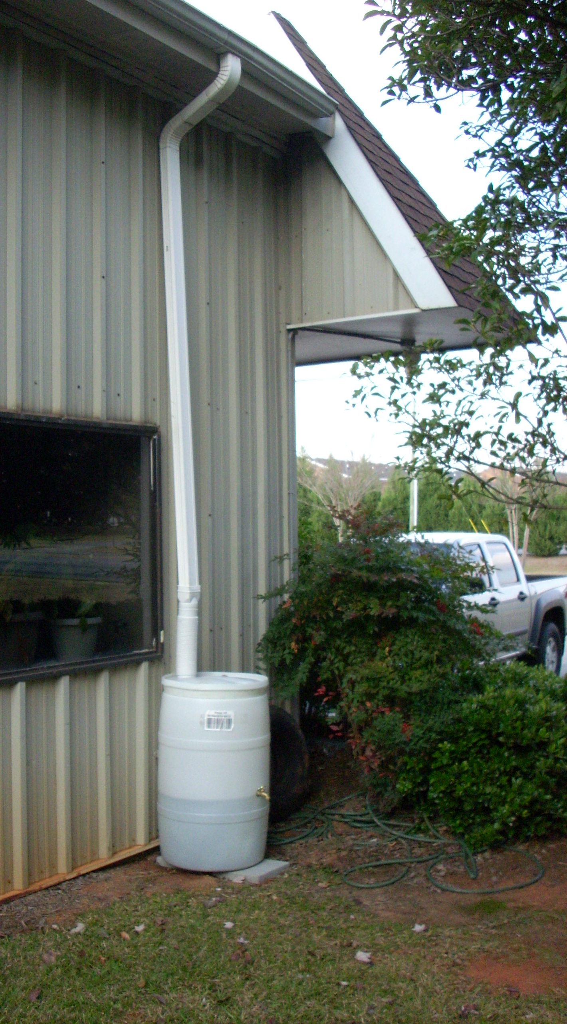
Drought Year Rainfall (2007) Athens, GA
April | 1.8 inches
May | 0.55
June | 2.23
July | 3.04
August | 1.31
September | 2.15
October | 1.61
November | 2.12
Notes:
2007 was a 150 year drought and during the growing season there was still over an inch of rain each month except May.

Slide 49
Rainfall on a 20 x 50’ roof area (1,000 ft²)
Athens, GA 2007 (drought year)
Month | Rainfall | 624 (gal/in) |  | Volume (gallons)
 | 2007 | 75% | 95% | 75% | 95%
April | 1.8” | 468 | 593 | 842 | 1067
May | 0.55” | 468 | 593 | 257 | 326
June | 2.23” | 468 | 593 | 1044 | 1322
July | 3.04” | 468 | 593 | 1423 | 1802
Aug | 1.31” | 468 | 593 | 613 | 777
Sept | 2.15” | 468 | 593 | 1006 | 1275
Oct | 1.61” | 468 | 593 | 753 | 954
Nov | 2.12” | 468 | 593 | 992 | 1257
ª
ªRain harvest potential from rooftops, Arizona Dept. of water resources

Slide 50
275 gallons @ $100, or $0.36 per gallon
55 gallons @ $35, or $0.64 per gallon

Slide 51
1200 gallons @ $600, or $0.50 per gallon

Slide 52
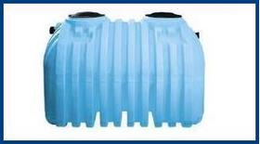
Buried Tanks
- Septic tanks (baffles)
- More expensive
~$939/1000 gallon
$0.94/gallon

Slide 53
Value of Harvested Rain Water Athens-Clarke County
 | Utility Costs $ / 100 cu. ft. (748 gallons) | 1,000 ft² $ / inch of rain | Rainfall 2007 inches | 2007 $/ growing season
Water | $2.10 | $1.75 | 14.3 | $ 25.03
Sewer | $1.82 | $1.52 | 14.3 | $ 21.74
Total | $3.92 | $3.27 | 14.3 | $ 46.77
~ 10 year return on a system that costs $500

Slide 54
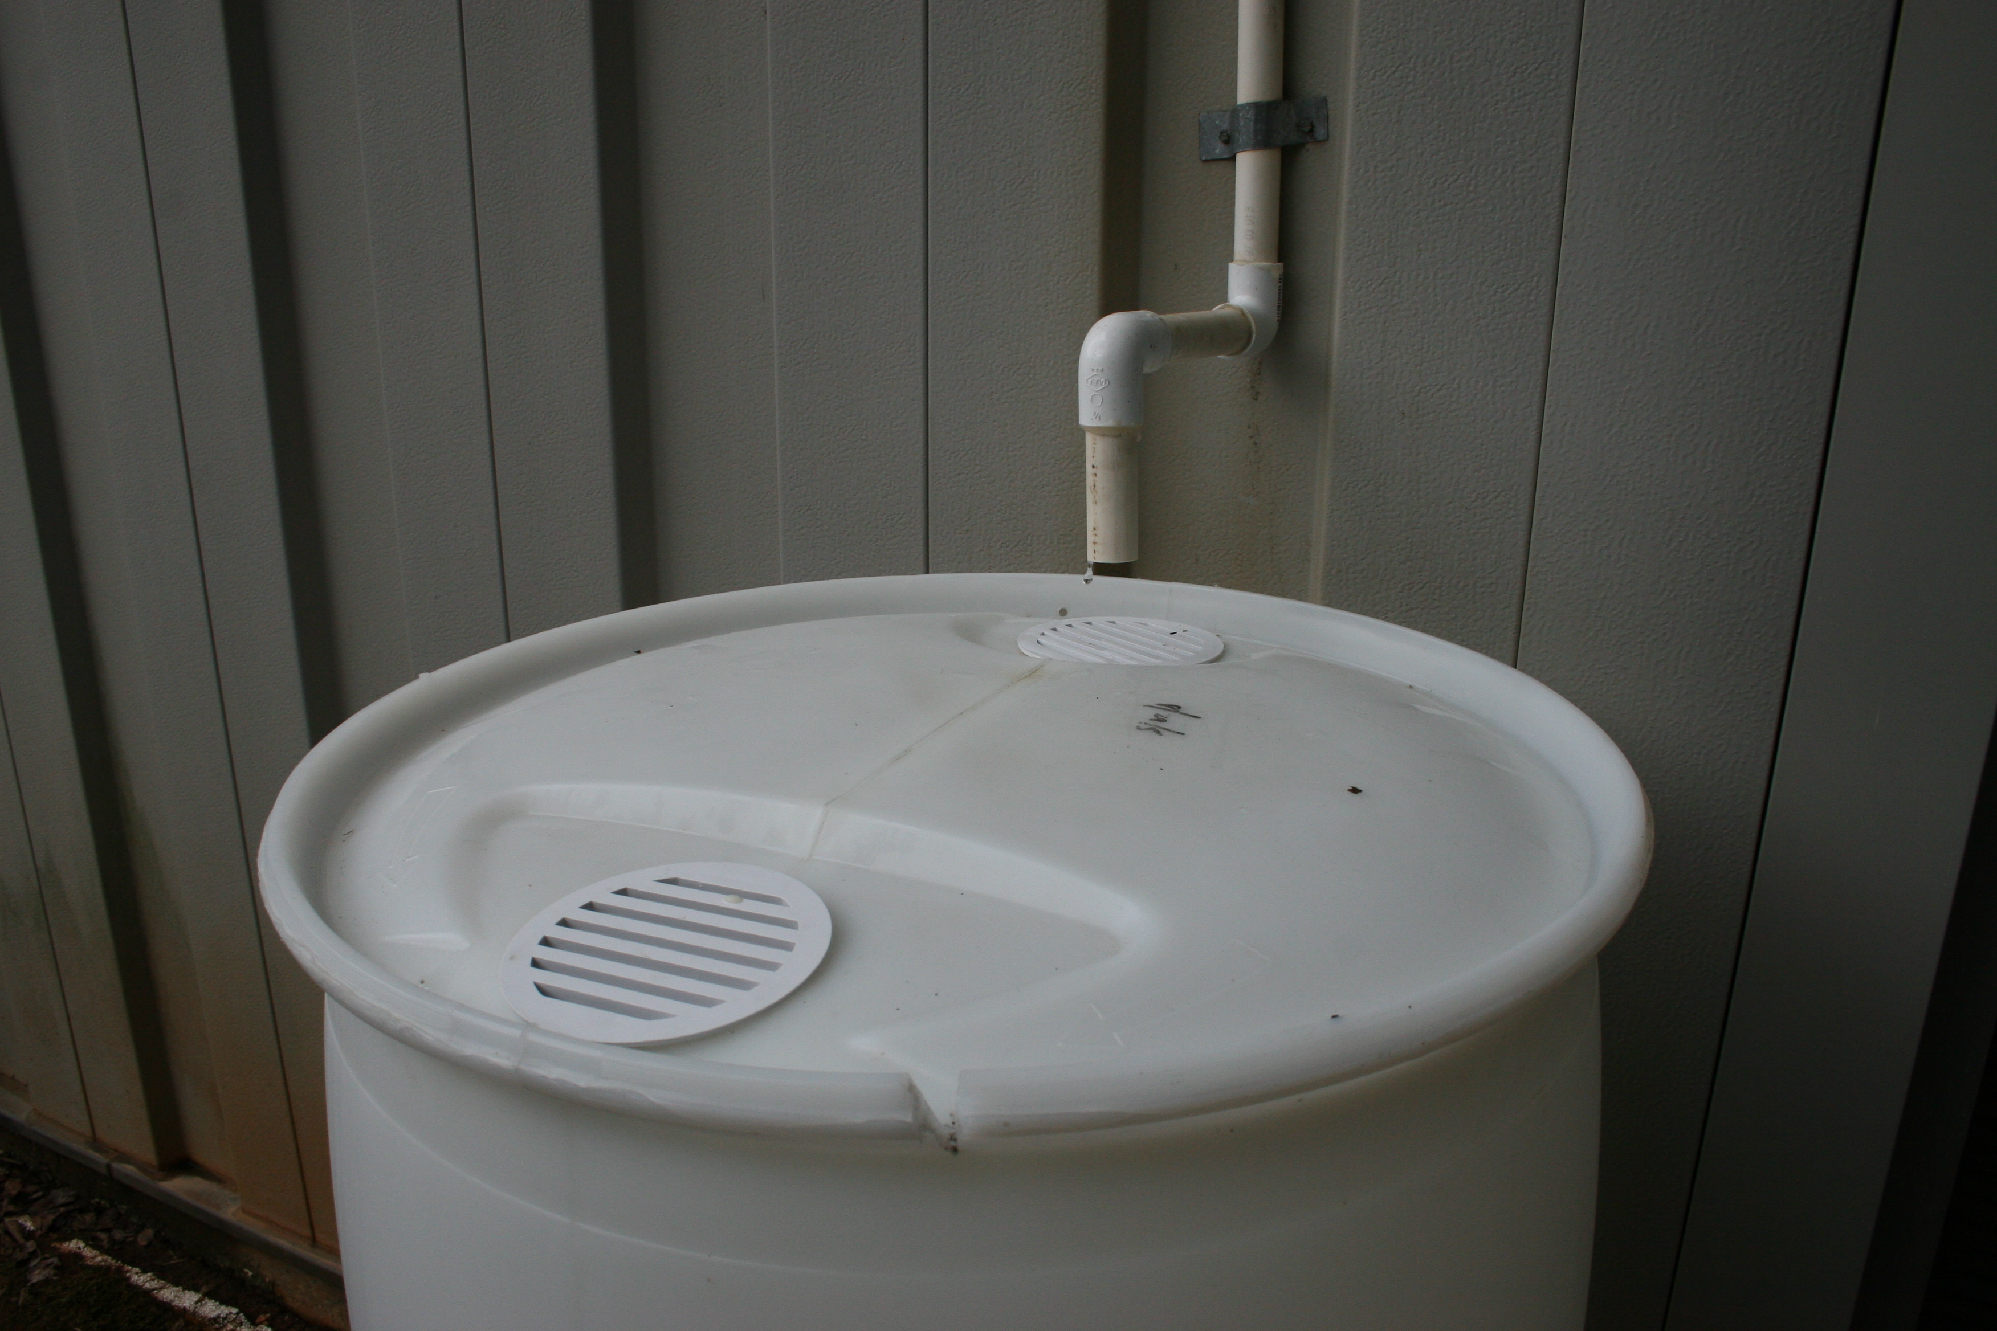
Condensate from Air Conditioners and Dehumidifiers
Home AC can produce over 5 gal./day

Slide 55
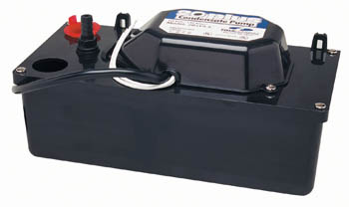
Condensate Harvesting Potential
AC production | Example: 7 gpd
Multiply by 7 to convert to gallons per week | 49 gal. per week
Multiply by 4 to convert to gallons per month | ~200 gal. per month
Condensate pump
-$50
-25 gal/hr
-15 feet of head
Need ~7 gal/day to get 200 gal/month

Slide 56
Value of Harvested Condensate Athens-Clarke County, 10 gpd drip
 | Utility Cost $ / 100 cu. ft. (748 gallons) | Gallons/ season | 2007 $/ growing season
Water | $2.10 | 2400 | $ 6.74
Sewer | $1.82 | 2400 | $ 5.84
Total | $3.92 | 2400 | $ 12.58
< 10 year return on $100 investment

Slide 57
Irrigation With Harvested Water
Conserve by watering individual plants
Notes:
4. PRAYER FOR RAIN. Periodic drought makes the problem even more pronounced, causing reservoir and river levels to drop and often forcing water authorities and elected officials to place restrictions or bans on outdoor water use in an effort to conserve available water supplies.

Slide 58
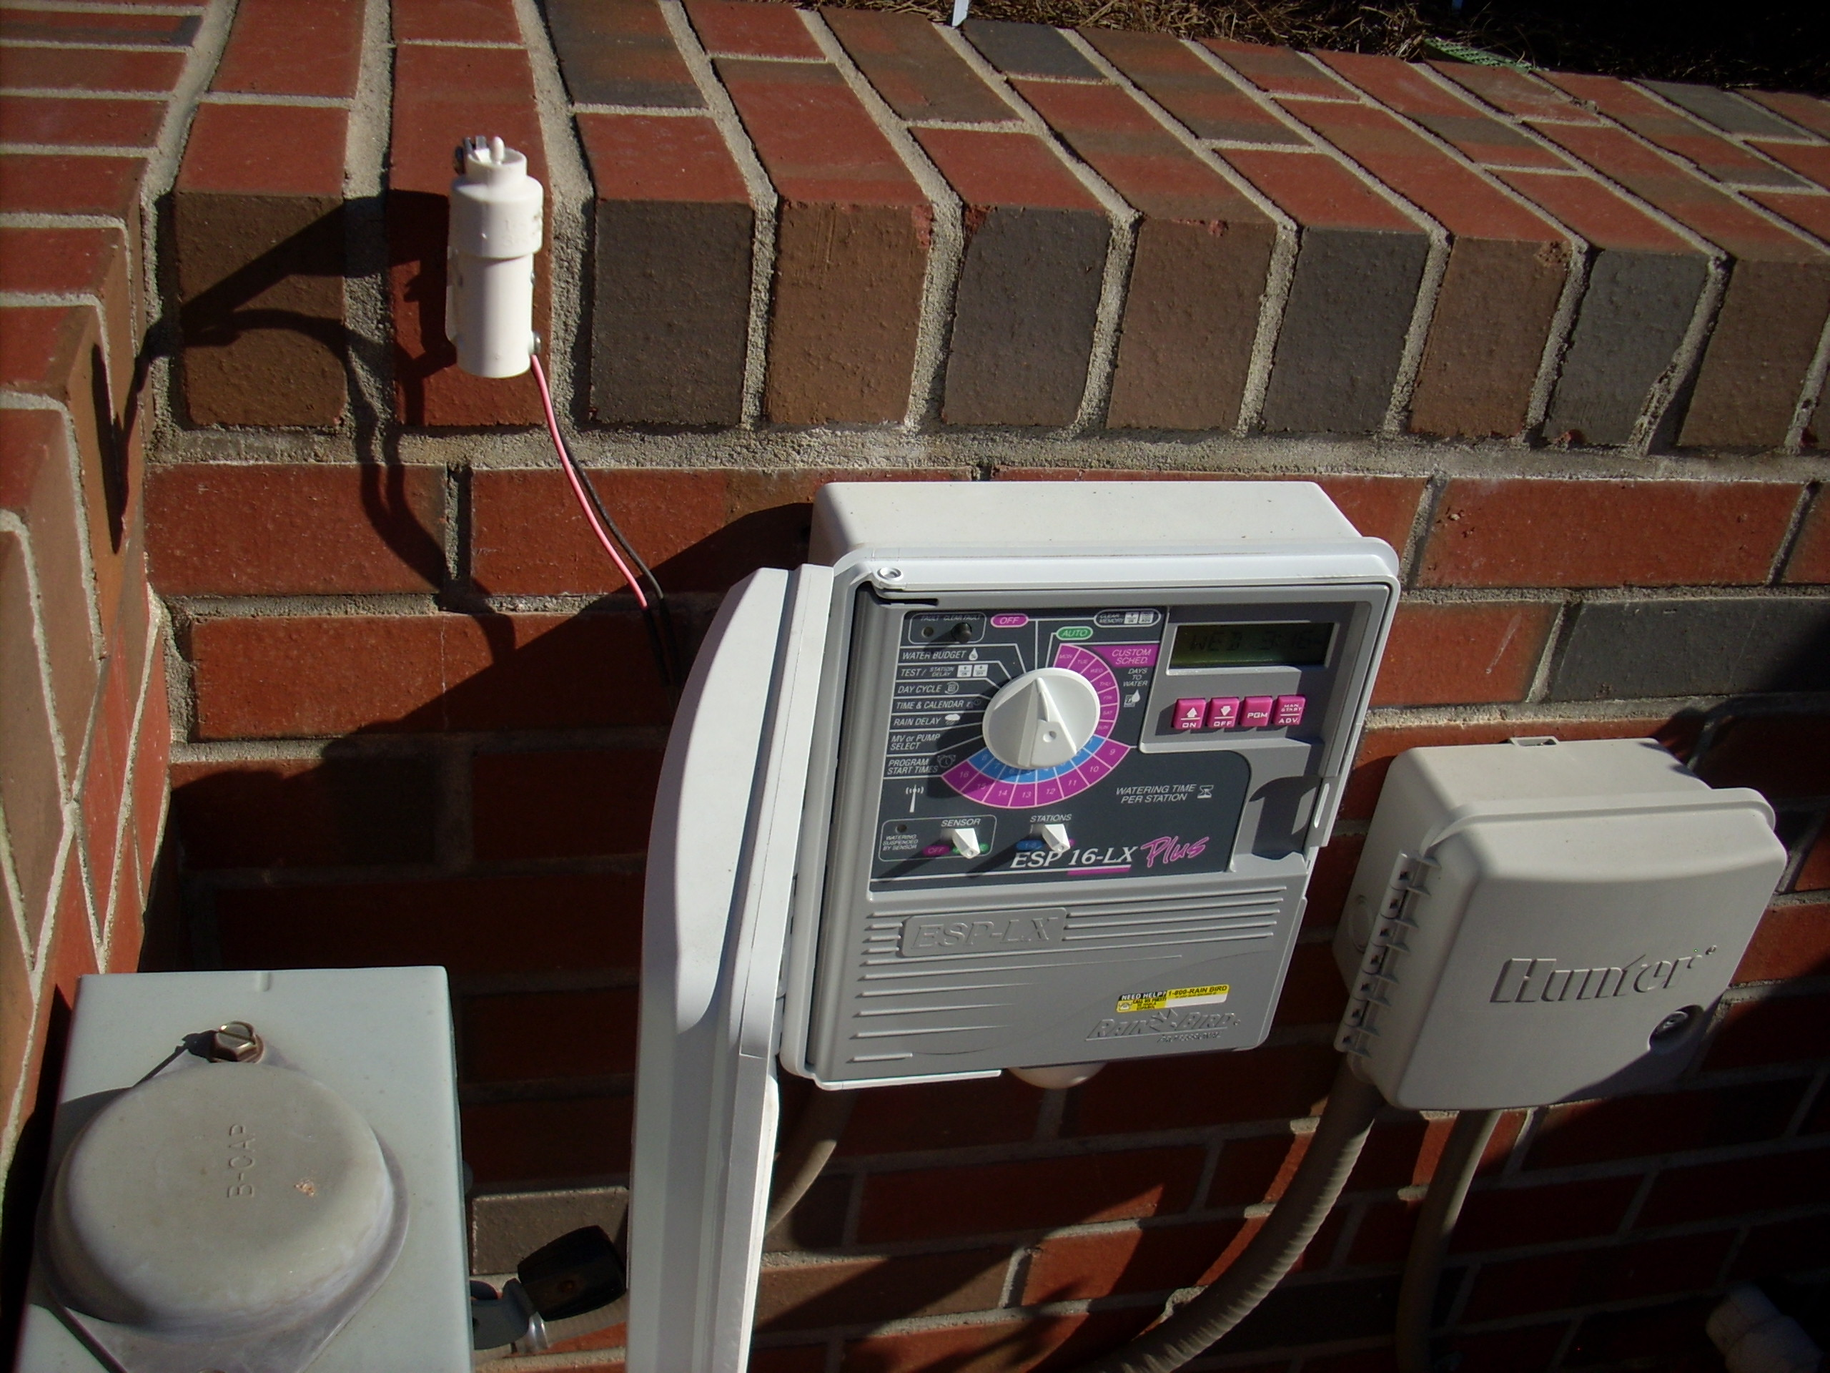
Irrigation Controller

Slide 59
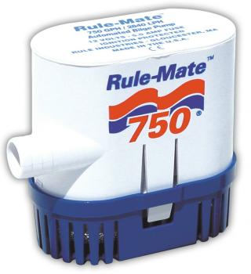
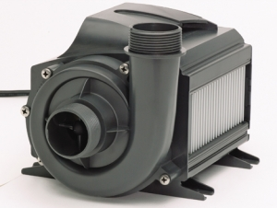
Pump
12VDC
240 VAC
110 VAC
- May need strainer (pump filter)
May need to divert some water back to reservoir to cool pump (prevent deadhead)
Consider pressure
Loose 1 psi for every 2.31 feet of head
Drip irrigation may require certain pressure (25psi)
Notes:
Doesn’t take a big pump to deliver 50 gallons of water in an hour, once per week

Slide 60
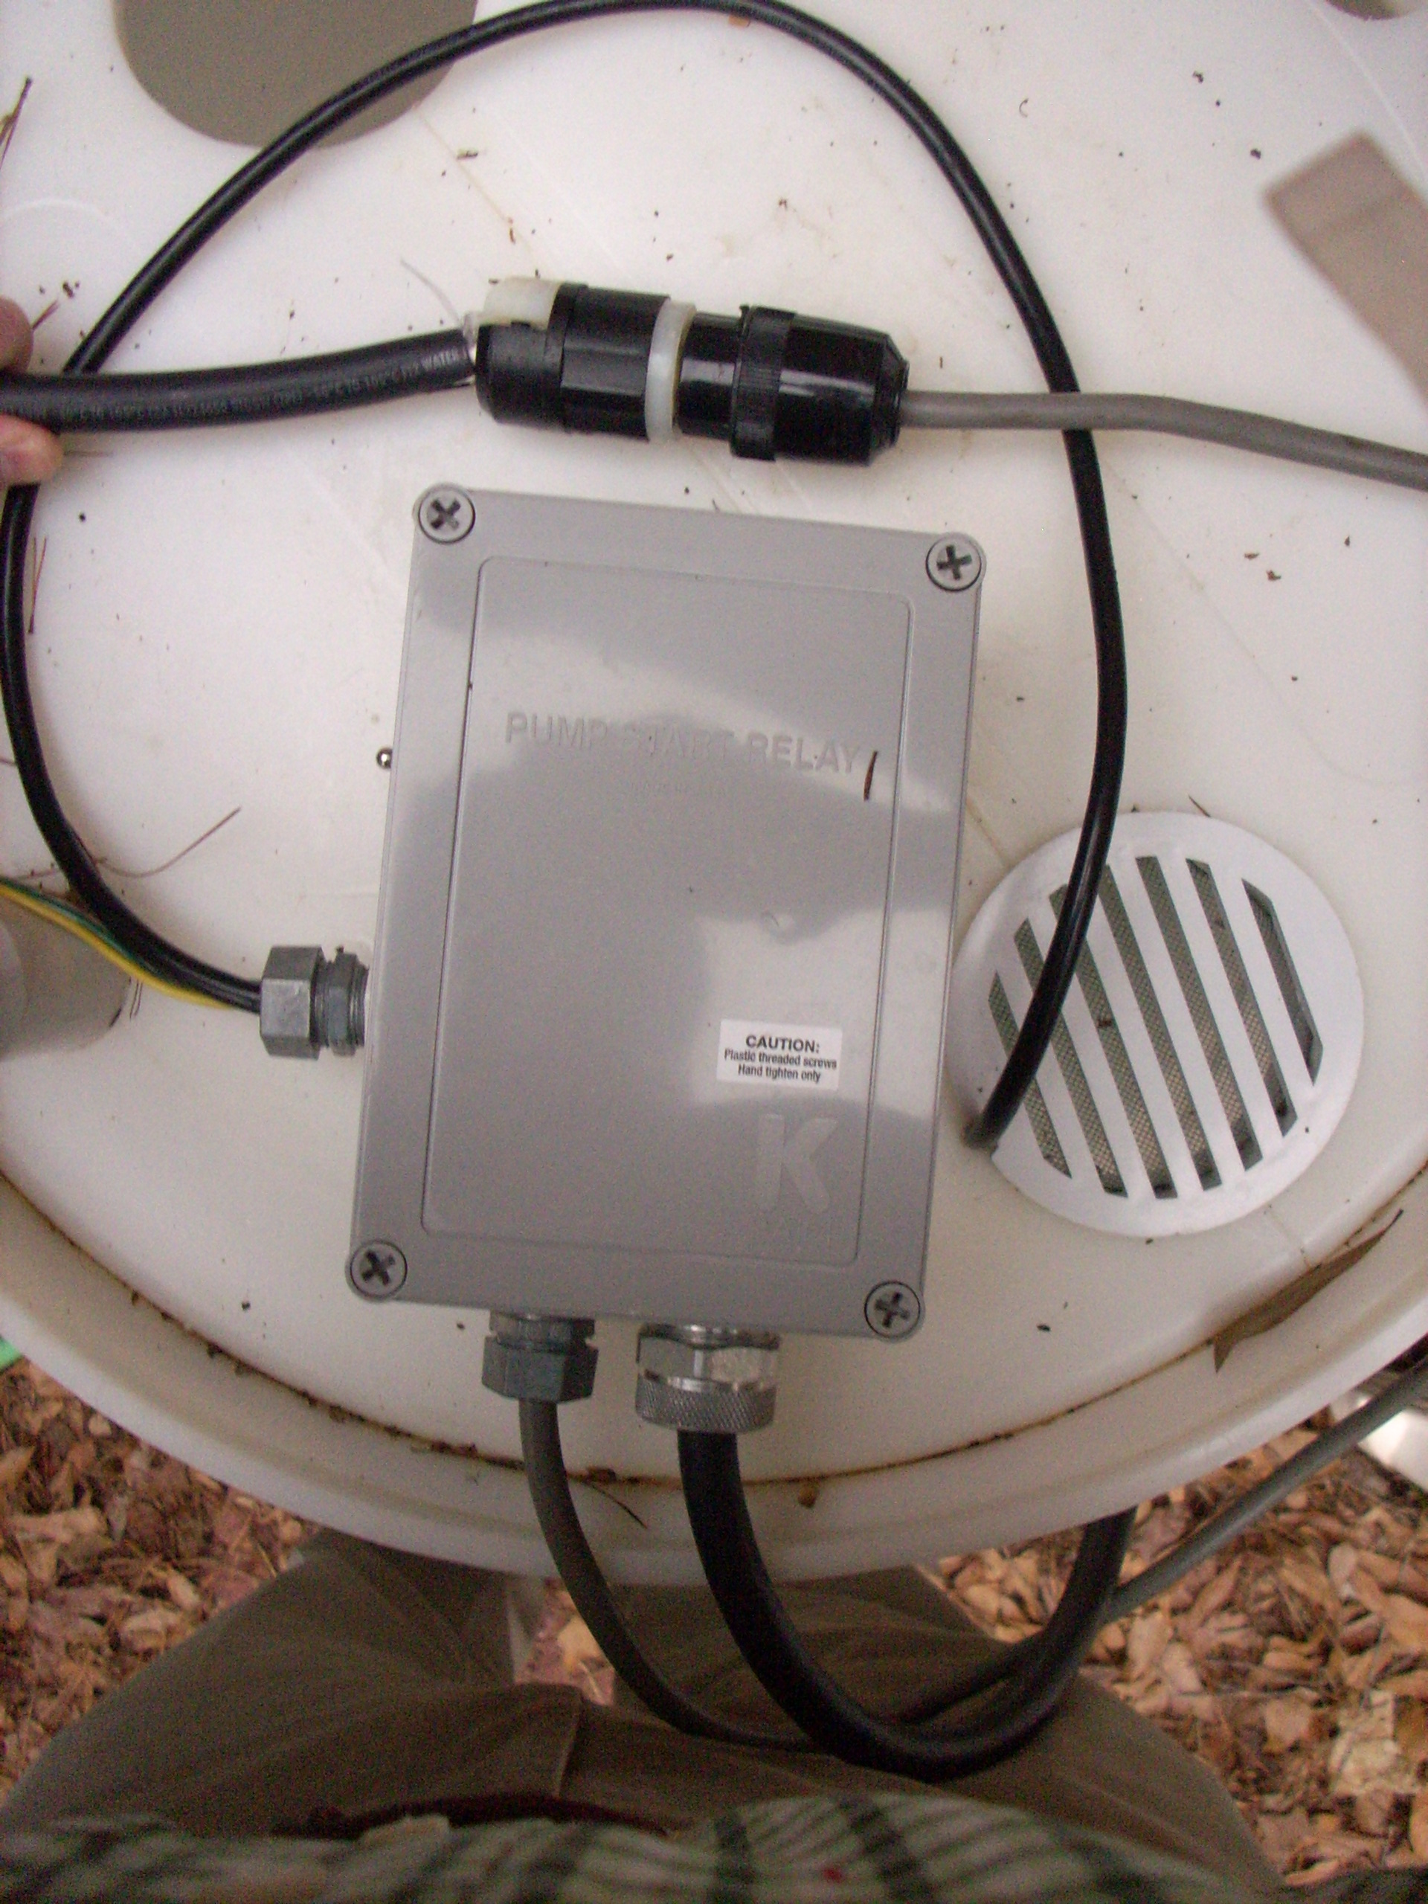
Pump Relay
- 24 VAC from irrigation controller “flips switch”
Can be used to control AC or DC pumps
Can install an outlet for “plug-in” pumps

Slide 61
Float switch
- Shuts off pump when reservoir is empty
- Some pumps incorporate this feature

Slide 62
Intake screen
Foot valve

Slide 63
Irrigation Filter

Slide 64
Emitters
- Many shapes and styles
Flow rate 0.5 – 10 gal./hr
Pressure compensating
(designed for ~25+ psi)

Slide 65
Example:
- 25 mature plants (4 feet tall)
- Plant requirement – 4 gallons each
- Total requirement: 25 x 4 = 100 gallons
Possible Setup
2 ghp emitters, 2 per plant (100 gph)
200 gph/60 min = 1.7 gph
*May need to recirculate some water back
into tank to prevent pump overheating

Slide 66
Most pumps are water cooled
Require 2+ GMP flow
2 gpm = 120 gph
May need to recirculate some water
Ex. 1.7 gpm, need ~.05gpm

Slide 67
Water Ban Survival Guide
Landscape Design
Irrigation Design
Harvest Rainwater
Harvest Condensate

