Slide 1

Athletic Field Basics
Construction & Maintenance
Billy Skaggs
County Extension Agent
UGA Cooperative Extension – Hall County
Adapted from presentation by Dr. Gil Landry.

Slide 2
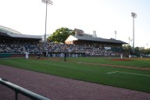
Athletic Field Management
A good athletic field management program produces an attractive and wear-resistant surface.
This results from proper field construction, turfgrass selection, properly-timed cultural practices and good judgment of field use.

Slide 3
Grass Selection
The best and most commonly-used turfgrasses for sports fields are Tifway 419, TifSport and Tifway II hybrid bermudagrasses.
Tif-Sport is a UGA release and has better cold tolerance and better turf quality at lower mowing height than the other two grasses.
Princess-77 and other ‘newer’ seeded type bermudagrasses are preferred for non-irrigated, low maintenance fields.

Slide 4
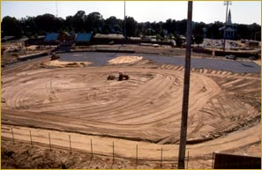
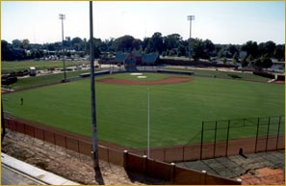
Athletic Field Construction
Proper construction produces a field with good surface and internal drainage that is more easily maintained.
Field maintenance is generally easier on sandy, well-drained soils than on finer-textured soils that have high clay and silt content.

Slide 5
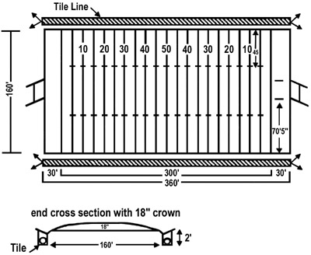
A football field should have a crown of 12 inches for sandy soils and 18 inches for clay soils from the sideline to the center or a 1 percent to 1.5 percent slope.

Slide 6
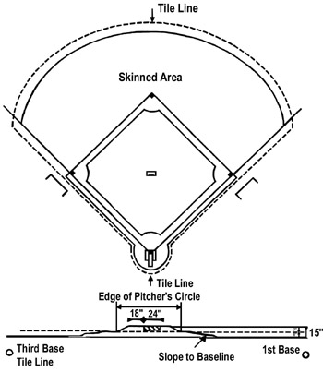
Baseball infields should have a 1 percent slope or an 8-inch fall from the bottom of the pitcher's mound to beyond the baseline.

Slide 7
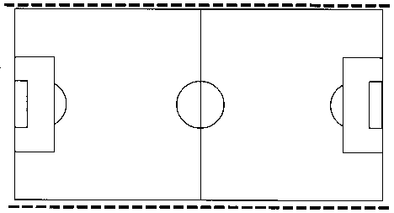
Soccer Field
Dimensions and drainage plans for soccer fields
Tile lines with catch basin and/or risers to catch surface drainage
Maximum length = 120 meters (393.6 ft)
Minimum length = 90 meters (295.2 ft)
Maximum width = 90 meters (295.2 ft)
Minimum width = 45 meters (147.6 ft)
(http://www.agry.purdue.edu/turf/pubs/ay31.htm#Grade)

Slide 8
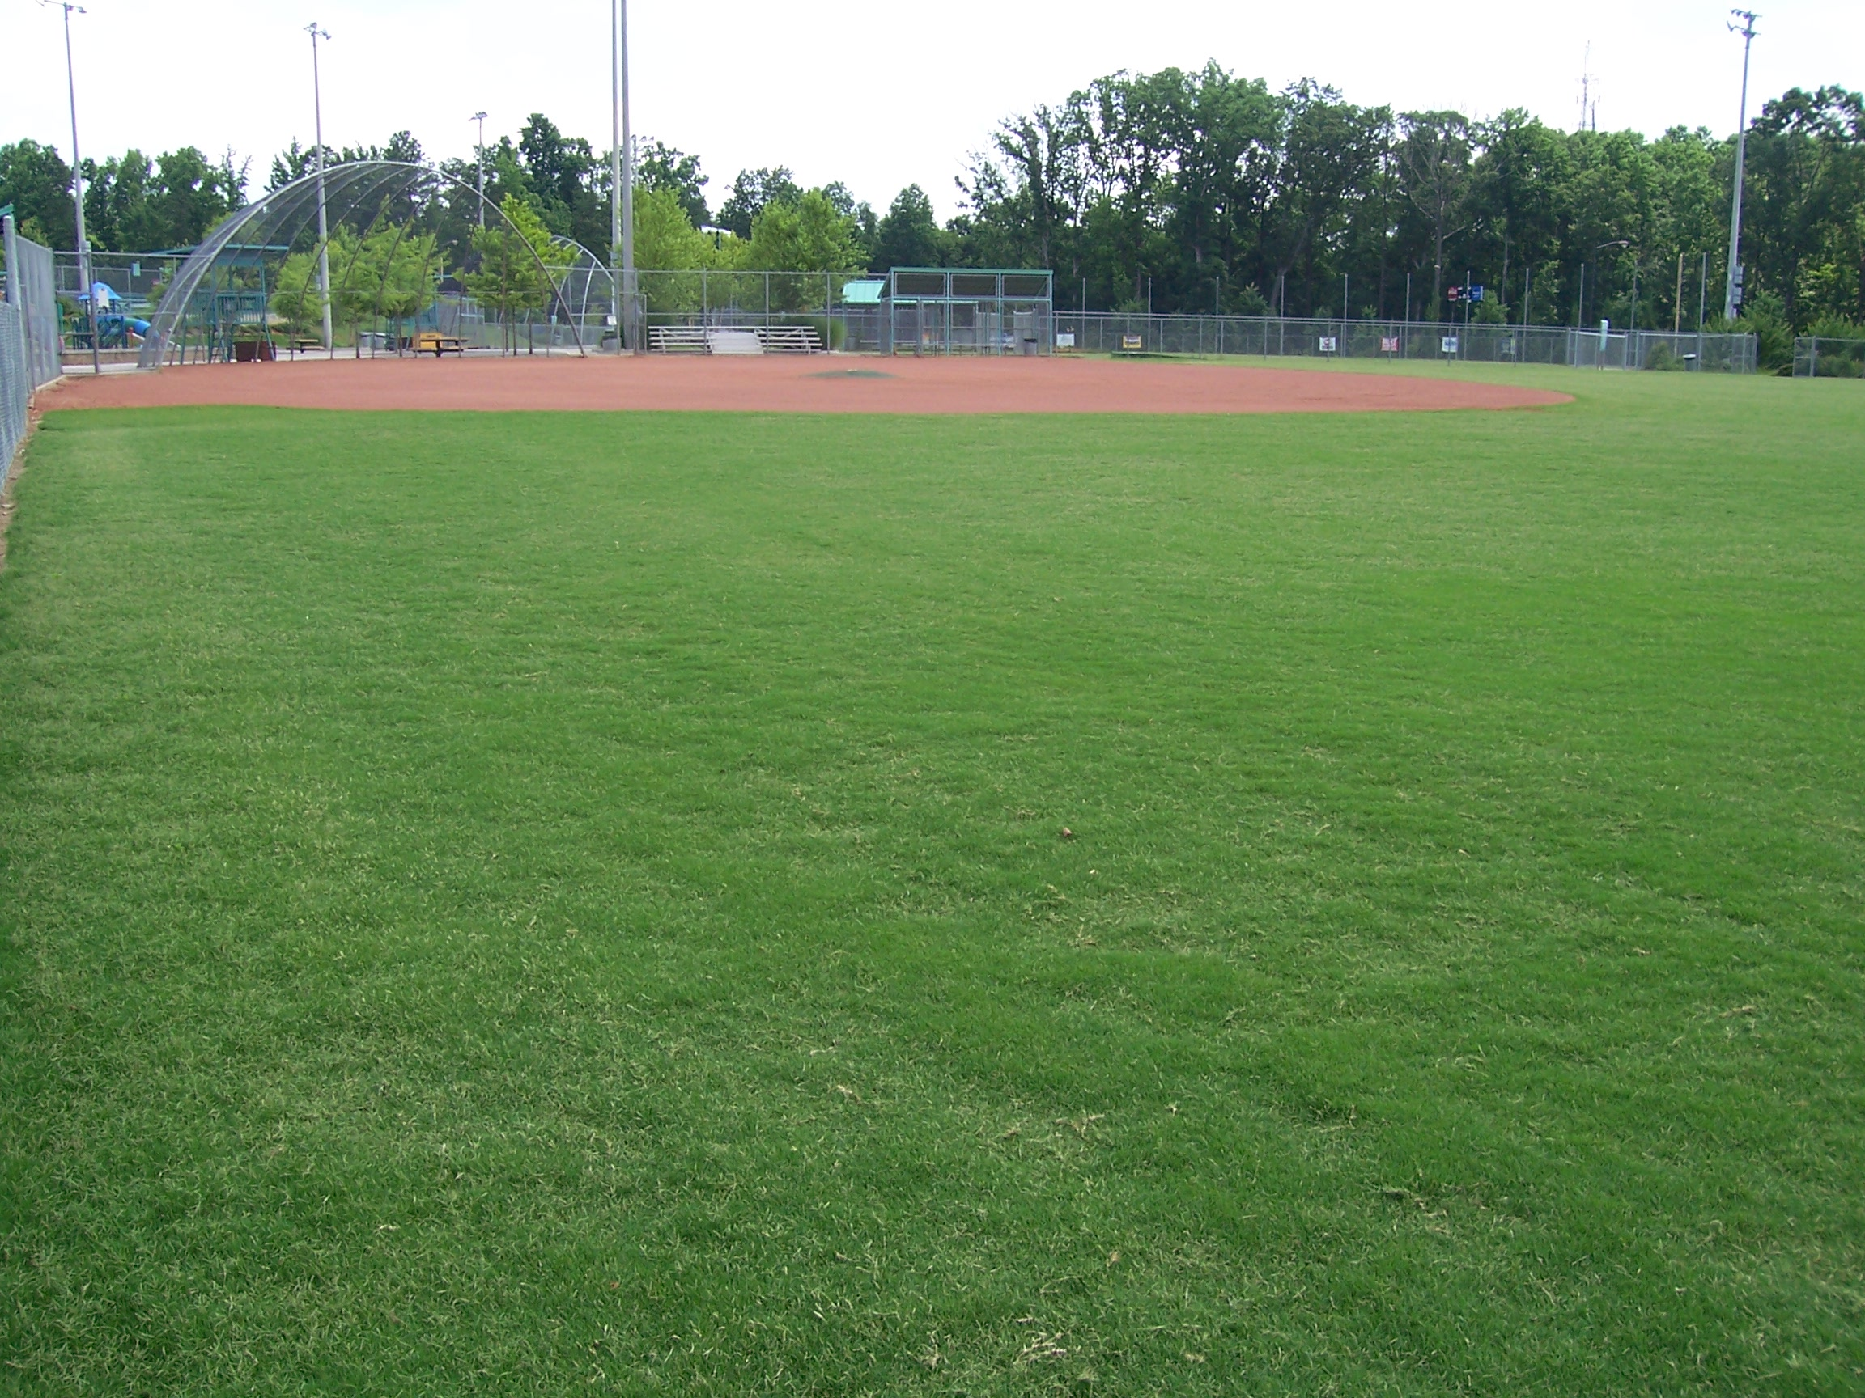
Mowing
Proper mowing promotes deep rooting and good shoot density, desirable mat, and uniform growth.
Always keep your mower in good condition. In particular, dull mowing blades tear the grass blades giving the lawn a ragged appearance.
Hybrid bermudagrasses (Tifway, TifSport and Tifway II) should be mowed at a height of ³/₄ to 1 inch.
For common bermudagrass, 1¹/₂ to 2 inches is preferred.

Slide 9
Mowing
The first mowing in the spring should be low by as much as one-half the desired final height. This helps increase turf density and allows the cutting height to be raised during the summer if needed.
The grass should be mowed often enough so that no more than ¹/₃ of the leaf surface is removed at a mowing. Generally, this means the field should be cut twice a week during the summer.
Higher mowing heights don't need as frequent mowing but result in lower quality and weaker turf.

Slide 10
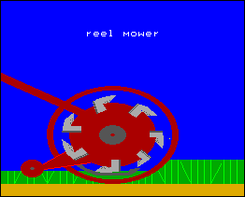
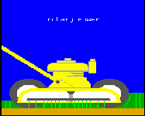
Reel Mowers vs. Rotary Mowers
If mowing frequency is properly adjusted, clippings may be returned without harming the turf.
If excessive clumping of clippings occurs, they should be removed. Reel mowers provide the best cut for bermudagrass turf.
Regardless if a reel or rotary mower is used, keep the blades sharp and properly adjusted.

Slide 11
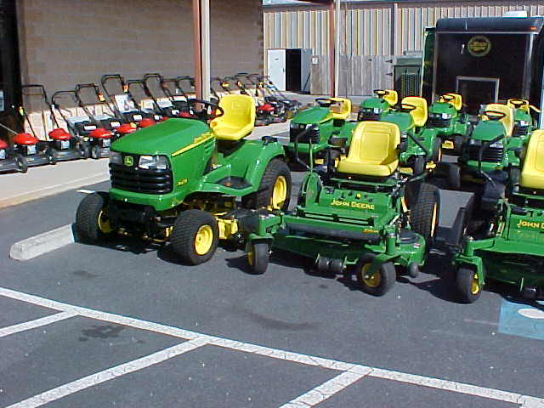
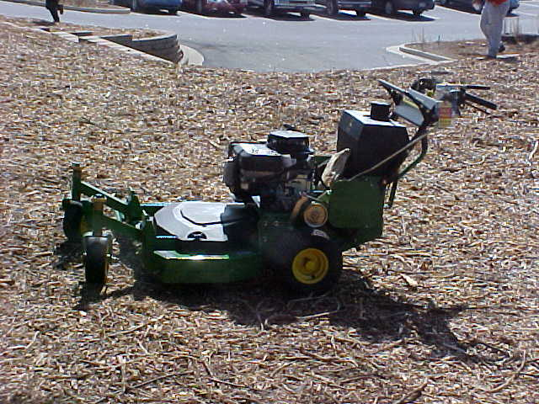
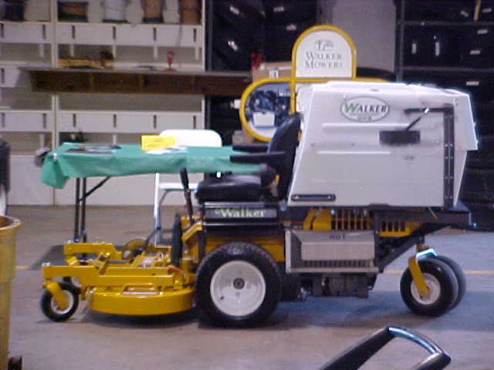
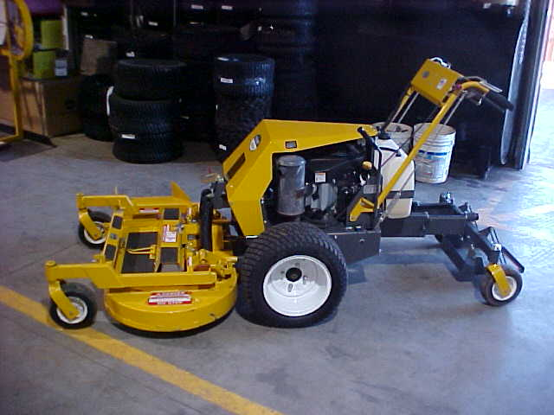
Rotary Mowers

Slide 12
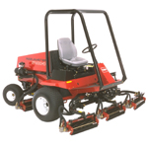
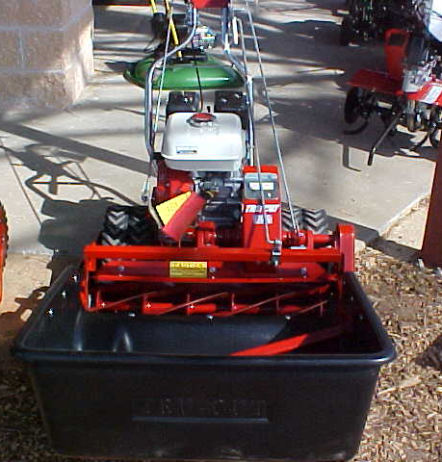
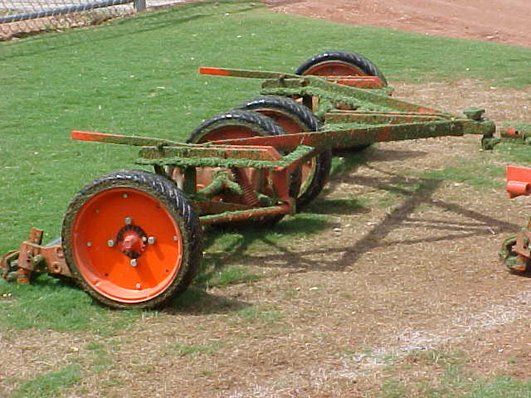
Reel Mowers

Slide 13
Fertilization
Fertilization programs should take into account:
  Turf requirements
  Soil test results
  Maintenance practices (mowing, irrigation, etc.)
  Turf traffic or play
Most turfgrasses do best when fertilized with a 3-1-2 or 4-1-2 ratio fertilizer if a soil test is not available.

Slide 14
Fertilization
Bermudagrass athletic fields require 3 to 7 pounds of nitrogen per 1,000 sq. ft. per year (3 to 5 pounds in north Georgia). Nitrogen is applied at a rate of 1 pound N per 1,000 sq. ft. per month of active growth.
Typical fertilizer program:
  Apply a complete fertilizer (nitrogen, phosphorus and potassium) in early spring when green up begins, and again two to four weeks before the average first frost date.
  During the growing season, apply nitrogen as desired to maintain turf vigor. The more often a field is used, the more often N-fertilizer should be applied to maintain rapid growth for proper recovery from use.

Slide 15
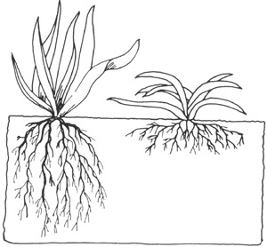
Irrigation
* Deep watering leads to deep rooted turf.
It is very difficult to maintain an athletic field without irrigation.
Best time to irrigate is just before wilt occurs. Most grasses have a darker or a dull bluish-green color, and the leaf blades begin to fold or roll when the grass is under water stress. Irrigation should begin when these signs are first observed.
Apply enough water to soak the soil to a depth of at least 6 to 8 inches. On medium-textured soils, this usually means applying about 1 inch of water per week during the summer. Light, frequent irrigations encourage shallow, weak root systems and thatch accumulation.

Slide 16
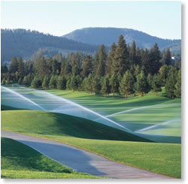
Irrigation
Best time to irrigate is before sunrise because there is less wind and lower temperatures, thus less water loss to evaporation.
Irrigation at night is more efficient than irrigation during the day. Irrigating after dew develops or before the morning dew dries off does not increase disease problems.
Irrigating 24 to 48 hours before major field use will help reduce soil compaction.
On many fine-textured soils, runoff may begin before the soil is properly wet to the right depth. When runoff occurs, stop irrigating and let the water soak into the soil for one to two hours before starting again. It may be necessary to repeat this cycle several times before irrigation is complete.

Slide 17
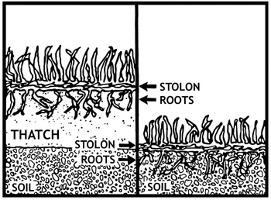
Thatch: accumulation of dead and dying plant material at the soil surface.
Restricts water and air movement into the soil which are both needed for good root growth. This also leads to more frequent watering.
Provides an ideal environment for some turf insects and disease organisms.
Makes mowing difficult because the turf becomes spongy; allows mower to sink into the turf and cause scalping.
Raises the growing points (crowns), runners (rhizomes and stolons), and roots above the soil surface. These plant parts are then exposed to greater extremes in temperature, which often cause winter injury.
Can restrict downward movement of pesticides and fertilizers in the soil. This results in reduced effectiveness of these materials.

Slide 18
Cultivation
Cultivation practices reduce surface compaction and thatch accumulation, improve soil aeration and water infiltration, and promote root growth.
Practices include:
  Vertical Mowing
  Core Aeration
  Topdressing

Slide 19
Cultivation
The traffic on fields produces a compacted surface layer in the top 2 to 3 inches of soil. This results in reduced pore space, reduced internal air and water movement and gradual thinning of the turf.
The centers of football fields, around sideline bench areas, soccer goal mouths and baseball diamond infields are good examples of areas prone to soil compaction. These conditions are worsened when the field is used under wet conditions.

Slide 20
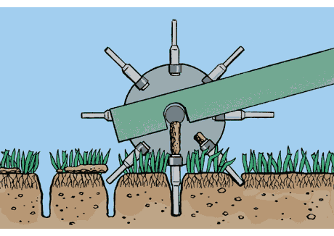
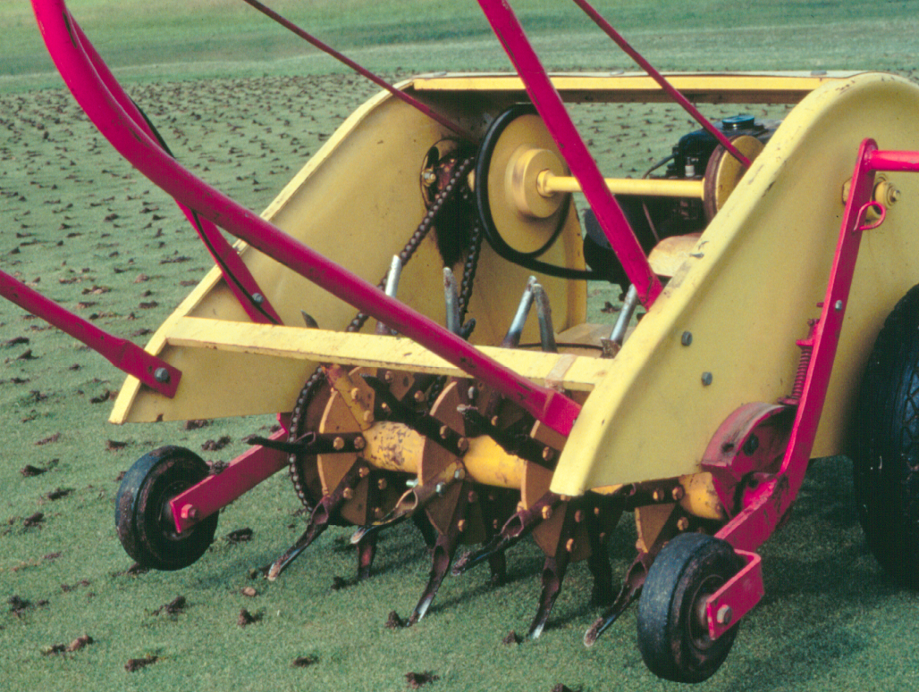
Aeration
Aeration (using hollow tines or open spoons) is the most common means of relieving soil compaction, encouraging deep rooting and improving turf quality. Aeration is very important, yet often neglected.
Coring commonly uses a machine that removes a soil core ³/₄ - 1 inch in diameter to a depth of 3 to 4 inches. A core of soil should be removed and deposited on the soil surface.
Frequency of aeration generally depends on soil texture and frequency of field use. Fine texture soils, fields with heavy use and fields used when wet need more frequent aeration.

Slide 21
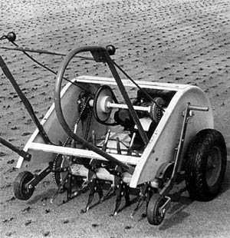
Aeration
As a general rule, the spacing between aeration holes should be 2 to 3 inches; 3 passes in different directions.
Aerate fields a minimum of two times per year. The first should be done in the spring just before fertilization and the second in mid summer.
Each aeration should involve a minimum of three passes over the playing field. If field use is heavy or the soil is compacted, aerate monthly during the growing season.
After the soil cores have dried, they can be crumbled and spread over the turf by using a flexible steel drag mat or some other means.

Slide 22
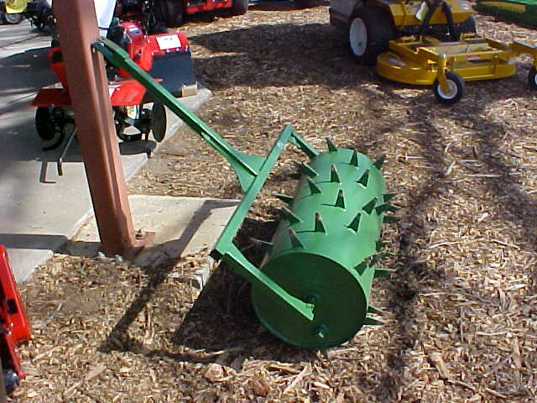
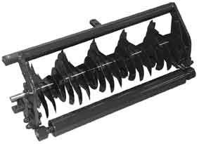
Slicing
Slicing with solid blades 1/4 to ½ inch wide cultivates the soil with minimum surface disruption. Units with offset times can be quite effective in relieving soil compaction.

Slide 23
When to aerate…
Aerate when soil moisture is at field capacity. This generally translate to 8 to 24 hours after rainfall or irrigation or when a spoon-type aerator would remove soil cores to the surface.
If moisture were higher or lower, cores would not easily move to the surface.
Some equipment, particularly solid tines or blades, are most effective when soil moisture is drier than field capacity.
Aerate when the turf is actively growing and not under stress.

Slide 24
Vertical Mowing
Vertical mowing is only needed where thatch is excessive (generally thicker than ½ inch). Thinned areas should not be vertically mowed unless done prior to reseeding or overseeding and when the turf is actively growing.

Slide 25
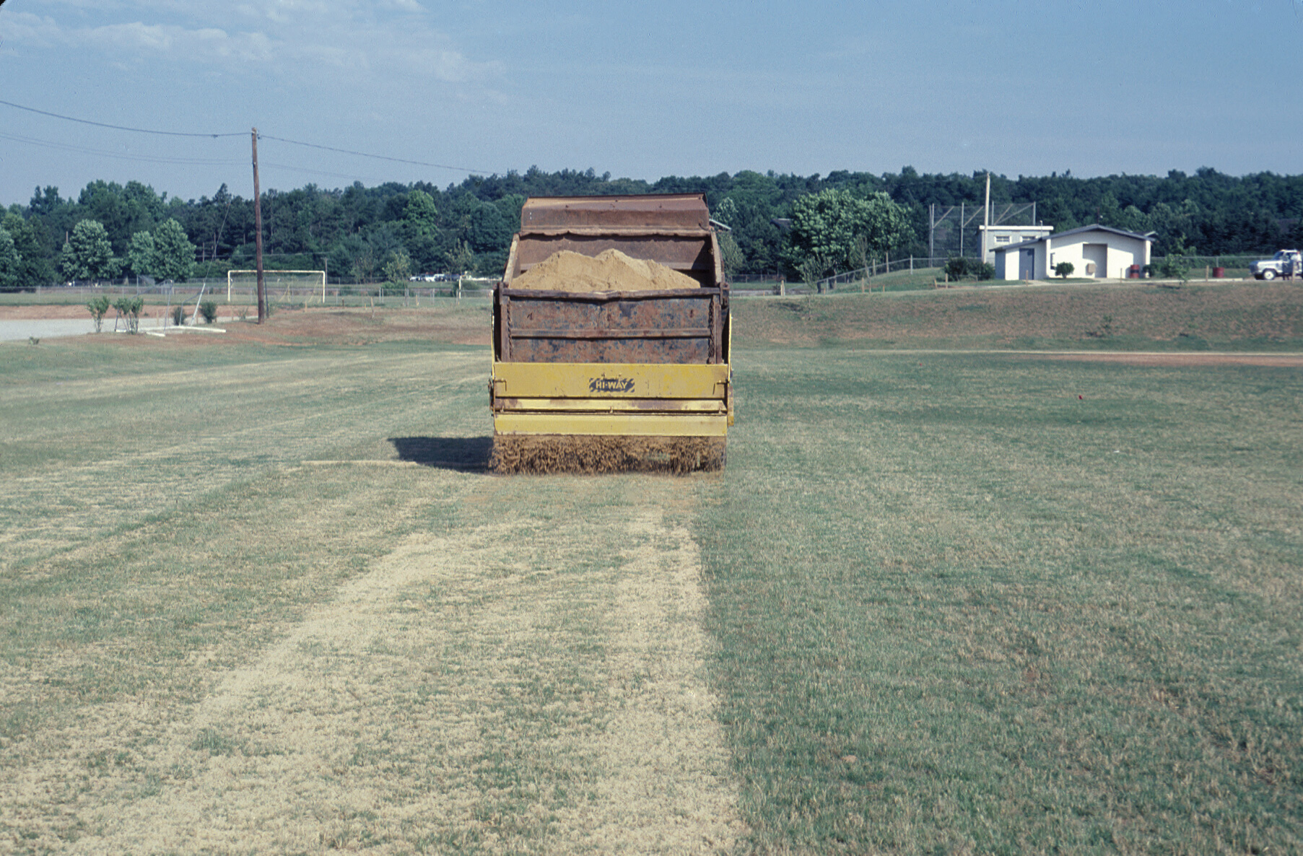
Topdressing
Topdressing is the addition of a thin layer of soil on the turf surface.
Parts of the field that are used continuously tend to become depressed from the heavy use.
Topdressing with a ¹/₈-inch layer (10.4 cu. ft. or 0.4 cu. yds. per 1,000 sq. ft.) can level and smooth these areas.
In addition to smoothing the surface, topdressing also reduces thatch.

Slide 26
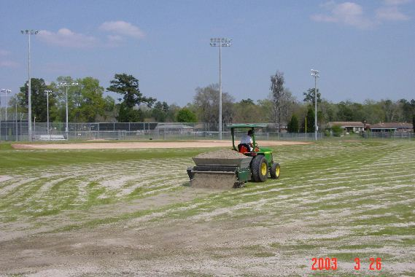
Topdressing
Topdressing after fertilization and during periods of active growth is best.
Light, frequent topdressings to build up lower areas are preferred over less frequent, heavier topdressings.
The topdressing soil should be of similar texture to the soil on site and can be dragged into the turf with a flexible mat.

Slide 27
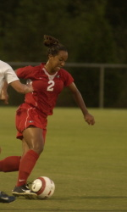
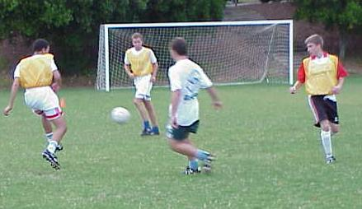
High Wear Areas
Soccer fields create special challenges because the fields are heavily used in the fall and spring when bermudagrass is growing slowly or not at all.
One technique used to address this issue is to construct fields so sidelines can be moved 2 to 3 yards in all directions.
This helps reduce wear from the linesman. Using movable goals helps disperse traffic.

Slide 28
High Wear Areas
Another practice for such conditions is to use more fertilizer later in the year. This helps retain growth later in the fall and earlier in the spring.
These areas also need more aeration to reduce the soil compaction (once per month). Finally, allowing the turf to grow slightly higher (up to ½ inch) in the fall should improve wear tolerance.

Slide 29
Field Use
There is a limit to the amount of traffic even the best managed turf can stand without excessive injury. Steps that reduce management problems include the following:
schedule minimum use when the field is wet;
rotate areas of play to permit recovery of turf;
avoid or reduce concentrated foot traffic, such as band practice, whenever possible;
limit or withhold use of newly-planted areas until the turf is mature and developed;
allow the turf to recover from winter dormancy before using it in the spring.

Slide 30

THANKS!
For more information, visit the UGA
Turfgrass Website at:
  www.georgiaturf.com
  Billy Skaggs, Hall County Extension Agent
  770-535-8293 bskaggs@uga.edu

