Slide 1
Reading Writing and Ridding of Ants
Ant Management for Cherokee County Schools
Todd Hurt
UGA Extension Agent
Cherokee County

Slide 2
Reading Writing and Ridding of Ants
Ant Biology -Tom Weissling, Phil Koehler & Betty Ferster, University of Florida
Ant Control - Daniel R. Suiter, Ph.D.
Liability and Pesticide Labeling

Slide 3
Introduction: Ant Facts
There are approximately 9,000 - 10,000 described
species of ants in the world.
It is estimated that one-third of the entire animal
biomass of the Amazon basin is composed of ants
and termites
Ants are found everywhere in the world except
Antarctica, Iceland, Greenland, and a few isolated
islands
Ants are one of the most common insects found within
structures

Slide 4
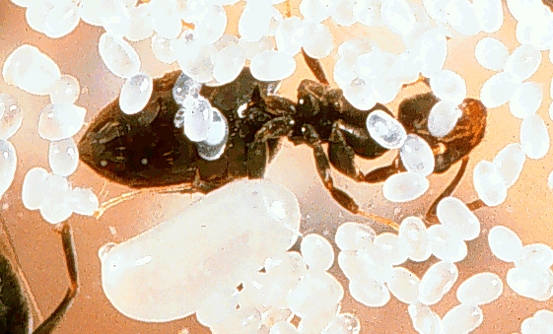
Classification & Structure
Ants are closely related to bees and wasps
Primary characteristics:
  Chewing mouthparts
  Complete metamorphosis (egg, larva, pupa, adult)

Slide 5
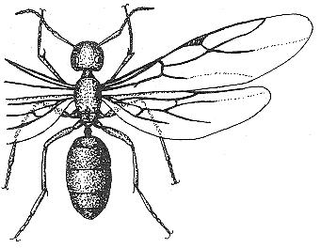
  Anterior of abdomen is constricted, forming the
  petiole.
  There may be raised
  bumps (nodes) on the
  petiole.

Slide 6
  Antennae are elbowed (genticulate)
  Two pair of membranous (transparent) wings on
  swarming reproductives

Slide 7
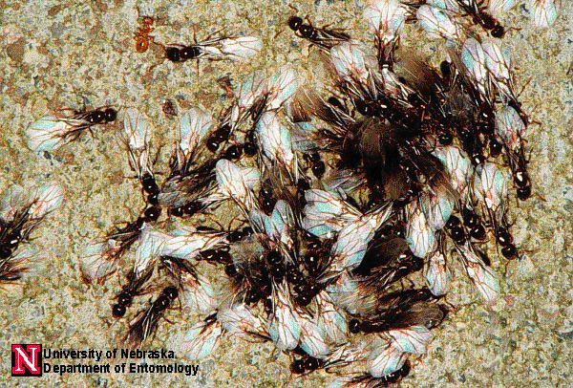
Social Structure
Ants are social insects that live in colonies with one
(monogyne) to several (polygyne) queens, workers,
and at certain times of the year…winged
reproductives

Slide 8
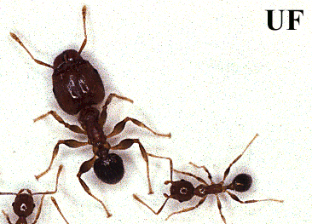
Social Structure
Soldiers or large workers are present in some species

Slide 9
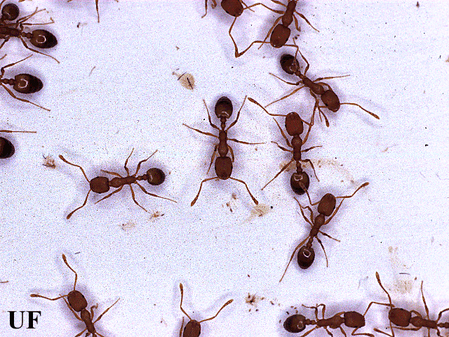
Social Structure
Workers are sterile females that have many duties,
such as caring for the queen(s) and her developing
offspring, building and expanding the nest, and
foraging for food.

Slide 10
Establishment of New Colonies
Through nuptial flights: (Most species)
Newly mated queen sheds her wings and digs a nest
in a suitable location
She then closes the cell and sits for weeks to months
while her eggs mature
Developing larvae are fed by the queen
Newly formed adults dig their way out of the cell and
gather food to feed themselves and the queen
The queen lays more eggs which are cared for by the
new workers

Slide 11
Establishment of New Colonies
Through Budding: (Pharaoh ants, white-footed
ants, Argentine ant)
Used by queens not capable of extended flight
Is the movement of a group (1-several queens and
some workers) to a new location.

Slide 12
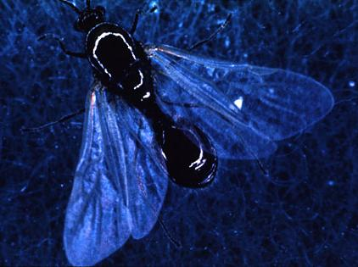
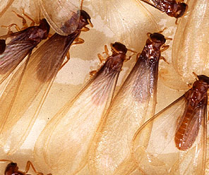
Swarming ants are often
mistaken for swarming termites
USDA
USDA
Careful examination is required to
differentiate

Slide 13
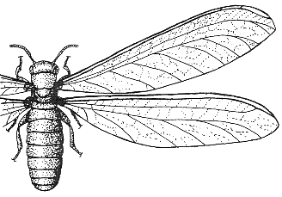
Swarming
Ants vs. Termites
Front and hind wings of
termite equal size. Hind
wing of ant smaller than
front wing
“Waist” of termite almost
as wide as abdomen.
“Waist” of ant
constricted.
Antenna of termite
thread-like. Ant
antenna is elbowed.
Winged “Alate” Termite
Winged “Alate” Ant

Slide 14
Biology
Eggs hatch into white, soft, legless larvae.
Larvae are usually fed food that is liquefied and
predigested by workers.
Larvae go through several growth stages and then
pupate. During the pupal stage, larvae make the
transition to the worker or reproductive adult stage.
Six weeks to 2 months are usually required for
development from egg to adult, but this time frame
can vary depending on the type of ant, temperature,
and quality of diet.

Slide 15
Biology
Some ants eat an extremely wide range of food
(sweets, grease, starches, plants, seeds), while others
stick with one kind of food…such as sugary solutions.
Adult workers lick or crush solids and swallow the
liquid material. Can regurgitate (spit-up) this liquid
food and feed it to other members of the colony
(trophallaxis).
Worker ants locate food by random searching.

Slide 16
Biology
When food is located, workers usually deposit a
chemical trail (trail pheromone) on their way back to
the nest that other workers will follow to the source.
B. Ferster

Slide 17
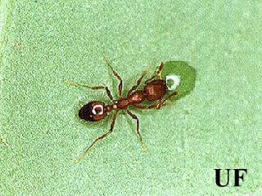
Biology
Workers will also forage for water.
Pharaoh ant

Slide 18
Beneficial Role of Ants
Important predators of some insects
Play a major role in recycling and the formation of
topsoil
Are pollinators of some plants
Are used as human food (i.e., honey-pot ants)
Once used for medicinal purposes in many parts
of the world

Slide 19
Harmful Aspects of Ants
Role in human health:
  Bites and stings can be painful, dangerous, and
  even deadly
  A few species can be mechanical vectors of
  pathogenic bacteria
Role in agriculture:
  May feed on planted seeds
  Many species protect (tend) aphids and other
  sucking insects that are feeding on plants from
  predators and parasites

Slide 20
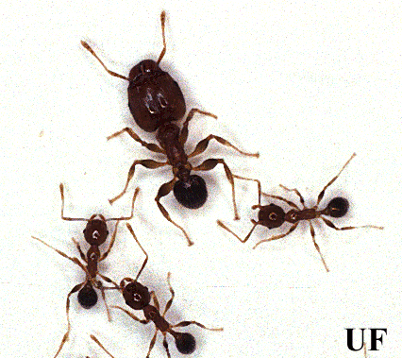
bigheaded ant, Pheidole megacephala

Slide 21
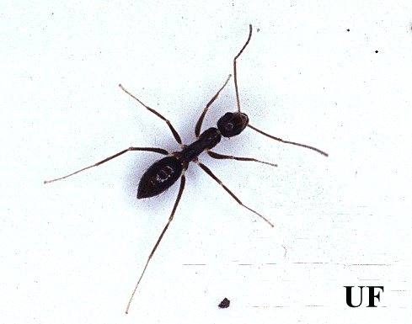
crazy ant, Paratrechina longicornis.

Slide 22
crazy ant, Paratrechina longicornis
Do not bite or sting
Black, 3 mm long, with long legs
and antennae.
Workers move erratically.
Colonies are usually found in
both moist and dry environments.
Outdoors, nests are often in wood,
tree holes and in mulch.
Indoors, nests are often in wall voids and under items.
One node on the petiole.
Workers are monomorphic, and colonies are polygyne.

Slide 23
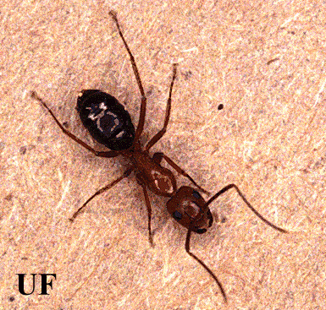
Florida carpenter ant,
Camponotus abdominalis floridanus.

Slide 24
Florida carpenter ant,
Camponotus abdominalis floridanus
Can inflict a painful bite if handled
5 to 10 mm long, with a
yellowish-red thorax and a
black abdomen.
Nest in many locations such as
in mulch, logs and in wall voids.
Can hollow out decayed wood in
order to make nest, depositing wood pieces nearby.
Have one node on the petiole.
Workers are polymorphic (many sizes), and colonies are
monogyne (one queen).

Slide 25
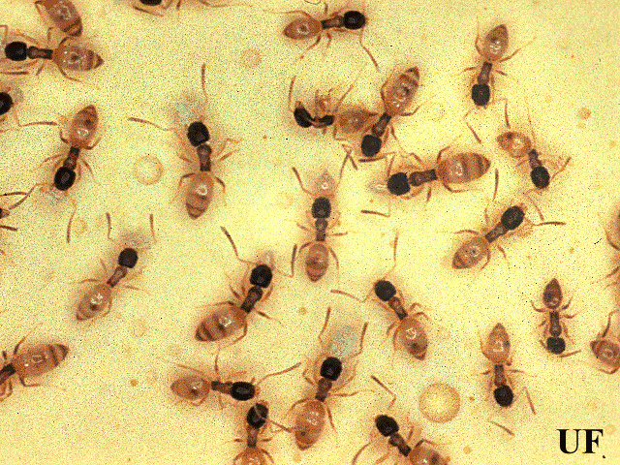
ghost ant, Tapinoma melanocephalum

Slide 26
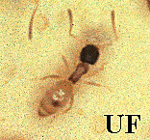
ghost ant, Tapinoma melanocephalum
Do not bite or sting
About 1 mm long, with a black head
and thorax and milky-white
abdomen and legs.
Can nest outdoors or indoors
Often forage indoors.
Have a musty odor when squashed.
Have a high need for moisture and are often seen in
kitchens and bathrooms.
Petiole has one node and is hidden by the abdomen.
Workers are monomorphic and colonies are polygyne.

Slide 27
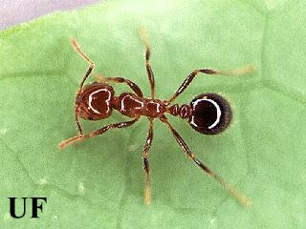
imported fire ant, Solenopsis invicta

Slide 28
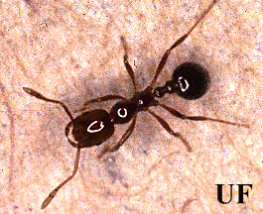
imported fire ant, Solenopsis invicta
Workers can sting, commonly
causing a white pustule to form.
Reddish-brown and 2 - 6 mm long.
Antennae with 2-segmented club
Build large mounds in open, sunny
areas and can forage indoors.
Have two nodes on the petiole.
Workers are polymorphic, and colonies are usually
monogyne, rarely polygyne.
Now established in Southern California

Slide 29
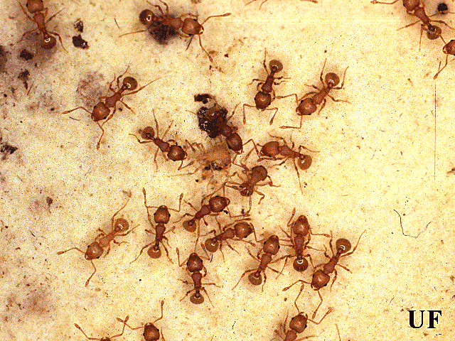
little fire ant, Wasmania auropunctata

Slide 30
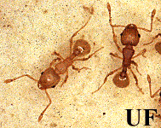
little fire ant, Wasmania auropunctata
Can inflict a painful sting.
Golden brown and 1 to 2 mm long.
Commonly nest in soil under logs
and debris, or in trees.
There are two nodes on the petiole.
The head is covered with grooves.
Workers are monomorphic and colonies are polygyne.

Slide 31
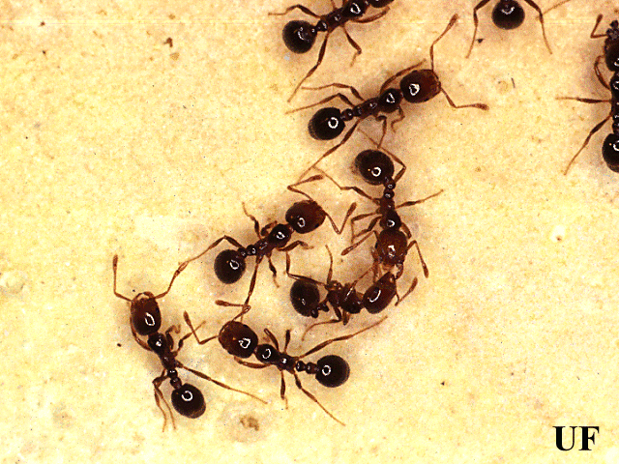
native fire ant, Solenopsis geminata.

Slide 32
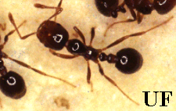
native fire ant, Solenopsis geminata
Workers can sting, but no white
pustule forms.
Reddish- brown to black and
3 to 6 mm long.
Build irregular, crater-shaped
mounds in sunny areas.
Nests also found in along walkways, under plants, dead
tree stumps, under houses, in houses.
Have two nodes on the petiole.
Workers are polymorphic, and colonies are monogyne
Established throughout the southern U.S. Isolated
infestations have been reported from some northern states.

Slide 33
Pharaoh ant, Monomorium pharaonis

Slide 34
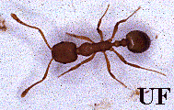
Pharaoh ant, Monomorium pharaonis
Do not bite or sting
Rust- colored and about
2 mm long.
Usually nest indoors
(in wall voids, refrigerator
insulation, books, etc.).
Have two nodes on the petiole.
Antennae are 12-segmented with a three-segmented club.
Workers are monomorphic and colonies are polygyne.

Slide 35
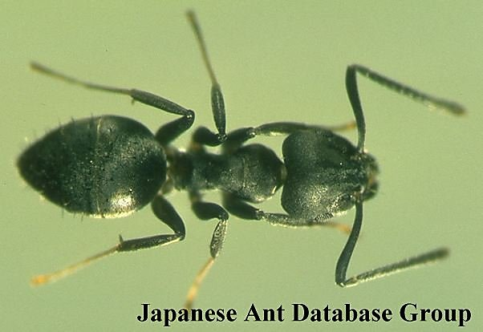
white-footed Ant, Technomyrmex albipes

Slide 36
white-footed ant, Technomyrmex albipes
Do not bite or sting
Black and about 3 mm long
Nest indoors and outdoors
in a variety of locations
Have one node on the petiole
Tarsi are yellowish to white
Workers are monomorphic and colonies are polygyne.
Recently introduced into south Florida from ???
Wing-less, worker-like, reproductives make up about
half of the colony
Colonies incredibly large (can be >1 million individuals)

Slide 37
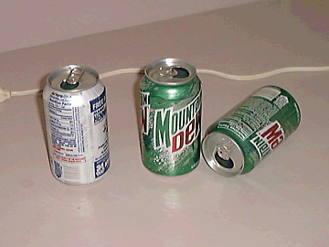
Steps to Ant Management
1) Prevention
  a) Cleanliness…store food in tight containers, clean
  up spilled food,
  do not let empty
  soda cans or
  other food-
  containing
  garbage sit inside
  structures for
  more than a
  day.

Slide 38
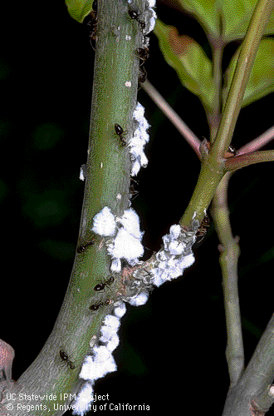
Steps to Ant Management
1) Prevention
  b) Plants inside, or against
  the outside wall of
  structures should be
  removed if ants are
  present on them, or
  aphids, whiteflies, or
  scale insects on these
  plants should be managed.
  These insects produce
  honeydew (a sweet
  substance) that some ants will feed on.

Slide 39
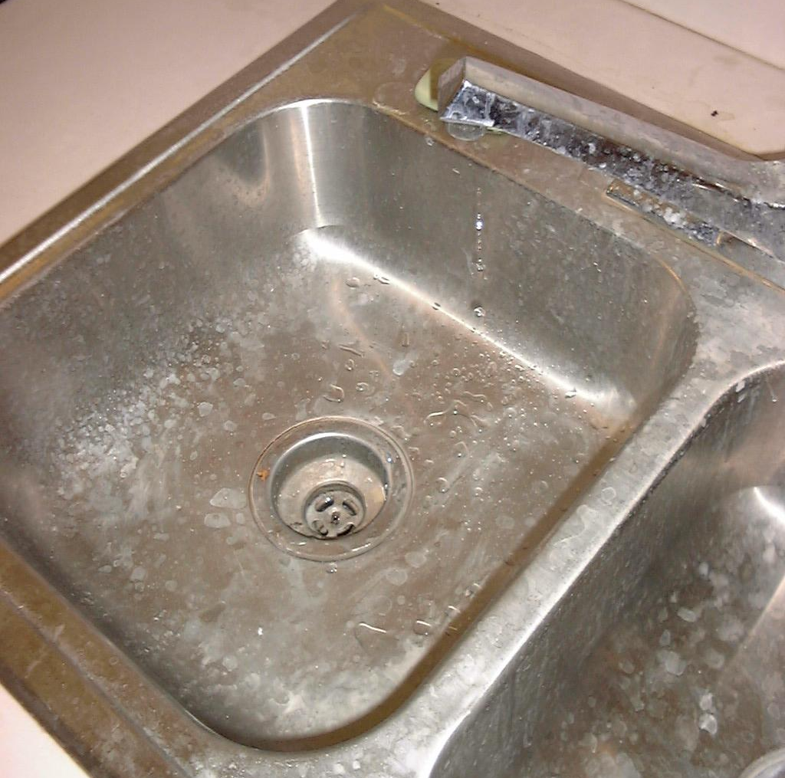
Steps to Ant Management
1) Prevention
  c) Ants search for
  water in addition
  to food. Reduce
  moisture sources
  such as condensation,
  leaks, and puddles
  as much as possible
  in and around
  structures.

Slide 40
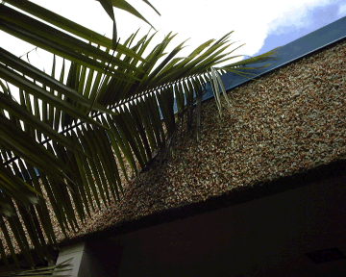
Steps to Ant Management
1) Prevention
  d) Trim trees and
  shrubs away
  from the
  structure to
  prevent ants
  from walking up
  the plants and
  entering via the
  roof or upstairs
  windows.

Slide 41
Steps to Ant Management
1) Prevention
  e) Some ants can be discouraged from entering
  structures by blocking their entry points.
  Caulk can be used to fill cracks in walls and
  around windows where ants are observed coming
  inside. In addition, damaged window screening
  should be replaced.

Slide 42
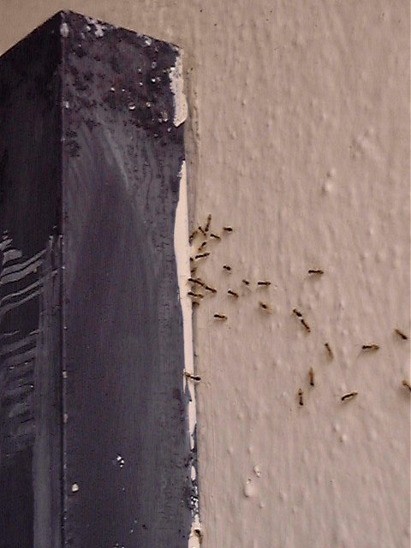
Entry can be
discouraged by
caulking access
points such as
around the base
of this porch
light.

Slide 43
Steps to Ant Management
2) Inspection
  a) Location of the nest is a key step in the
  management of ants. By killing the queen and
  brood, the production of new offspring is stopped,
  and the colony will die.
  If possible, follow foraging ants to their nest.
  If necessary, put food out to attract them, then
  follow workers who have eaten back their nest.

Slide 44
Steps to Ant Management
2) Inspection
  ) Keep track of where ants have been seen foraging
  for food or water, and where their nests are.
  Keep this information in a notebook.

Slide 45
Steps to Ant Management
3) Non-Chemical Methods
  Ants that are foraging indoors can be mopped up
  with soapy water, or removed with a vacuum.
  However, killing individual workers will have little
  overall effect in reducing the size of the ant colony.
  But, if the nest can be located and it is fairly easy to
  get to, the entire nest, including the queen and brood
  can be removed with a vacuum cleaner, or by some
  other method.

Slide 46
Pest Ants in Georgia
Daniel R. Suiter, Ph.D.
University of Georgia
College of Agricultural and Environmental Sciences
Georgia Experiment Station
Department of Entomology
1109 Experiment Street
Griffin, GA 30223-1797
770-233-6114; dsuiter@gaes.griffin.peachnet.edu

Slide 47
Pest Ants in Georgia
Carpenter ants, Camponotus species
Red imported fire ants, Solenopsis invicta
Argentine ant, Linepithema humile
Odorous house ant, Tapinoma sessile
Pharaoh’s ant, Monomorium pharaonis

Slide 48
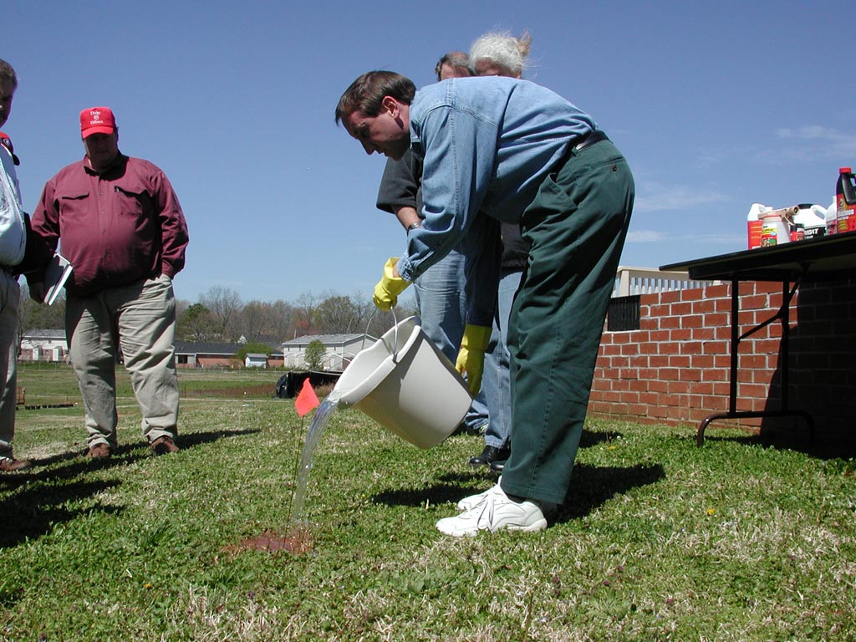
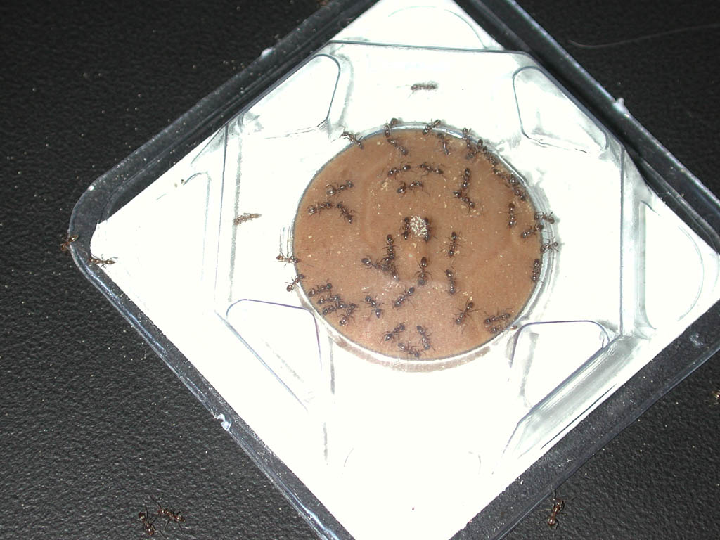
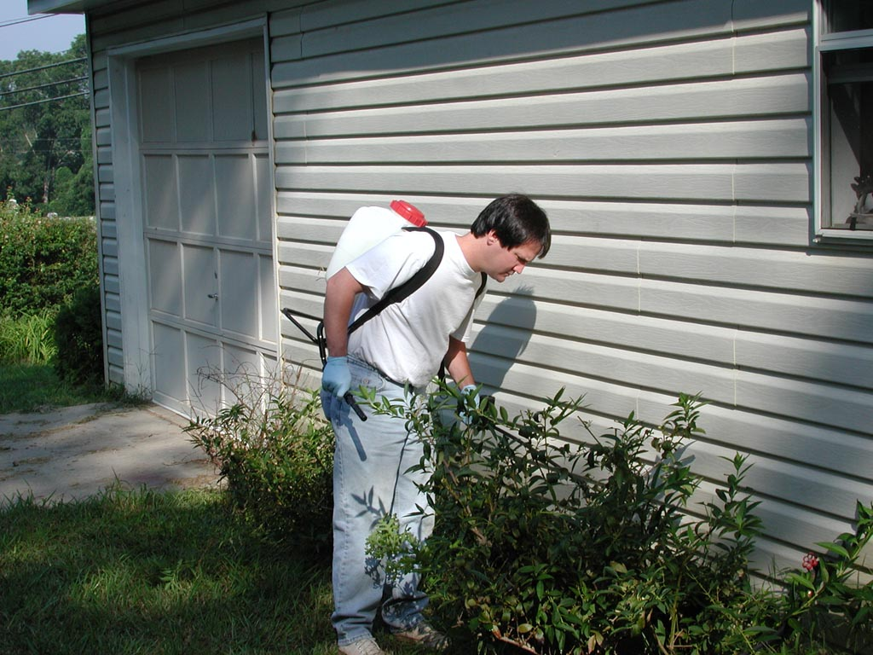
Ant Control is Situational
Situation 1: Nest is found
Solution: Physically remove or treat directly.
Success Rate: 100%
Direct Treatment
Situation 2: Nest cannot be found.
Solution: Offer bait(s).
Success Rate: Good to excellent if ants take the bait.
Bait
Situation 3: Nest cannot be found and ants do NOT take the bait(s).
Solution: General spray outside & dust inside.
Success Rate: Often poor.
Spray Outside

Slide 49
Formulations Used in
Ant Control
Outdoor Formulations
Indoor Formulations
Baits
  point source (liquids, stations, gels & pastes)
  scatter (granules)
Sprays (MEs, WPs, SCs)
  directed and focused
  undirected and general perimeter treatments
Granulars
must be watered in
Baits
  point source only (liquids, stations, gels & pastes)
Dusts
  in voids only, where customer is protected from exposure

Slide 50
Ant Control Baits
Baits are combinations of small amounts of pesticide with a food palatable to the target insect. Baits can be packaged as granules, pellets, gels, pastes, liquids, or ready to use stations.

Slide 51
Ant Control Baits
Advantages:
  easy/ready to use: granular, child-resistant station (most common), liquid
  not messy; less environmental contamination
  takes advantage of social nature of ants
Disadvantages:
  may dry out; go rancid.
  no one bait consistently controls all pest ants
  competing food sources reduces efficacy of baits

Slide 52
Ant Control Baits
Recommended Use: Indoors and/or Outdoors. Place where ants are seen foraging; replace as needed.
Notes
  the most effective baits have a slow acting, palatable toxicant incorporated into a preferred food base.
  although slower, baits generally provide longer-lasting control than contact insecticides

Slide 53
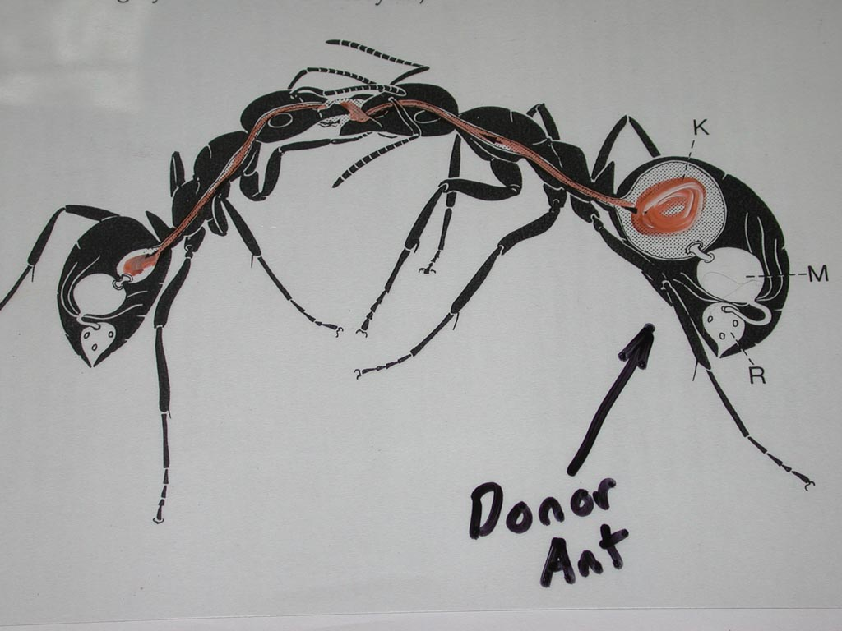
Biology of Ants
Trophollaxis (Food Sharing)

Slide 54
Ant Control
Liquid Sprays
Kills ants that contact residual; also repels ants.
Availability
  concentrate or ready-to-use
Recommended Use: Outdoors only
  treat the perimeter
  treat entry points
  treat accessible nests
Notes:
  short residual on outdoor surfaces—reapply every 4-6 weeks.

Slide 55
Ant Control Granules
Granules are formed by coating or impregnating coarse particles of a substance (e.g., clay pellets, limestone chips, corn cob) with pesticide to obtain a certain percentage concentration.

Slide 56
Ant Control Granules
Advantages:
  easily applied (ready to use); no drift
  release pesticide slowly; long residual
  no problems with inhalation; reduced exposure risk
  Penetrates thatch and mulch much deeper than sprays; excellent, prolonged availability.
Disadvantages:
  must be watered-in after application
  can be costly if over-applied

Slide 57
Ant Control Aerosol Cans
Kills by direct contact.
Ready-to-use pressurized cans.
Recommended Use: Limited to None
Notes:
  commonly used to spray trailing ants, resulting in quick knockdown and immediate homeowner satisfaction (revenge killing).
  kills only workers that are sprayed; does not kill queen, resulting in persistent problem.
  messy, oily residue left on counters, floors, etc.

Slide 58
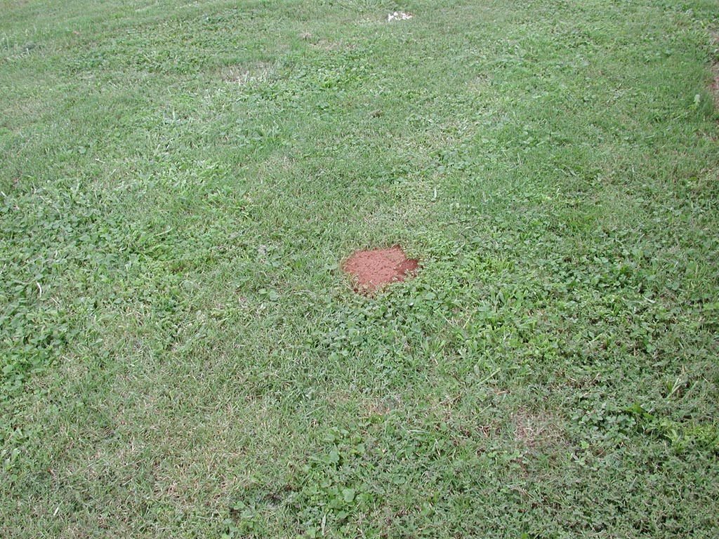
The “Two-Step” Method of Fire Ant Control
in Sensitive Areas
Step One: Bait Treatment
Broadcast granular bait in late afternoon,
when it is cool and ants are actively foraging.

Slide 59
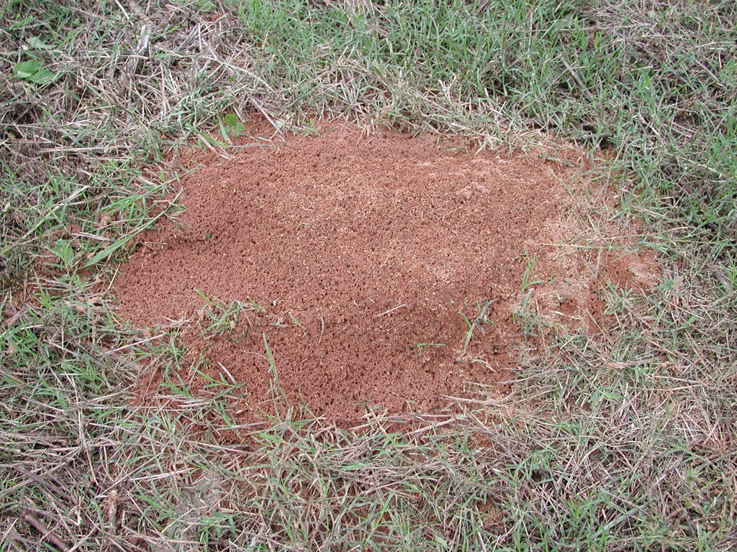
The “Two-Step” Method of Fire Ant Control
in Sensitive Areas
Step Two: Mound Treatment
One week after bait treatment,
locate active mounds…
…and treat with liquid or
dust insecticides.

Slide 60
The “Two-Step” Method of
Fire Ant Control
The “UP” Side
  environmentally friendly
  conserves competing ant species
  conserves fire ant natural enemies
The “DOWN” Side
  can be costly

Slide 61
Chemical Control
Dursban is Gone.
Diazinon sales end 2004
Talstar – RUP
Orthene
Sevin
Baits

Slide 62
Baits
Effective When ants are foraging 70-90 degrees F
Late afternoon is best
Broadcast or Mound Treatments (IMT)
Keep baits at least 10 feet away from ponds
Follow Labeled Directions
Apply When Children are not in the area for 24 hours
Baits are generally safer than sprays or dusts since they usually contain less than 1% active ingredient

Slide 63
Baits
Oral LD50
Amdro | hydramethyinon | 1131
Award | fenoxycarb | 16800
Asend | abamectin | 5000
Extinguish | Methoprene | 34600
Distance | Pyriproxyfer | >5000
Eliminator Ortho (bait) | spinosad | >5000
Fire Star Over n out TopChoice | Fipronil | 296

Slide 64
Fipronil
Frontline
Maxforce
Termidor
Over n Out

Slide 65
Bait Quality
Do not apply when ground is wet
Check for Expiration Date
Keep in air tight container in cool area
If rancid the ants will not take it.

Slide 66
Individual mound treatments
Do not apply to top of mound or disturb mound
Sprinkle about 2 tablespoons of bait around the mound
If foraging they will pick up bait in ten mins.
If they pick up bait then “spit it out” it may be rancid

Slide 67
Bait Efficacy
Hydramethylon, fipronil, spinosad results in 2-4 weeks (3-9 mo. Control)
Fenoxycarb, methoprene, pyriproxifen, abamectin results in 6-8 weeks (9-18 mo. Control)
Texas Study showed positive reults from 50:50 mix

