Slide 1
Notes:
UGA Slide

Slide 2
http://www.caes.uga.edu/extension/
Notes:
Extension Slide

Slide 3
Notes:
MG Slide

Slide 4
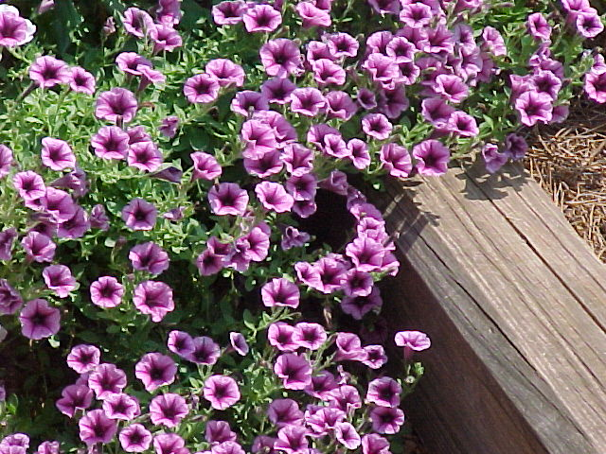
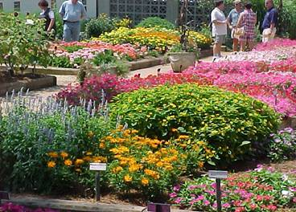
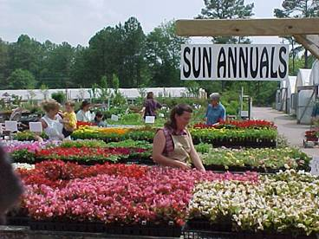
Part 1:Annuals For Georgia Gardens
Paul A. Thomas and Bodie V. Pennisi
The University of Georgia
College of Agricultural and Environmental Sciences
Department of Horticulture
Notes:
Notes to the presenter: This program is designed to be interactive. By this we mean that the participants in the classroom are expected to share their own gardening experiences with the presenter, and each other, as the talk progresses. This talk will quickly become a very boring review of one flower after another if experiences are not shared. Involve your audience! Most, if not all, of your student gardeners have experience in this area. A word of caution, the presenter must act as mediator and make sure that the length of question/answer time does not interfere with the overall schedule. Alternatively, questions and comments may be reserved for the end of the lecture and addressed as time permits
The presenter should review this text then review the “terms” provided on the slides with the audience to be sure everyone understands the “jargon.” Proceed to the script entries provided for the flower slides, which contain tips and specific suggestions for each recommended plant. The reviewer should quickly mention these points and then ask the audience to share their own experiences growing that specimen. Encourage participants to keep comments short and to the point. This is a two-hour program on annuals (one minute per slide average).

Slide 5
Learning Objectives
Lifecycles of annuals, perennials & biennials
Annuals - cultural requirements
Annuals- bed layout and planning & planting techniques for
Annuals- fertilization and maintenance & weed control
Notes:
Understand the unique lifecycles of annuals, perennials & biennials.
Understand cultural requirements that should be considered.
Understand bed layout and planning considerations and planting techniques for annuals.
Understand basic annual bed fertilization and maintenance including weed control.

Slide 6
Learning Objectives
Common annuals & benefits in container gardening
Qualities of perennials
Perennials- cultural requirements of, bed layout and planning considerations.
Perennials basic planting techniques for & division
Perennials- fertilization, maintenance, and weed control
Notes:
Have an appreciation for the common annuals available in Georgia and the benefits of annuals in container gardening.
Understand the qualities of perennials, why and where you would grow them.
Understand cultural requirements of perennials, bed layout and planning considerations.
Know basic planting techniques for perennials including division.
Understand basic perennial bed fertilization, maintenance, and weed control options for perennial beds.

Slide 7
Terms To Review
Annual: A plant which completes its life cycle in less than one year.
Annuals, as a group, are unable to withstand both summer’s heat
and winter’s cold.
Late Summer Annual: A plant which is vegetative early and mid-summer
and finally blooms in late summer only.
Tender Perennial: An annual which happens to over-winter. This
definition is very weather dependent. Some tender
perennials are annuals 7 out of 10 years!
Perennial: A plant which completes its life cycle in two or more years and
can withstand summer and winter conditions.
Biennial: A plant which usually completes its life cycle within two years.
Deer Tolerant: A plant usually not preferred by deer.
Notes:
Review Terms: On Slide

Slide 8
Terms To Review
Dead-heading: Removal of spent flowers before seed develops.
Random Seeding: Seeds broadcast in fall or spring without pattern.
Drought Tolerant: Plant recovers (grows/blooms) after prolonged drought.
Fertility: Heavy 3-4 applications : 1 lb of 10-10-10/100 sq. ft. / season.
Moderate 2 applications : 1 lb 10-10-10/100 sq. ft. / season,
i.e. one at transplant and one mid-season.
Low 1 application : 1 lb 10-10-10/100 sq. ft. at transplant
or in early spring before growth resumes.
Pinch at Transplant: Removal of top ¼ inch (including flowers) of the
terminal growth to promote branching.
Inconspicuous Bloom: Blooms not seen, very small or unimportant.
Notes:
Review Terms: On Slide

Slide 9
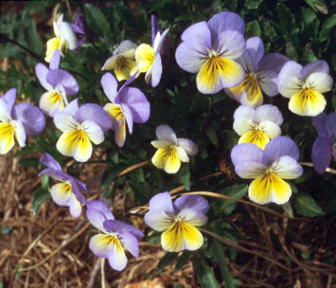
Installing Annuals
Notes:
Installing Annuals: Our presentation today is going to focus on how to properly install annual flowers and learn about the many species and cultivars available.

Slide 10
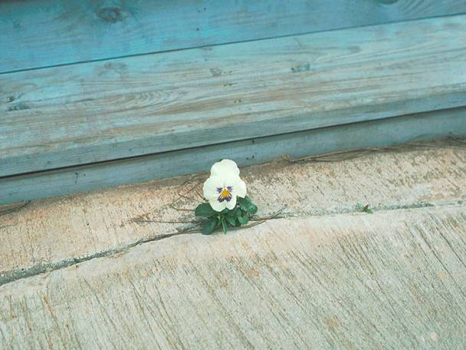
The Perfect Plant?
Notes:
The Perfect Plant: Everyone hopes to own the perfect plant. It would grow and flower with no care or worry. Sadly, even annuals are not the perfect plant. Like most plants, each species has a preferred set of conditions. Not all annuals are alike, and the gardener should not be tempted to cluster all annuals into one category. In this talk there are annuals best suited for shade, sun, wet, and dry conditions. Read through the cultural notes carefully so as to know where each recommended plant does best.

Slide 11
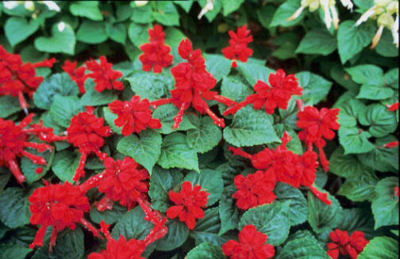
FACT
80% of plant problems result from the inability of the plant to tolerate or adapt to the local environment!
Notes:
Why Plants Perform Poorly: 80% of plant problems are a result of the inability of the plant to adapt to the local environmental conditions. In order to select the proper plant, one should first characterize the area in which you wish to plant . What is the soil pH? Is the soil compacted? Does it need organic matter? Is it shady most of the day or sunny? These questions are essential to ask to help you match the right plant to your location.

Slide 12
Selecting The Proper Annuals
Know their final size.
Know their height.
Know their pH and fertility requirements.
Know their watering requirements.
Know their bloom period.
Notes:
Selecting Appropriate Annuals: Once you know what set of environmental conditions you are working with in your garden, it is time to learn about the annuals you wish to plant.
Gardening advice abounds on the web, and books are good sources of information. However, be sure the information you are using is suited for the South. Annuals planted in the south portion of Georgia may need more irrigation than those in the north. On the other hand, South Georgia annuals may stay in bloom for most of the year. There are plenty of nationally popular annuals that do poorly here. It’s just too hot and the disease pressure is just too great during our hot, humid summers. Know the final width and height of the annual. Know the plant’s soil requirements and be sure to know how often it needs watering. Knowing how long it stays in bloom will also give you a good planning tool.

Slide 13
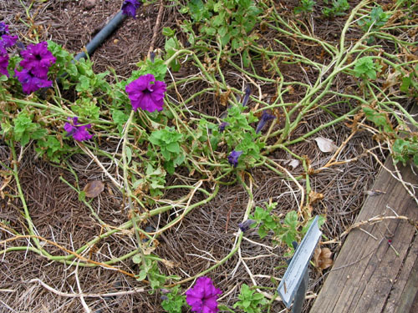
Evaluate The Old Planting
Notes:
Evaluate Current Plantings: Have previous plantings of this species had problems with disease? Has the bed been amended recently? Are there signs of compaction or puddling? Does the bed need to be raised to increase drainage?

Slide 14
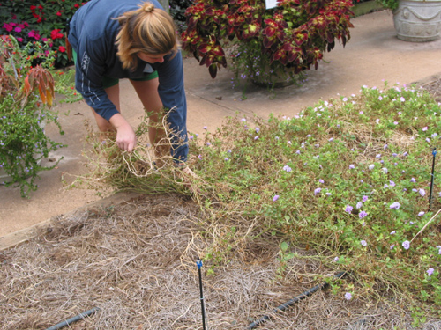
Remove Old Plant Materials
Notes:
Remove Old Plant Material: Sooner or later it is time to pull out the old and plant the new. Be sure you remove as much of the old plant, including the root system as you can. Left over root balls and branches may harbor disease. Cleaning an old bed will not eliminate pathogens, but may reduce them significantly.

Slide 15
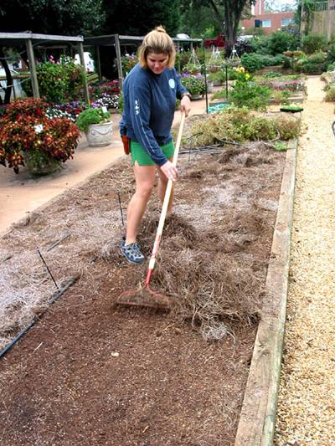
Remove Old Mulch Materials
Old mulch is less
functional due to
decomposition.
Removing the old
material can reduce
disease
Old mulch material
can be used in a
compost pile
Notes:
Bed Cleaning: Remove old mulch materials for the same reasons as listed for removing plant debris. Compost the mulch with the debris. Once composted properly, it will make a fine soil amendment.

Slide 16
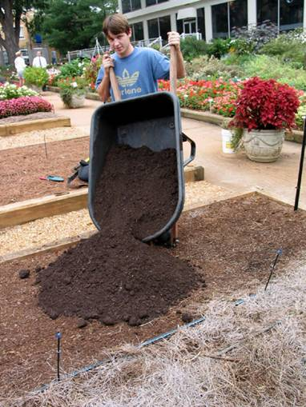
Add Compost / Organic
Matter And Amendments
Notes:
Amendments: Adding organic matter and amendments will greatly improve the ability of the beds to drain and hold nutrients. Most compost and organic materials, such as peat moss or composted yard trimmings, will work fine. Some beds, especially those with fine organic matter, benefit from adding coarse granite sand in addition to new, rough, organic matter. Don’t add sand to heavy clay soils, it will make the soil even harder to grow in.

Slide 17
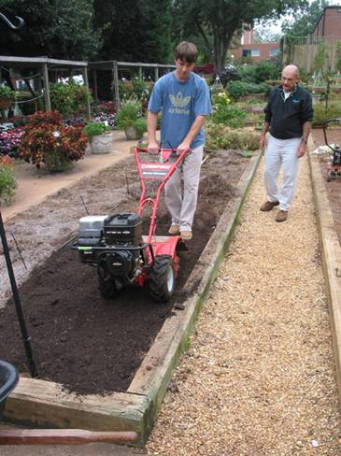
Dig In Or Till Thoroughly
At Least 12” Deep!
Notes:
Tilling: Dig or till the materials to a depth of 8-12 inches. This will provide a large area for good root growth, provide excellent drainage, and serve as a water and nutrient reservoir. Organic matter is added, as a ratio of 25% per volume of soil tilled, so 2 inches of organic matter would be added to an 6-inch tilling depth.

Slide 18
Plant Spacing
Distance Between Plants | Number of Plants Per 100 Sq. Ft.
6 Inch spacing | 400
8 Inch spacing | 227
10 Inch spacing | 143
12 Inch spacing | 70
Notes:
Spacing: Proper plant spacing depends upon the species selected. Usually bedding plants are expected to grow into each other and form a solid patch of color. For begonias, a 6-inch spacing (center to center) is required, and an 8-inch spacing is better. Vincas require 8 to 10-inch spacing when irrigated and at least 6-inch spacing when not irrigated. Impatiens can be planted on 10-inch centers if irrigated often and 6-inch centers if not. It should be apparent that each species has a different final size and growth habit. Know the plant’s mature spread and space them accordingly.

Slide 19
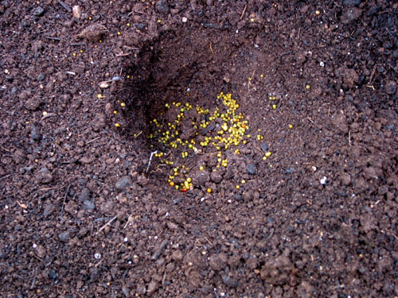
Make Sure The Hole Is
Larger Than The Root System.
Notes:
Planting: Be sure the hole in the soil is large enough to allow the plant’s root system to grow. Firm the soil from the surrounding hole against the root ball to ensure good soil-root contact. The plant should not be pressed into the soil, as this can cause root damage. The top of the root ball should not be left exposed as water will leave the root ball, causing the plant to dry faster than the surrounding soil. Slow release fertilizer, as shown, is the best material to use as it has less risk of burning roots.

Slide 20
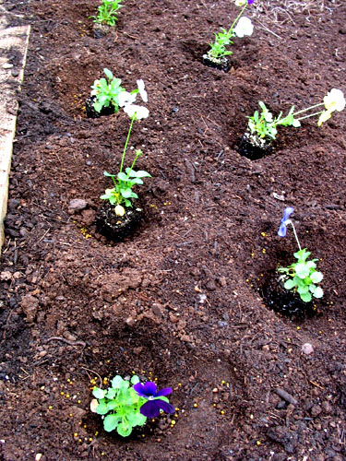
Use Care When Handling Plants
Try not to handle roots
Plant at the same
level as the root system
of the individual plant
Do not leave root balls
exposed as they may
later wick water.
Do not crush or press
into the ground!
Notes:
Handling Plants: Use care when handling bedding plants. Do not handle the plants by the root systems. The roots are the business end of the plant and are delicate. Even salts from your hands can damage roots. Rough handling can damage thousands of root cells, providing a great entry point for disease carrying organisms. Try to hold the plant by the stem portions.

Slide 21
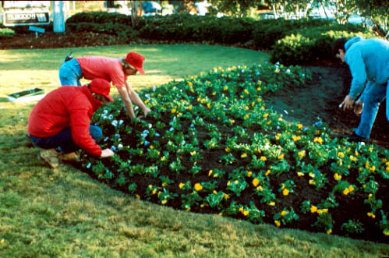
Step Away From The Planting
Be sure to check overall uniformity
and spacing consistency.
Notes:
Observation: Check for uniformity of spacing and planting depth. Planning the arrangement by placing the plants out prior to actual planting is a common practice among landscape professionals. Be sure the tops of the root balls are not visible, as they will lose moisture quicker than the surrounding soil if left exposed. A thin layer (less than 1/2 inch) of soil from the bed should cover the top of the root ball. Be sure also that plants are not planted too deep, and the spacing is consistent.

Slide 22
How Much Mulch To Apply?
3 to 5 inches is sufficient in gardens!
One bale of pine straw covers 50 – 80 sq. ft., depending on the bale size
Nine, 3 cu. ft. bags of pine bark mulch will cover 100 sq. ft. to a 3-inch depth
Notes:
Mulching: After planting, beds should be mulched to help conserve soil moisture, particularly given the hot, dry summers that the South typically experiences. Pine bark, pine straw or other suitable materials may be used and should be spread several inches thick throughout the bed and around the plants. Mulch reflects heat from the sun and helps keep the soil much cooler while allowing moisture to pass through from rainfall or irrigation.

Slide 23
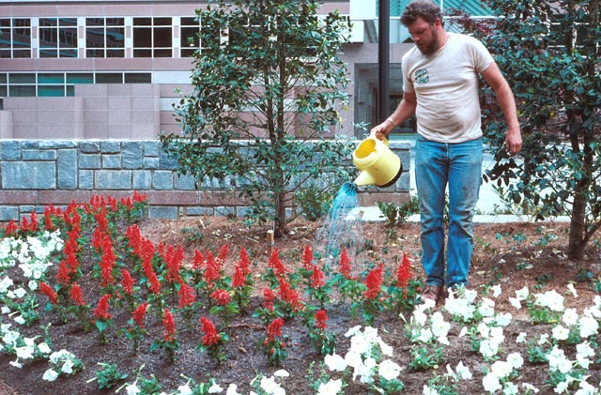
Irrigate & Fertilize!
Notes:
Irrigation: Water in thoroughly. This may mean watering two or three times the first day of planting. After that, water every two days the first week (in the absence of rainfall), and then reduce irrigation to once a week thereafter. The most common cause of bedding plant decline is over-watering.

Slide 24
Fertilization
Fertilizers only last so long!
Plants growing in shade require more fertilizer than
those in sun, due to competition from tree roots
Plants growing in sandy soils require more frequent
fertilization than those in clay soil due to leaching.
Rainfall dramatically affects fertility levels in long-term
gardens!
Some plants like low fertility!
An average recommendation is 1 lb granular
10-10-10 per 100 sq ft. Be sure to test soil first!
Notes:
Fertilizer: Fertilization is important for most bedding plants. It can be added to the soil during tilling, to the hole before transplant, or as a top dress after planting. The common 10-10-10 is a perfectly fine product for bedding plants. Fertilization needs to be performed at transplant, three to four weeks later, and again in mid-summer if the plant is a heavy feeder. Usually one pound of 10-10-10 per 100 square feet is adequate. Be sure to water in the fertilizer thoroughly each time. Slow release fertilizer may also be used in lieu of other applications. These time-released fertilizers will continue to release nutrition over the course of several months.

Slide 25
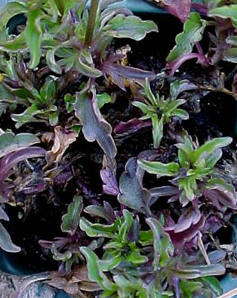
Cold Weather Starvation
Symptoms:
Leaf Purpling
Few Flowers
Chlorotic Centers
Viola Starvation
Notes:
Cold Weather Starvation: Annuals, such as pansies, can easily become hungry if inadequate fertility is present in the soil, especially if it rains a great deal. Slow growth, purple foliage, or bronzed leaves are signs of poor fertility. These symptoms may also be related to frozen soil. When roots are near freezing, they do not take up nutrients. Generally, pansies are fertilized early in November and again in late February, provided warm weather is present, though the times of fertilization may vary from year to year and region to region. Scout often for nutritional deficiencies, especially after the first major spring warm up.

Slide 26
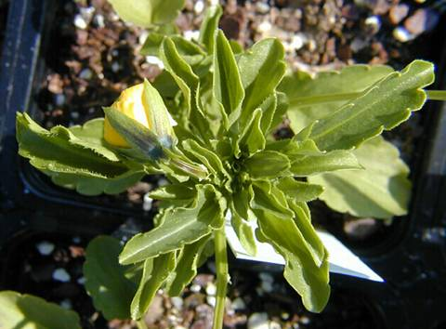
Warm Weather Starvation
Symptoms:
Chlorosis
Cupped leaves
Strap Leaves
Very Slow Growth
Very Poor Roots
Pansy starvation
Notes:
Warm Weather Starvation: Summer annuals can suffer from nutrient depletion in very hot weather, especially if the area is irrigated often. Under high rainfall or irrigation, fertilization every three weeks may be necessary. Warm season nutrient deficiencies may appear as pale green leaves, poor growth, and pale, under-sized flowers. A proper soil test can easily resolve the issue and provide information about what nutrients are needed in the soil.

Slide 27
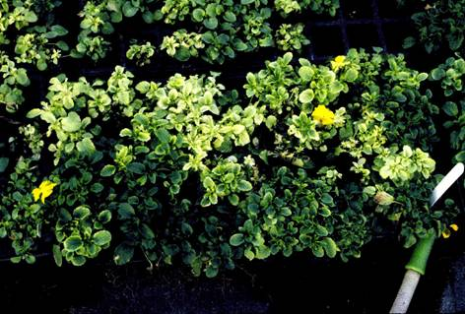
Over - Fertilization
Symptoms:
Marginal Chlorosis
Entire Leaf Yellowing
Basal Leaf Yellowing
No New Blooms
Necrosis / Death
Root Damage
Leach with water!
Overdose of a common fertilizer
Notes:
Over Fertilization: When most annuals are over-fertilized, they will respond by wilting. Excess fertilizer salts can damage roots, preventing water uptake. A less severe over-application can appear as marginal leaf burn or brown tips and aborted flowers. Leaching, or regular irrigation, will lessen the problem. Be sure to water in the fertilizer applications immediately.

Slide 28
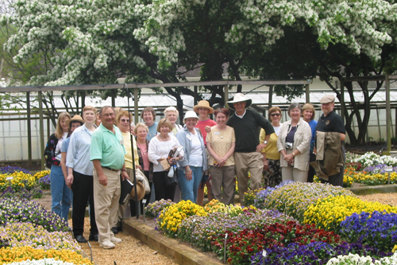
The Finished Product!
Macon Master Gardeners Visiting UGA
Notes:
The Finished Product!

Slide 29
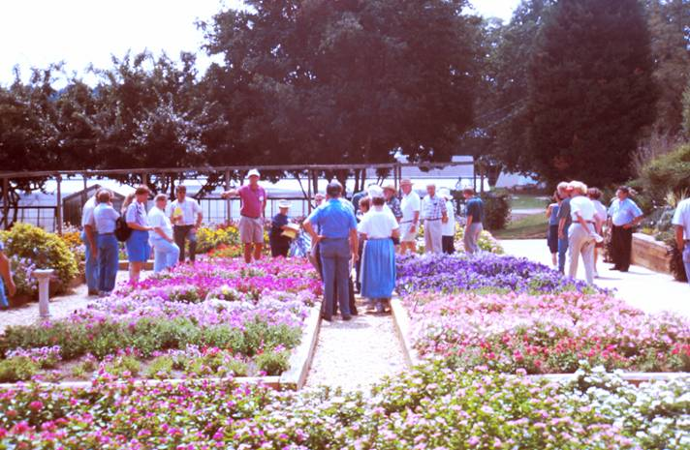
Annuals For Summer Sun
Annual Open House at the UGA Trial Gardens
Notes:
Annuals for Sunny Gardens: Everyone is welcome to visit the UGA Trial Gardens in the center of South Campus, in Athens, to learn more about annuals. They are open 24 hours a day and 7 days a week. Now let’s look at a wide variety of annual flowers and learn about their growing requirements, focusing first on those plants, which thrive in sunny locations.

Slide 30
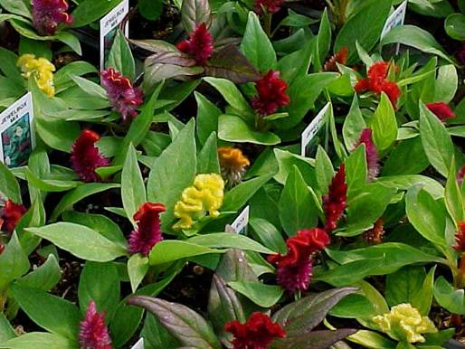
Cockscomb
Characteristics
Drought tolerant
15 – 30 inches tall
Location:
Full sun bedding
Plant Spacing:
6 inch centers
Care and Feeding:
Moderate fertility
Bloom Period:
May – November
Culture Concerns:
Deadhead first flowers and/or pinch at transplant for bushy growth
Celosia cristata
Notes:
Celosia cristata: This annual is best grown in large groups to get the best color effect. Be sure to keep Cockscomb moist for the first two weeks after transplanting. Deadheading early will allow a full display of color the rest of the summer. One can collect seed in fall, however, they will not be true to type, in that the new seedlings may not look exactly like the parents.

Slide 31
Characteristics:
Nectar source
Drought tolerant
Very floriferous
18-24 inches tall
Location:
Full sun bedding
Plant Spacing:
8 to 10-inch centers
Care and Feeding:
Low fertility,
Nitrate fertilizer
Deer tolerant
Bloom Period:
June – August
Culture Concerns:
Keep foliage dry
Avoid overhead watering
Vinca
Catharanthus roseus
Notes:
Catharanthus roseus: The key to growing Vinca is keeping the soil fertility low. In fact, most Vinca do not need additional fertilizing if fertilizer is added to the soil at transplant. Too much fertility will yield leggy plants and increase chances for disease. Avoid overhead watering, especially in late June and July.

Slide 32
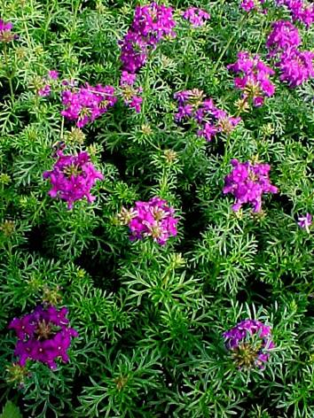
Moss Verbena
Characteristics:
Nectar source
Drought tolerant
Groundcover
4 – 6 inches tall
Location:
Full sun-bedding
Hanging baskets
Plant Spacing:
8 inch centers
Care and Feeding:
Low fertility
Deer tolerant
Bloom Period:
May - December
Culture Concerns:
Spider mites
Well-drained
Verbena tenuisecta ‘Imagination’
Notes:
Verbena tenuisecta: This low-growing, flowering ground cover can grow in almost any soil, provided the soil drains well. This plant is very drought tolerant but it is susceptible to spider mites and thrips. Adding copious amounts organic matter along with small amounts of coarse sand to clay soils is recommended in order to loosen up and improve the drainage of poor soils.

Slide 33
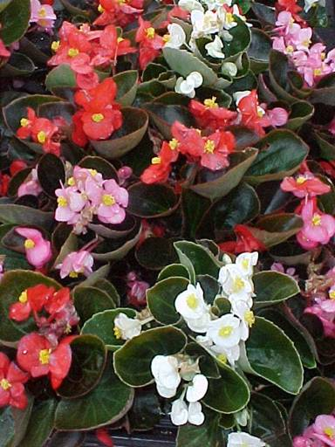
Bedding Begonia
Characteristics:
Groundcover
Floriferous
12 to18 inches tall
Location:
Full sun to partial shade
Plant Spacing:
8 to 12- inch centers
Care and Feeding:
Moderate fertility
No drought
Bloom Period:
May – August
Culture Concerns:
Fades in drought
Botrytis
Begonia spp.
Notes:
Begonia: A long-time favorite, this plant requires care the first two weeks after transplant. Never let begonias get soggy or bone dry. Pinching aggressive shoots early in the season may correct irregularly shaped plants. You can cut back begonias of this type in mid-summer to about 2 inches high if drought or hail damages the leaves. They will return with a flourish if watered and fertilized just after being trimmed back.

Slide 34
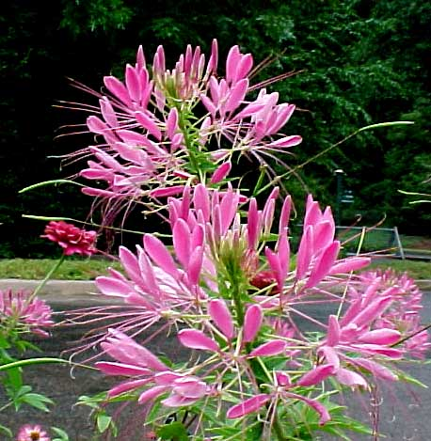
Spider Flower
Characteristics:
Nectar source
Drought tolerant
36 to 54 inches tall
Location:
Full sun bedding
Plant Spacing:
4-inch centers or
random seeding
Care and Feeding:
Moderate fertility
Deer tolerant
Well drained
Bloom Period:
June – September
Culture Concerns:
Reseeds
Cleome hassleriana
Notes:
Cleome hassleriana: This is a very tall garden annual, (though some cultivars grow to only three feet in height), and may require staking in areas that are known to be windy. If knocked down in a thunderstorm, staking will usually save the plant. Warning: If cared for properly, this plant will disperse seeds throughout the garden. The seeds are in spring-loaded pods that fling them as far as 5 feet away. This is intended to be a colony plant, meaning that it is used in large numbers for best effect.

Slide 35
Bush Violet
Characteristics:
Mounding
12 –25 inches tall
Location:
Full sun bedding
Patio containers
Plant Spacing:
10- inch centers
Care and Feeding:
Moderate fertility
No drought
Bloom Period:
June – September
Culture Concerns:
Mites
Browalia americana
Notes:
Browalia americana: Browalia is a tender, low-growing bedding plant that provides the color blue to the garden. Blue is the hardest of all colors to establish effectively, as it is dark and requires intense bloom to compete with, for example, red or white flowers. Never let this tender plant get completely dry. It will not recover. It must be kept moist to perform well.

Slide 36
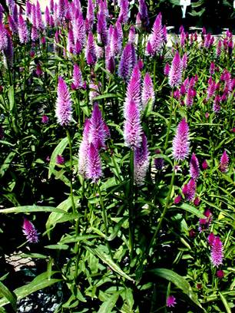
Spike Celosia
Characteristics:
Nectar source
Drought tolerant
30 –54 inches tall
Location:
Full sun bedding
Plant Spacing:
4 inch centers
Care and Feeding:
Moderate fertility
Bloom Period:
May – August
Culture Concerns:
Deadhead or pinch at transplant for bushy plant
Celosia spicata
Notes:
Celosia spicata: Spike Celosia is a great plant if seeded or transplanted in large groups. It is very drought tolerant and of great interest to bees and some butterflies. Spikes can be cut and dried. Cut them when they are between 1/2 and 1/3 open for longevity. Solitary plants will require staking.

Slide 37
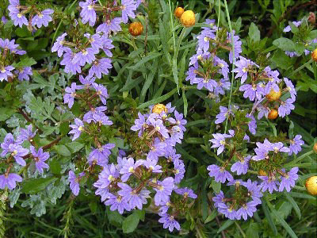
Fan Flower
Characteristics:
Groundcover
10-12 inches tall
Location:
Full sun bedding
Plant Spacing:
6 – 8 inch centers
Care and Feeding:
Heavy fertility
No drought
Deer tolerant
Bloom Period:
May – September
Culture Concerns:
Must be kept moist
Early season pinch
Scaveola aemula ‘New Blue Wonder’
Notes:
Scaveola aemula ‘New Blue Wonder’: This plant is great as a sunny ground cover near turf areas that are watered often. It grows fast, requiring feeding every three to four weeks, but will out-perform most other annuals subjected to moist soils all summer. Oddly, deer do not seem interested in this plant, except in severe drought. Scaveola also does well as a hanging basket and as a cascading plant in large containers. This annual dies immediately at first frost.

Slide 38
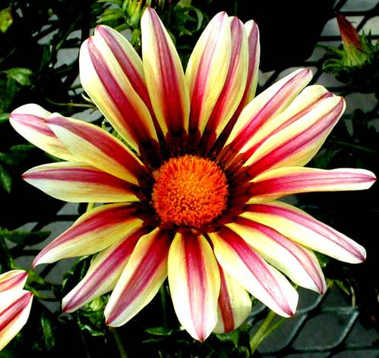
Treasure Flower
Characteristics:
Drought tolerant
12-18 inches tall
Location:
Full sun bedding
Plant Spacing:
5 -7 inch centers
Care and Feeding:
Moderate fertility
Bloom Period:
June – September
Culture Concerns:
Well drained soils
Gazania splendens
Notes:
Gazania splendens: This South African plant is called the Treasure Flower because of the multitude of colors each specimen portrays. It provides the best color display when planted densely and early in the season. Gazanias require a mid-summer fertilization and occasional irrigation to provide the most blooms. Deadheading keeps the plant looking neat.

Slide 39
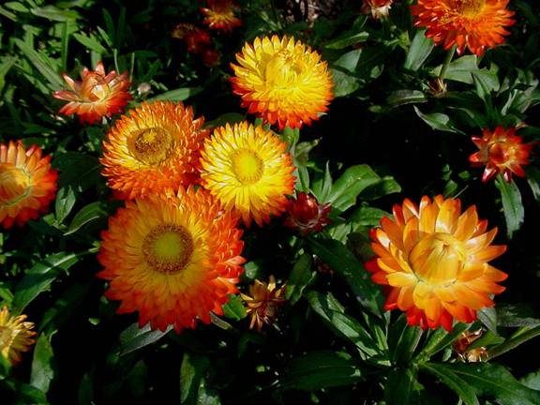
Strawflowers
Characteristics:
Late summer color
as dried flowers
24-28 inches tall
Location:
Full sun bedding
Plant Spacing:
8-inch centers
Care and Feeding:
Moderate fertility
Deer tolerant
Well drained soils
Bloom Period:
June – August
Culture Concerns:
Cut flowers when
partially open.
Helichrysum bracteatum
Notes:
Helichrysum bracteatum: Strawflowers are easily grown and have the added benefit of being good cut flowers that dry well. Cut Helichrysum just as the first or second tier of bracts has expanded away from the bud-like petal cluster. An example can be seen in the upper right and left-hand corners of this slide. Hang the plants upside down in a dry room. They will unfold several more layers before completely drying. Dried Helichrysum can last for many years.

Slide 40
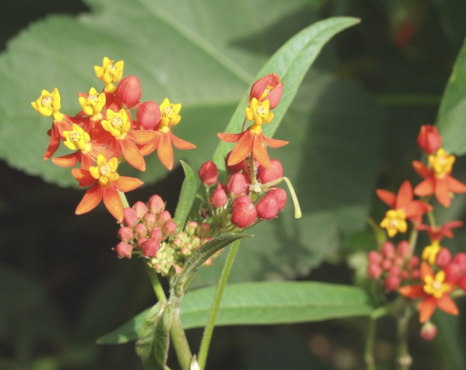
Bloodflower
Characteristics:
Nectar source
Drought tolerant
48-60 inches tall
Location:
Full sun bedding
Plant Spacing:
4 to 6-inch centers
Care and Feeding:
Moderate fertility
Deer tolerant
Bloom Period:
June – October
Culture Concerns:
Aphids
Well drained
Asclepias currisavica
Notes:
Asclepias currisavica: Monarch caterpillars love this Asclepias just as much as our native perennial butterfly weed. This plant grows tall, and makes impressive mounds of color when grown in large numbers. It will produce seeds that can be re-established next spring. Solitary plants may need staking later in the summer, especially once more seed pods form.

Slide 41
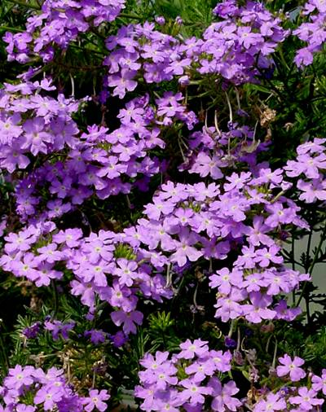
Annual Verbena
Characteristics:
Floriferous
12-15 inches tall
Location:
Full sun (Morning)
Plant Spacing:
4-inch centers
Care and Feeding:
Moderate fertility,
Heat tolerant
Bloom Period:
June – August
Culture Concerns:
Mites
Well drained soils
Mildew
Verbena spp.
Notes:
Verbena spp.: Some plants are just hard to grow, and annual Verbena can be one of them. This plant is best suited for the upper mid-west and California coast, but will survive and do well in Georgia if shaded from mid-afternoon sun, watered frequently, and good fertility is maintained throughout the summer. Avoid overhead watering as it tends to promote mildew in this plant. Drip irrigation is best. So why bother growing this plant? Because the color range in this species is fantastic.

Slide 42
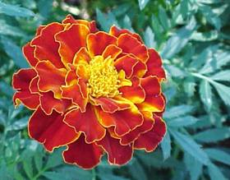
Marigold
Characteristics:
Floriferous
12 to 32 inches tall
Location:
Full sun bedding
Plant Spacing:
4-inch centers
Care and Feeding:
Moderate fertility
Deer tolerant
Bloom Period:
May - October
Culture Concerns:
Mites / Heat
Tagetes hybrida
Notes:
Tagetes hybrida : Some folks swear by them-- others swear at them! Marigolds are susceptible to summer’s heat, spider mites, iron toxicity, and drought. If you can provide well-drained soils, irrigate weekly, fertilize monthly, and deadhead every two weeks, you may experience the satisfying color display marigolds can provide. Some people plant them in August for late summer and early fall color.

Slide 43
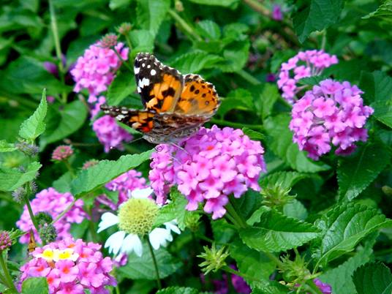
Running Lantana
Characteristics:
Nectar source
Drought tolerant
Spreading groundcover
12 – 15 inches tall
Location:
Full sun bedding
Plant Spacing:
24 - inch centers
Care and Feeding:
Moderate fertility
Deer tolerant
Bloom Period:
May – October
Culture Concerns:
Well drained soils
White flies
Lantana montevidensis
Notes:
Lantana montevidensis: A great ground cover that is heat and drought tolerant, attracts clouds of butterflies, and comes back in spring 2 out of 5 years if mulched. The key to growing excellent running Lantana is heavy fertilization at transplant, followed by three to four weeks of consistent watering. The plant requires little care once established, but may need to be cut back mid-summer to encourage repeat flowering.

Slide 44
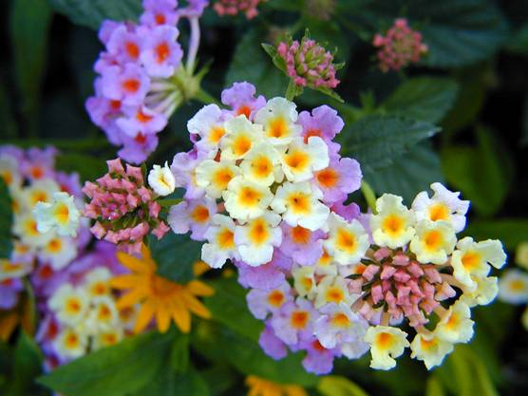
Mounding Lantana
Characteristics
Nectar source
Drought tolerant
18 – 60 inches tall
Location:
Full sun bedding
Plant Spacing:
1 to 2 foot centers
Care and Feeding:
Moderate fertility
Deer tolerant
Bloom Period:
June – October
Culture Concerns:
Mildew / Whiteflies
Well drained soils
Lantana camara
Notes:
Lantana camara: Mounding Lantana is closely related to the running type. It forms 15 to 36 inch tall mounds depending on the cultivar used. ‘New Gold’ is a popular golden yellow cultivar that is drought tolerant and survives in poor soils. Keep in mind that some cultivars, such as ‘Patriot Rainbow,’ are slow growing compared to ‘New Gold’. Know your plants before mixing cultivars of lantana for long-term color effect.

Slide 45
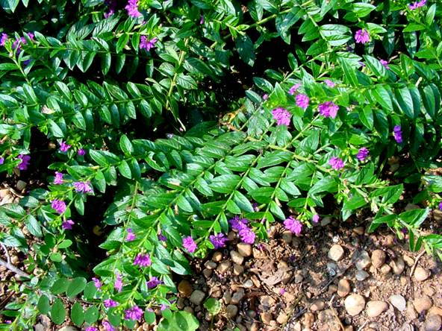
Mexican Heather
Characteristics
Nectar source
15 – 18 inches tall
Location:
Full sun or
partial shade
Plant Spacing:
12-Inch centers
Care and Feeding:
Moderate fertility
Heat tolerant
Bloom Period:
June – October
Culture Concerns:
Constant fertility
Cuphea hyssopifolia
Notes:
Cuphea hyssopifolia: Cupheas are a large group of herbaceous annuals and perennials. This selection is one that will grow well near heavily irrigated turf. Another great annual Cuphea is ‘Scarlet Queen,’ a cultivar bred at the University of Georgia. Both are easy-care annuals that only require minimal irrigation once established.

Slide 46
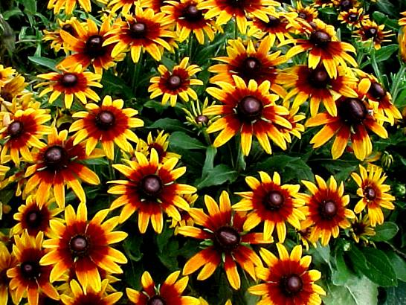
Blackeyed Susans
Characteristics:
Nectar source
Drought tolerant
18 – 28 inches tall
Location:
Full sun bedding
Plant Spacing:
6 to 8 inch centers
Care and Feeding:
Moderate fertility,
Heat tolerant
Bloom Period:
June – August
Culture Concerns:
Deadheading
Mildew
Rudbeckia hirta
Notes:
Rudbeckia hirta: Black-eyed Susans are easy to grow from seed and grow well until mid-summer’s heat. To keep them blooming, one must deadhead all spent flowers weekly, as well as fertilize and irrigate monthly. Don’t crowd these annuals, as they will stretch and become floppy. Mildew can sometimes be a problem

Slide 47
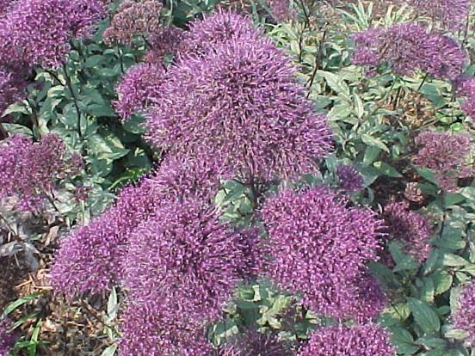
Throatwort
Characteristics:
Nectar source
24 – 48 inches tall
Location:
Full sun bedding
Plant Spacing:
6 to 8-inch centers
Care and Feeding:
Moderate fertility,
No drought!
Bloom Period:
June – September
Culture Concerns:
Mildew
Well drained soils
Must not dry out
Trachelium caeruleum
Notes:
Trachelium caeruleum: Throatwort has enjoyed an increase in popularity due to new and improved cultivars coming onto the market. Care must be given to transplants, early fertility, and consistent irrigation is a must. Plant them in large groups, as single plants get lost in the garden due to the dark blue flower clusters. Throatwort looks great as a background plant behind white Zinnia linearis.

Slide 48
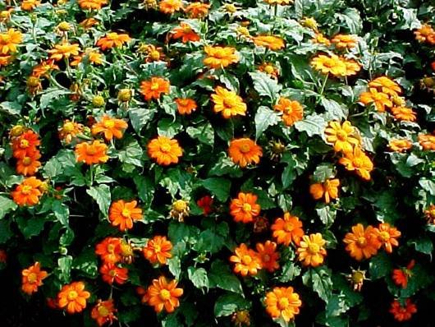
Mexican Sunflower
Characteristics:
Nectar source
Drought tolerant
Late blooming
36 -78 inches tall
Location:
Full sun bedding
Plant Spacing:
2-foot centers
Care and Feeding:
Moderate fertility
Deer tolerant
Bloom Period:
July - November
Culture Concerns:
Can get huge!
Mildew
Tithonia rotundifolia ‘The Torch’
Notes:
Tithonia rotundifolia: The Mexican Sunflower is an excellent butterfly attractor, and true to its name, is a sun-loving plant capable of tolerating drought and heat. The species form gets huge, up to 10 feet if fertilized. New cultivars average 6 feet and frequent fertilization after seeding or transplanting causes excessive growth. Water when wilted to prevent rank growth. Mexican Sunflower will perk right up after a wilt. Mexican Sunflower is a great plant for Xeriscape gardens.

Slide 49
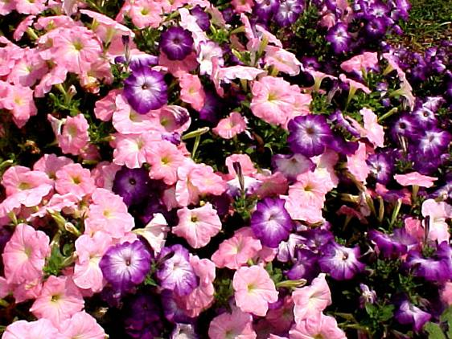
Bedding Petunias
Characteristics:
Floriferous
12 – 24 inches tall
Spring, fall color
Location:
Full sun bedding
Plant Spacing:
6 – 8 inch centers
Care and Feeding:
Moderate fertility
No drought
Bloom Period:
April - December
Culture Concerns:
Mid-summer trimming is required
Petunia hybrida
Notes:
Petunia hybrida - Bedding Type: There are hundreds of petunia hybrids to choose from. They are easy to grow as long as you continue to provide fertility and irrigation weekly for the duration of the summer and fall. If not fed or irrigated, they cease blooming mid-summer and become very unattractive. Clipping long growth can sometimes rejuvenate an unsightly plant. Petunias will flower well into late fall, even after the first few frosts.

Slide 50
Cascading Petunias
Characteristics:
Hanging baskets
6 - 10 inches tall
3 - 4 foot cascades
Location:
Full sun bedding
Plant Spacing:
6 to 9-inch centers
Care and Feeding:
Heavy fertility,
No drought
Bloom Period:
May – November
Culture Concerns:
Summer trimming
Petunia hybrida ‘Cascadia’
Notes:
Petunia hybrida - Cascading Type: Cascading petunias are bred to grow long and fast. They form great cascades of flowers over walls, in hanging baskets and over planter boxes. Like their bedding cousins, they require constant fertility and moisture to maintain flowering through the summer heat. They need trimming mid-summer to shape and rejuvenate them.

Slide 51
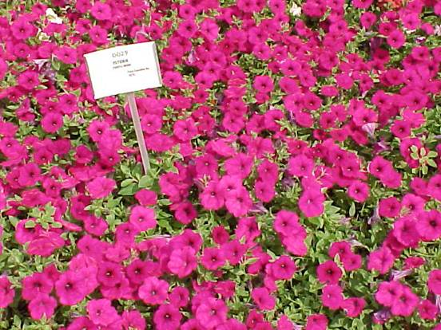
SuperPetunia
Characteristics:
Groundcover
8-12 inches tall
Location:
Full sun
Plant Spacing:
24-inch centers
Care and Feeding:
Heavy fertility,
No drought
Bloom Period:
June – October
Culture Concerns:
Rampant spreader
Petunia ‘Purple Wave’
Notes:
Petunia hybrida - Super Petunia Type: Bred in Japan, this petunia hybrid is well named given its aggressive, fast growth habit. Many of the super petunias can grow 4 to 5 feet per season, and may take over a garden. However, in poor soils or areas where you want color quickly, these are great plants. To maintain flowering, it is essential to keep these plants well fertilized and watered. Professionals fertilize every two or three weeks! Trimming to shape and maintaining boundaries are essential activities, especially when grown in small groups of purple and white.

Slide 52
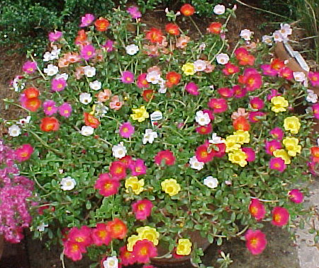
Purslane Portulaca
Characteristics:
Groundcover
6 - 12 inches tall
Location:
Full sun bedding
Plant Spacing:
8-inch centers
Care and Feeding:
Moderate fertility
Bloom Period:
June – August
Culture Concerns:
Well drained
Flowers close by 4:00 pm
Portulaca grandiflora
Notes:
Portulaca grandiflora: Moss Rose or common Portulaca is a very drought tolerant plant once established. Shown here is the new ‘Yubi’ cultivar series, which sports a single flower form with flat, beaver-tail leaves. The common moss rose is a double flower form with succulent needle-like leaves. Both have flowers that close by 4 pm

Slide 53
Ornamental Sweet Potato
Characteristics:
Groundcover
12 – 15 inches tall
Location:
Full sun
Plant Spacing:
2 foot centers
Care and Feeding:
Moderate fertility
No drought
Bloom Period:
Inconspicuous
Culture Concerns:
Chewing insects
Rampant growth
Ipomea batatus ‘Marguerite’
& ‘Blackie’
Notes:
Ipomea batatus: Ornamental Sweet Potatoes are very popular as a fast-growing annual ground cover. The trouble is, this ornamental sweet potato can grow so fast, they overcome the most carefully laid out garden plans. There are several ways to keep them in check. Low fertility, frequent trimming, and reduced irrigation will slow their growth. Notice how complimentary the sweet potato cultivar ‘Marguerite’ looks against Rhoeo pallida (Purple Passion) in the lower right-hand corner. The cultivar ‘Blackie’ is located in the upper left-hand portion of the slide. This plant group is barred from interstate transportation due to concerns about potato weevil.

Slide 54
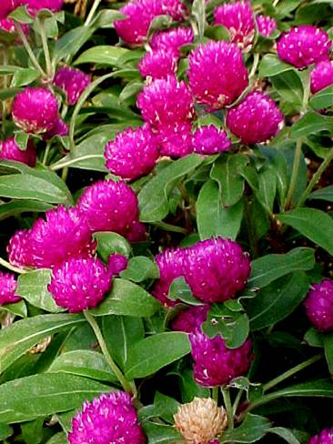
Globe Flower
Characteristics:
Drought tolerant
15 - 48 inches tall
Good dried flower
Location:
Full sun bedding
Plant Spacing:
8-inch centers
Care and Feeding:
Low fertility
Deer tolerant
Bloom Period:
June – August
Culture Concerns:
Mildew
Well drained
Pinch at transplant
Gompherena globosa
Notes:
Gompherena globosa: Globe Flowers are very attractive to butterflies and moths, and do very well in drought. The key to a great color display is to plant them in large groups on 8-inch centers so that the young plants will branch well before bumping into their neighbors. This annual benefits from a mid-summer fertilization only if planted late in the spring.

Slide 55
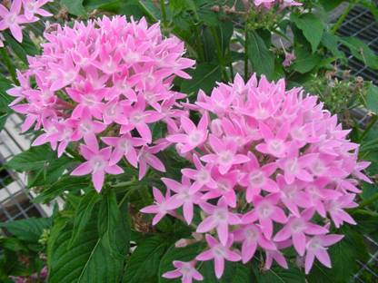
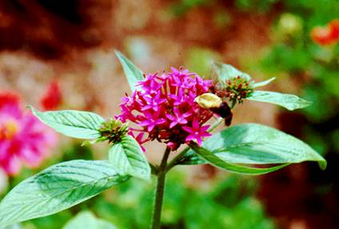
Pentas
Characteristics
Nectar source
15-28 inches tall
Location:
Full sun bedding
Plant Spacing:
8-inch centers
Care and Feeding:
Moderate fertility
No drought
Bloom Period:
June – October
Culture Concerns:
Mildew
White Flies
Pentas lanceolata
Notes:
Pentas lanceolata: Pentas are great butterfly attractors, and do well in Georgia’s heat and humidity. Pentas do require a four-week establishment period in most Georgia soils, and benefit from a mid-summer fertilization. For best growth and flowering, do not expose Pentas to drought or soggy soils. Pentas may be cut back if gangly, which can happen if planted too closely together. White flies may be problematic pests in some regions.

Slide 56
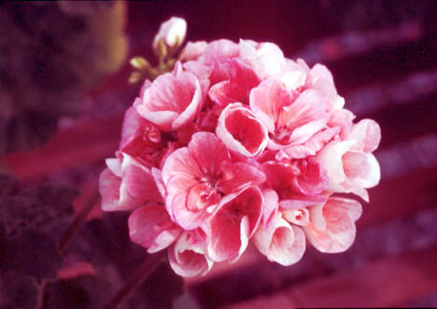
Geraniums
Characteristics:
Container plant
18 – 24 inches tall
Location:
Full sun bedding
Plant Spacing:
8 to 10-inch centers
Care and Feeding:
Heavy fertility
Bloom Period:
April – November
Culture Concerns:
Mealy bugs
Mildew
Deadheading
Declines in heat
Pelargonium hortorum
Notes:
Pelargonium hortorum Geraniums have been a favorite of gardeners for over a hundred years. Geraniums grow best in well-drained soils that dry out from time to time. They enjoy consistent fertility in containers, and a mid-summer fertilization when in a bedding situation. Planting in soggy soil or allowing drought in full sun are the usual ways one kills a geranium.

Slide 57
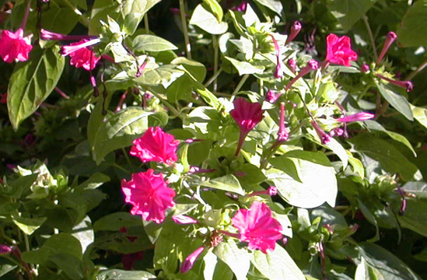
Four O’ Clocks
Characteristics:
Nectar source
Drought tolerant
18 – 54 inches tall
Location:
Full sun bedding
Plant Spacing
24-inch centers
Care and Feeding:
Moderate fertility
Pinching early
Early staking
Bloom Period:
June – September
Culture Concerns:
Shrub-like
Reseeds
Mirabilis jalapa
Notes:
Mirabilis jalapa: Four O’ Clocks are so named because they open their flowers late in the afternoon. Primarily moth pollinated, this plant forms a shrub in Georgia, and with proper fertility and watering, can grow quite large. They require full sun, plenty of root space and good organic soil to perform well. Pink and purple are common colors, but white and other shades are also found. Grown easily from seed, the plants can become problematic after a year or two as they naturally reseed.

Slide 58
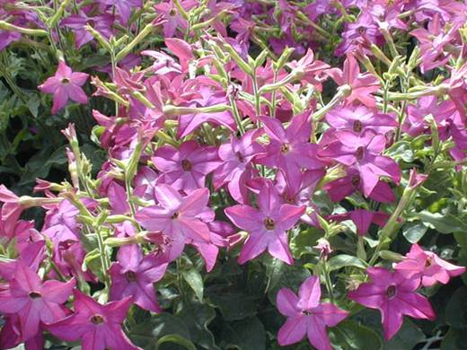
Ornamental Tobacco
Characteristics:
Nectar source
Location:
Full sun bedding
Plant Spacing:
6-inch centers
Care and Feeding:
Heavy fertility
Bloom Period:
June – September
Culture Concerns:
Well drained soils
Declines in drought
Nicotiana alata
Notes:
Nicotiana alata: There are many cultivars of ornamental tobacco available on the market. They are heat tolerant but not drought tolerant. This is another bedding plant that must be fed and watered often to maintain flower production and growth through the late summer. Leaves can be sticky, so weeding or deadheading is a chore. This generally can be avoided if you touch the plants in the early morning, before high light and heat promote exudation of the sticky ingredients.

Slide 59
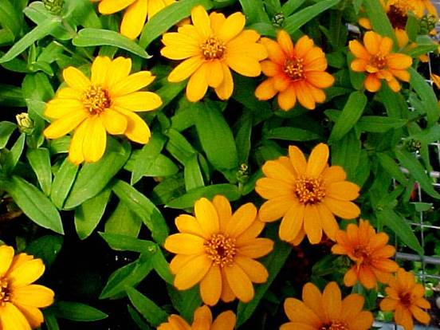
Creeping Zinnia
Characteristics:
Nectar source
Drought tolerant
12 – 20 inches tall
Cascading
Location:
Full sun bedding
Plant Spacing:
8 to 10-inch centers
Care and Feeding:
Moderate fertility
Bloom Period:
June – October
Culture Concerns:
Mildew
Well drained
Zinnia angustifolia
Notes:
Zinnia angustifolia: This is a creeping form of Zinnia that does very well in Georgia. They form a colorful ground cover that is drought tolerant and forgiving of abuse. If given a mid-summer fertilization, they will bloom well through fall. White, yellow and orange are the predominating colors. Mildew is sometimes a problem.

Slide 60
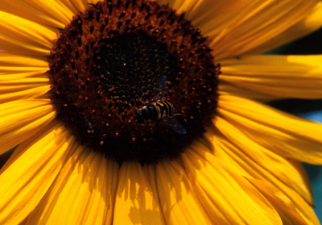
Sunflower
Characteristics:
Nectar source
Specimen / Border
Drought tolerant
4- 8 feet tall
Location:
Full sun bedding
Plant Spacing:
24-inch centers
Care and Feeding:
Moderate fertility
Bloom Period:
June – August
Culture Concerns:
Huge! Staking
Mildew
Helianthus annuus
Notes:
Helianthus annuus: The common Sunflower is still a popular back-of-the-garden plant that brings great yellow flowers to the garden mid-July through August. Depending on the cultivar, plants can range from 4 to 8 feet tall. Do not plant them closer than 12 inches apart or they will crowd each other and get leggy.

Slide 61
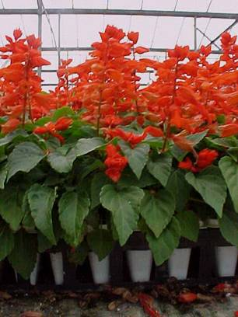
Scarlet Sage
Characteristics:
Nectar source
18 – 24 inches tall
Location:
Full sun bedding
Plant Spacing:
6 to 8 inch centers
Care and Feeding:
Heavy fertility
No drought
Bloom Period:
June – August
Culture Concerns:
Defoliates in drought
Salvia splendens
Notes:
Salvia splendens: There are many cultivars of Scarlet Sage, and each has its place. Pinch this plant early to induce branching. Your return in color will be 4-fold. Salvia tends to lose leaves mid-summer if experiencing drought. Keep up the fertility and water to avoid this problem. If they do become leggy, cutting back before mid-July and increasing moisture and fertility will usually generate a new flush of growth that blooms beautifully before the last of August.

Slide 62
Bedding Lobelia
Characteristics:
Hanging baskets
Early spring color
Mounding habit
15 - 24 inches tall
Location:
Full / part sun
Plant Spacing:
6-inch centers
Care and Feeding:
Moderate fertility
Cool, moist soils
No drought
Bloom Period:
March-May
Culture Concerns:
Well drained
Lobelia erinus
Notes:
Lobelia erinus: This is a very popular annual, due, once again, to that search for blue in the garden! However, it is very difficult to grow in Georgia. One should plan on using Lobelia as a short-lived spring annual, planted intensely in April, just after the last chance of frost. When planted in flower beds, assume it will be lost by June 15th. It will last a few weeks longer if started in early spring, under trees, in dappled light, but always succumbs to the heat by mid July. Hanging basket plants, if watered often and scouted for drying soil daily, are a much a better experience, especially in partial shade.

Slide 63
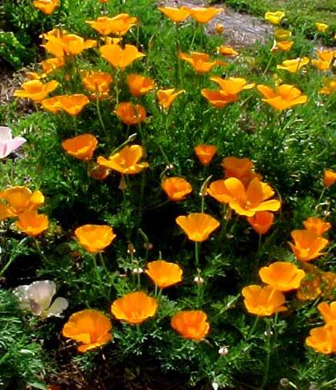
California Poppy
Characteristics:
Early spring color
12 - 20 inches tall
Location:
Full sun bedding
Plant Spacing:
4- inch centers
Random seeding
Care and Feeding:
Moderate fertility
No drought
Bloom Period:
March - May
Culture Concerns:
Well drained
Eschscholzia californica
Notes:
Eschscholzia californica: Very easy to grow. The California Poppy is a wonderful source of the color orange in early spring. Sowing seeds in the fall, on ground cleared of debris, is the least expensive way to go, and if planted intensely, this plant can be stunning! The beautiful blue green foliage looks great in winter. Allow the ground to remain undisturbed the rest of the winter and gently remove leaf debris in early March. E. californica blooms beautifully from mid-March to June 1st or so, depending on where you are in Georgia.

Slide 64
Annuals For Shady Location
Dr. Thomas’s Home In Athens, Georgia
Imagine What Shade-Tolerant Annuals Could Do For This Site!
Notes:
Annuals For Shady Areas

Slide 65
Impatiens
Characteristics:
Nectar source
Floriferous
18 – 24 inches tall
Location:
Full shade
Partial shade
Plant Spacing:
8 to 12-inch centers
Care and Feeding:
Moderate fertility
No drought
Bloom Period:
June – August
Culture Concerns:
High organic soils best
Impatiens walleriana
Notes:
Impatiens walleriana - Single Flower Form: Impatiens is likely the easiest shade-tolerant plant to grow in Georgia. They do well if kept moist and fertilized occasionally. Impatiens grows very large during the long growing season and tends to mound up if planted on 8-inch centers. They respond to this crowding by growing upwards resulting in a taller plant. If you wish for a shorter final height of 15 inches or less, you must plant them on 12-inch centers.

Slide 66
Double Impatiens
Characteristics:
Nectar source
High color density
18 - 24 inches tall
Hanging baskets
Location:
Full shade
Partial shade
Plant Spacing:
8 to 12-inch centers
Care and Feeding:
Moderate fertility
No drought
Bloom Period:
June – August
Culture Concerns:
High organic soils best
Impatiens walleriana
Notes:
Impatiens walleriana - Double Flower Form: As easy as Impatiens are to grow, many gardeners make the mistake of assuming that double impatiens respond the same as single flower forms. In fact, they do not. They grow more slowly, bloom less frequently and require more light and space to develop well. Because of this, they are almost exclusively used in containers and hanging baskets. They prefer artificial soil mixes, regular water, and adequate fertility. The double flowers drop when old and can make an unsightly mess in wet weather.

Slide 67
New Guinea Impatiens
Characteristics:
Nectar source
14-28 inches tall
Location:
Partial shade
Plant Spacing:
12- inch centers
Care and Feeding:
Heavy fertility
No drought
Organic soils
Bloom Period:
June – August
Culture Concerns:
Botrytis
Absolutely must be kept moist.
Impatiens hawkeri
Notes:
Impatiens hawkeri: New Guinea Impatiens is a very good example of a full to partial shade annual. They will grow in the darkest reaches of the garden, as long as it is always moist and occasionally fertilized. Best used in containers, New Guinea Impatiens does not tolerate full sun, excessive heat, or drought. Severe wilting causes death, or at best, very poor future growth. Partial sun, especially in the morning, will generate the best blooms.

Slide 68
Floss Flower
Characteristics:
Nectar source
12-15 inches tall,
12 inches wide.
Location:
Full - part shade
Plant Spacing:
4 to 8-inch centers
Care and Feeding:
Moderate fertility
No drought
Bloom Period:
June – October
Culture Concerns:
Bleaches in sun
Botrytis
Ageratum houstonianum
Notes:
Ageratum houstonianum: This annual poses a challenge to the gardener. The pale blue flowers are ideal for semi-shady gardens, and early spring beds. The challenge is to try to keep the plants cool over the summer. Ageratum will fade and decline in dry heat. They perform well in semi-sunny places, such as golf course areas, that are irrigated frequently. High organic soils, mulch, and special attention to soil temperature are the keys to success. If you have adequate time and water, Ageratum makes a nice blue bedding plant material that attracts both butterflies and moths.

Slide 69
Caladium
Characteristics:
Colorful foliage
28 – 36 inches tall
Location:
Full / part shade
Plant Spacing:
6 to 8-inch centers
Care and Feeding:
Heavy fertility
No drought
Bloom Period:
Inconspicuous
Culture Concerns:
Well drained
Dig tubers in fall
Caladium ‘Miss Muffet’
Notes:
Caladium spp: Caladiums have been used for decades as shade-tolerant bedding plants. They prefer warm, high organic soils that are well-drained, yet moist. The tubers can be lifted in fall after first nip of frost. They can be dried and stored in paper bags in a dry, cool (55 degrees F.) storage area. In spring, if one removes the central new growing point from the tuber with a sharp knife, the tuber will produce several new growths and make a much nicer plant once replanted.

Slide 70
Elephant Ears
Characteristics:
Full/part shade
Tolerates wet soils
36 - 78 inches tall
Location:
Full/part shade
Plant Spacing:
24-inch centers
Care and Feeding:
Moderate fertility
No drought
Bloom Period:
Inconspicuous
Culture Concerns:
Dig tubers in fall
Alocasia micholitziana ‘Maxkowskii’
Notes:
Alocasia micholitziana: Elephant ears are fast becoming a popular specimen plant due to its huge colored leaves and its rapid growth when placed in fertile and moist soil. This plant will tolerate full shade and look great. Depending on the cultivar, they can get quite large. The tuber can also be lifted in fall and stored for next year, or brought indoors as a houseplant in winter. It makes a fantastic colony or group planting of 12 to 25 plants. May be invasive near warm waterways. Poisonous.

Slide 71
Coleus
Characteristics:
Tolerates wet soils
24 – 30 inches tall
Location:
Shade/part shade
Plant Spacing:
8 to 10-inch centers
Care and Feeding:
Moderate fertility
No drought
Bloom Period:
Must deadhead
Culture Concerns:
Pinch at transplant
Mildew
Coleus ‘Wizard Mix’
Notes:
Coleus x hybrida: There are two forms of coleus on the market: sun loving and shade loving. This slide shows a shade loving variety, represented by the now universally used ‘Wizard’ mix. These coleus are easy to grow in semi-shade or full shade, but require dedicated removal of flowers. If flowers are removed before they open, the plant stays vegetative, and leaf color remains excellent.

Slide 72
Polkadot Plant
Characteristics:
Colorful foliage
Rapid growth
12-18 inches tall
Location:
Full shade/sun
Plant Spacing:
8 - inch centers
Care and Feeding:
Moderate fertility
No drought
Bloom Period:
Inconspicuous
Culture Concerns:
Mealy bugs
Summer trimming
Deadheading
Hypoestes phyllostachya
Notes:
Hypoestes phyllostachya: If pinched at transplant, and then again after two to three weeks, the Polkadot Plant can make a very impressive foliage display. These annuals require some sun for best color, but look OK in full shade, although the colors may not be as bright. Too much fertility causes leggy growth that must be cut back. Removal of flower stalks in August maintains vegetative leaves and the appearance of the plant. It may be brought in and used as a houseplant in fall, and it grows great in containers.

Slide 73
Torenia
Characteristics:
Nectar source
12 - 24 inches tall
Location:
Partial shade
Plant Spacing:
6-inch centers
Care and Feeding:
Moderate fertility
No drought
Bloom Period:
June – October
Culture Concerns:
Fades in bright sun
Torenia fournieri
Notes:
Torenia fournieri: There are two forms of Torenia, the common Monkey Flower, Torenia flava, and a new form, called the Sun Torenia, or Torenia fournieri. Both do well in partial shade, but flower poorly in full shade. The new sun Torenia blooms poorly in full shade and gets leggy, whereas the monkey flower grows and flowers well in full shade. Both are wonderful butterfly plants, preferred by Black Swallowtails, so they are worth planting at the outer edges of beds in dappled sun under trees.

Slide 74
Persian Shield
Characteristics
Mounding
24 - 36 inches tall
Location:
Full / part shade
Plant Spacing:
12 - inch centers
Care and Feeding:
Moderate fertility
No drought
Bloom Period:
Inconspicuous
Culture Concerns:
Mealy bugs
Fades in bright sun
Strobilanthes dyerianus
Notes:
Strobilanthes dyerianus: Persian Shield used to be considered a houseplant until it was discovered that it could be effectively used as a landscape or outdoor specimen in Georgia. Strobilanthes requires partial shade, or at least freedom from full sun by mid-afternoon. The foliage fades in drought and high heat. Trimming one half the plant mid-June, after it reaches its first color peak, seems to generate a much bushier plant for the remainder of the summer.

Slide 75
Native Impatiens
Characteristics:
Nectar source
Mounding habit
36 – 56 inches tall
Location:
Full/part shade
Plant Spacing:
8-inch centers
Random seeding
Care and Feeding:
Low fertility
No drought
Bloom Period:
June – July
Culture Concerns:
Reseeds
Needs moist soil
Impatiens capensis
Notes:
Impatiens capensis: Native impatiens is not related to the common impatiens cultivars we use in shade, so we have separated them in this presentation. When grown in very wet or moist shady areas, it can fill in beautifully. For example, it grows well under air conditioners where condensate drips continuously. It requires little fertility if planted in organic soils, and it is relatively pest free. I. capense forms a beautiful bush!

Slide 76
Annuals for Fall & Early Spring
Dr. Thomas’s Deck In Winter Without Annuals
Notes:
Annuals For Fall And Winter

Slide 77
Alyssum
Characteristics:
Nectar source
Groundcover
6 - 10 inches tall
Location:
Full sun/part shade
Plant Spacing:
4-inch centers
Care and Feeding:
Moderate fertility
No drought
Bloom Period:
Apr-June, Sept/Oct
Culture Concerns:
Declines in heat if dry
Lobularia maritima
Notes:
Lobularia maritima: Alyssum is another bedding plant that may not survive the heat, but gives so much color that most garden centers carry it. The way to keep Alyssum looking its best is proper irrigation. It requires well-drained but moist soils and mid-afternoon shade. It does beautifully in fall until frost, so the trick is to keep it happy during July and August. It can be planted as 4" pots in September. Do not over-fertilize or keep soggy. The plant may require some work but is well worth the effort.

Slide 78
Pansy
Characteristics:
Nectar source
Frost resistant
7 - 10 inches tall
Location:
Full sun
Plant Spacing:
4 to 8-inch centers
Care and Feeding:
Moderate fertility
No drought
Requires deer
protection
Bloom Period:
August-May
Culture Concerns:
Caterpillars
Viola wittrockiana
Notes:
Viola wittrockiana - The Common Pansy: Most gardeners have some experience with pansies. What is important here is to remind the Master Gardeners that the appropriate time to plant pansies is mid-September in North Georgia, and late October in South Georgia. Planting pansies in August is not a good thing to do as the high soil temperatures cause the plant to use up stored reserves and grow poorly, if at all. Wait for cooler weather, specifically, until cooler soil temperatures are present. Pansies may also be planted in late March for spring color through May 15th, although this is rarely done in the South. Pansies may not bloom all winter. Severe cold weather will halt blooming until warmer weather returns.

Slide 79
Violas
Characteristics:
Nectar source
Frost resistant
7 – 10 inches tall
Location:
Full sun
Plant Spacing:
4 to 8-inch centers
Care and Feeding:
Moderate fertility
No drought
Bloom Period:
August-May
Culture Concerns:
Caterpillars
Viola wittrockiana
Notes:
Viola wittrockiana - The Viola: Today, Violas are now as popular as pansies, and for good reason. They are more cold tolerant, bloom longer into the winter, last longer in the spring, and tend to put up more flower color per square inch than modern pansies. Hybrids of the original native “Johnny Jump Up,” the new Viola cultivars are ideally suited for Georgia’s fall, winter, and spring gardens.

Slide 80
Flowering Cabbage And Kale
Characteristics:
Foliage color
15 - 20 inches tall
Location:
Full sun bedding
Plant Spacing:
12 to 15-inch centers
Care and Feeding:
Moderate fertility
No drought
Bloom Period:
August-November
Culture Concerns:
Summer planting
Brassica oleracea
Notes:
Brassica oleracea: Ornamental cabbage and kale are specialty fall annuals that require some planning. Buying mature plants in full color is expensive, and given the vagaries of winter weather, they may also be short lived. You can plant seedlings in August on 8 to 12 inch centers and care for them just as you would garden cabbage. If fertilized and watered regularly, they will perform about as well. However, current marketing trends towards mature specimens, so you may have to grow your own seedlings.

Slide 81
Snapdragons
Characteristics:
Tall borders
15 – 48 inches tall
Location:
Full sun
Plant Spacing:
4 to 8-inch centers
Care and Feeding:
Moderate fertility
No drought
Bloom Period:
Aug-Nov, Apr-May
Culture Concerns:
Staking/Mildew
Antirrhinum majus
Notes:
Antirrhinum majus: Snapdragons are perhaps becoming as popular as pansies, however, these annuals have a different bloom pattern. The Snapdragon will flower until the first cloudy cold spell in November, then become inactive. The green plant material, if not severely frozen (10 degrees or less Fahrenheit) will survive and rebloom in April and May. The flowers will last until June. Gardeners need to remember that fall-planted snapdragons will normally not provide mid-winter color, but are worth the effort come spring. The ‘Rocket’ Series is a tall selection used as back borders to the winter garden. Others, such as the ‘Butterfly’ Series, can be used in the middle and front of beds.

Slide 82
Garden Mums
Characteristics:
Temporary color
15 - 28 inches tall
Location:
Full sun
Plant Spacing:
12 to 16-inch centers
Care and Feeding:
Moderate fertility
No drought
Bloom Period:
August - October
Culture Concerns:
Plant in tight bud
Dendranthemum morifolium
Notes:
Dendranthemum morifolium: Garden mums are not perennials as they rarely survive due to the tendency to plant them at the wrong time of year -- late October. The ideal time to plant is mid-August. This allows time for roots to develop as long as moisture is maintained in the soil. Although almost all Chrysanthemums are hardy in Georgia, the market trend in the U.S. is to use them as annuals. These hardy annuals rarely look good the following year without much pinching and fertilizing. Garden mums are best considered as temporary color, as they rarely last more than a few weeks due to frost. It is best to buy these in tight bud, just as color peeks from the blooms. The sooner and better you establish them, the longer they will last, frost being absent.

Slide 83
Annual & Biennial Dianthus
Characteristics
Nectar source
12 to 15 inches high
Location:
Full sun
Plant Spacing:
6-inch centers
Care and Feeding:
Heavy fertility
No drought
Well drained
Bloom Period:
June – August
Culture Concerns:
Trim to shape in
spring of 2nd year
Dianthus batrbatus ‘Telstar Series’
Notes:
Dianthus barbatus: Dianthus barbatus is an interesting species. They do very well in Georgia and are excellent fall and spring sources of color. Modern hybrids are classified as biennials, but in fact, in Georgia, they tend to segregate into “annual types” that live one fall and spring cycle, then die in the summer; and “perennial types” that live one to two years, sometimes more. Red cultivars are often more hardy than pinks and whites.

Slide 84
Annual Vines
Notes:
Annual Vines

Slide 85
Passion Vine
Characteristics
Trellis/groundcover
Good nectar source
Location:
Full sun
Plant Spacing:
12-inch centers
Care and Feeding:
Heavy fertility
No drought
Bloom Period:
June – October
Culture Concerns:
Sterile/not invasive
Caterpilliars ?
Passiflora ‘Byron’s Beauty’
Notes:
Passiflora ‘Byron’s Beauty’: This hybrid was bred at the USDA station at Byron, Georgia and is perhaps the best Passiflora available. It is sterile, does not send out runners, has fragrant blooms, and is a magnet for butterflies and their larvae caterpillars). It grows fast and is then killed by frost. A wonderful patio plant if established early and grown in full sun.

Slide 86
Cardinal Climber
Characteristics
Nectar source
Drought tolerant
Trellis vine
Location:
Full sun
Plant Spacing:
4-inch centers
Care and Feeding:
Moderate fertility
Bloom Period:
June – August
Culture Concerns:
Mildew & mites
Reseeding
Ipomoea sloteri
Notes:
Ipomoea sloteri: The Cardinal Climber is an old-timey plant sometimes called Hummingbird Vine. It is different from the Cypress Vine in that I. sloteri has larger flowers and wider leaves. It can be invasive in well-tended gardens as it re-seeds prolifically, but if given a trellis or deck railing, it rarely escapes to other areas. Start seeds in January in a sunny window for best possible plants in summer.

Slide 87
Cypress Vine
Characteristics:
Nectar source
Trellis vine
Location:
Full sun
Plant Size:
20 to 30 foot vines by
end of summer.
Care and Feeding:
Moderate fertility
Bloom Period:
June – November
Culture Concerns:
Mildew
Reseeds
Ipomoea quamoclit
Notes:
Ipomoea quamoclit: The Cypress Vine is a great hummingbird attractor and is very easy to grow rapidly from seed. It requires warm temperatures to grow well and begins to bloom regularly in late June. Peak bloom is August through October. This plant re-seeds more aggressively than the Cardinal Climber, and plants will spring up unexpectedly, years later. Choose location carefully.

Slide 88
Morning Glory
Characteristics:
Trellis vine
20-30 feet by end
of summer season
Location:
Full sun
Plant Spacing:
2-4 inches
Care and Feeding:
Moderate fertility
Bloom Period:
July – September
Culture Concerns:
Reseeds
Ipomoea tricolor
Notes:
Ipomoea tricolor: The Morning Glory is a wonderful flowering vine, as long as you take into account re-seeding and rampant growth. New cultivars of this popular vine now have many colors. Plants bloom August through November and are spectacular in morning sun. Scratch the seed coat with a file to allow water to penetrate for higher germination percentages, and do not use seed collected in the wild as most will express only the dominant deep purple color.

Slide 89
Mandevilla Vine
Characteristics:
Long lasting flowers
Flowers may be sparse
Location:
Full sun
Plant Size:
4 – 6 foot vines
Care and Feeding:
Moderate fertility,
No drought
Bloom Period:
June – August
Culture Concerns:
Mealy bugs
Mandevilla sanderi
Notes:
Mandevilla sanderi: Mandevilla Vine is an elegant vine with graceful pink flowers that adorns mail boxes and deck railings throughout the state. Purchasing established plants is best. Being a tropical plant, they will require adequate moisture and fertility, as well as full sun to bloom as expected. Mandevilla vine now comes in many colors including red, white and deep pink.

Slide 90
Allamanda Vine
Characteristics:
Very large bloom
Trellis vine
15 feet per season
Location:
Full sun
Plant Spacing:
12-inch centers
Care and Feeding:
Moderate fertility
No drought
Bloom Period:
May – October
Culture Concerns:
Mealy bugs
Allamanda cathartica
Notes:
Allamanda cathartica: This is a large vine used exactly the same way Mandevilla is used. It requires full sun to bloom and can grow 12-15 feet per season. Plan for a fairly heavy vine if considering trellises.

Slide 91
Purple Hyacinth Vine
Characteristics:
Trellis vine
Good nectar source
10 foot vine per season
Location:
Full sun
Plant Spacing:
4-inch centers
Care and Feeding:
Moderate fertility
No drought
Bloom Period:
June – September
Culture Concerns:
Reseeds
Dolichos lablab
Notes:
Dolichos lablab: Lablab Vine, or Purple Hyacinth Vine, is an easy to grow vine with pea-like purple flowers that produce deep purple pods. Scratch seed coats with a file to allow water penetration for rapid germination, and start indoors in February for large plants in May that will bloom quickly. Purple pods make attractive additions in fresh cut arrangements.

Slide 92
SweetPea
Characteristics:
Mounding or
trellis vine
3 foot vines
Location:
Full sun
Plant Spacing:
2-inch centers
Care and Feeding:
Moderate fertility
No drought
Bloom Period:
May – June
Culture Concerns:
Dies out in mid-summer
heat if not kept moist
Lathyrus odoratus
Notes:
Lathyrus odoratus : Many gardeners feel they cannot grow Sweet Peas in Georgia. However, Sweet Peas appear late in August on roadsides from Sea Island to Blairsville. The key is to germinate them in February, and plant them in full sun early in March. They will grow quickly and reach blooming size by mid-April. Fertilize and water them throughout the season. Depending on the summer heat, they may continue to bloom in summer or die out. If they do survive, the fall color is wonderful.

Slide 93
Nasturtium
Characteristics:
Groundcover
12 feet vines by summer
Location:
Full sun
Plant Spacing:
4-inch centers
Seeds require cold snap
Care and Feeding:
Moderate fertility,
No drought
Bloom Period:
June – September
Culture Concerns:
Frequent irrigation
Tropaoleum majus
Notes:
Tropaoleum majus: Nasturtiums are edible vines that are beautiful in early and late spring, producing peppery tasting leaves and orange blooms. Unless kept moist and shaded from mid-day sun, they tend to decline in mid-summer. Fall planted vines rarely achieve size sufficient to bloom. Why bother? Nasturtiums are perfect as spring and early summer filler before your Allamanda and Madevillia take center stage and bloom.

Slide 94
Snail Vine
Characteristics:
Trellis vine
10-20 feet per season
Location:
Full sun
Plant Spacing:
2-inch centers
Care and Feeding:
Moderate fertility
No drought
Bloom Period:
July – October
Culture Concerns:
Slow growing at first
Vigna caracalla
Notes:
Vigna caracalla: Usually grown from seed, the Snail Vine takes time to get sufficient size to flower, but once there, it is a steady producer of curly sky-blue or lavender flowers that resemble snails. Full sun, organic soils, frequent watering and consistent fertility are a must to get good results. When cared for, this vine can grow 20 feet per season.

Slide 95
Annuals Best For Cut Flowers
Notes:
Annuals For Cut Flowers

Slide 96
Verbascum
Characteristics:
Back of bed plant
Height to 36”
Location:
Full sun
Plant Spacing:
10-inch centers
Care and Feeding:
Moderate fertility
No drought
Bloom Period:
June – August
Culture Concerns:
Mites
Deadheading essential
Verbascum ‘Southern Charm’
Notes:
Verbascum ‘Southern Charm’: Southern Charm is the one Verbascum cultivar that does well in the South. This plant is being promoted by several plant companies. However, it has one flaw. It must be deadheaded immediately when the bloom stalk declines, or the plant will simply die. One can generate three to four flushes of blooms by deadheading, and the plant become bushier and more impressive after each deadheading.

Slide 97
Cosmos
Characteristics:
Mass planting best
Cut flower
Drought tolerant
18-48 inches tall
Location:
Full sun
Plant Spacing:
Spring seeding
or 4-inch centers
Care and Feeding:
Moderate fertility
Bloom Period:
June – October
Culture Concerns:
Great for poor soils
Cosmos bipinnatus
Notes:
Cosmos bipinnatus: Cosmos deserves an award. It is drought tolerant and easily grown from seed. It blooms all summer, even in dry, hot weather. For best results, plant seed in late March, and fertilize immediately upon seeding. It will not require fertility being added until mid-summer, when a trimming and fertilization will cause a flush of late summer and early fall color.

Slide 98
China Pinks
Characteristics:
Nectar source
Fragrant flowers
15-18 inches tall
Location:
Full sun
Plant Spacing:
4-inch centers or
random seeding
Care and Feeding:
Moderate fertility
No drought
Bloom Period:
June – August
Culture Concerns:
Fall seeding
Dianthus chinensis
Notes:
Dianthus chinensis: These Dianthus are true annuals. Seed planted in November will generate a colony of mixed light pinks, reds, whites, shaded, and clear-petaled flowers. However, the real treat is its fragrant flowers. This is a plant that our grandmothers cherished for kitchen cut flowers. It tends to die in late May. Seed collected at that time will bloom true to type for many years.

Slide 99
Peruvian Lily
Characteristics:
Cut flower
12-24 inches tall
Location:
Full sun/part shade
Plant Spacing:
12-inch centers
Care and Feeding:
Moderate fertility
No drought
Bloom Period:
June – August
Culture Concerns:
March planting
Tender perennial in south Georgia
Fades mid-summer
Alstroemeria aurea
Notes:
Alstroemeria aurea: Peruvian Lily is sometimes referred to as a tender perennial in south Georgia because it survives the winter. However, it is really a hardy annual statewide, as it often succumbs to summer heat rather than cold. Alstroemeria makes a great selection for cut flowers as the flowers seem to last forever in a vase. High organic soils, consistent fertility, and moisture will ensure strong flower stalks. If they return next year, all the better.

Slide 100
Summer Snapdragon
Characteristics:
Container plant
Border plant
24 - 28 inches tall
Location:
Full sun
Plant Spacing:
5 to 7-inch centers
Care and Feeding:
Heavy fertility
No drought
Bloom Period:
June - October
Culture Concerns:
Pinch at transplant
Angelonia angustifolia ‘Angel Mist’
Notes:
Angelonia angustifolia: The new, virus-free cultivars of Angelonia are wonderful. The flowers are often multi-colored, and it is a prolific bloomer. Angelonia is best used in intensely planted beds intended for up-close viewing, or in large patio planters as specimen plants if you are after more than excellent cut flowers. It tends to get lost in traditional garden designs due to the small, sometimes dark flowers. It has few pests or cultural problems.

Slide 101
Bachelor’s Buttons
Characteristics:
Spring color
Cut flower
Location:
Full sun
Plant Spacing:
4-inch centers
Random seeding
Care and Feeding:
Moderate fertility
No drought
Bloom Period:
April – June
Culture Concerns:
Reseeds
Centaurea cyanus
Notes:
Centaurea cyanus: Bachelor’s Button are used extensively as a roadside beautification flower in spring, but it was originally an old timey cut flower for the kitchen. It blooms along with China Pinks and makes a beautiful vase with an addition of spring perennial blooms. Sow seed in October and fertilize in early March. Centaurea dies back by July, and more quickly in drought or hot summers.

Slide 102
Delphiniums
Characteristics:
Border plant
Cut flower
24 - 56 inches tall
Location:
Full sun
Plant Spacing:
4 to 6-inch centers
Care and Feeding:
Moderate fertility
No drought
Bloom Period:
June – August
Culture Concerns:
Mites
Aphids
Dephinium spp.
Notes:
Delphinium spp.: Delphiniums are worth the hassle and trouble. Sow seed in fall or set out well-established plants in March. Staking may be required as spring temperatures increase, and storm winds push them over. It is recommended you read up on this species before attempting a large planting. The cut flowers are spectacular but require a bit of planning and work.

Slide 103
Zinnia
Characteristics:
Nectar source
Cut flower
16 - 24 inches tall
Location:
Full sun
Plant Spacing:
4-inch centers
Random seeding
Care and Feeding:
Moderate fertility
No drought
Bloom Period:
June – September
Culture Concerns:
Mildew
Zinnia ‘DreamLand’ Series
Notes:
Zinnia elegans: Zinnias have been around as cut flowers for over a hundred years. However, mildew problems and a tendency to decline in summer heat has reduced their popularity. Set out plants in April, fertilize at transplant, and then three weeks later. Deadheading is essential throughout the summer, and if done consistently, along with the use of drip irrigation to prevent wet foliage, your efforts will yield a picture perfect bed of flowers.

Slide 104
Unusual Annuals For Sunny Locations
The Trial Gardens At The Coastal Gardens, Savannah
Notes:
Unusual Annuals For Sunny Locations:

Slide 105
Pigeon Berry
Characteristics:
Nectar source
Shrub-like
30 - 50 inches tall
Location:
Full sun
Plant Spacing:
24-inch centers
Care and Feeding:
Moderate fertility
No drought
Bloom Period:
June – August
Culture Concerns:
Tender perennial in South Georgia
Duranta erecta
Notes:
Duranta erecta: Used in South Georgia for many years, Pigeon Berry is a great, bush-like annual that attracts Swallowtails and other butterflies. If mature gallon-size plants are installed, gorgeous plants with yellow berries will develop by late summer. Flower color ranges from blue and white, although the blue form is superior. It may over-winter if it is planted near foundations, mulched, and protected from the cold.

Slide 106
Sun-Loving Coleus
Characteristics:
Mounding
36-54 inches tall
Location:
Full sun!
Plant Spacing:
24 to 26-inch centers
Care and Feeding:
Heavy fertility
No drought
Bloom Period:
Must deadhead
Culture Concerns:
Mealy bugs
Coleus ‘Solar Flare’
Notes:
Coleus x hybrida : Sun Loving Type: We have already discussed the shady cousins to this form of coleus. Derived from south Asia, sun-loving coleus are wonderfully adapted to hot, sunny locations provided you give them adequate moisture. Fertilize heavily upon transplant and water often until established. The real benefit is the high-contrast foliage of the new cultivars. Deadheading the occasional flowers late in summer will keep the plant vegetative until first frost. Remember, large-leafed ones can get large.

Slide 107
Ugandan Glorybower
Characteristics:
Shrub-like
45 - 60 inches tall
Location:
Full sun
Plant Spacing:
24 to 26-inch centers
Care and Feeding:
Heavy fertility,
No drought
Even moisture
Bloom Period:
June – October
Culture Concerns:
Needs early shaping for best results.
Clerodendrum myricoides
Notes:
Clerodendrum myricoides: Like the Duranta, this bushy plant has beautiful, sky-blue flowers. It has been around for many years but recently has been sold in chain stores and garden centers and is gaining popularity. Purchase full-size plants in one-gallon pots, establish them outdoors in April, and bring them indoors in the fall. C. myricoides need a sunny south window during the winter to do well indoors. Trimming in July helps maintain shape. This plant requires little care and is worth the effort.

Slide 108
Tall Cigar Plant
Characteristics:
Nectar source
Shrub-like
36 - 48 inches tall
Location:
Full sun
Plant Spacing:
24 to 26-inch centers
Care and Feeding:
Heavy fertility
No drought
Bloom Period:
June – November
Culture Concerns:
Aphids
Cuphea micropetalum
Notes:
Cuphea micropetalum: This Cuphea has done so well at the UGA and Savannah trial gardens that it deserves mention here. This drought tolerant Cuphea is upright to 3 feet tall and sports thousands of yellow and orange cigar-shaped flowers. The overall effect is stunning. It makes a great specimen plant and is outstanding for large containers. Plant quart- or gallon-size plants in April for best results.

Slide 109
Angel’s Trumpet
Characteristics:
Tree-like
4 - 5 feet tall
Location:
Full sun
Plant Spacing
30 to 36-inch centers
Care and Feeding:
Heavy fertility
No drought
Bloom Period:
June - September
Culture Concerns:
All parts poisonous
Brought indoors
Brugmansia suaveolens
Notes:
Brugmansia suaveolens: Angels Trumpet has become very popular in the early 2000's and is available in several colors. However, it is a poisonous plant in that its leaves, fruit, and seeds are very poisonous if eaten. Do not let this plant make seed pods if it resides around small children. It tastes bad, and animals instinctively avoid it. Children, however, like to experiment. Remove spent flowers immediately. It is safe to handle and makes a drought tolerant, impressive patio plant or stunning bedding plant. It can be over-wintered indoors, save for losing many leaves.

Slide 110
Mealy Cup Sage
Characteristics:
Nectar source
Mounding
24 - 28 inches tall
Location:
Full sun
Plant Spacing:
5 - 6 inch centers
Care and Feeding:
Moderate fertility
No drought
Bloom Period:
June – October
Culture Concerns:
Well drained soils
Aphids
Salvia farinacea
Notes:
Salvia farinacea: This is another annual that sometimes over-winters if the roots are in well-drained soils. It is not the cold that kills it, rather soggy wet roots. Mealy Cup Sage makes a great bedding plant, and, if planted on 5 to 6-inch centers, it will generate a very dense blue or white show of flowers all summer. Often cited as a perennial, this plant has yet to catch on as an annual bedding plant in many parts of the state.

Slide 111
Globe Allium
Characteristics:
Nectar source
Back border
Specimen plant
36 - 54 inches tall
Location:
Full sun
Plant Spacing:
10 to 12 - inch centers
Care and Feeding:
Moderate fertility
No drought
Bloom Period:
June – August
Culture Concerns:
Well drained
Allium giganteum
Notes:
Allium giganteum: This unusual specimen comes from a large bulb planted in March. If watered and fertilized regularly, it will produce a huge, round Allium flower on a 3 - 5 foot stalk, depending on the age and size of the bulb. You must have well-drained soils, or the bulb will rot. Drought causes short, malformed stalks. Lift bulbs in late fall and keep them dry and cool (45ºF). Replant bulbs the following spring.

Slide 112
Joseph’s Coat
Characteristics
Tall back border
Specimen plant
Drought tolerant
36 - 54 inches tall
Location:
Full sun
Plant Spacing:
14- 18 inch centers
Care and Feeding:
Moderate fertility
Staking
Bloom Period:
June – August
Culture Concerns:
Huge!
Mildew
Amaranthus tricolor
Notes:
Amaranthus tricolor: This plant is known as Summer Poinsettia or Chinese Spinach. These plants are amazing when grown well. Start seedlings indoors and plant early in April after frost. Fertilize and water regularly until three feet tall. The plant will finish very nicely the rest of the summer without additional care. The flowers, which are actually bracts, or modified leaves, are huge and impressive. Plants can get up to 6 feet tall in good garden soil. Give them space in the back of the garden. Staking may be needed.

Slide 113
Hibiscus
Characteristics:
Nectar source
Shrub-like
30 - 48 inches tall
Location:
Full sun
Plant Spacing:
26 to 30-inch centers
Care and Feeding:
Moderate fertility
No drought
Bloom Period:
June – October
Culture Concerns:
Brought indoors
Hibiscus rosa-sinensis
Notes:
Hibiscus rosa-sinensis: Our common tropical Hibiscus is being improved by breeders even today. Larger, more impressive flowers and better-colored foliage are now available. Buy large-size plants and always maintain fertility and watering. It can be brought indoors in winter if it has space to grow and a large, south facing window for light.

Slide 114
Ornamental Peppers
Characteristics:
Colored fruit
Container plant
Location:
Full sun bedding
Plant Spacing:
12 to 15-inches tall
Care and Feeding:
Moderate fertility
No drought
Bloom Period:
June – October
Culture Concerns:
Very hot peppers!
Capsicum annuum
Notes:
Capsicum annuum : Ornamental Peppers are making a come-back. Once adversely known for the ease with which the plants dropped fruit, the new, pepper-persistent varieties are available and can easily be used as a dense bedding plant or as a specimen plant in a small container garden. Even moisture and fertility are best. Drought may cause defoliation and decline. Cautions: Although the peppers are edible, they are usually very hot!

Slide 115
Texas Firebush
Characteristics:
Nectar source
Shrub-like
14 - 24 inches tall
Location:
Full sun
Plant Spacing:
12-inch centers
Care and Feeding:
Moderate fertility
Deer protection
Bloom Period:
June – October
Culture Concerns:
Well drained
Hamelia patens
Notes:
Hamelia patens: Texas Firebush is a plant that is a joy to see. It attracts hummingbirds, butterflies, and other nectar-seeking wildlife, and has scarlet to red orange flowers all summer. However, it requires, or rather, demands well-drained soils and full sun to survive. It will cease blooming in clay soils. Adding organic matter, course sand, and bark mulch to garden soil to aid drainage is essential.

Slide 116
Leadwort
Characteristics:
Nectar source
Shrub-like
24 - 36 inches tall
Location:
Full sun
Plant Spacing:
24 to 26-inch centers
Care and Feeding:
Heavy fertility
No drought
Organic soil
Bloom Period:
June – October
Culture Concerns:
Tender perennial in South Georgia
Plumbago auriculata
Notes:
Plumbago auriculata: The Blue Plumbago is thought of as a perennial in South Georgia, but is considered an annual flower in most other areas of the state. A plant in a 4" pot will grow to a three-foot wide bush if watered and fertilized regularly. This plant needs full sun and plenty of water to bloom. It is pest free and easy to grow once established.

Slide 117
Cat Whiskers
Characteristics:
Unusual flowers
Height to 28 inches
Location:
Full sun/part shade
Plant Spacing:
6 to 8-inch centers
Care and Feeding:
Heavy fertility
No drought
Bloom Period:
June – August
Culture Concerns:
Declines in heat
Orthosiphon stamineus
Notes:
Orthosiphon stamineus: Cat Whiskers is an annual that you either love or hate. The stamens resemble cat whiskers and the pure white form is quite attractive in beds. These plants need frequent additions of fertilizer and frequent watering to do well. Pinching is required early on, and they may need to be trimmed to shape by mid-summer.

Slide 118
Cannas
Characteristics
Tall – vigorous
48 - 84 inches tall
Location:
Full sun
Plant Spacing:
8-inch centers
Care and Feeding:
Moderate fertility
No drought
Bloom Period:
June – September
Culture Concerns:
Pull flower canes
Leaf rollers
Lift tubers in fall
Canna x hybrida
Notes:
Canna x hybrida: An old time favorite is being rejuvenated by new cultivars such as ‘Lucifer’ and ‘Tiger Stripe.’ Cannas need water to bloom well. Remove spent flower stalks by twisting them and then giving a sharp pull. Stalks can also be cut at their base. Removing flower stalks will generate new shoots. The “roller worms” that tie up the foliage are skipper butterfly larvae.

Slide 119
Yellow Bleeding Hearts
Characteristics:
Unusual flowers
Trellis vine
6 -7 feet per season
Location:
Full sun
Plant Spacing:
6-inch centers
Care and Feeding:
Moderate. fertility
No drought
Bloom Period:
June – August
Culture Concerns:
Never expose to drought!
Dicentra scandens
Notes:
Dicentra scandens: Yellow Bleeding Hearts are just that, yellow. This vine is a real conversation piece. Sometimes considered a perennial, most gardeners find it makes a good annual vine. This plant requires afternoon shade and good soil. You cannot allow this plant to dry out, and both under and over fertilization will cause serious problems also. Too much sun and resulting heat causes fading and decline. Start seed indoors in April, and transplant when 3 inches long.

Slide 120
Medallion Flower
Characteristics:
Mounding
Drought tolerant
36 - 48 inches tall
Location:
Full sun
Plant Spacing:
4 to 6-inch centers or random seedling
Care and Feeding:
Low fertility
Bloom Period:
June – October
Culture Concerns:
Reseeding!
Melampodium paludosum
Notes:
Melampodium paludosum: Gold Medallion Flower is easy to grow from seed and very drought tolerant. A small seedling grows to a four-foot mound with thousands of flowers by September. The downside of this plant is that every flower generates many seed, and the end result can literally be thousands of seedlings the following spring.

Slide 121
Black-Eyed Susan Vine
Characteristics:
Trellis vine
7 - 8 feet per season
Location:
Full sun
Plant Spacing:
4-inch centers or
2 -nch seeding
Care and Feeding:
Moderate fertility
No drought
Bloom Period:
June – October
Culture Concerns:
Reseeds
Thunbergia alata
Notes:
Thunbergia alata: This vine is an heirloom vine that has made a comeback. It requires full sun, even fertility, and watering, but it is so attractive on fences and railings that few mind the extra work. It will take partial shade but will flower less intensely. Flowering continues until frost.

Slide 122
Princess Flower
Characteristics:
Specimen plant
36 - 48 inches tall
Location:
Full sun
Plant Spacing:
24-inch centers
Care and Feeding:
Moderate fertility,
No drought
Bloom Period:
August -September
Culture Concerns:
Slow starter
Tibouchina urvilleana
Notes:
Tibouchina urvilleana: Tibouchina is a fantastic annual for Georgia gardens. The huge, deep purple-blue or purple flowers bloom late in summer and are well worth the wait. The large fuzzy leaves provide interest all summer. Fertility and water are essential, and organic soils increase plant size.

Slide 123
Purple Calico Plant
Characteristics:
Foliage effect
Mounding
36 - 48 inches tall
Location:
Full sun
Plant Spacing:
36-inch centers
Care and Feeding:
Heavy fertility,
No drought
Keep moist
Bloom Period:
Inconspicuous
Culture Concerns:
Well drained soils
Alternanthera dentata ‘Wave Hill’
Notes:
Alternanthera dentata: There are many Alternantheras on the market now. All make excellent bedding plants. However, the ‘Wave Hill’ cultivar shown here is exemplary of this tough annual. It is also the largest of the available Alternantheras, growing to 4 feet. Full sun, frequent watering, and fertility yield a dense display of chocolate-tinged purple foliage. When planted intensely, on 2-foot centers, the effect is awesome. It requires well-drained soils.

Slide 124
Purple Heart
Characteristics:
Groundcover
Drought tolerant
12 - 15 inches tall
Location:
Full sun/part shade
Plant Spacing:
6 to 8-inch centers
Care and Feeding:
Moderate fertility
Bloom Period:
Inconspicuous
Culture Concerns:
Tender perennial in middle and south Georgia
Setcreasea pallida
Notes:
Setcreasea pallida (purpurea): Purple Heart is fast becoming a favorite annual bedding plant used as a contrast to ‘Marguerite’ sweet potato vine and other bright foliage plants such as sun loving coleus. It is easy to grow, drought tolerant, and requires little care once established. It comes back after mild winters in some locations in Georgia.

Slide 125
Lion’s Ear
Characteristics:
Nectar source
Drought tolerant
Tall border plant
28 - 40 inches tall
Location:
Full sun
Plant Spacing:
8-inch centers
Care and Feeding:
Moderate fertility
Bloom Period:
August-September
Culture Concerns:
Well drained
Leonotis leonurus
Notes:
Leonotis leonurus: Lion’s Ear is a seldom seen annual that is ideally suited to Georgia. The orange flowers appear in late summer and continue to frost. It requires a long growing period and needs space to acquire size before blooming. Do not allow this plant to dry out early in the summer, as it will not recover.

Slide 126
Twinspur
Characteristics:
Nectar source
Groundcover
12 - 18 inches tall
Location:
Full sun
Plant Spacing:
8-inch centers
Care and Feeding:
Moderate fertility
No drought
Bloom Period:
June – August
Culture Concerns:
Growth slow in heat
Diascia rigescens
Notes:
Diascia rigescens: Twinspur is a new plant that is just making its way into Georgia gardens. It forms a spreading mat of flowers and seems to take the heat and humidity well if watered regularly and fertilized occasionally. Full sun is essential for dense blooms, and well-drained soils help prevent root rots that can take over when beds are wet for long periods of time.

Slide 127
Happy Gardening !
Notes:
The End of Part 1. We hope this has introduced you to the world of annuals and the hundreds of choices you may make while planning your garden. Happy Gardening.

