Slide 1

Notes:
1. UGA Logo

Slide 2
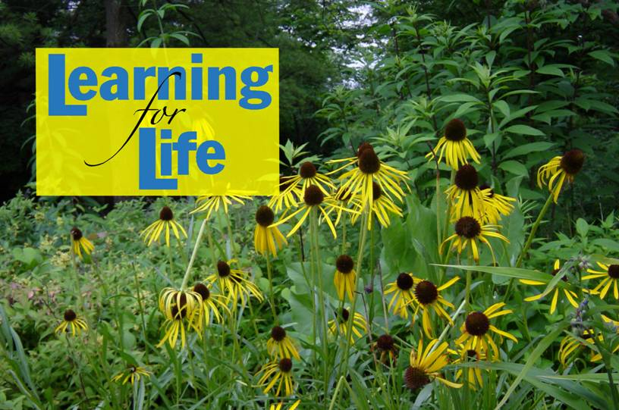
http://www.caes.uga.edu/extension/
Notes:
2. UGA Cooperative Extension Web address

Slide 3

Notes:
3. Georgia Master Gardener Logo

Slide 4
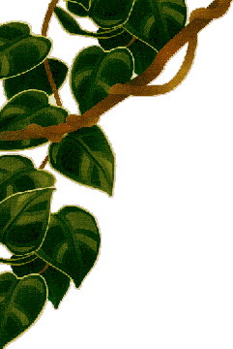

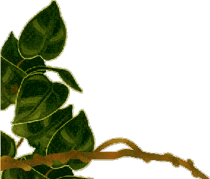
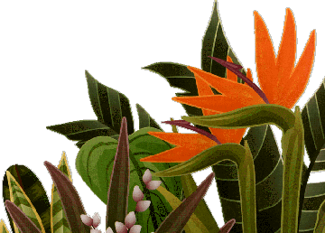
All You Need To Know About House Plants
Notes:
4. Title Slide. In this presentation we will acquaint you with the amazing world of house plants: what they are, what they do for you, which plants to select, how to take care of them and enjoy them...

Slide 5
Learning objectives
How light, temperature, and relative humidity affect plant growth on indoor plants
How to measure light intensity inside your home
How plants are classified according to their light requirements
How to properly water and fertilize indoor plants
Notes:
5. Learning Objectives
After you complete your study of this chapter you should be able to:
Know how light, temperature, and relative humidity affect plant growth on indoor plants.
Know how to measure light intensity inside your home.
Know how plants are classified according to their light requirements.
Know how to properly water and fertilize indoor plants.

Slide 6
Learning objectives
Symptoms of inadequate or excess light, relative humidity, nutrition, and water, in indoor plants.
Process of acclimatization and symptoms of an acclimatized plant.
Techniques of proper pruning, grooming, cleaning and repotting indoor plants.
How to select containers for indoor plants.
Major pests and diseases on indoor plants and how to keep plants pest- and disease-free.
Notes:
6. Learning Objectives continued
Recognize symptoms of inadequate or excess light, relative humidity, nutrition, and water, in indoor plants.
Understand the process of acclimatization and know the symptoms of an acclimatized plant.
Know the techniques of proper pruning, grooming, cleaning and repotting indoor plants.
Know how to select containers for indoor plants.
Know the major pests and diseases on indoor plants and how to keep plants pest- and disease-free.

Slide 7
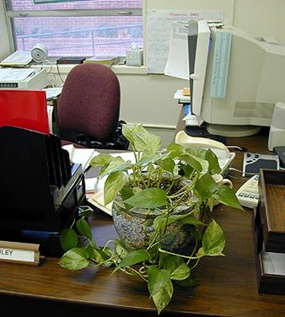
Why Have Indoor Plants ?
Bring the outdoors indoors.
Aesthetic qualities.
Enhance the sense of well-being.
Satisfying hobby.
Plants for sweeter air.
Notes:
7. Much of the scenic beauty of nature has been replaced by densely populated areas that sprawl for miles from urban centers. This visual pollution affects us all and leaves us with a longing for closer contact with nature. We spend about 90% of our time indoors. Interior plants are an ideal way to surround us with attractive and restful settings. In addition, house plants can be a satisfying hobby and they can help purify the air in our homes.
House plants not only convert carbon dioxide to oxygen but also trap and absorb many pollutants. Many of these chemical compounds are released into our air through a process called "off-gassing" and often come from everyday items present in our homes and office.
NASA discovered over 300 organic compounds aboard the space shuttle and, in its endeavor to conquer space, began testing common house plants for their capacity to purify indoor air.

Slide 8
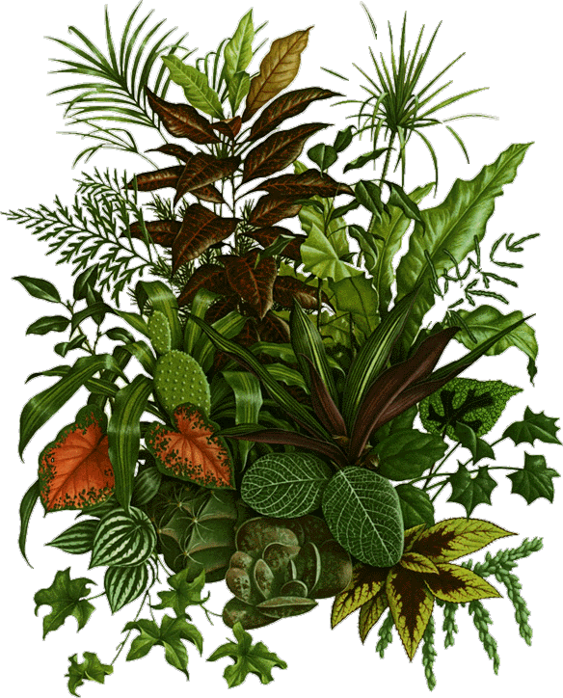
Indoor Plants for Clean Air
As a rule of thumb, allow one houseplant per 100 square feet of living area. Keep in mind that plants will not do much to alleviate tobacco smoke in the air.
Aglaonema, Chinese Evergreen
Aloe, Aloe Vera, Burn Plant
Chlorophytum, Spider Plant
Dieffenbachia, Dumbcane
Epipremnum, Golden Pothos
Ficus, Ficus
Hedera, English Ivy
Philodendron, Heart leaf Philodendron
Spathiphyllum, Mauna Loa
Notes:
8. How many and which plants to have in order to purify the indoor air? … (read slide text)
This a list of some of the plants that showed potential for improving indoor air quality in NASA’s experiments.

Slide 9
Where Do Indoor Plants Come From?
Most indoor plants originate in the tropical and subtropical areas of the world – approx. 3000 miles to the north and south of the equator.
Knowing a plant’s background can help you understand their growth requirements.
Notes:
9. To better understand indoor gardens, we need to know where the plants originated from…(read slide text)

Slide 10
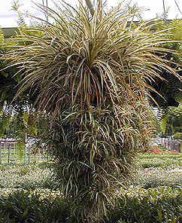
Things You Need to Know
Plant Growth is Affected by:
    Light
    Temperature
    Relative Humidity
    Water
    Nutrition
    Soil
Acclimatization
Notes:
10. How do you go about having plants in your home?
Before selecting house plants, consider their growth requirements … (read slide text)
Also consider acclimatization, a term, which we will explain in some detail later ...

Slide 11
Light
Light is needed for the plant to produce food and survive; generally the more light the more food is produced for growth.
Light is measured in units called footcandles. One foot candle (ft-c) is the amount of light cast by a candle on a white surface one foot away in a completely dark room.
Outdoors the light levels on a bright day range from 10,000 ft-c in an open sunny area to 250 ft-c or less in the shade of a large tree.
Notes:
11. Of all the factors affecting plant growth in interiors, adequate light is by far the most important... (read slide text)

Slide 12
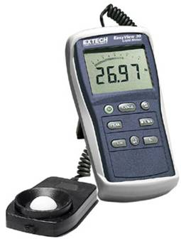
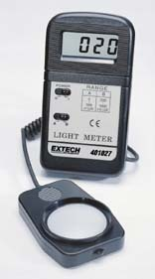
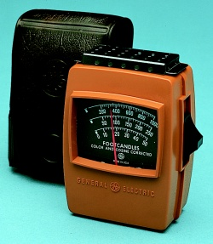
To find out the light levels in your home you can use:
a light meter
Notes:
12. It would be very helpful if you could have some general idea of how much light was present in a given location in your house. You could get a fairly good estimate with a hand-held light meter…

Slide 13
a 35mm camera:
set film speed indicator to ASA 25 and the shutter speed to 1/60th second
place a piece of white paper where you want to measure the light levels, aim the camera toward it close to fill the view, and adjust the f/stop so that meter indicates a correct exposure
read the approx. light level from the table
Notes:
13. … or you could use a 35mm camera, and do the following…(read slide text)

Slide 14

f/2 | 40 ft-c | f/8 | 600 ft-c
f/2 | 75 ft-c | f/11 | 1200 ft-c
f/4 | 150 ft-c | f/16 | 2400 ft-c
f/5.6 | 300 ft-c
Notes:
14. This table allows you to obtain the light intensity reading practically everywhere in your home. For example, if the f/stop setting is f/16, the approximate light levels are 2,400 footcandles.

Slide 15
Light
Using the light readings, your home can be divided into four areas, which have the following light levels for 8 hours a day.
1) LOW LIGHT AREAS: 25 to 75 ft-c
2) MEDIUM LIGHT AREAS: 75 to 200 ft-c
3) HIGH LIGHT AREAS: over 200 ft-c but not direct sun
4) SUNNY LIGHT AREAS: at least 4 hours of direct sun
Most people find 20 to 30 footcandles necessary for reading.
Notes:
15. Using the light readings your home can be divided into four areas, which have the following light levels for 8 hours a day…(read slide text)

Slide 16
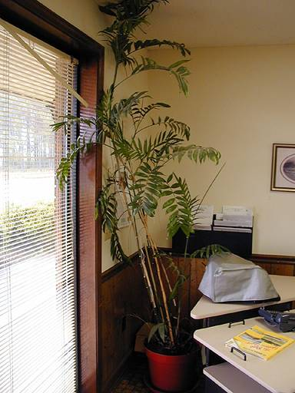
Light
The amount of light in a given location can vary and is affected by:
  trees outdoors (may shade at certain times)
  roof overhangs (may shade at certain times)
  wall color (reflectance)
  window curtains
  day length
  time of day
  time of year
Notes:
16. In your home the amount of light in a given location is variable and is affected by the following factors…(read slide text)

Slide 17

Example: Within Your Home Changes in Natural Light Penetration Occur with the Seasons
Summer sun
Winter sun
Notes:
17. For example, look at the different light patterns penetrating the same window during summer… and during winter…. Obviously, you should take this into account when placing your plants in front of that window.

Slide 18
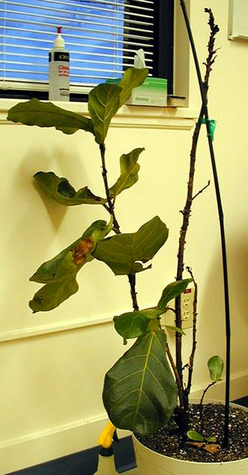
Light
You could do one of two things:
select plants for a given light intensity
change the light intensity to suit the chosen plants.
Notes:
18. When shopping for indoor plants you could do one of two things. Select plants for a given location given that you already know the approximate light levels in the spot. On the plant label you can find information on the light requirements of every plant. If you want to buy a plant, which has label that tells you to give it high light, but the selected area in your home does not provide adequate light for it, you could supplement the natural light with artificial light sources.

Slide 19
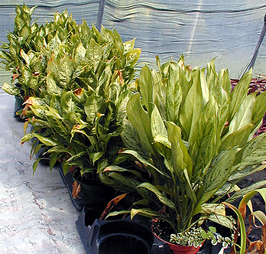
Artificial lighting is also available:
  fluorescent lights
  special incandescent lights.
Increasing the number of hours of low light can also help your plants:
  16 hrs light / 8 hrs dark.
Too much sunlight can damage your plants!
  do not take houseplants outdoors in direct sun
  change light gradually.
Notes:
19. If natural light is not sufficient, you could also use artificial fluorescent and/or special incandescent lights available in many garden centers to provide supplemental light for your plants.
Increasing the number of hours of light can also help. For example, you could use 16 hours of light and 8 hours of dark. In other words, extend the number of hours during which plants receive light.
While adequate light is crucial for plant growth, too much light can damage your plants. Many foliage plants are native to the tropical rain forests where light intensity is low and are actually injured by bright light. Therefore, be careful when placing certain plants in direct sunlight in front of a window. This can only result in bleached, scorched leaves and unhappy plants!

Slide 20
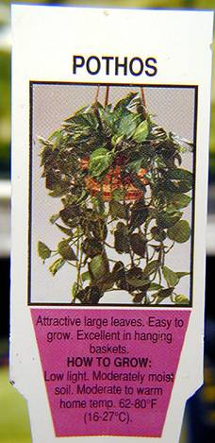
Indoor plants are classified according to the amount of light needed for growth:
  low (min. 25-75 ft-c, 75-200 for good growth)
  medium (min. 75-150 ft-c, 200-500 preferred)
  high (min. 150-1000 ft-c, 500-1000 preferred)
  very high (min. 1000 ft-c, 1000+ preferred).
Commercial producers supply this information in general terms on the label with which the plant is sold.
Notes:
20. Indoor plants are classified according to the amount of light needed for growth... (read slide text) Growers supply this information in general terms on the label with which the plant is sold. You could use this information when shopping for indoor plants.

Slide 21
Which windows provide how much light ?
Windows with eastern exposures receive direct morning light from sunrise until nearly midday.
Footcandle readings can reach 5,000-8,000. As the morning progresses, the direct sun recedes from the room.
An eastern room is cooler compared to south or west rooms because the house absorbs less radiant heat.
Most plants grown indoors prefer an eastern exposure.
Notes:
21. Which windows in your home provide the best light and temperature conditions for indoor plants? Generally, windows with eastern exposure provide the best light and temperature conditions for most indoor plants’ growth…(read slide text)

Slide 22
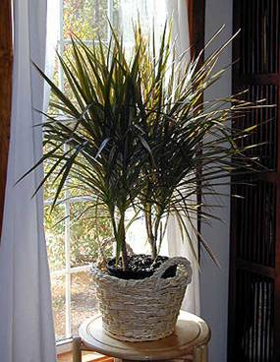
The Sunny South
On a bright, sunny winter day this exposure provides greenhouse-like conditions.
Direct light comes into a south window only at midday.
The amount of light that enters a southern window is only a portion of the available light outdoors on a clear day.
Notes:
22. Windows with southern exposure give the largest variation in light and temperature conditions…(read slide text)

Slide 23
The Sunny South
The sun at noon on a summer day may measure 10,000 ft-c. Indoors, however, a southern window with wide eaves outside will receive about the same amount of light as a window with northern exposure.
Southern and western exposures are interchangeable for most plants.
In the winter, most plants but those with definite preference for northern exposure can be placed in a room with southern exposure.
Notes:
23. Continued from the previous slide, read slide text

Slide 24
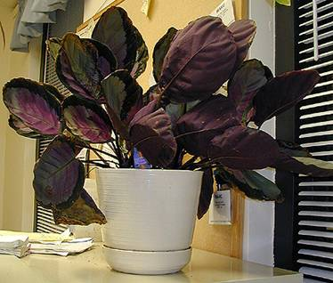
The Cool North
Since the USA is in the northern hemisphere, it receives most of its sunlight from the south. Out of the four exposures, the northern exposure receives the least light and least heat the year round.
Because of the low light (as low as 200 ft-c on a clear winter day), maintaining healthy plants can be a challenge.
Notes:
24. Windows with northern exposure provide the least light and the lowest temperature …(read slide text)

Slide 25
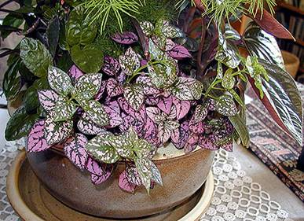
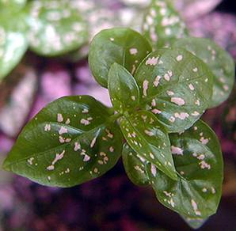
The Cool North
Some indoor plants can tolerate it, others prefer this exposure, e.g. African violets.
Best for plants with green foliage because the coloration on variegated foliage tends to disappear under low light conditions.
Notes:
25. Continued from the previous slide, read slide text

Slide 26
How Do You Know that Your Plant is Not Getting Enough Light ?
The plant does not grow.
The internodes (spaces between leaves) are much longer than the internodes on the older part of the plant.
The new leaves are much smaller than older leaves.
The leaf color is a lighter green on the newer foliage than on the older foliage.
The older leaves may die.
Notes:
26. What are the symptoms that your plant is not receiving adequate light? …(read slide text)

Slide 27
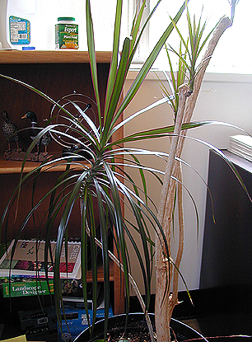
Phototropism
The directional growth of plant parts toward light; if allowed to continue mature tissue will have a fixed curvature.
Treatment: turn the plant a
quarter turn every few days.
Notes:
27. It is most common for indoor plants to bend towards the light source. The process is called phototropism and can result in a permanent, asymmetrical growth and unattractive plant appearance. To prevent this, turn the plant a quarter of turn every few days.

Slide 28


Temperature
32ºF
77ºF
100ºF
^{Biological Activities}
^{(Most Organisms)}
58ºF
^{Interior}
^{Plants}
86ºF
72ºF
82ºF
^{Human Comfort}
Notes:
28. Temperature is the second most important factor influencing plant growth in interior environments.
We feel comfortable in the range 72 to 82 degrees and interior plants are OK from 58 to 86 degree range, which is very similar. In comparison, the biological activities of most living entities are in the range of 32 to 100 degrees.

Slide 29
Sugars
Starch
Storage
+
Carbon dioxide
Photosynthesis
Temperature and Light
Respiration
Sugars
Starch
Storage
Energy
Maintenance
Growth
Notes:
29. Temperature and light are linked through the processes of photosynthesis and respiration. Photosynthesis builds sugars and starch, which are then broken down by respiration to provide energy for developing new tissues (growth) and for maintenance of existing ones. High temperature speeds up respiration. If the plant is not producing sufficient sugars (as under low light), then high temperatures may break down what little sugars are made, leaving little to none for growth. Maintenance takes precedence over growth, therefore under insufficient light plants do not grow. If light is so low that not enough sugars are produced for maintenance, the plant eventually dies.

Slide 30
The Yin and Yang of Plant Life
For plants, the secret to life & growth is:
Photosynthesis
+ Reserves !
Respiration
Notes:
30. You may think of photosynthesis and respiration as the Yin and Yang of plant life -- two parts of a circle. For a plant to grow, reserves must exist.

Slide 31
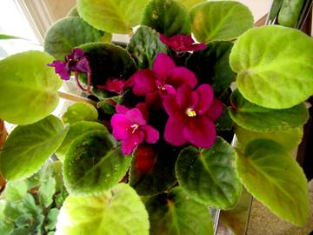
When Sugar Levels Are Low…
The plant takes nutrients and sugars from the older leaves to maintain the new leaves.
To help your plant you have two options:
Raise light levels to increase
photosynthesis (sugar).
Reduce night temperature to
reduce respiration rates and
allow more sugars for growth.
Notes:
31. When sugar levels are low the plant takes nutrients and sugars from older leaves to maintain new leaves. To help your plant you have to options: raise light levels to increase photosynthesis and sugar production, or reduce night temperature to lower respiration rates and allow more sugars for growth.

Slide 32
Temperature
During summer, air conditioning may be turned off at night or weekend thermostat settings raised and that could result in higher than desirable night temperatures.
During winter, heating may be turned off at night or weekend thermostats settings lowered and that could result in lower night temperatures.
Notes:
32 What temperatures are likely to occur in your home?
…(read slide text)

Slide 33
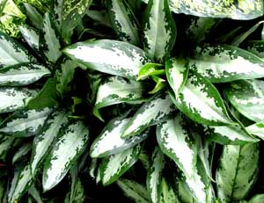
Temperature
Be especially careful not to allow temperatures to drop below 50ºF or chill damage will result on some sensitive foliage plants (e.g. Aglaonema).
Chill damage is manifested with yellowing lower leaves and/or defoliation of lower leaves.
Notes:
33. Chill sensitive plants, such as Aglaonemas, should not be exposed to temperatures below 50 degrees Fahrenheit. Chill damage is manifested with yellowing of lower leaves and defoliation.

Slide 34
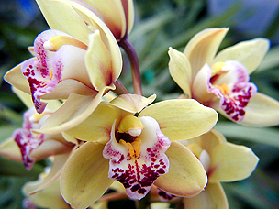
Temperature
Plants vary in their minimum and maximum requirements.
Some tropical plants will do best if temperatures are 90º-95ºF.
Such temperatures in interiors are detrimental to plants, especially if light levels are low.
The best temperature range for indoor plants is:
70º - 80ºF day 65º - 70ºF night
Notes:
34. Other tropical plants will grow best if the temperatures are 90 to 95 degrees. Such temperatures are rarely allowed indoors. Most plants grown indoors come from the tropics and are best suited to “live” in our homes because they have similar to human temperature requirements. You should maintain temperatures of 70º - 80ºF day and 65º - 70ºF night even though you may not be in the house.

Slide 35

Relative Humidity
The amount of moisture contained in the air.
Very important factor, easily overlooked. In the greenhouse relative humidity is 50% or higher.
For interior plants relative humidity below 20% is considered “low”, up to 40-50% is medium, and above 50% is high.
Rapid transpiration and water loss may result when newly purchased plants are placed in 10-20% RH (house).
Notes:
35. Relative humidity is the amount of moisture contained in the air …(read slide text)

Slide 36
Relative Humidity
Effect of relative humidity on a plant leaf
H2O
70⁰F
H2O
70⁰F
H2O
H2O
H2O
H2O
H2O
Relative Humidity =
Relative Humidity =
10%
50%
Notes:
36. The lower the humidity, the more water dry air absorbs from each leaf. At 10% relative humidity the leaf on the left loses a lot more water compared to the leaf on the right, which is in 50% relative humidity. Both leaves are at the same temperature 70 degrees.

Slide 37
Relative Humidity
Effect of relative humidity and air temperature on a plant leaf
90⁰F
70⁰F
H2O
H2O
H2O
H2O
H2O
H2O
H2O
H2O
H2O
Relative Humidity = 50%
Relative Humidity = 50%
Notes:
37. The higher the temperature, the more water vapor the air can hold and the more water will be lost from the plant. At 90 degrees air temperature the leaf on the left loses a lot more water compared to the leaf on the right, which is at 70 degrees. Both leaves are at the same relative humidity 50%.

Slide 38
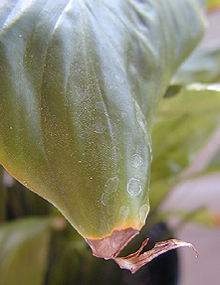
Relative Humidity
Signs of low relative humidity are leaf marginal and/or tip burn.
Elevate RH by:
placing plants close together
placing a shallow water container with lava rock or gravel near the plants
using a humidifier
spraying water around the plants.
Notes:
38. Signs of low RH are leaf marginal and tip burn.
You should take steps to help your plants adjust to the low relative humidity in your home by doing one or several of the following: place plants close together to create a microenvironment with a higher RH; place a shallow container filled with water and lava rocks or gravel, which will provide evaporation from a large surface area and increase the RH; use a humidifier; use mist bottles to spray water around the plant. In reality, you need to stay over the plant and mist every few minutes to make a difference in RH around the plant. Plants with hairy leaves do not need water sprayed on the foliage and/or flowers.

Slide 39

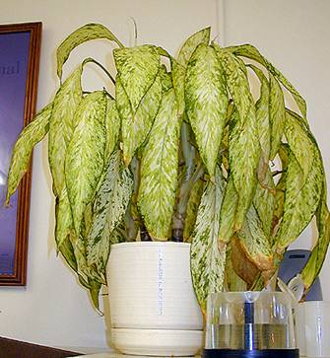
Watering Your Plants
CONSIDERATIONS:
Plant type.
Plant size.
Container volume.
Soil moisture.
Light Intensity.
Notes:
39. When dealing with how much water to apply, consider the following:
Not all plants are similar in their water requirements. Usually this information, just like the light preference, is included on the plant label. For example, a croton which likes high light, will likely need more frequent watering compared to a succulent plant such as Opuntia cactus. Both have similar light needs, but dissimilar water requirements. Likewise, larger-size plants need more water compared to smaller size plants. If the growing container is too small, more frequent waterings are needed. How much water is already present in the growing medium will also affect your watering frequency. Plants under high light transpire more water, compared to plants under low light

Slide 40
When and How to Water
Many problems can be traced to improper watering.
You should feel the soil – push your finger an inch or so below the surface; if it is still moist do not water.
“Watering meters” are available.
Containers with saucers may result in a rapid build-up of soluble salts, causing root rot and growth decline.
discard any water in the saucer after each irrigation
once a month apply large quantities of water to the soil (called leaching).
Notes:
40. Learning to water is one of the most important skills in plant care. Applying too much water can suffocate plant roots; too little water causes growth to become erratic and stunted. Watering frequency will depend on the conditions under which the plants are growing.
Water-devices, or water-meters are available to simplify watering matters for you.
Containers with saucers may cause an excessive build-up of soluble salts (chemicals coming from the applied fertilizer). High levels of soluble salts will cause damage to the roots and growth decline. To correct this, discard any water in the saucer after each irrigation and apply large quantities of water to the soil to get rid of the soluble salts.

Slide 41
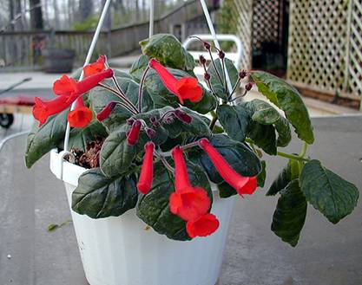
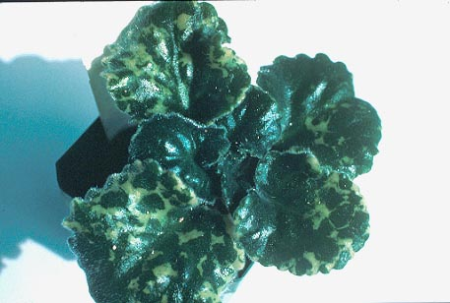
Water Temperature
Cold water (45⁰F) can damage sensitive plants such as African violets and other Gesneriads (e.g., Gloxinia, Achimenes).
Notes:
41. Water temperature is an important consideration with plants such as gesneriads. Cold water (45⁰F) can cause discolored spots and blotches on the leaves, caused by chlorophyll degradation.

Slide 42
Water Quality
Plants differ in their tolerance to certain chemical additives commonly found in drinking water, e.g. fluorine (fluoride).
Check level of fluorine in the water supply, and if high, do not use on susceptible plants, e.g. dracaenas and cordylines.
Do not use plants susceptible to chlorine (chloride) around pools, e.g. dracaenas and cordylines.
In these plants, leaf necrosis will occur if exposed to high levels of fluorine and/or chlorine.
Notes:
42. The quality of the irrigation water is an issue with plants, which are susceptible to fluorine and chlorine, such as Dracaenas (Corn plant) and Cordylines (Ti plant). If you have some of these, let the water stand for several days to allow some chlorine and fluorine to be lost from the water before applying it the plants. If you have susceptible plants close to an open pool, move them away so water splashes do not reach the foliage. If you have an enclosed pool, do not use susceptible plants around it.

Slide 43
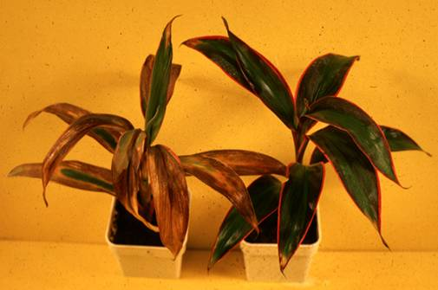
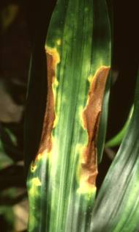
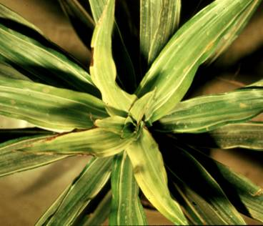
Fluoride Damage on Dracaena and Cordyline
Notes:
43. Symptoms of fluoride damage on Dracaena and Cordyline include tip and leaf scorching, as in Dracaena shown in the lower pictures.
Sometimes the damage can be very severe as in this Cordyline plant in the top picture, left.

Slide 44

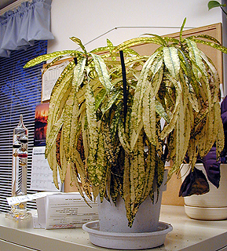
How to Feed Your Plants
CONSIDERATIONS:
Type of plant.
Volume of soil (pot size).
Light intensity.
Notes:
44. Before feeding your plants, consider the following:
Plant type. Some plants are heavy feeders, for example all Ficus species, while others need little or no additional fertilizer for months, for example various succulents.
Volume of soil. How much growing medium is present—smaller size pots require less fertilizer compared to larger size pots because the first contain less soil.
Light intensity. The higher the light levels, the more nutrients are needed for plant growth.
If you have just bought a plant from a plant store, don’t rush to apply fertilizer to it. In most cases the amount of fertilizer applied by the commercial producer while growing the plant will supply enough nutrients for two to three months in your home. This rule is flexible and if you notice deficiency symptoms you should fertilize.

Slide 45
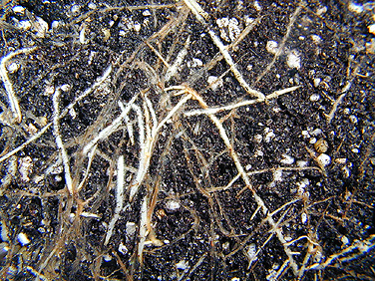
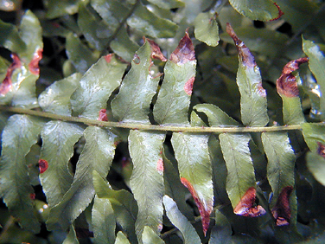
Fertilizer (liquid, powder, or tablet) dissolves in soil water and forms “salts” in the water.
Adding more fertilizer when plants haven’t yet used the fertilizer already present, will cause the soil water to become so “salty” that it “burns” the roots by removing water from them.
Notes:
45. High levels of fertilizer can cause build-up of soluble salts, which can injure roots by removing water from them. Notice healthy roots are white, while dead roots are brown. Dead roots also invite root disease. Soluble salt burn is manifested as leaf marginal and tip burn.

Slide 46
The secret to fertilizing plants indoors is to apply small amounts of fertilizer as the plant grows. Without new growth, the plant has only a limited need for more fertilizer.
During winter when light levels are reduced, a plant’s need for fertilizer is reduced.
During summer when light levels increase and the plant is growing, its need for fertilizer is increased.
How often should you fertilize your plants?
“Less is better than more.”
Notes:
46. The secret to fertilizing plants indoors… (read slide text)

Slide 47
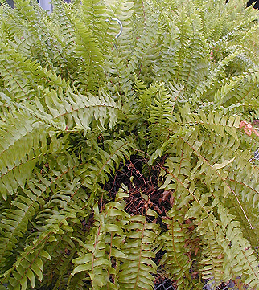
As a starting point, you could use about ¼ the label rate for monthly applications.
If the overall plant color becomes lighter green, fertilize every two weeks.
If the new growth is dark green but leaves are small and internodes seem longer than on older growth, decrease the fertilizer rate.
Notes:
47. As a starting point… (read slide text)

Slide 48
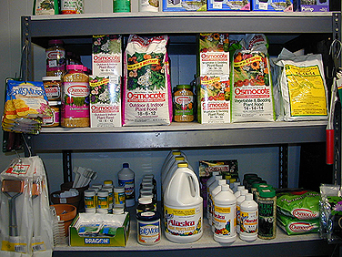
Forms of Fertilizers Used Indoors
LIQUIDS
POWDERS
TABLETS
SPIKES
GRANULES
Notes:
48. Different forms of fertilizer are available to the indoor gardener. Many come in a specially designed formula for indoor plants. Generally, they contain less of a percentage of the required mineral elements to help avoid the overfertilization problems.

Slide 49
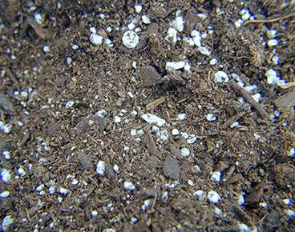
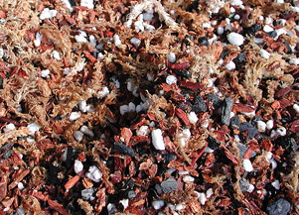
Soil
Any well drained and aerated soil mix.
The mix should provide adequate water and nutrient holding capacities, support for the roots, and good drainage and aeration.
peat moss, processed bark, perlite, vermiculite, coarse sand, scoria, pumice and amendments
Notes:
49. The growing medium serves the purpose of providing anchorage, water and minerals. When you repot your plants make sure that the new mix is well drained and aerated, and holds water and nutrients well. Good potting mix provides ample amounts of oxygen to the root system. Most professional mixes are good to use, and they consist of varying proportions of peat moss. Photo on left shows a soilless mix consisting of bark, peat moss and perlite. The photo on right shows a soilless mix specially designed for orchids; notice the coarser components, it also has charcoal added to it.

Slide 50
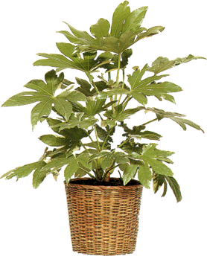
ACCLIMATIZATION:
Adaptation of a Plant
to the New Environment of Your House
Favorable environment for
maximum growth
high light high nutrition
high water supply
high temperature
low light
low relative
humidity
Interior
environment
Notes:
50. The last but not the least thing you need to know is acclimatization, the adaptation of the plant to the new environment of your home.
From the greenhouse, plants come ‘spoiled’, with ‘high expectations’, so to speak. They were used to high light and nutrition, high water supply, high temperatures and high relative humidity. Your home, with its low light and low RH, is most likely going to be quite stressful experience for them. The greater the difference between the previous environment and the environment of your house, the bigger the stress the plant endures.
For an indoor gardener it would be helpful to understand the process of acclimatization and how it applies to indoor plants.

Slide 51
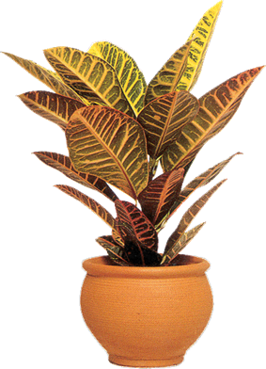

The Two Sides of Acclimatization
Light Acclimatization
Soil Acclimatization
low light
less growth
less need for nutrients
less water need
reduce nutrient application
reduce water frequency
Notes:
51. There are two sides of acclimatization. The aboveground, or light acclimatization involves adapting to low light, which means less growth and less needs for nutrients.The belowground, or the soil acclimatization involves reducing nutrient and water applications.
Acclimatization is generally done in the greenhouse or the nursery. Plants are grown for a period of time under low light levels and less nutrients. Since this slows down plant growth, acclimatized plants are not ready for the market as early as non-acclimatized plants and this raises their price. Acclimatized plants cost more compared to non-acclimatized plants.
You can do your own acclimatization as well. Place newly purchased plants in bright areas in your home, at least for a three to four weeks, then move to a final location. The porch or patio can be the first place for your plants in the warm months, as long as the plants are not in direct sunlight.

Slide 52
You Can Never Go Wrong if You Remember To:
Learn as much as possible about the extent of acclimatization of the purchased plants.
Provide necessary conditions:
Light is the most important factor!
Apply fertilizer and water at reduced rates.
Notes:
52. You should learn as much as possible about the extent of acclimatization of your chosen plants.
When shopping for plants at a garden center, ask if the plants have been acclimatized. This information is generally known by the retailer. If you are buying directly from a greenhouse or a nursery, ask the people that work there if the plants have been acclimatized.
Remember that the most important factors about plant growth indoors are adequate light, and fertilizer, and water at reduced rates.
The most common thing that happens to plants once placed indoors is defoliation. As long as it is not extensive, and slows down after a few weeks, your plants are going to be OK.

Slide 53
Differences Between Acclimatized and Nonacclimatized Plants
Acclimatized | Nonacclimatized
Medium to dark green leaves | Yellowish to light green leaves
Large leaves | Small leaves
Flat leaves | Partially folded leaves
Thin leaves | Thick leaves
Leaves widely spaced | Leaves crowded together
Notes:
53. Here are the most notable differences between acclimatized and non-acclimatized plants. These can help you shop

Slide 54
Acclimatized | Nonacclimatized
Internodes long | Internodes short
Thin to medium stems | Thick stems
Leaf position horizontal or slightly flexed | Leaf position upright
Few new leaves | Many new leaves
Wide branch angles | Acute angles
Notes:
54. continued

Slide 55
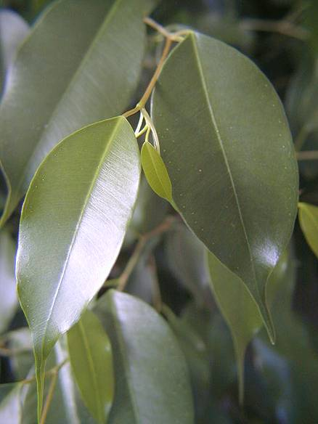
The Cheapest Plant
To Buy Is
An Acclimatized Plant !
Notes:
55. And remember, the cheapest plant to buy is an acclimatized plant! It is well worth the money in a long run.

Slide 56
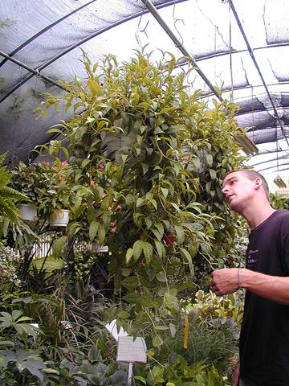
How To Buy A Winner ?
Plant Appearance
Buy only healthy-looking plants with medium to dark green foliage (unless foliage is supposed to be of different color).
Examine undersides of foliage for pests.
Notes:
56. What should you look for when shopping for plants?
Don’t try to play plant doctor! Buy only healthy-looking plants. A plant with yellow or brown leaves, foliage with spots, is not what you should get. If the plant was unhealthy from the nursery, chances are that it will die before long once placed indoors. Look for pests on the undersides of leaves.

Slide 57
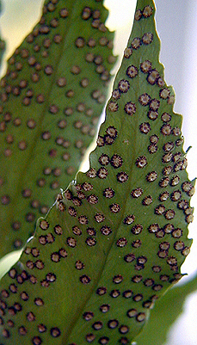
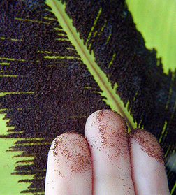
Light brown or dark brown spots, as well as long brown rows, found on the underside of fern leaves are not sign of a disease!
  They are fruiting structures, which contain spores.
Notes:
57. If you are shopping for ferns do not be alarmed if you see brown-colored spots or long rows of structures on the lower leaf surface. These are reproductive structures.

Slide 58
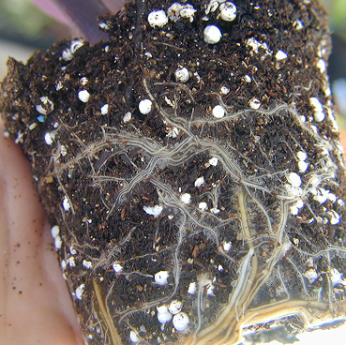
Examine the root system
  healthy roots are generally white
  roots should be visible along the outside of the soil ball
  roots have a healthy, earthy odor.
Notes:
58. Remove the plant from the pot and look at the root system: Is it healthy? Well-developed? Any discolorations, generally brown or blackened roots, are signs of problems. Some plants have roots with colors other than white, such as Dracaenas, which has orange roots. Unhealthy roots also may smell bad.

Slide 59
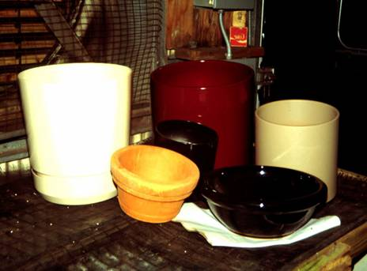
Choosing a Planter
Suitability for the plant's needs
Suitability for the needs of the individual and the environment
Cost & availability
Strength & durability
Weight
Drainage
Notes:
59. Planters can enhance the decorative value of your plants. Try to answer all of the following questions.
Is the chosen planter suitable for the particular plant?
Do you like this planter and will it go well with your interior decor?
How expensive is it? Fancy planters may cost more than the plant inside!
How strong and durable is it?
Can you move it around with ease?
Does it provide good drainage?

Slide 60
Clay Pots vs. Plastic Pots
Advantages of clay pots:
Advantages of plastic pots:
less liable to tip over because of their weight
after watering the soil drains more rapidly and waterlogging is less likely
lightweight less liable to break
watering is needed less often
decorative and colorful forms
easy to clean
Notes:
60. Many people ask which type pot is better for plants grown indoors. Clay pots or plastic pots? Here are the advantages of each…(read slide text)

Slide 61
Providing for Excess Water in Planters with Drainage
How to leach ?
Once a month apply a gallon of water to every cubic foot of potting medium.
After a few hours follow with half a gallon of water.
If the potting medium contains soil, apply only once 5 gallons of water per every cubic foot of growing medium.
Planter with
a saucer
Notes:
61. In general, you can have either a pour-through (drainage) planter or a watertight planter (self-watering). You should be aware of a few things in choosing either one.
As we said earlier in the watering portion of this presentation, planters with drainage will result in a rapid build-up of soluble salts, causing root rot and growth decline. Therefore, you should empty the saucer after every watering and leach the soil once a month by applying a gallon of water to every cubic foot of potting medium. After a few hours follow with half a gallon of water.
If the potting medium contains soil, apply only once 5 gallons of water per every cubic foot of growing medium.

Slide 62
Providing for Excess Water in Self-Watering (Watertight) Planters
Watertight planters have several parts:
an outer part, which is decorative and watertight
an inner part, which has a drain
a water indicator in between
gravel or other means of elevating the bottom.
drain hole
gravel or elevated bottom
water indicator
Notes:
62. Watertight planters have several parts:
An outer, decorative and watertight container;
A smaller inner container with a drain hole at the bottom, which sits on gravel;
A water indicator in between the two containers.

Slide 63
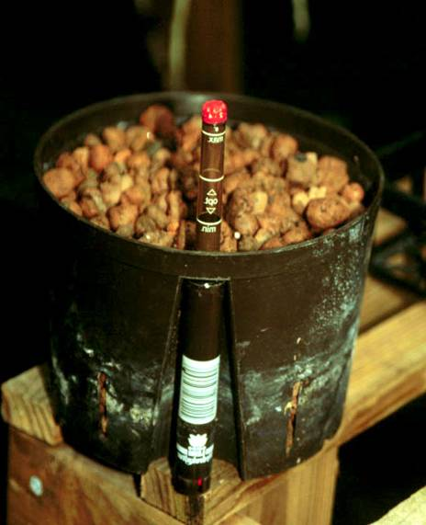
Interior of a Watertight
Planter
Notes:
63. This is what the interior of a watertight planter looks like. Shown are the inner container and the water indicator.

Slide 64
Self-Watering Planters
Minimize moisture stress in interiors.
Excellent where water source is inconvenient or plants are located in difficult to access areas; not suitable for cacti and succulents.
Growing medium has to be very porous.
Accumulation of fertilizer salts may occur – leaching is recommended.
Notes:
64. The self-watering planters have the advantage of minimizing water stress and are very good for plants with high water requirements, like peace lilies. However, do not use them for cacti and succulents. These planters should not be used with heavy soil mixes due to the wicking action of the soil components, which can result in retention of excess moisture. With reduced oxygen, roots will be stressed and the plants will be susceptible to soil-borne diseases. Salts could accumulate so you should leach monthly similarly to planters with drainage.

Slide 65
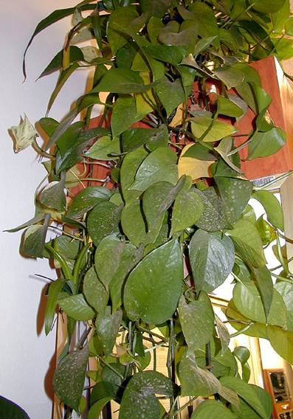
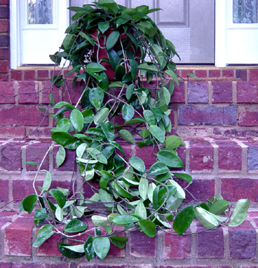
Time to Prune, Groom and Repot
Notes:
65. Once your plants start looking like this, it is time to prune, groom, and repot…

Slide 66
The Best Time To Prune
“When the knife is sharp”
    Natural plant growth cycles
Frequent light pruning -- removal of shoots or shoot tips when small and young.
The frequent light pruning is also called pinching.
When removing shoots, make the cut close to the originating stem.
Pinching will increase branching on the stem and result in a stockier, fuller plant.
Notes:
66. When is the best time to prune? “When the knife is sharp” goes the old saying, and it means using the natural life cycles as a guide. For example, when the plant is growing rapidly and you want to maintain a certain size, this is a good time to prune.
it is advisable to do light, frequent pruning, which is the removal of shoots or shoot tips when they are small, also known as pinching.
Pinching will increase branching on the stem and the result will be a stockier, fuller plant.

Slide 67
Shoot pruning
Works only with plants, which branch or form additional growing tips.
Growing tips are removed at frequent intervals.
Notes:
67. Examples of shoot pruning… Use it on Schefflera, Ficus, English Ivy, Peperomia, begonias.

Slide 68
1
3
Leaf Pruning
2
Notes:
68. Non-branching plants, such as Aspidistra, Syngonium, Agave, some dracaenas, Aglaonema, Sansevieria, and Dieffenbachia, need different type of pruning.
Often in interior environments, parts of their leaves turn yellow and brown.
Examples of leaf pruning… Remove the entire leaf as in 1 and 2, or only the discolored part, as in 3.

Slide 69
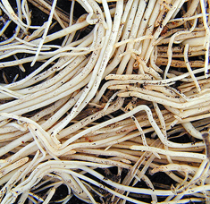
Root Pruning
Root pruning of pot-bound plants is essential for optimum growth after repotting.
Pull away the roots from the soil mass and cut back to within one inch of the soil.
Alternative method: make three or four vertical cuts one inch deep into the soil mass on the opposite sides of the root ball.
Notes:
69. When the plant has outgrown its container and needs more space to grow, root pruning should be applied.
Do this by pulling away roots from the soil mass and cutting back to within 1” of the soil mass.
The alternative method is to make 3 or 4 vertical cuts 1” deep in the soil ball on the opposite sides of the root ball.

Slide 70
Why Clean
Water exudation may accumulate salts along the leaf margins and/or tips creating necrotic areas.
Dust dulls normal leaf coloration.
Dust creates shade on plant surfaces reflecting light that can be used in photosynthesis.
Dust on lower leaf surfaces may clog stomata (specialized cells involved in water transpiration), inhibiting gas exchange within the leaf.
Notes:
70. A clean plant is a healthy plant.
Plants possess water pores along the leaf edges. These structures are called hydathodes and they excrete water along the edge of the leaf.
Dissolved salts may accumulate in these areas and cause necrosis of the surrounding leaf tissue.
Dust collects and not only dulls leaf color but also causes light reflection thus lowering available light.
Dust also clogs stomata, the natural openings in the leaf through which water evaporates and gas exchange occurs.

Slide 71
Wipe leaves with a sponge or a soft, damp cloth.
If the plant is small, you can dip the foliage in lukewarm water.
Use a clean, unused paintbrush as a duster when cleaning African violet leaves and cacti.
Remove dead flowers.
Often tips and leaf margins turn brown (remember fluoride damage on dracaenas and cordylines).
Cut these dead leaf parts close to the point of origin.
Pull out or cut dead leaves off.
Notes:
71. Leaves with thick, shiny cuticles (croton, ficus, peace lily, bromeliads) can be cleaned with a damp sponge. If the plant is small, dip the foliage in tepid water, and swirl it around. You cannot use water when cleaning cacti, African violet leaves, and other plants with hairy leaves. On these, use a clean, small brush to remove dust. If you have a flowering plant, remove dead flowers regularly. Leaves with tip and/or marginal necrosis, such as fluoride damage, should be trimmed to the healthy part. Dead leaves should be either pulled out or cut off.

Slide 72
Determining The Need For Transplanting
1. The plant appears top-heavy.
2. The plant fills the container with new shoots.
3. Extensive root growth out of the pot's drainage holes.
Notes:
72. How do you know that your plant needs a bigger pot? (read slide text)

Slide 73
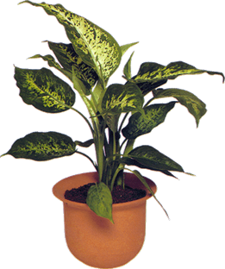
The Standard Pot
Pot Size: a wide range available between 1 ½ inch and 15 inches.
Ideally plants should be repotted in one inch increments but this is also acceptable:
10in
7in
5in
3.5in
2.5in
Notes:
73. Many pot sizes are available for home gardeners to choose from.
Ideally plants should be repotted in 1” increments but the following is also OK: 2 and a half inch into 3 and half inch pot into 5” into 7” into 10”. Going from 5” pot to a 10” pot gives more soil than the plants need initially. It is better to go through smaller increments of pot size than to double the pot size in one step.

Slide 74


A Properly Repotted Plant
plant is repotted at original
depth
plant is vertically
aligned and centered
in the pot
1 inch of new
soil is present on all sides
water reservoir
is approx. 1-2"
new soil is firmly
packed into
place, but not
to excess
1” of firmed
soil mix is placed at bottom
original
root
mass
pot chips or shards are placed
to reduce erosion
(optional)
gravel layer is used for
drainage (optional)
Notes:
74. A well-repotted plant has the following features…. (read slide text)

Slide 75
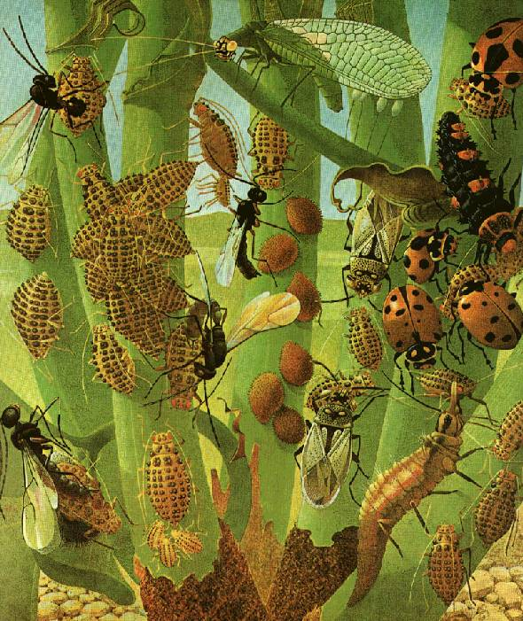
Scales and, Mites and, Aphids, oh My!
Notes:
75. Very few plants stay pest- and/or disease-free forever. Pests are more likely to be encountered on indoor plants compared to diseases. This is because the interior environment rarely offers favorable conditions for foliar diseases to develop. However, when plants are grown under stressful conditions such as low light and excess water, you may find soil-borne pathogens.

Slide 76


Scales
Scales are 1/8” to 1/3” long, color depends on species.
The three main families of scales are armored (the body covering can be separated from the body), soft (the body covering cannot be separated from the body), and mealybugs.
Notes:
76. Scales are…(read slide text)

Slide 77


Scales attack leaves and stems, sucking plant juices, causing stunting, leaf discoloration, and death of the tissue. With exception of armored scales, honeydew is also excreted.
Scales
Scales are usually inconspicuous, and by the time an infestation is noted the population is usually very large.
Notes:
77. Scales attack…(read slide text)

Slide 78


Mealybugs
Mealybugs are soft-bodied, 1/5” to 1/3” long, covered by white, waxy filaments, giving them a white, cottony appearance.
Insects are frequently found on the new growth at the stem apex where they suck plant juices, causing leaf wilting and abscission.
Some species appear first on the undersides of leaves.
Notes:
78. Mealybugs are…(read slide text)

Slide 79

Mealybugs
Mealybugs excrete a sticky honeydew, which attracts sooty mold.
Mealybugs are the major pest problem on house plants!
Notes:
79. Mealybugs excrete…(read slide text)

Slide 80

Aphids
Aphids are soft-bodied, pear-shaped, 1/25” to 1/8” long, usually green in color, but may be pink, blue, brown, yellow or black.
Insects are found on new growth or on underside of young leaves, where they suck plant juices, causing deformed, curled growth of new leaves, buds and flowers.
Notes:
80. Aphids are…(read slide text) The aphids can be wingless or winged. The aphid on the right is the most common form, the aphid on the left is a winged form, which develops when colonies become too large. Some aphid species start on lower leaves, and other still, concentrate primarily on the stem.

Slide 81

Aphids
Aphids excrete sticky “honeydew”, on which grows a black fungus called sooty mold.
Often cast aphid skins present on leaves.
Notes:
81. Aphids excrete…(read slide)

Slide 82

Spider Mites
The most common and destructive mites on foliage plants, referred to as two-spotted spider mites, red spider mite or red spiders. The adult females are approx. 1/50” long, hardly visible with unaided eye.
Mites are the second most common pest problem on house plants!
Notes:
82. Spider mites are…(read slide text)7

Slide 83

Spider Mites
Feed on undersides of young leaves. Infected areas are greyish or yellowed speckled.
Webs form as means of spreading.
Hot and dry conditions are favorable.
Notes:
83. Spider mites feed…(read slide text)

Slide 84

Thrips
Thrips are not as common pests on house plants but are common on plants in patios, and other outdoor areas.
Thrips are small, slender, 1/25” to 1/12” long, tan, black, or brown in color, with lighter markings.
Notes:
84. Thrips are…(read slide text)

Slide 85

Thrips
Adults and larvae feed on young bud tissue, shoot apex, or flowers and leaves by sucking sap and cell contents.
Injured tissue has a whitish or silver-flecked appearance due to the light, which is reflected from the cell walls of the empty cells.
Notes:
85. Adults and larvae…(read slide text)

Slide 86
Controlling Pests Indoors
Best method is prevention -- purchase pest-free plants.
Take the affected plant outside in a protected, shaded area, and let nature take its course.
Wipe with soapy water and soft cloth:
  use 2 tsp. of insecticidal soap / gallon of water.
Remove light infestation of mealybugs or aphids with a cotton swab dipped in rubbing alcohol.
Do not use beneficial insects there is not enough food to sustain them!
Notes:
86. What to do when pests threaten your plants?
Best method is to never let them in your house! By purchasing pest-free plants you minimize your problems.
If they do come, then what?
One way is to take the affected plant outside in a protected, shaded area, and let nature take its course! Natural predators will most likely come and clean your plant from the pest.
If you want a faster way, you can use an insecticidal soap and wipe with soapy water and a soft cloth. Best is to treat plants, which have been hardened off in the interior environment. When you’re bringing new plants, if they have not been acclimatized (used to lower light, less fertilizer and water), they are going to be tender, and you should treat them after the first couple of weeks.
Remove light infestations of mealybugs or aphids with a cotton swab dipped in rubbing alcohol.
Forget about using beneficial insects!
They may work great in the greenhouse with thousands of plants and pests but there is just not enough food in your home to sustain their population.
Most pests can be controlled culturally on indoor plants without the use of chemicals.

Slide 87
Trouble in Paradise - Diseases
The disease triangle:
Plant
Pathogen
Environment
All three factors must be present for a disease to occur, i.e., susceptible plant, viable pathogen, and a favorable environment.
Away from the favorable conditions in the greenhouse, a foliar disease is unlikely to find and invade your plants.
Notes:
87. Another potential problem in your indoor garden is the occurrence of various diseases. For a disease to happen, three factors must be present: a susceptible plant, a viable pathogen, and a favorable environment. Since your home has very low relative humidity and you are most likely to apply water directly to the growing medium thus keeping the foliage dry, chances of a foliar disease occurring are minimal.

Slide 88

Most leaf spots found on indoor plants are not usually caused by a disease but are related to environmental stress.
for example, tan to brown spots without a pattern are sun scalds,
caused by water droplets acting as lenses and concentrating the light.
Look for a tan center, dark border and a light halo around the spot -- signs of a disease.
Notes:
88. Most commonly, you’ll see leaf spots. However, usually they are not caused by a disease. For example leaf scalds occur when leaf water droplets on the leaves act as lenses and focus excessive light in one spot, thus causing bleaching of chlorophyll and death of the underlying tissue.
Signs of a disease are spots with patterns: tan center, dark border and a light halo. Often you can see dark structures on the underside of the spot, the disease spores which are means of spreading.
Avoid causing stress to your plants. A healthy plant is much more likely to fight off a disease than a stressed one.
The most common causes of stress in interiors are low light and overwatering.

Slide 89



Is the Disease Fungal, Bacterial or Viral ?
spots
soft spots
sooty molds
rusts
wilts
Bacterial
mildews
rots
mottling
cankers
distortion
spots
dwarfing
wilts
Viral
Fungal
Notes:
89. This is a simple key that you can use in identifying the causal agent for a disease. Bacterial diseases cause spots, soft spots and wilts. The signs of a fungal disease are sooty molds, rusts, mildews, rots, cankers, spots, and wilts. Viral diseases cause mottling, distortion and dwarfing.

Slide 90

Soil-borne Fungal Pathogens
These pathogens normally invade plants at or below the soil line, and disease development is usually well underway before symptoms are noted aboveground.
This disease type is most common when the growing medium is kept too moist and oxygen is too low.
Low light and over watering are the most frequent causes of soil-borne diseases indoors.
Notes:
90. When plants are stressed, most commonly you will find soil-borne pathogens. They invade plants at or below the soil line, and disease development is usually well underway before symptoms are noted on plant parts aboveground. This disease type is most common when the growing medium is kept excessively moist.
Low light and overwatering are the most frequent causes for creating a favorable environment for soil-borne diseases indoors.

Slide 91
Controlling Diseases Indoors
In most cases, your indoor garden will be disease-free due to the low relative humidity in your home.
Leaf spots will never go away!
Only living plants can be saved! A dead plant will remain dead and no special measures are going to bring it back!
Avoid causing stress to your plants -- a healthy plant is much more likely to resist a disease than a stressed plant.
Do not overwater and save yourself a lot of heartache!
Notes:
91. Keeping trouble out of paradise:
In general, you will not see disease problems.
However, once your plants get leaf spots, the spots will not go away! Only new leaves will be spot-free.
Only living plants can be saved. It is best to cut your losses and go buy another plant than try to save a dying one.
Best advice is to avoid stressing your plants. Remember, just like you, a healthy plant is much more likely to resist a disease if healthy.
Watch out for excessive water!

Slide 92

What to Choose ?
Key to Interior Performance
Light Levels 50 – 200 ft-c*
(*away from windows)
Excellent
Very Good
Good
ICU
Notes:
92. Finally we come to the fun part -- plant selection. There is so much out there, from which to choose?
Here is what you can expect if you place the following species, listed in alphabetical order, under light levels of 50 to 200 ft-c, a realistic situation for any home.
Excellent means the plant will perform nicely and continue growing indoors;
Very good is similar to excellent but with less growth;
Good means that the plant will probably not grow much;
And lastly, ICU means that the plant will need intensive care., i.e., high light, or it will not make it.

Slide 93






Excellent - Aglaonemas
Notes:
93. You can expect superior performance and long life from aglaonemas. Numerous cultivars offer beautifully patterned foliage.

Slide 94





Good Alocasia
ICU Alocasia
Notes:
94. Alocasias have startling leaf colorations and shapes and some species will do OK under 50 to 200 ft-c. Others, however, will need more light.

Slide 95




ICU Anthurium
Notes:
95. Anthuriums, a beautiful flowering tropical species, offers cultivars with colors of the spathe from pure white to deep-red. Unfortunately, you will find out that most cultivars will not continue flowering in your home.

Slide 96


Excellent Aspidistra
(Cast Iron Plant)
Notes:
96. Aspidistra, dubbed a ‘black thumb’ plant, is an admirable hero of the low-light interior garden. Cultivars with nonvariegated and variegated foliage are available.

Slide 97

Very Good Bromeliads
Notes:
97. Bromeliads do very good indoors and many gorgeous species and cultivars are readily available on the market.

Slide 98






ICU – Calathea (Peacock Plant)
Notes:
98. Calatheas for all their beauty need extra light. If you need a short-lived table center piece, there is no better one, and numerous cultivars are available to choose from.

Slide 99






ICU - Calathea (Peacock Plant)
Notes:
99. More great-looking calatheas…

Slide 100







Good - Dieffenbachia (Dumb Cane)
Notes:
100. Dieffenbachias come in leaf colorations from almost entirely white with green margins to deep green with every possible yellow spotted pattern in between.
They will not disappoint you.

Slide 101




Very Good - Dracaena
Good - Dracaena
Notes:
101. Dracaenas are tough and should be included as members of your indoor garden club.

Slide 102




Good Ferns
ICU Ferns
Notes:
102. Ferns may look great but not for long. Some species could do OK a little longer, for example,the bird nest and staghorn ferns.

Slide 103







Good - Ficus
ICU - Ficus
Notes:
103. Ficus comes in all different shapes, sizes, and colors. Many species and cultivars will do good, but some won’t. Ficus benjamina ‘Wintergreen' comes from a new generation of Weeping Figs, with high tolerance to defoliation. It is characterized with large, glossy leaves with deep green color. Other improved varieties are ‘Midnight’ and ‘Monique’.

Slide 104

Good Palms
ICU Palms
Notes:
104. Palms, just like ferns, are spectacular, and some species, such as Parlor Palm, would do OK under low light. But most palms need more light for superior performance.

Slide 105





Very Good - Philodendron
Notes:
105. Philodendrons are great, both in appearance and interior performance. Their dark, heart-shaped leaves compliment any romantic setting…

Slide 106



Very Good -Schefflera
(Umbrella Tree)
Good - Schefflera
Notes:
106. Scheffleras are widely used and for good reason but will benefit from moderate light levels.

Slide 107






Excellent - Spathiphyllum (Peace Lily)
Notes:
107. Spathiphyllums are the long-standing warriors in the interior garden. They will keep flowering under low light. An excellent, durable plant for low light interiors.

Slide 108





Good - Syngonium (Nephthytis)
Notes:
108. Syngoniums will do OK if given a bit more light. Very nice cultivars selections are available.

Slide 109

New Foliage Plants
Chlorophytum orchidantheroides ‘Fire Flash’
New species of Chlorophytum, Spider Plant.
Wide, glossy-green lanceolate leaves, coral midveins and petiole. Flowers are white in a dense cylindric panicle partway hidden in the foliage.
Notes:
109. Today, numerous species and cultivars of foliage plants are available, and new ones are introduced every year. Foliage plant breeders have focused their efforts on improving plant appearance and performance in the interior environment. Qualities such as tolerance to low light levels and low temperatures, repeat flowering, and increased disease resistance are used as selection criteria for many of the new cultivars introduced each year. Here is a short list of some new introductions you may encounter on the market.

Slide 110


Spathiphyllum ‘Hi Ho Silver’ (left) blooms with a symmetrical shape and looks like a gray-green Chinese Evergreen.
Spathiphyllum ‘Domino’ (right) is the first Peace lily with variegated foliage.
Notes:
110. Read slide text…

Slide 111


Homalomena ‘Purple Sword’ has dark-green and silver-marked leaves with contrasting dark purple on the undersides. Leaf petioles also are purple.
Carludovica ‘Jungle Drums’ is stemless with rounded, fan-shaped leaves usually cut in two parts. They resemble palm leaves but are much softer in texture.
Notes:
111. Read slide text…

Slide 112


Dracaena ‘Rikki’ has deep-green glossy leaves, with highlighted yellow bands in the center running the length of the leaf.
Zamioculcas zamiifolia, "ZZ" plant has thick, fleshy, glossy, dark-green leaves and sturdy, rounded stems. It is related to Philodendrons. Tolerates low light and dry conditions.
Notes:
112. Read slide text…

Slide 113
Questions?
Notes:
Discussion Questions
1. How do light, temperature, and relative humidity affect plant growth on indoor plants?
2. What are the guidelines you would use when watering and fertilizing indoor plants?
3. What is acclimatization and how would you recognize an acclimatized plant?
4. How would you select an indoor plant?
5. How often should you prune and what techniques would you use for different indoor plants?
6. How would you repot an overgrown plant?
7. What are the major pests and diseases on indoor plants?
Questions?

Slide 114


Bodie V. Pennisi and
Paul A. Thomas
Extension Floriculture Specialists
Copyright©, 2003
The University of Georgia
Department of Horticulture
Notes:
credits

