Slide 1
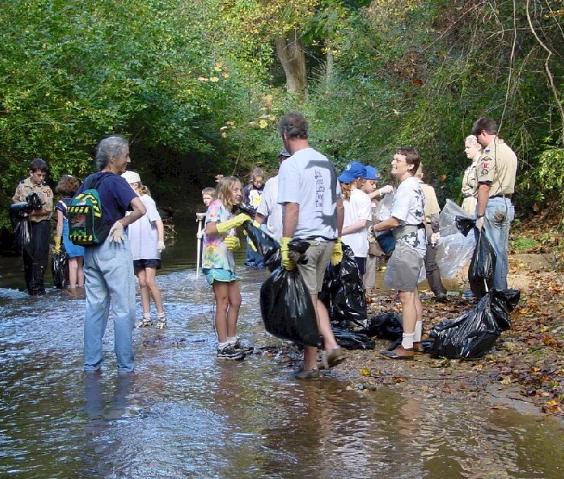
Advanced MG Training
Water Monitioring
Frank Henning
UGA Watershed Extensin Agent
Upper Oconee Watershed

Slide 2
Advanced MG Training
Water Monitoring
Program Goals:
  Increase public awareness of water quality issues
  Provide Master Gardeners with the tools and training to understand, evaluate and improve their local waterways
  Encourage partnerships between citizens, their neighbors and local government
  Teach Master Gardeners how to collect reliable water quality data

Slide 3
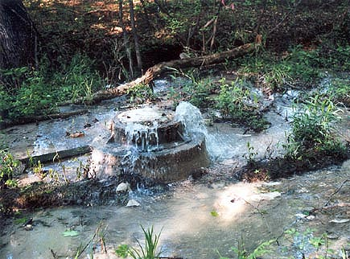
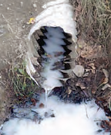
Point Source Pollution
    Industrial Discharge
    Sewage treatment plant
    Exposed leaking sewer pipe
Regulated by EPD through the NPDES permitting process
Pollutant source more easily identified (point to source)

Slide 4
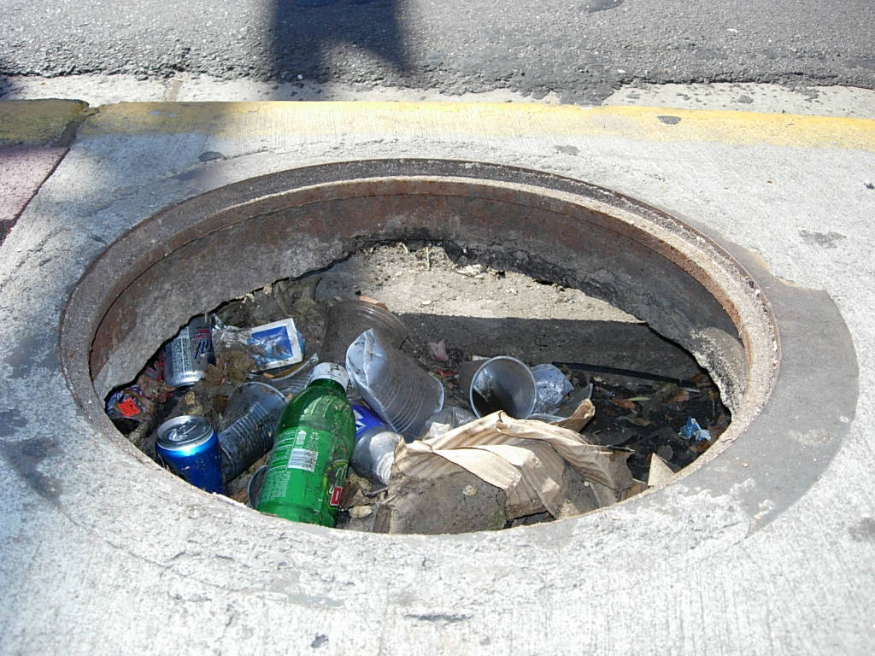
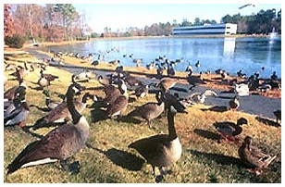
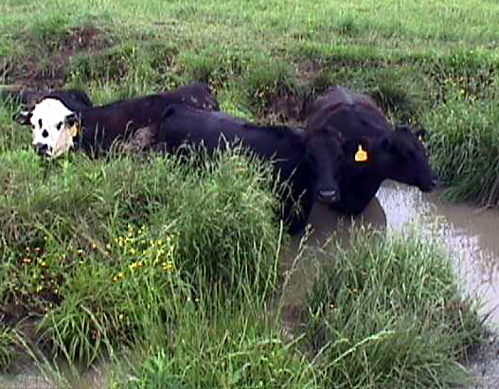
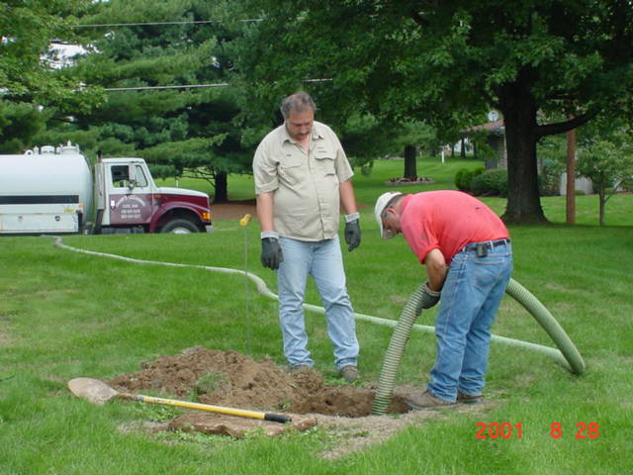
Nonpoint Source
    Erosion Sediment
    Fertilizers, pesticides
    Animal wastes
    Runoff from roads and parking lots
    Illicit Spills and illegal dumping
    Leaking septic systems
The #1 cause of water quality problems
No easily identifiable source and everyone contributes

Slide 5
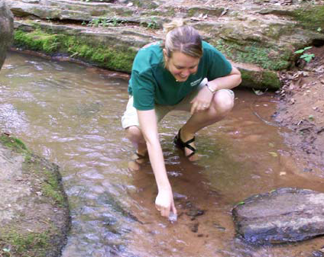
Why Monitor?
  Its Fun
  Good way to learn about local streams and other water bodies
  Water quality is important. Many economic and Quality of life issues related to the quality of the rivers, streams and wetlands around us

Slide 6
Where to Start
Visit with landowners and local government
Determine what data will be used for
Find local partners
Set up a workday
Start/join a water group
Groups: Georgia Adopt-A-Stream, Alabama Water Watch…

Slide 7
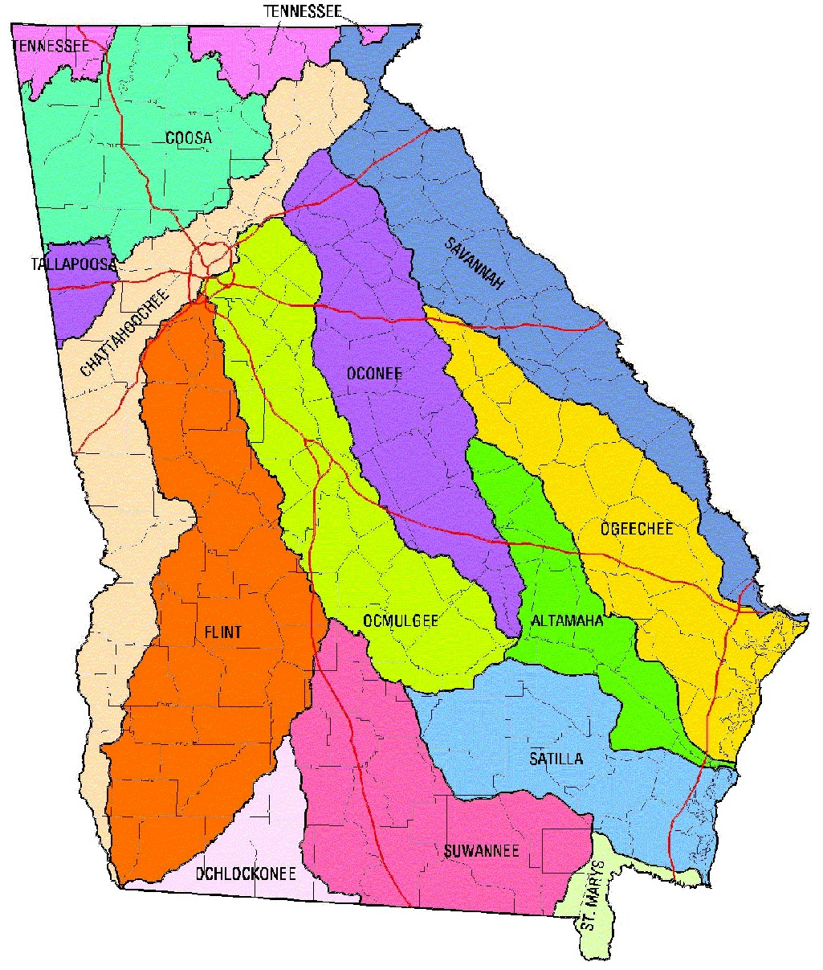
Learn about Watersheds

Slide 8
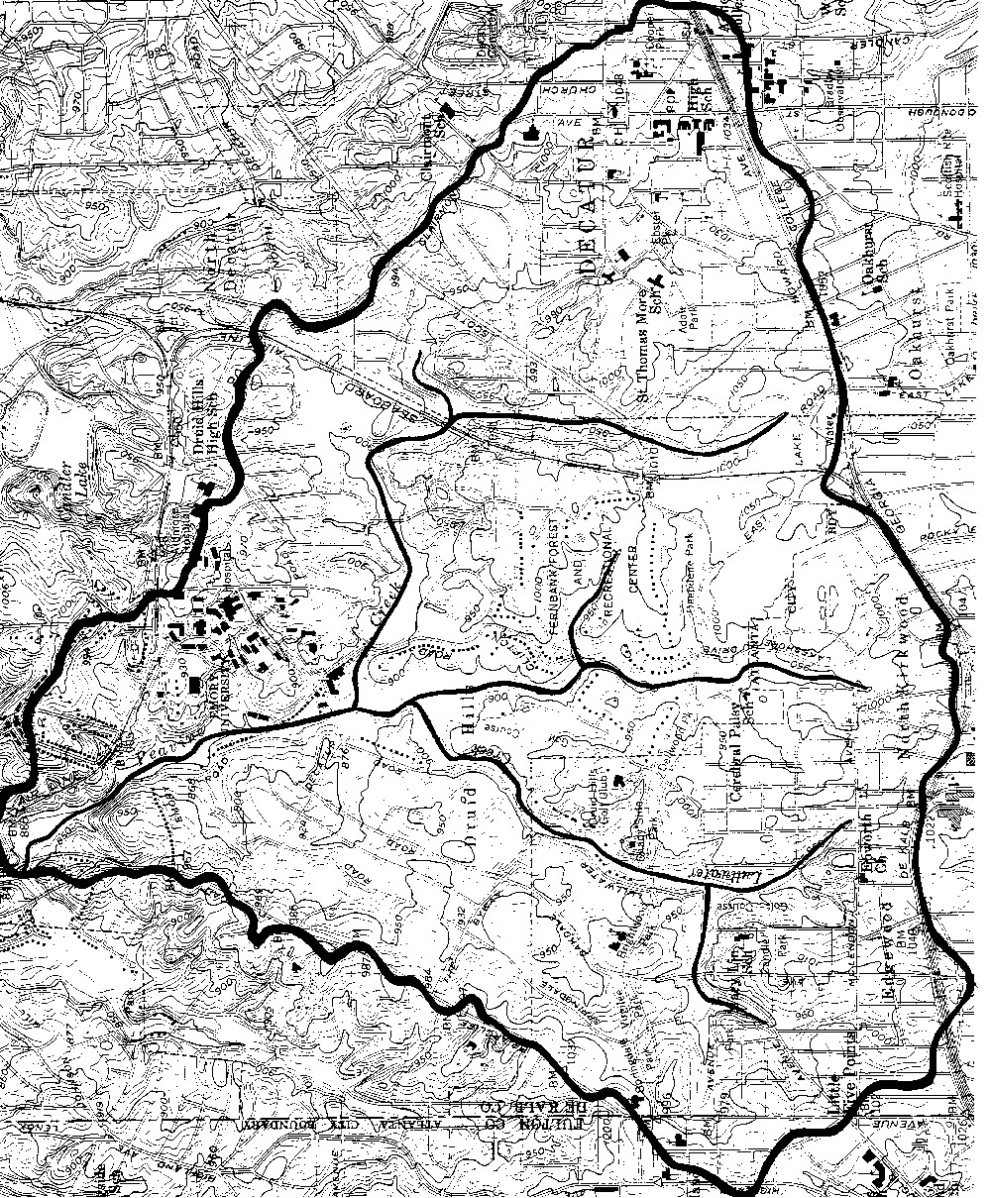
Map Your Watershed
What
Mapping your watershed and conducting a comprehensive survey of the land uses, potential and actual pollution sources, geography and history of your waterbody and its watershed
Why
Getting to know your watershed is the first step to understanding your stream, wetland or lake
The health of your waterbody is directly impacted by land uses and activities
When
Every year

Slide 9
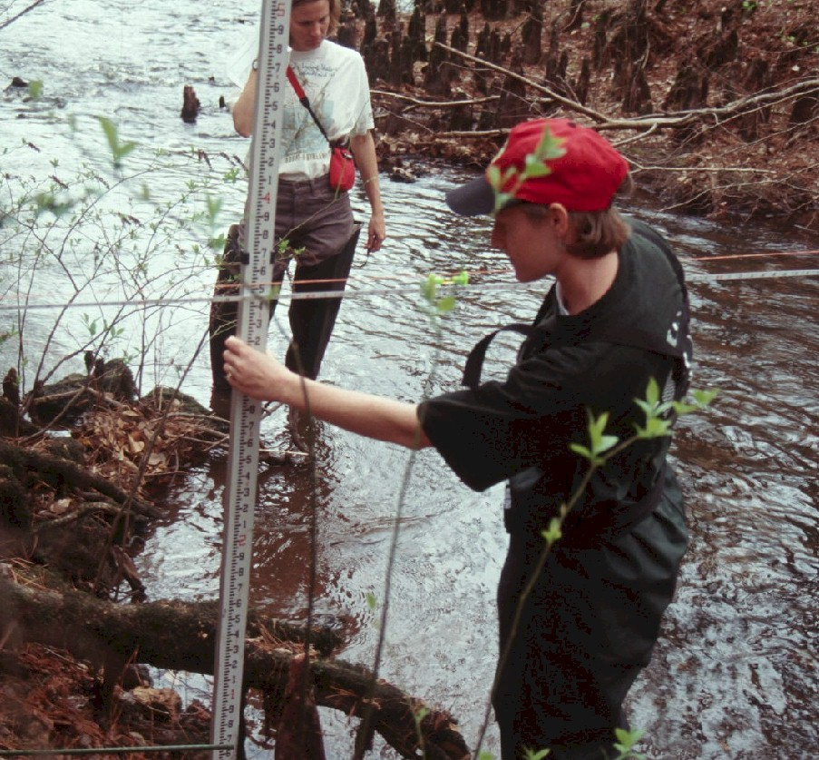
Visual Stream Assessment
What
Visual & physical evaluation of stream conditions
Why
Critical water pollutants and habitat damage, such as sedimentation, erosion and excessive nutrients, can be detected through the visual survey
How Often
Quarterly or once every season

Slide 10
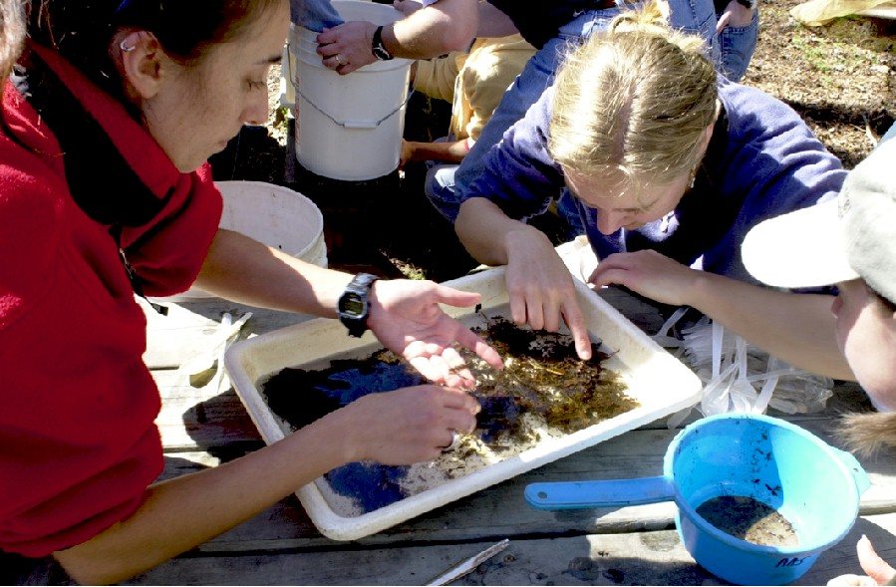
Macroinvertebrate Monitoring
What
Inventory of Macroinvertebrates in the stream
Why
Stream health can be determined by the diversity of macroinvertebrates found. The presence of macroinvertebrates indicate the quality of both water and habitat
When
Quarterly or once every season

Slide 11
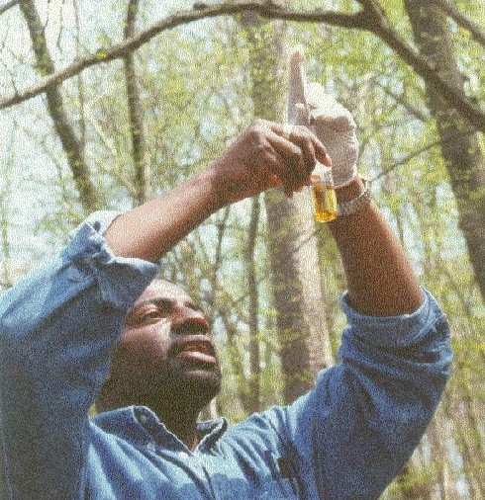
Chemical Monitoring
What
The basic tests are pH, dissolved oxygen, temperature, EC, Turbidity
Advanced tests include phosphates, nitrates and alkalinity
Why
Provides “snap shot” of water quality
Oxygen is needed for respiration
Temperature is directly related to biological activity
pH measures the acidity or alkalinity of the water
Phosphates and nitrates are nutrients that cause algal blooms when present in excess
When
Once a month

Slide 12
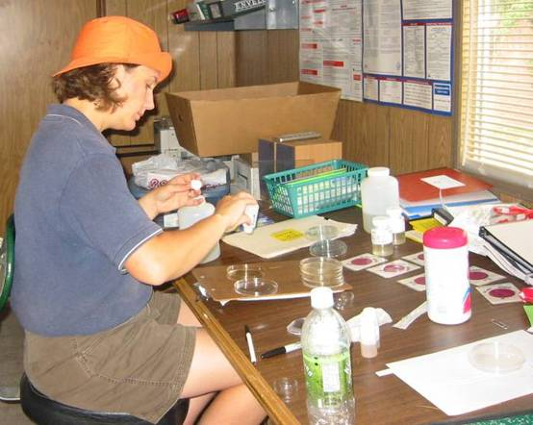
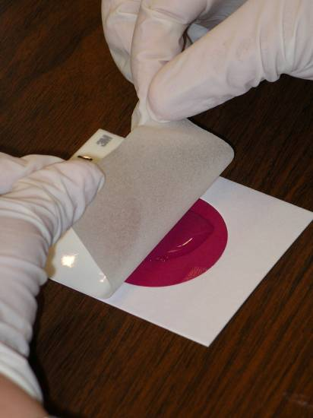
Bacteria Monitoring
Some pollutants may contain water-borne pathogens (bacteria, viruses, algae, parasites, etc.)
Bacteria correlated to pathogen presence
Tests are relatively safe, simple, fast and inexpensive

Slide 13
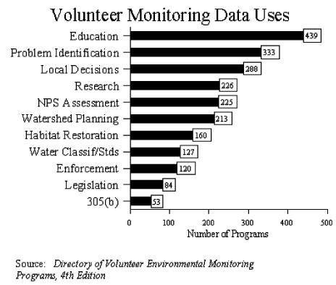
Quality Assurance
Collect reliable data
Certified data (QAQC - Quality Assurance Quality Control)
Individuals can be certified
Share data

Slide 14
Credits:
Some of the material used in this presentation was provided by:
Allison Hughes
Georgia Adopt-A-Stream
4220 International Parkway
Suite 101
Atlanta, Georgia 30354
www.GeorgiaAdoptAStream.org
404-675-1635
Presentation compiled by:
Frank Henning
UGA Watershed Extension Agent
Upper Oconee Watershed, GA
fhenning@uga.edu

Slide 15
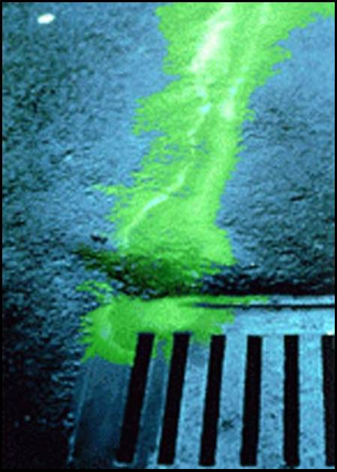
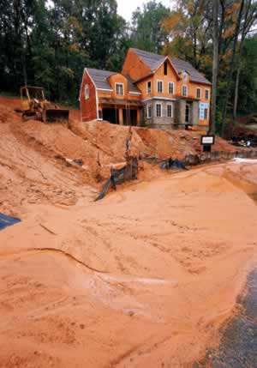
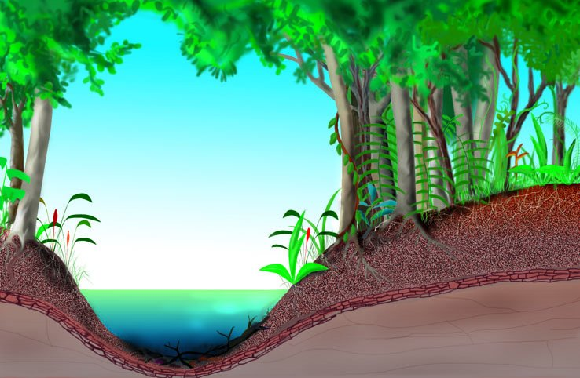
Advanced MG
Water Resources
How Land Use Affects Water Quality

Slide 16
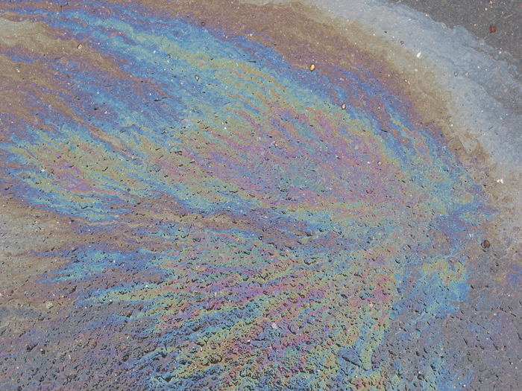
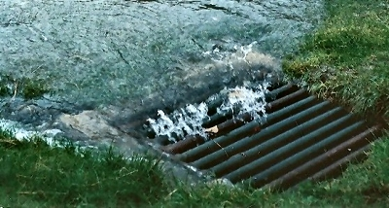
What is NonPoint Source Pollution?
(NPS)
NPS occurs when water washing over the land picks up contaminants and carries them into waterways, either directly or through storm drain collection systems.

Slide 17
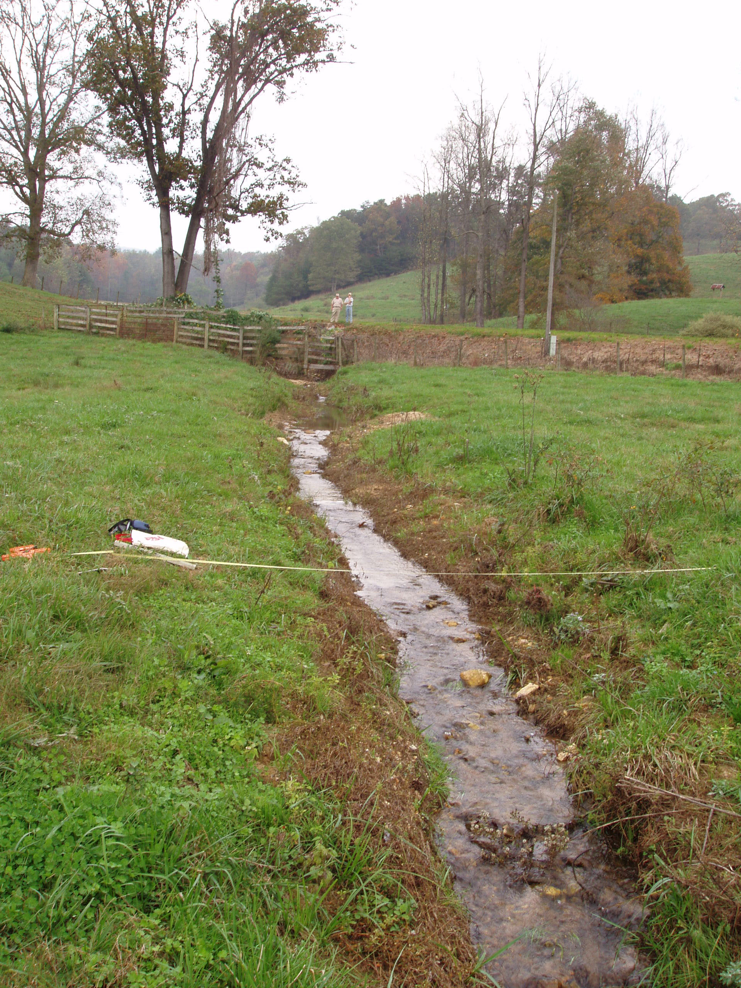
Watershed Assessment
Oil and Chemicals
  Urban, agricultural and industrial runoff
Bacteria
  Animal waste, urban runoff,
  wildlife
Nutrients / euthrophication
  Point sources, Urban runoff,
  Animal waste and fertilizers
Sediment
  Development, Cropland,
  Streambanks, Roads

Slide 18
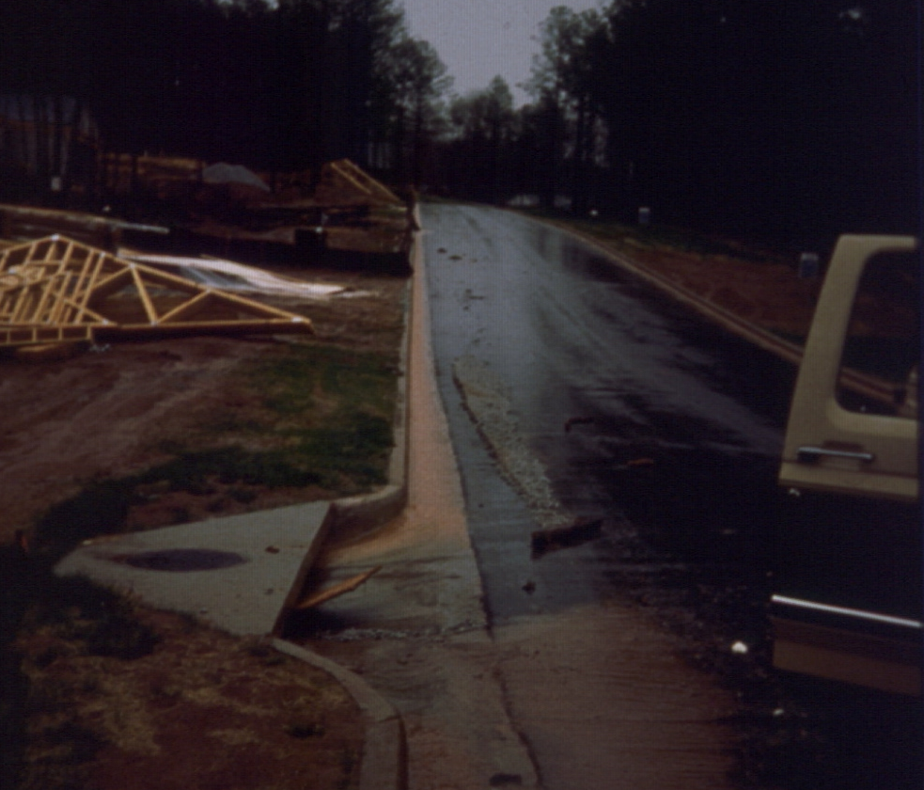
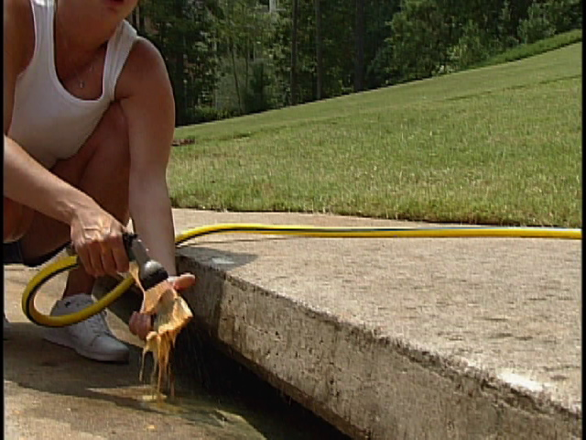
Nonpoint Source
    The #1 cause of water quality problems

Slide 19
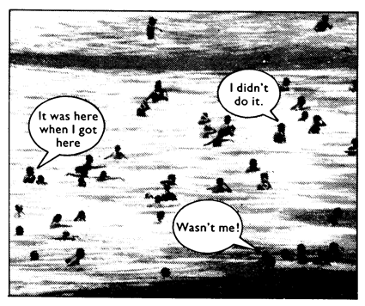
Nonpoint Source Pollution
No easily identifiable source
Everyone contributes

Slide 20

Waterway Health & Imperviousness
Watershed Imperviousness
0% 10% 20% 30% 40% 50% 60%
Protected
Impacted
Degraded
Waterway Health
Adapted from Schueler, et. al., 1992
Notes:
Graph: Relationship between % of impervious cover and water quality degradation
Impervious cover is integrative, in that it indicates overall water quality impacts of urbanization without regard to specific pollutants or resources. Study after study points to common thresholds for water quality degradation at 10 & 25%. Where impervious cover is below 10%, water quality is pretty well protected. (Some studies show that more sensitive habitats may be impacted at lower levels of 7-8%.) From 10% to about 25%, we see impacted water quality. And above about 25%, degradation is unavoidable. Certain measures can be taken to reduce impacts, but water quality is still going to suffer some level of degradation.

Slide 21
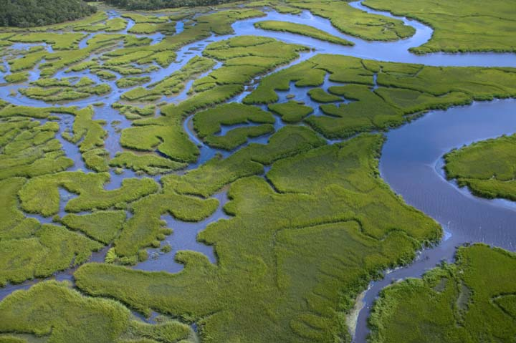
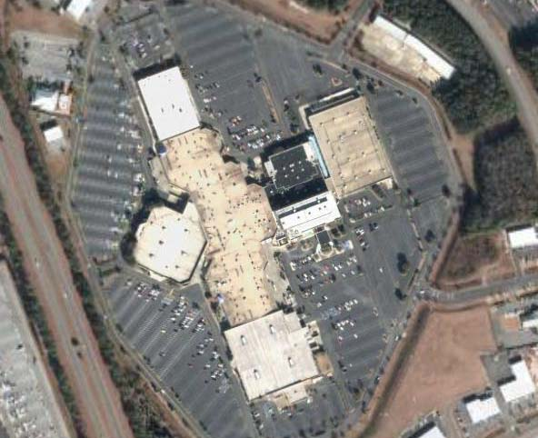
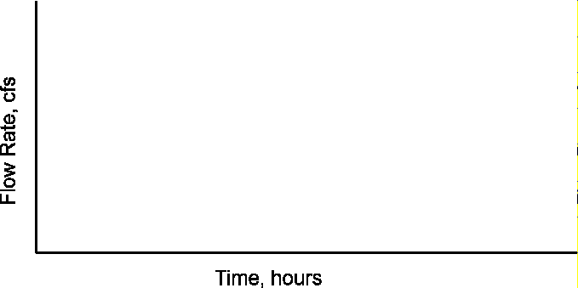
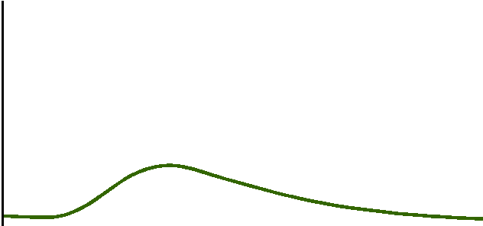
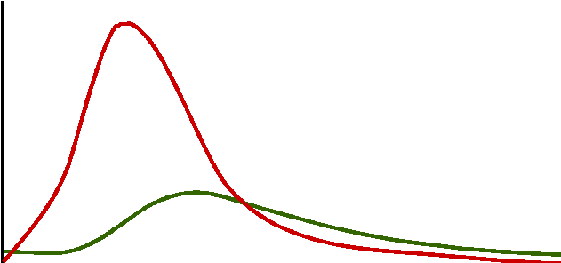
The Science of Stormwater…
More Runoff
Arriving Faster

Slide 22
Potential Solutions:
Improved planning and site design
Education and good stewardship
Adopt and install pre and post development Best Management Practices
Notes:
Better planning can prevent water quality problems while BMPs can manage the symptoms of problems once they have been created
When it comes to water protection, NEMO recommends a 3-tiered approach to Natural Resource Based Planning. Typically, communities seeking to address nonpoint source pollution focus on #3 first. However, we suggest doing so only after undergoing the first two. Research increasingly shows that mechanical “fixes” have minimal success in cleansing stormwater. It’s more effective and more cost-effective to address runoff proactively through better planning and design.
The strategy we recommend include three tiers to prevent, minimize and mitigate impacts.
The first tier can really only be accomplished through a dedicated outreach program like nemo targeted at local government officials. However, the second and third tier strategies can be incorporated by other stakeholder groups as well as local governments. The private sector is a driving force in development, and the coastal ga nemo program recognized a need to incorporate another, complementary outreach program to address specific issues for those stakeholders.

Slide 23
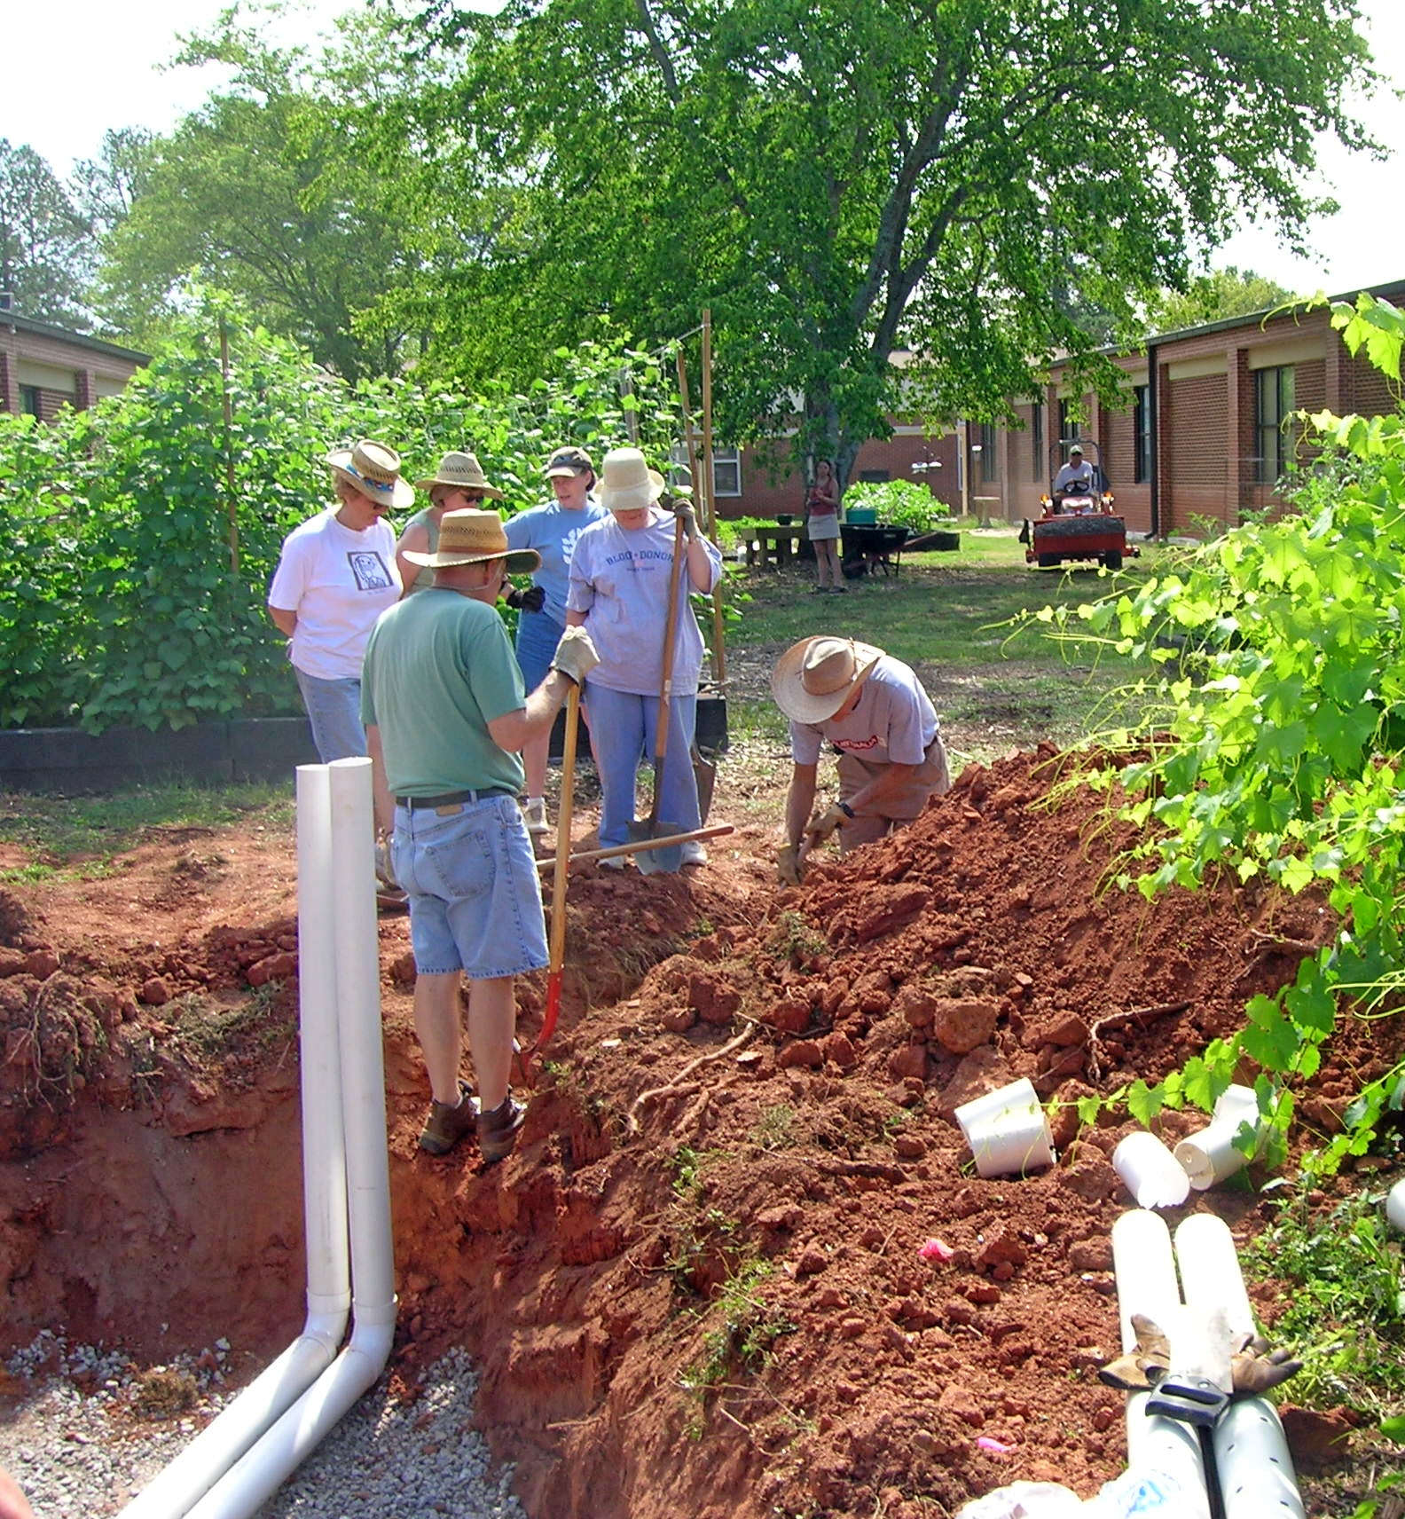
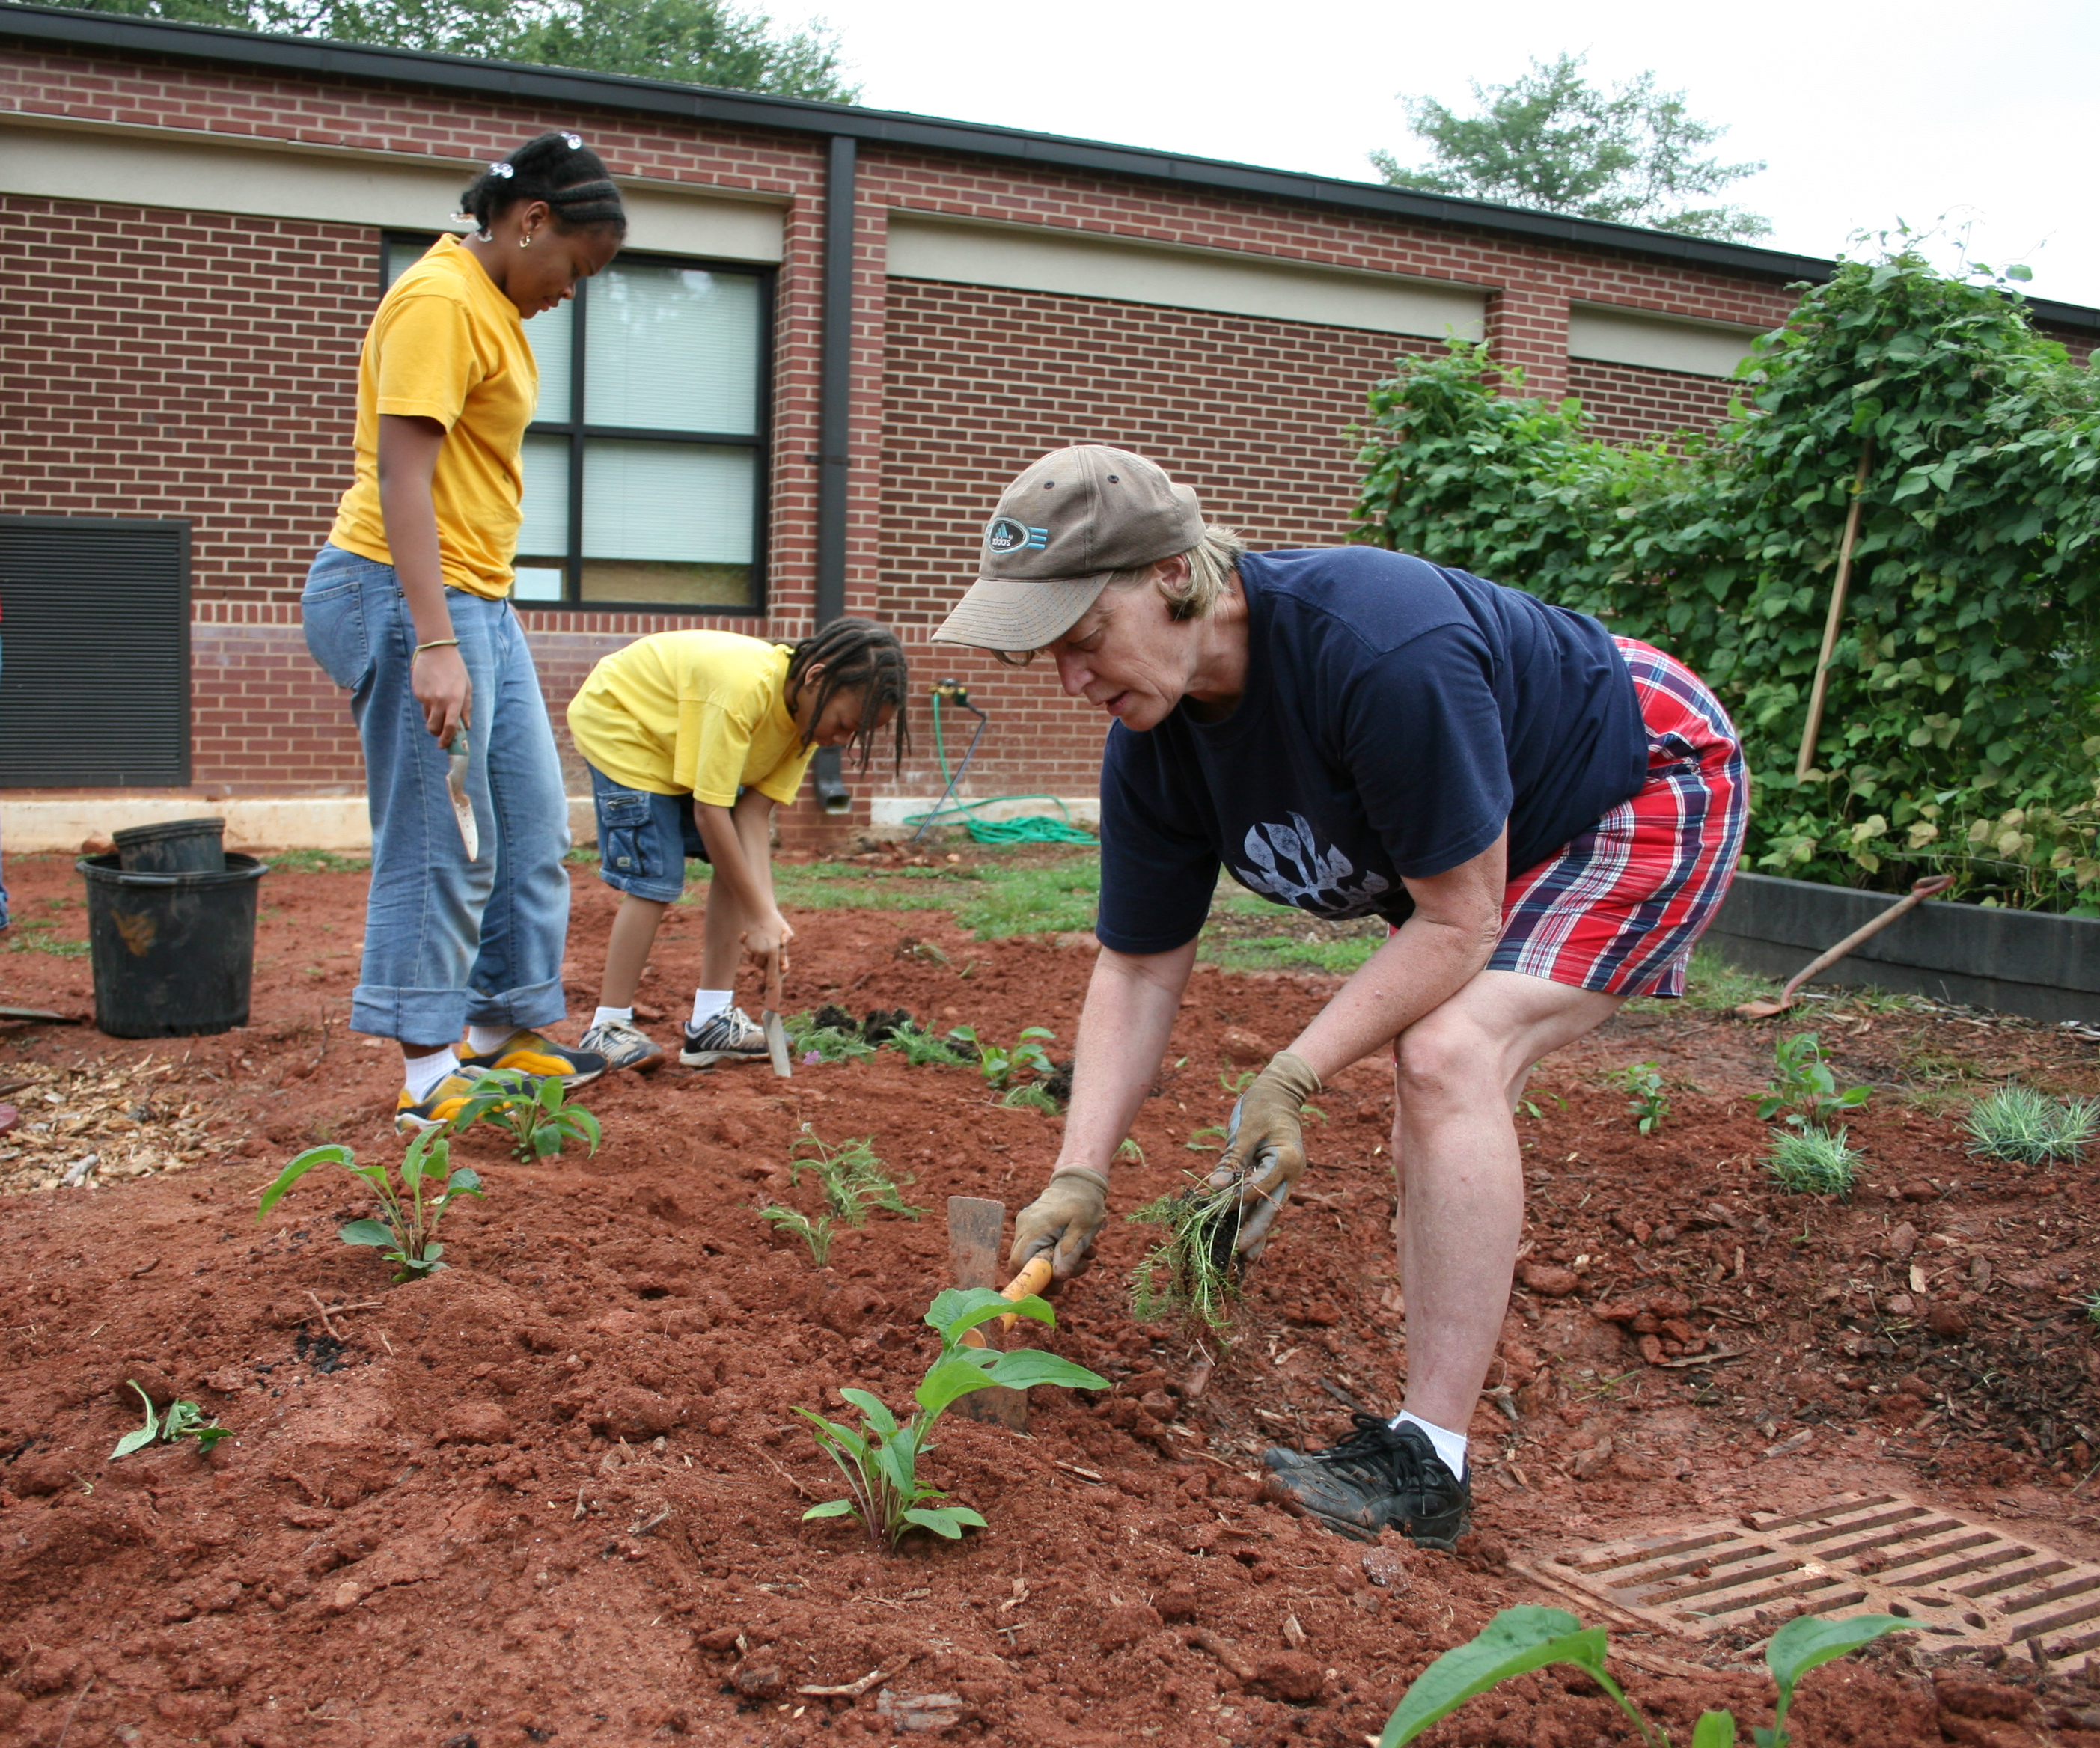
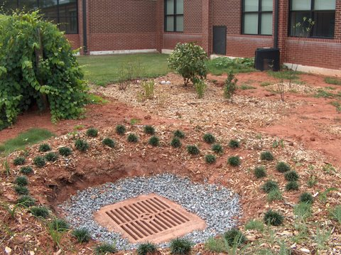

Slide 24
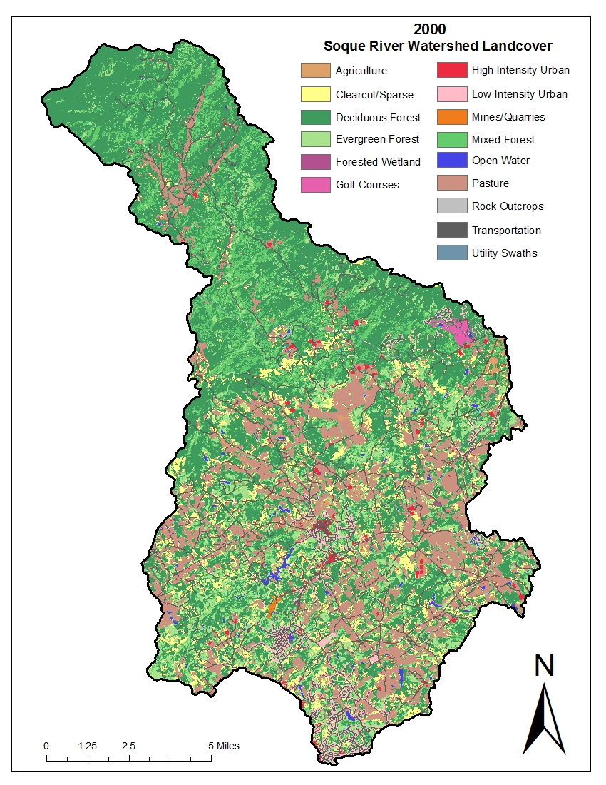
Relationship between land use / land cover and biological health
Duncan Hughes,
Soque Watershed, GA, 2007

Slide 25
Positive correlations (p < .05)
Variable 1 | Variable 2 | Correlation
Macros | % Cobble | .56
Macros | % Forest | .66
Habitat Score | % Cobble | .72
Habitat Score | % Forest | .68
% Silt / Clay | % Urban | .75
Duncan Hughes, Soque Watershed, GA, 2007

Slide 26
Negative correlations (p < .05)
Variable 1 | Variable 2 | Correlation
Macros | % Silt / Clay | -.44
Macros | % Urban | -.55
Macros | % Agriculture | -.11
Habitat Score | % Silt / Clay | -.55
Duncan Hughes, Soque Watershed, GA, 2007

Slide 27
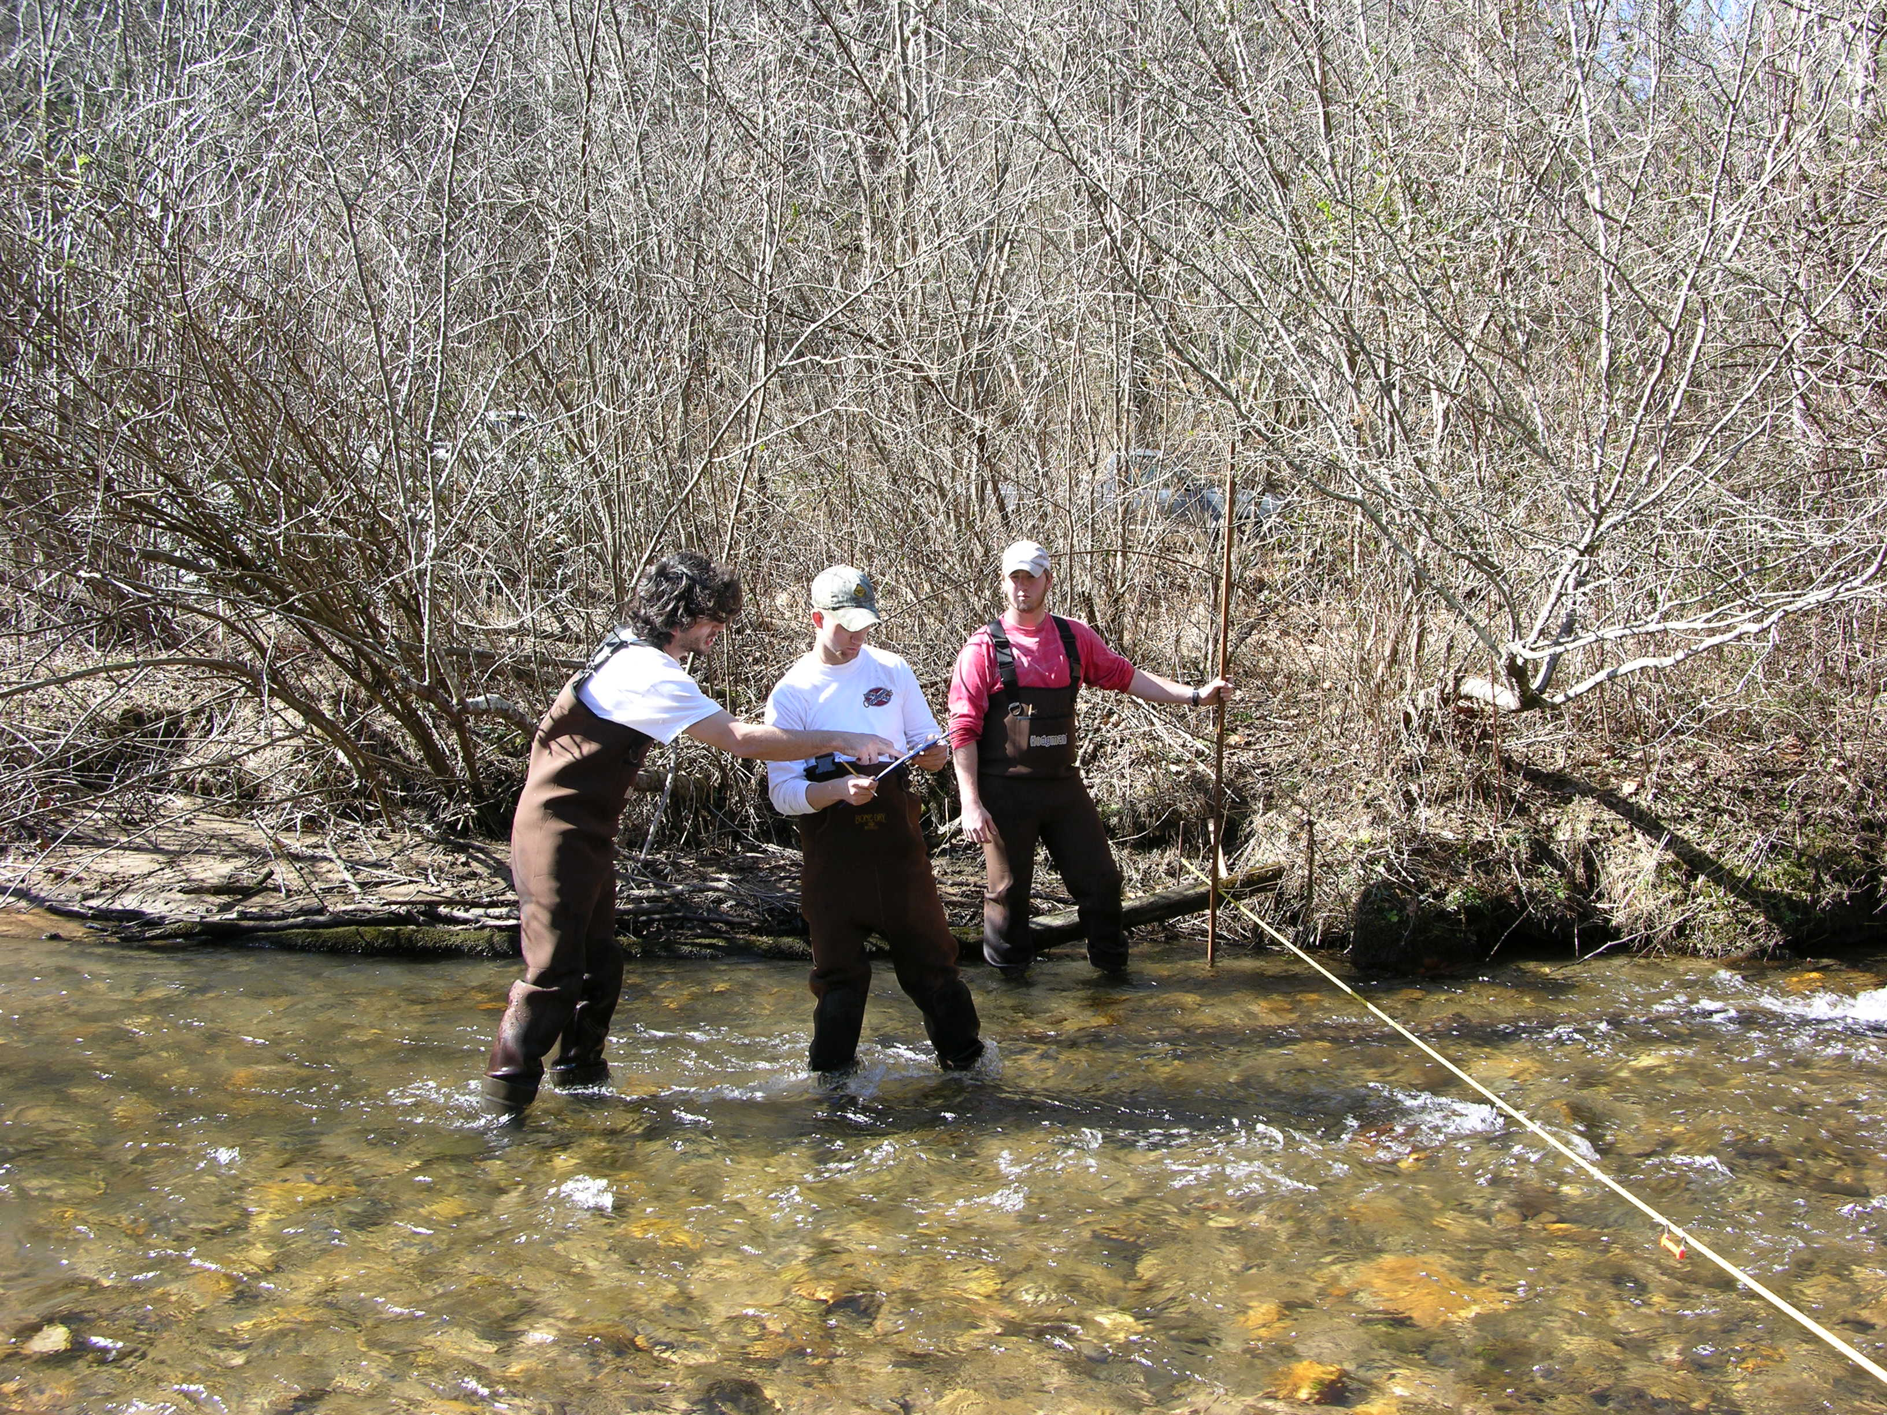
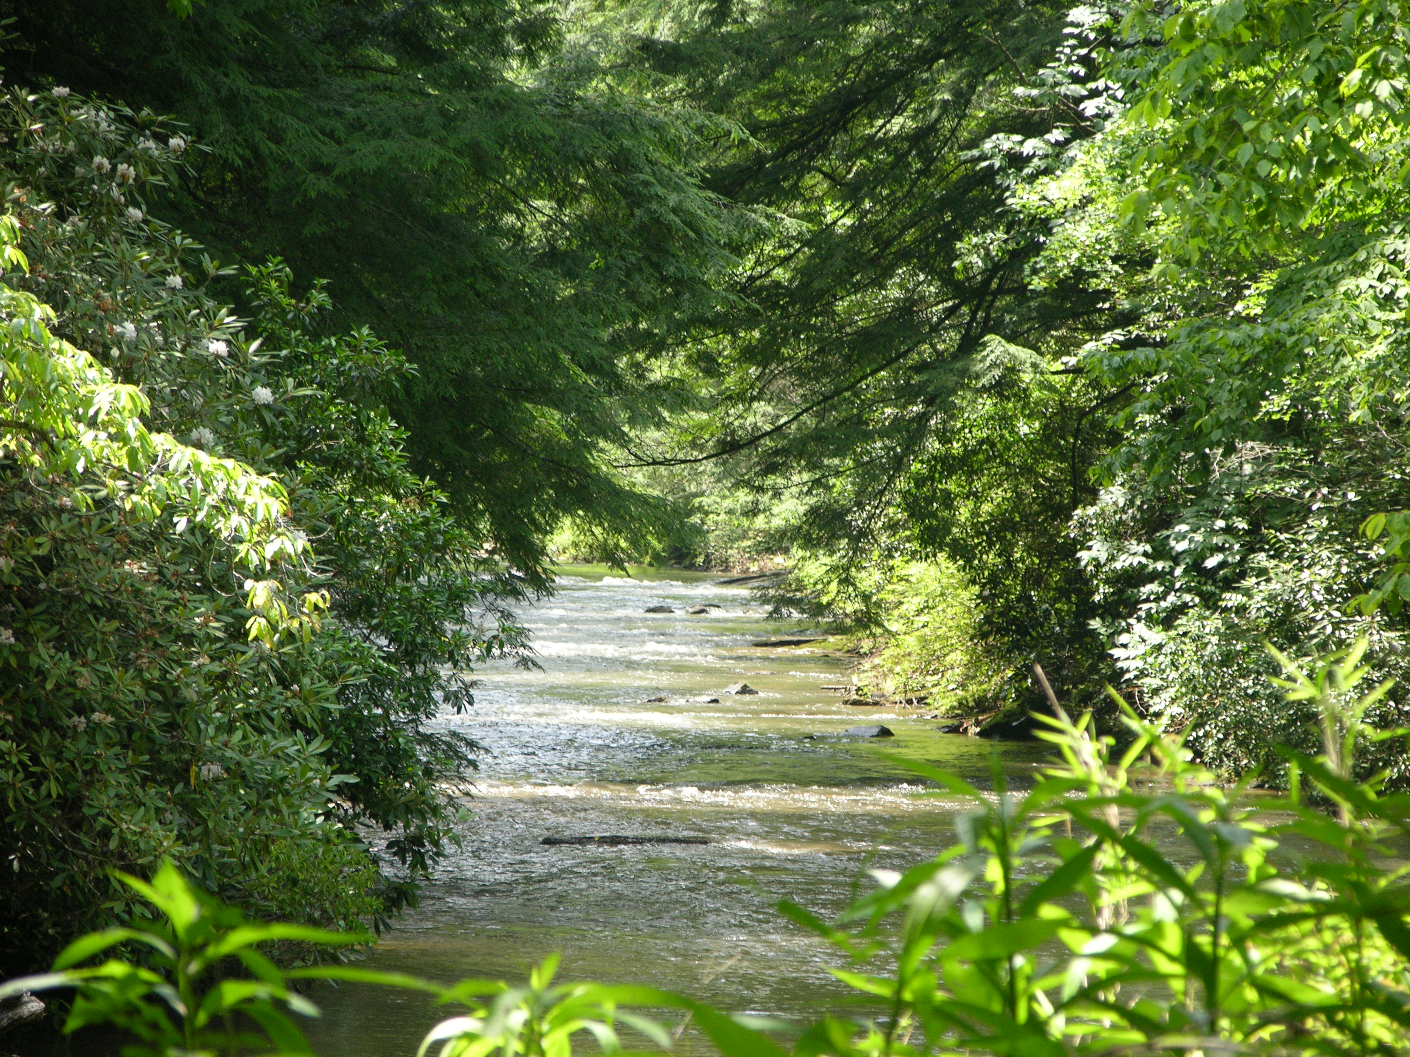
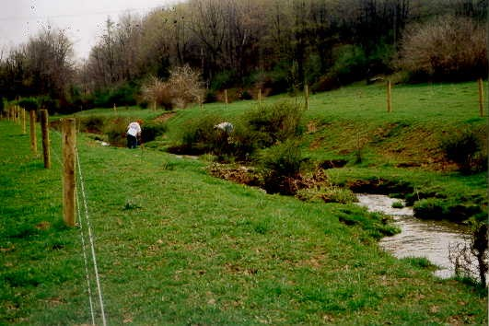
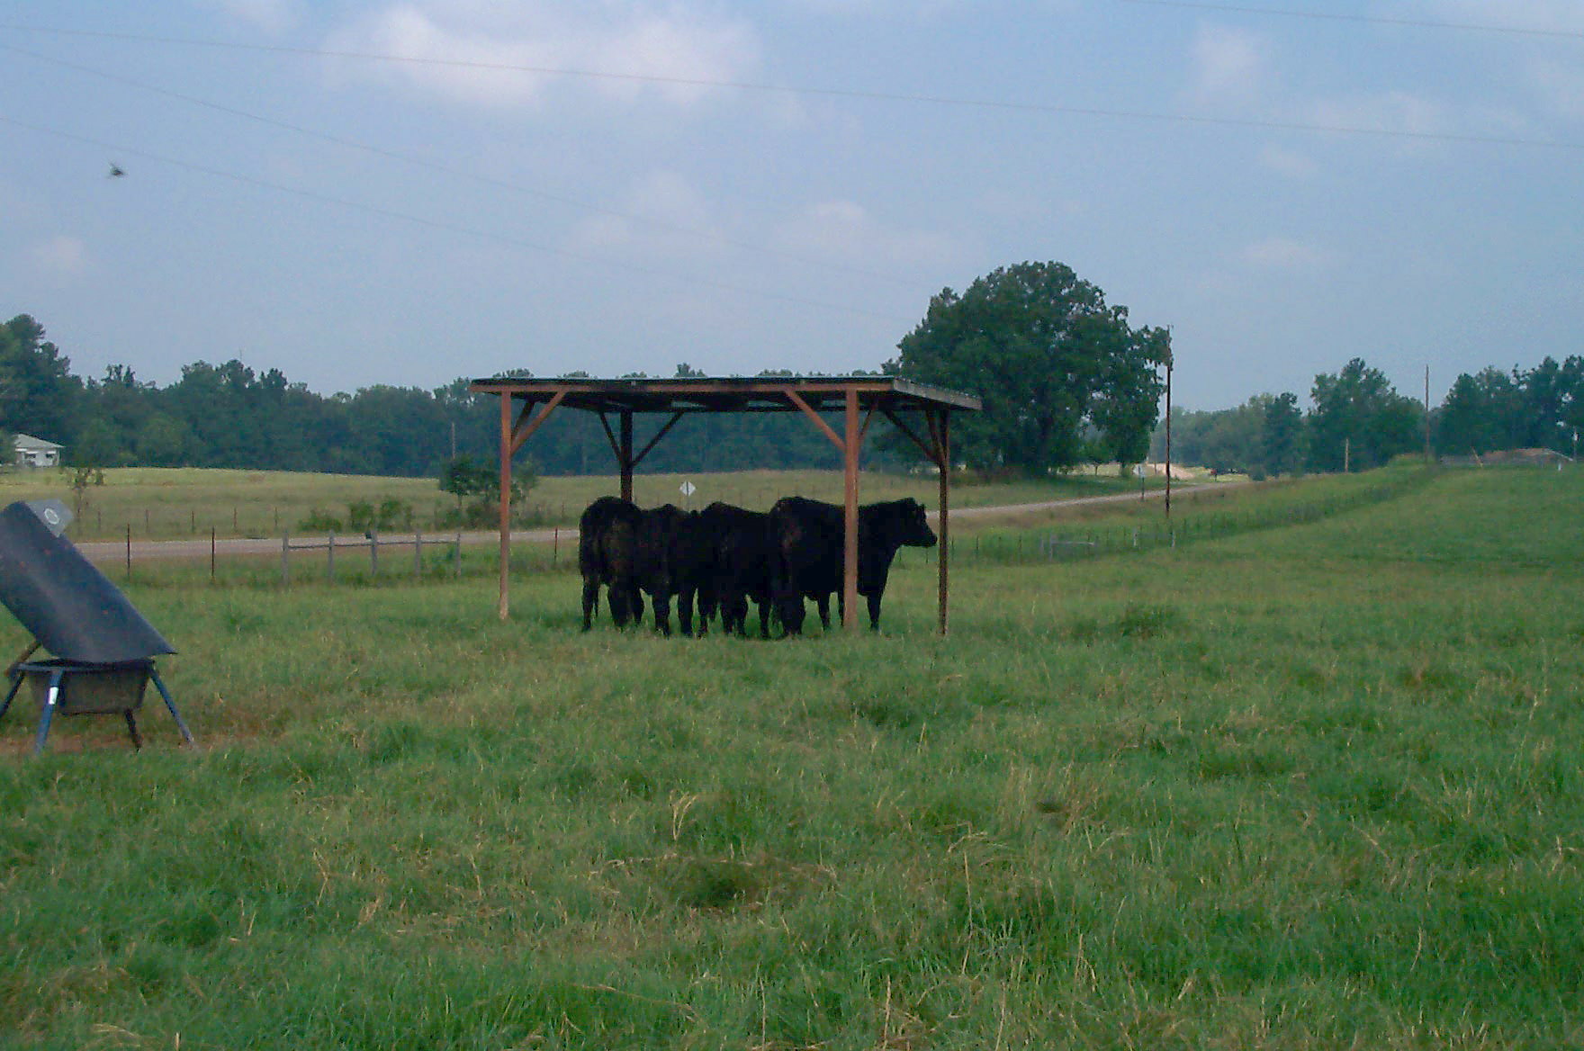
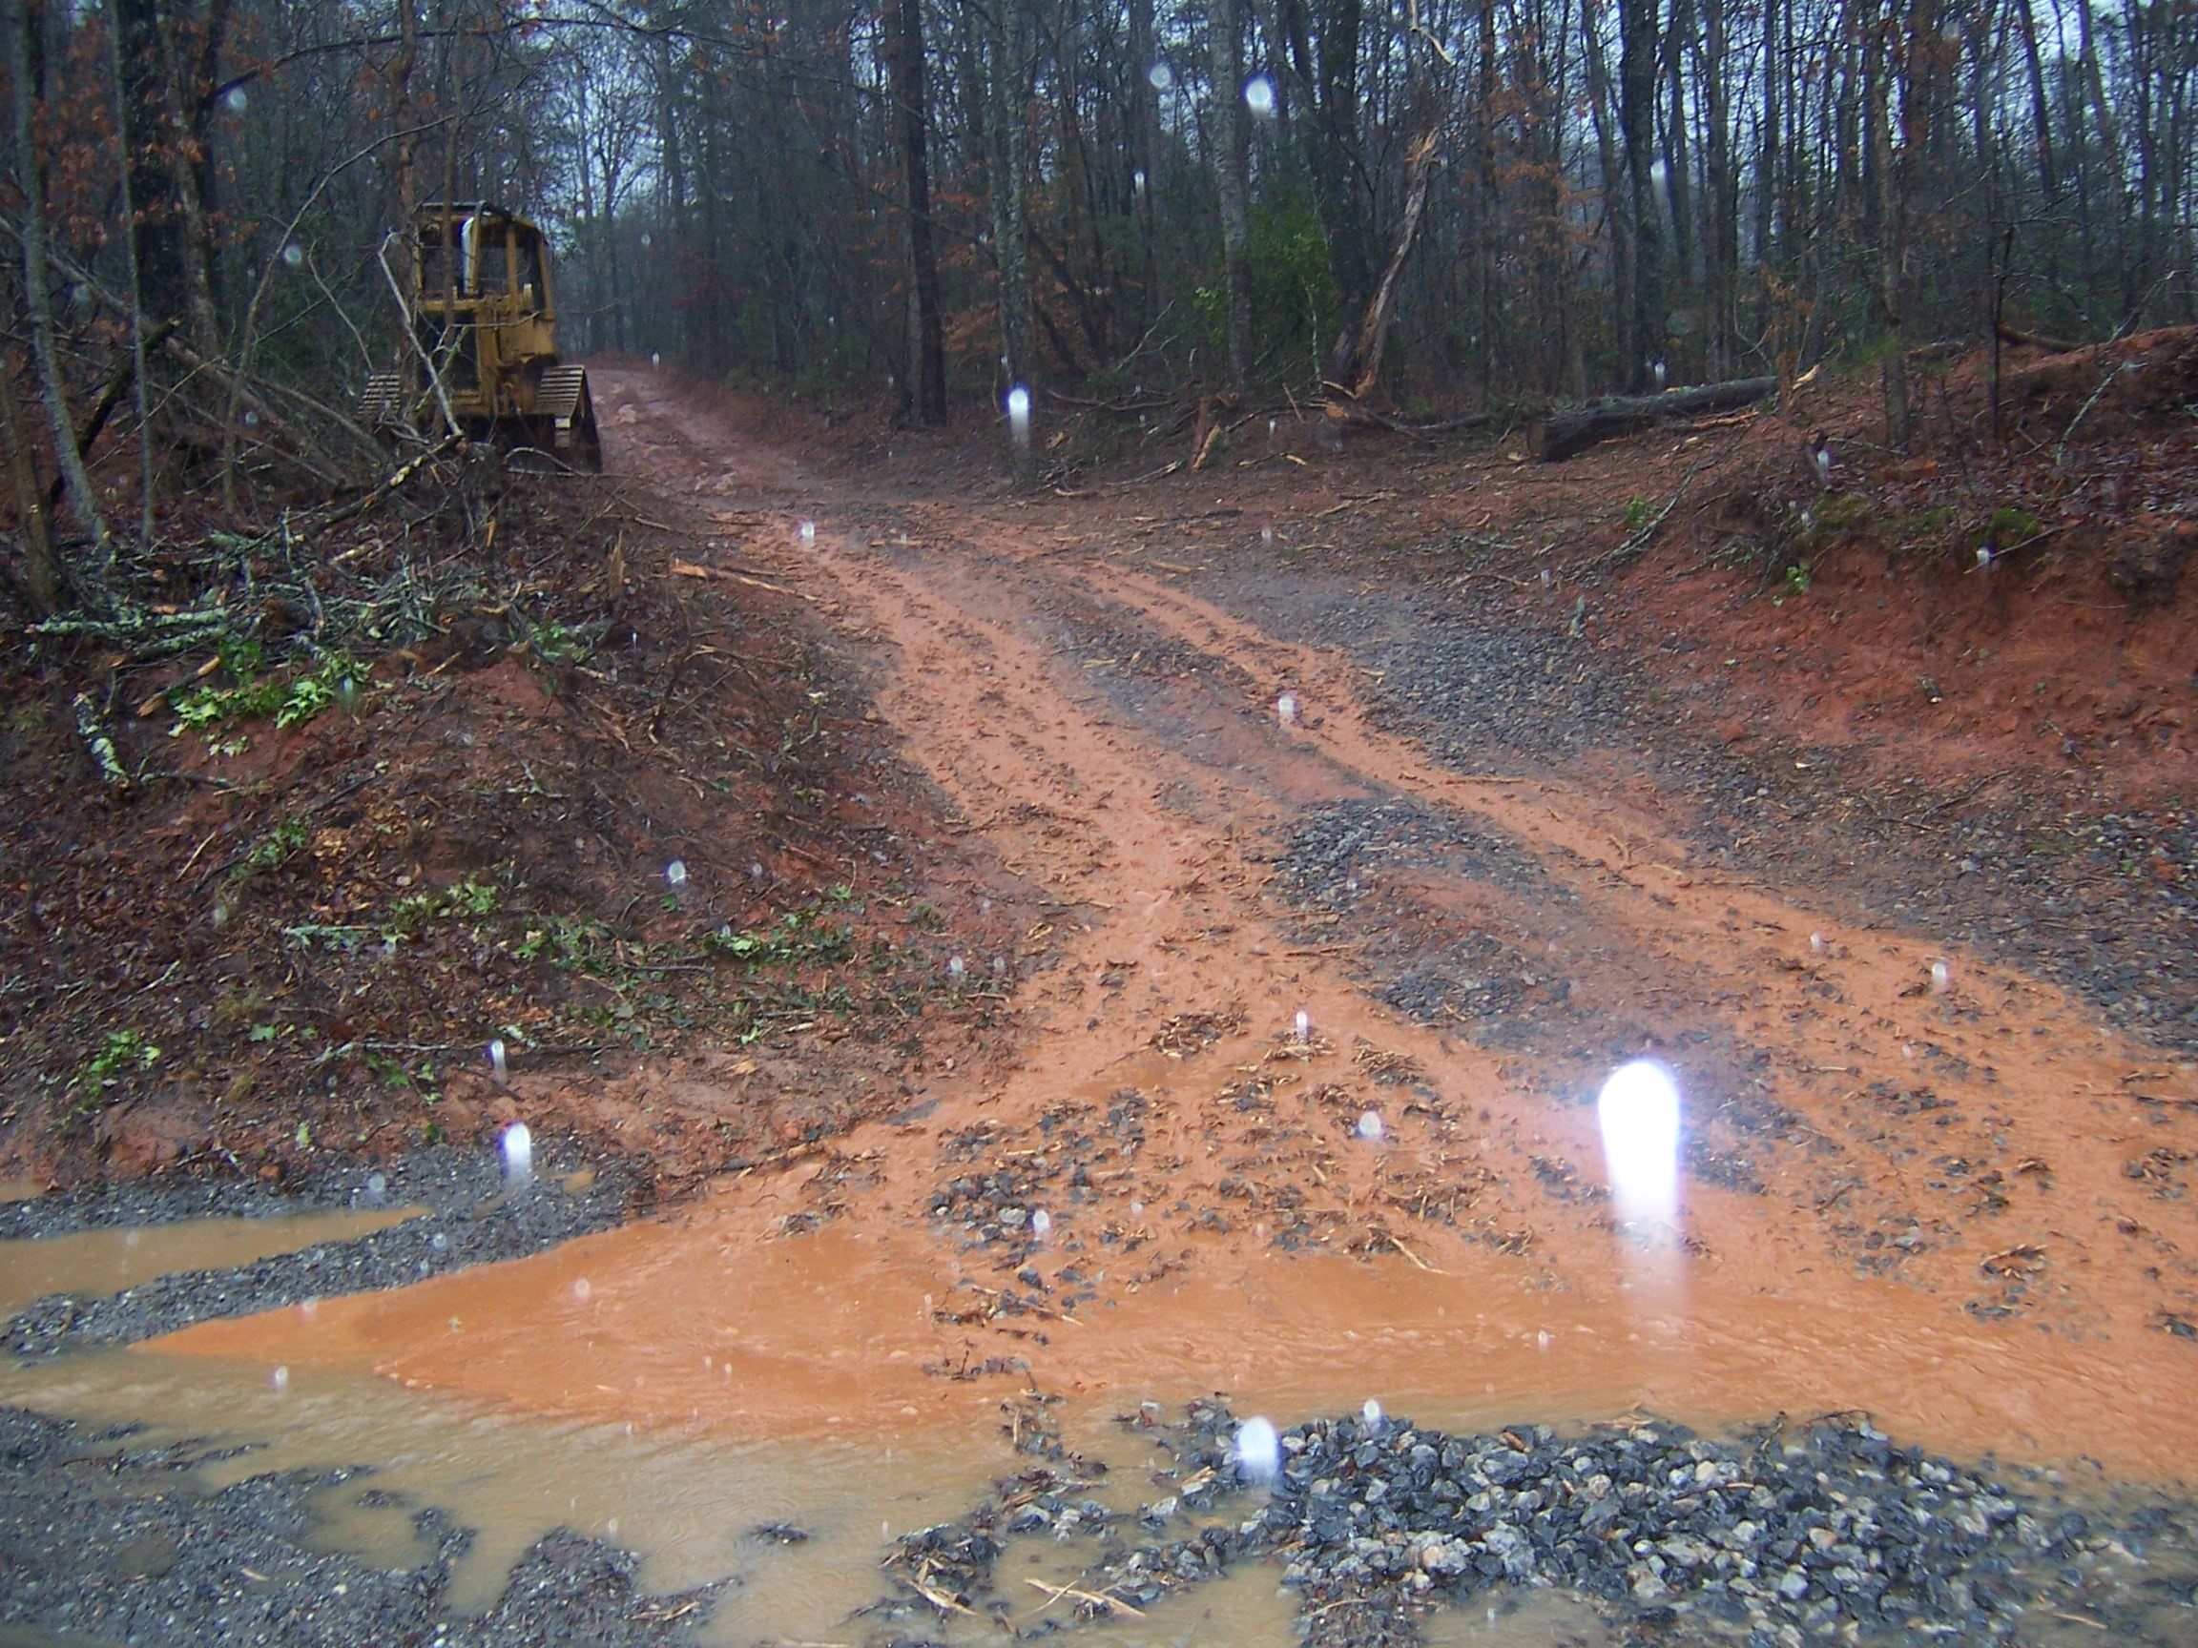
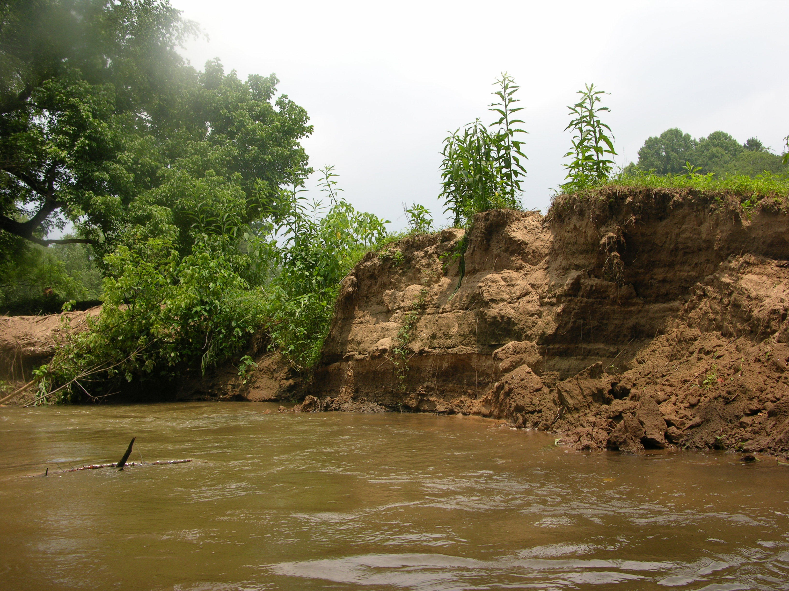
Good Water
Quality
Impact
Large Impact

Slide 28
Credits
Katie Hoover Alvarado, Public Service Assistant/NEMO Coordinator, University of Georgia Marine Extension Service Katie
Duncan Hughes, Watershed Coordinator, Soque River Watershed Partnership
Presentation compiled by:
Frank Henning
UGA Watershed Extension Agent
Upper Oconee Watershed, GA
fhenning@uga.edu

Slide 29
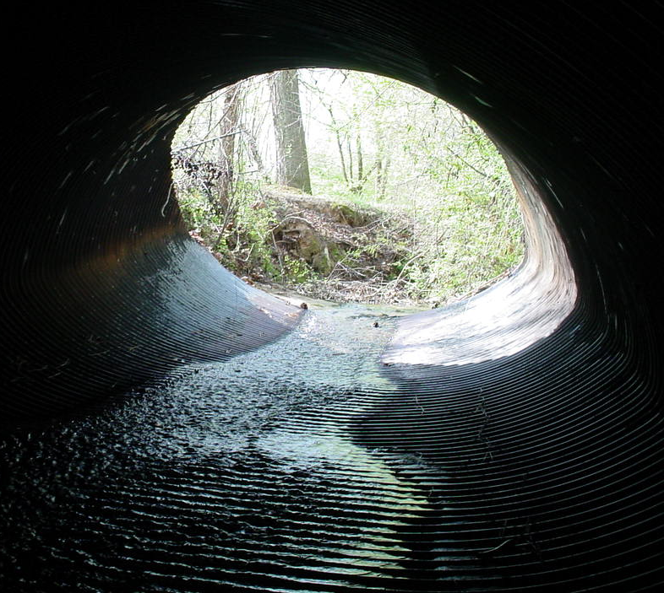
Visual Assesment
& Pollution Prevention

Slide 30
Trying to Promote clean water
Not point a finger
Picture from Georgia Soil and Water Conservation Commission
Notes:
A beautiful North Georgia stream.

Slide 31
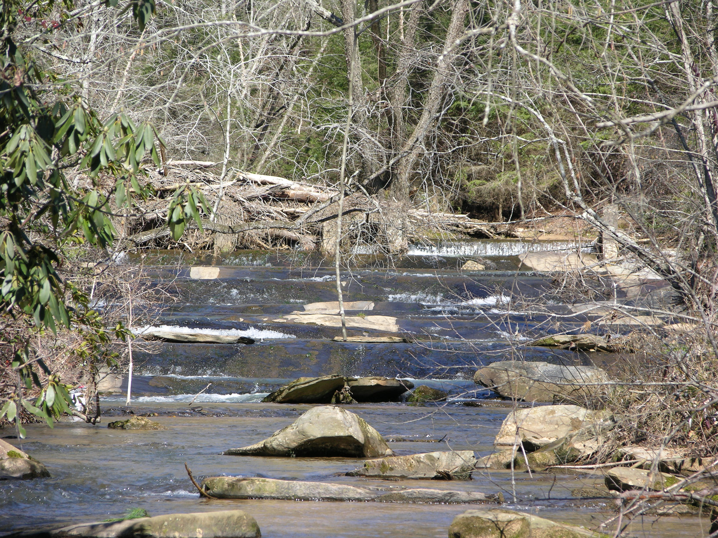
What Makes a Healthy Stream?

Slide 32
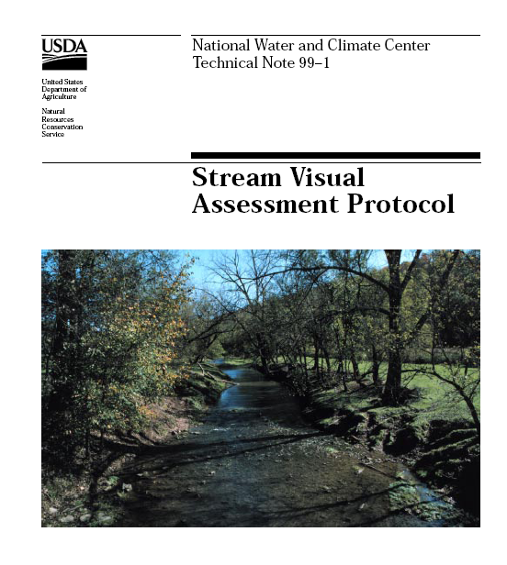
https://aww.auburn.edu/Docs/stream%20visual%20assess.pdf

Slide 33
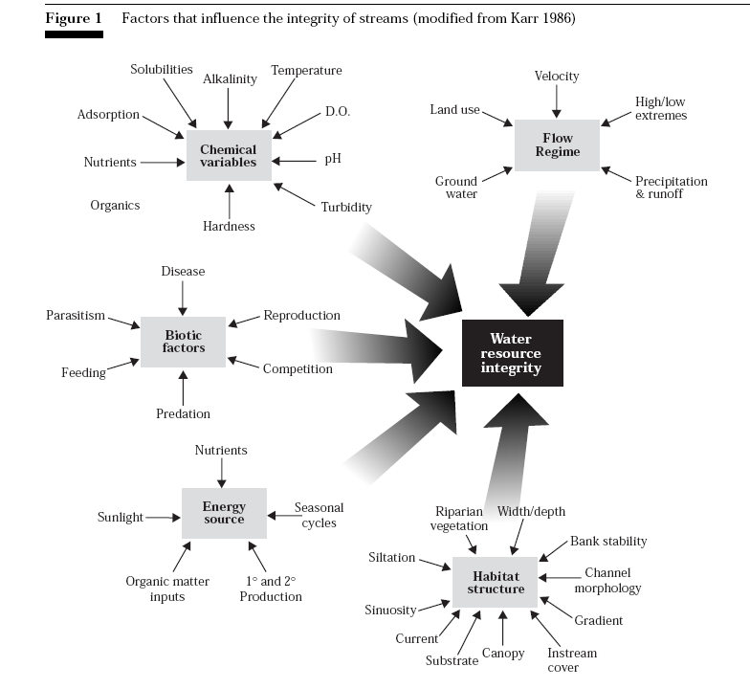

Slide 34
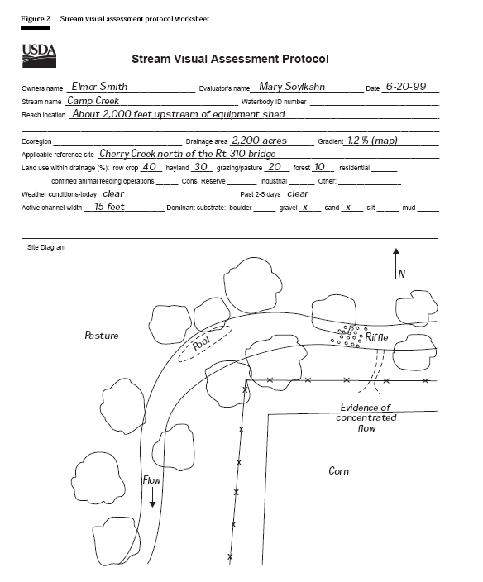

Slide 35
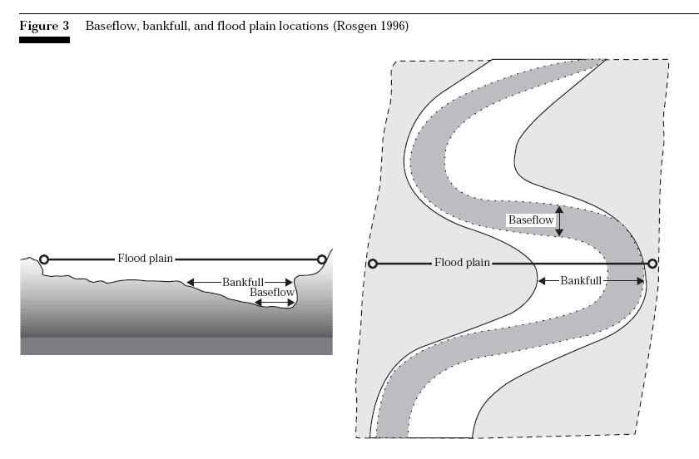
Length of assessment reach = 12 x channel width
Each element rated on a 1 – 10 scale

Slide 36
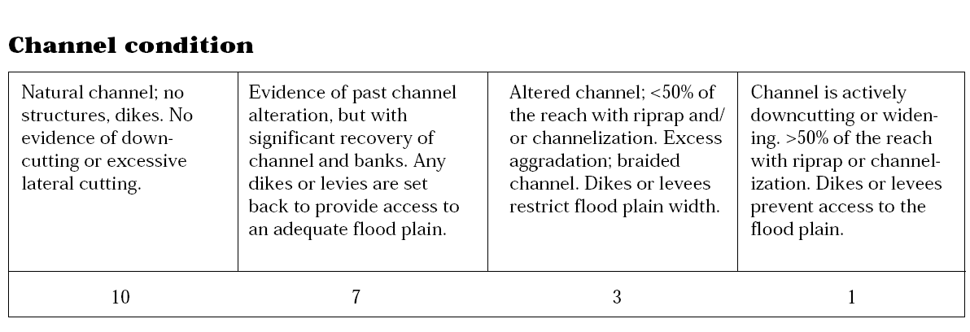
Downcutting and lateral cutting impair stream function
Excessive bank-armoring usually leads to more problems

Slide 37
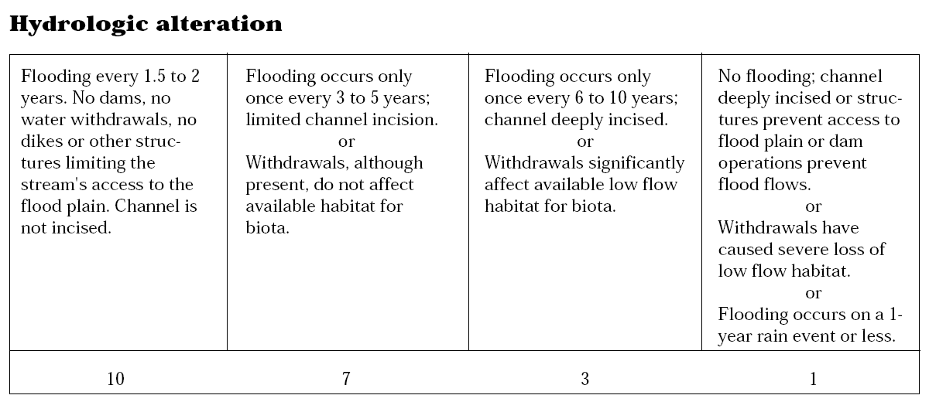
Energy balances with bedload
Maintain channel shape and function
Keep gravel clean
Form pool and riffle habitat

Slide 38
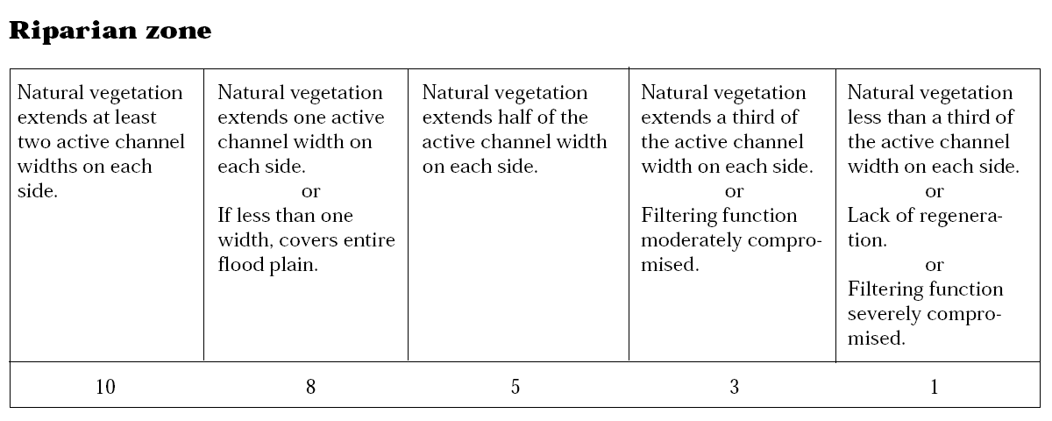
Reduces pollutants
Helps control erosion
Cools streams
Root and debris provide habitat
Refuge for fish during out-of-bank flows

Slide 39
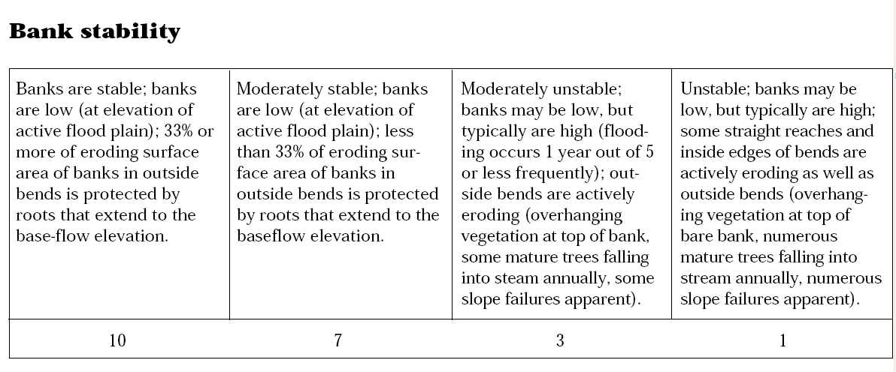
Roots of perennials should extend to base flow
Trees, shrubs, sedges & rushes withstand

Slide 40

Look for algae, scum, dyes, oil
Green color indicates nutrient enrichment

Slide 41

Some aquatic vegetation is normal
Intense algal blooms, thick mats of algae &
dense macrophytes degrade habitat

Slide 42

May isolate populations
Prevent migration, breeding, foraging,

Slide 43

Number of cover types 5x channel width

Slide 44

Important resting and feeding spots
Typical: 1-2 pools/reach
Abundant: 4+ pools/reach
Only shallow streams should be scored

Slide 45

Stream bottom, woody debris, other habitat surfaces
Variety of substrates within a reach 5x channel width

Slide 46


Slide 47

Odor
Floatables (sewage, oil sheen, suds)
Biological indicatiors (algae blooms…)

Slide 48


Slide 49


Slide 50


Slide 51

Look around
Promote clean water
Education
Cooperation
Urban / Industrial

Slide 52
Stormwater &
Riparian

Slide 53
Sewage

Slide 54

Agriculture

Slide 55

Wildlife

Slide 56
Presentation compiled by:
Frank Henning
UGA Watershed Extension Agent
Upper Oconee Watershed, GA
fhenning@uga.edu

Slide 57


Advanced MG
Water Quality

Slide 58

Fish and many other animals live in water
Eat
Breathe
Excrete wastes
Reproduce
Take in and lose salts
Notes:
4

Slide 59
Key Water Quality Factors
Temperature
Oxygen/CO₂
Alkalinity, Hardness & pH
Nutrients (NH₃ and P)
Sediment
Electrical conductivity

Slide 60

Dissolved Oxygen
Importance
  highest cause of mortality
Safe levels
  greater than 5 mg/L
Dense bloom, bloom die-off
herbicide app. & turnover

Slide 61
DISSOLVED OXYGEN
DO levels may increase due to
  Diffusion from the atmosphere,
  Bi-product of photosynthesis
  Turbulent mixing (riffles)
  Cool Temperature (shade, weather)
DO levels may decrease due to
  Warm temperatures (sun, industry)
  Plant respiration (especially at night)
  Overload of decaying organic matter (due to excess nutrients)
  Slow moving, deep water

Slide 62

Photosynthesis = O₂
Respiration = CO₂

Slide 63

Daily O₂, CO₂ Cycles

Slide 64

DO Management
Avoid Overfeeding
Maintain Proper Densities
Avoid Over-fertilization
Intelligent Weed Control
Monitor Inflow Quality
Aeration

Slide 65

pH
Measure of the hydrogen
ion concentration
1-14 scale
  less than 7 acidic
  greater than 7 basic
Safe range
  6.5 - 9

Slide 66

Hardness
Hardness if the measure of divalent cations
  calcium
  magnesium
Hardness is used as an indicator of alkalinity but hardness is not a measure of alkalinity
  magnesium or calcium sulfate increases hardness but has no affect on alkalinity
Recommended hardness levels > 20 ppm

Slide 67

Alkalinity
Alkalinity is the capacity of water to buffer against wide pH swings
Acceptable range 20 - 400 mg/L

Slide 68

Liming Ponds
Total Alkalinity > 20 ppm
Agricultural Lime
~ every 2 – 4 years
Broadcast Over the
Entire Pond Surface
Professional Liming
Barges on Large Ponds

Slide 69
Guidelines for
Application of Lime in Ponds
Total Alkalinity Lime/Surface Area
12 mg/l 1-2 ton
12 - 14 mg/l 1 ton
15 - 25 mg/l 1/2 ton
25 mg/l or more None
Notes:
27

Slide 70
CONDUCTIVITY
Measurement of water’s ability to pass an electrical current
Is affected primarily by geology of the area through which the water flows through
  water that flows through granite tends to have low conductivity
  water that runs through limestone and clay may have higher conductivity

Slide 71
CONDUCTIVITY
Georgia generally ranges from 50 to 1500us/cm
Conductivity > 300 us/cm may indicate contaminants
Sources of Conductivity
  Mining operations – release of iron, copper, cadmium
  Agriculture – nutrient ions
  Sewage effluent – chloride, nitrates, and phosphate
  Urban runoff – auto fluids, salts, nutrients and chemicals

Slide 72

Nutrients & Fertilization
For Ponds
5-10 apps per year
Start in February
Time apps using secchi disk
Shade out weeds

Slide 73
NUTRIENTS
Nitrates
  A nutrient found in the water from fertilizers or animal waste. Sewage is the main contributor.
  Normal background levels are below 1ppm
Phosphates
  A nutrient found in water from soaps, fertilizer, animal waste, industrial effluent and sewage
  Normal background levels are below 0.1ppm
  Excess nutrients can cause algal blooms, affect sensitive macroinvertebrates, and decrease dissolved oxygen levels

Slide 74

Fertilization Supplements the Food Chain
More Fish - Not Bigger Fish
Multiplies the Base of the Food Chain
Increases Carrying Capacity 4X

Slide 75
Fish Production
Recommends maintaining concentrations of:
  600 parts per billion Nitrogen
  30 parts per billion Phosphorus

Slide 76
The Nitrogen Cycle
Water plants
Food
Excess
food
Algae
Fishes
Nitrate (NO )
Feces
3
Urine
Peptides
Amino acids
Urea
Nitrite (NO )
Ammonia
(NH )
2
3
Notes:
21

Slide 77


Slide 78

Eutrophication
Low DO
Algae
Weeds
Volume loss

Slide 79

Test Kits
Turbidity (Secci or turbidimeter)
DO
Ammonia
Nitrate
Phosphate
pH
Temp
Alkalinity
Hardness

Slide 80
Lab Analysis (Extension)
Alkalinity
Hardness
Phosphorus
1.800.ASK UGA1

Slide 81
More Information
http://srac.tamu.edu/
http://county.ces.uga.edu/habersham/aqua/pondmanagement.html

Slide 82

Which Test?
Accurate
Approved (EPA, EPD)
Fast
Simple
Field vs. lab
Inexpensive
Cumbersome
Safe
Disposal issues

Slide 83

Reference
Material
http://www.cwp.org/IDDE/IDDE.htm

Slide 84

Laboratory Chemicals
Avoid hazardous materials if possible

Slide 85

Directions and Safety

Slide 86

Sampling Requirements
Sampling Methods
Collect sample where
stream is well mixed
Sample from horizontal
and vertical center of flow
Don’t stir sediment at
bottom of stream
Face sampling container
upstream
Keep samples free of
floating debris
Notes:
A large mouth jar should be used .
The jar should be open facing upstream and the sample should be taken from the vertical and horizontal center of the receiving water or outfall channel. Care should be taken not to disturb the sediment at the bottom of the channel so as to avoid an artificially inflated number and also avoid collecting trash such as leaves in the sample.

Slide 87
Recommended Procedures
Samples and equipment should be cleaned prior to use
Label sample containers before sampling
Avoid touching the inside of the container
Use safety precautions
Analyze immediately and record results
Notes:
Sampling containers should be labeled prior to collecting samples and should be clean and well rinsed

Slide 88

Test Strips and meters

Slide 89

Maps
Private property
Significance/convinence
Impaired streams (TMDL, Watershed Assessment, previous volunteers)
Associated Land Uses
Identify location (GPS)

Slide 90
Targeted Sampling
Playing the children’s game of
“hot” and “cold”

Slide 91

Residential

Slide 92

Industrial

Slide 93

Stormwater Benchmarks

Slide 94


Separate the
Source

Slide 95

Residential

Slide 96


How Surfactants
and Fluoride Work Together
Surfactants
Fluoride
Likely Cause
Low High Tap water
Low Low Natural sources
+
=

Slide 97
Credits
Steven Patrick, UGA County Extension Coordinator, Habarsham County
Amy Morrison, Oconee County Stormwater/Environmental Coordinator
Presentation compiled by:
Frank Henning
UGA Watershed Extension Agent
Upper Oconee Watershed, GA
fhenning@uga.edu

Slide 98




Macroinvertebrates
Advanced MG Training
Water Monitoring

Slide 99



Benthic macroinvertebrates
“Resident monitors”
Biological indicators of water quality
  Abundance
  Diversity
  Pollution tolerance
  Life cycle

Slide 100

Benthic macroinvertebrates indicators of water quality
Ubiquitous in aquatic habitats
Resident monitors
Generally restricted mobility
Multi-year life cycles
Easy to identify
Documented stress response
Establish biological criteria

Slide 101



What are Benthic Macroinvertebrates?
Commonly referred to as: “macros”
Benthic = bottom dwelling
Macro = large enough to be seen without aid of a microscope
Invertebrate = without a backbone

Slide 102



Common benthic macroinvertebrates include:
  insects (stonefly, dragonfly)
  annelids (aquatic earthworms, leeches)
  crustaceans (amphipods, crayfish shrimps)
  mollusks (clams and snails)
4 Functional Feeding Groups
  Shredders
  Grazers
  Collectors
  Predators
Notes:
We’re all familiar with aquatic macroinvertebrates … even if we only know the adults of some of them – dragonflies, damselflies, mayflies, etc.

Slide 103



Shredders
Commonly found in leaf packs
Crane Fly
Stone Fly
Notes:
Shredders are usually found in streams that have healthy streamside forests that provide leaves for them to shred. That is, Shredders dig coarse particulate organic matter (leaves) Leaf picture from Rockie English, Clemson Univ.

Slide 104



Collectors – Filter Feeders
Mayfly
Filter organic matter from water column
Black Fly
Larvae
Caddisfly nets in the current.
http://www.westol.com/~towhee/
Notes:
These guys are going after the fine particulate organic matter … in part generated by the shredders from coarse particulate organic matter. They have adaptations to catch small food bite suspended in water. Black fly larva have anal attachment discs, i.e. butt suckers.

Slide 105



Grazers
Mayfly
Feeds on periphyton attached to rocks, large woody debris
Riffle Beetle
Snails
Notes:
Exactly what the name suggests … they crawl along surfaces scraping off algae, etc.

Slide 106



Predators
Dragonfly
Stonefly
Feed on other organisms
Damselfly
Notes:
Very exciting group! Don’t forget that the dragonfly nymph has a huge mouth and is really good at ‘scooping’ up victims.

Slide 107
Volunteer Monitoring
Alabama Water Watch
Georgia Adopt-A-Stream
Rapid assessments that assign stream health numbers based on macroinvertebrates. Can be compared annually for trends.

Slide 108
Bioindicators
Aquatic macroinvertebrates are used to assess the relative health of a stream system and its watershed
  relatively immobile -they will ‘take a hit’ with water pollution
  are easy to capture, relatively abundant and easy to distinguish
  have diverse communities with varying levels of tolerance to pollution
Notes:
They are a stream’s mini-meters – it’s like looking at a photo album of what’s been happening with stream water and habitat quality

Slide 109
EPT Index
This measures the total number of species within the orders Ephemeroptera (mayfly), Plecoptera (stonefly), and Trichoptera (caddisfly)
Mayflies, stoneflies, and caddisflies generally require high levels of dissolved oxygen
A high EPT Index generally indicates a stream and watershed with low disturbance and pollution levels

Slide 110
Volunteer Water Quality Monitoring
  To increase public awareness about water quality & nonpoint source pollution
  To give citizens the tools & training to protect their watershed
  To encourage partnerships between citizens & local government
  To collect quality baseline water quality data

Slide 111
Stream Habitats
Riffles - shallow area of a stream in which water flows rapidly over a rocky or gravelly stream bed
Leaf packs - decomposing vegetation that is submerged in the water
Vegetated margins - area along the edge of water body consisting of overhanging bank vegetation
Woody debris - dead or living trees, roots, limbs, or other submerged organic matter
Sand/rock/gravel streambed - area of stream with coarse substrate

Slide 112
Stream Types and Sampling Locations
Rocky Bottom Streams
    Generally found in North GA and Piedmont Region
    Characterized by fast moving water flowing over large rocks and boulders
    Stream stretch consist of pool/riffle system
Muddy Bottom Streams
    Found mostly in South GA and urban environments due to erosion and sedimentation
    Slow moving water with little or no turbulence
    Substrate is generally composed of fine silt, sand or coarse gravel

Slide 113
Rocky Bottom Sampling Method
3 Riffle areas
    Sample 2x2 foot area with kick seine net
4 Leaf packs
    Take 4 handfuls (1 square foot) of decayed, submerged leaves

Slide 114
Muddy Bottom Sampling Method
Sample 3 different habitats using D-frame net
    Vegetative Margins
        7 scoops (1 square foot)
    Woody Debris with organic matter
        4 scoops (1 square foot)
    Sand/rock/gravel or coarsest area of streambed
        3 scoops (1 square foot)

Slide 115
Calculate Your Results
If you find:
A variety of macroinvertebrates, lots of each kind
Little variety, with many of each kind
A variety of macroinvertebrates, but a few of each kind, or No macroinvertebrates but the stream appears clean
Few macroinvertebrates and the streambed is covered with sediment
You may have:
Healthy stream
Water enriched with organic matter
Toxic pollution
Poor habitat from sedimentation

Slide 116
Sensitive
Sensitive to pollution
Sensitive to low dissolved oxygen
Indicate Good Water Quality

Slide 117

Caddisflies (Order Trichoptera)
Up to 1” in length
6 legs attached to thorax
Fleshy abdomen; some with hair-like gills
Prolegs with hooks at end of abdomen; some have tufts of hair
Some build cases from rocks and/or plant material
Some spin nets as a retreat and to collect detritus
Some crawl around in search of prey
Sensitive or moderately sensitive to pollution
head
thorax
abdominal gills
(Netspinner)
abdomen
prolegs with hooks

Slide 118






Caddisflies (Order Trichoptera)
Common Families:
  Northern casemaker
  Saddle casemakers
  Humpless case-maker
  Netspinner (Hydropsychidae)
  Freeliving (green rock worm)
  Fingernet
Freeliving (predators)

Slide 119


Hellgrammites (Dobsonflies)
Order Megloptera
Dobsonflies
  Measures ¾ - 4” long
  Large pinching jaws
  Long, somewhat flattened body
  Lateral appendages along the length of the abdomen
  Sensitive to pollution

Slide 120





Mayflies (Order Ephemeroptera)
Mature larvae measure up to 3/4 inch in length (excluding tails)
Two rows of long hairs present on inside of front legs, used for filtering food particles from the water.
Slender antennae
May be minnow like with a vertically oriented head and three tails (as pictured) or may be more flattened with a horizontally oriented head and two tails.
Similar to a stonefly, but with noticeable gills on abdomen and three tails instead of two

Slide 121




Snails (Class Gastropoda)
Hard spiral shell
Gilled snails (right-side opening with narrow end up)
Pouch snails (left-side) are tolerant
Don’t count empties
limpet

Slide 122



Riffle Beetles (Order Coleoptera)
1/16” – ¼” in length
Diverse Order of insects
Includes Riffle beetles, Predaceous beetles, Water
Penny, & Whirligigs
Sensitive to Pollution
Whirligig
beetle
Predaceous
beetle
Riffle
beetle
adult
adult

Slide 123

STONEFLY NYMPH
Measure ¹/₂ -1¹/₂ inch in
length (not including tails)
2 sets of wing pads
Branched gills between
legs on underside of body
(Hairy Armpits)
Yellow to brown in color
3 plates
head
2 claws
thorax
Two tails, prominent antennae, and two claws at the end of each leg.
Do not tolerant low levels of dissolved oxygen and therefore prefer cold, swift-moving streams. The streamlined, flattened bodies of stonefly nymphs enable them to move about the rocky streambed in rapid currents. Shredders and predators.
abdomen
sometimes gills
visible on thorax
2 tails

Slide 124

Water Penny Larvae
(Order Coleoptera)
Size – up to ½”
Looks like flat oval disk
Plates extend from all sides
Cannot survive on rocks covered with excessive algae or sediment
Prefers fast moving streams

Slide 125
Somewhat-Sensitive

Slide 126


Beetle Larvae

Slide 127


Clams & Mussels (Class Bivalvia)
2 shells hinged together
Clams are smaller and rounder than mussels
Somewhat tolerant of pollution
Important for stream health because they filter feed and clean the water
clam
mussel

Slide 128



Craneflies (Order Diptera)
Long, fleshy abdomen
Head often withdrawn & concealed by thorax
Some have pairs of prolegs beneath abdomen
Somewhat tolerant (other Diptera are more tolerant)
Some are shedders, other predators
head
prolegs

Slide 129


Crayfish (Order Decapoda)
Crustaceans
5 pairs of walking legs
Enlarged claw at end of first pair of legs
Wide flipper at end of abdomen
Somewhat tolerant of pollution
Omnivore - mostly eats plant material, but also consumes carrion, scrapes algae, and preys on live macros

Slide 130


Dragonflies & Damselflies
(Order Odonata)
Dragonflies
  Size: 1 ½ – 2”
  Large abdomen tapers to point(s), but no tail
  Internal gills are not visible
Damselflies
  Narrow abdomen ends with 3 paddle-like gills
Dragonflies & Damselflies
  Predators
  Extendable, hinged jaw captures prey
  Somewhat tolerant

Slide 131


Sowbugs & Scuds (Crustacea)
Aquatic Sow bug (Order Isopoda)
  Size: ¼ - ¾”
  Tan, brown, or greyish in color
  7 pair of segmented legs
  Body flattened top-to-bottom
  Crawls flat on bottom of tray
Scud (Order Amphipoda)
  Size 1/8 – 1/4”
  Curved, shrimp-like body
  7 pair of segmented legs
  Flattened from side-to-side
  Swims on its side

Slide 132

Fishfly
Size: ¾ - 4”
Two short tube-like structures on tail end
Lack cotton-like gill tufts

Slide 133


Alderfly
Measure to 1 inch in length (including tail).
Abdomen terminates in a single tail.
Lateral filaments along abdomen.
Often pale to deep reddish-brown in color.

Slide 134


Atherix (watersnipe)
Measure 12-18 mm in length.
Color varies from pale to green.
Abdomen has well developed pairs of ventral prolegs and short dorsal and lateral filaments.
Posterior pair of processes.
Widespread in well oxygenated streams and rivers. Some species burrow in soft sediments

Slide 135
Tolerant
More tolerant of polutants
More tolerant of low dissolved oxygen

Slide 136



Aquatic Worms
Round, segmented body
Small hair-like bristles along body
Tolerant of pollution

Slide 137


Blackflies (Order Diptera)
Shaped like bowling pin
Two fans on top of head for filtering
Attaches to substrate with ring of hooks
Single proleg beneath head
Tolerant of pollution
proleg

Slide 138

Leeches
Measure 1.0 mm to 5.0 cm in length.
Typically dorsoventrally flattened.
Always have 34 segments.
Suckers at both ends.
Leeches are common in warm protected waters of lakes, ponds, streams, and marshes.
Leeches usually avoid light by hiding under rocks or among aquatic vegetation or detritus.
Silty substrates are unsuitable for leeches because they cannot attach properly.

Slide 139



Midges (Order Diptera)
Worm-like, but with definite head and prolegs (usually)
“Twitchy” swimmers
Pollution tolerant
prolegs
head

Slide 140



Pouch or Lunged Snails
Size: up to 2”
Usually open to the left when point is up
No operculum, air breathers
Don’t count empty shells

Slide 141
Credits
Eve Brantley, Alabama Cooperative Extension System
Georgia Adopt-A-Stream
Presentation compiled by:
Frank Henning
UGA Watershed Extension Agent
Upper Oconee Watershed, GA
fhenning@uga.edu

Slide 142

Bacteria & Other
Microbes
Advanced MG Water Training
Water Monitoring

Slide 143

Agenda
Water-borne diseases
Pathogen indicators
  Coliform
  Streptococcus
  Enterococcus
Enumeration Methods
  Membrane filter
  Multiple tube fermentation
Surface Water Standards
How much water can wild birds contaminate?
Survival and Transport

Slide 144

Water borne pathogens
1991 Cholera Epidemic 1,000,000 cases/10,000 deaths
Bacteria
Virus
Protozoa
Helmiths
Spirochete
Rickettsia
Algae

Slide 145

Bacteria
Enteritis, diarrhea, and dysentery
  Campylobacter
  Cholera
  E. coli 0157:H
  Salmonella
  Shigella
Enteric fever
  Typhoid
  Paratyphoid
Paralysis
  Botulism

Slide 146
Bacteria…….continued
Eye, ear, and skin infections
  Miscellaneous bacteria
Urinary tract infections
  E. coli
  Others

Slide 147
Viruses
Enteritis, diarrhea, and dysentery
  Rotavirus
  Norwalk
Flu like (liver damage)
  Hepatitis A
  Hepatitis E
Paralysis
  Polio

Slide 148




Protozoa
Giardia
Cryptosporidia
Amoeba

Slide 149




Helmith
Round worm
Tape worm
Hook worm
Whip worm

Slide 150



Others…..
Algae
  Mycrocystis
  Dinoflaggelates
Fungi
Water-related diseases
  Malaria
  Schistosomiasis
  Yellow fever
  Dengue fever

Slide 151
Problems
Numerous water borne pathogens
Individual pathogen numbers may be too low to detect in a reasonable sized water sample
Isolation and detection of some pathogens can take several days, weeks, or months
Absence of one particular pathogen does not rule out the presence of another

Slide 152
Indicator Organism Concept
Correlated to the presence of pathogens
Population large enough to isolate in small water samples (100 mL)
Rapid
Inexpensive
Safety, not culturing pathogens

Slide 153
Coliform Group (total coliform)
Coliform genera
  Enterobacter
  Klebsiella
  Citrobacter
  Escherichia
Enterobacteriaceae
  Facultative anaerobe
  Gram negative
  Non-spore forming
  Rod shaped
  Ferment lactose
  Produce gas and acid within 48 h @ 35 C

Slide 154
Coliform Group
Total coliform
Fecal coliform
  All total coliform criteria
  Grows at 44.5 C
Escherichia coli
  Individual species
  Enzyme specific
total coliform
fecal coliform
E. coli

Slide 155
EPAs E. coli Criteria
Illness Rate/1000 | Geometric Mean/100mL | Single Sample/100mL
8 | 126 | 235
9 | 206 | 300
10 | 206 | 383
11 | 263 | 490
12 | 336 | 626
13 | 429 | 799
14 | 548 | 1021

Slide 156
Georgia EPD Fecal Coliform Standard for Water Contact Activities
Geometric mean (GM)
  GM= (Y₁ * Y₂ * Y₃ * Y₄)^{1/4}
  At least 4 samples
  Over a 30-day period
  At least 24 hours apart

Slide 157
Fishing and Drinking--Fecal Coliform Georgia Standards
May thru October
  GM not to exceed 200 MPN/100-ml
  No individual samples exceeding 4,000 MPN/100-ml
November thru April
  GM not exceeding 1,000 MPN/100-ml
  No individual sample exceeding 4,000 MPN/100-ml

Slide 158
Using E. coli to Estimate Fecal Coliform
(E. coli * 1.38)
Fecal Coliform MPN/100mL | E. coli MPN/100mL | EPA’s Guidance MPN/100mL
145 | 200 | 126
218 | 300
364 | 500
727 | 1000
2908 | 4000
Paul Vendrell, 2006 UGA

Slide 159


ONPG-Total Coliform
MUG- E. coli

Slide 160
Factors that determine the fecal coliform concentration in water
Survival/Die-off
Source
Transport

Slide 161
Factors Affecting Bacterial Survival/Die-off
Drying
Temperature
pH
uV Radiation
Competition
Turbidity
Predation
Toxic substance

Slide 162
Factors Effecting Transport
Precipitation
Slope
Runoff
Soil type
Surface features
Deposition proximity to water
Relationship with sediment

Slide 163

2005 Results
Percent of samples with home lab and state lab values both either above or below the 235 cfu/100 mL cutoff value.
Test | n | % Agreement
Colisure (IDEXX) | 174 | 88%
Petrifilm (3M) | 499 | 85%
Colilert (IDEXX) | 163 | 83%
Easygel - Incubated | 504 | 81%
Coliscan MF | 95 | 79%
Easygel - Room Temp | 250 | 63%

Slide 164
(1) Cost of Home Lab Methods
Method | Cost/Sample | Additional Costs
Coliscan® Easygel | $1.85 | Incubator (varies)
3MTM PetrifilmTM | $1.06 | Incubator (varies)
Coliscan® MF | $1.70 | Incubator (varies) Filter apparatus ($7.00) Syringe & hose ($2.50)
ColisureTM Method with the IDEXX Quanti-Tray®/2000 | $5.45 | Incubator (varies) Sealer ($4,000) UV light & box ($240)

Slide 165
Credits
Paul Vendrell, UGA Cooperative Extension
Kris Stepenuck, USDA CSREES Great Lakes Regional Water Quality Program
Presentation compiled by:
Frank Henning
UGA Watershed Extension Agent
Upper Oconee Watershed, GA
fhenning@uga.edu

