Slide 1
ARCSA American Rainwater Catchment Systems Association

Slide 2
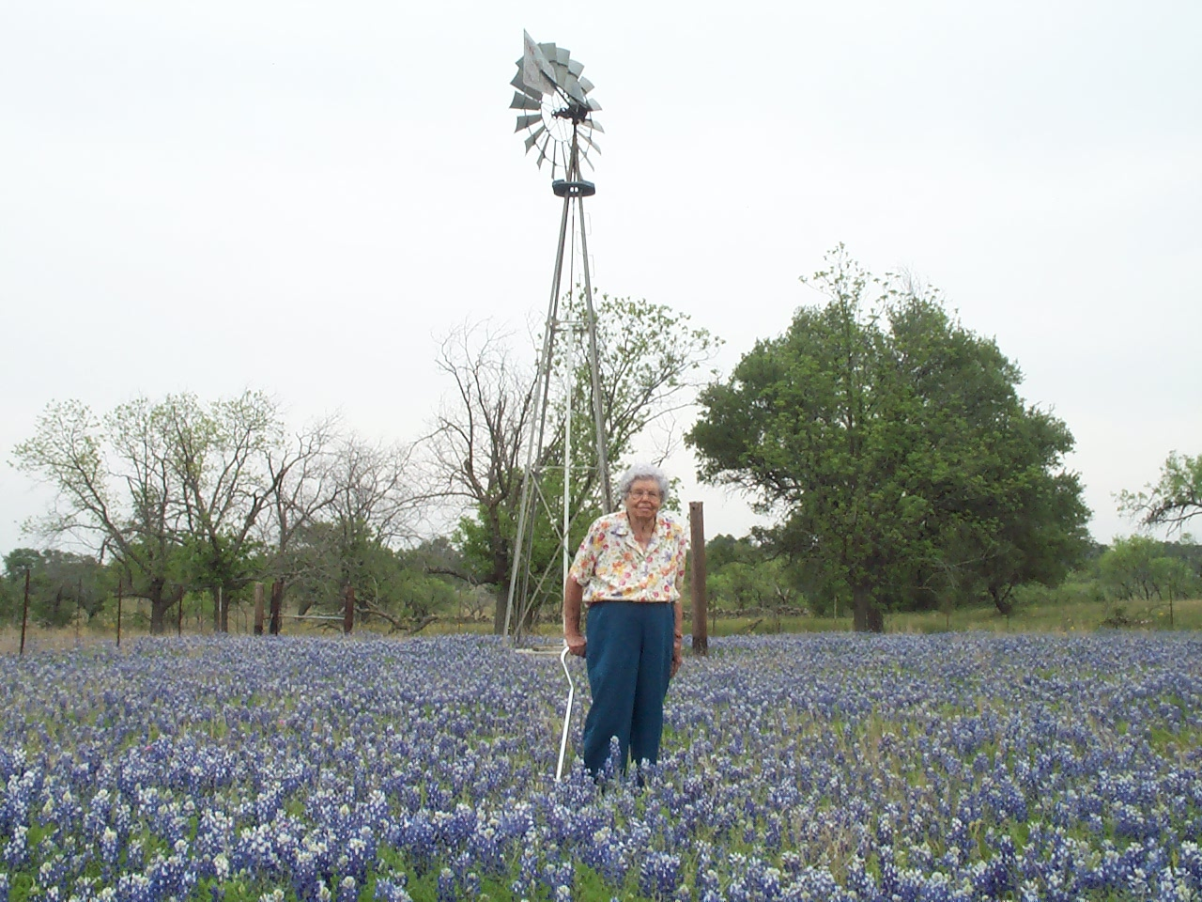

Slide 4
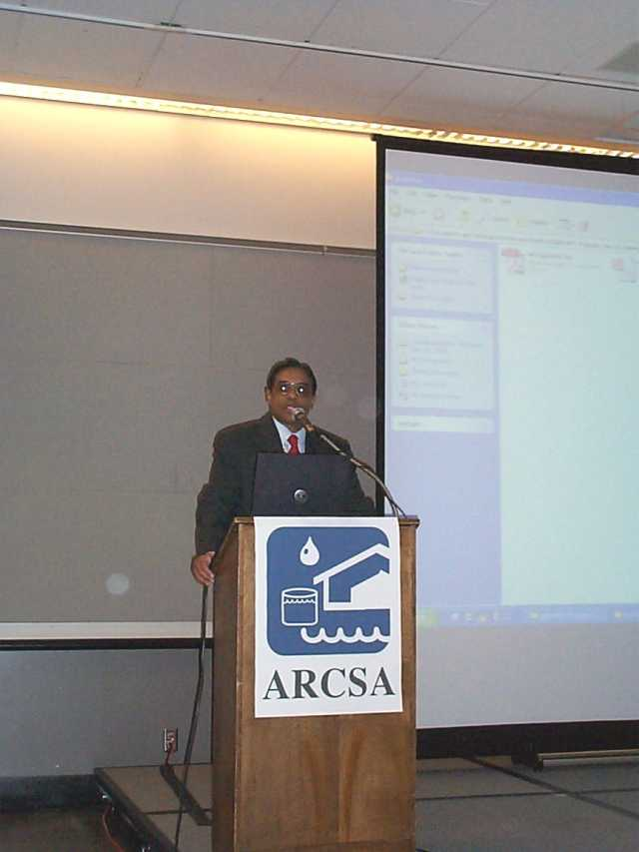
ARCSA Began in 1994
ARCSA was founded by Dr. Hari J. Krishna in Austin, Texas in 1994 to promote rainwater catchment systems in the United States.

Slide 5
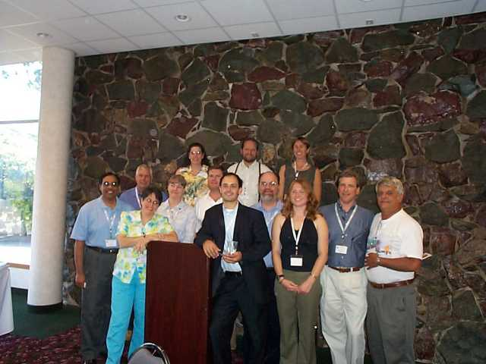
Membership consists of:
professionals working in city, state, and federal government
academia
manufacturers and suppliers of rainwater harvesting equipment
consultants, and other interested individuals.

Slide 6
The Objectives Of ARCSA Are:
1. To promote rainwater catchment systems through meetings and seminars,
2. To provide networking between people with experience in rainwater catchment systems and those who might need technical or professional assistance in developing or building such systems,
3. To provide a forum for discussion of new methods, techniques, and materials pertaining to rainwater catchment systems,
4. To develop informal publications to assist in the design and use of rainwater catchment systems, and
5. To establish acceptable treatment methods for harvested rainwater.

Slide 7
Current Officers
Tim Pope, President - Friday Harbor, WA
Dr. Dennis Lye, Vice President - Cincinnati, OH
Billy Kniffen, Treasurer - Menard, TX
Joe Wheeler, Secretary - Austin, TX
Heather Kinkade-Levario, Past President Phoenix, AZ
Terry McMains, Director-at-Large - Santa Fe, NM

Slide 8
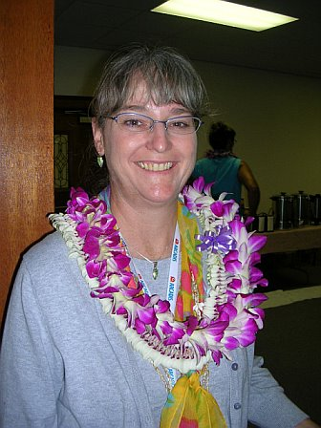
Tim Pope and Heather Kinkade-Levario Present and Past President

Slide 9
ARCSA Regional Representatives:
Central States Ramiro Ortiz, Texas
Northeast Bob Boulware, Indiana Phil Reidy, Massachusetts
Northwest Mike Broili, Washington Anitra Accetturo, Washington
Southeast Shawn Hatley, North Carolina Scott Stapleton, South Carolina
Southwest Jack Schutlz, California Marilyn Crenshaw, California/New Mexico
Pacific Jason Kerrigan, Australia Trisha Macomber, Hawaii

Slide 10
ARCSA's 2008 National Conference Santa Monica, California Tuesday-Thursday, Sept. 16-18, 2008

Slide 12
Builder will create environmentally friendly master-planned community
By M.B. Taboada AMERICAN STATESMAN STAFF Thursday, November 15, 2007
Georgetown is getting its first all-green subdivision. Green Builders Inc. is creating an 800-acre master-planned community with 2,000 houses that will be environmentally friendly and feature rain harvesting and energy-saving heating and cooling systems.
will be priced from the low $200,000s to the $500,000s.

Slide 13
Endeavor Real Estate Group LLC will seek national or local green certification for 4,500 multifamily units at the Domain in North Austin.
Rutherford West in Driftwood will be an 800-acre community, with 400 acres set aside as a conservation area.
Elm Grove in Buda, which will take two to three years to build, will have 320 green homes priced from the low $200,000s to the low $300,000s.
And the 530-acre New Sweden Community in Pflugerville, which has not broken ground, will have 1,600 homes. The project, which is expected to take six to eight years to complete, will have organic farming, a community garden and a catfish pond.

Slide 14
There are Only Three Things Certain in Texas
Death, Taxes, and another Drought
Texans use between 8 and 9 billion gallons of water per day. The aquifers are recharged at a rate of 4 to 5 billion gallons per day.
Conservation is the easiest and cheapest way to make our water use sustainable.
A breakdown of energy use by department shows that the Austin Water Utility uses 60% of the total amount of energy used by the City of Austin.

Slide 15
Reduce
Storm Water

Slide 17
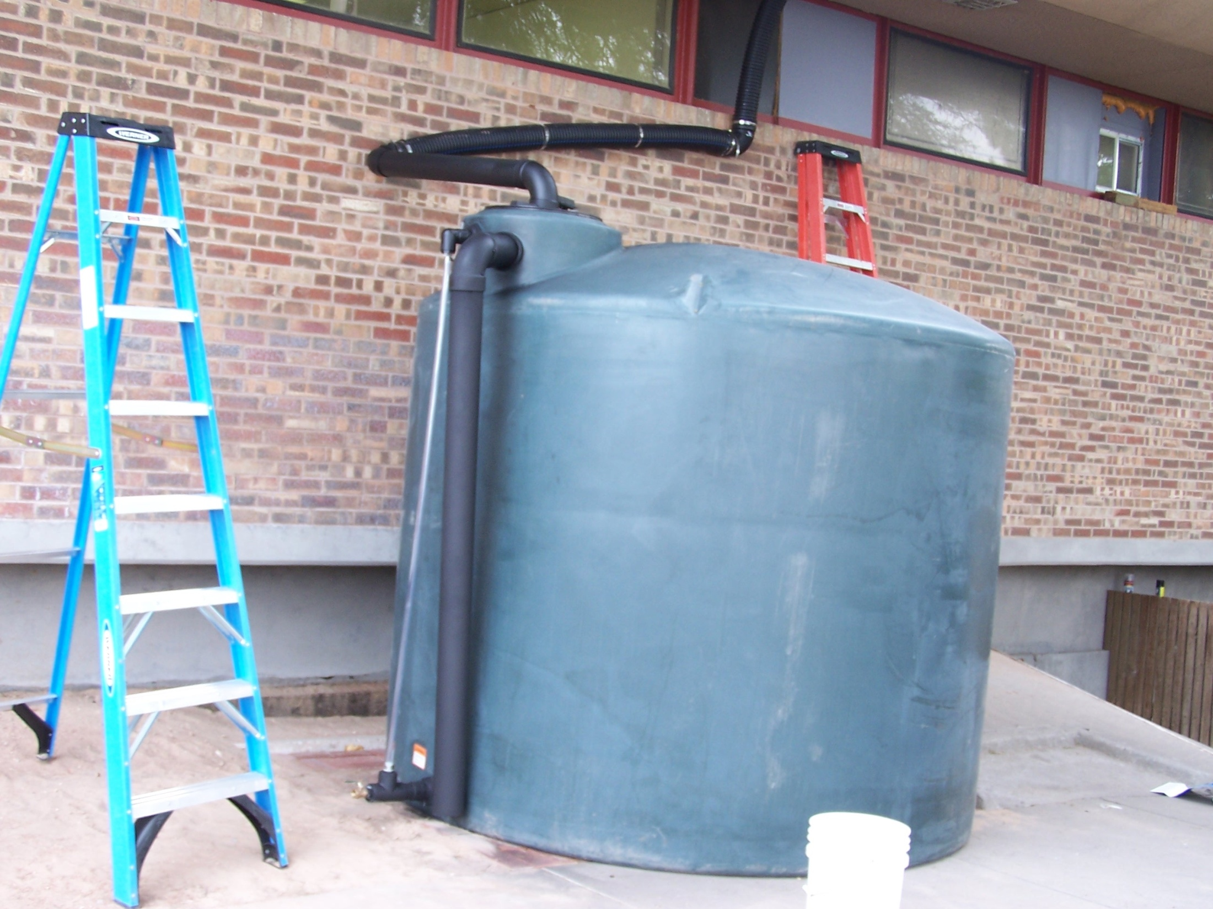

Slide 18
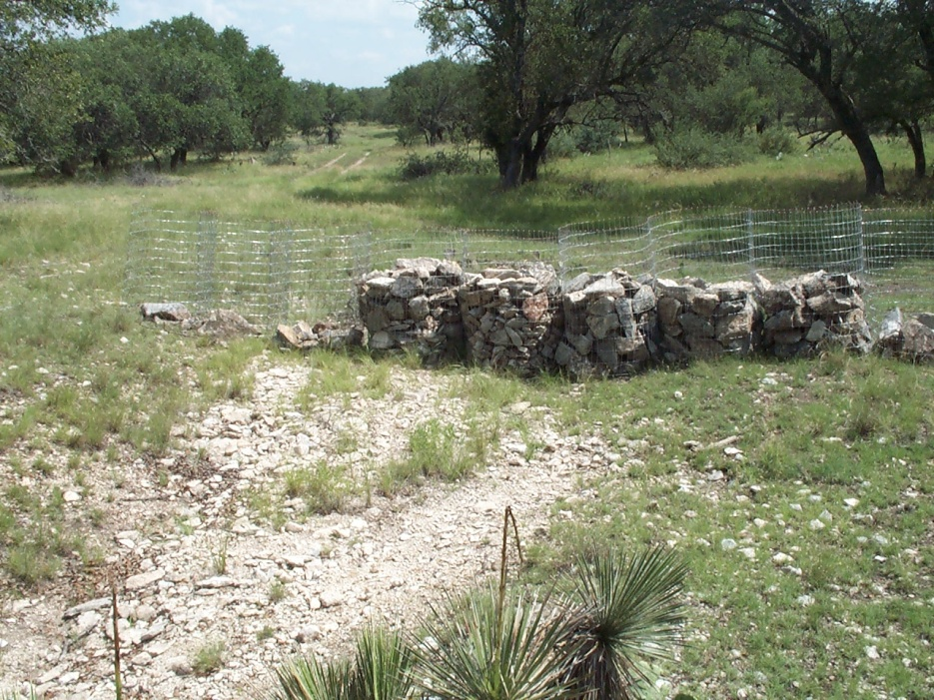
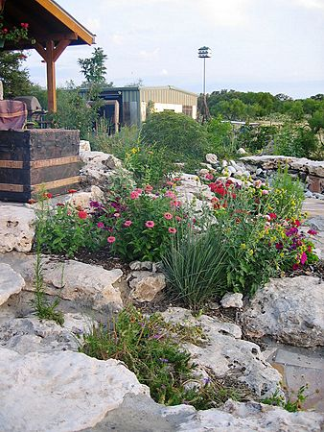
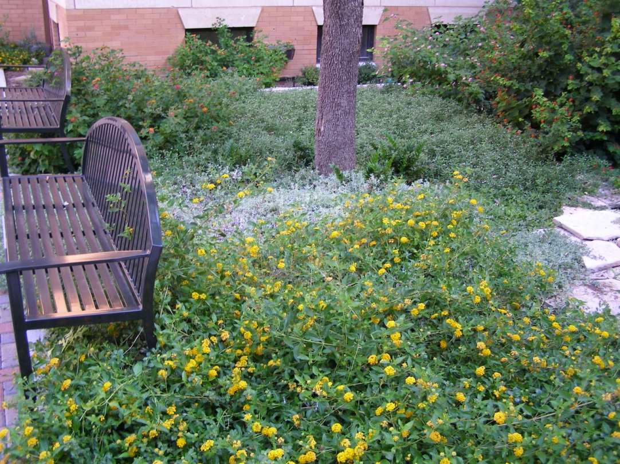
Passive Collection Spreader Dams, Stock Tanks, Ripping, Berms and Basins
Every Raindrop is Important
Notes:
The idea of passive collection is to reduce runoff and put more water into the ground so it can be used by plants or recharge aquifers. Designing the landscape to hold or slow water movement down reduces storm water and increases the bank of water available for plants.

Slide 19
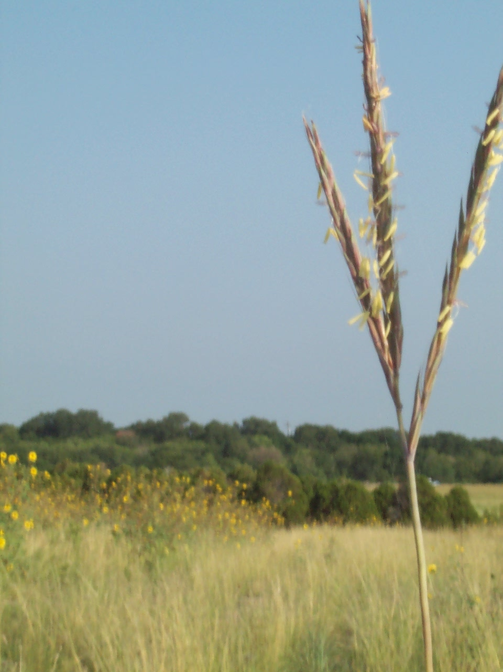
Climax Grass Species
Little Bluestem
Big Bluestem
Yellow Indiangrass
Switchgrass
Sideoats Grama

Slide 20
1/3 of Root Die Annually

Slide 21
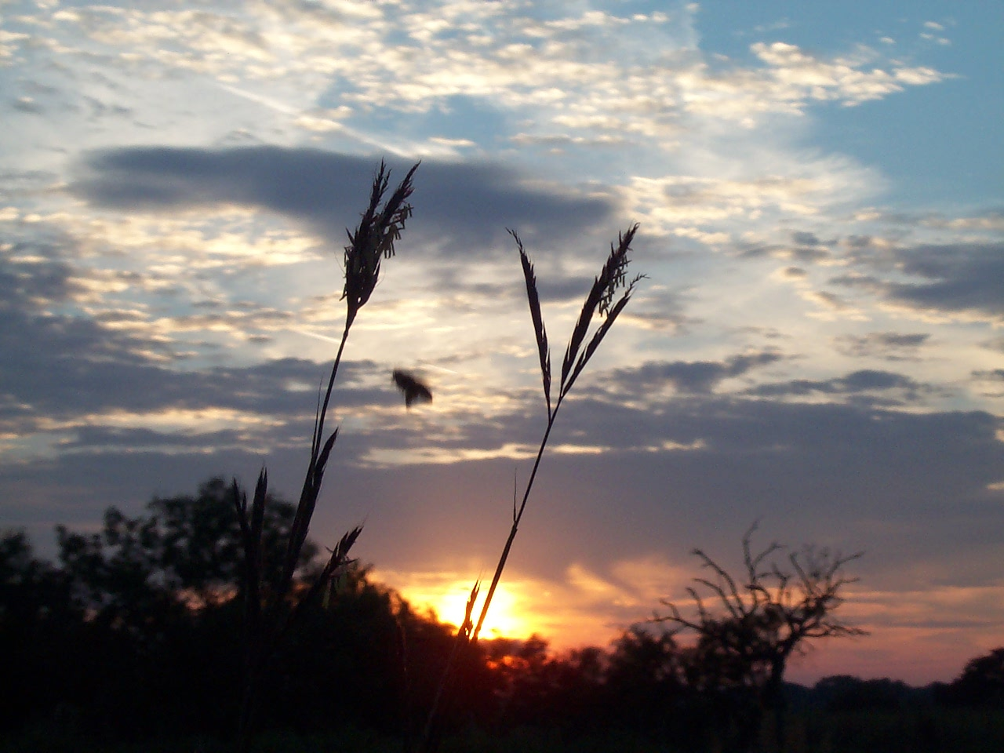
Big Bluestem

Slide 22
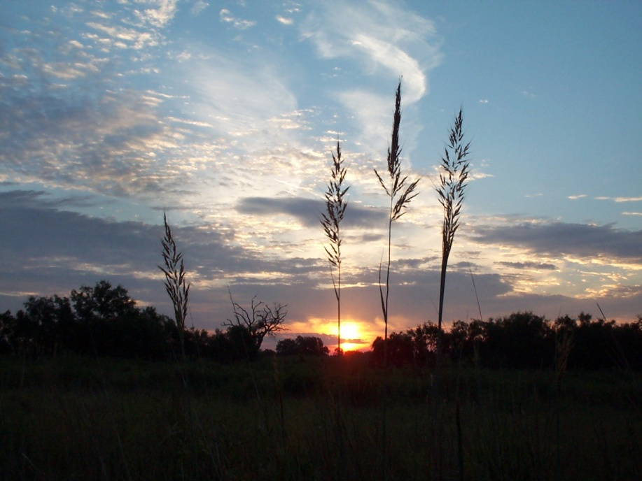
Yellow Indiangrass

Slide 23
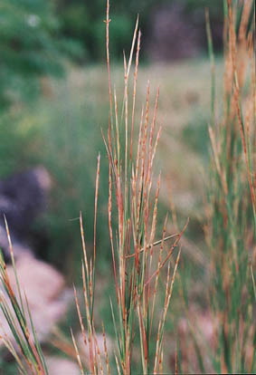
Little Bluestem

Slide 24
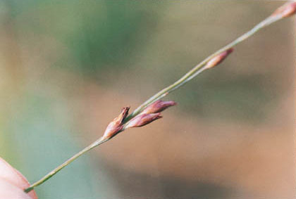
Switchgrass

Slide 25
“The nation behaves well if it treats the natural resources as assets which it must turn over to the next generation increased and not impaired in value.” - Teddy Roosevelt

Slide 26
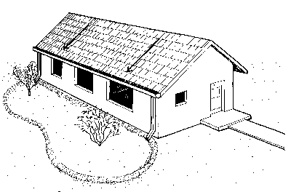
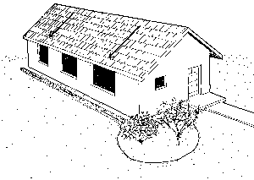
Rain Gardens
Notes:
Rain Gardens are new for Texas. However they are being used in other states to catch water running off the house and/or yard so that none leaves your property. They are designed to have a level, flat bottom and hold up to a 2 or 3 inch rainfall event and shallow enough to have the water infiltrate the soil with-in 24 hours so there is no mosquito problem.
The plants in a rain garden need to be able to utilize the increased rainfall.

Slide 27
Rain Gardens
Notes:
Here the picture shows the garden capturing rainfall on a level but shallow area.

Slide 29
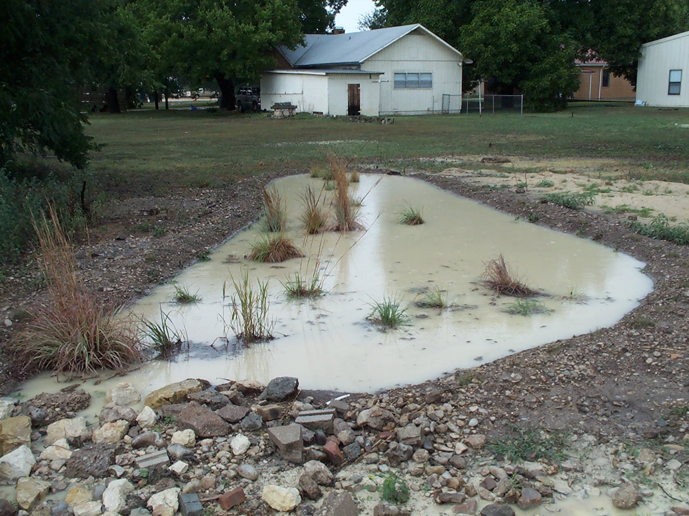
Menard Library

Slide 30
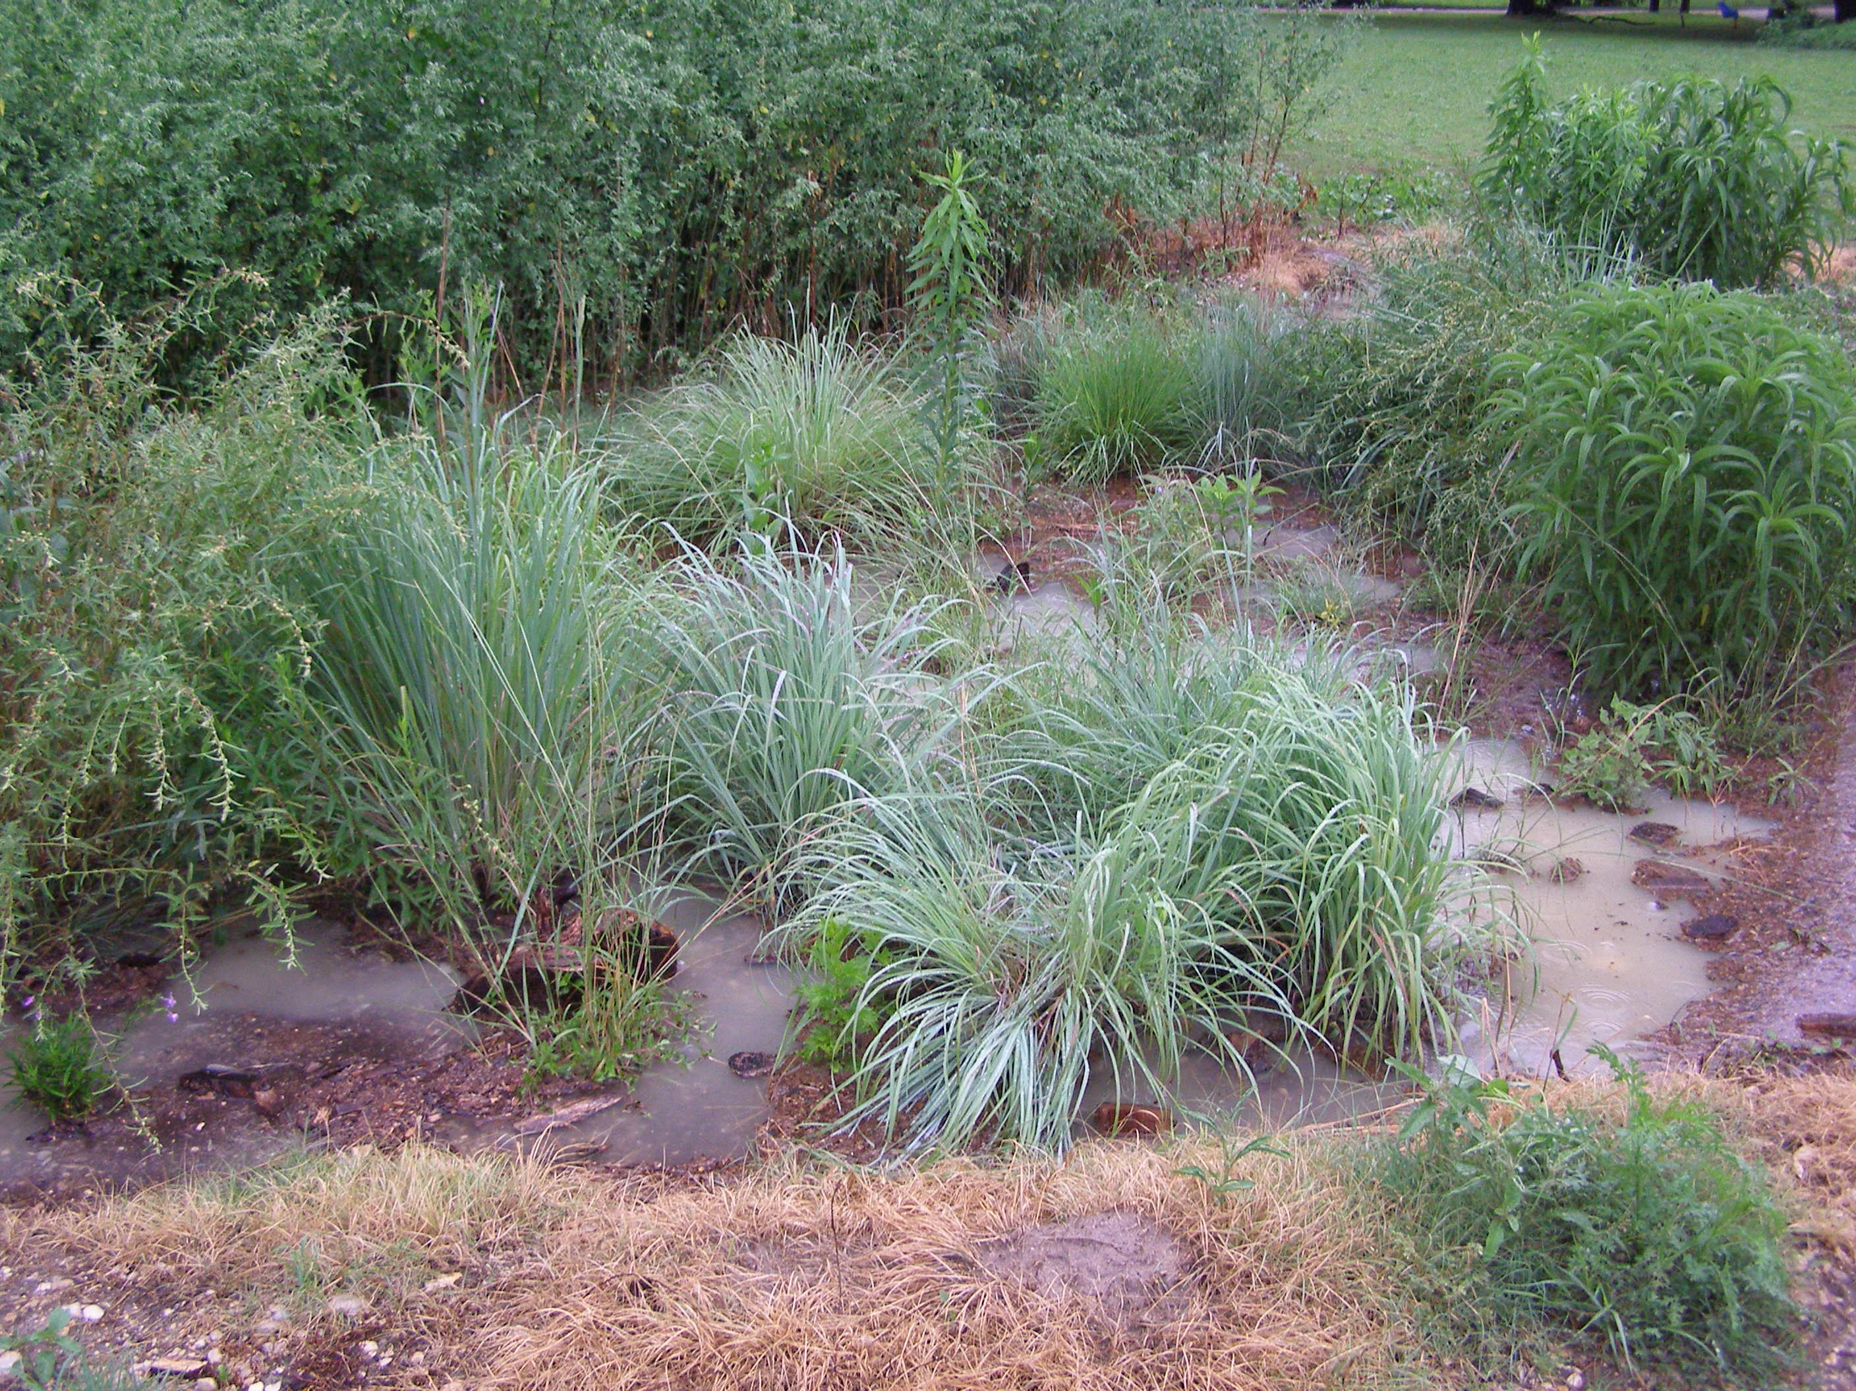

Slide 31
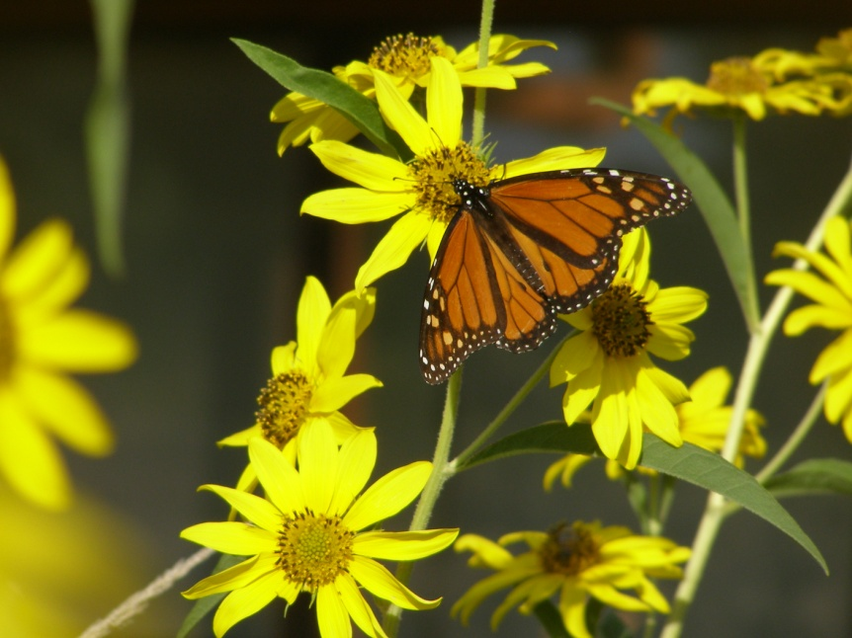

Slide 32
A Kansas City Metropolitan Initiative
To establish the Kansas City Area as a leader in water quality
To engage citizens in practical “backyard” solutions for water quality improvement
3 ½ Year initiative to install 10,000 rain gardens in 2006-07-08

Slide 33
From Rain Barrels

Slide 34
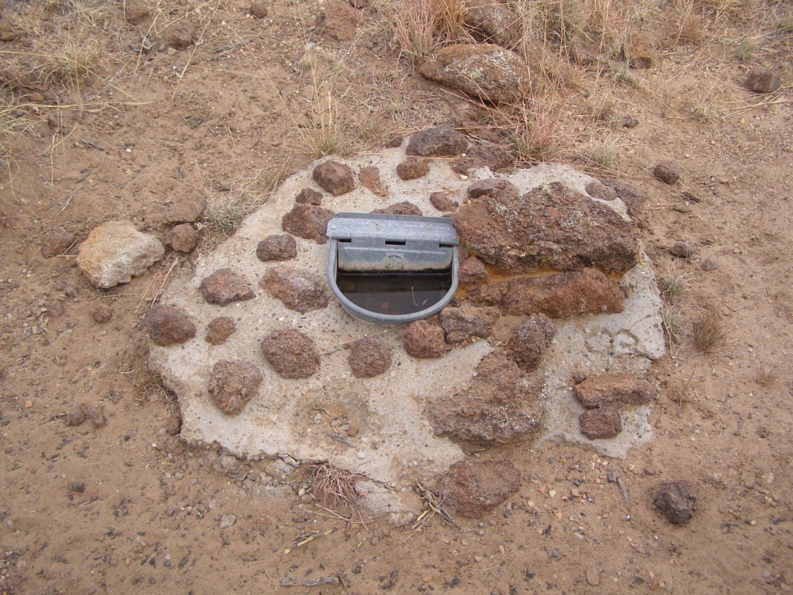
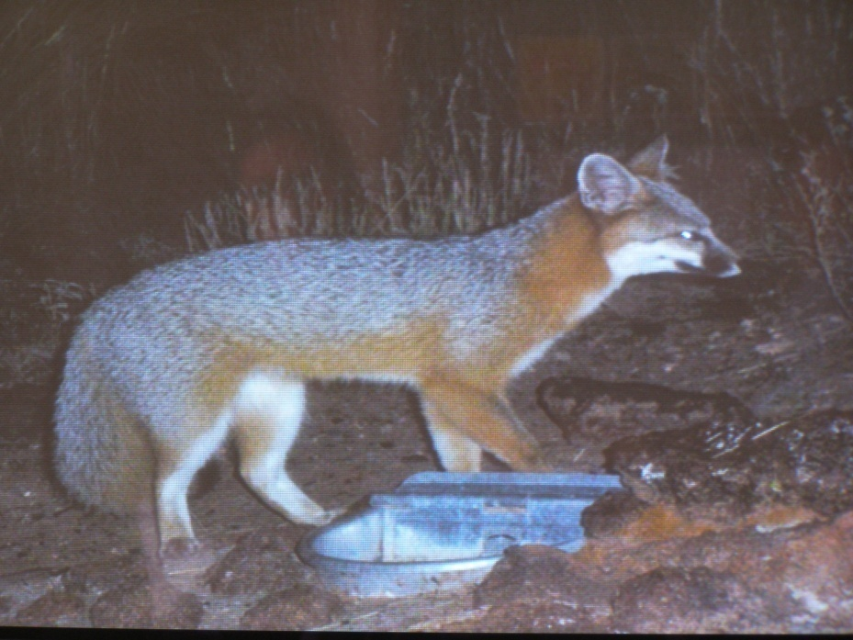
Wildlife

Slide 35
Landscape Collection Systems

Slide 36
In-Home Use

Slide 37
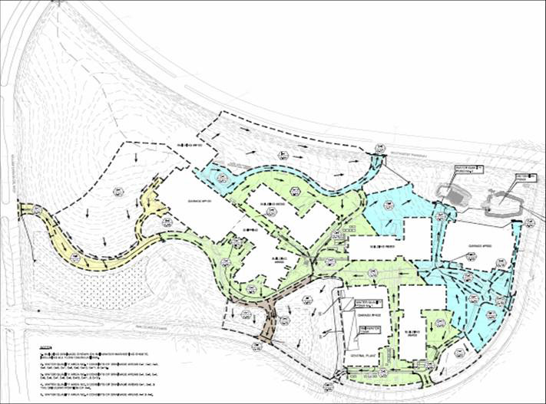
Large Commercial Installations
Each building on the Lone Star site will have specially designed roofs that will collect rainwater into a series of cisterns spread throughout the campus. Collected rain water will be used for irrigation, the additional collected rainwater will be used to help cool the buildings

Slide 38
AMD Lone Star
AMD is spending approximately $11.5 million on innovative environmental measures
Each building on the Lone Star site will have specially designed roofs that will collect rainwater into a series of cisterns spread throughout the campus.
In addition, AMD is seeking LEED (Leadership in Energy and Environmental Design) Gold certification by the U.S. Green Building Council. This level of sustainable design has only been achieved by one building in all of Texas

Slide 39
3 Acre Building 5 Acre Parking Lot

Slide 40
How Much Runoff Is There?
Stormwater runoff from the building is 77,546 gallons per inch of rainfall or 2,171,299 gallons per year.
Stormwater from of the parking lot is 136,232 gallons per inch of rainfall or 3,814,492 gallons per year.
Total: Stormwater flooding down Leon Creek is 5,985,791 gallons or 19.25 acre feet per year.

Slide 41
Boerne Champion High School will have it’s own rainwater harvesting system, The new system will gather over 4.5 million gallons of water from parking lot run-off, roof gutters and air-conditioner condensation. This water will be stored in elevated tanks and underground storm drains. School to open in fall 2008.

Slide 42
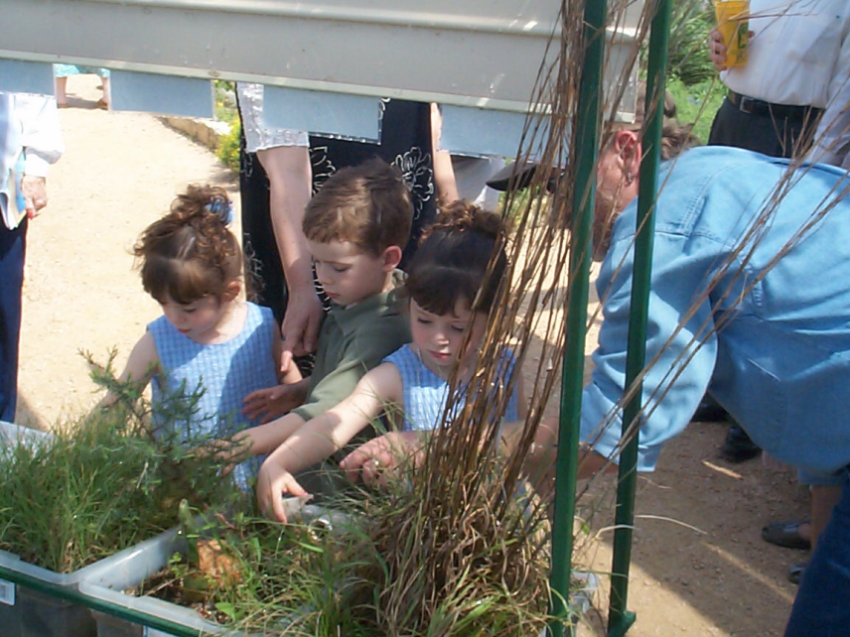
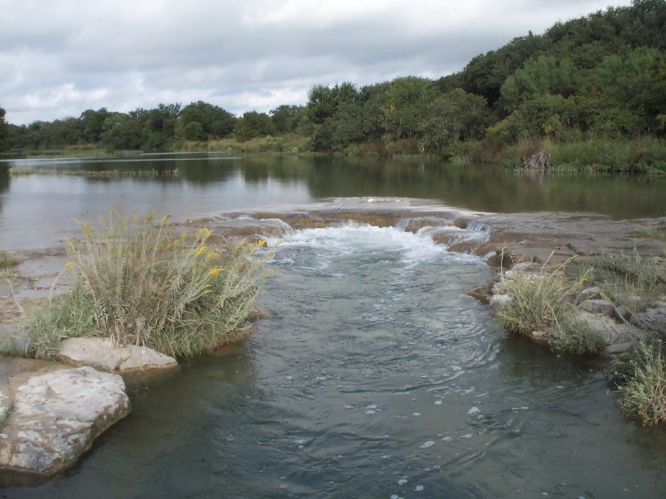
All Rainfall Is Valuable
Notes:
The first point to get across is that all rainfall is valuable and as good Master Gardeners and stewards of our natural resources, managing rainfall is the first key to good stewardship.
Rainfall captured on the land recharges aquifers, is filtered by vegetation and runs off slowly carrying very little sediment. Rainfall infiltration into the soil provides plants with a bank of water. Adding compost to the soil improves the soil’s water holding ability and mulch on the surface cools the soil surface, reduces evaporation and slows water runoff.
The impact of capturing rainfall, improves aquifer recharge, helps plants to grow which in-turn provides for insects, animals and birds (and humans) and all the other creatures in the soil we can not see.

