Slide 1
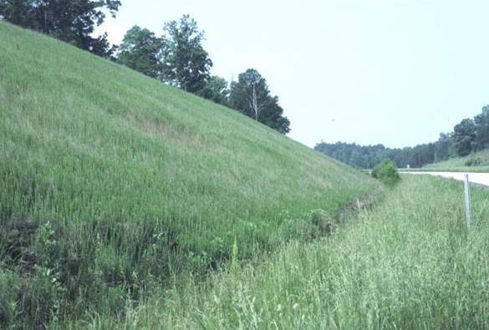
Vegetative Practices for Erosion and Sedimentation Control
Level IA: Fundamentals Seminar
Education and Training Certification
Requirements for Persons Involved with Land Disturbing Activities
Issued September 2005

Slide 2
Objective
Understand the role of vegetative measures and how they are selected, installed, and maintained
Notes:
Self-explanatory

Slide 3
Key Points
Excess soil erosion is not inevitable
A system of measures is needed
Vegetative measures provide many benefits
Site characteristics determine selection
Each measure has many components
Maintenance is required
Notes:
Self-explanatory

Slide 4
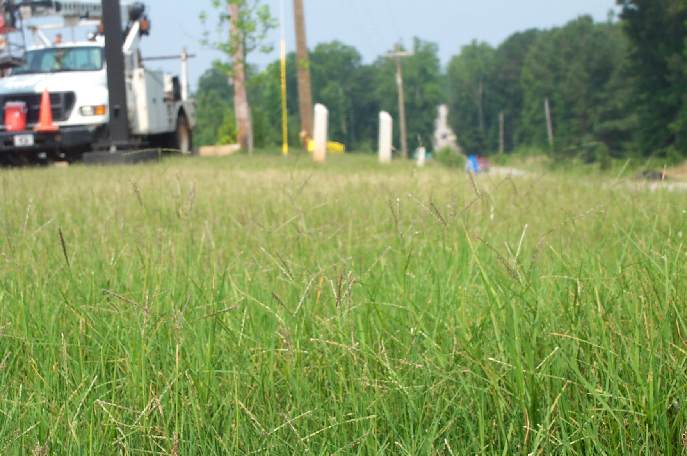
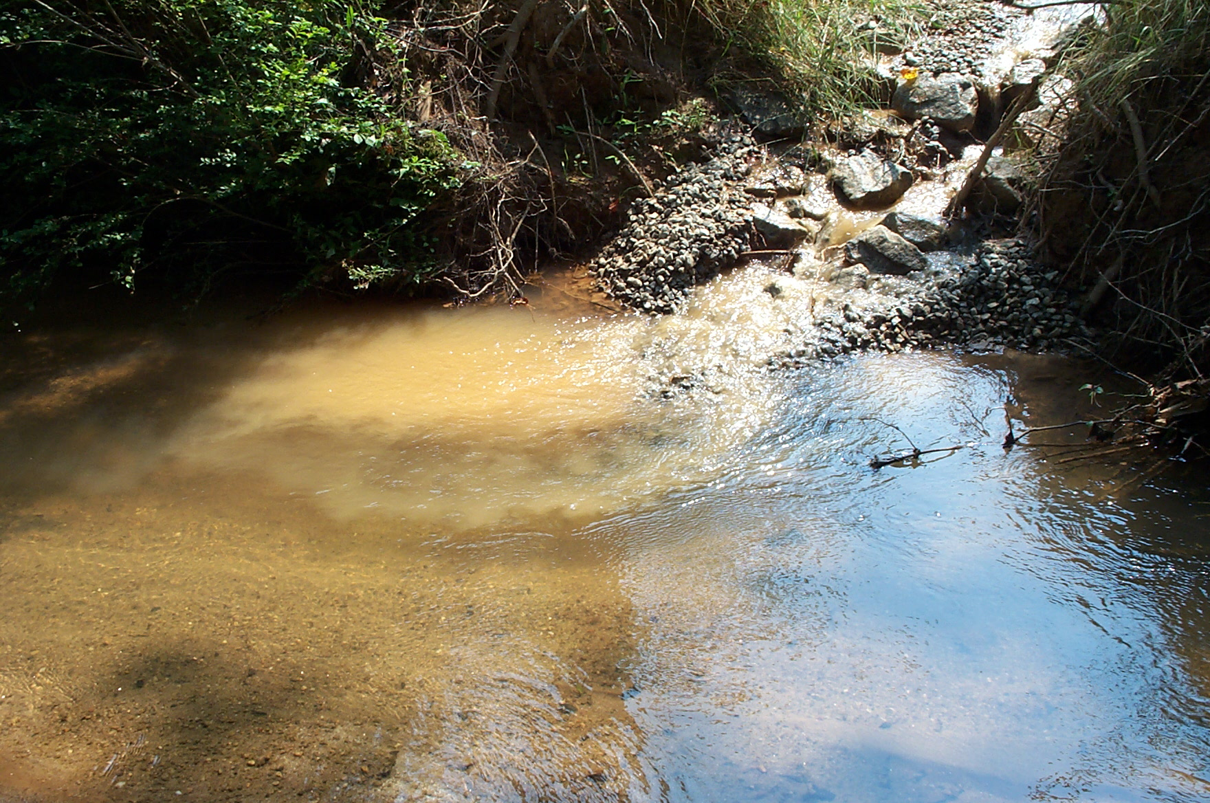
Erosion and Sediment Control
Very important to all of us
All benefit if successful
If not done properly:
  polluted streams
  project delays
  increased construction costs
  $$$ for cleanup
  additional time needed to re-do measures
  additional problems onsite and offsite
Notes:
Soil erosion is a natural process and occurs with all land uses.
Soil erosion and sedimentation is greater on construction sites than on any other land use.
Reducing soil erosion and sedimentation on construction sites is essential to protect our water and other natural resources.

Slide 5
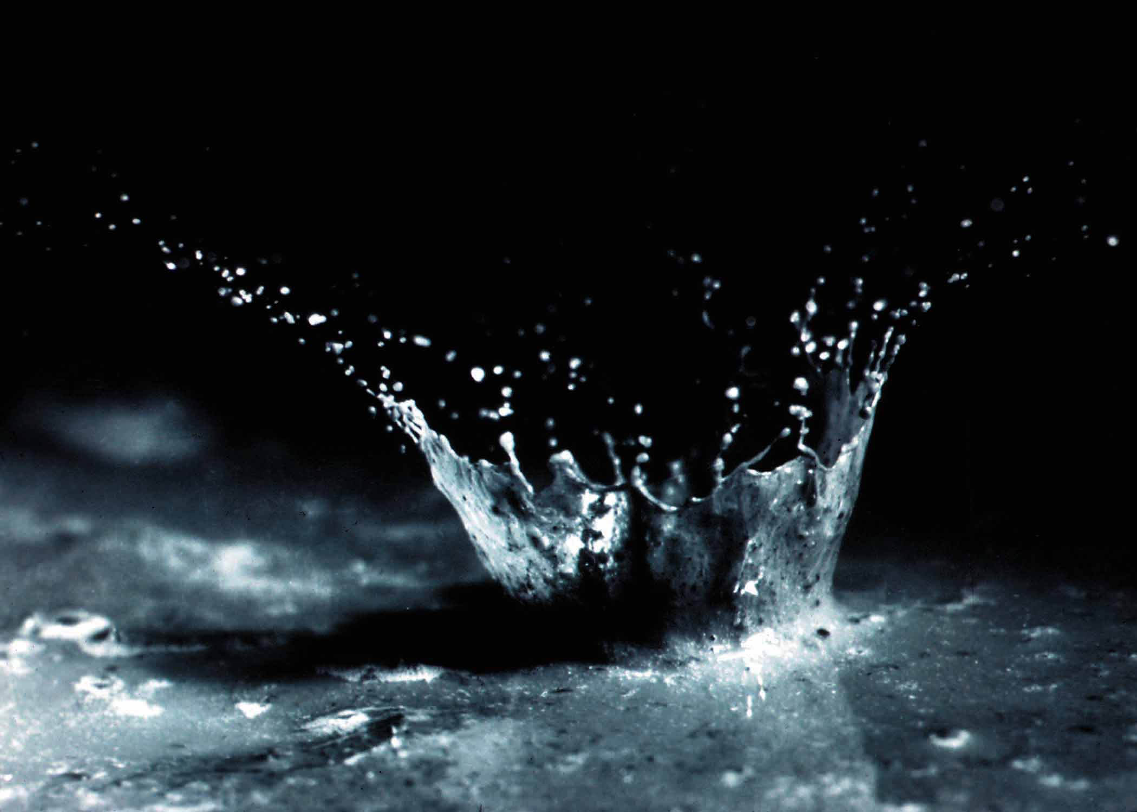
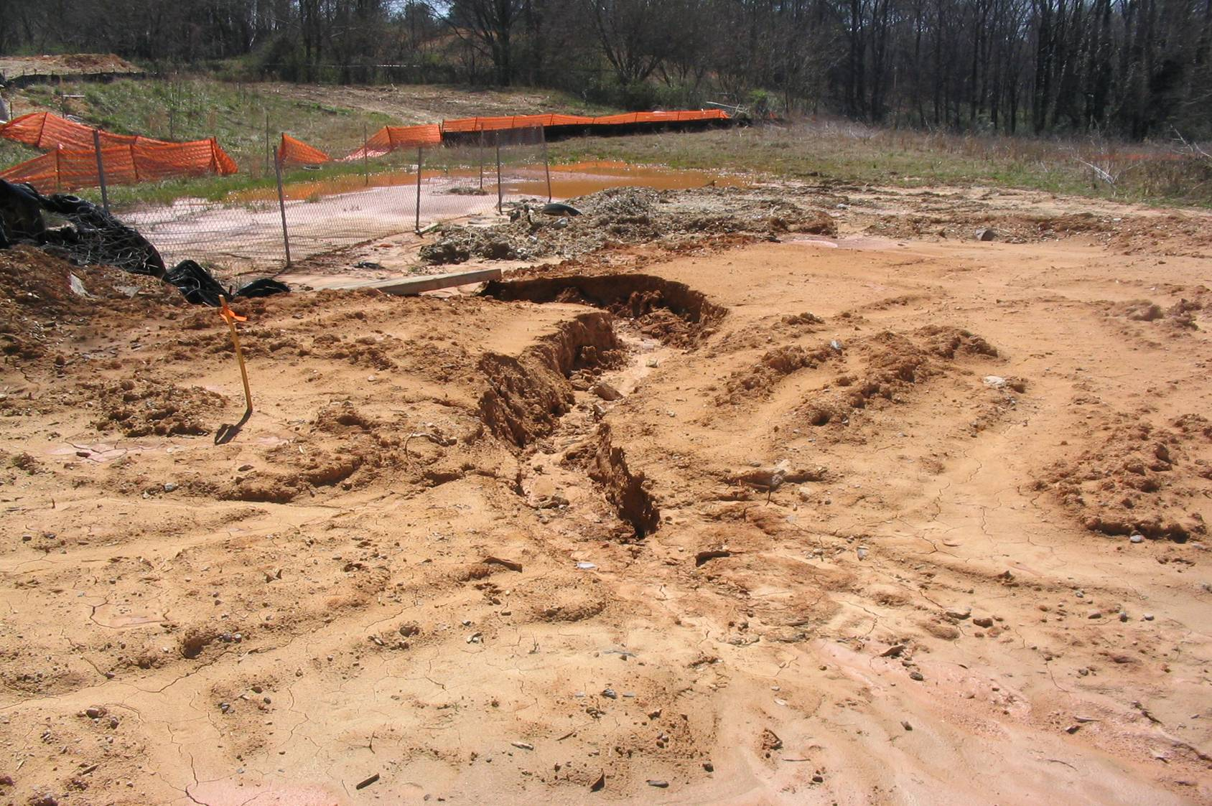
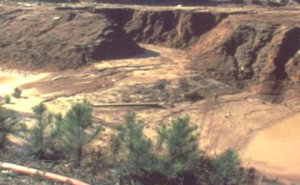
Erosion or Sediment Control?
Soil Erosion
Soil particles are detached and transported
Occurs on all land
Sedimentation
Deposition of eroded soil
Sediment is #1 non-point source pollutant in U.S.
Notes:
They are different processes.
The main goal is to prevent soil erosion. Without soil erosion, there would be no sedimentation.
Soil erosion is easier to control.
Sediment control is more difficult and much more expensive.

Slide 6
Effective E&SC requires a System
One measure does not solve all erosion and sediment control problems
Vegetative and structural measures are needed
  Both have important and different roles
  They complement and aid each other
Notes:
Vegetative, structural, and management measures are needed in the system.

Slide 7
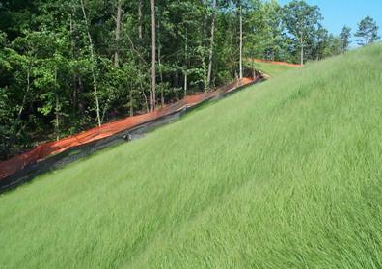
Benefits of Vegetation in E&SC
Intercepts raindrops
Reduces detachment
Slows runoff
Cleans runoff
Reduces runoff
Increases infiltration
Protects structures, rivers, streams, and ponds
Reduces maintenance of sediment basins
Improves aesthetics, soil quality, and wildlife habitat
Notes:
Vegetation provides many benefits.
The main benefit is to intercept the raindrops and prevent them from causing detachment, the first step in the soil erosion process.

Slide 8
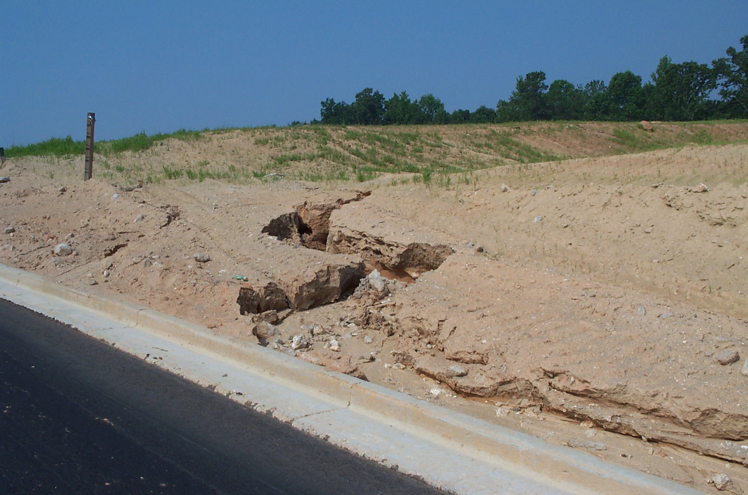
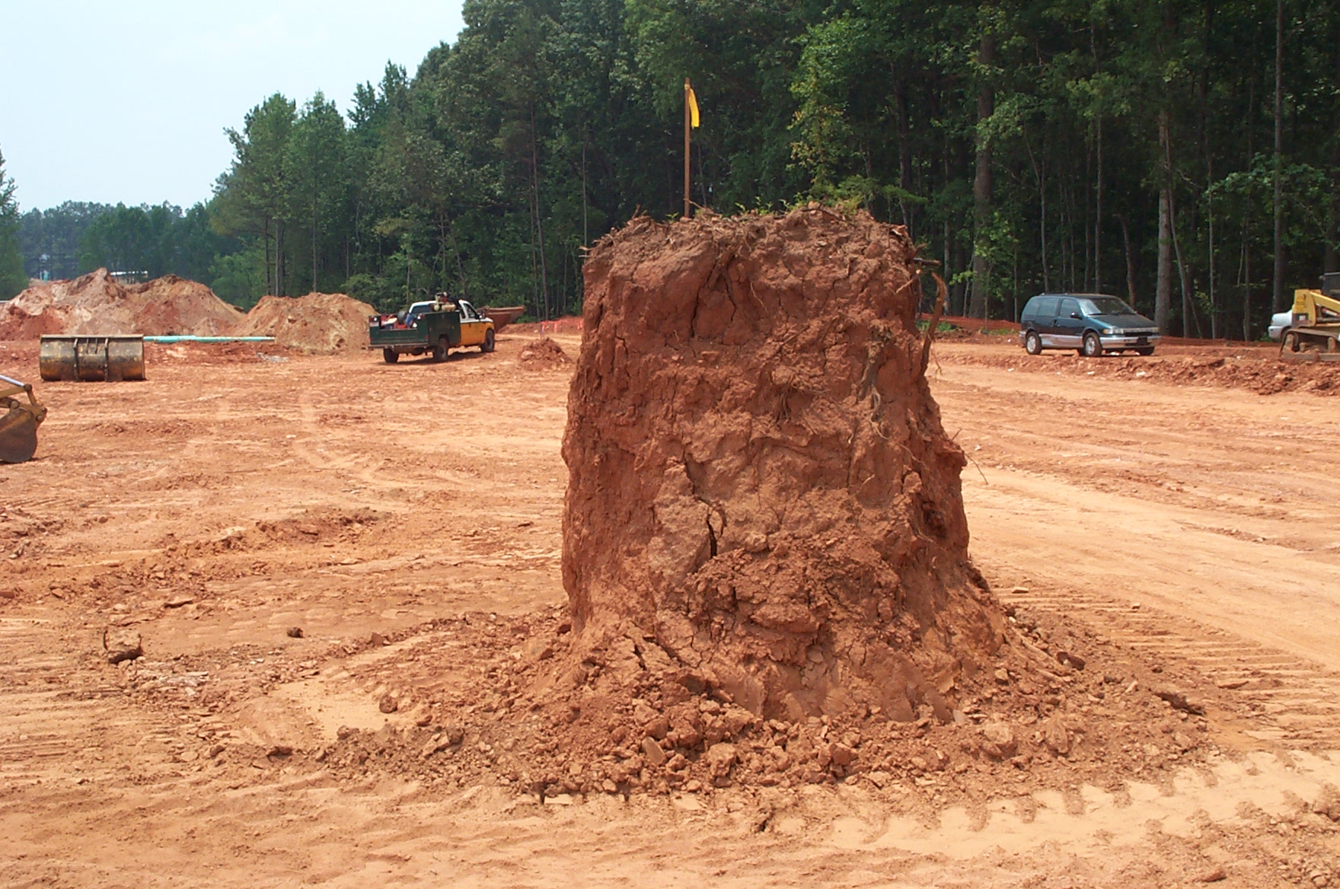
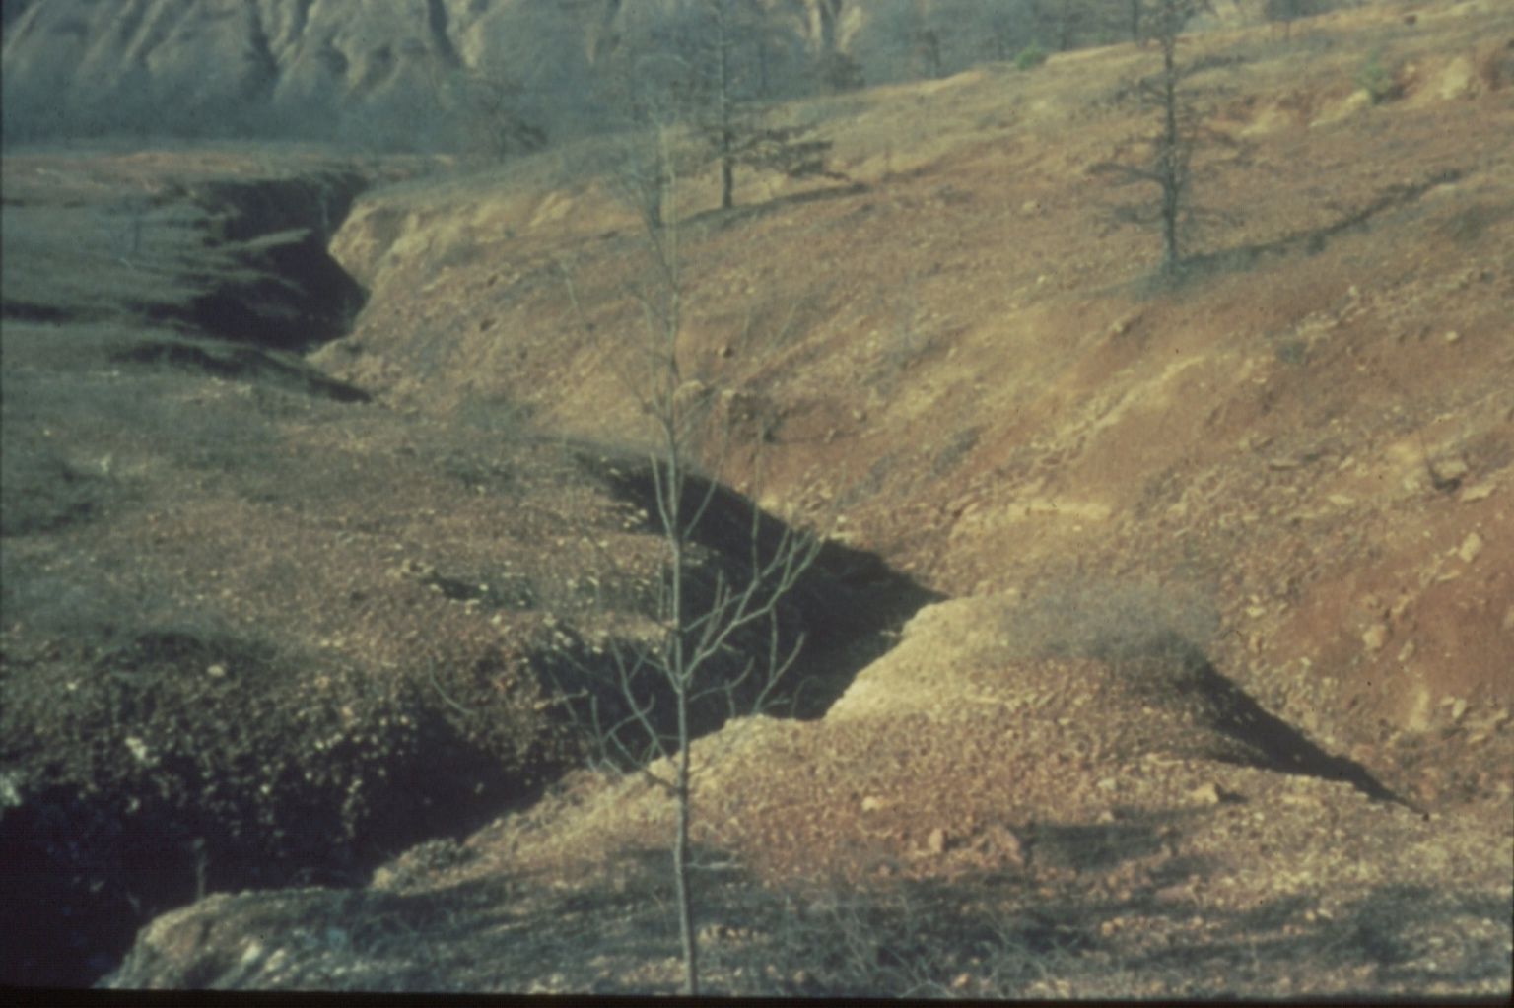
Construction Sites are inhospitable for vegetative growth
    Topsoil is removed
    Steep slopes
    Low soil moisture
    Low soil fertility
    Acidic soils
    Concentrated flow
    Compacted soils
Intensive treatment is needed.
Pasture planting methods are not effective.
Notes:
Most times we are not dealing with flat, fertile land.
Intensive planning, application, and maintenance are needed.

Slide 9
Vegetative Practices
“Manual for Erosion and Sediment Control in Georgia”
Bf Buffer Zone
Cs Coastal Dune Stabilization
Ds1 Mulching Only
Ds2 Temporary Seeding
Ds3 Permanent Seeding
Ds4 Sodding
Du Dust Control
Mb Matting and Blankets
Pm Polyacrylamide
Sb Streambank Stabilization
Tb Tackifiers and Binders
Notes:
These are the vegetative measures that are listed in the “Manual for Erosion and Sediment Control in Georgia” and the “Field Manual”.
We will briefly discuss each of them.

Slide 10
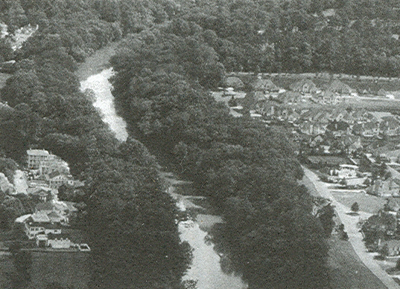
Buffer Zone
Undisturbed or planted vegetative strip
General Buffer – surround sites
Vegetated Stream Buffer – border streams
Bf
Filter sediment & other pollutants
Reduce runoff velocities
Stabilize stream banks
Provide flood protection
Improve fish/wildlife habitat
Reduce construction noise
Improve aesthetics
Notes:
Buffers are very important in protecting our natural resources.
Stream buffers and general buffers provide many benefits.

Slide 11
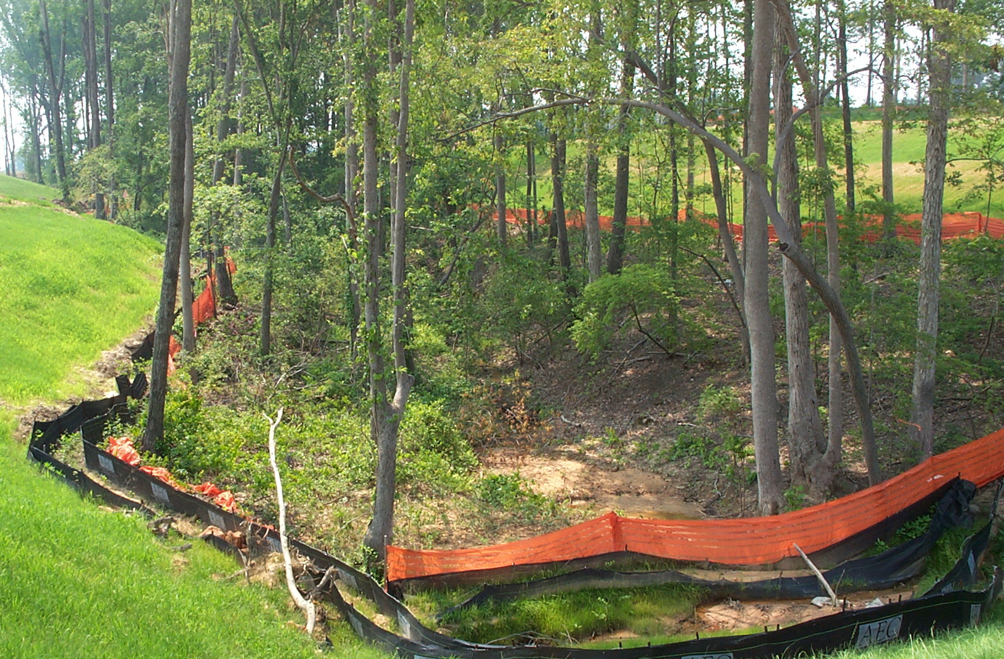
Buffer Specifications are Based on
Site Conditions
  Purpose
  Topography
  Watershed size
  Stream size
  Trout stream
  Maintenance
Notes:
As with all measures, the design criteria and minimum requirements for a specific project are based on site characteristics.

Slide 12
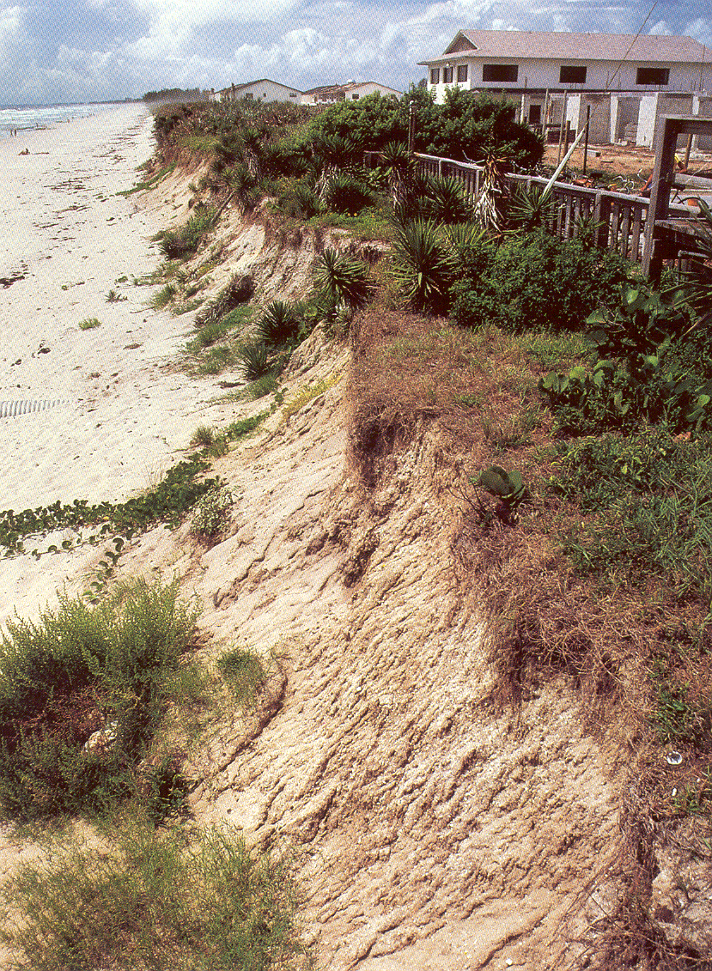
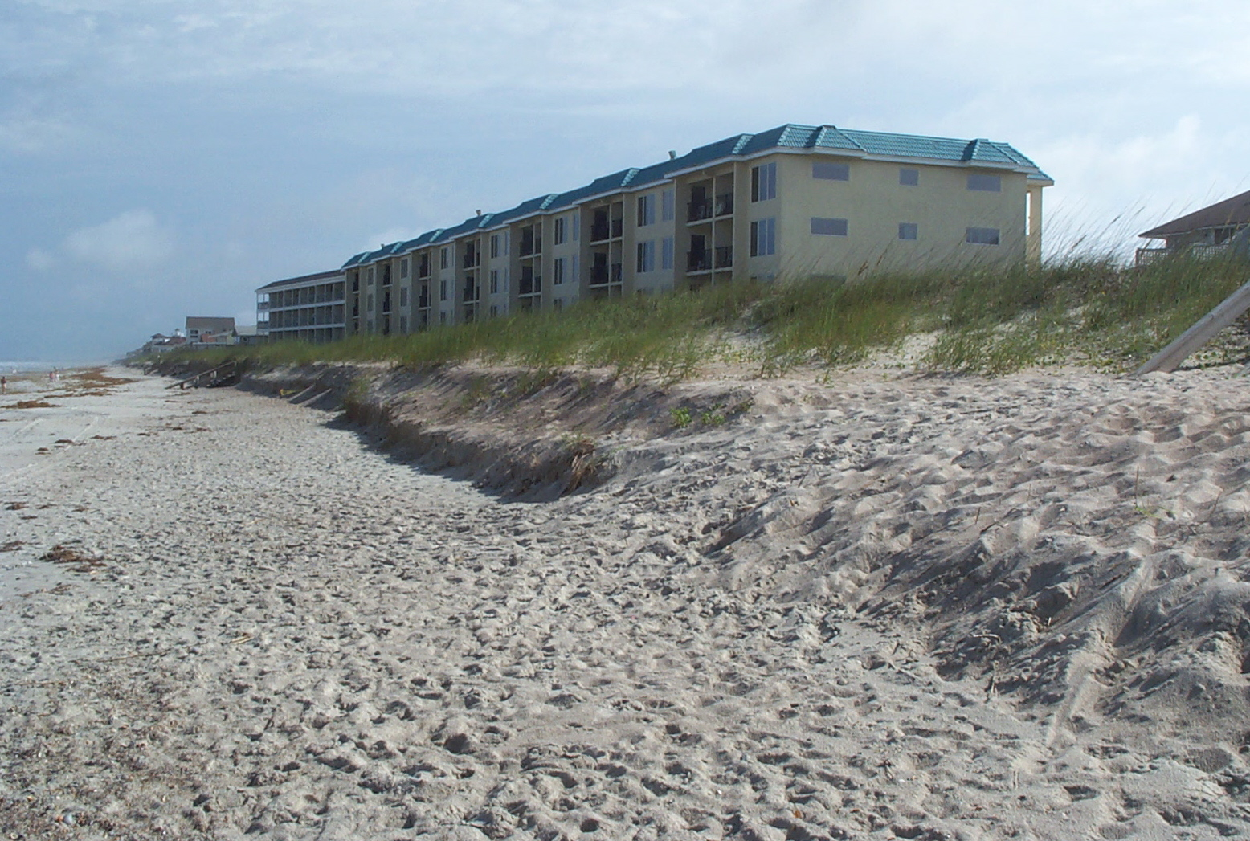
Cs
Coastal Dune Stabilization (with Vegetation)
Planting vegetation on
denuded, constructed,
or re-nourished dunes
Permits (local/state/federal)
Fertilization
Planting
Irrigation
Sand fences
Maintenance
Protection from traffic
Notes:
Coastal dunes are very fragile areas.
As with all measures, there are several important components.

Slide 13
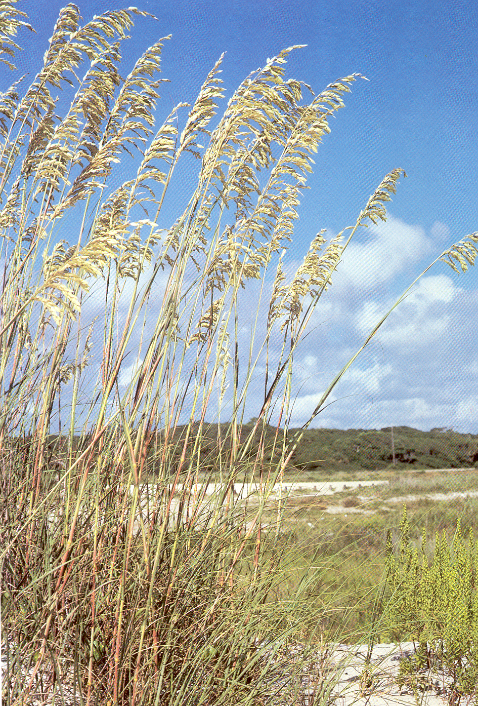
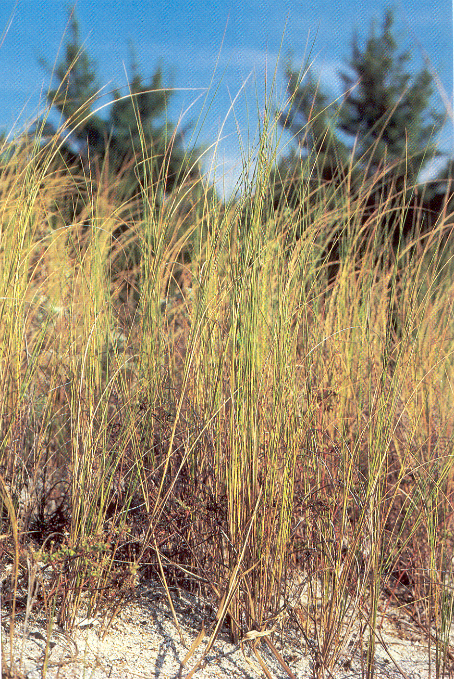
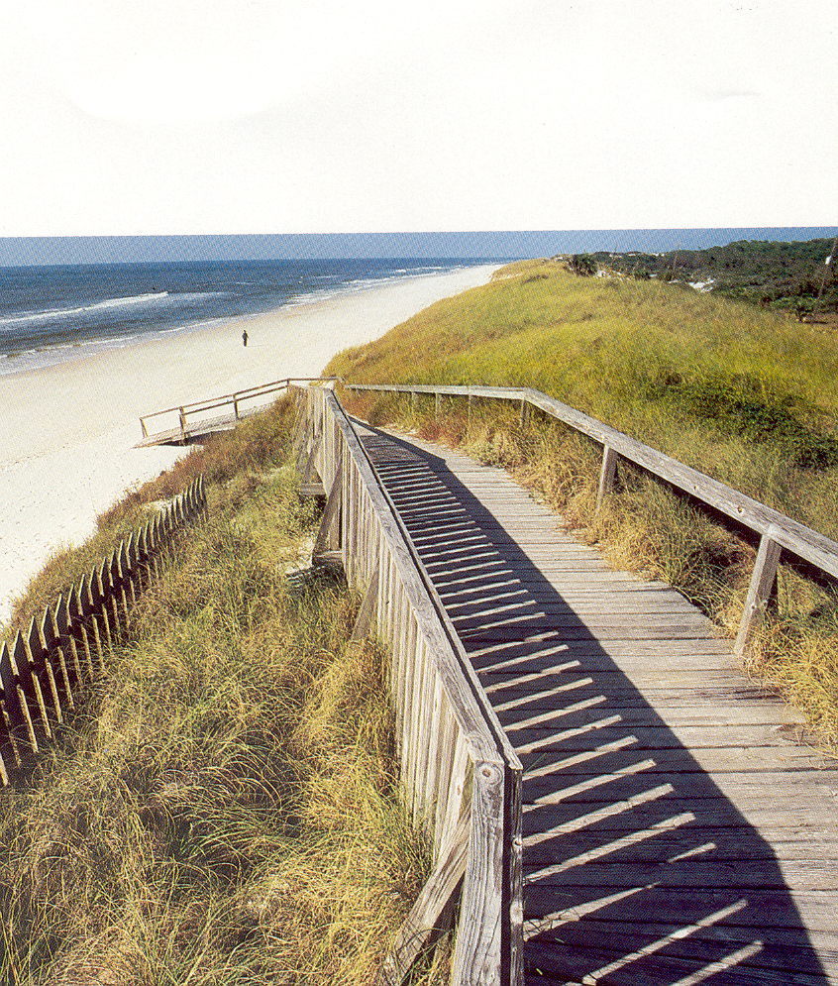
Sea Oats
Cordgrass
Cross Walk
Notes:
Many native species of plants can be used.
It is very important to eliminate human and vehicular traffic on dunes.

Slide 14
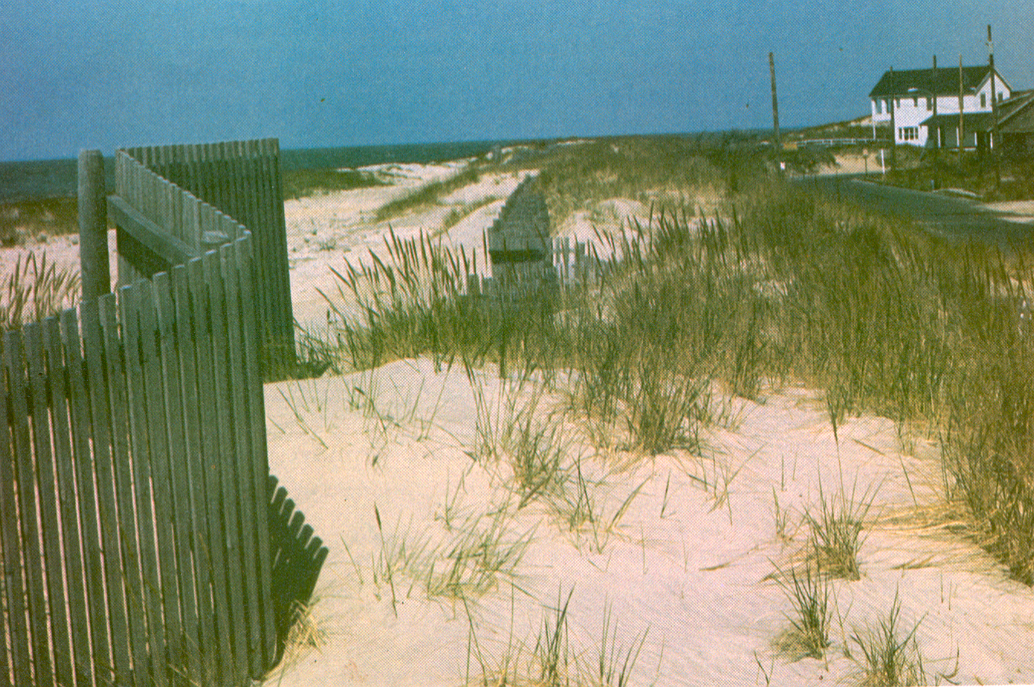
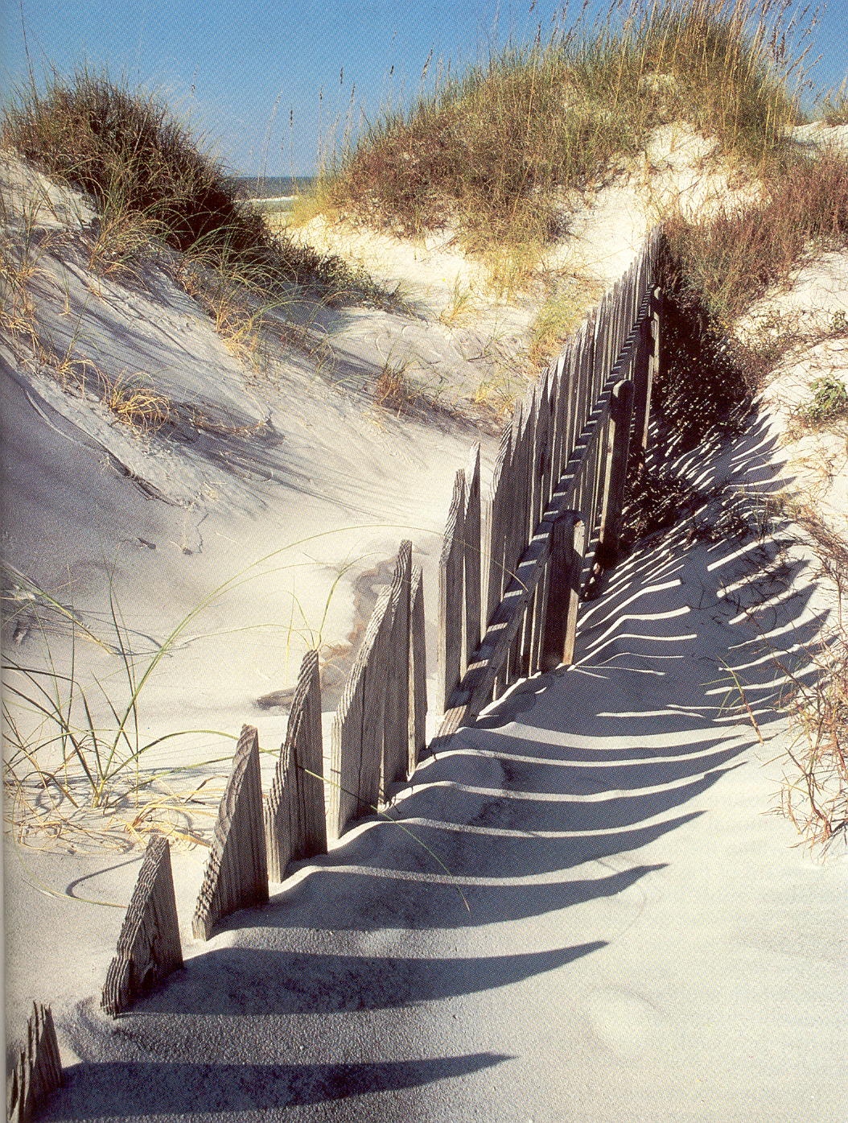
New Sand Fence
1 Year Old
Sand fences help build higher dunes by trapping sand.
Notes:
Once the sand reaches the top of the fence, another fence can be added to build additional dune height.
Once the appropriate height is reached, the dune can be vegetated.

Slide 15
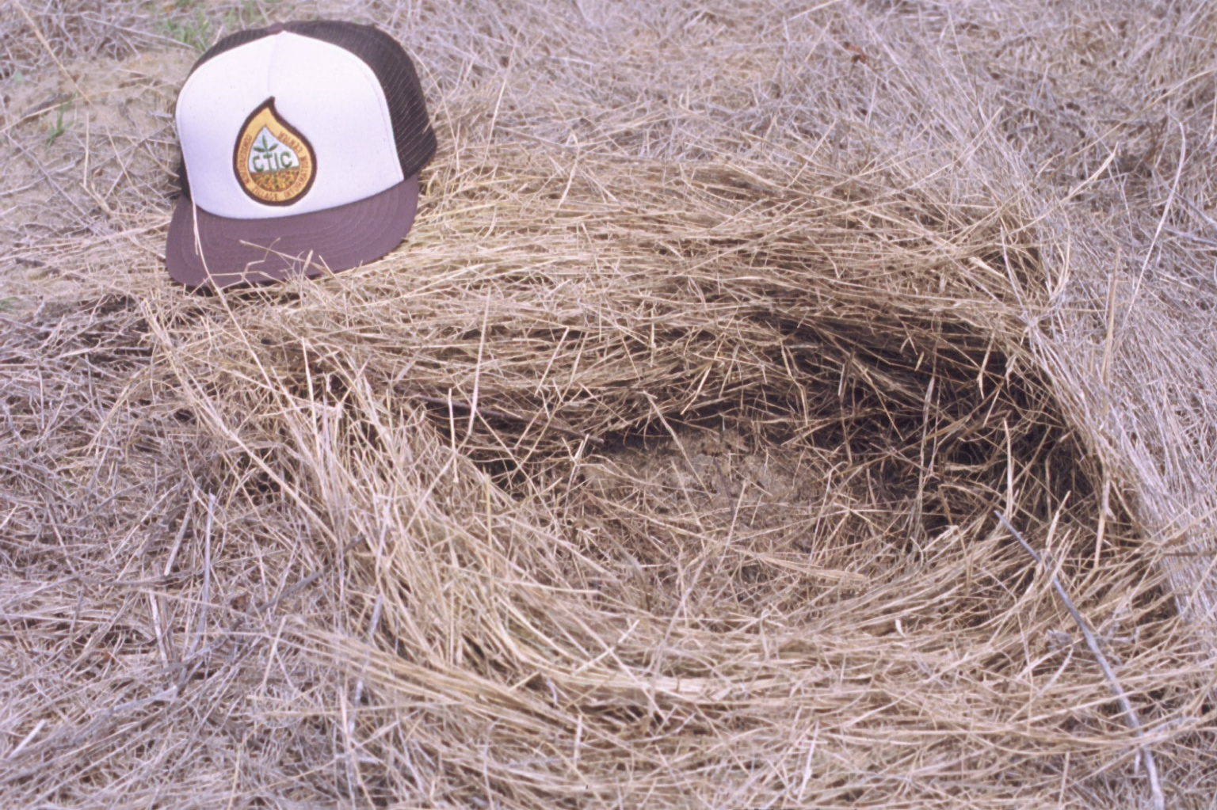
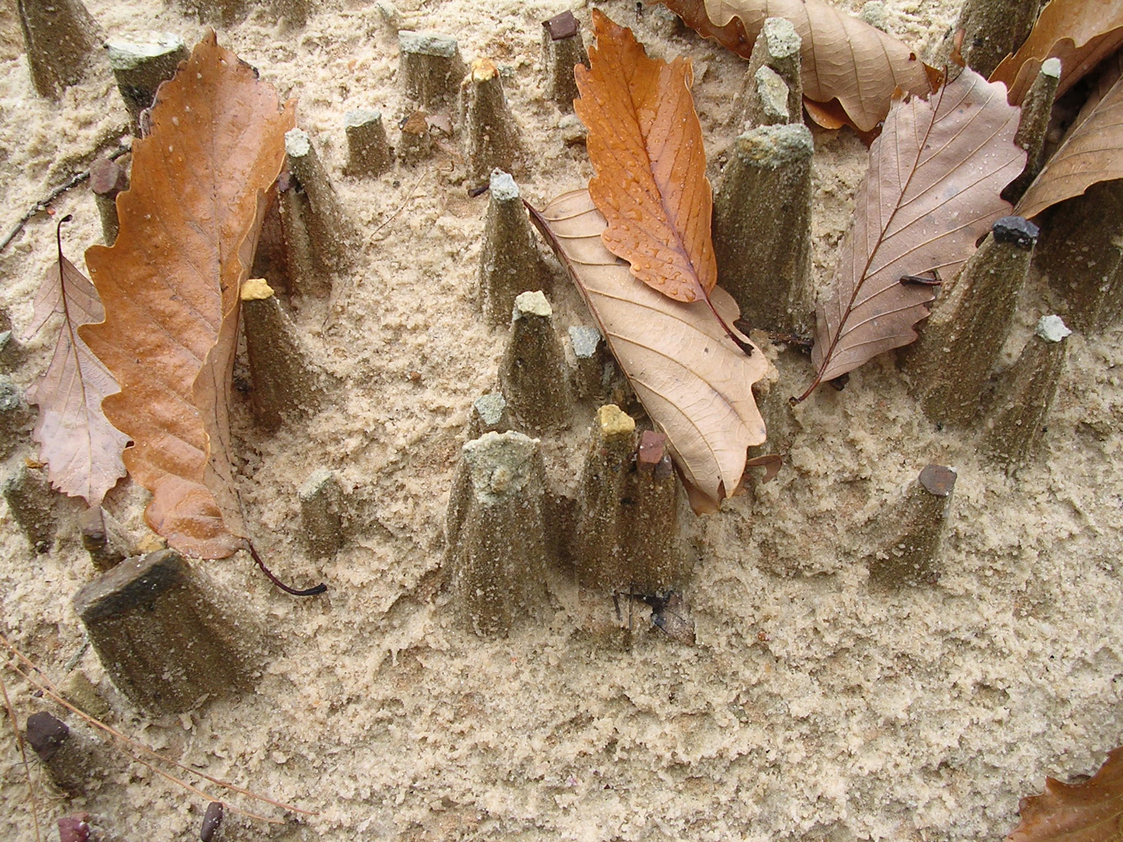
Ds1
Disturbed Area Stabilization (With Mulching Only)
Applying plant residues or other suitable materials to the disturbed soil surface
Reduce runoff and erosion
Conserve moisture
Prevent surface compaction
Control undesirable vegetation
Modify soil temperature
Increase biological activity in the soil
Notes:
Useful on areas where final grading has not been done and during times when poor germination is to be expected, such as times when the season is not optimal for the desired plant species to be planted.

Slide 16
Per the “Manual for E&SC in Georgia”
Ds1 - Mulching Only
On exposed areas within 14 days of disturbance
Apply at the appropriate depth
Must be anchored
Maintain cover on 90% or more of the soil surface
Can be used alone for up to 6 months
Notes:
It is very important that all mulch materials be anchored, especially on steep slopes.
If protective cover is needed for longer than 6 months, a permanent measure should be used instead.

Slide 17
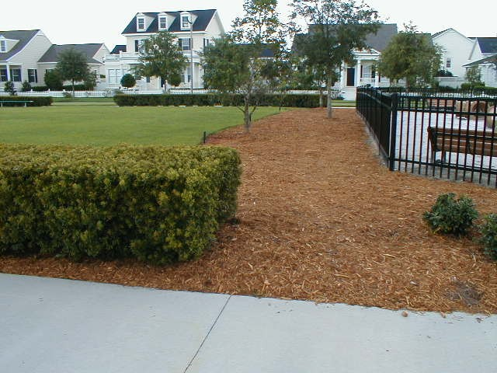
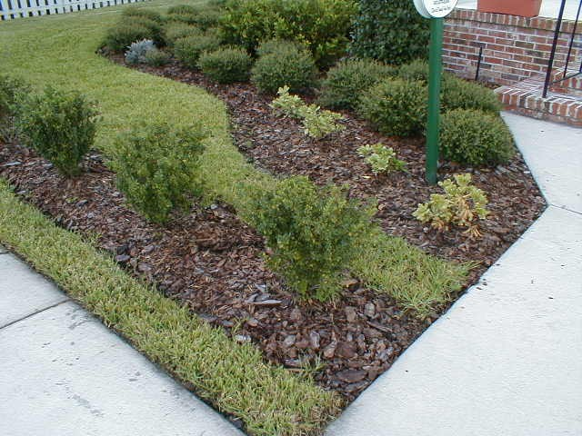
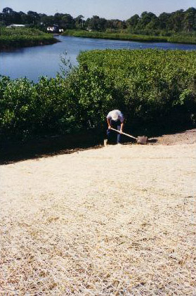
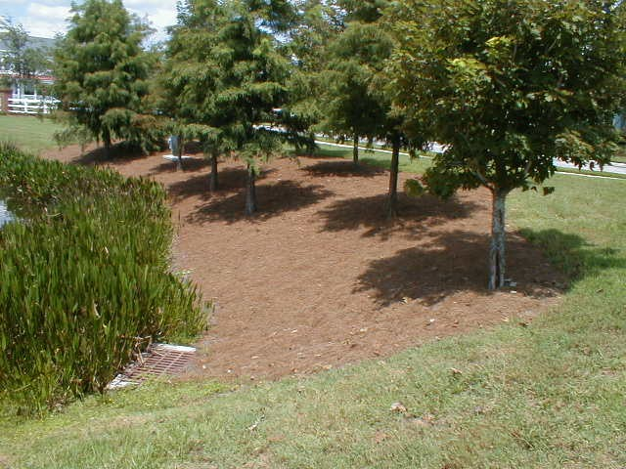
Cypress mulch
Pine Bark
Pine Straw
Blanket
Notes:
Many products can be used.

Slide 18
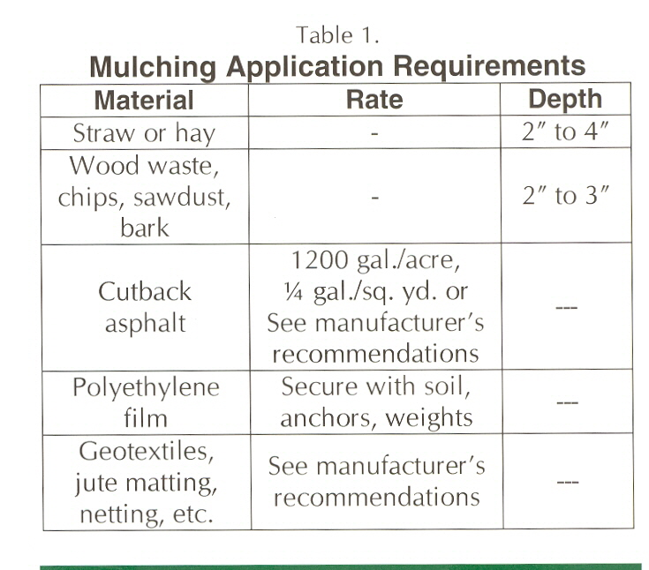
Notes:
From the “Manual”
These are rates for when mulching is used alone. Where seeding is done, the mulch application rates are much lower to allow seedling emergence and development.

Slide 19
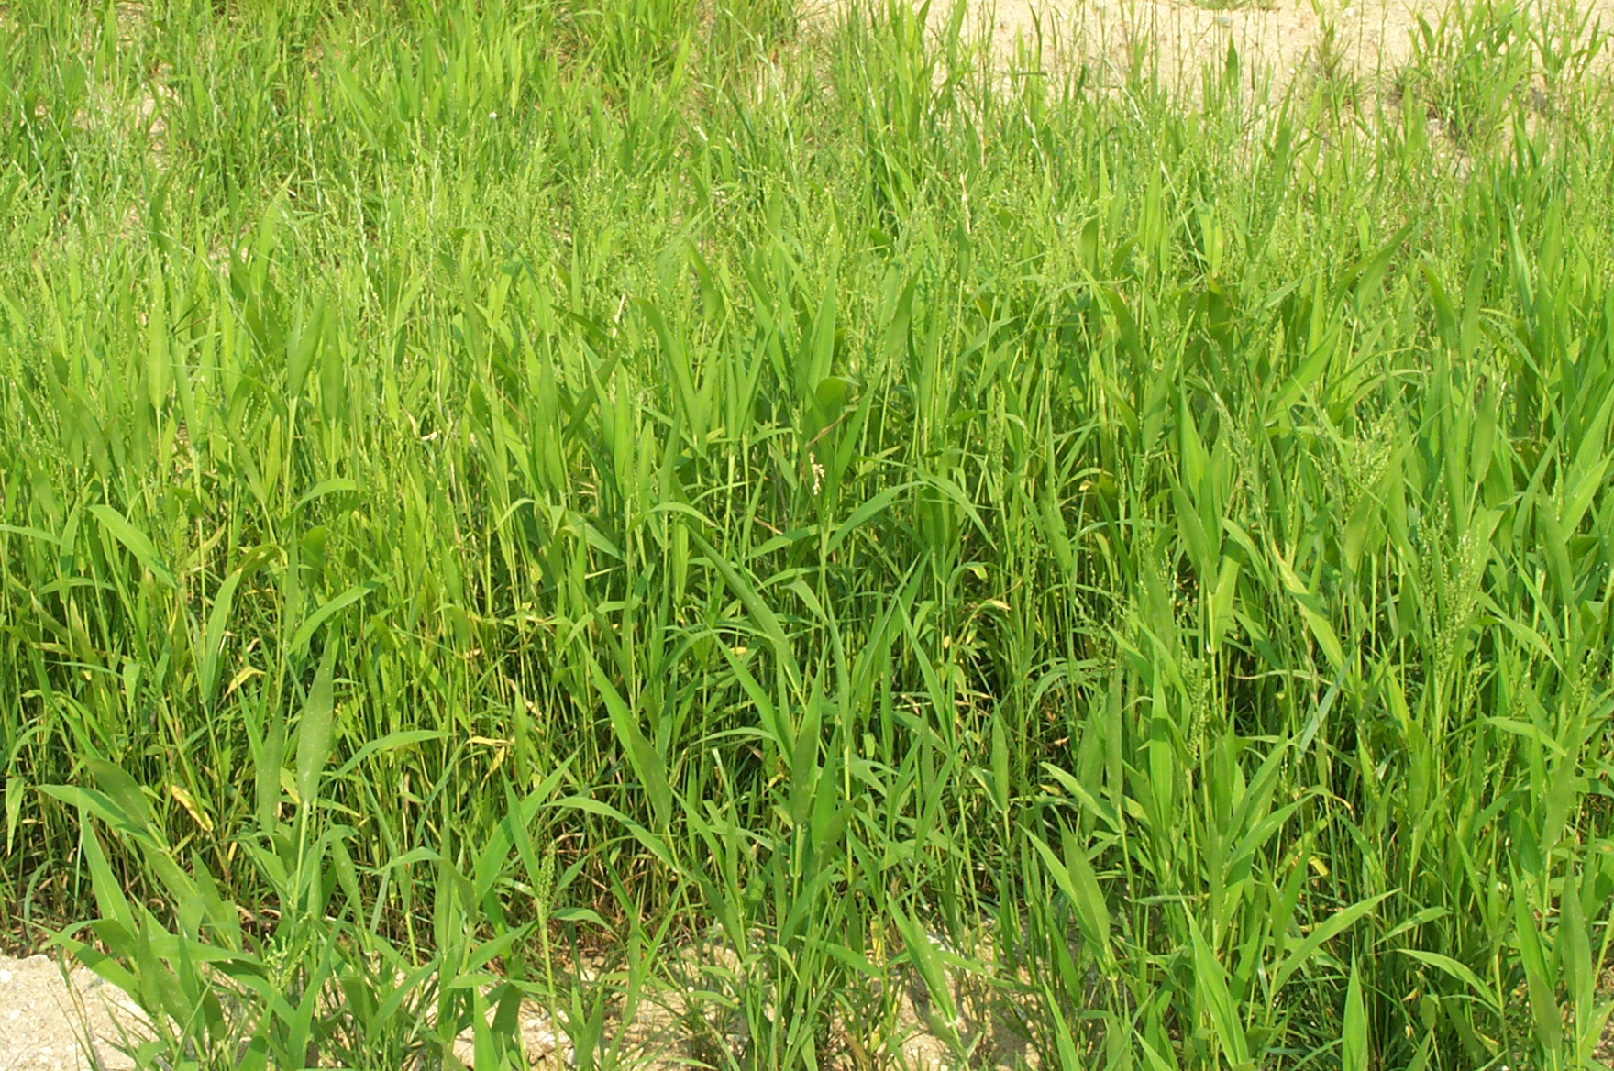
Ds2
Disturbed Area Stabilization
(With Temporary Seeding)
Establishing fast growing vegetation for seasonal soil protection
Reduce soil erosion
Reduce runoff
Increase infiltration
Improve aesthetics
Improve soil quality
Improve wildlife habitat
Browntop millet
Notes:
As with Ds1, this measure is for areas that are not at final grade.
It is important to use fast growing plant species that will also provide adequate protective cover.

Slide 20
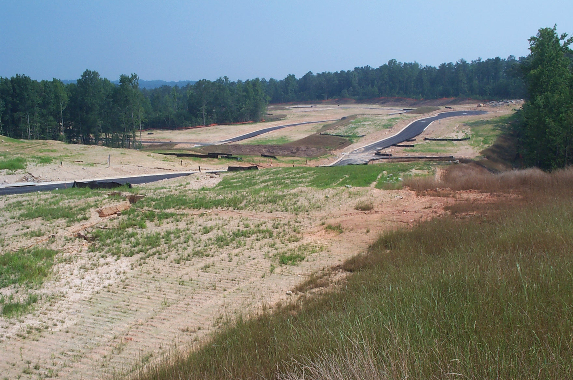
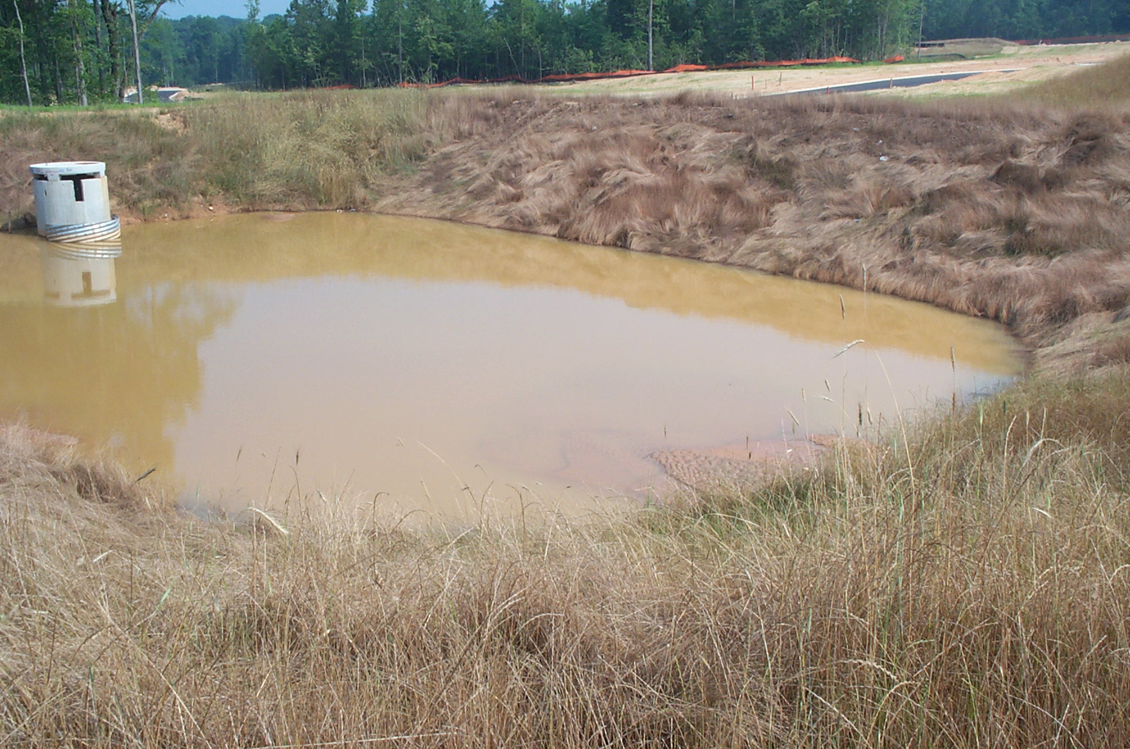
Required Temporary Seeding
Rough graded areas
Diversions
Sides of temporary basins
Stockpiled soil
Temporary dams
Notes:
Self-explanatory.

Slide 21
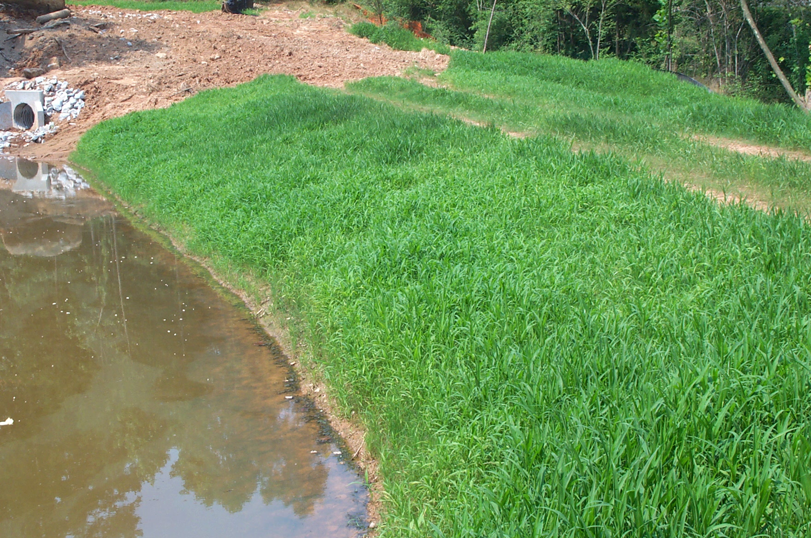
Temporary Seeding
Ds2
Components
  grading & shaping
  lime
  fertilizer
  seedbed preparation
  quality seed
  proper planting techniques (rates/timing/depth)
  mulch
  irrigation
Notes:
More is involved than just planting seed.

Slide 22
Per the “Manual for E&SC in Georgia”
Ds2 - Temporary Seeding
On all exposed areas within 14 days of disturbance
Maintain cover on 90% or more of the soil surface
Can be used alone for up to 6 months
Permanent vegetation will be used if area is to be undisturbed for more than 6 months
Notes:
Again, if protective cover is needed for more than 6 months, use a permanent measure.

Slide 23
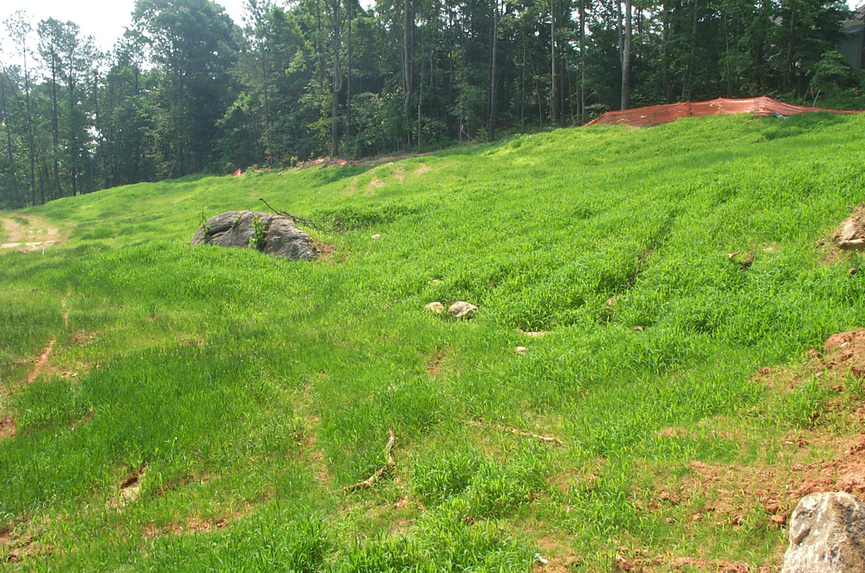
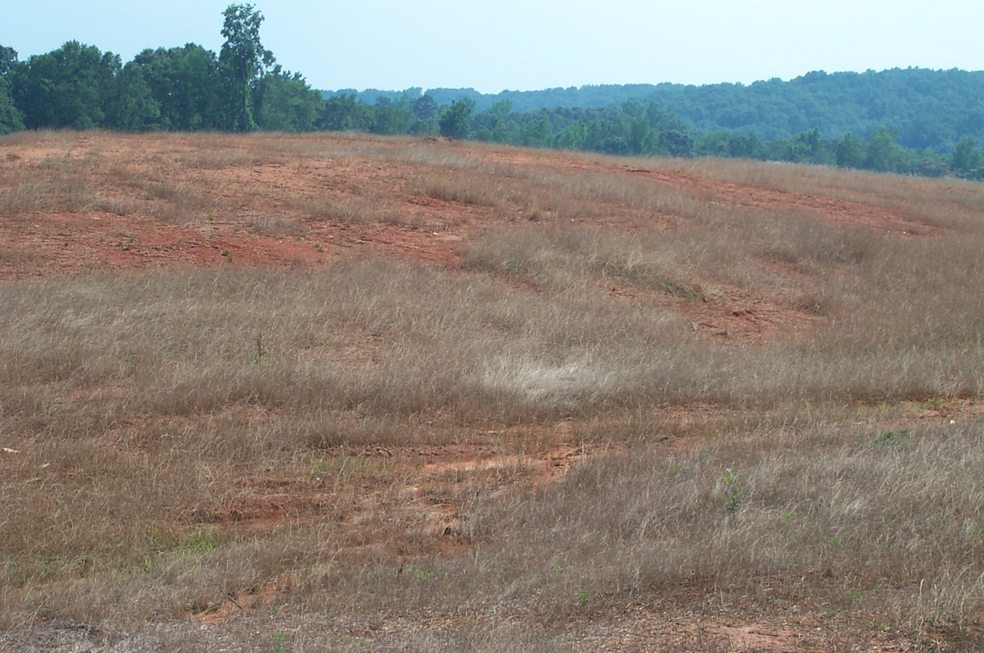
Ds2 – Plant Selection
Germinate quickly
Noncompetitive
Adequate cover
90 % cover ?
Notes:
Select plants that will:
germinate quickly
provide adequate cover for erosion control
will not be competitive to permanent species planted later
It is very important that they be planted at the proper time of the year and maintained properly. Adequate fertilization, including topdressing, is required.

Slide 24
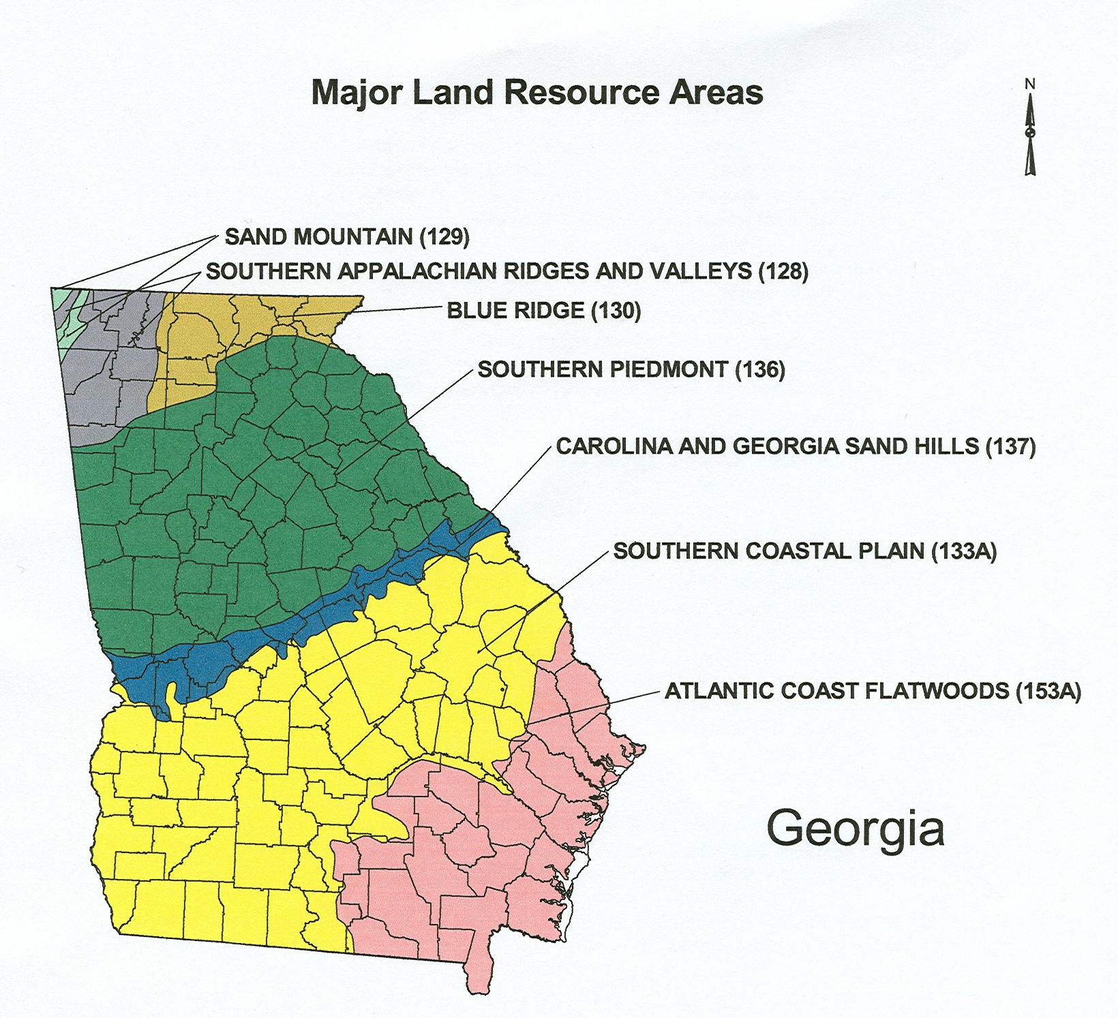
Regional variations:
Climate
&
Soils
Notes:
Climate and soils greatly affect plant growth.
To determine which plants should be used on a construction sites for both temporary and permanent measures, always consider the location of the site and the soils that are present.

Slide 25
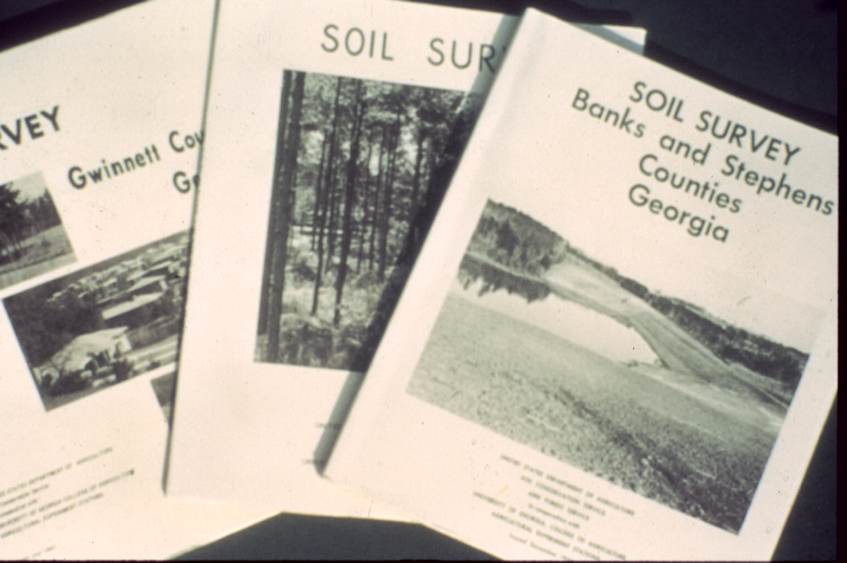
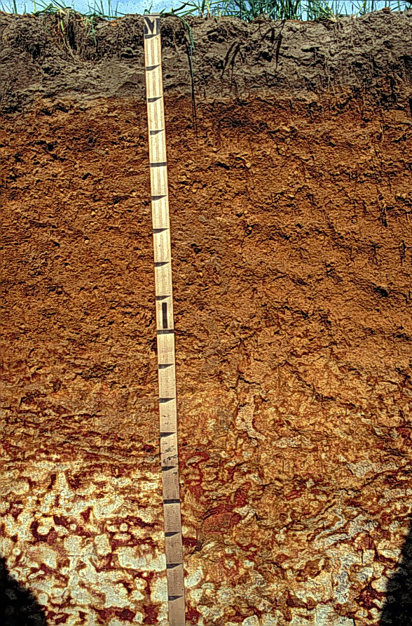
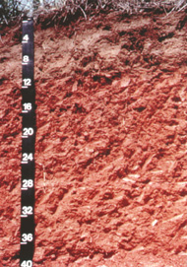
Soils make a difference
Tifton
Cecil
They vary across the state.
They vary on a site.
Notes:
Most of the soils in the State have been mapped.
Contact your local USDA-Natural Resources Conservation Service (NRCS) office for copies of soil surveys.

Slide 26
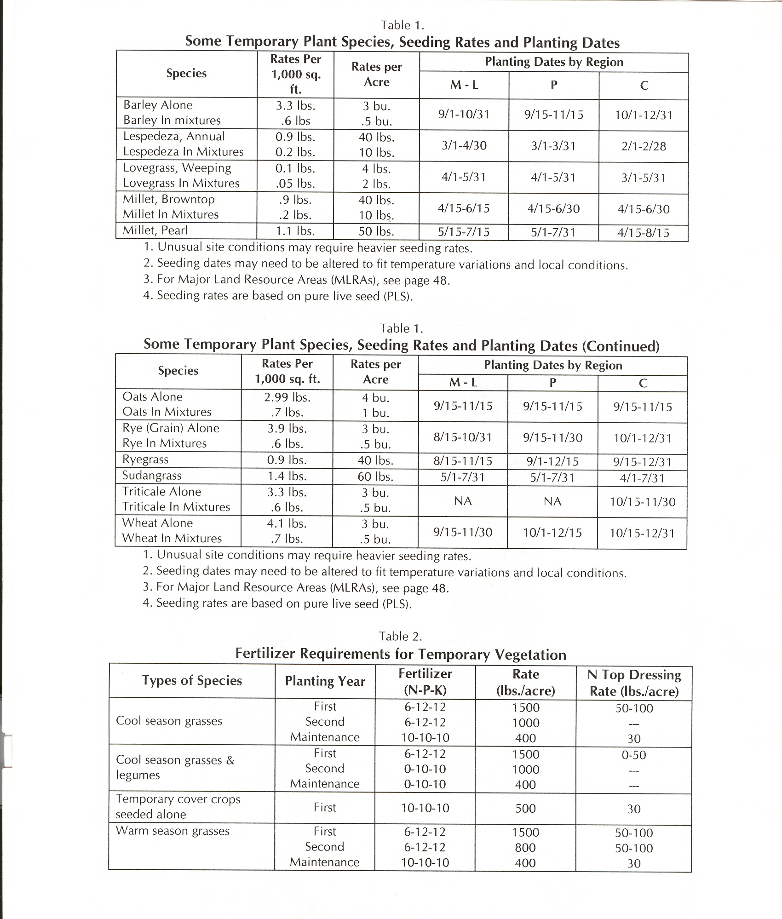
Regional differences in the “Manual”
-species
-rates
-planting dates
Notes:
Plant selection tables are listed in the “Manual”.
Species, PLS seeding rates, approved planting dates, and other data is provided for different areas of Georgia.

Slide 27
Plants for Temporary Cover
Warm season annuals Cool season annuals
-brown top millet -rye
-pearl millet -ryegrass
-sudan grass -wheat
Warm season perennials Cool season perennial
-common bermuda -tall fescue
-weeping lovegrass
Notes:
Many plant choices are available.
Most plants used for temporary cover are annuals, but some perennials also germinate quickly and provide good cover.

Slide 28
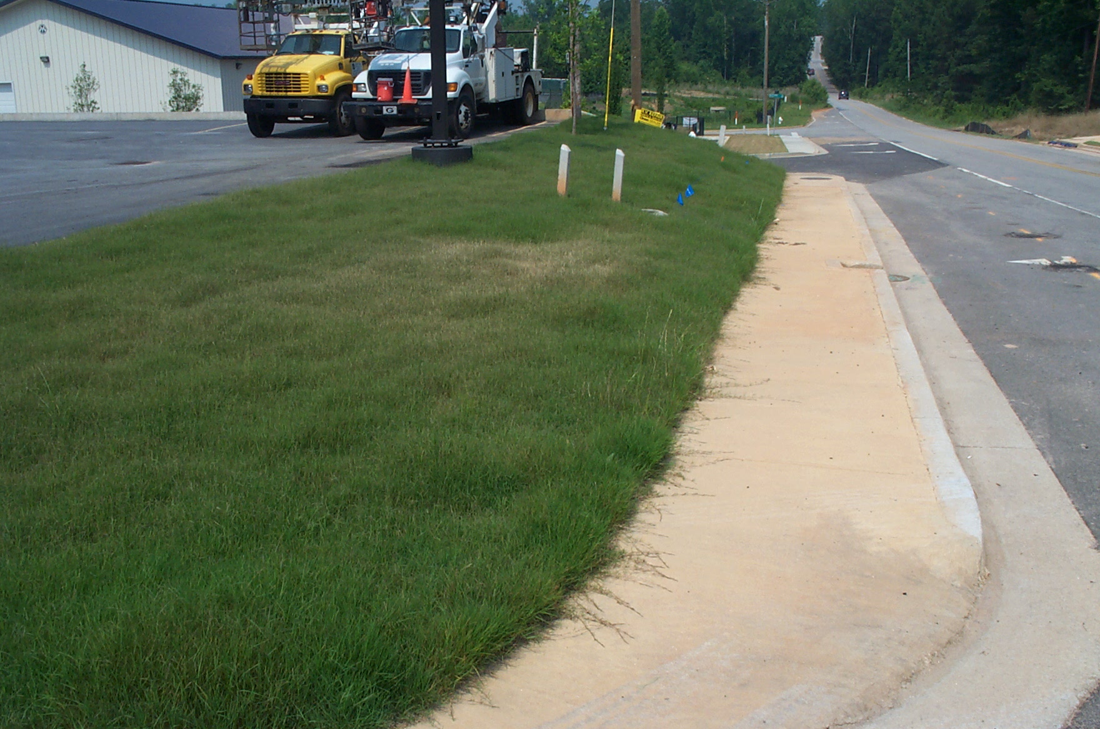
Ds3
Disturbed Area Stabilization
(with Permanent Vegetation)
Planting perennial vegetation (grasses, legumes, vines, shrubs, and trees) on exposed areas
-Final permanent stabilization
-Rough graded sites >6 months
Notes:
For areas where final grading has been done or for rough graded areas where soil protection is needed for >6 months.

Slide 29
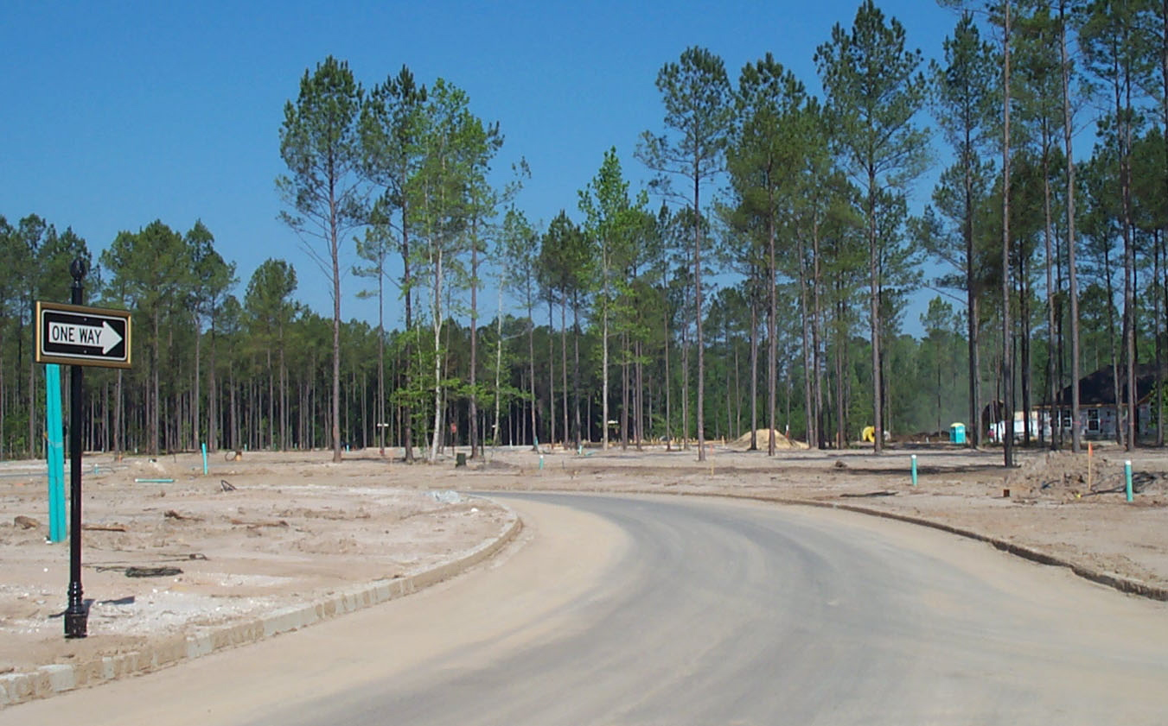
Permanent Vegetation
Ds3
Plans are based on site conditions.
Site location
Soil characteristics
Topography
Concentrated water flow
Planned land use
Soil fertility
Soil pH
Notes:
All sites are different and require specific treatment.

Slide 30
Components
Ds3
Grading and shaping Inoculants
Lime Planting method
Fertilizer Seeding depth
Seedbed preparation Mulch
Species selection Anchoring mulch
Seeding rates Irrigation
Seeding dates Maintenance
Notes:
Many components are required.
If one or more are lacking, failure may result.

Slide 31
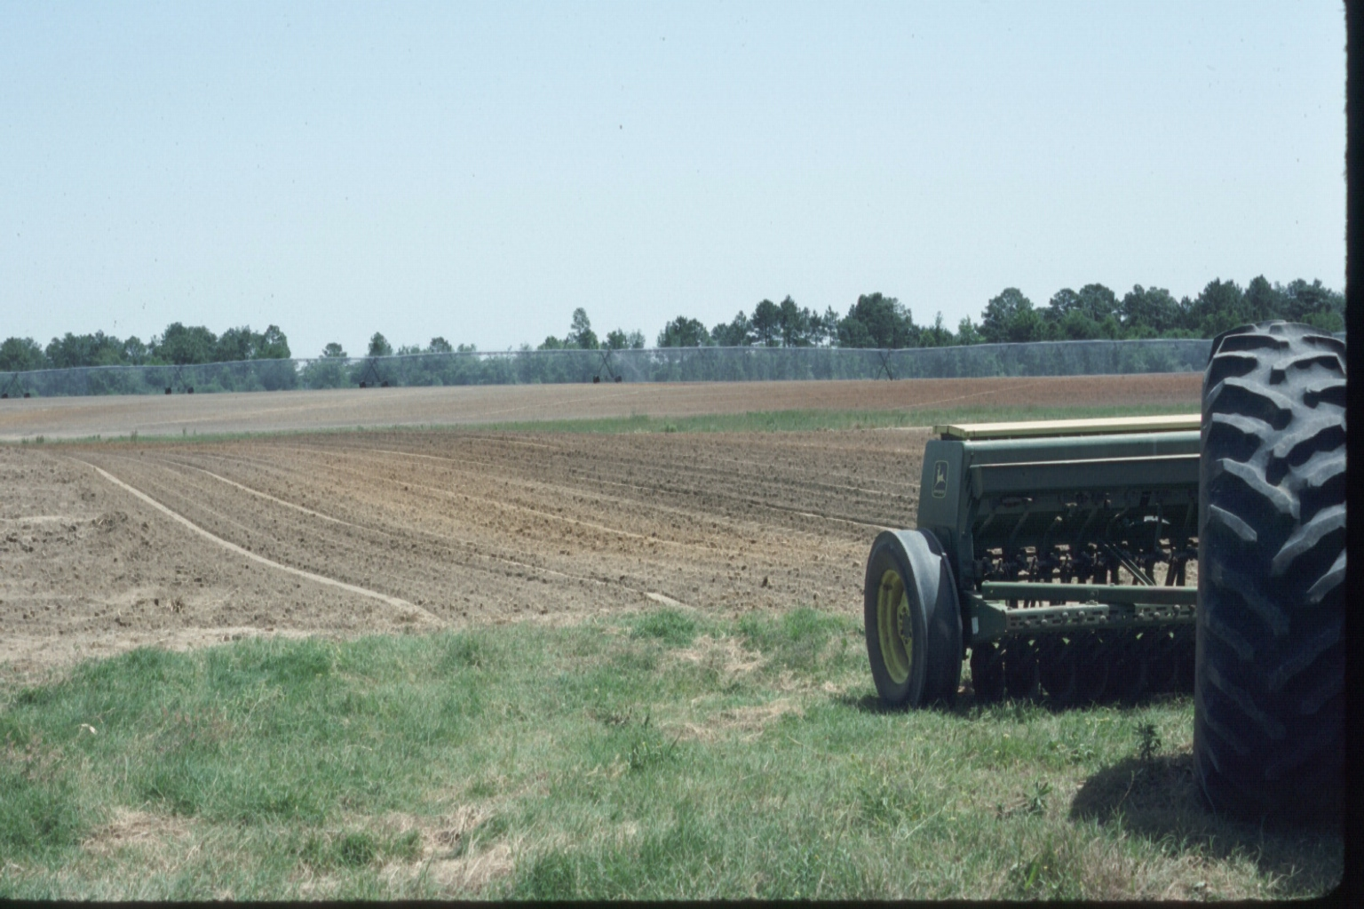
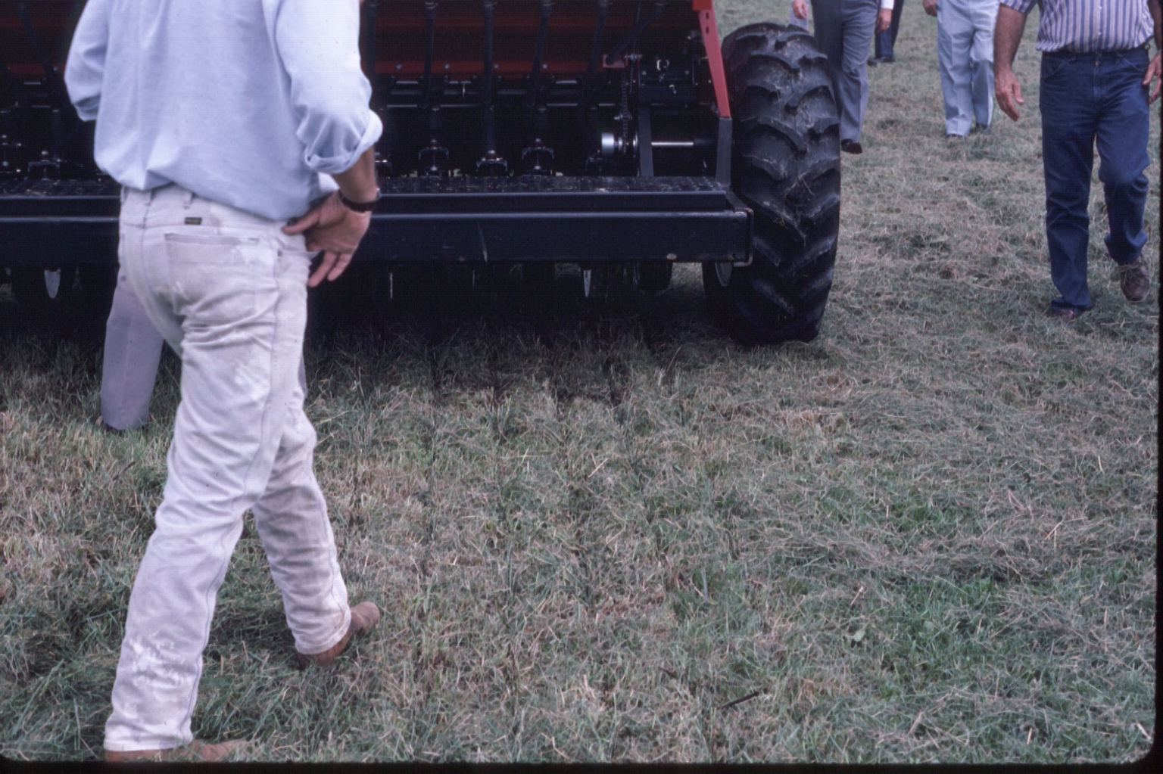
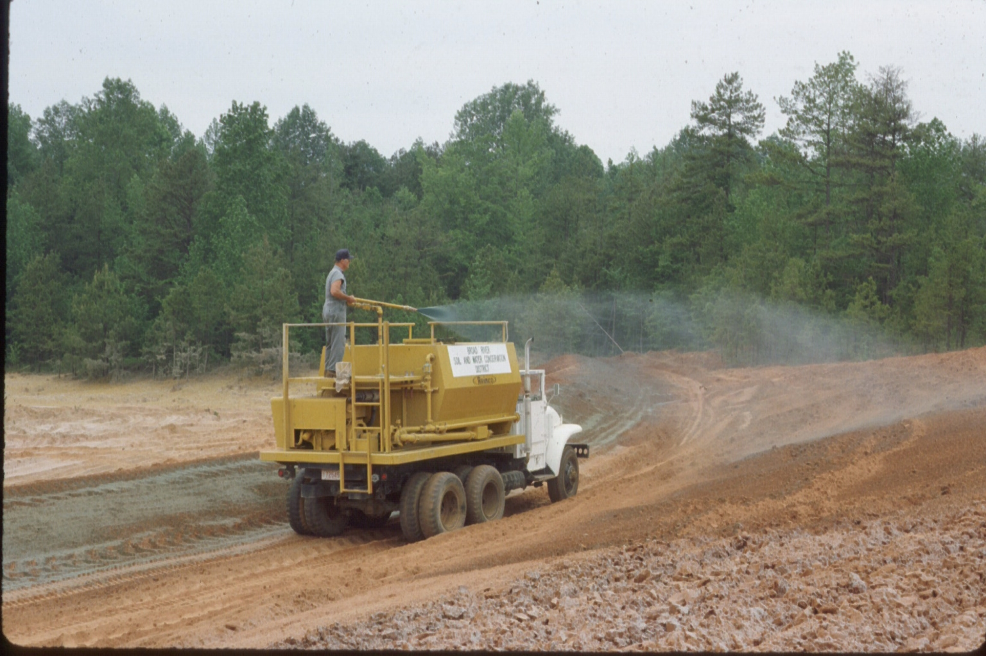
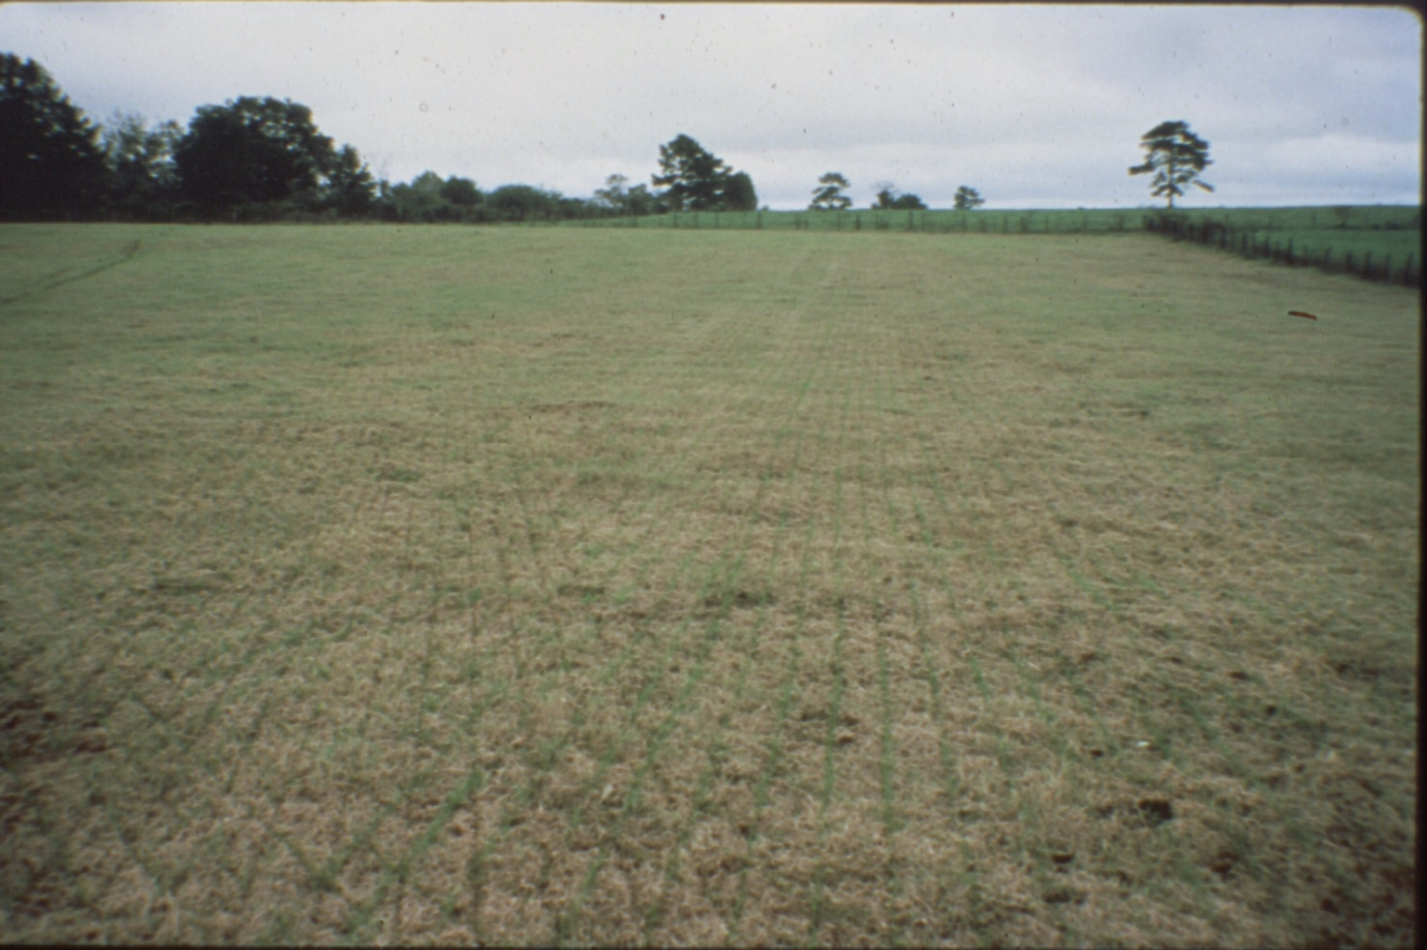
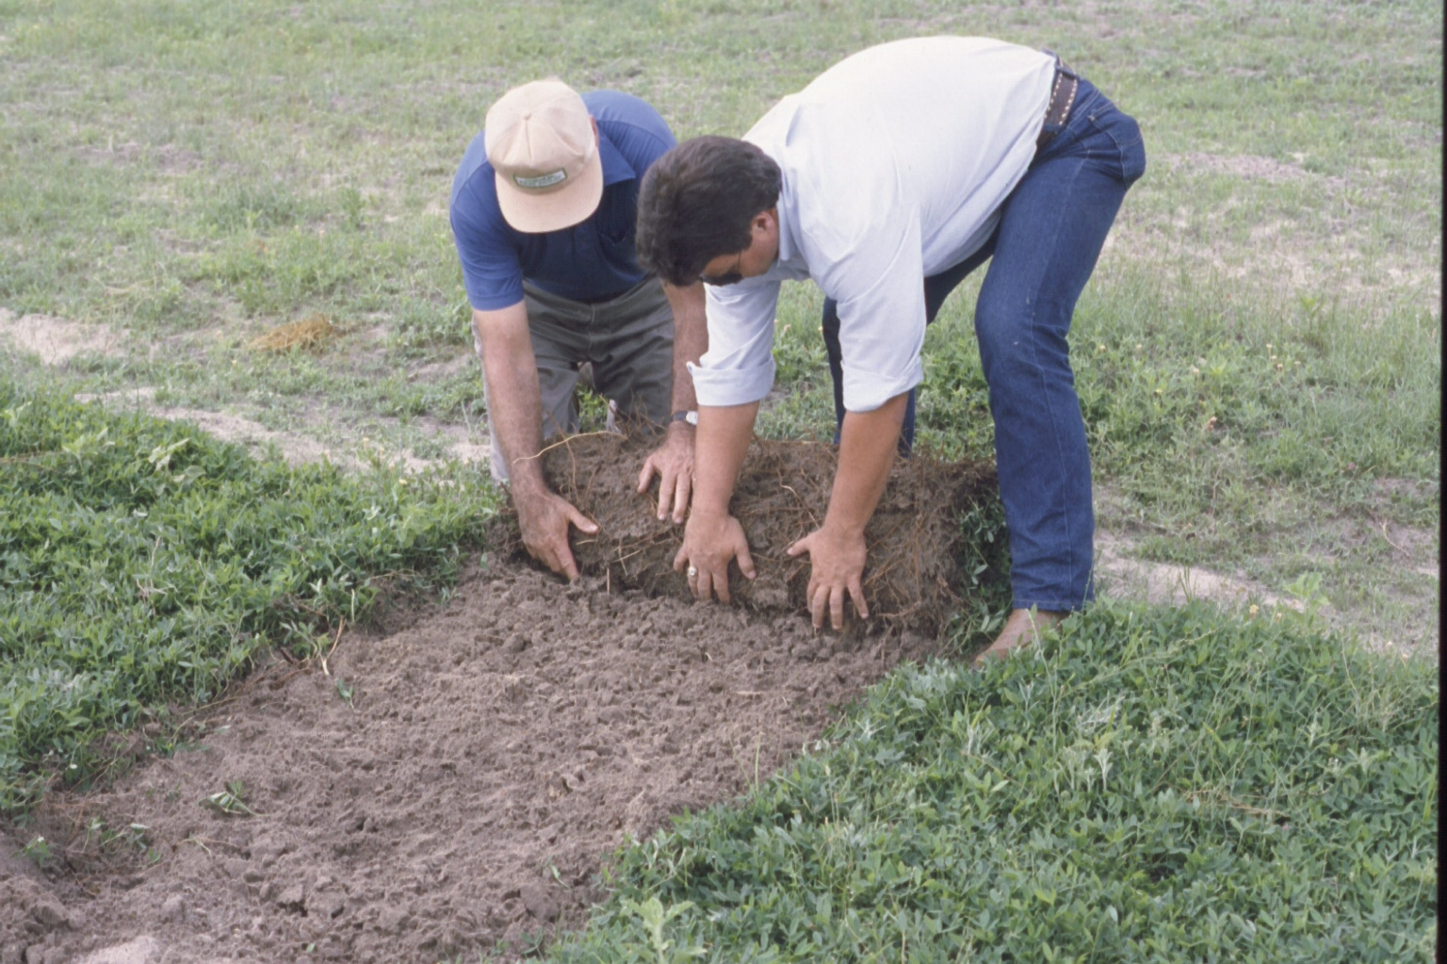
Many Planting Methods are used
Notes:
Conventional seeding should be the first choice because it:
prepares a seedbed
incorporates lime and fertilizer into the soil
ensures good seed-to-soil contact
most times is cheaper

Slide 32

Seedbed Preparation
Provides good growing medium
Critical for good plant growth
Not normally needed for hydroseeding
Incorporate lime and fertilizer 4 to 6 inches
Notes:
Too often, seed are thrown on the top of compacted soil.
Young plant seedlings are fragile and need all the help we can give them to survive.
Seedbed preparation provides many benefits to young plants.

Slide 33
Soil Tests and Nutrient Management
Determine soil acidity and fertility
Provide ample nutrients for plants
Protect the environment
Notes:
The soil on most construction sites has low pH and low fertility.
Inadequate plant nutrients will prevent good plant growth.
And, excess nutrient applications can harm the environment.
Soil tests and nutrient management plans tell (1) the existing soil pH and fertility and (2) how much lime and fertilizer should be applied to the target plant species for good growth.

Slide 34
pH Scale
Neutral
1 2 3 4 5 6 7 8 9 10 11 12 13 14
More Acid More Basic
(10 fold difference in acidity from one number to the next)
Notes:
A soil pH of 6 – 6.5 is needed by most plants used on construction sites.
A pH of 5 is 10x more acid than a pH of 6.
A pH of 4 is 100x (10 x 10) more acid than a pH of 6.

Slide 35
Soil Acidity (pH)
Affects plant growth
Most GA soils are acidic
Most plants used need a soil pH of 6.0 - 6.5
Apply 1 – 2 T/A of agricultural lime
Notes:
If the soil has a pH that is too low, most or the plants used on construction sites can not utilize plant nutrients that are present in the soil. And, some other elements in the soil can be toxic to plants if the pH is too low.
Agricultural lime is applied to raise the soil pH.
It is applied in the form of calcium carbonate (CaCO3).

Slide 36
Agricultural Lime
Does not move readily through the soil
Can be lost in runoff
Conventional planting – apply immediately before seedbed preparation
Hydroseeding - apply after straw/hay mulch, with topdressing, or with 2nd year fertilizer
Notes:
Calcium does not move down through the soil profile as fast as some other nutrients.
Ideally, agricultural lime should be mixed into the soil during the seedbed preparation.
Where other planting methods are used, apply the lime only after adequate protective cover exists on the soil.

Slide 37
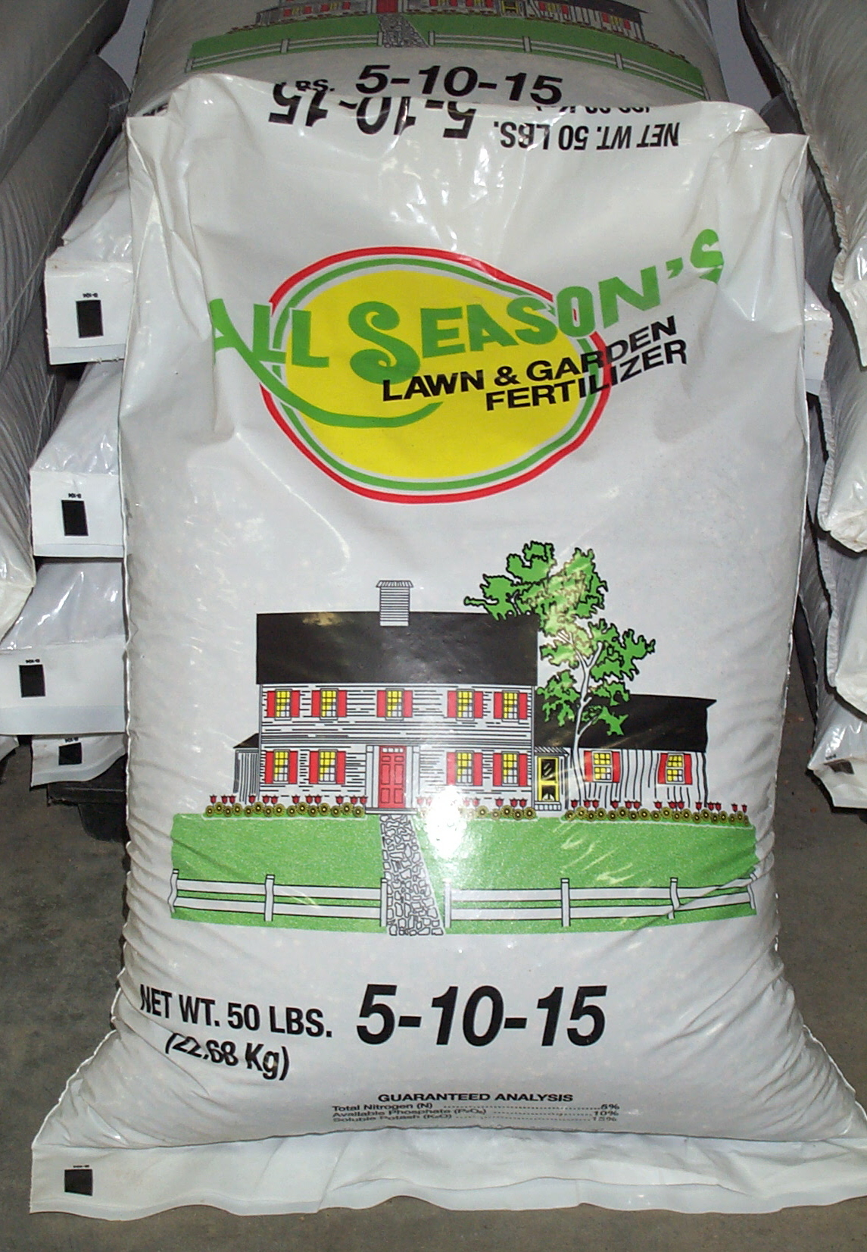
Fertilization
Initial – immediately before or at planting
Topdressing – 6 to 8 weeks after planting
2nd year – the year after planting
Maintenance – each year
Fertilize based on target species
Don’t “plant it and forget it”
Notes:
Fertilizer is one of our best conservation tools.
The initial fertilizer is not all that is needed. Topdressing, 2nd year, and maintenance applications are very important also.

Slide 38
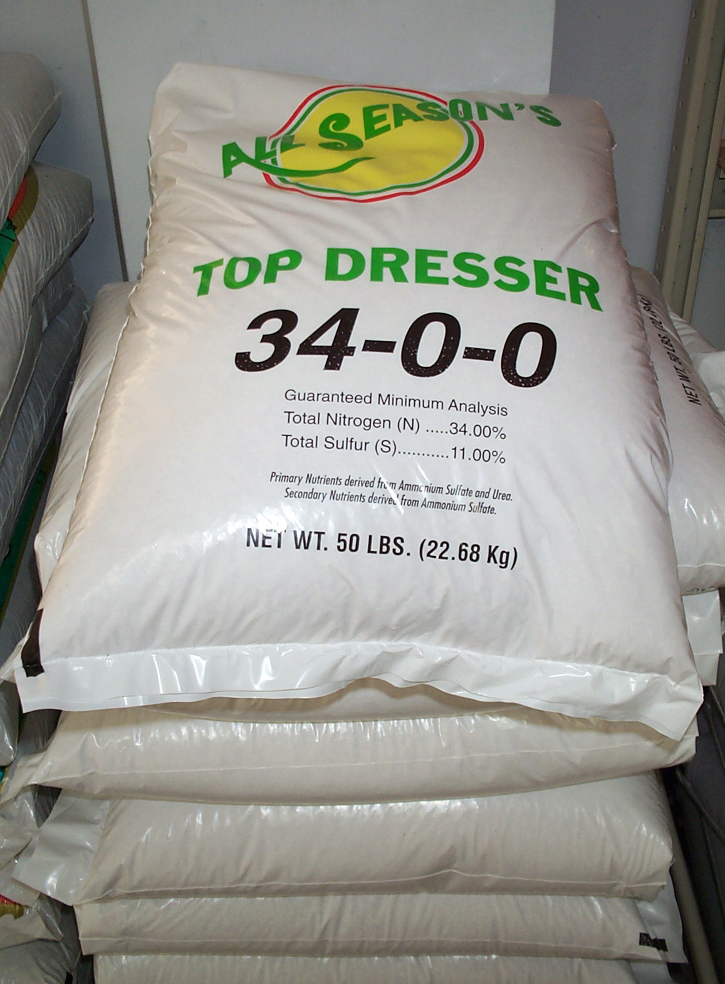
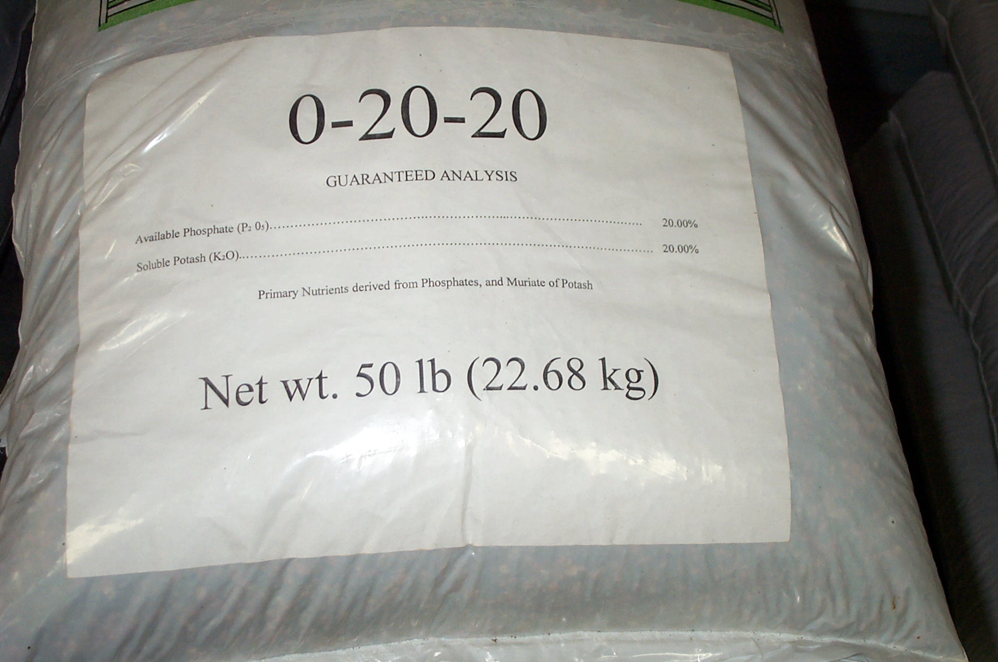
Fertilizer
Q. What do the numbers mean?
A. The fertilizer analysis
Notes:
The analysis is printed on each bag.

Slide 39
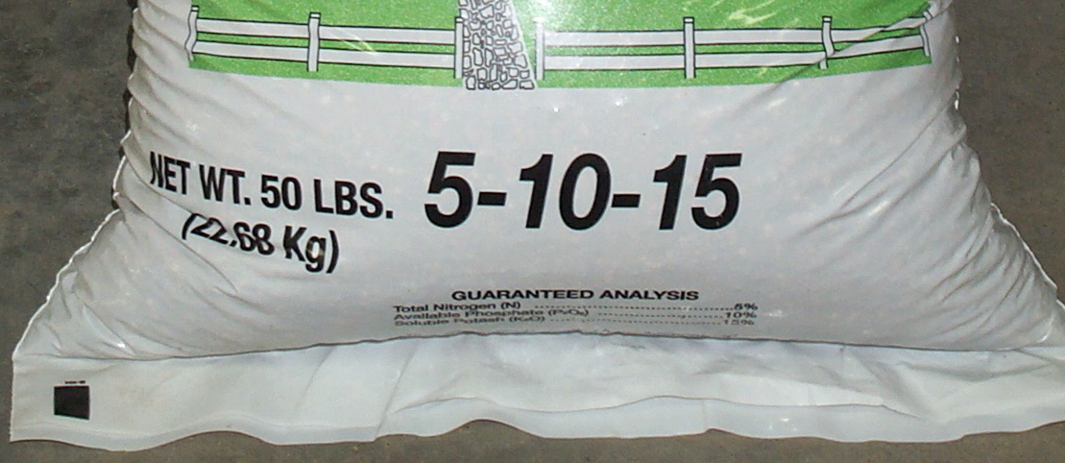
Fertilizer Analysis
% Nitrogen % Phosphorous % Potassium
This 50 LB bag contains 30% plant food (15 LB) and 70% filler.
Notes:
This 50 LB bag contains 2.5 LB of nitrogen, 5 LB of P₂O₅, and 7.5 LB of K₂O.
The remaining contents (35 LB) is filler material that aids in the accurate application of the nutrients.

Slide 40
Fertilizer
Selection is based on needs of the target species
Initial fertilizer
Ammonium nitrate
(N topdressing for grasses)
For legumes
Notes:
Each plant type needs different plant food.
For instance, if nitrogen is continually applied to perennial legumes such as sericea lespedeza, it will encourage competition from grasses that require N.
Legumes get all of the N they need from bacteria if the seeds are inoculated properly.

Slide 41
Fertilizer for Grasses
Timing Analysis
First Year N, P, K
Topdressing N
Second Yr. N, P, K
Maintenance N, P, K
Notes:
It is important that grasses receive all three major nutrients.

Slide 42
Fertilizer for
Grass/Legume Mixtures
Timing Analysis
First Year N, P, K
Topdressing N
Second Yr. P, K
Maintenance P, K
The desired species are legumes
Legumes get N from bacteria
Notes:
After the topdressing is applied, usually only P and K fertilization is needed by perennial legumes such as sericea lespedeza and crown vetch.
Too much N applied will encourage competition from grass species.

Slide 43
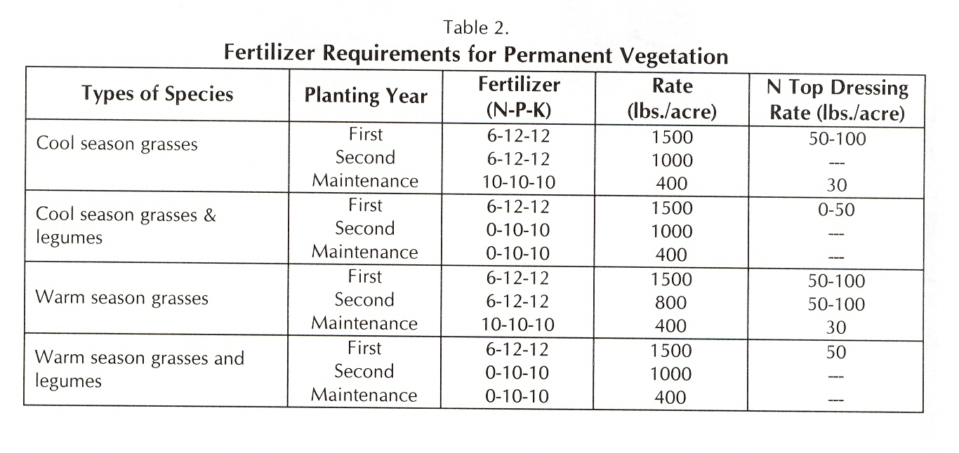
Notes:
Fertilization recommendations are provided in the “Manual”.

Slide 44
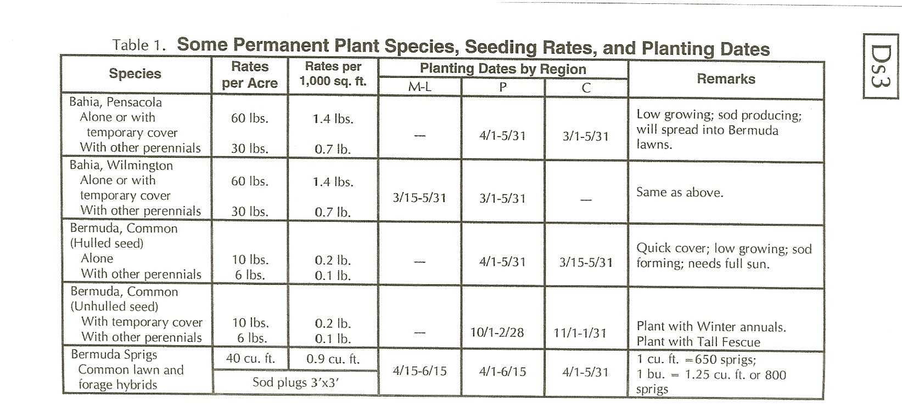
Data in “Manual” and “Field Manual”
Notes:
Plant selection tables for permanent plant species are provided in the “Manual” also.

Slide 45


Consider Native Grasses
Well adapted
Extensive root system
Attractive
Excellent for wildlife
Low maintenance
Little bluestem
Broomsedge bluestem
Reed canary grass
Eastern gama grass
Big bluestem
Indian grass
Switchgrass
Virginia wildrye
Notes:
Native species provide good cover and require less maintenance than introduced species.
They also provide more benefits for wildlife.

Slide 46
Seeding Rates for a Quality Stand
Under-seeding reduces the stand
Over-seeding creates excessive demand for moisture, nutrients, light, and space
More is not always better
More seed will not overcome poor planting techniques
Notes:
Good seed planted at the proper rate is necessary.
Both too little seed or too many seed can result in inadequate cover.

Slide 47
Species | PLS ^{1/} Seeding Rate^{2/} LB/AC | Seed/LB | Seed/Sq. Ft.
Common bermuda | 10 | 1,800,000 | 410
Weeping lovegrass | 4 | 1,500,000 | 140
Tall fescue | 50 | 227,000 | 260
Bahia | 60 | 166,000 | 230
Sericea lespedeza | 60 | 350,000 | 480
^{1/} PLS = Pure Live Seed ^{2/} Seeding rate when seeded alone
Notes:
All of the seeding rates in the “Manual” are Pure Live Seed (PLS) rates.
These seeding rates are adequate in Georgia.
“We do not need to mulch with seed.”

Slide 48

Seed Label
Notes:
Check the seed tag or label. Valuable information is provided.
All seed sold or offered for sale in Georgia is supposed to have had a germination
test done during the last 9 months. (See the “Georgia Seed Law” available from
the GA Department of Agriculture.)
Please note:
1. All of the material in a bag of seed is not seed.
2. All of the seeds in a bag are not good seeds.
All seed should be evaluated for seed quality before planting.

Slide 49
Pure Live Seed (PLS) Calculations
Step 1: Get information from seed label:
-tall fescue seed
-95% purity
-85% germination
Step 2: Calculate the PLS value of the seed:
PLS = 0.95 x 0.85 = 0.81 or 81%
Step3: Calculate the seeding rate:
50 #/AC = 62 #/AC are needed
0.81
Notes:
Accurate seeding rates for any available seed can be determined quickly by using the data on the seed tag.
The % purity tells you what part of the material in the bag are seed of the desired species.
The % germinations tells you what part of the seed of the desired species will germinate and grow.
Simply multiply the % purity x the % germination and divide this value into the recommended seeding rate to get the PLS seeding rate for the seed purchased.

Slide 50
Optimum Planting Dates for
Warm Season Plants
Plant common bermuda and weeping lovegrass in the early spring:
April 1 - May 15
This permits germination, plant growth, and root
development prior to the hot and dry summer.
Notes:
All plants need to be planted at the proper time.

Slide 51

Optimum Planting Dates for
Cool Season Plants
Plant rye, ryegrass, and tall fescue in early fall:
September 1 - October 15
This permits germination, plant growth,
and root development prior to the
winter cold and spring drought.
Notes:
The rye in the background was planted on October 1.
The rye in the foreground is from the same sack of seed and received the same fertilization. It was planted in December.
The date of planting greatly affects the growth of all plants used for erosion control on construction sites.

Slide 52


Some plants develop slowly and companion plants are needed
Sericea lespedeza emerging
in weeping lovegrass
Sericea lespedeza 2-3 years later
Other examples are bahia grass and crown vetch.
Notes:
Companion plants that germinate quicker are used to hold the soil, mulch, fertilizer, and seed of the desired species in place until the perennial plants become established.

Slide 53

Limit Seeding Rates of Companion Plants
Annuals are more vigorous and grow faster
Compete for nutrients, moisture and space
Notes:
Do not use too many seeds of the companion plant species. Annuals are more vigorous than perennial plant species and if seeded at a high rate will shade out the other plants.

Slide 54


Cool Season Companion Plants
Rye is the best winter annual.
It grows best on cold, acidic soils.
Use ½ BU/AC (28 LB).
Do not use ryegrass in seeding mixtures. It is too competitive.
Notes:
Rye should be the first choice.
Ryegrass is a sod-forming annual and is not recommended for seeding mixtures.

Slide 55


Seed inoculation is needed for legumes
Nodules of
nitrogen fixing
bacteria on roots
Notes:
All legume seed should be inoculated with the proper strain of bacteria prior to planting.
This symbiotic relationship benefits the plants and bacteria.
-The plant provides a home for the bacteria.
-The bacteria provides nitrogen to the plants.

Slide 56


Hydroseeded Areas - not mulched
Ft. Stewart
S. Fulton
Notes:
All seeded areas should be mulched properly to prevent the loss of seed, fertilizer, and lime.

Slide 57

Mulch is very important!
Dry straw - 2 T/A
or
Dry hay - 2 ½ T/A
This will cover about 75% of the soil surface
Notes:
These rates will provide good soil cover and allow the young plant seedlings to grow.
Use good mulch.
It should be dry and not caked.
It should not contain weed seed, especially of plants such as Johnsongrass and other noxious weed species.

Slide 58


Anchoring Straw and Hay Mulch
1. Mulch crimper
2. Asphalt emulsion
3. Tackifiers
4. Netting or mesh
Notes:
All mulch materials should be anchored to the soil surface.
Mulch crimpers are useful on conventionally seeded sites because a seedbed is prepared.

Slide 59

Ds4
Disturbed Area Stabilization (with Sodding)
Establishing immediate ground cover with permanent sod
Effective on steep slopes and in concentrated flow areas
Components:
soil preparation
topsoil
lime
fertilizer
anchoring (>3:1 slope)
irrigation
maintenance
Cimarron Valley Sod
Notes:
Sodding provides immediate soil protection

Slide 60



Sod Solutions
Bobcat
Sod Solutions
Notes:
It is important to prepare the soil and incorporate the initial lime and fertilizer prior to applying sod.
Living plant material and a thin slice of soil that contains plant roots are planted.
Use fresh plant material.

Slide 61

Notes:
Many sod choices are available and are listed in the “Manual”.

Slide 62

Dust Control
Du
Controlling surface and air movement of dust
Temporary
  Mulch
  Temporary plantings
  Tackifiers/binders
  Rough tillage
  Irrigation
  Barriers
  Calcium chloride
Permanent
  Permanent vegetation and stone
Notes:
Although less than water erosion, we do have wind erosion in Georgia.
As with water erosion, it is important to keep the soil covered.

Slide 63

Mb
Erosion Control Matting and Blankets
Protective coverings used to establish permanent vegetation
Protects young plants
Promotes plant establishment
Helps reduce erosion
-Temporary and permanent blankets
-All must be approved by GDOT
Notes:
These materials are required on some areas.

Slide 64

Mats and Blankets
Slopes steeper than 2.5:1 and 10’ high or higher
Concentrated flow areas
Cuts and fills within stream buffers
Streambanks
Tidal shorelines
Other areas
Notes:
Examples of areas where mats and blankets are required in Georgia.

Slide 65



Blankets must be applied correctly
Notes:
They will fail if not applied and anchored correctly.
The soil should be smooth underneath them.
One layer, applied correctly, should be sufficient. Follow the manufacturer’s recommendations.

Slide 66

Blankets must be anchored.
Start at top of slope and work down.
Notes:
They must be anchored properly.

Slide 67
Pm
Polyacrylamide (PAM)
Land application of anionic polyacrylamide as
temporary soil binding agent
To reduce erosion from wind and water on construction sites and agricultural lands
Other benefits may include improved water quality, infiltration, soil fertility, and visibility
Notes:
PAM products are used on construction sites and agricultural land.

Slide 68
Polyacrylamide
Pm
If timely establishment of vegetation is not feasible
Site specific material
Direct soil surface application
BMPs must be used with PAM
Repeat application if area is disturbed
Do not apply to surface water
Notes:
It is important to apply the correct product according to the soil present on the site.
A temporary measure.

Slide 69


Streambank Stabilization (using Permanent Vegetation)
Sb
Using native plant material to maintain or enhance streambanks
Before
After
Notes:
Anytime you have concentrated water flow, soil erosion problems are more difficult to solve.

Slide 70
Sb
Streambank Stabilization (using Permanent Vegetation)
Intensive planning is required
Live stakes, joint plantings, live fascine, brushmattresses, live cribwalls, branchpacking
With structural measures
½ fertilizer at planting, ¼ when new growth is 2” tall, and ¼ about six weeks later
Labor intensive
Local, state, and federal permits
Notes:
Intensive planning and treatment is required.
The assistance of specialists may be needed.

Slide 71

Tb
Tackifiers and Binders
Used to anchor straw or hay mulch
Holds mulch in place
Options in “Manual”
Notes:
Mulch will wash off and blow off sites also.
Tackifiers and binders help to hold mulch in place.

Slide 72


Tp
Topsoiling
Stripping, storing, and using
topsoil as topdressing
Reduces lime and fertilizer needs
Better plant growth
Notes:
The topsoil is the most fertile part of the soil.
It is also the part of the soil that infiltrates water more rapidly than the other soil layers.
If possible, stockpile and reuse all of the topsoil available on a site.
Apply as topdressing immediately before planting permanent vegetation.

Slide 73
Additional Tools for Success
“Tracking” with bulldozer
Shape of grassed waterways
Subsoiling
Maintenance
Notes:
We can achieve better plant growth with a few simple techniques.

Slide 74

Source: Florida Erosion and Sediment Control Inspector’s Manual
Notes:
Tracking up and down the slope with equipment on tracks will provide small indentions in the soil for seed, fertilizer, and water to accumulate.

Slide 75

Tracked with bulldozer
Notes:
This steep slope was tracked with a bull dozer prior to hydroseeding.
The only living vegetation is in the small depressions.

Slide 76




Concentrated flow requires special treatment
Divert to a safe outlet
Notes:
Concentrated flow areas are the most difficult to establish in temporary and permanent vegetation.

Slide 77


Choice of Grassed Waterway Shape Can Aid Vegetative Establishment
Trapezoidal – flat bottom
(runoff in sheet flow)
Parabolic
D
Triangular
Notes:
Flat bottom waterways result in sheet flow of runoff and help vegetation to become established.
Avoid v-shaped grassed waterways if possible.

Slide 78

Severely eroded and compacted areas need additional treatment
Increased runoff
Less soil water
Less root development
Restricted plant growth
Inadequate cover
Subsoil:
when the soil is dry
on the contour
4 - 6 months before planting trees
Notes:
Soil compaction problems restrict plant root growth and result in increased runoff and less soil moisture.
Soil compaction problems occur all over the state, including the sandy soils of south Georgia.
It is important to reduce soil compaction problems prior to planting.

Slide 79


Effects of Subsoiling and Fertilization at McCaysville, GA
1983
2003
Notes:
Prior to subsoiling, several plantings had failed on this site.
We had 98% tree survival after subsoiling and using fertilizer pellets.

Slide 80


Maintenance is important
Fertilizer and/or lime needed here
Many plants used are not native to our area
Notes:
Most of the plants used for erosion control are introduced species that are not native to Georgia.
It is important that they receive ample maintenance applications of lime and fertilizer.

Slide 81

Mowing Problems
Notes:
Most folks mow steep slopes too close.
Over mowing kills a lot of vegetation and results in bare soil.

Slide 82

Proper Mowing of Critical Areas
Maintain at least 6” of top growth on all grasses
Never remove > 50% of top growth with one cutting
Mow sericea
lespedeza only
when dormant
% of top growth removed
all
Notes:
Plants need the above ground (canopy) and below ground (root) portions.
They have different purposes and support each other.
Both are important.

Slide 83


Summary
Vegetation can be established successfully
There are no “Cook Book Recipes”
Site specific planning is needed
More seed will not overcome poor techniques
Maintenance is required
Notes:
Excess soil erosion does not have to be a result of construction activities in our State.

Slide 84
Questions ?

